Slide 1
Phenotyping of bacterial colonies by elastic light scatter
Euiwon Bae
School of Mechanical Engineering
Bartek Rajwa
Bindley Bioscience Center/ Department of Basic Medical Science
Valery Patsekin
Bindley Bioscience Center
J. Paul Robinson
Department of Basic Medical Science/Biomedical Engineering
jpr@flowcyt.cyto.purdue.edu

Slide 2
Bacterial classification

Slide 3

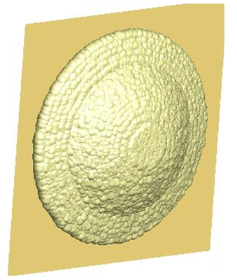
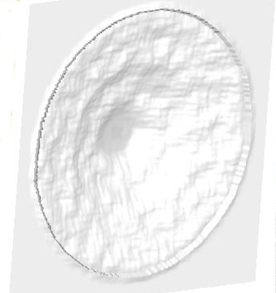
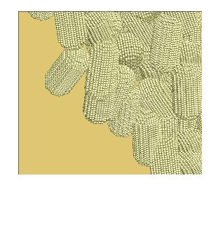
Bacterial classification
A
C2
A- Plane wave
B- Bacterial colony
C1- Individual bacterium
C2-Bacteria w/ ECM
B
D- ‘Imprinted’ wave
E- Far-field patterns
D
C1
E

Slide 4
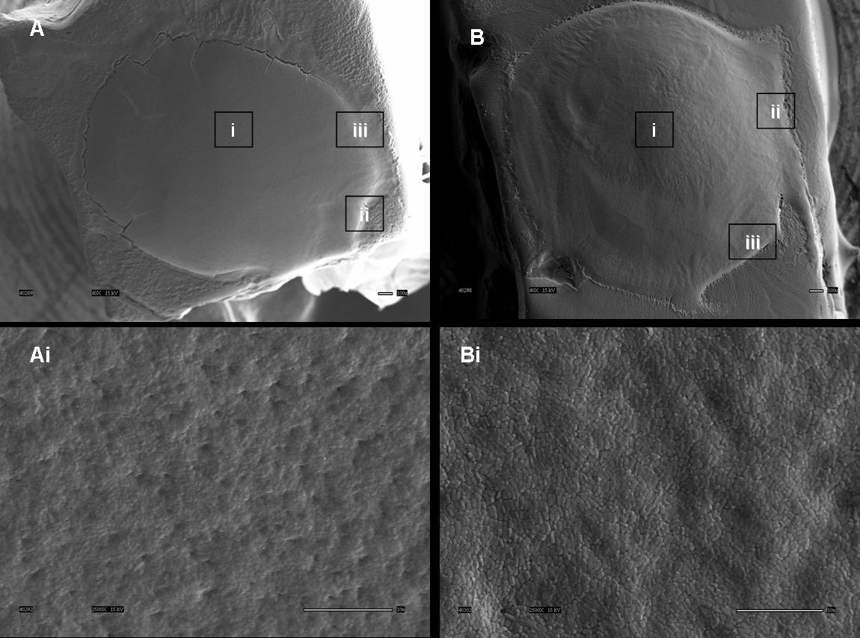
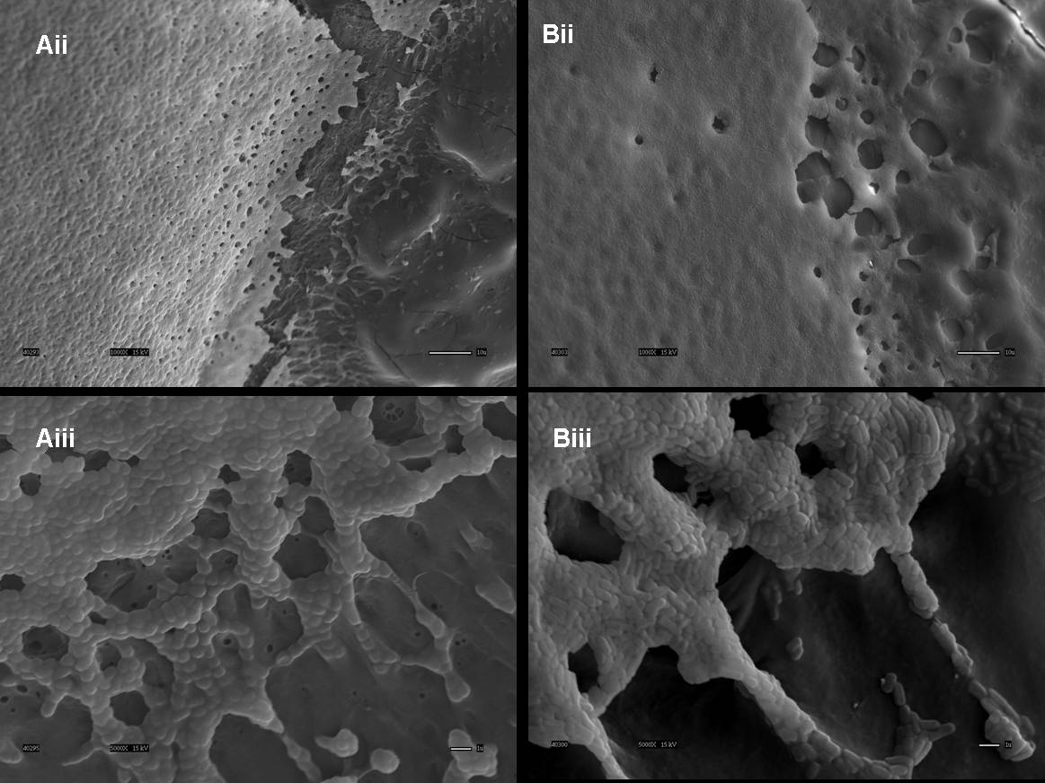
Bacterial classification
L. monocytogenes
L. innocua
Cryo-NanoSEM of Listeria colonies

Slide 5
INSTRUMENTATION
Integrated Colony Morphology Analyzer (ICMA)
mini-BARDOT
E. Bae “Portable bacterial identification systems based on elastic light scatter patterns”, Journal of Biological Engieernig, 2012.
HTS device
E. Bae, “Development of a microbial high-throughput screening instrument based on elastic light scatter patterns”, Review of Scientific Instruments, Vol. 83, 044304, 2012.
Notes:
CDC estimates that 76 million case of food-borne illness and 5,000 associated deaths occur in the United States every year
The detailed investigations to find the source or cause of the food related illness take over 20 days to complete
Huge economic and reputation loss suffered by food industry companies
They need a fast, label-free, non-invasive and not labor intensive detection method to efficiently identify the potential risk and avoid the huge economic loss incurred in the later stage

Slide 6
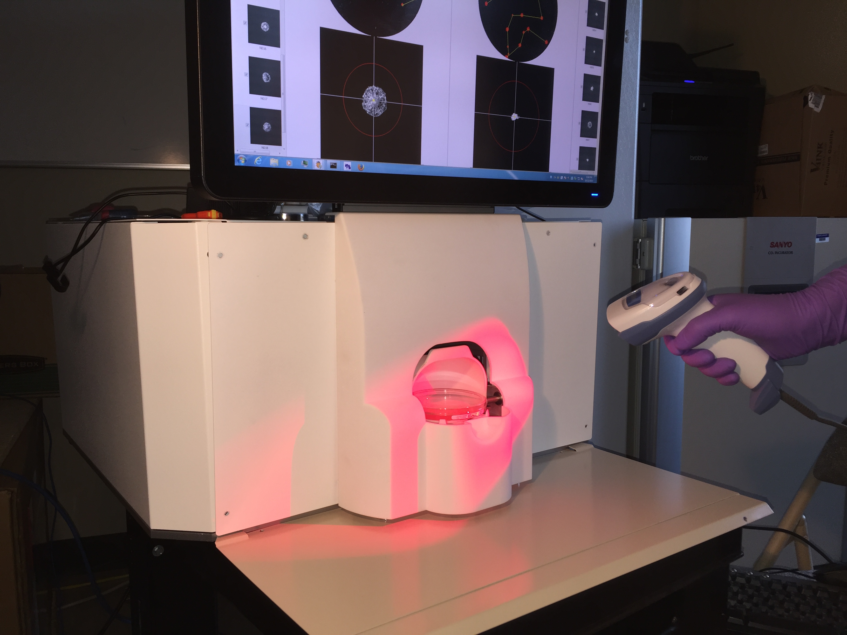
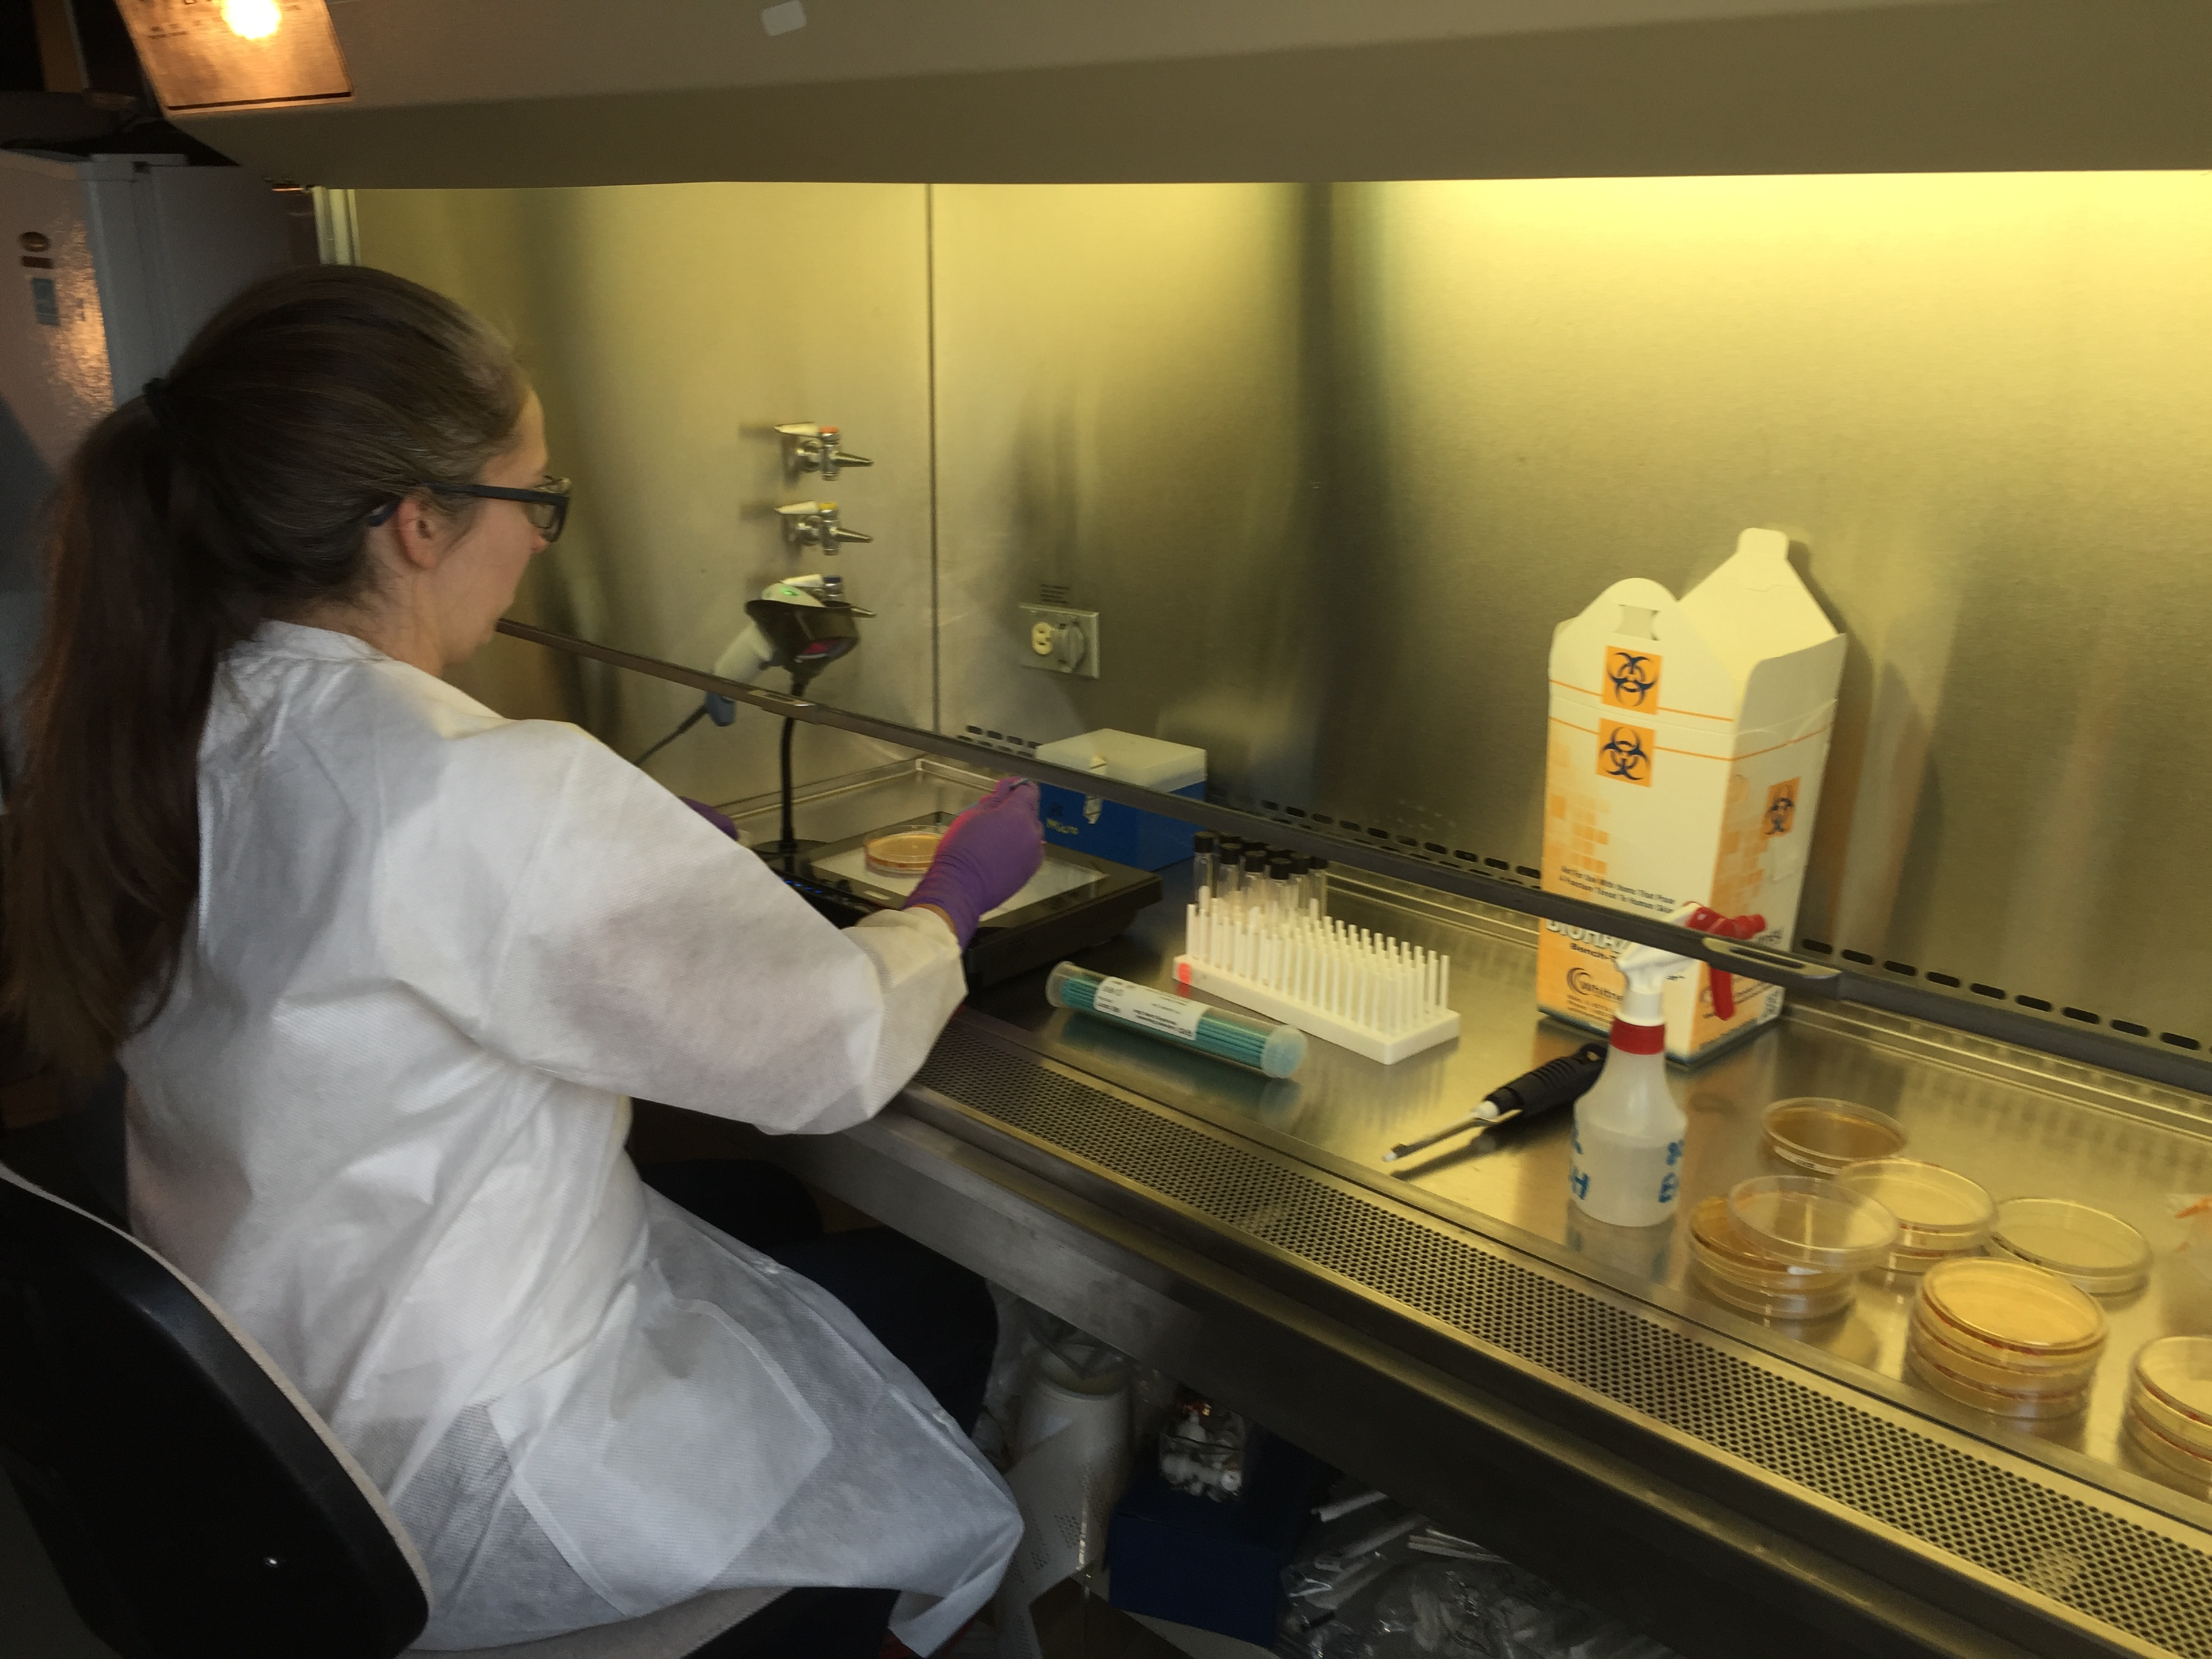
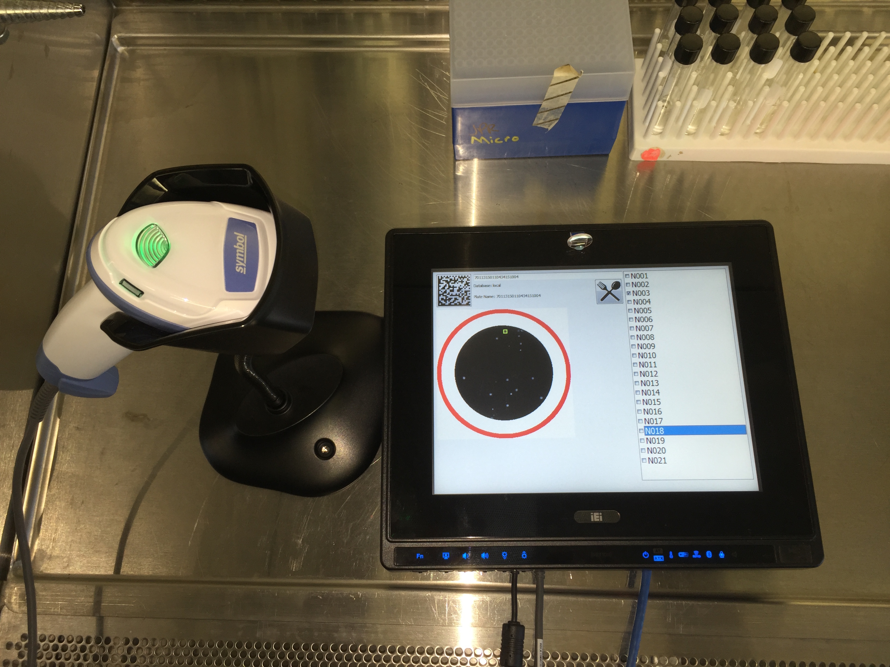
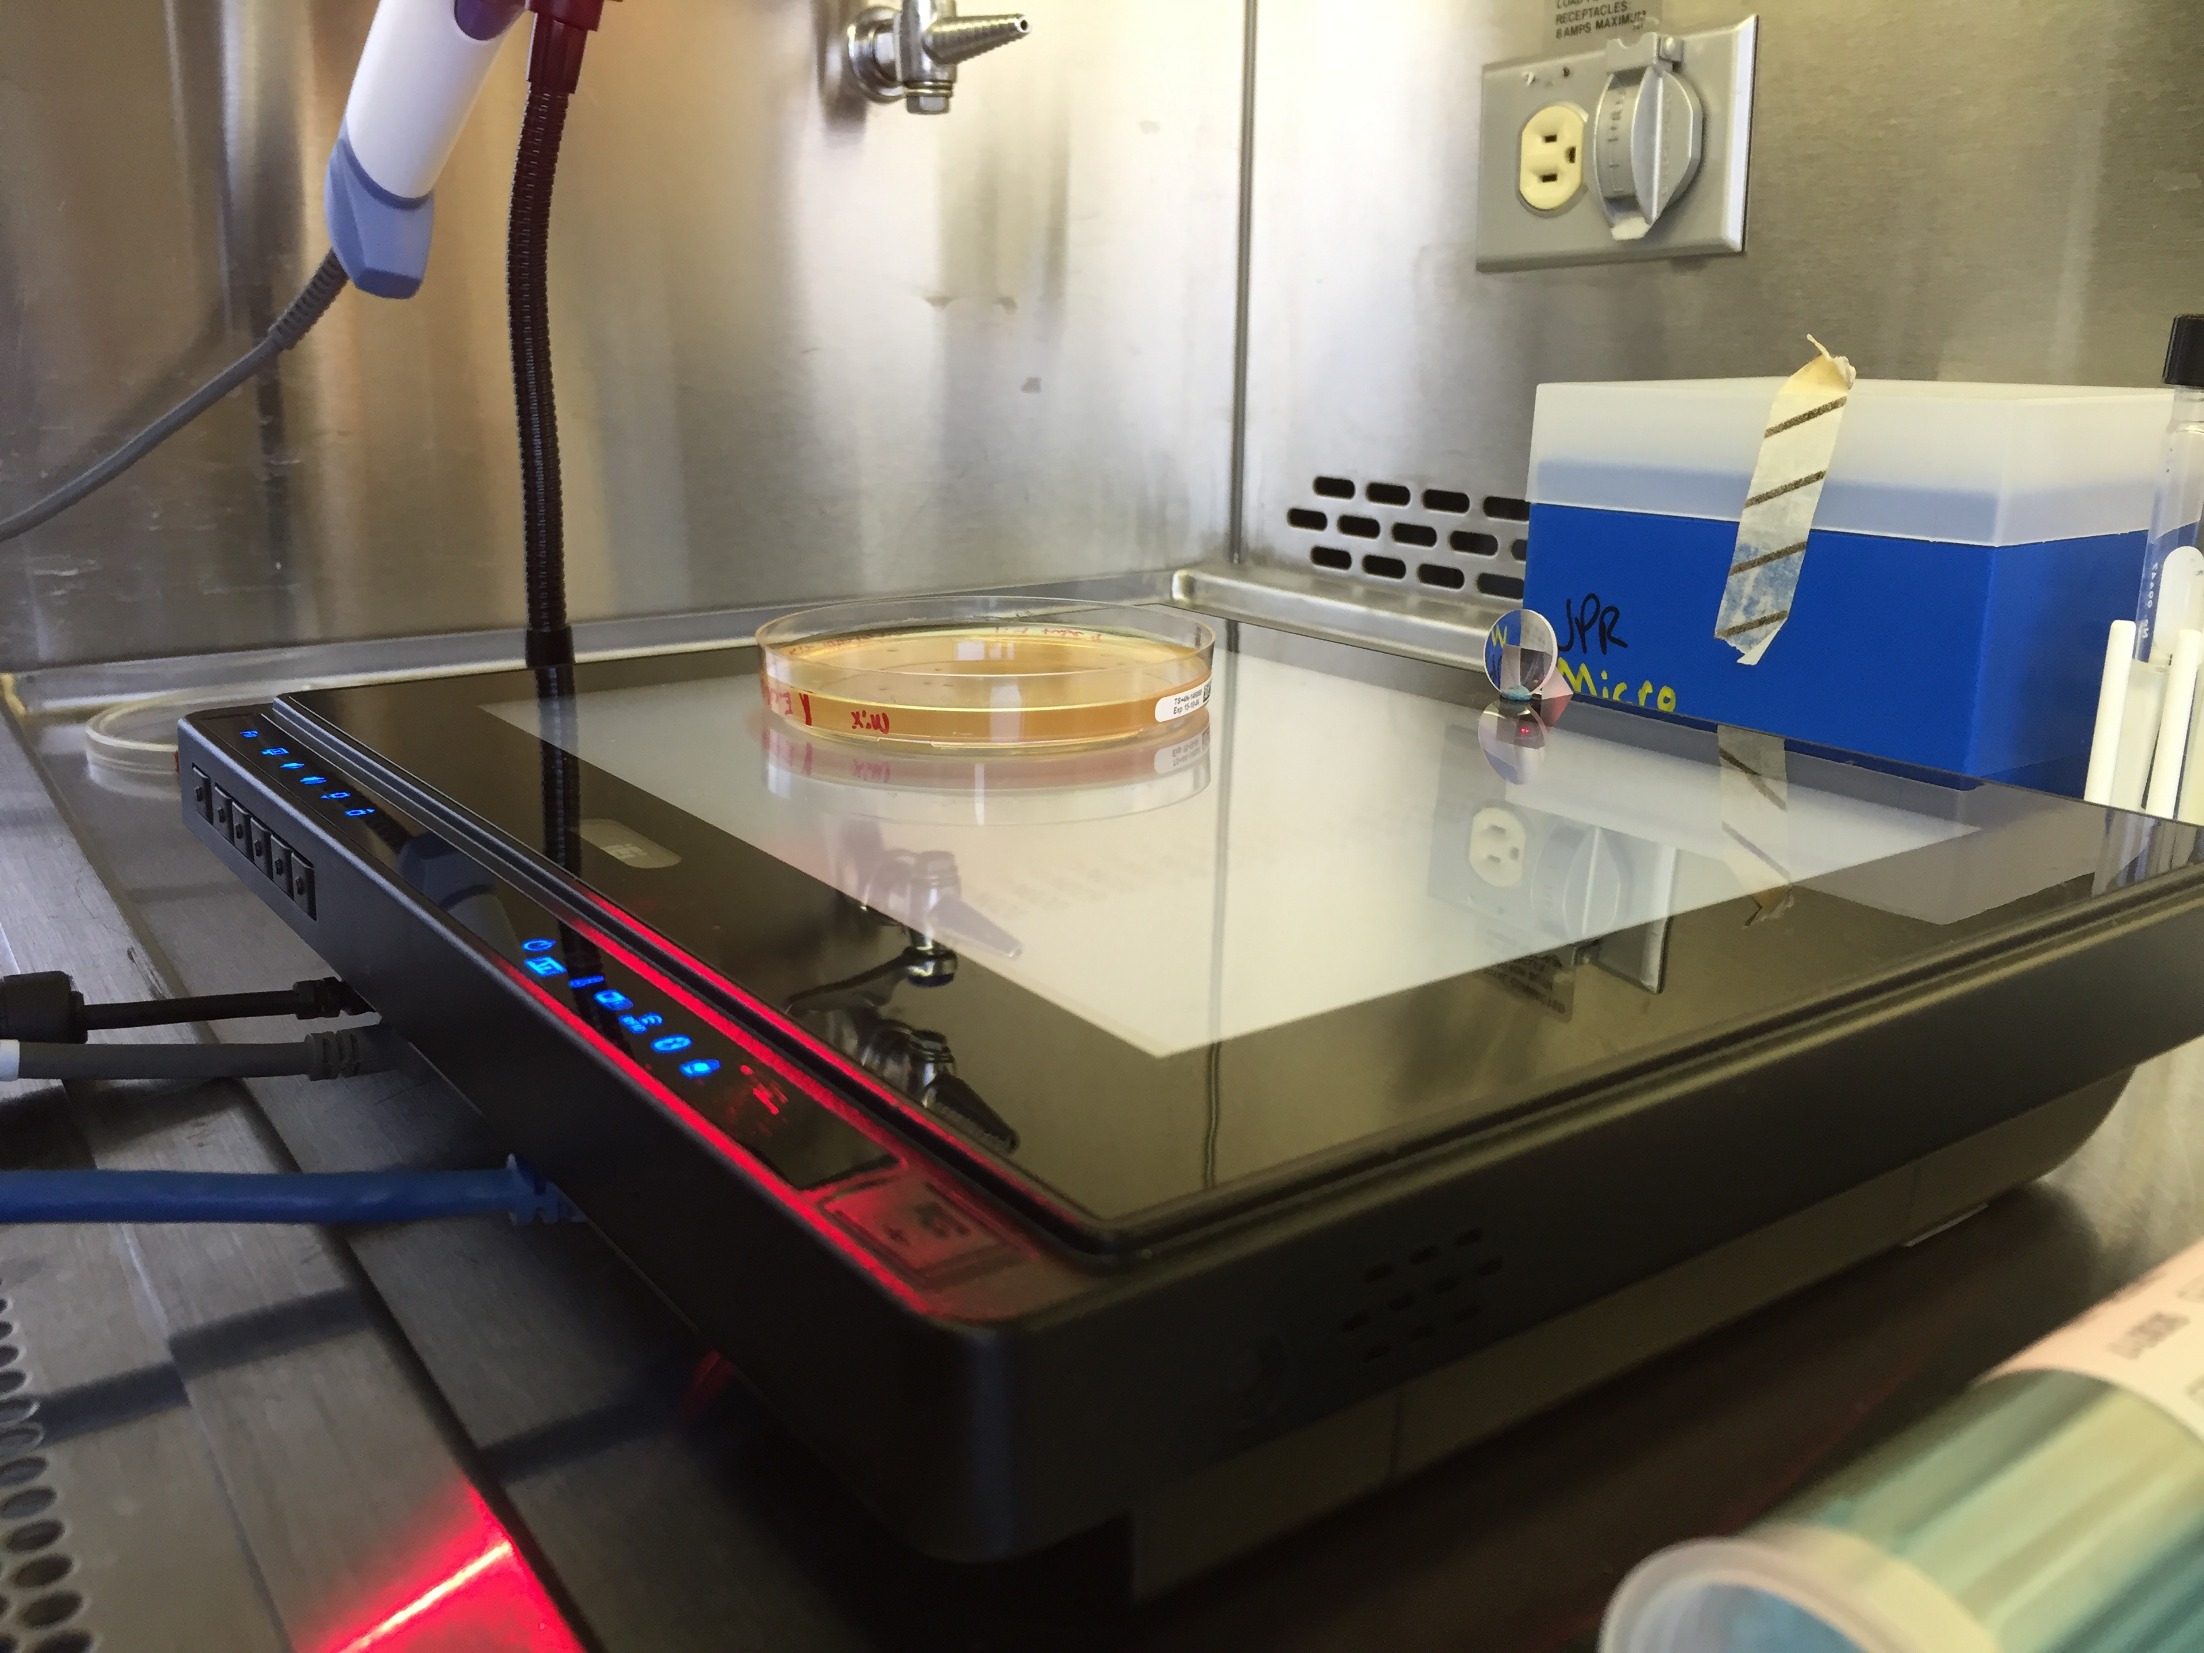
Current BEAM INstrument

Slide 7
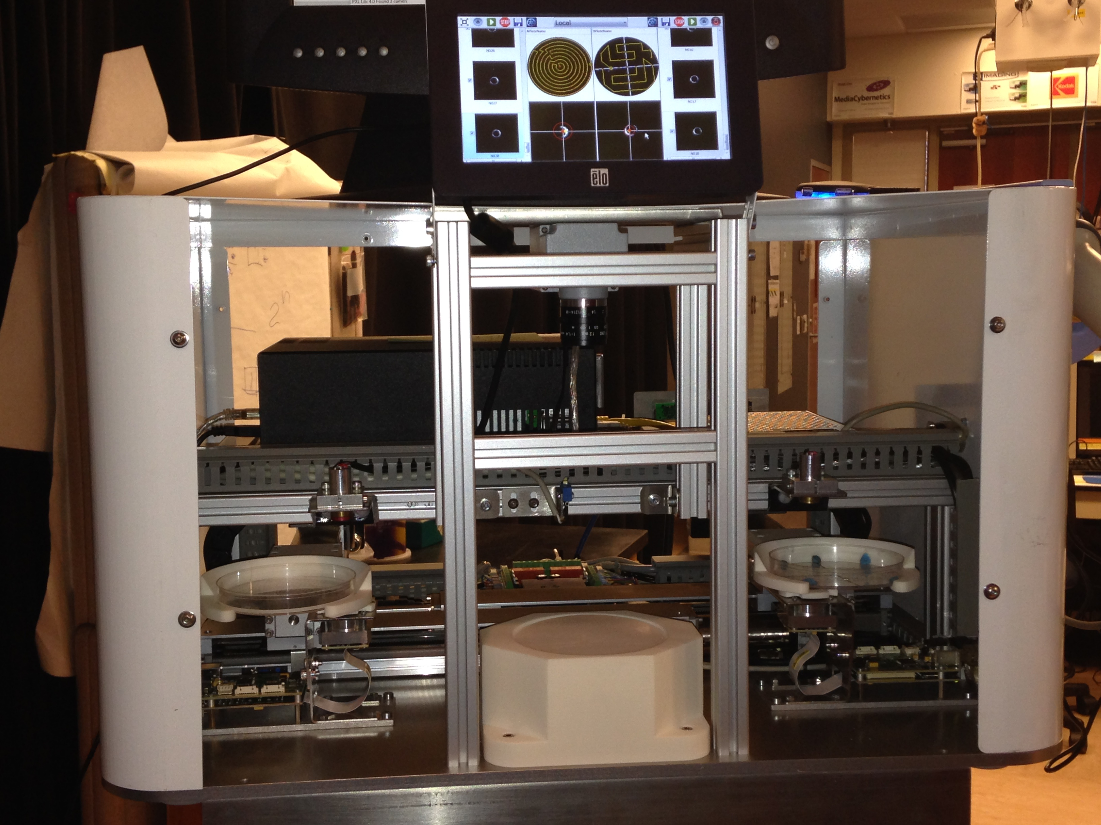
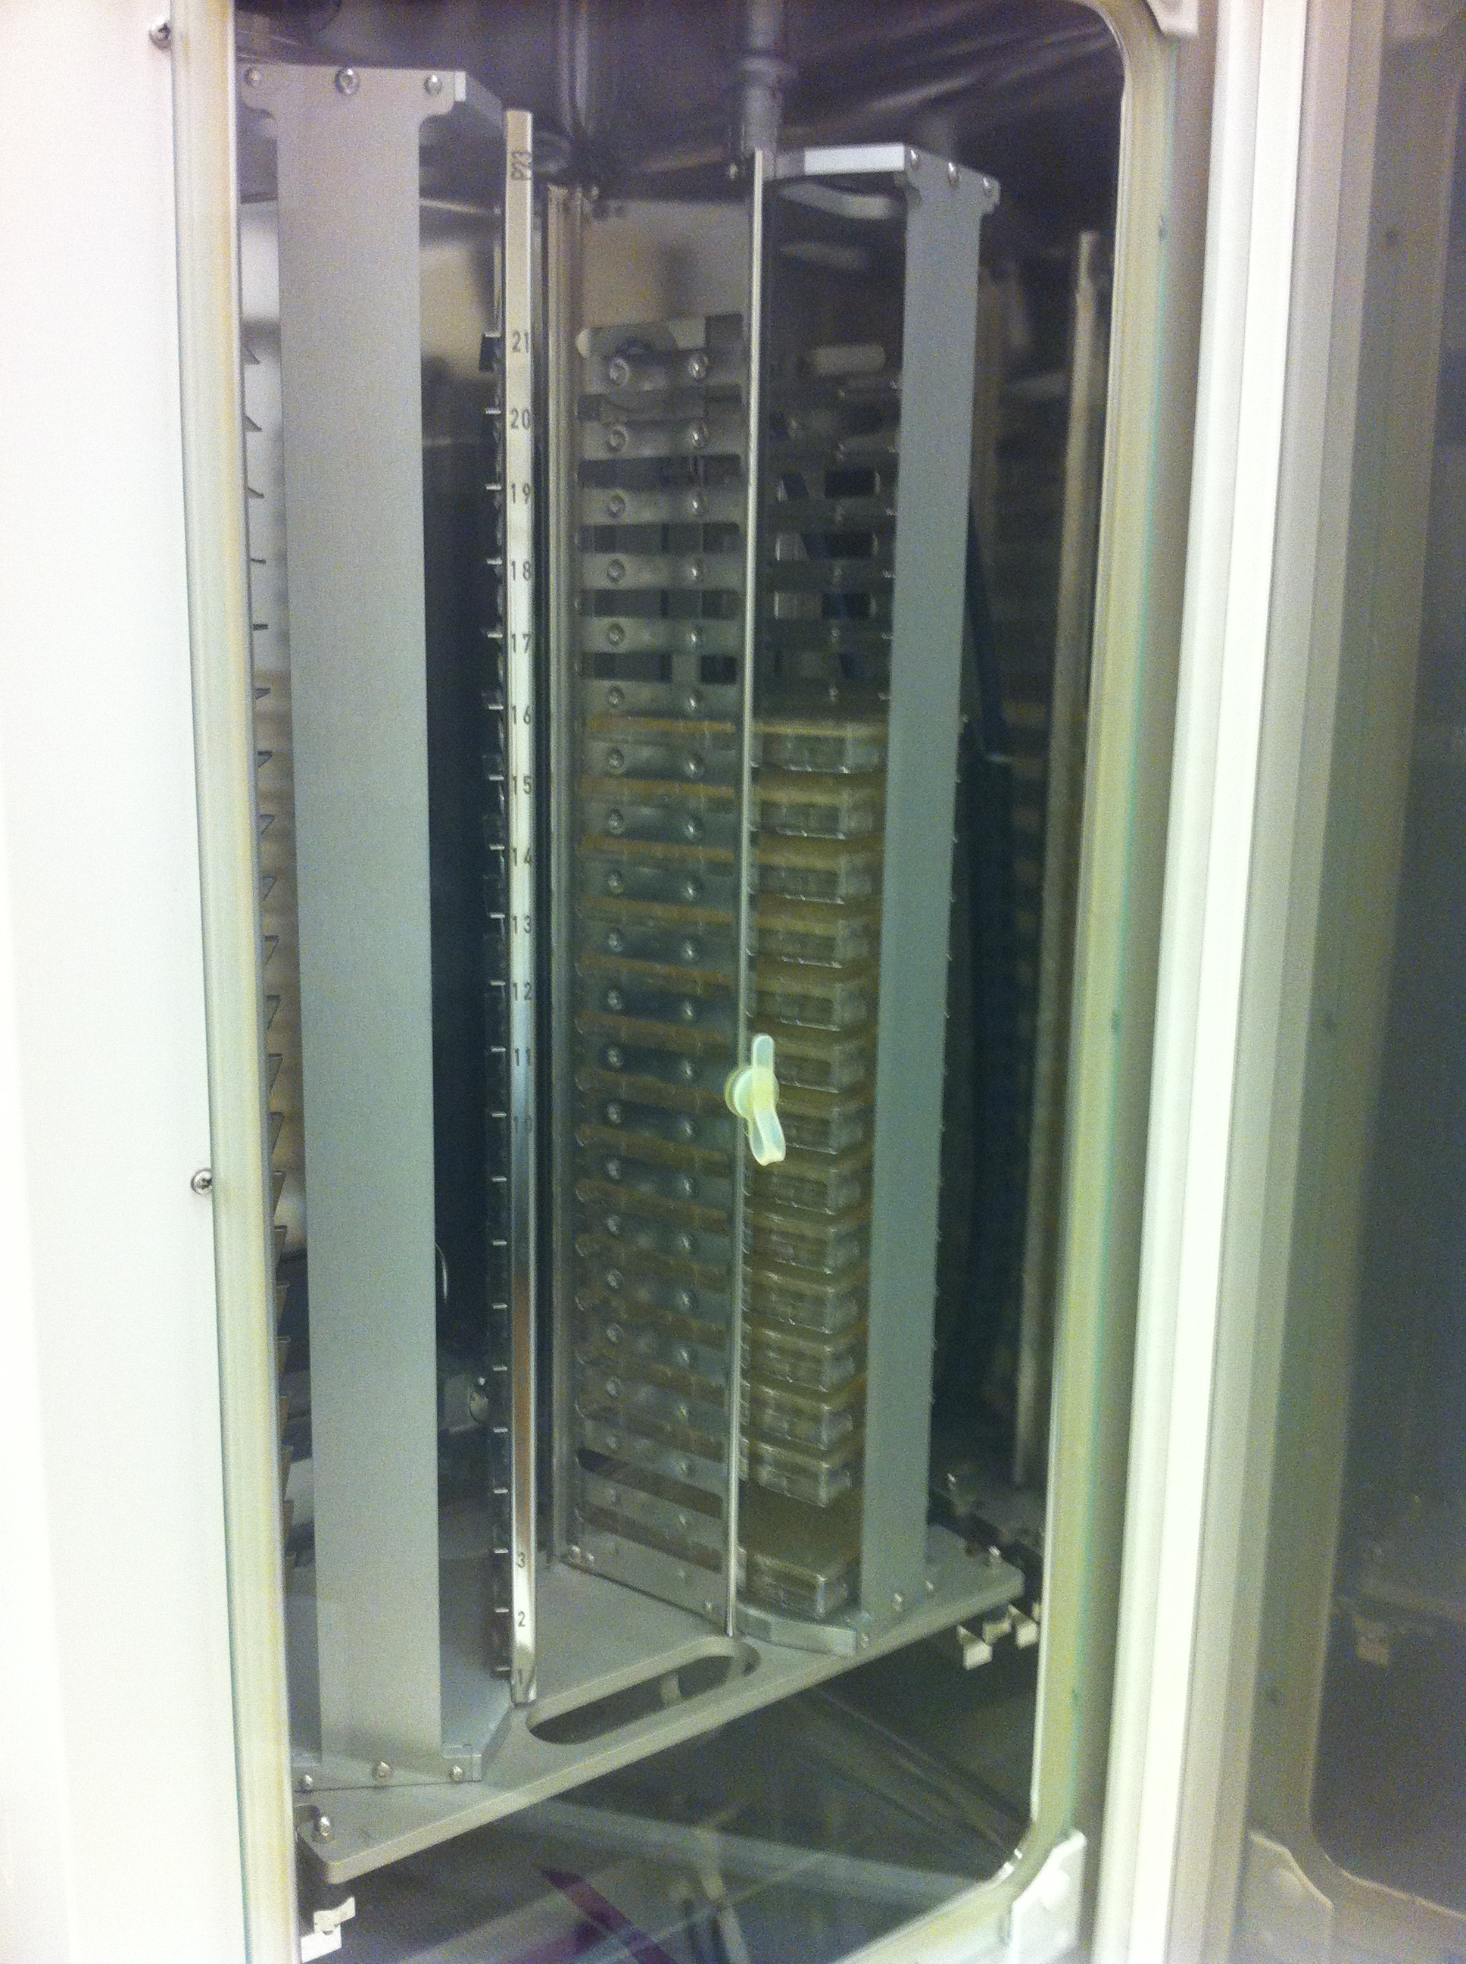
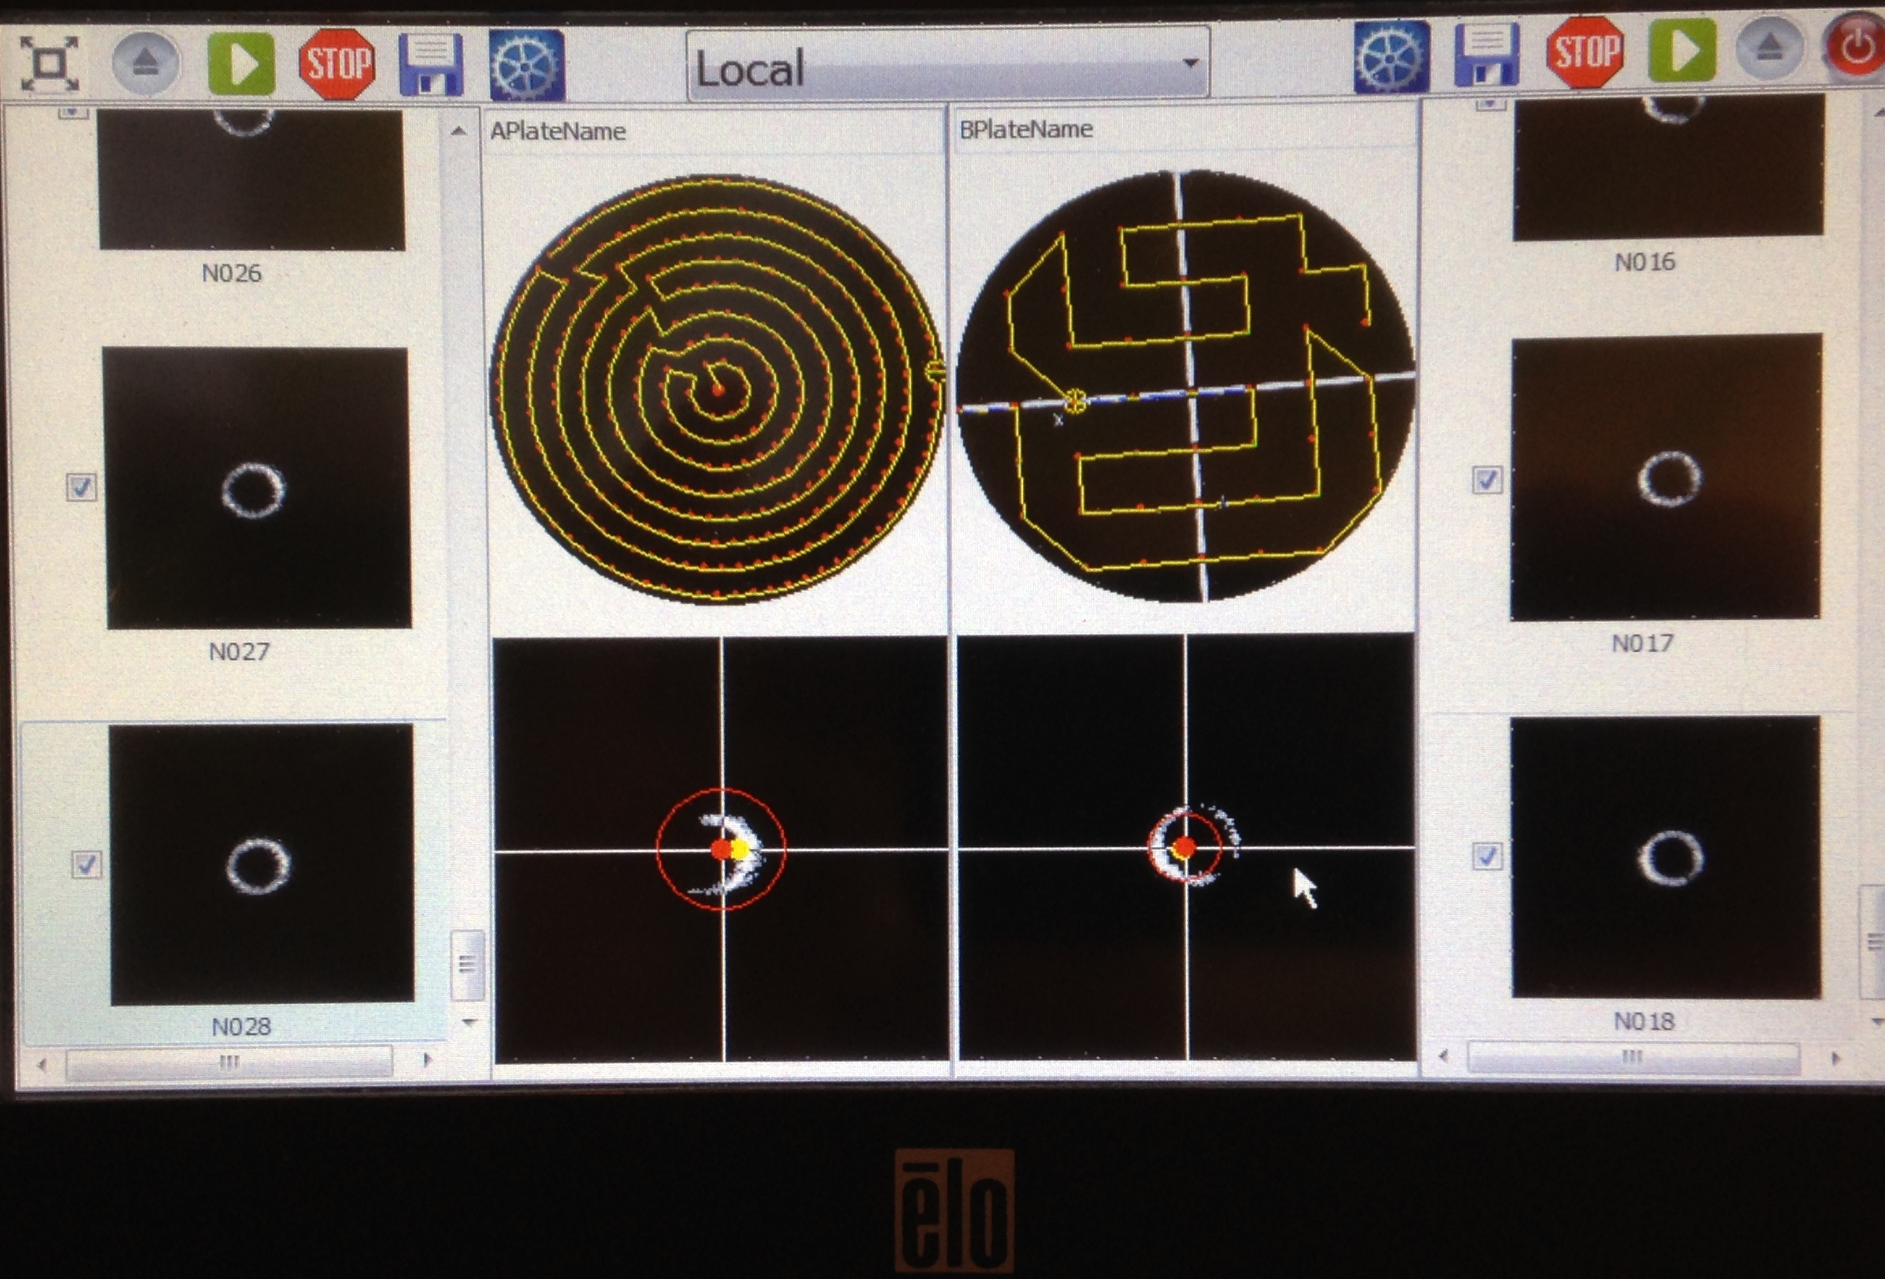
Double stage instrument – software – Automation
Automation system allows unassisted operation

Slide 8
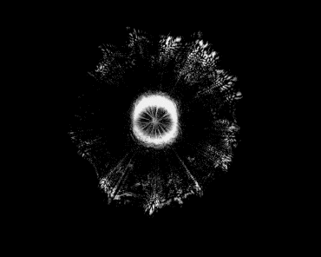
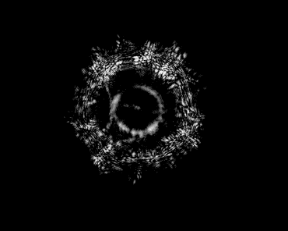
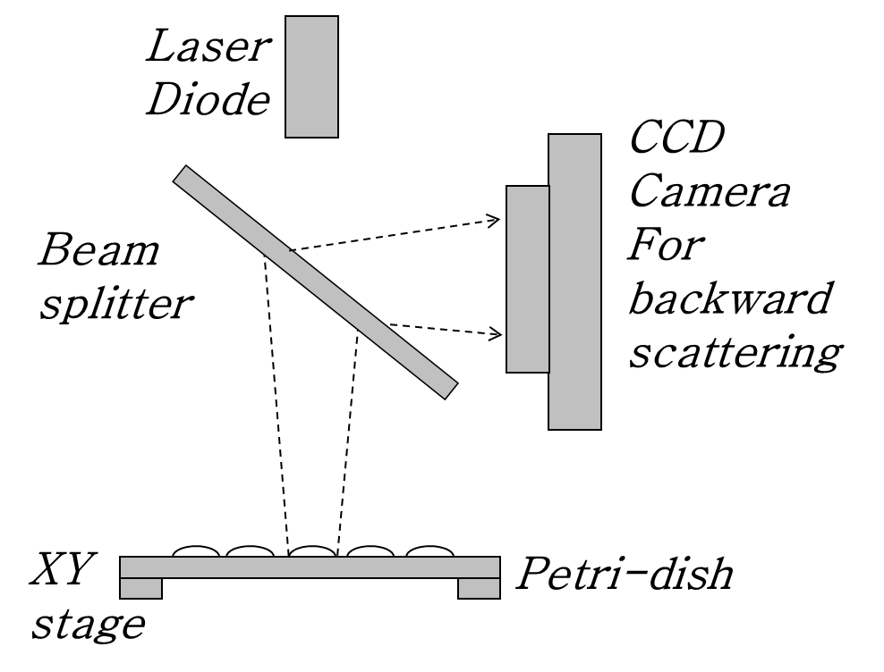
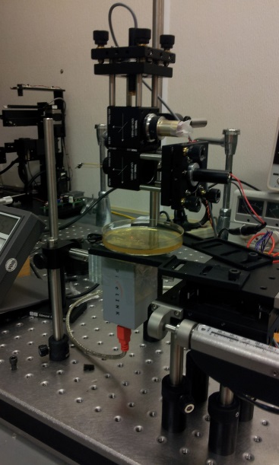
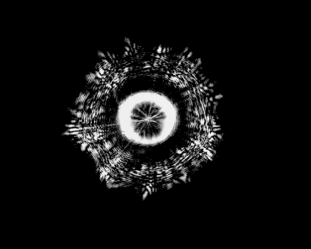
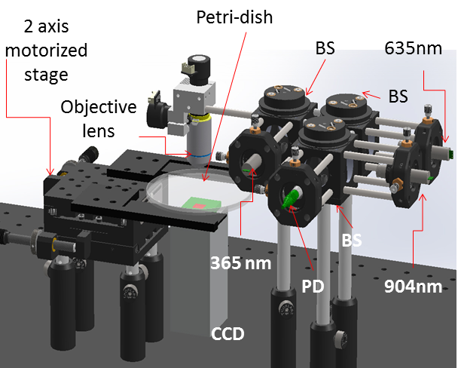
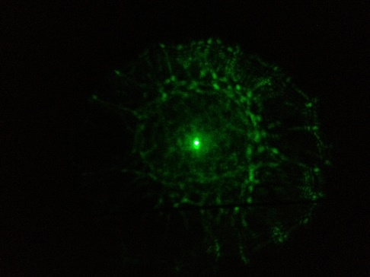
INSTRUMENTATION
Multi-spectral BARDOT: Increase the
wavelengths to 405 nm (near Blue) and 904 (NIR)
Reflection type BARDOT
405 nm
904 nm nm
635 nm nm
Notes:
CDC estimates that 76 million case of food-borne illness and 5,000 associated deaths occur in the United States every year
The detailed investigations to find the source or cause of the food related illness take over 20 days to complete
Huge economic and reputation loss suffered by food industry companies
They need a fast, label-free, non-invasive and not labor intensive detection method to efficiently identify the potential risk and avoid the huge economic loss incurred in the later stage

Slide 9
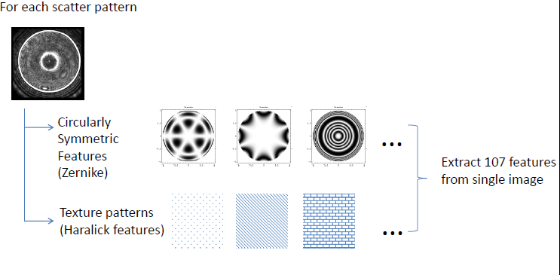
ANLYSIS
Notes:
CDC estimates that 76 million case of food-borne illness and 5,000 associated deaths occur in the United States every year
The detailed investigations to find the source or cause of the food related illness take over 20 days to complete
Huge economic and reputation loss suffered by food industry companies
They need a fast, label-free, non-invasive and not labor intensive detection method to efficiently identify the potential risk and avoid the huge economic loss incurred in the later stage

Slide 10
Application: Food safety
P.P. Banada et al,, “Label-free detection of multiple bacterial pathogens using light scattering sensor”, Biosensors and Bioelectronics, Vol. 24, pp.1685-16
Notes:
Slide 1. Background of the project objectives, milestones,
and work done over the past year;

Slide 11
Application: Food safety
P.P. Banada et al,, “Label-free detection of multiple bacterial pathogens using light scattering sensor”, Biosensors and Bioelectronics, Vol. 24, pp.1685-16
Notes:
Slide 1. Background of the project objectives, milestones,
and work done over the past year;

Slide 12
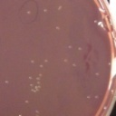
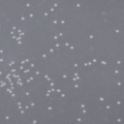
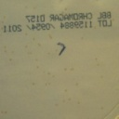
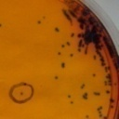
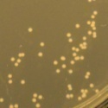
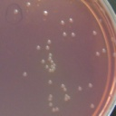
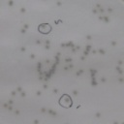
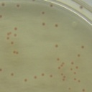
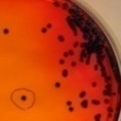
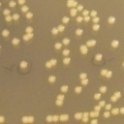
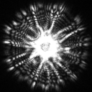
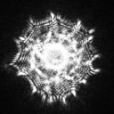
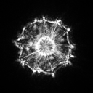
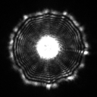
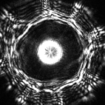
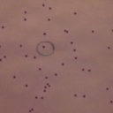
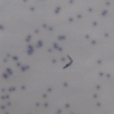
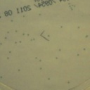
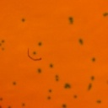
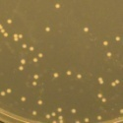
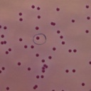
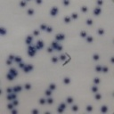
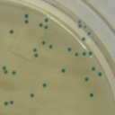
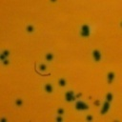
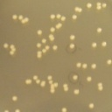
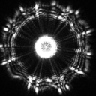
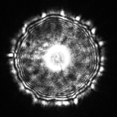
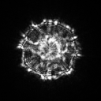
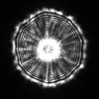
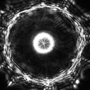














Application: Food safety
 |  | SMAC | Rainbow | Chromagar | R & F | BHI
Serogroup O157 ( O157:H7) | Coloration (10 -12 h)
 | Coloration (18 - 20 h)
 | Scattering pattern
Serogroup O26 (O26:H11 SJ3) | Coloration (10 -12 h)
 | Coloration (18 - 20 h)
 | Scattering pattern
Serogroup O45 (O45:H2 05-6545) | Coloration (10 -12 h)
 | Coloration (18 - 20 h) |  |  | N/A *
 | Scattering pattern
Yanji Tang et al "Light Scattering Sensor for Direct Identification of Colonies of Escherichia coli Serogroups O26, O45, O103, O111, O121, O145 and O157", PLoS ONE, vol. 9, no. 8, p. e105272, Aug. 2014.
Notes:
Slide 1. Background of the project objectives, milestones,
and work done over the past year;

Slide 13
Application: Food safety
Yanji Tang et al "Light Scattering Sensor for Direct Identification of Colonies of Escherichia coli Serogroups O26, O45, O103, O111, O121, O145 and O157", PLoS ONE, vol. 9, no. 8, p. e105272, Aug. 2014.
Notes:
Slide 1. Background of the project objectives, milestones,
and work done over the past year;

Slide 14


Application: Food safety
PFEG
cluster
ELS cluster
D21: J. P. Robinson: Poster Session 2: A rapid label-free technology for microbial identification for microbial identification for food borne pathogens.
Notes:
Slide 1. Background of the project objectives, milestones,
and work done over the past year;

Slide 15




Application: Probiotics study

Slide 16




Slide 17

Automation is well defined

Slide 18
APPLICATION: Bio-security
Security
Intel
PCR
Fingerprint
Partial ID
Absolute
ID
Samples are spaced at 6 hour Intervals for demonstration purposes only
ELS
Pattern
Generation
Unknown
Send to DB
ELS
Pattern
Generation
Unknown
Send to DB
ELS
Pattern
Generation
Partial ID
Send to DB
ELS
Pattern
Pathogen ID
RED Alert
Sample 1
Clinical
isolate
Lab A
New York
Sample 2
Factory food
Distribution
Center
Lab B- LA
Sample 3
Clinical
isolate
Lab C
Chicago
Central
DB
Local
DB
Local
DB
Local
DB
Sample “n”
Lab W
Miami
0
6
12
18
24
30
36
42
48 Hrs
A sample arrives at lab A in New York. A pattern is taken – no identification made. A second sample from a food distribution center is sent to a lab in LA. It is processed by ELS – a partial ID is made as the system knows it has seen that patter before but it does not have an ID. A third specimen arrives at a Chicago lab. Immediately the system recognizes that the pattern has been seen 3 times- this is a major alert flag. By this time (18 hours after 1st sample) a full ID has been made and a full red alert is engaged. The pattern from a subculture of the isolate is used to train the database classifier with ‘truth” and from now on, all subsequent isolates of this organism are immediately recognized regardless of the isolation site.
Unknown
Alert
No Alarm
Pattern A
Unknown
Alert
Yellow
Pattern A
Partial ID
Alert
Orange
Pattern A
Known ID
Alert
RED
Pattern A
Known ID
Alert
RED
Pattern A
0
6
12
18
24 Hours
Time sequence for alert confirmation

Slide 19
Opportunities
Compared to MALDI-TOF – we have a significant economy
Light scatter has many opportunities in sterilization monitoring using automated systems
System cost is much lower (1/5 at least)
Operational cost is much lower (no reagents necessary)
User can make own database
Note: Doclu LLC has been established to develop the commercial versions of system operation and analysis for the Light Scatter technology. Doclu has licensed the code from PRF and will develop new versions for benchtop and fully automated industrial applications. Doclu is owned by JPR, EB, VP and BR.

