Slide 1


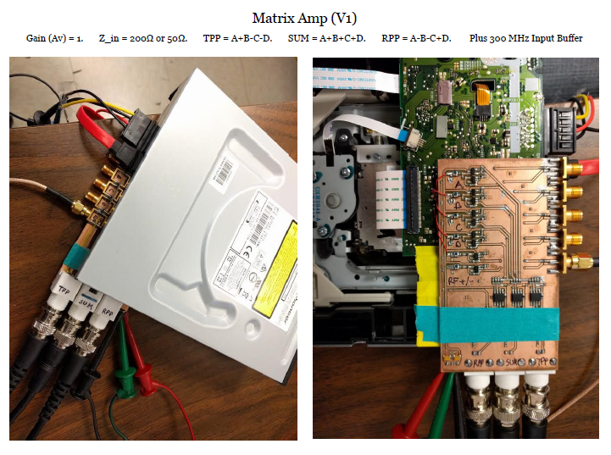
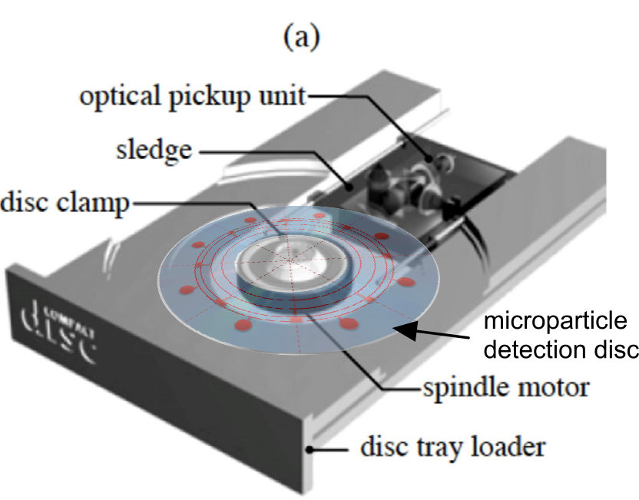
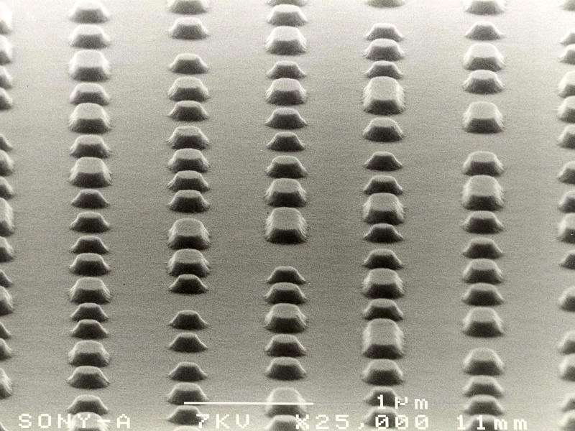
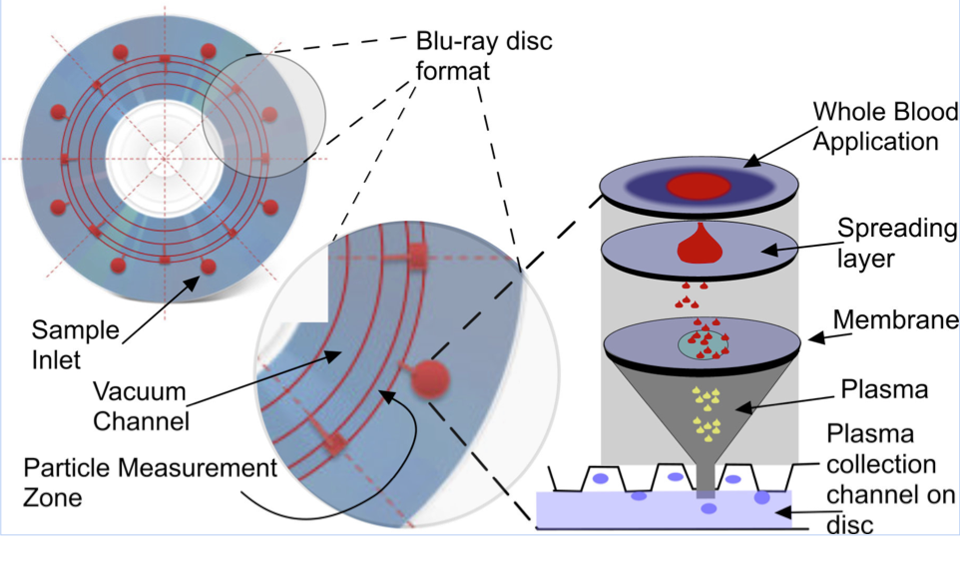
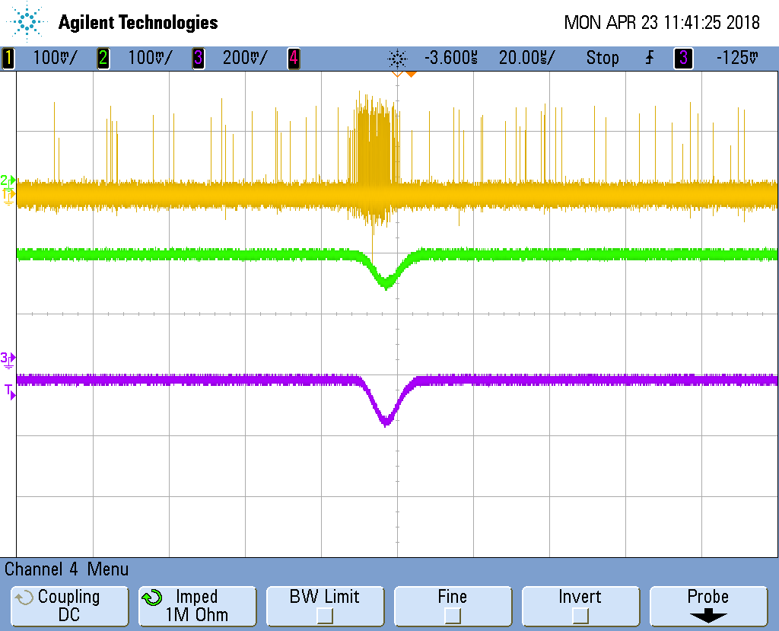
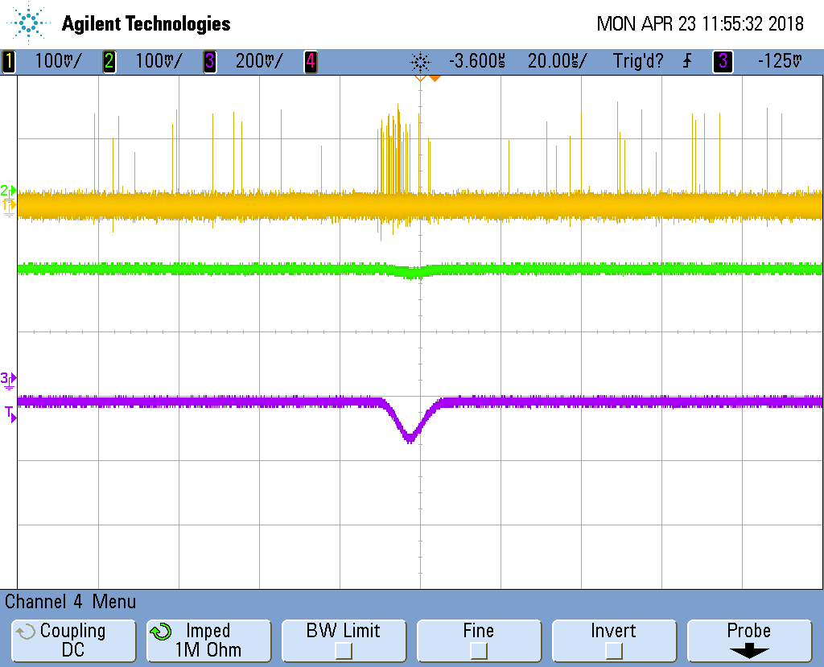
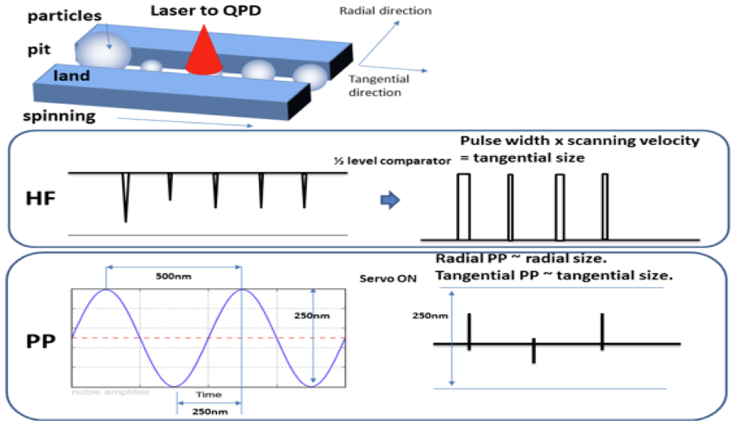
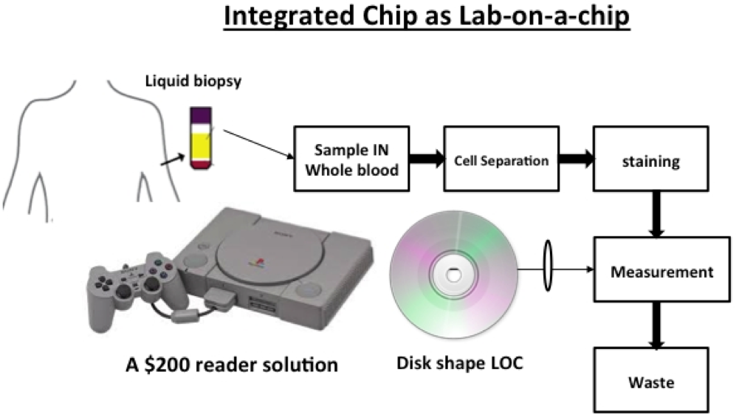
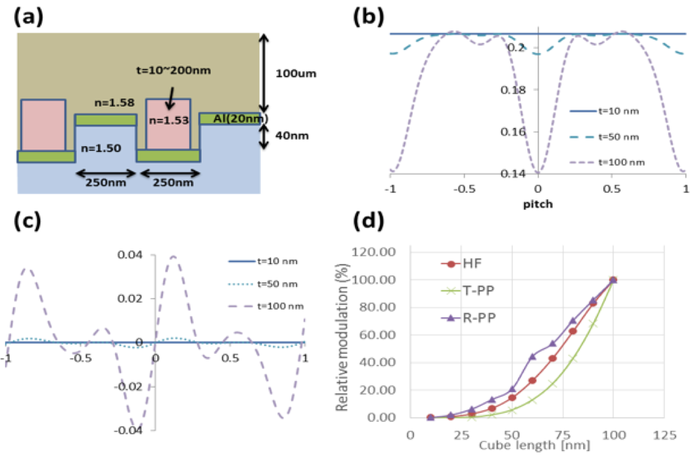
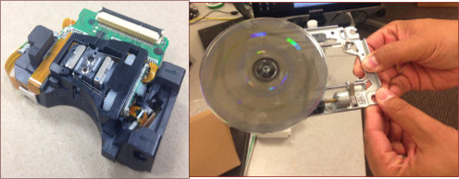
MY-Blu – Disposable Disc Technology for Evaluation of Plasma EVs
J.Paul Robinson, Purdue University M. Yamamoto, Miftek Corp., West Lafayette, IN USA
Corporation
Introduction & Background
MY-Blu disc and reader
Development of disposable-based diagnostics is a fundamental requirement for widespread distribution models. In particular, the need for low cost and mass production ensures the technology can also impact resource limited environments.
Of particular interest today is the measurement of extracellular vesicles – or EVs. There is now a generalized belief that EVs constitute a very important component of both normal and abnormal physiology. It has been demonstrated that EVs are present in cancer, cardiac disease, abnormalities in platelet metabolism, endothelial-derived microparticles, neutrophil activation, and apoptotic-related activity and opioid induced EV production.
Many syndromes are now known to cause the production and distribution of microparticles. Acute coronary syndrome, tumor-derived tissue factor, and a variety of tumors are known to release microparticles into the blood. All of these can be monitored routinely given a low-cost, low–blood volume technique. It also may be possible to measure HIV viral load in a drop of blood. This is a goal of developing a new technology that can screen anyone at any time for any EV.
A modified Blu-ray reader has been manufactured using special electronics capable of measuring three key spatial and one fluorescence signal. The spatial location of a particle is determined by measuring a high frequency (HF) signal, a Tangential Push-Pull (TPP) and a Radial Push-Pull (RPP) signal.
When combined in specially designed electronics, these signals can identify the location and size of a nanoparticle.
Some examples of clinical applications of EVs
As the disc rotates the 405 nm laser interrogates the channels in the disc and reports the data.
Signal Analysis
EV measurement options
One particle pulse
From this pulse, we can determine all of the spatial and fluorescence characteristics.
Principle of EV analysis by MY-Blu
Fluorescence-conjugated antibody detecting exosome origin
The principle of measuring EVs is similar to pits on a video disc. As shown left, the actual pits are separated spatially – a pit edge signal identifies the starting location and a similar measurement happens for EVs. The combination of the HF and TPP & RPP (not shown) signals the presence of a particle. The single photon detection sensor measures the fluorescence signal which is separated by wavelength splitting dichroics. Multiple “colors” (up to 8) of antibodies can be determined for every particle.
B
C
λ650nm
Introducing Blu-ray RPG technology
A
C
λ550nm
Blu-ray was developed in the 1990s to provide a very high capacity data storage technology for music and video. Blu-ray was perhaps the earliest implementation of very high resolution, low cost manufacturing. We have repurposed both the disc structure and the reader to create a disposable technology for diagnostics of very small particles – from 20nm up to 300nm. The key to this technology is it can be mass produced in the same factory as current discs.
Pit Edge
detection
HF
signal
Actual
DVD
b/r Pits
EV or
particles
First single-photon measurement of EVs in NG108 cells
How MY-blu works
NG108 Cell expressed Extracellular Vesicles
EVs derived from NG108 stimulated mouse neuronal cell line are shown at left where packets of single photons are shown correlated with a scatter signal (violet). This demonstrates the power of single photon sensitivity as non labeled EVs also show signal.
The principle of measurement of MY-Blu is based on a refractive phase grating (RPG) surface. Essentially a laser beam (405 nm) is reflected off the aluminum coated surface of a microfluidic chamber etched into the disc, and using a series of well characterized signals, both the size and fluorescence intensity of a very small particle can be determined.
As can be seen at right, a disc can have multiple ports for adding liquid sample such as plasma, CSF or cell culture fluid. By utilizing 4 key signals from the disc electronics, the size, location, and fluorescence intensity and wavelength can be determined.
My-Blu is based on the development of both the signal detection and analysis electronics and a unique design of microfluidic channels in the MY-Blu disc all readable by a modified Blu-ray player (below)
Stained (Di-8-ANEPSS)
Un-Stained
Conclusion
MY-Blu represents the next generation of mass producible technology for small particle detection and is highly suited to measurement of plasma EVs now known to be present in high numbers in a variety of clinical syndromes. MY-Blu has the capacity to replace many current diagnostics with a cheaper and higher resolution technology.
Idea of retrieving the particle geometry from the tracking error signals from the optical pickup. Top image shows a conceptual diagram of a spinning disc with particles inside the groove. Both boxes of HF and PP signal can be utilized to estimate tangential and radial size of the particles inside groove.
Because discs can be produced on current Blu-ray lines with minor modification, this technology can capture the huge development cost of the Blu-ray disc and drive technology for diagnostics. MY-Blu technology can be applied in the doctor’s office, CRO, emergency ward, or operating theater. Total cost of the system is less than $20,000.
J. Paul Robinson: wombat@purdue.edu
Masanobu Yamamoto: CTO@miftek.com
Patents Pending
Figure Predicting the HF and PP signals by vector diffraction simulations. (a) First rigorous vector diffraction models were solved for a given setup when rectangular pillar of varying thickness were placed inside the groove. (b) Utilizing QPD setup we can estimate the current output from the HF signal. (c) T-PP signal. (d) Overall correlation between the cube size and relative modulation.
www.miftek.com

Slide 2
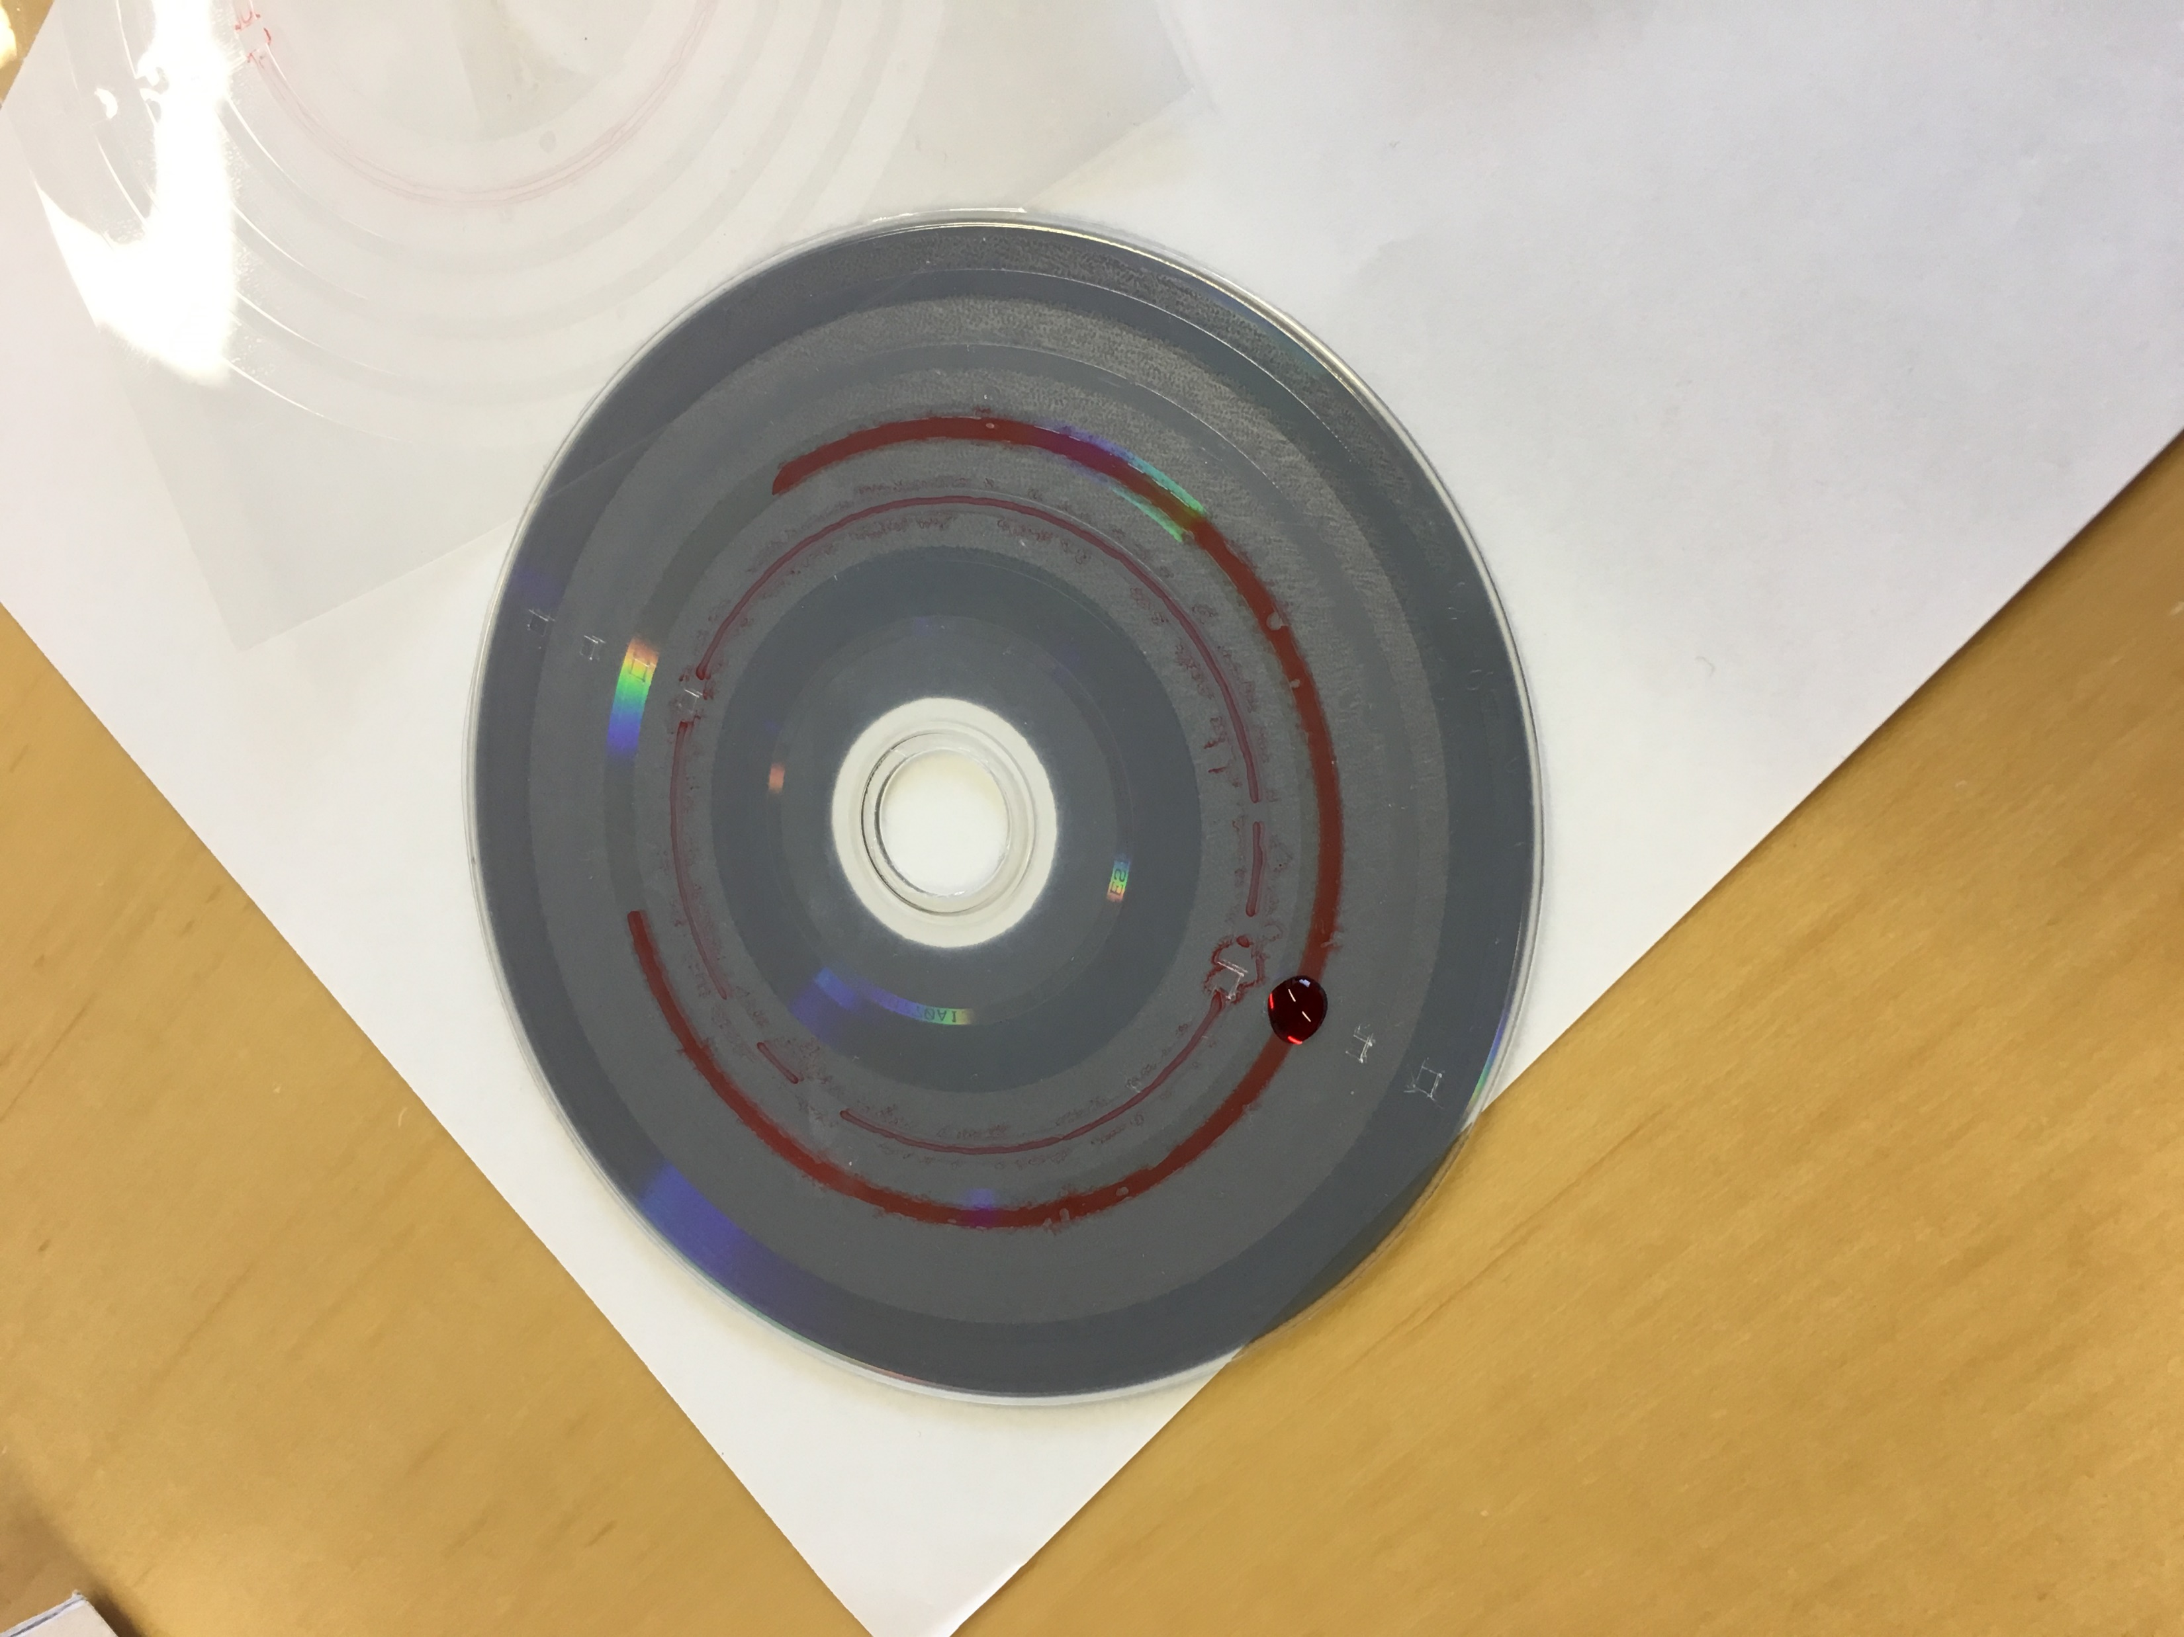
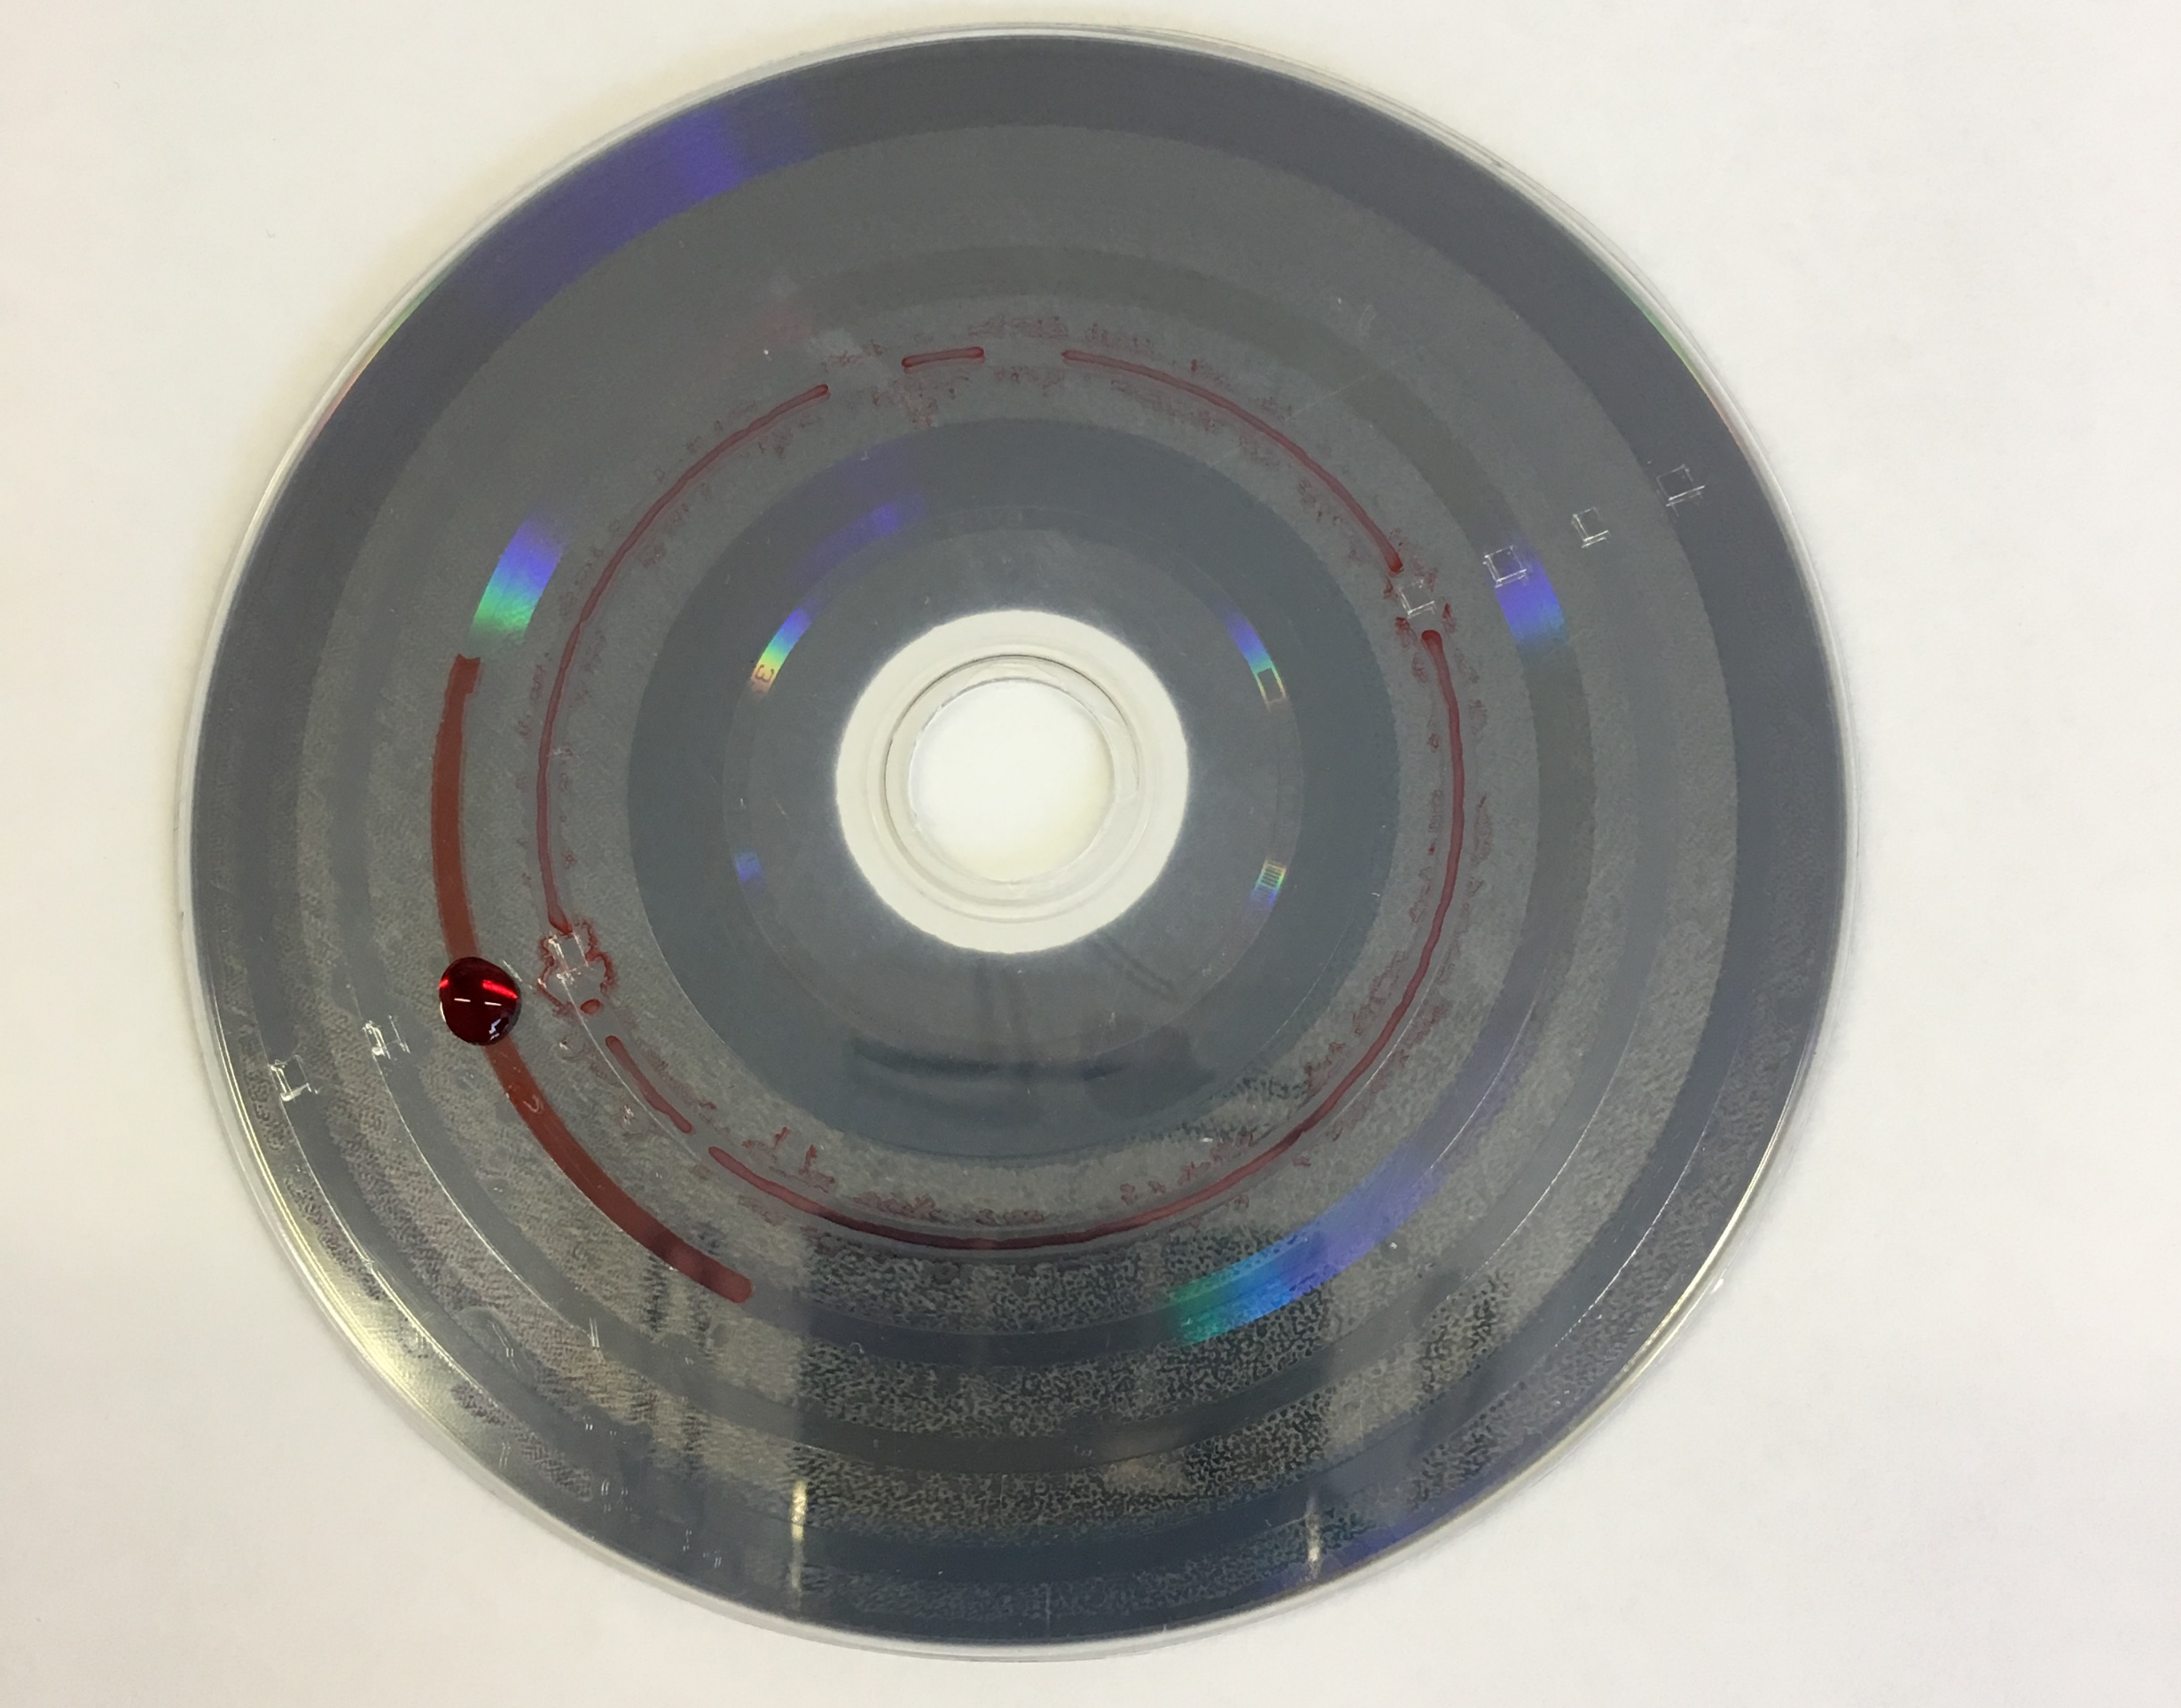
Zone Layout:
Center Hole
←disc center
R:11.5-22
R：
22-26
R:54-60
R:26-27
Unit：mm
sample zone 1
R:27-27.5
○Remark
R:27.5-30
R:30-32
：Inlet
R:32-34
：inner inlet
R:34-35
sample zone 2
R:35-36
：connecting
R:36-38
R:40-42
R:38-40
R:42-43
R:48-50
：measurement zone
sample zone 3
R:43-44.5
R:50-51
：reservoir zone
R:44.5-46
R:51-53
R:46-48
R:53-54
：PSA
sample zone 4

