Slide 1


(MY-Blu Technology)
MIFtek New Technologies
New Diagnostic Tools
Broad Implications
(Many Apps)
Research Market
University labs
Hospital labs
Biotech industry
Two Initial Clinical Apps
CARDIAC
HIV VIRUS LOAD
CytoVas develops the
Cardiac diagnostic and
Manages regulatory path
Further Clinical Applications
CONFIDENTIAL

Slide 2
Miftek Milestones
* Patents issued or allowed US PTO
# Patents issued or allowed JP PO
Technology
Company
IP
Financing
Partnership
Market
2014
Idea
Miftek
JPR/MY
Phototeklab
2015
Scanning Cytometry
Cytomics Analytical
*
US 9,372,143
NIH/Elevate
Salustek
Miftek
#
2015
Scanning Cytometry
JP2016-514059
Roche
*
2016
Planar Flow Chip
Miftek
PCT/US14/71391
Hamamatsu
Miftek
*
Reflective phase
PCT 2016/161337
Time Seq Cytometry
Miftek
*
US15/187,346
2017
Blu-ray
Cytomics Analytical
NIH/Elevate
Sony
Lintec
Nikon
Photon Sensor blue (design
Freeze integ to Blu-ray)
Miftek
IP submitted
JPR/MY
LIPS Spectrometer
Miftek
IP submitted
JPR/MY
Biolegend
Spectral Cytometry
Miftek
IP submitted
JPR/MY
1st sale Nikon
2018
Photon Sensor red
Miftek
JPR/MY
Pembroke Inst
ARI
Sale Univ Tech Syd
Photon Counting
Miftek
IP submitted
JPR/MY
Q4
MY-Blu bus unit
Various
CytoVas
2019
MY-Blu validation
My-Blu sales
2020

Slide 3
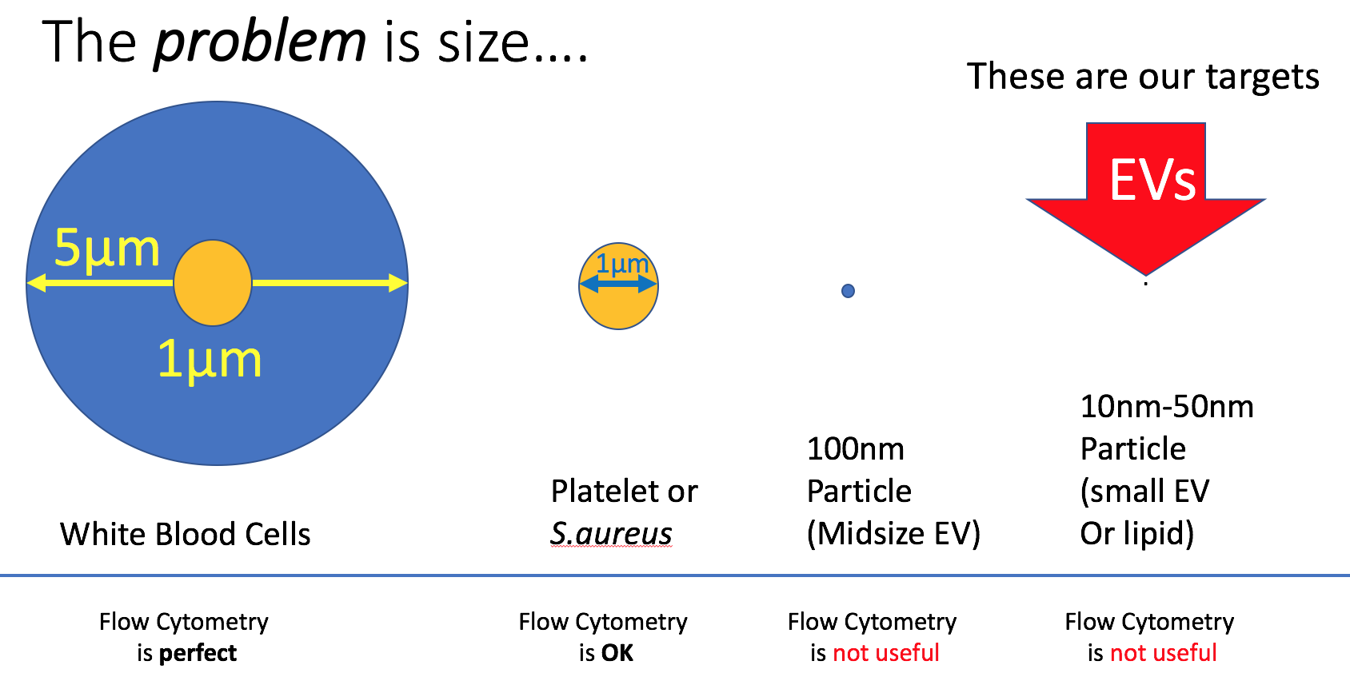
My-blu is a small microfluidic device
Based on: Blu-ray technology adapted for microfluidic applications
Uniquely sensitive single photon light detection
Analytical flow cytometry methodology
Innovative data flow methodology
Addresses Challenging Biological Sample Issues:
Current
technology
New
technology

Slide 4
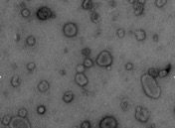

Papers published using the term “Extracellular Vesicles”
Problem: Extracellular Vesicles (EVs) in blood or other body fluids; new technology needed
HIV viruses quantification is require for HIV diagnosis; new technology needed
Cardiac disease is now monitored by EV analysis; new technology needed
High Profile
Very Important
Difficult to measure
All Cancers
Drug Therapies
Cardiac Disease
Platelet Diseases
Neutrophil Diseases
Apoptotic Diseases
Drugs of Addiction
HIV viruses in blood
Size between 10-200nm
Low diffractive properties
Very high number/ml
No instrument available for biological particles
Speed of analysis is important
Quantitation is critical
Multiple parameters desirable
93% since 2014
3500
Partial
Year
Publications from Pubmed ”Extracellular Vesicles”

Slide 5

Opportunities
First target markets
Urine
Analysis
Industrials
Plastics,
reagents
Food,
Cosmetics
Blood Analysis
Cell Culture
Fluids
EVS from plasma cardiovascular disease
EVS from CSF
EVs from joint fluid
HIV in blood
EVS from urine
EVs for research
Liquid QC (reagents)
Water purity
QC of Biologicals
Food, Cosmetics,
Biocidal product
(10 ~ 100nm) (EU 2019-20 regulations)
Safety regulatory in environment and workspace
Questions:
Are there nanoparticles?
How many?
How big?
Can I identify them using a tag – like fluorescence?
Real time
Quantitation

Slide 6
Key Market Issues
1. Microfluidics is one of the most important future markets
2. There are over 200,000 research scientists in USA that are targets
3. There are 5,534 American Hospital Association Reg Hospitals in USA
4. There are 145,000 hospitals worldwide
Frost and Sullivan report, 2015

Slide 7

Frost and Sullivan report, 2015

Slide 8
Many of these researchers find EVs, viral particles or other small particles in their research
For initial clinical market

Slide 9
My-blu is initially a research application
JPR, MY 50%
Frost and Sullivan report, 2015

Slide 10

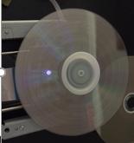
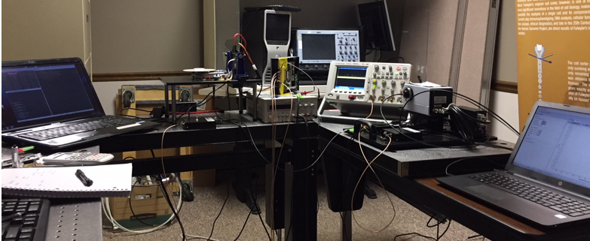
Integration of Blu-ray disc platform & single photon detection
Technology:
PlaystationTM
MY-Blu disc with microfluidics channel
Prototype Development
Drive control PC
Blu-ray drive
Photon Spectrometer
Consumer mass production platform for:
Blu-ray discs
Blu-ray disc drive
Capitalizing on $100 million investment in Blu-ray development
Notes:
Note to applicant: The description provided here should not overlap with slide 5 – “Your Technology”

Slide 11
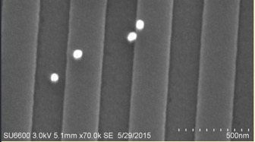
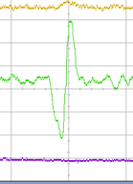
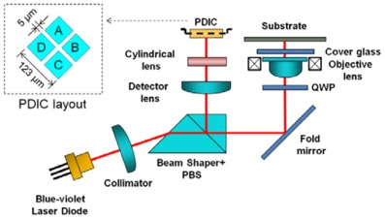
Optical phase/single photon detection by 250nm laser spot
Technology:
4 key discoveries
4 Unique Signals
Spot 250nm
Particle dia.< 100nm
50nm particles
Groove
250nm
Land
250nm
1
HF
Spot Size FWHM
250nm
2
TPP
TPP,HF,RPP
mainly TPP
3
RPP
Photon burst
signal from
EV of NG108 cell
4
Fluorescence
Photon Sensor
200~300ns
Patents submitted
Notes:
Note to applicant: Provide a brief summary of your technology (a one sentence description of the technology and 1-3 sentences describing the scientific foundation).

Slide 12
Intellectual Property
ISSUED/allowed PATENTS
Key patent
Allowed April 13, 2018
1. Photon Counting and Spectroscopy Provisional 13-APR-2017 Full Patent submitted: April 12, 2018
2. Scanning Imaging Cytometry US Issued US 9,372,143 B2 June 22, 2016
3. Flow cytometry using hydrodynamically planar flow PCT/US14/71391
4. Particle Detection Using Reflective Phase Grating PCT WO2016/161337A1
5. Cellular Tracking C096-0008USP1
6. Image flow cytometer, system & method JP 2016-514059 Issued Aug 22, 2017
7. Time Sequential Cytometry (Notice of allowance 15/187,346 04/13/18)
8. Multispectral microparticle fluorescence photon cytometry
All required intellectual property necessary for the MY-blu technology will be licensed to newco

Slide 13
‘My-BLU’ Milestones for 24 mths
NEED
Pathway to cardiovascular and the research markets
Phase II = $1.5 million (Indiana State) + $1.5 million (Investors)
Months | 3 | 6 | 9 | 12 | 15 | 18 | 24
FL photon Detection | Complete Concept | Test multiple samples | Finalize optical params
Format/Disc Development | Addressing Format | Cover&Disc Manufacturing | New discs fm’t Diff app’n | New disc format & app | New app’n | New app’n
Integrated Drive System Development | Define commercial options | System design finalization | Photon detection Control Software | In multi-lab testing 6 units | Design Mod for manuf Final product |  | product sales at 18 mths
Calibration Statistics Application | Simulation application | Statistical Analysis Software Dev | Calibration and application | New application Develop’mt | New application Develop’mt | First product delivery at 18 months
}
Phase III = partner with major pharma company
Notes:
Note to applicant: Provide a timeline of commercialization steps, including any interactions with regulatory agencies, if needed.

Slide 14
CellTient Corp. will be formed to drive My-blu
NEW
IEDC
$1.5 million
$1.5 million
Investors
Develop MY-Blu
JPR, MY 50%
Note – we have not disclosed the names of these companies in public yet
Current
Investment
IP value*
$400k
Lintec
$500k
Sony DADC
$1 million
Roche
$250k
NIH
$500k
Salustek
$50k
JPR/MY
$500,000
reagent
Ptnr Dyes
=
>$3 million
Investors
$1.5 million
=
New Business operation
5-7 new Engineers/Scientists
5-10 additional employees over 24 mths
TIME
JPR 20%
MY 40%
KH 20%
$1.5 million (Elevate) +
Indiana Links: Sony DADC, Roche
CONFIDENTIAL
*MY-blu IP will become fully licensed to CellTient Corp. - Single Photon IP and other patents will be licensed for use with all MY-Blu products

Slide 15

Research Market Production Cost Estimates
Cost of 500 units production
disc drive $500,000 (assume $1000 each) $500,000
Discs $500,000 (assume $5 each ) 50,000 discs $250,000
Packaging $25 x 500 = $12,500 $12,500
Electronics, Software, fiber optics $500 x 500 = $250,000 (assume $500 cost per unit) $250,000
Construction, case, etc $200 x 500 = $10,000 (assume $200 cost per unit) $100,000
Cost of reagent kits (3rd party manufacture) 50,000 kits (5 tests each) $500,000
Total System manufacture cost = ~$1,700,000
Total expenses
Cost of sales at 30% per unit $2,250,000
Total parts cost $1,700,000
Development cost $2,000,000
Taxes, legals, operating $250,000
total cost of project $6,200,000
Income systems 500 x $15,000 = $7,500,000
Disc sales at $15 each (5 tests) (assume 50% sales) $375,000
Reagent kit sales (Kit is $20 for 5 tests) (50% sales) $500,000
Total return on system sales $8,375,000
Return on Investment $2,175,000
Research Market Only
Initial Clinical Market
Assumptions:
Sale price of System $15,000 (Unit BOM cost $2,200)
Disc cost $5/unit Sale at $15/unit
Reagents cost $10/unit of 5 tests - sale at $20/5 tests
Packaging at $25/unit
Electronics, fiber-optics, software at $500/unit
Construction of system at $200/unit
System unit cost: ~$3,400
Assumptions:
Sale price of System $16,000 (Unit BOM cost $2,200)
Disc cost $5/unit Sale at $15/unit
Reagents sold directly by CytoVas
Packaging at $25/unit
Electronics, fiber-optics, software at $500/unit
Construction of system at $200/unit
System unit cost: ~$3,400
Cost of production of system =$3400
Sale price of system =$15,000
Ratio is ~5 x cost
Future Market: Research 2000-4000 units ($15k)(5 years)
Clinical Market: 5000-10,000 units 5 years ($15-25k)

Slide 16
MY-Blu Sales Projections
MY-Blu Systems
MY-Blu Discs
See Xl file “sales projections” for raw data
Research Units @$15,000
Clinical Units @$16,000
Millions
System Units
Year
Disc sales are based on mostly research discs for first two years – after new assays are designed and implemented, clinical sales will increase significantly. Discs are not reusable as with increased sales, disc cost will reduce to around $5 increasing profit
Year
Sales projections for first 5 years show first two years with few clinical instruments as testing will be required. By year 3 we believe sufficient testing will be performed to allow sales for clinical diagnostics.
Assumptions: Disc cost $10.00
“Clinical disc may be a premium – but discs are essentially the same.
More than one type of disc may be made (1, 2, 4, 8, 16 ports) different costs
Disc sales bring in higher return for clinical (200%) than research assays
Note: cost of sales for Research Units is 25% (around $3750 ea)
Cost of sales for Clinical units is 0.3% (CytoVas bears cost)

Slide 17

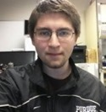


Founded 2014 to develop new technologies for biotechnology
Mission : Next Generation Cellular Analysis & Flow Cytomety
Single Cell, Single Photon & Single molecule technologies
Principles: Masanobu Yamamoto, Eng, Inventor, 40 yrs Sony Eng (48.75%)
  J. Paul Robinson, Prof, Inventor, Biomed Eng (48.75%)
  Keegan Hernandez, Elec Eng, Miftek Corp (2.5%)
MY and JPR created separate IP partnership (Captl LLC) that holds all IP developed
IP as needed is licensed to particular entity
Miftek is the contracting partner to Cytomics Analytical LLC
Miftek has many international collaborations with technology companies
We will form to drive the My-Blu technology
Existing
Licensed
will develop the product and will be open to investment by major pharma
will bring in CEO to manage corporation
will hire 6-7 engineers
will hire 2-3 Biologists
will hire 2-3 Sales/marketing people
Electronics
Optics
Single Photon
Licensed
Reflective Phase
Grating
Supported
* HIV viral Load
Bio
* Cardiac EVs
NIH
support
IP
Licensed
IP required licensed from CAPTL
CAPTL LLC

Slide 18
Management
Initial management will be driven by J. Paul Robinson to begin hiring engineering and biology staff.
The company will utilize the 3 FT and 5 PT staff currently working in Miftek and some of their time will be used by CellTient Corp. and eventually replaced by new employees. This will allow CellTient Corp. to begin rapidly and will allow current staff to train new people
Within 3 months, our goal is to hire a new CEO who has marketing and management experience to move the company forward
Initially the company will remain in the current physical space where Miftek is operating. There is room for 6-8 additional staff without pressuring other operations.
There are alternative spaces in Lafayette and Indianapolis as the company expands.
We anticipate hiring sales and marketing people as the product line is developed

Slide 19
Exit Strategy
Negotiation between Year 2-3 to obtain 15-20% investment from big pharma (preferably Roche)
With $5-10 million investment, principles will become consultants and technical support
Pharma will move products through regulatory agencies for in vitro diagnostics
5 years pharma will purchase 100% company and expand technology and applications

Slide 20
Company Future
Primary goal will be partner with big Pharma to help transition company into the regulatory market. This will require significant investment and management
Existing technical staff will continue to support technology, but the company will have a full complement of excellent technical talent that will see the company through the next phase.

Slide 21
Current Space
1231 Cumberland Ave
West Lafayette, In 47906
$1825/month incl utilites
PRF

Slide 22
Elevate DECK (MY-Blu)
Company—and its principals.
Brief history.
Go high level on technology.
IP
Problem/Opportunity you are addressing
Current status—technology development + market validation
Route and timing to market(s)
Past financing/needed financing
Use of Funds
Nature of exit(s)
How company will develop
Deal parameters (Elevate tends to do convertible notes)
CONFIDENTIAL

