Slide 1


(MY-Blu Technology)
MIFtek New Technologies
New Diagnostic Tools
Broad Implications
(Many Apps)
Research Market
Industrial Market
Two Initial Apps
CARDIAC EVs
HIV VIRAL LOAD
CytoVas develops the
Cardiac diagnostic and
develops regulatory path
Large Lab based
Cell culture market
Lab based plasma
testing
Food nanoparticles
Water testing
Chemical
manufacturing
Plastics
Further Clinical
Applications
(platelets, cancer
Neuroscience, etc)

Slide 2
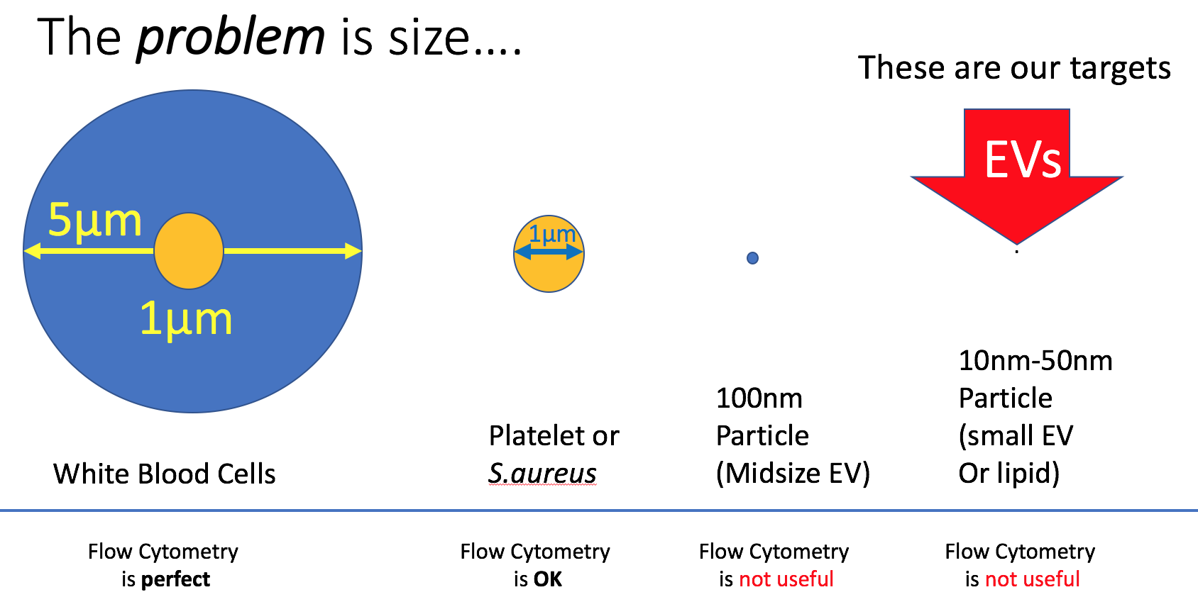
My-blu is a small microfluidic device
Based on: Blu-ray technology adapted for microfluidic applications
Uniquely sensitive single photon light detection
Analytical flow cytometry methodology
Innovative data capture methodology
Mass-produced disc and reader technology
The only technology that can currently actually see these particles is Electron Microscopy
Addresses Challenging Biological Sample Issues:
Not
measurable
Measurable
Using current
technologies

Slide 3
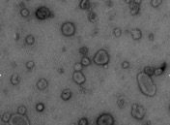

Papers published using the term “Extracellular Vesicles”
Problem: Extracellular Vesicles (EVs) in blood or other body fluids; new technology needed
HIV viruses quantification is require for HIV diagnosis; new technology needed
Cardiac disease is now monitored by EV analysis; new technology needed
High Profile
Very Important
Difficult to measure
All Cancers
Drug Therapies
Cardiac Disease
Platelet Diseases
Neutrophil Diseases
Apoptotic Diseases
Drugs of Addiction
HIV viruses in blood
Size between 10-200nm
Low diffractive properties
Very high number/ml
No instrument available for biological particles
Speed of analysis is important
Quantitation is critical
Multiple parameters desirable
93% since 2014
3500
Partial
Year
Publications from Pubmed ”Extracellular Vesicles”

Slide 4

Opportunities
First target markets
Urine
Analysis
Industrials
Plastics,
reagents
Food,
Cosmetics
Blood Analysis
Cell Culture
Fluids
EVS from plasma cardiovascular disease
EVS from CSF
EVs from joint fluid
HIV in blood
EVS from urine
Evs for research
Liquid QC (reagents)
Water purity
QC of Biologicals
Food, Cosmetics,
Biocidal product
(10 ~ 100nm) (EU 2019-20 regulations)
Safety regulatory in environment and workspace
Questions:
Are there nanoparticles?
How many?
How big?
Can I identify them using a tag – like fluorescence?
Real time
Quantitation

Slide 5
Market Production Cost Estimates first 500 units only
Cost of 500 units production
Disc drive $500,000 (assume $1000 each) $500,000
Discs $500,000 (assume $10 each) 50,000 discs $500,000
Packaging $25 x 500 = $12,500 $12,500
Electronics, Software, fiber optics $500 x 500 = $250,000 (assume $500 cost per unit) $250,000
Construction, case, etc $200 x 500 = $10,000 (assume $200 cost per unit) $100,000
Cost of reagent kits (3rd party manufacture) 50,000 kits (5 tests each) $500,000
Total System manufacture cost = ~$1,950,000
Total expenses
Cost of sales at 25% per unit $1,875,000
Total parts cost $1,950,000
Development cost (10 salaries 2 years) $2,000,000
Taxes, legals, operating $250,000
total cost of project $6,075,000
Income systems 500 x $15,000 = $7,500,000
Disc sales at $15 each (5 tests) (assume 50% sales) $375,000
Reagent kit sales (Kit is $20 for 5 tests) (50% sales) $500,000
Total return on system sales $8,375,000
Return on Investment $2,300,000
Research Market Only
Initial Clinical Market
Assumptions:
Sale price of System $15,000 (Unit BOM cost $2,200)
Disc cost $10/unit Sale at $15/unit
Reagents cost $10/unit of 5 tests - sale at $20/5 tests
Packaging at $25/unit
Electronics, fiber-optics, software at $500/unit
Construction of system at $200/unit
System unit cost: ~$3,400
Sales cost 25%=$3750
Assumptions:
Sale price of System $16,000 (Unit BOM cost $2,200)
Disc cost $10/unit Sale at $25/unit
Reagents sold directly by CytoVas
Packaging at $25/unit
Electronics, fiber-optics, software at $500/unit
Construction of system at $200/unit
System unit cost: ~$3,400
Sale cost $500 (CytoVas)
Cost of production of system =$3400
Sale price of system =$15,000
Ratio is ~5 x cost
Future Market: Research 2000-4000 units ($15k)(5 years)
Clinical Market: 3000-8,000 units 5 years ($16k+)

Slide 6
MY-Blu Sales Projections
MY-Blu Systems
MY-Blu Discs
Research Units @$15,000
Clinical Units @$16,000
Millions
System Units
Year
Assumptions: Disc cost $10.00
“Clinical disc may be a premium – but discs are essentially the same.
More than one type of disc may be made (1, 2, 4, 8, 16 ports) different costs
Disc sales bring in higher return for clinical (200%) than research assays
Year
Note: cost of sales for Research Units is 25%
Cost of sales for Clinical units is 0.3% (CytoVas bears cost)

