Slide 1

Particle Signal Simulation(22): 2CH Photon Detection
- 2CH Photon Stream Detection is achieved at experimental set-up!!
ParticleSignalSimulation(22)2CHPhotonDetection.pptx
Jul.31, 2019
Keegan/Myama

Slide 2
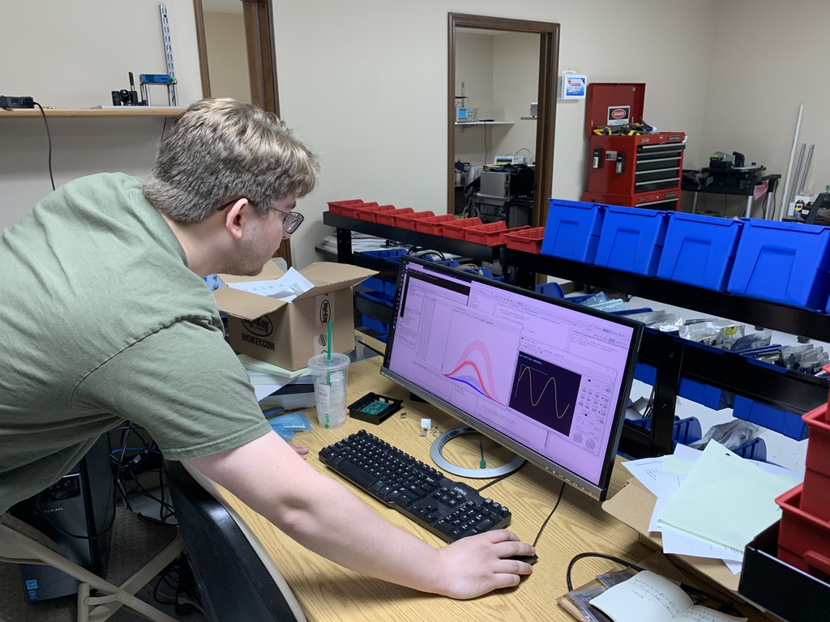
2CH Photon Stream Capturing Set-up

Slide 3
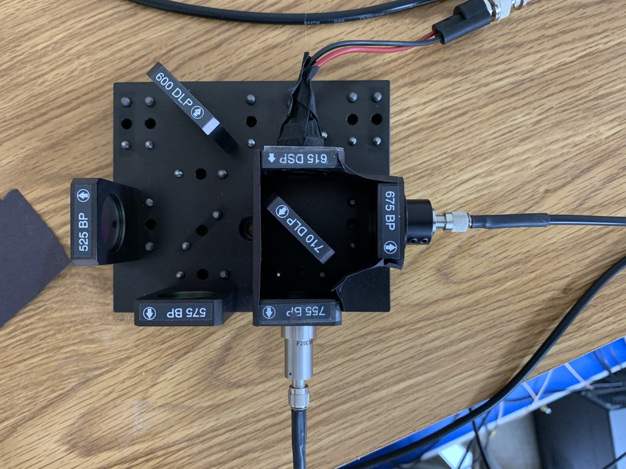
2CH light source (red LED)
LED
Optical layout
2 ch – one is 675 nm
Other is 755 nm
Dichroic is 710
To Sensor 1
To Sensor 2

Slide 4
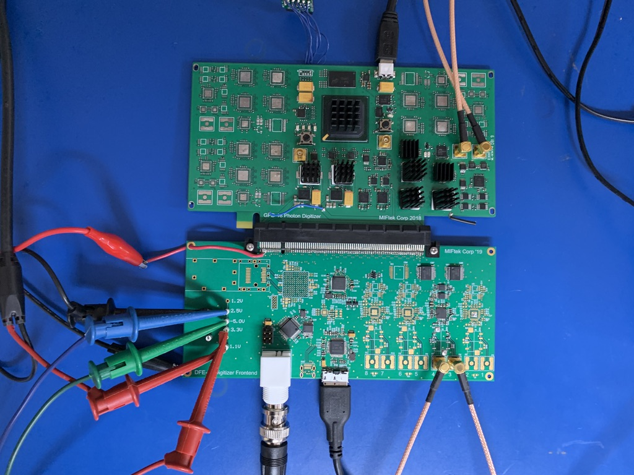
Board layout:
From sensor
8 ch board
New digital output
Board to computer
From sensor

Slide 5
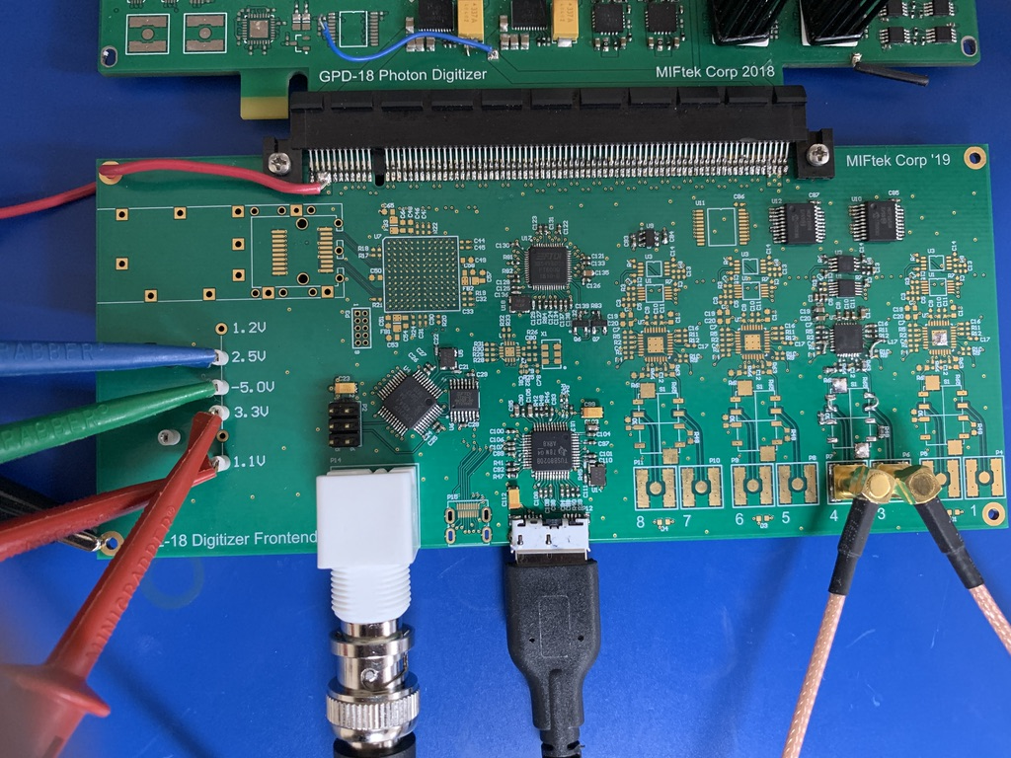
8CH Frond-end board:
Ethernet
Counter
2CH comparator
(8 ch possible on this
board)
USB data
From sensor

Slide 6
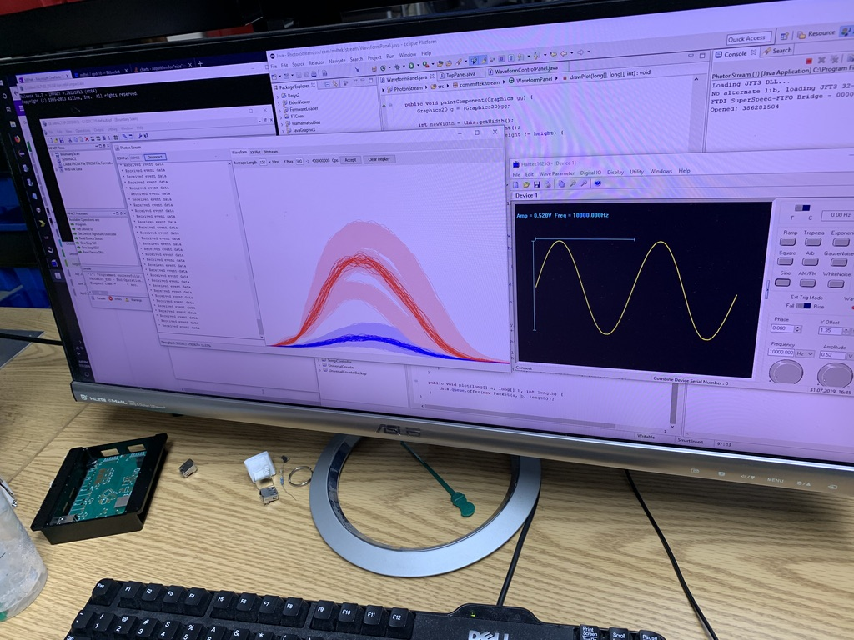
Data transfer to PC via. USB3.0 (2,000event/s) with 30 μs band (this is carrying all photon counts
(will be faster with narrower band, and when taking photon packets not single photons)

Slide 7
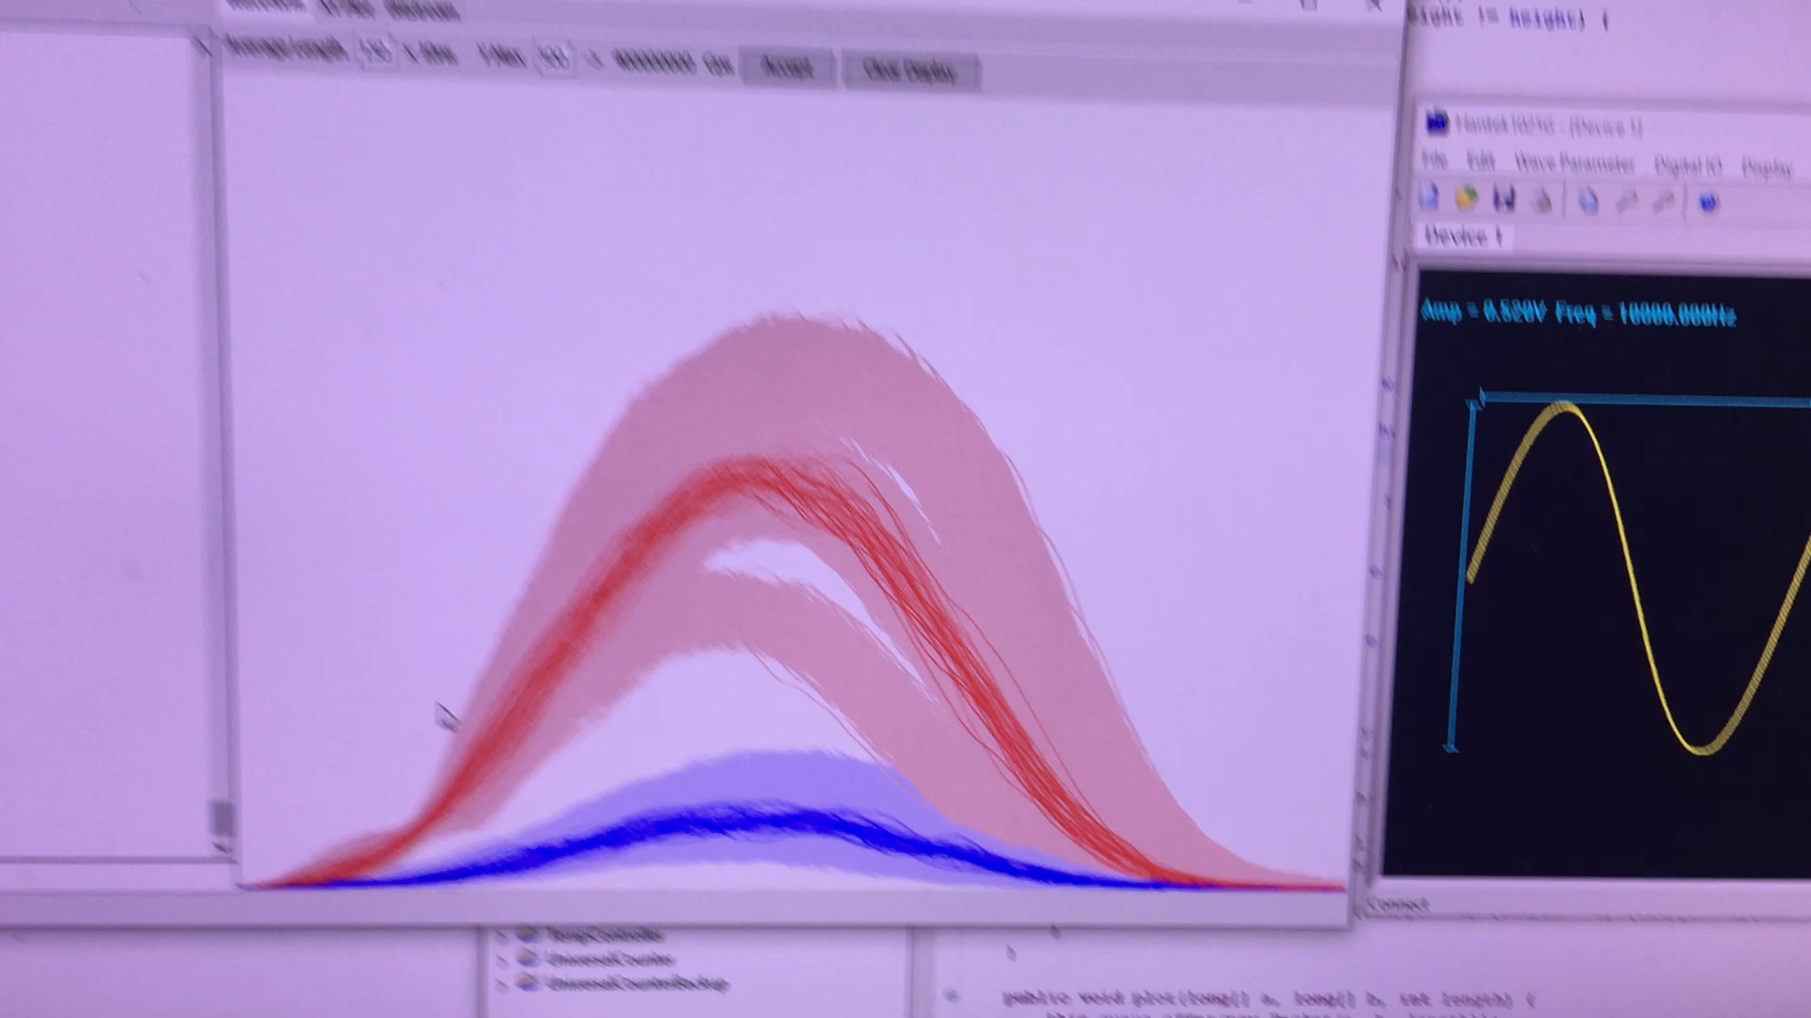
Video -Real time collection of 2 color data

Slide 8
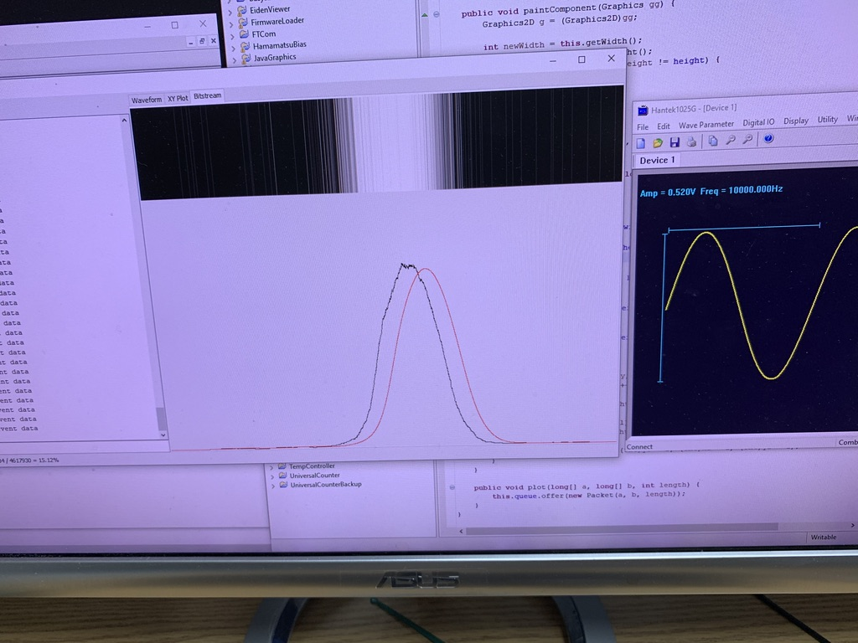
Moving averaging profile:
Photon burst image
Moving averaging profile

Slide 9
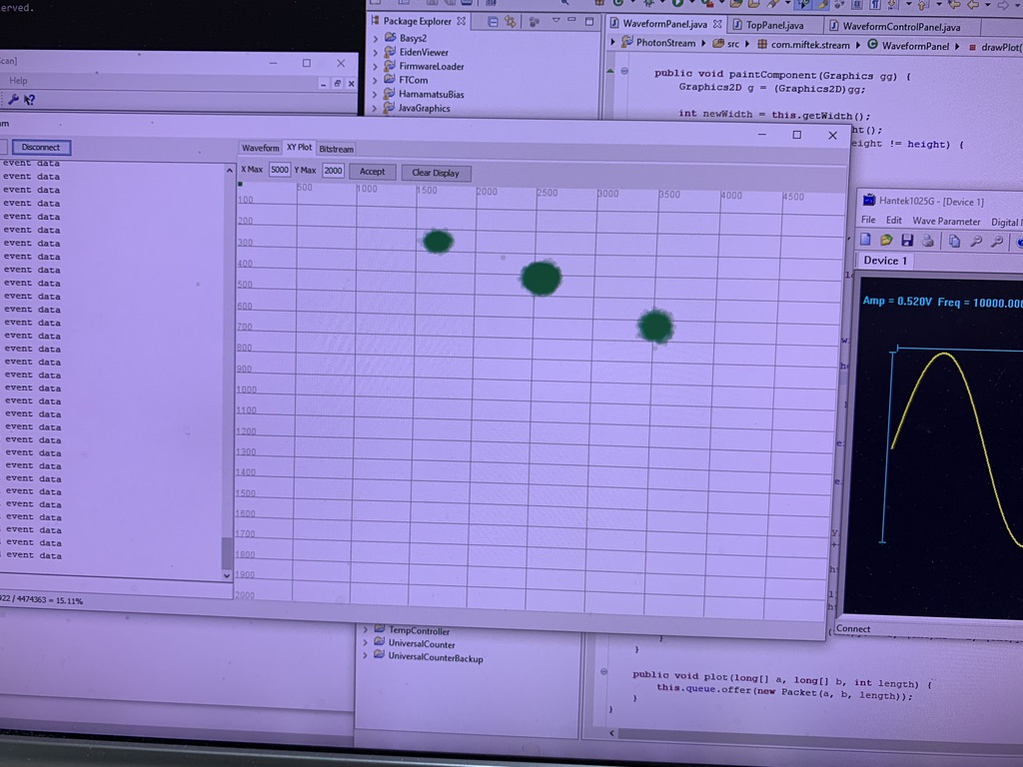
2D plotting (Photon Statistics - Poisson distribution)
Very nice tight
Packets – proves system is
Very solid and data packets
Are clearly separable and distinct
X
Y

