Slide 1


Advances in Cell Analysis
J. Paul Robinson,
SVM Professor of Cytomics,
Professor of Biomedical Engineering, Purdue University, USA
Sysmex Presentation
June 2014

Slide 2
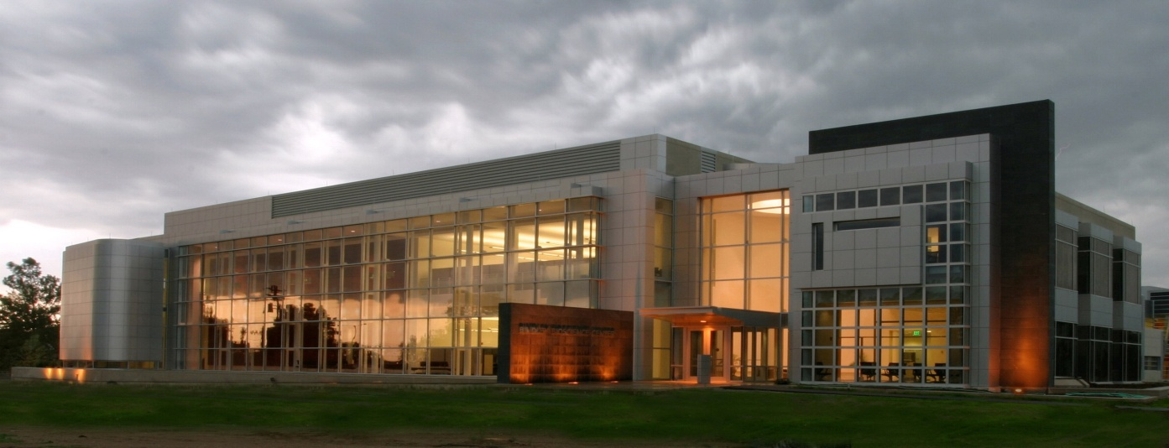
Purdue University Cytometry Laboratories Acknowledgements
Contributors
  Staff Scientists: Valery Patsekin,
Graduate Students: Awais Mansoor, Angela Wolf, Fiona Thomas, Anthony Pedley
Undergrad Students: Nicole Lewis, Peter Carlsgaard
Faculty: Bartek Rajwa, Euiwon Bae, J. Paul Robinson
Data sets: Gary Nolan Lab, David Hedley, Bernd Bodenmiller, Paul Wallace
Staff
  Jennie Sturgis (Imaging)
  Kathy Ragheb (Flow)
  Cheryl Holdman (Flow)
  Raymond Fatig (cell culture)
Funding:
NIH, NSF, USDA, Purdue University
Corporate: Beckman-Coulter, Point-Source, Parker-Hannifin, Polysciences, Bangs labs, Roche, MediaCybernetics, Q-Imaging, Kodak Medical Systems, Crystalplex, Becton-Dickinson , Icyt, eBioscience,
Edmund Optic, Digilab Inc., Spherotech, Inc..
IntelliCyt, Inc
Bindley Bioscience Center, Purdue University
Research reported in this presentation was supported by the National Institute of General Medical Sciences & the National Cancer Institute of the National Institutes of Health under Award Numbers 1R56AI089511-01, R21RR033593-01 & 1R33CA140084. and the UDSA under award # ARS 342365. The content is solely the responsibility of the authors and does not necessarily represent the official views of the National Institutes of Health.

Slide 3
Background and Concepts
Part 1
Flow cytometry saw little changed over its first 40 years:
  An historical Review
Some emerging technologies:
  Spectral cytometry
  HT flow cytometry
  The impact of HT cytometry
  The impact of next generation analytical concepts
Part 2
Part 3

Slide 4
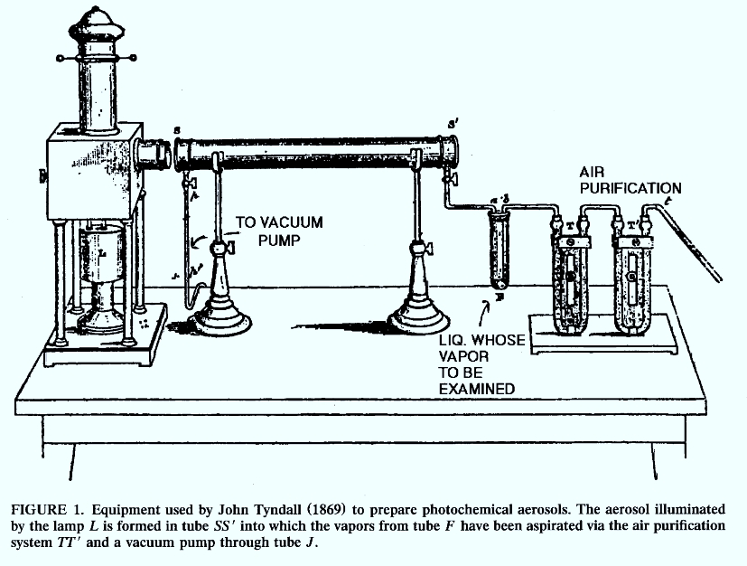
Tyndall 1869
1869

Slide 5
Andrew Moldavan
1934
It is unclear if Moldavan ever built his cell counter. His short article (less than half a page) describes a number of problems but no results.
“The purpose of the experiment is to have each microscopical cell passing through the capillary tube, register itself automatically on the photoelectric apparatus, thus creating a micro-current which can be amplified and recorded.”
Manuscript:
Photo-Electric Technique for the Counting of Microscopical Cells
Andrew Moldavan
Montreal, Canada
Science 80:188-189, 1934
Moldavan (1934) demonstrates use of a suspending fluid in which were blood cells - the measurements were made in a capillary tube using a photoelectric sensor to make extinction measurements

Slide 6
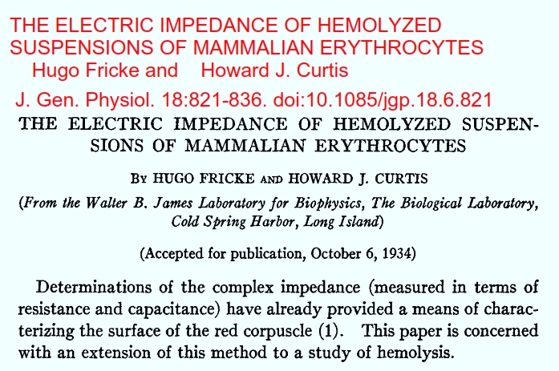
1934

Slide 7

Conjugated Fluorescein with Isocyanate
1950
Coons and Kaplan (1950) - conjugated fluorescein with isocyanate - better blue green fluorescent signal - further away from tissue autofluorescence. This method used a very dangerous preparative step using phosgene gas

Slide 8
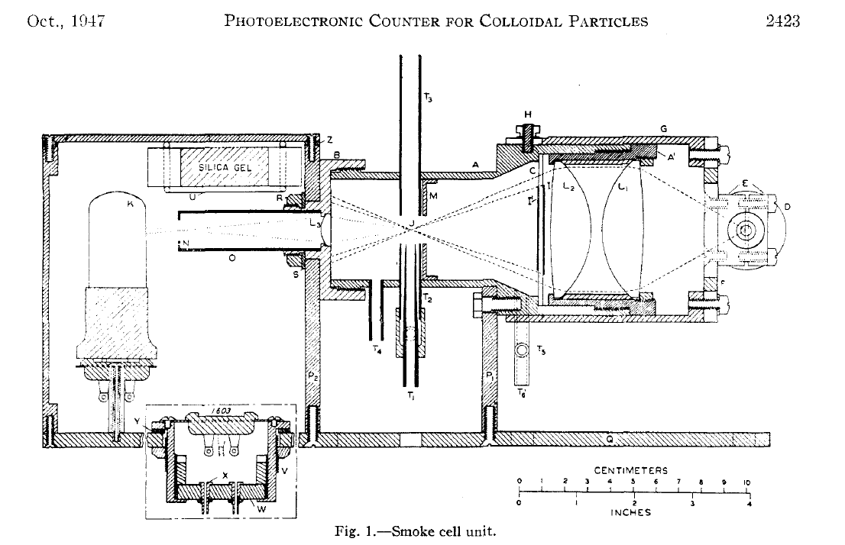
Gucker’s Apparatus
1947
Developed a flow cytometer for detection of bacteria in aerosols
Instrument: Sheath of filtered air flowing through a dark-field flow illuminated chamber. Light source was a Ford headlamp, PMT detector (very early use of PMT)
A Photoelectronic Counter for Colloidal Particles1
BY FRANK T. GUCKER, J R . , ~ CHESTER T. O’KONSKI,~ HUGH B. PICKARD3 AND JAMES N. PITTS, JR.4

Slide 9
Gucker’s Apparatus
1947
Developed a flow cytometer for detection of bacteria in aerosols
Instrument: Sheath of filtered air flowing through a dark-field flow illuminated chamber. Light source was a Ford headlamp, PMT detector (very early use of PMT)
A Photoelectronic Counter for Colloidal Particles1
BY FRANK T. GUCKER, J R . , ~ CHESTER T. O’KONSKI,~ HUGH B. PICKARD3 AND JAMES N. PITTS, JR.4

Slide 10
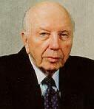
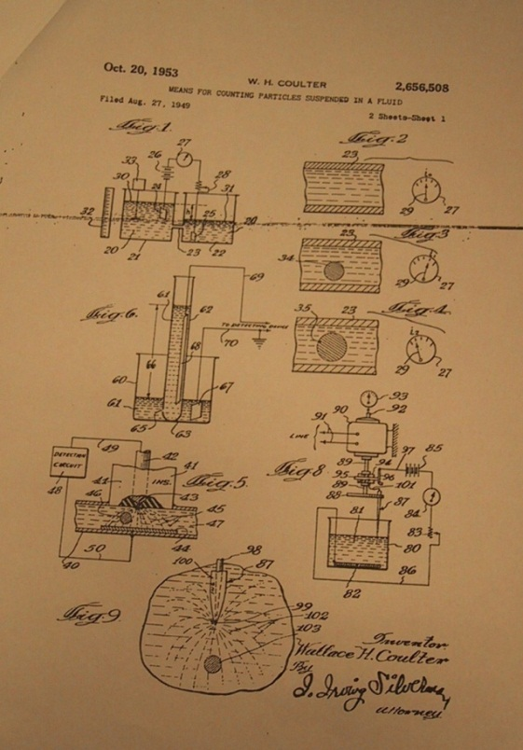
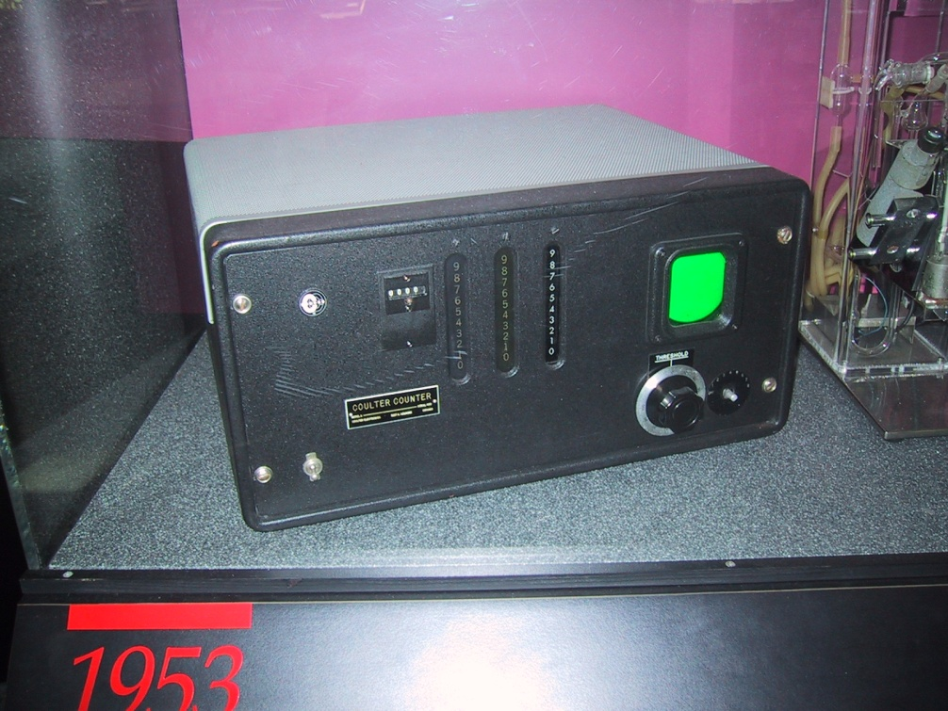
Wallace Coulter
1949
Wallace Coulter - Coulter orifice - 1956 -
(patent 1953) - measured changes in electrical conductance as cells suspended in saline passed through a small orifice
Coulter’s
Original 1953
Patent app’n
From 1949
©J.Paul Robinson
1949 - Coulter WH, US Patent 2,6756, 508.
“Electrical sensing zone method”)
The first commercial version of the Coulter Counter

Slide 11
Conjugated Fluorescein with Isocyanate
1950
Coons and Kaplan (1950) - conjugated fluorescein with isocyanate - better blue green fluorescent signal - further away from tissue autofluorescence. This method used a very dangerous preparative step using phosgene gas

Slide 12
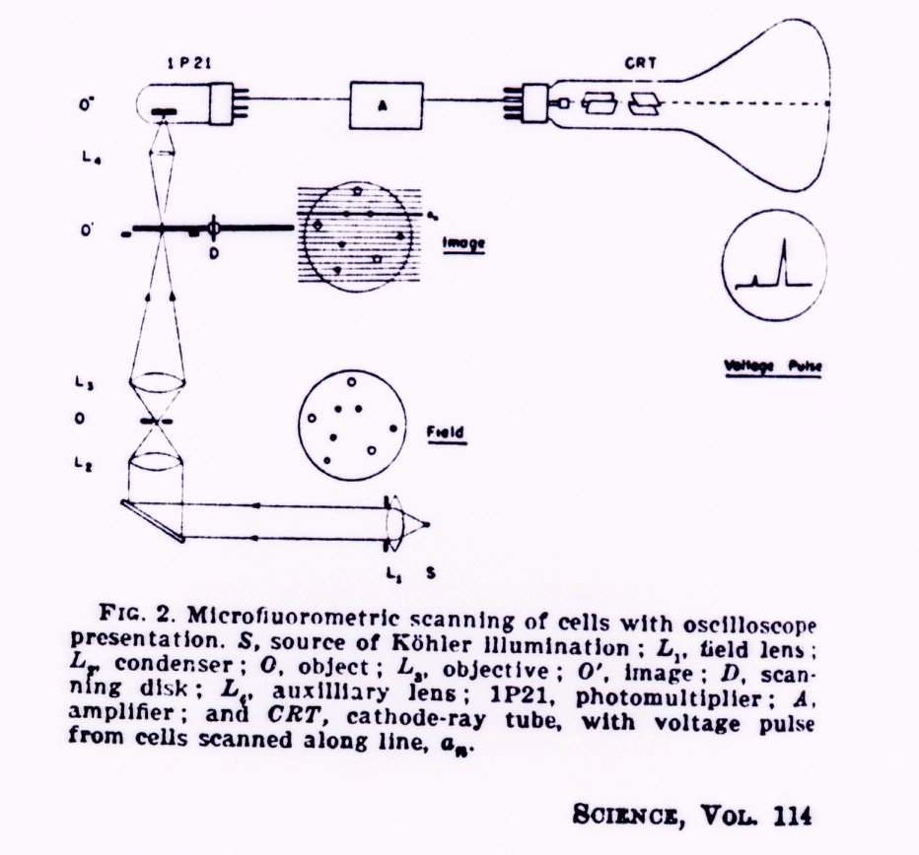
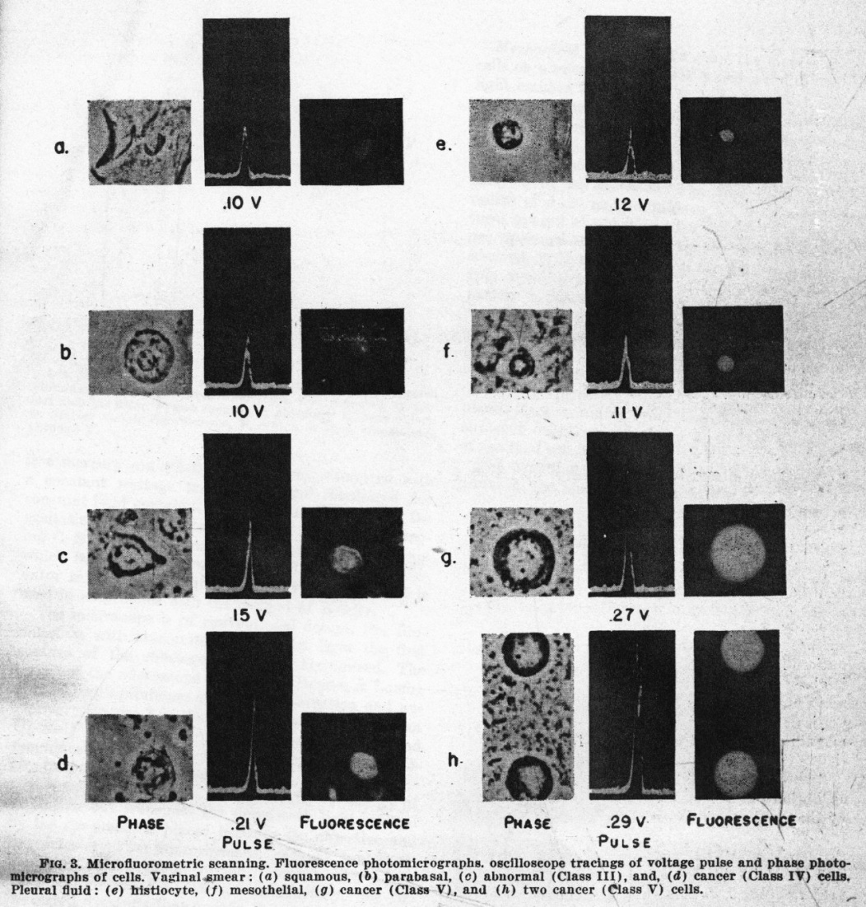
Early Microfluorometric Scanner
Robert Mellors 1951
1951
RC Mellors & R. Silver, A microfluorometric scanner for the differential detection of cells: application to exfoliative cytology, Science 104, 1951

Slide 13
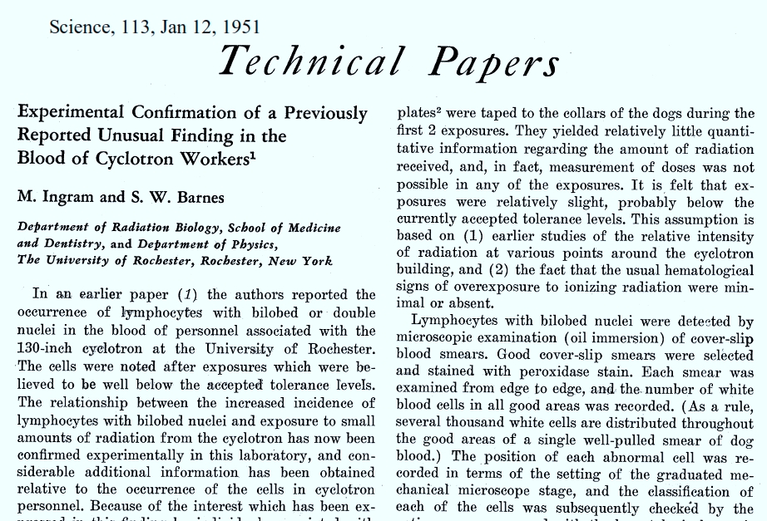
Marylou Ingram
1951

Slide 14
P.J. Crosland-Taylor
1952
Sheath Flow Principle – 1952-3
“Provided there is no turbulence, the wide column of particles will then be accelerated to form a narrow column surrounded by fluid of the same refractive index which in turn is enclosed in a tube which will not interfere with observation of its axial content.”
A Device for Counting Small Particles Suspended in a Fluid through a Tube
P.J. Crosland-Taylor
Bland-Sutton Institute of Pathology
Middlesex Hospital, London, W.1. June 17, 1952 Nature 171: 37-38, 1953

Slide 15
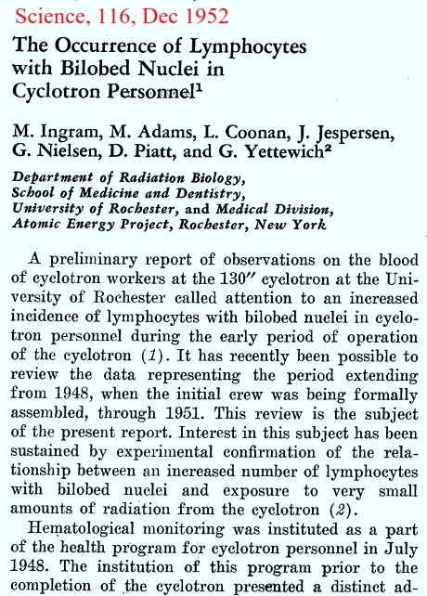
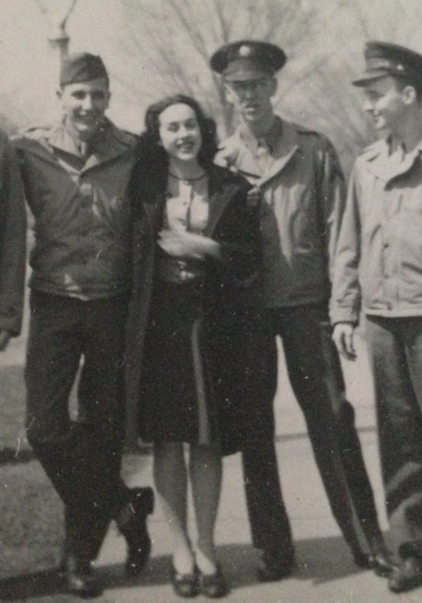
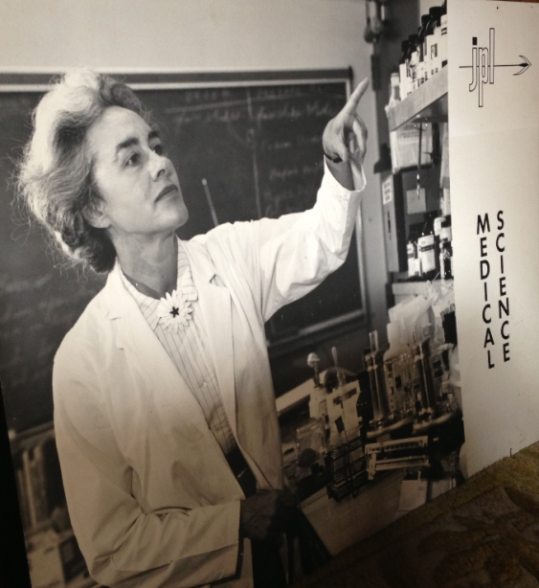
1952
Marylou Ingram in medical school 1944
1960

Slide 16
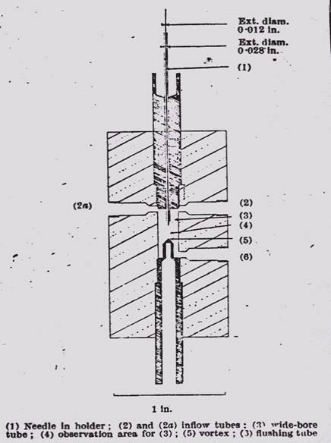
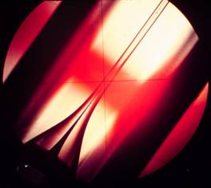
Fundamental principle of Sheath Flow
PJ Crosland-Taylor
1953
A device for counting small particles suspended in fluid through a tube, Nature 171, 1953 (ref 4756)
An Electronic Blood-Cell Counting Machine, Blood 13, 1958 (ref 40974)

Slide 17
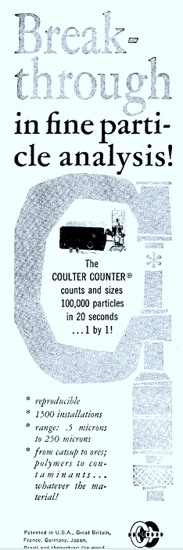
1500 Coulter Counters
1961

Slide 18
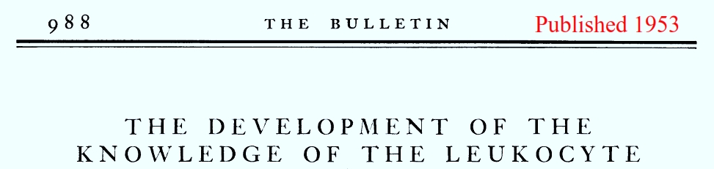
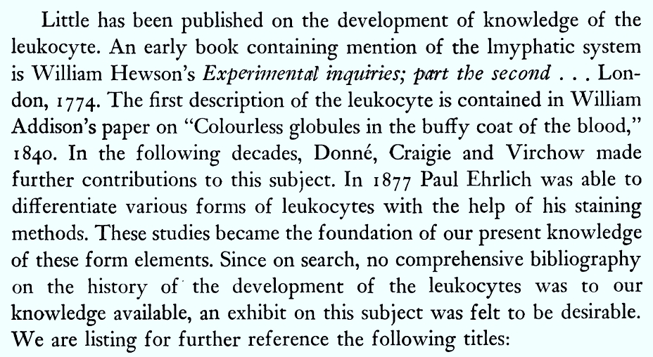
1953

Slide 19
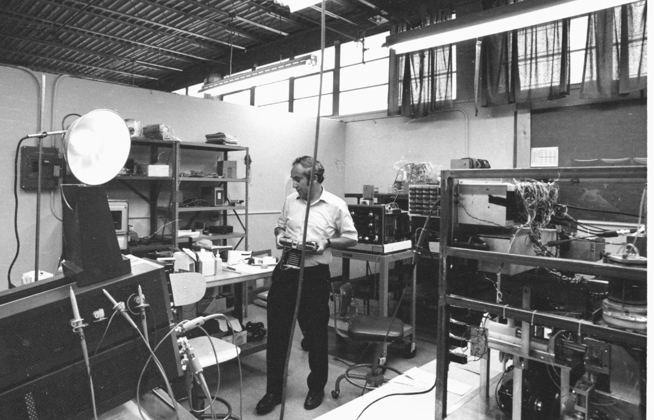
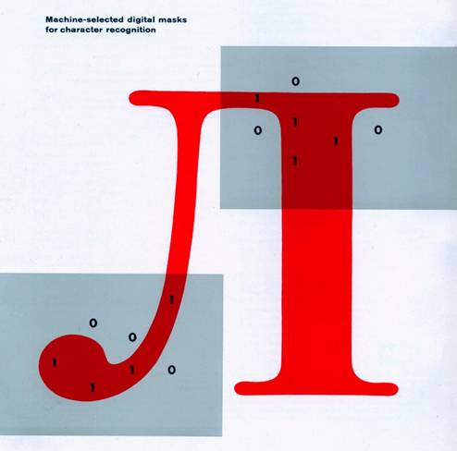

Before Cytometry
Lou Kamentsky – at the IBM’s Watson Labs 1950s and 1960s
1960s
Slide Kindly Supplied by Compucyte

Slide 20
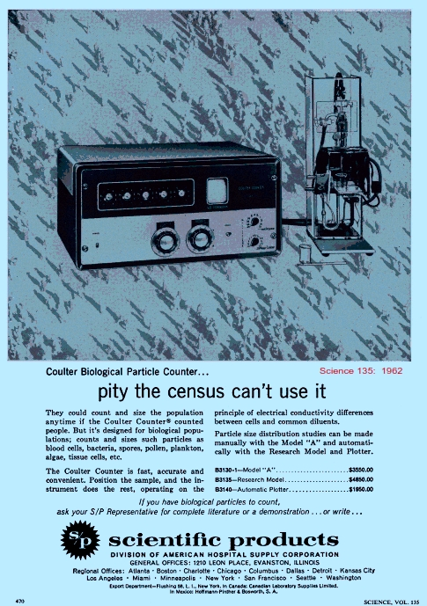
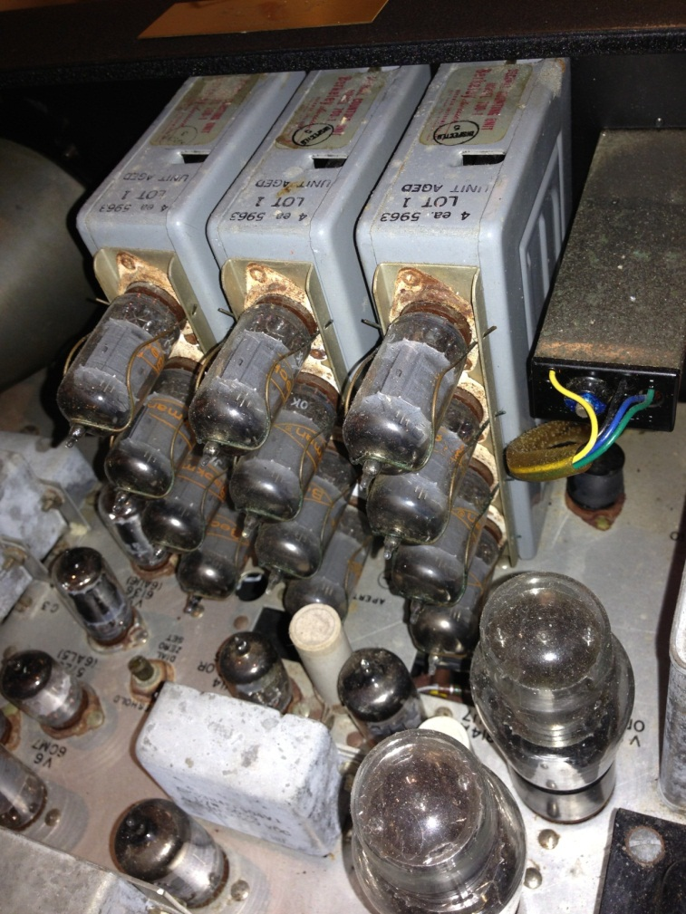
1962
Valves, Valves and Valves….

Slide 21
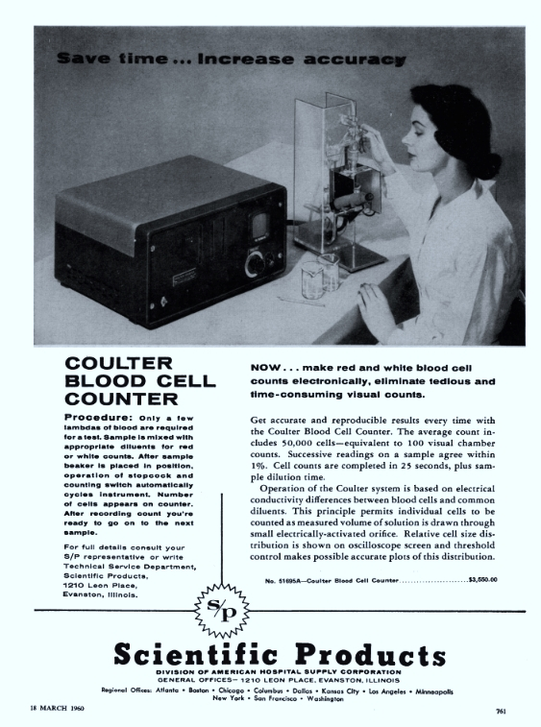
1962

Slide 22
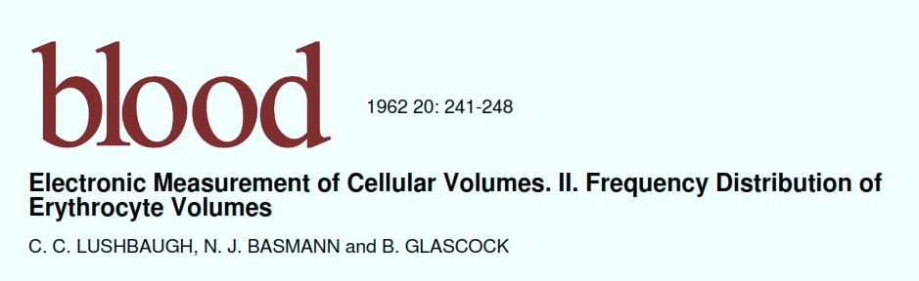
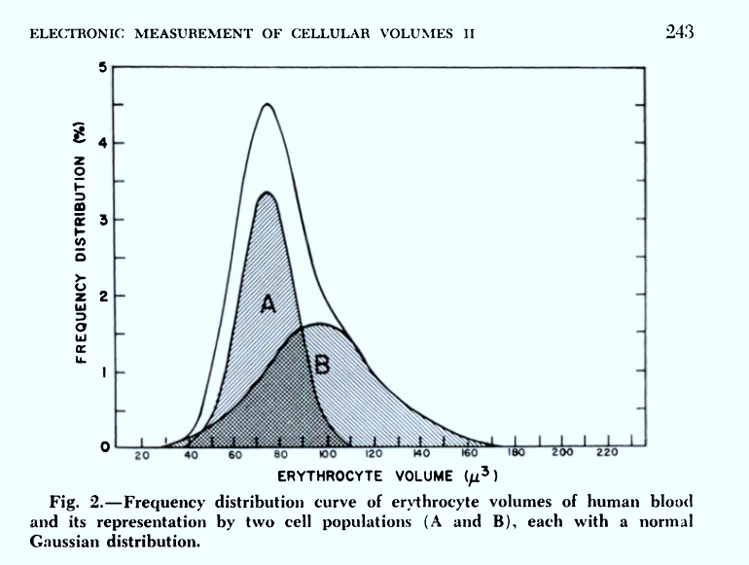
1962

Slide 23
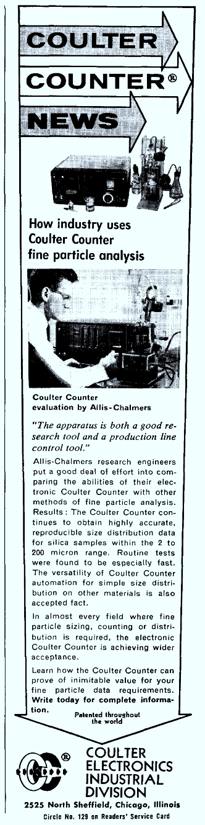
1963

Slide 24
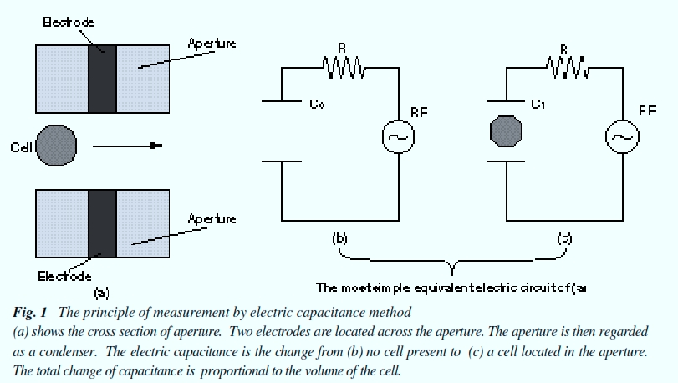
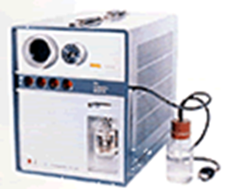
TOA Enters blood analysis field - 1963
1963-Automatic blood cell counting instrument developed and first unit delivered. CC-1001 developed
Sysmex Journal International, Vol 9, #1, 1999

Slide 25
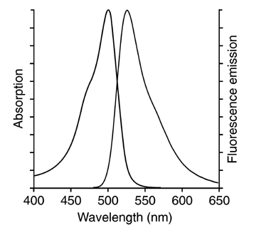
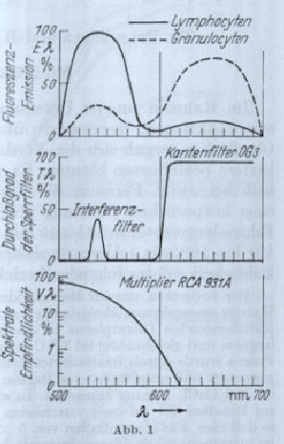
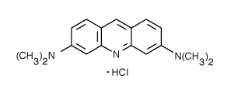
Historical Overview
1964
Early flow systems
Hallermann et al, Kosenow - 1964 - AO staining of leukocytes - was able to use fluorescence (in a flow based system) to select leukocytes from red cells despite a low ratio (1/1000) because they took up lots of AO - also claimed to be able to discriminate between monocytes and PMN
Molecular Formula: C₁₇H₂₀ClN₃
Molecular Weight: 301.82
CAS Number/Name: 65-61-2 / 3,6-Acridinediamine, N,N,N',N'-tetramethyl-, monohydrochloride
Halleman 1964 AO
Scan and structure from www.probes.com

Slide 26
Richard Sweet
1964
Richard Sweet developed the electrostatic ink-jet printer which was the principle used by Mack Fulwyler to create a cell-sorter.

Slide 27
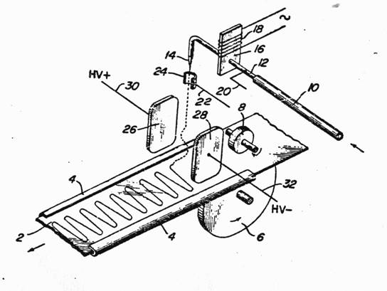
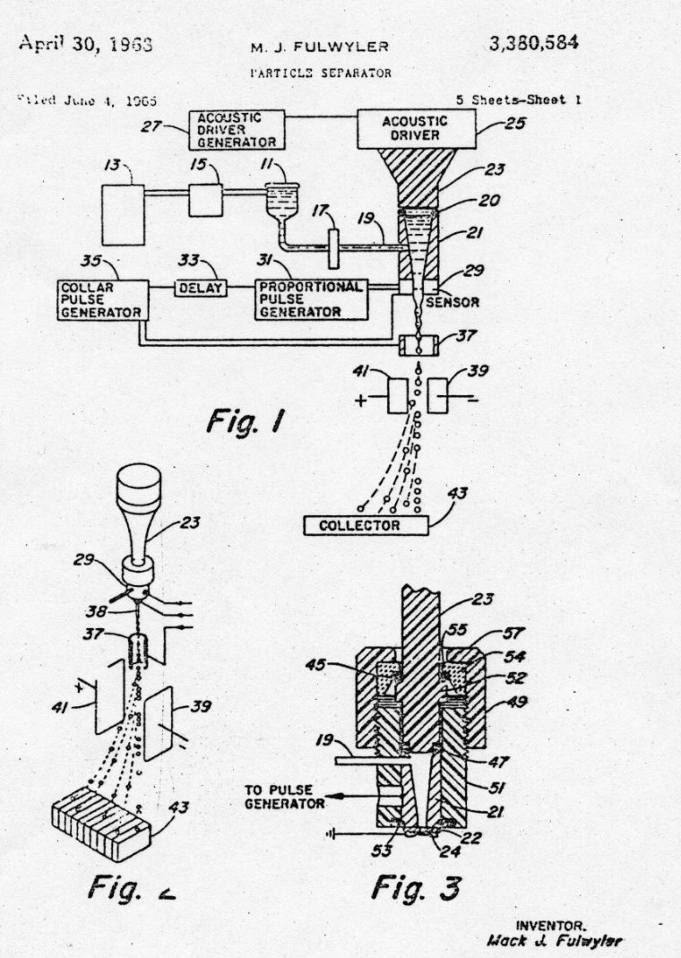
Electrostatic Printing and Droplet Sorting
RG Sweet - MJ Fulwyler
1965
RG Sweet, Fluid Droplet Recorder
U.S. Patent 3,596,275
filed 3/25/64 (ref 40975)
MJ Fulwyler, Particle Separator, U.S.
Patent 3,380,584 filed 6/4/65

Slide 28
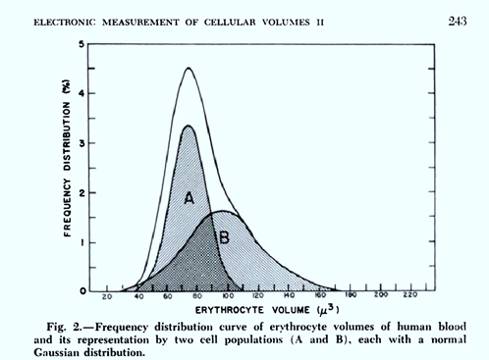
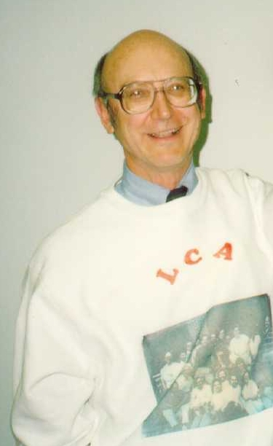
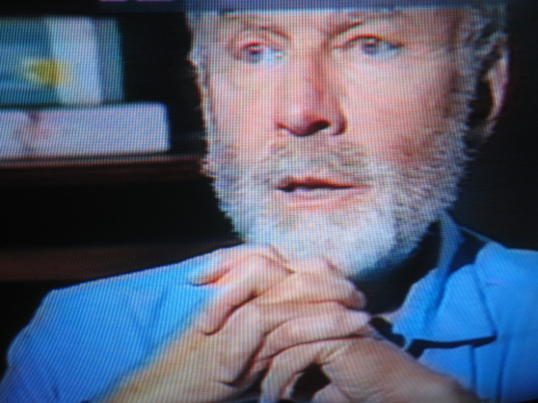
Mack Fulwyler
1965
Mack Fulwyler – worked in Marvin van Dilla’s lab at Los Alamos. – developed the sorter in 1965 – initially used electronic cell volume - at Los Alamos National Labs - this instrument separated cells based on electronic cell volume (same principle as the Coulter counter) and used electrostatic deflection to sort. The cells sorted were RBC because they observed a bimodal distribution of cell volume when counting cells - the sorting principle was based on that developed for the inkjet printer by Richard Sweet at Stanford in 1965.
Mack Fulwyler
Marvin van Dilla
(Photo dated 6/91)
After determining that the bimodal distribution was artifactual, this group were able to sort neutrophils and lymphocytes from blood.
Lushbaugh, CC, Basmann,NJ, Glascock, B. Electronic measurement of cellular volumes.
II Frequency distribution of erythrocyte volume. Blood 1962 20:241-248 Correspondence Blood 1964:23:403-405

Slide 29
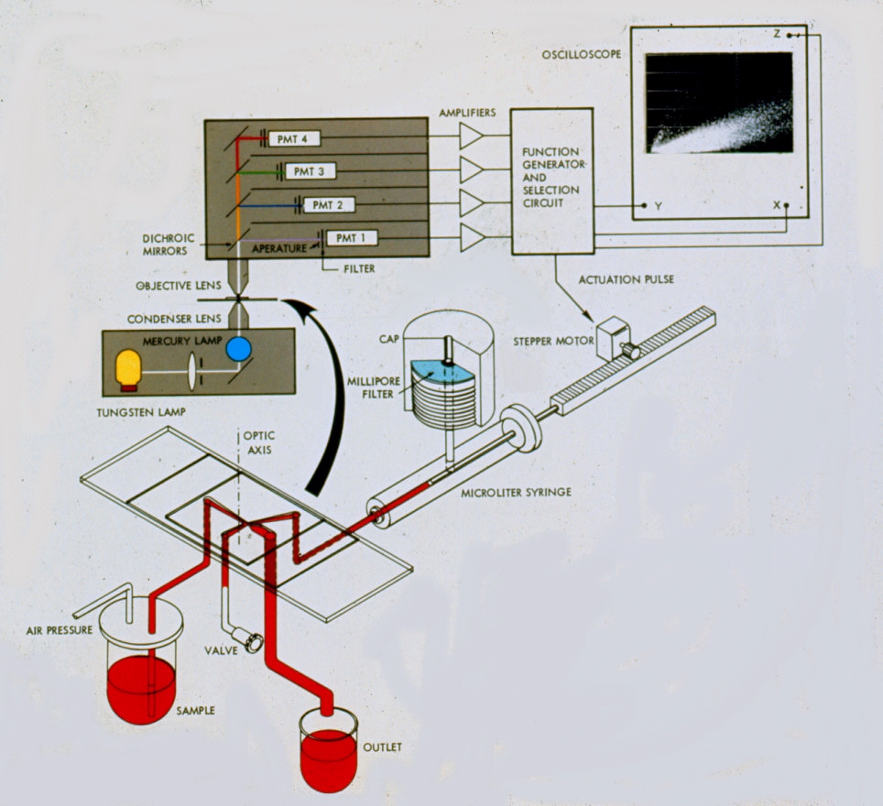

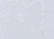
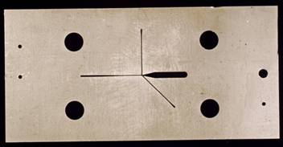
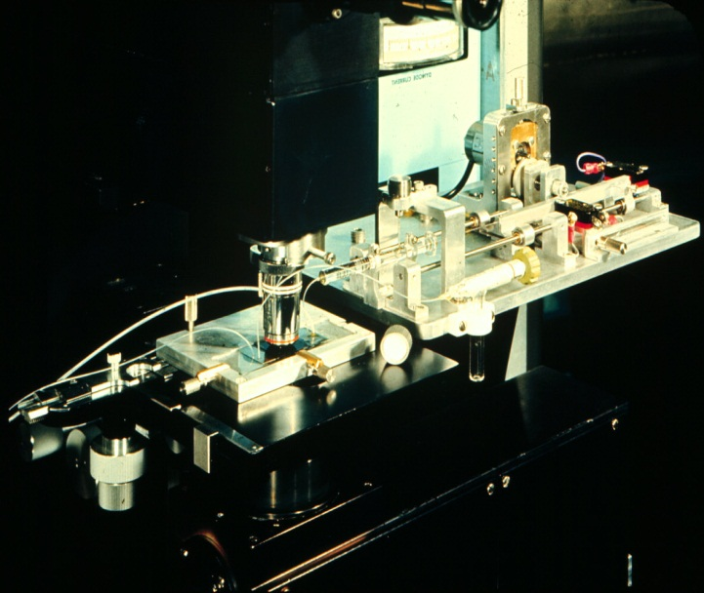
Sorting Cancer Cells - Kamentsky
1965
Technology was based on a fluidic switched “Typewriter” that IBM was developing in Zurich research laboratories.
Spectrophotometric Cell Sorter, LA Kamentsky and MR Melamed, Science 156, 1967 (ref 4134)

Slide 30
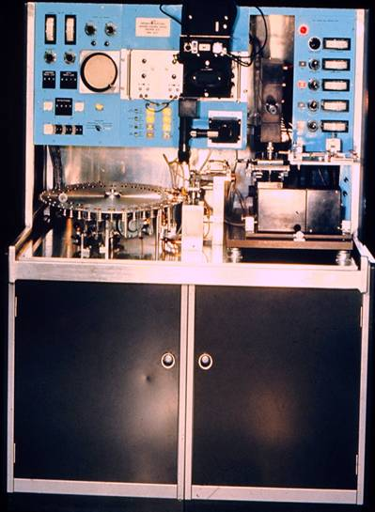
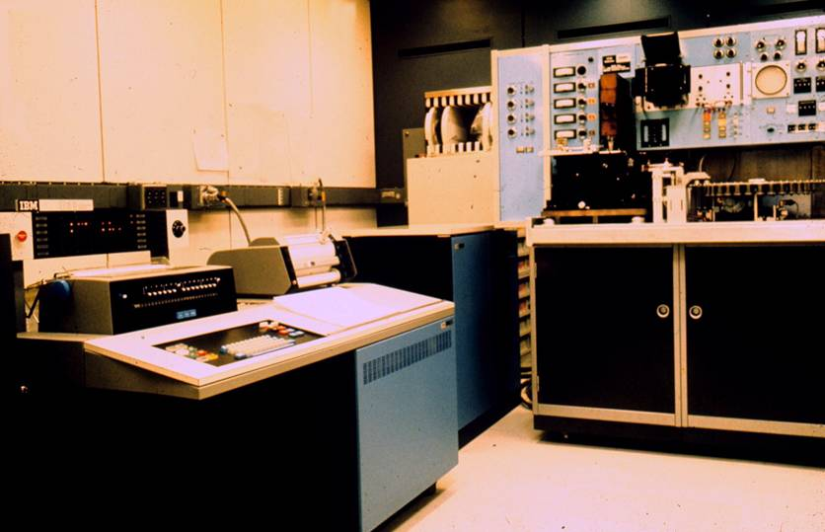

Four Sensors, Sorting, Auto Sampling and Computer Data Reduction
1966
IBM 1620 Computer
This instrument became the “Hemalog D” by Technicon in 1974
Two analytic instruments were built and one was delivered to LA Herzenberg at Stanford University 1967

Slide 31
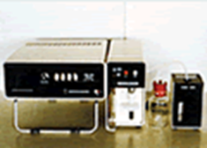
TOA Automatic Hematology Analyzer - 1966
Automated Hematology Analyzer, CC-1002

Slide 32
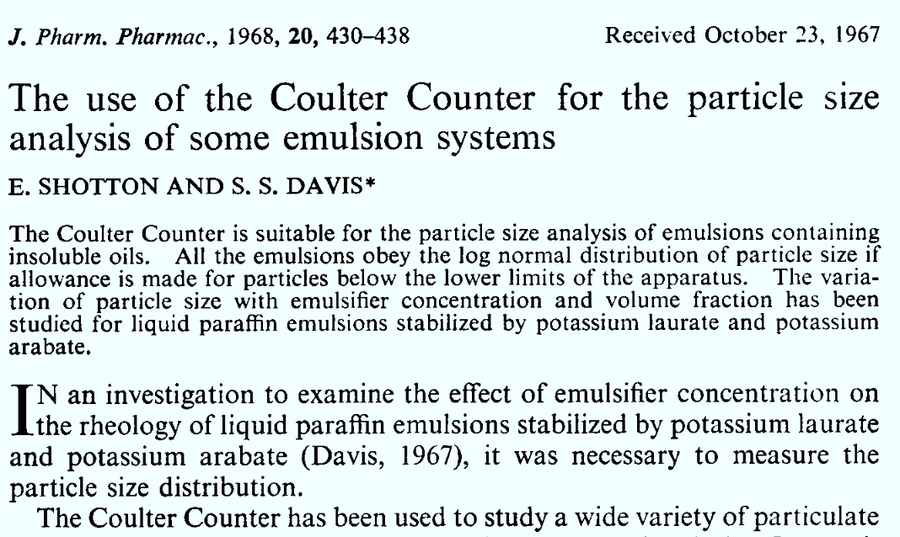
1967

Slide 33
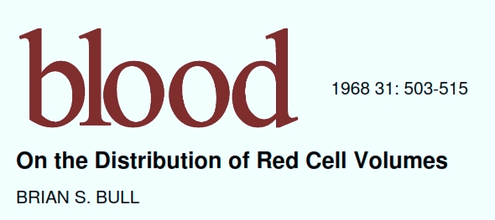
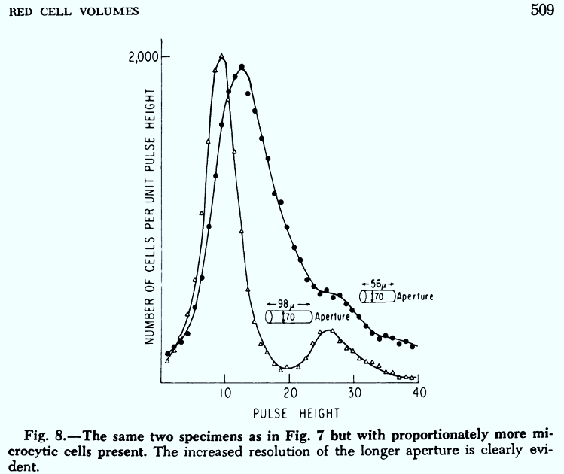
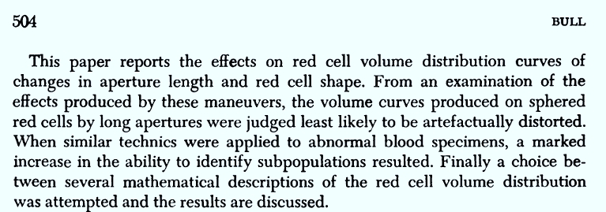
1968

Slide 34
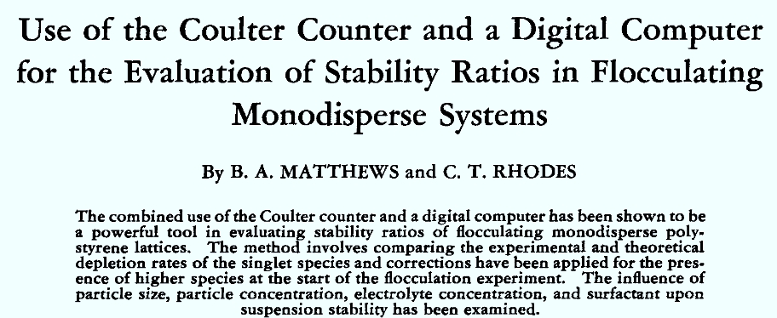
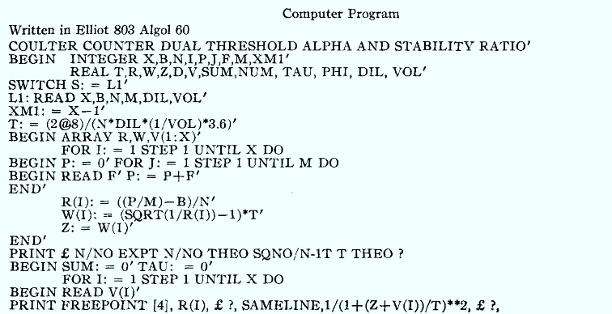
1968
J.Pharm.Sci 57:557-563, 1968

Slide 35
Sysmex precursor formed - 1968
1968 - -Establishes a medical equipment sales company, Toa Medical Electronics Co., Ltd. (now Sysmex Corporation).

Slide 36
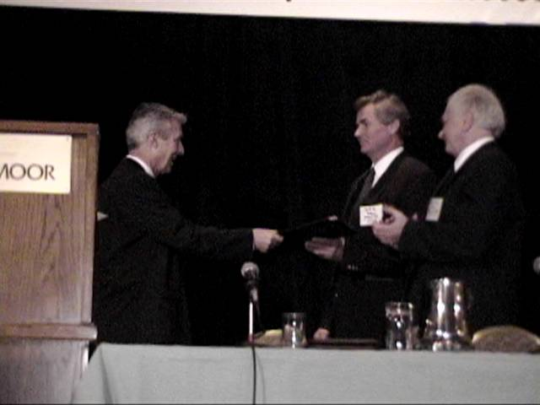


Dittrich & Göhde
1969
Dittrich & Gohde - 1969 - Impulscytophotometer (ICP)- used ethidium bromide for a DNA stain and a high NA objective used as a condenser and collection lens
Phywe AG of Gottingen (1969) - produced a commercial version of the ICP built around a Zeiss fluorescent microscope
Laerum, Göhde, Darzynkiewicz (1998)
Göhde and Laerum (1998)
http://www.partec.de/partec/flowmuseum.html
ICP 11 (1969)
Distributed by Phywe, Göttingen
The first commercial flow cytometer
PDP 11 computer
Photos ©2000 – J.P. Robinson

Slide 37


Herzenberg Lab
1969
Len Herzenberg - 1969 - sorter based on fluorescence (arc lamp) built after working with one of Kamentsky’s RCS systems where they built an instrument they called the Fluorescence Activated Cell Sorter (FACS)
Photos from 2000 – JP Robinson

Slide 38

Kamentsky & Biophysics Systems
1970
Kamentsky also built a fluidic cell-sorter to evaluate the cells identified in his RCS. An RCS was sent to Stanford for use by Leonard Herzenberg . The unit was also the model for the Technicon D instrument built by Technicon. (Reference: Shapiro)
©J.Paul Robinson
Kamensky’s first benchtop instrument the Cytograph. This measured scatter using a He-Ne laser. This particular instrument was a model prior to the fluorescence detection model.

Slide 39



Evolution of Leukocyte Gating Strategy for Cluster Subsetting
1971
LR Adams & LA Kamentsky,
Machine characterization of human leukocytes by acridine orange fluorescence, Acta Cytologica 15, 1971
Monocytes
Lymphocytes
Granulocytes
Biophysics Systems
GC Salzman, JM Crowell, JC Martin, TT Trujillo, A. Romero, PF Mullaney, & PM LaBauve,
Cell classification by laser light scattering: identification and separation of unstained leukocytes,
Acta Cytologica 19, 1975
Los Alamos
RA Hoffman, PC Kung, WP Hansen,
Simple & rapid measurement of human T
lymphocytes and their subclasses,
PNAS 77, 1980
Ortho

Slide 40

Herzenberg & Becton-Dickinson
1972
Herzenberg -1972 -2013 Argon laser flow sorter - placed an argon laser onto their sorter and successfully did high speed sorting - Coined the term Fluorescence Activated Cell Sorting (FACS) This instrument could detect weak fluorescence with rhodamine and fluorescein tagged antibodies. A commercial version was distributed by B-D in 1974 and could collect forward scatter and fluorescence above 530 nm.
Herzenberg was the recipient of the very
Prestigious 2006 Kyoto Prize for his work
in development of fluorescence based
flow cytometry. Many people well known
in the field were trained in his lab
(Photo from the official Kyoto Prize website)

Slide 41


Herzenberg and Bonner
1972
WA Bonner, HR Hulett, RG Sweet and LA Herzenberg,
Fluorescence Activated Cell Sorting, Review of Scientific Instruments 43, 1972

Slide 42
TOA 1972
1972 - -Transfers medical equipment division operations to
Toa Medical Electronics Co., Ltd. (now Sysmex Corporation).

Slide 43






Biophysics Systems
Ortho Instruments
Cytograf (1970)
ELT 8 (1977)
50H (1978)
Cytofluorograf (1970)
Spectrum (1979)
FC200 (1975)

Slide 44


BD
1974
Coulter
FASEB April 1974 – Coulter Booth

Slide 45


EPICS II
1974
Delivered to Chet Herman
NIH in 1974

Slide 46
Hemalog D
1974
Technicon - Hemalog D - 1974 - first commercial differential flow cytometer - light scatter and absorption at different wavelengths - chromogenic enzyme substrates were used to identify neutrophils and eosinophils by peroxidase and monocytes by esterase, basophils were identified by the presence of glycosaminoglycans using Alcian Blue - the excitation for all measurements was a tungsten-halogen lamp
Insert photos on page 60
Image from Shapiro “Practical Flow Cytometry”, 3rd. Ed.Wiley-Liss, 1994

Slide 47

Mack Fulwyler
1975
Coulter Electronics manufactured the TPS-1 (Two parameter sorter) in 1975 which could measure forward scatter and fluorescence using a 35mW argon laser.
This photo (left) is one of only one or two surviving TPS Instruments. It is very similar to the Coulter Counter of the day.
Photo ©2000 – J.P. Robinson

Slide 48



Monoclonal Antibodies
1975
César Milstein
Georges J.F. Köhler

Slide 49

1975

Slide 50

TOA Releases Automated Hematology Analyzer
1975 - Released the first fully Automated Hematology Analyzer developed in Japan, "CC-710.“

Slide 51


Biophysics -Ortho
1977
Ortho Diagnostics (Johnson and Johnson) purchased Biophysics in 1976 and in 1977 the System 50 Cytofluorograph was developed - this was a droplet sorter, with a flat sided flow cell, forward and orthogonal scatter, extinction, 2 fluorescence parameters, multibeam excitation, computer analysis option.
1979 - NIH scientists had added a krypton laser at 568 nm to excite Texas Red fluorescence at 568 nm and emit at 590-630 nm. Argon (488 nm FITC was measured simultaneously without signal cross-talk - thus the FACS IV was developed (B-D).
FC 200(1975)
System 50H (1978)

Slide 52


Chromosome Analysis on the TPS-1 Sorter
1977

Slide 53


Two groups of Lymphocytes
B Cells and T Cells….
1977

Slide 54


Coulter Electronics
1978
1977-78 developed the Epics series of instruments which were essentially 5 watt argon ion laser instruments, complete with a multiparameter data analysis system, floppy drive and graphics printer.
Photo ©2000 – J.P. Robinson
Epics V front end (left) and MDADS (right)

Slide 55

1978 Sysmex corporation born

Slide 56




















And so we get to the present…
BC
BC
BC
Bryte
Luminex
BC
Bay
Biosciences
Millipore/Guava
Accuri
BC
Amnis
BD
BD Aria
BD
BC
Sony
BD Influx
Apogee

Slide 57
The next generation of cytometry…
Part 2
Spectral Cytometry

Slide 58




Hyperspectral Single Cell Cytometry
64 ch ADC`
10 μs available
10,000-100,000 cells
Built in 2002-2003

Slide 59


Detectors
ADC Electronics
32 spectral channels Hamamatsu
6 regular fluorescence channels
1 side scatter channel
6 forward scatter detectors
1 time gate
64 ch 16 Bit ADC
Purdue Issued Patent #7,280,204

Slide 60






PE
Chlorophyll
Rh-123
“2” color analysis
Bang’s
Labs
Dyed
Beads*
These CAN now be resolved
These CANNOT be resolved
Advanced classification tools
like PCA are required

Slide 61

Spectral “fingerprints” identify samples

Slide 62

Spectral “fingerprints” identify samples
This technology is now a commercial technology (Sony) (…to HT)

Slide 63


Slide 64

5-(and-6)-carboxy-2´,7´-dichlorofluorescein diacetate (CDCFA)
5(6)-carboxy-4',5'-dimethylfluorescein (CDMFA)
5-sulfofluorescein diacetate (SFDA)
Cell Tracker Green – 5-chloromethylfluorescein diacetate (CTG)
5-(and-6)-carboxy-2´,7´-dichlorofluorescein diacetate, succinimidyl ester (DCF)
bis-(1,3-dibutylbarbituric acid)trimethine oxonol (DiBAC₄(3))
3,3'-dipentyloxacarbocyanine iodide (DiOC₅(3))
3,3'-dihexyloxacarbocyanine iodide (DiOC₆(3))
Rhodamine 110

Slide 65









7 of 9 “green” dyes could be resolved
All dyes
Oxonol Events: 3373
Human Lymphocytes

Slide 66
Nanocrystals/Micro-Dots multiplexed systems
New probes
Potentially 1000’s of combinations
Sensitive, long lived, less bleaching
Difficult to make
Will require some advanced classification software

Slide 67
Part 3
High Throughput Screening
and
Advanced Analytical Systems

Slide 68





Slide 69


Optical Design of a basic flow cytometer
PMT 5
HyperCytTM system added to flow cytometer
PMT 5
PMT 4
Sample
PMT 4
PMT 3
Dichroic
Flow chamber
Filters
PMT 3
Dichroic
PMT 2
Flow chamber
Filters
PMT 2
Scatter
Scatter
PMT 1
PMT 1
Laser
Laser
Copyright 2006 Nature Publishing Group
Nature Reviews Protocols
Sensor
Sensor
Bandpass
Bandpass
Filters
Filters
HyperCyte diagram kindly supplied by Larry Sklar
384 wells/10 min
1 μl/sample 5000 cells/μl
Notes:
Basic schematic for how a flow cytometer works – a cell passes via a laser (blue line) and signals are passed down to each PMT and light scatter detector

Slide 70

Automated
Cytomat
Incubator
Automated Biomek
Preparative system
Automated HyperCyte
Sample Delivery
Cyan flow cytometer

Slide 71




Circa, 1990-present
ANALYSIS
1 sample 10 to 30 minutes
Run 30-60 samples
per hour

Slide 72


Slide 73








The Operational Modality of Flow Cytometry
Traditional
HT Flow
1. Take a complex biological sample
1. Take a complex biological sample
2. Create very large scale “systems level” experimental grids
2. Separate that sample into single samples
3. Run each sample as a single unit
3. Run samples as a high speed, low volume set
4. Put all the data back together again
4. Combine data automatically as sets
5. Try to relate each piece of data back to the original biological system
5. Conduct simultaneous
advanced analysis in
parallel
The operational modality of Flow Cytometry.pptx

Slide 74




Graphical data processing environments
IBM Data Explorer
Khoros
AVS
Orange

Slide 75




Traditional gating process
Decision
Traditional flow gating logic and analysis approach
Decision
Result
Decision
Repeat ad infinitum
Result
Decision
‘What we see depends mainly on what we are looking for.’ John Lubbock

Slide 76


Graphical cytometry analysis pipeline builder
We call this a Logic Map
Control +
Control -
Build curve
distance
A3
Drug 1
Label 1
B3
Drug 2
Extract features
Drug 3
C3
Drug 4
D3
distance
Drug 5
E3
Label 2
Drug6
F3
Drug 7
G3
Drug 8
H3
distance
Drug 9
I3
Label 3
Drug 10
J3
Result

Slide 77



Rapid Processing
List Mode files
(96 or 384 wells)
(entire directory)
About 30 seconds
Protocol
IC50 or appropriate
result

Slide 78

PlateAnalyzer Output
Different Models

Slide 79



3 functional assays, 32 drugs, 10 points per drug, 96 curves, (12 min to run 384 samples, 5000 cells per sample including all analysis
mBBr
Calcein
Mitosox
1 Click
1 minute

Slide 80


Slide 81

Multiparametric and multifactorial HT cytometry
Find the features describing the populations f₁,.. f_{n}
+
+
Define multiple populations in the feature space
Find the features (such as IC₅₀)
Create n × m array of features, where every m could be a vector [f₁,…,f_{n}]
concentration
HT flow cytometry
compounds

Slide 82
Problem 1: eliminate operator’s input in analysis
gate
Calculate fraction of “positive” and “negative” cells
gate
Problems?
Well… plenty actually

Slide 83


Alternative?
Heuristic methods
  Minkowski-form
  Weighted-Mean-Variance (WMV)
Distance functions used in nonparametric tests
  χ ² (Chi Square)
  Kolmogorov-Smirnov (KS)
  Cramer/von Mises (CvM)
Information-theory divergences
  Kullback-Liebler (KL)
  Jeffrey divergence (JD)
Spectral measures
  Spectral angle mapper
  Bhatacharyya distance
Ground distance measures
  Histogram intersection (Overton)
  Quadratic form distance (QF)
  Wasserstein-Rubinstein-Mallows distance (Earth Movers Distance)
80
Method I
  Sort the apples (“gate” the green and red populations, or red and non-red)
  Count red and green (non-red)
  Compare the counts
Method II
  Find a bucket full of red apples only
  Find the distribution
  Take a bucket with red and green apples and find the distribution
  Compare the distribution
60
Percentage of green apples
40
20
-5
-10
-15
-20
Harvest day

Slide 84
Automated Gating
Purdue has developed current patent space:
  Distance measures for flow cytometry
  Variety of automated gating processes

Slide 85

Analysis Logic Map Format

Slide 86

3. The parameter box must be connected to both the drug box and the controls
Measuring KS Distance
Quadratic form Distance
Kullback-Leibler Distance
2. A parameter box appears
You can select any parameter for KS distance, or quadratic form distance, or Kullback-Leibler distance if you wish. There are several different distance measures you can choose from – or add you own!!
1. Select the desired parameter and press “DISTANCE”

Slide 87


Comparison – Gating vs NonGating
IC50
KL-Values
*Patent pending

Slide 88











CD3/CD14/CD7/cd38/Kappa/HLADR/CD57/CD11b/CD15/CD16/CD56/CD52/CD30/CD19/CD71
Different colors represent different phenotypes
Variable parameters
Variable parameters

Slide 89


Slide 90




Mass Cytometry - CyTOF

Slide 91




14x14x12=2353
dasatinib
H-89
imatinib
rapamycin
SB-202190
sorafenib
SP600125
staurosporine
sunitinib
UO126
VX680
BTK inhibitor III
IKK inhibitor X
JAK inhibitor I
JAK2 inhibitor III
JAK3 inhibitor VI
Lck inhibitor
PP2
Syk inhibitor IV
Akti-1/2,
GDC-0941
streptonigrin
Go-6983
Crassin
Data from Bernd Bodenmiller, Nolan Lab

Slide 92


Very complex data sets

Slide 93

PlateAnalyzer Logic Map for HC Analysis
(Example screenshot of the software)

Slide 94




Cytospec Software
PlateAnalyzer Software

Slide 95
Cytospec Software
CYTOSPECTM (Written 2002 - updated Sept 16, 2012)
The following program is called Cytospec ^{(TM)} and is a general purpose flow cytometry analysis program
For 32 bit you need the EXE file (download now). For 64 bit use this EXE file (Download now).
Tutorial
Brief instructions for running Cytospec are here (download now) and will be updated one of these days!
1. Tutorial without audio (use above file) (play)
Video Tutorials: YOUTUBE & Twitter HANDLE is @CYTOMETRYMAN
The following video tutorials teach you all the basics of Cytospec. You can use the 5 color listmode file HERE if you want to play along!
1. Demo 1 -YOUTUBE or download- Basic introduction
2. Demo 2 - YOUTUBE or download-Tabloid output
3. Demo 3 - YOUTUBE or download- PCA - how to apply it\
4. Demo 4 - YOUTUBE or download- More PCA
5. Demo 5 - YOUTUBE or download- Some Utility Features
6. Demo 6 - YOUTUBE or download- More Utility Features
7. Demo 7 - YOUTUBE or download- Create a new FCS file and perform PCA on it

Slide 96
Summary
Flow cytometry can be used for high throughput sampling for various drug screens, toxicology, etc
Flow cytometry can collect very high content data and new approaches to data processing are necessary
New approaches require more automation which leads to lower per test cost, better QC and faster results
New classification tools allow us to enhance the analytical process and assist in identifying signaling pathways
For analysis of these complex data sets – the complexity can be “under the hood”, but must be easy, interactive and accurate
Visualizing and manipulating very large data sets is quite possible using newly developed analytical tools

