Slide 1

Real-time, Interactive approaches to high throughput/high content flow cytometry data analysis
J. Paul Robinson, SVM Professor of Cytomics, Professor of Biomedical Engineering, Purdue University, USA
“Advances in Cytometry: New applications and insights in basic and clinical research”
Bordeaux, France
October 1-3, 2013

Slide 2
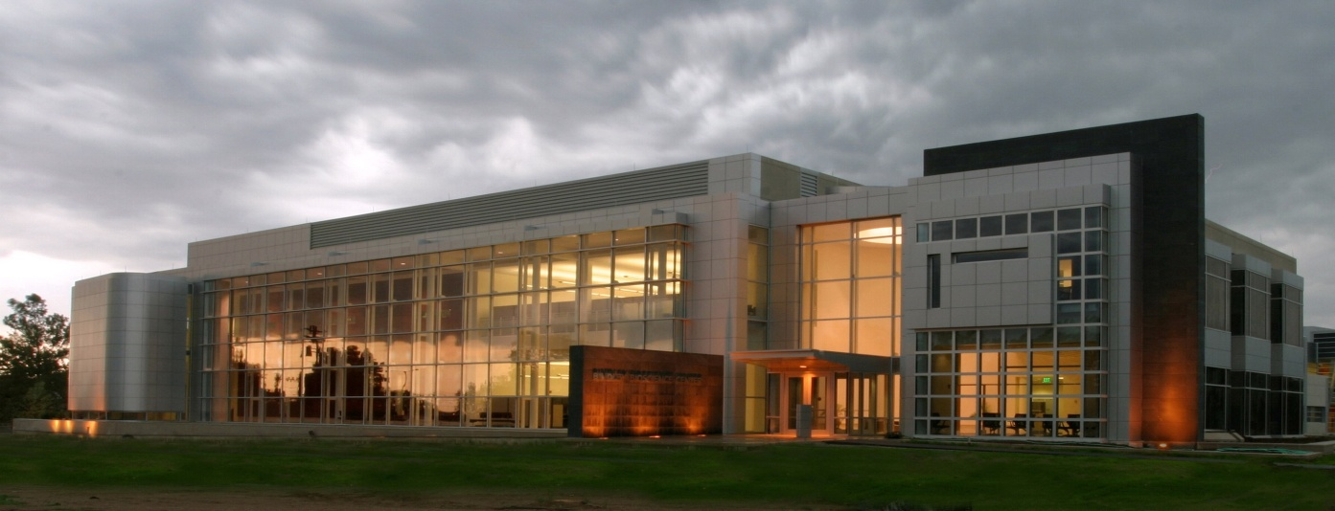
Purdue University Cytometry Laboratories Acknowledgements
Contributors
  Staff Scientists: Valery Patsekin,
Graduate Students: Awais Mansoor, Angela Wolf, Fiona Thomas, Anthony Pedley
Undergrad Students: Nicole Lewis, Peter Carlsgaard
Faculty: Bartek Rajwa, Euiwon Bae, J. Paul Robinson
Data sets: Gary Nolan Lab, David Hedley, Bernd Bodenmiller, Paul Wallace
Staff
  Jennie Sturgis (Imaging)
  Kathy Ragheb (Flow)
  Cheryl Holdman (Flow)
  Raymond Fatig (cell culture)
Funding:
NIH, NSF, USDA, Purdue University
Corporate: Beckman-Coulter, Point-Source, Parker-Hannifin, Polysciences, Bangs labs, Roche, MediaCybernetics, Q-Imaging, Kodak Medical Systems, Crystalplex, Becton-Dickinson , Icyt,
eBioscience, ITG Indiana, Roche, Edmund Optic, Perkin Elmer, Digilab Inc., Spherotech, Inc., IntelliCyt, Inc
Bindley Bioscience Center, Purdue University
Research reported in this presentation was supported by the National Institute of General Medical Sciences & the National Cancer Institute of the National Institutes of Health under Award Numbers 1R56AI089511-01, R21RR033593-01 & 1R33CA140084. The content is solely the responsibility of the authors and does not necessarily represent the official views of the National Institutes of Health.

Slide 3
Background and Concepts
Flow cytometry saw little changed over its first 30 years
There are some current fundamental changes
HT flow cytometry has been developed
New ways of analyzing routine clinical data
HC flow cytometry now well underway
Discussion areas:
  Identify tools that create HT data in cytometry
  Demonstrate how high throughput cytometry works using drug screening as an example
  Show current tools and processes of analysis
  Clinical applications – new opportunities
  Expand flow cytometry as a systems approach to discovery

Slide 4

Multiparametric and multifactorial HT cytometry
Find the features describing the populations f₁,.. f_{n}
+
+
Define multiple populations in the feature space
Find the features (such as IC₅₀)
Create n × m array of features, where every m could be a vector [f₁,…,f_{n}]
concentration
HT flow cytometry
compounds

Slide 5
Problem 1: eliminate operator’s input in analysis
gate
Calculate fraction of “positive” and “negative” cells
gate
Problems?
Well… plenty actually

Slide 6


Alternative?
Heuristic methods
  Minkowski-form
  Weighted-Mean-Variance (WMV)
Distance functions used in nonparametric tests
  χ ² (Chi Square)
  Kolmogorov-Smirnov (KS)
  Cramer/von Mises (CvM)
Information-theory divergences
  Kullback-Liebler (KL)
  Jeffrey divergence (JD)
Spectral measures
  Spectral angle mapper
  Bhatacharyya distance
Ground distance measures
  Histogram intersection (Overton)
  Quadratic form distance (QF)
  Wasserstein-Rubinstein-Mallows distance (Earth Movers Distance)
80
Method I
  Sort the apples (“gate” the green and red populations, or red and non-red)
  Count red and green (non-red)
  Compare the counts
Method II
  Find a bucket full of red apples only
  Find the distribution
  Take a bucket with red and green apples and find the distribution
  Compare the distribution
60
Percentage of green apples
40
20
-5
-10
-15
-20
Harvest day

Slide 7
How do you collect that much data on a flow cytometer?

Slide 8
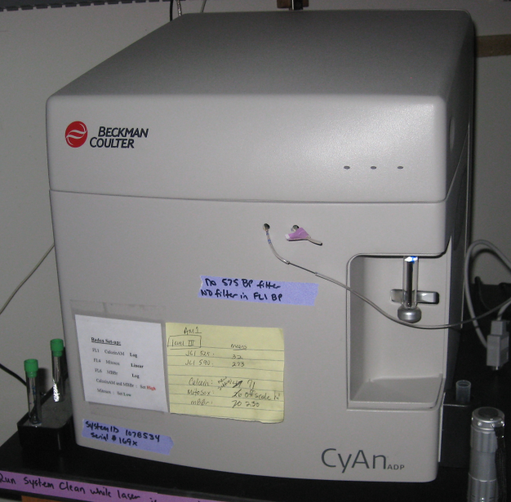
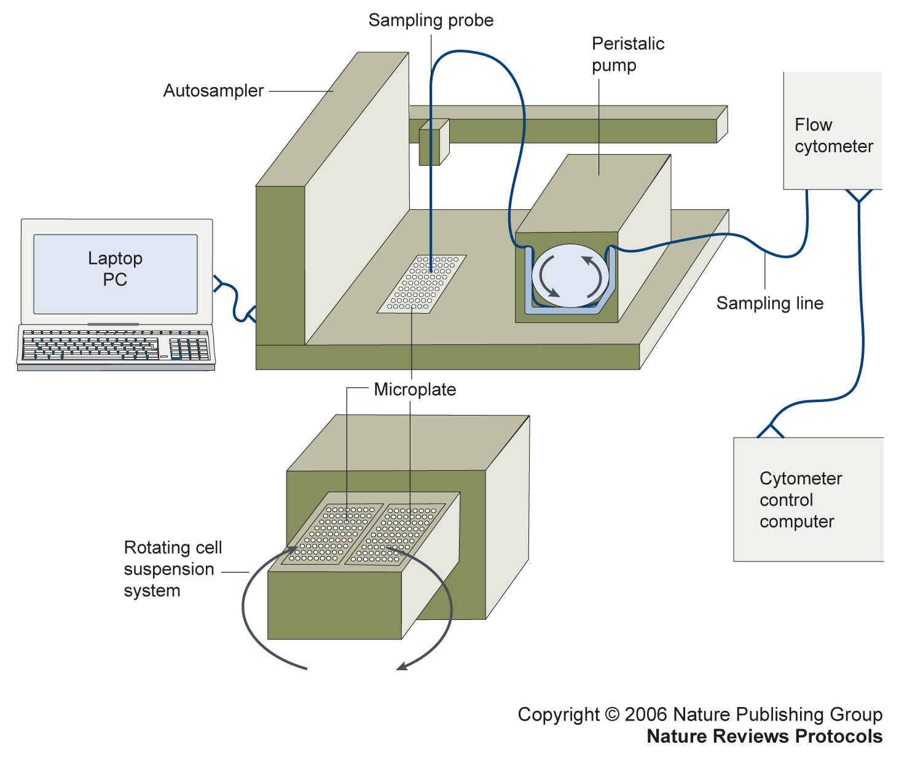
Optical Design of a basic flow cytometer
PMT 5
HyperCytTM system added to flow cytometer
PMT 5
PMT 4
Sample
PMT 4
PMT 3
Dichroic
Flow chamber
Filters
PMT 3
Dichroic
PMT 2
Flow chamber
Filters
PMT 2
Scatter
Scatter
PMT 1
PMT 1
Laser
Laser
Copyright 2006 Nature Publishing Group
Nature Reviews Protocols
Sensor
Sensor
Bandpass
Bandpass
Filters
Filters
HyperCyte diagram kindly supplied by Larry Sklar
384 wells/10 min
1 μl/sample 5000 cells/μl
Notes:
Basic schematic for how a flow cytometer works – a cell passes via a laser (blue line) and signals are passed down to each PMT and light scatter detector

Slide 9
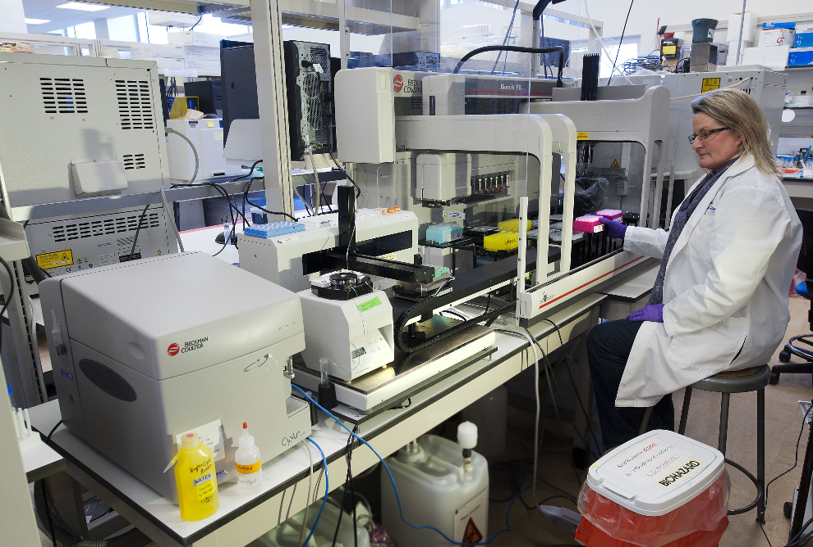
Automated
Cytomat
Incubator
Automated Biomek
Preparative system
Automated HyperCyte
Sample Delivery
Cyan flow cytometer

Slide 10




Traditional gating process
Decision
Traditional flow gating logic and analysis approach
Decision
Result
Decision
Repeat ad infinitum
Result
Decision
‘What we see depends mainly on what we are looking for.’ John Lubbock

Slide 11
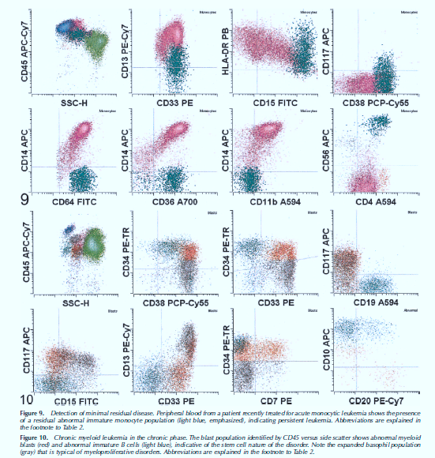
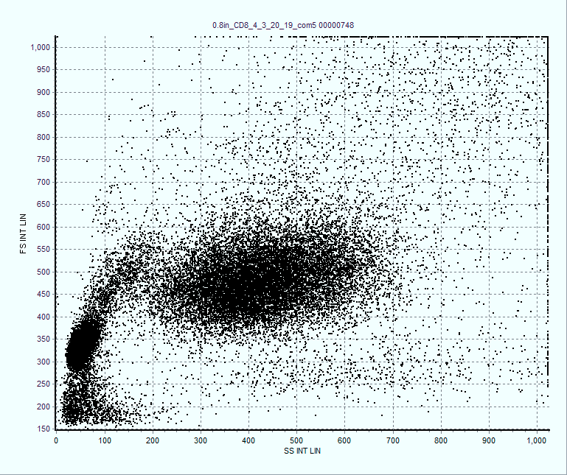
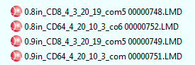
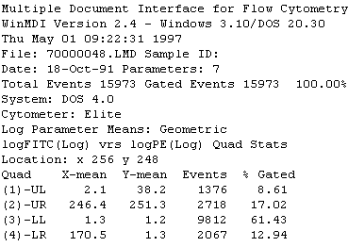
Circa, 1990-present
ANALYSIS
1 sample 10 to 30 minutes
Run 30-60 samples
per hour

Slide 12
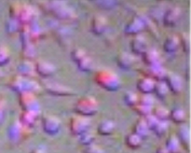
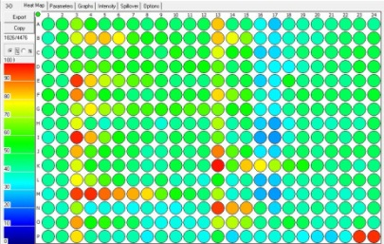
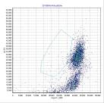
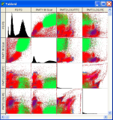
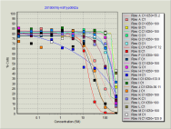


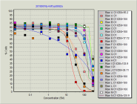
The Operational Modality of Flow Cytometry
Traditional
HT Flow
1. Take a complex biological sample
1. Take a complex biological sample
2. Create very large scale “systems level” experimental grids
2. Separate that sample into single samples
3. Run each sample as a single unit
3. Run samples as a high speed, low volume set
4. Put all the data back together again
4. Combine data automatically as sets
5. Try to relate each piece of data back to the original biological system
5. Conduct simultaneous
advanced analysis in
parallel
The operational modality of Flow Cytometry.pptx

Slide 13
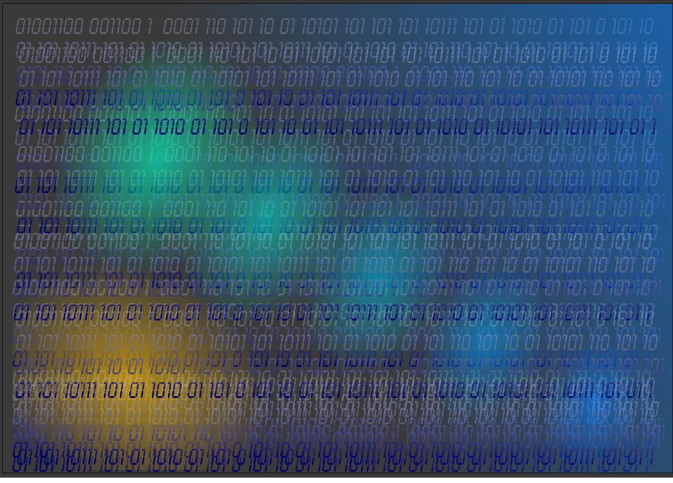
‘It’s not what you look at that matters, it’s what you see.’
Henry David Thoreau

Slide 14
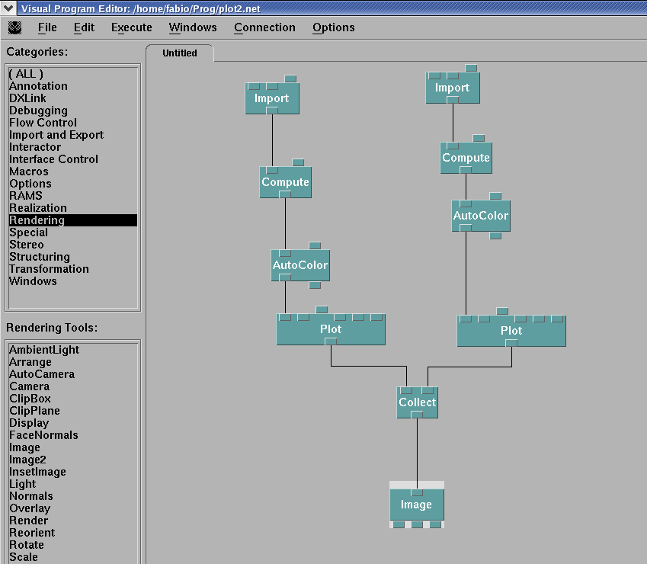
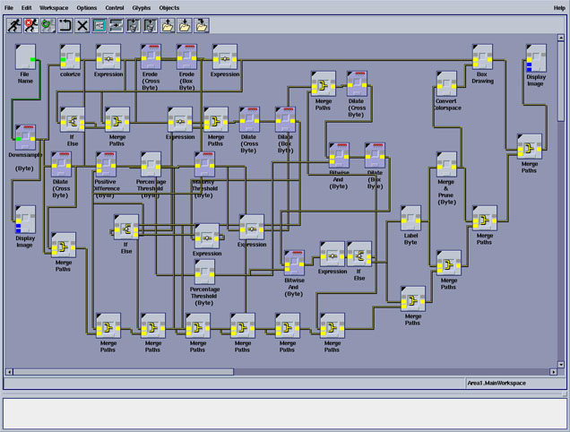
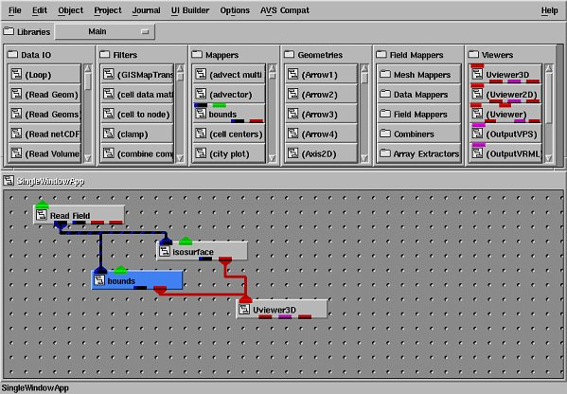
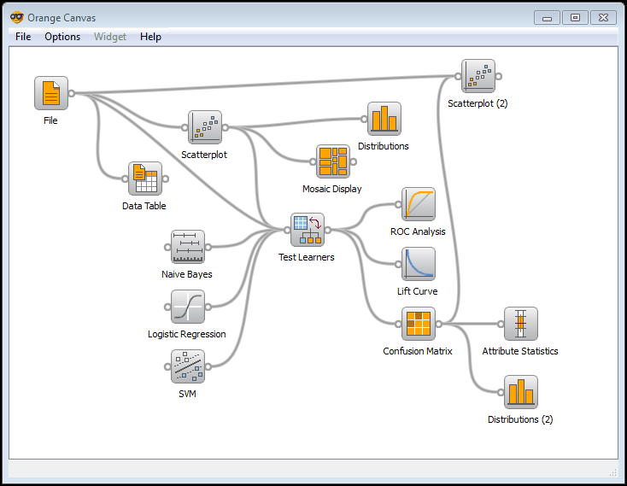
Graphical data processing environments
IBM Data Explorer
Khoros
AVS
Orange

Slide 15
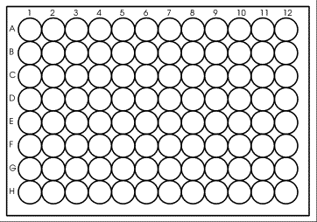
Populate the plate with appropriate assay components
Stimulators
Conc
Or different
activation times

Slide 16
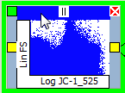

Graphical cytometry analysis pipeline builder
We call this a Logic Map
Control +
Control -
Build curve
distance
A3
Drug 1
Label 1
B3
Drug 2
Extract features
Drug 3
C3
Drug 4
D3
distance
Drug 5
E3
Label 2
Drug6
F3
Drug 7
G3
Drug 8
H3
distance
Drug 9
I3
Label 3
Drug 10
J3
Result

Slide 17
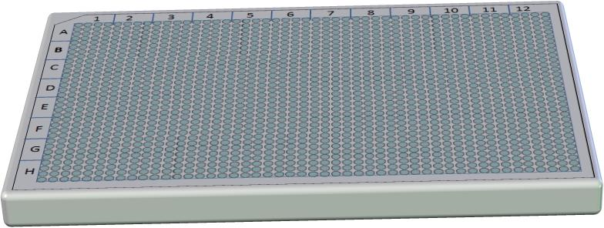
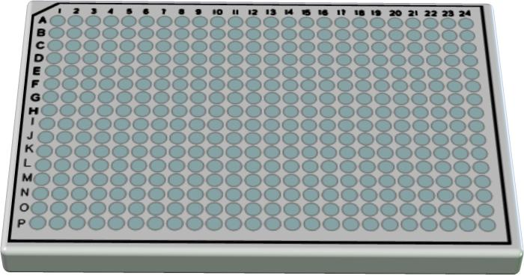
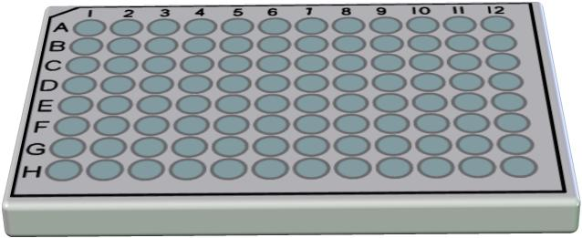


Slide 18
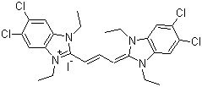
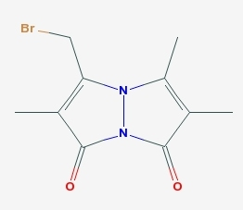
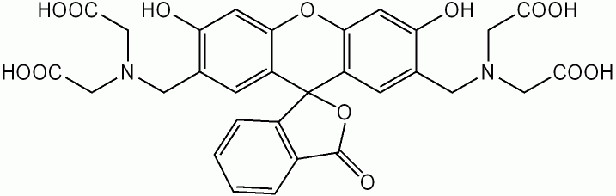
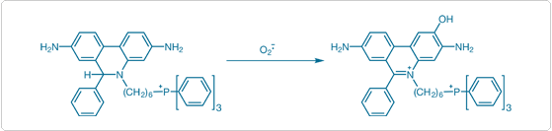
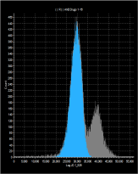
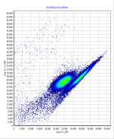
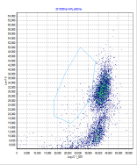
Example Drug Screen
Membrane Potential, Glutathione, Viability, Superoxide
JC-1
Calcein
Mitosox ^{[1]}
mbbr

Slide 19
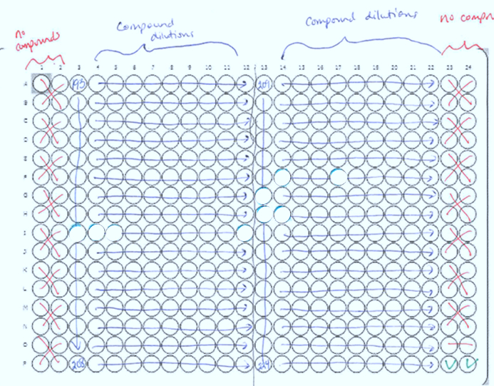
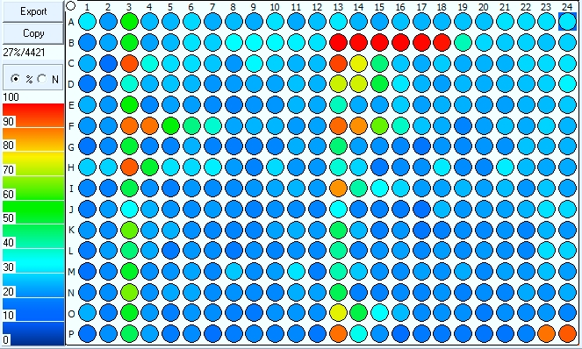
Plate design-Analysis
High Conc Drugs
Positive Control
(Vancomycin)

Slide 20
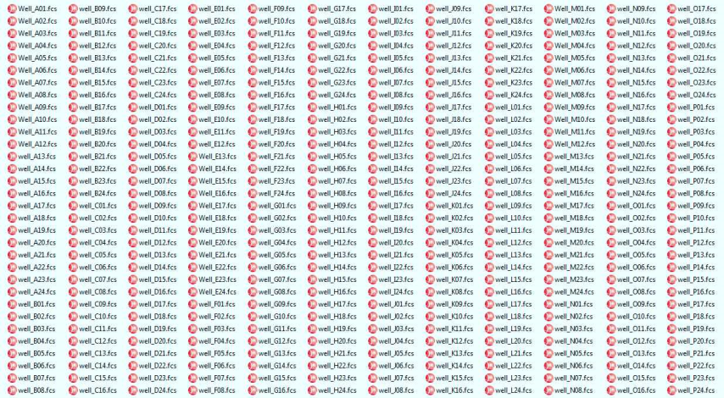
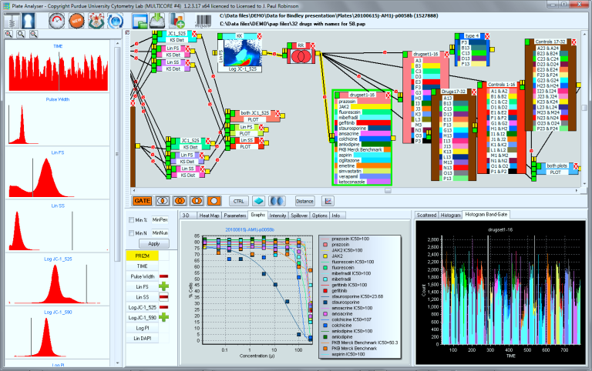
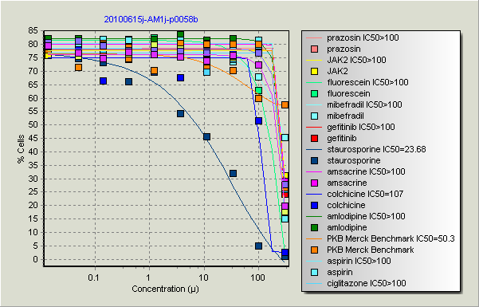
Rapid Processing
List Mode files
(96 or 384 wells)
(entire directory)
About 30 seconds
Protocol
IC50 or appropriate
result

Slide 21
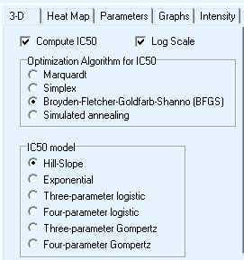
PlateAnalyzer Output
Different Models

Slide 22
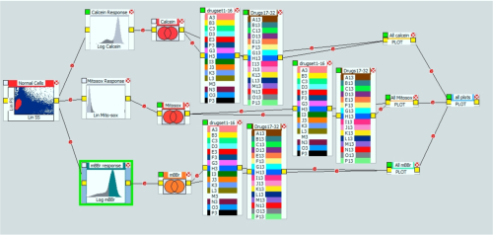
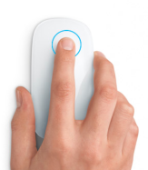
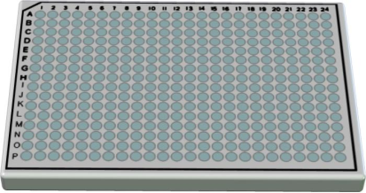
3 functional assays, 32 drugs, 10 points per drug, 96 curves, (12 min to run 384 samples, 5000 cells per sample including all analysis
mBBr
Calcein
Mitosox
1 Click
1 minute

Slide 23
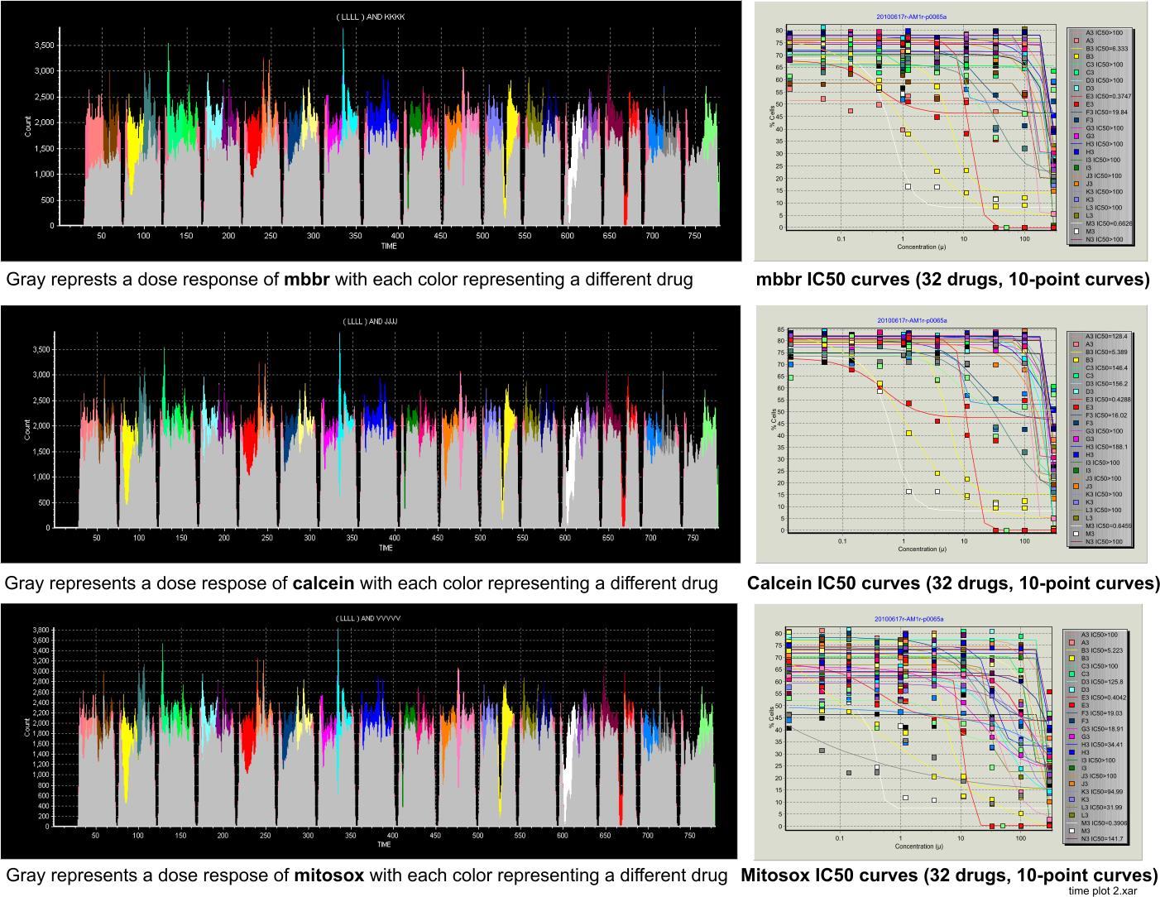

Slide 24
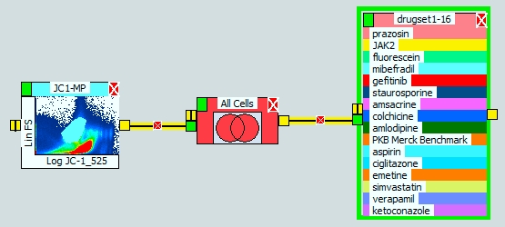
Processes can be very simply defined
Select cells
(can be any
Gating process)
Some rules
(any Boolean
Process or other)
Identify drugs
and doses – can
be any number
of drugs or concs

Slide 25
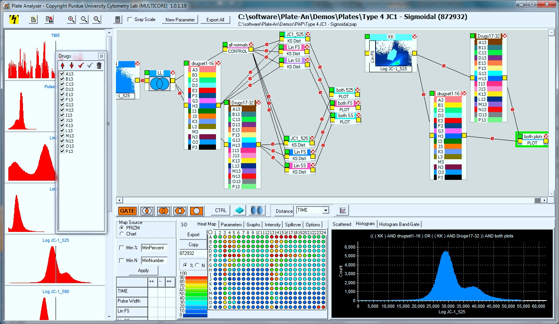
Analysis Logic Map Format

Slide 26
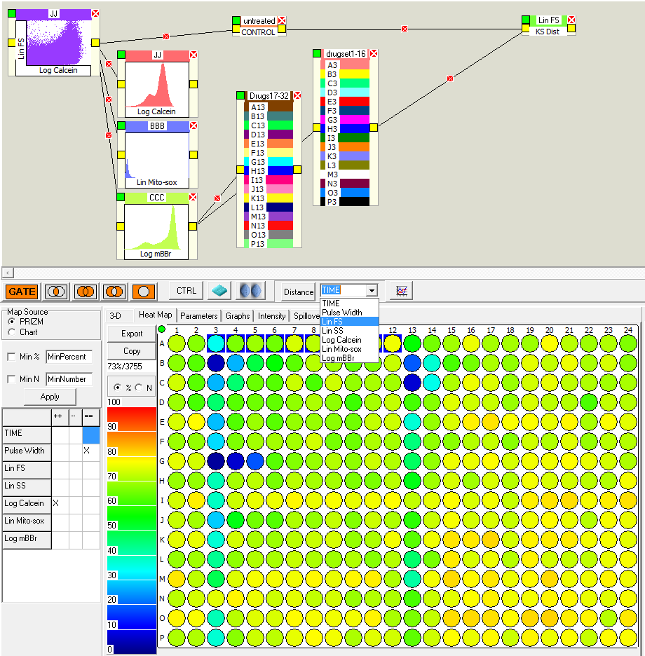
3. The parameter box must be connected to both the drug box and the controls
Measuring KS Distance
Quadratic form Distance
Kullback-Leibler Distance
2. A parameter box appears
You can select any parameter for KS distance, or quadratic form distance, or Kullback-Leibler distance if you wish. There are several different distance measures you can choose from – or add you own!!
1. Select the desired parameter and press “DISTANCE”

Slide 27
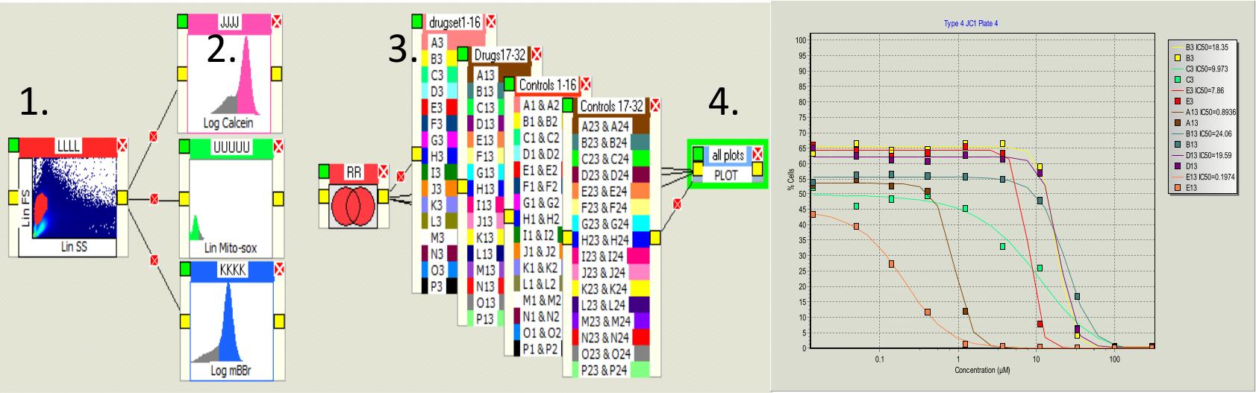
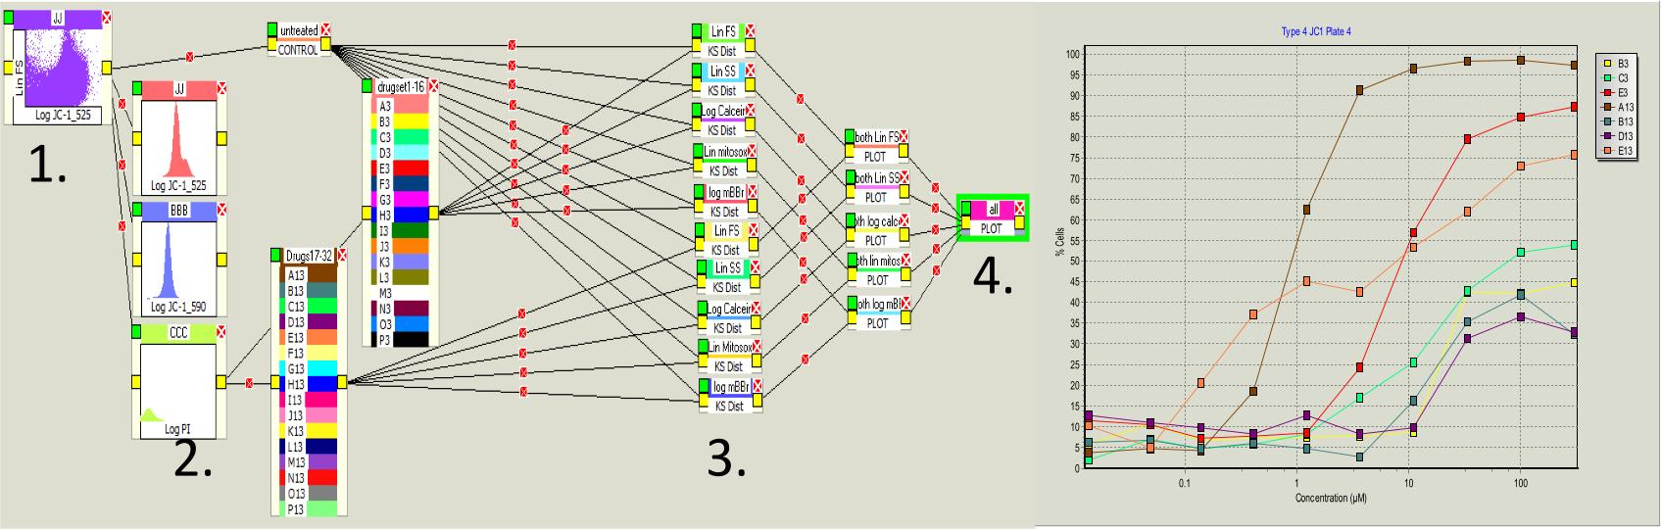
Comparison – Gating vs NonGating
IC50
KL-Values
*Patent pending

Slide 28
Clinical Cytometry
4-9 color phenotyping is current standard
Samples are run single tubes
Preparation is primarily manual
Analysis is mostly manual
Analysis is essentially the same as it was 20 years ago

Slide 29
Typical 4 Color Clinical Panel
1. CD3/CD14/DR/CD45
2. CD3/CD4/CD8/CD45
3. CD7/CD13/CD2/CD19
4. KAP/LAM/CD19/CD5
5. CD20/CD11c/CD22/CD23
6. CD38/CD10/CD19/CD34
7. CD57/CD56/CD33/CD3
8. CD11b/CD13/CD33/CD34
9. CD15/CD56/CD7/CD34
10. CD16/CD32/CD45/CD64
11. CD41/CD71/CD45/CD34
12. CD38/CD138/CD45/CD56
13. CD16/CD163/CD13/CD117
14. CD52/CD30/CD19/CD20
15. Isotype
16. Auto
17. Live Dead (Viability)

Slide 30
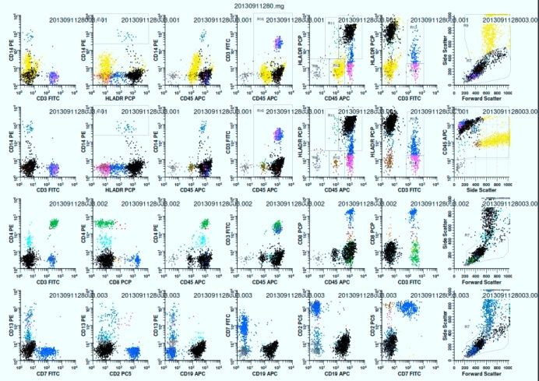
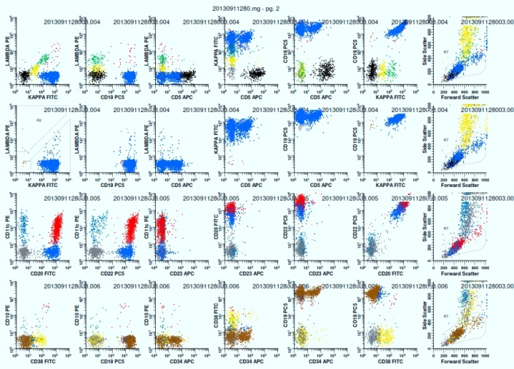
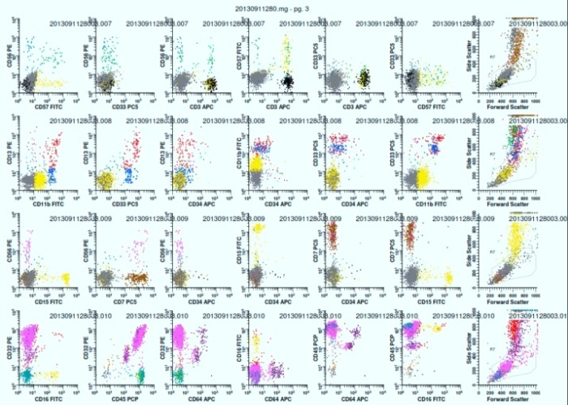
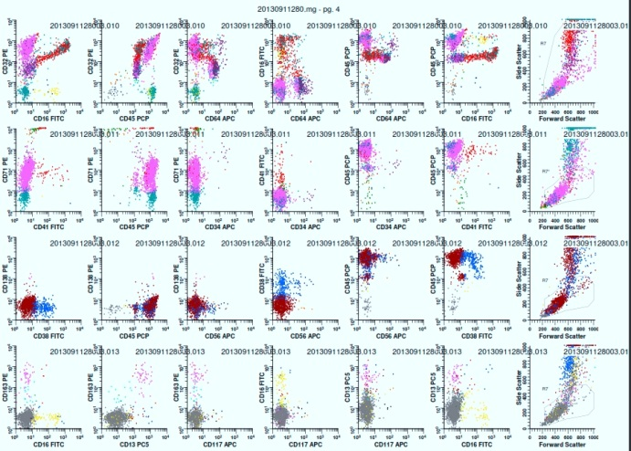


Clinical Sample – 17 Tube assay
Data kindly supplied by Dr. Paul Wallace

Slide 31

Similar situation with 9 color clinical samples
Data from Brent Wood publication

Slide 32











CD3/CD14/CD7/cd38/Kappa/HLADR/CD57/CD11b/CD15/CD16/CD56/CD52/CD30/CD19/CD71
Different colors represent different phenotypes
Variable parameters
Variable parameters

Slide 33



Example with 10 phenotypic markers
Example Parameter
-ve
high
low
medium

Slide 34

The power of cytomics

Slide 35


Slide 36

Multicolor Flow Analysis 7 color (9 param) data with dose response curves
Logic Map to produce curves
Data kindly provided by Peter Krutzik and Garry Nolan, Stanford

Slide 37




Mass Cytometry - CyTOF

Slide 38



1 giant data file
De-Barcode

Slide 39




14x14x12=2353
dasatinib
H-89
imatinib
rapamycin
SB-202190
sorafenib
SP600125
staurosporine
sunitinib
UO126
VX680
BTK inhibitor III
IKK inhibitor X
JAK inhibitor I
JAK2 inhibitor III
JAK3 inhibitor VI
Lck inhibitor
PP2
Syk inhibitor IV
Akti-1/2,
GDC-0941
streptonigrin
Go-6983
Crassin
Data from Bernd Bodenmiller, Nolan Lab

Slide 40


Very complex data sets

Slide 41

PlateAnalyzer Logic Map for HC Analysis
(Example screenshot of the software)

Slide 42

Analysis Logic Map Format

Slide 43

Logic Map Component

Slide 44






A single analysis program can produce 14 x 14 x 12 (2352) IC50 curves
14 phosph’n sites per cell type
8 drug conc.
12 stimulants in each box
Each box produces 12 IC50 curves
Gating parameters
14 cell types
Each histogram above, is used as a
Sequential gate for each of the 14
Subpopulaitons and 12 stimulators
Data Kindly supplied by Bernd Bodenmiller

Slide 45

C:\xara stuff\Cytof ideas

Slide 46


C:\xara stuff\Cytof ideas

Slide 47

C:\xara stuff\Cytof ideas

Slide 48


C:\xara stuff\Cytof ideas

Slide 49


Slide 50


C:\xara stuff\Cytof ideas

Slide 51


pzap70
C:\xara stuff\Cytof ideas

Slide 52


Slide 53

Once you have access to the complete sets – you may be able to integrate pathway analysis

Slide 54

PlateAnalyzer Software
Free software –
with automated updates
Can read most instruments
No maximum file size
Reads entire plate assays at once
No gating restrictions or limitations
All samples are instantly viewable at all times
Advanced statistical operators available

Slide 55
Resources
Video Tutorials: cyto.purdue.edu/Purdue_software
Download PlateAnalyzer: vault.cyto.purdue.edu
          You need a license – email JPR
          Email: wombat@purdue.edu
Cytospec Software:
http://www.cyto.purdue.edu/Purdue_software

Slide 56

Cytometry lectures
cyto.purdue.edu/flowcyt/educate/pptslide.htm

Slide 57

cyto.purdue.edu/flowcyt/educate/pptslide.htm

Slide 58
Cytospec Software
CYTOSPECTM (updated Sept 16, 2012)
The following program is called Cytospec ^{(TM)} and is a general purpose flow cytometry analysis program
For 32 bit you need the EXE file (download now). For 64 bit use this EXE file (Download now).
Tutorial
Brief instructions for running Cytospec are here (download now) and will be updated one of these days!
1. Tutorial without audio (use above file) (play)
Video Tutorials: YOUTUBE & Twitter HANDLE is CYTOMETRYMAN
The following video tutorials teach you all the basics of Cytospec. You can use the 5 color listmode file HERE if you want to play along!
1. Demo 1 -YOUTUBE or download- Basic introduction
2. Demo 2 - YOUTUBE or download-Tabloid output
3. Demo 3 - YOUTUBE or download- PCA - how to apply it\
4. Demo 4 - YOUTUBE or download- More PCA
5. Demo 5 - YOUTUBE or download- Some Utility Features
6. Demo 6 - YOUTUBE or download- More Utility Features
7. Demo 7 - YOUTUBE or download- Create a new FCS file and perform PCA on it

Slide 59








Some Cytospec examples using PCA

Slide 60
Resources - PlateAnalyzer
Files needed:
Drug concentration file (an example, but you can make any one you want) (download now)
Sample Data file: zip file - this must be unszipped - it contains 384 well data - each are fcs files showing 32 drugs (30 megs) (download now)
Tutorial files (these were made on an earlier version, but they are very similar to the current version) Many of these are on YouTube - search for "PUCL, PlateAnalzyer, Purdue"
1. The quick 45 second demo (play) YOUTUBE
2. Instant gates (play) YOUTUBE
3. Basic analysis (download now) (23.8 megs)
4. Exporting data in CSV format YOUTUBE
5. New Drugbox controls YOUTUBE
6. Logic Map YOUTUBE
7. Wells with no cells video! YOUTUBE
8. AutoUpdate feature (play) auto%20updates.wmv
9. Enhanced features March 2012 YOUTUBE
10. SMILES codes read for drugs see YOUTUBE
11. New DRUGBOX Controls features YOUTUBE
12. Export CSV data files YOUTUBE
13. Dealing with Empty Wells YOUTUBE
14. 40 PLUS parameter data CyTOF analysis YOUTUBE
15. Autowell finder-extracting single wells from large files for Accuri YOUTUBE

Slide 61


Slide 62

Purdue Cytometry Discussion List
subscribe@cyto.purdue.edu

Slide 63
Summary
High throughput flow cytometry is not only possible, there are significant advantages for some assay systems
Flow cytometry can collect high content data and new approaches to data processing are necessary
New approaches require more automation which leads to lower per test cost, better QC and faster results
New classification tools allow us to enhance the analytical process and assist in identifying signaling pathways
For analysis of these complex data sets – the complexity can be “under the hood”, but must be easy, interactive and accurate
Visualizing and manipulating very large data sets is quite possible using newly developed analytical tools

