Slide 1
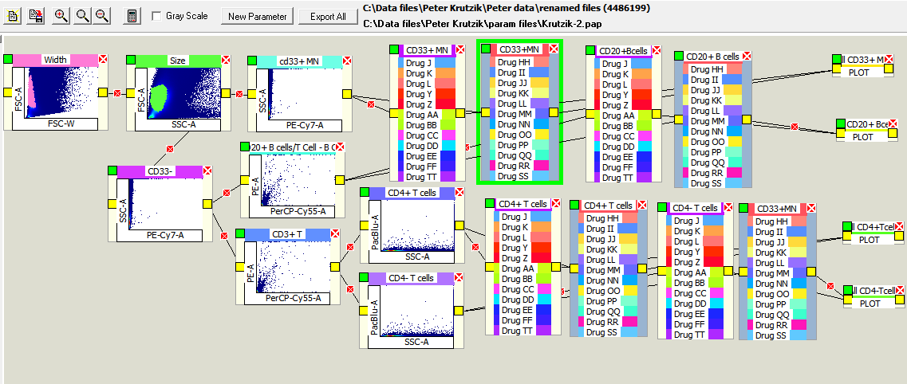
Peter Krutzik data
Logic Tree-110505
Plots can plot
All IC50 curves for
linked containers
1st gate
2nd gate
3rd gate
CD33+ MN drugs
(left bank, right bank)
CD20+ B cells drugs
(left bank, right bank)
4th gate
CD4+ T cells drugs
(left bank, right bank)
CD4- T cells drugs
(left bank, right bank)
Ignore the shapes of plots in the above icons – they do not represent the correct display
Of data = and are only here to determine gating logic.

Slide 2
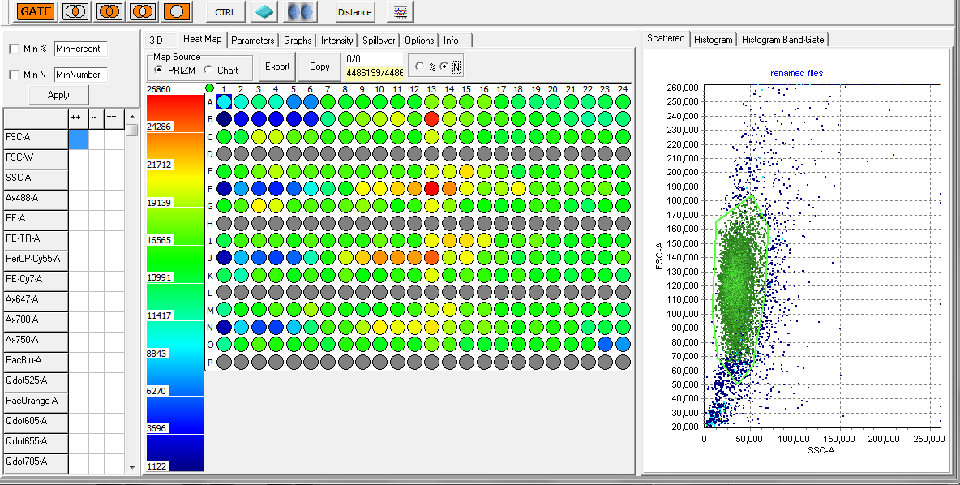
Colors represent the number of cells per well based on the gated pop’n

Slide 3
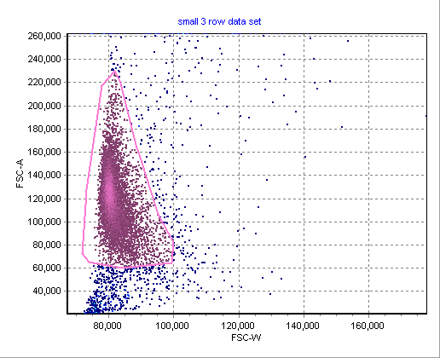
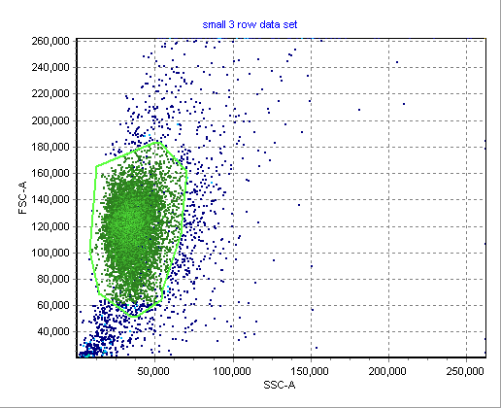
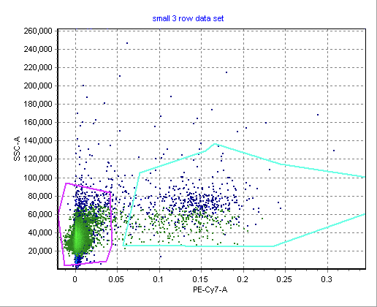
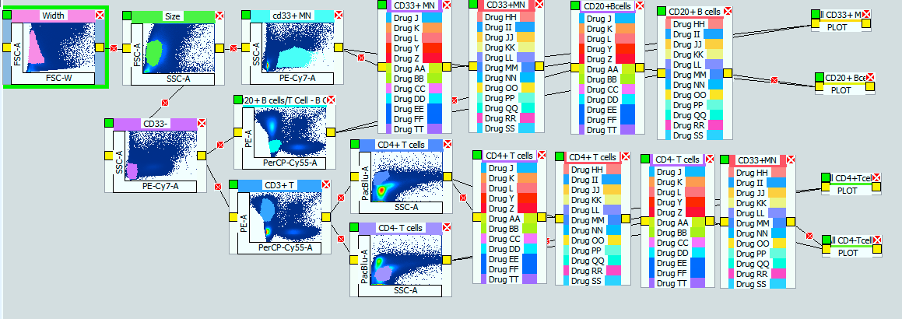
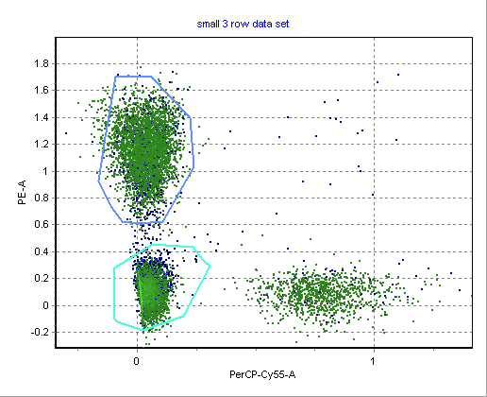
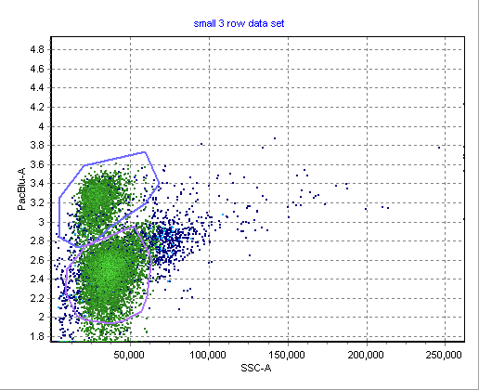
CD20+ B cells gate should be on PerCP positive cells
This gate is OK, CD4- cells are used as the “CD8+ cells”, about 95% accurate of course
Not sure about this gate

Slide 4
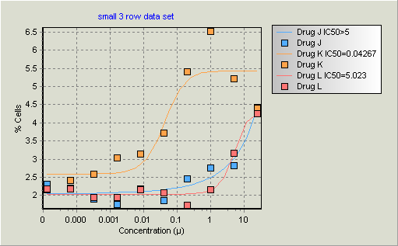
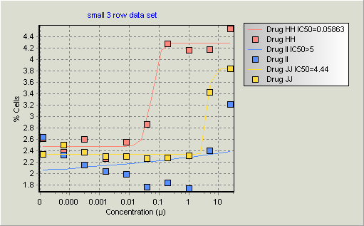
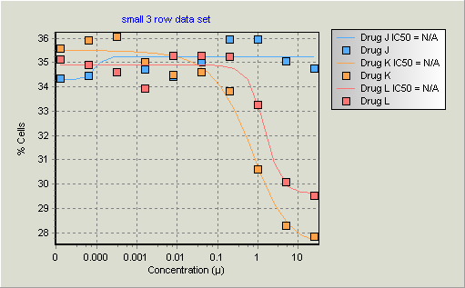
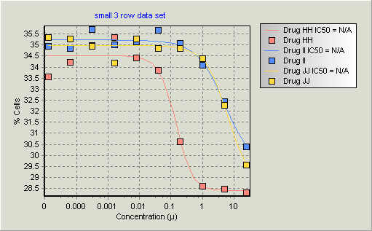
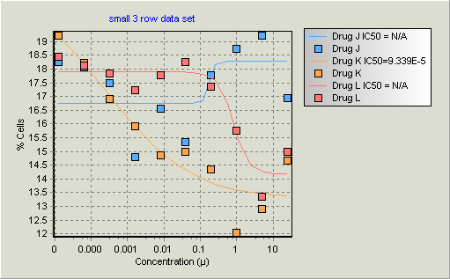
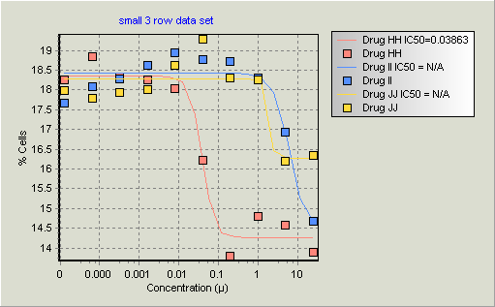
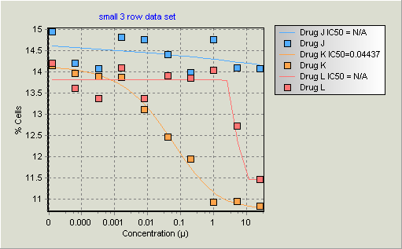
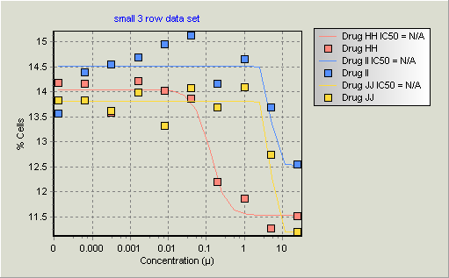
First 3 rows of data only for testing

Slide 5
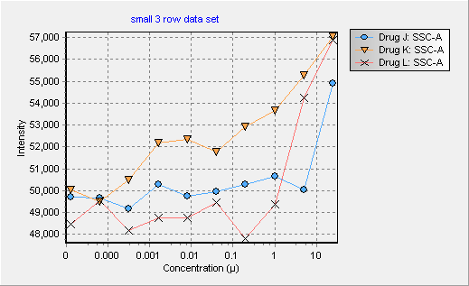
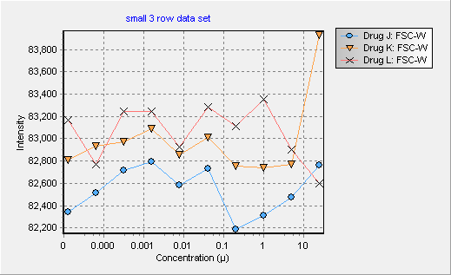
Ungated data (this can be gated as well)
Change of Side scatter (SSW)
over 10 concentrations
Change of FSC-W
over 10 concentrations
Gate “intensity” plots by just clicking on the gate regions or
Drug containers…..(we need a better name!!)

Slide 6
The sort of final process
1. Load the data files
2. Load the Logic Tree (krutzik-6.pap)
3. Load the parameter file (peterconcs-2.csv)
(note that there are odd numbers in P23, P24 as we usually put valinomycin at 50mM in these wells…so we forgot to remove them, but since there is nothing in this plate in row P it does not matter.
July 1

Slide 7
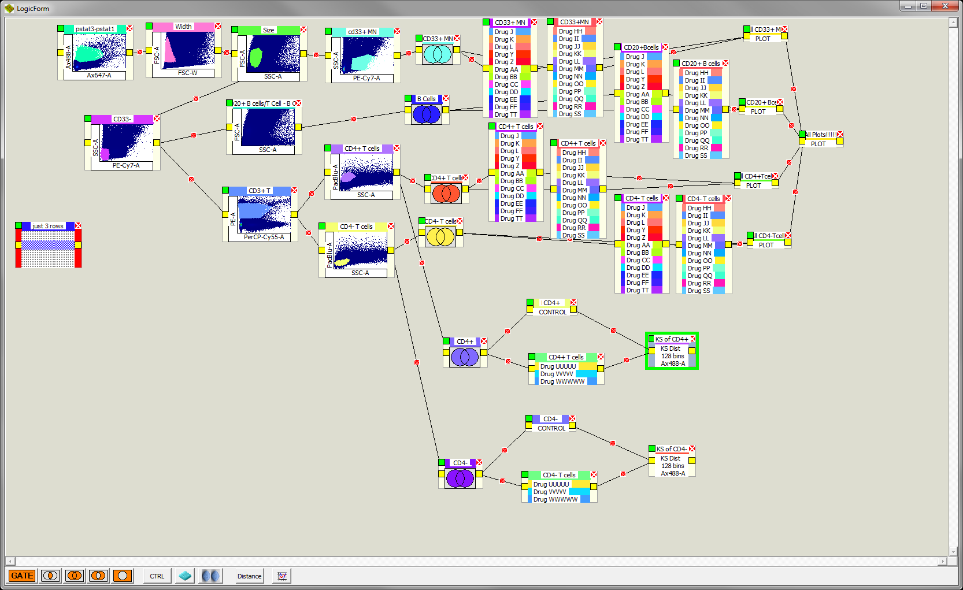
Hamburger with the lot!
(If you grab the doubleline at the left of the logic tree, you can drag the entire logic tree to
A second monitor – make it easier for big things like Krutzik monstrosities!)

Slide 8
Other things you can do
Clicking on the top left colored square in any box, makes that gate “modal” ie it cuts out all other data. You can turn it on or off – sides become colored.
You only need these when you want to plot multiple curves on the same graph…
If you were to link this
Gate at the beginning
And made it a modal gate,
Then you would only analyzer
These blocks…and this is
Useful if there is a differential
Number of cells in different
Sets (click on the % cells, or N (umber) of cells
And the colors are easy to see for very small pop’ns
(note you may have to double click on the scale color
Bar which auto scales or fixed scales
These are examples of generating KS From your curves – I made just one for CD4_ and CD4+ - you can play with this.
Bartek wrote code in R that will then compare Curves automatically – but its not in PlateAnalyzer Yet – we will put it in soon.

