Slide 1
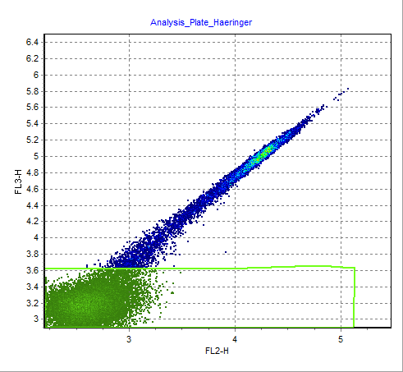
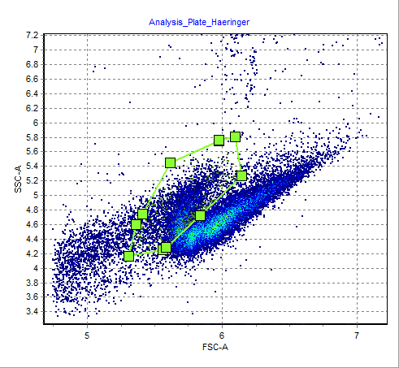
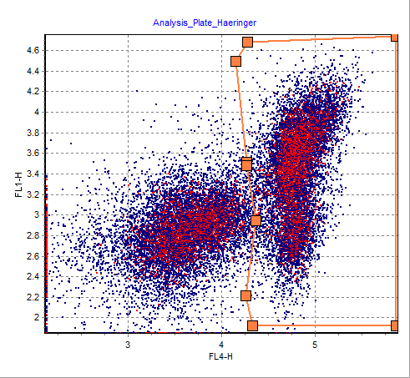
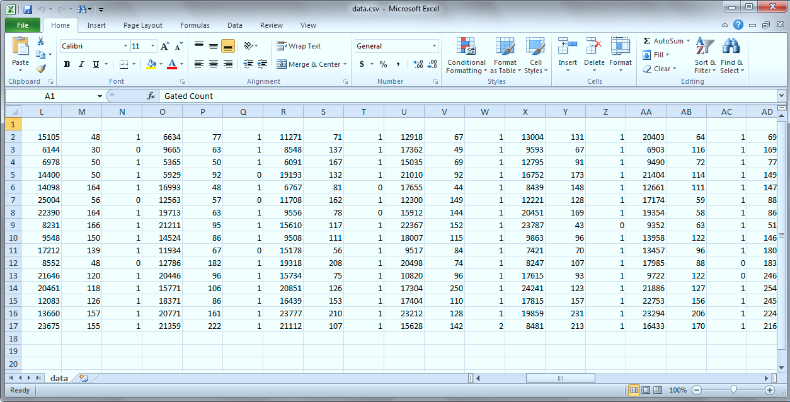
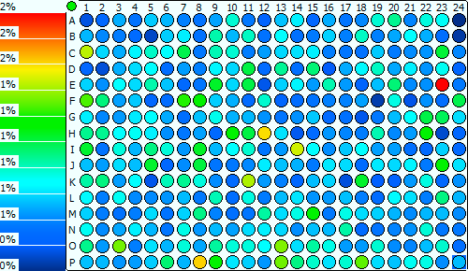
Plate Analyzer - Purdue University
Dr. Haeringer data
Professor J. Paul Robinson
Email: jpr@flowcyt.cyto.purdue.edu

Slide 2
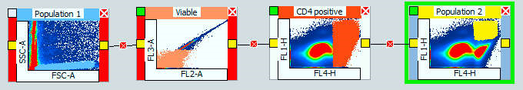
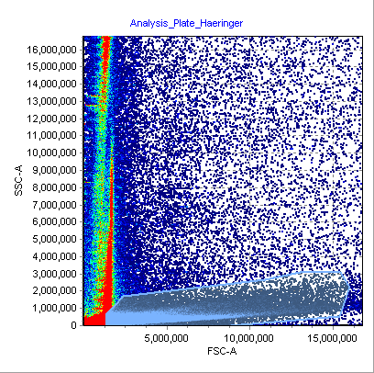
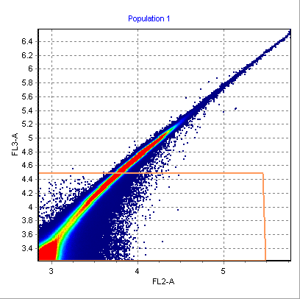
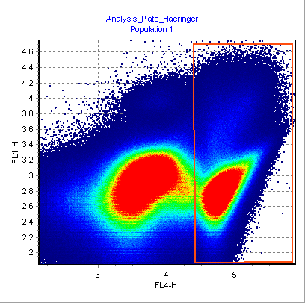
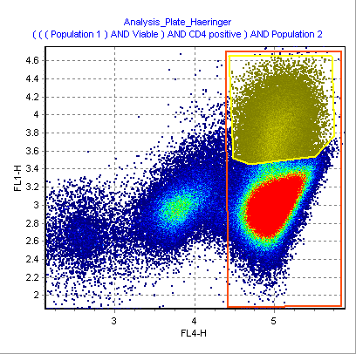
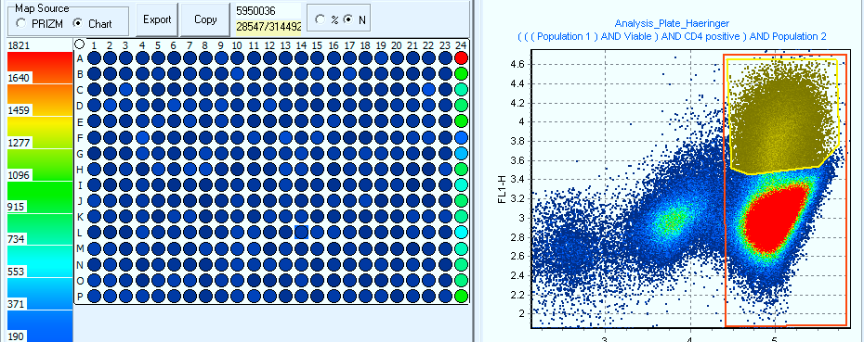
This is a simple algorithm
Set Scatter gate
Set Viability gate
Set data extraction gate
Tight gate

Slide 3
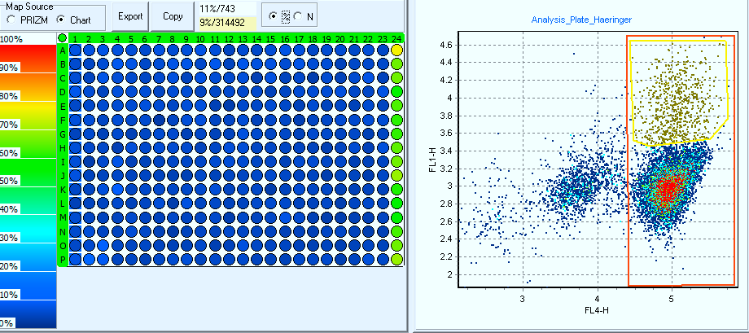
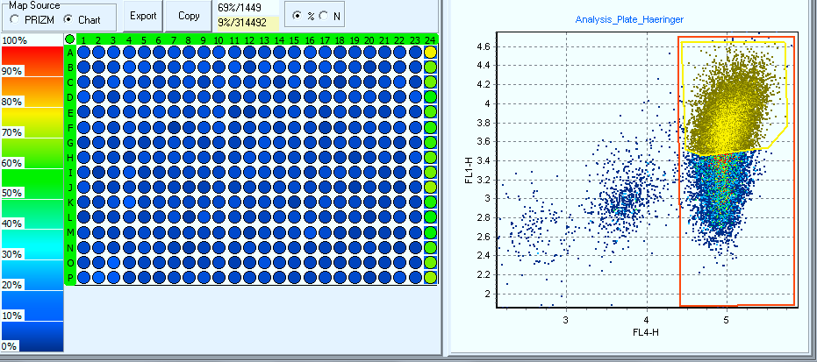
Positive cell populations
Only Column 1
Only Column 24

Slide 4
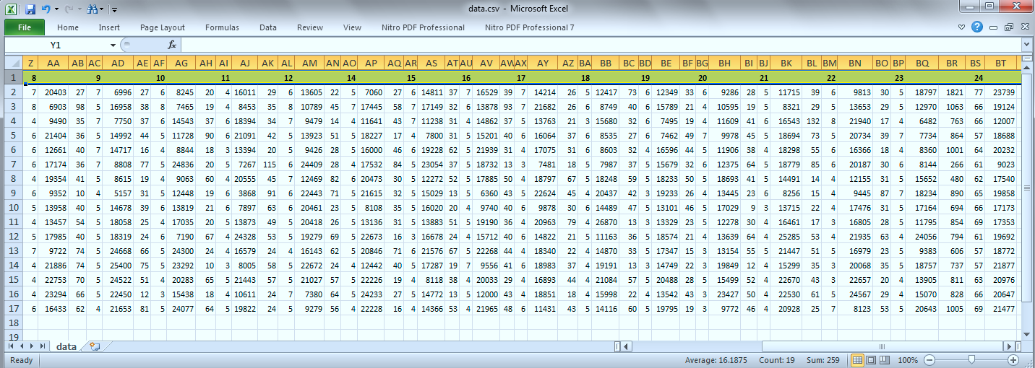
Data
Only columns 8-24 are visible on this sheet – could not fit them all on the page..
Columns are: Gated Count, Percent, Total count
Purdue results.ppt

Slide 5
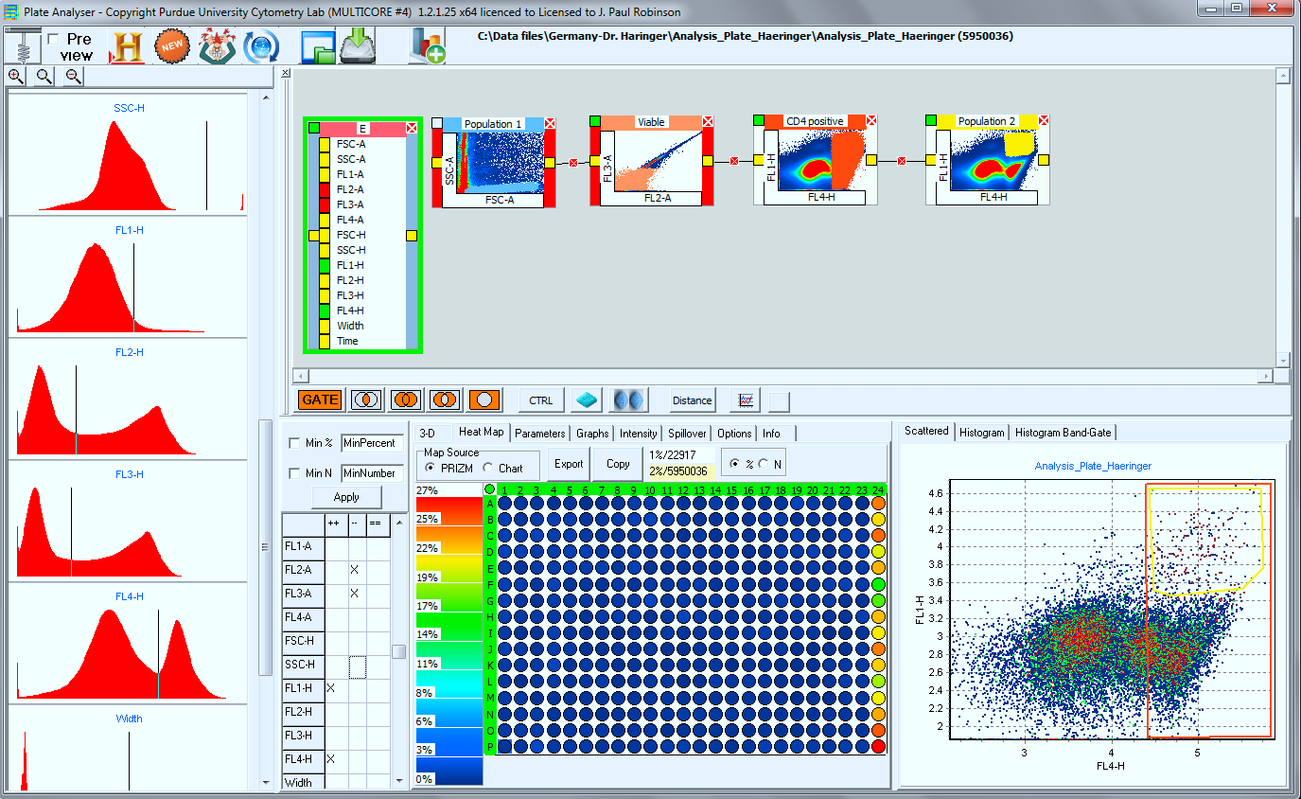
A single combinatorial gate can achieve the same result in seconds
These gates are set here
And you get the same result here
We create a combinatorial gate here

