Slide 1
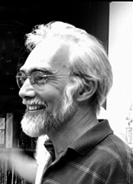
BMS 631 - Lecture 2 - Who’s and Why’s of Flow Cytometry
J. Paul Robinson, PhD
Distinguished Professor of Cytometry
Professor of Biomedical Engineering
Notice: The materials in this presentation are copyrighted materials. If you want to use any of these slides, you may do so if you credit each slide with the author’s name. It is illegal to place these notes on CourseHero or any other site.
Who’s and Why’s of Flow Cytometry
The History of Flow Cytometry:
An introduction to the early beginnings of flow cytometers; the rationale for early investigations; a summary of the state-of-the-art; the events that led to modern cytometry; early fluorescent dyes; image analysis; DNA cytology
Reading materials: (Shapiro 3rd ed. Pp 43-71; 4th Ed. Shapiro pp 73-100)
All materials used in this course are available for download on the web at
http://tinyurl.com/2wkpp
Lecture last modified Jan, 2024

Slide 2
Learning Objectives
At the conclusion of this lecture you should understand:
Important historical contributions to the development of flow technology
The driving force for instrument development
Basic concepts used in flow cytometry
Let’s go back over 50 years

Slide 3
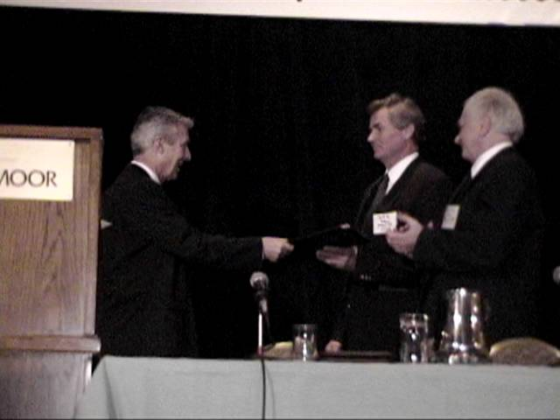
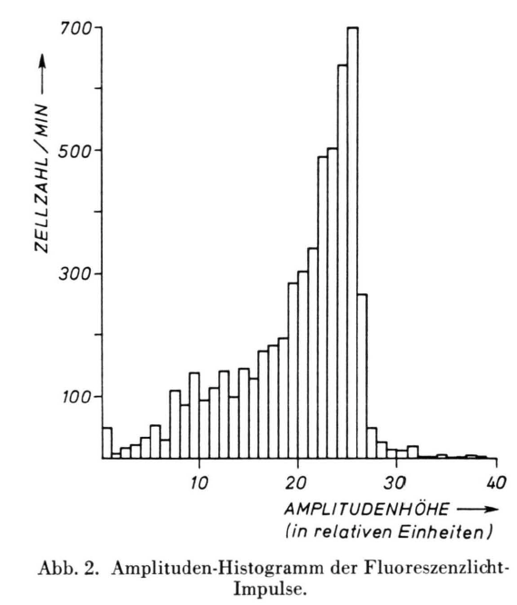
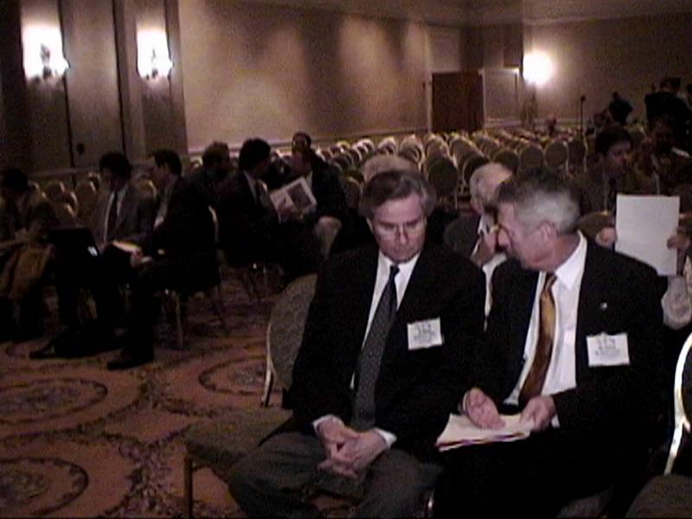
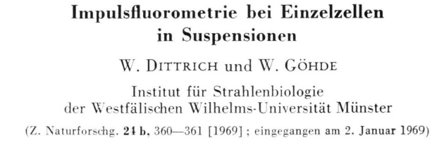
Dittrich & Göhde
Dittrich & Gohde - 1969 - Impulscytophotometer (ICP)- used ethidium bromide for a DNA stain and a high NA objective used as a condenser and collection lens
Laerum, Göhde, Darzynkiewicz (1998)
Göhde and Laerum (1998)
Photos ©2000 – J.P. Robinson

Slide 4
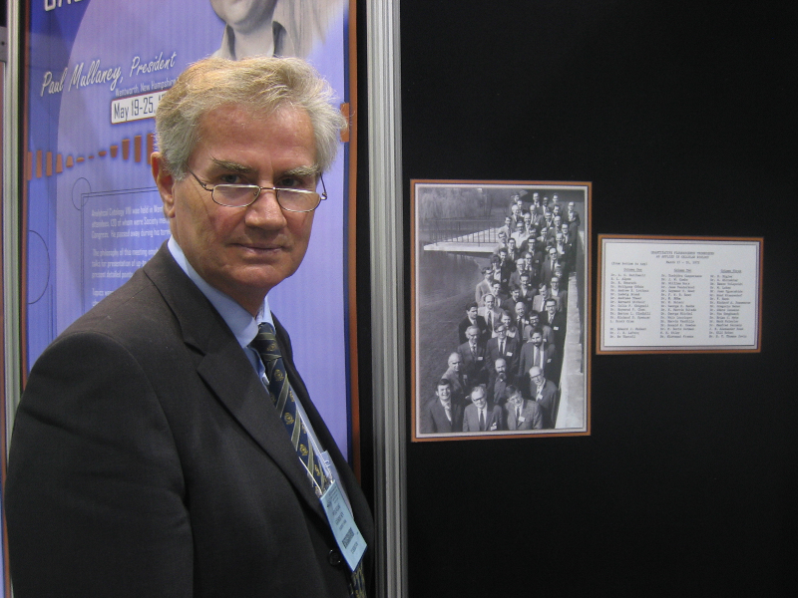
More on Wolfgang Göhde
Flow Cytometry Pioneer – First fluorescence commercial flow cytometer
Established a flow cytometry company in Germany (Partec) and was responsible for bringing lower cost instruments to Africa and other resource limited countries.

Slide 5
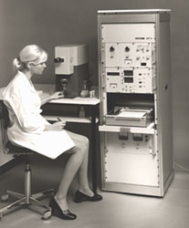
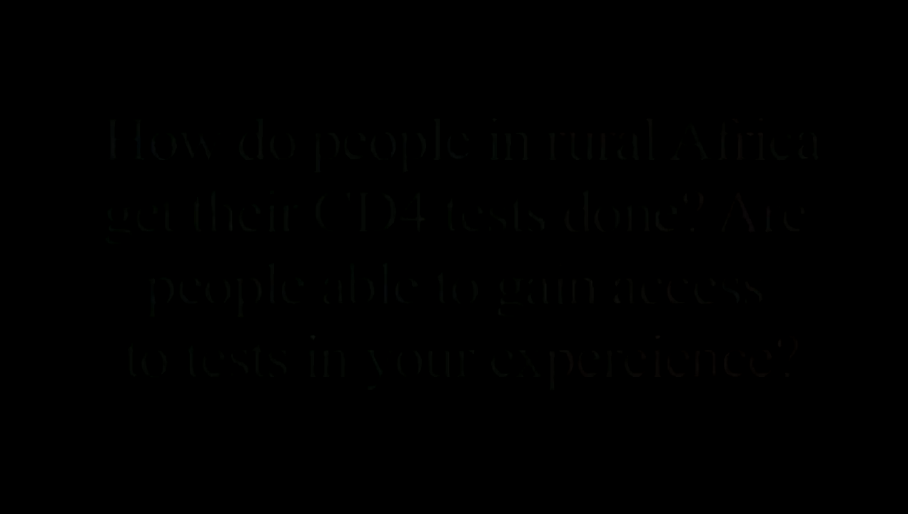
History
Phywe AG of Gottingen (1969) - produced a commercial version of the ICP built around a Zeiss fluorescent microscope
Video 54 s
http://www.partec.de/partec/flowmuseum.html
ICP 11 (1969)
Distributed by Phywe, Göttingen
The first commercial flow cytometer
PDP 11 computer
Wolfgang Göhde discussing his work in Africa in 2007

Slide 6
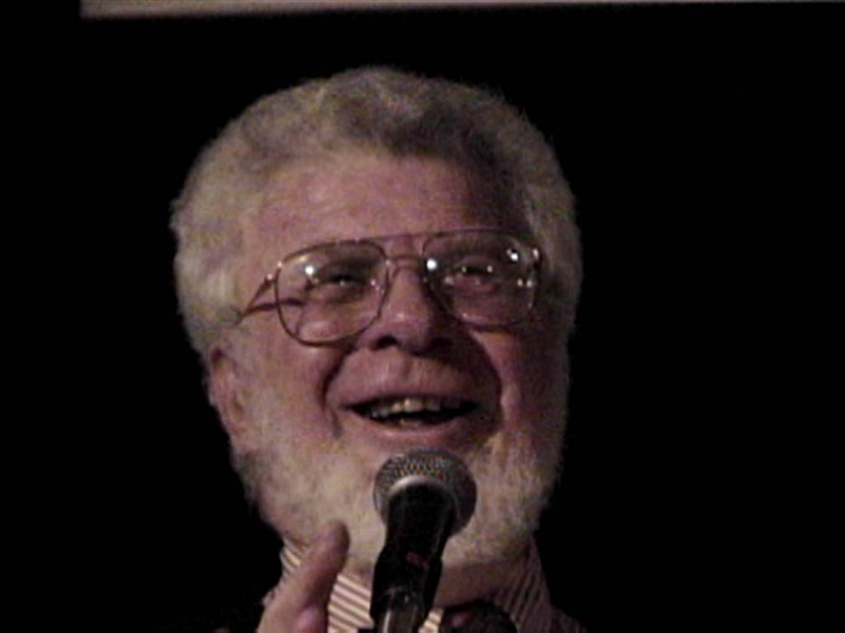
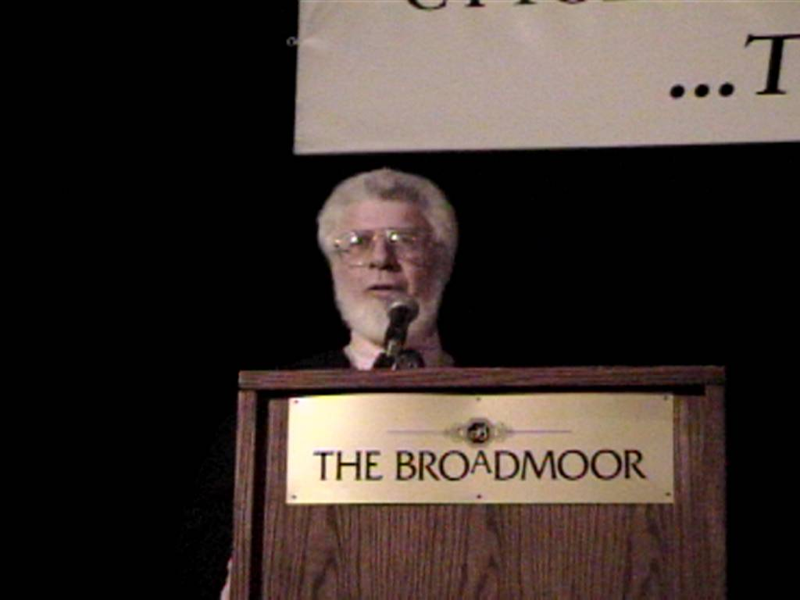
Pre 1969 – Fulwyler, van Dilla etc. we have discussed
Herzenberg
Len Herzenberg - 1969 - sorter based on fluorescence (arc lamp) built after working with one of Kamentsky’s RCS systems where they built an instrument they called the Fluorescence Activated Cell Sorter (FACS)
Photos from 2000 – J.P. Robinson

Slide 7
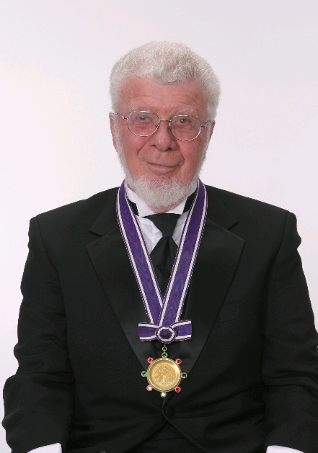
Herzenberg & Becton-Dickinson
Herzenberg -1972- Argon laser flow sorter - placed an argon laser onto their sorter and successfully did high speed sorting - Coined the term Fluorescence Activated Cell Sorting (FACS) This instrument could detect weak fluorescence with rhodamine and fluorescein tagged antibodies. A commercial version was distributed by B-D in 1974 and could collect forward scatter and fluorescence above 530 nm.
Herzenberg was the recipient of the very
Prestigious 2006 Kyoto Prize for his work
in development of fluorescence based
flow cytometry. Many people well known
in the field were trained in his lab
(Photo from the official Kyoto Prize website)

Slide 8

The driving force for Len Herzenberg
Reproduced with Permission
Smithsonian
Video 2:05

Slide 9

Why sorting and Fluorescence?
Reproduced with Permission
Smithsonian
Video 5:17

Slide 10
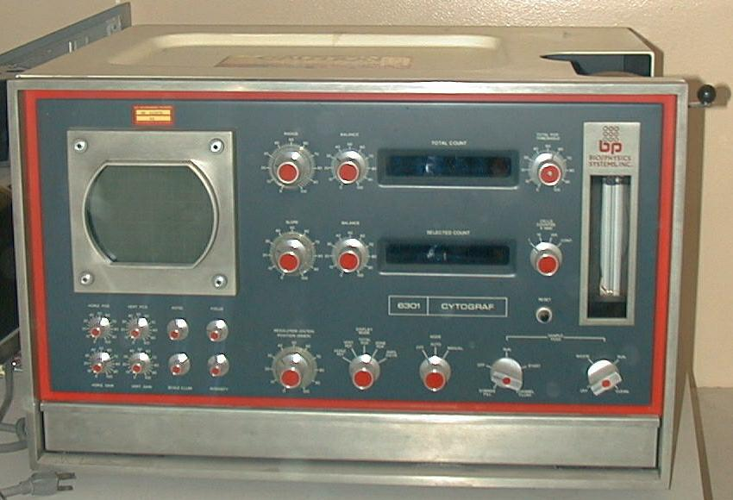
Kamentsky
Kamentsky - Bio/Physics Systems - 1970 commercial cytometer - the “Cytograph” He-Ne laser system at 633 nm for scatter (and extinction) - supposedly the first commercial instrument incorporating a laser. It could separate live and dead cells by uptake of Trypan blue. A fluorescence version called the “Cytofluorograph” followed using an air-cooled argon laser at 488 nm excitation
This is an example of
an early commercial
instrument that measured
scatter using a laser
1970 Cytograph presently at the Purdue University Cytometry Laboratories
Photo ©2000 – J.P. Robinson

Slide 11
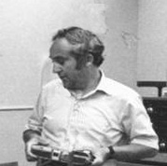
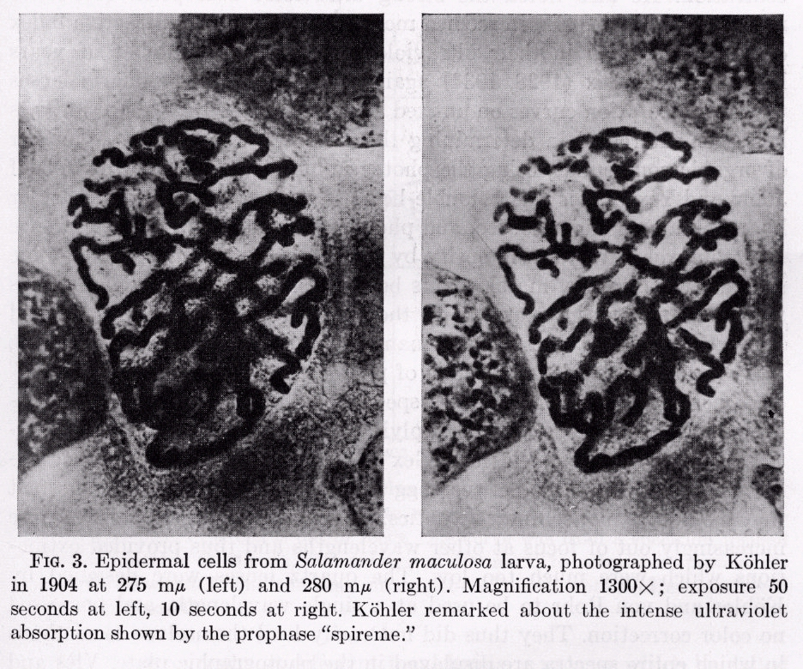

First Ultraviolet Imaging
A. Kohler 1904
275 nm
280 nm
Dr. Kamentsky
Salamander maculosa larva epidermal cells - 1300 X
A. Kohler, Mikrophotographische Untersuchungen mit ultraviolettem Licht, Z. Wiss. Mikroskopie 21, 1904

Slide 12
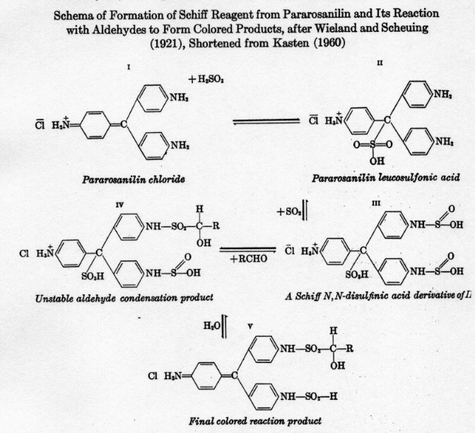

Feulgen Reaction 1924
Schema of formation of Schiff Reagent from Pararosanilin and its reaction with aldehydes to form colored products
After Wieland and Scheuing (1921)
Shortened from Kasten (1960)
R. Feulgen & H. Rossenback, Microskopisch-chemischer Nachweis einer Nucleinsaure von
Typus der Thymonucleinsaure und auf die darauf berunhende elektive Farbung von
Zellkernen in mikroskopischen Präparaten, Hoppe Seyler Z. Physiol. Chem. 135, 1924

Slide 13
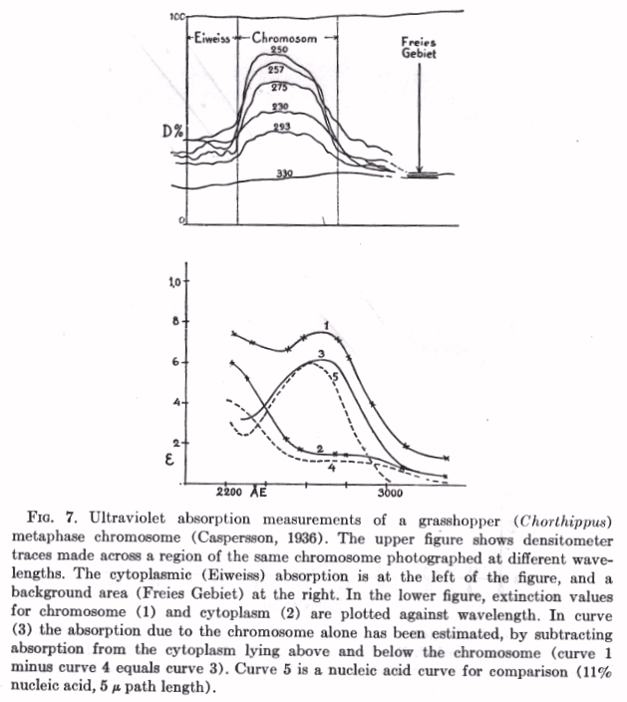
UV Measurements of DNA and Cytoplasm
T. Caspersson 1936
Ultraviolet absorption measurements of
a grasshopper metaphase chromosome
Densitometer traces across
a region of the chromosome
Extinction values for chromosome and cytoplasm plotted against wavelength
Cytoplasmic absorption
Chromosomal absorption
Background signal
Uber den chemischen Aufbau der Strukturen des Zellkernes, Skand. Arch. Physiol. 73, 1936

Slide 14
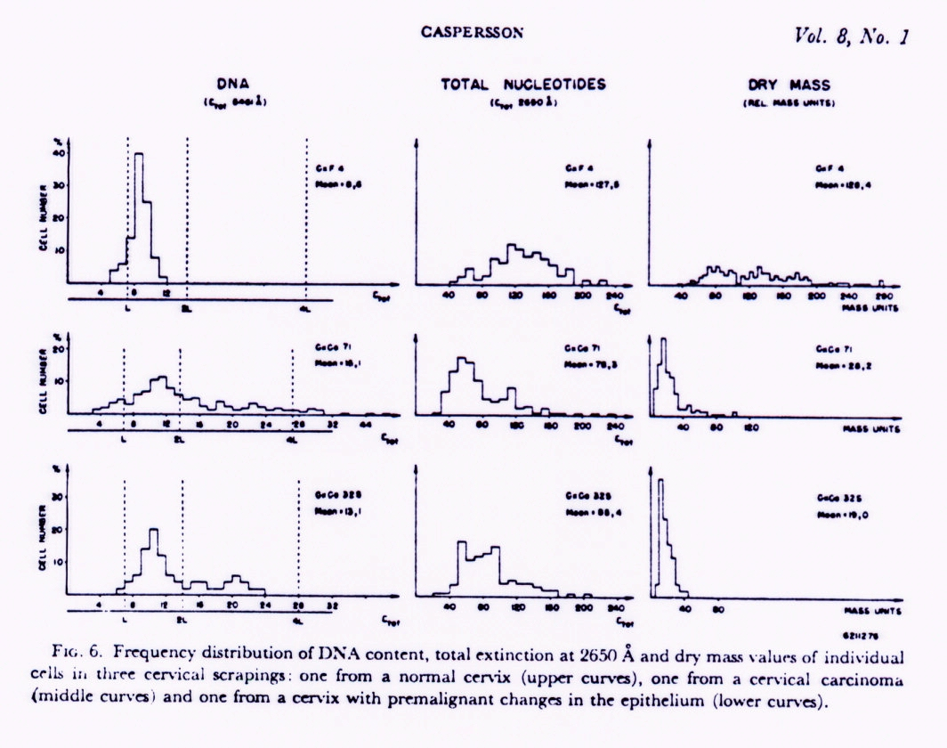
Relating Cytometry to Pathology
O. Caspersson 1964
Cells from a normal cervix
Frequency distribution of DNA content
Cells from a cervical carcinoma
Premalignant cells from the epithelium
Quantitative cytochemical studies on normal, malignant, premalignant and atypical cell populations from the human uterine cervix, Acta Cytologica 8, 1964
(ref 49068)

Slide 15
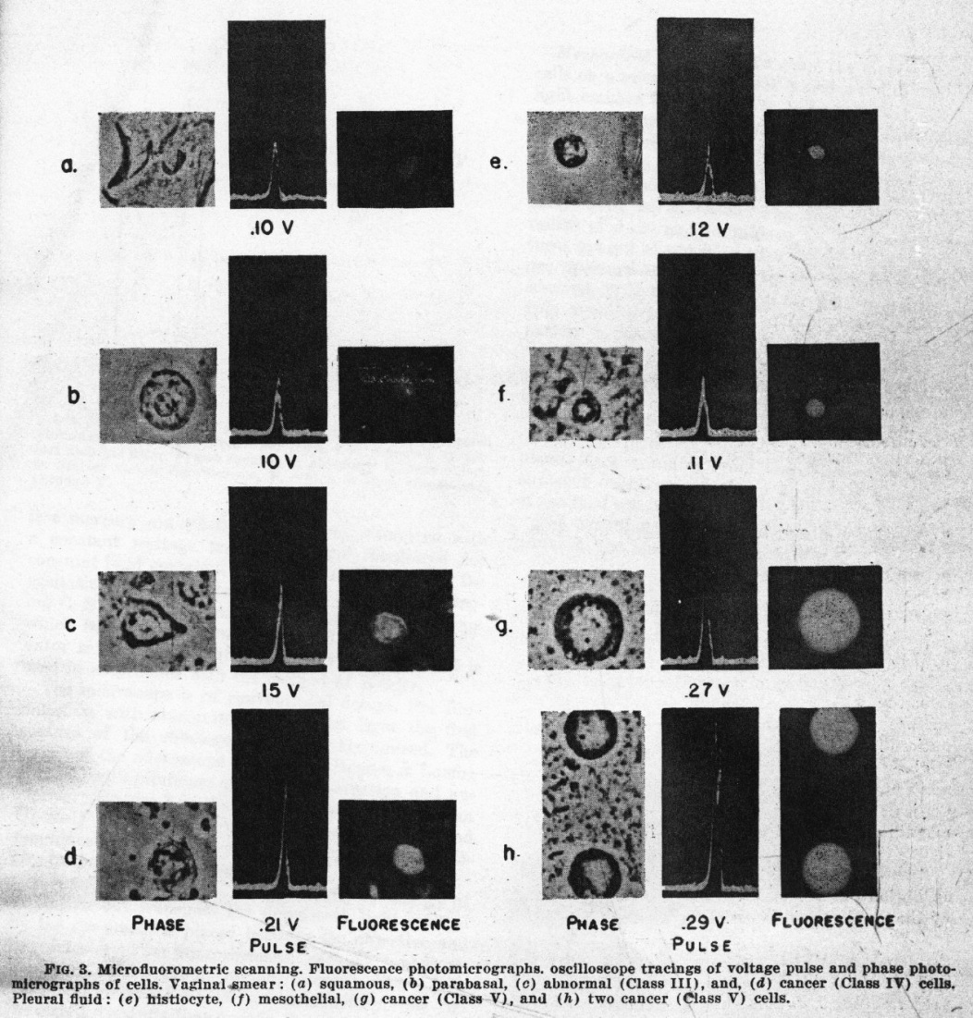
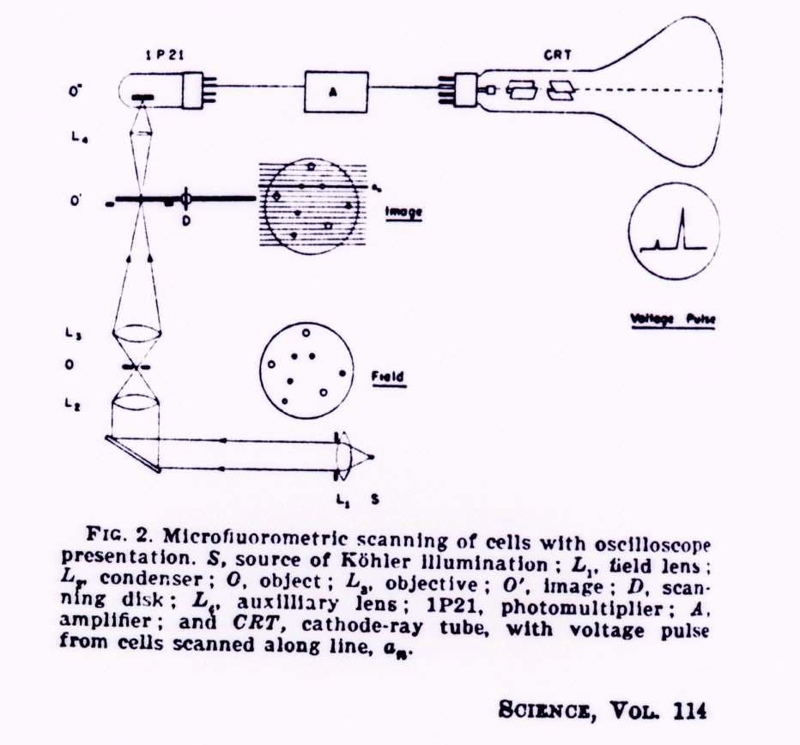
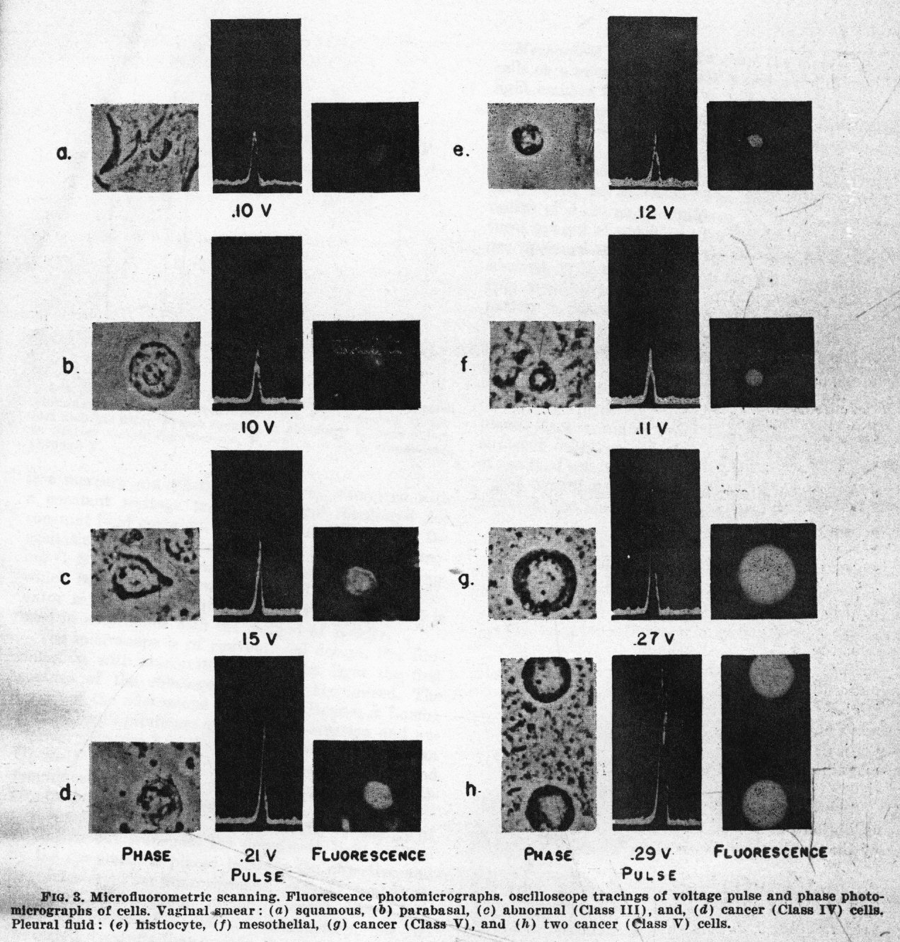
Early Microfluorometric Scanner
Robert Mellors 1951
Phase photomicrograph
Voltage trace
Fluorescence photomicrograph
RC Mellors & R. Silver, A microfluorometric scanner for the differential detection of cells: application to exfoliative cytology, Science 104, 1951

Slide 16
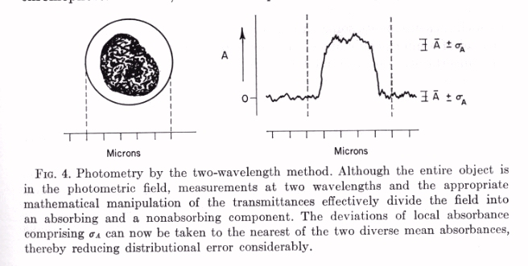
Cytometry Analytic Techniques
M.R. Mendelsohn 1958
The Two-Wavelength Method of Microspectrophotometry
J. Biophys. Biochem Cytol. 4, 1958

Slide 17
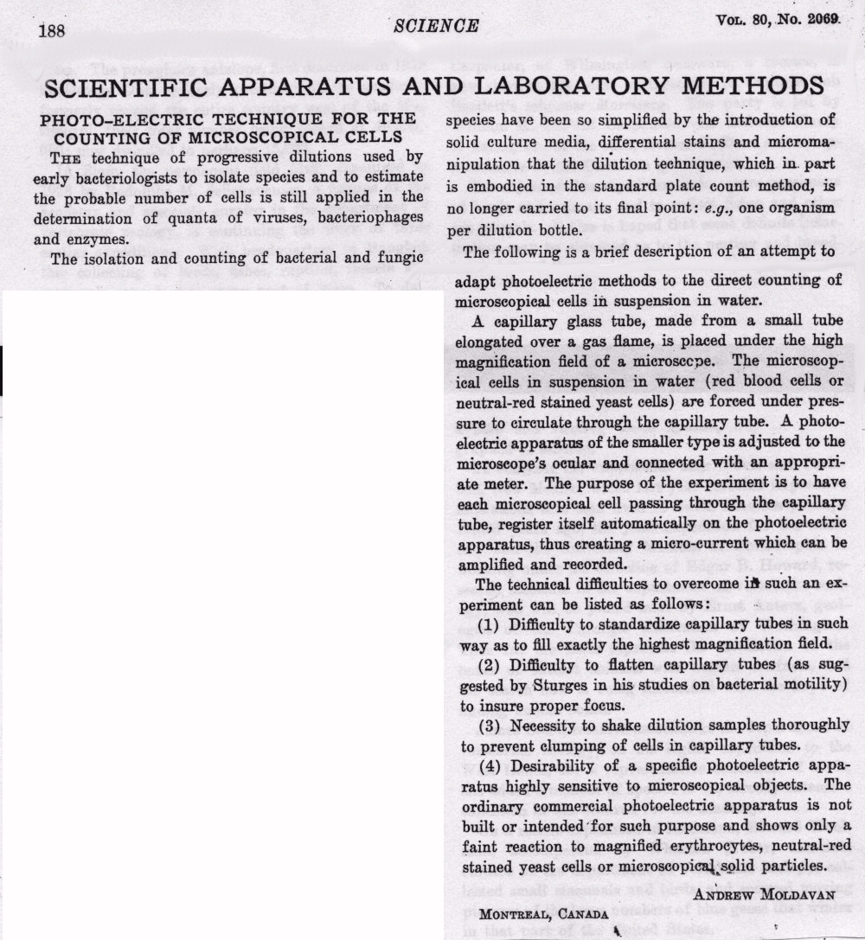
Flow Cell Counter - First Try
Andrew Moldavan 1934
Refman: 4478

Slide 18
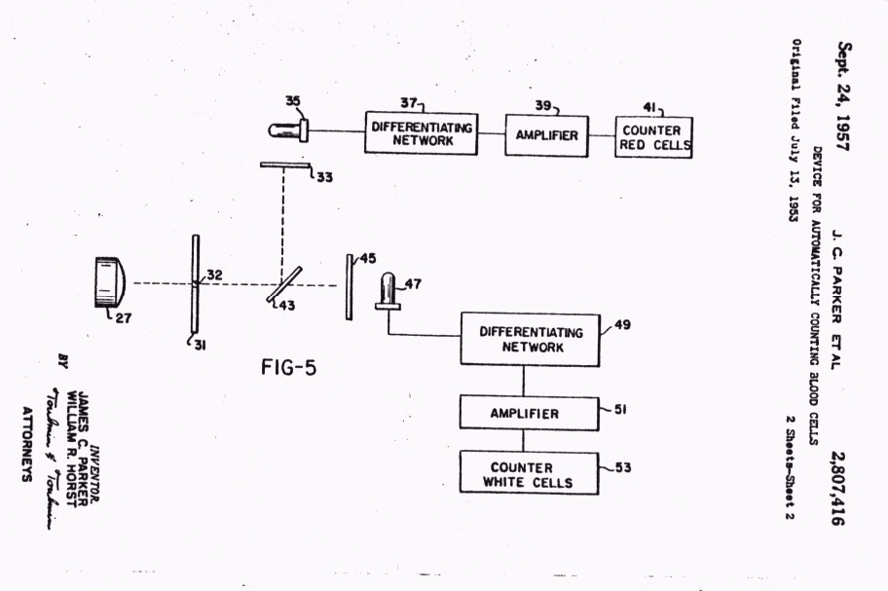
Two-Color Cell Counter Patent
JC Parker and WR Horst 1953

Slide 19
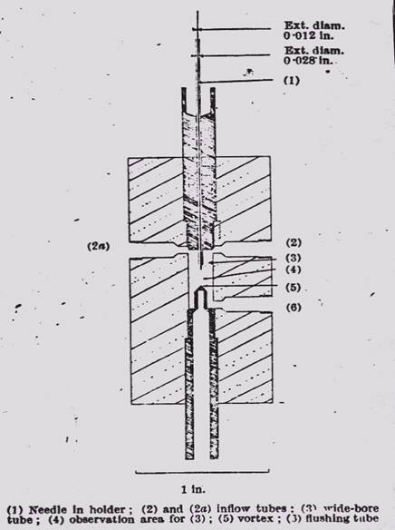
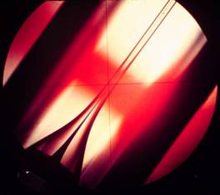
Sheath Flow
PJ Crosland-Taylor 1953
A device for counting small particles suspended in fluid through a tube, Nature 171, 1953 (ref 4756)
An Electronic Blood-Cell Counting Machine, Blood 13, 1958 (ref 40974)

Slide 20
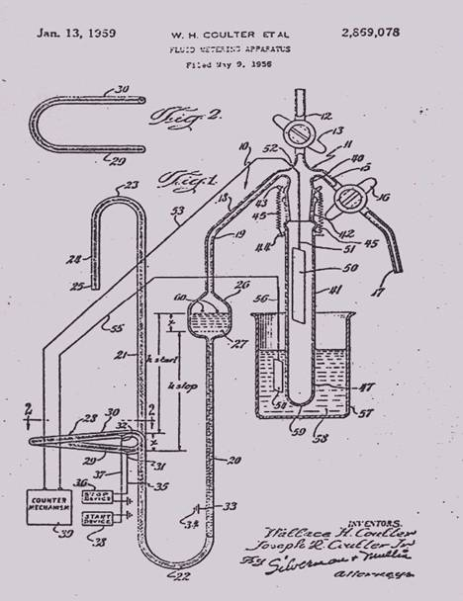
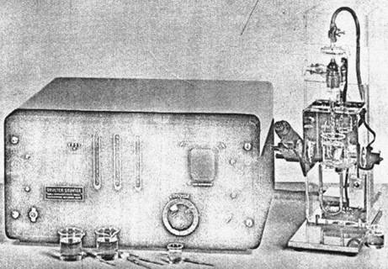
Coulter Counter 1956

Slide 21
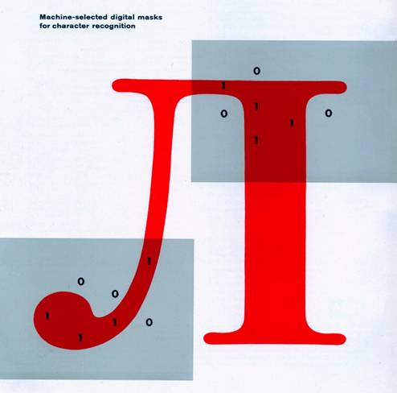
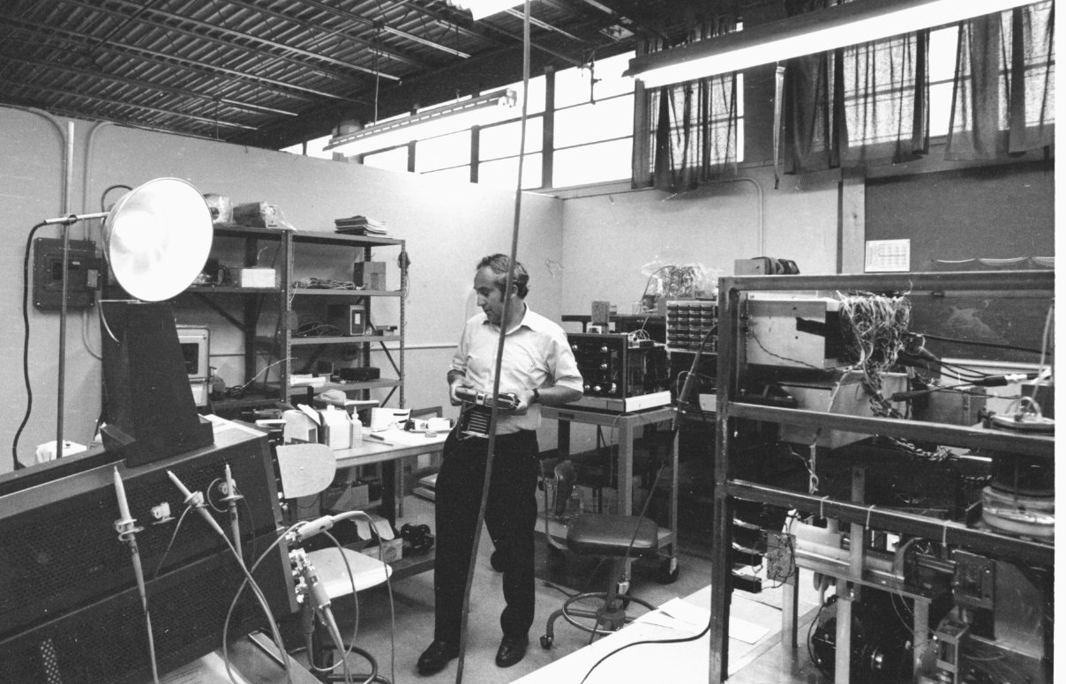
Before Cytometry
Dr. Kamentsky
LA Kamentsky & CN Liu, Computer-automated design of multifont print recognition
logic, IBM J. Research & Development 7, 1963 (ref 40705)

Slide 22
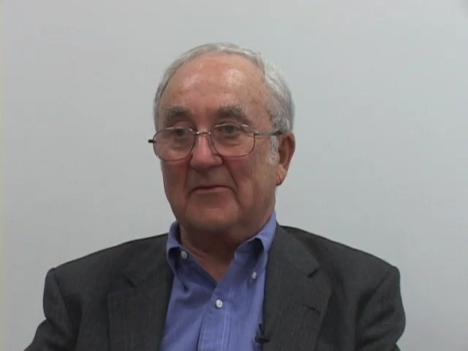
Kamenstsky’s work at IBM and Character recognition
Video 1:17

Slide 23
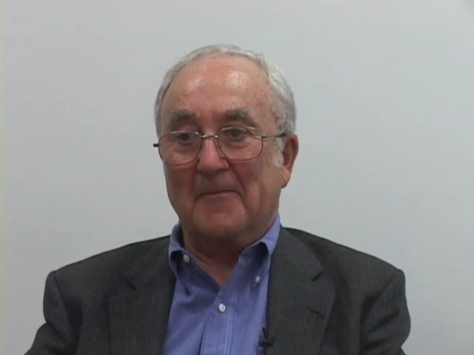
Kamenstky explains how IBM became involved with pathology
Video 1:12

Slide 24
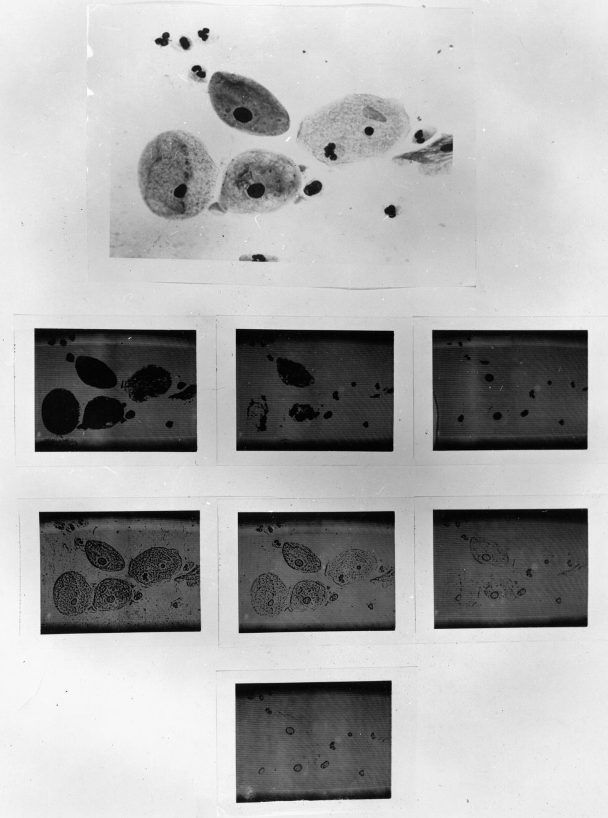
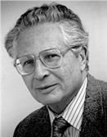
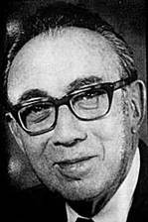
Visible & UV Scanning
Dr. Kamentsky
Dr. Melamed
Dr. Koss
Brightfield Image
UV Images

Slide 25
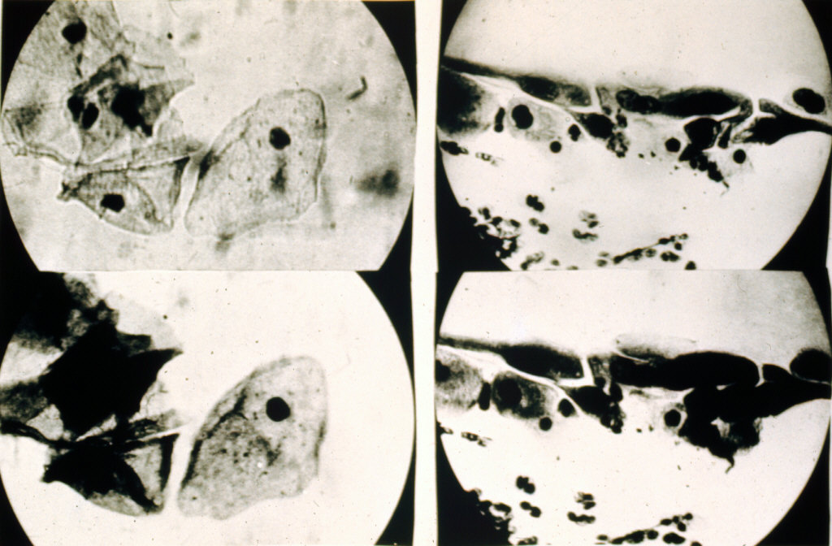
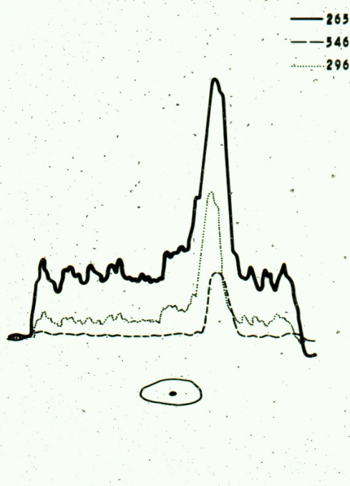
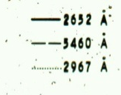
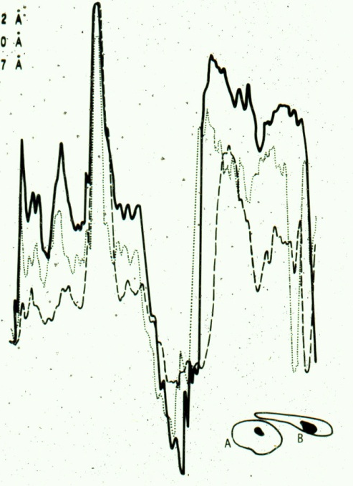

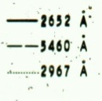
UV Scanning
Measurements
Dr. Kamentsky
Normal Cells
Cancer Cells
Ultraviolet Absorption in Epidermoid Cancer Cells LA Kamentsky, H. Derman,
and MR Melamed, Science 142, 1963 (ref 40210)

Slide 26
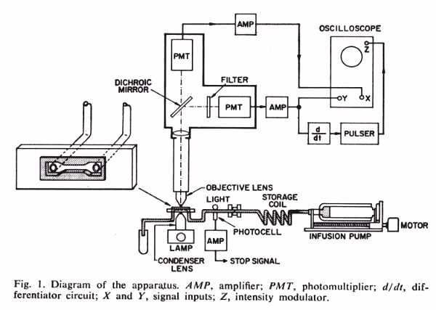
Flow Cytometry
LA Kamentsky, MR Melamed & H. Derman, Spectrophotometer: New instrument for ultrarapid cell analysis, Science 150, 1965 (ref: 4144)

Slide 27
Flow Cytometry
LA Kamentsky, MR Melamed & H. Derman, Spectrophotometer: New instrument for ultrarapid cell analysis, Science 150, 1965 (ref: 4144)

Slide 28
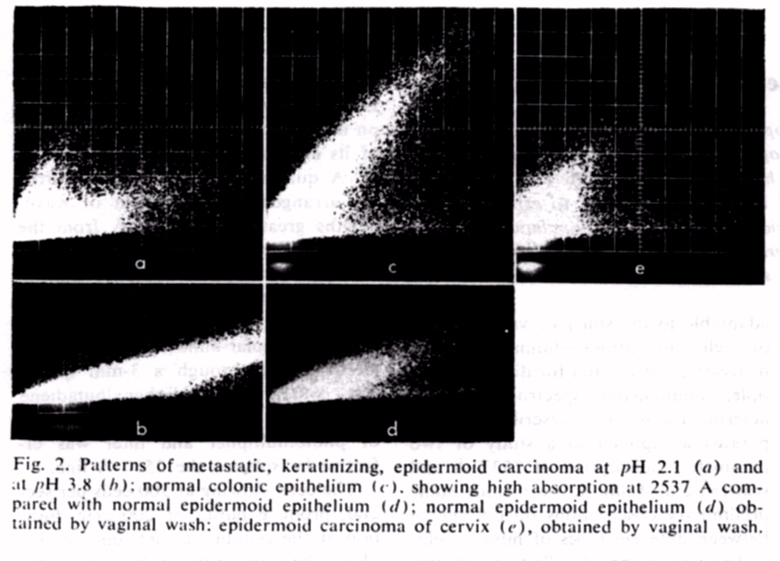
Flow Cytometry
Epidermoid carcinoma
at pH 2.1
Normal colonic epithelium
Epidermoid carcinoma
of the cervix
Epidermoid carcinoma
at pH 3.8
Normal epidermoid
epithelium

Slide 29
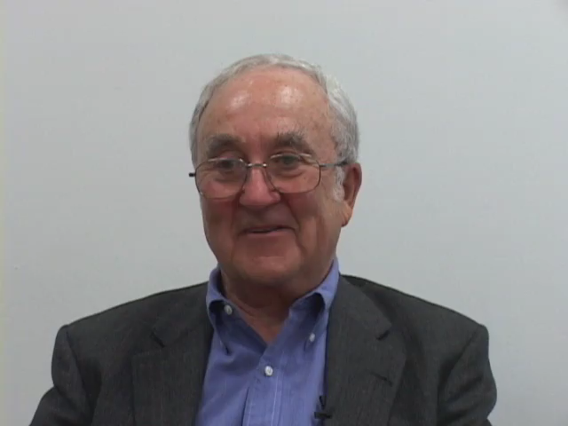
Kamensky gives up on imaging and starts flow cytometry - 1963
Video 1:42

Slide 30
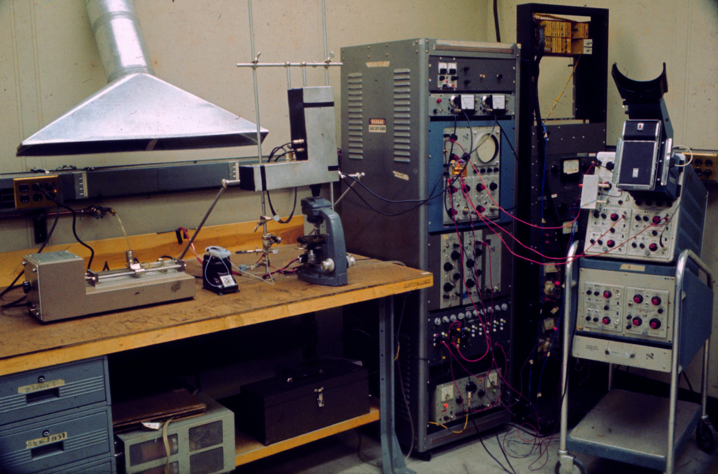
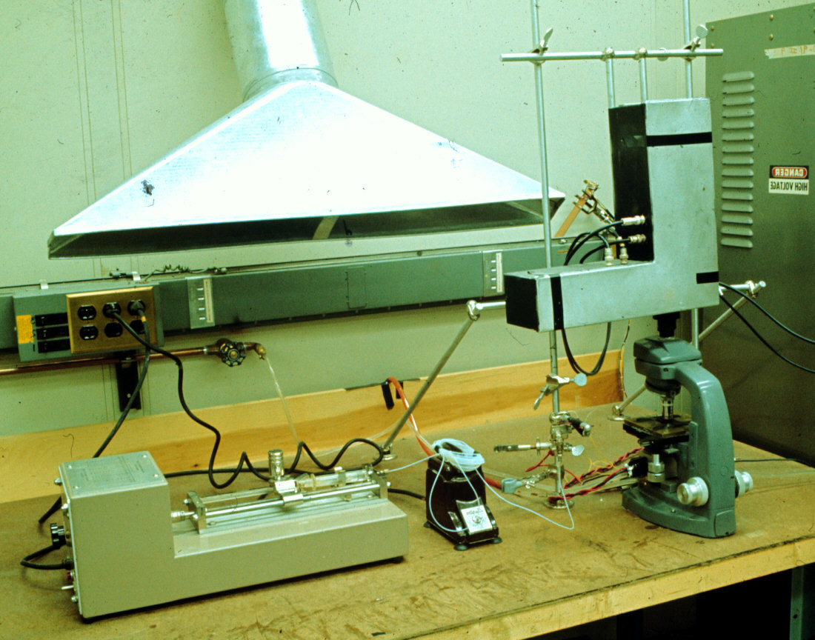
First Analytic Flow Instrument 1963

Slide 31
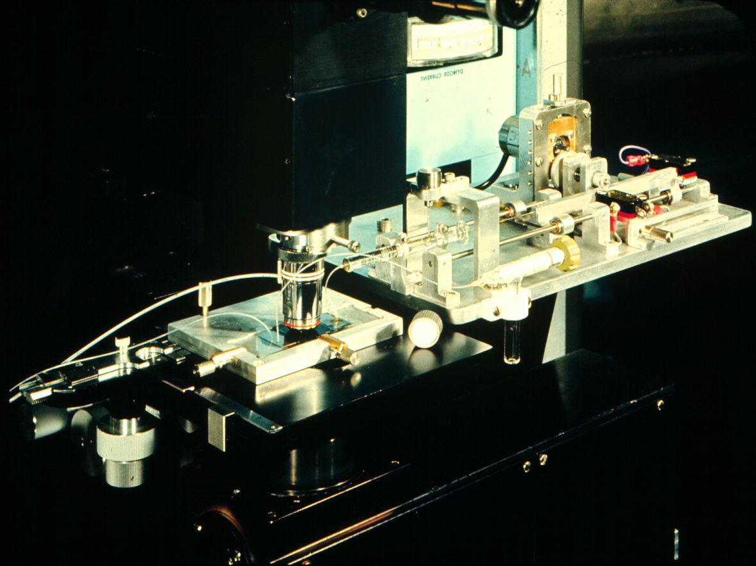
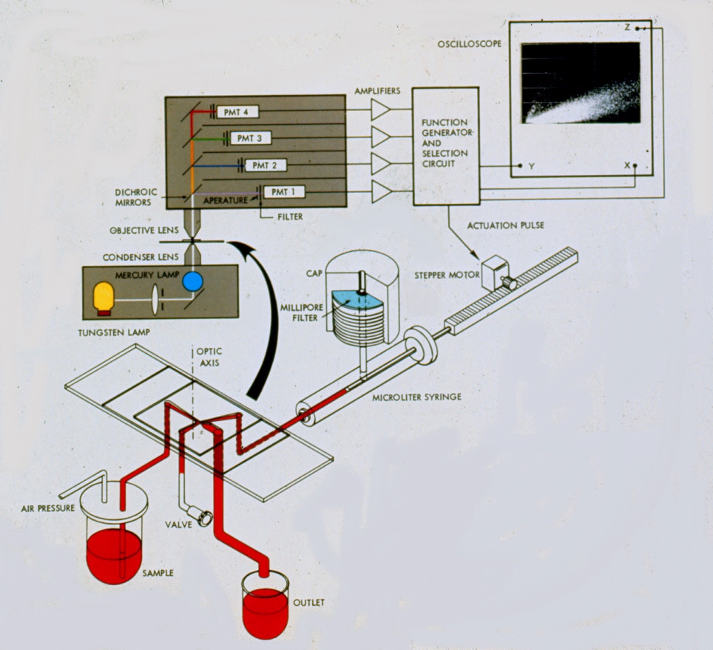
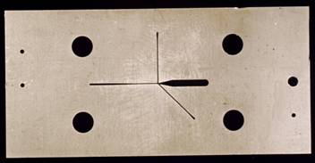

More Sensors and Sorting 1965
Slide Kindly Supplied by Compucyte
Spectrophotometric Cell Sorter, LA Kamentsky and MR Melamed, Science 156, 1967 (ref 4134)

Slide 32
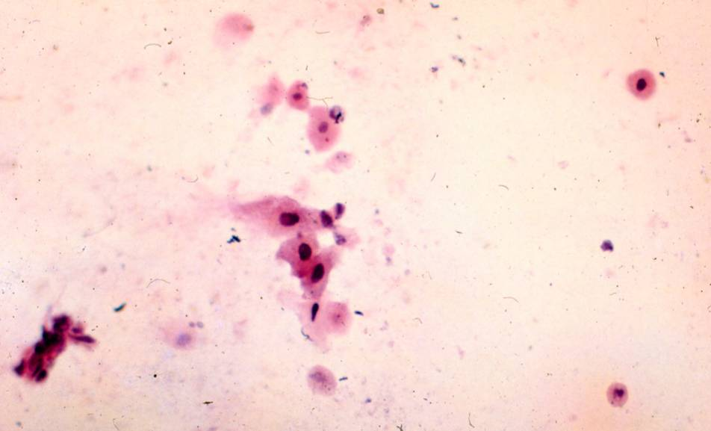
More Sensors and Sorting 1965
Spectrophotometric Cell Sorter, LA Kamentsky and MR Melamed, Science 156, 1967 (ref 4134)

Slide 33
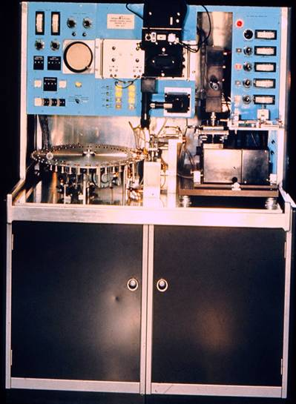
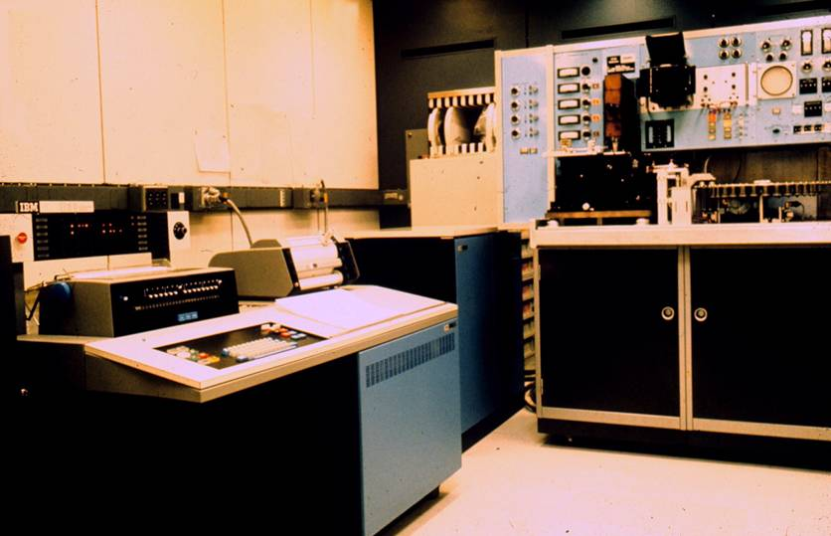
Four Sensors, Sorting, Auto Sampling and Computer Data Reduction 1966
Two analytic instruments were built and one was delivered to LA Herzenberg at Stanford University 1967

Slide 34


Evolution of Flow Instruments
WA Bonner, HR Hulett, RG Sweet and LA Herzenberg,
Fluorescence Activated Cell Sorting, Review of Scientific Instruments 43, 1972

Slide 35


Electrostatic Printing and Droplet Sorting
RG Sweet - MJ Fulwyler
RG Sweet, Fluid Droplet Recorder
U.S. Patent 3,596,275
filed 3/25/64 (ref 40975)
MJ Fulwyler, Particle Separator, U.S.
Patent 3,380,584 filed 6/4/65

Slide 36

Impulsecytophotometer
W. Dittrich and W. Gohde 1969
W. Dittrich and W. Gohde, Impulsfluorometrie bei Einzelzellen in Suspensionen,
Zeit. F Naturforschung 24b, 1969 (ref 4755)

Slide 37



Los Alamos Contributions
MA VanDilla, TT Trujillo, PF Mullaney &
JR Coulter, Cell Microfluorometry: A
Method for Rapid Fluorescence Measurement,
Science 163, 1969
PM Kraemer, DF Petersen & MA Van Dilla, DNA Constancy in Heteroploidy and the Stem
Line Theory of Tumors, Science 174, 1971

Slide 38



Evolution of Leukocyte Gating Strategy for Cluster Subsetting
LR Adams & LA Kamentsky,
Machine characterization of human leukocytes by acridine orange fluorescence, Acta Cytologica 15, 1971
Lymphocytes
Granulocytes
Monocytes
GC Salzman, JM Crowell,
JC Martin, TT Trujillo,
A. Romero, PF Mullaney, & PM LaBauve, Cell classification by laser light scattering: identification and separation of unstained leukocytes,
Acta Cytologica 19, 1975
RA Hoffman, PC Kung,
WP Hansen, Simple & rapid
measurement of human T
lymphocytes and their
subclasses, PNAS 77, 1980

Slide 39






Biophysics Systems
Ortho Instruments
Spectrum (1979)
ELT 8 (1977)
50H (1978)
FC200 (1975)
Cytograf (1970)
Cytofluorograf (1970)

Slide 40


Mack Fulwyler
Coulter Electronics manufactured the TPS-1 (Two parameter sorter) in 1975 which could measure forward scatter and fluorescence using a 35mW argon laser.
This photo (left) (©2000 – J.P. Robinson) is one of only one or two surviving TPS Instruments. It is very similar to the Coulter Counter of the day.
Photo ©2000 – J.P. Robinson

Slide 41




Shapiro (sadly passed away in Nov, 2021)
Shapiro and the Block instruments (1973-76) - a series of multibeam flow cytometers that did differentials and multiple fluorescence excitation and emission
Photos ©2000 – J.P. Robinson

Slide 42
Hemalog D
Technicon - Hemalog D - 1974 - first commercial differential flow cytometer - light scatter and absorption at different wavelengths - chromogenic enzyme substrates were used to identify neutrophils and eosinophils by peroxidase and monocytes by esterase, basophils were identified by the presence of glycosaminoglycans using Alcian Blue - the excitation for all measurements was a tungsten-halogen lamp
Insert photos on page 60
Image from Shapiro “Practical Flow Cytometry”, 3rd. Ed.Wiley-Liss, 1994

Slide 43




Monoclonal Antibodies
César Milstein was awarded the 1984 Nobel Prize in Physiology or Medicine jointly with his former postdoctoral fellow Georges J. F. Köhler (AAI '85) and theoretician Niels Jerne (AAI '73). Milstein and Köhler won the prize for developing the hybridoma method of producing monoclonal antibodies.
Georges J.F. Köhler
The Nobel Prize in Physiology or Medicine 1984
Born: 17 April 1946, Munich, Germany
Died: 1 March 1995, Freiburg im Breisgau, Germany
Published in a letter to Nature (I understand that the paper was not accepted originally as a full paper so they submitted it as a letter)

Slide 44

Monoclonal Antibodies 1975
Kohler and Milstein's hybridoma technology (1975)
Newsreel from the day the Nobel Prize was announced
Video 0.40
Video from Novelprize.org
Noble Prize in 1984

Slide 45


Coulter Electronics
1977-78 developed the Epics series of instruments which were essentially 5 watt argon ion laser instruments, complete with a multiparameter data analysis system, floppy drive and graphics printer.
Huge computer
racks all with
oscilloscopes
Photos ©2000 – J.P. Robinson
Epics V front end (left) and MDADS (right)

Slide 46


Biophysics -Ortho
Ortho Diagnostics (Johnson and Johnson) purchased Biophysics in 1976 and in 1977 the System 50 Cytofluorograph was developed - this was a droplet sorter, with a flat sided flow cell, forward and orthogonal scatter, extinction, 2 fluorescence parameters, multibeam excitation, computer analysis option.
1979 - NIH scientists had added a krypton laser at 568 nm to excite Texas Red fluorescence at 568 nm and emit at 590-630 nm. Argon (488 nm FITC was measured simultaneously without signal cross-talk - thus the FACS IV was developed (B-D).
FC 200(1975)
System 50H (1978)

Slide 47



Stuart Schlossman
Schlossman at the Farber Institute in Boston, began to make monoclonal antibodies to white blood cell antigens in 1978. Eventually he collaborated with Ortho Diagnostics who distributed the famous “OK T4” etc., Mabs
BD as well as Coulter Immunology also distributed his antibodies, and this resulted in some interesting legal issues in the late 1980’s and early 1990’s
Monoclonal antibodies defining distinctive human T cell surface antigens
P Kung, G Goldstein, EL Reinherz and SF Schlossman Science 19 October 1979: Vol. 206 no. 4416 pp. 347-349 DOI: 10.1126/science.314668
Monoclonal Antibodies:
Kohler G, Milstein C. Continuous cultures of fused cells secreting antibody of predefined specificity. Nature Lon. 1975;256:495-497.

Slide 48
Introductory Terms and Concepts
Variable/Parameter (see Note below)
Light Scatter- Forward (FALS), narrow (FS)
- Side scatter, Wide angle, 90 deg, Orthogonal
Fluorescence – band width, or spectral range
Absorption/axial light loss
Time
Count
Note: People in the field of flow cytometry interchangeably use the term “parameter”
with “variable”. While it is technically incorrect to use the term parameter unless we are
talking about a derived value, it is common usage.

Slide 49
Concepts
    Scatter: Size, shape, granularity, polarized scatter (birefringence), effective refractive Index
    Fluorescence:
    Intrinsic: Endogenous pyridines and flavins
    Extrinsic: All other fluorescence profiles
    Absorption
    Axial Light loss: Loss of light (blocked) (best measure for particle size)
    Time: Useful for kinetics, Quality Control, stop count
    Cell Count: Always part of any collection
    Tube Number or Identifier /well number

Slide 50
Instrument Components
Electronics: System control, pulse collection, pulse analysis, triggering, time delay, data display, gating, sort control, light and detector control
Optics: Light source(s), detectors, optical filters, spectral separation
Fluidics: Specimen control, sorting, rate of data collection
Computation/Data Analysis: Data display & analysis, multivariate/ simultaneous solutions, identification of sort populations, quantitation, ratios

Slide 51
Data Analysis Concepts
    Data plotting
    Single parameter - Histogram
    Dual parameter – Dot plot
    Multiple parameter – 3 D plot or a variety of plots such as PCA* or other analytical displays
    Complex plots – time course, concentration curves, cell cycle analysis, heat maps, plate maps, etc.
    tSNE, UMAP, and a variety of displays are currently used in flow cytometry
Note: these terms are introduced here, but will be discussed in more detail in later lectures
* PCA – Principal Component Analysis

Slide 52




Data Presentation Formats
How flow cytometry data are presented: Examples
Side Scatter Projection
    Histogram
    Dot plot
    Contour plot
    3D plots
    Dot plot with projection
    Overviews/composites (multiple histograms)
    Various analytical plots
    Complex analysis like SPADE, tSNE, UMAP, PCA
Neutrophils
Forward Scatter
From OIMP-069
Forward Scatter Projection
Monocytes
Lymphocytes
0
200
400
600
800
1000
90 Degree Scatter
Thanks Wiki

Slide 53


Data Analysis Concepts
What do you analyze and what do you ignore?
    Gating
    Single parameter
    Dual parameter
    Multiple parameter
    Back gating
Note: terms are introduced, but will be discussed in more detail in later lectures
2P Gate
For example
You can evaluate these cells
and ignore
these
Gate
Linear Gate
Gate
Gating is a fundamental part of flow cytometry data collection & Analysis

Slide 54
Sorting
Sorting is the process of physically separating a cell from a population
Sorting can be accomplished by a number of techniques, but the primary one is electrostatic sorting (microfluidic chips are also effective)
Sorting can be 1-way, 2-way, 4-way or 7-way in modern sorters
Sorting can be accomplished under sterile conditions for subsequent cell culture
Sorting can be achieved at high speeds over 100,000 events per second
Newest sorters include SPECTRAL sorters that can use spectral unmixing to sort (e.g. Thermo Bigfoot)

Slide 55
Lecture Summary
History of Flow Cytometry
Some Key Individuals
Key ideas that established current approaches
Introduction to terms of use in flow cytometry

