Slide 1
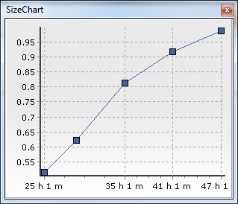
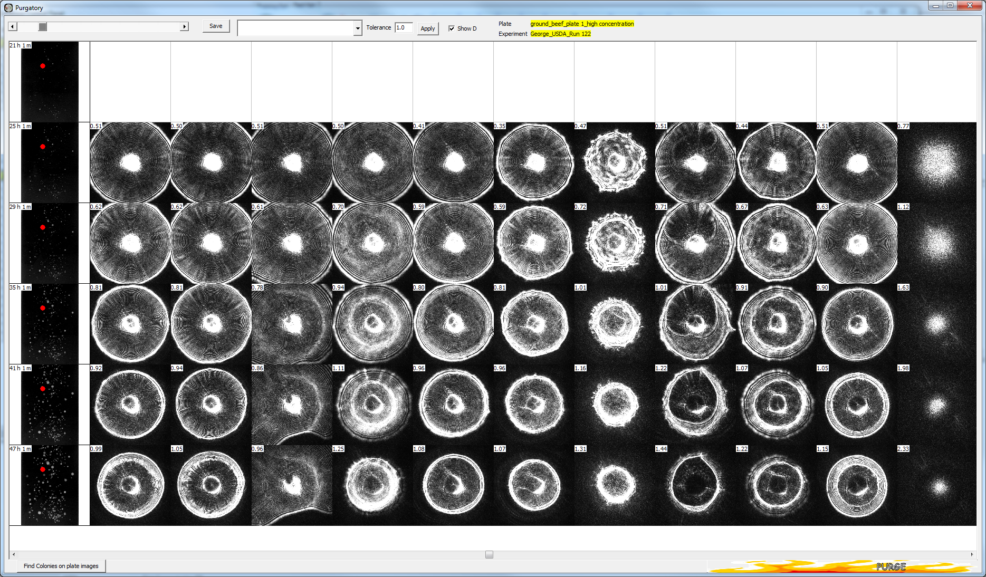
NEW FEATURE High Dynamic Range (HDR): Using dual simultaneous imaging, we collect two images of every colony, but one is HDR – that is High Dynamic Range. The HDR is typically “less dense” (lighter) than the regular image and it basically takes the central “bright zone” of the image and extracts valuable information from it. Until we instigated HDR we lost this information. This gives us a lot more information than before.
Notes:
Data from
George_USDA_Run 122
Name : ground beef plate 1 high concentration
Incubation 21- 47 hours (captures every 2 hrs)

Slide 2
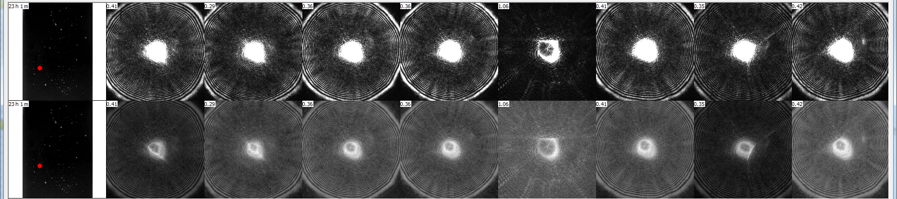
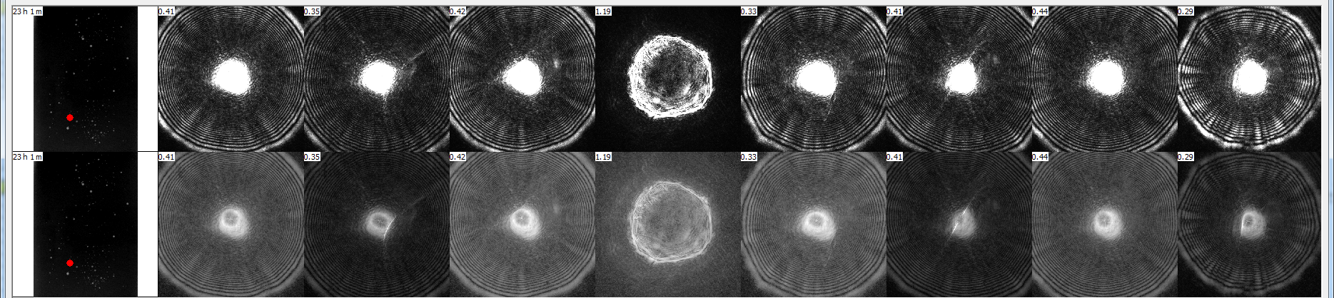
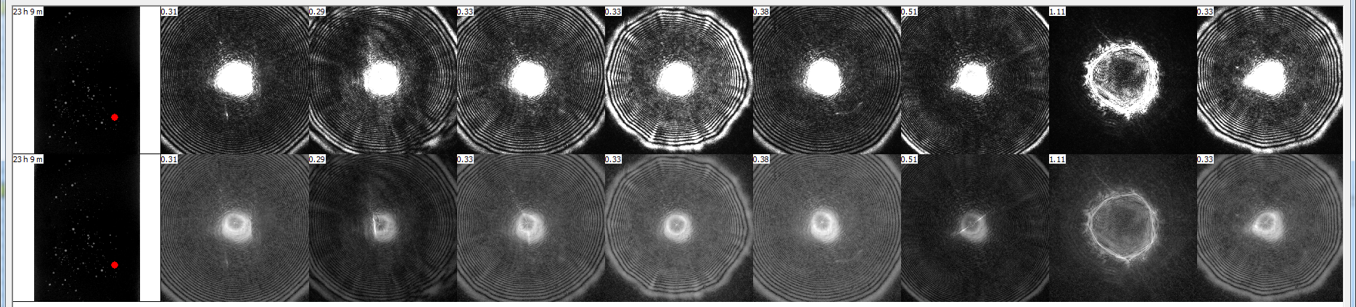
Lower image is HDR – note more details
Notes:
Comparing regular & HDR images
Data from
George_USDA_Run 122
Name : ground beef plate 1 high concentration
Incubation 23 hours (captures every 2 hrs) for Row 1 and 2
George_USDA_Run 122
Name : ground beef plate 2 high concentration
Incubation 23 hours (captures every 2 hrs) for Row 3

