Slide 1

Reagent Free Advances in Scatter and Analysis
J. Paul Robinson
Euiwon Bae, Bartek Rajwa
Arun Bhunia, & E. Dan Hirleman

Slide 2

Overview
Over the past several years:
We have developed all the analytical software, classification routines and data management that has driven discovery using light scatter technology
We have designed 3 different models of hardware used for light scattering analysis
We created the algorithms for classification and identification of organisms
We developed a master database concept that manages data, creates classifiers, save profiles and drives the identification process
We have developed new label free approaches to rapid organism identification
We have recently developed a unique technology that we believe has the possibility of enormous benefit.

Slide 3
Background to PUCL Lab
PUCL Environment
Biomedical Engineering combined with Microbial laboratory
Combination of engineering in hardware design and manufacturing ability
Advanced software development team linked to instrument design
Informatics capability in developing advanced classification algorithms with capacity to integrate these into easily accessible software platforms
Automation capacity in sample preparation, as well as high throughput robotically driven analysis

Slide 4
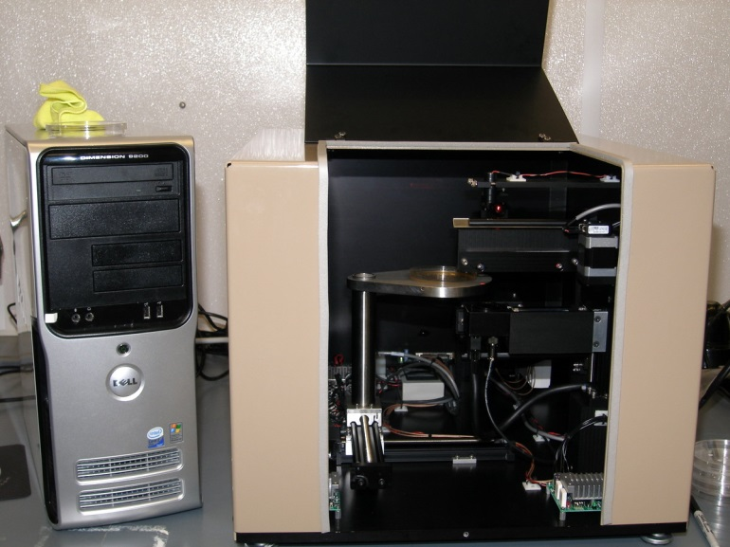
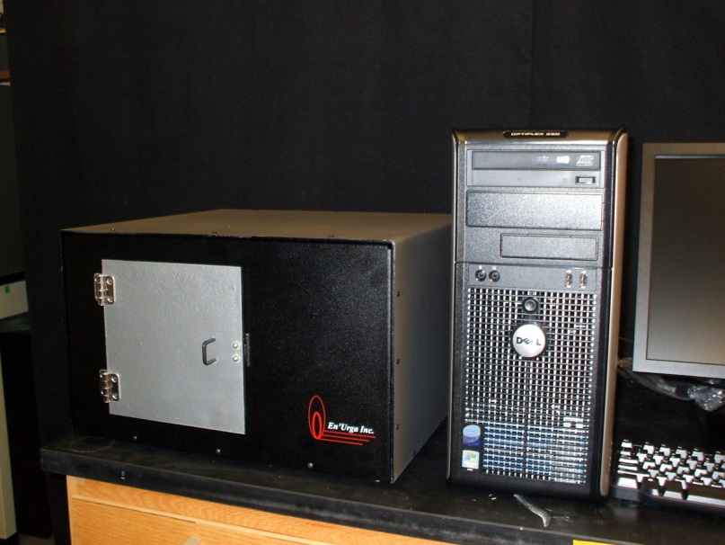
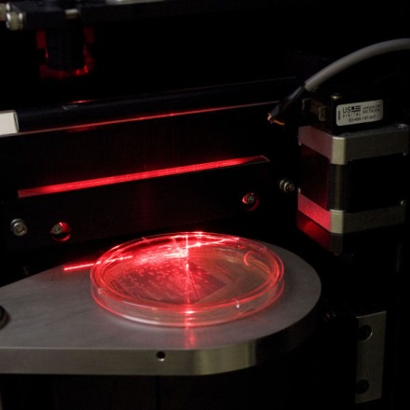
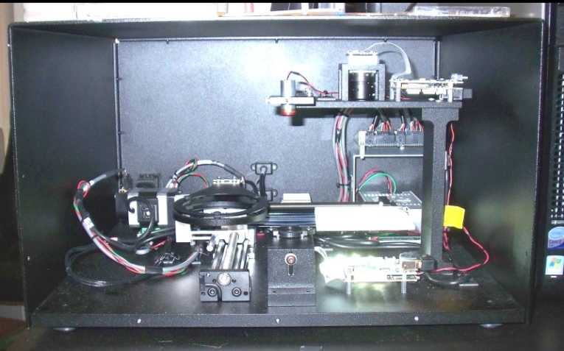
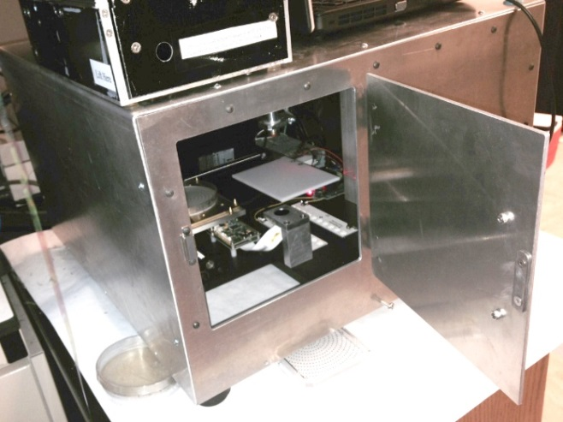
Brief Instrument History
V2-Creation Date: 2009-05-27
BARDOT V1 Creation Date 2007-10-18
V2 Creation Date: 2009-09-11
V3 Creation Date : 2011

Slide 5
Some background on Scatter Technology

Slide 6
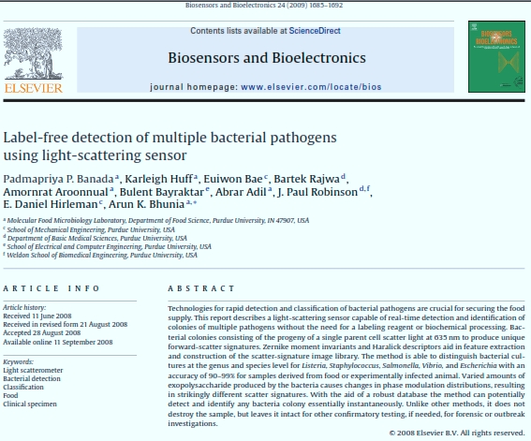
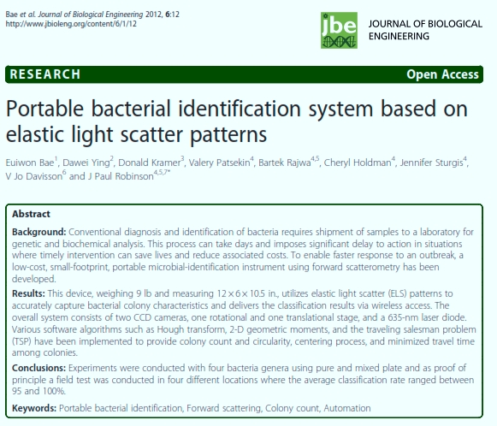
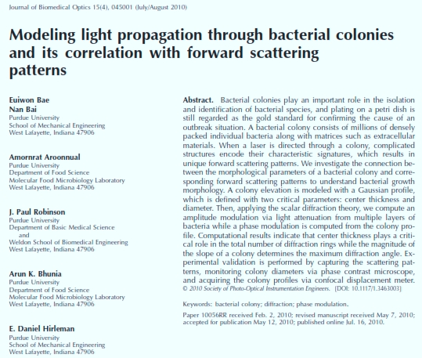
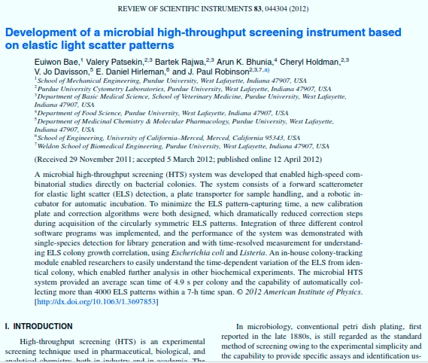
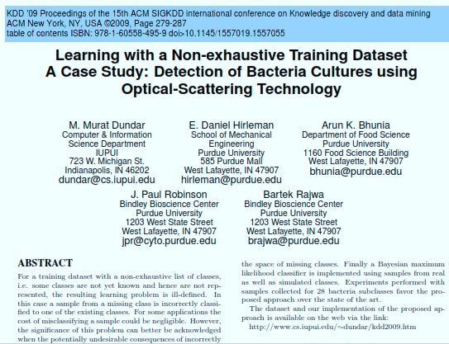
Productivity
9 Instruments Manufactured
West Virginia University Medical School (1)
Battelle Labs, Ohio (1)
Univ. California Merced (1)
USDA (Portable Instrument) (3rd of 3 prototypes)
PUCL laboratories (4)
Modified existing instruments (2)

Slide 7
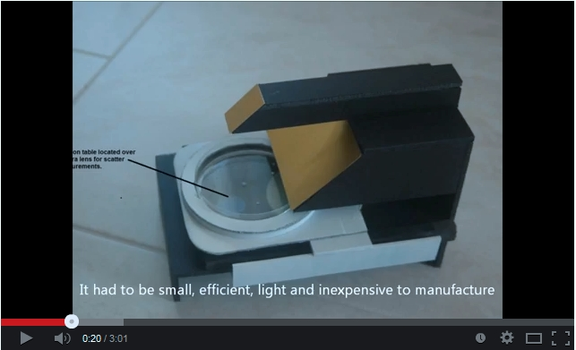
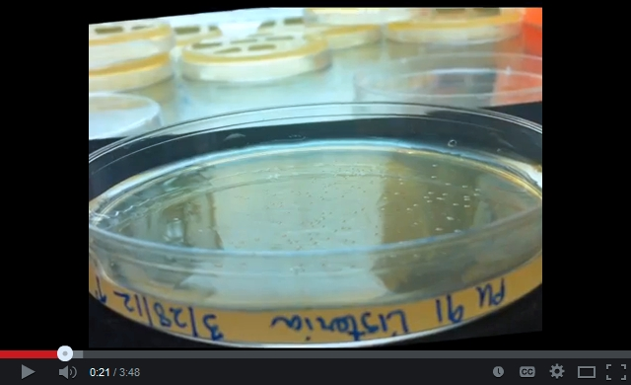
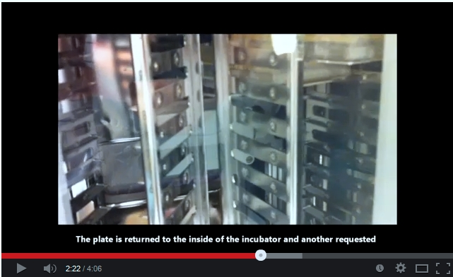
Publicity
Created several Youtube Videos to show capacity of Technology

Slide 8
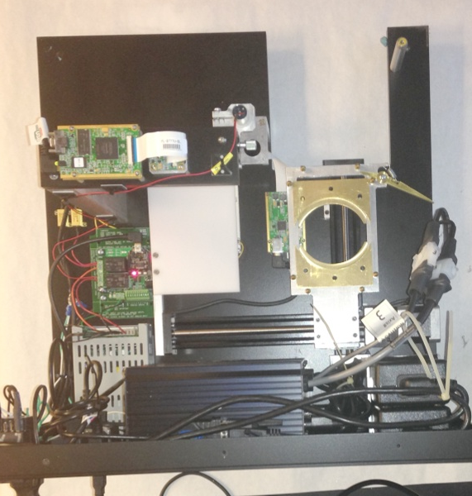
Latest Benchtop Detector
Every Part Auto Cad for
CNC manufacture
Single USB cable to computer
New USB Hub
New
Controllers
(All USB)
New
plate loader
with dual
capacity
New Light Source
New lens mount
New base plate design
New plate holder/
release
New camera mount

Slide 9
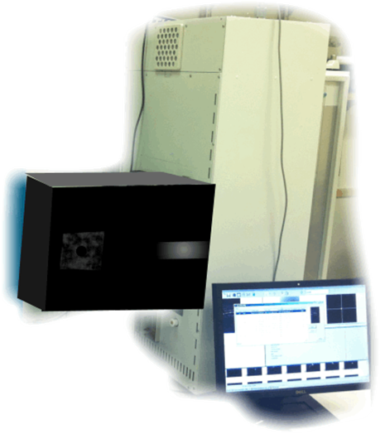
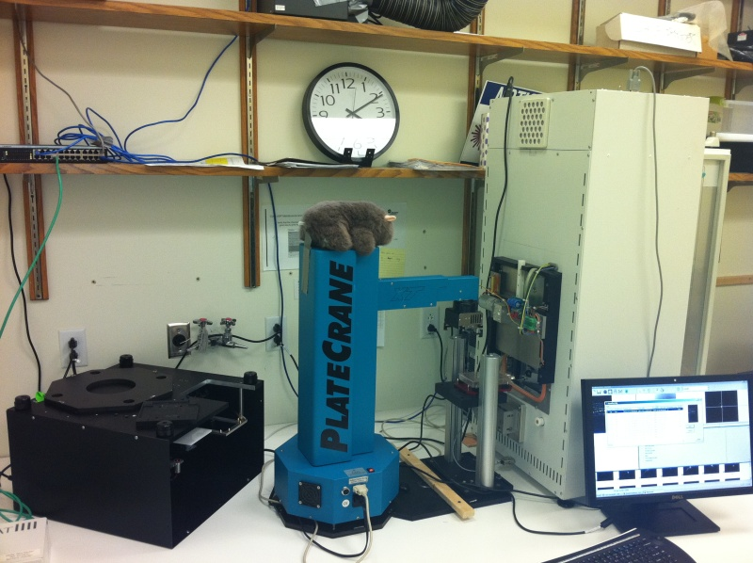
Automation
Original Automated Prototype
Integrated unit on commercial robotic Incubator

Slide 10
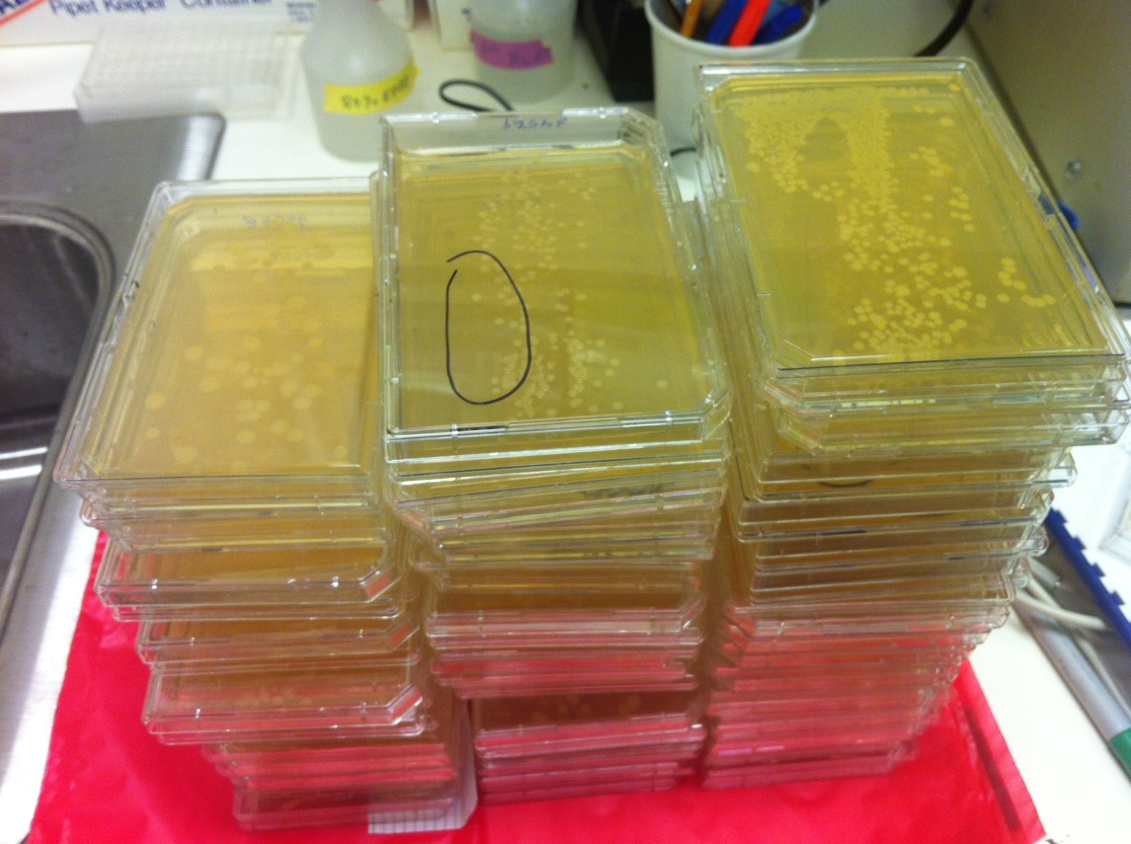
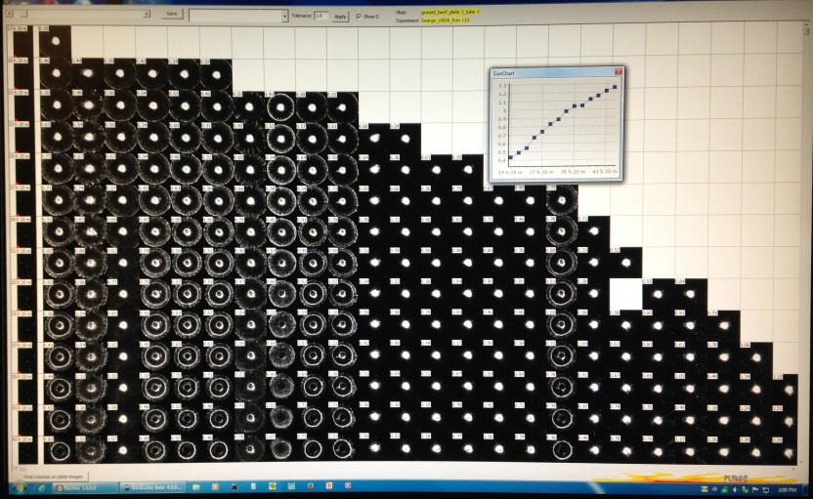
Automation

Slide 11
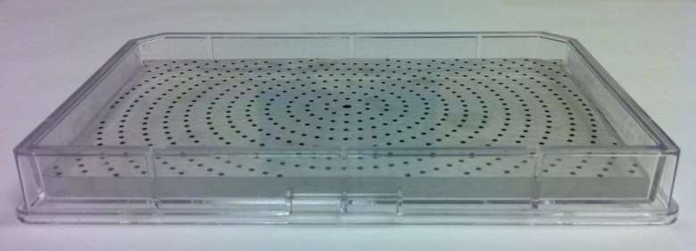
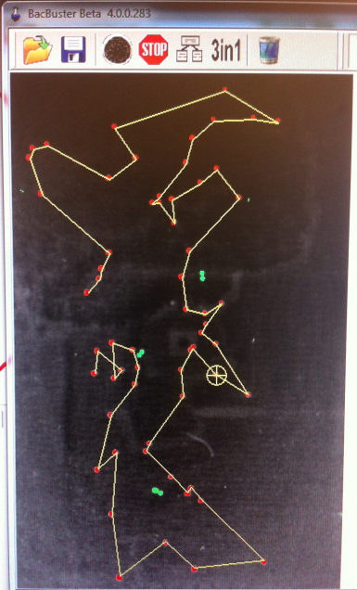
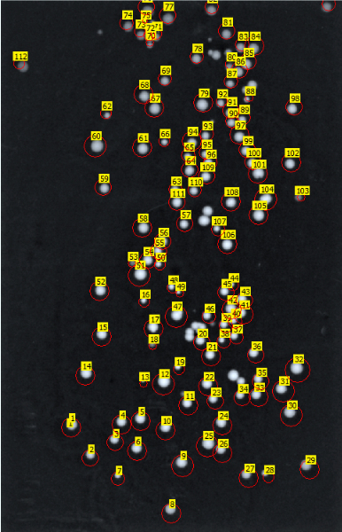
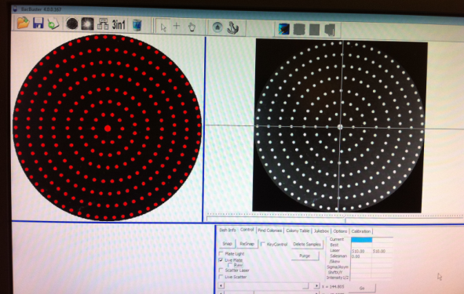
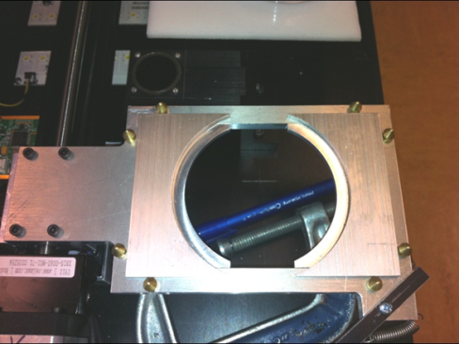

Key Features Developed
Efficiency
“Traveling Salesman”
Calibration Plates for Round and Rectangular Plates
Visual colony # with Report
Automated Calibration Software
Dual plate holders in
All bench instruments
Plate Sieve – Time based Analysis

Slide 12
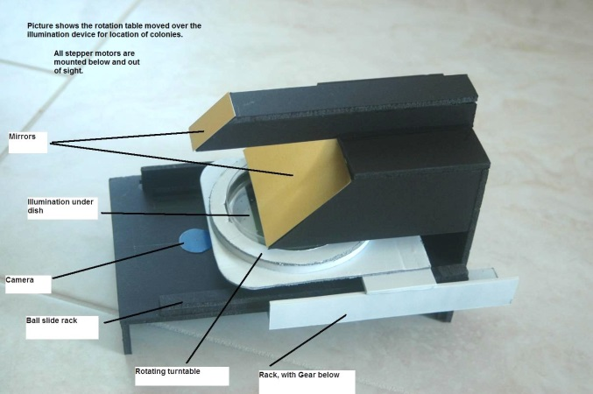
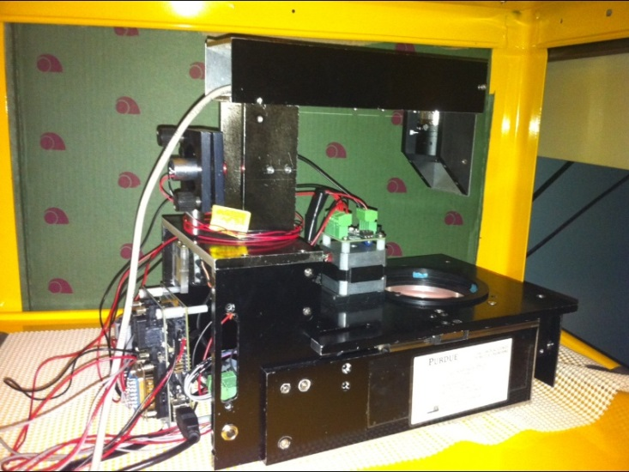
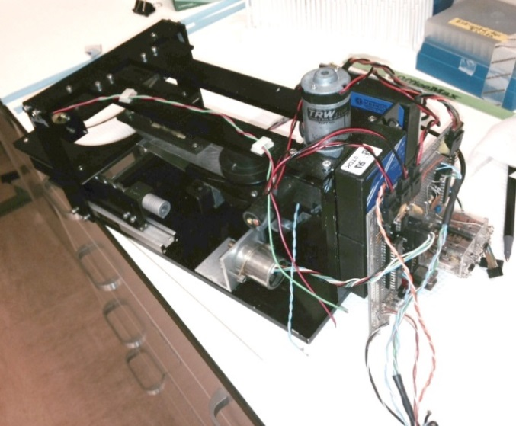
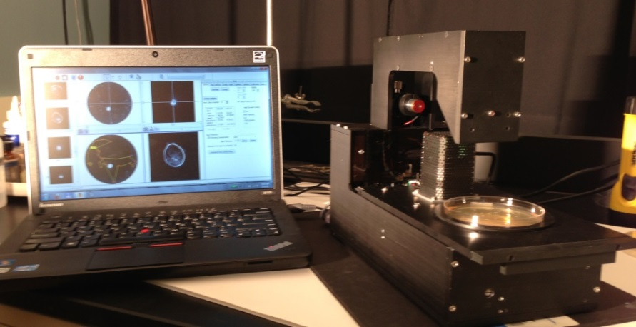
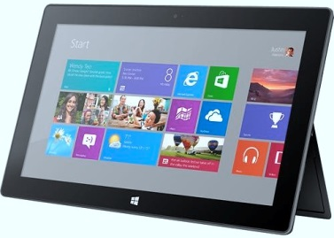
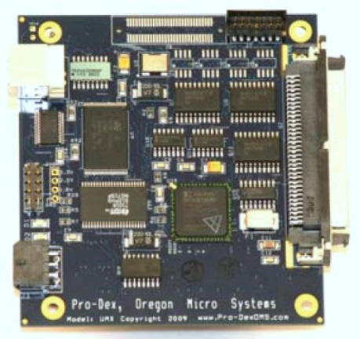
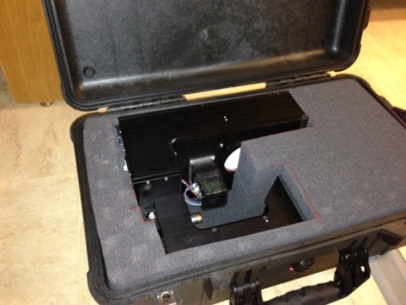
Portable Instrument
Version 1
Version 2 - model
Version 2
Version 3
Version 3 new controller & in Travel Case

Slide 13
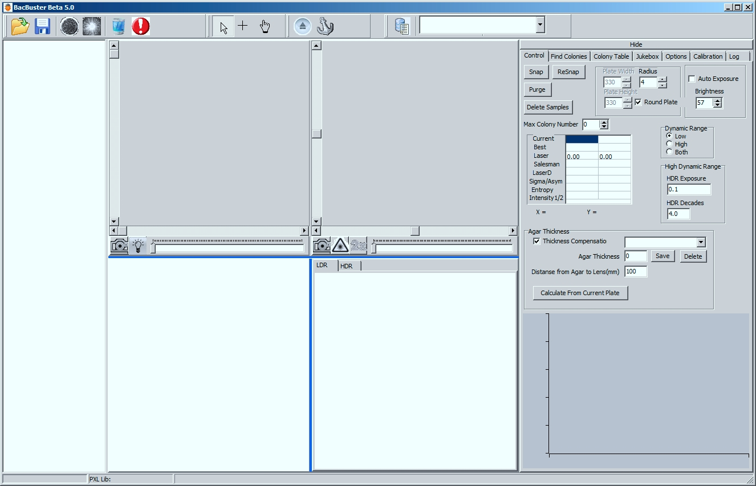
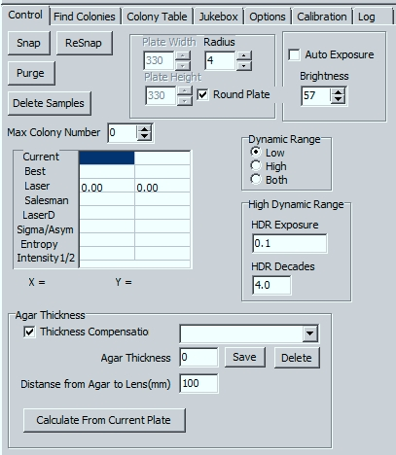
Dual Imaging Mode
To HDR or not, that is the question? Can something be done about it? Sure, just click a button!!

Slide 14
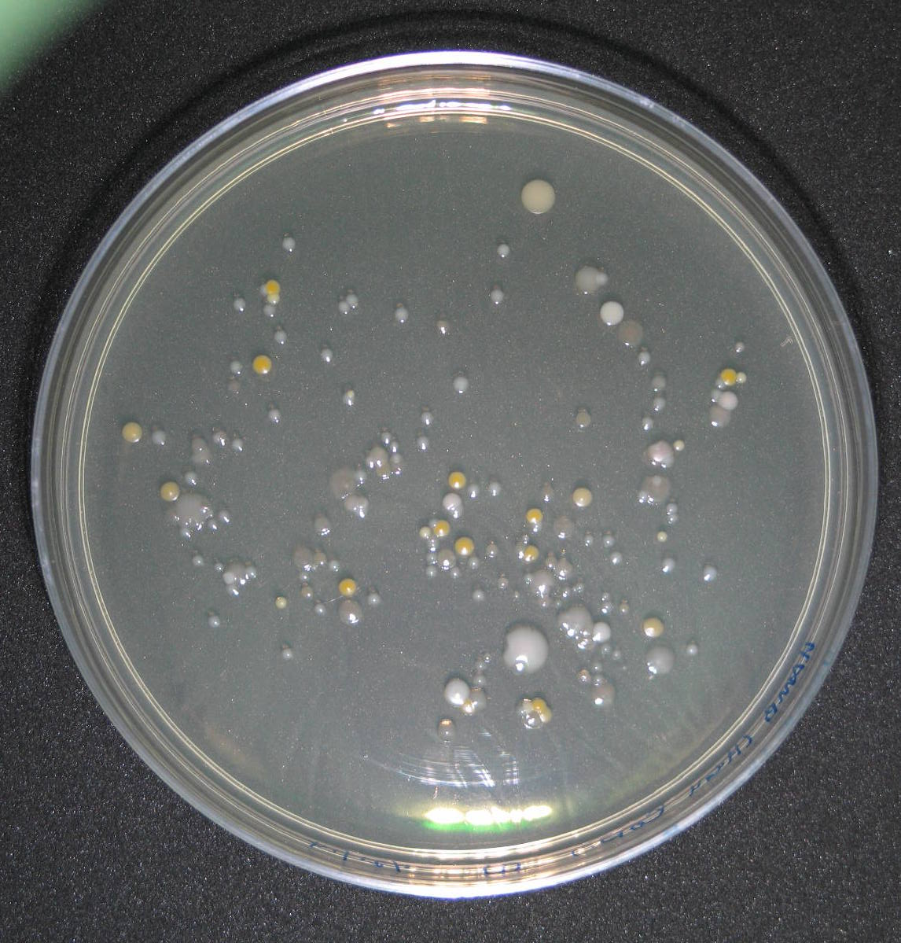
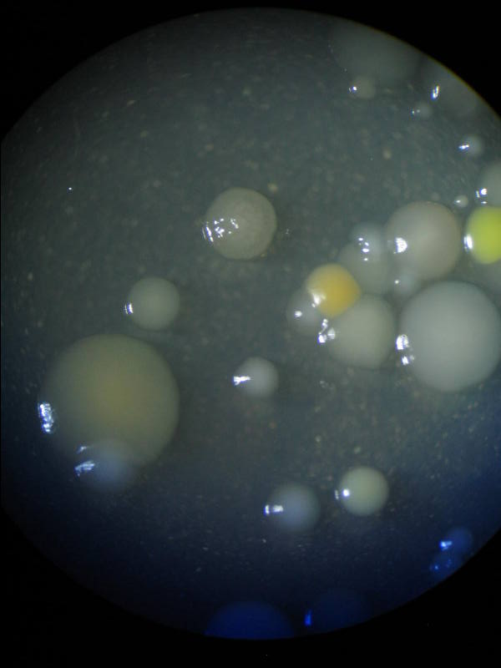
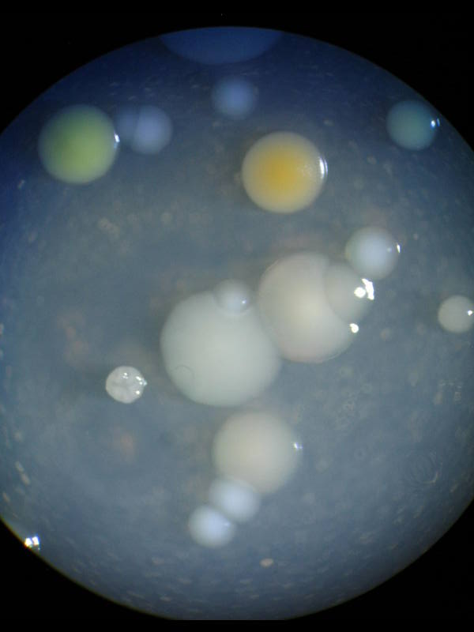
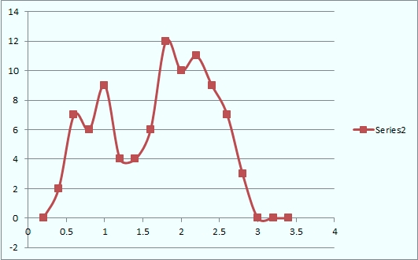
Colony Differentiator
Problem: How many “types” of colonies are on this plate?

Slide 15
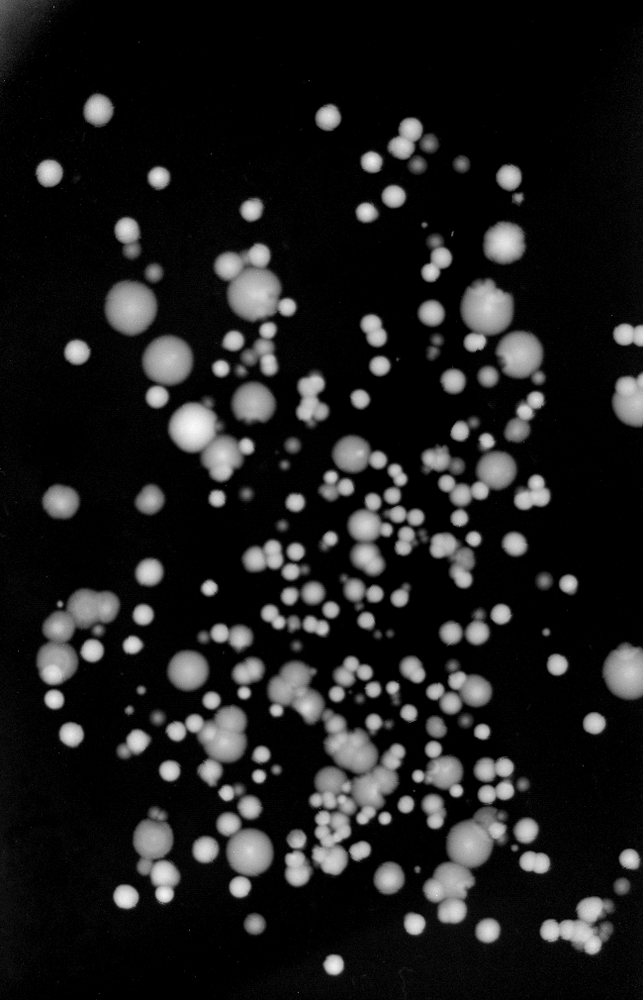
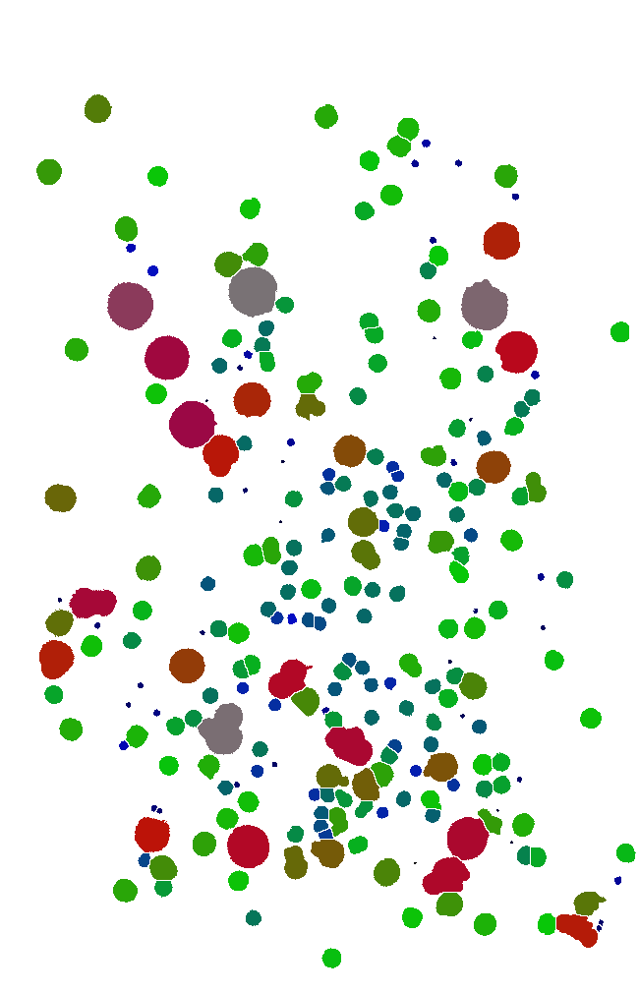
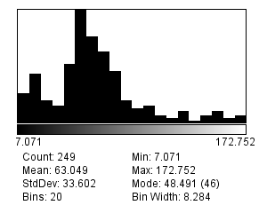
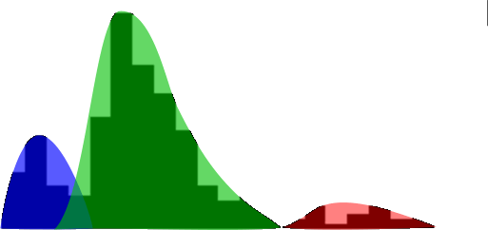
Hamburger mixed culture
Reduced data set
3 primary groups of colonies
Colony Differentiator

Slide 16
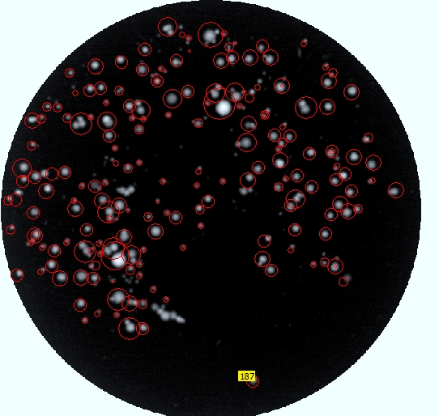
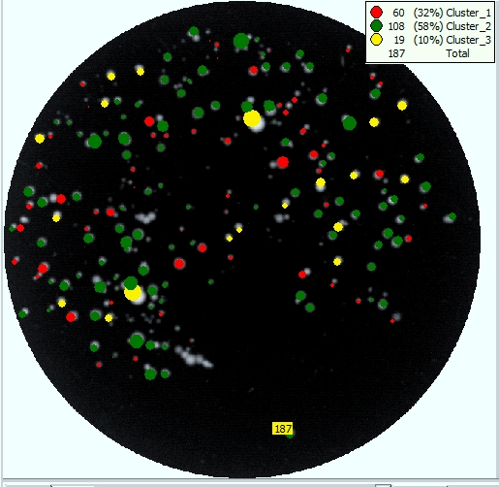
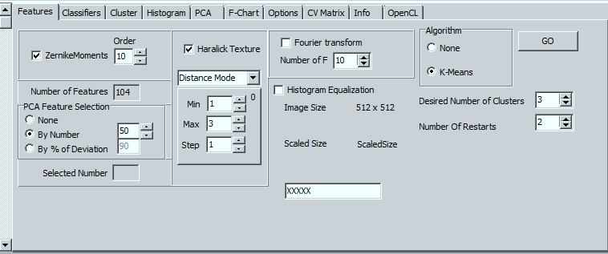
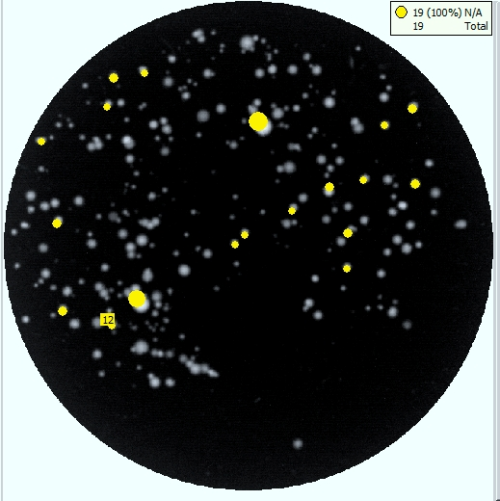
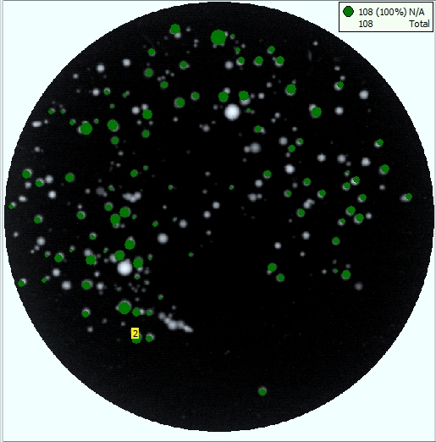
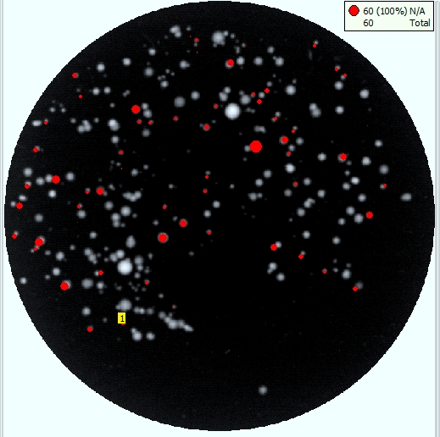
Original plate
Colony Differentiator
Class 1
Class 2
Class 3

Slide 17
Future opportunities
Micro Colonies – as small as 50 microns – may be possible to analyze data within 3-4 hours
Requirements:
High resolution optical system
new approaches of colony illumination
New centering algorithms
Different camera system
Alternative analytical toolsets – both hardware and software
Combination analytical techniques
Raman & Scatter (Preliminary studies already performed)
Scatter and morphology (preliminary studies)
Backscatter, and forward scatter (Preliminary studies)

Slide 18
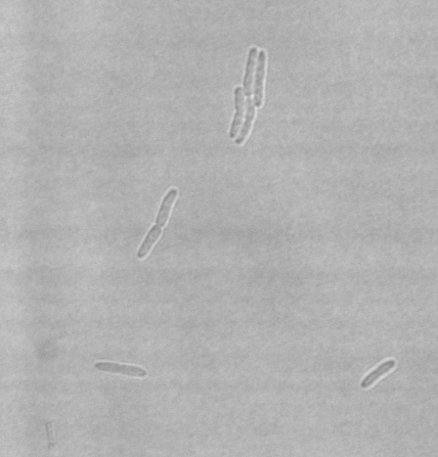
Understanding what scatter really means
Growing colonies from single
organisms to determine total
number for analytical support.
These data will be important as we try to better define what are the fundamental components that impact the light scatter patterns we are trying to understand.
A micro colony forming
From a single
organism
1μm

Slide 19
Multiple Organism Colonies
A colony formed by 3 organisms (S.aureus)

Slide 20
Micro Colony Growth
A colony formed by a single organism (S.aureus)

Slide 21
Conclusion & Summary
Our team of Euiwon Bae, Bartek Rajwa, Jennie Sturgis, Cheryl Holdman, Valery Patsekin have a combination of skills that drive our common goals
We have designed and built several different toolsets that have the ability to rapidly identify pathogenic organisms
We have integrated advanced algorithms into easy to use software and reliable hardware
We have developed a strong data base system for data management
New approaches have identified some outstanding opportunities not yet capitalized on un light scatter

Slide 22
Acknowledgements
Valery Patsekin
Euiwon Bae
Bartek Rajwa
Jennie Sturgis
Cheryl Holdman
Kathy Ragheb
Esther Foo
Funding: USDA, CFSE, NIH, PUCL

