Slide 1
State of Flow Cytometry 2023
SLAS Meeting,
San Diego,
February 2023
J. Paul Robinson
Note: these slides represent my personal view of the cytometry world. I may have
missed some issues and the viewer should be aware that this is not a complete list of what is currently available and should make your own judgements of the accuracy of this information.

Slide 2
Technology Status
Instrument types
Analyzers
Polychromatic
Spectral
Sorters
Specialty Instruments

Slide 3
Polychromatic Flow Cytometers
Becton Dickinson Many instruments
ThermoFisher Bigfoot, Attune, Attune Cytopic
Beckman Coulter CytoFlex, Cytoflex CS
Stratedigm several analyzers
Sysmex Partec and new analyzer
Cytonome Sorters
Nanoselect Sorter
Agilent (Acea) range
Sartorius High Throughtput system
BioRad several instruments including S3 sorter
Luminex (flow range purchased by Cytek)

Slide 4
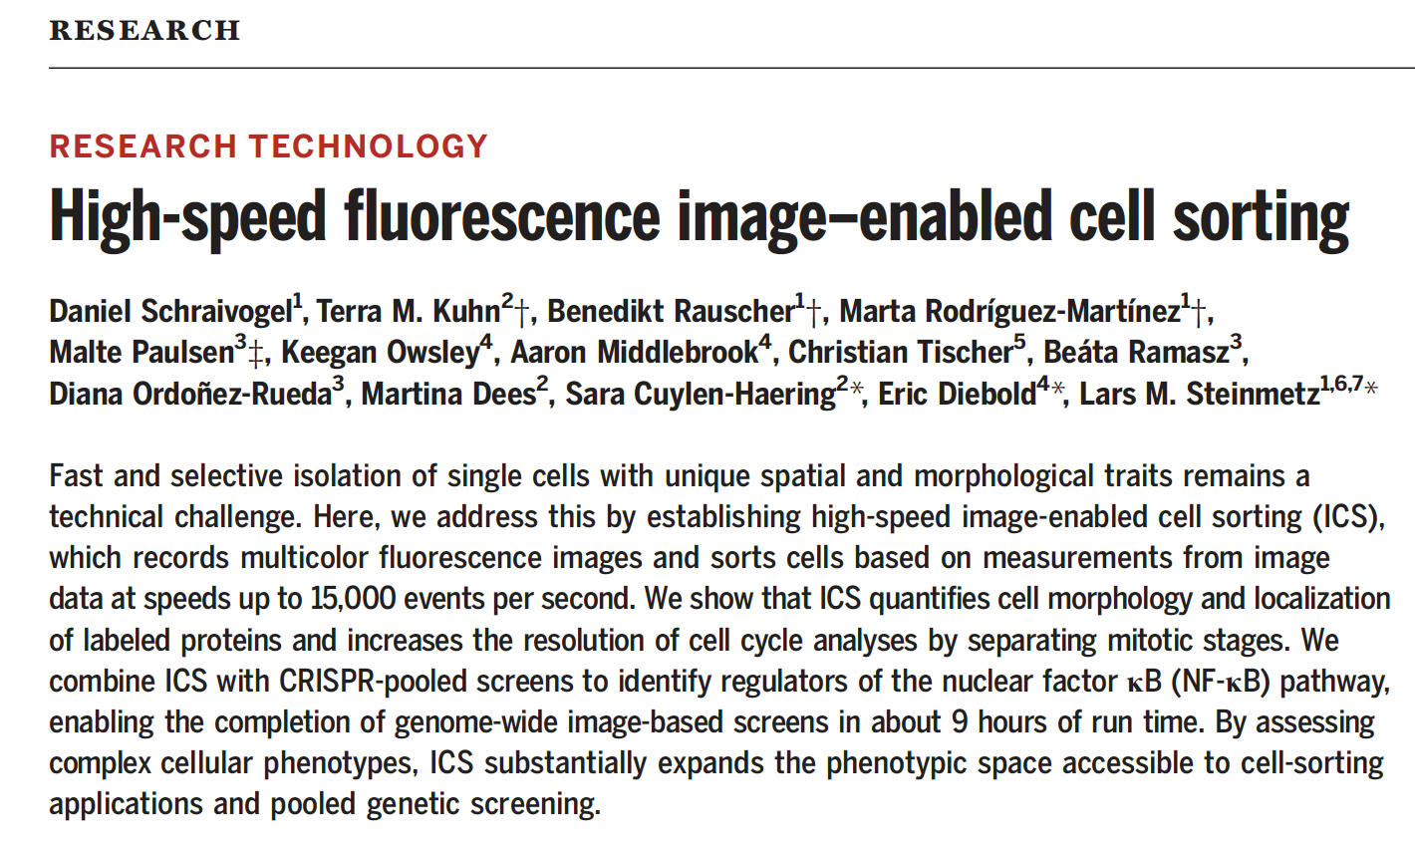
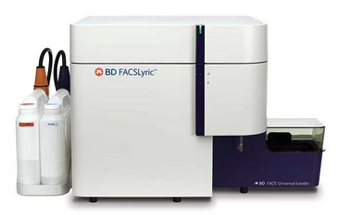
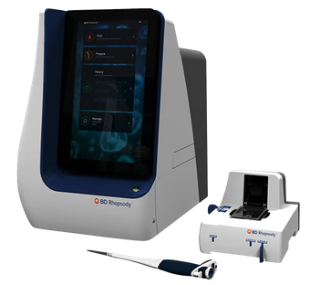
Research Analyzers
Multipmics systems
Rhapsody
Clinical Analyzers
Research Sorters

Slide 5
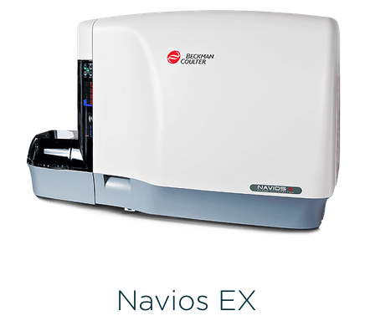
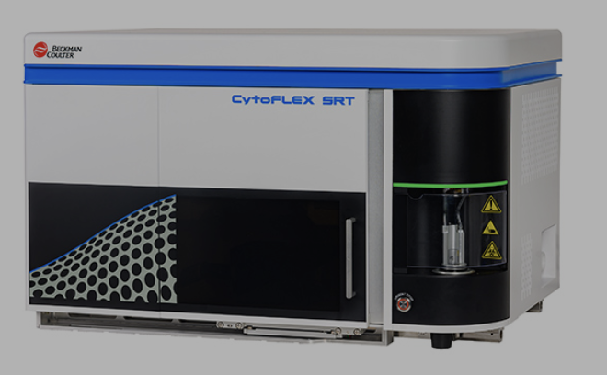
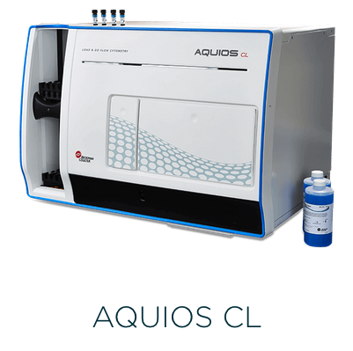
CytoFlex is their primary analysis instrument. The larger sorters are being replaced by the cytoFlex SRT
CytoFlex SRT
Sorter
Large Clinical Market and Antibody/reagent market

Slide 6
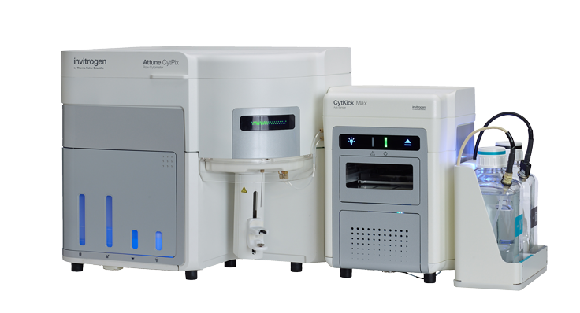
The developed the Attune, then the Attune NXT
The created a sort of imaging Attune CytPix high-speed brightfield camera
high-speed brightfield camera
Evaluation: Does not give users any significant advantage
Locks in Thermo into this platform that cannot survive in the long term
They have separated their spectral sorting group and their ”high technology” flow group – they are going to try to develop a spectral flow cytometer but likely to take 2-3 years and then will only be an instrument similar to current technologies

Slide 7
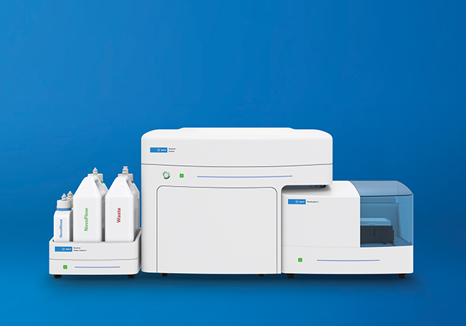
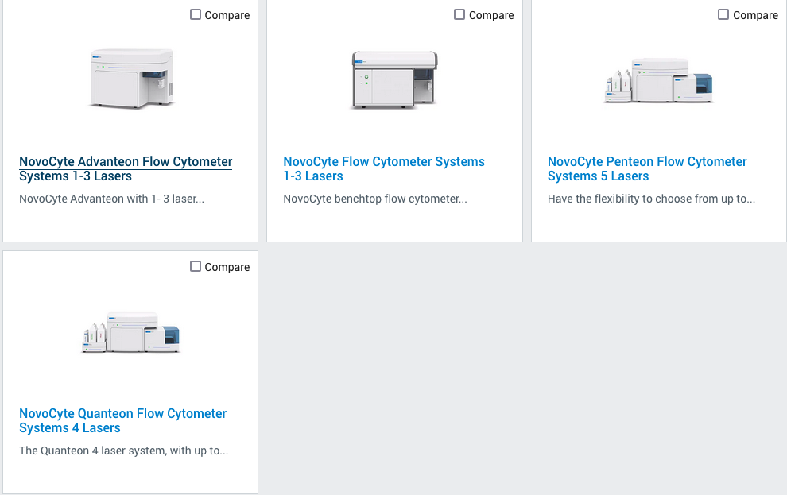
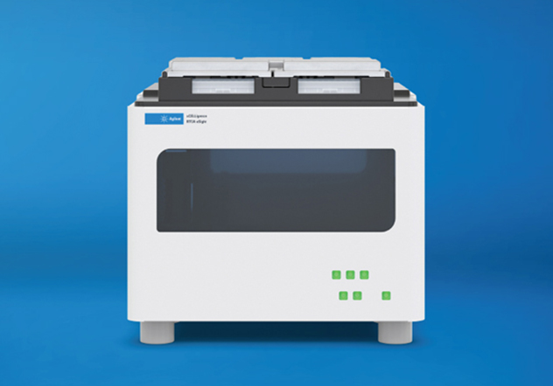
(Acea Instruments)
Agilent xCELLigence Real-Time Cell Analysis

Slide 9
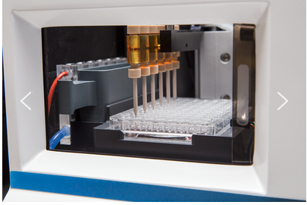

Slide 10
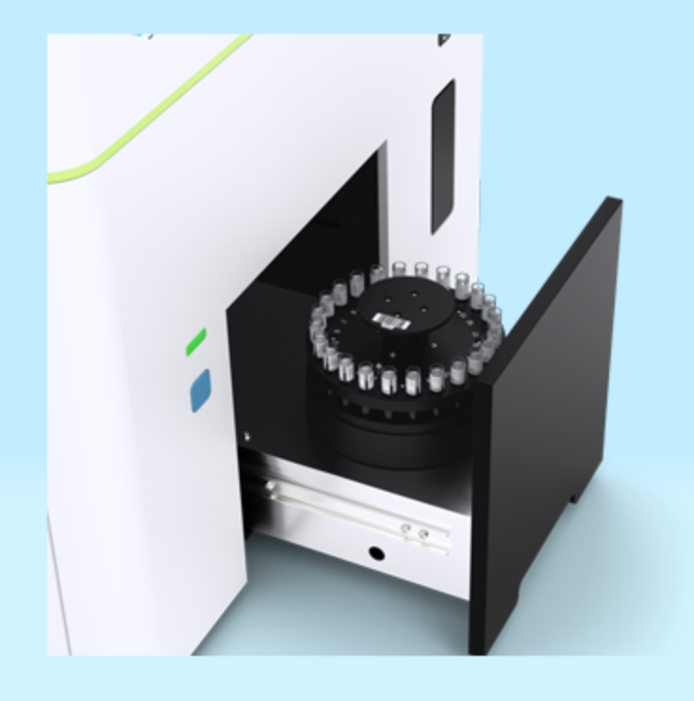
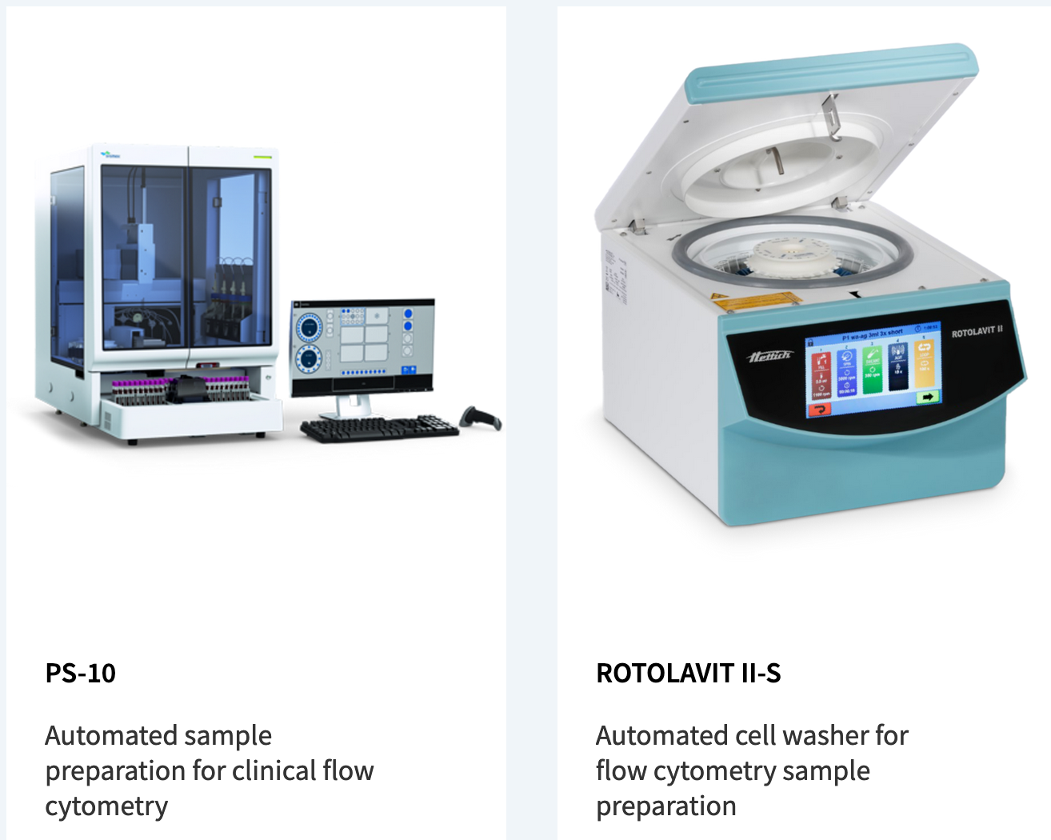
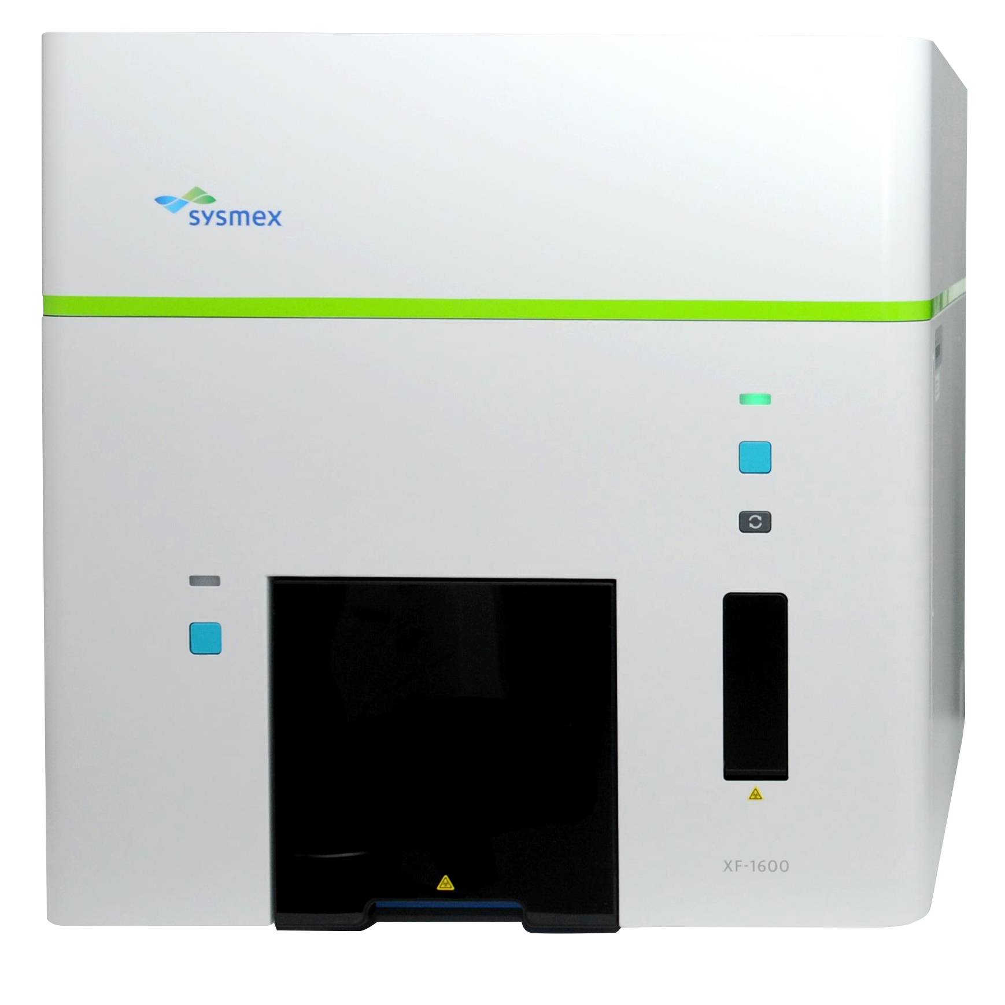
Sysmex America Launches XF-1600™: New Automated Flow Cytometer
25 year old Partec technology
Have developed a new 10 color analyzer
Together with an automation station for sample prep

Slide 11
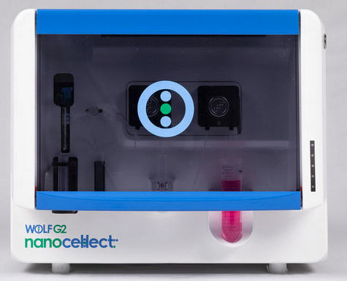
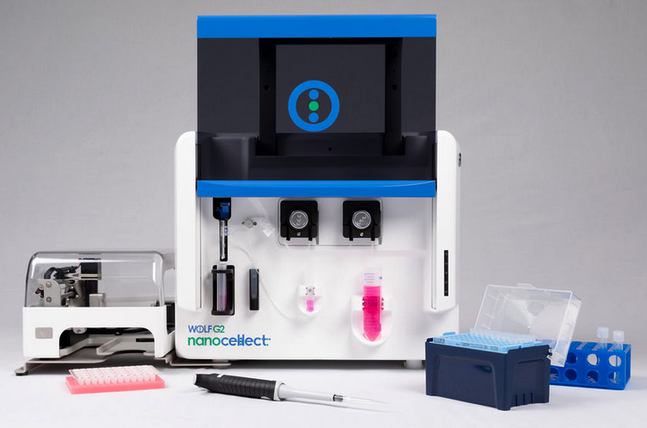
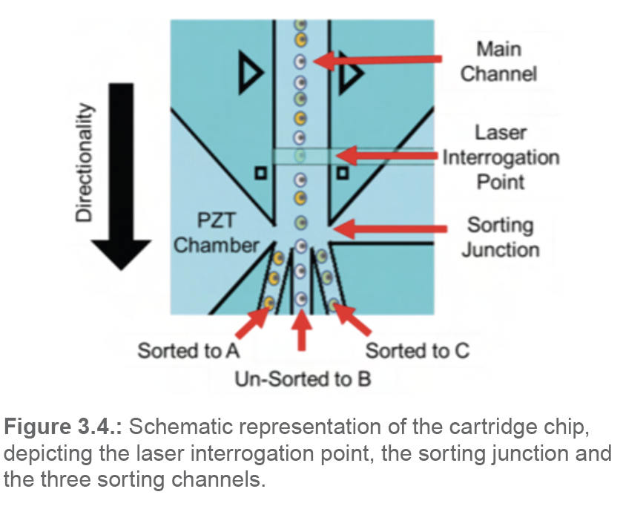
Up to Two Lasers and Nine Colors
disposable microfluidic cartridges.
The new WOLF G2 instrument has significantly expanded the capabilities of gentle benchtop microfluidic cell sorting with two lasers and up to nine colors, while maintaining simple workflows for either bulk sorting or single-cell dispensing. Single-cell sorting can be completed in 96- or 384-well plates when using the WOLF G2 in conjunction with the N1 Single-Cell Dispenser.

Slide 12
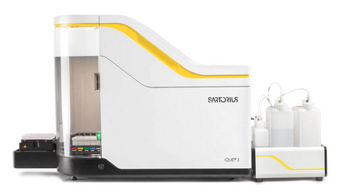
Purchased Intellicyt
Intelicyt moved from Accuri to ACEA cytometers ACEA was sold to Agilent
Incucyte Live-Cell Analysis very competitive market
Market is almost exclusively pharma

Slide 13
Spectral Cytometers
SONY Sony SH8000 and ID7000
Cytek Cytek Northern Lights & Aurora and Aurora CS
Becton Dickinson A5 SE
ThermoFisher Bigfoot

Slide 14
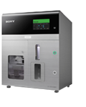
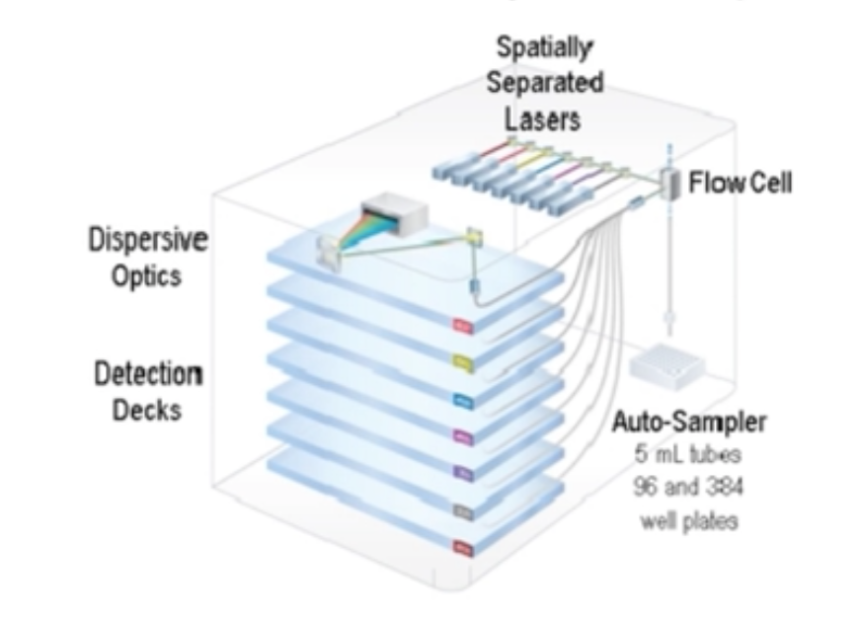
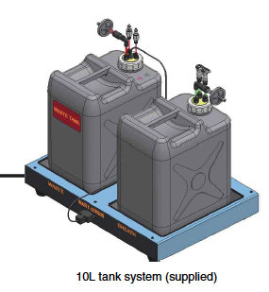
SONY
Main Features: The LE-ID7000 series (hereinafter referred to as the ID7000) is a spectral analysis type cell analyzer. Equipped with up to seven lasers and more than 180 channel photodetectors, it can acquire high-accuracy spectral data from various fluorochromes, and supports multi-color analysis of 44 or more colors. The software supports a spectral reference library that greatly improves the workflow for multicolor experiments, by eliminating complicated single-stain acquisition and fluorescence compensation. The unit also incorporates event rate detection and automatic shutdown functions.
$30k
$28k

Slide 15
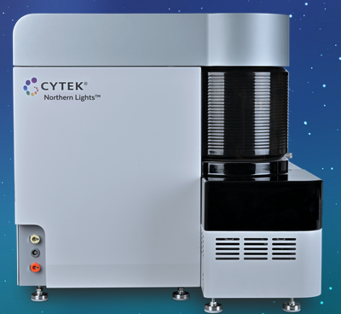
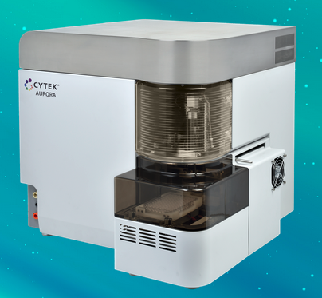
Recently purchased Luminex flow cytometry port folio

Slide 16
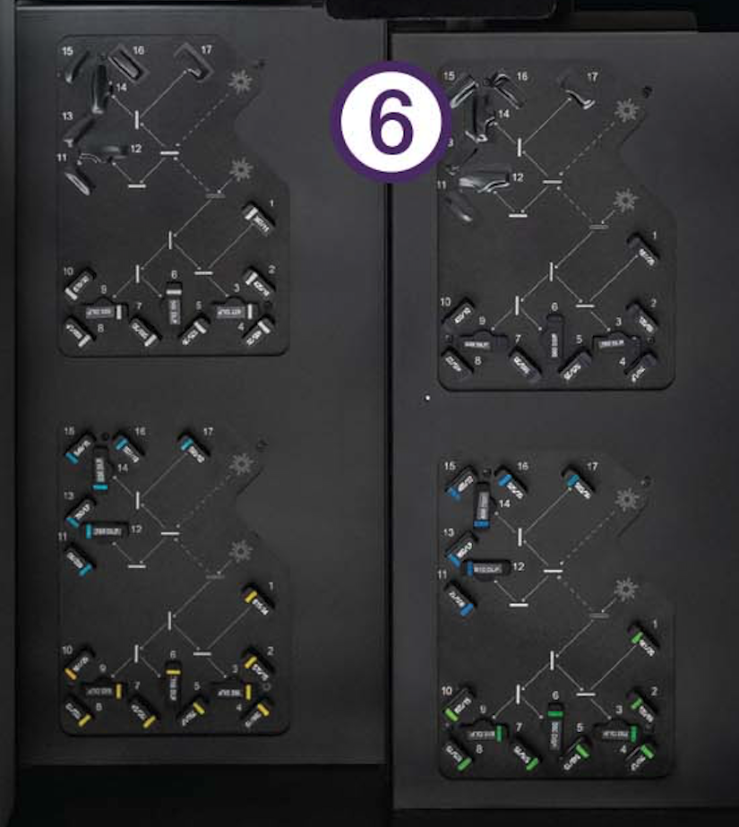
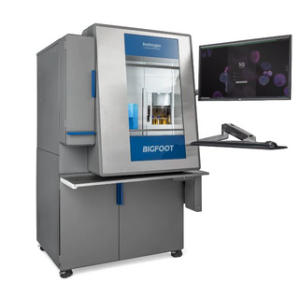
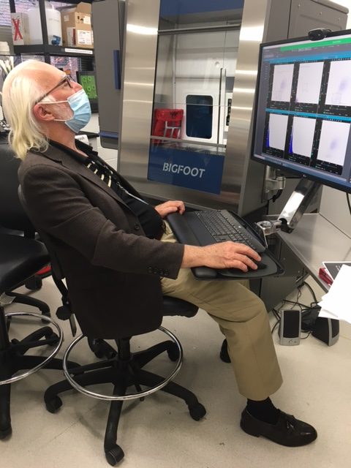
ThermoFisher
Bigfoot – 60 PMT, 9 laser spectral sorter
Lots of filters…..!!

Slide 17
Fluorescent Probe Status
Reagents available
Companies making dyes

Slide 18
Calibration Beads
Types of beads
Companies making beads

Slide 19
Computational Tools
Software packages
Companies Involved

Slide 20
Assay Status
Immunophenotyping
DNA Analysis
Small Particle Analysis
Clinical Diagnostics
Functional Studies
Cytokines Studies
Plant Cytometry
Cell Sorting
Water quality analysis
Cell Cycle & Cell Proliferation
Cell Signaling
Immuno-checkpoint analysis
Invitro toxicity
Apoptosis
Transfection & Cell Viability
Cancer/immuno-oncology
Hematology/Malignancies
Infections and Autoimmunity
Organ Transplantation
Pharmaceutical Applications

Slide 21
Opportunities
Workflow Automation
Cell Therapy
New technologies may open unused approaches

Slide 22
Business Aspects
Market Overview
Patent Space (109 Patents in Flow cytometry space 2019-22)
Market Share of companies

Slide 23
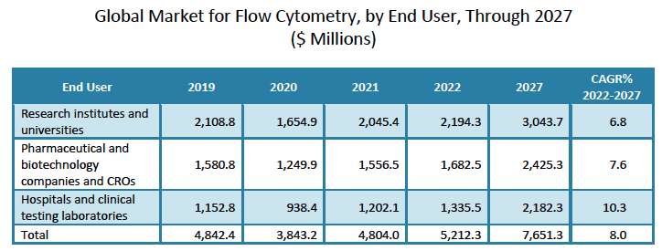

Slide 24
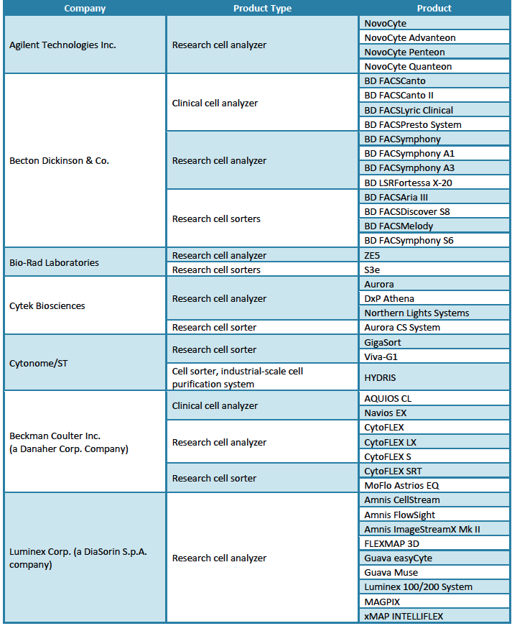
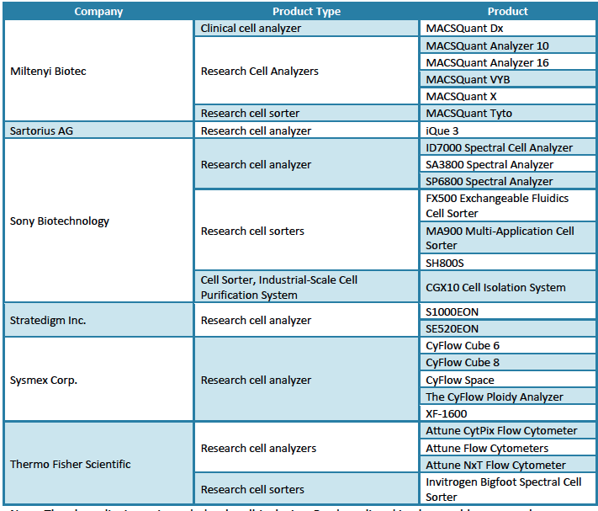

Slide 26
Summary
The field is growing at a good pace
New technologies are likely to emerge over the next 2 years
Polychromatic cytometry will remain for some years, but it will eventually be reduced in impact
Spectral cytometry will become the predominant technology

