Slide 1
Advanced Flow Cytometry
J. Paul Robinson & John Nolan

Slide 2
Mass Cytometry – A Technology Impacting Flow Cytometry
Advanced Short Course
J. Paul Robinson
Distinguished Professor of Cytomics
Professor of Biomedical Engineering
Director, Purdue University Cytometry Laboratories
I wish to thank Dr. Hervé Luche from the
Centre d’Immunophenomique Marseille, France
For providing most of the slides on mass cytometry
Additional slides kindly provided by Standard Bio Tools

Slide 3
Key Links
Purdue List Serve &
Robinson Lab
cyto.purdue.edu
isac-net.org
scintillon.org/nolan_lab
ISAC
Nolan Lab
John P. Nolan - jnolan@scintillon.org
J. Paul Robinson – wombat@purdue.edu

Slide 4

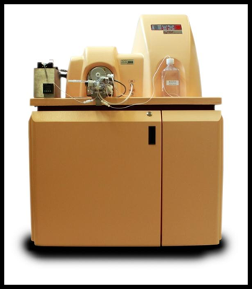
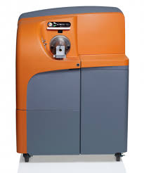
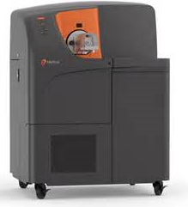
A rapidly evolving suite of instruments
2011
2013
2015
CyTOF1
CyTOF2
Helios

Slide 5
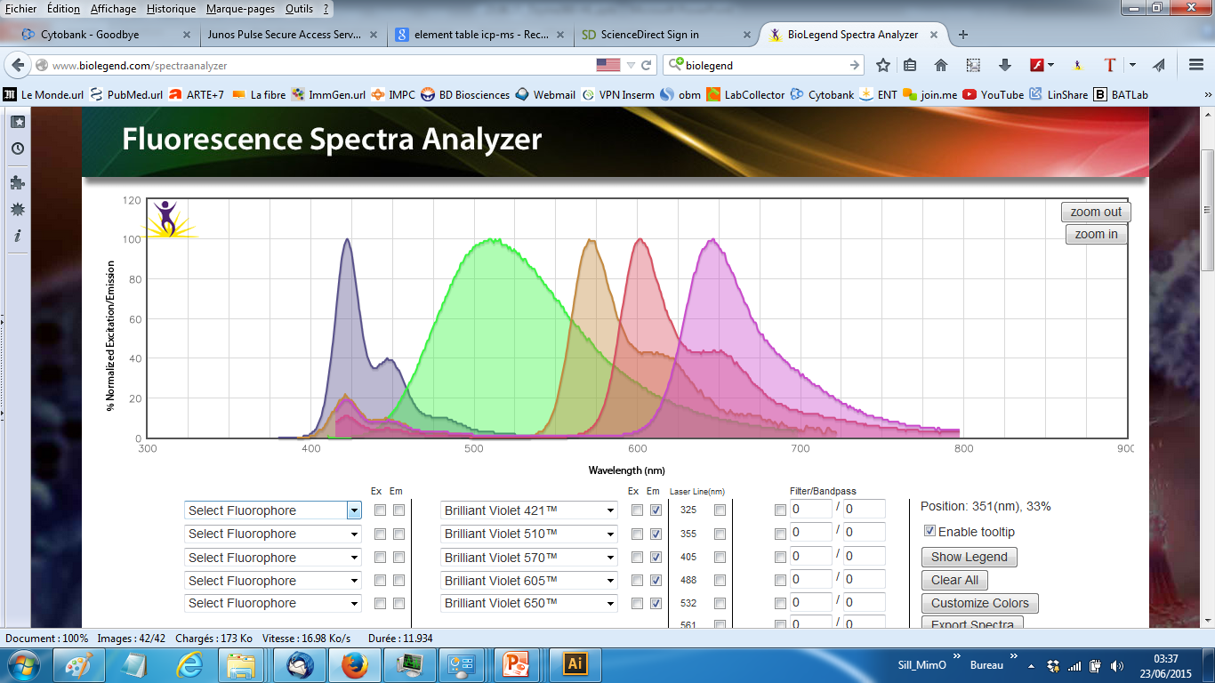
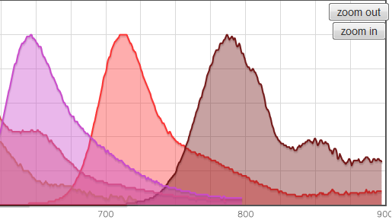
What is the issue with Fluorescence based Flow Cytometry?
Emission spectra
Wave Length (nm)
There are a limited number of bands that we can handle using fluorescence
What are the alternatives?

Slide 6
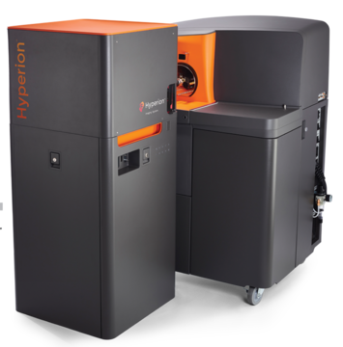
Dual mode use of CyTOF
Maximize your investment by leveraging the power of flow cytometry and imaging capabilities in one system
Convenient switching between tissue imaging and suspension modes offers benefits to translational researchers who need data from multiple sample types
Add in-depth spatial data to their work previously performed using disaggregated tissue samples analyzed by mass or flow cytometry.
Spatial imaging
Flow cytometry
6

Slide 7
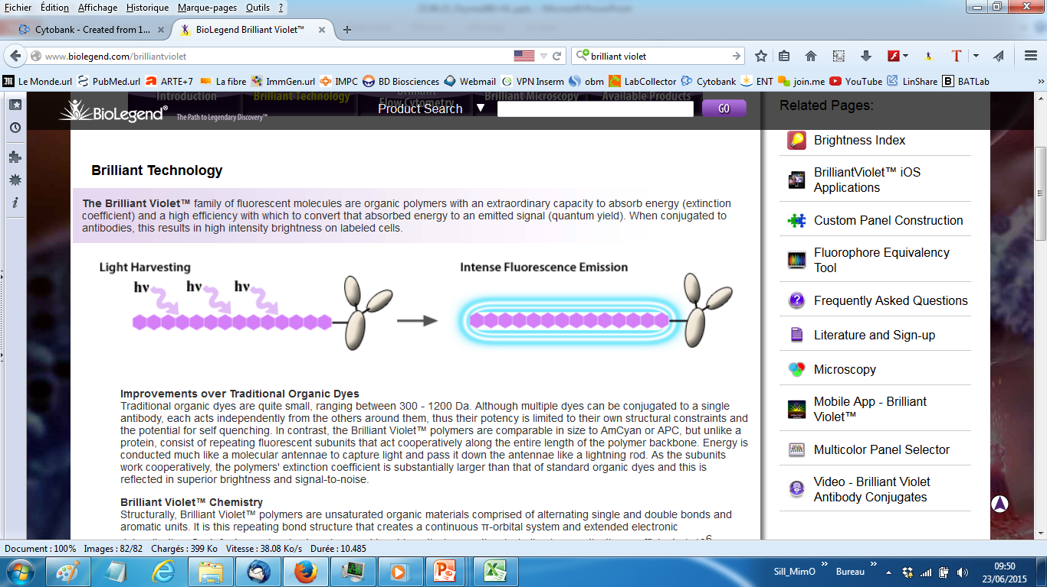
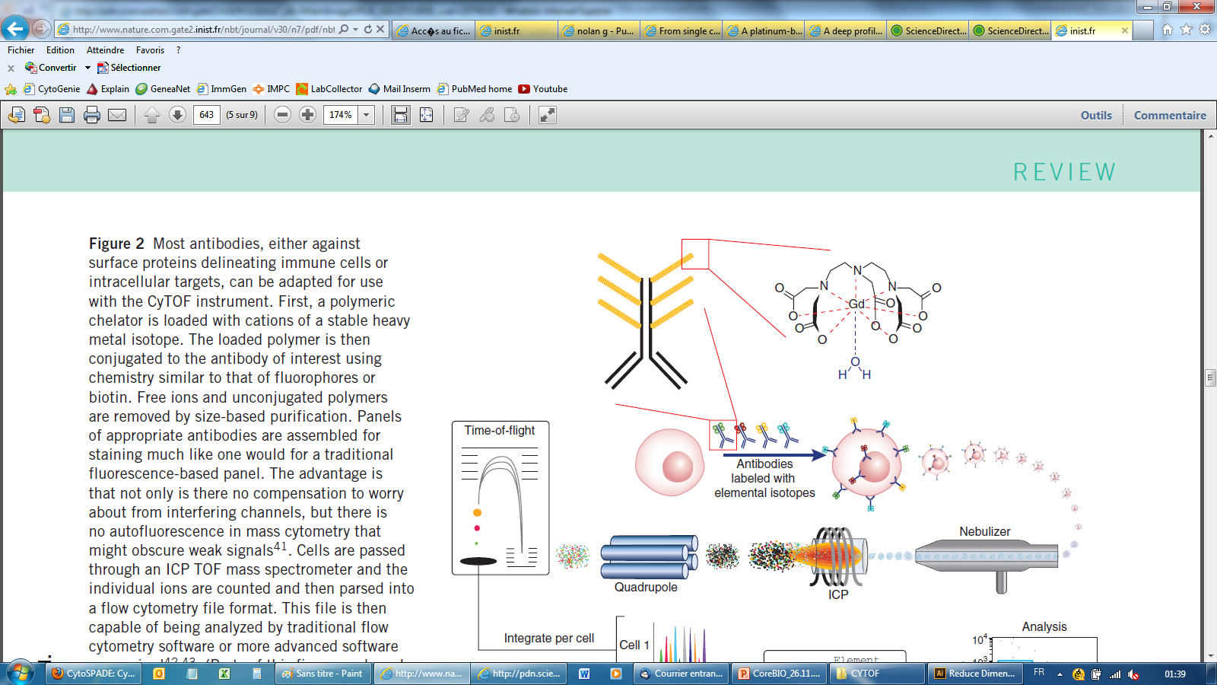
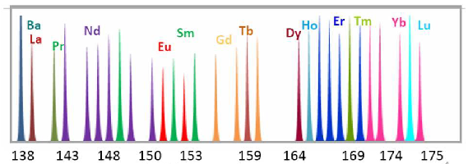
The immuno-technology behind mass cytometry…
Syrigen dye – Antibody
Emission spectra
MaxPAR Antibodies
Wave Length (nm)
4-5 polymer per antibody
16-22 chelating unit per polymer
100-80 atoms coupled per antibody
Isotopic Mass (Da)

Slide 8
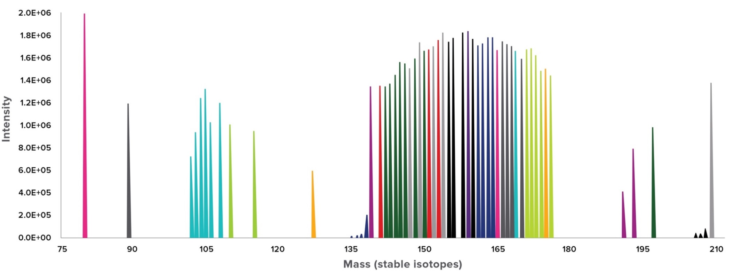
More than 50 isotopes can be simultaneously measured per tube of cell sample with CyTOF reagents.
Metal tags have distinct signals which can be separated with 1 Dalton resolution as well as less variable probe intensities. In addition, nothing analogous to autofluorescence exists when using CyTOF technology since the metals that we use as probes don’t exist naturally in biological systems
Nothing analogous to autofluorescence - Because we use lanthanide metals and other elements not naturally found in cells, there is no measurable background cellular signal.
Slide supplied by Standard BioTools

Slide 9
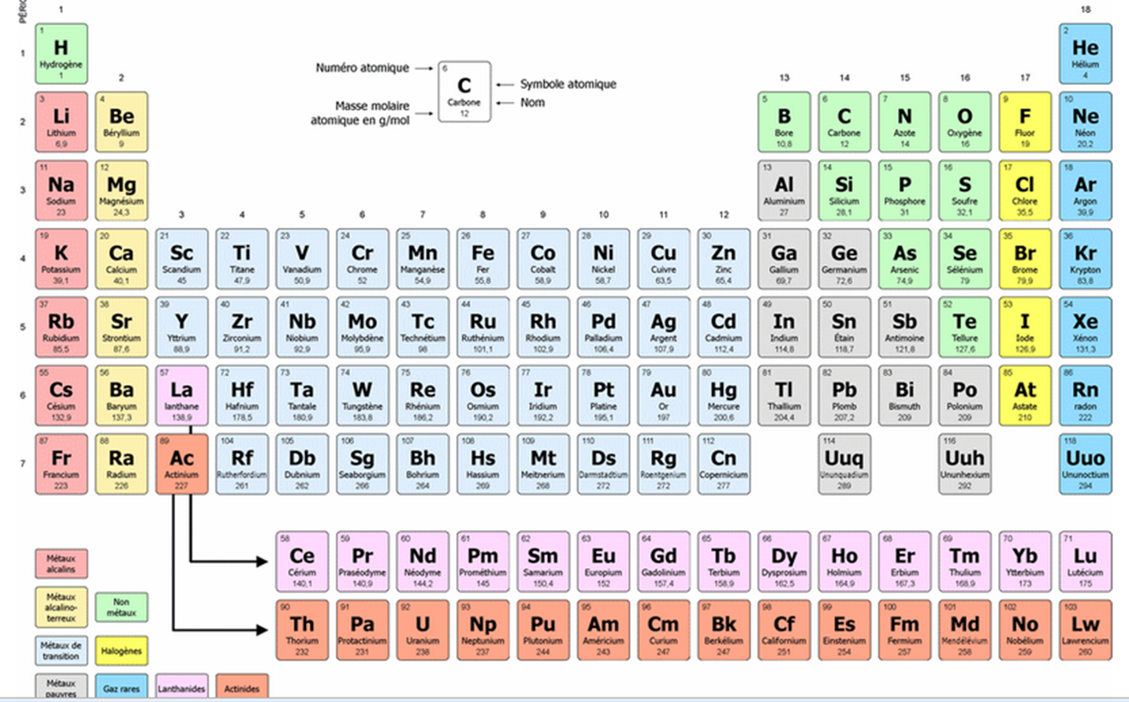
….allied to the analytical power of ICP-MS
Helios
135 channels
45 mAb Tags
6 Dyes
www.editions-petiteelisabeth.fr/tableau_periodique_des_elements_2.php

Slide 10
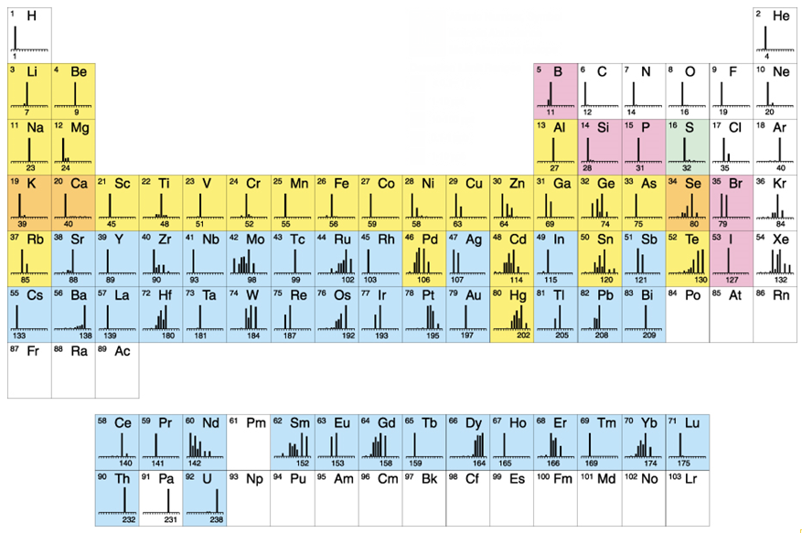
Current isotope tags available directly are highlighted in pink.
Other isotopes that have been reported in the literature are in green.
Slide supplied by Standard BioTools
Notes:
CyTOF uses different elements as tags, versus fluorochromes in flow cytometry. These isotope tags can be attached to probes such as antibodies, intercalators, and other probes to measure a variety of intra- and extracellular moeities.
The periodic table shows each element with lines that represent isotopic forms of that element. Our current isotope tags are highlighted in pink. Other isotopes that have been reported in the literature are in green.
Our isotope tags are primarily from the lanthanide series, also known as the rare earth elements. The primary advantages of using rare-earth metals are they are not found endogenously in biological samples, are readily available, and have similar chemical properties.

Slide 11
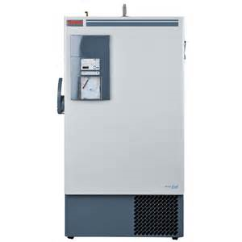
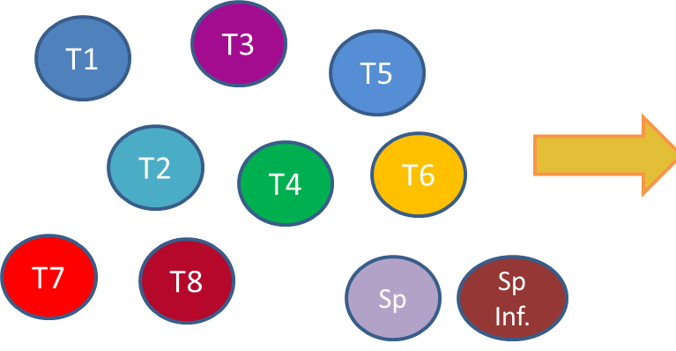
Combined immuno-phenotyping and functional workflow

Slide 12
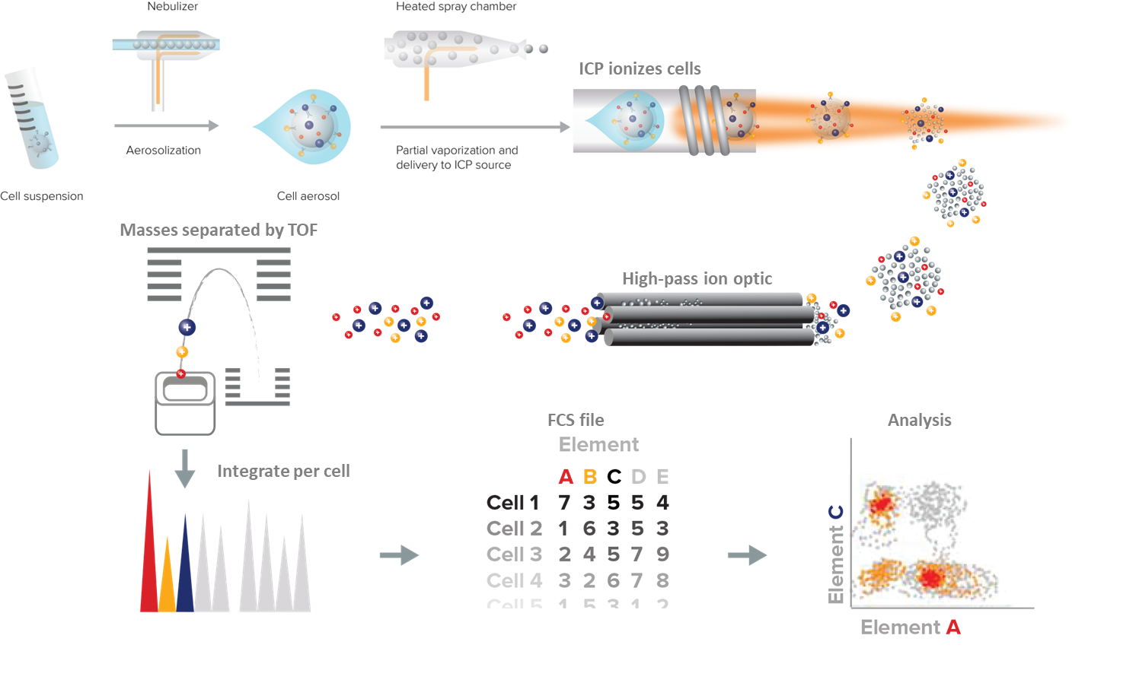
Mass cytometry principle
Slide supplied by Standard BioTools

Slide 13
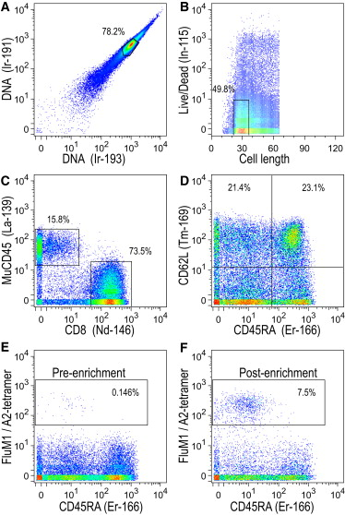
How does the raw data look like ?
Newel, Immunity, 2012

Slide 14
How to immuno-phenotype ?
Variations
Operator
Reagents
Instrument
Data Analysis
NEUTRAL
I
ZE

Slide 15
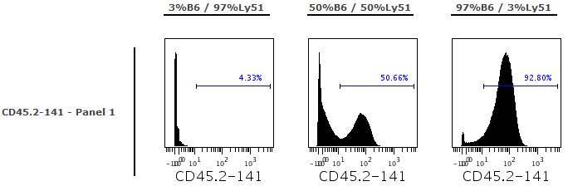
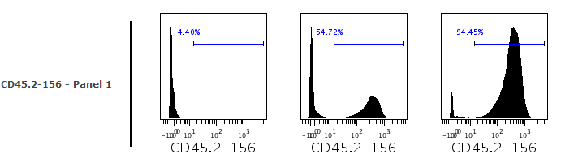
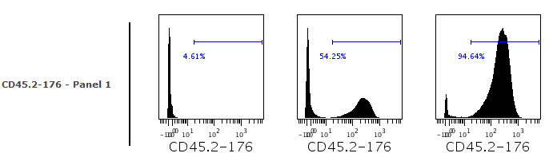
The difference in sensitivity is really minimal
1µg of CD45.2-141Nd
CD45.2-141Nd-2013JL26
61 atoms/mAb
Intensity signal : 63
1µg of CD45.2-156Gd
CD45.2-156Gd-2013SE03
61 atoms/mAb
Intensity signal : 342
1µg of CD45.2-176Yb
CD45.2-176Yb-2013JL05
47 atoms/mAb
Intensity signal : 207
Same trend observed fitting with intrument sensitivity curves but this has no impact on the frequencies observed. Even in the worst combination, we can accurately measure the cell frequency of each genotype
Experiment: 13-SE19-TEST-MMK

Slide 16
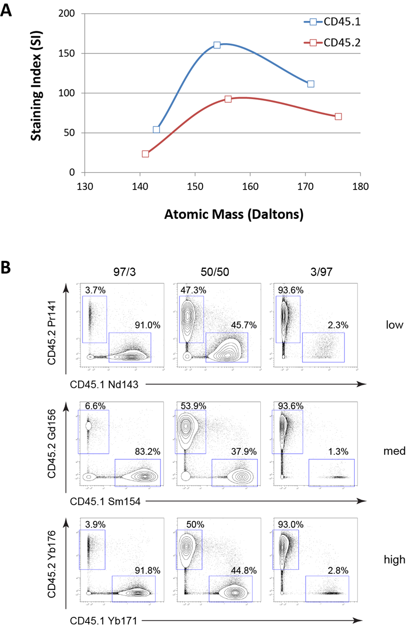
Implication for panel design
All metals are not equals in terms of sensitivity
As for other cytometry method, panel design is required
Tricot et al., Cytometry A (2015)

Slide 17
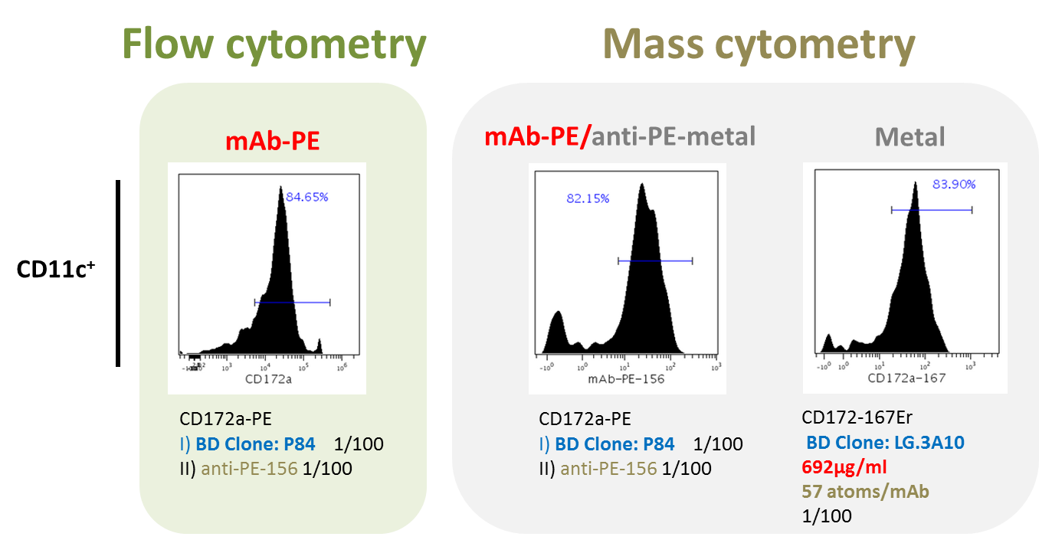
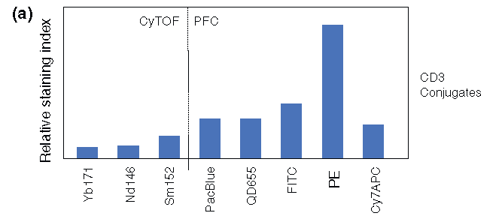
Systematic validation method for new antibodies/metal conjugates
    Staining intensity
The stain index in mass cytometry is less than conventional fluorescent dyes

Slide 18
Main types of contamination in mass cytometry
¹⁴⁵Nd
Impurities (-1)
Abondance (+1)
Oxydes (+16)
¹⁴⁶Nd
Signal Cross-talks are due to:
Isotopic impurities of metals (+ and/or – several Da)
Abundance sensitivity (+ and/or – 1 Da)
Oxidation (+16 Da) of reporter ions during the acquisition
Takahashi, Cytometry Part. A, Cytometry A. 2016 Sep 15

Slide 19
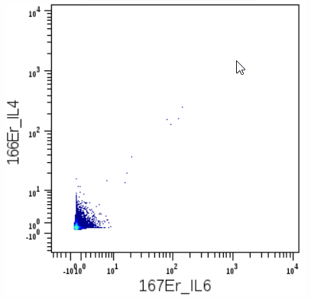
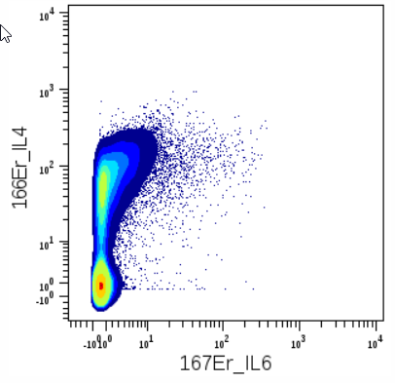
Cold case: impurity issue
Lat^{Y136F} CD4 Tc
Unstimulated
Stimulated

Slide 20
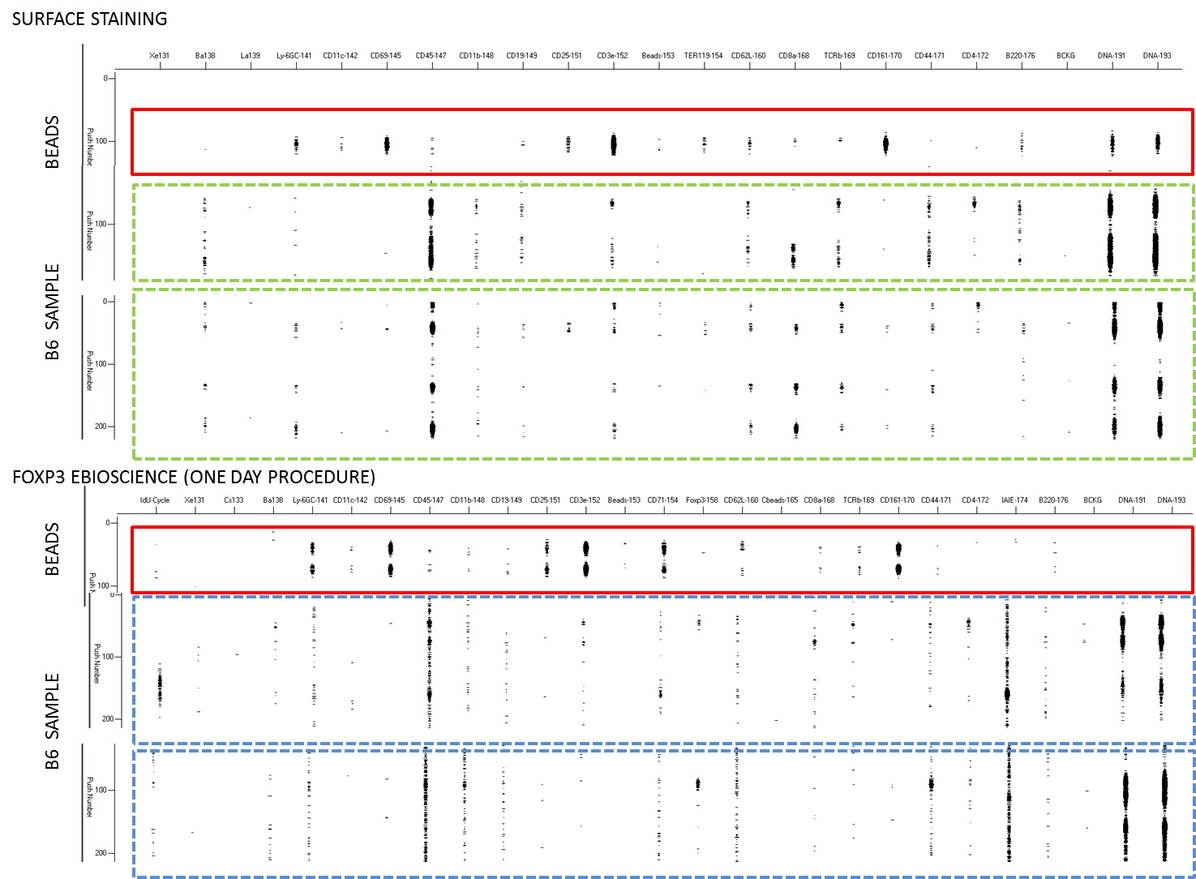
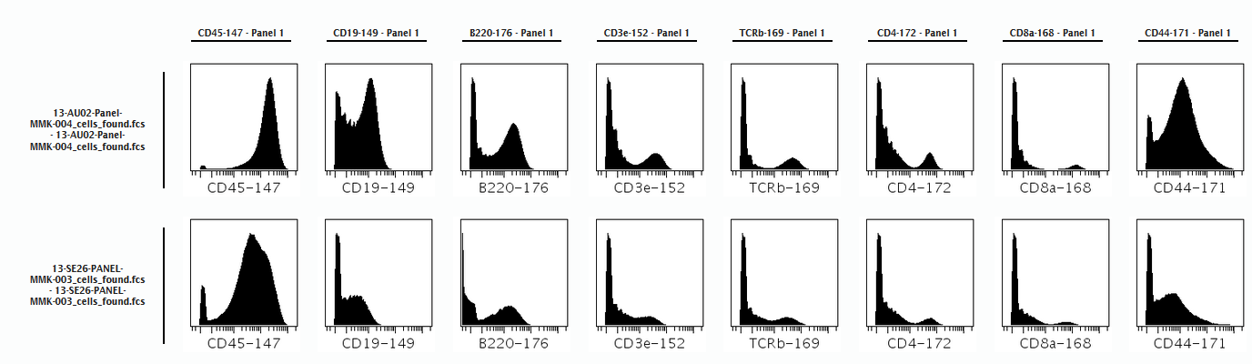
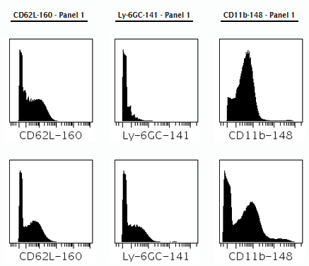
Sample preparation is key: Effect of inappropriate initial fixation
for intranuclear staining

Slide 21
Molecules below 100 molecules/cell cannot be identified due to ion detection efficiency (1 in 10.000 ion)
30% (CyTOF1) to 60% (Helios) of the cells injected are actually acquired by the system
All metals are not equals (2-3 X difference between chanels). This difference in sensitivity is not in the same range than flow (40-50 X)
Dynamic range of measurement is smaller than by fluoresence flow cytometry
No spectral overlaps but cross-talks and impurities that can spoil your measured signals
Carefully design marker/metal pair
Carefully choose conjugates combinations for a meaningful analysis
Hudge responsability in the field of mass cytometry to seriously consider this step :
  unprecedented combinations of cellular marker investigated: QC ?
  Unravel heterogeneity that is real not artefactual

Slide 22
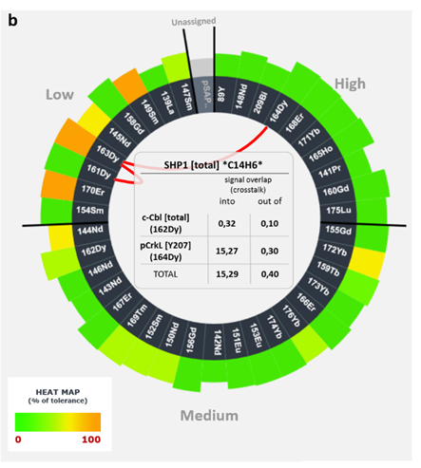
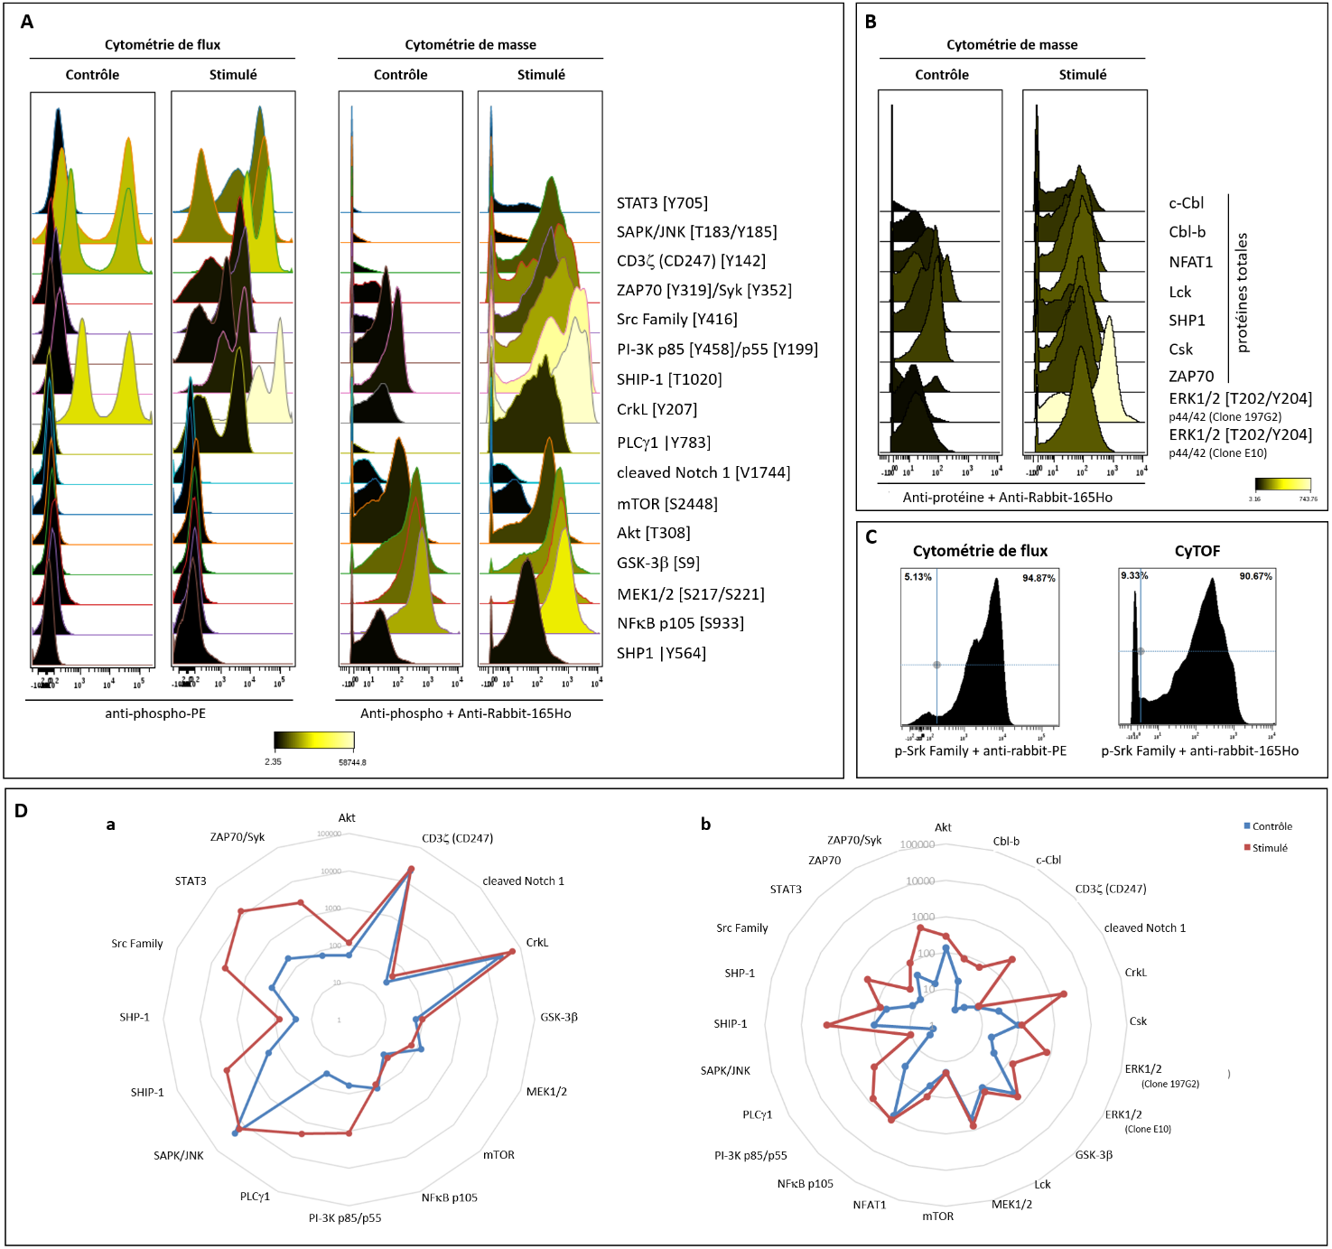
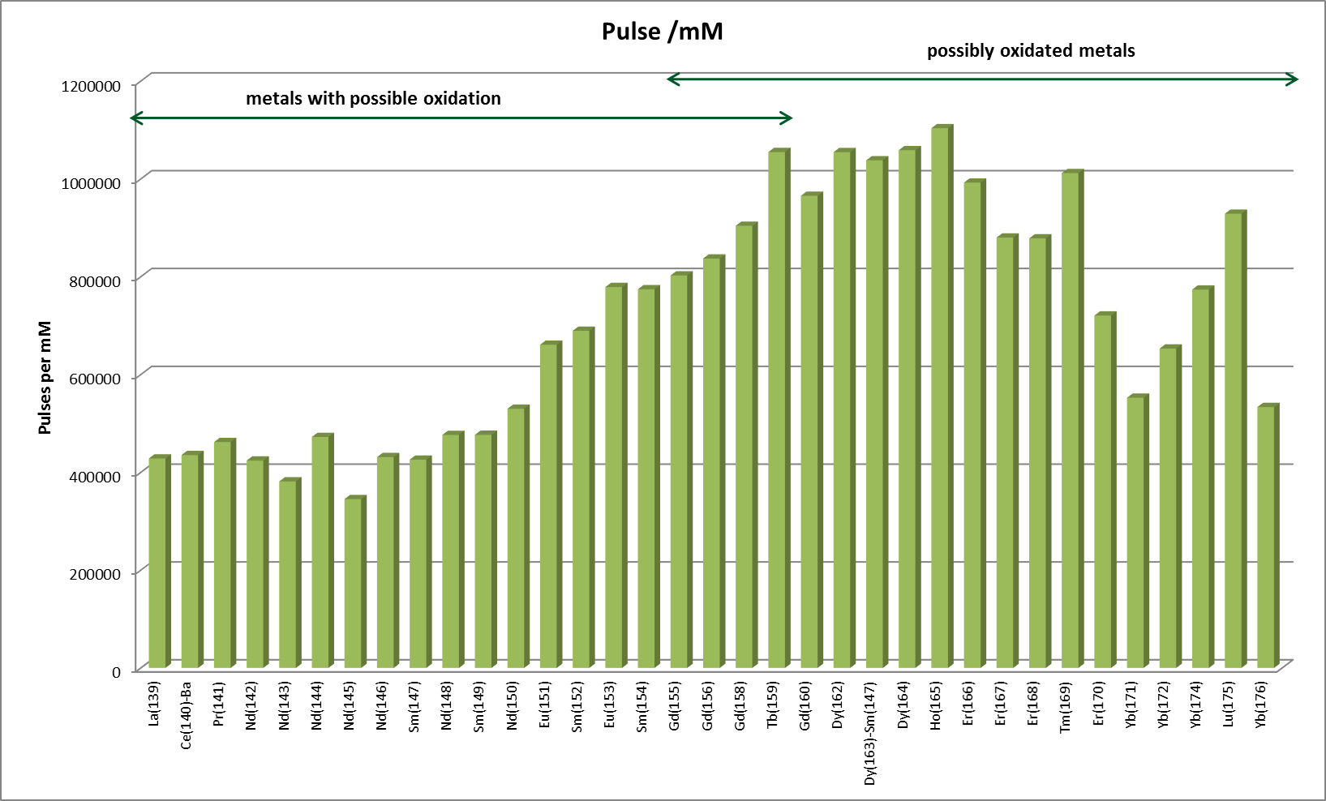
Strategy for careful panel design
Basal
Stimulated
Validate all you protocols by conventional flow
Establish ranking of marker you want to adress in one chanel
Use your mass response curve as a normaliser to predict signal intensity in a given chanel
Use Panel designer tool to minimize crosstalks

Slide 23
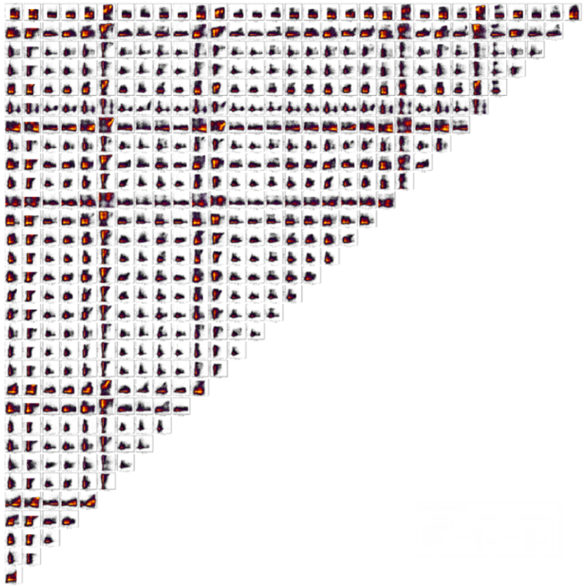


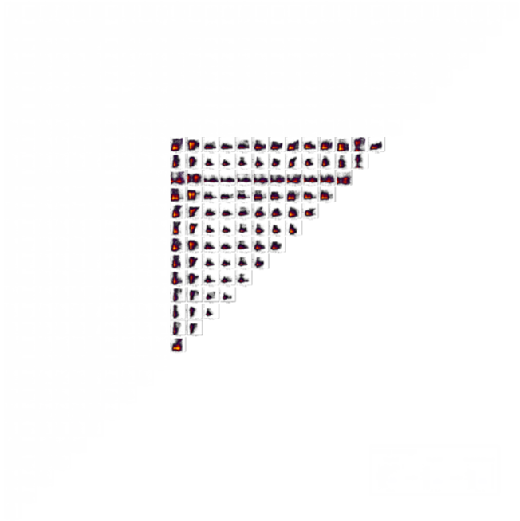
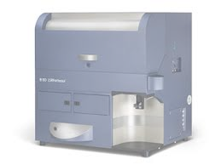
How to apprehend the multi-parametric headache
1983
Parameters:0004
Plots:0006
2011
Parameters:0032
Plots:0496
2016
Parameters: 40
Plots: >600
2000-2010
Parameters:0014
Plots:0091
1989
Parameters:0008
Plots:0028

Slide 24
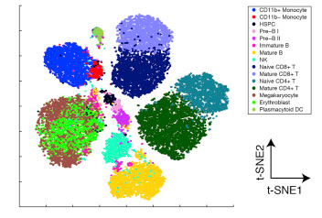
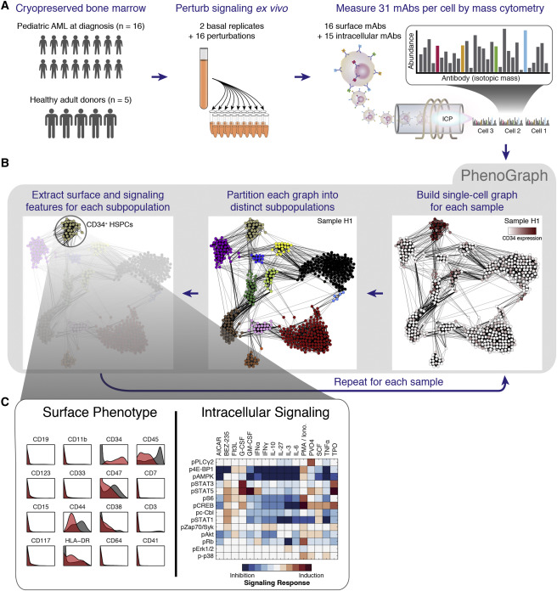
Unsupervised analysis methods to handle this amount of data
FlowSOM
ViSNE
OneSense
Van Gassen, Cytometry, 2015
Cheng, JI, 2015
Levine, Cell, 2015

Slide 25

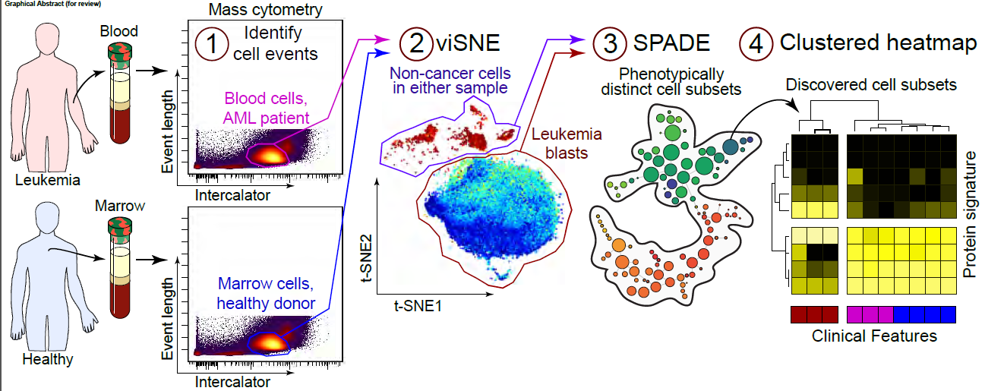
Concept of analysis pipelines
Diggins, Methods, 2015

Slide 26
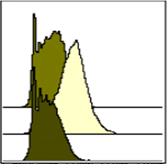
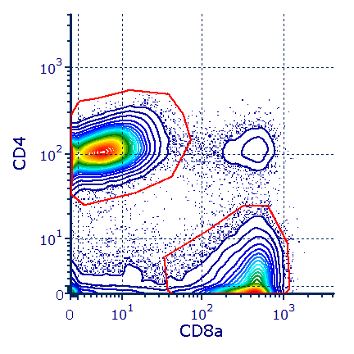
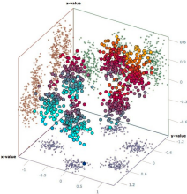
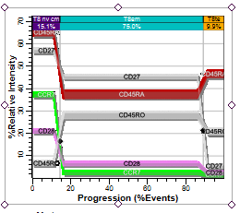
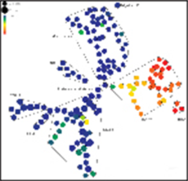
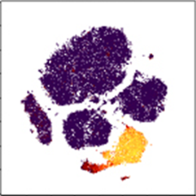
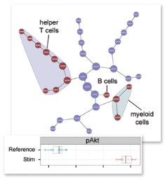
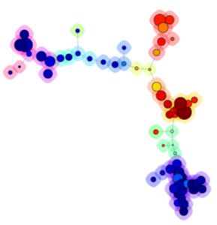

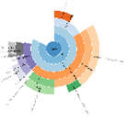
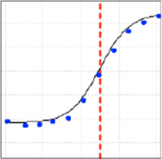
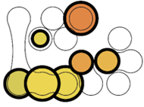
Analyze
Multidimensional tools
Raw data plots
Histogram
Biaxial plot
3D plot
Dimensionality reduction algorithms
Probability
state modeling
SPADE
viSNE
Citrus
FlowSOM
Statistics
Box plot
Heat map
Network
Sunburst
Dose curve
26
Slide supplied by Standard BioTools

Slide 27
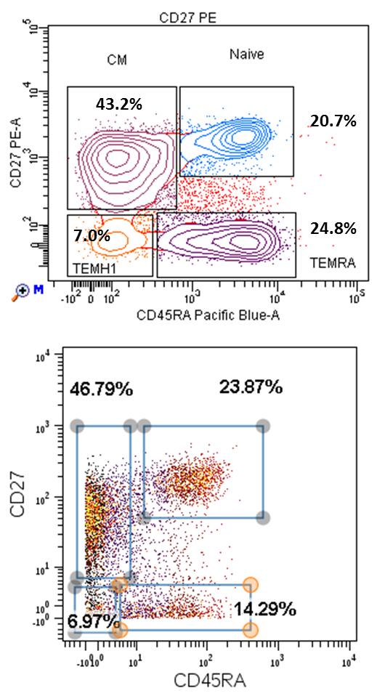
Mass/flow correlation for CD8 Tc sub-populations
CD8+ L-T
Mass
Flow

Slide 28
How to setup a CyTOF experiment ?
Configure your instrument (laser power, BP/LP/ND filters)
Characterize your instrument (CSTs and QCs)
Design your panel accordingly
Optimize settings for your assay (2,5 SDEN, Lin Max)
Run appropriate controls (Comp Beads, FMOs for continuums)
QC your data (Dead cells, Doublets, Clogs, Mis-annotations) !
Use adapted analysis tools
Configure your instrument (QC, Mass Range, Dual Calibration)
Characterize your instrument (Sensitivity across Mass range)
Optimize settings for your assay (Nebular Flow for Oxydation)
Design your panel accordingly
Run appropriate controls (Eu/eQ/Comp Beads, Cells + DNA)
QC your data (Dead cells, Ion Cloud Fusion, Doublets)
Use adapted analysis tools (Cytobank + SPADE, VisNE)

Slide 29

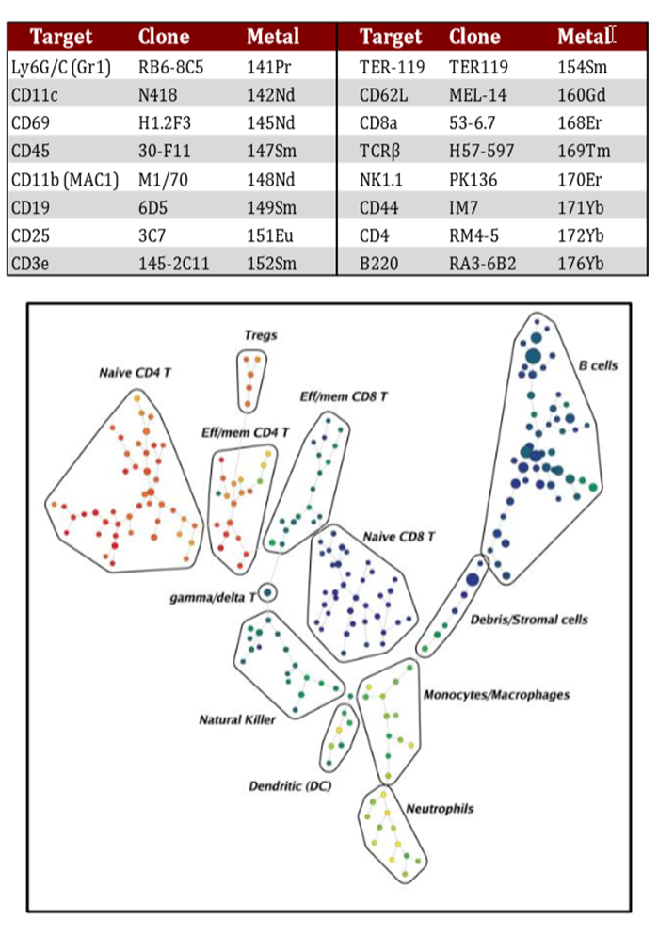
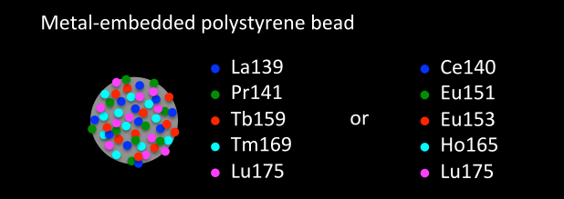

Available tools to help in mass cytometry
Normalisation Beads
Panel Kits
Panel Designer tool

Slide 30

Proliferation assay made simple:
IdU incorporation and detection on CyTOF
hCD45⁺ JURKAT cells
Incubation time
1%
35%
46%
55.7%
IdU detection is easier than BrdU assay by conventional flow

Slide 31


Classical gating method is not appropriate
Splenocytes
Activated Tc
« Singlets » gate
Proliferating cells
Splenocytes
« Proliferation » gate
65
Loss of proliferating cells

Slide 32



Sample multiplexing via Barcoding
Cells are encoded with combinations of various dyes
Each combination is unique and refers to a given well
All wells can later be combined for simultaneous staining and acquisition
Barcode 1
Barcode 2
CD45 (30F11)
Barcode 3
CD45.2 (104)
Thymus/Spleen/LN

Slide 33

Sample Barcoding for multiplexed analysis
Minimize experimental variations
Decrease experimental artefacts
Decrease cell loss
Reduce time at washing steps
Allow simultaneous analysis
Improved data comparison

Slide 34



Acquisition and standardized analysis
Same panel used on all samples at once
Antibody staining done one the same day for all samples
Same analysis strategy can be used
CD8
CD4
MHCII
Ly6G/C
All frequencies are determined on similar VISNE plot for all mutants

Slide 35

How does SPADE work ?
(Spanning-tree Progression Analysis of Density-normalized Events)
Qiu, Nat. Biotech, 2011, “Extracting a cellular hierarchy from high-dimensional cytometry data with SPADE”
SPADE (Spanning-tree Progression Analysis of Density-normalized Events) is a way to automatically identify populations in multidimensional flow cytometry data files.

Slide 36




Unsupervised analysis and visualization using SPADE trees
CD3
CD4
CTRL
MUT
CTRL
MUT

Slide 37


Cytokine and Transcription factor detection in dLN and tumor infiltrating leukocytes
IL17A
TNFα
IL2
IL4
IFNγ
CD4+ TILs
IL2
CD4 Tc
CD8 Tc

Slide 38


Comparison of cell frequencies by CyTOF and fluorescence
Conventional flow cytometry
CyTOF
.
12.5%
14.3%
18.4%
17.7%
21.9%
37.4%
26.1%
39.8%
18.5%
2.7%
18.4%
0.6%
14%
1.3%
19.9%
2.0%
Bendall, Simonds et al. Science 332 (2011): 687–96
Slide supplied by Standard BioTools
38

Slide 39

Impact of sample freezing and storage on assay results
1
2
3
Stain
and process PBMC or whole blood samples in ready-to-use assay tube.
Acquire
data with customized acquisition template on the Helios™ mass cytometer.
Report
population frequencies, QC metrics and data plot displays with Maxpar® Pathsetter™.
Goal: Evaluate the impact of freezing whole blood stained with the Maxpar® Direct™ Immune Profiling Assay™ on population frequency analysis, using Maxpar Pathsetter.
Design: Stained 2 whole blood donors with the assay in quadruplicate for immediate acquisition and for 4 time points after freezing
Slide supplied by Standard BioTools
39

Slide 40












Freezing sample study design
All samples stained in assay tubes on Day 0
Donor 1 Donor 2
Standard workflow
Acquire fresh samples as a baseline control.
4ºC overnight
Maxpar Pathsetter report: Population Frequencies
Frozen at –80$o$C
Day 7
Storage condition:
Pelleted in 100 µL Fix and Perm Buffer plus iridium
Day 21
Day 28
Day 60
Slide supplied by Standard BioTools
40

Slide 41
Population frequencies of fresh and frozen samples
Frequencies are consistent across samples frozen for up to 2 months when compared to freshly acquired samples.
41
Slide supplied by Standard BioTools
41

Slide 42
Population frequencies of fresh and frozen samples
Frequencies are consistent across samples frozen for up to 2 months when compared to freshly acquired samples.
42
Slide supplied by Standard BioTools
42

Slide 43
30 panel premade markers
Pre-made Panels
MDIPA Expansion Panels
  Maxpar® Direct™ Immune Profiling Assay™, 30 Marker—25 Tests
  Maxpar® Direct™ Myeloid and B cell Expansion Panel 1
  Maxpar® Direct™ Myeloid and B-cell Expansion Panel 2
  Maxpar® Direct™ NK Cell Expansion Panel 1
  Maxpar® Direct™ T-cell Expansion Panel 1
  Maxpar® Direct™ T-cell Expansion Panel 2
  Maxpar® Direct™ T-cell Expansion Panel 3
  Maxpar® Direct™ Basic Activation Expansion Panel
  Maxpar® Direct™ T Cell Activation Expansion Panel
Cell type and application panels
  Maxpar® Human ES/iPS Phenotyping Panel Kit—25 Tests
  Maxpar® Human Treg Phenotyping Panel Kit, 13 Markers
  Maxpar® Human B-Cell Phenotyping Panel Kit, 12 Marker— 25 Tests
  Maxpar® Human PB Basic II Phenotyping Panel Kit, 7 Marker—25 Tests
  Maxpar® Human T Cell Immuno-oncology EX Panel Kit, 8 marker-25 Tests
  Maxpar® Basic Human T Cell Immuno-oncology Panel Set-25 Tests
  Maxpar® Complete Human T Cell Immuno-oncology Panel Set-25 Tests
  Maxpar® Human PB Basic Phenotyping Panel Kit, 7 Marker—25 Tests
  Maxpar® Human PB Phenotyping Panel Kit, 17 Marker—25 Tests
  Maxpar® Human T-Cell Phenotyping Panel Kit, 16 Marker—25 Tests
  Maxpar® Human T-Cell Phenotyping EX Panel Kit, 10 Marker—25 Tests
  Maxpar® Human Intracellular Cytokine I Panel Kit, 11 Marker—25 Tests
  Maxpar® Signaling I Panel Kit, 7 Marker—25 Tests
  Maxpar® Human HSPC PhenoEXPanel Kit, 7 Marker— 25 Tests
  Maxpar® Human Helper T Cell Phenotyping Panel Kit, 15 marker - 25 Tests
  Maxpar® Human AML Phenotyping Panel Kit, 15 Marker—25 Tests
  Maxpar® Human Mono/Macro Phenotyping Panel Kit, 15 Marker—25 Tests
  Maxpar® Cell Cycle Panel Kit, 5 Marker—25 Tests
  Maxpar® Mouse Sp/LN Basic Phenotyping Panel Kit, 6 Marker—25 Tests
  Maxpar® Mouse Sp/LN Phenotyping Panel Kit, 16 Marker—25 Tests
  Maxpar® Mouse Intracellular Cytokine I Panel Kit, 8 Marker—25 Tests
  Maxpar® Signaling I Panel Kit, 7 Marker—25 Tests
  Maxpar® Cell Cycle Panel Kit, 5 Marker—25 Tests

Slide 44
55 markers
Deep immune phenotyping reveals similarities between aging, Down syndrome, and autoimmunity
Science Translational Medicine Lambert, K. https://pubmed.ncbi.nlm.nih.gov/35020411/
Panel size: 55
NASH limits anti-tumour surveillance in immunotherapy-treated HCC
Nature Pfister, D. https://www.nature.com/articles/s41586-021-03362-0
Panel size : 55

Slide 45









EFFICIENT, AUTOMATED WORKFLOW
1. System set up
2. Sample introduction
3. ROI Selection
4. Automated acquisition of ROI”s and generation of images
5 Cell segmentation
6. High-plex analysis
How Imaging Mass Cytometry works
Each individual ROI dataset is ready for analysis immediately after acquisition
Precise laser beam focuses on 1 μm² spots in the selected region and plumes of material are generated. Plumes are ionized and passed for CyTOF time-of-flight analysis.
Compact datasets (approx. 150 MB for 1 mm² ROI with 37 markers)
can be extracted as .TIFF files compatible with a series of downstream providers
Notes:
This graphic helps explain how the imaging step in the Hyperion Imaging System works.The use of the system is incredibly easy, it’s not even a microscope. You just switch on the machine, place the slide, then select on the slide all the different regions of interest or TMA’s that you want to acquire.
Once this is done, the system will automatically acquire these regions of interest for you. The way this works is a precise laser directs 1 square-micron pulse to collect biological tissue samples that contain the metal-tagged antibodies. The metal tags are ionized, resulting in separate and distinct signals that are sent for detection by time-of-flight technology, the basis of CyTOF mass cytometers. Once the metal tags are detected, the coordinates from each signal are used to produce tissue images at single cell resolution with MCD Viewer software. This occurs in a single scan as the slide moves and the laser samples along the selected region.
One thing that is important to note is that the region is immediately ready for cell segmentation and analysis after acquisition, and these data sets are incredibly compact making it easy to mange your data analysis. Now you are ready to view and validate your images and perform segmentation and higher order data analysis.
-----------------------------------------------------------------------------------------------------
If there’s a question about speed: a one-millimeter area will take approximately 52 min to image on the Hyperion+ System. This imaging can be done unattended, important for when larger areas may be imaged overnight.

Slide 46

Cell Segmentation Kit
Verified panels to standardize workflow
  Standardizes cell segmentation for effective assignment of cellular borders, the most critical step in spatial imaging
  Covering all tissue types and disease
  Enables faster interpretation from the vast amount of important data that comes from high-multiplex single-cell imaging approaches.
Standardize
Sample
Insights
Analyze
Expedites analysis from high-plex data
Catena et al. Cytometry Part A (2018)

Slide 47
Verified panels to standardize workflows
Maxpar Human IO Panel Kits
Tumor-Infiltrating Lymphocyte
Panel, 9-plex
Immune Activation Panel
5-plex
        Granzyme B
        Ki-67
        PD-1
        PD-L1
        Nucleic acid stain
Tissue Architecture Panel
6-plex
        aSMA
        Vimentin
        E-cadherin
        Collagen
        Histone H3
        Nucleic acid stain
          CD3
          CD4
          SCD8
          CD20
        FoxP3
        CD68
        CD45RO
        panCK
        Nucleic acid stain
Standardize
Breast cancer
Sample
Insights
Design
Expedites experimental design with verified panels

Slide 48
Dual mode use of CyTOF
Maximize your investment by leveraging the power of flow cytometry and imaging capabilities in one system
Convenient switching between tissue imaging and suspension modes offers benefits to translational researchers who need data from multiple sample types
Add in-depth spatial data to their work previously performed using disaggregated tissue samples analyzed by mass or flow cytometry.
Spatial imaging
Flow cytometry

Slide 49




Streamlined workflow
Efficient
1
2
3
4
Design
Panels using pathologist-verified Maxpar antibodies conjugated to metal tags.
Stain
All in one Stain tissues (FFPE
or frozen) or fixed
cells using familiar
IHC protocols.
Image
Image protein markers
at single-cell resolution
using the Hyperion
Imaging System.
Analyze
Analyze images in
minutes using MCD™
Viewer and easily export
for secondary analysis.
Notes:
From sample to insight
Simplifying workflow
high-multiplex panel design and eliminating the impact of tissue autofluorescence by using highly pure metal tags for which signals are separated by mass instead of by wavelength. Incorporating an easy-to-use immunohistochemistry workflow that simultaneously detects many proteins in a single scan, IMC is ideal for uncovering new insights in health and disease and empowering the development of better diagnostics and more effective therapies.

Slide 50


HOW IMAGING WITH THE HYPERION⁺ IMAGING SYSTEM WORKS
Load the sample into the Hyperion Imaging System.
Precise laser ablation of the region of interest
Laser beam focuses on 1 μm² spots in the selected region.
Collects metal-tagged proteins
Sends for CyTOF analysis
Notes:
After a slide stained with a panel of metal conjugated antibodies is loaded into the instrument, a region of interest to image is selected. Then, a laser with a precise 1 micron beam rasters across the tissue. The stained tissue ablated by the laser is then carried by gas to the mass cytometer. The ablated tissue is ionized in a high energy argon plasma. The resulting ions are routed to the time-of-flight chamber where they are measured by a single detector on the basis of mass. Once the metal tag ions are detected, the signals are mapped back to the coordinates of the spot of ablated tissue. This data are used to produce tissue images at subcellular resolution with MCD Viewer software. This occurs in a single scan as the slide moves, and the laser samples along the selected region. The Hyperion Imaging System can be run unattended.
----------------------------------------------------------------------------------------------------------------------------------------------------------------------------------------------------------------------------------------------------------------------------------------------------------
<<Speaker notes>>If there’s a question about speed: a one millimeter area will take approximately 1 ½ to 2 hours to image. This imaging can be done unattended, important for when larger areas may be imaged overnight. There is also a slide in the appendix regarding speed.

Slide 51







THE HYPERION IMAGING SYSTEM
A truly hands-free workflow
Pathologist
ROI Selection
Operator
Switch on/calibrate IMC and insert slide
Only hands-on step
Principal Scientist (and team)
Reviews the data
Operator
Input experimental parameters
Confirm ROI selection
Start acquisition
Operator/Pathologist
Visualize ROIs acquisition in real time
and change acquisition order
Researcher/Bio-Informatician
Analyzes the data

Slide 57
The Bottom line – There are alternatives to traditional flow cytometry
Mass Cytometry is
Mass Cytometry provides similar results to flow cytometry
It uses the same antibodies, but they are conjugated with heavy metals not fluorescent molecules
The data analysis is more complex than flow cytometry as there are usually more parameters
Flow cytometry has demonstrated an increased number of parameters probably because of mass cytometry
There are advantages of both technologies as there are disadvantages

