Slide 1
Advanced Flow Cytometry
J. Paul Robinson & John Nolan

Slide 2



High Throughput Flow Cytometry
Advanced Short Course
J. Paul Robinson
Distinguished Professor of Cytometry
Professor of Biomedical Engineering
Director, Purdue University Cytometry Laboratories
@Cytometryman

Slide 3
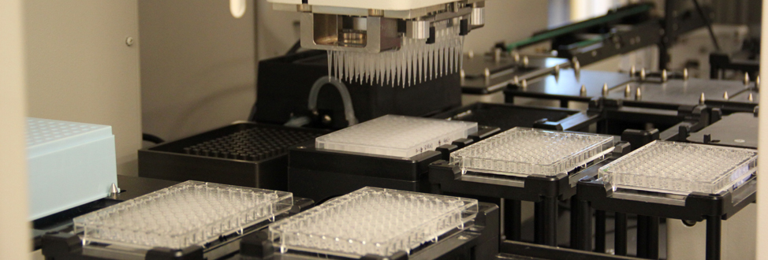
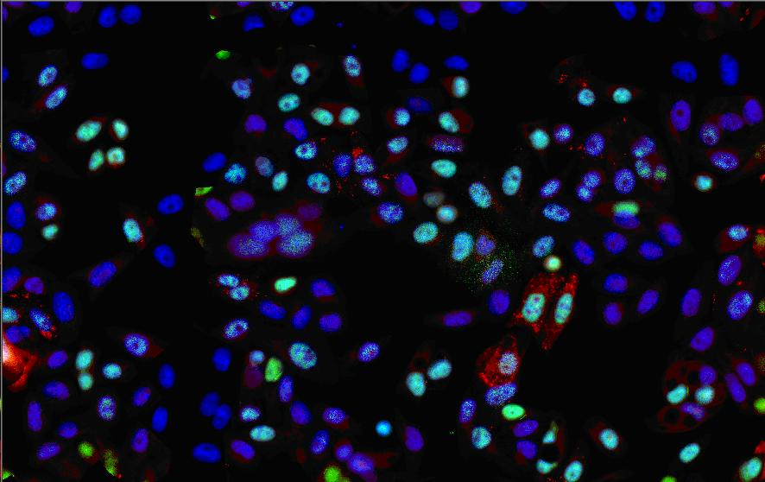
The Challenge - lots of samples
Almost all screening of cellular systems uses image based systems
Imaging systems used to be really really slow……
Then some smart people automated them
And now they are fast, easy to use and are the foundation of cellular screening networks
http://www.linkedin.com/company/high-throughput-screening
https://gcc.rice.edu/Screening_Facilities.aspx

Slide 4
So what actually happens inside the box that makes image so attractive for HT Screening
✔
It uses standard plates
Plates can be loaded using automation
Automated analysis programs find most of the cells
Each cell is then classified as a unit and analysis performed
Data are output into a database [even tho’ there are no standard formats yet….]
It’s all done with mirrors…..well almost!
✔
✔
✔
✔
✔
✪

Slide 5
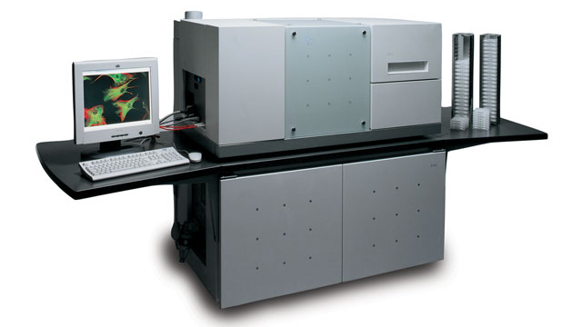
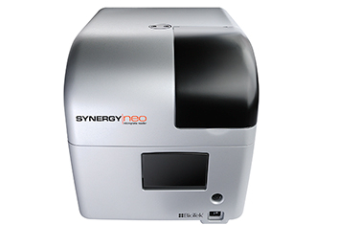
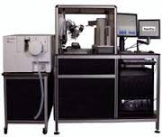
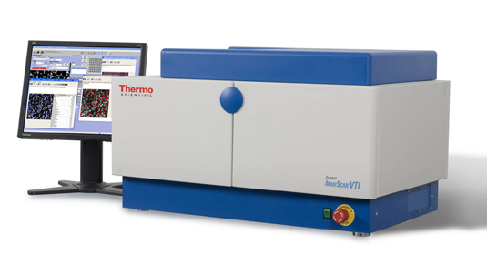
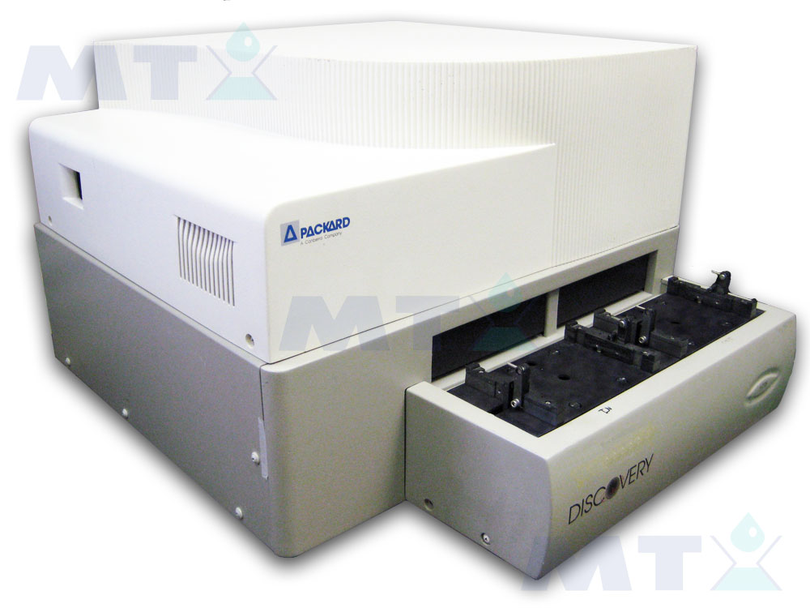
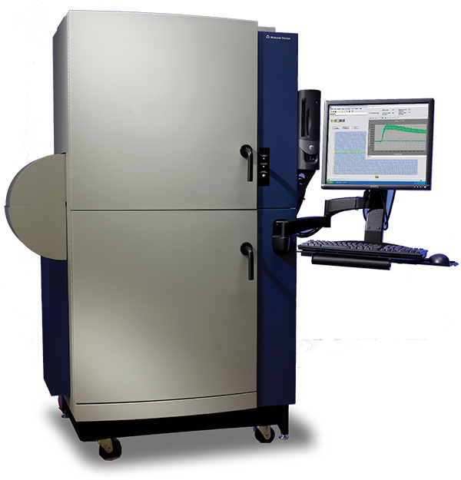
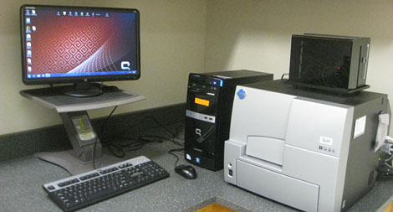
Many good image screening instruments – this is big business!!
And a new one every other week!!

Slide 6
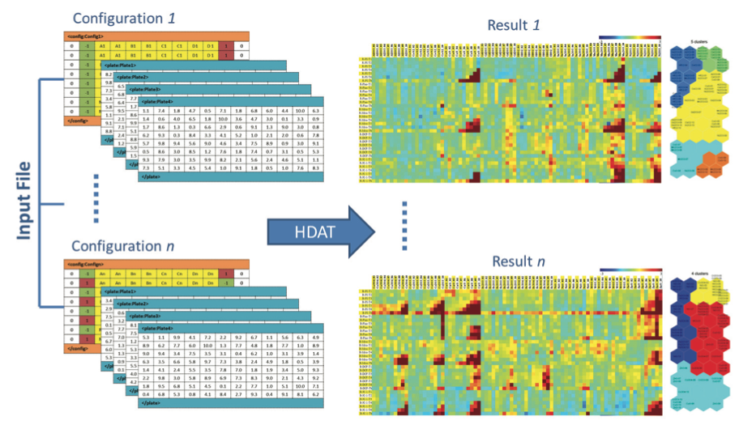
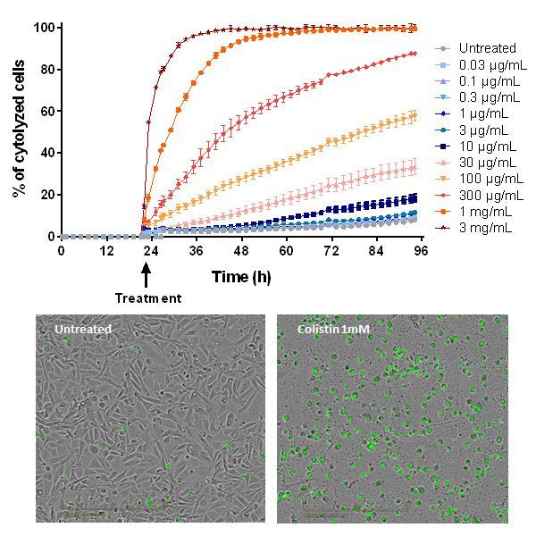
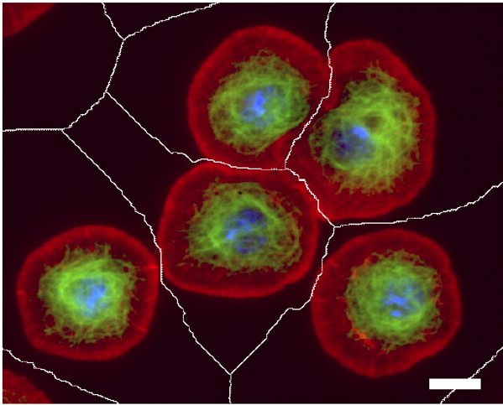
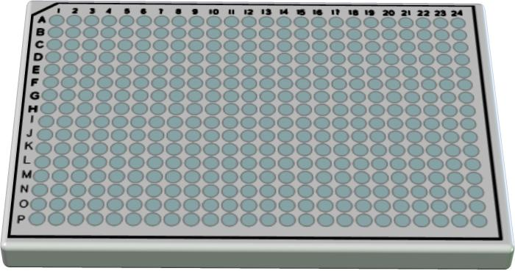
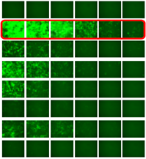
Image analysis in HT space is well defined
Note: All images on this slide are from web
http://www.fluofarma.com/live-content-imaging-cro-services.html
Segmentation from: 2010 // JCB vol. 191 no. 3 471-478
http://robertrallo.wordpress.com/2013/10/22/hdat-web-based-high-throughput-screening-data-analysis-tools/
http://dharmacon.gelifesciences.com/rnai-and-custom-rna-synthesis/microrna/smartchoice-shmimic-lentiviral-microrna/

Slide 7
What conclusions can we make?
HT screening using imaging systems works well but…
You cannot do both Hi-Thru-put and Hi-Res simultaneously
So there is compromise even in HT imaging
If you go for the absolute maximum resolution you may well be incapable of determining what a “normal” sample is as all of the samples may prove to be “different” because of very high information density….

Slide 8
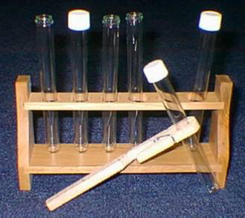
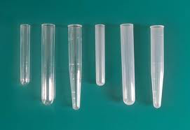

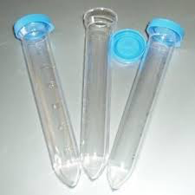
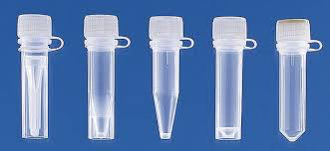
So let’s look at Flow Cytometry
Nothing is standard – tiny tubes, middle size tubes, really big tubes…and even some plates
Only clinical systems are being hightly automated and nothing really works yet
Tubes are usually loaded manually, at the best a 96 well plate….which is really really slow
Data are complicated and messy – there is no standard analysis
Database management? What is that?
FCS File standard exists meaning file structure is standard
Every cell is identified automatically – it a fundamental advantage – no segmentation required

Slide 9

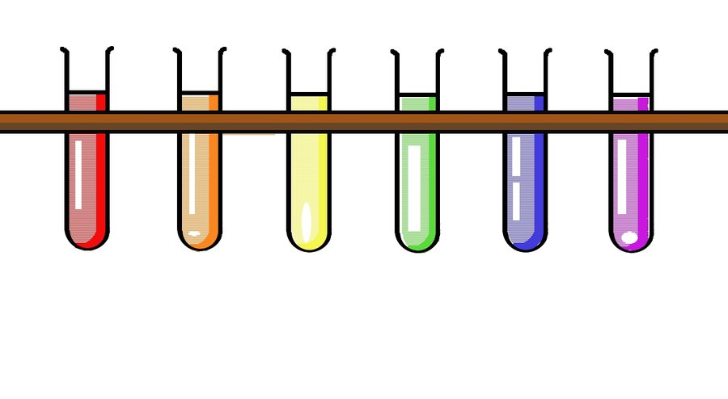
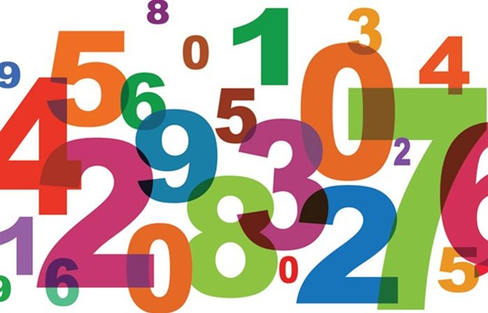
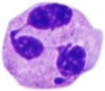

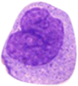
Traditional Flow Cytometry
(which people either love or hate!)
.
.
.
✪

Slide 10
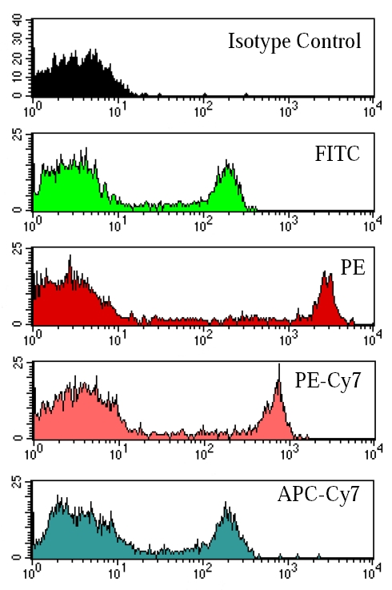
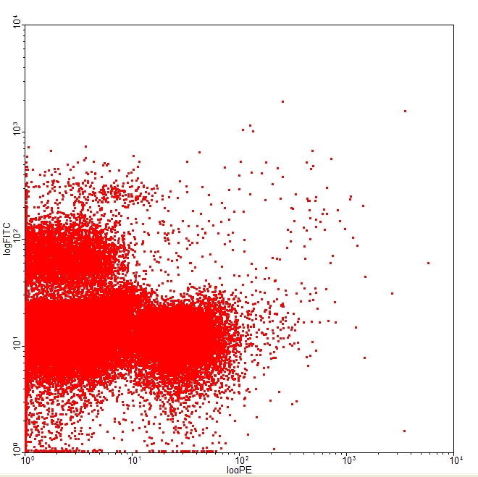
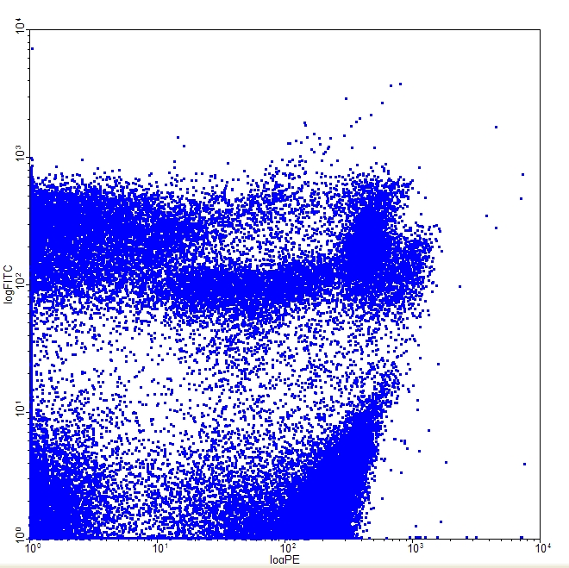
Digging deeper in “Flow” Issues
(or arguments you are currently using not to use flow)
Gating
Meaning of data (%, mean, etc)
# of samples available

Slide 11
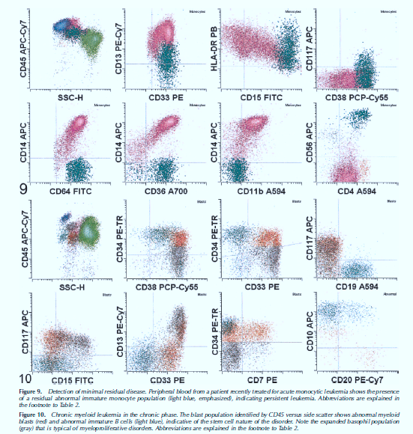
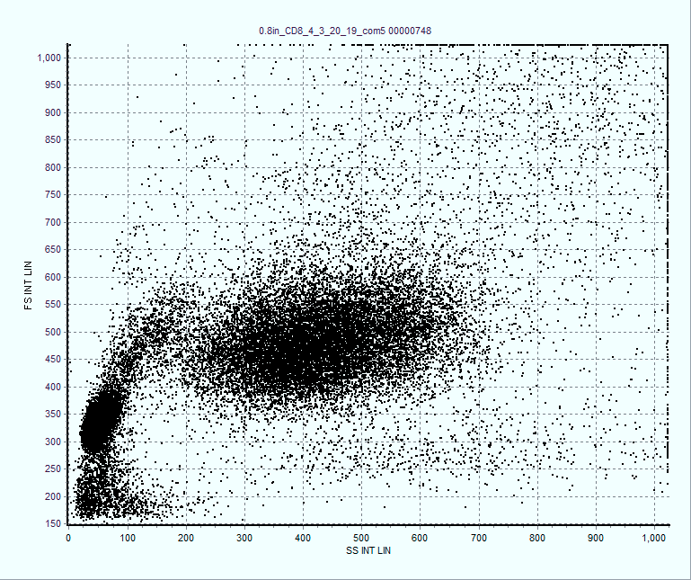
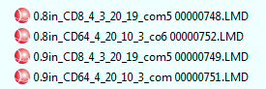
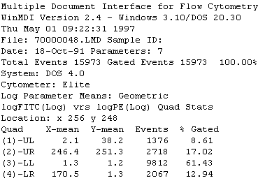
Circa, 1990-present
ANALYSIS
1 sample 10 to 30 minutes
Run 30-60 samples
per hour

Slide 12



Traditional gating process
Decision
Traditional flow gating logic and analysis approach
Decision
Result
Decision
Repeat ad infinitum
Result
Decision
‘What we see depends mainly on what we are looking for.’ John Lubbock

Slide 13
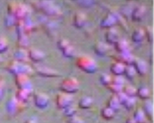
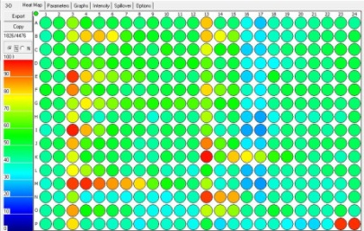
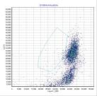
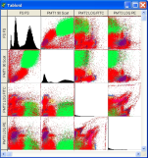
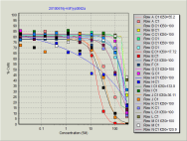


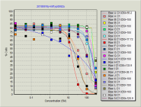
The Operational Modality of Flow Cytometry
Traditional
HT Flow
1. Take a complex biological sample
1. Take a complex biological sample
2. Create very large scale “systems level” experimental grids
2. Separate that sample into single samples
3. Run each sample as a single unit
3. Run samples as a high speed, low volume set
4. Put all the data back together again
4. Combine data automatically as sets
5. Try to relate each piece of data back to the original biological system
5. Conduct simultaneous
advanced analysis in
parallel
The operational modality of Flow Cytometry.pptx

Slide 14

Multiparametric and multifactorial HT cytometry
Find the features describing the populations f₁,.. f_{n}
+
+
Define multiple populations in the feature space
Find the features (such as IC₅₀)
Create n × m array of features, where every m could be a vector [f₁,…,f_{n}]
concentration
HT flow cytometry
compounds

Slide 15
Problem 1: eliminate operator’s input in analysis
gate
Calculate fraction of “positive” and “negative” cells
gate
Problems?
Well… plenty actually

Slide 16
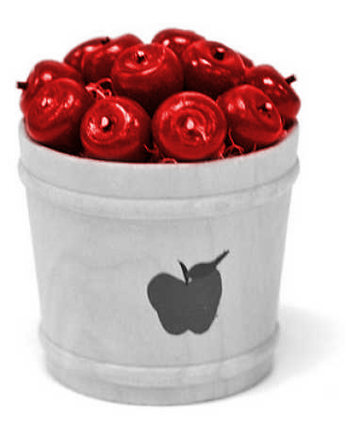
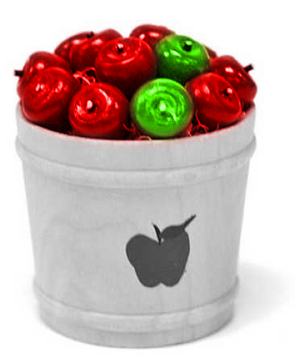
Alternative?
Heuristic methods
  Minkowski-form
  Weighted-Mean-Variance (WMV)
Distance functions used in nonparametric tests
  χ ² (Chi Square)
  Kolmogorov-Smirnov (KS)
  Cramer/von Mises (CvM)
Information-theory divergences
  Kullback-Liebler (KL)
  Jeffrey divergence (JD)
Spectral measures
  Spectral angle mapper
  Bhatacharyya distance
Ground distance measures
  Histogram intersection (Overton)
  Quadratic form distance (QF)
  Wasserstein-Rubinstein-Mallows distance (Earth Movers Distance)
80
Method I
  Sort the apples (“gate” the green and red populations, or red and non-red)
  Count red and green (non-red)
  Compare the counts
Method II
  Find a bucket full of red apples only
  Find the distribution
  Take a bucket with red and green apples and find the distribution
  Compare the distribution
60
Percentage of green apples
40
20
-5
-10
-15
-20
Harvest day

Slide 17
How do you collect that much data on a flow cytometer?

Slide 18
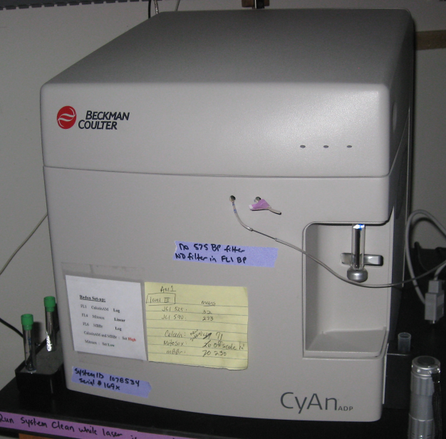
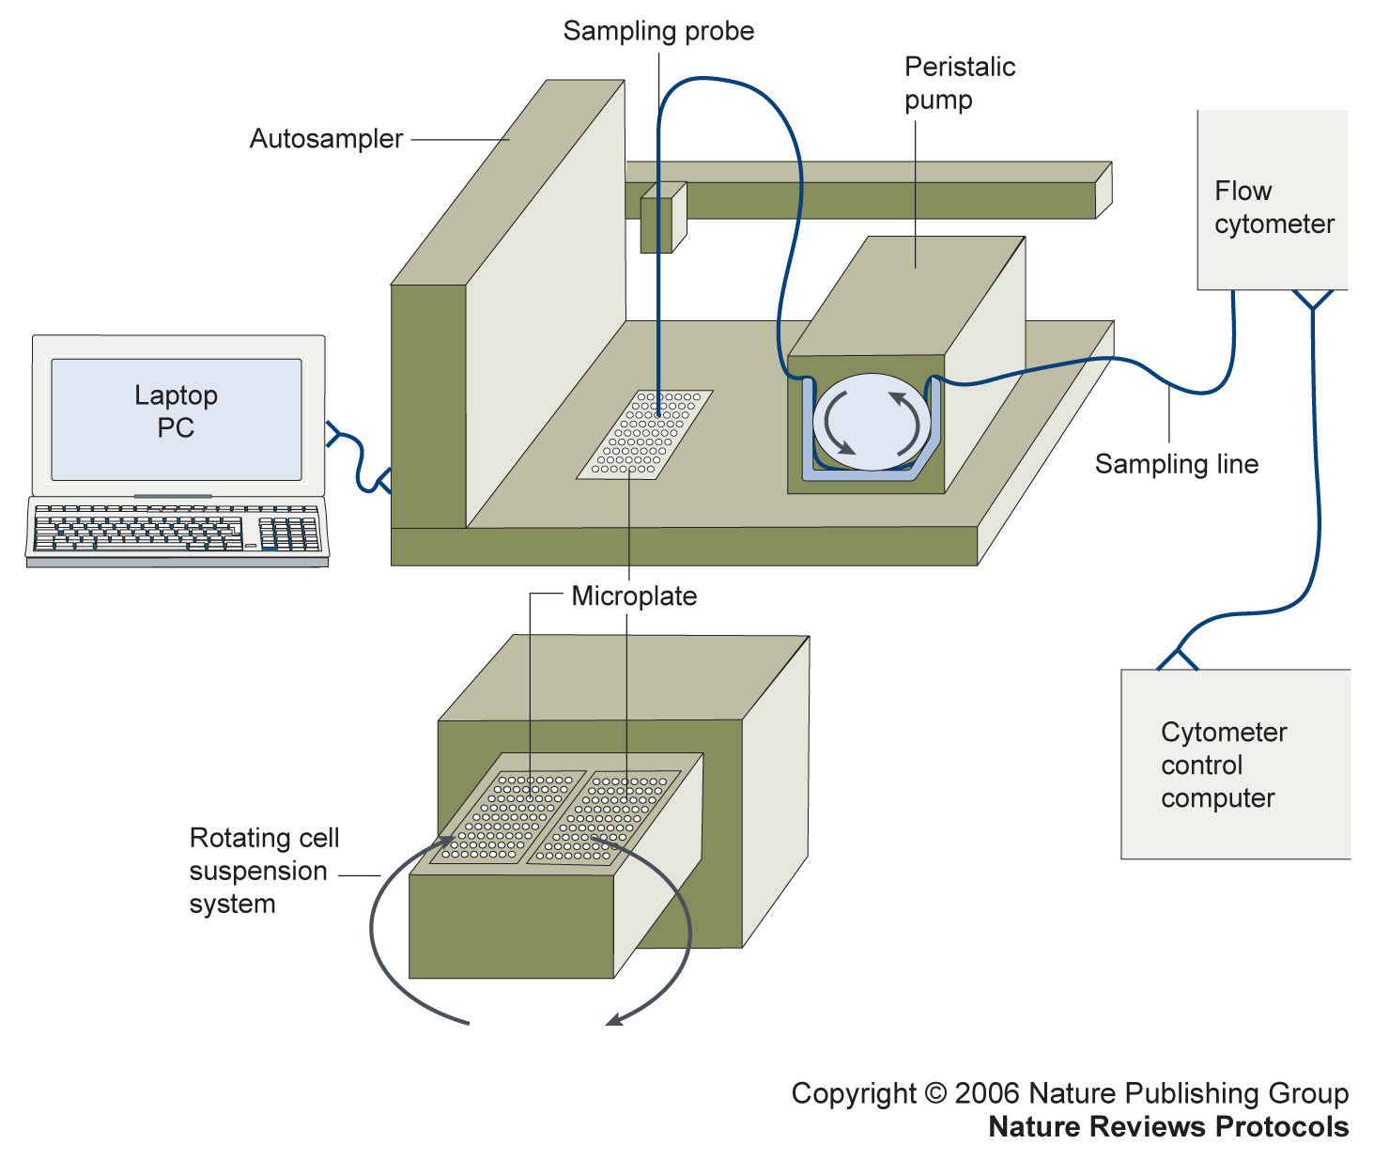
Optical Design of a basic flow cytometer
HyperCytTM system added to flow cytometer
PMT 5
PMT 5
PMT 4
Sample
PMT 4
PMT 3
Dichroic
Flow chamber
Filters
PMT 3
Dichroic
PMT 2
Flow chamber
Filters
PMT 2
Scatter
Scatter
PMT 1
PMT 1
Laser
Laser
Copyright 2006 Nature Publishing Group
Nature Reviews Protocols
Sensor
Sensor
Bandpass
Bandpass
Filters
Filters
HyperCyte diagram kindly supplied by Larry Sklar
384 wells/10 min
1 μl/sample 5000 cells/μl
Notes:
Basic schematic for how a flow cytometer works – a cell passes via a laser (blue line) and signals are passed down to each PMT and light scatter detector

Slide 19
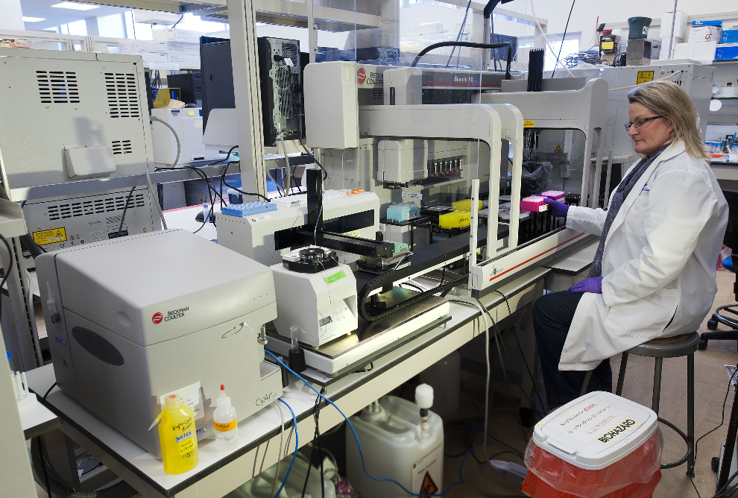
Automated
Cytomat
Incubator
Automated Biomek
Preparative system
Automated HyperCyte
Sample Delivery
Cyan flow cytometer

Slide 20
The Operational Modality of Flow Cytometry
Traditional
HT Flow
1. Take a complex biological sample
1. Take a complex biological sample
2. Create very large scale “systems level” experimental grids
2. Separate that sample into single samples
3. Run each sample as a single unit
3. Run samples as a high speed, low volume set
4. Put all the data back together again
4. Combine data automatically as sets
5. Try to relate each piece of data back to the original biological system
5. Conduct simultaneous
advanced analysis in
parallel
The operational modality of Flow Cytometry.pptx

Slide 21
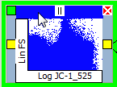

Graphical cytometry analysis pipeline builder
We call this a Logic Map
Control +
Control -
Build curve
distance
A3
Drug 1
Label 1
B3
Drug 2
Extract features
Drug 3
C3
Drug 4
D3
distance
Drug 5
E3
Label 2
Drug6
F3
Drug 7
G3
Drug 8
H3
distance
Drug 9
I3
Label 3
Drug 10
J3
Result

Slide 22
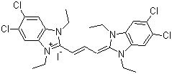
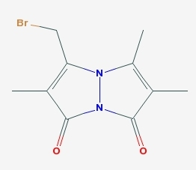
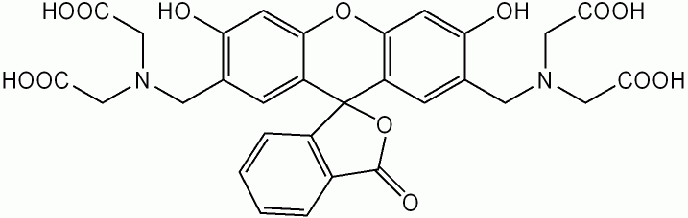
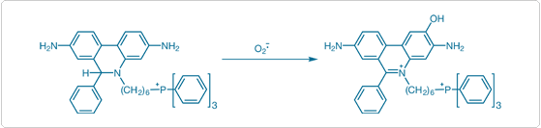
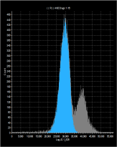
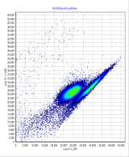
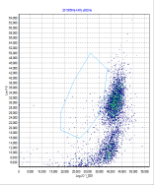
Example Drug Screen
Membrane Potential, Glutathione, Viability, Superoxide
JC-1
Calcein
Mitosox ^{[1]}
mbbr

Slide 23
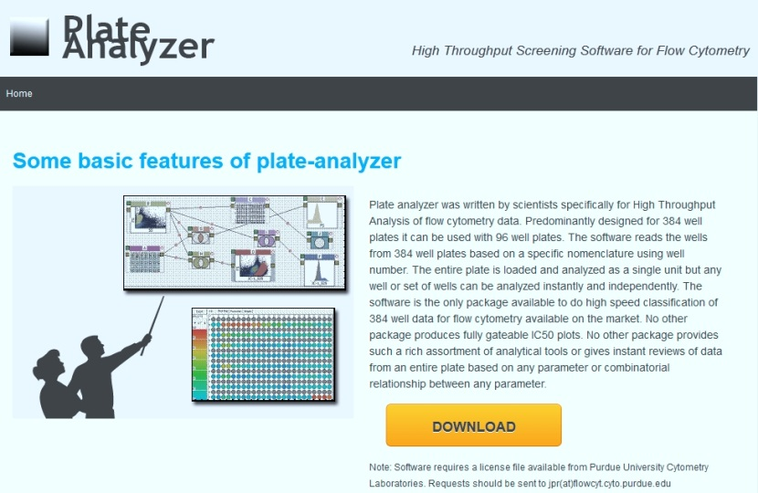
Need to develop new paradigm in flow cytometry analysis
PlateAnalyzer
Created concept of Logic Maps
New statistical processes
Analyzes entire plates not single samples
Entirely graphic model
PlateAnalyzer is Free for non-profit institutions

Slide 24
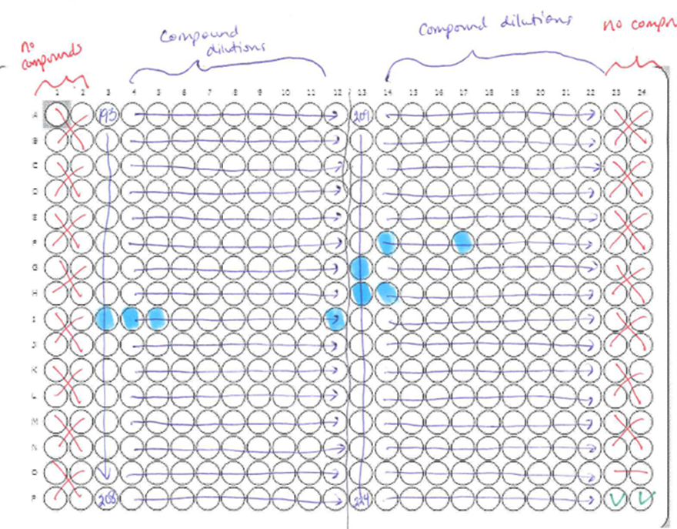
384 Well Plate layout For drug screen – Mito Memb Pot
JC-1
2 color assay
Negative
control wells
Negative
control wells
Valinomycin
positive controls
3-5,000 cells per well (1 to 2 x 10⁶ cells/plate)

Slide 25


Plate design-Analysis
High Conc Drugs
Positive Control
(Vancomycin)

Slide 26


Lots of files to analyze….
All 384 list mode files are loaded in a few seconds…

Slide 27

Highlight the Analysis Logic Map Format

Slide 28


Drug Screening

Slide 29

Processes can be very simply defined
Select cells
(can be any
Gating process)
Some rules
(any Boolean
Process or other)
Identify drugs
and doses – can
be any number
of drugs or concs

Slide 30



Rapid Processing
8 min
Run time
On flow
cytometer
List Mode files
(96 or 384 wells)
(entire directory)
About 30 seconds
30 second
Analysis time
On computer
Protocol
Instant results
So essentially no post processing time
IC50 or appropriate
result

Slide 31



3 functional assays, 32 drugs, 10 points per drug, 96 curves, (10 min to run 384 samples, 5000 cells per sample including all analysis)
mBBr
Calcein
Mitosox
1 Click
1 minute

Slide 32

Data from every graph is available as an XL spreadsheet

Slide 33

Flow Analysis - 7 color (BD instrument)
(9 param) data with 8pt dose response curves
Logic Map to produce curves
Data kindly provided by Peter Krutzik and Garry Nolan, Stanford

Slide 34

PlateAnalyzer Logic Map for HC Analysis
(Example screenshot of the software)

Slide 35






A single analysis program can produce 14 x 14 x 12 (2352) IC50 curves
14 phosph’n sites per cell type
8 drug conc.
12 stimulants in each box
Each box produces 12 IC50 curves
Gating parameters
14 cell types
Each histogram above, is used as a
Sequential gate for each of the 14
Subpopulaitons and 12 stimulators
Data Kindly supplied by Bernd Bodenmiller

Slide 36

Analysis Logic Map Format

Slide 37


C:\xara stuff\Cytof ideas

Slide 38

C:\xara stuff\Cytof ideas

Slide 39


C:\xara stuff\Cytof ideas

Slide 40


Slide 41


pzap70
C:\xara stuff\Cytof ideas

Slide 42

Summary
High throughput flow cytometry is not only possible, there are significant advantages for many screening assay systems
It opens up many alternatives that are NOT available with traditional image cytometers
Flow cytometry can collect very high content data in a systems biology mode
New classification tools allow us to enhance the analytical process and assist in identifying signaling pathways
For analysis of these complex data sets – the complexity can be “under the hood”, but must be easy, interactive and accurate
Home of the Purdue Cytometry Discussion list cytometry@lists.purdue.edu
@Cytometryman

