Slide 1
Advanced Flow Cytometry
J. Paul Robinson & John Nolan

Slide 2



Advanced Data Processing
Advanced Short Course
J. Paul Robinson
Distinguished Professor of Cytomics
Professor of Biomedical Engineering
Director, Purdue University Cytometry Laboratories
@Cytometryman

Slide 3
Start with simple analytical approaches…
http://www.bdbiosciences.com/documents/Simplifying_Complex_Flow_Cytometric_Analyses.pdf

Slide 4
Slight more complex gating….
http://www.bdbiosciences.com/documents/Simplifying_Complex_Flow_Cytometric_Analyses.pdf

Slide 5
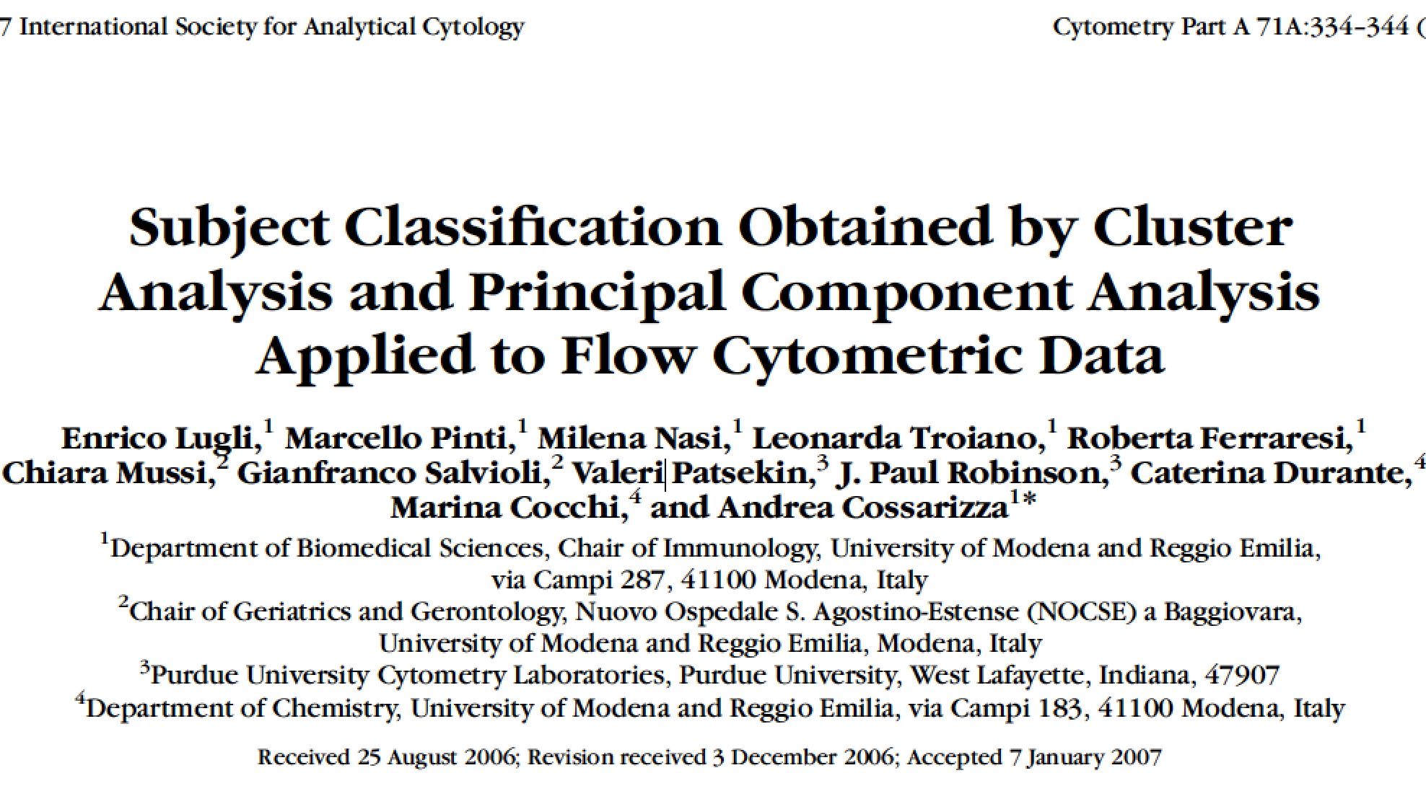
Advanced approaches to flow analysis

Slide 6
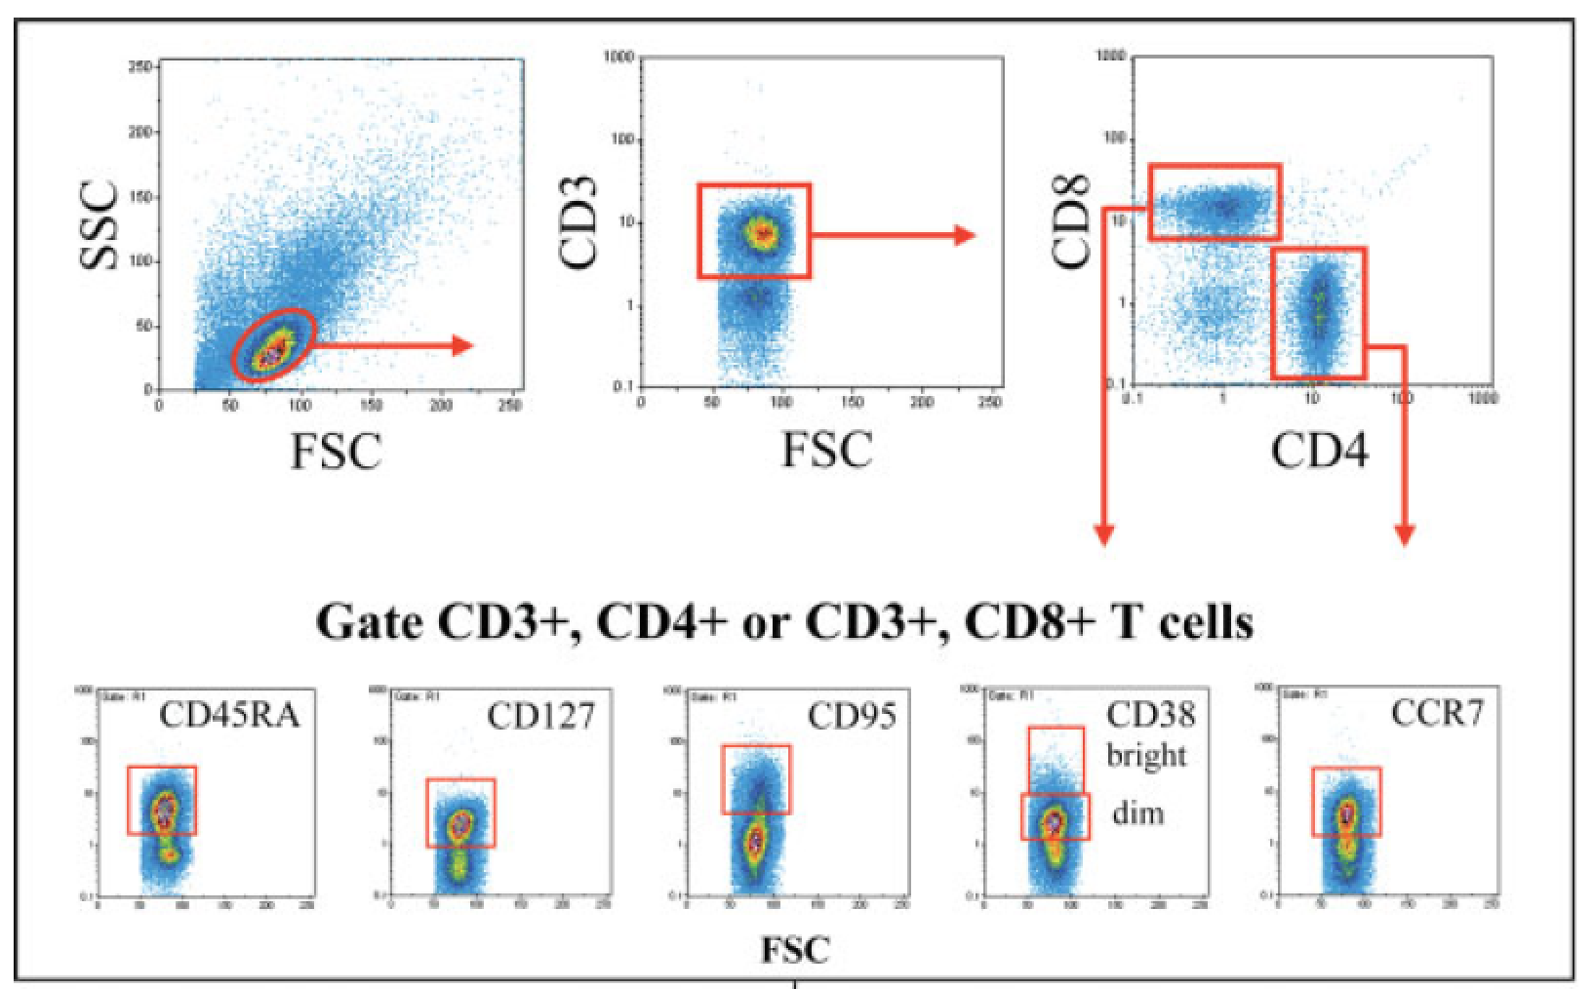
Many subsets, many samples….
Data from Cytometry Part A 71A:334–344 (2007)

Slide 7
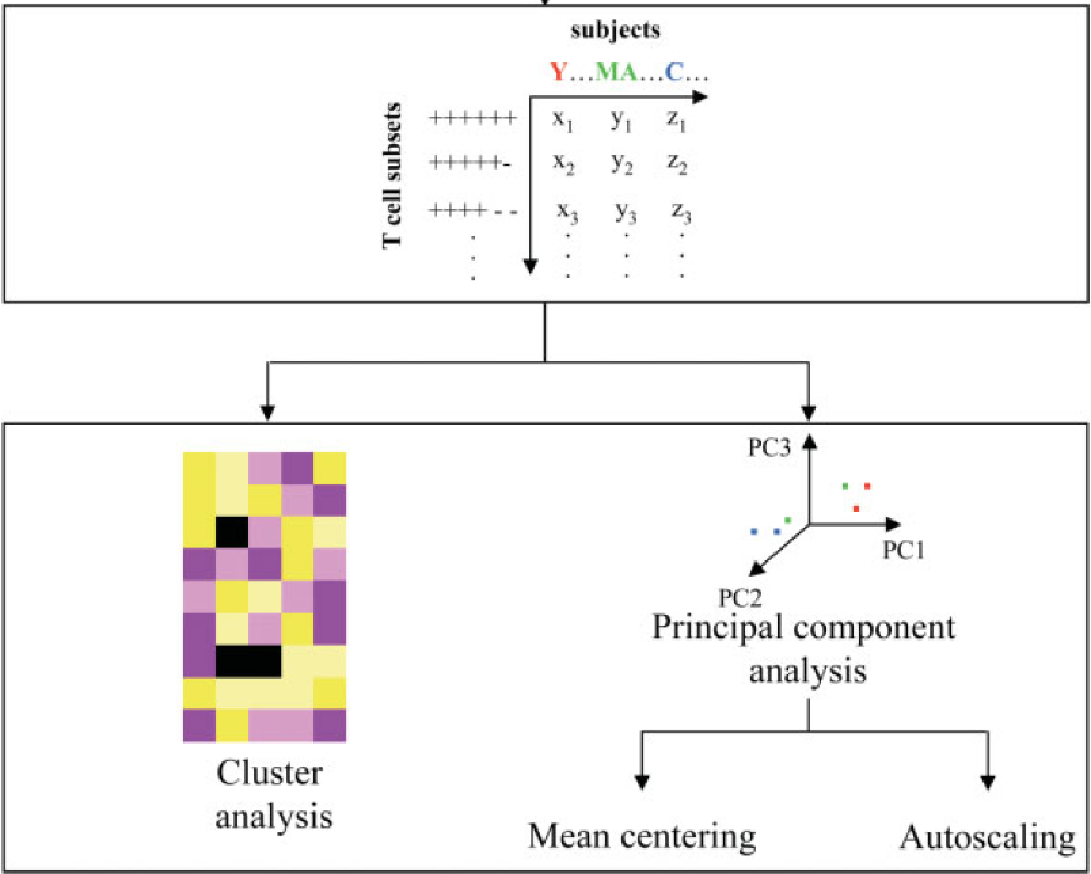
Data from Cytometry Part A 71A:334–344 (2007)

Slide 8
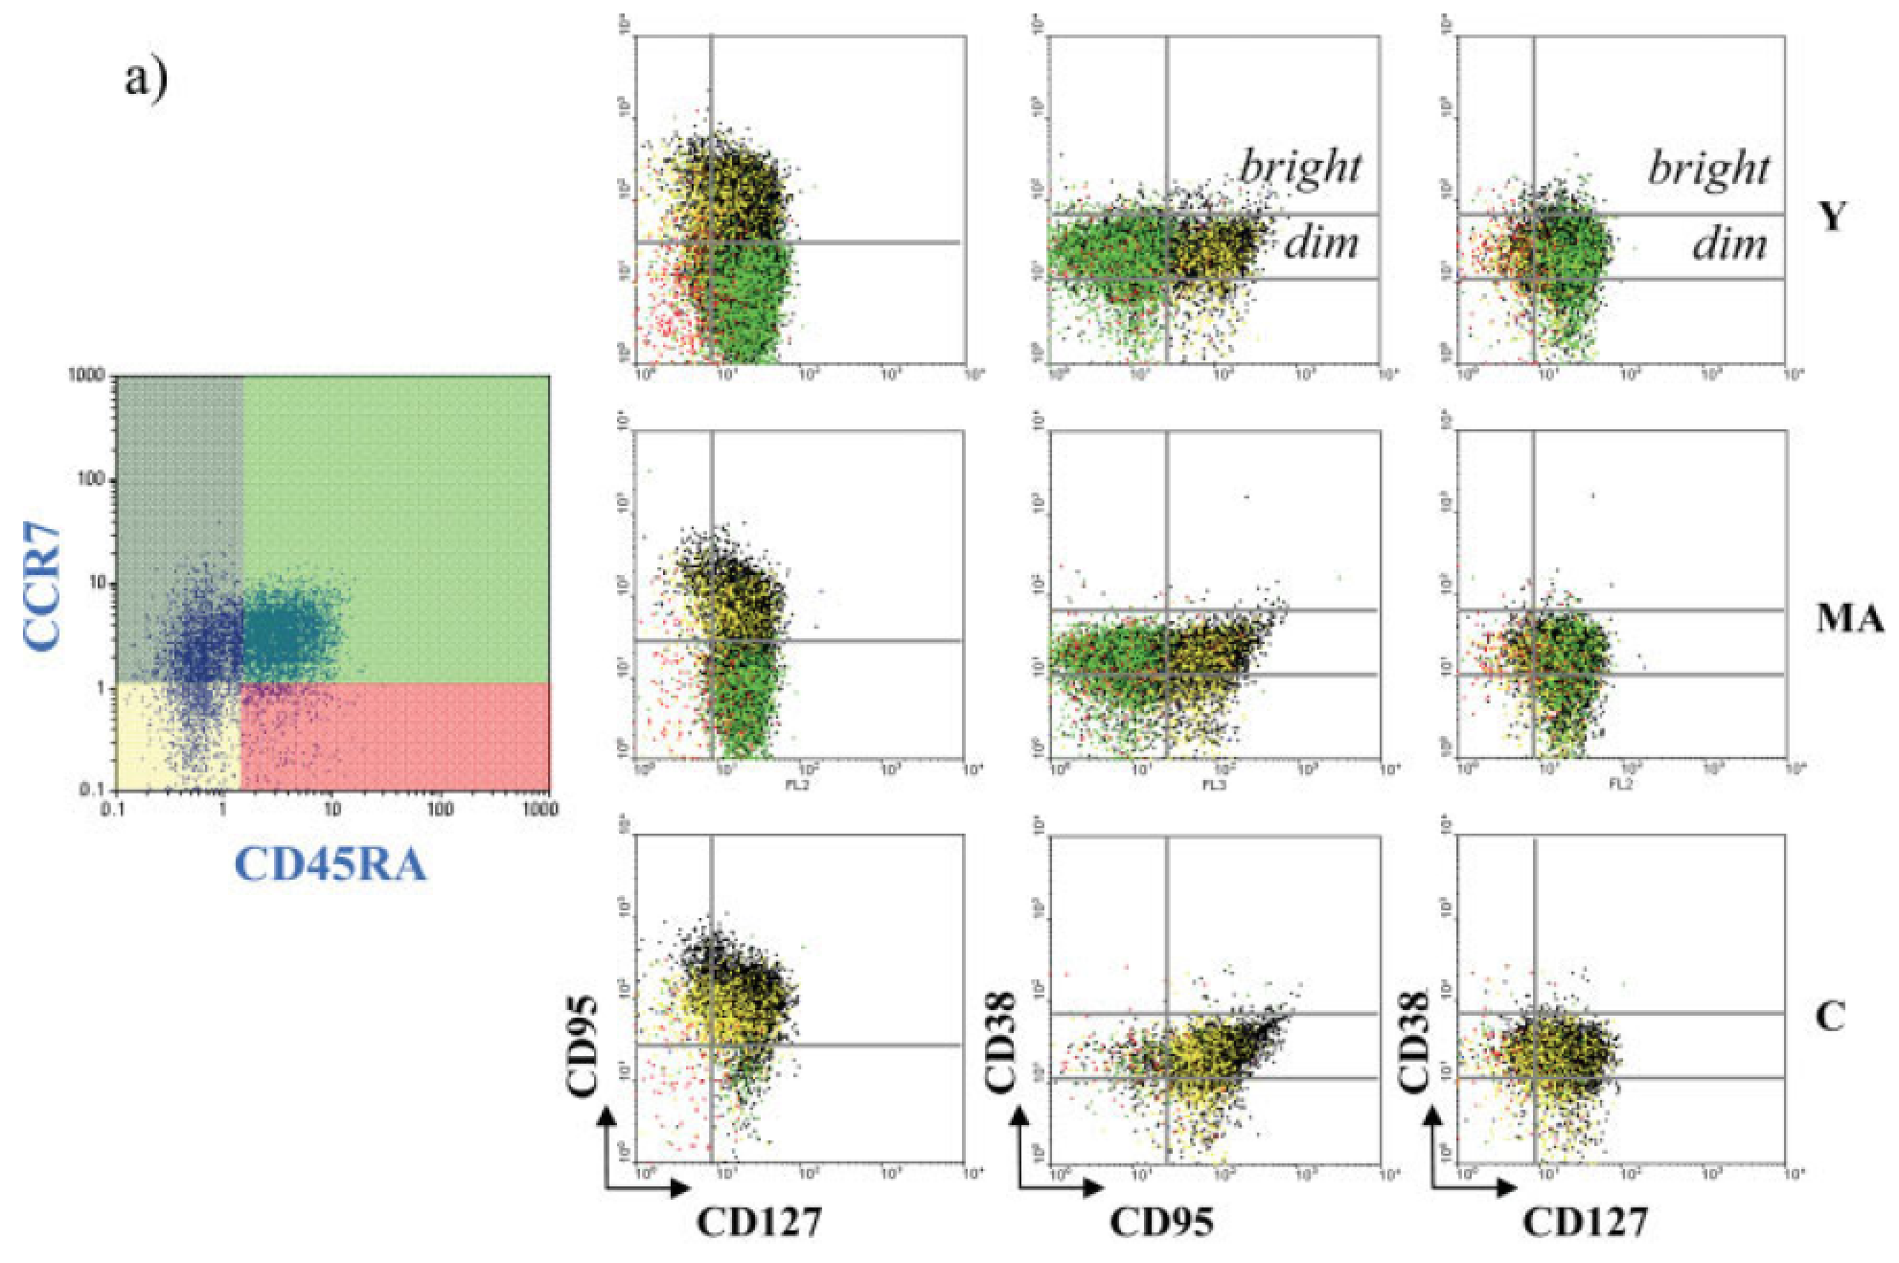
Data from Cytometry Part A 71A:334–344 (2007)

Slide 9
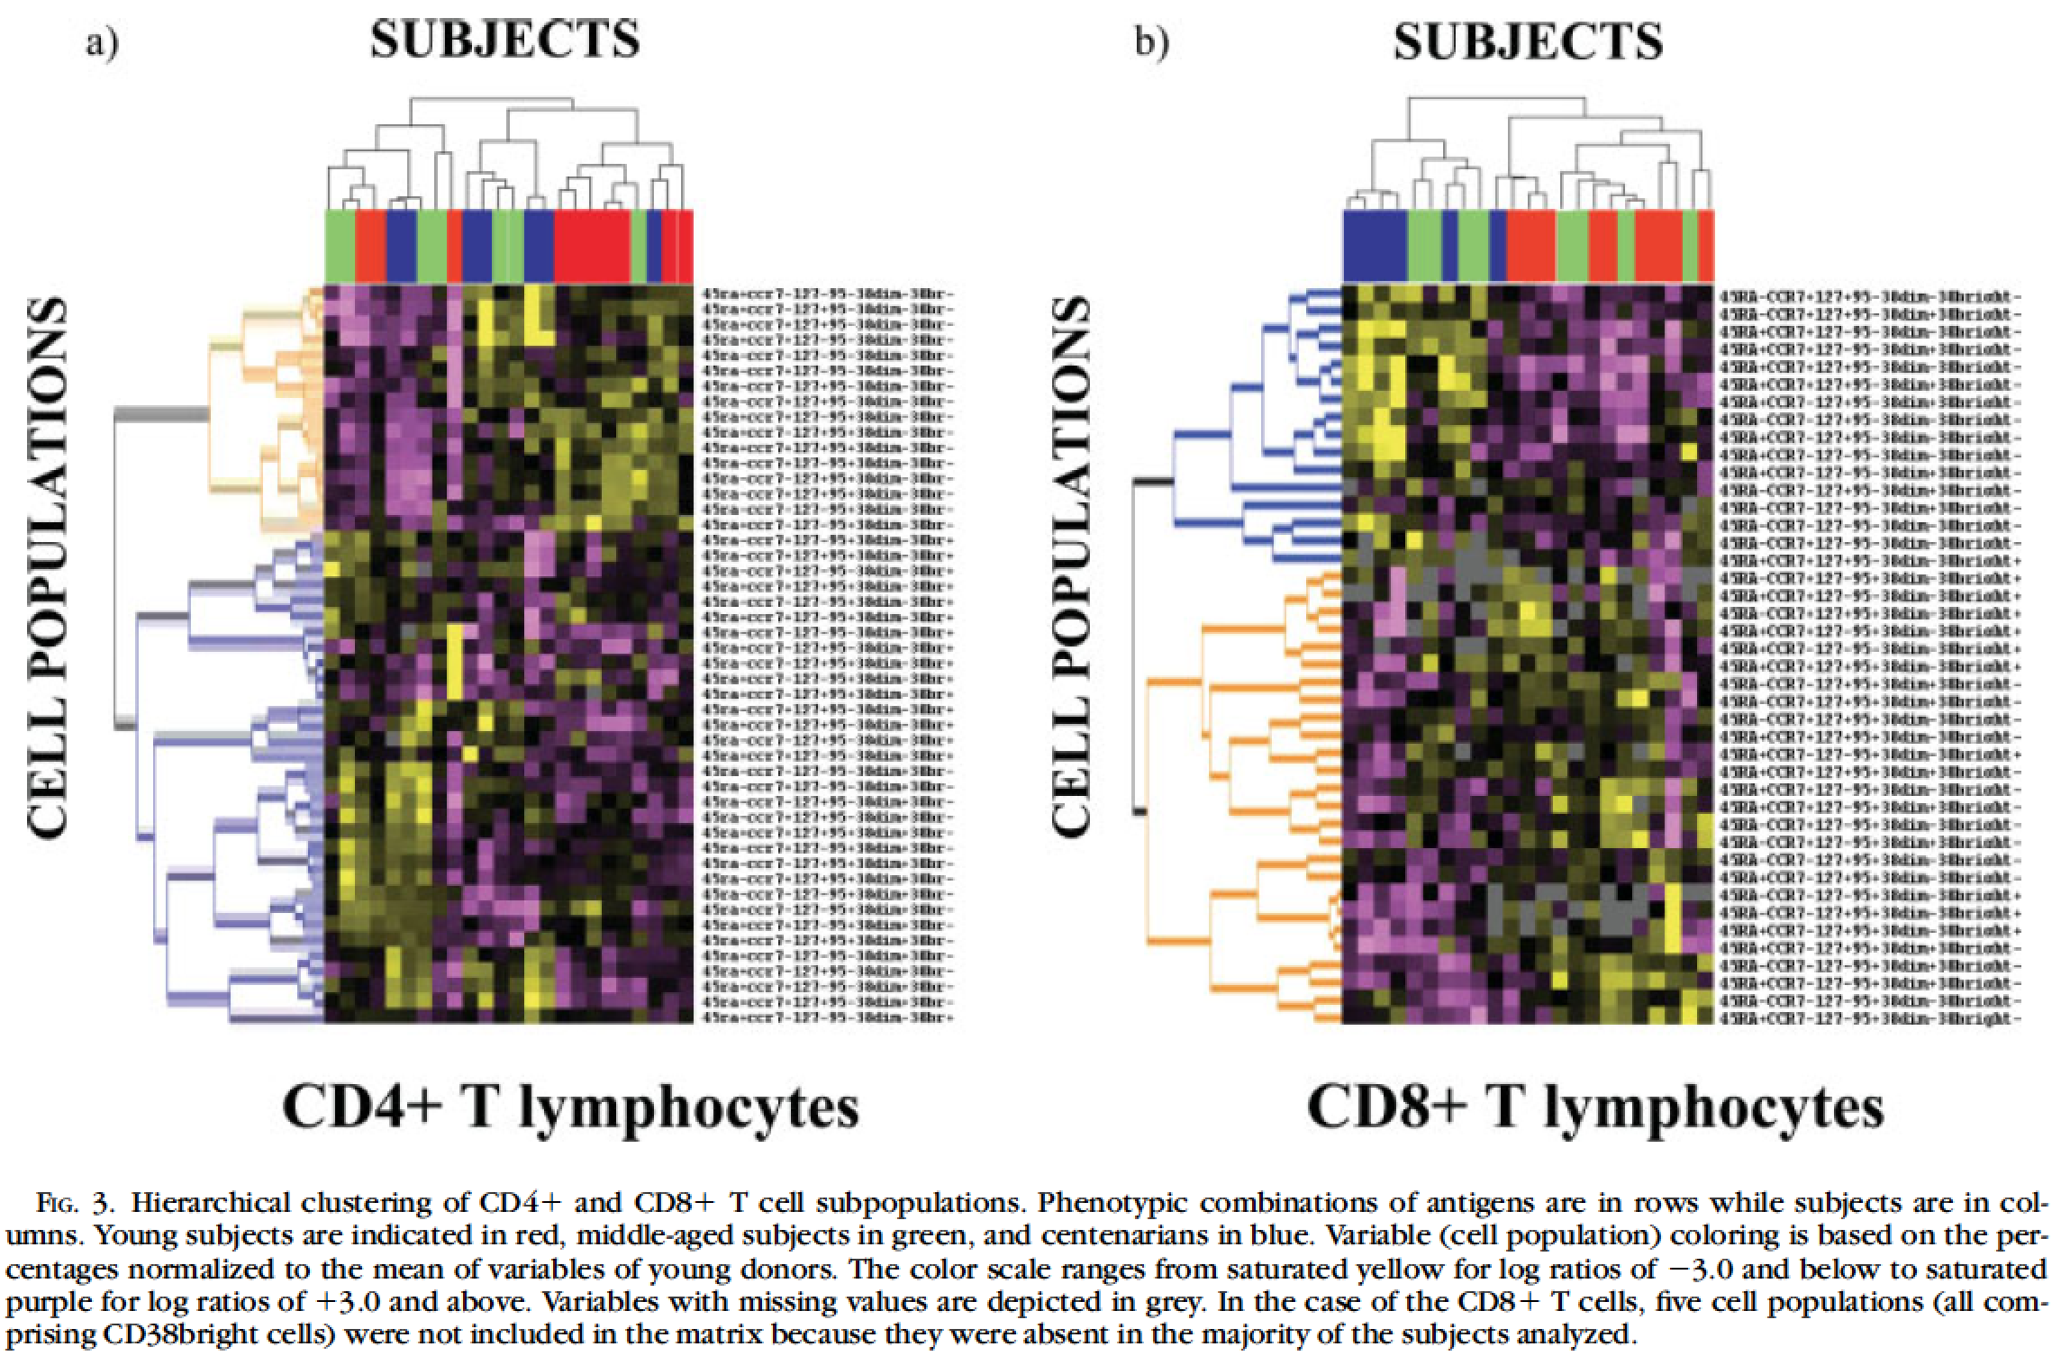
Data from Cytometry Part A 71A:334–344 (2007)

Slide 10
Problem 1: eliminate operator’s input in analysis
gate
Calculate fraction of “positive” and “negative” cells
gate
Problems?
Well… plenty actually

Slide 11

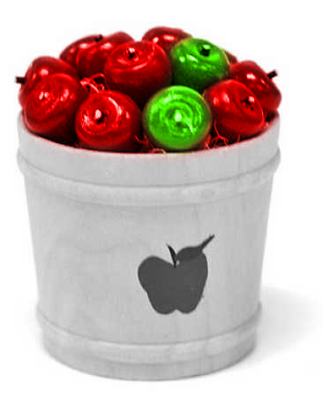
Alternative?
Heuristic methods
  Minkowski-form
  Weighted-Mean-Variance (WMV)
Distance functions used in nonparametric tests
  χ ² (Chi Square)
  Kolmogorov-Smirnov (KS)
  Cramer/von Mises (CvM)
Information-theory divergences
  Kullback-Liebler (KL)
  Jeffrey divergence (JD)
Spectral measures
  Spectral angle mapper
  Bhatacharyya distance
Ground distance measures
  Histogram intersection (Overton)
  Quadratic form distance (QF)
  Wasserstein-Rubinstein-Mallows distance (Earth Movers Distance)
80
Method I
  Sort the apples (“gate” the green and red populations, or red and non-red)
  Count red and green (non-red)
  Compare the counts
Method II
  Find a bucket full of red apples only
  Find the distribution
  Take a bucket with red and green apples and find the distribution
  Compare the distribution
60
Percentage of green apples
40
20
-5
-10
-15
-20
Harvest day

Slide 12
Cytometry PtA 89A:44-58, 2016

Slide 13
Cytometry 77A:705-713, 2010

Slide 14
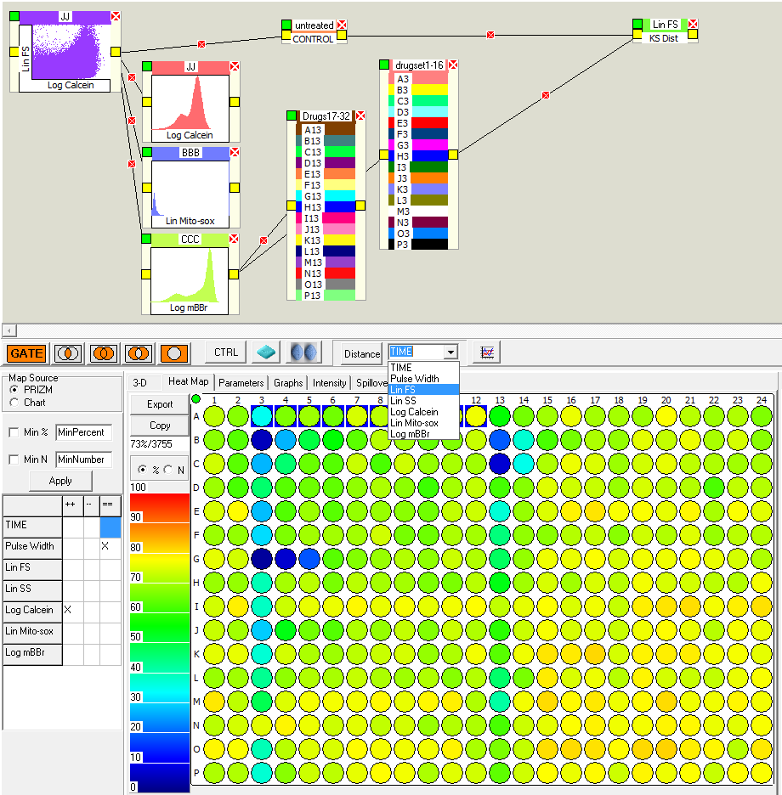
Advanced Analysis
3. The parameter box must be connected to both the drug box and the controls
Measuring KS Distance
Quadratic form Distance
Kullback-Leibler Distance
2. A parameter box appears
You can select any parameter for KS distance, or quadratic form distance, or Kullback-Leibler distance if you wish. There are several different distance measures you can choose from – or add you own!!
1. Select the desired parameter and press “DISTANCE”

Slide 15
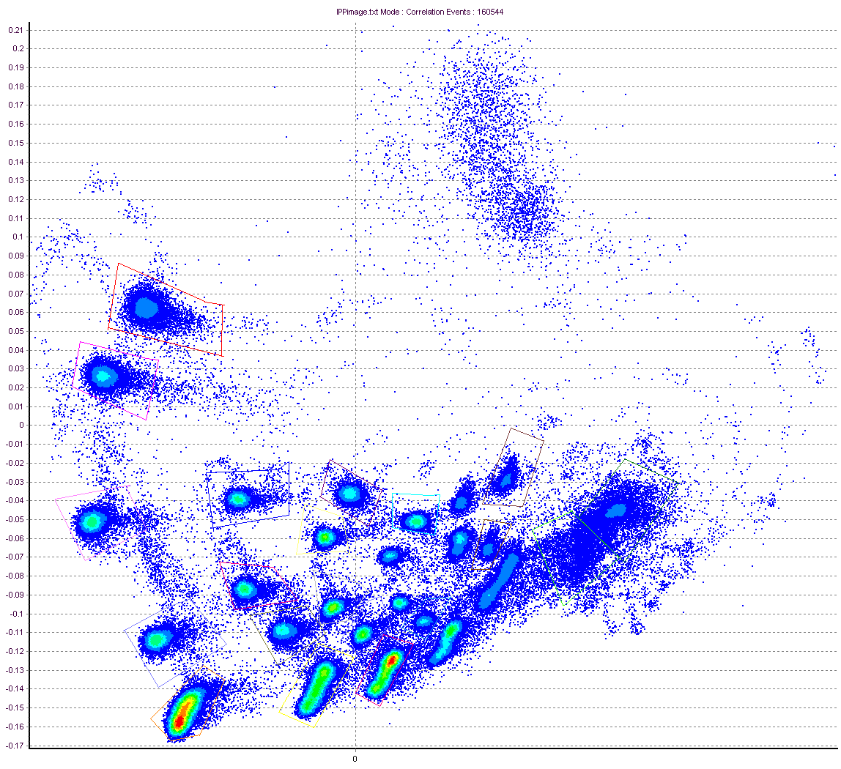
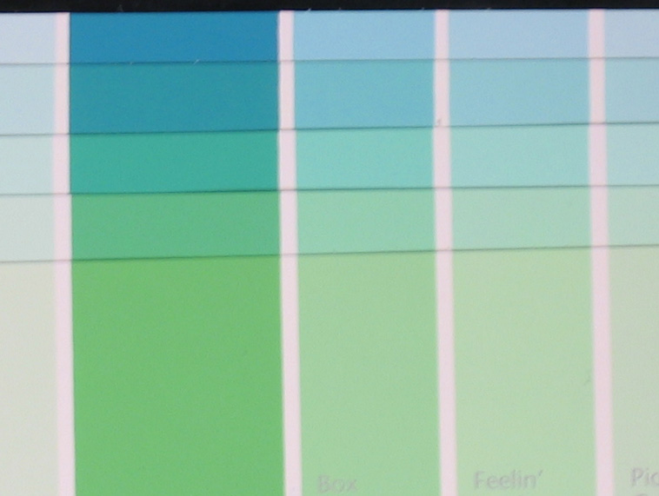
Reflection Example – Clustering
PCA Density Plot From Cytospec Software (Purdue)
Cytospec Software free download
http://www.cyto.purdue.edu/Purdue_software

Slide 16
Nanocrystals/Micro-Dots multiplexed systems
New probes
Potentially 1000’s of combinations
Sensitive, long lived, less bleaching
Difficult to make
Will require some advanced classification software

Slide 17
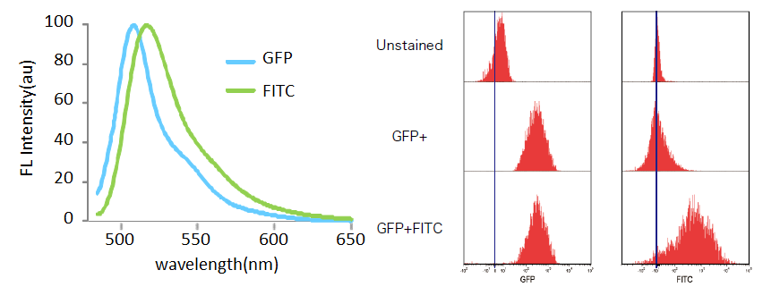
Separation of GFP and FITC signals using
spectral cytometry
Data courtesy of W.C. Hyun (UCSF)
Hyperspectral cytometry is capable of combining the channels in the PMT to form “virtual filters”
  Function as a regular polychromatic FC
  Capability of fine-tuning the detection to adjust for particular staining strategies as well as problems with label intensities or markers abundances.
Slide taken from Sony publicity materials

Slide 18
tSNE-T-Distributed Stochastic Neighbor Embedding (tSNE) is an algorithm for performing dimensionality reduction, allowing visualization of complex multi-dimensional data in fewer dimensions while still maintaining the structure of the data.
SNE is an unsupervised nonlinear dimensionality reduction algorithm useful for visualizing high dimensional flow or mass cytometry data sets in a dimension-reduced data space. The tSNE platform computes two new derived parameters from a user defined selection of cytometric parameters. The tSNE-generated parameters are optimized in such a way that observations/data points which were close to one another in the raw high dimensional data are close in the reduced data space
http://docs.flowjo.com/d2/wp-content/uploads/sites/6/2016/02/TQC.BD14color.Compare1-Layout-2.png

Slide 19
SPADE-Spanning tree Progression of Density normalized Events
(SPADE) is an algorithmic visualization tool for high-dimensional flow and mass cytometry data.
Bendall SC, Simonds EF, Qiu P, Amir ED, Krutzik PO, Finck R, Bruggner RV, Melamed R, Trejo A, Ornatsky OI, Balderas RS, Plevritis SK, Sachs K, Pe’er D, Tanner SD, Nolan GP. Single-cell mass cytometry of differential immune and drug responses across a human hematopoietic continuum. Science. 2011 May 6; 332(6030):687-96
http://blog.cytobank.org/2011/05/20/what-is-spade/
http://docs.flowjo.com/d2/plugins/spade/

Slide 20
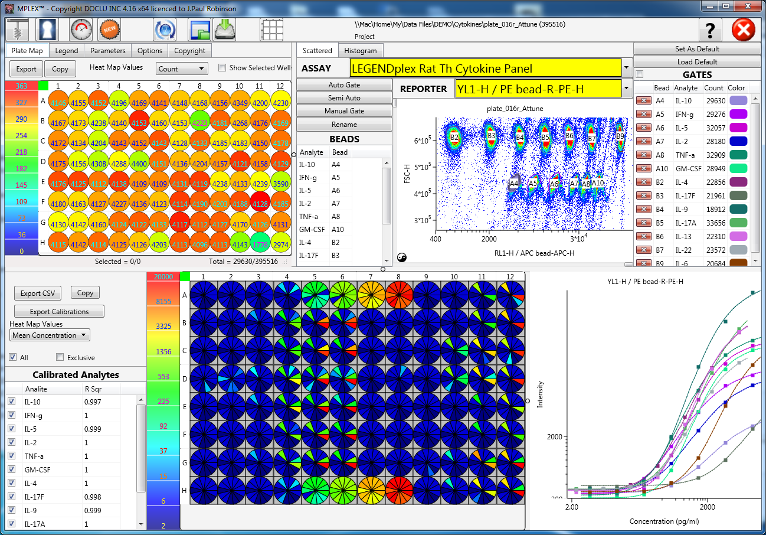
Cytokine analysis
made with MPLEX

Slide 21
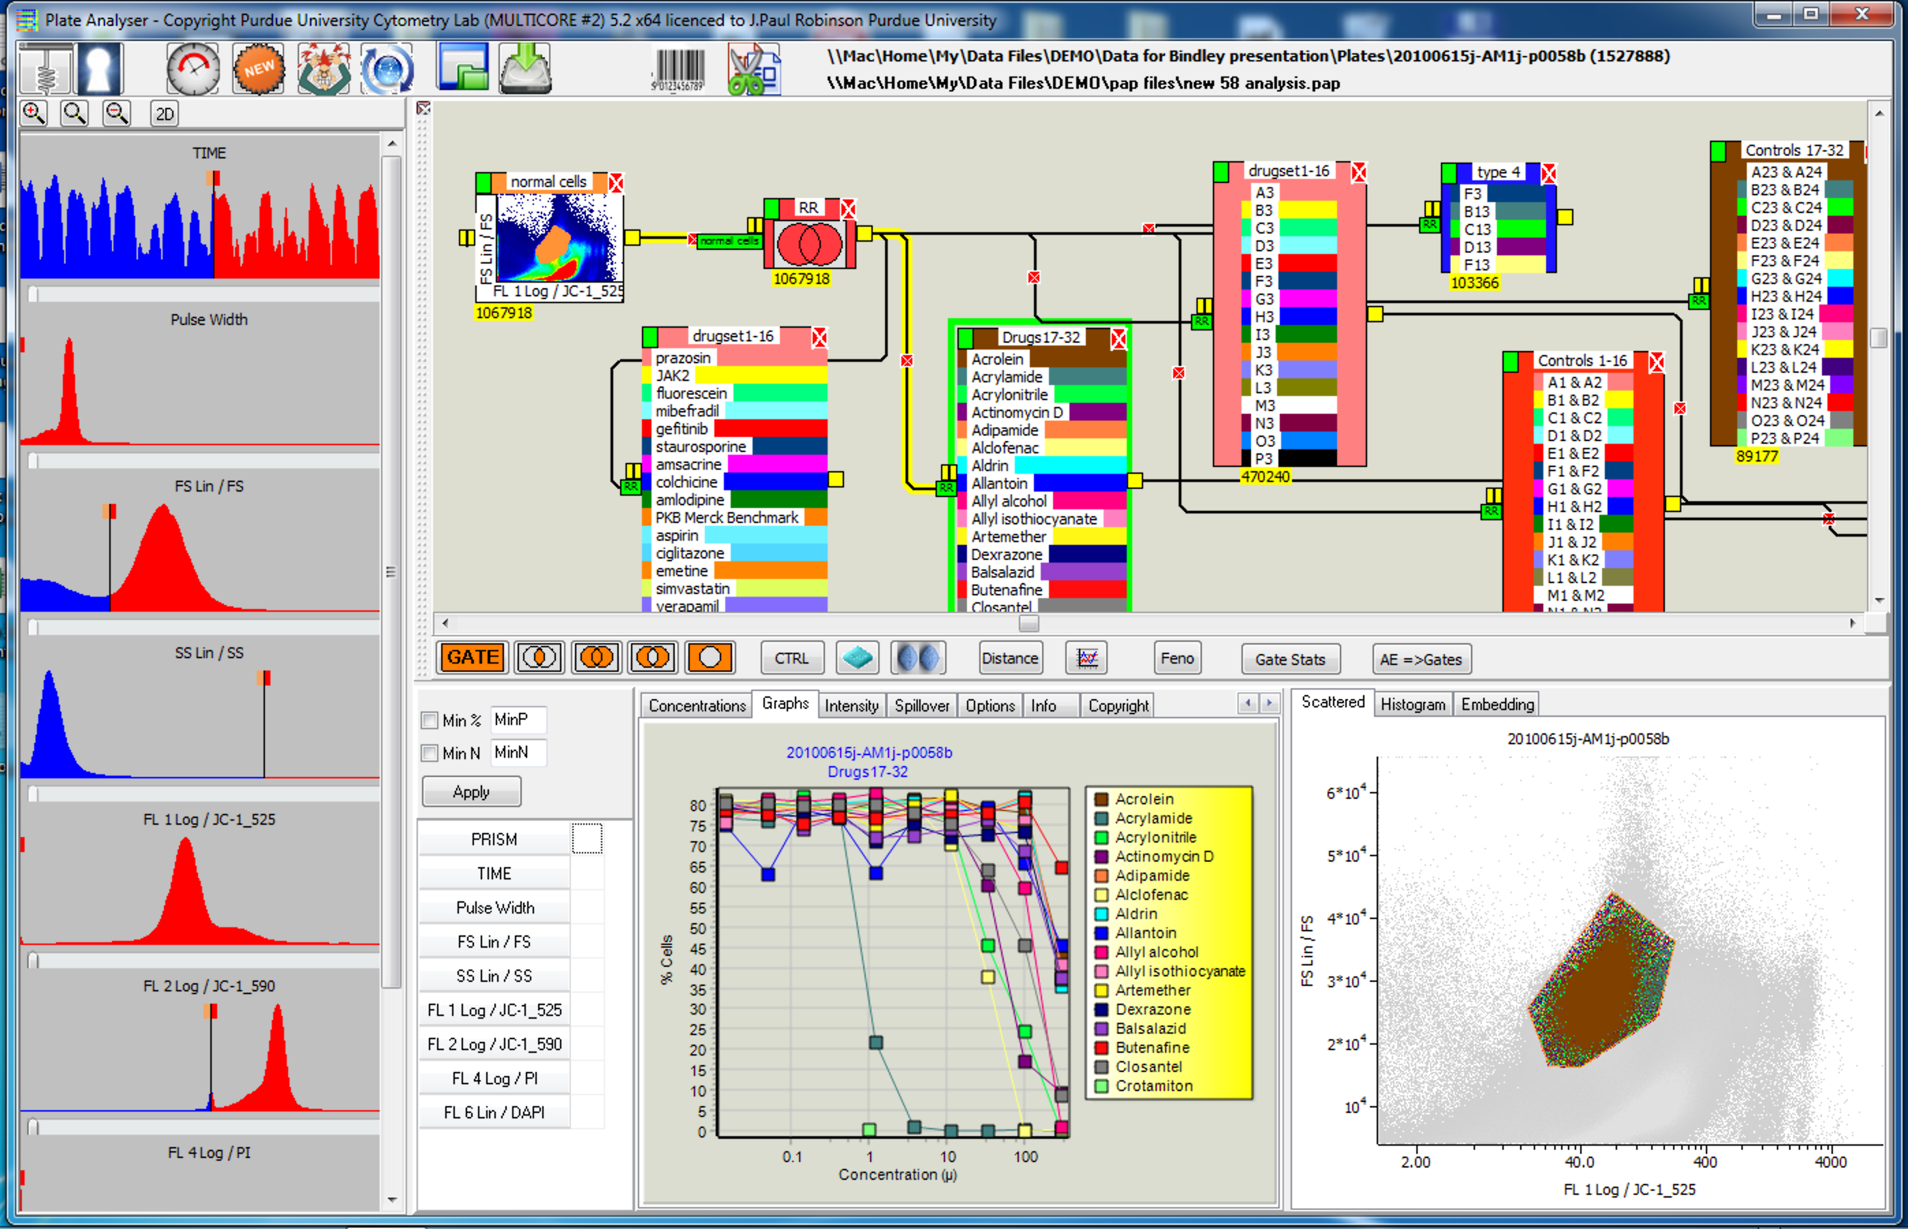

Slide 22
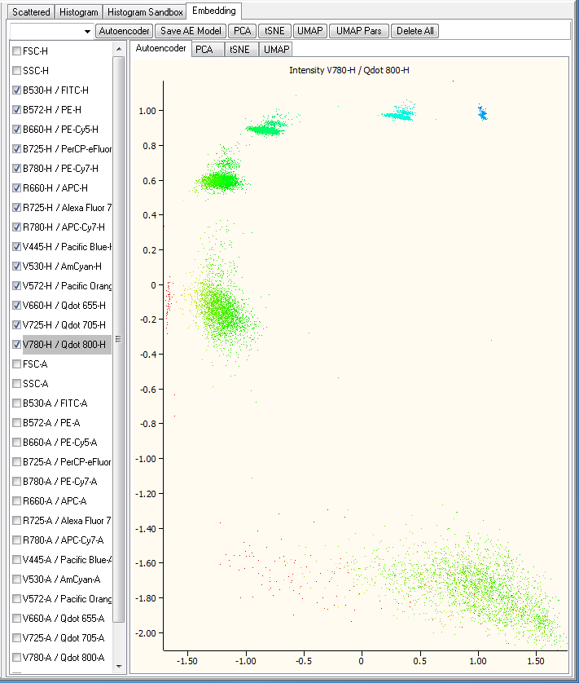
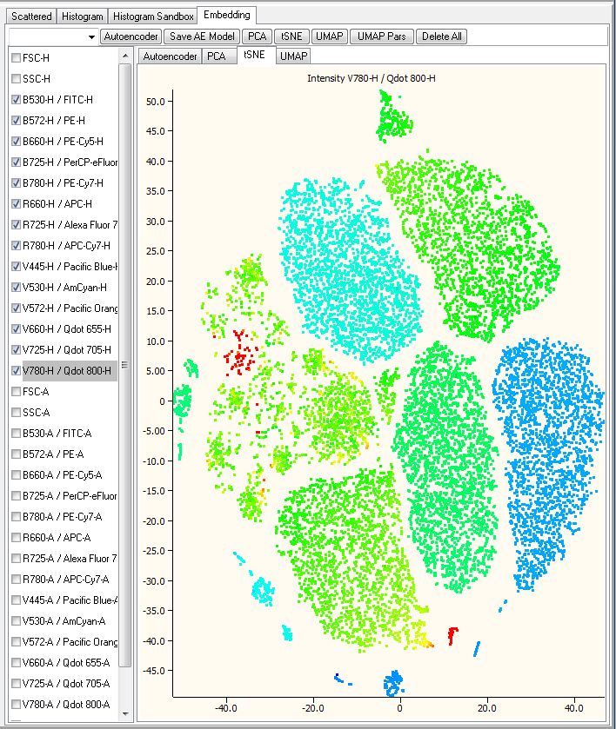
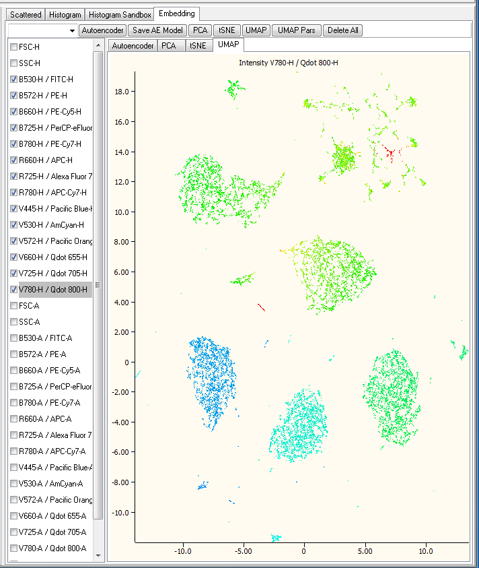
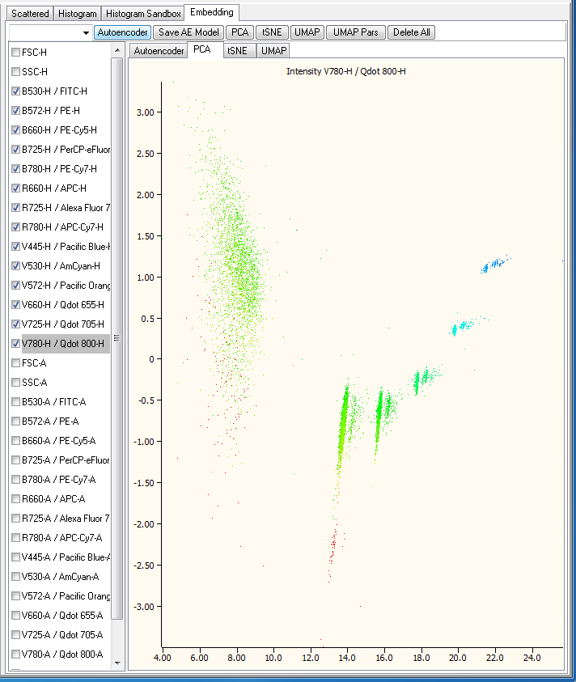
tSNE plots made with PlateAnalyzer software
Because of the high dimensionality of some flow data, we need to reduce this a a 2-dimensional description of the data – this allows us to interpret some complex data, but it is still not really very useful111

Slide 23
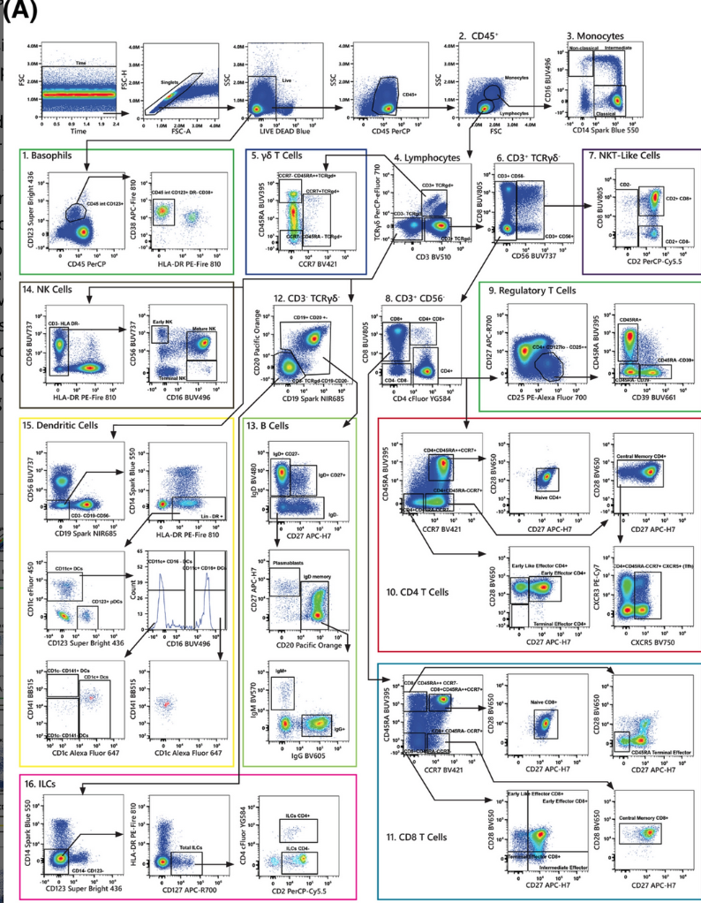
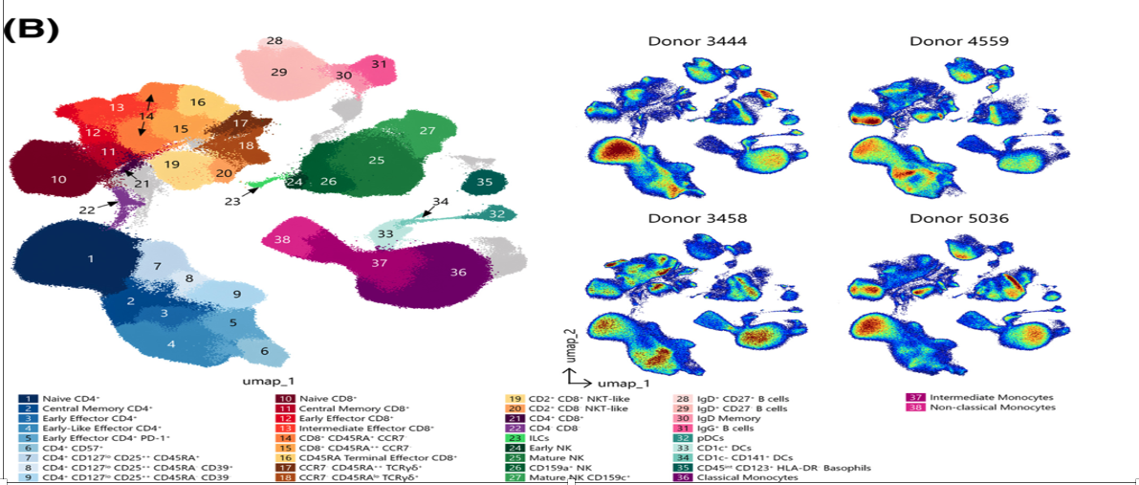
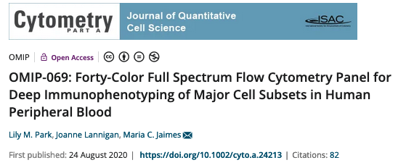
Complex data sets

Slide 24
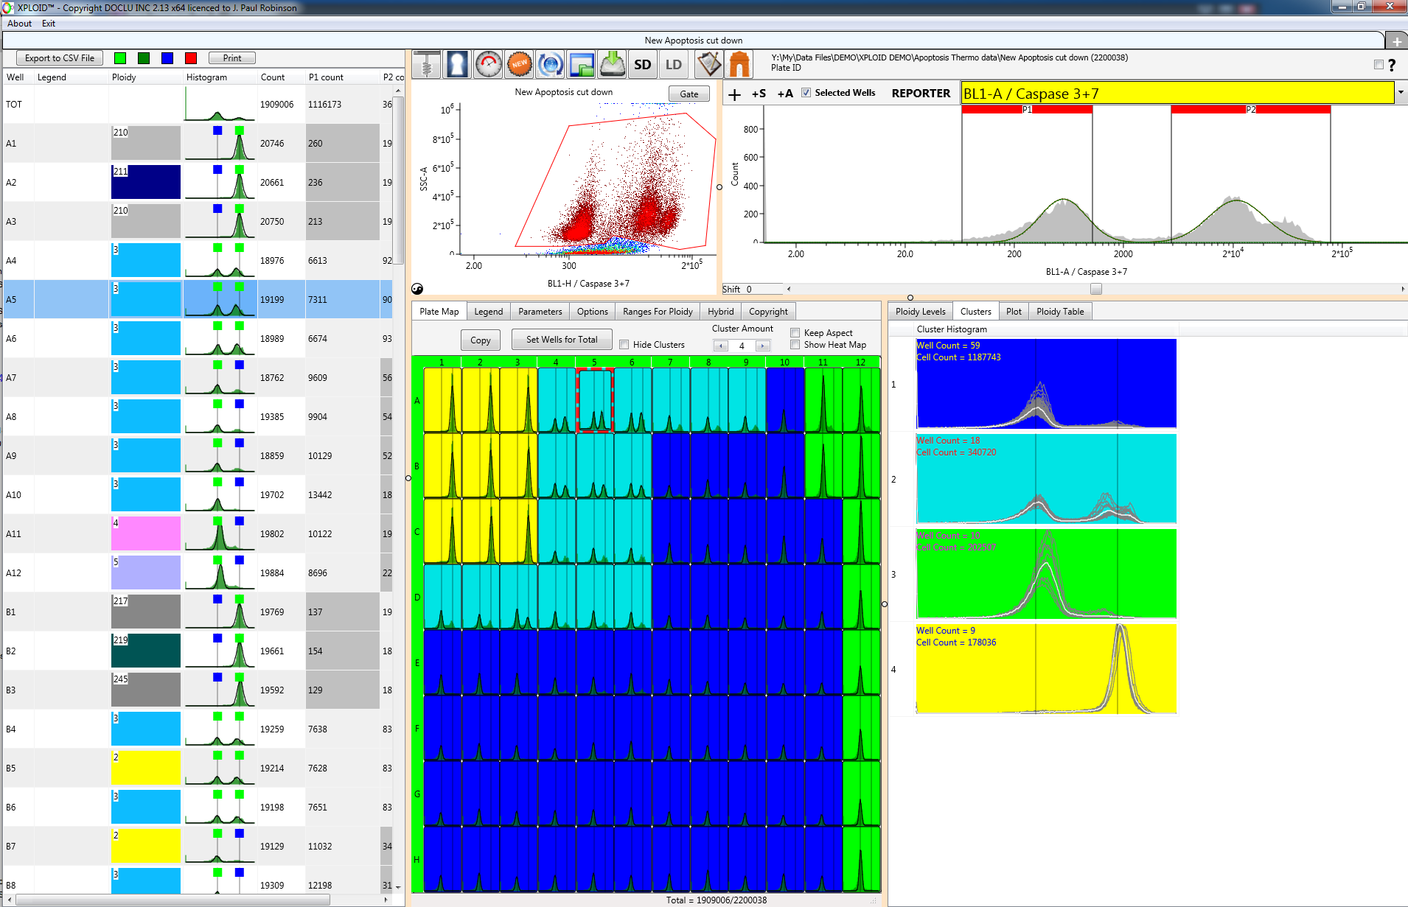
Automated DNA analysis for Plant hybrids
XPLOID from Purdue
Automated Classification

Slide 25
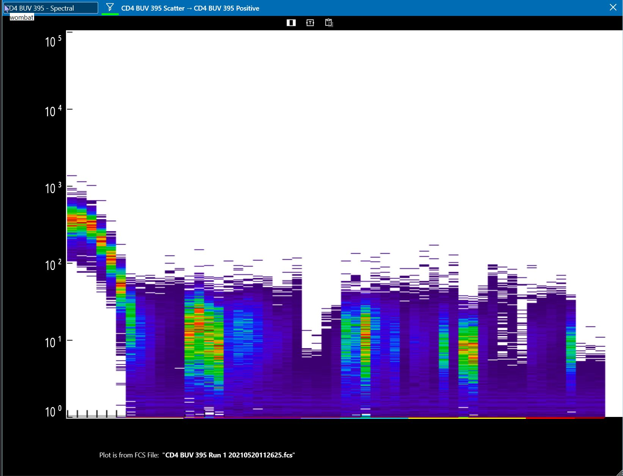
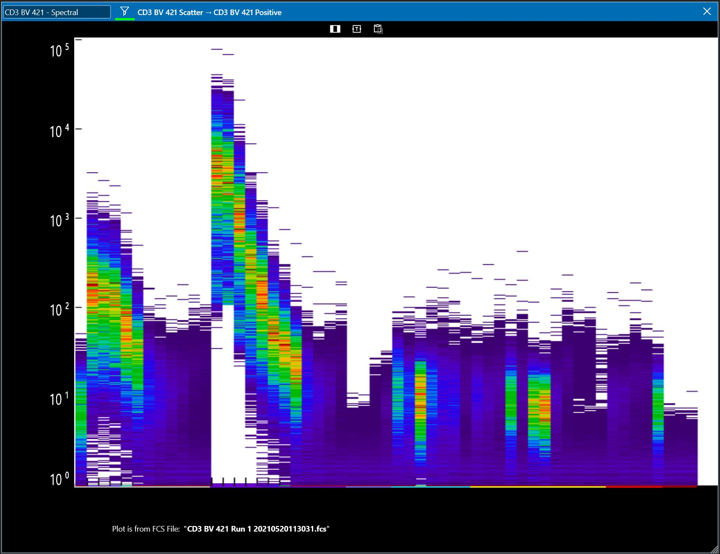
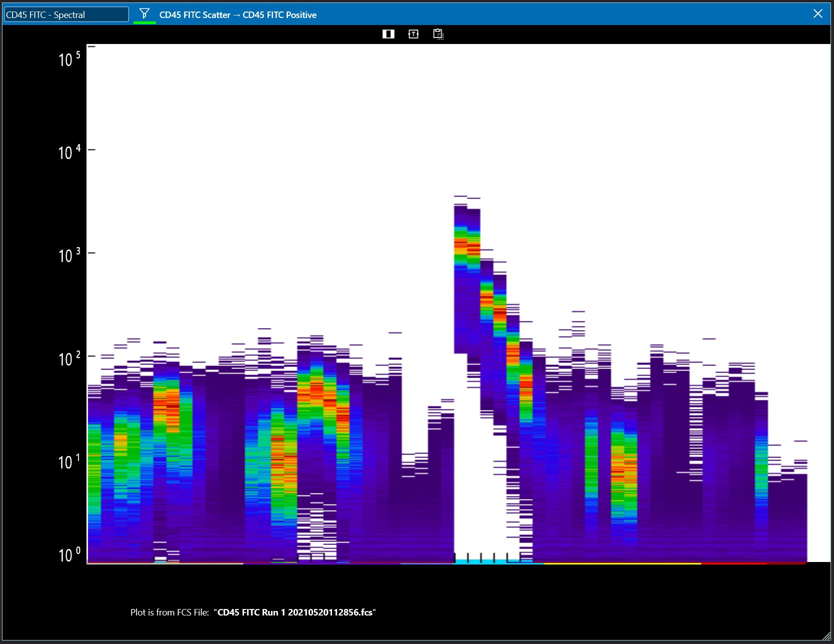
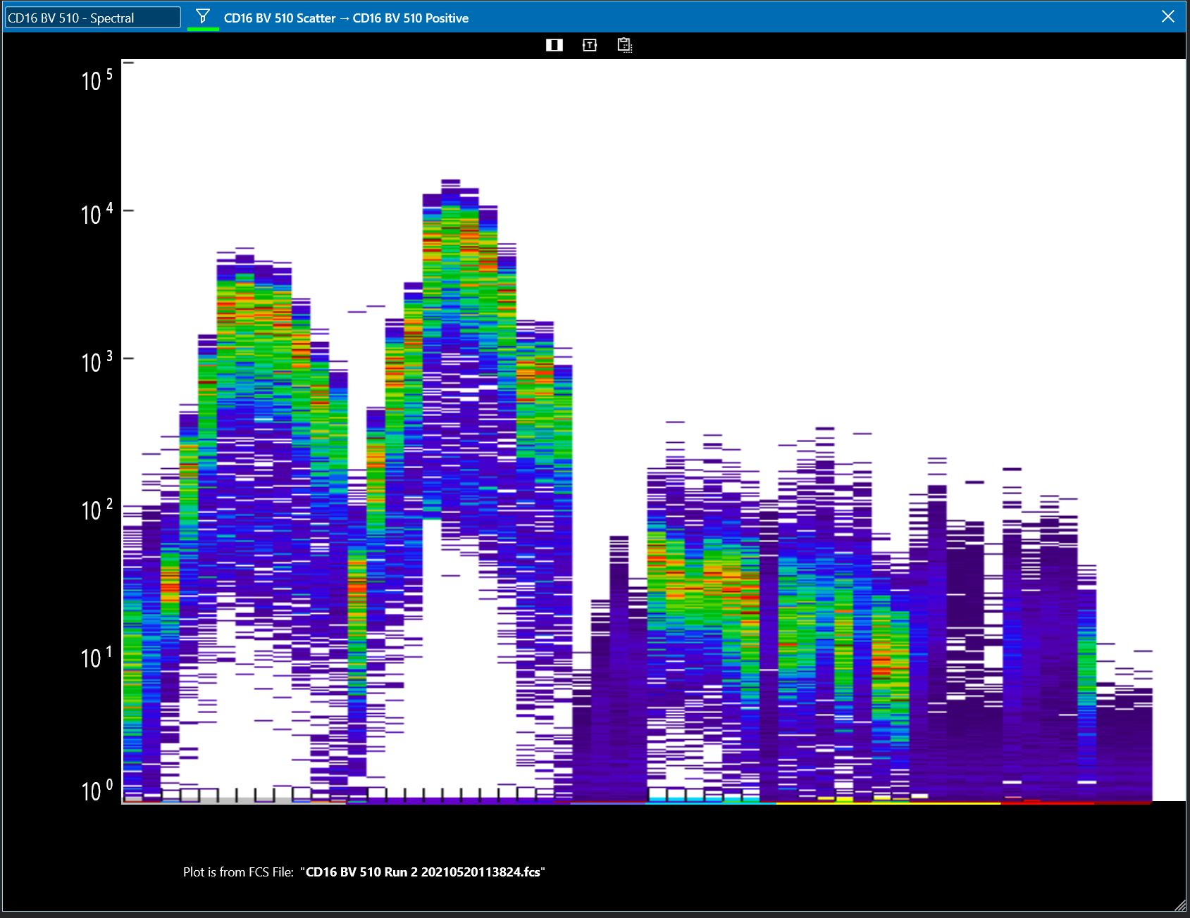
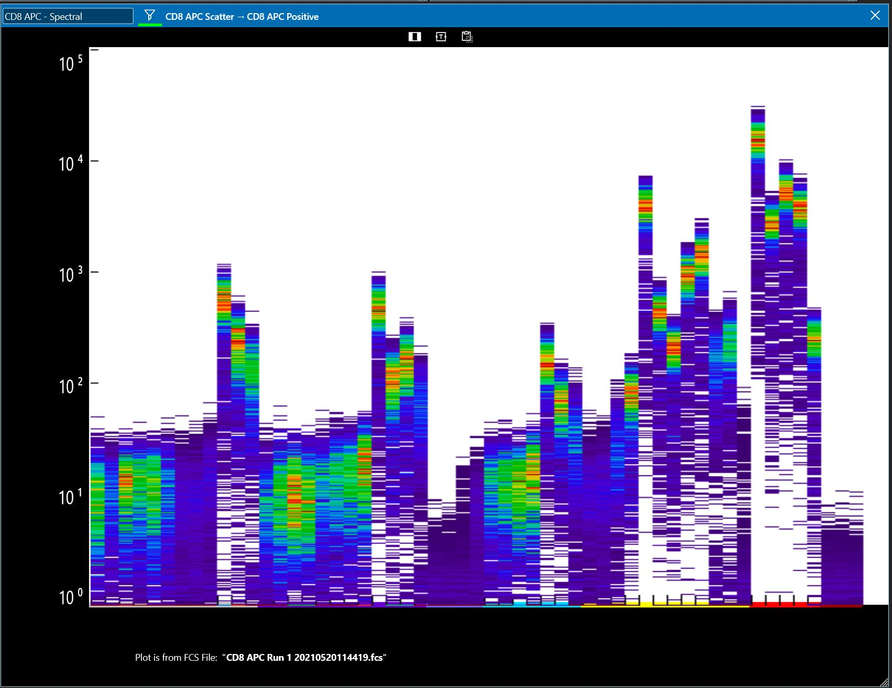
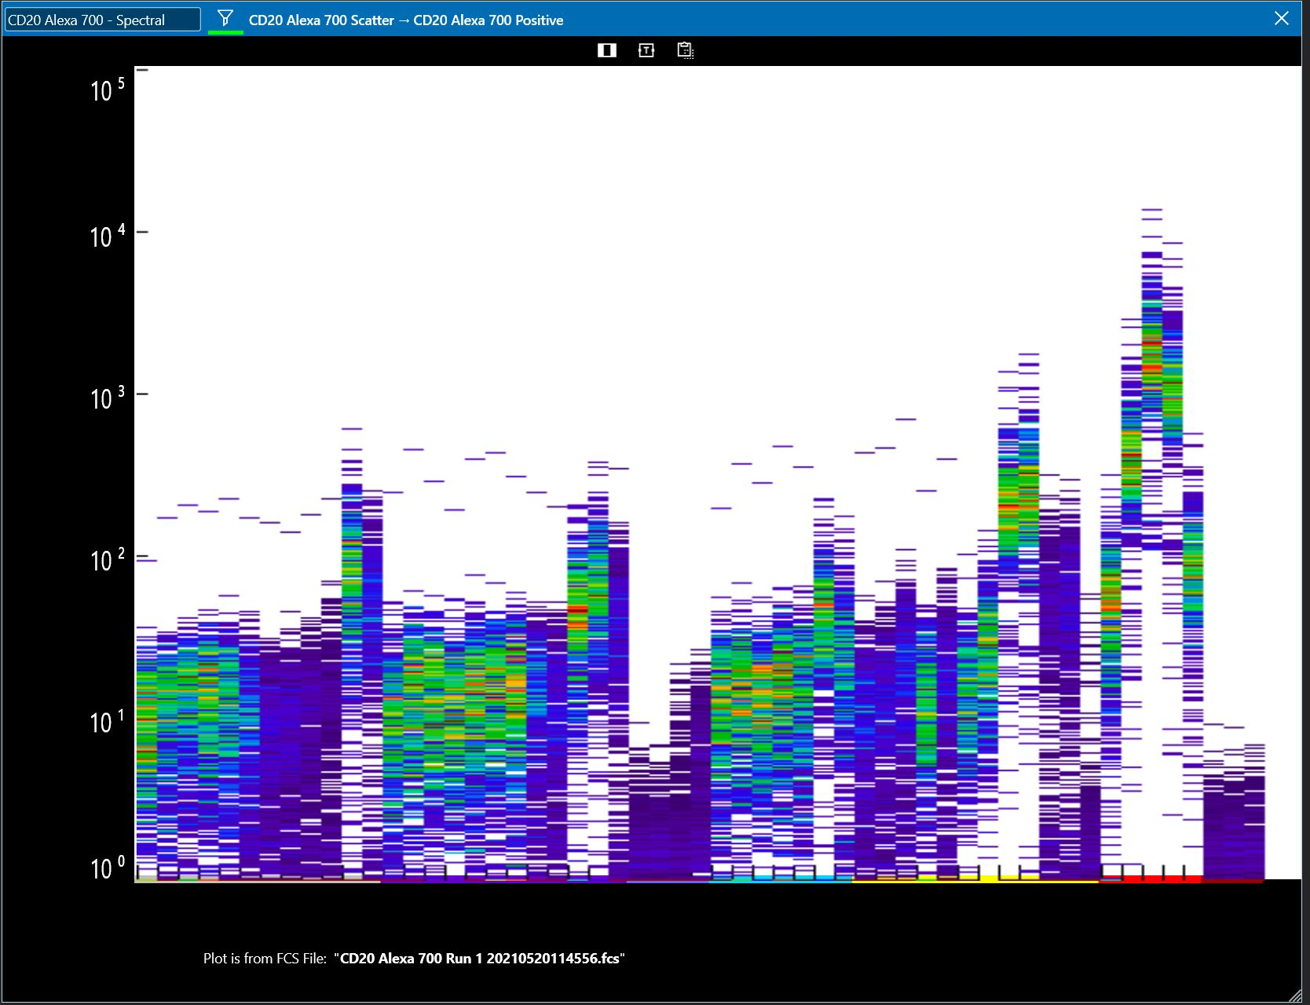
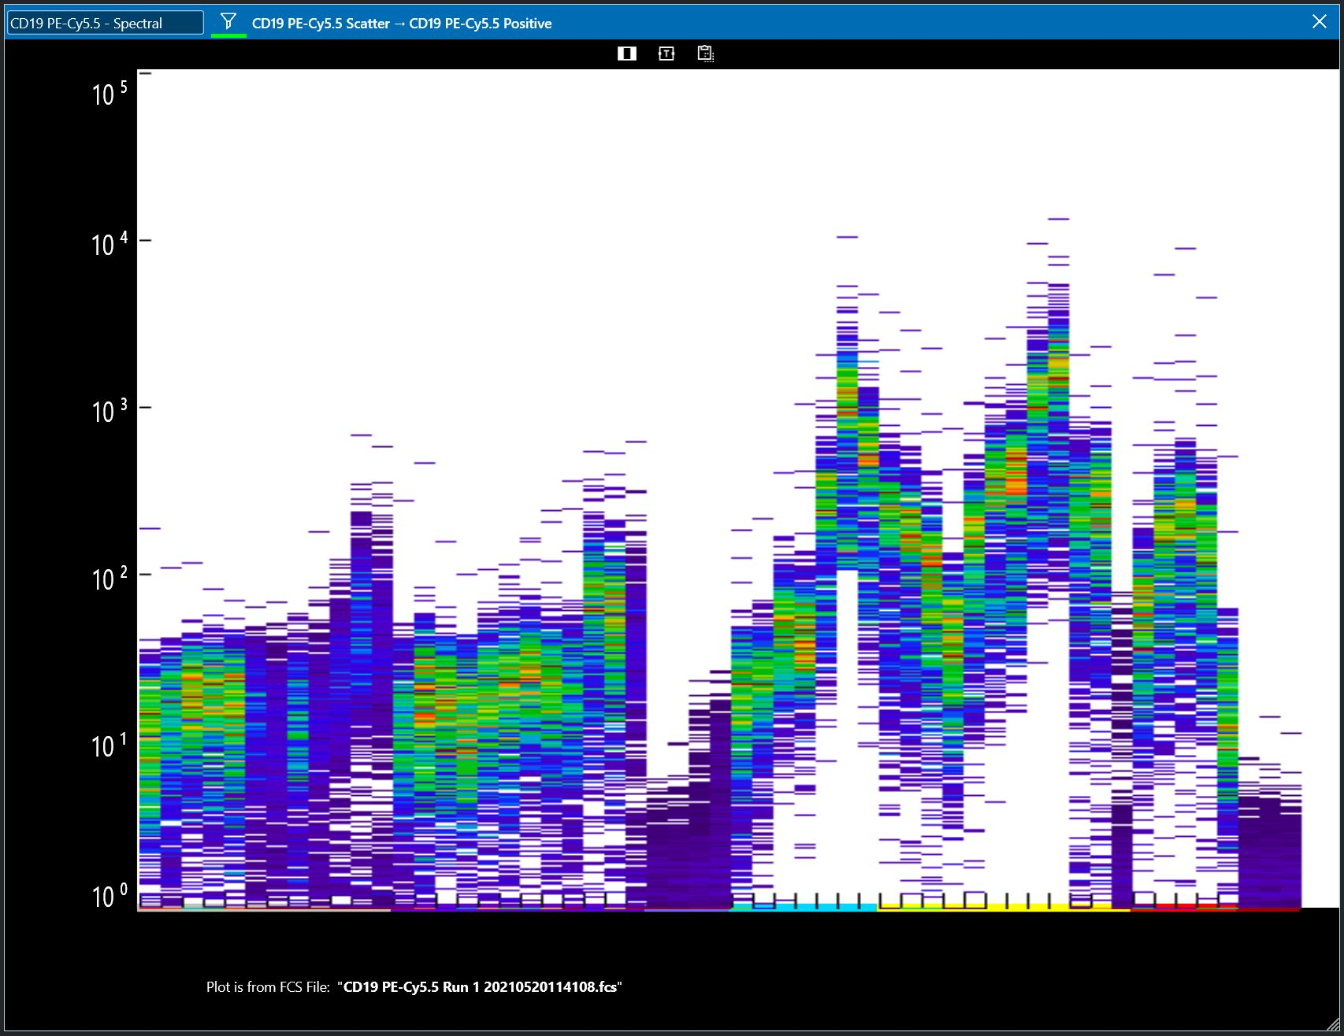
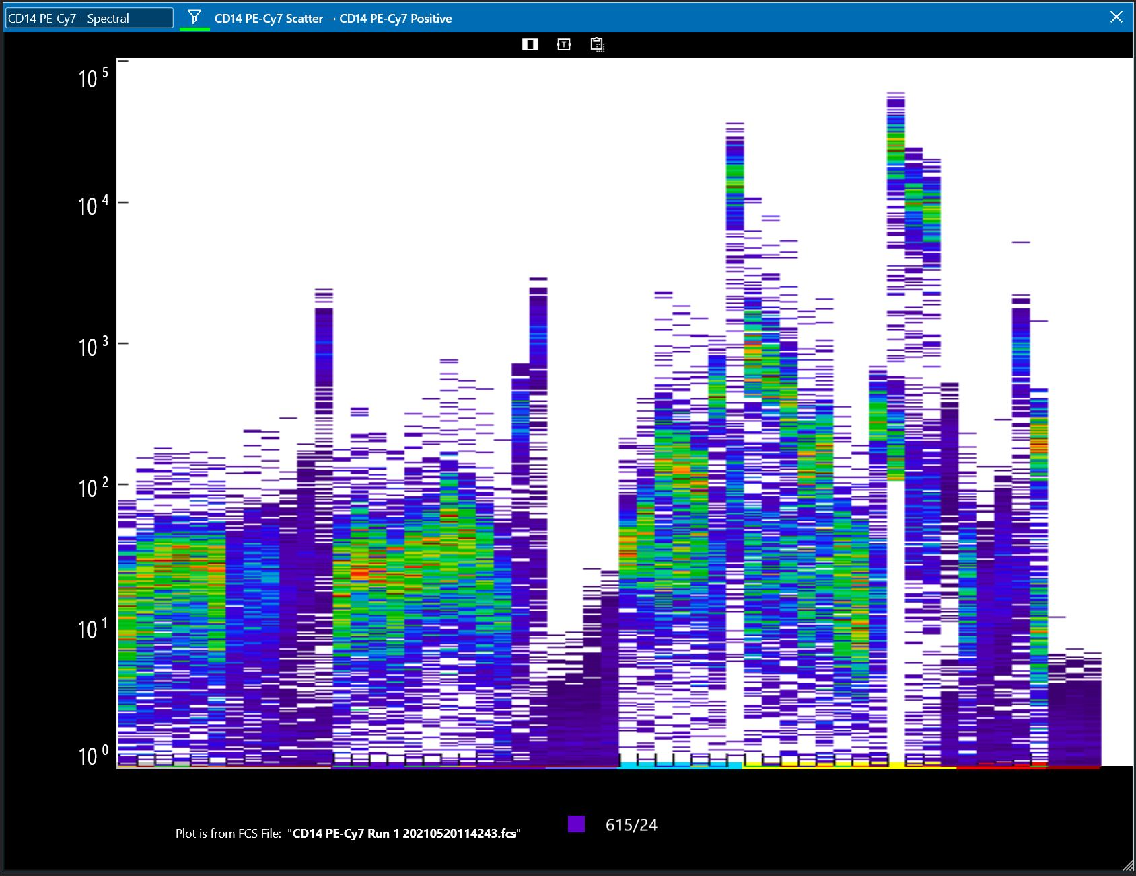
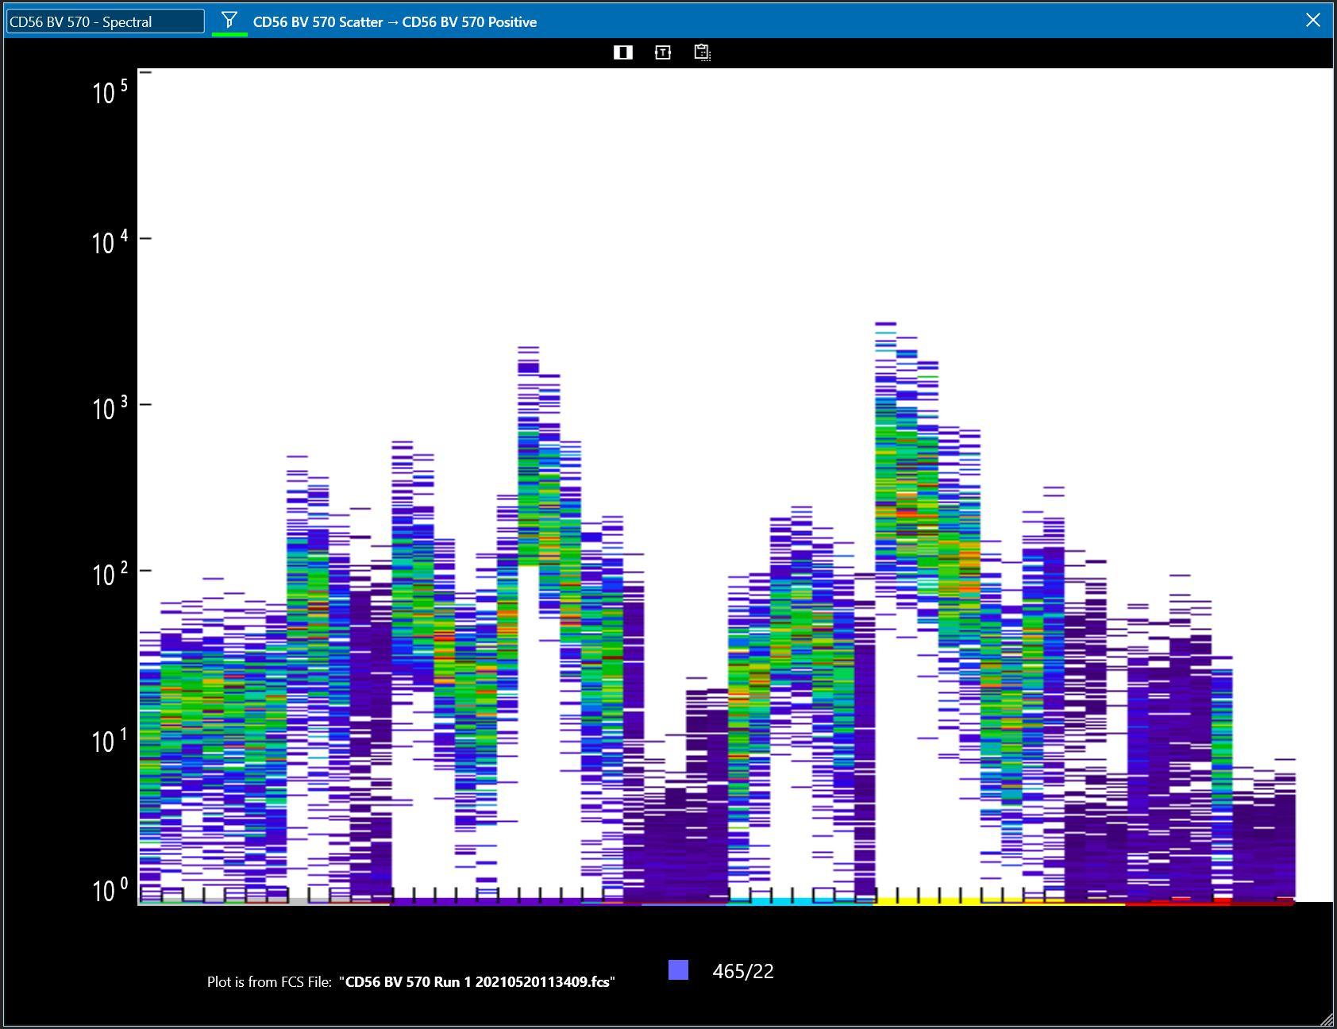
Spectral unmixing of multiple colors (in this data set 9)
CD4-BUV395
CD3 BV 421
CD45 FITC
Mixture
CD16 BV 510
CD8 APC
CD20 Alexa 700
CD19 PE-Cy5.5
CD14 PE-Cy7
CD56 BV 570

Slide 26
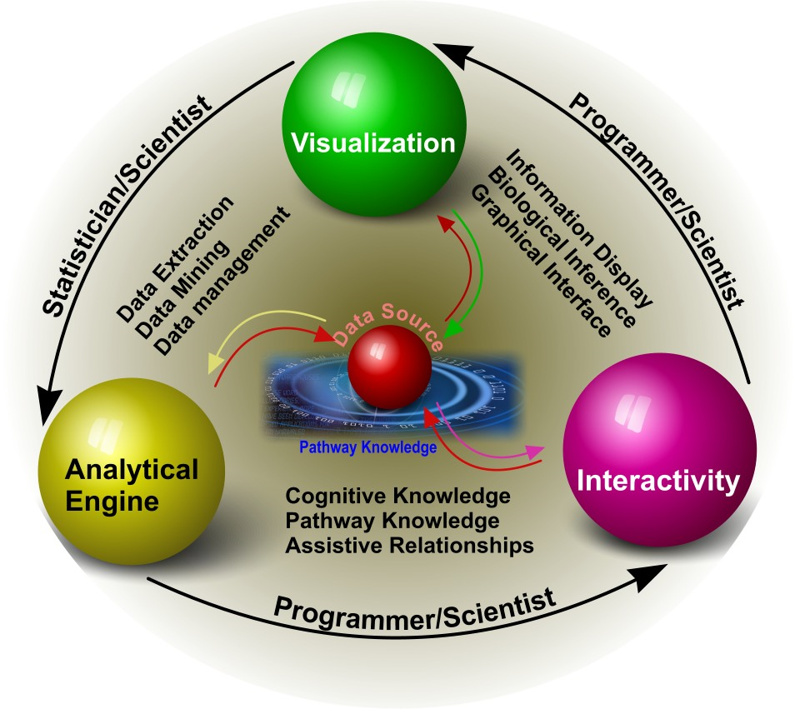

Slide 27
Summary
Traditional Data Processing is fine for the majority of flow cytometry
Advanced processes are necessary when using high parameter data sets
Care must be taken with use of processes such as tSNE and SPADE – they are processes that depend on a variety of components and will never produce the identical graph

