Slide 1
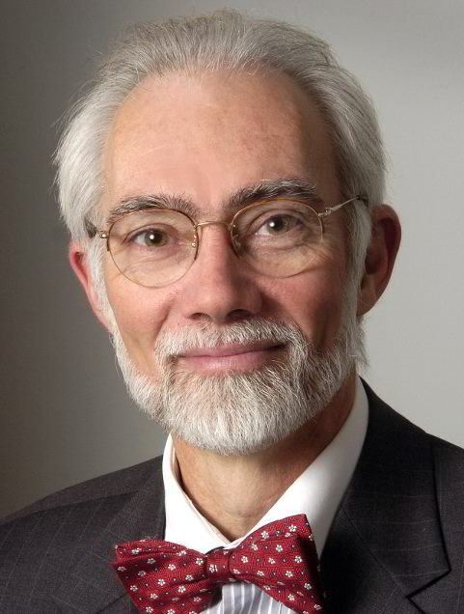



The Science of Innovation
J. Paul Robinson
SVM Professor of Cytomics
Professor of Biomedical Engineering
Director, Purdue University Cytometry Laboratories
@cytometryman
cytometryman
cytometryman

Slide 2
This presentation will focus on how some particular inventions were driven, why they were invented and what the impact of that invention was. There are many reasons why something is invented. It can be a brilliant idea that someone has and ends up being important in the larger picture. However, most often an invention is created because it was not possible to achieve some goal and after careful thought, a brilliant invention might be created.
In this presentation I will tell the story of the invention of the cell sorter which was invented exactly 50 years ago and published in Science in November 1965. This is a wonderful example of how an invention was driven by science and how that invention shaped and molded and indeed was a major contribution to the field of Immunology.
The story starts with a pathologist using yet another technology just invented. The pathologist misuses the technology and publishes results that appear from a biological perspective to have credence. But an engineer, evaluating that work, determines that the technology was misused and that the results did not represent the published finding. The problem was that there was no way to test this hypothesis without inventing a new technology.
What is exciting about this invention is that it built on two previous inventions – the Coulter Counter and the Ink jet printer – both of whom were in their infancy. It is a story of collaboration, cooperation, and sharing of information. It is a story of persistence and one that led to an amazing discovery that became a large field of research and clinical diagnostics. What is sad, is that despite the huge impact, that the inventors were never recognized for the Nobel-level discovery they made.
Fulwyler, M. J. (1965). "Electronic separation of biological cells by volume." Science 150: 910-911.

Slide 3
What is Innovation?

Slide 4


Slide 5
Innovation can be lots of things
Creating something that seems obvious after you see it, might mean it is innovative
Seeing a solution that currently does not exist might be innovative
Solving a difficult problem might use an innovative approach
Thinking “outside the box” can be innovative
“The term innovation can be defined as something original and more effective and, as a consequence, new, that "breaks into" the market or society”
https://en.wikipedia.org/wiki/Innovation

Slide 6
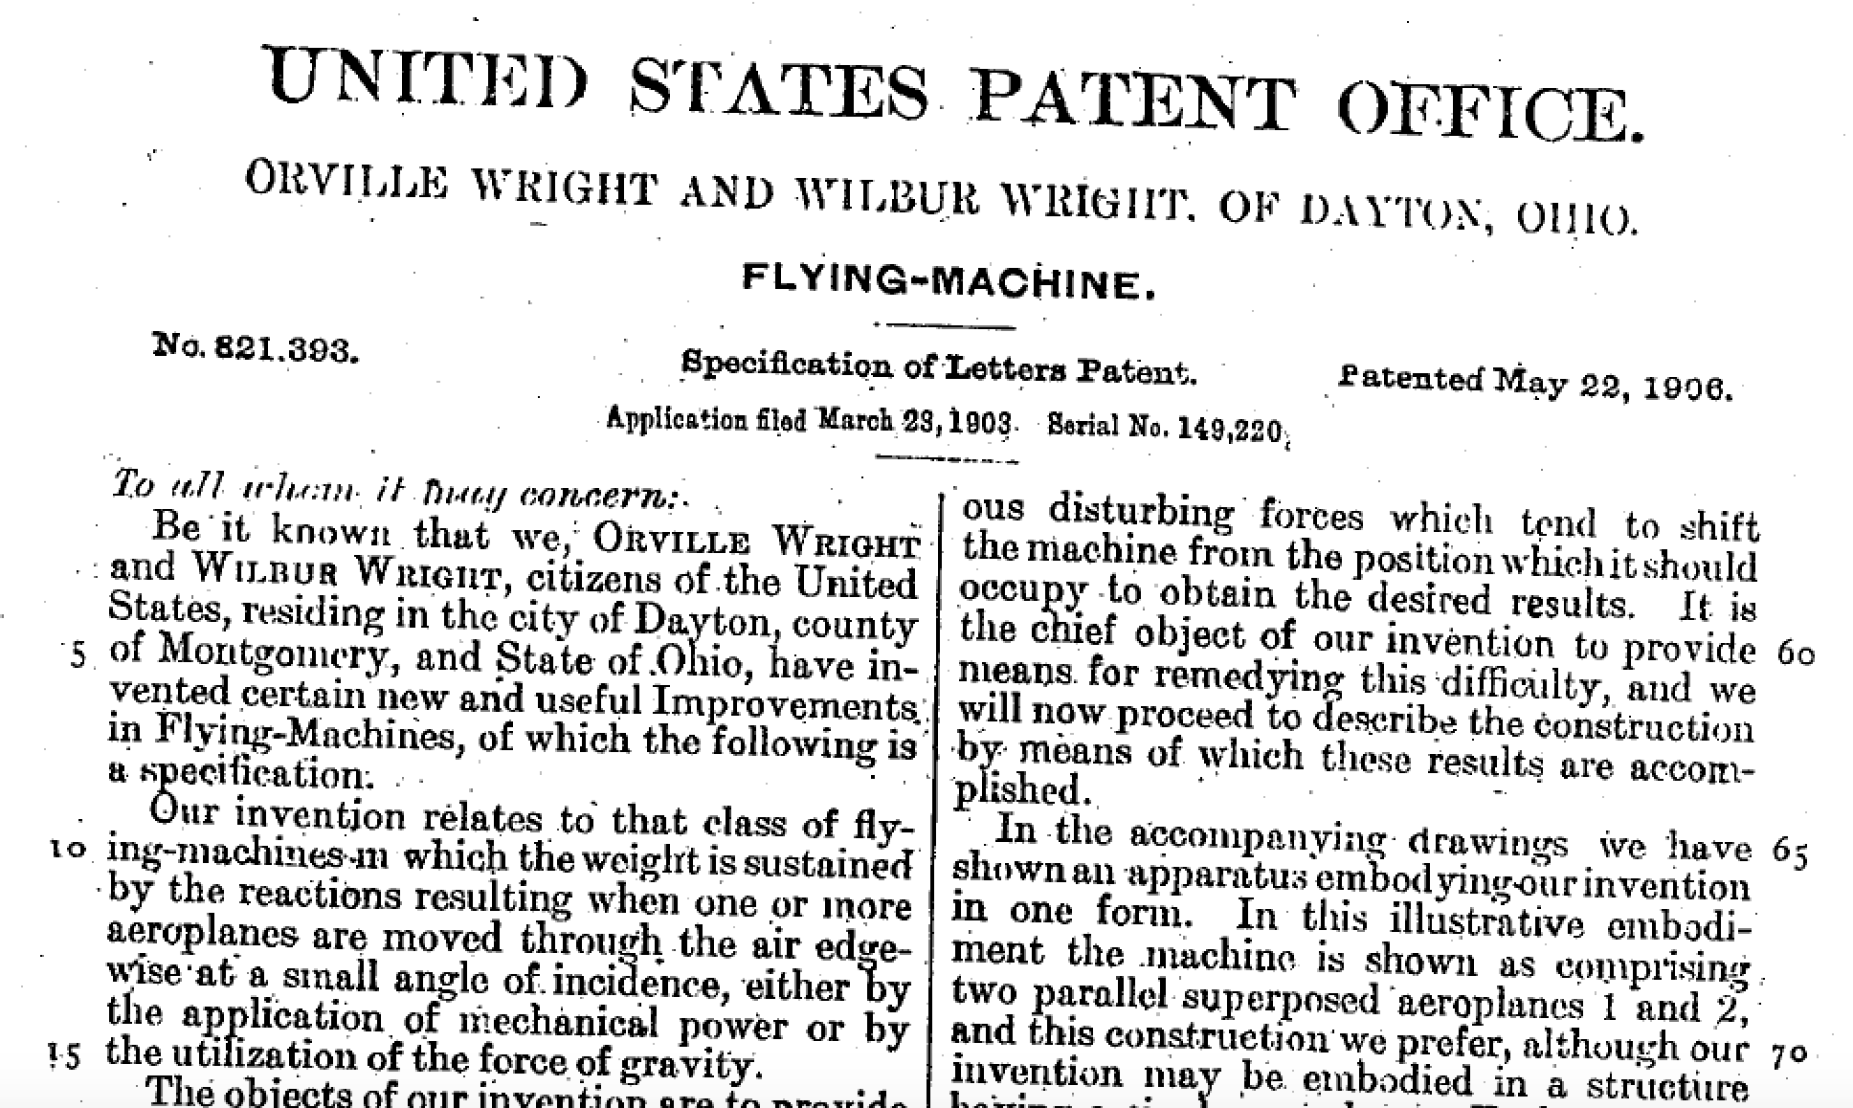


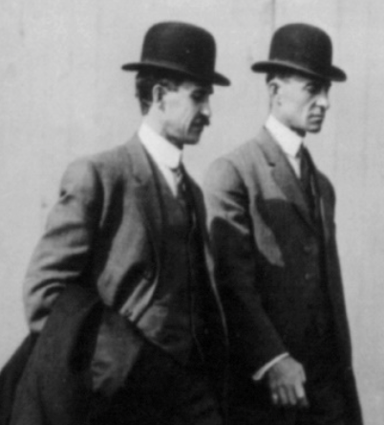
@cytometryman
Wright - US821393 A
Photo: https://reasonandreflection.wordpress.com/tag/orville-wright/

Slide 7
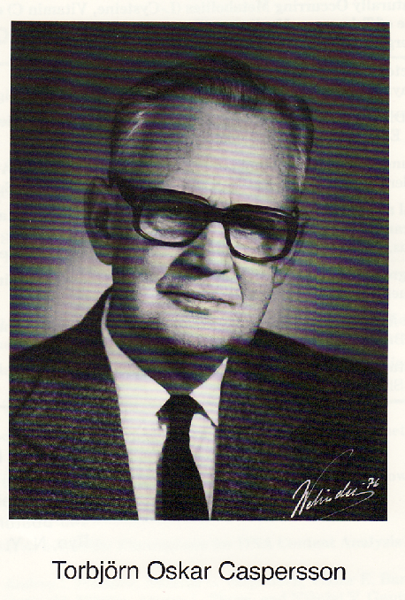
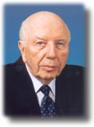
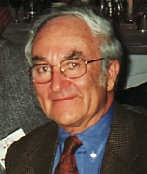
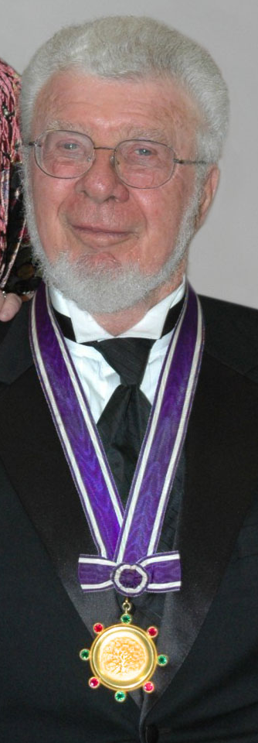

Cytometry has a history of over 100 years with lots of innovation
Ehrlich 1880s - used acidic and basic dyes to identify acidophilic, eosinophilic, basophilic and neutrophilic leukocytes 1880’s to study the dynamics of ocular fluids- used fluorescein for first time
Feulgen (1925) - demonstrated that DNA was present in both animal and plant cell nuclei - developed a stoichiometric procedure for staining DNA involving a derivatizing dye, (fuchsin) to a Schiff base
Caspersson - (1938-1998) - 1941 - “demonstrated that nucleic acids, far from being waste products, were necessary prerequesites for the protein synthesis in the cell (published in Naturwissenschaften in January 1941) and that they actively participated in those processes.” [“History of the Development of Cytophotometry from 1935 to the present” in Analytical and Quantitative Cytology and Histology, pp2-6, 1986]
Early interests in cancer diagnosis from Papanicolaou & Traut (1941)
Tremendous technology developments in the 1950-60,70s including Ploem’s epi-fluorescence microscope, Coulter’s counter, Gohde & Kamentsky’s cytometer and Fulwyler’s sorter, & Herzenberg immunophenotyping
Automation in the 1990s led to vast numbers of cytometry instruments
2000’s – next generation technologies with advanced bioinformatics

Slide 8
Cell analysis technology state-of-the-art
1950s
1960s
1970s
1980s
1990s
2000s
2010s
2020s
Cell counting
Cell sorting
Advanced Cell detection systems
Cell separation/classification – Monoclonal Antibodies
Polychromatic (multicolor) cytometry (1-3 colors)
Multicolor analysis (3-8) Reagent development – dyes and antibodies, bead assays
The age of new small instruments, 10-20 color, hyperspectral cytometry
Nano-cytomics – complex analysis - modeling
How are these discoveries made?

Slide 9
Pathways for discovery
Biological problem
Create new tools
Hypothesis
Experimental approach
Multidisciplinary
Use available tools
Biology
Engineering
Solution
Failure
New technology
Let’s look at an example…

Slide 10
Systems Integration at Cellular Level
Analytical Cytology
  Flow cytometry (next generation platforms)
  Single cell analysis systems
  Tissue analysis (integrated with cellular analysis)
  High Content Analysis (screening)
Image Analysis and Classification
  Single cells
  Tissues and organs – (even whole animal)
  Cell culture systems
Proteomics
  Cellular homogeneity via phenotypic classification
  Protein profiling (based on cellular level phenotypic identity)

Slide 11
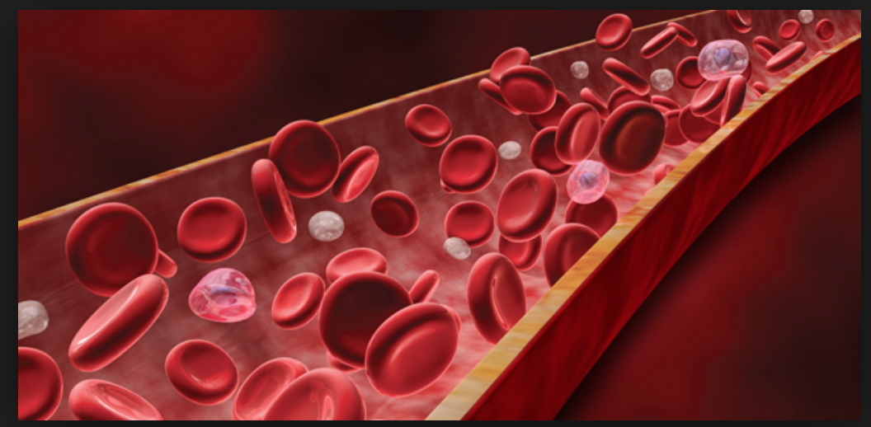
The invention of the blood cell counter
The problem: There was no fast, accurate way of quantifying red blood cell or white blood cell number for clinical evaluation
http://www.theatlantic.com/health/archive/2012/03/sorting-through-white-blood-cells-in-a-sample-to-diagnose-disease/254263/

Slide 12
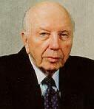
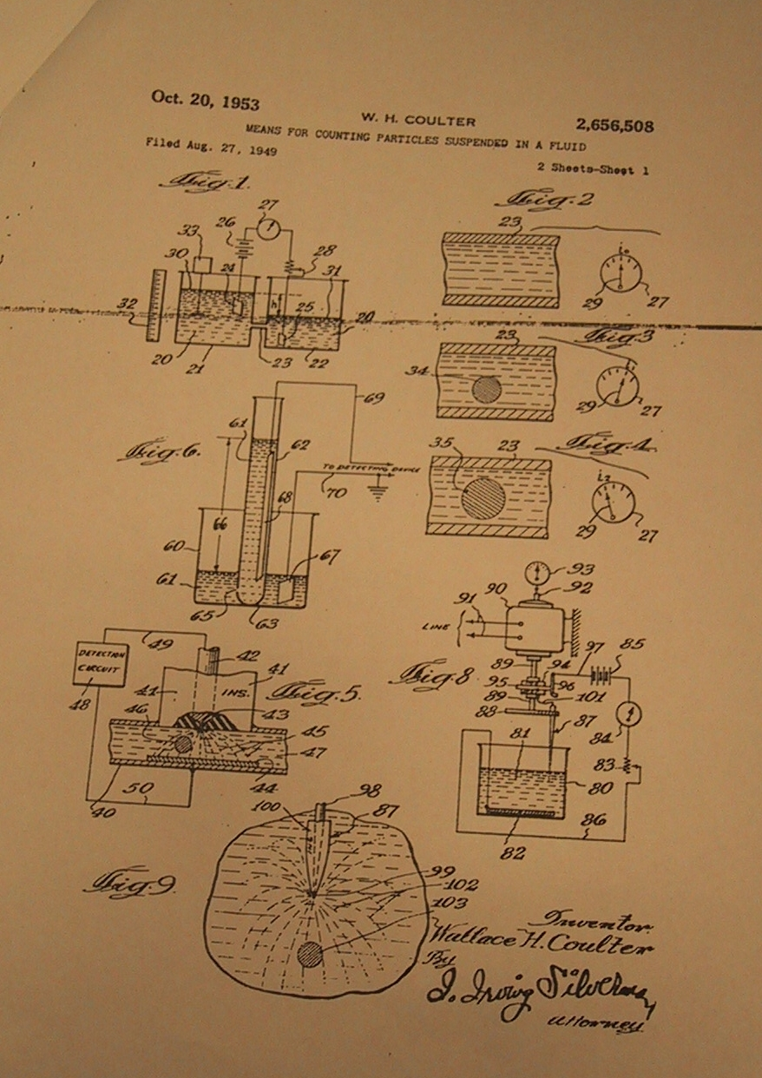
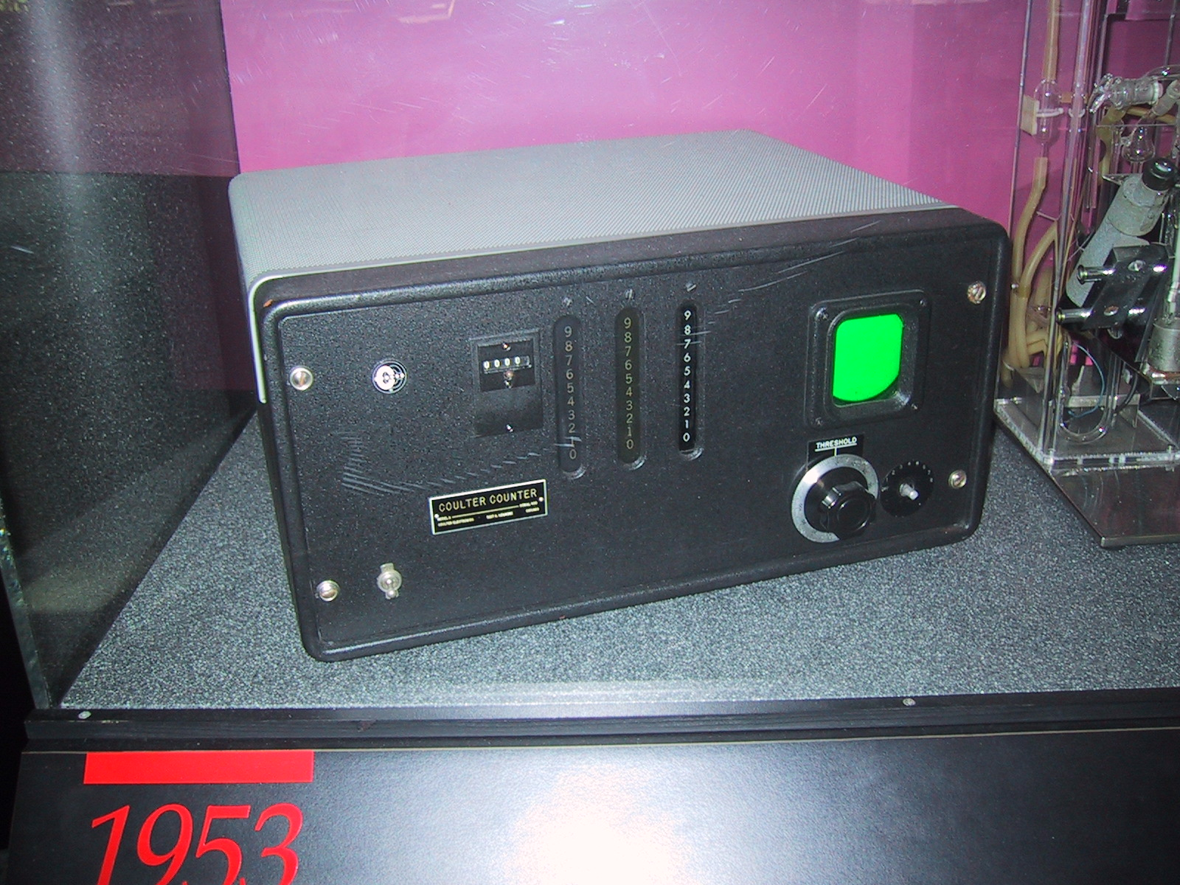
Wallace Coulter
Wallace Coulter - Coulter orifice – 1949-1956
(patent issued 1953) - measured changes in electrical conductance as cells suspended in saline passed through a small orifice
Coulter’s
Original 1953
Patent application
Filed on Aug 27, 1949
photo J.Paul Robinson
The first commercial version of the Coulter Counter

Slide 13
The first Coulter Counter
High Speed Automatic Blood Cell Counter and Cell Size Analyzer
Wallace H. Coulter
Coulter Electronics, Chicago, Illinois
Proc. Nat. Elect. Conf. of 1956 (published Vol 12:1034-1042, 1957)
Wallace Coulter’s only
Publication – but it was so
Innovative, that is all he needed!!

Slide 14
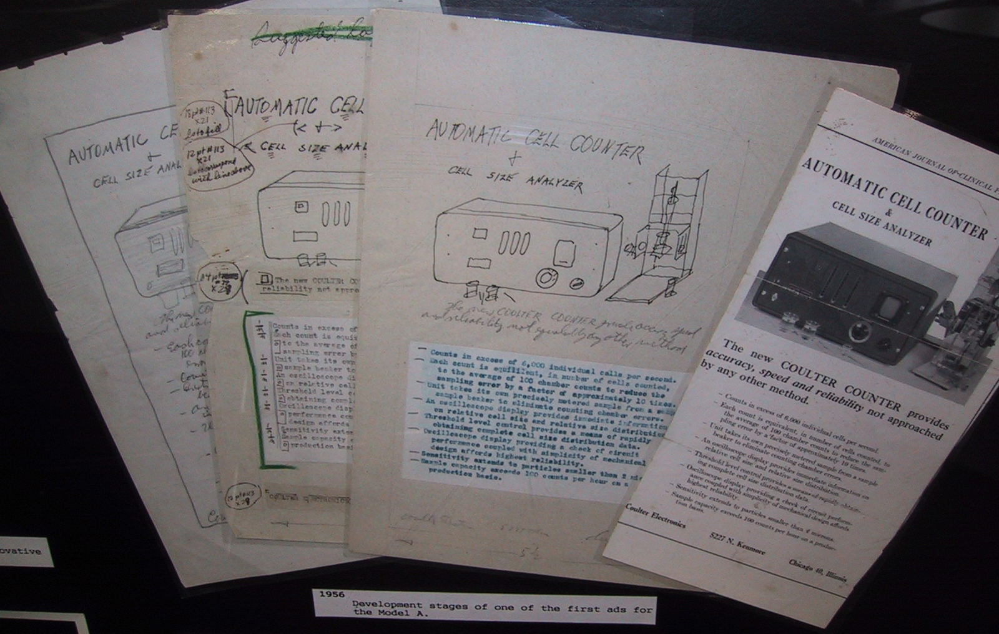
Hand-drawn advertising drafts of the first
Coulter Counter (1956)

Slide 15
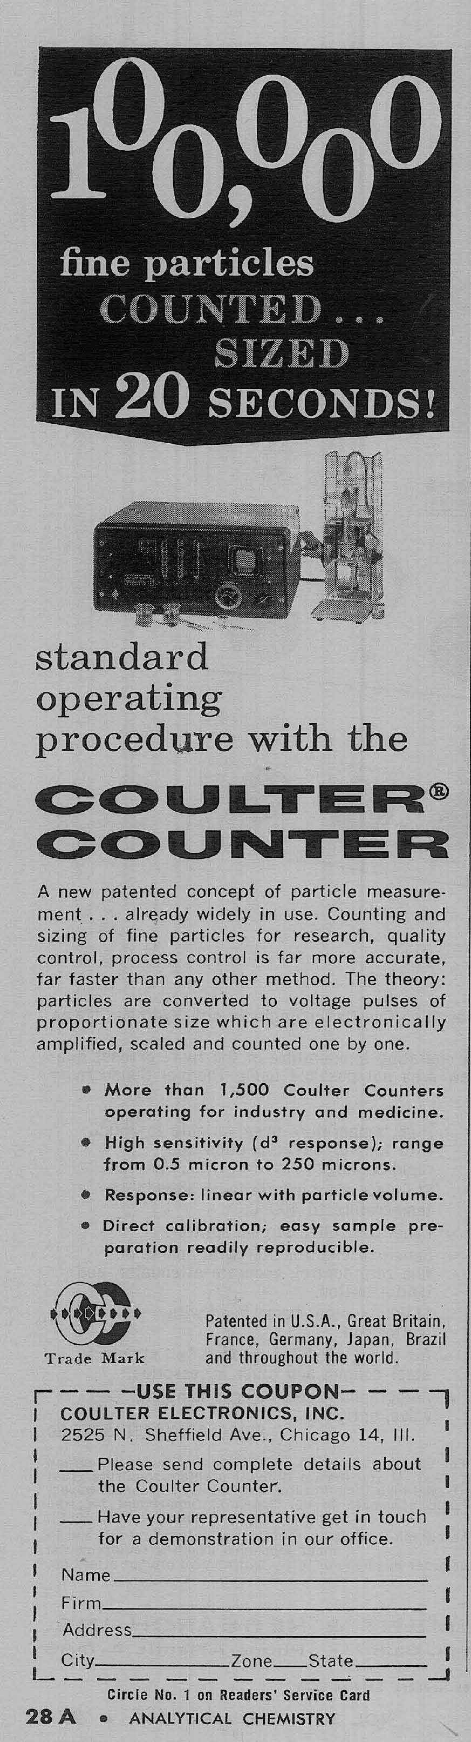
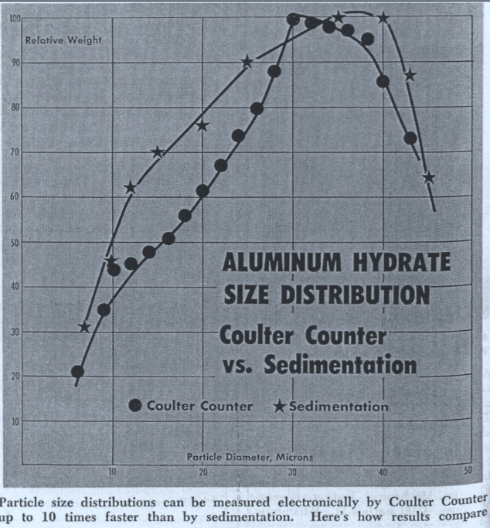
Industrial Applications of particle analysis

Slide 16
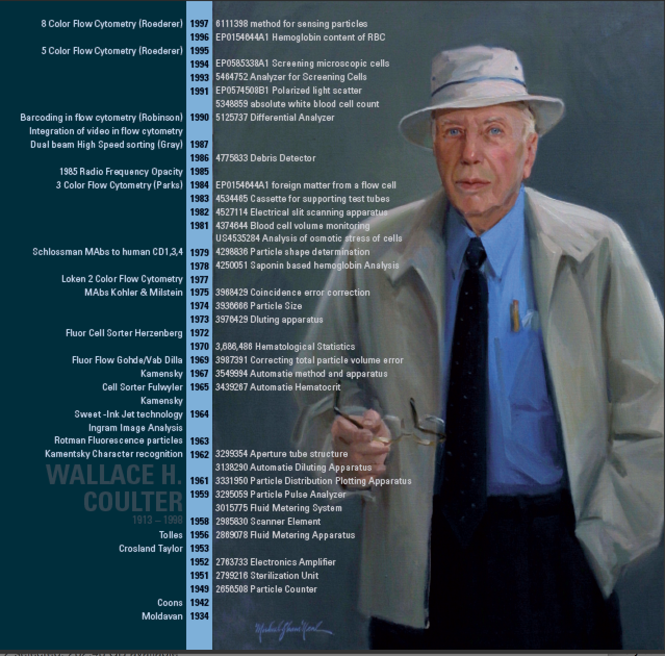
Wallace Coulter’s
85 Patents

Slide 17
The Impact
Within a few years the coulter counter became the blood cell counting standard
An entire industry developed around the world
The practice of medicine was radically changed as a fast, accurate test was available
Blood cell counts are probably one of the most prolific medical tests performed
An entirely new secondary field was created based on the knowledge gained from the Coulter Counter

Slide 18
2nd Example of New Technology
Invention of cell sorting - flow cytometry
Problem:
  pathologist uses new technology
  (Coulter counter late 1950s)
  Tries to use technology to interpret biology but does not understand it and makes fundamental error
Solution:
  New technology had to be developed to test hypothesis
  Pathologist proved wrong
  Others identify new uses for invented technology
photo J.Paul Robinson

Slide 19
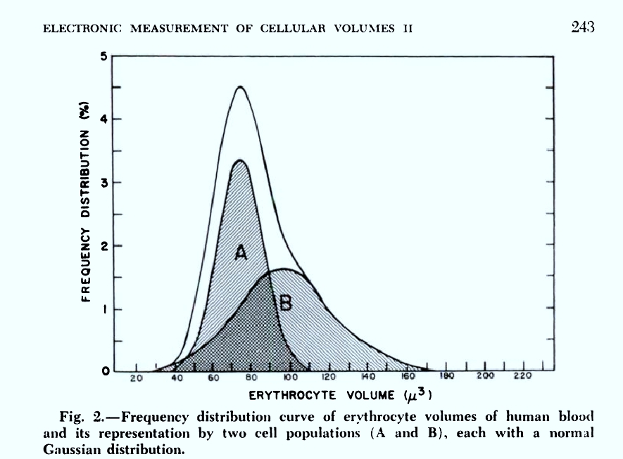
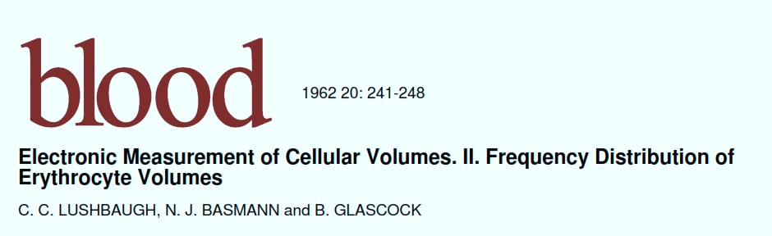
The publication that started flow cytometry
C.C. Lushbaugh performed some experiments that indicated to him that there were multiple populations of RBC based on impedance…..he published this in 1962

Slide 20
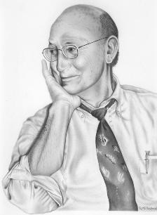

Mack Fulwyler - engineer
Four years later Mack Fulwyler looked at the data and believed that the data was not correct based on engineering principles – not biology.
Fulwyler Movie

Slide 21
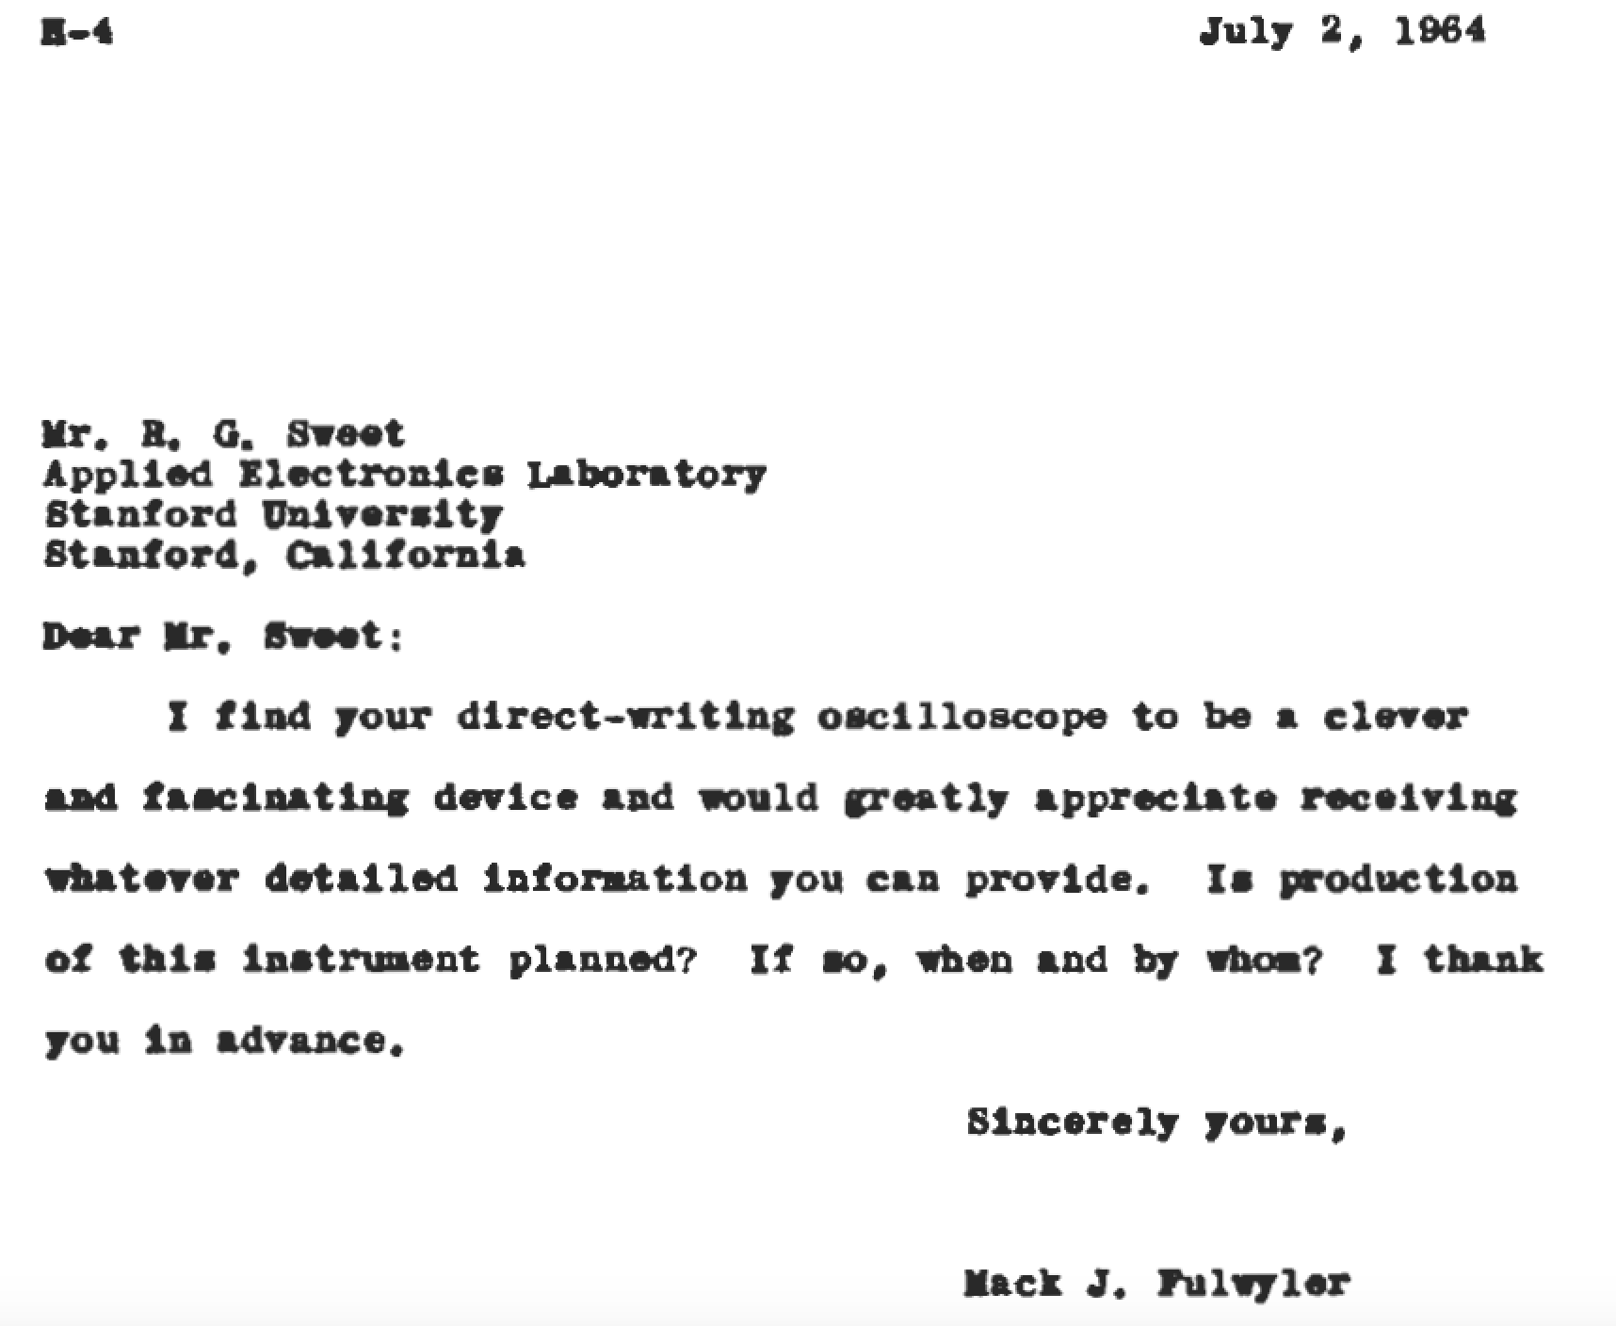
Fulwyler hears a talk by Sweet at a scientific conference

Slide 22
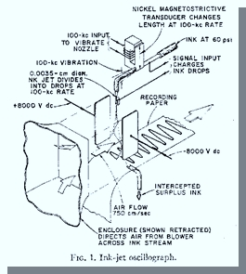
Richard Sweet and the invention of the Inkjet Printer
Sweet has invented the “Direct Writing Oscilloscope”

Slide 23
What does Sweet’s innovation do?
It takes a stream of ink, vibrates it at a very high frequency and make thousands of tiny drops
By changing the charge field, the steam of drops can be rapidly moved showing a high speed graph on paper

Slide 24
Sweet’s 1964 paper
This is the basis of the inkjet printer technology
The principle of
electrostatic deflection

Slide 25
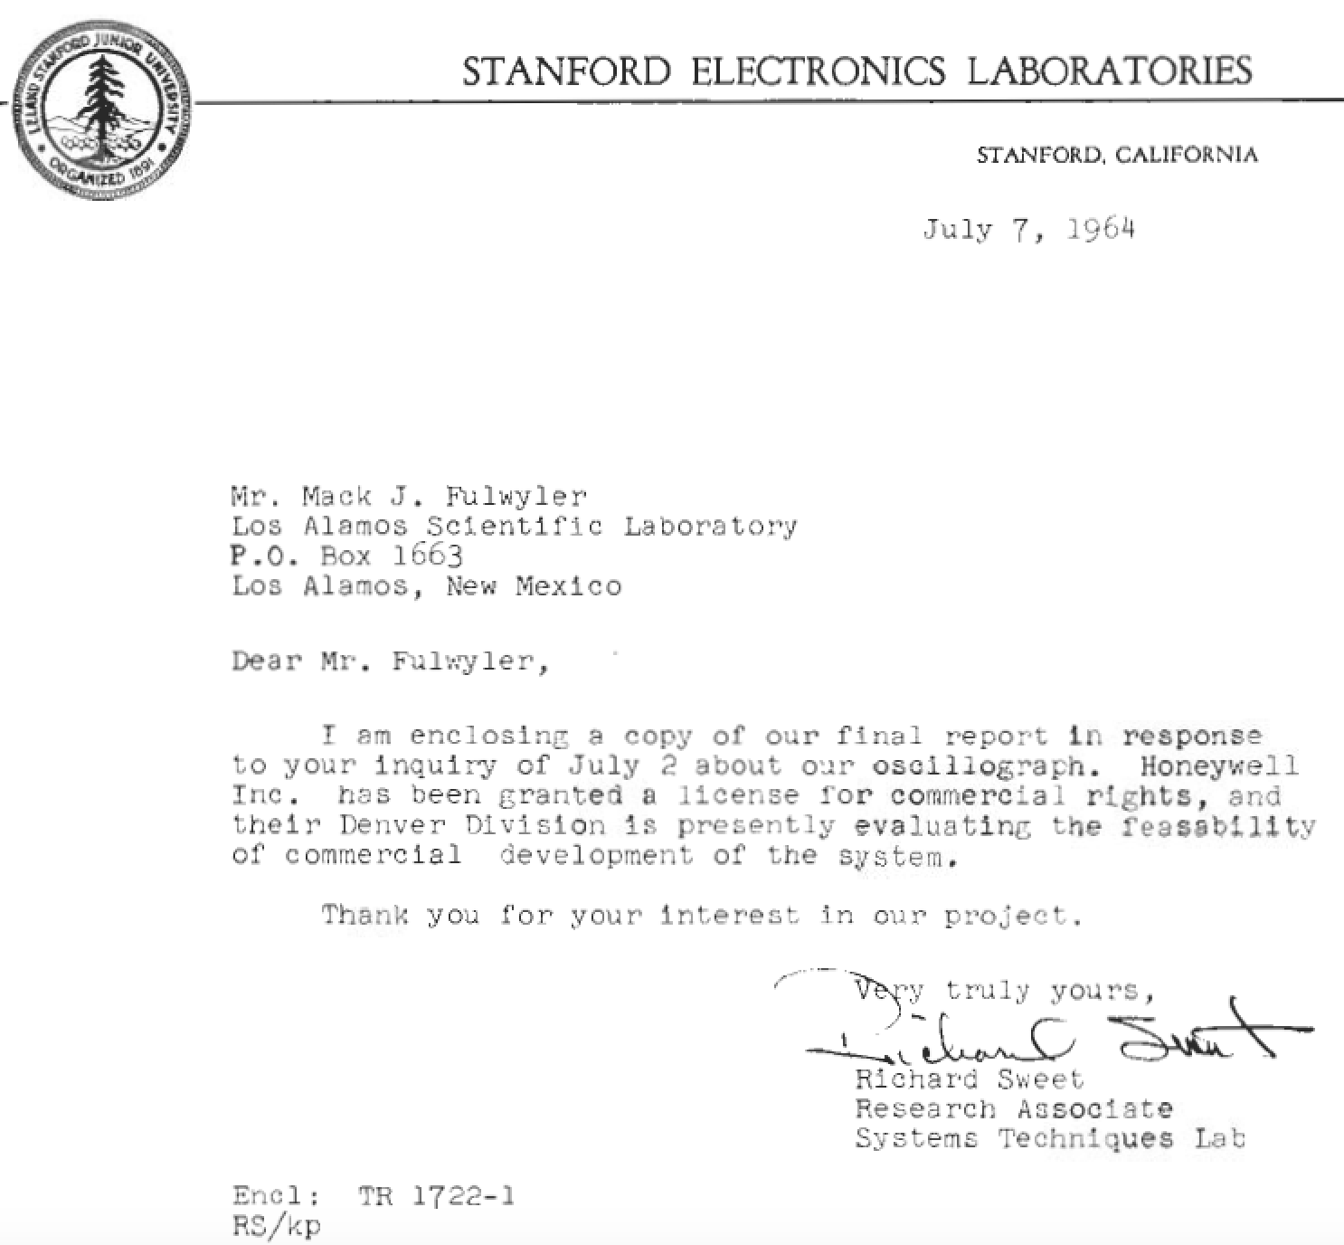
Sweet responds to Fulwyler’s letter 5 days later

Slide 26
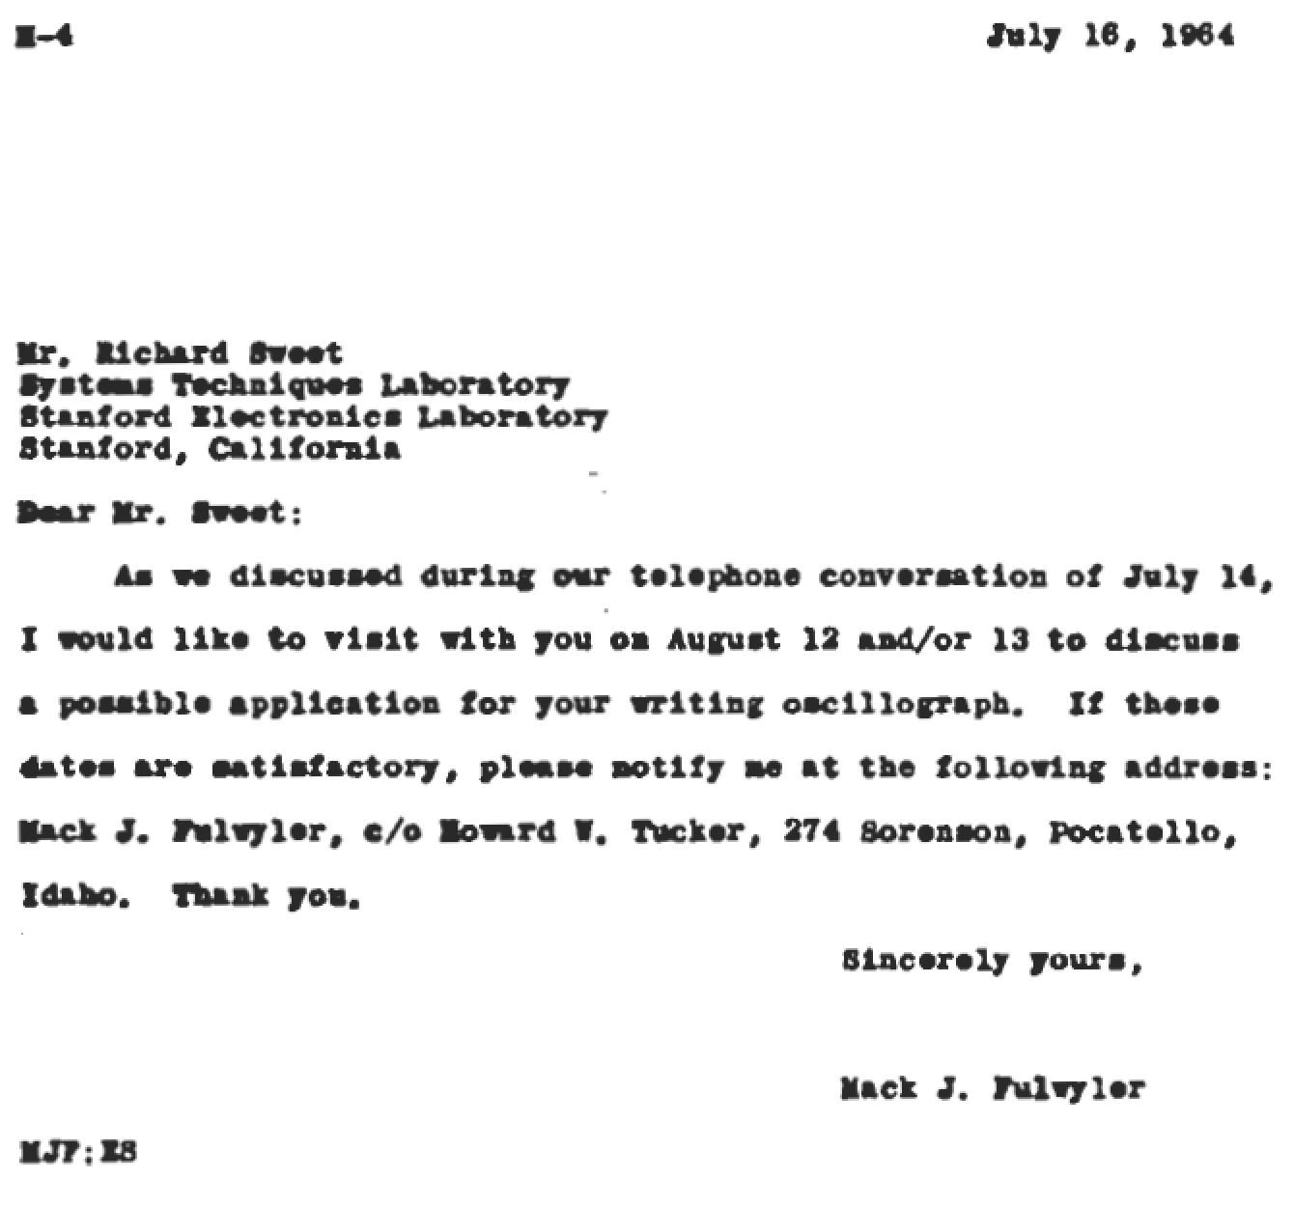
9 days later Fulwyler replies

Slide 27
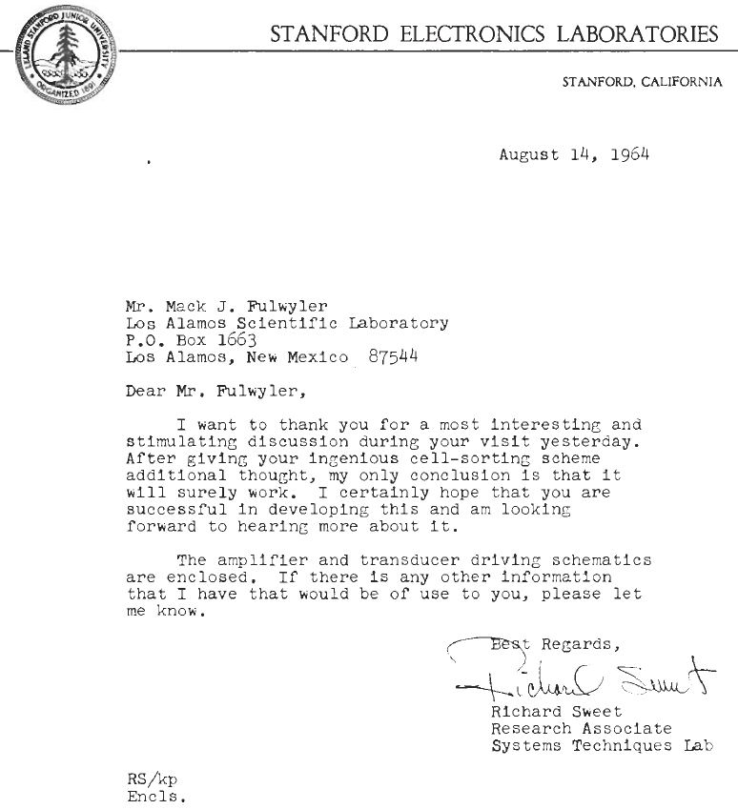
The beginning of the “cell sorter”
Fulwyler visits Sweet
“After giving your ingenious cell-sorting scheme
additional thought, my only conclusion is that it
will surely work.”

Slide 28
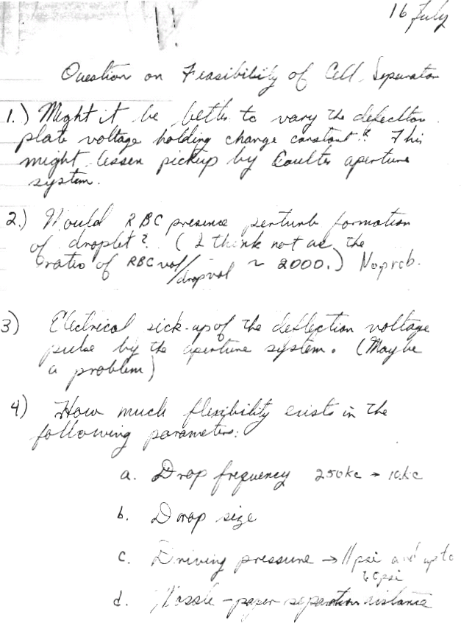
Fulwyler’s experimental
tasks

Slide 29
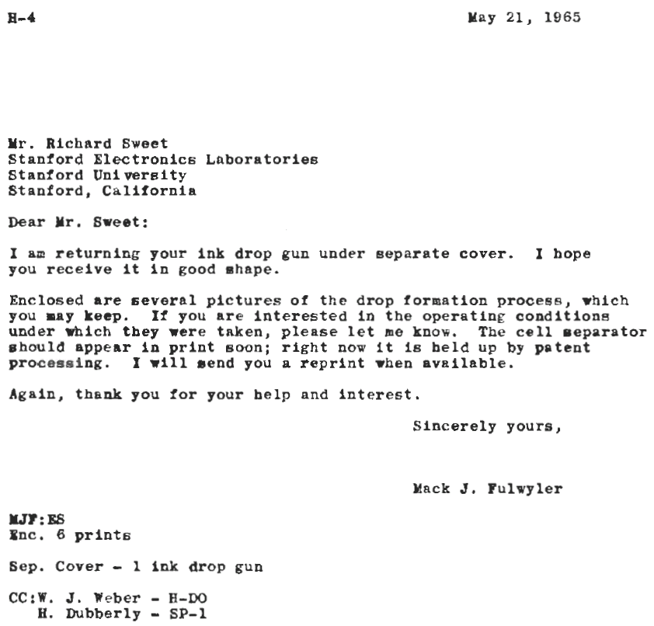
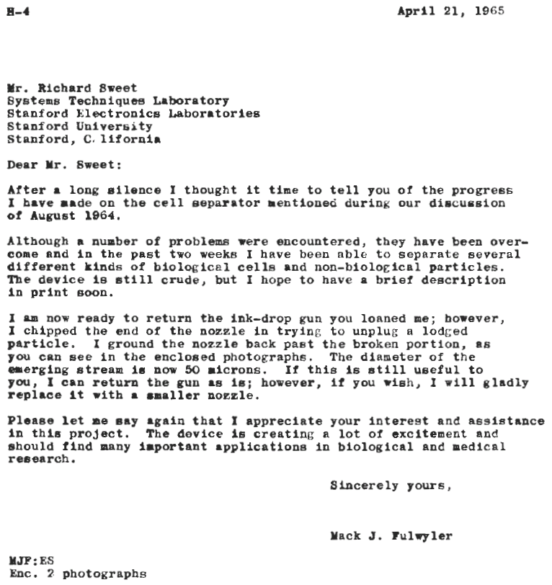

Slide 30
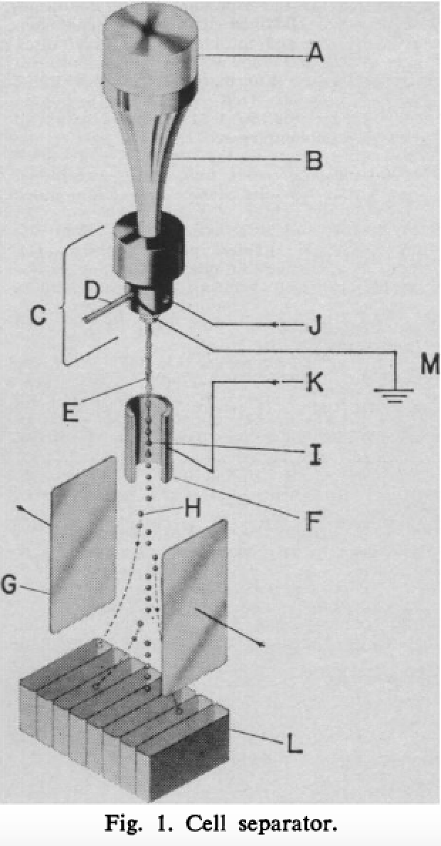
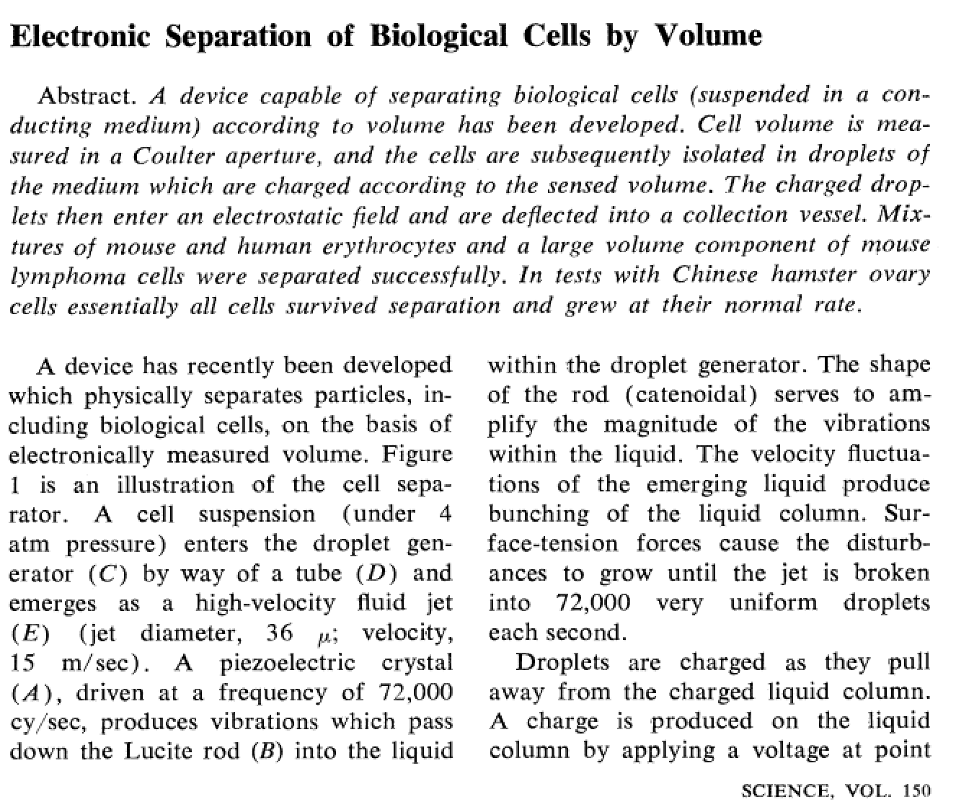
Fulwyler’s published paper in Science, Nov 1965

Slide 31
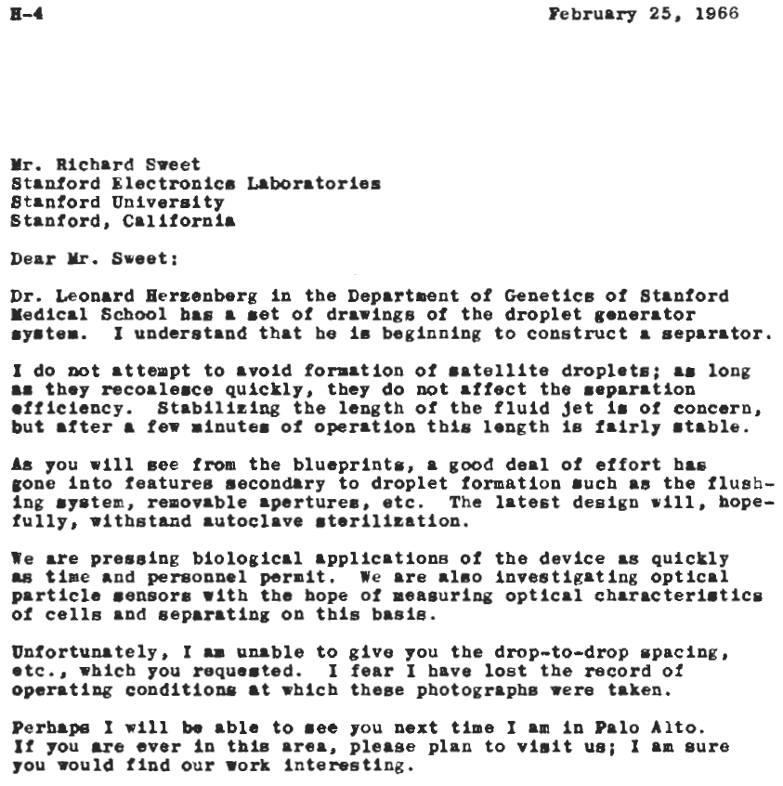
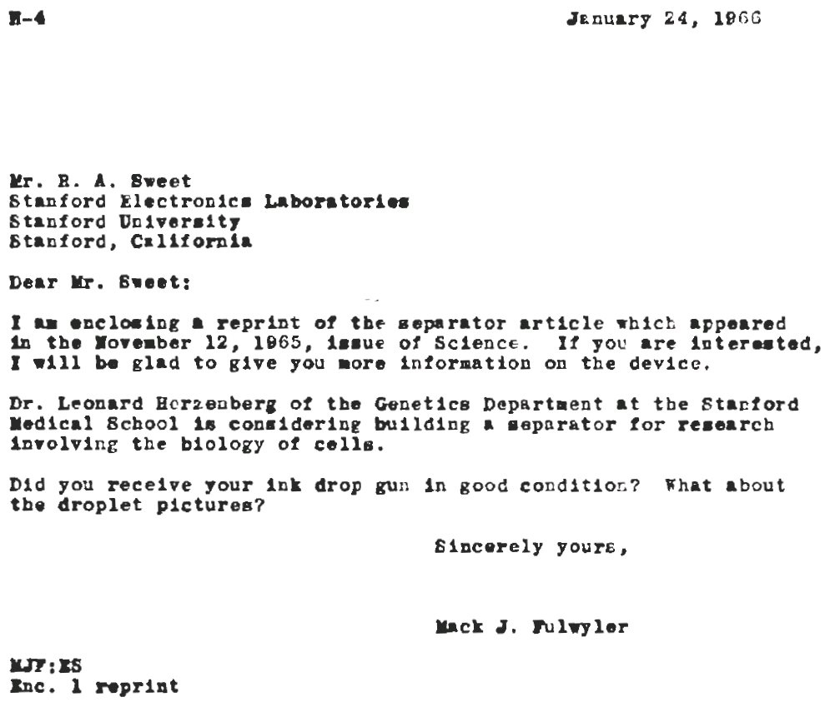
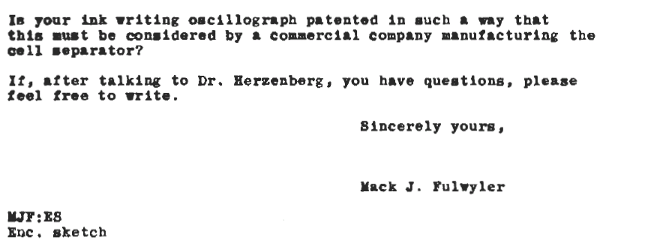

Slide 32
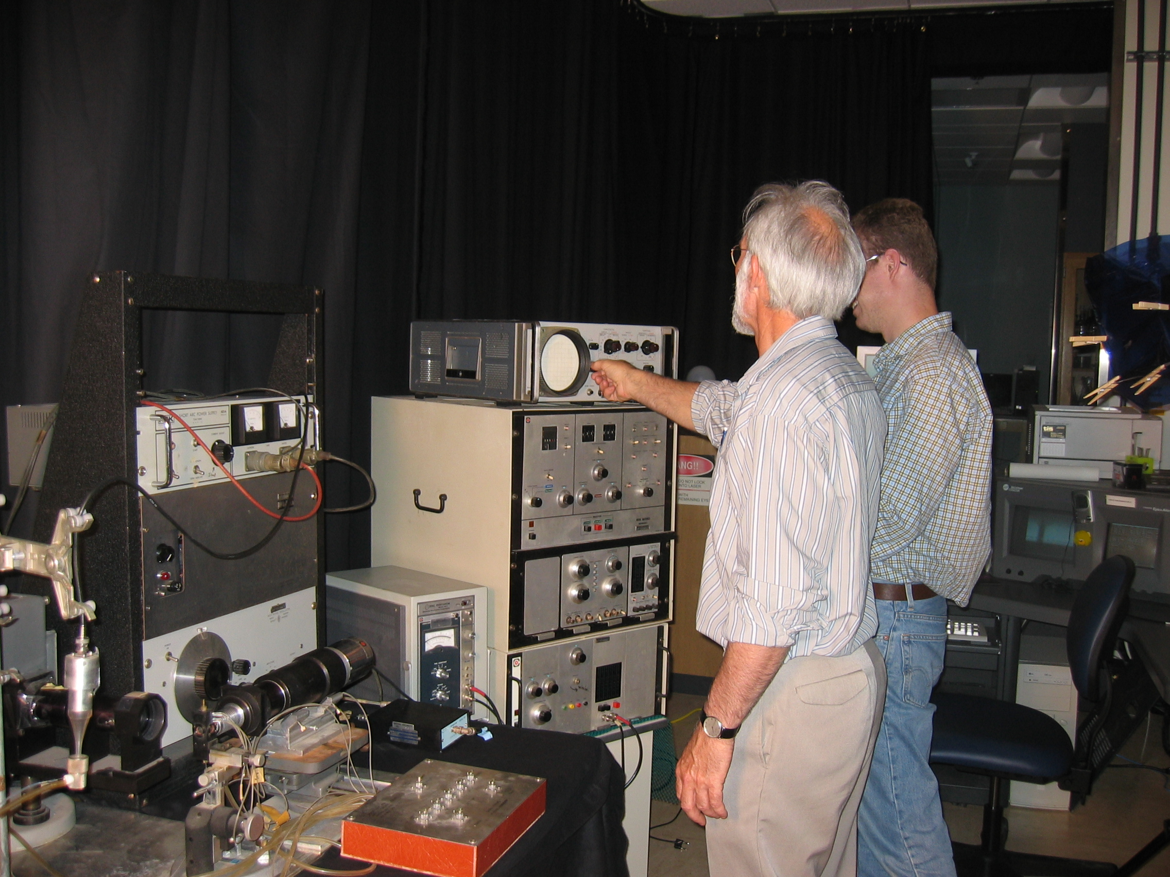
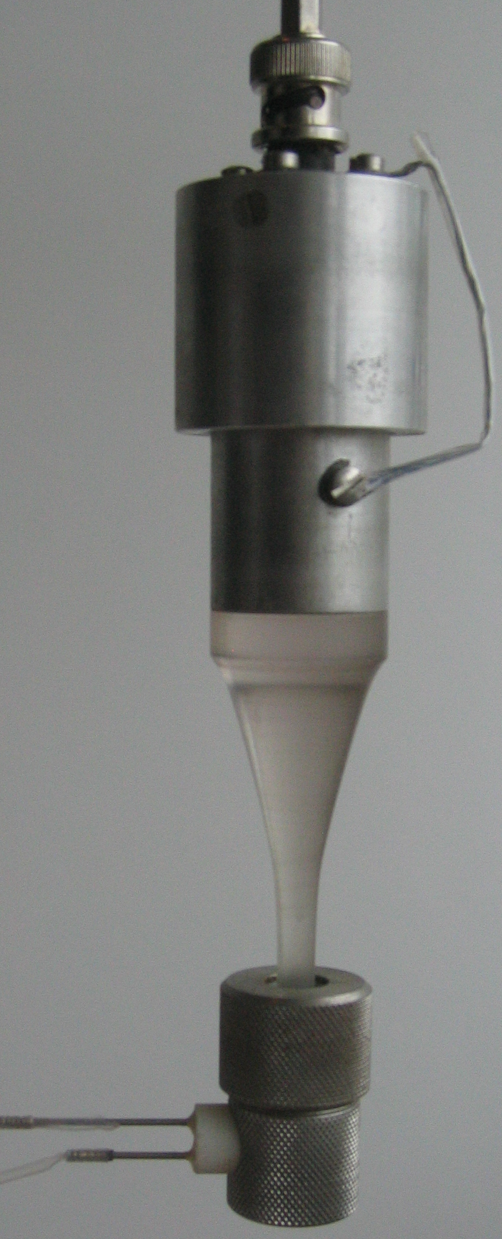
A rescued instrument built in 1967 – a copy of the original cell sorter
Fluorescence detector (PMT)
Flow
Chamber
Fluidics control unit
Fulwyler’s original cell sorter – a 1967 model

Slide 33
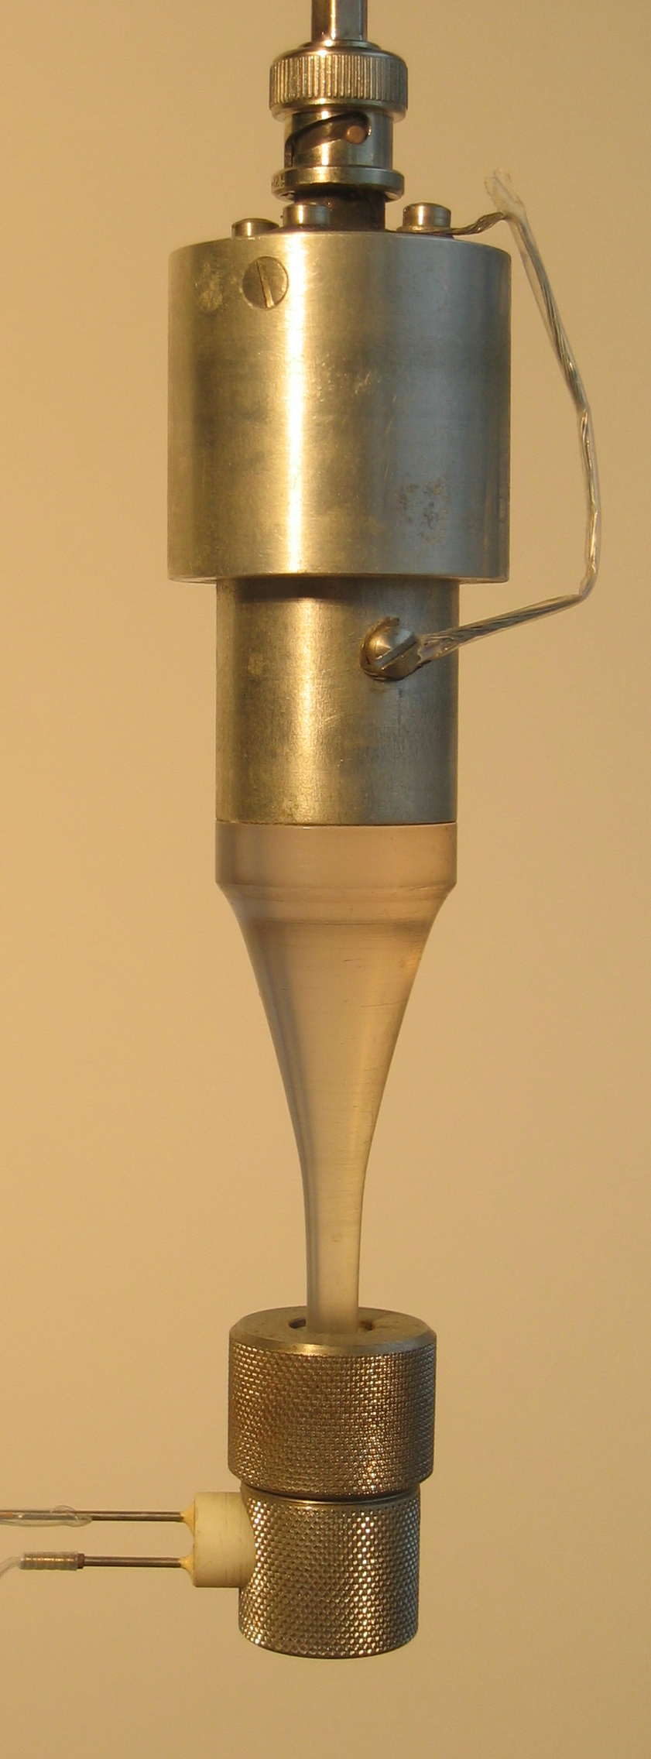

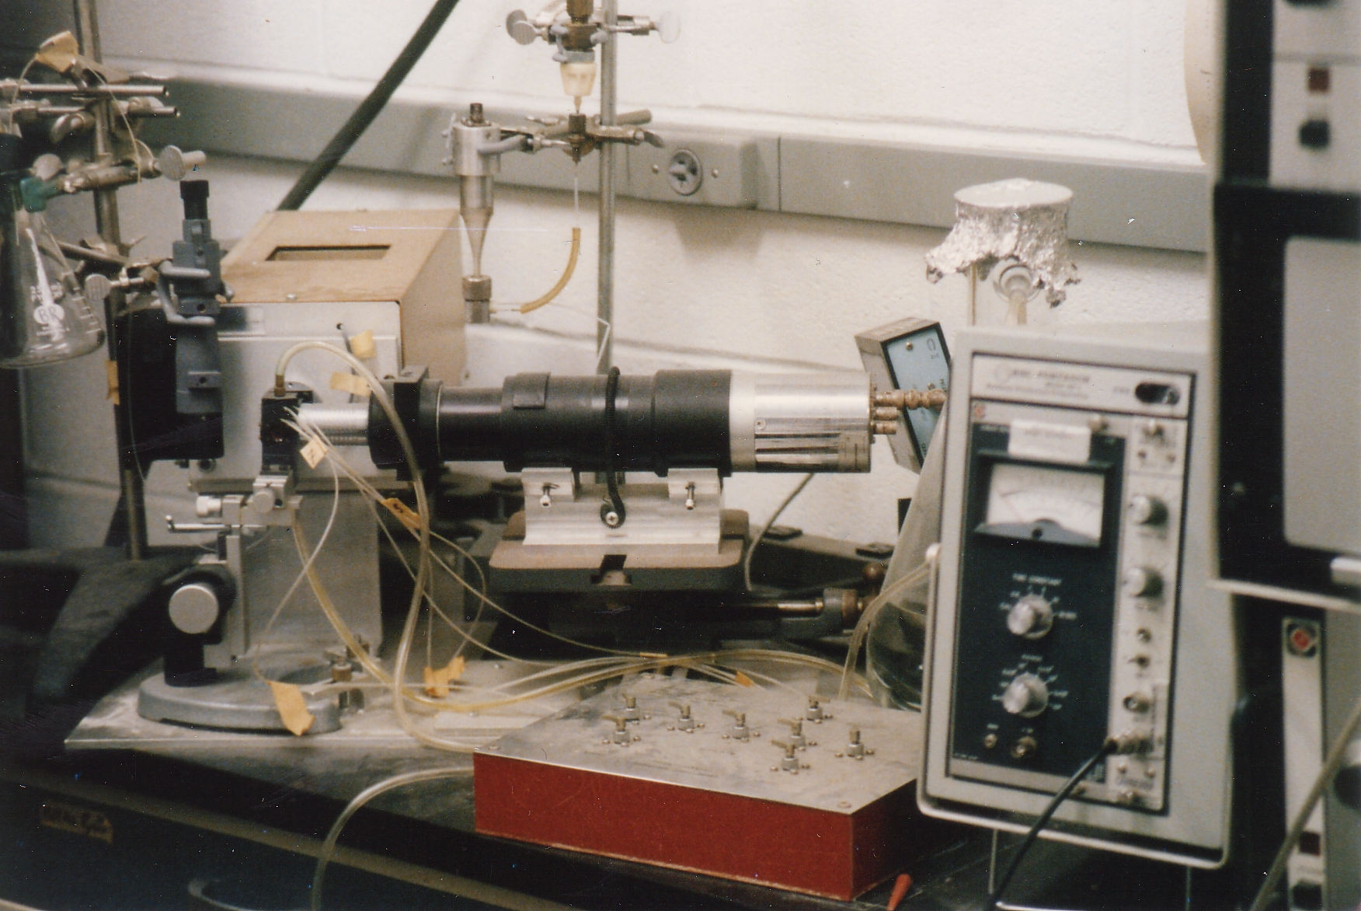
The original coulter volume sorting chamber 1965
The second instrument built in 1967 and delivered to
Dr. Boris Rotman’s Laboratory at Brown University
Fluorescence
detector

Slide 34
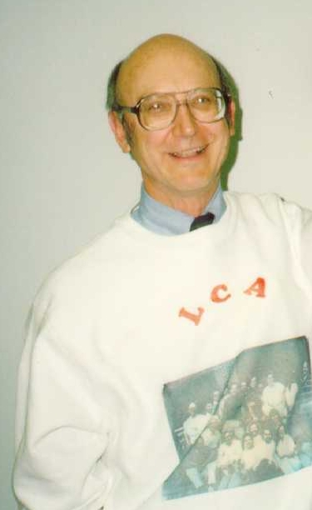
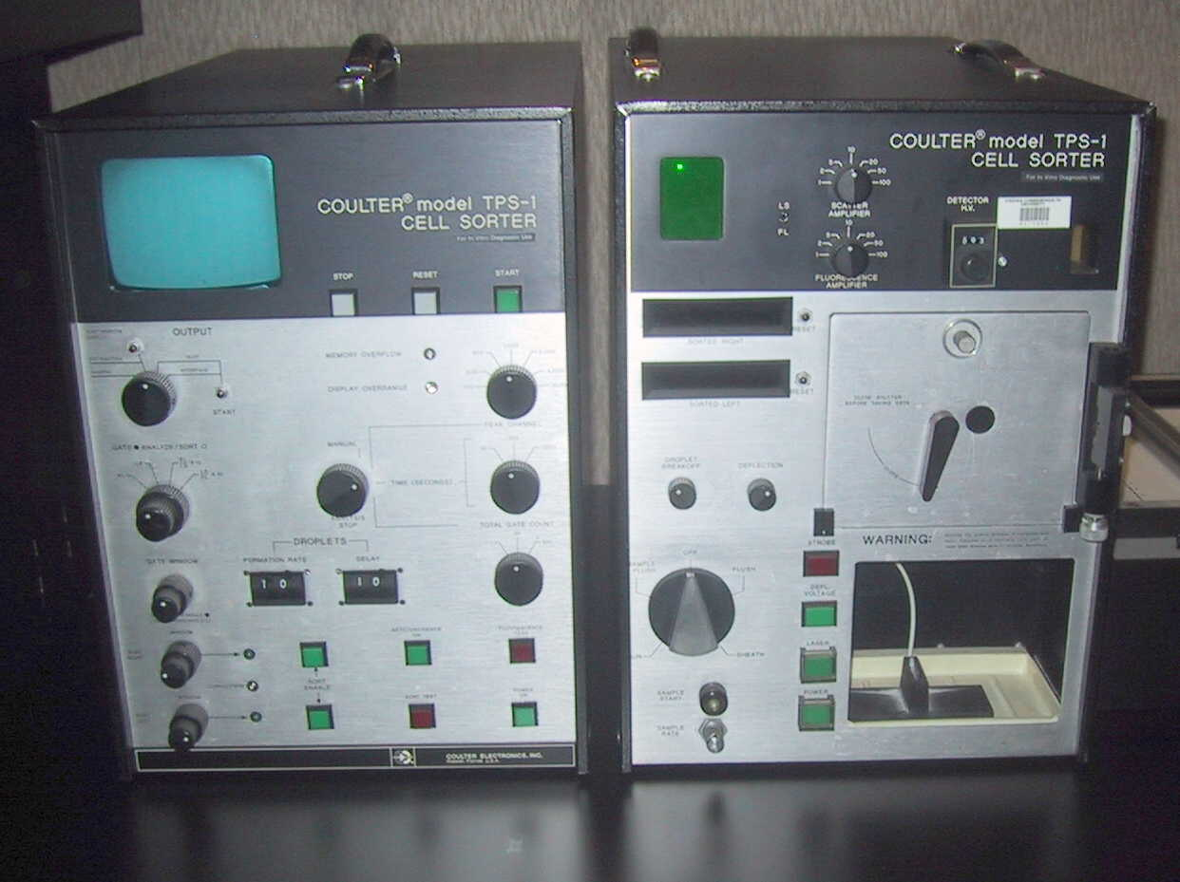
Mack Fulwyler
Coulter Electronics manufactured the TPS-1 (Two parameter sorter) in 1975 which could measure forward scatter and fluorescence using a 35mW argon laser.
This photo (left) (©2000 – J.P. Robinson) is one of only one or two surviving TPS Instruments. It is very similar to the Coulter Counter of the day.
Photo ©2000 – J.P. Robinson

Slide 35
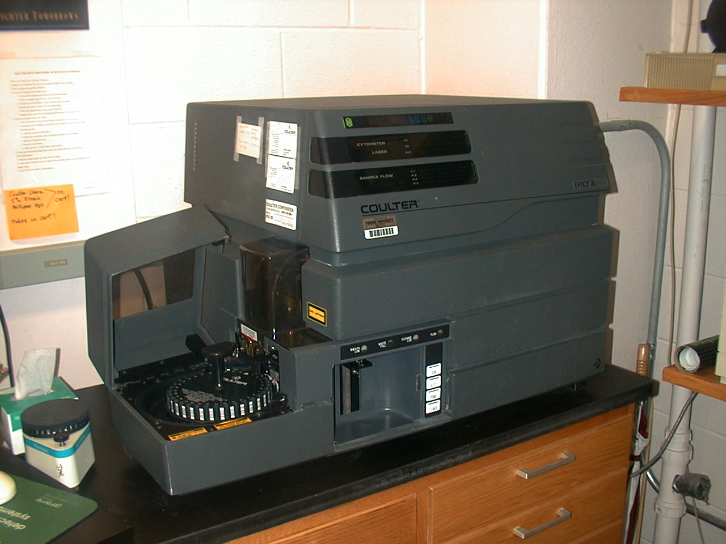
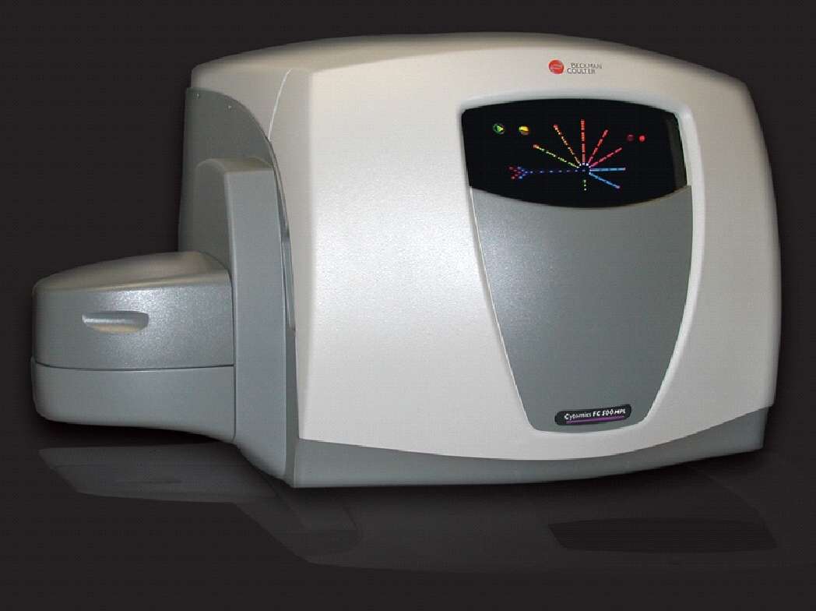
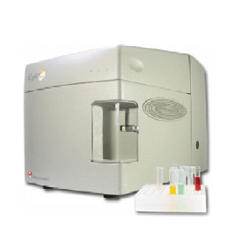
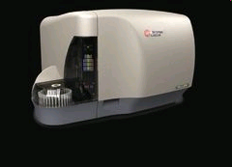
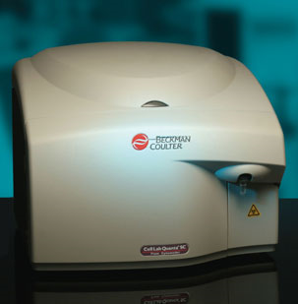
Coulter / Beckman Coulter
XL
FC500
Gallios
Cyan
Quanta

Slide 36
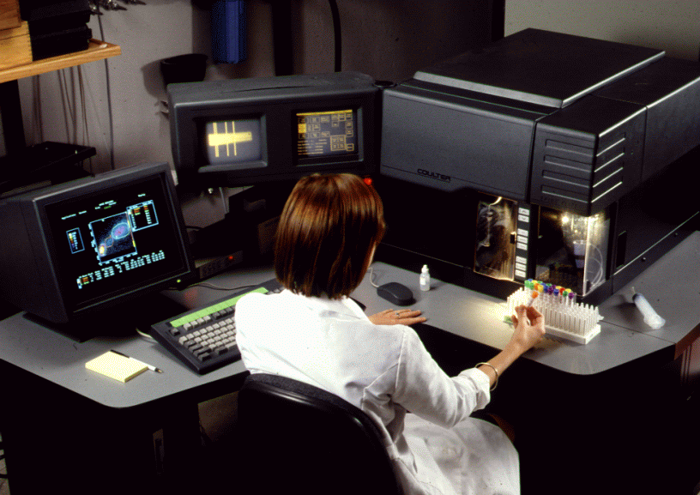
Purdue University
First Installed Elite - 1989

Slide 37
The Science of Innovation
Wallace Coulter
(Engineer)
Coulter Counter
Lushbaugh
(pathologist)
Used and Misused
Mack Fulwyler
(Engineer)
Creates test bed to
Challenge theory
Gohde
Herzenberg
Expand and develop
Flow cytometry technology

Slide 38
Innovation in Science is rarely an independent event
It is often a part of a series of discoveries that open up ideas
Innovation itself often creates many related fields
Much science is driven by innovative ideas but not all science is innovative even tho’ it is very important
Think “outside the box” and it may drive your innovative self!

Slide 39
Purdue University Cytometry Laboratories Acknowledgements
Contributors
  Staff Scientists: Valery Patsekin, Andy Bieberich, Maria Tsiper, Lararissa Avramova
Postdocs: Ana Juan, Ewa Biela
Graduate Students: Awais Mansoor, Angela Wolf, Fiona Thomas, Anthony Pedly, Carmen Gondhaleker
Undergrad Students: Nicole Lewis, Peter Carlsgaard, Eric Zigon, Maria Bogdanov
Faculty: Bartek Rajwa, Gérald Grégori , Euiwon Bae
Staff
  Jennie Sturgis (Imaging)
  Kathy Ragheb (Flow)
Funding:
NIH, NSF, USDA, Purdue University
Corporate: Beckman-Coulter, Point-Source, Parker-Hannifin, Polysciences, Bangs labs, Roche, MediaCybernetics, Q-Imaging, Kodak Medical Systems, Crystalplex, Becton-Dickinson , Icyt,
eBioscience, ITG Indiana, Roche, Edmund Optic, Perkin Elmer, Digilab Inc., Spherotech, Inc., IntelliCyt, Inc
Spectral technology Contributors:
J. Paul Robinson, Bartek Rajwa, Gerald Gregori, James Jones, Valery Patsekin
Research reported in this presentation was supported by the National Institute of General Medical Sciences & the National Cancer Institute of the National Institutes of Health under Award Numbers 1R56AI089511 & 1R33CA140084. The content is solely the responsibility of the authors and does not necessarily represent the official views of the National Institutes of Health.

