Slide 1
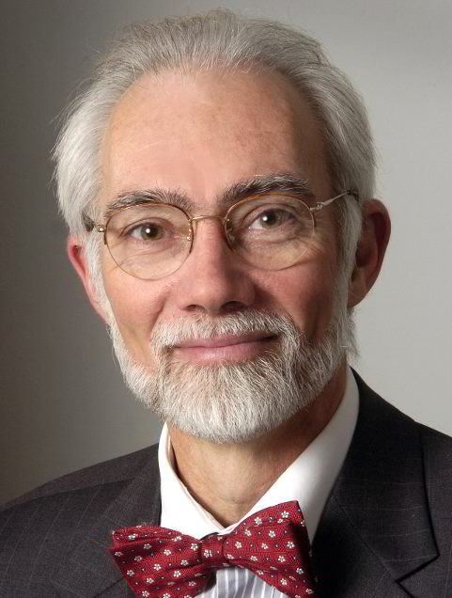






Frontiers in Cytometry still Exist!
J. Paul Robinson
The SVM Professor of Cytomics
Professor of Biomedical Engineering
Director, Purdue University Cytometry Laboratories
@Cytometryman
Home of the Purdue Cytometry Mail-list est 1989
cytometry@lists.purdue.edu

Slide 2
Purdue University Cytometry Laboratories Acknowledgements
Some slides from Prof Silas Leavesley,
Dept. of Chemical Engineering, University of South Alabama
Contributors
  Staff Engineer: Valery Patsekin
Graduate Students: Awais Mansoor, Angela Wolf, Fiona Thomas, Anthony Pedley,
Undergrad Students: Nicole Lewis, Peter Carlsgaard, Esther Foo, Eric Zigond,
Postdocs: Ewa Biela
Faculty: Bartek Rajwa, Euiwon Bae, J. Paul Robinson
Data and collaborations with: Gary Nolan Lab (Stanford), David Hedley (Toronto), Bernd Bodenmiller (Zurich), Paul Wallace (Buffalo)
Staff
  Jennie Sturgis (Imaging)
  Kathy Ragheb (Flow)
Funding:
NIH, NSF, USDA, Purdue University
Corporate: Beckman-Coulter, Point-Source, Parker-Hannifin, Polysciences, Bangs labs, Roche, MediaCybernetics, Q-Imaging, Kodak Medical Systems, Crystalplex, Becton-Dickinson , Sony Life Sciences,
eBioscience, ITG Indiana, Roche, Edmund Optic, Perkin Elmer, Digilab Inc., Spherotech, Inc., Intellicyt, Inc
Research reported in this presentation was supported by the National Institute of General Medical Sciences & the National Cancer Institute of the National Institutes of Health under Award Numbers 1R56AI089511-01, R21RR033593-01 & 1R33CA140084. The content is solely the responsibility of the authors and does not necessarily represent the official views of the National Institutes of Health.

Slide 3





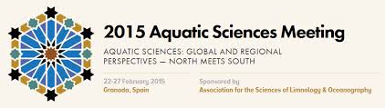


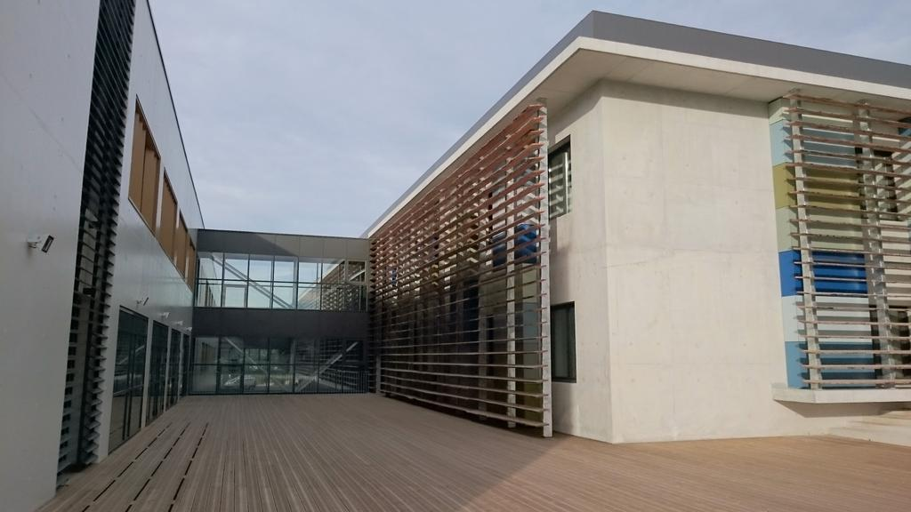
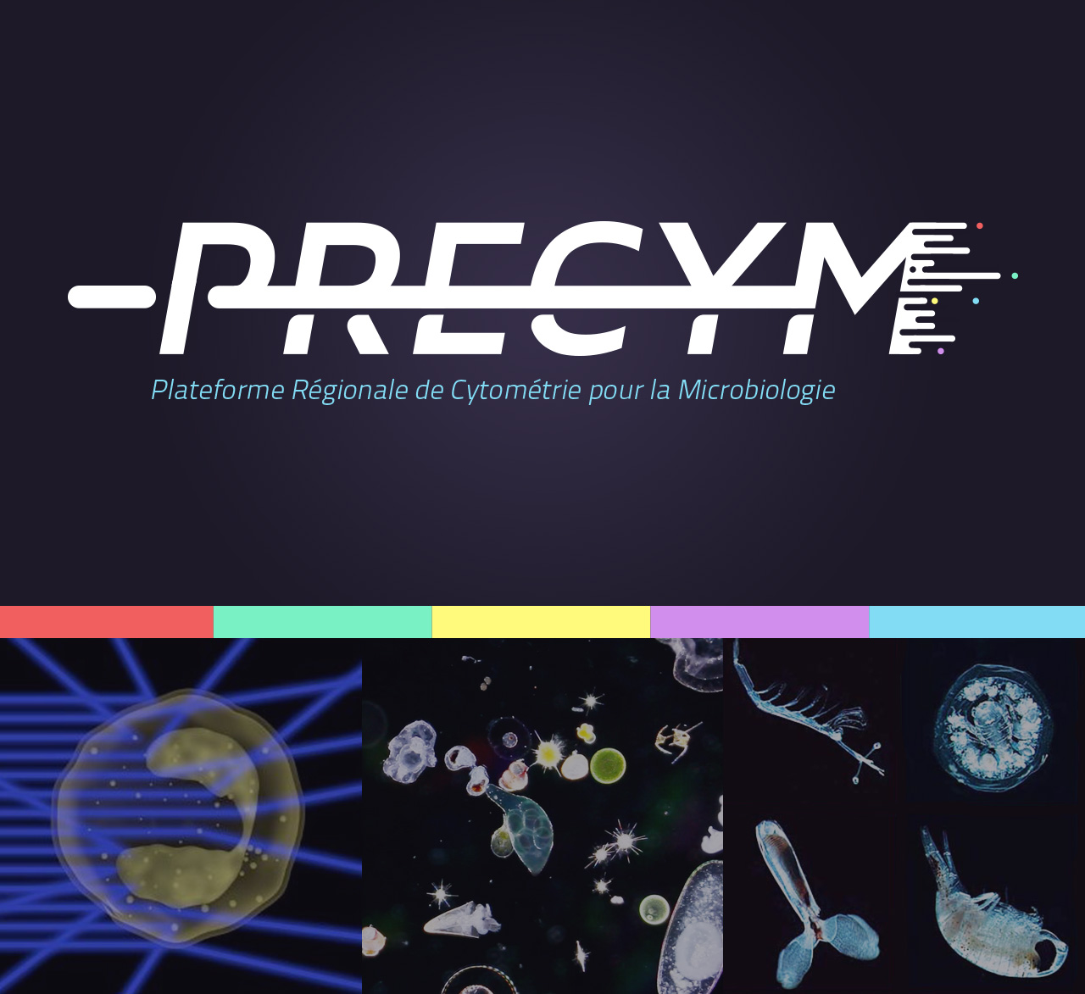
1
Granada, Spain, 22-27 February 2015
Mediterranean Institute
of Oceanography
IN SITU CHARACTERISATION OF THE MARINE MICROBE DYNAMICS THANKS TO HIGH FREQUENCY ANALYSIS
AT THE SINGLE CELL LEVEL: TOWARD NEW PARADIGMS
Grégori, G. J.; Dugenne, M.; Denis, M.; Thyssen, M.
Mediterranean Institute of Oceanography,
Aix-Marseille University, CNRS, IRD, Toulon University
OSU Pytheas
Campus de Luminy, Marseilles (France)
https://precym.mio.univ-amu.fr/
Slide from Gerald Gregori

Slide 4
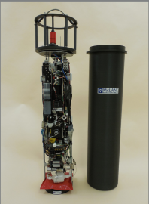
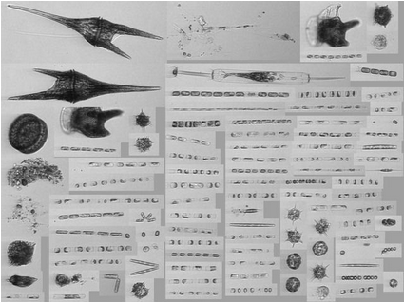
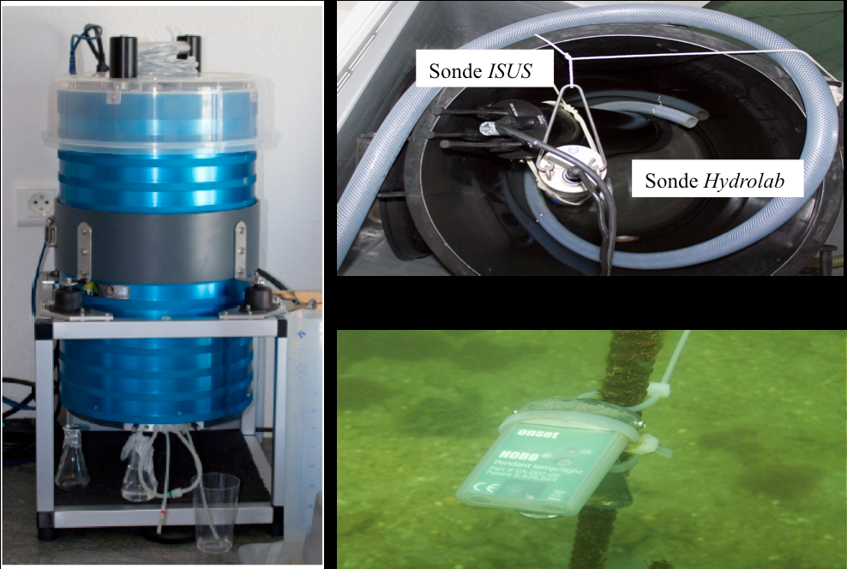
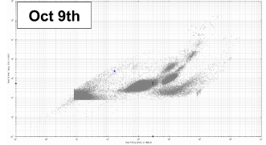
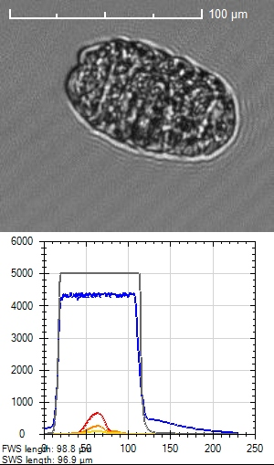
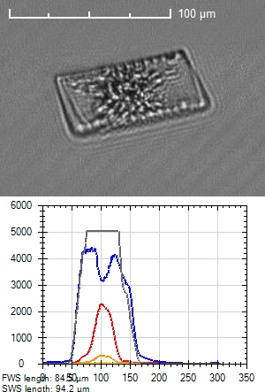
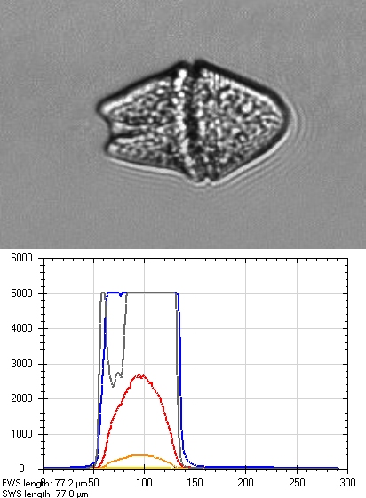
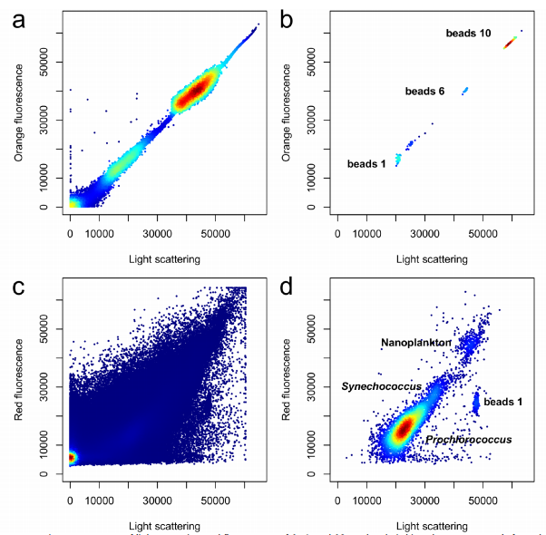
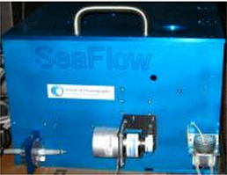
Automated High Frequency in-situ (submersible or not) flow cytometers
➔ Fluorescence and light scatter intensities recorded for each particle (cell)
Imaging FlowCytobot (IFCB)
McLane Research Laboratories
(Sosik et al.)
Images
Cytosense flow cytometer
Cytobuoy b.v.
Optical pulses + Image in flow
(Thyssen et al.; Dugenne et al.,
Pommati et al.; Artigas et al., etc.)
SeaFlow cytometer
School of Oceanography, University of Washington
Continuous, real-time
shipboard observations
of phytoplankton cells
(Ribalet et al.)
Slide from Gerald Gregori

Slide 5
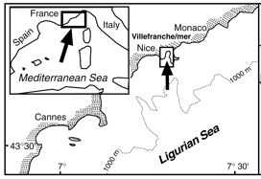
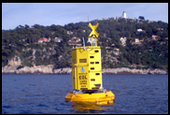
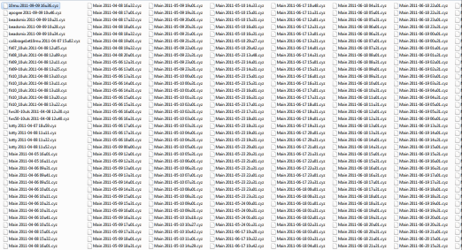
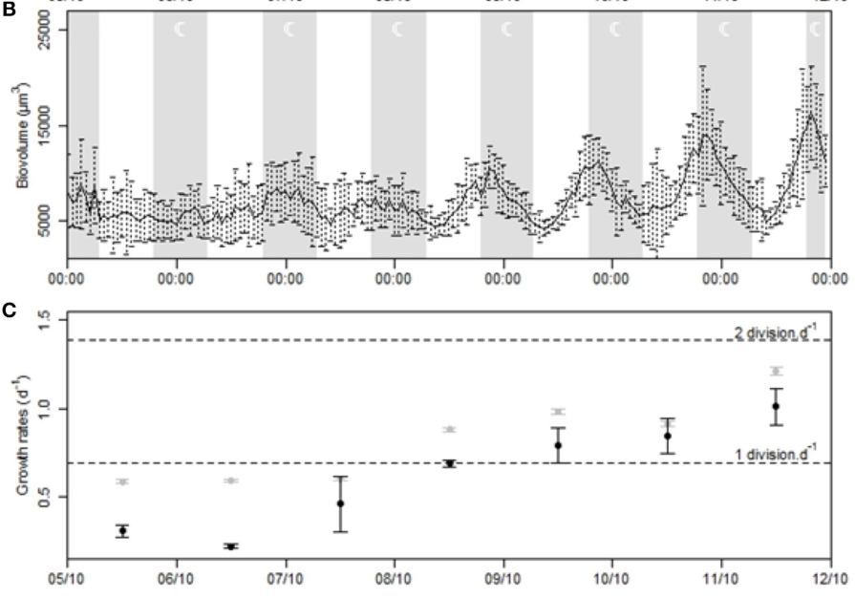
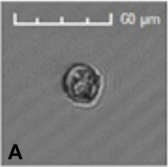
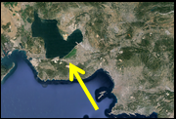

Dynamics of phytoplankton at a fixed station
Automated flow cytometer on multi-instrumental platform
- EOL Buoy (NW Mediterranean) : M. Thyssen (this session)
Rain
Nitrates
Picophytopk (Euk)
Nanophytoplankton
Microphytoplankton
Abundance
Days
- Berre Lagoon (NW Mediterranean) : M. Dugenne
Session 71, Thursday, 3:15 PM
(hundreds of samples)
Need for automated
data analysis (clustering)
+
Data mining
Dynamique de Gymnodinium
High frequency sampling
remotely controlled
(satellite, internet, Wifi)
Biovolume
Wind event
2 div./j
1 div./j
Sampling frequency
adaptation (sudden event)
Growth rate
Thyssen et al., 2014. Frontiers Mic., 5.
Dugenne et al., 2014. Frontiers Mic., 5.
Days

Slide 6
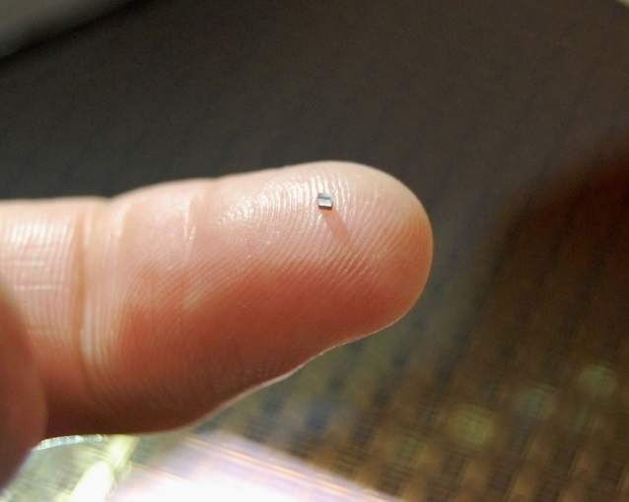
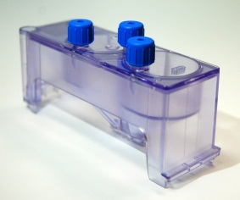
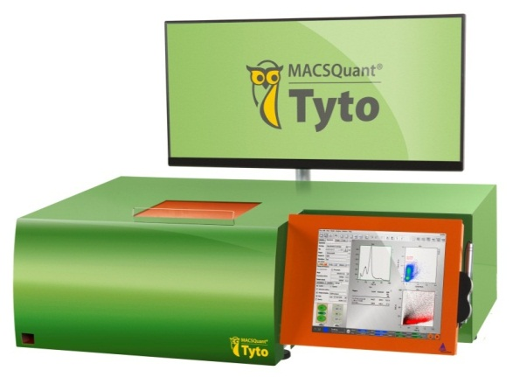
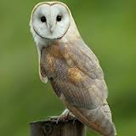
2
Owl Biomedical Microchip Sorting
Miltenyi Biotech
World’s fastest valve performs sorting
No sheath fluids or aerosols
Keep cells and operator safe with sterile, disposable, closed cartridge system
No cleaning or carryover between sorts
Provides low stress to cells, high cell viability
Cell throughput up to 200M cells/hour
  55k cells/s
8-color fluorescence-based sorting
4C – 37C temperature operation
“Walk-away” fluorescent cell sorting
Tyto Microchip
Tyto Cartridge
Slide from Jack Dunne

Slide 7

K562 Sorting from Background
High Speed Video

Slide 8
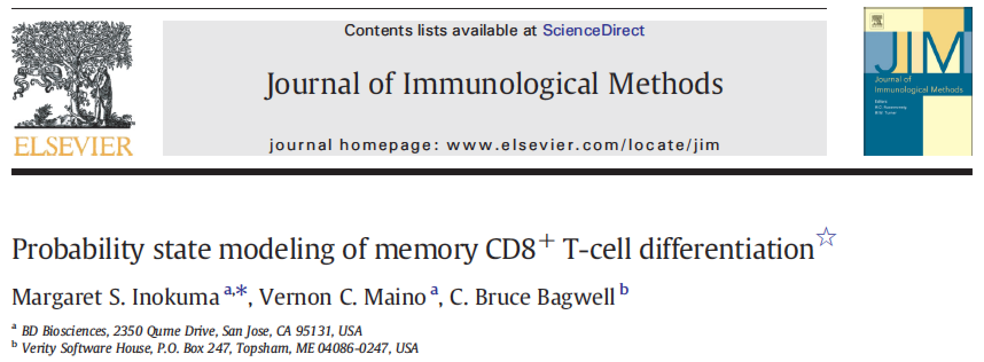
Bruce Bagwell’s Probability State Modeling
3
Slide from Bruce Bagwell

Slide 9
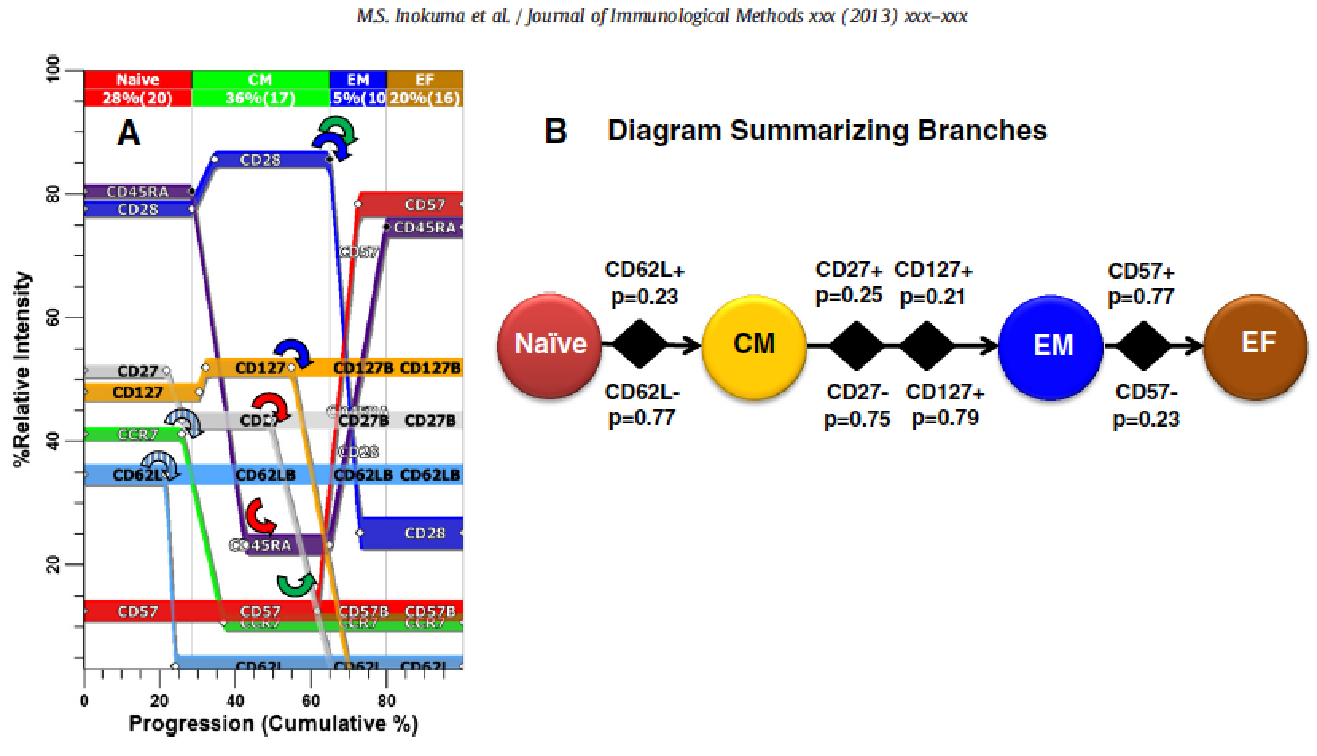
Slide from Bruce Bagwell

Slide 10
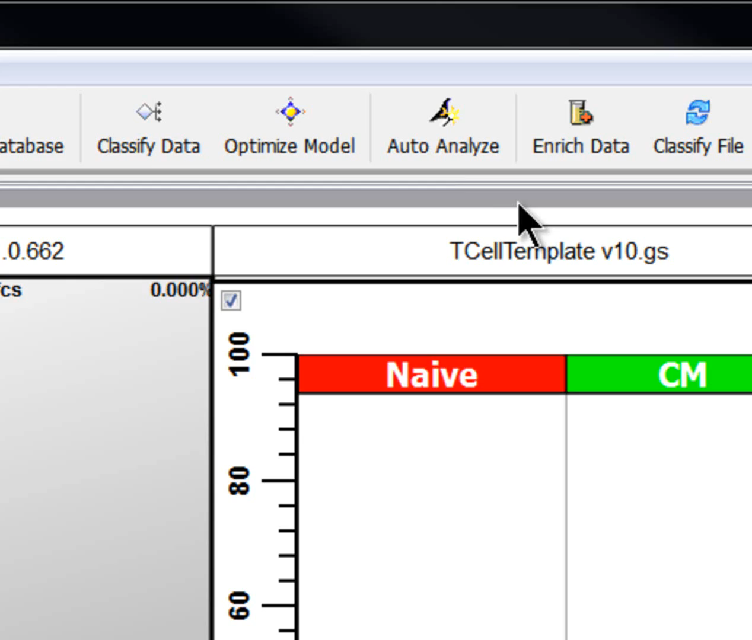

Slide 11
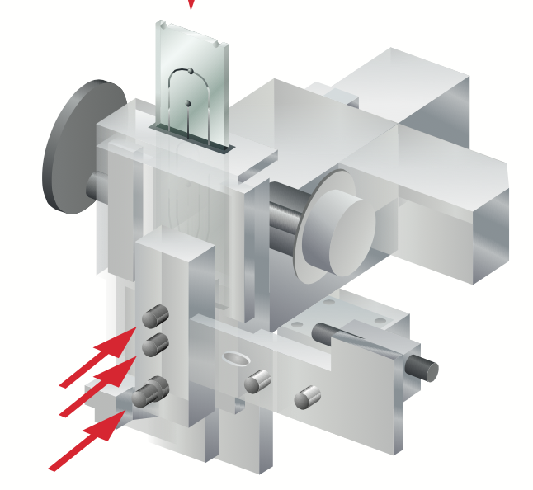
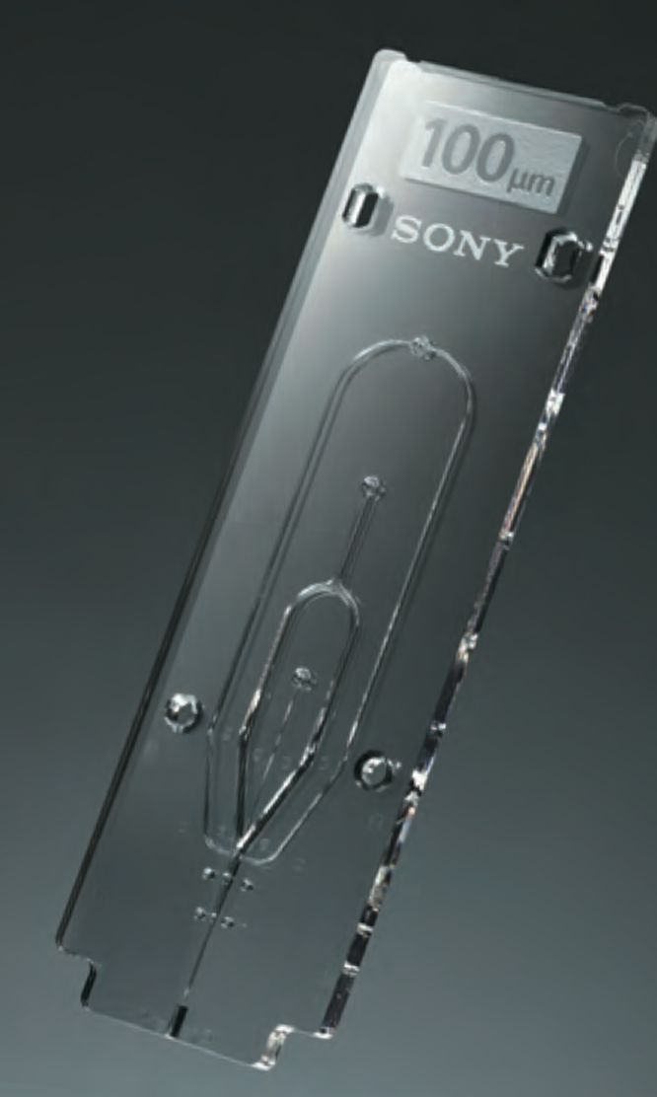
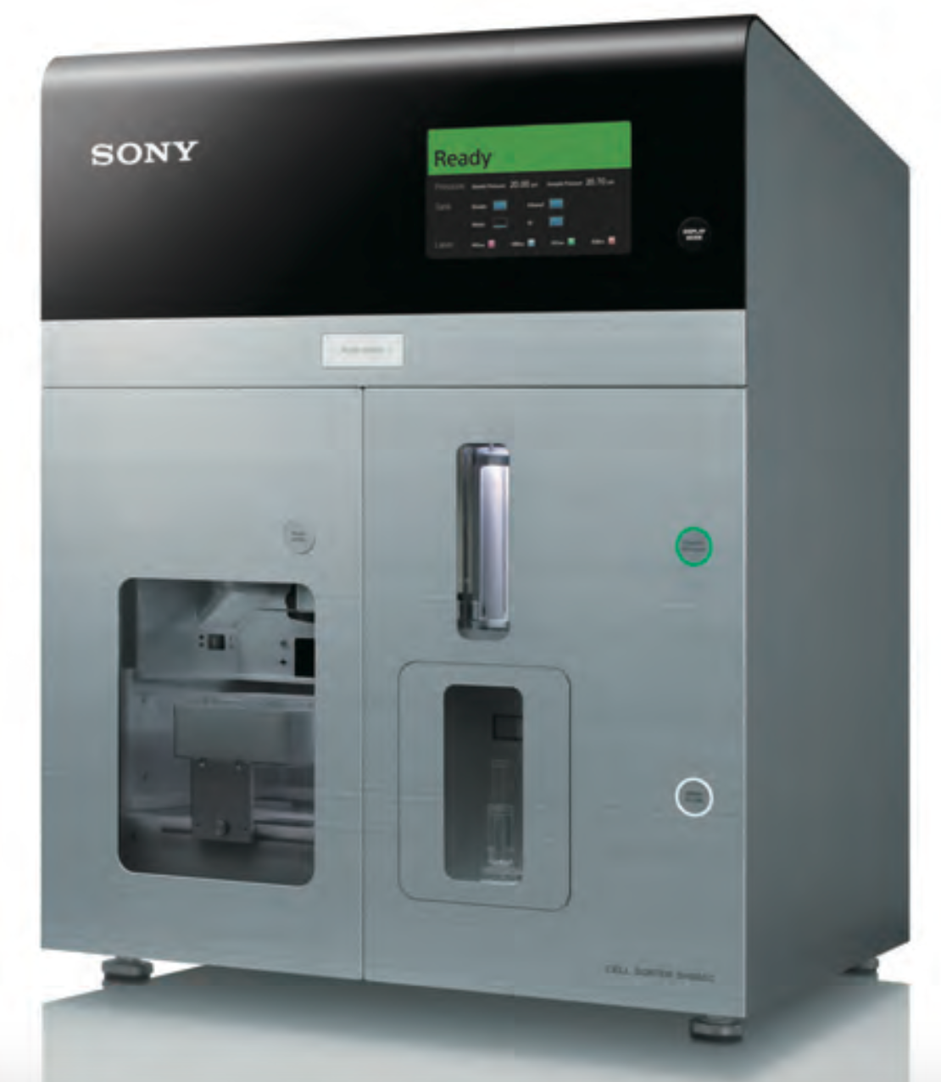
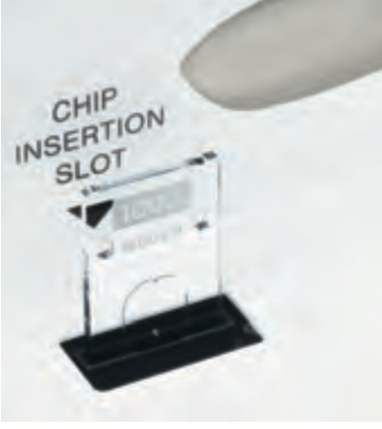
Sony Chip Technology
4

Slide 12
What if you could measure (almost) any color without changing any filters??
5
Hyperspectral
Cytometry
◉

Slide 13
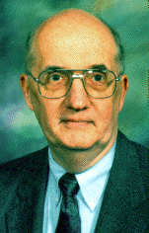
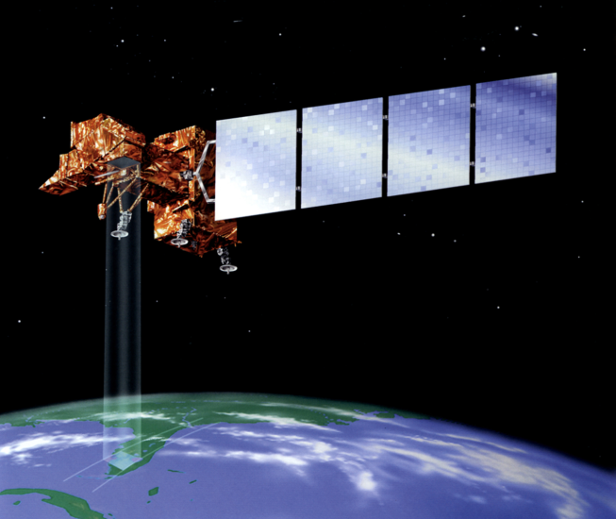
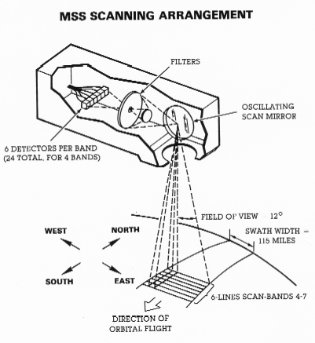
Let’s talk about remote sensing…
History of Multispectral Imaging
A Purdue solution – Prof David A. Landgrebe
The problem: how to classify objects in images of low spatial resolution?
Solution: use the spectral signature of individual pixels and classify them into categories.
1960 – the successful launching of the first weather satellite, TIROS-1.
1961 – the National Academy of Science through its National Research Council formed a committee on "Aerial Survey Methods in Agriculture“
1964 – Purdue, UC/Berkeley, and Michigan consortium starts developing methods for remote sensing
1966 – First multispectral pattern recognition methods capable of identifying individual crop species demonstrated by the Purdue researchers (Professor David Ladgrebe).
This became LANDSAT series of Earth satellites and is the basis for a new generation of instruments carried on Space Station platforms in the 1990's.
Notes:
The Michigan effort concentrated upon building and operating an airborne data collection system.
The UC/Berkeley group focused on perfecting manual data analysis schemes.
Purdue's focus was to be upon machine data-analysis methods and upon agricultural applications.

Slide 14
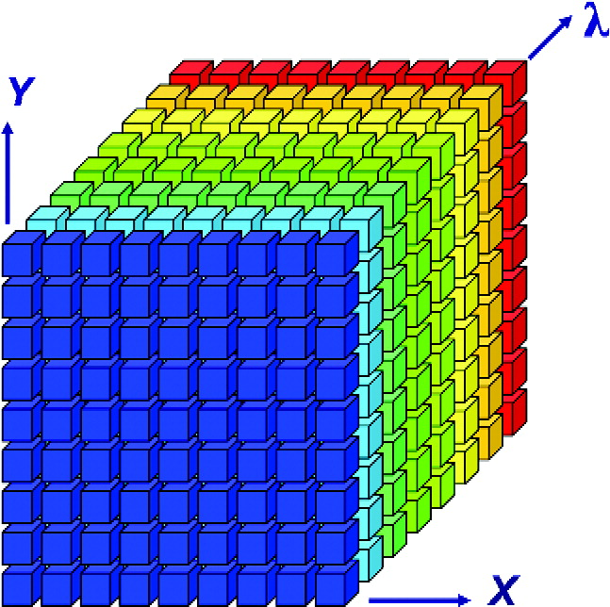
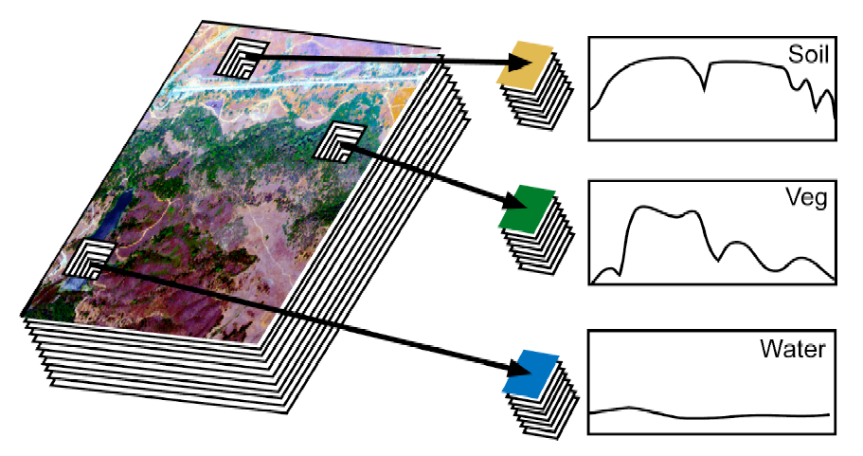
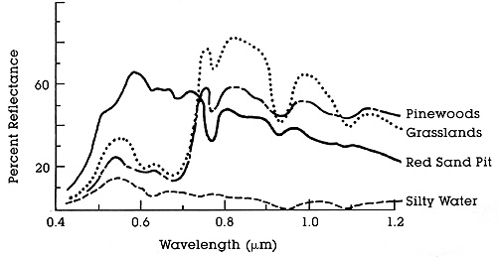
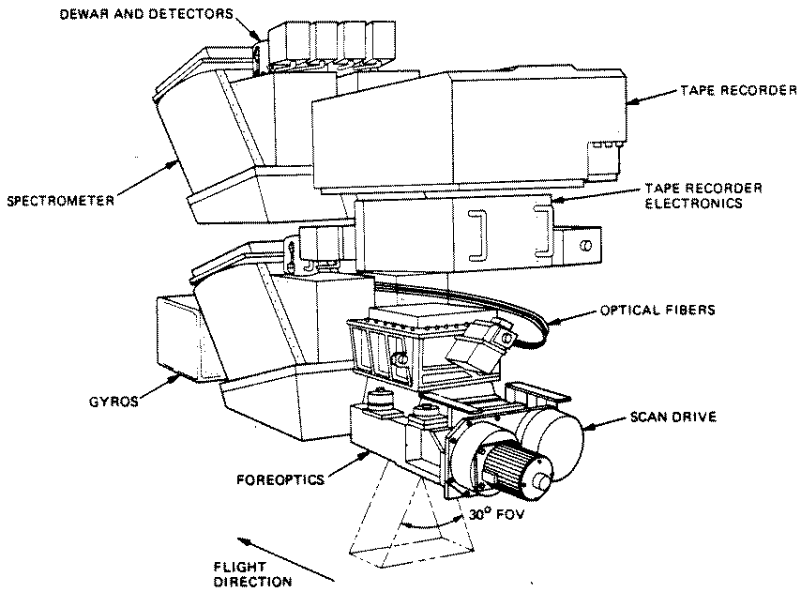
Spectral imaging in remote sensing from the 1960’s
Key Wavelengths
http://rst.gsfc.nasa.gov/Intro/Part2_5.html

Slide 15
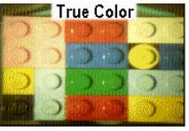

Color composition is a mixture of spectral bands
A photo of
the blocks
A “reconstruction”
A “reconstruction”
Proc. SPIE Vol. 4056, p. 50-64, Wavelet Applications VII, Harold H. Szu, Martin Vetterli; William J. Campbell, James R. Buss, Ed.
The Lego block explanation of spectral imaging!

Slide 16
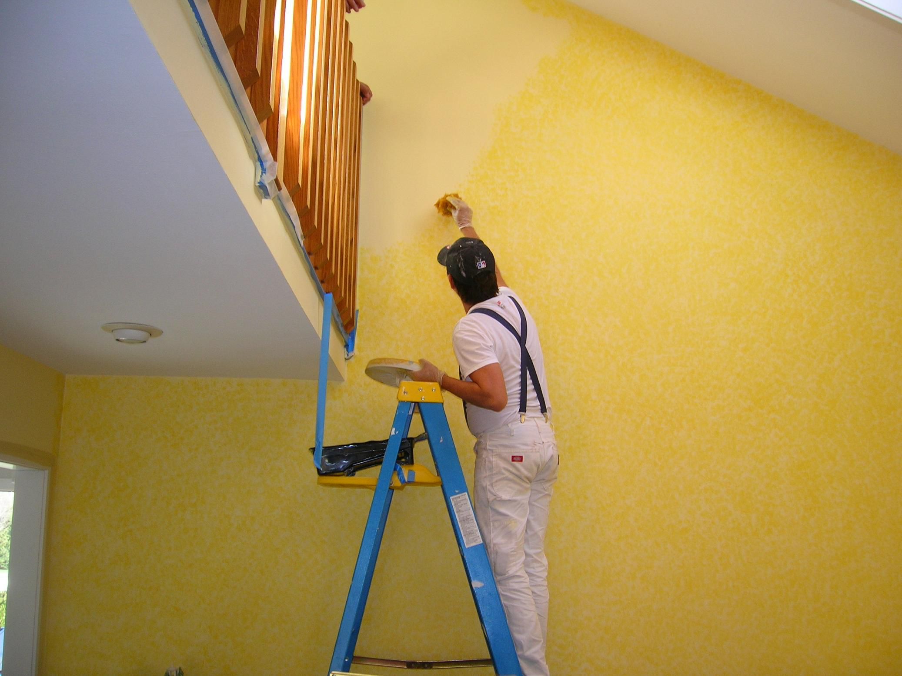
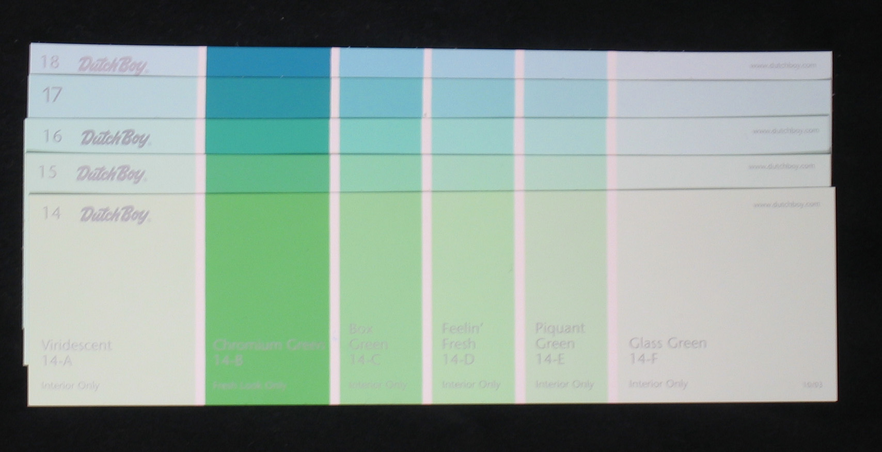
Reflection Example
Dutch Boy paint cards
Colors difficult to distinguish by visual inspection

Slide 17
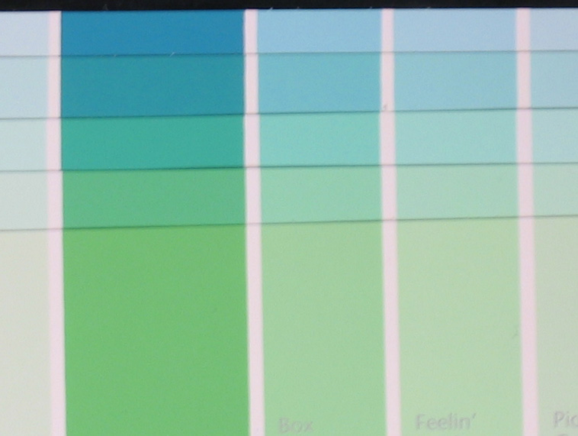
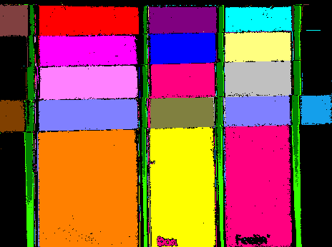
Reflection Example – Clustering
Distinctly separable spectra?
YES!

Slide 18
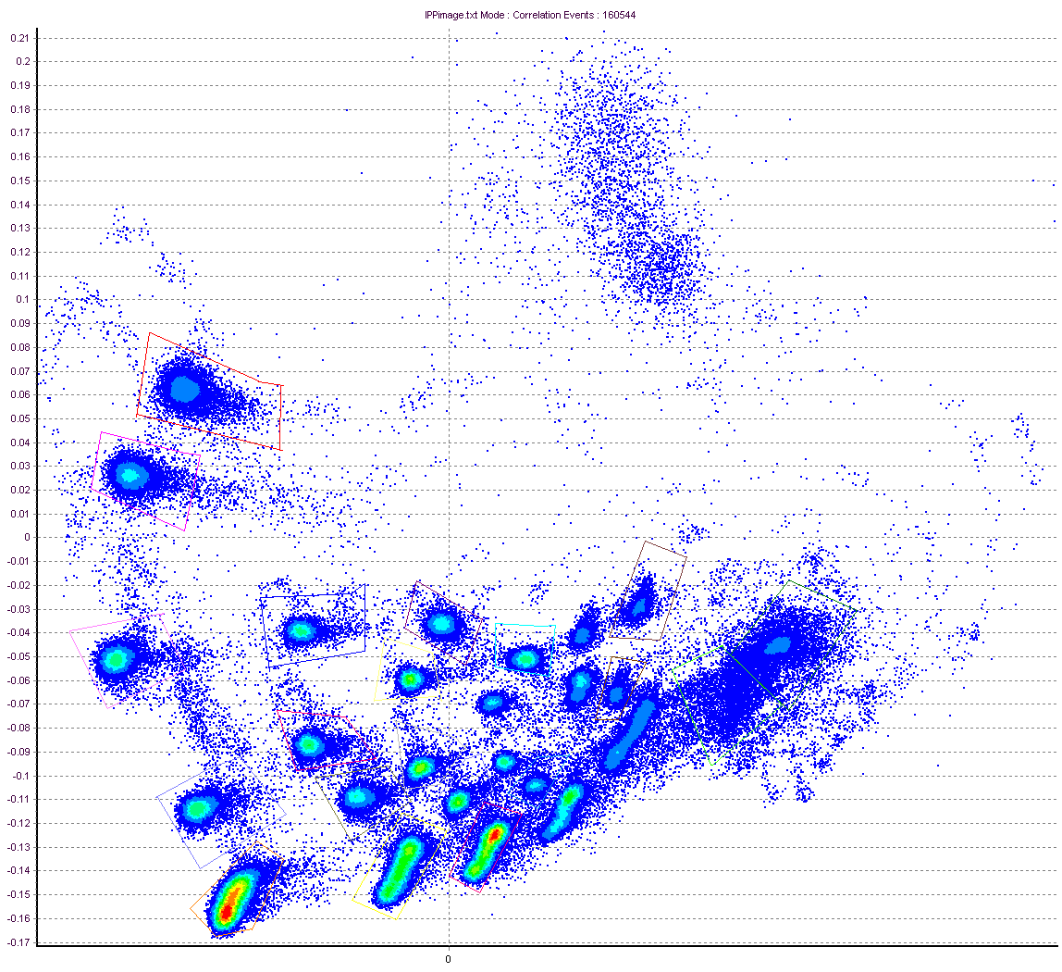
Reflection Example – Clustering
PCA Density Plot From Cytospec Software (Purdue)
PCA-2
PCA-1
Cytospec Software free download
http://www.cyto.purdue.edu/Purdue_software

Slide 19
Reflection Example – Clustering
PCA Density Plot From Cytospec Software (Purdue)
Cytospec Software free download
http://www.cyto.purdue.edu/Purdue_software

Slide 20
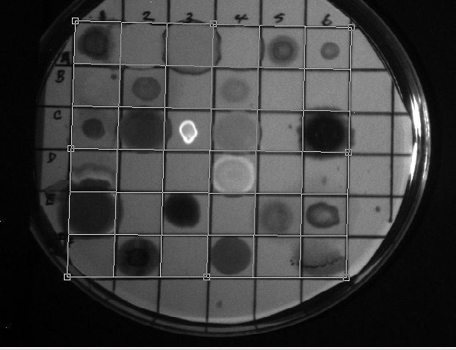
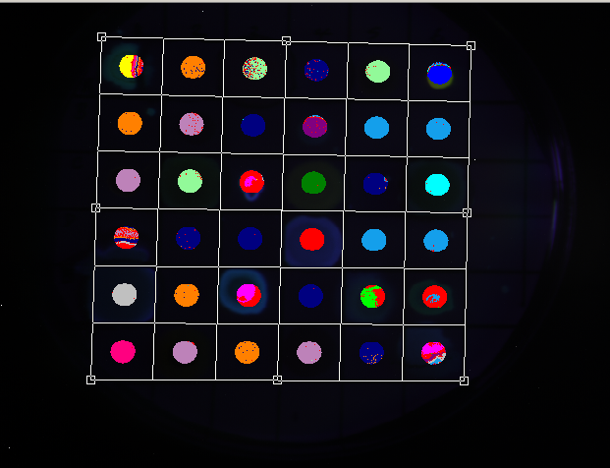
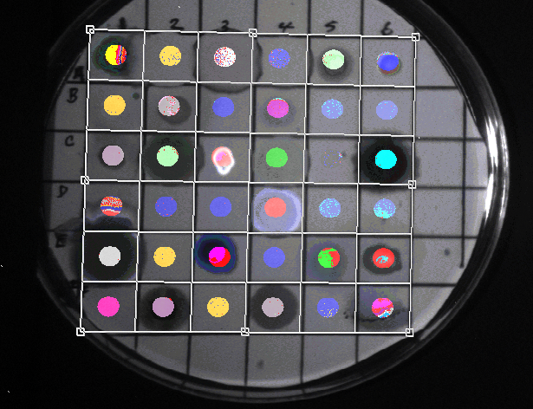
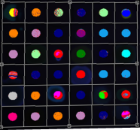
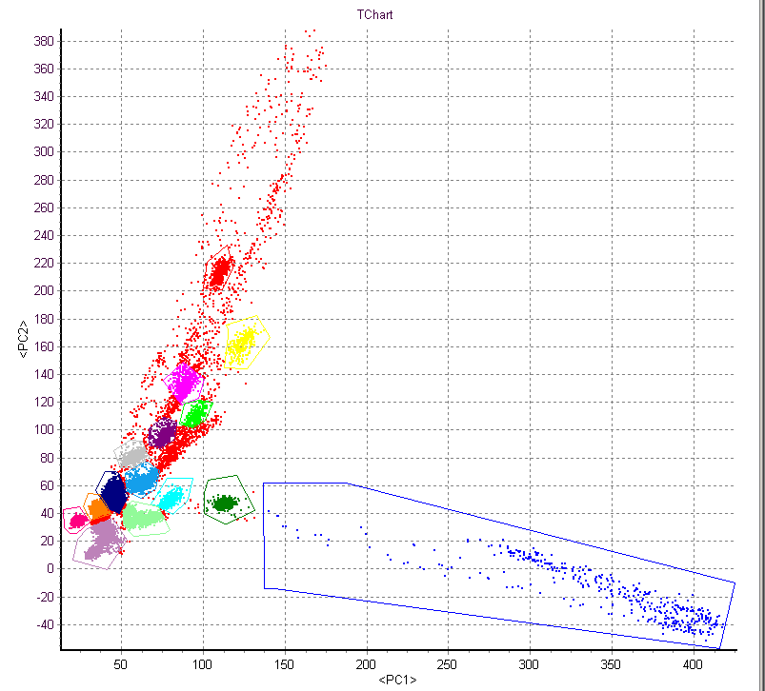
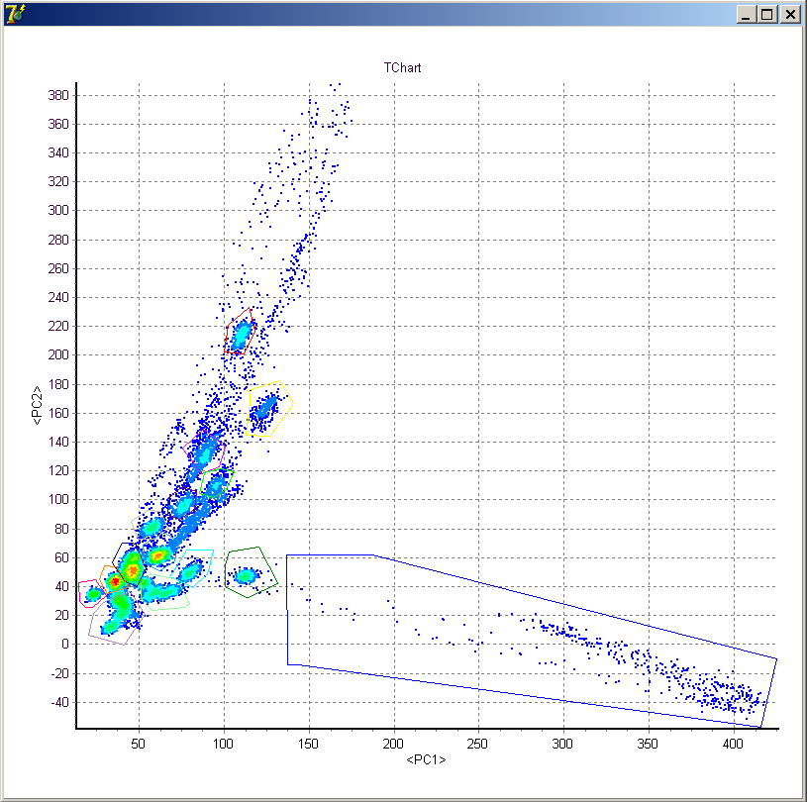
Fluorescence Example
Excitation = 488 nm
Emission = 510-750 nm
Δλ ≈ 4 nm
+
=
Reflected Image
Gated Analysis
Spatial + Chemical Information
Density plot
Nile Red
PCA
Nile Red
Post-acquisition analysis performed by Valery Patsekin, PUCL

Slide 21
Spectral Image Processing
Clustering
  Little or no a priori information
  Examples: Isodata, statistical (PCA), …
Classification
  Usually requires a training set
  Examples: Spectral angle mapper, maximum likelihood, minimum Euclidean distance, …
Unmixing
  Sub-pixel method
  Examples: Linear unmixing is the most common

Slide 22
4 colors - simultaneous collection
FITC
PE
PE-
TR
PE-CY5
530 580 630 680 730 780
Emission wavelength (nm)
System requires complex color compensation
Review

Slide 23
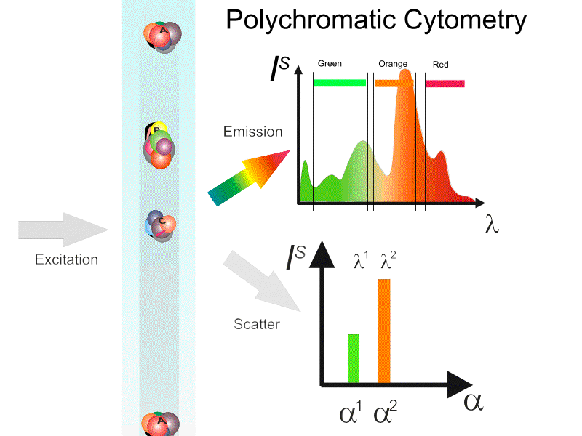

Slide 24


Basic gating and analysis
FS
90 LS
Selecting the “best” dye combinations is possibly the most time consuming and difficult aspect of polychromatic cytometry

Slide 25


Cell
Fingerprint

Slide 26


Cell#
λ
One full spectra per particle
Spectral Signature
Match Signature
Resolution of data point

Slide 27


Multicolor (polychromatic) vs. multispectral cytometry (I)
Single intensity as a parameter (usually)
Spectrum as a parameter

Slide 28
High-resolution cytology segmentation
Characteristic
Spectra
Conventional
RGB Image
Spectrally
segmented Image
Wavelength (nm)
High spectral resolution increases utility of spectrally responsive indicator dyes
Slide from Dr. Richard Levenson, CRi, Inc.,35B Cabot Rd.,Woburn, MA 01801, www.cri-inc.com
Notes:
Sensitive to very small changes in spectroscopic properties that would not be reliably detected by non-imaging spectroscopic techniques, and not by standard color-based imaging systems.

Slide 29


High-resolution cytology segmentation
Characteristic
Spectra
Conventional
RGB Image
Spectrally
segmented Image
Wavelength (nm)
High spectral resolution increases utility of spectrally responsive indicator dyes
Slide from Dr. Richard Levenson, CRi, Inc.,35B Cabot Rd.,Woburn, MA 01801, www.cri-inc.com
Notes:
Sensitive to very small changes in spectroscopic properties that would not be reliably detected by non-imaging spectroscopic techniques, and not by standard color-based imaging systems.

Slide 30







Spectral “unmixing”
Cell
Fingerprint
Before
After
Green
Dye 1: bis-(1,3-dibutylbarbituric acid)trimethine oxonol, DiBAC₄(3)
Dye 2: 3,3'-dihexyloxacarbocyanine iodide, DiOC₆(3)
Green
Human lymphocytes
FITC filter block
Unmixed
DiOC₆(3)
And bis-oxonol

Slide 31
Multispectral Cytometry. Why?
Identification of multiple spectrally overlapping stains (multiplexing)
Spectral barcoding
Potential capability of spectral un-mixing (multiple stains in a single particle)
Identification of intrinsic (autofluorescence) fluorescence
Opportunity for intelligent systems approach to classification

Slide 32



Advanced polychromatic cytometry
How do you do collect current cytometry?
spectrometer
Hyperspectral cytometry
14 PMTs
41 filters

Slide 33




Hyperspectral Single Cell Cytometry
64 ch ADC`
10 μs available
10,000-100,000 cells
First built in our lab in 2002-2003

Slide 34


Principle of Operation
US & foreign patents pending

Slide 35

A 32 Ch PMT detector

Slide 36


Slide 37


Slide 38
Spectral plots
5-(and-6)-carboxy-2´,7´-dichlorofluorescein diacetate (CDCFA)
5(6)-carboxy-4',5'-dimethylfluorescein (CDMFA)
5-sulfofluorescein diacetate (SFDA)
Cell Tracker Green – 5-chloromethylfluorescein diacetate (CTG)
5-(and-6)-carboxy-2´,7´-dichlorofluorescein diacetate, succinimidyl ester (DCF)
bis-(1,3-dibutylbarbituric acid)trimethine oxonol (DiBAC₄(3))
3,3'-dipentyloxacarbocyanine iodide (DiOC₅(3))
3,3'-dihexyloxacarbocyanine iodide (DiOC₆(3))
Rhodamine 110
400---------750nm
1
400---------750nm
2
400---------750nm
3
4
5
6
7
8
9

Slide 39

5-(and-6)-carboxy-2´,7´-dichlorofluorescein diacetate (CDCFA)
5(6)-carboxy-4',5'-dimethylfluorescein (CDMFA)
5-sulfofluorescein diacetate (SFDA)
Cell Tracker Green – 5-chloromethylfluorescein diacetate (CTG)
5-(and-6)-carboxy-2´,7´-dichlorofluorescein diacetate, succinimidyl ester (DCF)
bis-(1,3-dibutylbarbituric acid)trimethine oxonol (DiBAC₄(3))
3,3'-dipentyloxacarbocyanine iodide (DiOC₅(3))
3,3'-dihexyloxacarbocyanine iodide (DiOC₆(3))
Rhodamine 110

Slide 40


Confusion matrix
5-(and-6)-carboxy-2´,7´-dichlorofluorescein diacetate (CDCFA)
5(6)-carboxy-4',5'-dimethylfluorescein (CDMFA)
5-sulfofluorescein diacetate (SFDA)
5-(and-6)-carboxy-2´,7´-dichlorofluorescein diacetate, succinimidyl ester (DCF)
Cell Tracker Green – 5-chloromethylfluorescein diacetate (CTG)
bis-(1,3-dibutylbarbituric acid)trimethine oxonol (DiBAC₄(3))
3,3'-dipentyloxacarbocyanine iodide (DiOC₅(3))
3,3'-dihexyloxacarbocyanine iodide (DiOC₆(3))
Rhodamine 110
CDCFA
CDMFA
SFDA
CTG
DCF
DiBAC43
DiOC₅(3)
DiOC₆(3)
RH110
CDCFA
87.92%
0.00%
0.76%
2.72%
0.00%
6.04%
1.92%
0.64%
0.00%
CDMFA
0.24%
97.76%
0.52%
0.04%
0.00%
0.00%
0.16%
0.88%
0.40%
SFDA
0.04%
0.00%
94.36%
4.88%
0.00%
0.00%
0.00%
0.72%
0.00%
CTG
5.44%
0.00%
5.04%
86.44%
0.00%
0.20%
0.80%
2.04%
0.04%
DCF
0.00%
0.00%
0.00%
0.00%
100.00%
0.00%
0.00%
0.00%
0.00%
DiBAC43
3.72%
0.20%
0.04%
0.40%
0.00%
92.76%
0.96%
1.92%
0.00%
DiOC₅(3)
4.12%
0.28%
0.56%
1.92%
0.00%
1.32%
77.60%
14.20%
0.00%
DiOC₆(3)
1.92%
0.12%
0.76%
1.72%
0.00%
1.24%
17.72%
76.52%
0.00%
RH110
0.00%
0.00%
0.08%
0.36%
0.00%
0.00%
0.00%
0.20%
99.36%

Slide 41









7 of 9 “green” dyes could be resolved
All dyes
Oxonol Events: 3373
Human Lymphocytes

Slide 42


Spectra of gated zones
phycoerythrin
Rh123
Bang’s Labs, Inc
Dyed
Beads
chlorophyll

Slide 43




Chlorophyll
Rh-123
PE
Bang’s
Labs
Dyed
Beads*
These CANNOT be resolved easily
But can using classification tools like PCA

Slide 44



Sony* Spectral Cytometer
(*Sony licensed Purdue spectral Patent)
Slide taken from Sony publicity materials
Data from M. Tomura, Kyoto University

Slide 45

Sony Spectral Cytometer - 12 color separation
Slide taken from Sony publicity materials
Data from E.Watanabe, Y. Nakamuci, N. Watanabe and H. Nakamuchi, Univ. Tokyo

Slide 46

Separation of GFP and FITC signals using
spectral cytometry
Data courtesy of W.C. Hyun (UCSF)
Hyperspectral cytometry can capable of channels in the PMT to form “virtual filters”
  Function as a regular polychromatic FC
  Capability of fine-tuning the detection to adjust for particular staining strategies as well as problems with label intensities or markers abundances.

Slide 47

Cytometry Part A  87A: 830842, 2015
System for visualizing cellular movement in vivo using photoconvertible FPs in Kaede-transgenic mice and KikGR expressing mice
Enables labeling cells with photoconvertible FPs that change emission from green to red with UV exposure
Goal to monitor cellular movement between lymphoid organs and peripheral tissue by flow cytometry

Slide 48

Fundamental process in Spectral FCM
Cytometry Part A  87A: 830842, 2015

Slide 49

Confocal and
Flow data of
Photoconversion
process
Cytometry Part A  87A: 830842, 2015

Slide 50

Spectral Vs Conventional FCM
FITC^{519nm}/EGFP^{507nm}
KikGR-Green^{-(517nm)}/KiKGR+ Venus^{+(528nm)}
PE^{578nm} – KikGR-red^{591nm}
mAzami-Green(^{505nm}/mKusabira-Orange2^{565nm}
Cytometry Part A  87A: 830842, 2015

Slide 51

Cytometry Part A  87A: 830842, 2015

Slide 52

11 color separation
Cytometry Part A  87A: 830842, 2015

Slide 53
Is spectral an ideal cytometry machine?
Utilize optically maintenance/change-free optical design
Provide fully computer-assisted “compensation”
Unique for dyes that cannot be resolved with traditional instruments
Still need to provide guidance for label panels design
Able to measure multiple biological features including cell autofluorescence
So far, with 2 lasers, up to 20 colors have been measured

Slide 54
Spectral Imaging
Advantages & Disadvantages
Advantages
  Spectral discrimination
  Autofluorescence removal
  Quantitation
  Can use many (any) fluorochromes
  Can use very similar dyes (ie same color!!)
Disadvantages
  System has to be specifically designed for spectral
  Narrow bands → Poor S/N (per band)
  Wavelength dependence of system must be considered:
    Optical components
    Noise
    Sample
    Speed??
    Issues with multiple lasers
    Unknown if very low expressing epitopes will work well

Slide 55
Conclusions
Spectral Cytometry is now a commercial reality
Spectral Cytometry will soon meet the standards set by the imaging community some 15 years ago
Spectral deconvolution is more mathematically “pure” than current cytometry “compensation”
Many probes not usable together can be used with spectral instruments
Spectral hardware should be cheaper and simpler than polychromatic cytometry (in future)
There are clearly many opportunities to advance this technology into new domains

