Slide 1




Spectral Cytometry: Is this the future or is it now?
J. Paul Robinson
The SVM Professor of Cytomics
Professor of Biomedical Engineering
Director, Purdue University Cytometry Laboratories
@Cytometryman
Home of the Purdue Cytometry Mail-list est 1989
cytometry@lists.purdue.edu

Slide 2
Purdue University Cytometry Laboratories Acknowledgements
Some slides from Prof Silas Leavesley,
Dept. of Chemical Engineering, University of South Alabama
Contributors
  Staff Engineer: Valery Patsekin
Graduate Students: Awais Mansoor, Angela Wolf, Fiona Thomas, Anthony Pedley,
Undergrad Students: Nicole Lewis, Peter Carlsgaard, Esther Foo, Eric Zigond,
Postdocs: Ewa Biela
Faculty: Bartek Rajwa, Euiwon Bae, J. Paul Robinson
Data and collaborations with: Gary Nolan Lab (Stanford), David Hedley (Toronto), Bernd Bodenmiller (Zurich), Paul Wallace (Buffalo
Staff
  Jennie Sturgis (Imaging)
  Kathy Ragheb (Flow)
Funding:
NIH, NSF, USDA, Purdue University
Corporate: Beckman-Coulter, Point-Source, Parker-Hannifin, Polysciences, Bangs labs, Roche, MediaCybernetics, Q-Imaging, Kodak Medical Systems, Crystalplex, Becton-Dickinson , Icyt,
eBioscience, ITG Indiana, Roche, Edmund Optic, Perkin Elmer, Digilab Inc., Spherotech, Inc., IntelliCyt, Inc
Research reported in this presentation was supported by the National Institute of General Medical Sciences & the National Cancer Institute of the National Institutes of Health under Award Numbers 1R56AI089511-01, R21RR033593-01 & 1R33CA140084. The content is solely the responsibility of the authors and does not necessarily represent the official views of the National Institutes of Health.

Slide 3
“Everything there is to be invented in flow cytometry has already been invented”

Slide 4
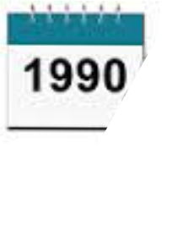
1t’s 1990
You too can do 3 colors
  …..it’s pretty hard, but the best labs are doing it!
Software – Oh, you don’t want to use the software on your flow cytometer for analysis?
Disc drive capacity – Noone could possibly need more than 80 megs….
New Sorters – at least 10,000 cells per second – you will never need to go faster
New Computers – the IBM PC introduced to run a sorter

Slide 5
Yes there really was a time when a 3 color assay was a key publication
Steinkamp, J. A., Stewart, C. C., Crissman, H. A.; Three-color fluorescence measurements on single cells excited at three laser wavelengths, CYTOMETRY, 2, 226-231, 1982
Lanier, L. L., Loken, M. R.; Human lymphocyte subpopulations identified by using three-color immunofluorescence and flow cytometry analysis: correlation of Leu-2, Leu-3, Leu-7, Leu-8, and Leu-11 cell surface antigen expression, J. Immunol, 132: 151-156, 1984
Lansdorp, P. M., Smith, C., Safford, M., Terstappen, L. W. M. M., Thomas, T. E.; Single laser three color immunofluorescence staining procedures based on energy transfer between phycoerythrin and cyanine 5; Cytometry, 12:723-730, 1991
Robinson, J. P., Maguire, D. J., Kelley, S., Ragheb, K., King, G. B.; Statistical determination of minimum cell numbers for 2 and 3 color immunophenotyping, Cytometry Supl 6: 75, 1993

Slide 6

So, what could be around the cytometric corner?
Turn page to see
Future cytometry secrets
2016

Slide 7
How about…..
Flow Cytometers that don’t need trained technicians?
Completely automated clinical diagnostic systems
Instruments that can run a million cells/second
Would you believe 100 parameter analysis
Flow cytometers that give you 3D images as well as regular phenotypic data
Instruments that can measure 20 nm particles
Instruments that can measure almost any color fluorochrome without reconfiguration
Instruments that can run 20,000 flow samples a day

Slide 8
Believe it or not…..
Most of these scenarios already exists in one form or other…..or soon will be…

Slide 9
Optical Design
PMT 5
PMT 4
Sample
PMT 3
Dichroic
Flow cell
Filters
PMT 2
Scatter
PMT 1
Laser
Sensor
Bandpass
Filters
Review

Slide 10
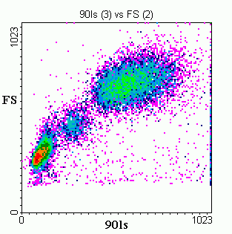
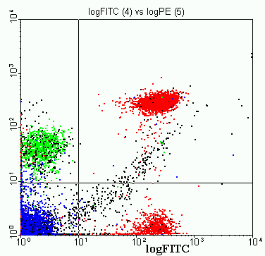
Population selection electronically
We can select any population for any set of parameters, and analyze them with different parameters
Review

Slide 11
350
457
488
514
610
632
Common Laser Lines
300 nm
400 nm
500 nm
600 nm
700 nm
PE-TR Conj.
Texas Red
PI
Ethidium
PE
FITC
cis-Parinaric acid
Review

Slide 12
4 colors - simultaneous collection
FITC
PE
PE-
TR
PE-CY5
530 580 630 680 730 780
Emission wavelength (nm)
System requires complex color compensation
Review

Slide 13
What if you could measure any color without changing any filters??
Hyperspectral
Cytometry
◉

Slide 14
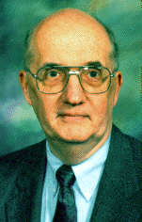
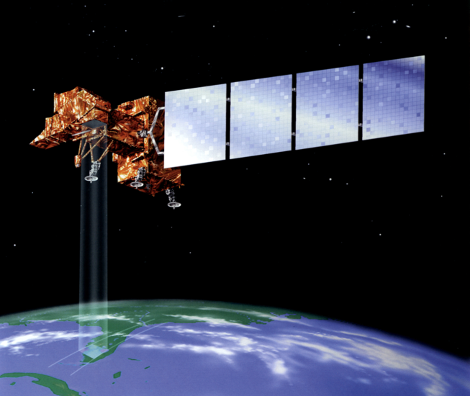
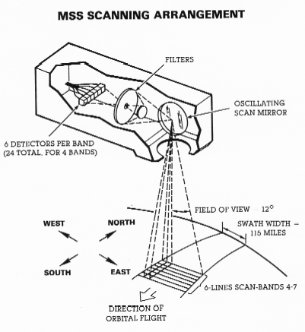
Let’s talk about remote sensing…
History of Multispectral Imaging
A Purdue solution – Prof David A. Landgrebe
The problem: how to classify objects in images of low spatial resolution?
Solution: use the spectral signature of individual pixels and classify them into categories.
1960 – the successful launching of the first weather satellite, TIROS-1.
1961 – the National Academy of Science through its National Research Council formed a committee on "Aerial Survey Methods in Agriculture“
1964 – Purdue, UC/Berkeley, and Michigan consortium starts developing methods for remote sensing
1966 – First multispectral pattern recognition methods capable of identifying individual crop species demonstrated by the Purdue researchers (Professor David Ladgrebe).
This became LANDSAT series of Earth satellites and is the basis for a new generation of instruments carried on Space Station platforms in the 1990's.
Notes:
The Michigan effort concentrated upon building and operating an airborne data collection system.
The UC/Berkeley group focused on perfecting manual data analysis schemes.
Purdue's focus was to be upon machine data-analysis methods and upon agricultural applications.

Slide 15
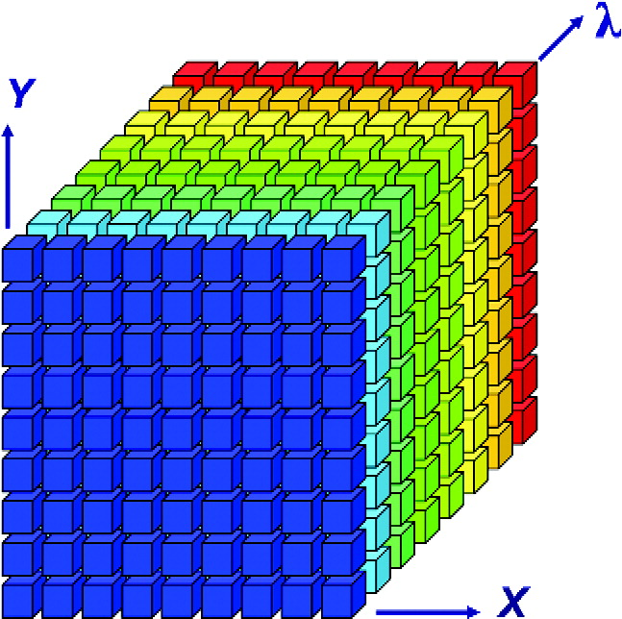
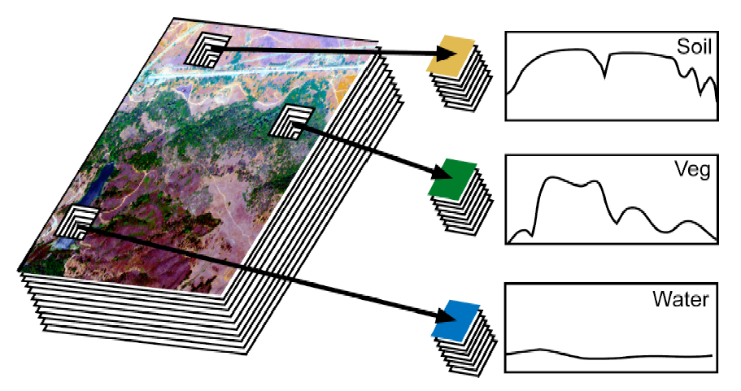
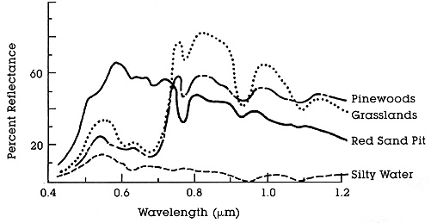
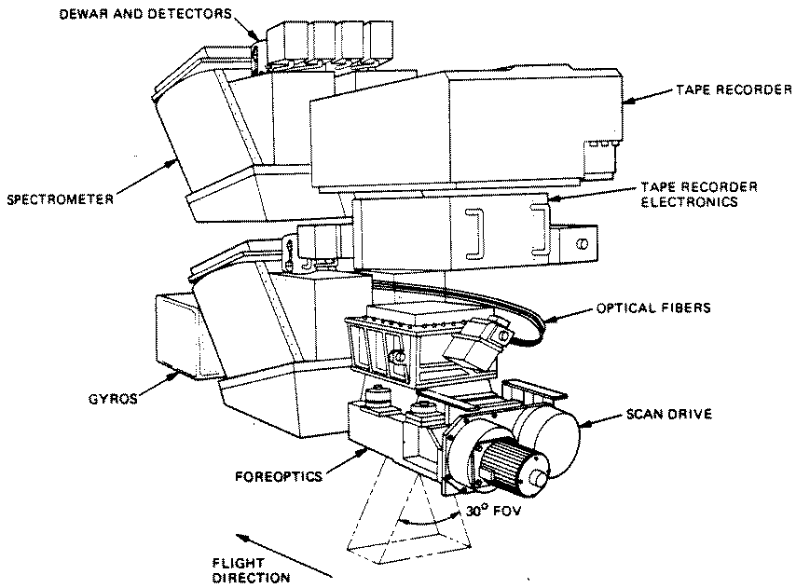
Spectral imaging in remote sensing from the 1960’s
Key Wavelengths
http://rst.gsfc.nasa.gov/Intro/Part2_5.html

Slide 16
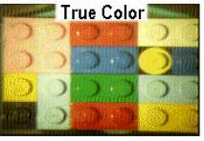

Color composition is a mixture of spectral bands
A photo of
the blocks
A “reconstruction”
A “reconstruction”
Proc. SPIE Vol. 4056, p. 50-64, Wavelet Applications VII, Harold H. Szu, Martin Vetterli; William J. Campbell, James R. Buss, Ed.
The Lego block explanation of spectral imaging!

Slide 17
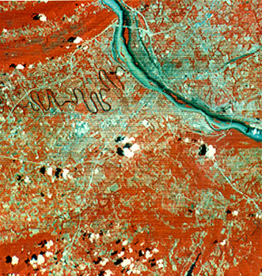
Spectral Imaging from the 1960’s
Spectral = multiple bands
Hyperspectral ≥ 20 bands
Used by NASA in the LandSAT program.
Many applications in biology and medicine.
Key Wavelengths
http://rst.gsfc.nasa.gov/Intro/Part2_6.html
http://rst.gsfc.nasa.gov/Intro/Part2_5.html
Notes:
Multispectral imaging is a process in which a series of monochrome images are taken at multiple wavelengths.
Multispectral imaging was pioneered by engineers such as David Landgrebe, at Purdue, as part of the LandSat project.
Although originally developed for use in the space program, it has many applications in biology and medicine.
This is because multispectral imaging can detect wavelength-dependent reflection or emission with a much higher spectral resolution than the human eye or RGB color imaging.
Here is an example of multispectral images taken by NASA. The image at left is a false color image of red and IR wavelengths. The coloring enhances the contrast between vegetation and buildings.
At right are sample spectra from a multispectral image set. Clearly, certain wavelengths are better for differentiating vegetation than others.
3-color RGB imaging often groups these wavelengths into the same color channel, resulting in a loss of data and an illusion of colors that may not be present in the original sample.

Slide 18
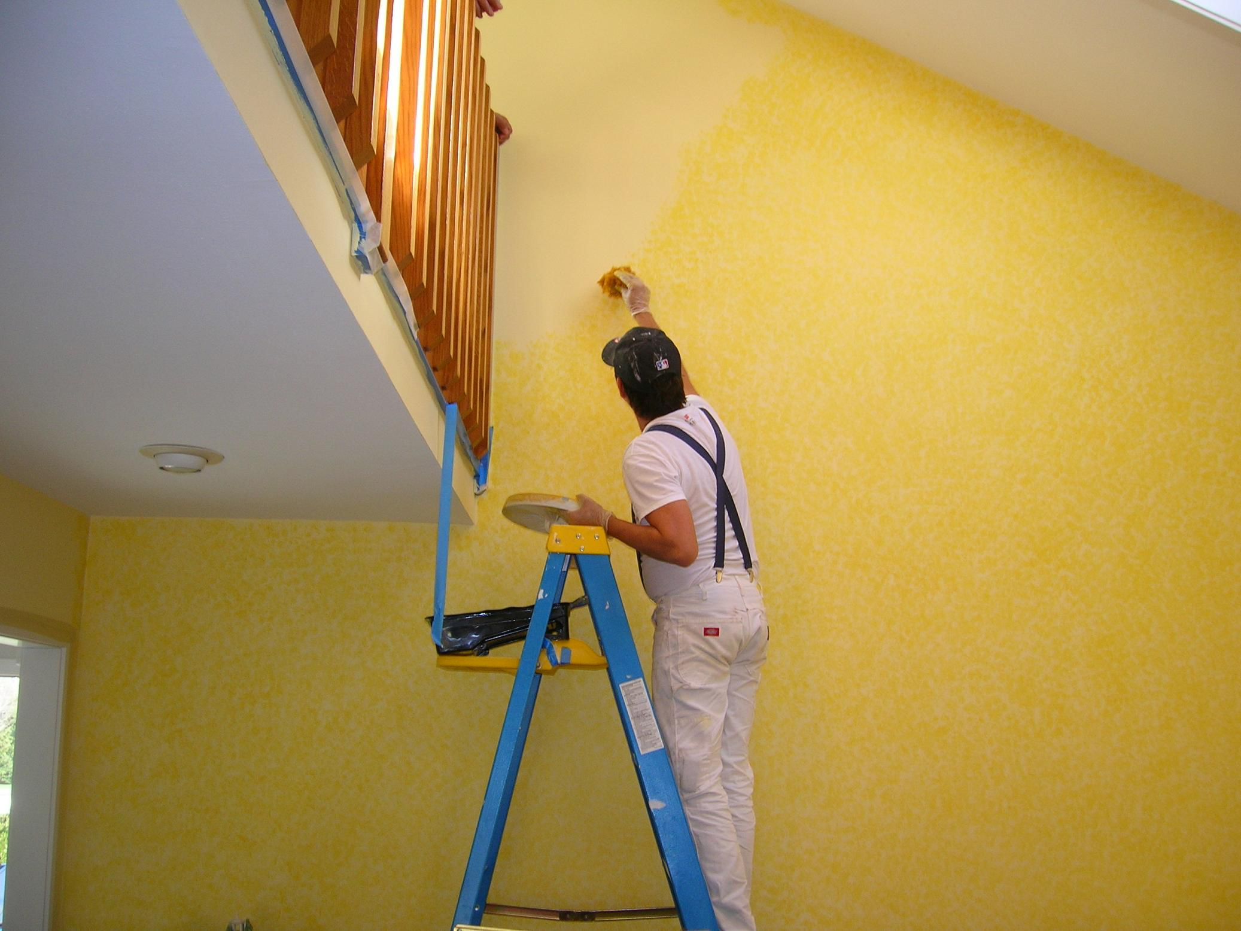
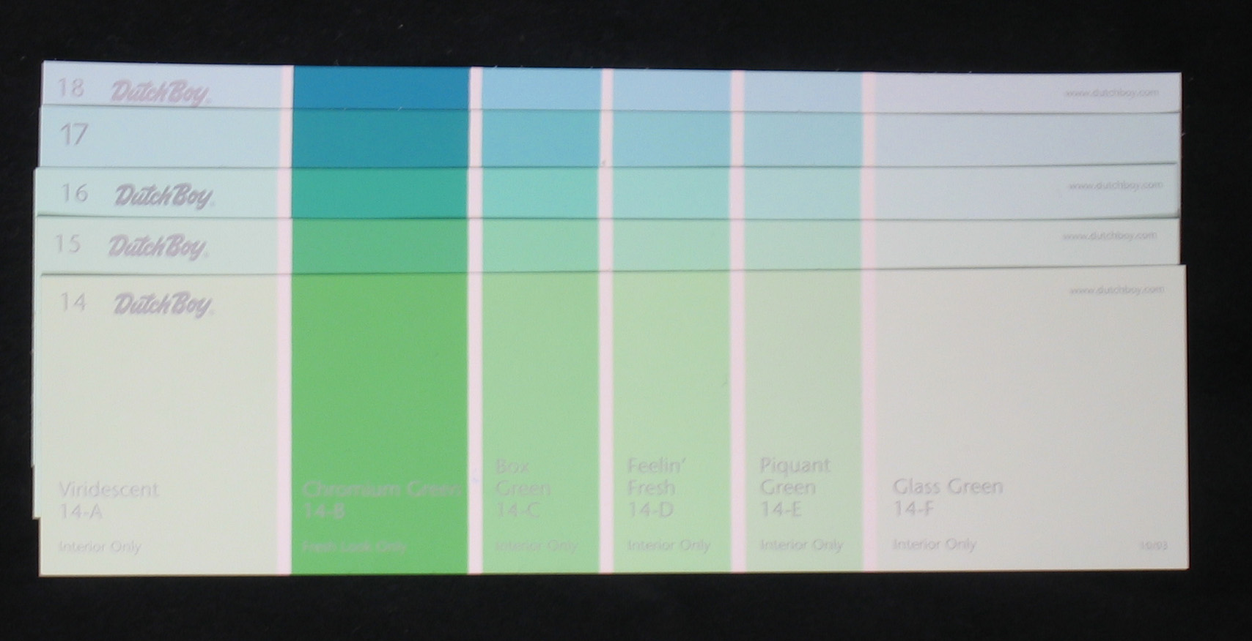
Reflection Example
Dutch Boy paint cards
Colors difficult to distinguish by visual inspection

Slide 19
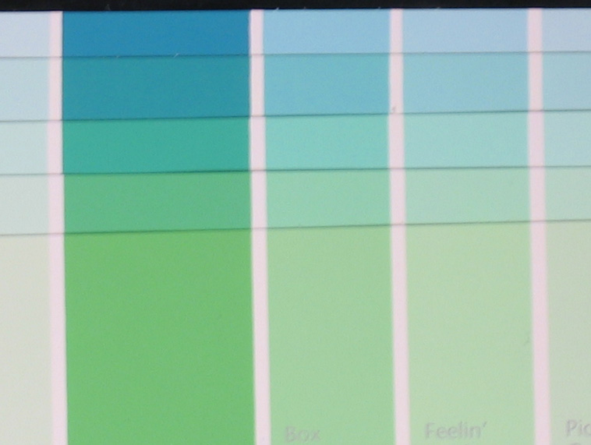

Reflection Example – Clustering
Distinctly separable spectra?
YES!

Slide 20
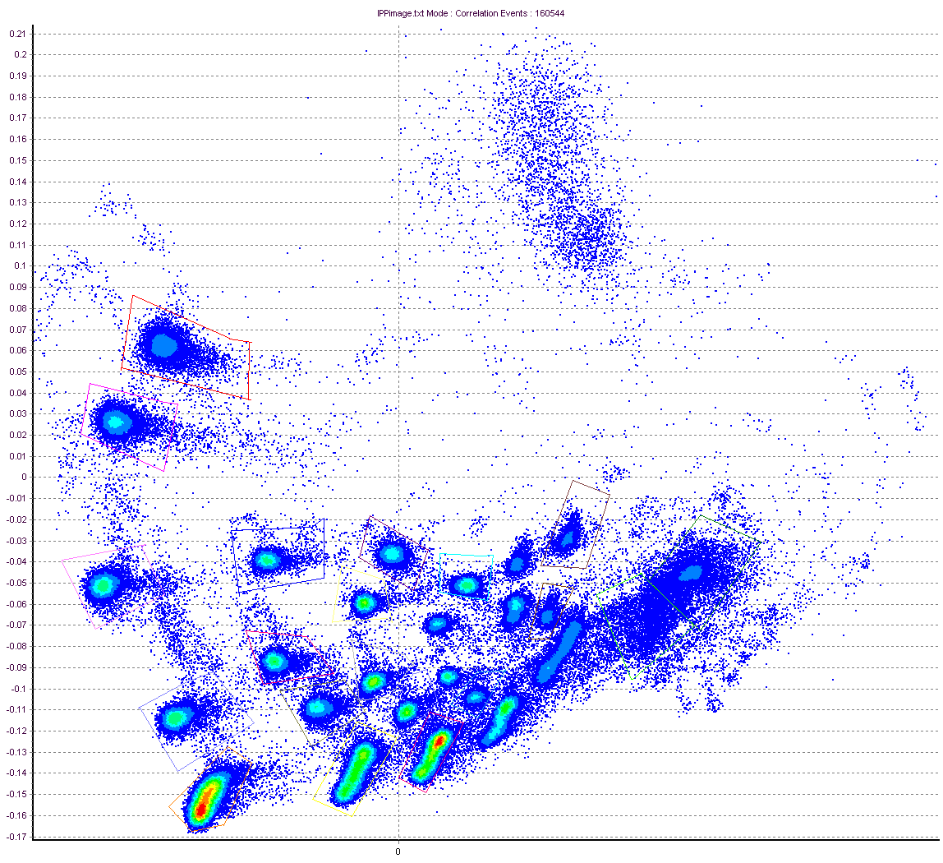
Reflection Example – Clustering
PCA Density Plot From Cytospec Software (Purdue)
PCA-2
PCA-1
Cytospec Software free download
http://www.cyto.purdue.edu/Purdue_software

Slide 21
Reflection Example – Clustering
PCA Density Plot From Cytospec Software (Purdue)
Cytospec Software free download
http://www.cyto.purdue.edu/Purdue_software

Slide 22
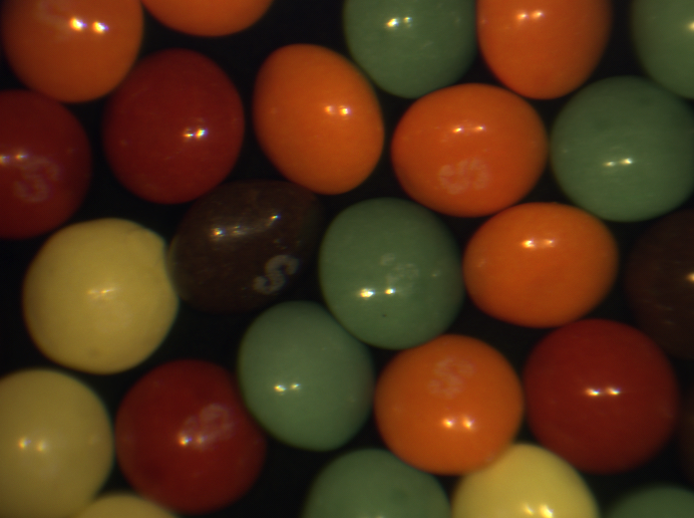
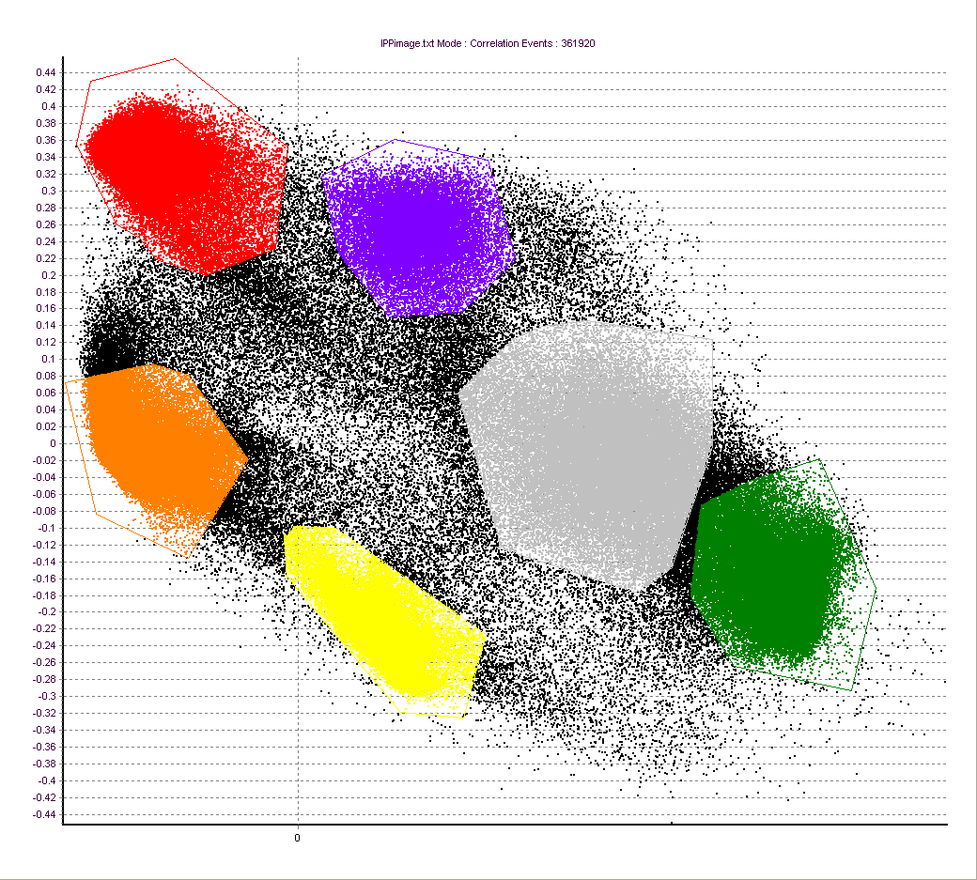
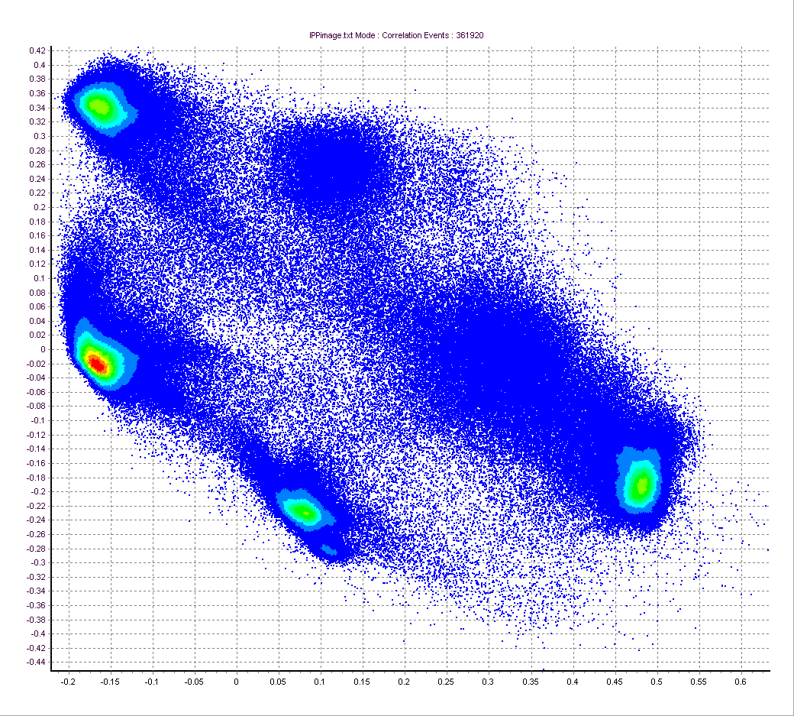
Colored candies

Slide 23
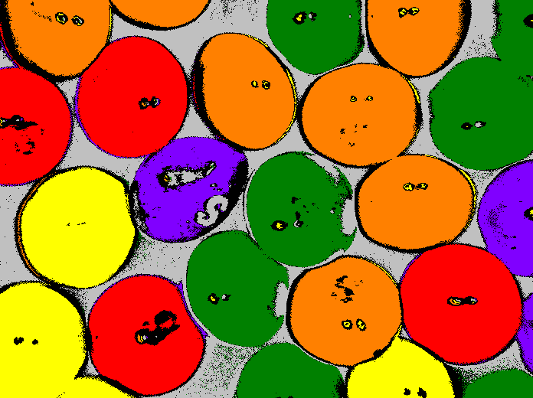
Classified Skittles
1
1
1
3
1
1
3
1
2
1
2
1
1
1
3
2
3
2
3
1
1
3
3
2
1
3
1
2
2
2
3
3

Slide 24
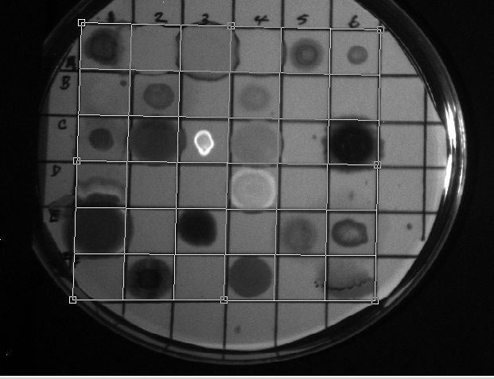
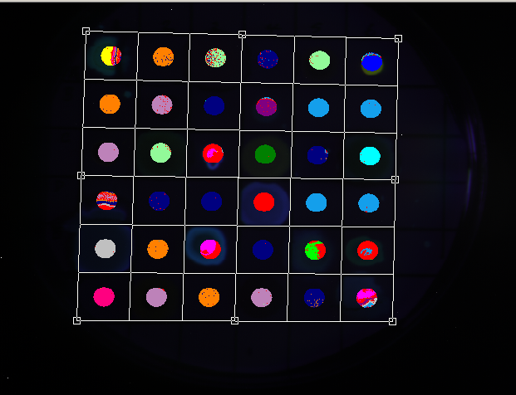
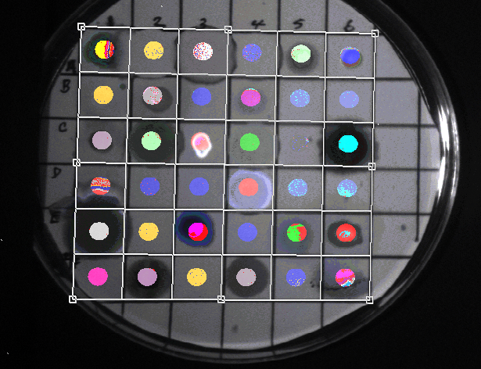
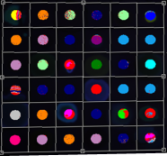
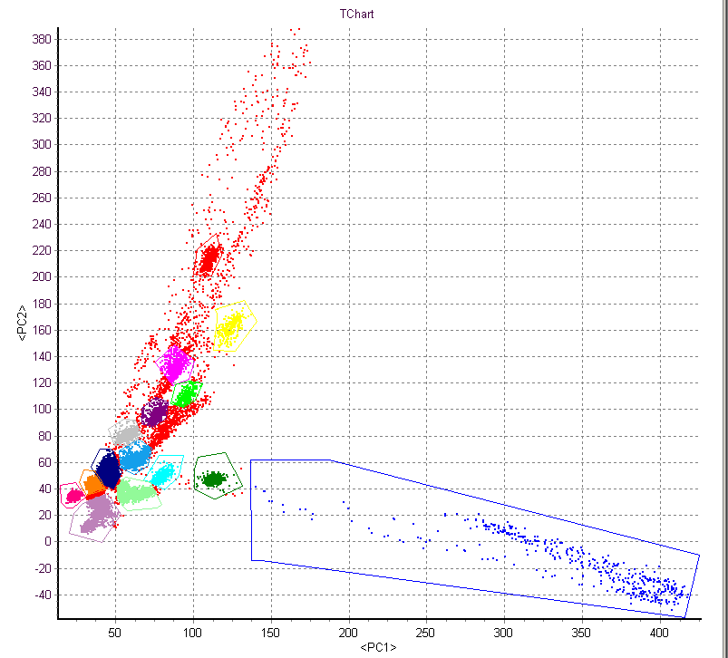
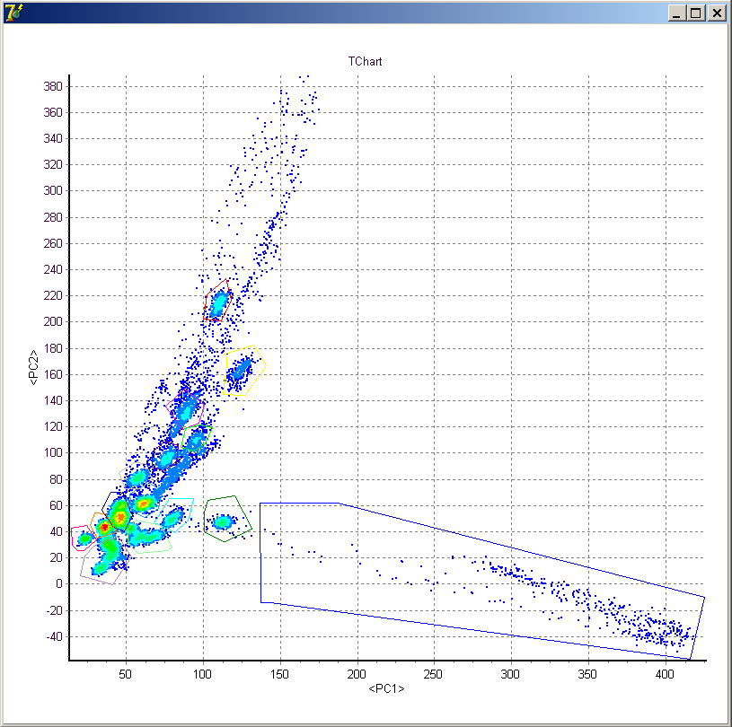
Fluorescence Example
Excitation = 488 nm
Emission = 510-750 nm
Δλ ≈ 4 nm
+
=
Reflected Image
Gated Analysis
Spatial + Chemical Information
Density plot
Nile Red
PCA
Nile Red
Post-acquisition analysis performed by Valery Patsekin, PUCL

Slide 25
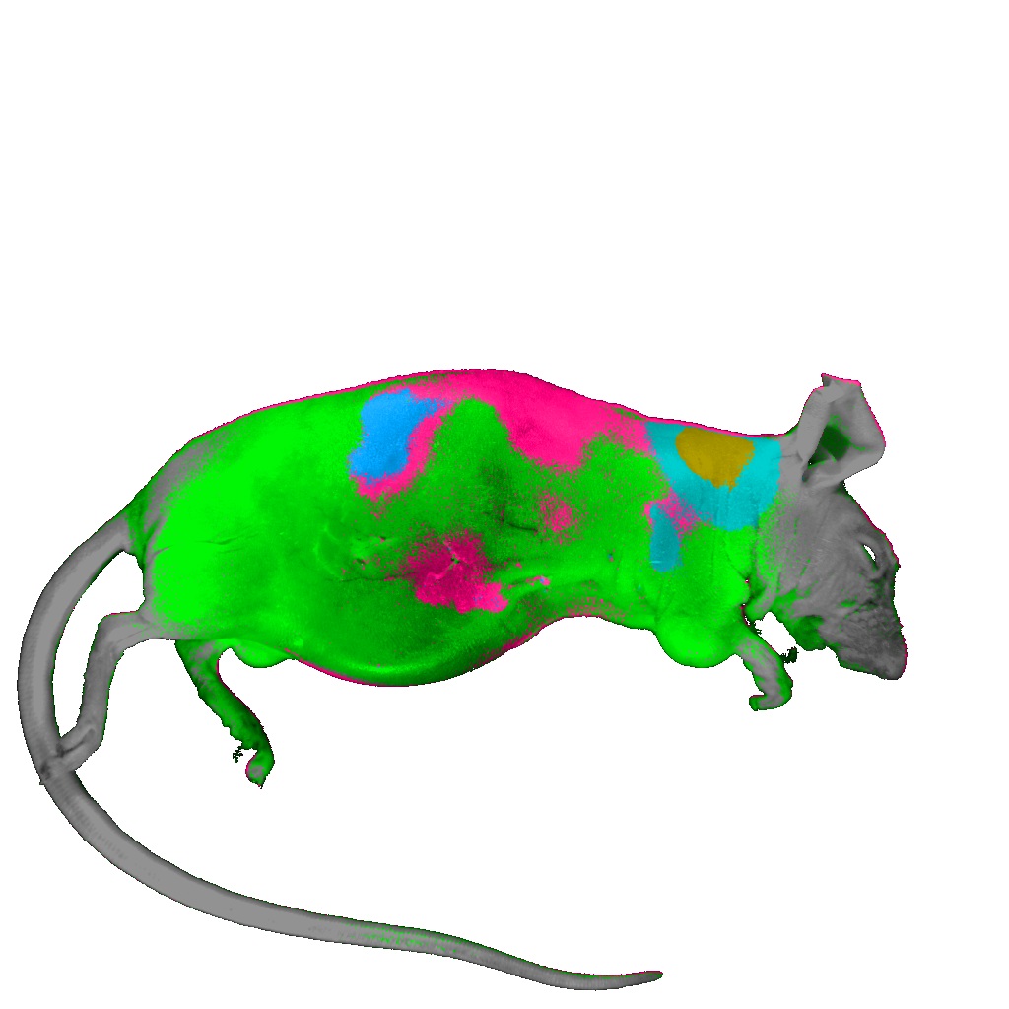
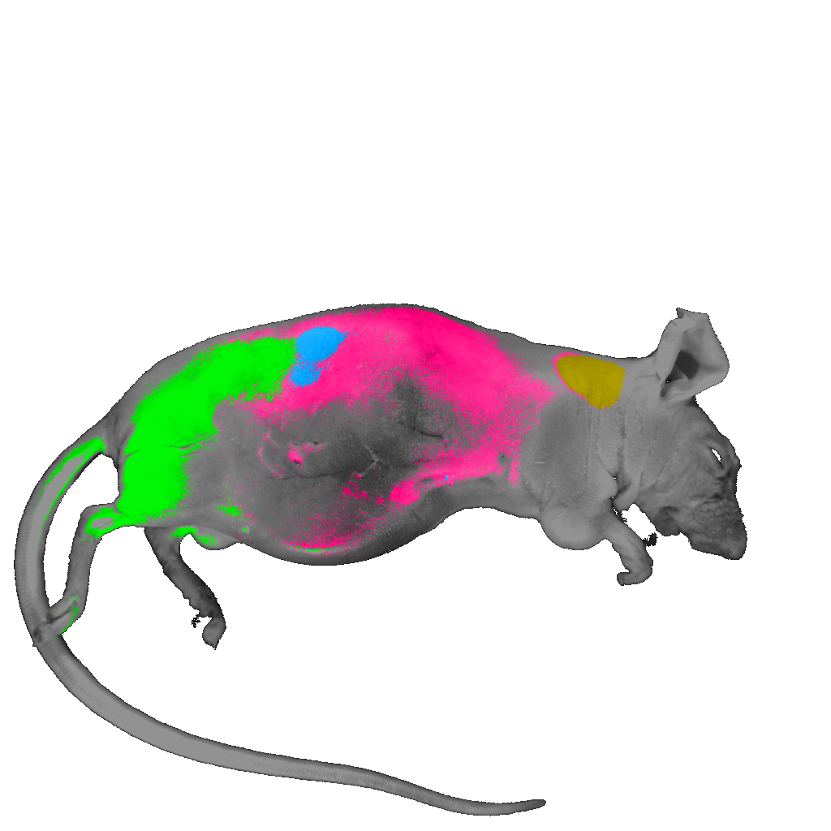
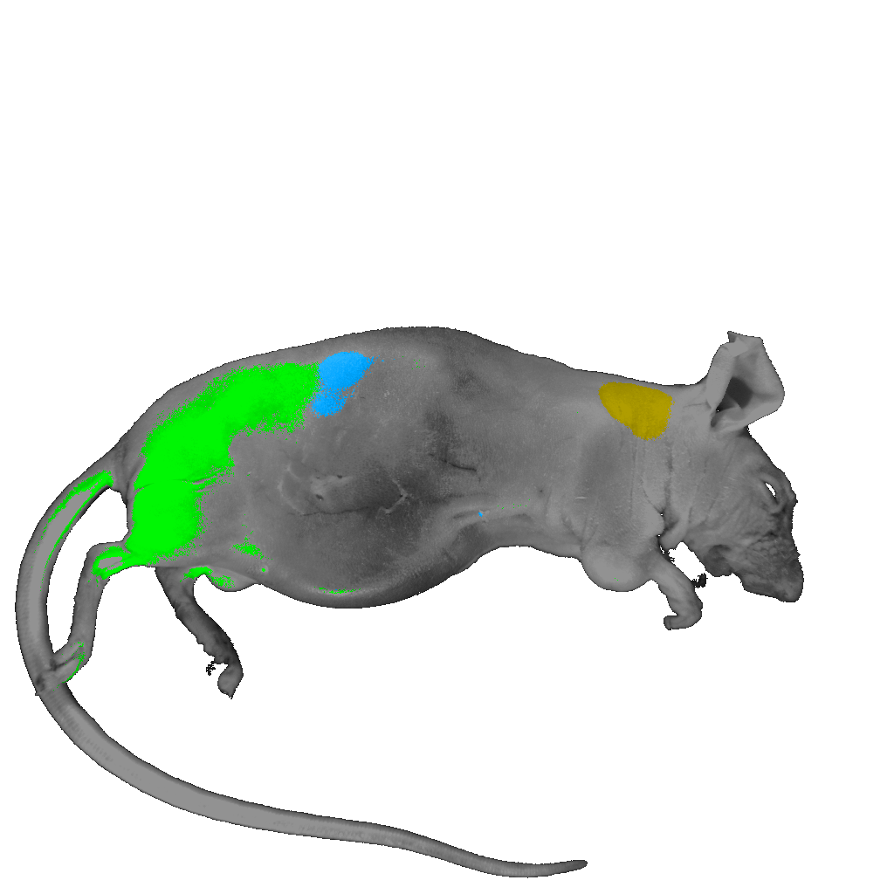
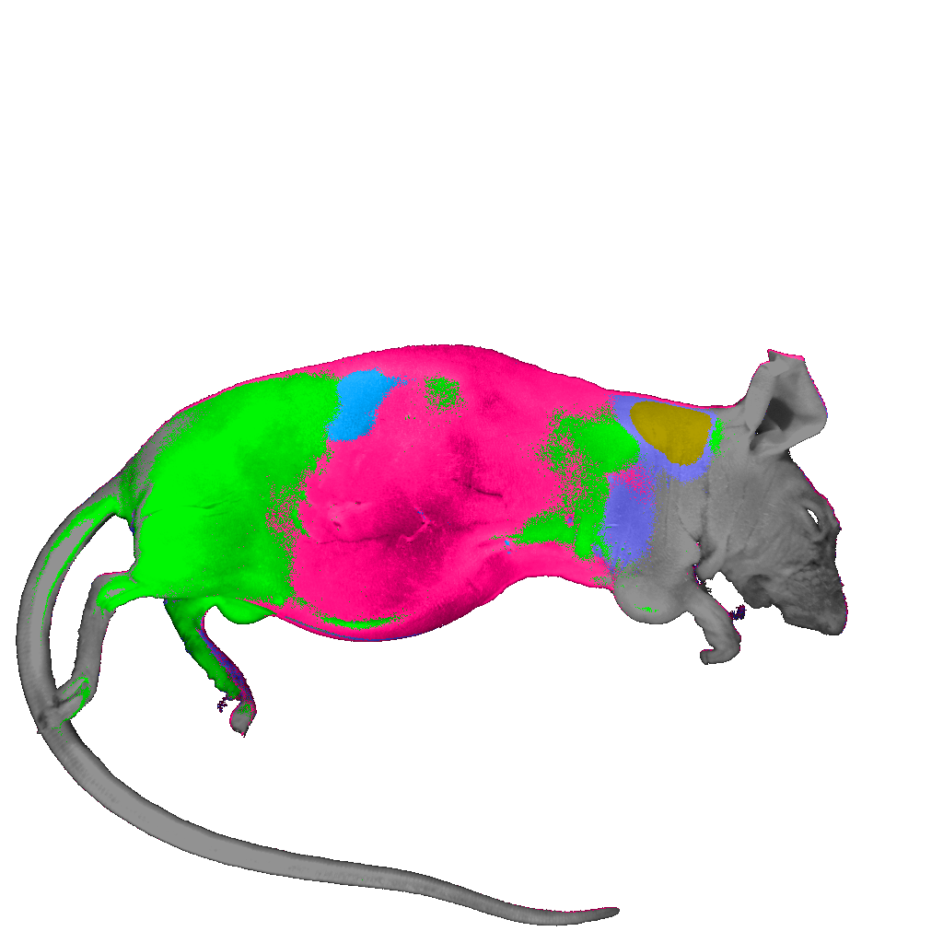
Clustering Algorithms
Spectral Angle Mapper
Maximum Likelihood
ECHO (2x2): Spectral-Spatial
Fisher Linear Likelihood

Slide 26
Spectral Image Processing
Clustering
  Little or no a priori information
  Examples: Isodata, statistical (PCA), …
Classification
  Usually requires a training set
  Examples: Spectral angle mapper, maximum likelihood, minimum Euclidean distance, …
Unmixing
  Sub-pixel method
  Examples: Linear unmixing is the most common

Slide 27
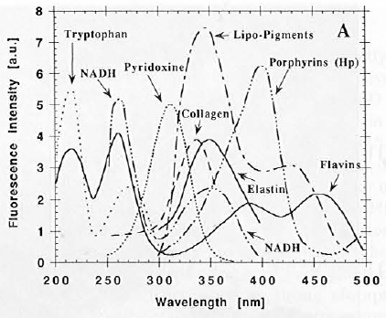
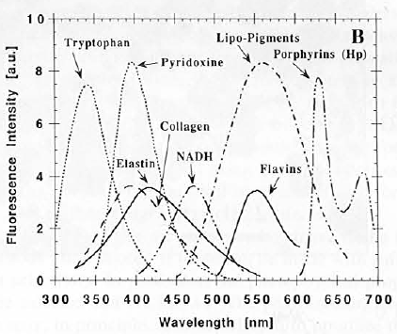
Spectral Imaging in Biology
Endogenous molecules have unique fluorescence spectra
  Complicates studies with fluorescence labels
  Could be a source of untapped cellular information
Absorption
Emission
Wagnières,Star, Wilson, “In vivo fluorescence spectroscopy and imaging for oncological applications” Photochem. and Photobio., 68(5), 603-632, 1998.
Notes:
It is useful to begin within the context of the biomolecules that attenuate photonic flux.
Many biomolecules are endogenous fluorophores with unique absorption and fluorescence emission spectra.
The combination of these individual spectra yield the spectrum seen by the imaging detector.
If the individual spectra contributing to this overall spectrum are known, it is possible to calculate the relative contribution of each of these individual spectra (given that an adequate number of wavelengths are sampled).
The relative contribution of these individual spectrum may correlate to the biomolecule concentration.
Thus, multispectral imaging suggests the possibility of mapping relative endogenous fluorophore concentration in a tissue sample.
Furthermore, occurrence of some biomolecules can be correlated to cellular events.
Here you see plots of the absorption and emission spectra for some relevant biomolecules.

Slide 28
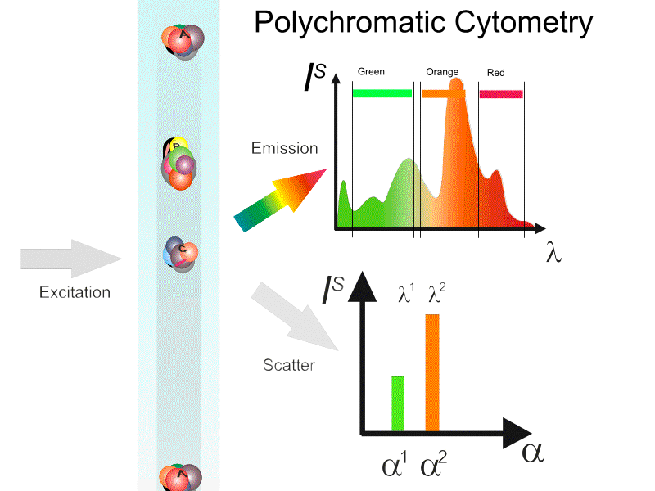

Slide 29
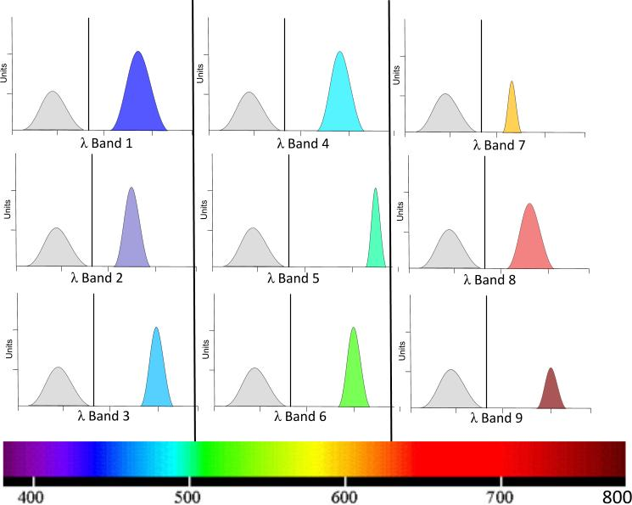
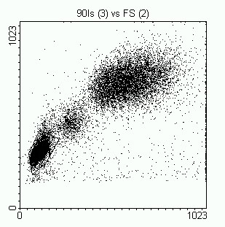
Basic gating and analysis
FS
90 LS
Selecting the “best” dye combinations is possibly the most time consuming and difficult aspect of polychromatic cytometry

Slide 30
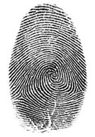
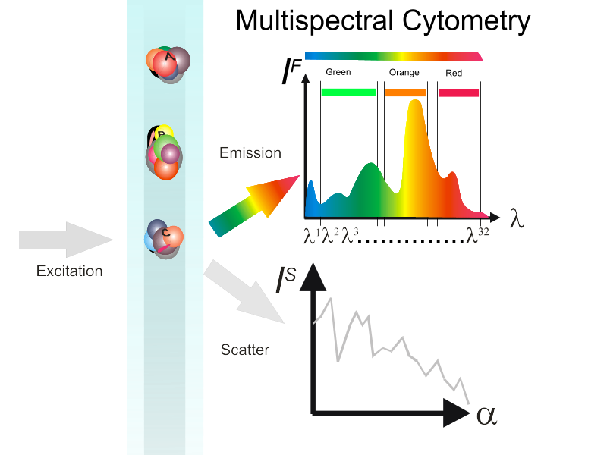
Cell
Fingerprint

Slide 31
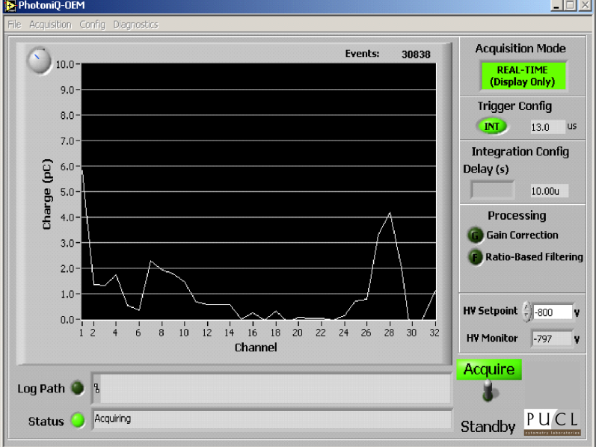

Cell#
λ
One full spectra per particle
Spectral Signature
Match Signature
Resolution of data point

Slide 32
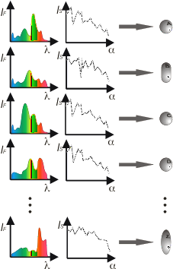
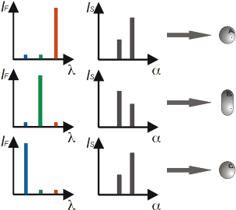
Multicolor (polychromatic) vs. multispectral cytometry (I)
Single intensity as a parameter (usually)
Spectrum as a parameter

Slide 33
High-resolution cytology segmentation
Characteristic
Spectra
Conventional
RGB Image
Spectrally
segmented Image
Wavelength (nm)
High spectral resolution increases utility of spectrally responsive indicator dyes
Slide from Dr. Richard Levenson, CRi, Inc.,35B Cabot Rd.,Woburn, MA 01801, www.cri-inc.com
Notes:
Sensitive to very small changes in spectroscopic properties that would not be reliably detected by non-imaging spectroscopic techniques, and not by standard color-based imaging systems.

Slide 34
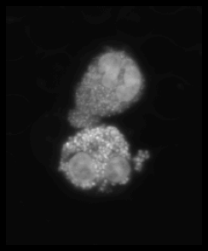
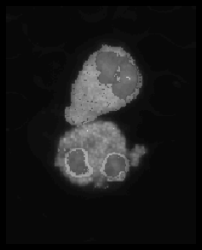
High-resolution cytology segmentation
Characteristic
Spectra
Conventional
RGB Image
Spectrally
segmented Image
Wavelength (nm)
High spectral resolution increases utility of spectrally responsive indicator dyes
Slide from Dr. Richard Levenson, CRi, Inc.,35B Cabot Rd.,Woburn, MA 01801, www.cri-inc.com
Notes:
Sensitive to very small changes in spectroscopic properties that would not be reliably detected by non-imaging spectroscopic techniques, and not by standard color-based imaging systems.

Slide 35


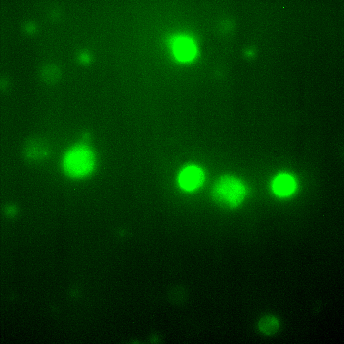
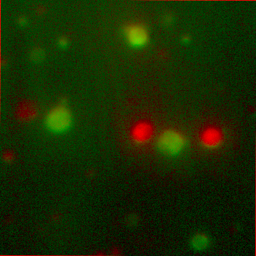
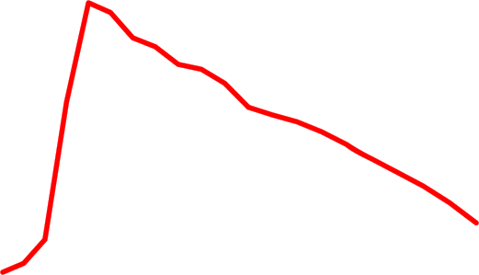


Spectral “unmixing”
Cell
Fingerprint
Before
After
Green
Dye 1: bis-(1,3-dibutylbarbituric acid)trimethine oxonol, DiBAC₄(3)
Dye 2: 3,3'-dihexyloxacarbocyanine iodide, DiOC₆(3)
Green
Human lymphocytes
FITC filter block
Unmixed
DiOC₆(3)
And bis-oxonol

Slide 36
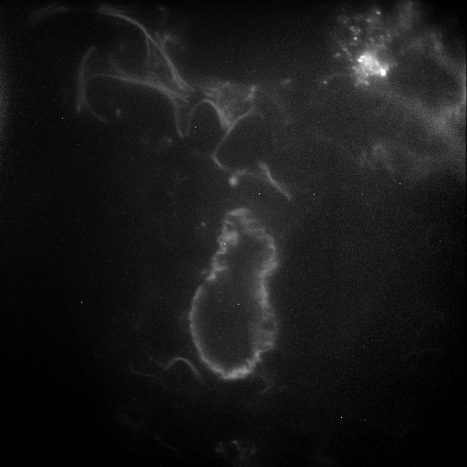
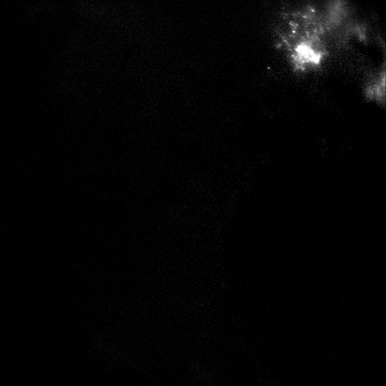
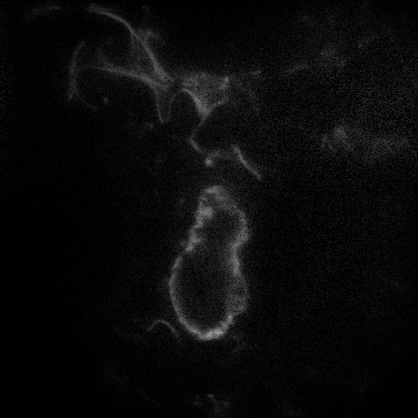
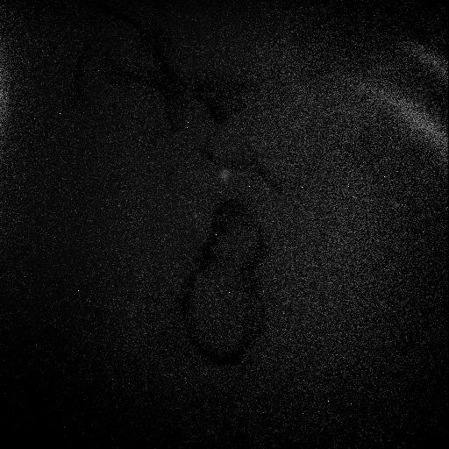
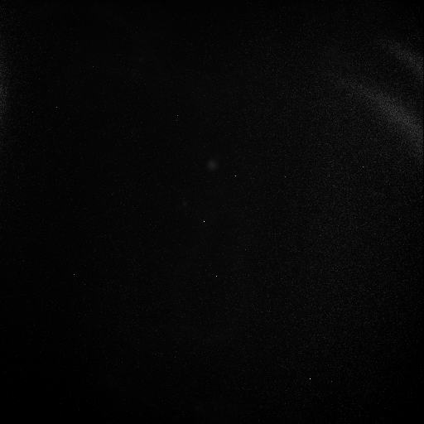

Separating GFP from Lung Autofluorescence
Raw Image
Unmixed Image
GFP
Autofluorescence
Background
RMS Error

Slide 37
Multispectral Cytometry. Why?
Identification of multiple spectrally overlapping stains (multiplexing)
Spectral barcoding
Potential capability of spectral un-mixing (multiple stains in a single particle)
Identification of intrinsic (autofluorescence) fluorescence
Opportunity for intelligent systems approach to classification

Slide 38



Advanced polychromatic cytometry
How do you do collect current cytometry?
spectrometer
Hyperspectral cytometry
14 PMTs
41 filters

Slide 39




Hyperspectral Single Cell Cytometry
64 ch ADC`
10 μs available
10,000-100,000 cells
First built in our lab in 2002-2003

Slide 40


A new generation of hyperspectral detector
installed on a conventional flow cytometer
FC500
Gallios
Spectral
optics
FC500/GALLIOS Hybrid + 32 channel electronics + iFlex Viper (Qioptiq)

Slide 41


Principle of Operation
US & foreign patents pending

Slide 42

A 32 Ch PMT detector

Slide 43


Slide 44


Slide 45
Spectral plots
5-(and-6)-carboxy-2´,7´-dichlorofluorescein diacetate (CDCFA)
5(6)-carboxy-4',5'-dimethylfluorescein (CDMFA)
5-sulfofluorescein diacetate (SFDA)
Cell Tracker Green – 5-chloromethylfluorescein diacetate (CTG)
5-(and-6)-carboxy-2´,7´-dichlorofluorescein diacetate, succinimidyl ester (DCF)
bis-(1,3-dibutylbarbituric acid)trimethine oxonol (DiBAC₄(3))
3,3'-dipentyloxacarbocyanine iodide (DiOC₅(3))
3,3'-dihexyloxacarbocyanine iodide (DiOC₆(3))
Rhodamine 110
400---------750nm
1
400---------750nm
2
400---------750nm
3
4
5
6
7
8
9

Slide 46
Scatter matrix
Matrix of 2-D scatterplot allow us to visualize all the possible combination of channels.
Result: we are overwhelmed by information, so the matrix is not very useful

Slide 47


Confusion matrix
5-(and-6)-carboxy-2´,7´-dichlorofluorescein diacetate (CDCFA)
5(6)-carboxy-4',5'-dimethylfluorescein (CDMFA)
5-sulfofluorescein diacetate (SFDA)
5-(and-6)-carboxy-2´,7´-dichlorofluorescein diacetate, succinimidyl ester (DCF)
Cell Tracker Green – 5-chloromethylfluorescein diacetate (CTG)
bis-(1,3-dibutylbarbituric acid)trimethine oxonol (DiBAC₄(3))
3,3'-dipentyloxacarbocyanine iodide (DiOC₅(3))
3,3'-dihexyloxacarbocyanine iodide (DiOC₆(3))
Rhodamine 110
CDCFA
CDMFA
SFDA
CTG
DCF
DiBAC43
DiOC₅(3)
DiOC₆(3)
RH110
CDCFA
87.92%
0.00%
0.76%
2.72%
0.00%
6.04%
1.92%
0.64%
0.00%
CDMFA
0.24%
97.76%
0.52%
0.04%
0.00%
0.00%
0.16%
0.88%
0.40%
SFDA
0.04%
0.00%
94.36%
4.88%
0.00%
0.00%
0.00%
0.72%
0.00%
CTG
5.44%
0.00%
5.04%
86.44%
0.00%
0.20%
0.80%
2.04%
0.04%
DCF
0.00%
0.00%
0.00%
0.00%
100.00%
0.00%
0.00%
0.00%
0.00%
DiBAC43
3.72%
0.20%
0.04%
0.40%
0.00%
92.76%
0.96%
1.92%
0.00%
DiOC₅(3)
4.12%
0.28%
0.56%
1.92%
0.00%
1.32%
77.60%
14.20%
0.00%
DiOC₆(3)
1.92%
0.12%
0.76%
1.72%
0.00%
1.24%
17.72%
76.52%
0.00%
RH110
0.00%
0.00%
0.08%
0.36%
0.00%
0.00%
0.00%
0.20%
99.36%

Slide 48

5-(and-6)-carboxy-2´,7´-dichlorofluorescein diacetate (CDCFA)
5(6)-carboxy-4',5'-dimethylfluorescein (CDMFA)
5-sulfofluorescein diacetate (SFDA)
Cell Tracker Green – 5-chloromethylfluorescein diacetate (CTG)
5-(and-6)-carboxy-2´,7´-dichlorofluorescein diacetate, succinimidyl ester (DCF)
bis-(1,3-dibutylbarbituric acid)trimethine oxonol (DiBAC₄(3))
3,3'-dipentyloxacarbocyanine iodide (DiOC₅(3))
3,3'-dihexyloxacarbocyanine iodide (DiOC₆(3))
Rhodamine 110

Slide 49









7 of 9 “green” dyes could be resolved
All dyes
Oxonol Events: 3373
Human Lymphocytes

Slide 50


Spectra of gated zones
phycoerythrin
Rh123
Bang’s Labs, Inc
Dyed
Beads
chlorophyll

Slide 51




Chlorophyll
Rh-123
PE
Bang’s
Labs
Dyed
Beads*
These CANNOT be resolved easily
Accept using classification tools like PCA

Slide 52



Sony* Spectral Cytometer
(*Sony licensed Purdue spectral Patent)
Slide taken from Sony publicity materials
Data from M. Tomura, Kyoto University

Slide 53

Sony Spectral Cytometer - 12 color separation
Slide taken from Sony publicity materials
Data from E.Watanabe, Y. Nakamuci, N. Watanabe and H. Nakamuchi, Univ. Tokyo

Slide 54

Separation of GFP and FITC signals using
spectral cytometry
Data courtesy of W.C. Hyun (UCSF)
Hyperspectral cytometry can capable of channels in the PMT to form “virtual filters”
  Function as a regular polychromatic FC
  Capability of fine-tuning the detection to adjust for particular staining strategies as well as problems with label intensities or markers abundances.

Slide 55

Cytometry Part A  87A: 830842, 2015
System for visualizing cellular movement in vivo using photoconvertible FPs in Kaede-transgenic mice and KikGR expressing mice
Enables labeling cells with photoconvertible FPs that change emission from green to red with UV exposure
Goal to monitor cellular movement between lymphoid organs and peripheral tissue by flow cytometry

Slide 56

Fundamental process in Spectral FCM

Slide 57

Confocal and
Flow data of
Photoconversion
process

Slide 58

Spectral Vs Conventional FCM
FITC^{519nm}/EGFP^{507nm}
KikGR-Green^{-(517nm)}/KiKGR+ Venus^{+(528nm)}
PE^{578nm} – KikGR-red^{591nm}
mAzami-Green(^{505nm}/mKusabira-Orange2^{565nm}

Slide 59


Slide 60

11 color separation

Slide 61
Spectral system – an ideal cytometry machine?
Able to measure multiple biological features
Utilize optically maintenance/change-free optical design
Provide fully computer-assisted “compensation” (well compensation as we know it today is no more!!)
Provide guidance for label panels design

Slide 62
Spectral Imaging Advantages & Disadvantages
Advantages
  Spectral discrimination
  Autofluorescence removal
  Quantitation
  Can use many (any) fluorochromes
  Can use very similar dyes (ie same color!!)
Disadvantages
  System has to be specifically designed for spectral
  Narrow bands → Poor S/N (per band)
  Wavelength dependence of system must be considered:
    Optical components
    Noise
    Sample
    Speed??
    Issues with multiple lasers
    Unknown if very low expressing epitopes will work well

Slide 63
Conclusions
Spectral Cytometry is now a commercial reality
Spectral Cytometry will soon meet the standards set by the imaging community some 15 years ago
Spectral deconvolution is more mathematically “pure” than current cytometry “compensation”
Many probes not usable together can be used with spectral instruments
Spectral hardware should be cheaper and simpler than polychromatic cytometry (in future)
There are clearly many opportunities to advance this technology into new domains

Slide 64
Acknowledgements:
This research was performed at Purdue University Cytometry Laboratories by an international team.
Computer Scientist
Biophysicist
Coffee
maker
The development team photo in 2004 when the original concept was created

Slide 65
Thank you for your attention

