Slide 1
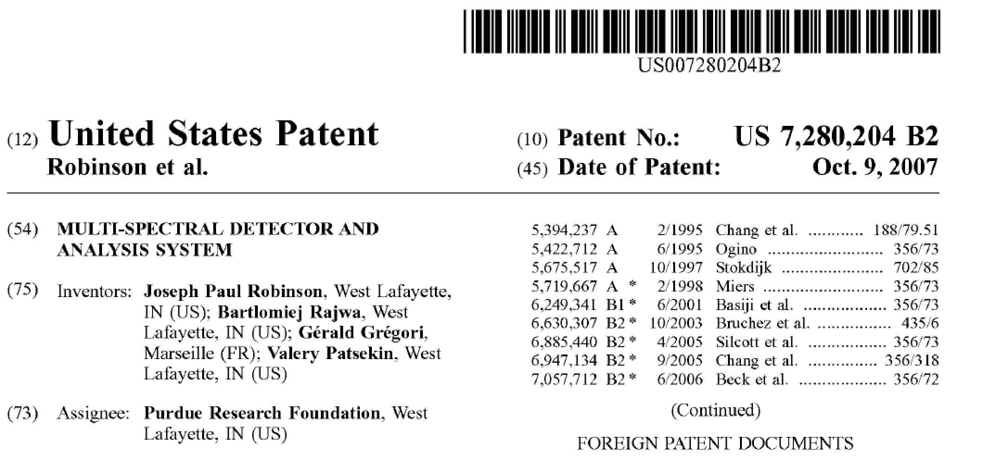
The background to the discovery of Spectral Flow Cytometry
The original team:
J. Paul Robinson, Bartek Rajwa, Gerald Gregori, Valery Patsekin, James Jones
The key patent: US7,280,204
This patent covers all current spectral flow cytometers

Slide 2
Flow cytometry in early 2000s…
© J. Paul Robinson, Purdue University

Slide 3
We all know of the race to measure more colors….
2 colors…
3 colors…
5 colors…
8 colors…
11 colors…
18 colors…
Everything was about increasing the power of flow cytometry…….
The problem was how to fit more colors into available bands………
Should we use more lasers? Bigger Lasers?
New Dyes? Tandem Dyes?
© J. Paul Robinson, Purdue University

Slide 4
It occurred to our Purdue group that we could solve the problem by not having to worry about the band width of the dyes at all – but take advantage of the fact that each dye exhibited a specific spectral signature.…..
© J. Paul Robinson, Purdue University

Slide 5
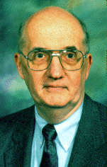
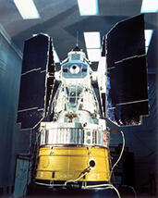
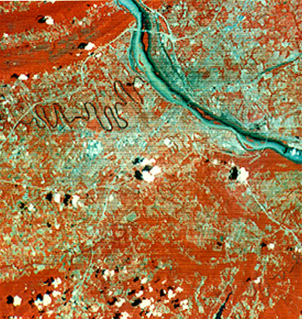
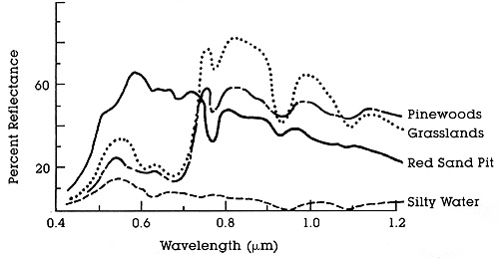
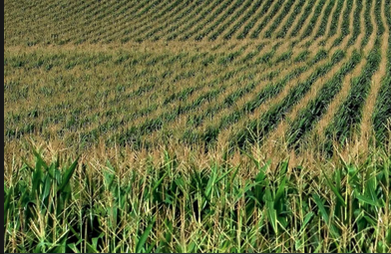
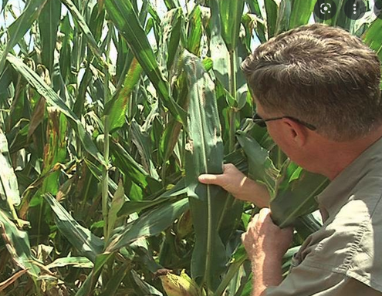
What drove us to this direction?
Spectral Imaging from the 1960’s
“Inside Landsat 1 (1972) was a Return Beam Vidicon (RBV) and a secondary, experimental Multi-Spectral Scanner (MSS). The RBV was supposed to be the prime instrument, but the MSS data was demonstrably superior.”
Prof. David Landgrebe
https://www.usgs.gov/landsat-missions/landsat-1
The cross-track scanning was accomplished by an oscillating mirror; six lines were scanned simultaneously in each of the four spectral bands for each mirror sweep. The forward motion of the satellite provided the along-track scan line progression.
The foundation of Remote Sensing
Healthy Corn
Diseased Corn
http://rst.gsfc.nasa.gov/Intro/Part2_6.html
http://rst.gsfc.nasa.gov/Intro/Part2_5.html
© J. Paul Robinson, Purdue University
Notes:
The story of spectral analysis actually started at Purdue University. Professor David Landgrebe, a professor of electrical engineering, was trying to use spectral analysis to determine the disease spread in corn fields. Since Indiana is a huge corn producer, this was economically important. In the 1960s, he used a plane carrying a spectrometer, and they flew it over corn fields and collected the signature of chorophyl. The signature changed when the plan was diseased. He was convinced that this technology could be expanded. In 1972, he convinced the defense dept, to include a spectrometer into the first satellite that was sent up to scan the earth. They used the RBV syste, that they thought would be great - and they included Landgrebes spectrometer system as a backup. It turned out that the backup worked and the RBV did not. And from this point all satelites (now called Landsat) were basedon spectral imaging. We visited Prof Landgrebe in about 2000 when we wanted to use spectral for flow – and we learned a lot about unmixing data, spectral bandwidther, etc. etc. The technology developed by Prof Landgrebe because know as Remote Sensing.

Slide 6
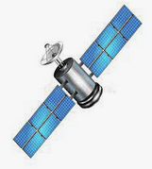
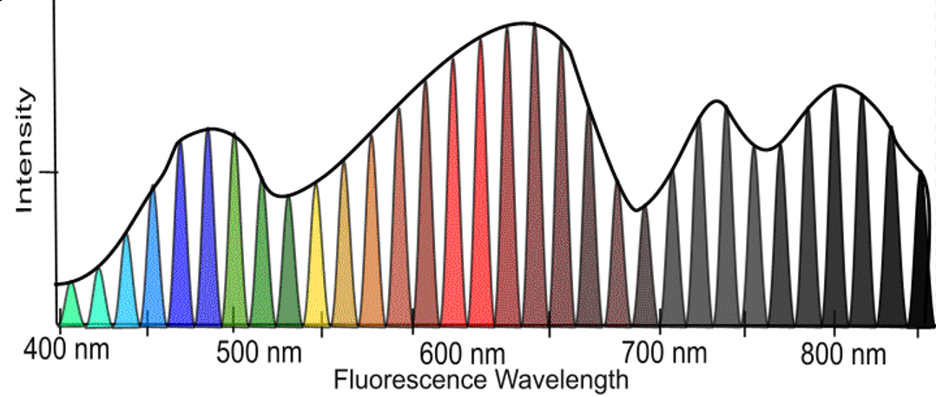
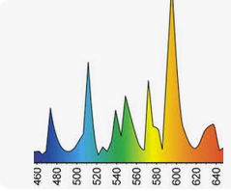

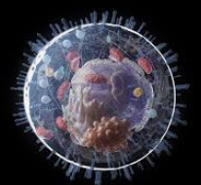
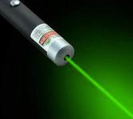
Remote Sensing
Intimate Sensing
Cell Signature
© J. Paul Robinson, Purdue University
Notes:
We took the ideas of Remote Sensing and created Intimate Sensing – although we never actually published anything with that name. it was the concept however.

Slide 7
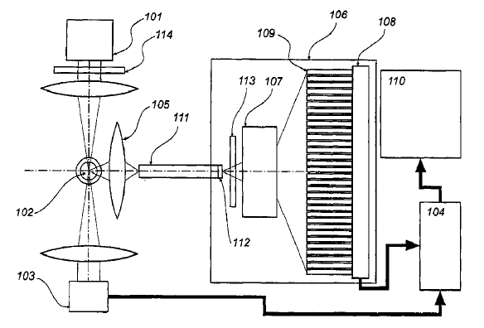
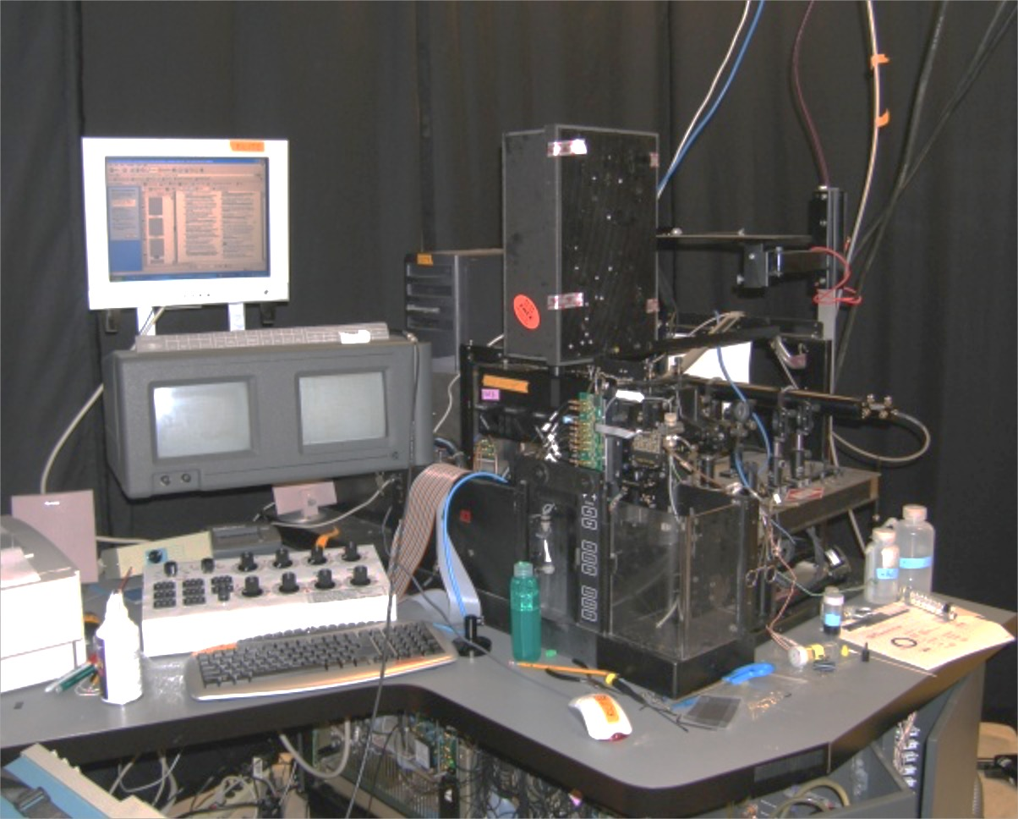
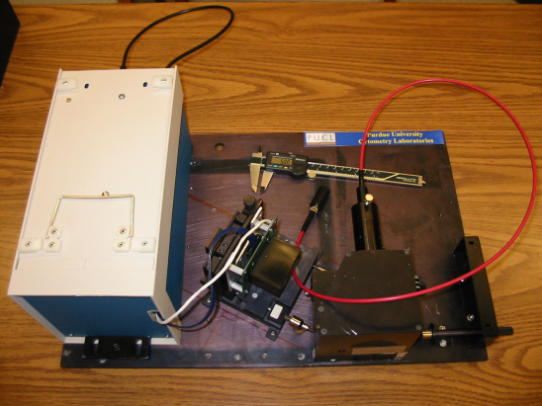
Detectors
Purdue Designed Spectral Flow Cytometry (Circa 2002)
ADC Electronics
32 spectral channels Hamamatsu
6 regular fluorescence channels
1 side scatter channel
6 forward scatter detectors
1 time gate
64 ch 16 Bit ADC
Purdue Issued Patent #7,280,204
© J. Paul Robinson, Purdue University

Slide 8
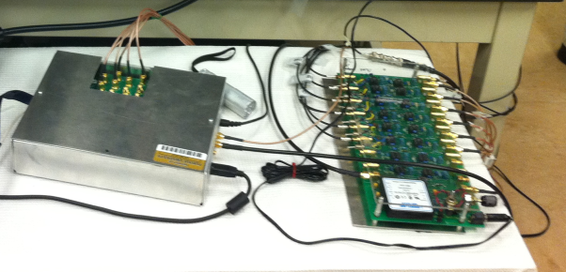
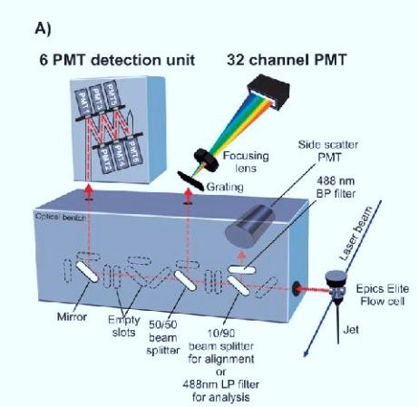
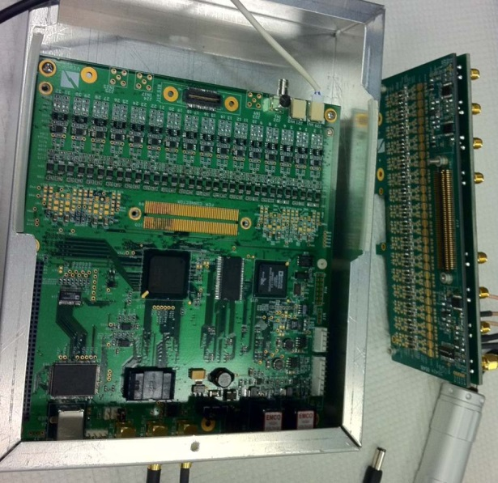
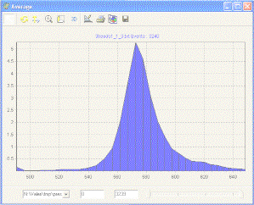
Hyperspectral Single Cell Cytometry
64 ch ADC`
10 μs available
10,000-100,000 cells
Built in 2002-2003
© J. Paul Robinson, Purdue University
Notes:
In our first iteration of spectral flow, we did not have a traditional polychromatic cytometer. When we tried to analyze the data, it was confusing as we were unable to work out exactly how to analyze it – we did not have ground truth. So we added a 6 PMT detector array to our spectral system and this gave us some insights as to what was actually happening in the spectral data. This is shown on the top left.

Slide 9
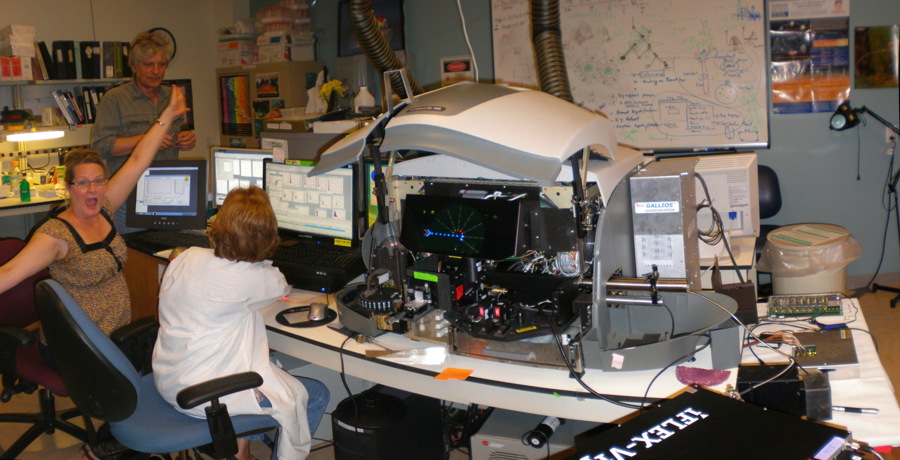
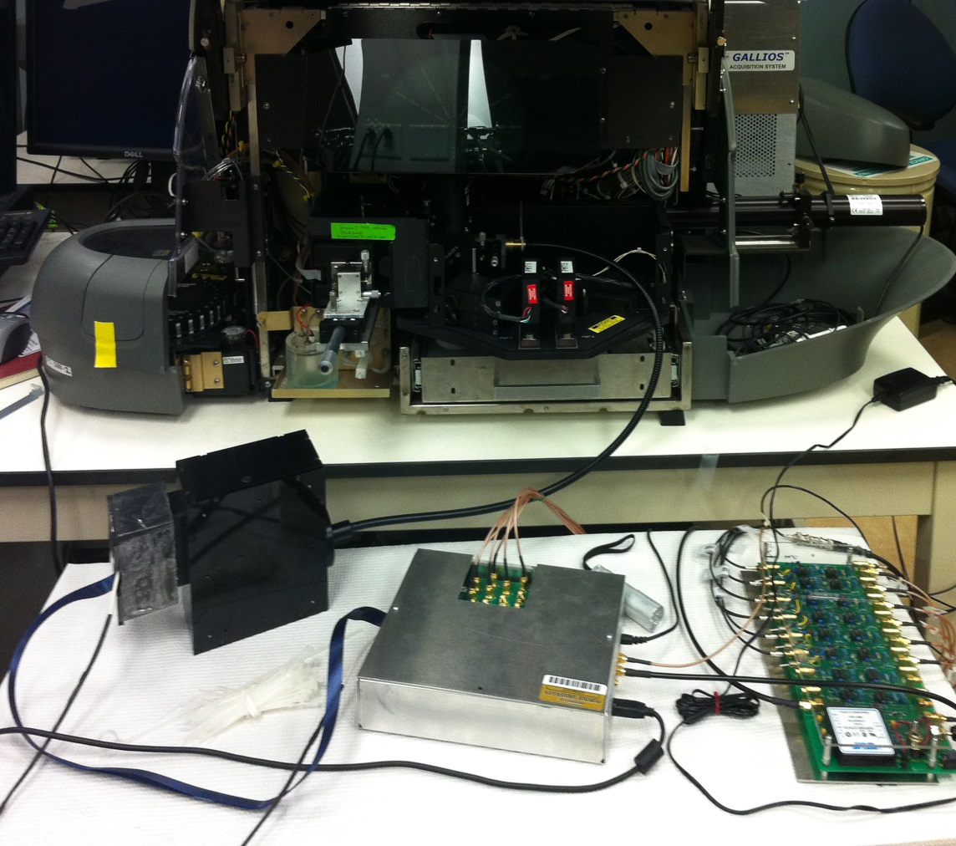
A new generation of hyperspectral detector
installed on a conventional flow cytometer
FC500
Gallios
Spectral
optics
FC500/GALLIOS Hybrid + 32 channel electronics + iFlex Viper
© J. Paul Robinson, Purdue University
Notes:
Several years after our first instrument, we took anm FC500 and combined it with the gallios electronics to get a 12 ch polychromatic system and added a 32 ch PMT for spectral.

Slide 10
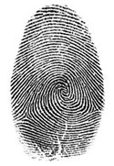
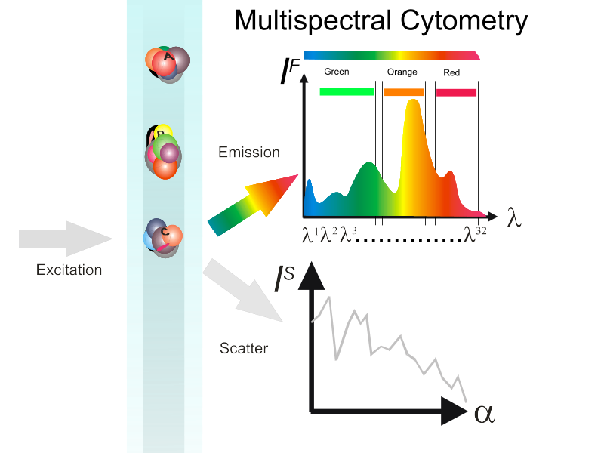
Cell
Fingerprint
© J. Paul Robinson, Purdue University
Notes:
We defined the concept of the wavelength signature to be a parameter in flow cytometry. previously the only critical thing folks cared about in polychromatic cytometry was signal intensity. But that is not the most critical think in spectral

Slide 11
Multicolor (polychromatic) vs. multispectral cytometry (I)
P¹ P² P³…..
Single intensity as a parameter (usually)
Spectrum as a parameter
© J. Paul Robinson, Purdue University

Slide 12
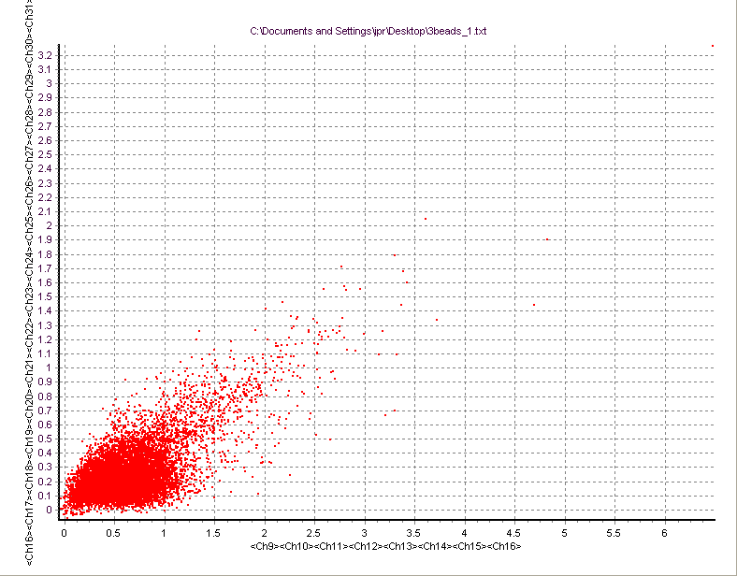
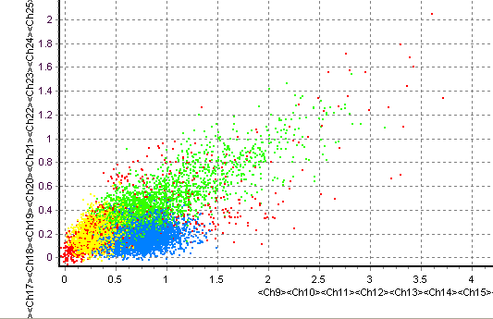
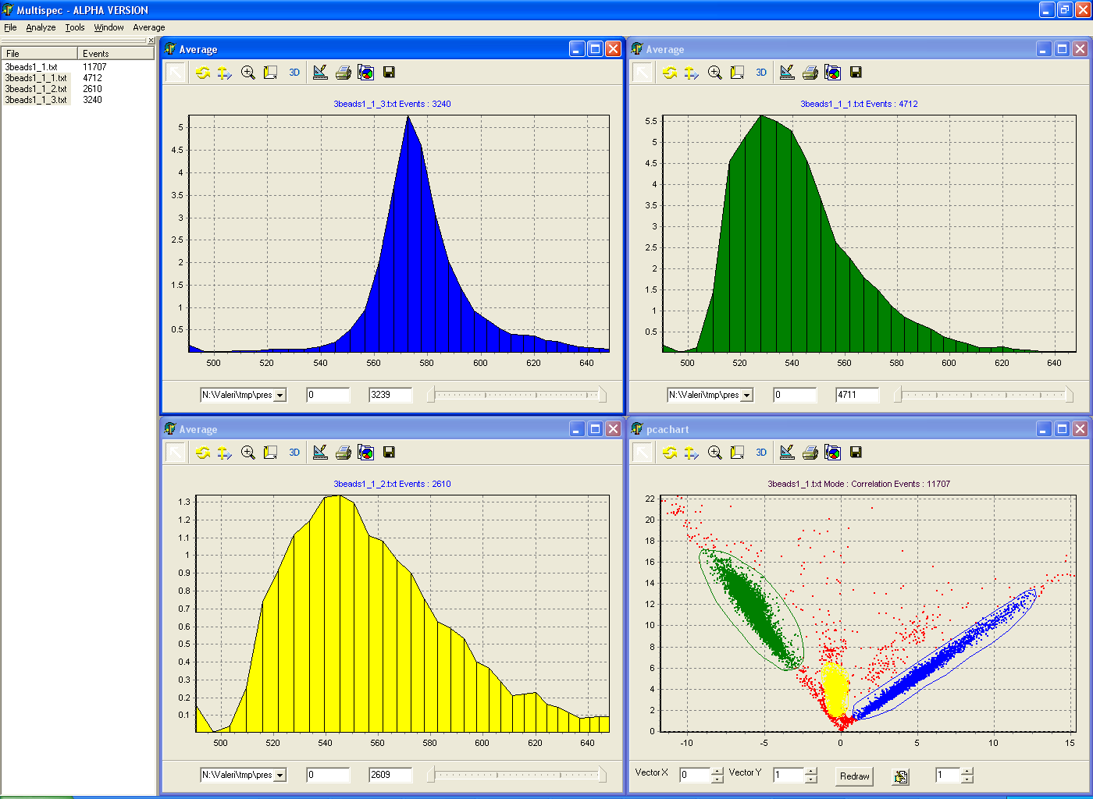
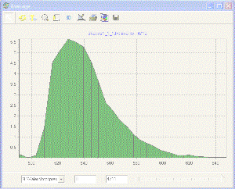
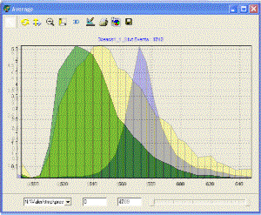
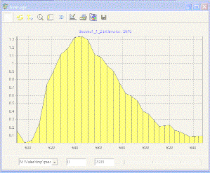
PE
Chlorophyll
Rh-123
“2” color analysis
Bang’s
Labs
Dyed
Beads*
These CANNOT be resolved
These CAN now be resolved
Advanced classification tools
like PCA are required
© J. Paul Robinson, Purdue University
Notes:
Our first experiments were based on beads, then we moved to lymphocytes.

Slide 13
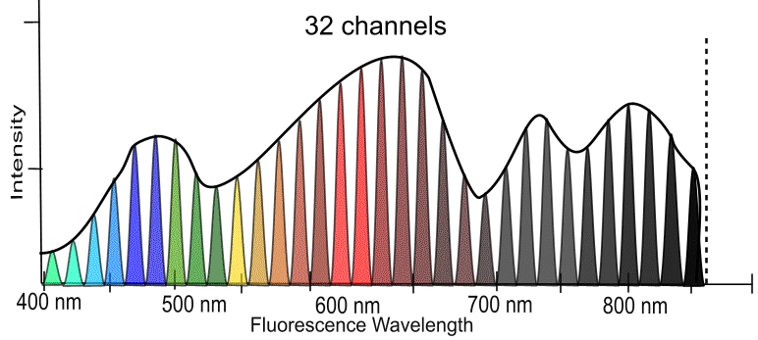
Spectral “fingerprints” identify samples
© J. Paul Robinson, Purdue University

Slide 14
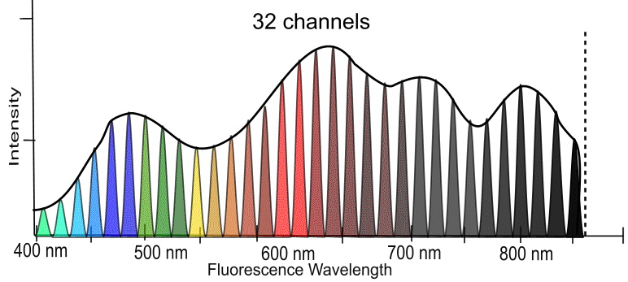
Spectral “fingerprints” identify samples
This technology is now a commercial technology (Sony) (…to HT)
© J. Paul Robinson, Purdue University

Slide 15
SVM classification – summary
Collect training dataset
Select features
Model-based
selection
Clean controls required (training samples)!
One training and validation process in completed, classification can be performed “on fly”
Statistics-based
selection
Build the classifier
Collect your data
Train and validate
the classifier
Classify in real-time
The language is different to our traditional cytometric thinking…..
© J. Paul Robinson, Purdue University
Notes:
We recognized that we would need to develop special software approaches.

Slide 16
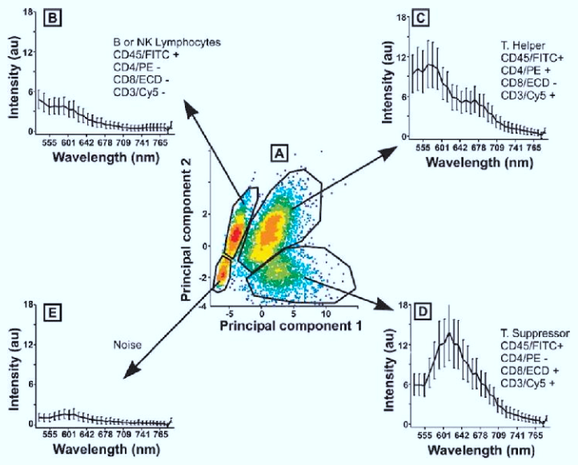
First cellular experiments – human* lymphocytes
Here is how we explained Spectral Cytometry in 2005
Lymphocytes stained with 5 colors. For some reason only 4 colors worked – not sure why, but the reagent may have been bad – but this was real data using my blood (as usual)!!!
(* With the assumption that JPR is classified as human)
Slide from 2004-5
© J. Paul Robinson, Purdue University

Slide 17
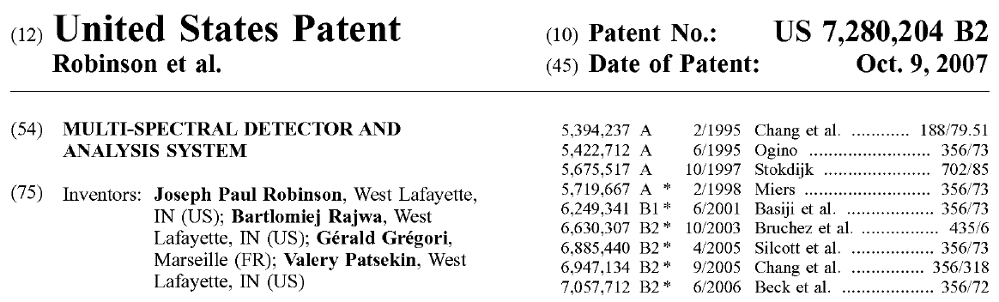
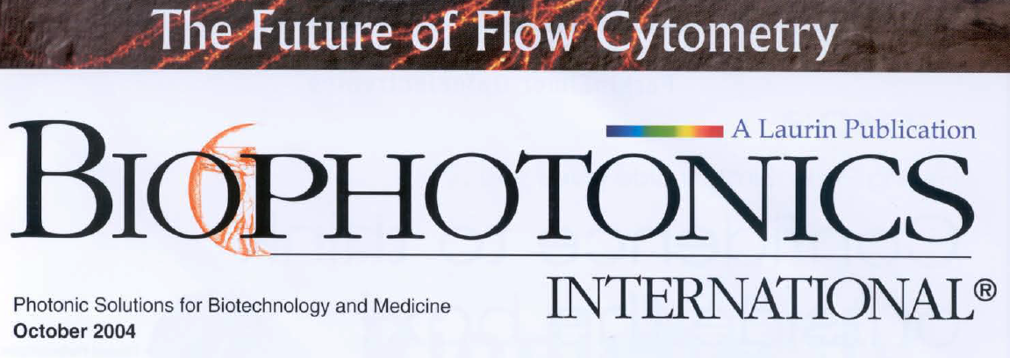
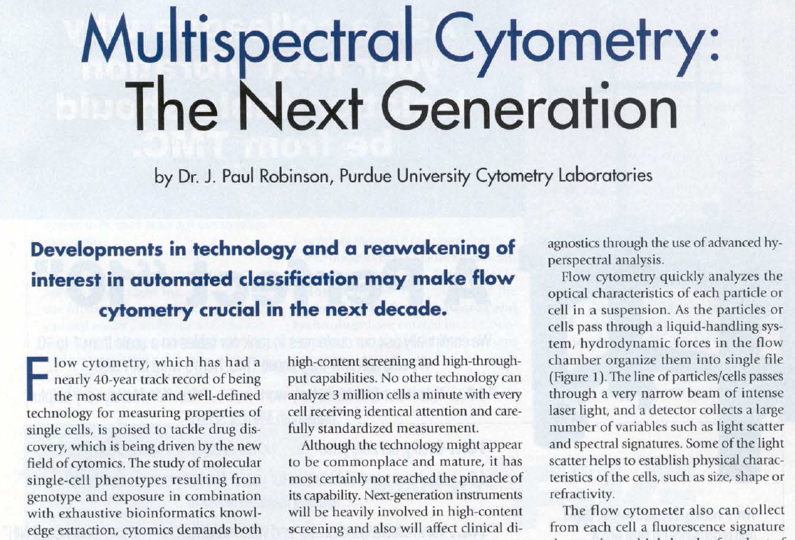
Spectral Flow Cytometry as used today was developed at Purdue University between 2000-2004
Expires on
August, 25, 2025
This is the first article explaining how spectral flow cytometry worked. The reason it was published in this magazine, was because, at this time, it took at least a year to publish anything – and we were able to get this in within a couple of months.
Documents available here
http://www.cyto.purdue.edu/Spectral_Flow_Cytometry
© J. Paul Robinson, Purdue University

Slide 18
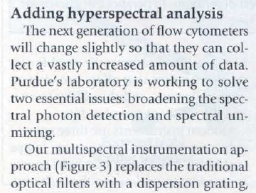
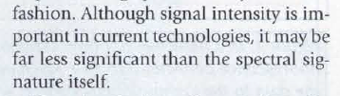
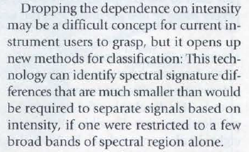
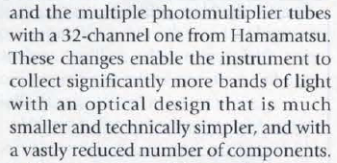
Some statements in the 2004 manuscript
© J. Paul Robinson, Purdue University

Slide 19
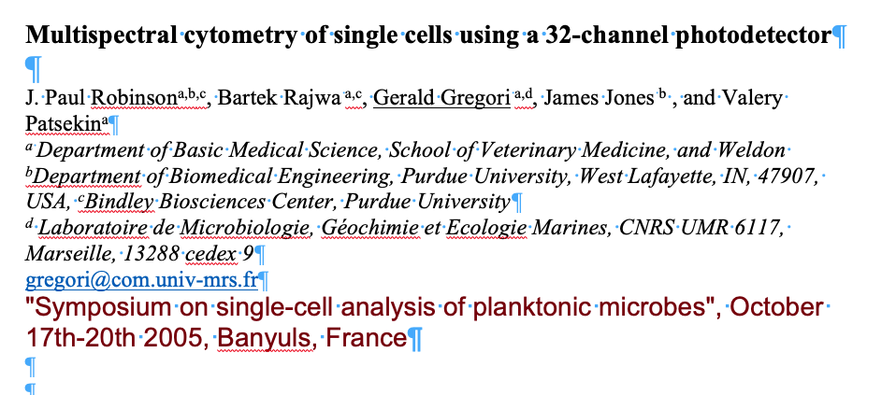
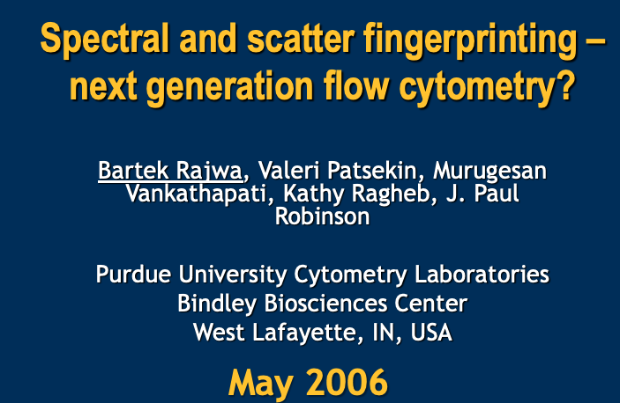
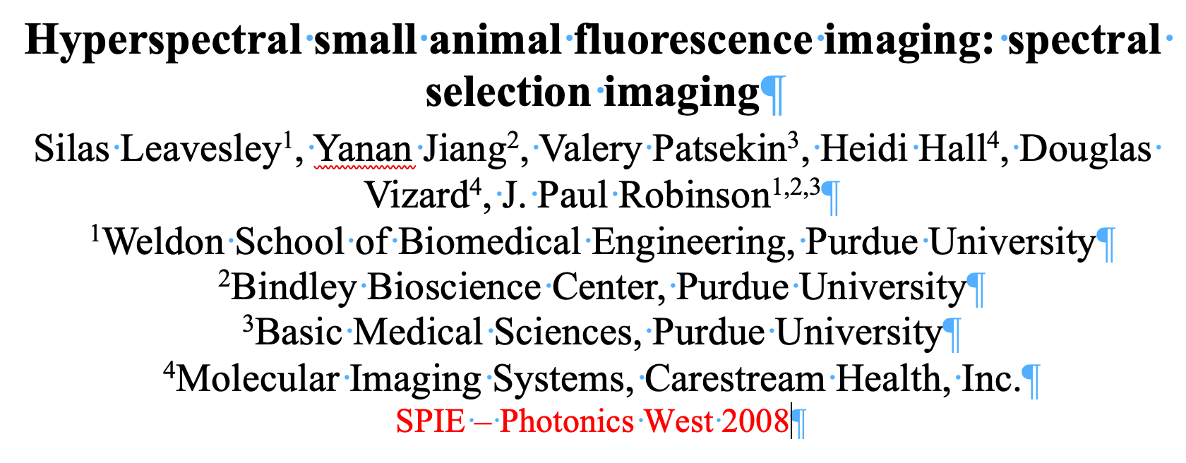
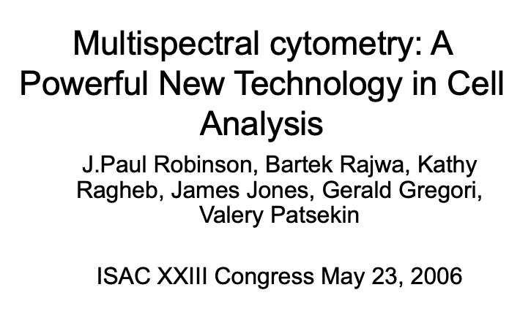
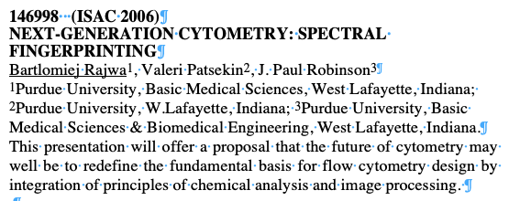
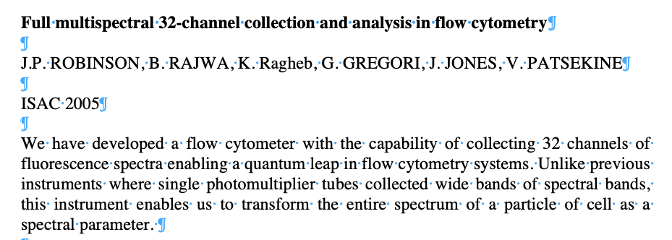
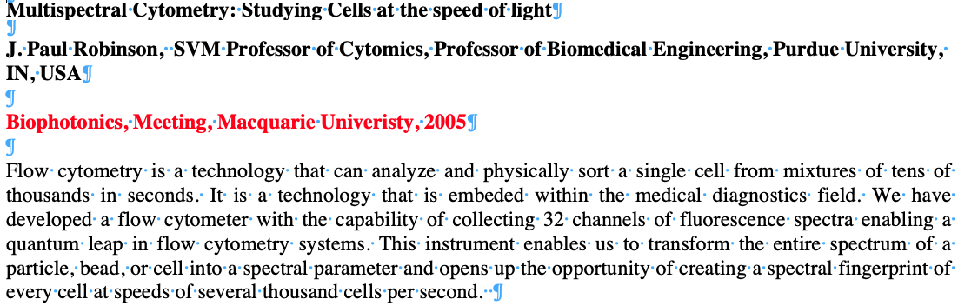
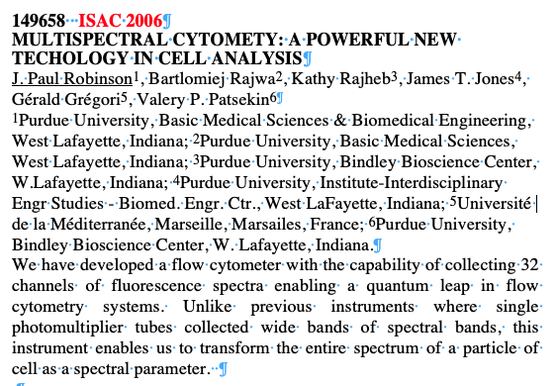
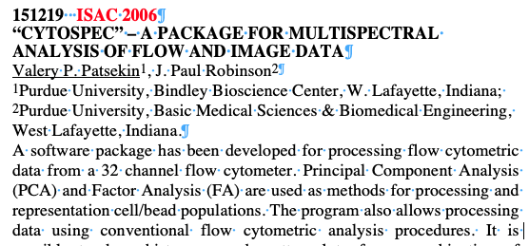
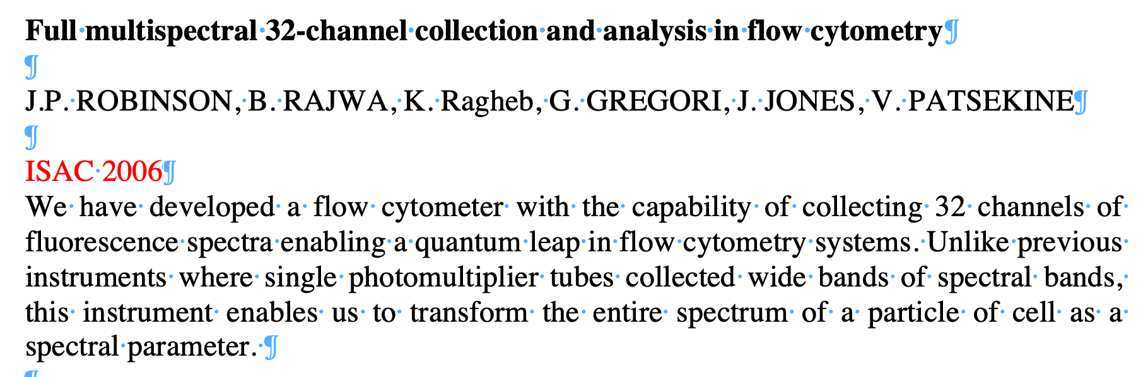
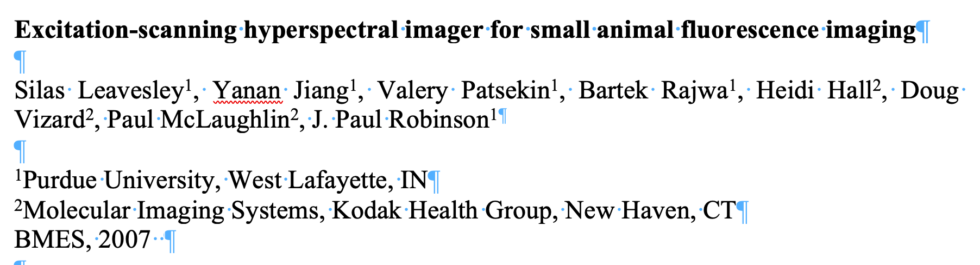
From 2004- 2010 – at least 30 + talks on spectral cytometry
© J. Paul Robinson, Purdue University

