Slide 1




Spectral Cytometry: Is this the future or is it now?
J. Paul Robinson
The SVM Professor of Cytomics
Professor of Biomedical Engineering
Director, Purdue University Cytometry Laboratories
@Cytometryman
Home of the Purdue Cytometry Mail-list est 1989
cytometry@lists.purdue.edu

Slide 2
Purdue University Cytometry Laboratories Acknowledgements
Some slides from Prof Silas Leavesley,
Dept. of Chemical Engineering, University of South Alabama
Contributors
  Staff Engineer: Valery Patsekin
Graduate Students: Awais Mansoor, Angela Wolf, Fiona Thomas, Anthony Pedley,
Undergrad Students: Nicole Lewis, Peter Carlsgaard, Esther Foo, Eric Zigond,
Postdocs: Ewa Biela
Faculty: Bartek Rajwa, Euiwon Bae, J. Paul Robinson
Data and collaborations with: Gary Nolan Lab (Stanford), David Hedley (Toronto), Bernd Bodenmiller (Zurich), Paul Wallace (Buffalo), Jonathon Irish Lab (Vanderbilt)
Staff
  Jennie Sturgis (Imaging)
  Kathy Ragheb (Flow)
Funding:
NIH, NSF, USDA, Purdue University
Corporate: Beckman-Coulter, Point-Source, Parker-Hannifin, Polysciences, Bangs labs, Roche, MediaCybernetics, Q-Imaging, Kodak Medical Systems, Crystalplex, Becton-Dickinson , Icyt,
eBioscience, ITG Indiana, Roche, Edmund Optic, Perkin Elmer, Digilab Inc., Spherotech, Inc., IntelliCyt, Inc
Research reported in this presentation was supported by the National Institute of General Medical Sciences & the National Cancer Institute of the National Institutes of Health under Award Numbers 1R56AI089511-01, R21RR033593-01 & 1R33CA140084. The content is solely the responsibility of the authors and does not necessarily represent the official views of the National Institutes of Health.

Slide 3
“Everything there is to be invented in flow cytometry has already been invented”

Slide 4
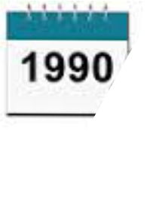
1t’s 1990
You too can do 3 colors
  …..it’s pretty hard, but the best labs are doing it!
Software – Oh, you don’t want to use the software on your flow cytometer for analysis?
Disc drive capacity – Noone could possibly need more than 80 megs….
New Sorters – at least 10,000 cells per second – you will never need to go faster
New Computers – the IBM PC introduced to run a sorter

Slide 5
Yes there really was a time when a 3 color assay was a key publication
Steinkamp, J. A., Stewart, C. C., Crissman, H. A.; Three-color fluorescence measurements on single cells excited at three laser wavelengths, CYTOMETRY, 2, 226-231, 1982
Lanier, L. L., Loken, M. R.; Human lymphocyte subpopulations identified by using three-color immunofluorescence and flow cytometry analysis: correlation of Leu-2, Leu-3, Leu-7, Leu-8, and Leu-11 cell surface antigen expression, J. Immunol, 132: 151-156, 1984
Lansdorp, P. M., Smith, C., Safford, M., Terstappen, L. W. M. M., Thomas, T. E.; Single laser three color immunofluorescence staining procedures based on energy transfer between phycoerythrin and cyanine 5; Cytometry, 12:723-730, 1991
Robinson, J. P., Maguire, D. J., Kelley, S., Ragheb, K., King, G. B.; Statistical determination of minimum cell numbers for 2 and 3 color immunophenotyping, Cytometry Supl 6: 75, 1993

Slide 6

So, what could be around the cytometric corner?
Turn page to see
Future cytometry secrets
2016

Slide 7
How about…..
Flow Cytometers that don’t need trained technicians?
Completely automated clinical diagnostic systems
Instruments that can run a million cells/second
Would you believe 100 parameter analysis
Flow cytometers that give you 3D images as well as regular phenotypic data
Instruments that can measure 20 nm particles
Instruments that can measure almost any color fluorochrome without reconfiguration
Instruments that can run 20,000 flow samples a day

Slide 8
Believe it or not…..
Most of these scenarios already exists in one form or other…..or soon will be…

Slide 9
So is it true that you could measure any color without changing any filters??
Spectral
Cytometry
◉

Slide 10
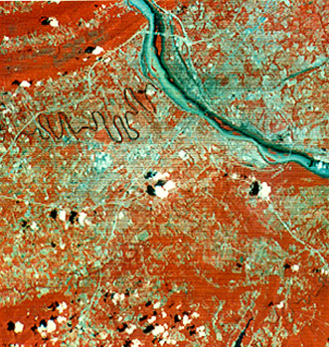
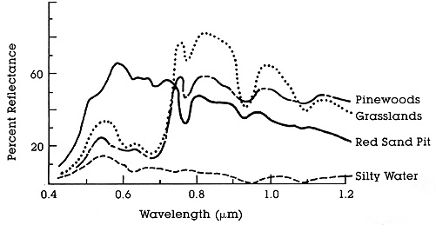
Spectral Imaging from the 1960’s
Spectral = multiple bands
Hyperspectral ≥ 20 bands
Used by NASA in the LandSAT program.
Many applications in biology and medicine.
Key Wavelengths
http://rst.gsfc.nasa.gov/Intro/Part2_6.html
http://rst.gsfc.nasa.gov/Intro/Part2_5.html
Notes:
Multispectral imaging is a process in which a series of monochrome images are taken at multiple wavelengths.
Multispectral imaging was pioneered by engineers such as David Landgrebe, at Purdue, as part of the LandSat project.
Although originally developed for use in the space program, it has many applications in biology and medicine.
This is because multispectral imaging can detect wavelength-dependent reflection or emission with a much higher spectral resolution than the human eye or RGB color imaging.
Here is an example of multispectral images taken by NASA. The image at left is a false color image of red and IR wavelengths. The coloring enhances the contrast between vegetation and buildings.
At right are sample spectra from a multispectral image set. Clearly, certain wavelengths are better for differentiating vegetation than others.
3-color RGB imaging often groups these wavelengths into the same color channel, resulting in a loss of data and an illusion of colors that may not be present in the original sample.

Slide 11
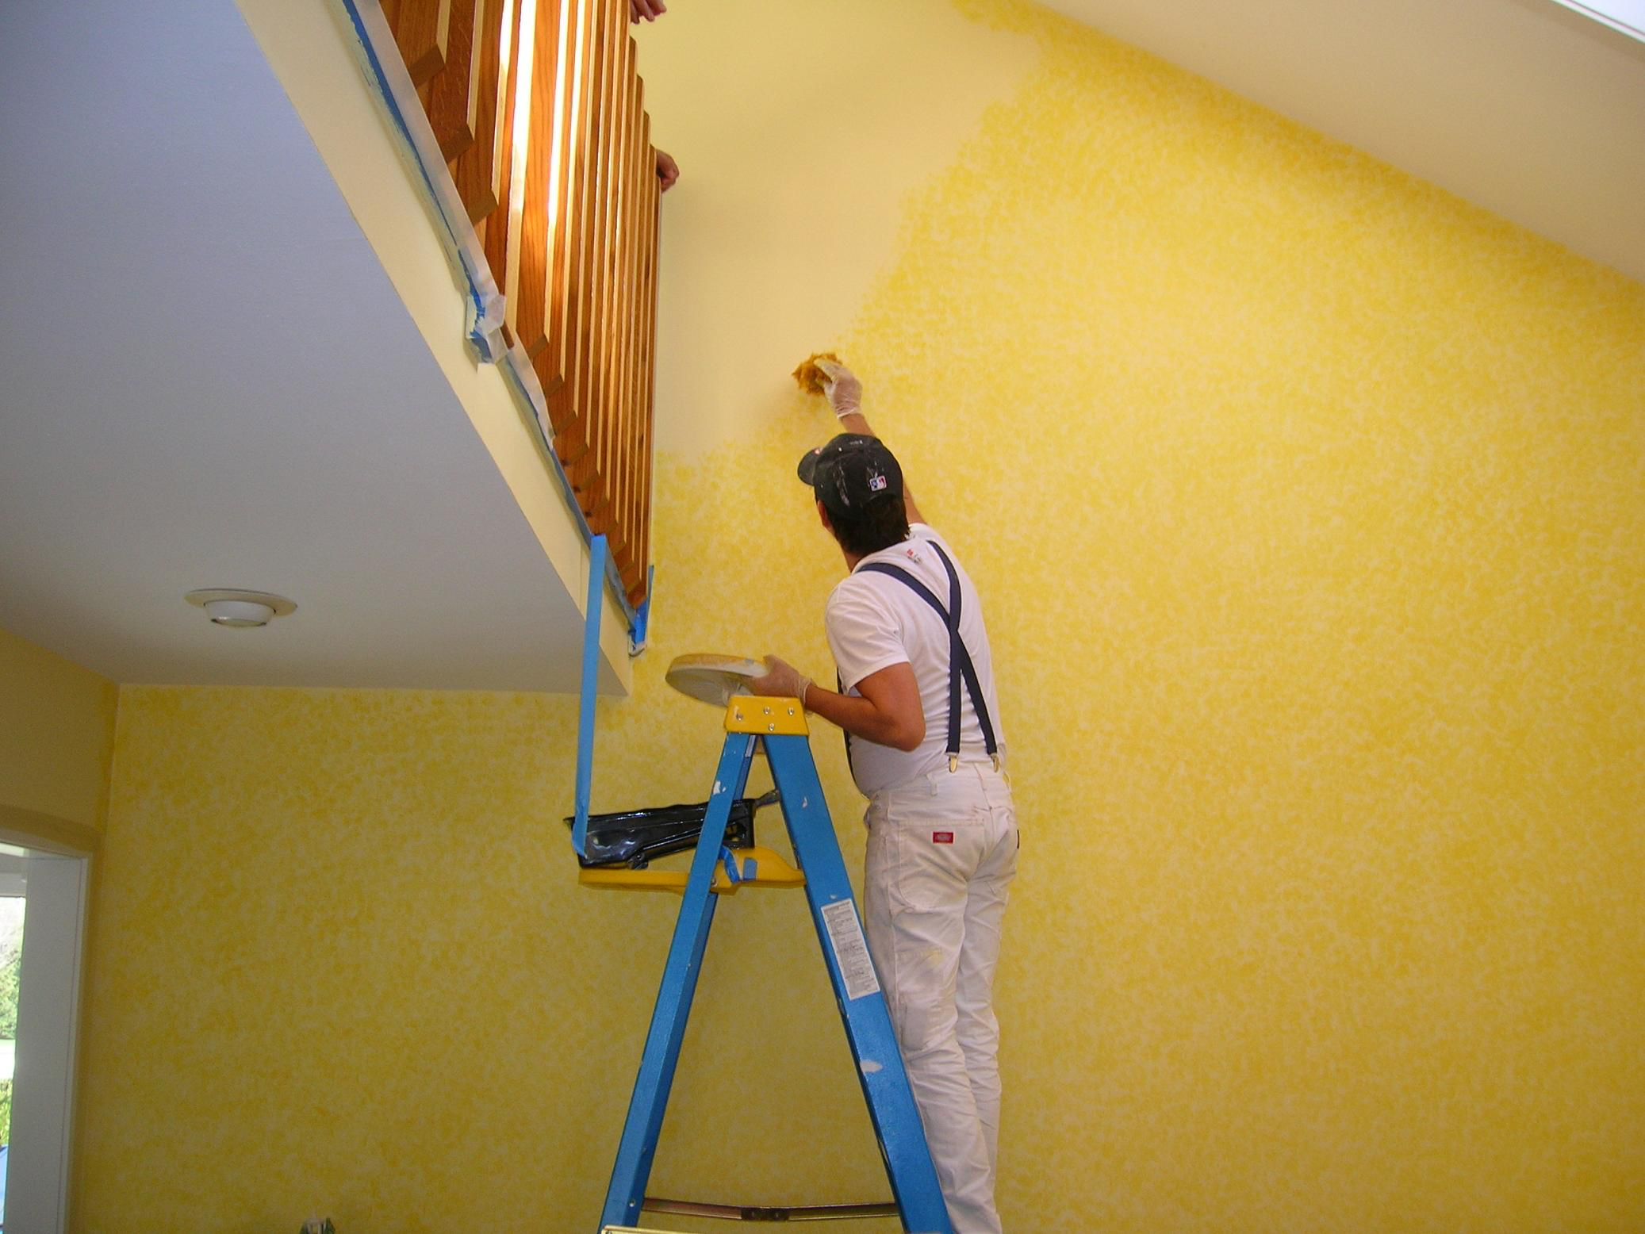
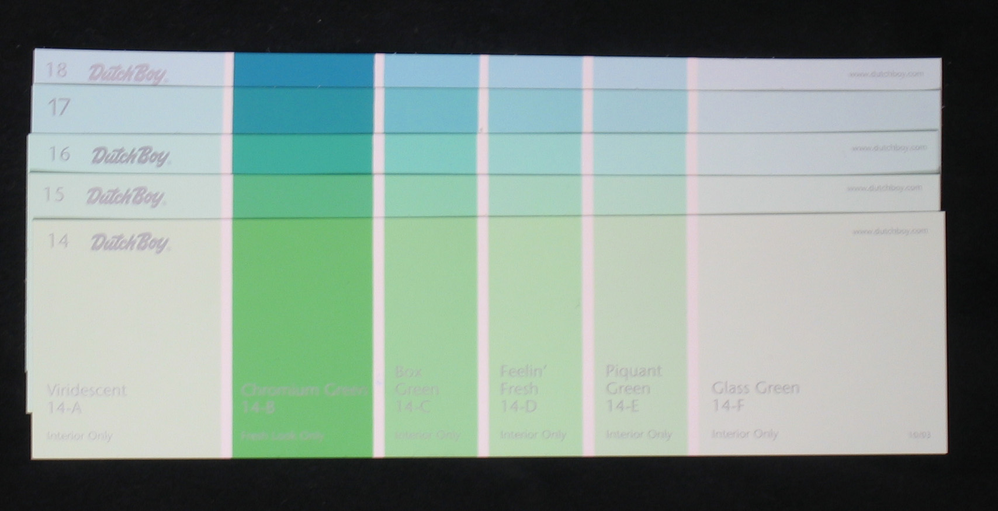
Reflection Example
Dutch Boy paint cards
Colors difficult to distinguish by visual inspection

Slide 12
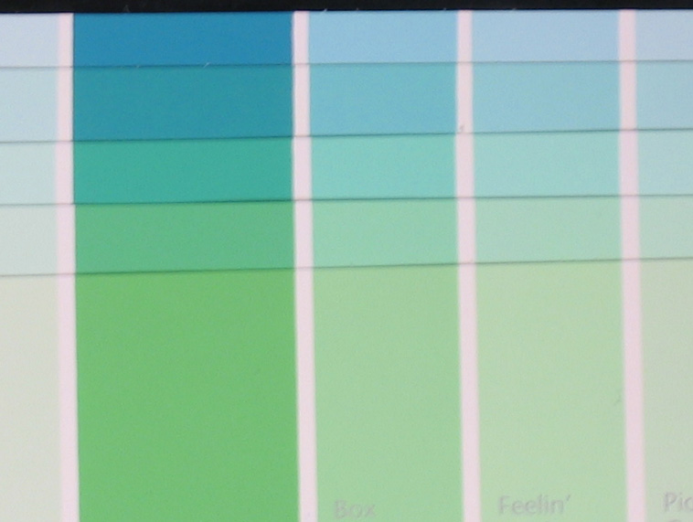
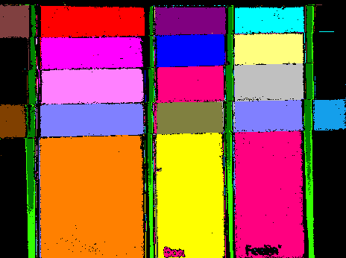
Reflection Example – Clustering
Distinctly separable spectra?
YES!

Slide 13
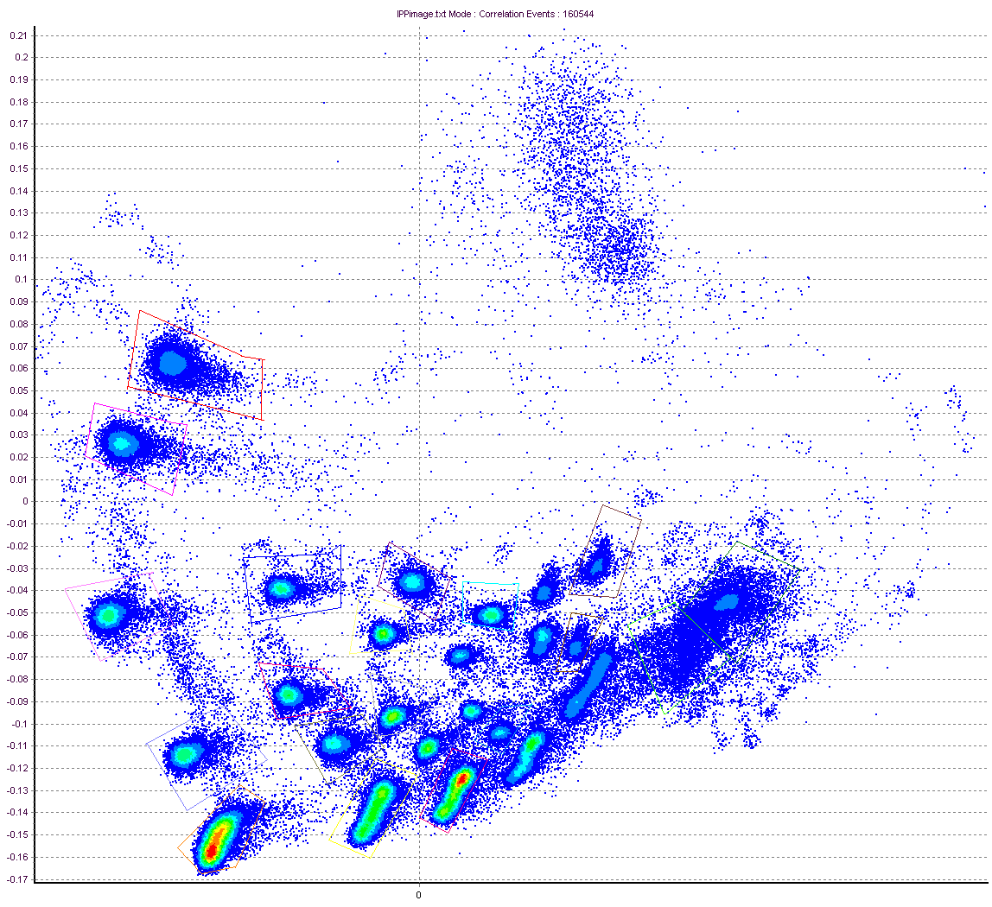
Reflection Example – Clustering
PCA Density Plot From Cytospec Software (Purdue)
Cytospec Software free download
http://www.cyto.purdue.edu/Purdue_software

Slide 14
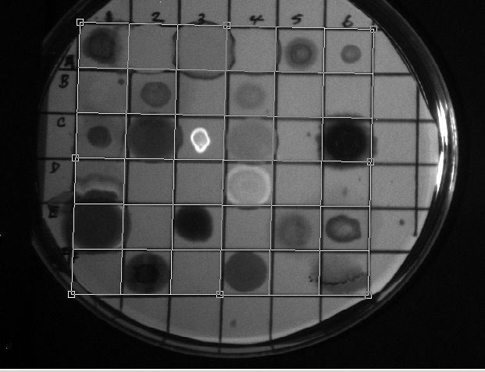
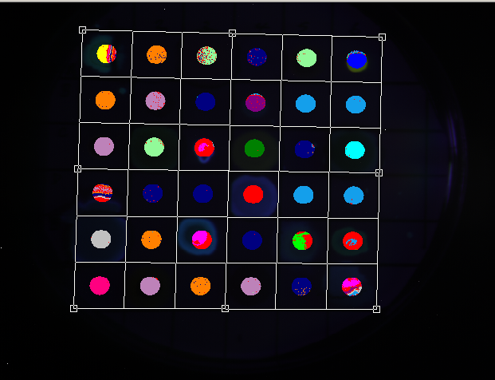
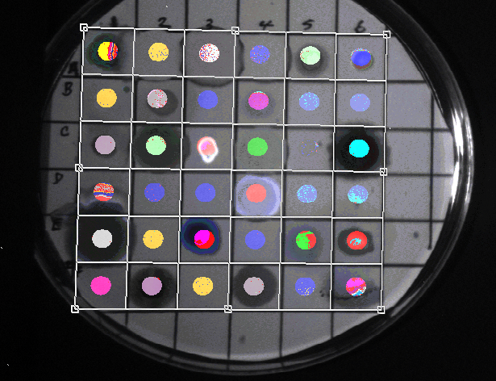
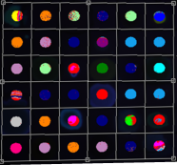
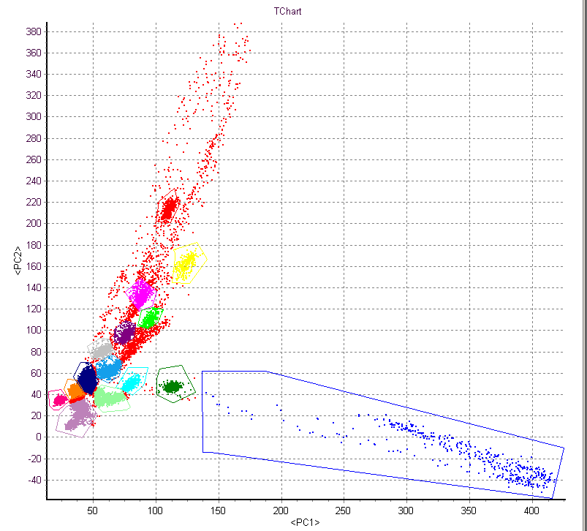
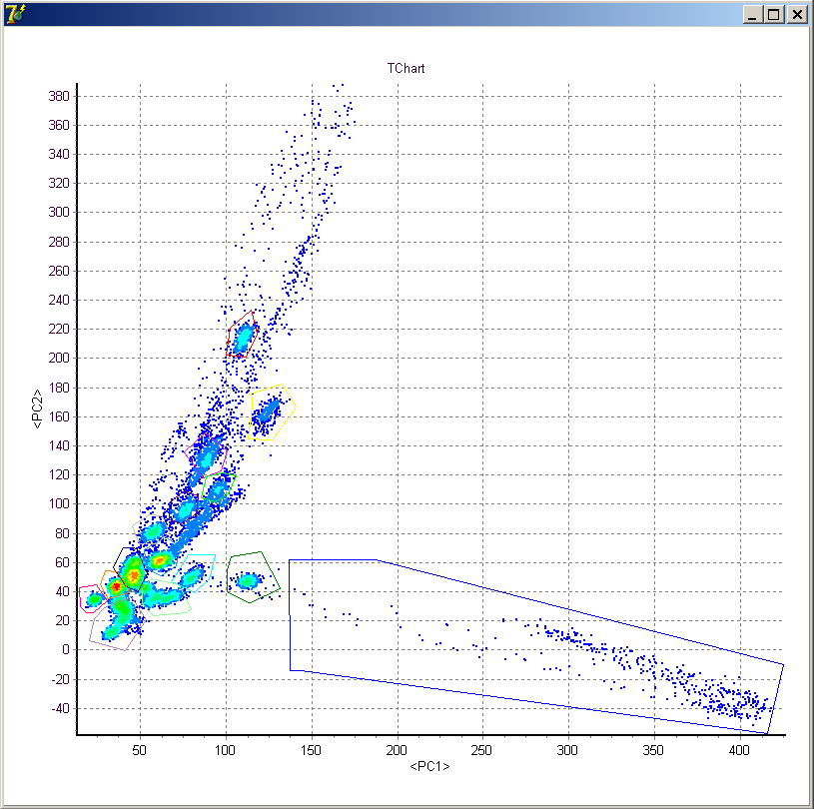
Fluorescence Example
Excitation = 488 nm
Emission = 510-750 nm
Δλ ≈ 4 nm
+
=
Reflected Image
Gated Analysis
Spatial + Chemical Information
Density plot
Nile Red
PCA
Nile Red
Post-acquisition analysis performed by Valery Patsekin, PUCL

Slide 15
Spectral Image Processing
Clustering
  Little or no a priori information
  Examples: Isodata, statistical (PCA), …
Classification
  Usually requires a training set
  Examples: Spectral angle mapper, maximum likelihood, minimum Euclidean distance, …
Unmixing
  Sub-pixel method
  Examples: Linear unmixing is the most common

Slide 16
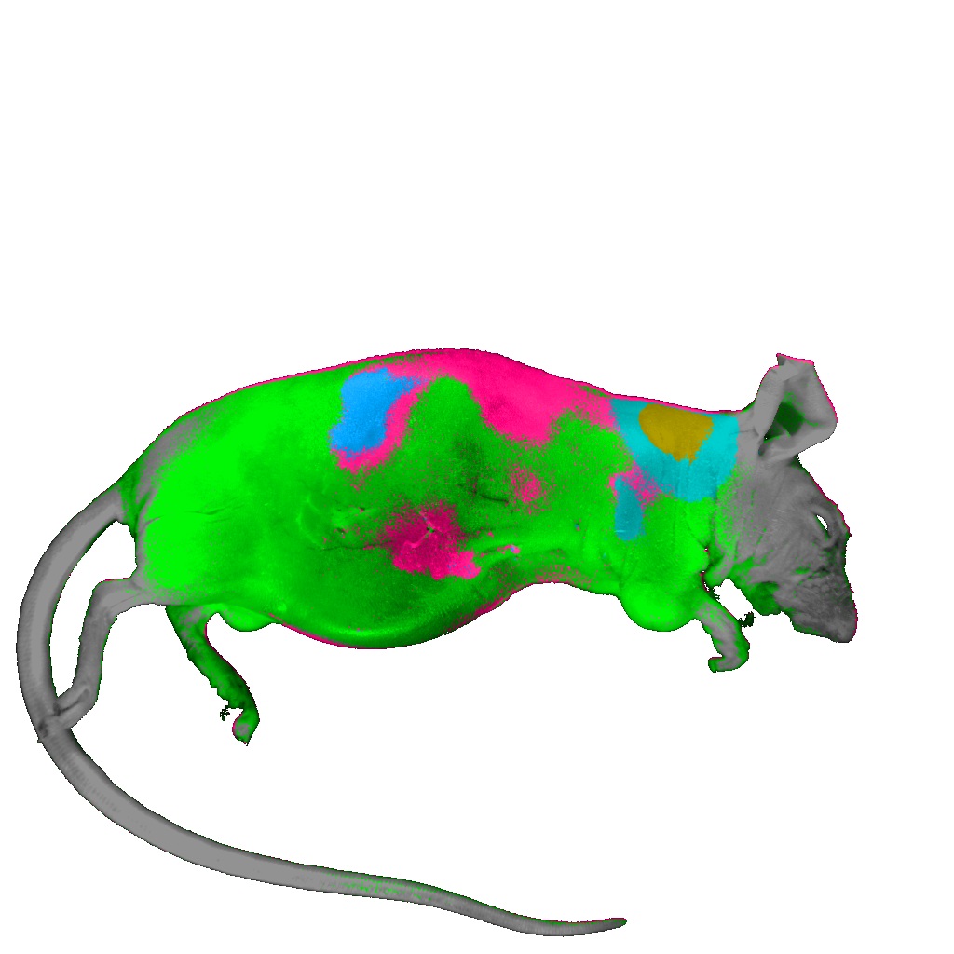
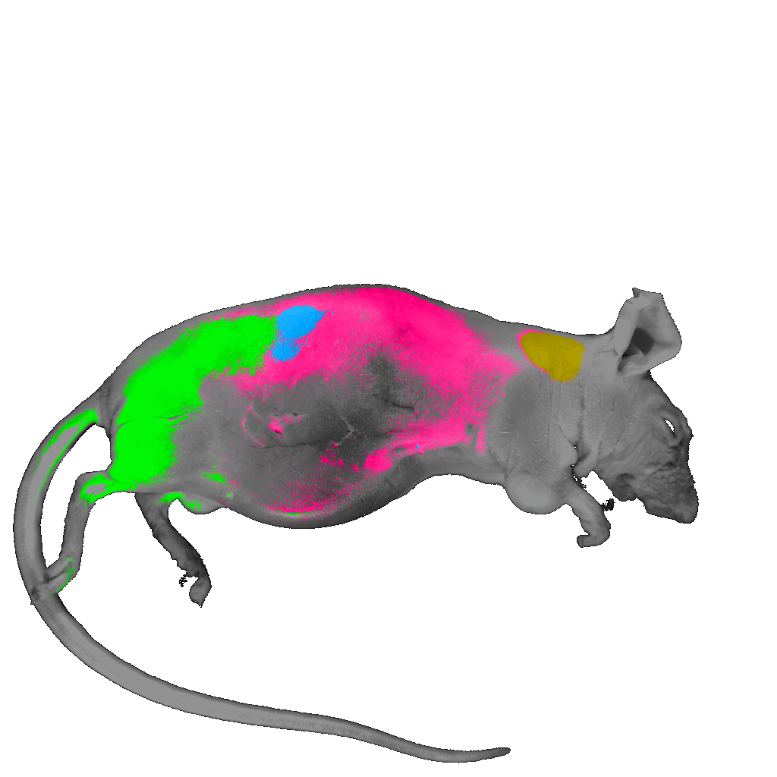
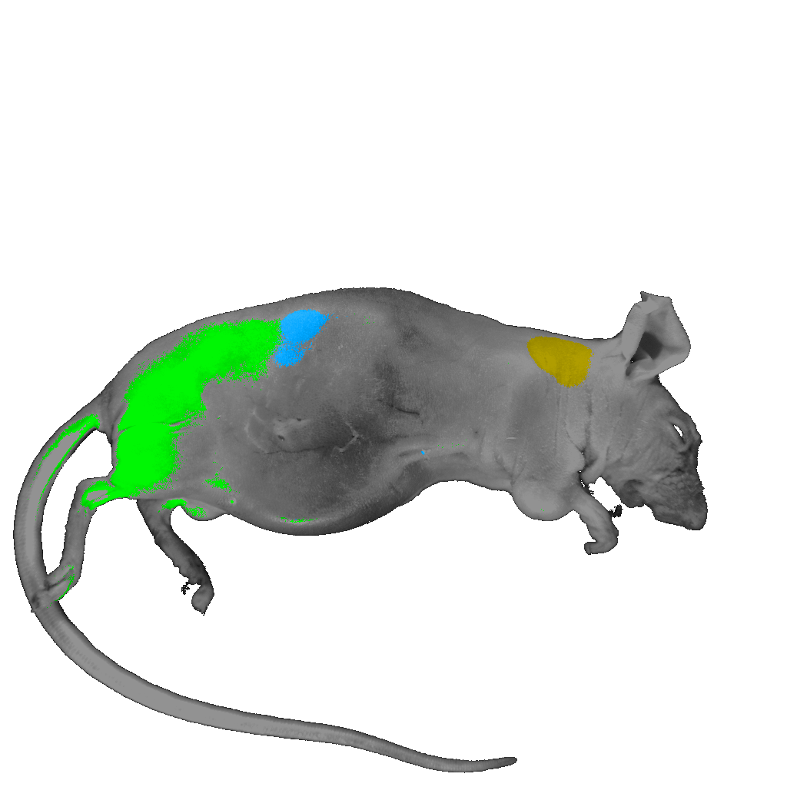
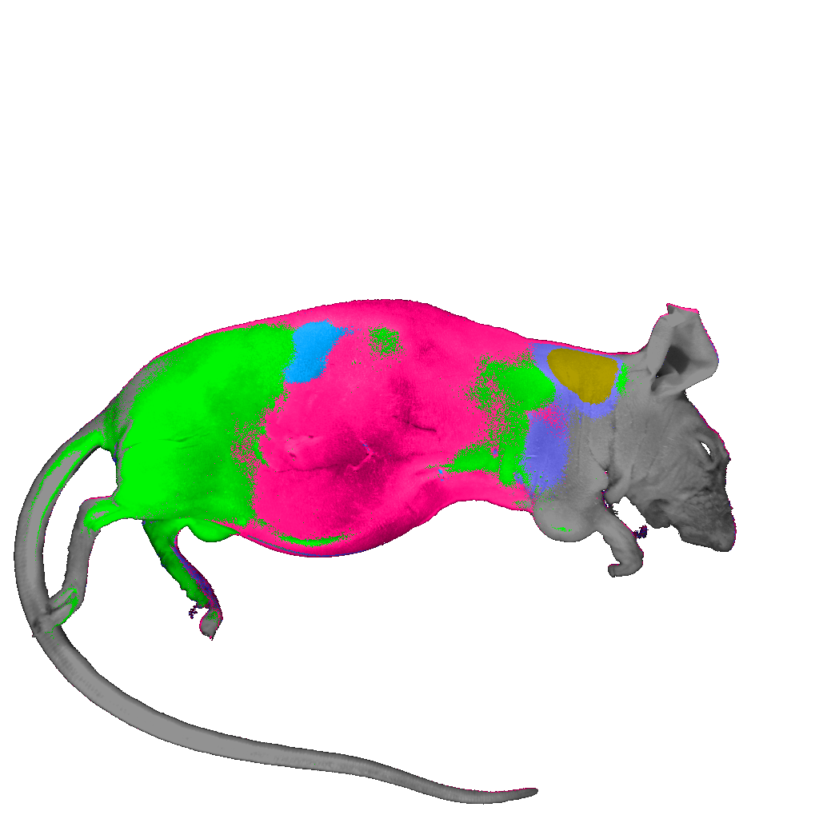
Clustering Algorithms
Spectral Angle Mapper
Maximum Likelihood
ECHO (2x2): Spectral-Spatial
Fisher Linear Likelihood

Slide 17
Spectral Imaging Advantages & Disadvantages
Advantages
  Spectral discrimination
  Autofluorescence removal
  Quantitation
  Can use many (any) fluorochromes
  Can use very similar dyes (ie same color!!)
Disadvantages
  System has to be specifically designed for spectral
  Narrow bands → Poor S/N (per band)
  Wavelength dependence of system must be considered:
    Optical components
    Noise
    Sample
    Speed??
    Issues with multiple lasers
    Unknown if very low expressing epitopes will work well

Slide 18
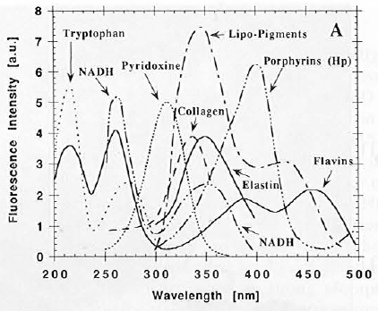
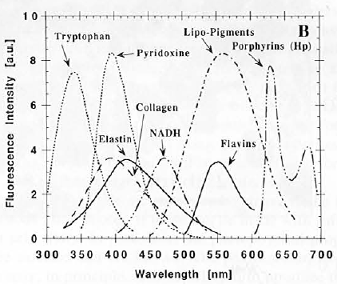
Spectral Imaging in Biology
Endogenous molecules have unique fluorescence spectra
  Complicates studies with fluorescence labels
  Could be a source of untapped cellular information
Absorption
Emission
Wagnières,Star, Wilson, “In vivo fluorescence spectroscopy and imaging for oncological applications” Photochem. and Photobio., 68(5), 603-632, 1998.
Notes:
It is useful to begin within the context of the biomolecules that attenuate photonic flux.
Many biomolecules are endogenous fluorophores with unique absorption and fluorescence emission spectra.
The combination of these individual spectra yield the spectrum seen by the imaging detector.
If the individual spectra contributing to this overall spectrum are known, it is possible to calculate the relative contribution of each of these individual spectra (given that an adequate number of wavelengths are sampled).
The relative contribution of these individual spectrum may correlate to the biomolecule concentration.
Thus, multispectral imaging suggests the possibility of mapping relative endogenous fluorophore concentration in a tissue sample.
Furthermore, occurrence of some biomolecules can be correlated to cellular events.
Here you see plots of the absorption and emission spectra for some relevant biomolecules.

Slide 19
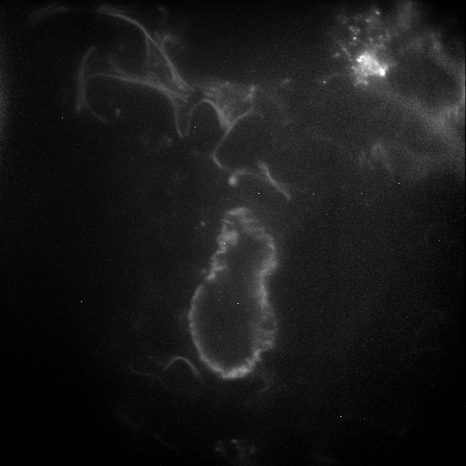
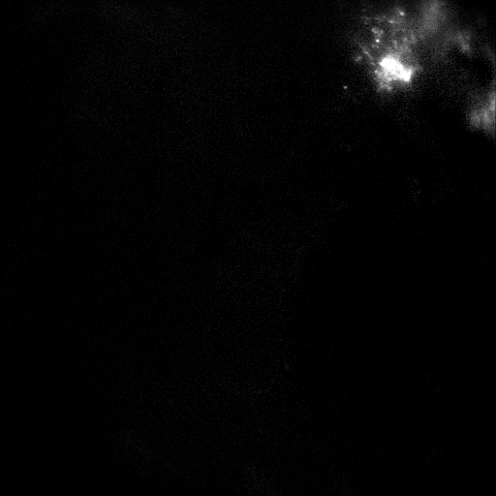
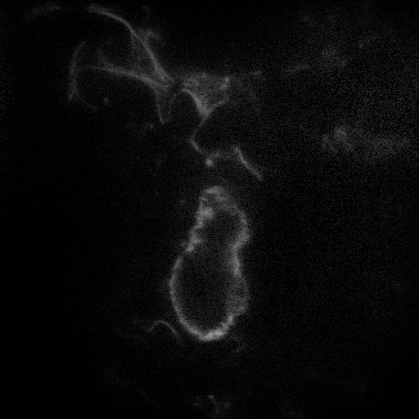
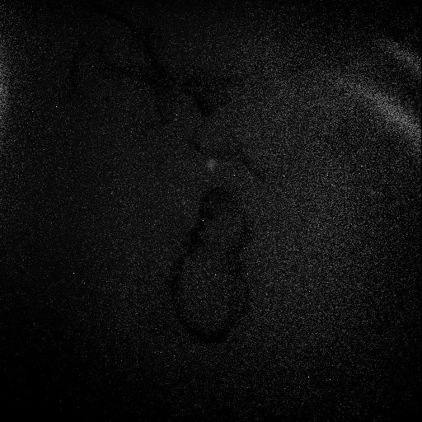
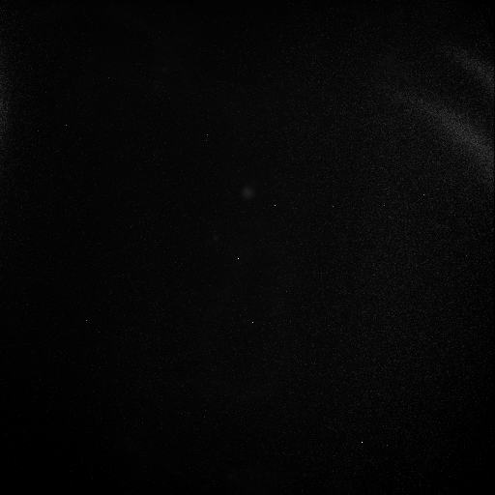
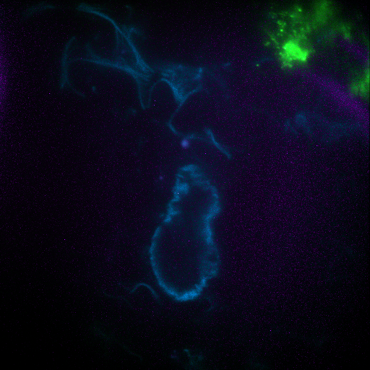
Separating GFP from Lung Autofluorescence
Raw Image
Unmixed Image
GFP
Autofluorescence
Background
RMS Error

Slide 20

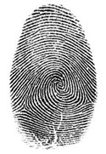

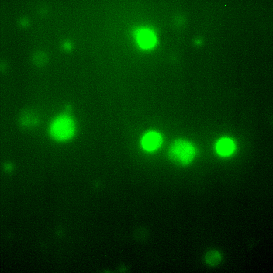
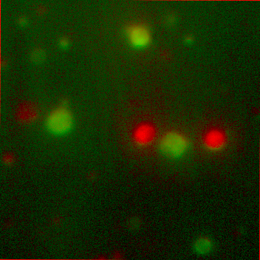
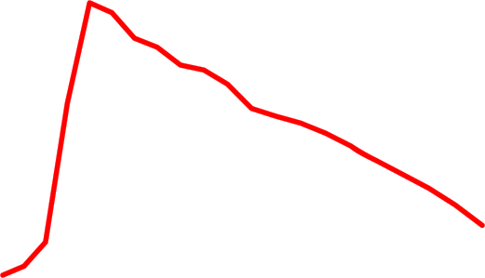
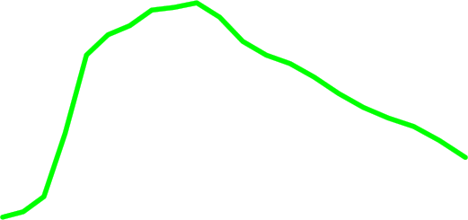

Spectral “unmixing”
Cell
Fingerprint
Before
After
Green
Dye 1: bis-(1,3-dibutylbarbituric acid)trimethine oxonol, DiBAC₄(3)
Dye 2: 3,3'-dihexyloxacarbocyanine iodide, DiOC₆(3)
Green
Human lymphocytes
FITC filter block
Unmixed
DiOC₆(3)
And bis-oxonol

Slide 21
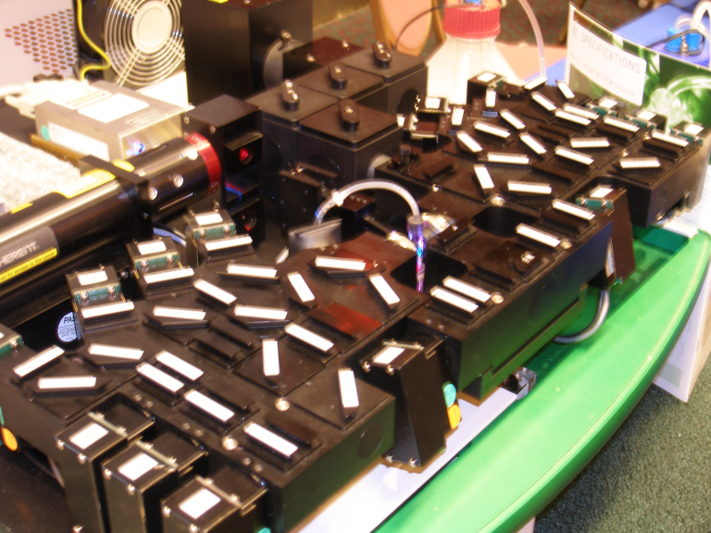
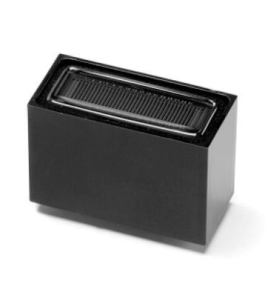
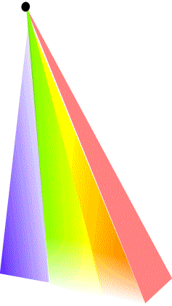
Advanced polychromatic cytometry
How do you do spectral cytometry?
spectrometer
Hyperspectral cytometry
14 PMTs
41 filters
Photo: Andrea Cossarizza Lab instrument

Slide 22
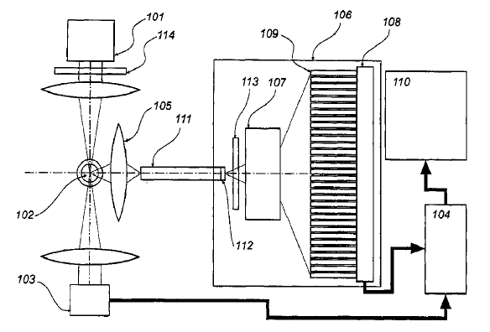
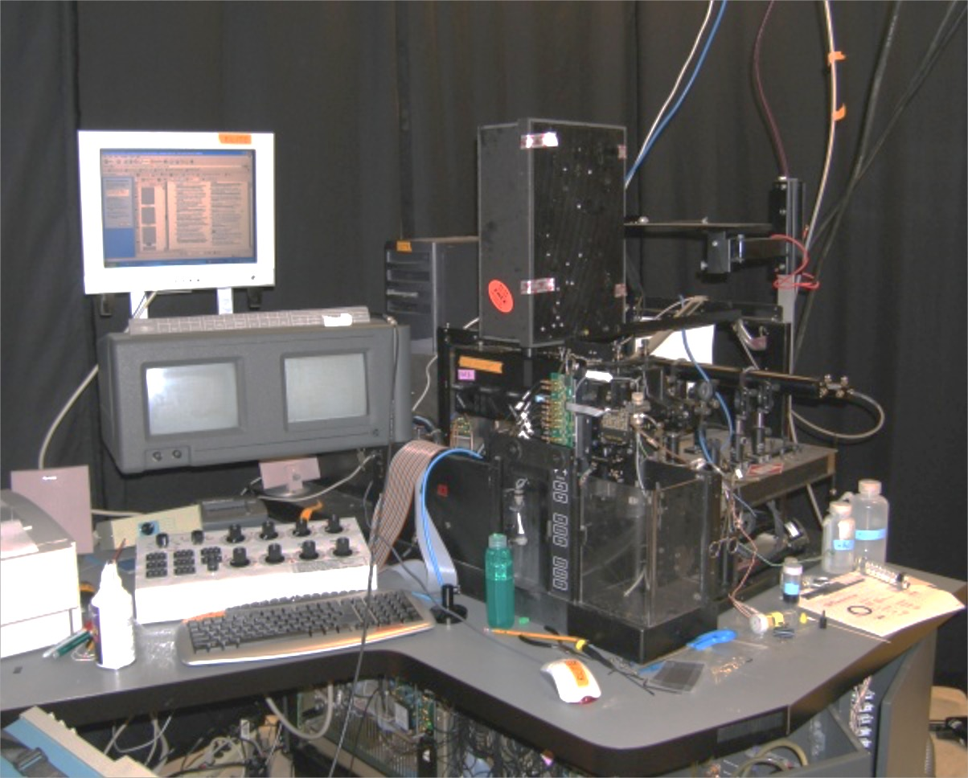
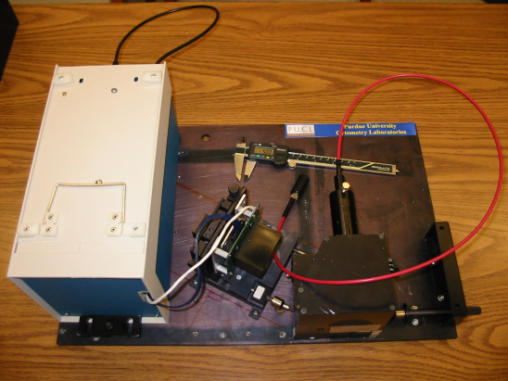
Detectors
Purdue Designed Spectral Flow Cytometry (Circa 2002)
ADC Electronics
32 spectral channels Hamamatsu
6 regular fluorescence channels
1 side scatter channel
6 forward scatter detectors
1 time gate
64 ch 16 Bit ADC
Purdue Issued Patent #7,280,204

Slide 23
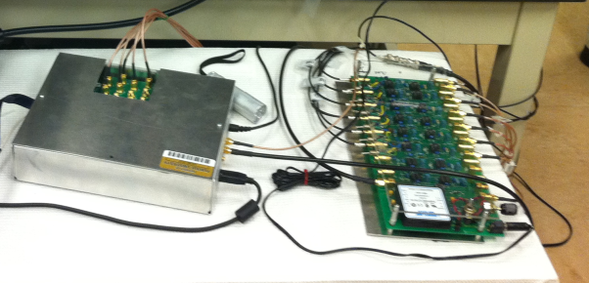
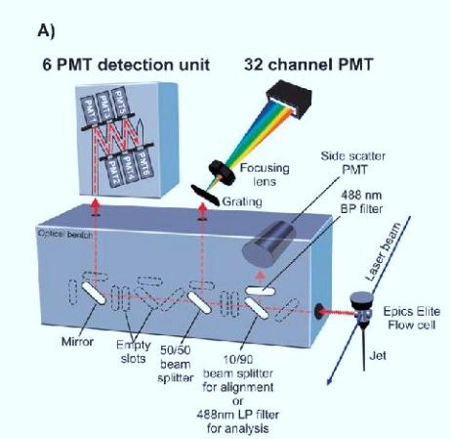
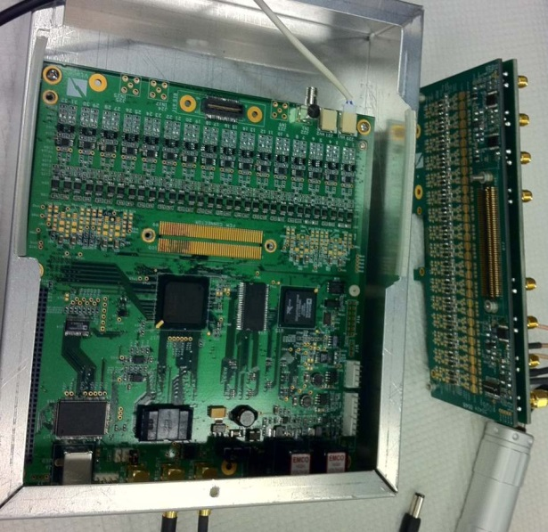
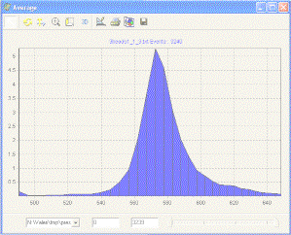
Hyperspectral Single Cell Cytometry
64 ch ADC`
10 μs available
10,000-100,000 cells
Built in 2002-2003

Slide 24
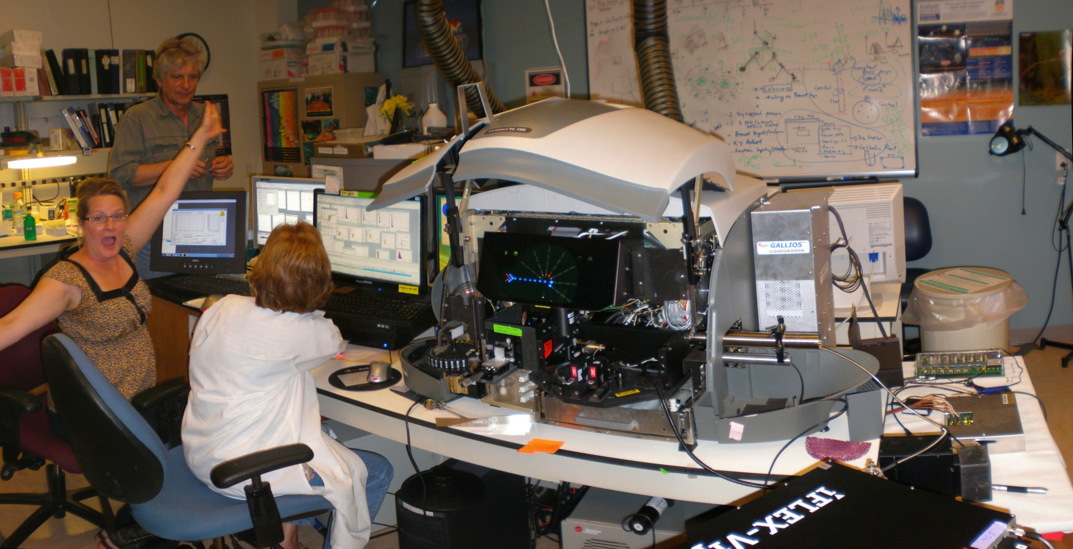
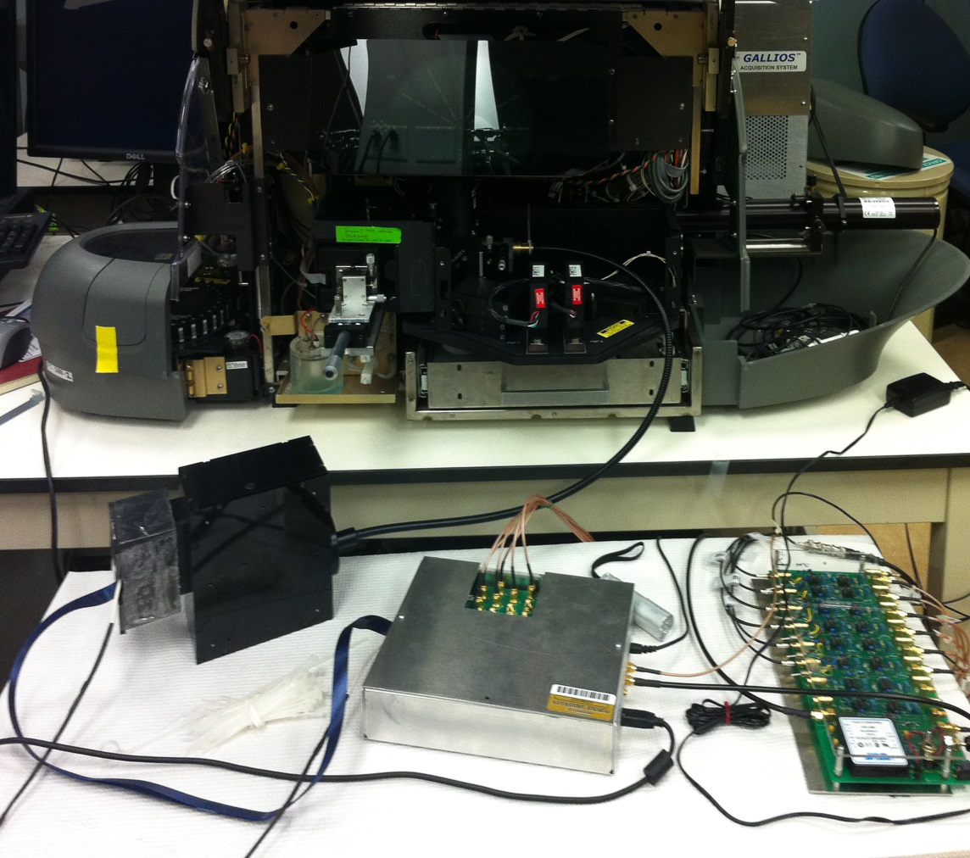
A new generation of hyperspectral detector
installed on a conventional flow cytometer
FC500
Gallios
Spectral
optics
FC500/GALLIOS Hybrid + 32 channel electronics + iFlex Viper (Qioptiq)

Slide 25
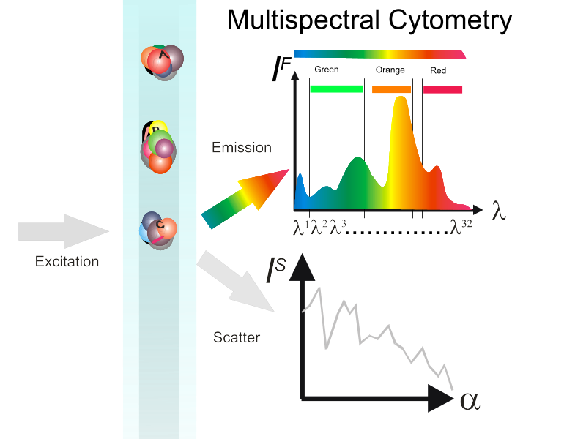
Cell
Fingerprint

Slide 26
Multicolor (polychromatic) vs. multispectral cytometry (I)
P¹ P² P³…..
Single intensity as a parameter (usually)
Spectrum as a parameter

Slide 27
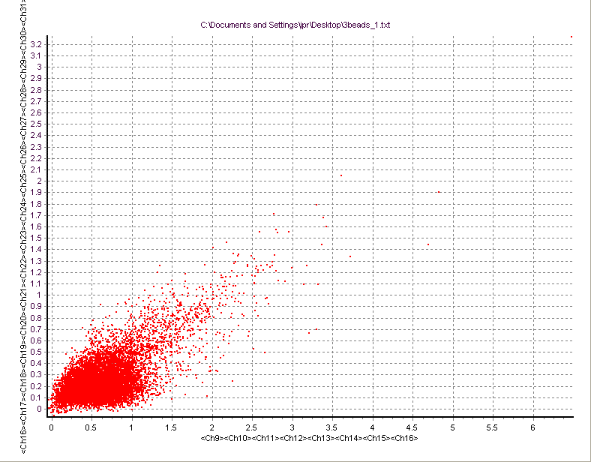
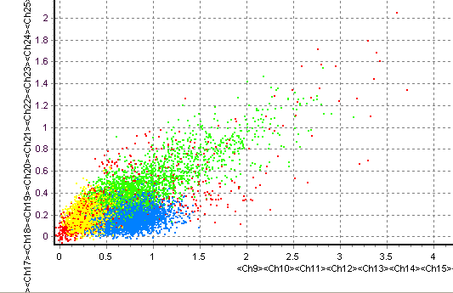
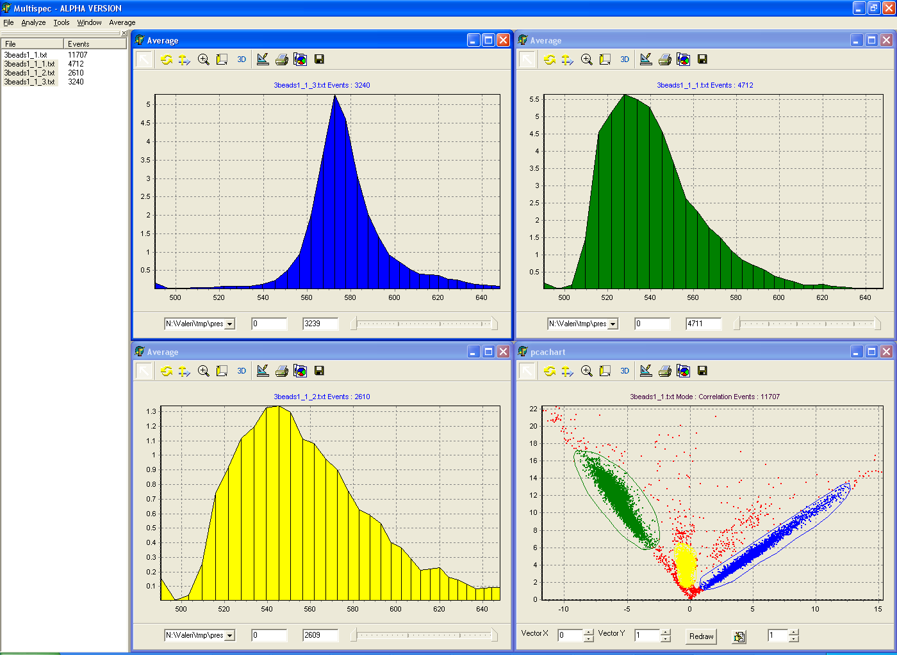
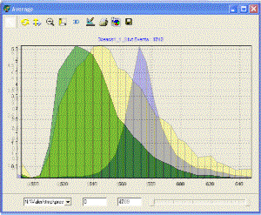
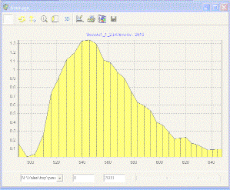
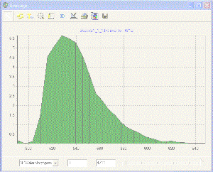
PE
Chlorophyll
Rh-123
“2” color analysis
Bang’s
Labs
Dyed
Beads*
These CAN now be resolved
These CANNOT be resolved
Advanced classification tools
like PCA are required

Slide 28

Face Recognition Technology (Picasa)

Slide 29

Spectral “fingerprints” identify samples

Slide 30

Spectral “fingerprints” identify samples
This technology is now a commercial technology (Sony) (…to HT)

Slide 31
Supervised vs. Unsupervised
Learning
Unsupervised learning (clustering)
  The class labels of training data is unknown
  Given a set of measurements, observations, etc. with the aim of establishing the existence of classes or clusters in the data
Supervised learning (classification)
  Supervision: The training data (observations, measurements, etc.) are accompanied by labels indicating the class of the observations
  New data is classified based on the training set

Slide 32


Slide 33

5-(and-6)-carboxy-2´,7´-dichlorofluorescein diacetate (CDCFA)
5(6)-carboxy-4',5'-dimethylfluorescein (CDMFA)
5-sulfofluorescein diacetate (SFDA)
Cell Tracker Green – 5-chloromethylfluorescein diacetate (CTG)
5-(and-6)-carboxy-2´,7´-dichlorofluorescein diacetate, succinimidyl ester (DCF)
bis-(1,3-dibutylbarbituric acid)trimethine oxonol (DiBAC₄(3))
3,3'-dipentyloxacarbocyanine iodide (DiOC₅(3))
3,3'-dihexyloxacarbocyanine iodide (DiOC₆(3))
Rhodamine 110

Slide 34
Spectral plots
5-(and-6)-carboxy-2´,7´-dichlorofluorescein diacetate (CDCFA)
5(6)-carboxy-4',5'-dimethylfluorescein (CDMFA)
5-sulfofluorescein diacetate (SFDA)
Cell Tracker Green – 5-chloromethylfluorescein diacetate (CTG)
5-(and-6)-carboxy-2´,7´-dichlorofluorescein diacetate, succinimidyl ester (DCF)
bis-(1,3-dibutylbarbituric acid)trimethine oxonol (DiBAC₄(3))
3,3'-dipentyloxacarbocyanine iodide (DiOC₅(3))
3,3'-dihexyloxacarbocyanine iodide (DiOC₆(3))
Rhodamine 110
1
2
3
4
5
6
7
8
9

Slide 35
Scatter matrix
Matrix of 2-D scatterplot allow us to visualize all the possible combination of channels.
Result: we are overwhelmed by information, so the matrix is not very useful

Slide 36
Principal components
The principal components with the highest variance, however, do not necessarily carry the greatest information to enable a discrimination between classes.

Slide 37
Method: Automated classification using support vector machines
The SVM algorithm creates a hyperplane that separates the data into two classes with the maximum-margin. The SVM idea was proposed by Vladimir Vapnik in 1963
For categorical variables a dummy variable is created with case values as either 0 or 1. Thus, a categorical dependent variable consisting of three levels, say (A, B, C), is represented by a set of three dummy variables: A: {1 0 0}, B: {0 1 0}, C: {0 0 1}

Slide 38









7 of 9 “green” dyes could be resolved
All dyes
Oxonol Events: 3373
Human Lymphocytes

Slide 39


Confusion matrix
5-(and-6)-carboxy-2´,7´-dichlorofluorescein diacetate (CDCFA)
5(6)-carboxy-4',5'-dimethylfluorescein (CDMFA)
5-sulfofluorescein diacetate (SFDA)
5-(and-6)-carboxy-2´,7´-dichlorofluorescein diacetate, succinimidyl ester (DCF)
Cell Tracker Green – 5-chloromethylfluorescein diacetate (CTG)
bis-(1,3-dibutylbarbituric acid)trimethine oxonol (DiBAC₄(3))
3,3'-dipentyloxacarbocyanine iodide (DiOC₅(3))
3,3'-dihexyloxacarbocyanine iodide (DiOC₆(3))
Rhodamine 110
CDCFA
CDMFA
SFDA
CTG
DCF
DiBAC43
DiOC₅(3)
DiOC₆(3)
RH110
CDCFA
87.92%
0.00%
0.76%
2.72%
0.00%
6.04%
1.92%
0.64%
0.00%
CDMFA
0.24%
97.76%
0.52%
0.04%
0.00%
0.00%
0.16%
0.88%
0.40%
SFDA
0.04%
0.00%
94.36%
4.88%
0.00%
0.00%
0.00%
0.72%
0.00%
CTG
5.44%
0.00%
5.04%
86.44%
0.00%
0.20%
0.80%
2.04%
0.04%
DCF
0.00%
0.00%
0.00%
0.00%
100.00%
0.00%
0.00%
0.00%
0.00%
DiBAC43
3.72%
0.20%
0.04%
0.40%
0.00%
92.76%
0.96%
1.92%
0.00%
DiOC₅(3)
4.12%
0.28%
0.56%
1.92%
0.00%
1.32%
77.60%
14.20%
0.00%
DiOC₆(3)
1.92%
0.12%
0.76%
1.72%
0.00%
1.24%
17.72%
76.52%
0.00%
RH110
0.00%
0.00%
0.08%
0.36%
0.00%
0.00%
0.00%
0.20%
99.36%

Slide 40
Misclassified events
Dichlorofluorescein diacetate
Dimethylfluorescein diacetate
Sulfofluorescein diacetate
Cell Tracker Green
Dichlorofluorescein, succinimidyl ester
DiBAC4(3) - oxonol
DiOC₅(3)
DiOC₆(3)
Rhodamine 110

Slide 41
SVM classification – summary
Collect training dataset
Select features
Model-based
selection
Clean controls required (training samples)!
One training and validation process in completed, classification can be performed “on fly”
Statistics-based
selection
Build the classifier
Collect your data
Train and validate
the classifier
Classify in real-time
The Language is different to our traditional cytometric thinking…..

Slide 42
Nanocrystals/Micro-Dots multiplexed systems
New probes
Potentially 1000’s of combinations
Sensitive, long lived, less bleaching
Difficult to make
Will require some advanced classification software

Slide 43



Sony SP6800 spectral cell analyzer 2013
Spatially separated lasers (488 nm and 638 nm)
The sample’s fluorescence spectra ranging from 500 nm to 800 nm are collected by a 32-channel linear array PMT detector equipped with a multi-prism monochromator
Notice of conflict of interest:
Purdue inventors receive income from non-exclusive License of US patent# 7280204 to Sony

Slide 44

Separation of GFP and FITC signals using
spectral cytometry
Data courtesy of W.C. Hyun (UCSF)
Hyperspectral cytometry is capable of combining the channels in the PMT to form “virtual filters”
  Function as a regular polychromatic FC
  Capability of fine-tuning the detection to adjust for particular staining strategies as well as problems with label intensities or markers abundances.
Slide taken from Sony publicity materials

Slide 45

Sony Spectral Cytometer
Slide taken from Sony publicity materials
Data from M. Tomura, Kyoto University

Slide 46

Sony Spectral Cytometer - 12 color separation
Slide taken from Sony publicity materials
Data from E.Watanabe, Y. Nakamuci, N. Watanabe and H. Nakamuchi, Univ. Tokyo

Slide 47
Polychromatic Cytometry ain’t so perfect!
Fundamental problems with compensation
“Spreading” – low intensity populations change shape
Some events fall below zero representing negative abundance
We are told that this is “because compensation is a subtractive process”
We are told “this is because of noise”.

Slide 48
Polychromatic Cytometry ain’t so perfect!
Fundamental problems with compensation
“Spreading” – low intensity populations change shape
Some events fall below zero representing negative abundance
We are told that this is “because compensation is a subtractive process”
We are told “this is because of noise”.

Slide 49
What have we learned?
Spectral cytometry recovers all the signal
If we model the noise distribution properly, we may be able to avoid spreading after unmixing.
Inaccuracies in the estimation can be addressed by Bayesian approaches

Slide 50


Here’s another challenge
Almost all screening of cellular systems uses image based systems
Imaging systems used to be really really slow……
Then some smart people automated them
And now they are fast, easy to use and are the foundation of cellular screening networks
http://www.linkedin.com/company/high-throughput-screening
https://gcc.rice.edu/Screening_Facilities.aspx

Slide 51
So what actually happens inside the box that makes image so attractive for HT Screening
It uses standard plates
Plates can be loaded using automation
Automated analysis programs find all the cells
Each cell is then classified as a unit and analysis performed
Data are output into a database [even tho’ there are no standard formats yet….]
It’s all done with mirrors…..well almost!
✔
✔
✔
✔
✔
✔
✪

Slide 52







Many good image screening instruments – this is big business!!
And a new one every other week!!

Slide 53





Image analysis in HT space is well defined
http://www.fluofarma.com/live-content-imaging-cro-services.html
Note: All images on this slide are from webb
Segmentation from: 2010 // JCB vol. 191 no. 3 471-478
http://robertrallo.wordpress.com/2013/10/22/hdat-web-based-high-throughput-screening-data-analysis-tools/
http://dharmacon.gelifesciences.com/rnai-and-custom-rna-synthesis/microrna/smartchoice-shmimic-lentiviral-microrna/

Slide 54
What conclusions can we make?
HT screening using imaging systems works well but…
You cannot do both Hi-Thru-put and
  Hi-Res simultaneously
So there is compromise even in HT imaging
If you go for the absolute maximum resolution you may well be incapable of determining what a “normal” sample is as all of the samples may prove to be “different” because of very high information density….

Slide 55





So let’s look at Flow Cytometry
Nothing is standard – tiny tubes, middle size tubes, really big tubes…and even some plates
Only clinical systems are being hightly automated and nothing really works yet
Tubes are usually loaded manually, at the best a 96 well plate….which is really really slow
Data are complicated and messy – there is no standard analysis
Database management? What is that?
FCS File standard exists meaning file structure is standard
Every cell is identified automatically – it a fundamental advantage – no segmentation required

Slide 56






Traditional Flow Cytometry
(which people either love or hate!)
.
.
.
✪

Slide 57



Digging deeper in “Flow” Issues
(or arguments you are currently using not to use flow)
Gating
Meaning of data (%, mean, etc)
# of samples available

Slide 58




Circa, 1990-present
ANALYSIS
1 sample 10 to 30 minutes
Run 30-60 samples
per hour

Slide 59



Traditional gating process
Decision
Traditional flow gating logic and analysis approach
Decision
Result
Decision
Repeat ad infinitum
Result
Decision
‘What we see depends mainly on what we are looking for.’ John Lubbock

Slide 60








The Operational Modality of Flow Cytometry
Traditional
HT Flow
1. Take a complex biological sample
1. Take a complex biological sample
2. Create very large scale “systems level” experimental grids
2. Separate that sample into single samples
3. Run each sample as a single unit
3. Run samples as a high speed, low volume set
4. Put all the data back together again
4. Combine data automatically as sets
5. Try to relate each piece of data back to the original biological system
5. Conduct simultaneous
advanced analysis in
parallel
The operational modality of Flow Cytometry.pptx

Slide 61

Multiparametric and multifactorial HT cytometry
Find the features describing the populations f₁,.. f_{n}
+
+
Define multiple populations in the feature space
Find the features (such as IC₅₀)
Create n × m array of features, where every m could be a vector [f₁,…,f_{n}]
concentration
HT flow cytometry
compounds

Slide 62
Problem 1: eliminate operator’s input in analysis
gate
Calculate fraction of “positive” and “negative” cells
gate
Problems?
Well… plenty actually

Slide 63


Alternative?
Heuristic methods
  Minkowski-form
  Weighted-Mean-Variance (WMV)
Distance functions used in nonparametric tests
  χ ² (Chi Square)
  Kolmogorov-Smirnov (KS)
  Cramer/von Mises (CvM)
Information-theory divergences
  Kullback-Liebler (KL)
  Jeffrey divergence (JD)
Spectral measures
  Spectral angle mapper
  Bhatacharyya distance
Ground distance measures
  Histogram intersection (Overton)
  Quadratic form distance (QF)
  Wasserstein-Rubinstein-Mallows distance (Earth Movers Distance)
80
Method I
  Sort the apples (“gate” the green and red populations, or red and non-red)
  Count red and green (non-red)
  Compare the counts
Method II
  Find a bucket full of red apples only
  Find the distribution
  Take a bucket with red and green apples and find the distribution
  Compare the distribution
60
Percentage of green apples
40
20
-5
-10
-15
-20
Harvest day

Slide 64
How do you collect that much data on a flow cytometer?

Slide 65


Optical Design of a basic flow cytometer
HyperCytTM system added to flow cytometer
PMT 5
PMT 5
PMT 4
Sample
PMT 4
PMT 3
Dichroic
Flow chamber
Filters
PMT 3
Dichroic
PMT 2
Flow chamber
Filters
PMT 2
Scatter
Scatter
PMT 1
PMT 1
Laser
Laser
Copyright 2006 Nature Publishing Group
Nature Reviews Protocols
Sensor
Sensor
Bandpass
Bandpass
Filters
Filters
HyperCyte diagram kindly supplied by Larry Sklar
384 wells/10 min
1 μl/sample 5000 cells/μl
Notes:
Basic schematic for how a flow cytometer works – a cell passes via a laser (blue line) and signals are passed down to each PMT and light scatter detector

Slide 66

Automated
Cytomat
Incubator
Automated Biomek
Preparative system
Automated HyperCyte
Sample Delivery
Cyan flow cytometer

Slide 67
The Operational Modality of Flow Cytometry
Traditional
HT Flow
1. Take a complex biological sample
1. Take a complex biological sample
2. Create very large scale “systems level” experimental grids
2. Separate that sample into single samples
3. Run each sample as a single unit
3. Run samples as a high speed, low volume set
4. Put all the data back together again
4. Combine data automatically as sets
5. Try to relate each piece of data back to the original biological system
5. Conduct simultaneous
advanced analysis in
parallel
The operational modality of Flow Cytometry.pptx

Slide 68


Graphical cytometry analysis pipeline builder
We call this a Logic Map
Control +
Control -
Build curve
distance
A3
Drug 1
Label 1
B3
Drug 2
Extract features
Drug 3
C3
Drug 4
D3
distance
Drug 5
E3
Label 2
Drug6
F3
Drug 7
G3
Drug 8
H3
distance
Drug 9
I3
Label 3
Drug 10
J3
Result

Slide 69







Example Drug Screen
Membrane Potential, Glutathione, Viability, Superoxide
JC-1
Calcein
Mitosox ^{[1]}
mbbr

Slide 70

Need to develop new paradigm in flow cytometry analysis
PlateAnalyzer
Created concept of Logic Maps
New statistical processes
Analyzes entire plates not single samples
Entirely graphic model
PlateAnalyzer is Free for non-profit institutions

Slide 71


Plate design-Analysis
High Conc Drugs
Positive Control
(Vancomycin)

Slide 72

Highlight the Analysis Logic Map Format

Slide 73


Drug Screening

Slide 74

Processes can be very simply defined
Select cells
(can be any
Gating process)
Some rules
(any Boolean
Process or other)
Identify drugs
and doses – can
be any number
of drugs or concs

Slide 75



Rapid Processing
8 min
Run time
On flow
cytometer
List Mode files
(96 or 384 wells)
(entire directory)
About 30 seconds
30 second
Analysis time
On computer
Protocol
Instant results
So essentially no post processing time
IC50 or appropriate
result

Slide 76



3 functional assays, 32 drugs, 10 points per drug, 96 curves, (10 min to run 384 samples, 5000 cells per sample including all analysis)
mBBr
Calcein
Mitosox
1 Click
1 minute

Slide 77

Advanced Analysis
3. The parameter box must be connected to both the drug box and the controls
Measuring KS Distance
Quadratic form Distance
Kullback-Leibler Distance
2. A parameter box appears
You can select any parameter for KS distance, or quadratic form distance, or Kullback-Leibler distance if you wish. There are several different distance measures you can choose from – or add you own!!
1. Select the desired parameter and press “DISTANCE”

Slide 78

Flow Analysis - 7 color (BD instrument)
(9 param) data with 8pt dose response curves
Logic Map to produce curves
Data kindly provided by Peter Krutzik and Garry Nolan, Stanford

Slide 79

PlateAnalyzer Logic Map for HC Analysis
(Example screenshot of the software)

Slide 80






A single analysis program can produce 14 x 14 x 12 (2352) IC50 curves
14 phosph’n sites per cell type
8 drug conc.
12 stimulants in each box
Each box produces 12 IC50 curves
Gating parameters
14 cell types
Each histogram above, is used as a
Sequential gate for each of the 14
Subpopulaitons and 12 stimulators
Data Kindly supplied by Bernd Bodenmiller

Slide 81

Analysis Logic Map Format

Slide 82


C:\xara stuff\Cytof ideas

Slide 83

C:\xara stuff\Cytof ideas

Slide 84


C:\xara stuff\Cytof ideas

Slide 85


Slide 86


pzap70
C:\xara stuff\Cytof ideas

Slide 87


Slide 88
Summary
Spectral Cytometry is a very attractive alternative for many flow cytometry experiments
It opens up many alternatives that are NOT available with traditional flow cytometers
High throughput flow cytometry is not only possible, there are significant advantages for many screening assay systems
Flow cytometry can collect very high content data in a systems biology mode
New classification tools allow us to enhance the analytical process and assist in identifying signaling pathways
For analysis of these complex data sets – the complexity can be “under the hood”, but must be easy, interactive and accurate

Slide 89
Thank you
Purdue University Cytometry Laboratories
Home of the Purdue Cytometry Discussion List
cytometry@lists.purdue.edu
@Cytometryman

