Slide 1


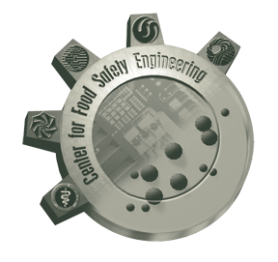


What is Quantum Cytometry? What Impact will it have on Cytometry? When will it arrive?
J. Paul Robinson
Distinguished Professor of Cytomics
Professor of Biomedical Engineering
Purdue University, West Lafayette, IN, USA
Home of the Purdue Email Discussion list since 1989
November 16, 2023

Slide 2

Disclosure: Professor Robinson is a founder of corporation and as such declares a conflict of Interest

Slide 3
A summary of this presentation….
Quantum flow cytometry is the next generation of flow cytometer that moves away from the current methods of detection, methods of calibration and even methods of analysis.
A quantum cytometer can self-calibrate. It represents an absolute self-calibration and has sensitivity for quantification and enumeration well beyond current detection approaches.
A quantum cytometer uses advanced laser manipulation technology. It delivers laser light to the sample in a different way. It collects signal from the sample in a different way. It has the ability to define the noise and the signal in such a way using photon statistics such that signal background is essentially absent.
Like quantum computing, technical components within traditional flow cytometers are unable to achieve the demands of quantum cytometry. Thus, new detectors are required, new high band-width diffraction elements are needed, electronics is orders faster than current electronics and the optics must evolve as much more advanced. Obviously, the software required is also different.
When you combine quantum cytometry with spectral cytometry, you move into a new domain heretofore untapped in the field. Instead of focusing on percentages of “positive” cells, a quantum cytometer can make definitive and quantitative measurements of many parameters of each cell simultaneously resulting in a vast increase of knowledge about each cell. As such the concept of many ‘colors” in cytometry is essentially passé with quantum cytometry. We need to move beyond this distracting concept of “how many colors is your machine?”. Quantum cytometry demands a new approach to data processing and analysis using machine learning embedded within the technology allowing a vast expansion of information and translation into valuable biological knowledge.
Technology has advanced so quickly, that it is reasonable to assume that quantum cytometry will emerge within the next couple of years.

Slide 4
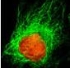
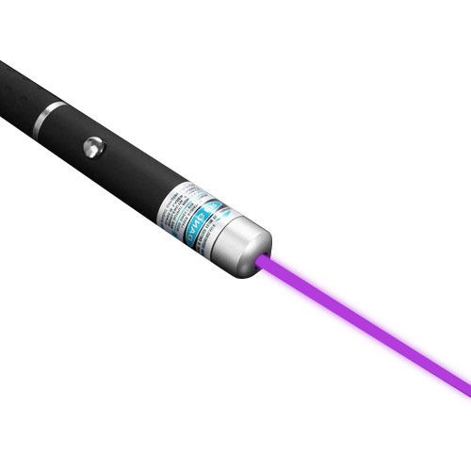
Flow Cytometry
Light Source
Cell
Fluorescence Result
500
600
700
800
Wavelength (nm)

Slide 5
Some terms we sometimes toss around…
Quantum comes from Latin, meaning "an amount" or "how much?"
Photon (from Greek phōs, phōtos, “light”)
All photons travel at the speed of light. Considered among the subatomic particles, photons are bosons, having no electric charge or rest mass and one unit of spin; they are field particles that are thought to be the carriers of the electromagnetic field.

Slide 6
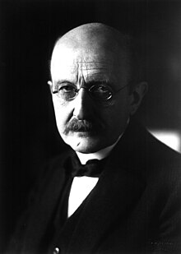
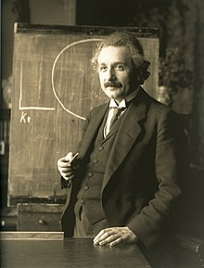
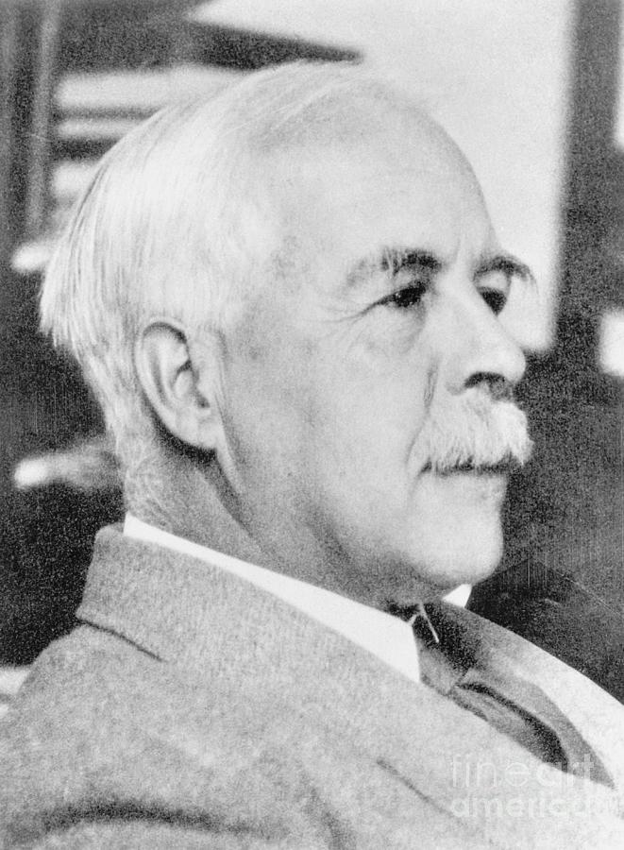
Quantum and Photon
In 1901, Max Planck used quanta to mean "quanta of matter and electricity",^{[5]} gas, and heat.^{[6]} In 1905, in response to Planck's work and the experimental work of Lenard (who explained his results by using the term quanta of electricity), Albert Einstein suggested that radiation existed in spatially localized packets which he called "quanta of light"
Planck
Einstein
“I therefore take the liberty of proposing for this hypothetical new atom, which is not light but plays an essential part in every process of radiation, the name photon.” In that sense, his concept differed from Einstein’s 1905 quantum theory of light, but “photon” came to be used to describe what Einstein originally termed “light quantum”
Lewis had a record 35 nominations to the Nobel Committee over his lifetime (despite 2 of his students winning Nobel prizes)
The term photon (from Greek phōs, phōtos, “light”), however, was not used until 1926. The energy of a photon depends on radiation frequency;
All photons travel at the speed of light. Considered among the subatomic particles, photons are bosons, having no electric charge or rest mass and one unit of spin; they are field particles that are thought to be the carriers of the electromagnetic field.
G. N. Lewis (1875-1946) proposed the term “photon” in 1926
Thanks Wiki
German Physicist and 1918 Nobel Prize for Physics recipient Max Planck (1858–1947)
Notes:
Describe the history of photons and quantum here – note that the word photon was defined first by GN Lewis in 1926

Slide 7
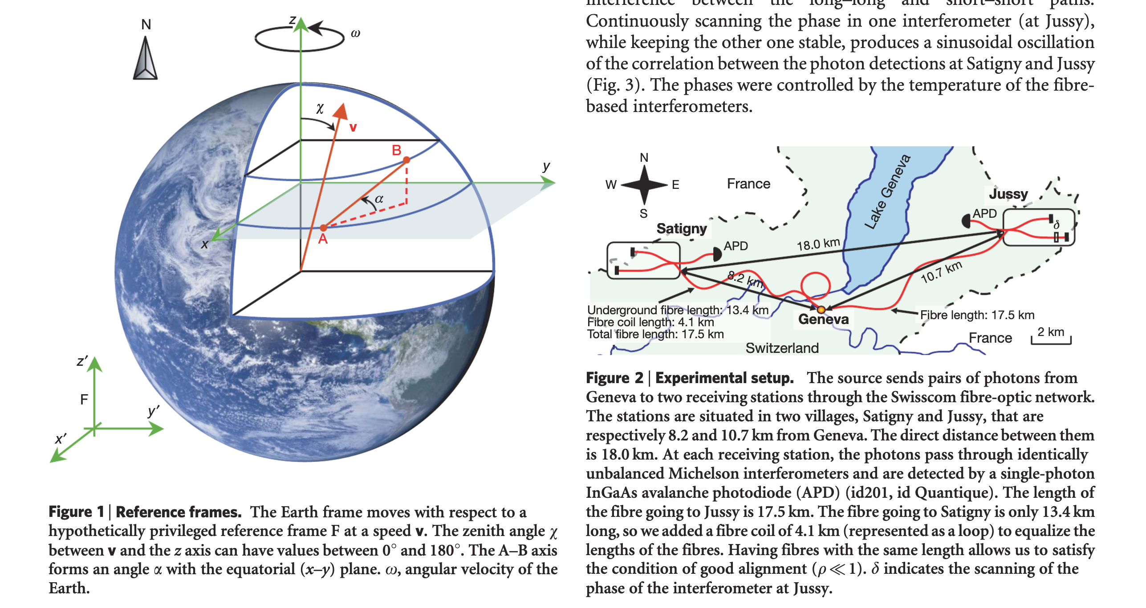
Quantum computing is a rapidly-emerging technology that harnesses the laws of quantum mechanics to solve problems too complex for classical computers.
Quantum entanglement is a bizarre, counterintuitive phenomenon that explains how two subatomic particles can be intimately linked to each other even if separated by billions of light-years of space. Despite their vast separation, a change induced in one will affect the other.
Photons can exert weird behaviour - Entanglement
Vol 454 | 14 August 2008 | doi:10.1038/nature07121

Slide 8
Quantum….
What is a quantum? A quantum (plural: quanta) is the smallest discrete unit of a phenomenon. For example, a quantum of light is a photon, and a quantum of electricity is an electron.
Quantum comes from Latin, meaning "an amount" or "how much?" If something is quantifiable, then it can be measured.
The word quantum refers to the smallest amount of something that you can have. You can't break a quantum of something into smaller parts. A quantum is the most basic building block.
Thanks Wiki

Slide 9
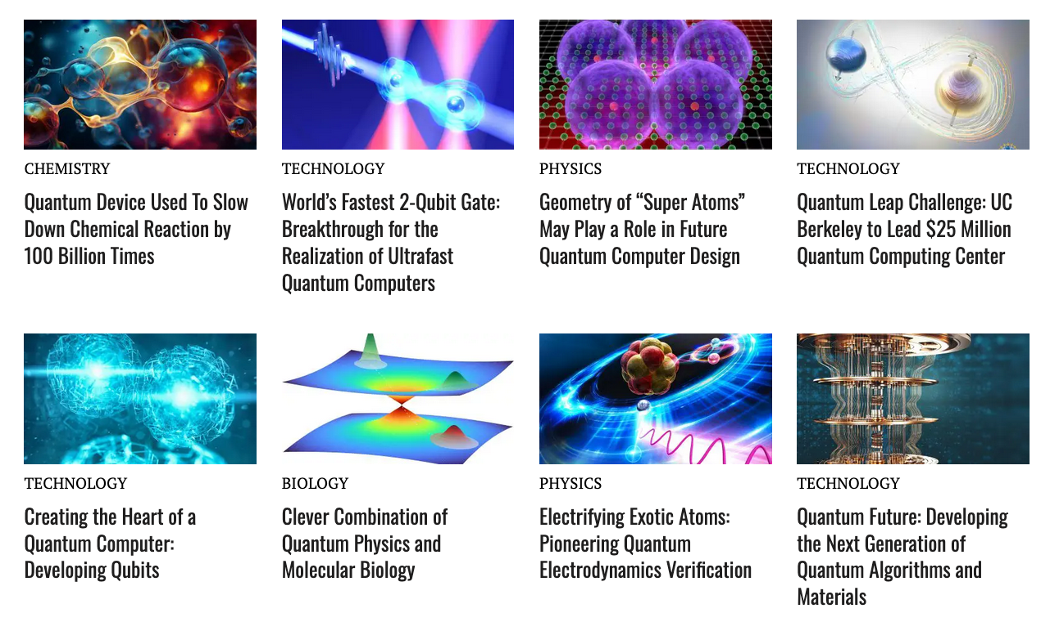
ARTICLES PUBLISHED RECENTLY ON THIS TOPIC

Slide 10
QUANTUM COMPUTING
For decades, our computers have all been built around the same design. Whether it is the huge machines at NASA, or your laptop, they are all essentially just glorified calculators, but crucially they can only do one thing at a time.
The key to the way all computers work is that they process and store information made of binary digits called bits. These bits only have two possible values, a one or a zero. It is these numbers that create binary code, which a computer needs to read in order to carry out a specific task, according to the book Fundamentals of Computers.
https://www.livescience.com/quantum-computing
Now….consider a photon…… think of it as a bit….. it’s ONE or ZERO
Notes:
The concept that photons are DIGITAL is important here – there can only be a photon – not a half photon or 1.5 photons – it means if you actually measure photons (and not photo-electrons) as all current technologies measure, you start and end in DIGITAL space – no more conversions that create noise, error ,etc – so we literally move from the ANALOGUE world to the DIGITAL world.

Slide 11
Old sayings are still relevant….
“You can’t put new wine into old wineskins….”
Notes:
well everyone knows what this means…

Slide 12
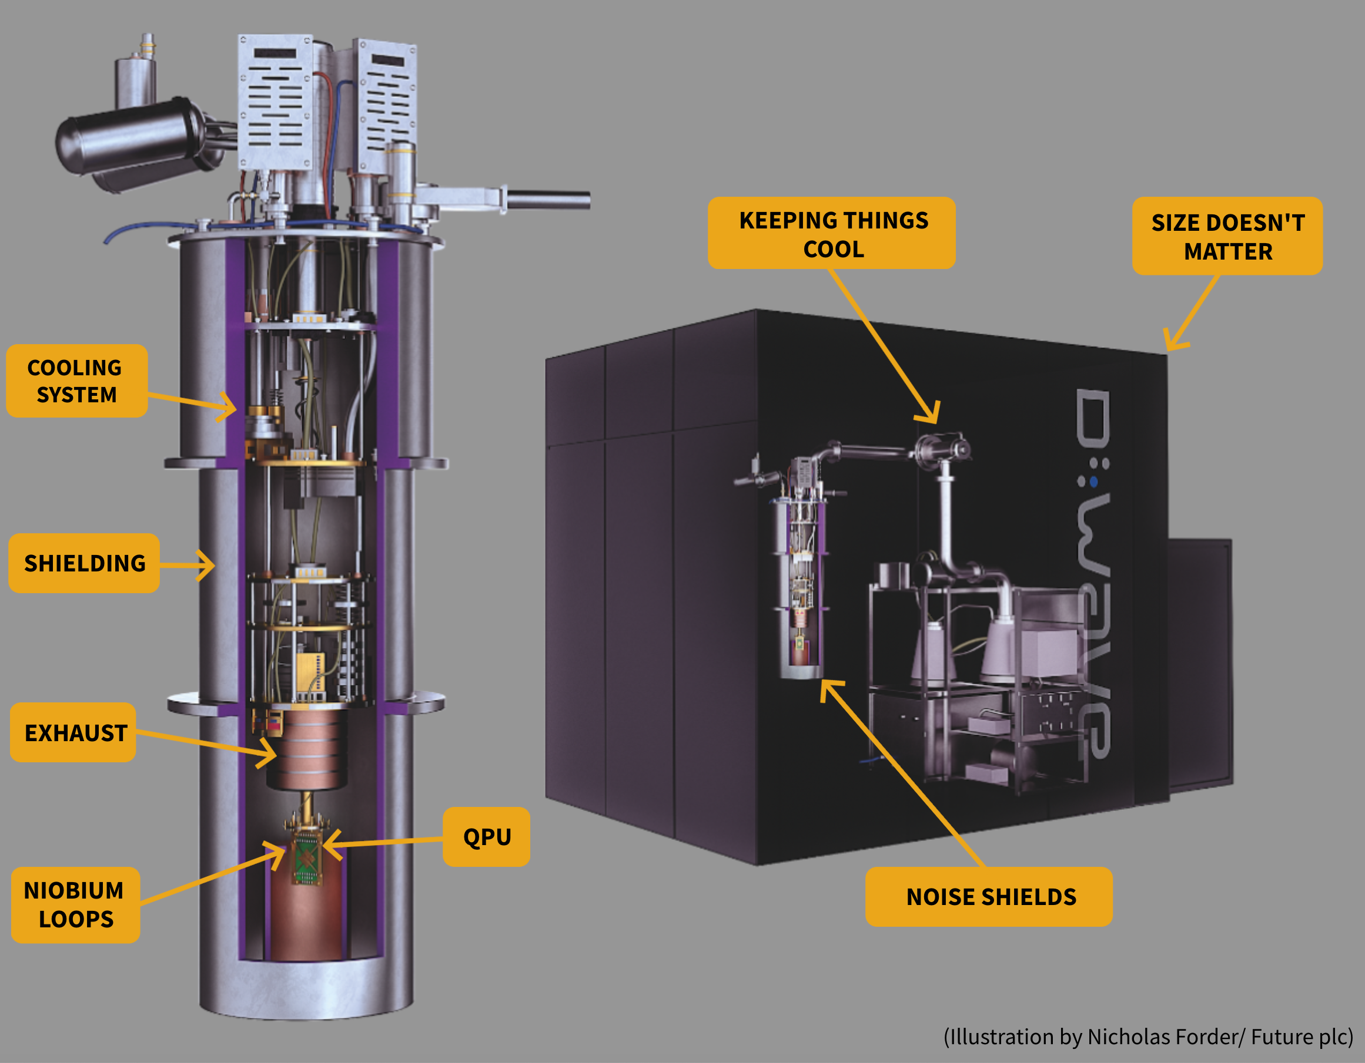
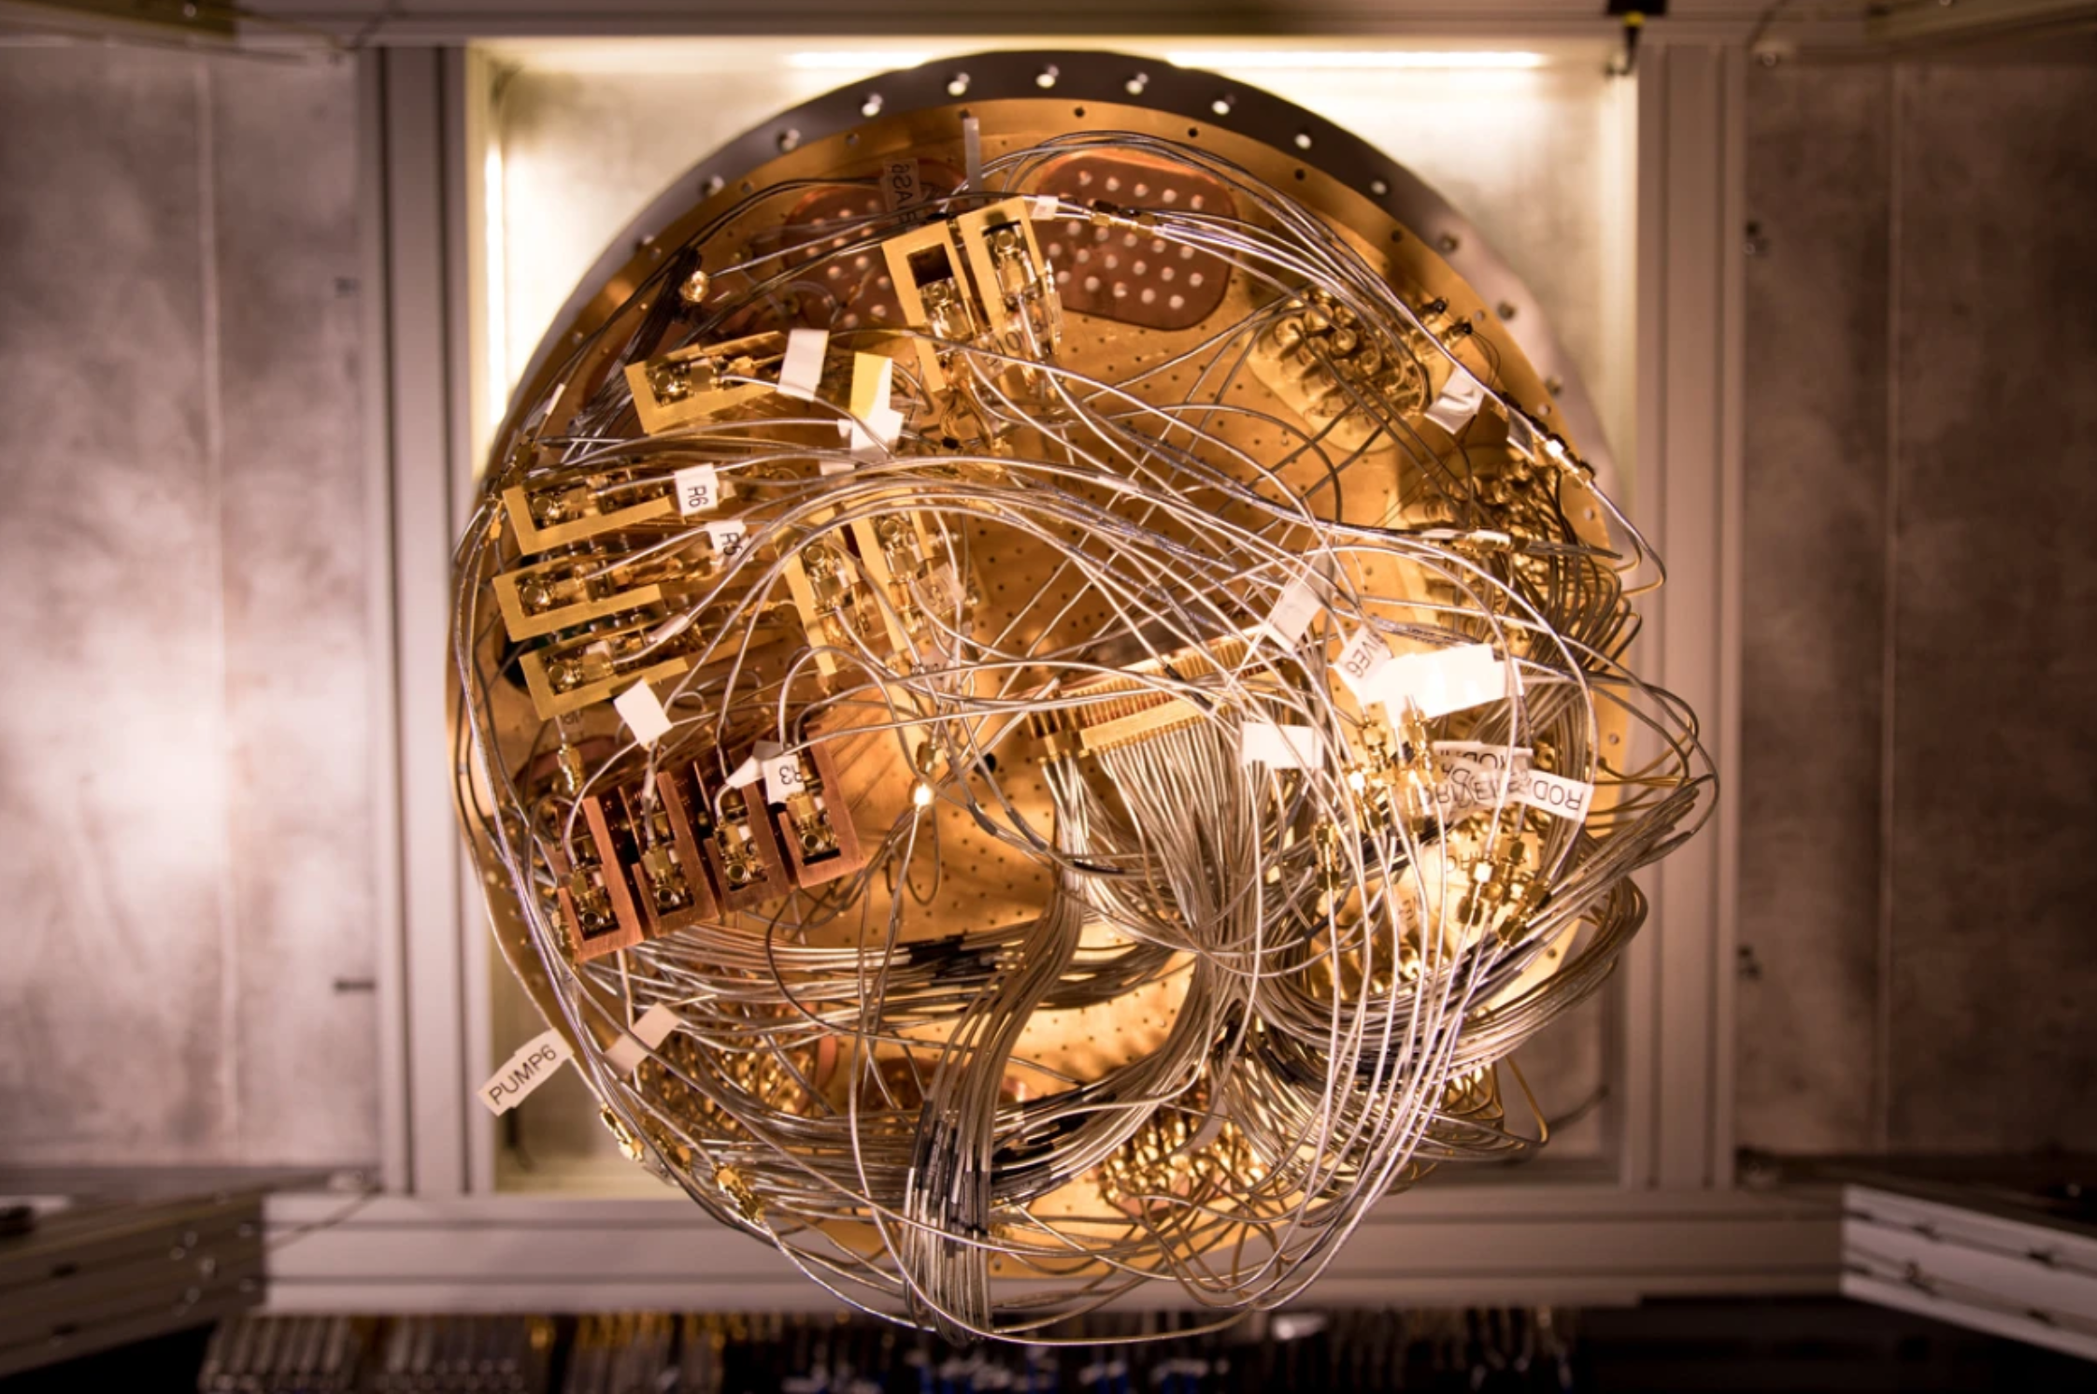
Quantum Computer Hardware is New Technology
https://www.nature.com/articles/d41586-019-02936-3
A cryostat used to cool Google quantum computing hardware.
Credit: Erik Lucero
https://www.livescience.com/quantum-computing
Notes:
To achieve Quantum computing, you cannot do this with current computer technology – it had to be completely new technology – super cooled systems, much more compact (less distance to travel), and a different set of parallel processors etc….the point here, is if we are to move cytometry to a new dimension, we need to design new hardware as the current hardware has been the same for decades – note that even the newest form of cytometry – spectral uses the same processors, detectors, optics, lasers as we have for decades. It appears to be a new technology, but it is 20 years old already.

Slide 13
Some facts about light…(photons)
Light travels 186,282 miles per second
Light travels 186.282 miles per ms
Light travels 0.186282 miles per μs or 299.792458 m (300 m)
1 cm corresponds to a light travel time of 49 ps
10 cm takes about 490 ps
20-30 cm (about how long a photon takes to get to the sensor in most flow cytometers about 1.0-1.5 ns
Micro 10⁻⁶ The time needed to execute one machine cycle by a 1960s minicomputer
Nano 10⁻⁹ The time needed to execute one machine cycle by a 1 GHz microprocessor
Pico 10⁻¹² The lifetime of a transition state one machine cycle by IBM silicon-germanium transistor
Femto 10⁻¹⁵ The cycle time for ultraviolet light with a wavelength of 300 nanometres
Atto 10⁻¹⁸ The best timing control of laser pulses

Slide 14
So fundamental issue #1
It takes time for photons to travel – so distances must be either short, or for multiple measurements…
.you need equal distances if possible….or you must adjust the electronics
30 cm (1 foot) – 1470 ps or 1.5 ns
Notes:
If you move to a truly single photon technology – there are lots of things you have to change – for example, if you have multiple detectors, all the detectors much be at the exact same distance from the electronics – because photons travel at the speed of light – so we cant just convert old systems to new technology.

Slide 15
So fundamental issue #2
New hardware is necessary to implement quantum computing
and…
New hardware is necessary to implement quantum cytometry

Slide 16
So fundamental issue #3
New software concepts and new libraries are necessary to implement quantum computing
and…
New software concepts are necessary to implement quantum cytometry

Slide 17

So, let’s review what the current state of art is in flow cytometry
https://www.thermofisher.com/uk/en/home/life-science/cell-analysis/cell-analysis-learning-center/molecular-probes-school-of-fluorescence/flow-cytometry-basics/flow-cytometry-fundamentals/electronics-flow-cytometer.html
https://www.nature.com/articles/d41586-019-02936-3

Slide 18
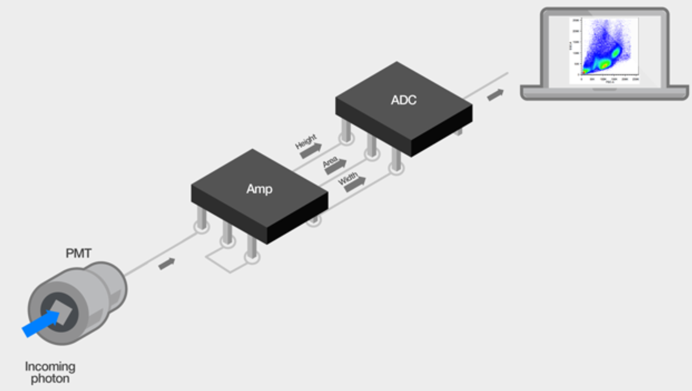
Follow the photons
The photons that are emitted when the laser hits the cell as it passes through the interrogation point are detected by the photomultiplier (PMD) or photodiode (PD). These photons can come from light being scattered by the cell or by fluorescence emission of fluorophores associated with the cell. Once in the detector, the photons are converted to electrons, and the signal is multiplied proportionately. The signal exits the detector as an electric current (also called photocurrent), and this is the point where the signal enters the electronics system. A simplification of the path of the photons as they travel through the electronics system can be seen in Figure 1. After exiting the detector the electric current travels to the amplifier (amp) where it is amplified and converted to a voltage pulse. This pulse is then converted to a digital number via the analog-to-digital converter (ADC). The digital number is transferred to the computer and becomes the data that you will analyze. Of course this is a dramatic simplification of the process, and there are some key points described in this section that you will need to understand about the data in order to accurately interpret the results of your experiment.
https://www.thermofisher.com/uk/en/home/life-science/cell-analysis/cell-analysis-learning-center/molecular-probes-school-of-fluorescence/flow-cytometry-basics/
flow-cytometry-fundamentals/electronics-flow-cytometer.html
Notes:
Discuss here the fact that flow cytometry folks misuse the term photon all the time. While they correctly say, “flow cytometry collects photons from fluorescent probes”…they then think they are actually measuring photons – but they are not – they are measuring photo-electrons – that is , a photon hits a cathode in a detector and then is converted to a phot-electron and then amplified via a process that is variable – and out the other end we get some voltage we then computer by converting this into a “digital” value so we can process this at “high speed”. In fact, this is an area where lots of noise, and error occurs.

Slide 19
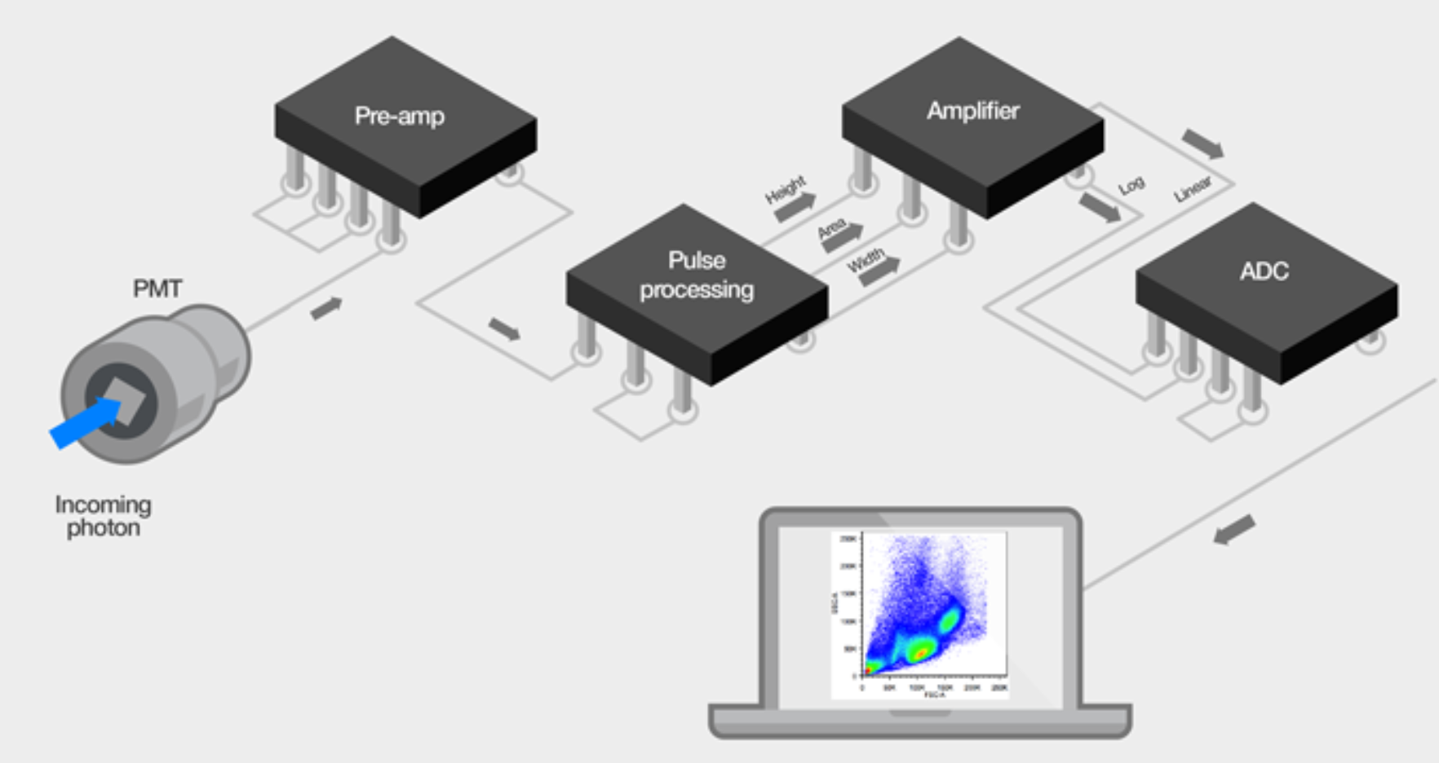
Flow cytometers—old versus new
The signal from the PMT is very low, and typically goes through some pre-amp circuitry to amplify the signal before processing. While there are still pulses generated in some earlier-generation flow cytometers that use an analog pulse processing path (Figure 8), modern cytometers use a digital signal processing path (Figure 9). In this pathway, after the amplification the signal pulse is sampled at some rate (between 10 and 25 MHz on commercial systems), and with each sampling the pulse is digitized based on the analog-to-digital converter (ADC) resolution (ranging from 14 to 24 bits).
Analog-to-digital converter (ADC) resolution increases with each new instrument generation
Newer instruments can handle larger data sets and convert at higher bit rates (24 versus 10 bit ADC). For the researcher, this means that higher data resolution can be obtained from the sample when analyzed on an instrument with a 24-bit ADC as opposed to a 10-bit ADC. The ADC resolution is a measure of the number of discrete “bins” or levels that the data can be placed into. For example, an 18-bit ADC has 2¹⁸ = 262,144 different bins that can be used to digitize the given value. At a given sampling point (represented by a rectangle in Figure 7, the ADC measures the value and places it in one of these bins. At the next sampling point the process is repeated, to give a measure of the whole pulse over time. More bins mean there is more “resolution” in the data, and flow cytometer manufacturers have taken the opportunity to more realistically distribute the bins along the log scale to better reflect this distribution.
Older Systems
https://www.thermofisher.com/uk/en/home/life-science/cell-analysis/cell-analysis-learning-center/molecular-probes-school-of-fluorescence/flow-cytometry-basics/
flow-cytometry-fundamentals/electronics-flow-cytometer.html

Slide 20
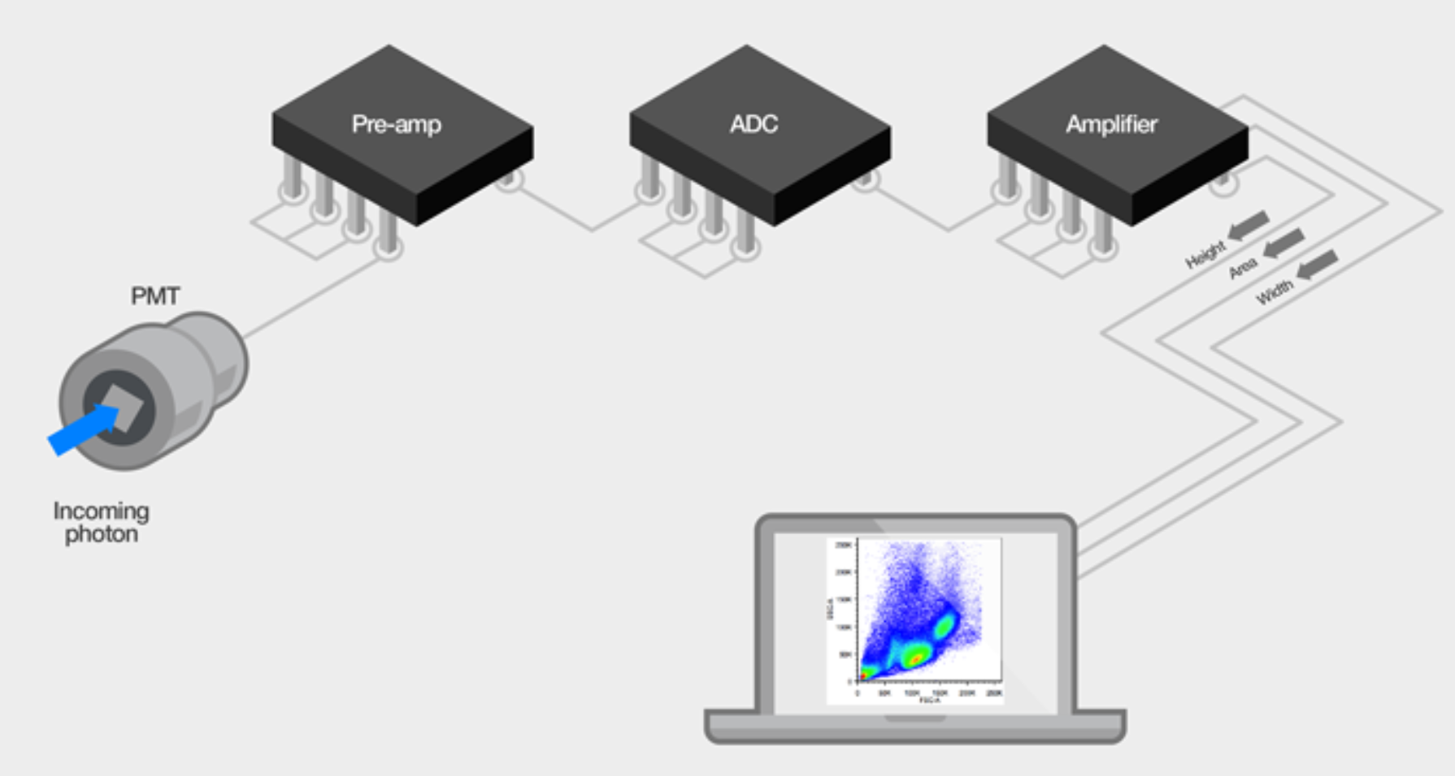
The signal from the PMT is very low, and typically goes through some pre-amp circuitry to amplify the signal before processing. While there are still pulses generated in some earlier-generation flow cytometers that use an analog pulse processing path (Figure 8), modern cytometers use a digital signal processing path (Figure 9). In this pathway, after the amplification the signal pulse is sampled at some rate (between 10 and 25 MHz on commercial systems), and with each sampling the pulse is digitized based on the analog-to-digital converter (ADC) resolution (ranging from 14 to 24 bits).
https://www.thermofisher.com/uk/en/home/life-science/cell-analysis/cell-analysis-learning-center/molecular-probes-school-of-fluorescence/flow-cytometry-basics/
flow-cytometry-fundamentals/electronics-flow-cytometer.html

Slide 21
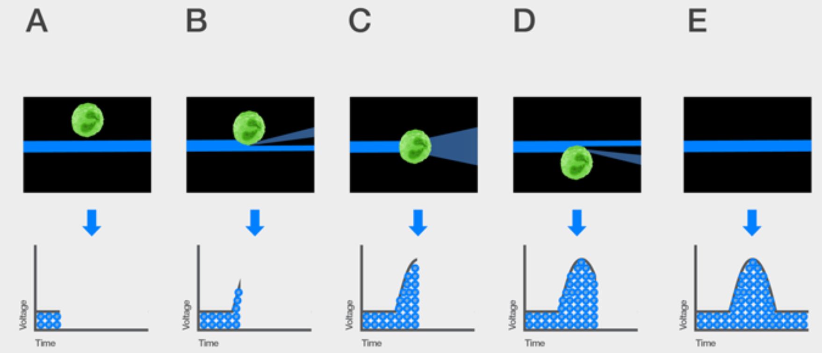
Understanding the voltage pulse
The voltage pulse (also called a signal pulse) is created when the cell reaches the interrogation point and crosses the path of the laser. The number of photons emitted is proportional to the fluorescent light generated after the cell passes through the laser as demonstrated by the pattern shown in Figure 2. These photons are converted to electrons in the detector, which is why these are called voltage pulses. The size of the voltage pulse also depends on the PMT voltage or pre-amplifier gain and the amplification factor (also called the amplification gain). Signals can be amplified by applying a voltage to the PMTs, thus creating a greater electrical current, or by increasing the amplification gain. Amplifier settings can be linear or logarithmic (Lin or Log). Log amplification is often used to separate negative from dim positive signals, whereas Lin amplification is often used to amplify scatter and fluorescent parameters.
https://www.thermofisher.com/uk/en/home/life-science/cell-analysis/cell-analysis-learning-center/molecular-probes-school-of-fluorescence/flow-cytometry-basics/
flow-cytometry-fundamentals/electronics-flow-cytometer.html

Slide 22
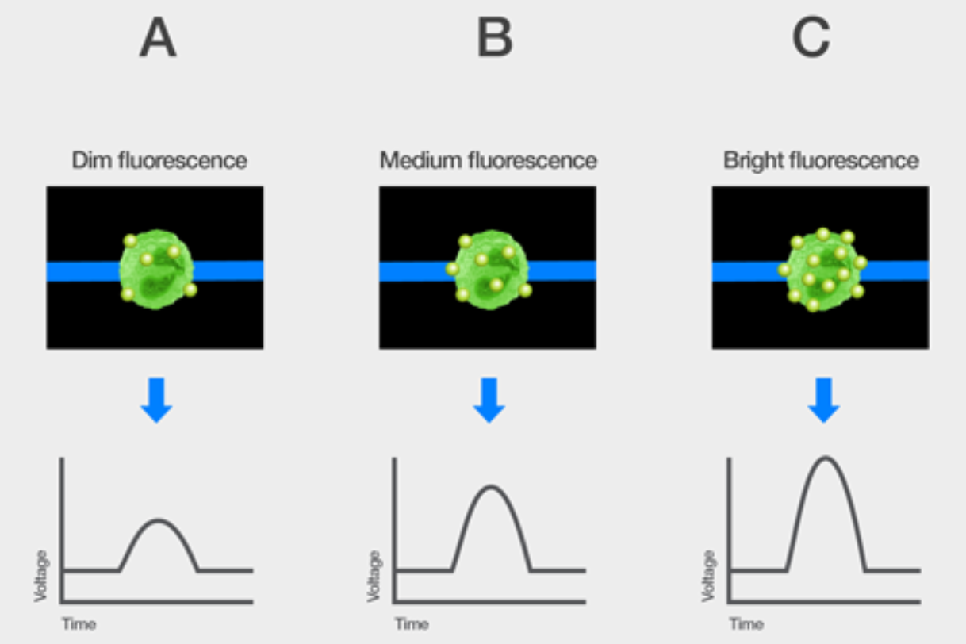
Interpreting the voltage pulse of fluorescence emission
As with FSC and SSC, the fluorescent light emitted by the cell as it crosses the laser beam will result in a voltage pulse. The amount of fluorescence emitted by the fluorophores associated with the cell is dependent on a couple of factors. The first factor is the number of fluorophores associated with the cell. For example, the cell could have low expression of the surface protein that you are detecting so that there are very few fluorescent antibody conjugates bound to the surface. Another example could be that a dead cell dye has bound in high quantities because the cell is no longer alive. Both of these examples would have different levels of fluorescence associated with the cell. Examples of the voltage pulses from three cells with different numbers of the same fluorophore label are illustrated in Figure 5.
The second factor that impacts the level of the fluorescence emission is the brightness of the fluorophores. Not all fluorophores are created equal when it comes to how much fluorescence is emitted. For example, some fluorophores have structures that lend themselves to much brighter fluorescence, like phycoerythrin (PE), which is a large protein from red algae. Other fluorophores are very small organic ring structures like fluorescein, which is significantly less bright than PE.
Notes:
Discuss here the nature of measuring a voltage pulse -etc

Slide 23
Comparing Electronics
In Cytometry 1.0 you have external peak hold circuits, log amps, etc. In that case you have an ADC which makes a couple analog to digital conversions per event. So it's maybe 10 bits x (number of parameters) x event rate = [hundreds of Kbps or a few Mbps]
In “digital” Cytometry 2.0 where you are directly sampling the waveforms, then the throughput is not dependent on event rate anymore, it's based on for example: 16 bits x ADC sample rate x (number of channels) = [hundreds of Mbps]
In ACTUAL DIGITAL Cytometry 3.0 with individual photon capturing, it’s a similar calculation but we have just 1 bit (photon/no-photon) x (number of channels = 42) x ADC sample rate (12Gsps) = [504 Gbps]
Actually, ADC for Cytometry 3.0 is Multi-gigabit transceiver, which is like a 1bit ADC

Slide 24
Current Cytometry – State of Art 1
Hardware
Polychromic Vs Spectral
  WDM
  BP and Dichroics
  Dispersion Elements
Detectors
  PMT
  APDs
  Si-PMs
Excitation systems
  Lamps
  Lasers
  LEDs

Slide 25
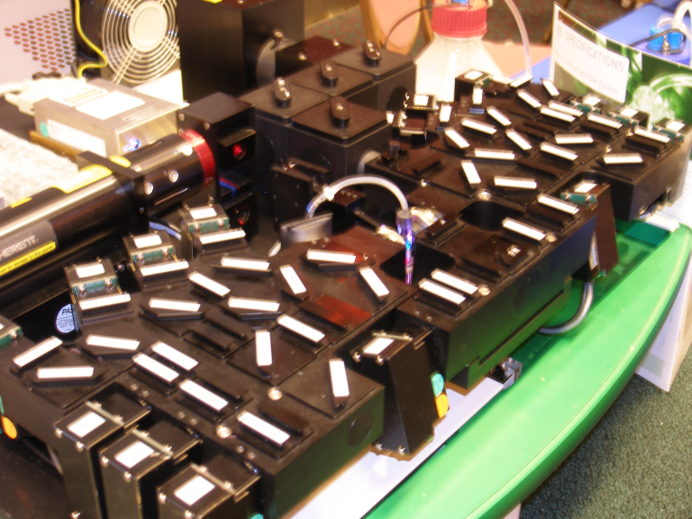

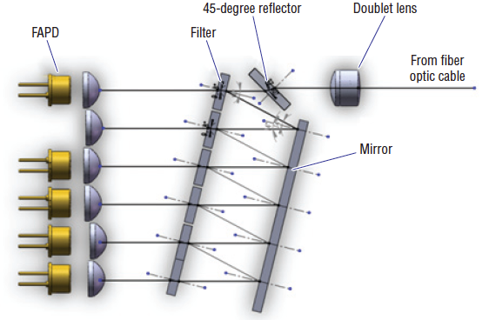
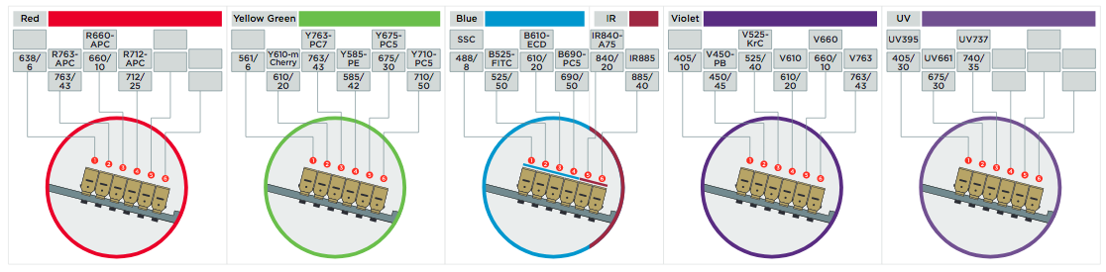
Polychromatic Principle of using ND and Dichroic filters
Notes:
Discuss how polychromatic cytometry uses one detector per dye – and there fore many components to ”clean” up the signal.

Slide 26
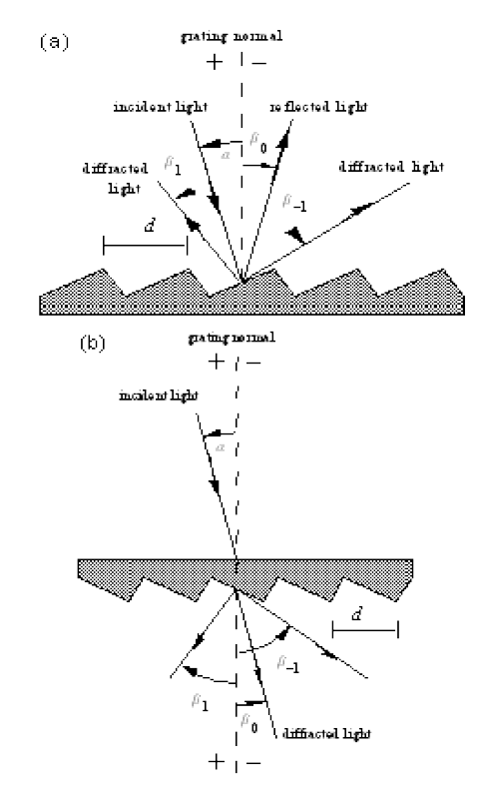
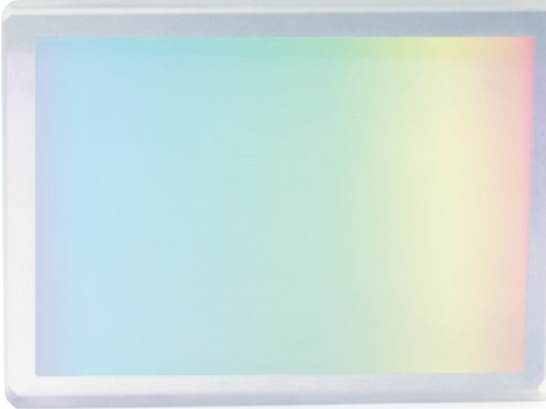
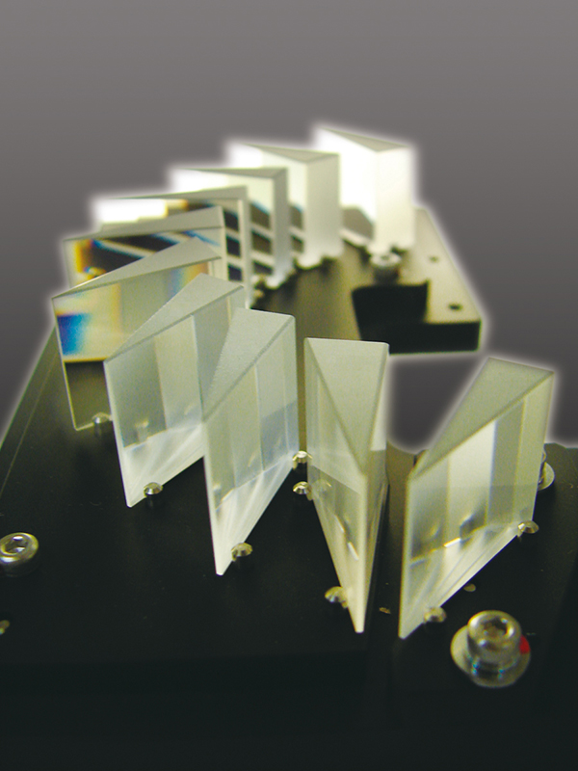
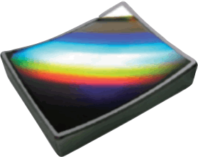
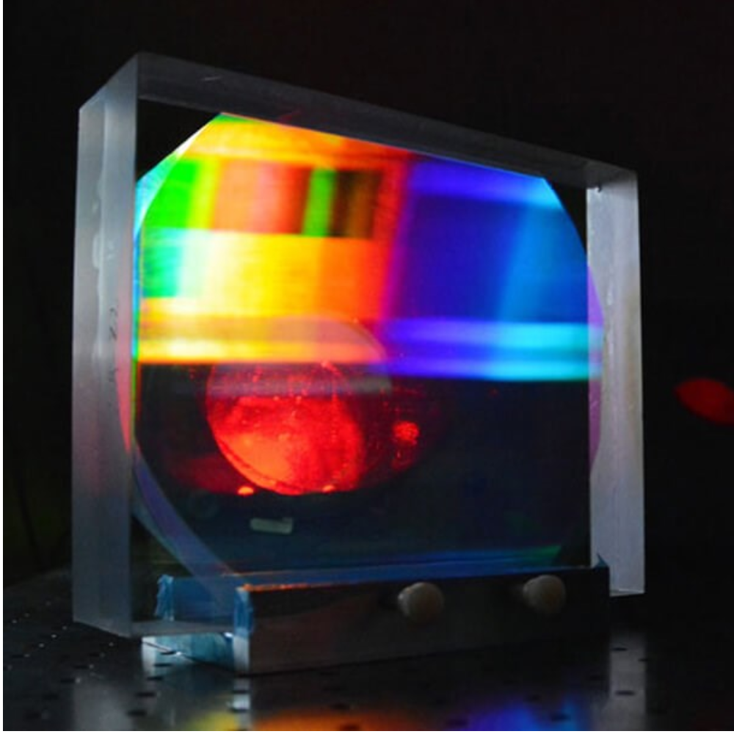
Dispersion Elements
Holographic filters
Notes:
Discuss the different types of dispersion elements that you can use for spectral cytometry

Slide 27
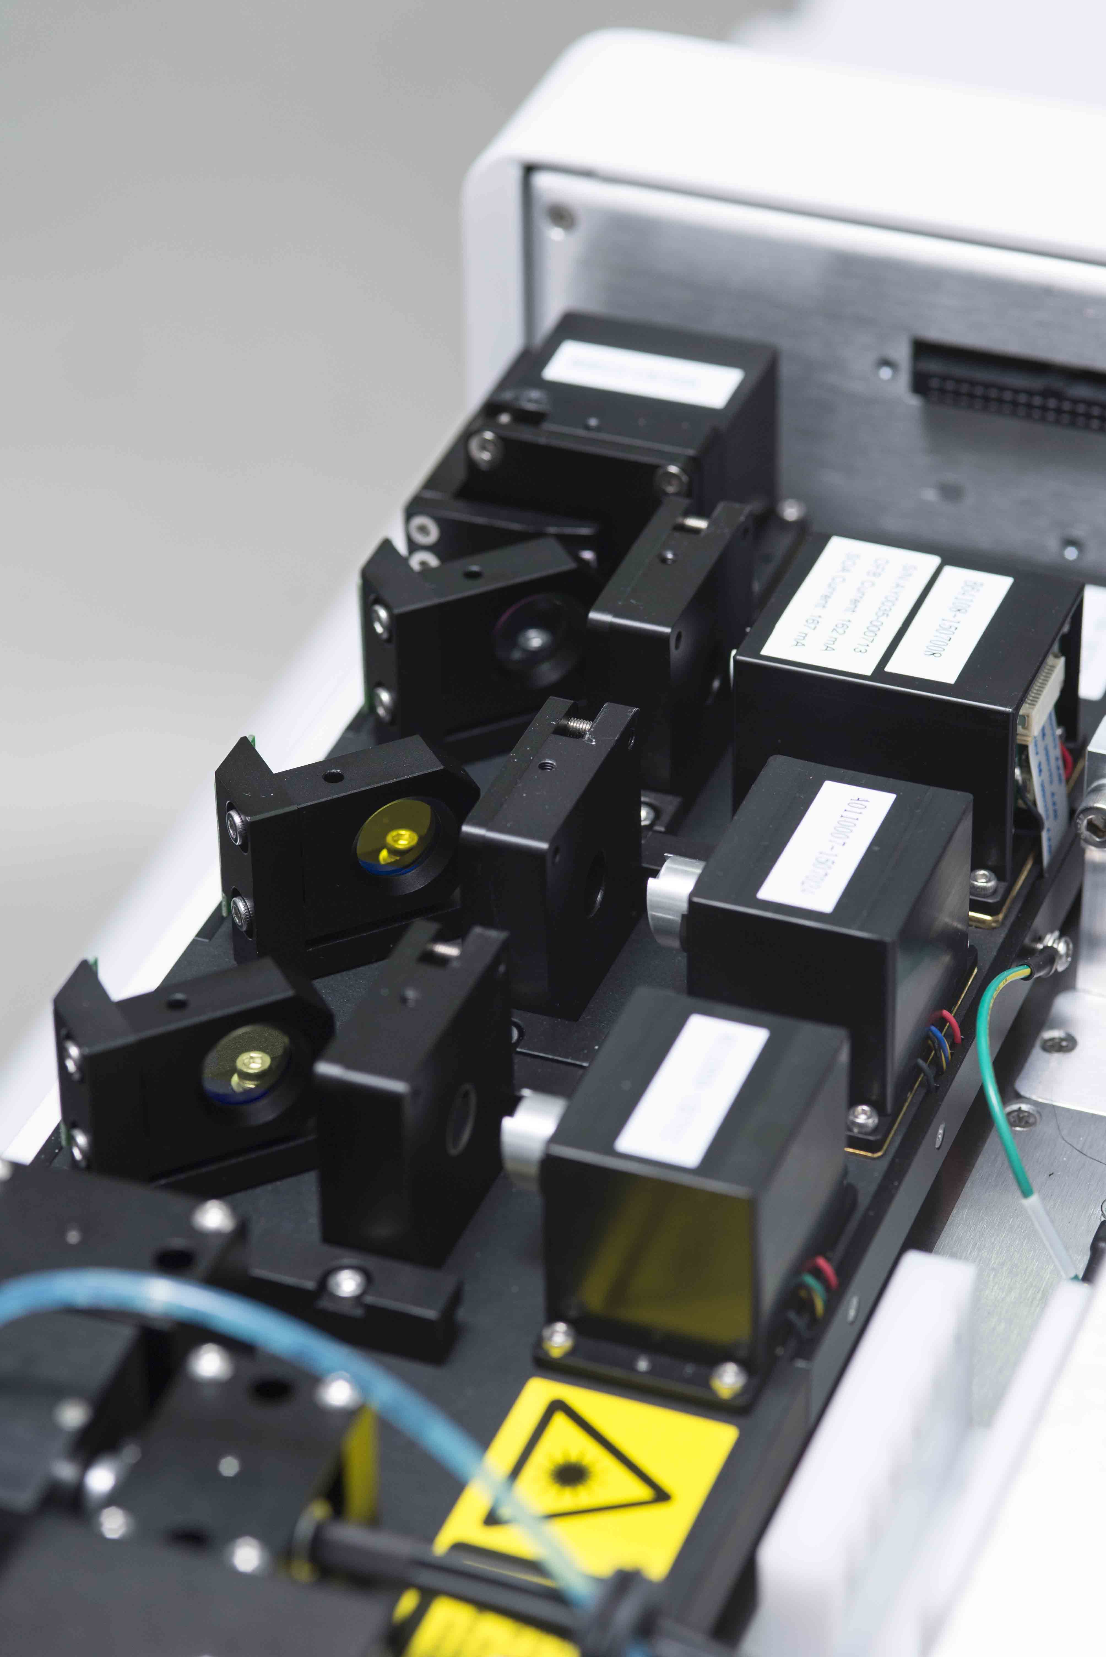
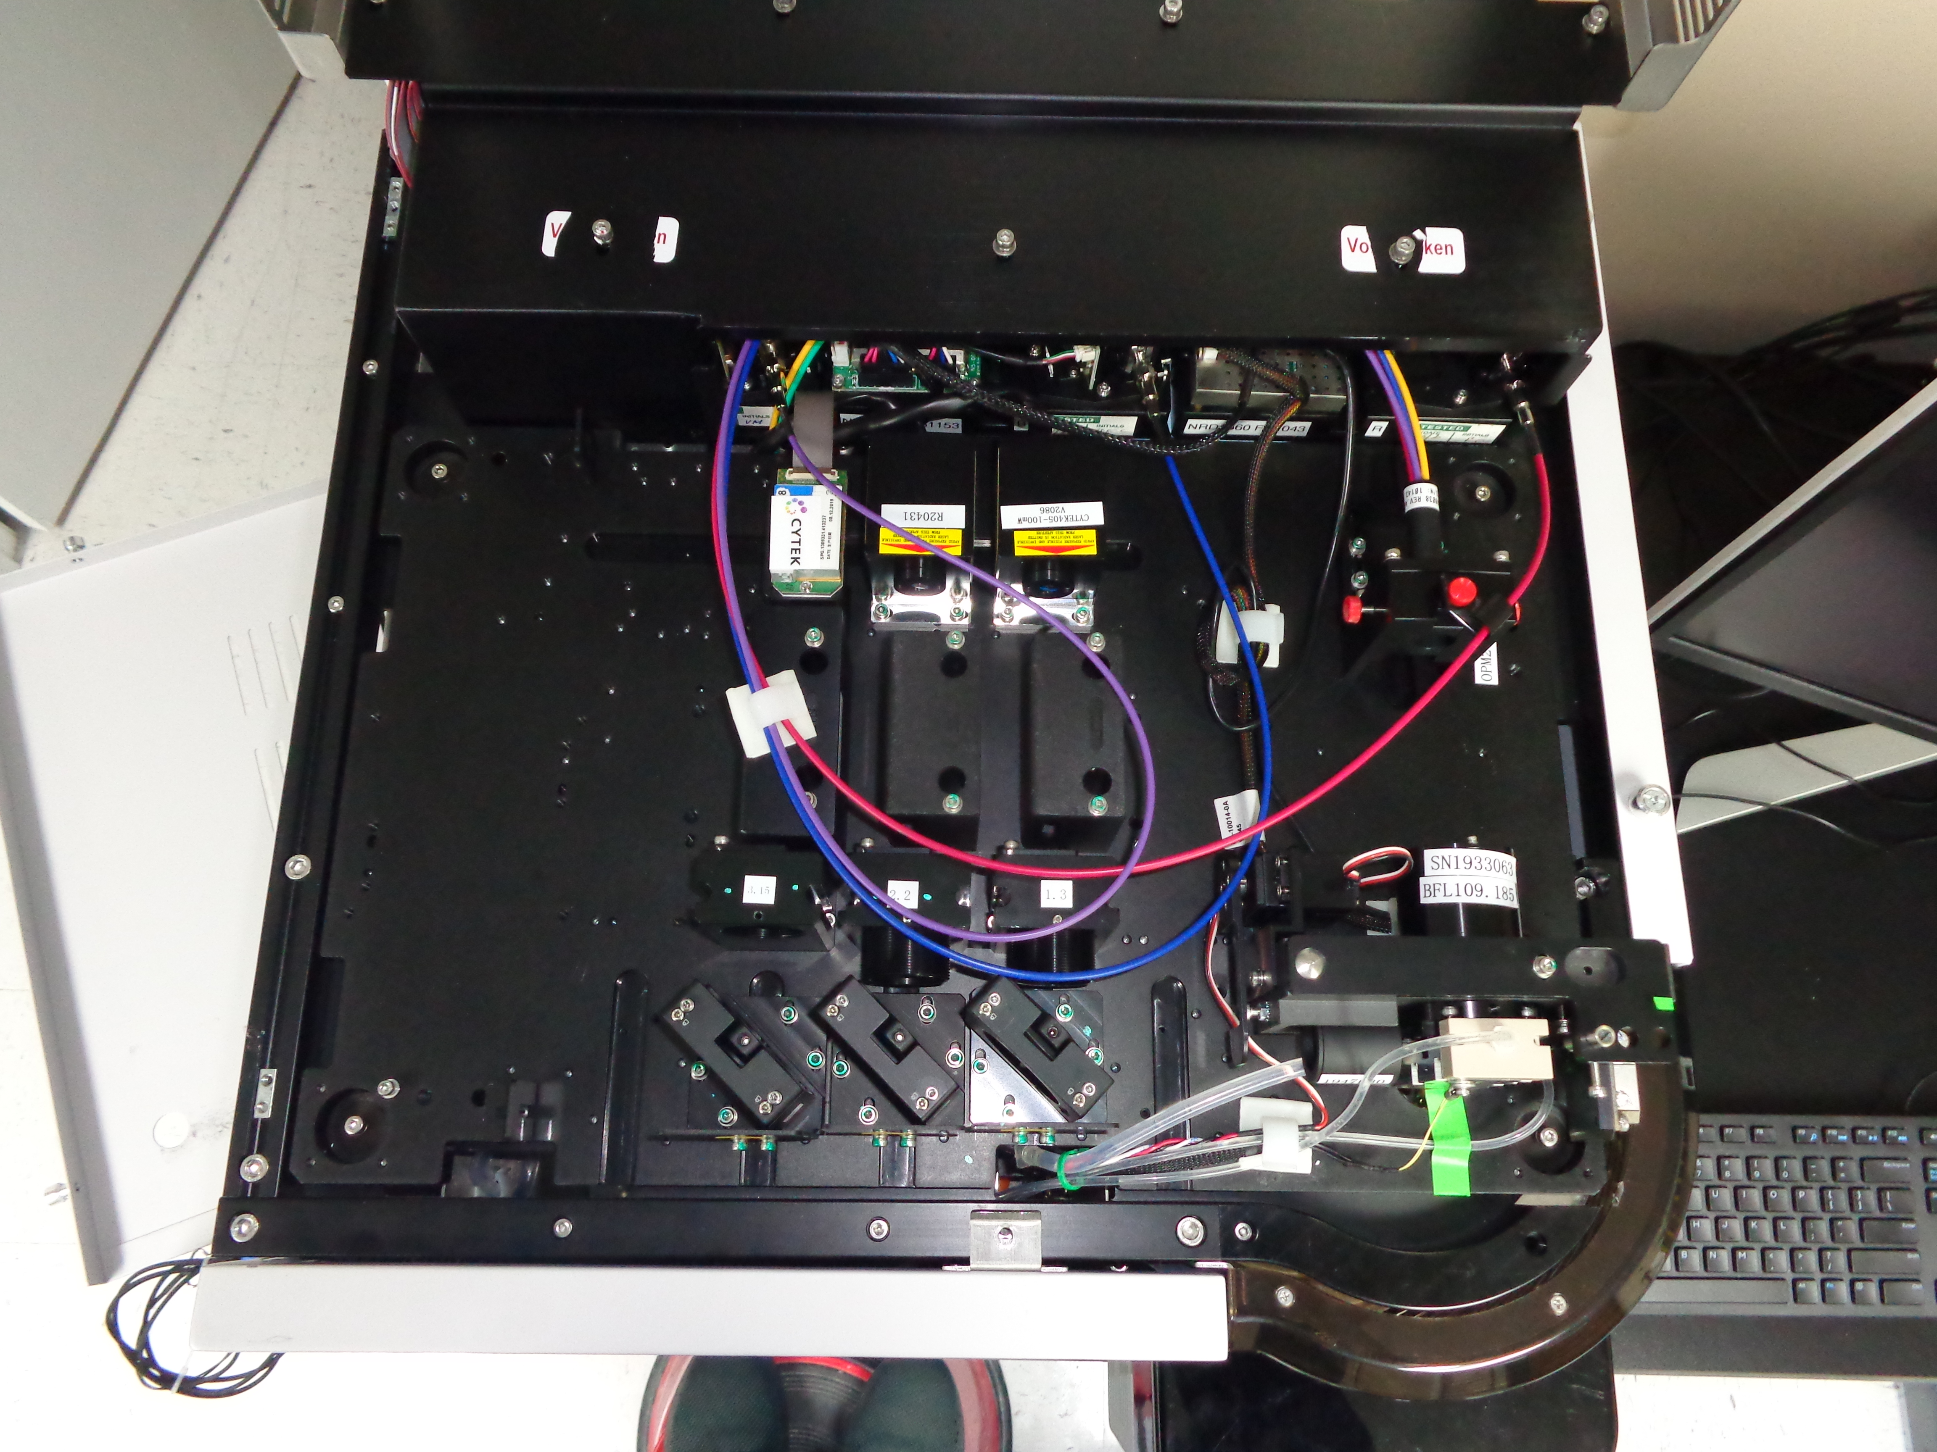
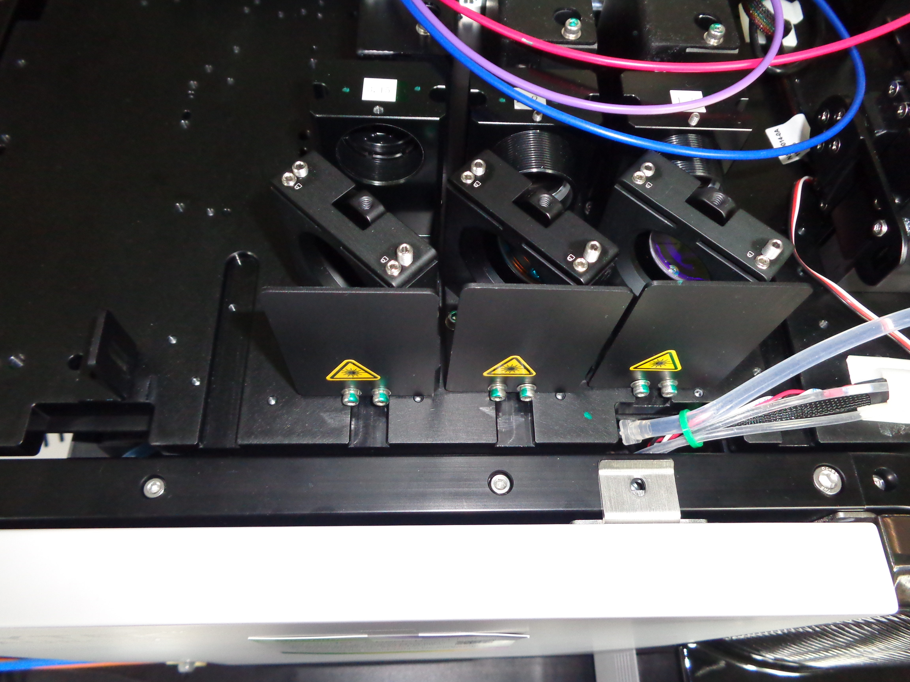
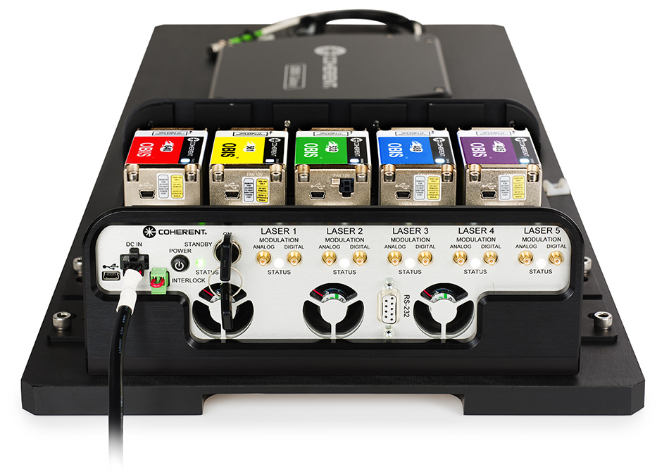
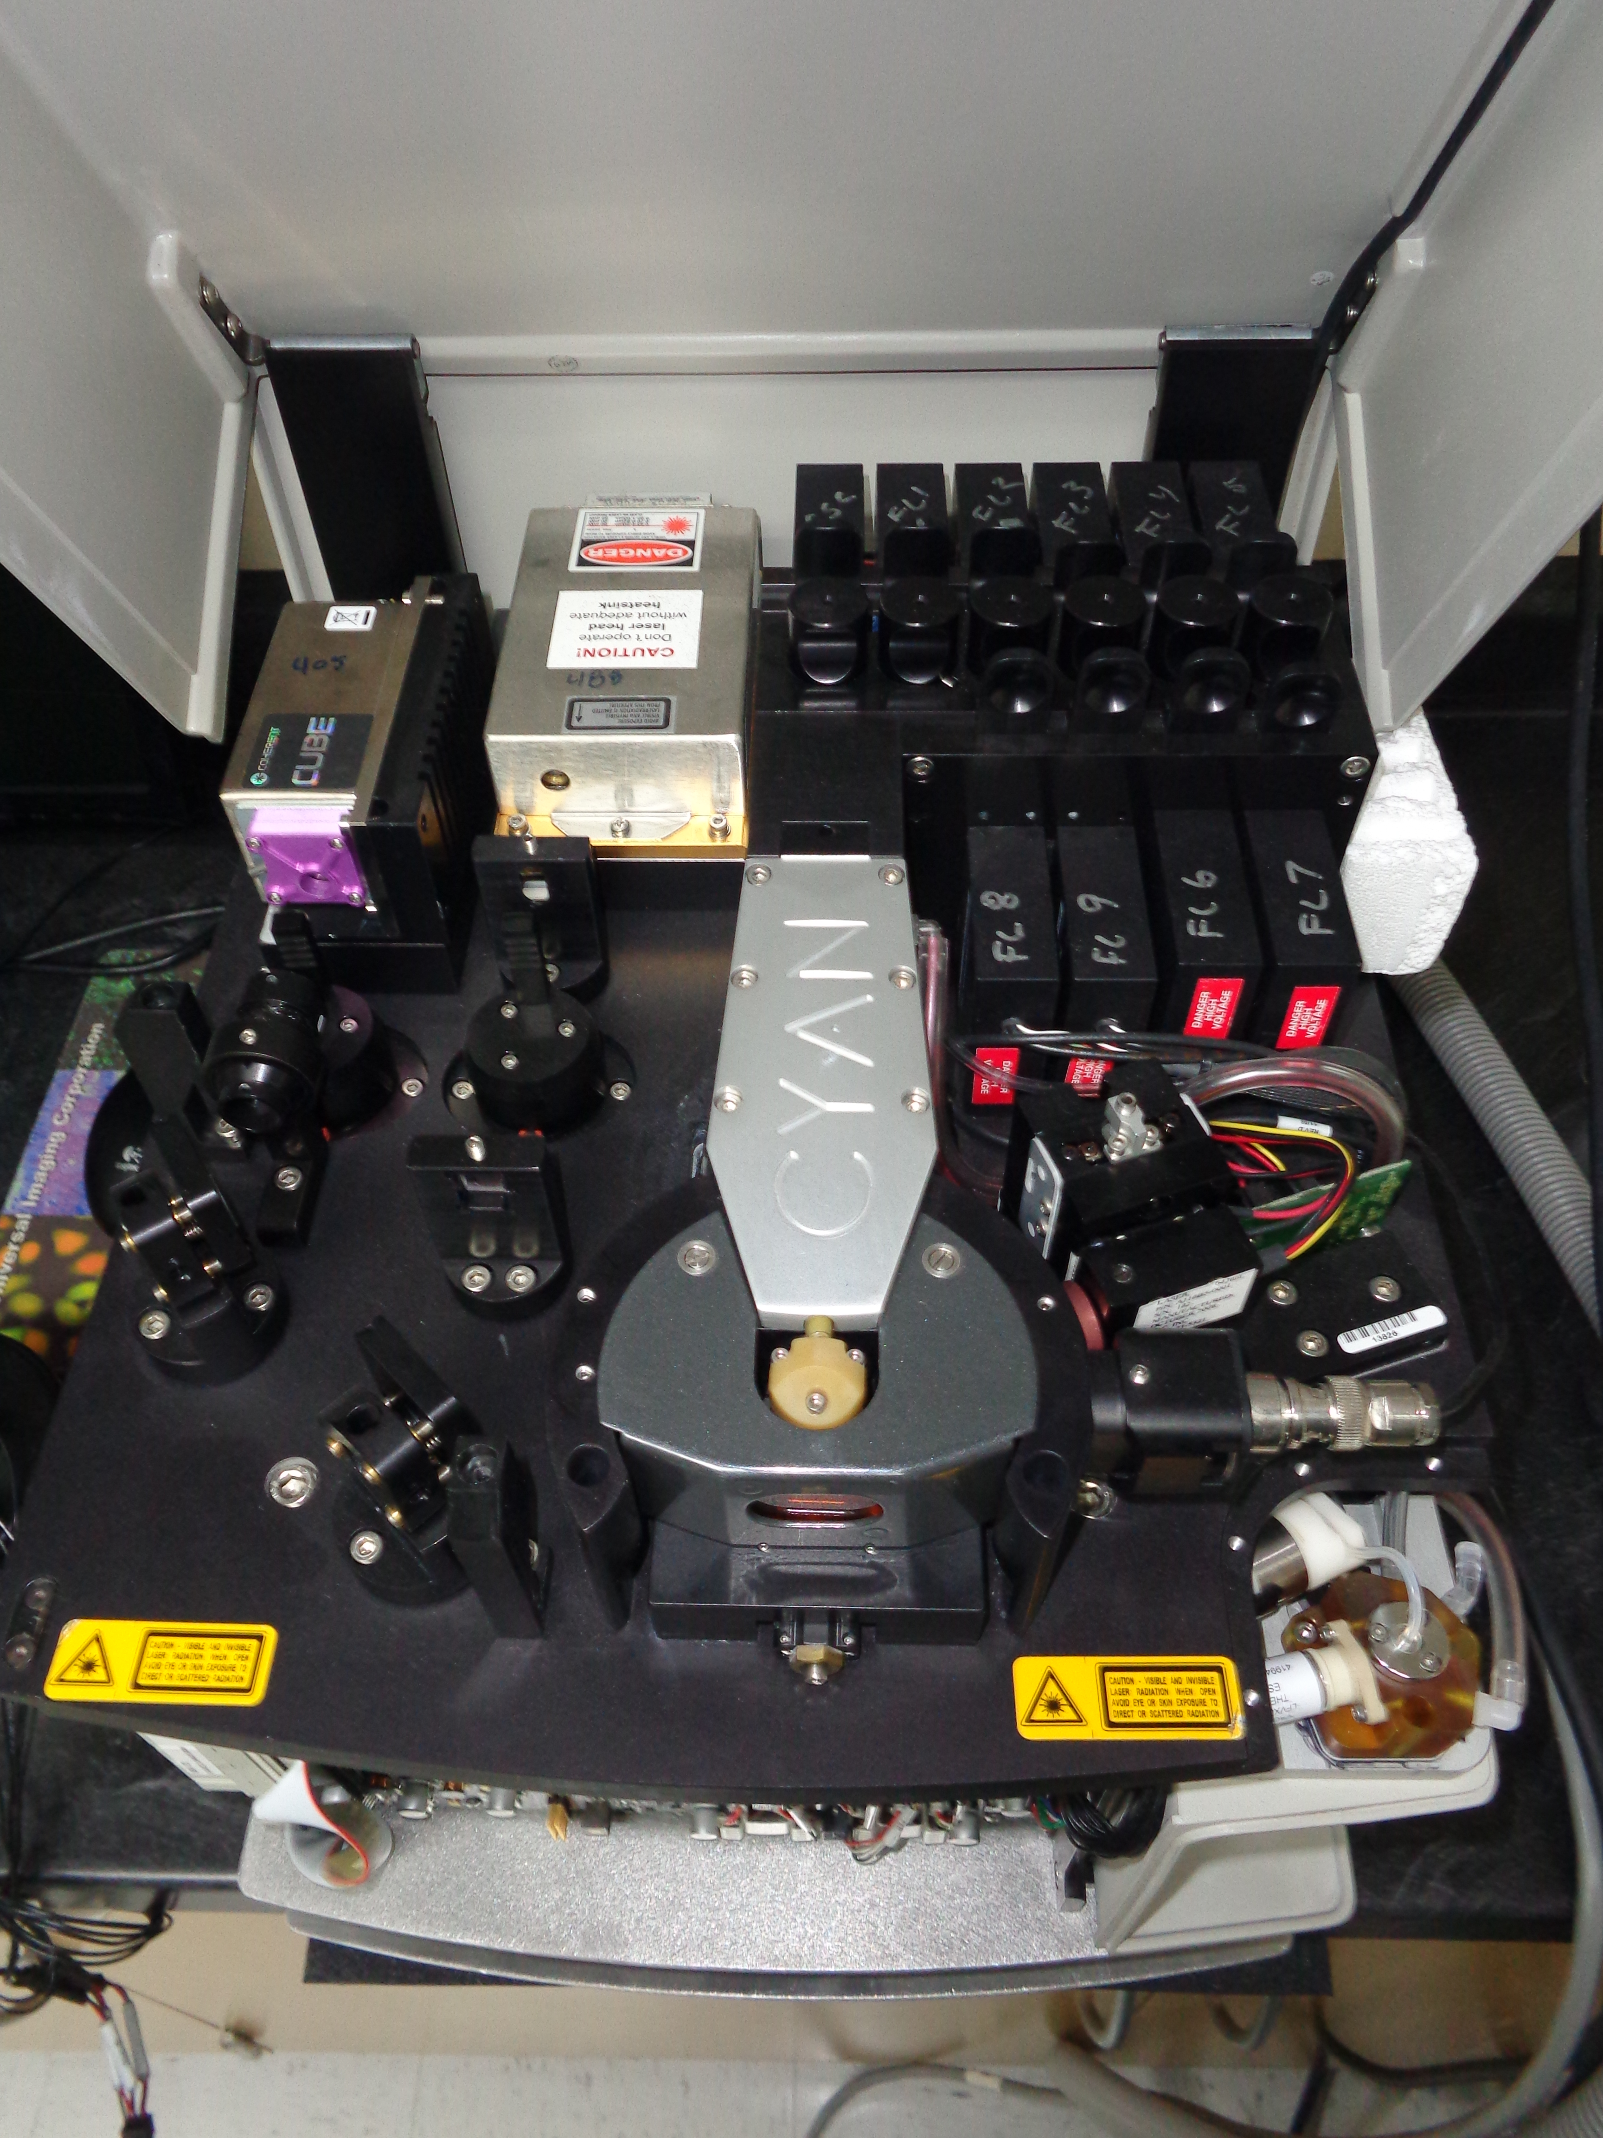
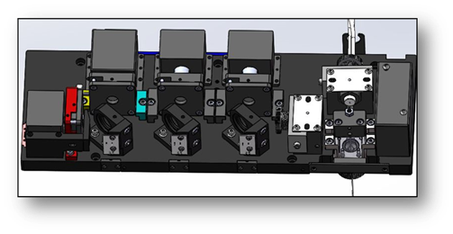
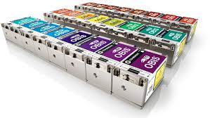
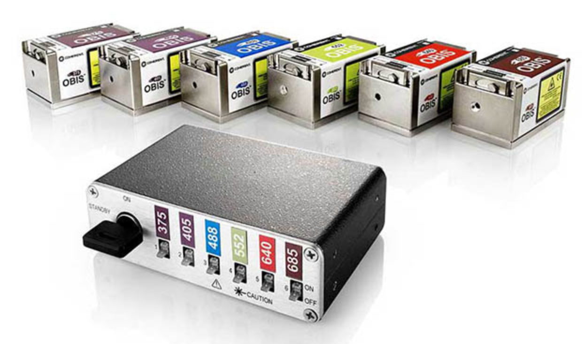
In virtually all current flow systems – the laser is – well just another torch …..
Notes:
Lasers in cytometry today are simple flashlights……nothing more. This is an old world approach to cytometry but it is embedded in the field.

Slide 28
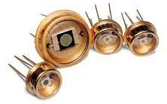
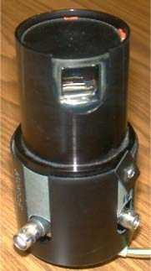
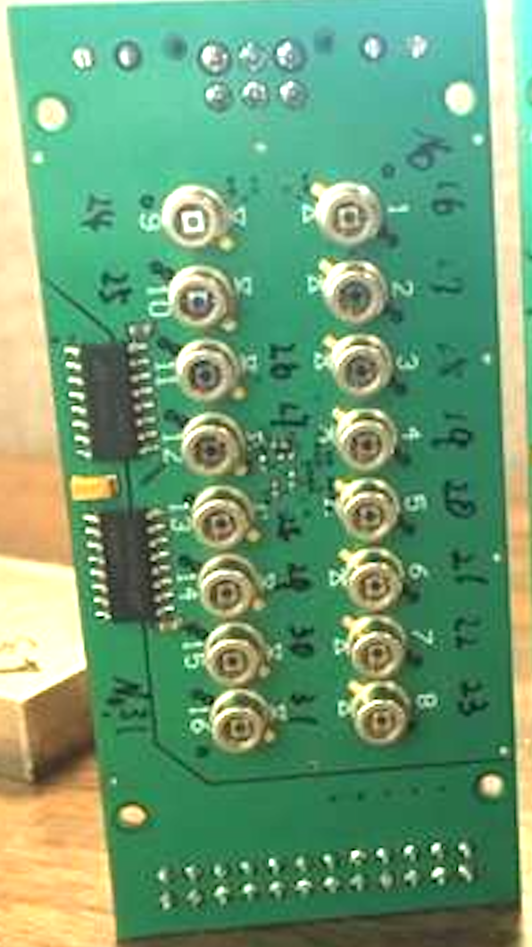
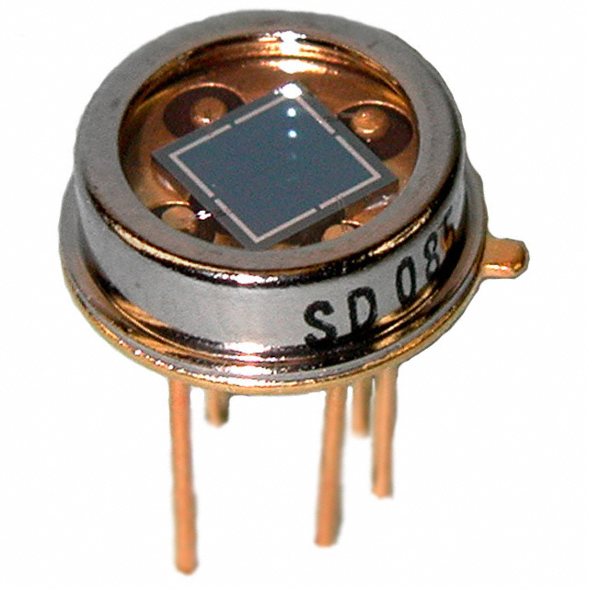
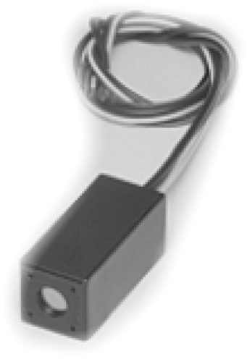
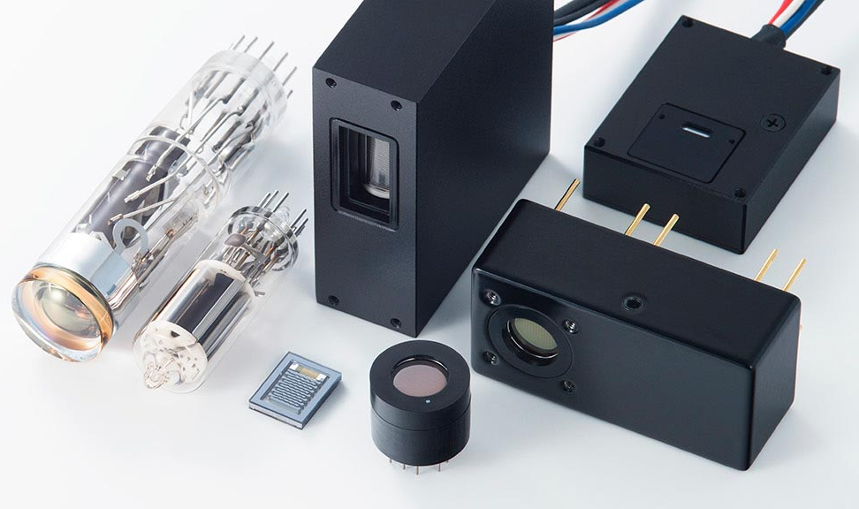
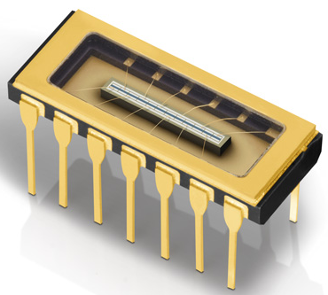
APDs, PMTs….
Notes:
All the detectors used in cytometry today are basically the same – they look different but the work the same way…they convert photons to phot-electrons.

Slide 29
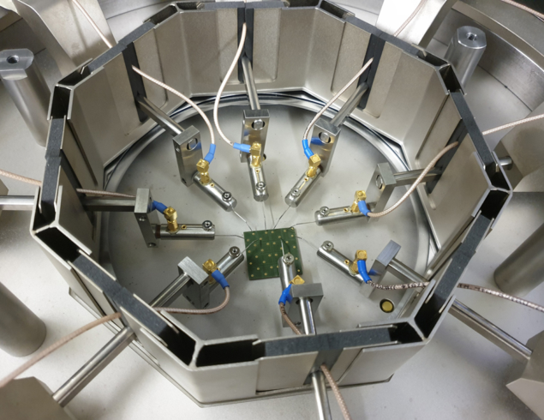
“…SiPMs are quickly replacing PMTs in a range of physics experiments.”
https://cerncourier.com/a/flying-high-with-silicon-photomultipliers/
higher photo-detection efficiencies (by roughly a factor of two), their lower operating voltage
One of the options to filter-out the pulse tail is to couple each SPAD pixel to the output with a capacitor. The high-pass filter created passes only the fast edge of the avalanche pulse….. This allows for a super fast detection technology
https://www.ncbi.nlm.nih.gov/pmc/articles/PMC9737098/
Notes:
SiPMs are a new generation of detectors – they can operate in Geiger mode -

Slide 30
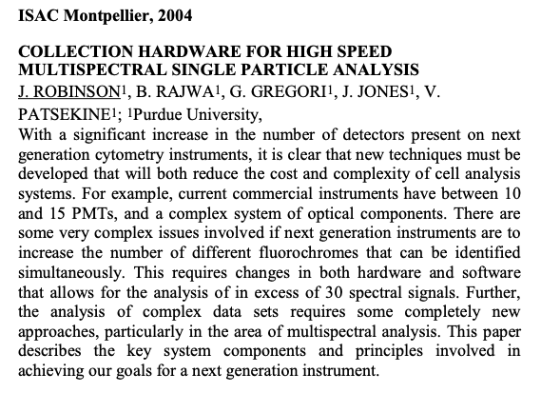
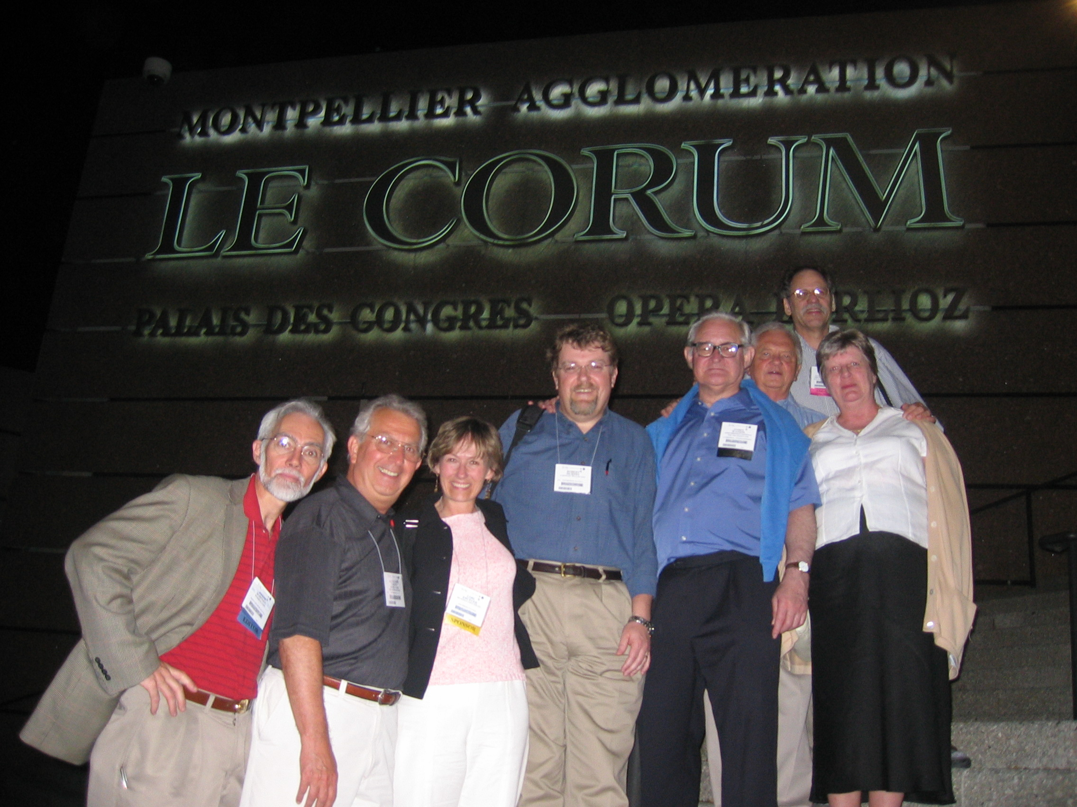
Let’s go back nearly 20 years….to May 2004
Notes:
The principle of spectral flow cytometry exactly as used today was presented by JPR at the May 2004 Cytometry meeting in Montpellier. The Cytek, and sony systems use the exact same principles as we presented many times

Slide 31
About terms of use
There are no real definitions….
Slide from ISAC 2004
Polychromatic cytometry – high number of what we would call “regular” spectral collection
Multispectral – probably 20-40 channels of dispersed spectral bands
Hyperspectral – probably 50-1000 spectral bands
2-8 color flow cytometry is not strictly “spectral” or “multispectral”
Notes:
In 2004 this slide was trying to explain some of the terms – while we used the term multispectral in those days, we currently just use the tem spectral cytometry. (Note Mario tried to convince everyone on about 2006-8 that polychromatic cytometry was actually “spectral” cytometry – but this was not accurate and probably confused the field – it made it difficult for us to convince people that in fact spectral cytometry was a totally different concept.

Slide 32
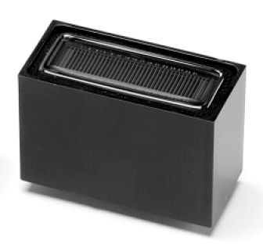
32-channel spectrograph. Optical Diagram
Slide from ISAC 2004
(JPR talk)
32-channel PMT
32-channel PMT
Lens
Diffraction grating
Flow chamber
Dichroic mirror
Side scatter detector
Concave mirror
Collimator
Enhanced Differentiation Module
Notes:
As presented in 20204 – pretty much exactly as Sony does spectral (Note that Sony licensed the Purdue ’204 patent)

Slide 33
Develop signal processing tools suitable as a foundation for clinical instruments
Slide from ISAC 2004
(JPR Talk)
Analysis of complex samples (mixed nanocrystals)
Polychromatic color system
32 channel system
Notes:
We were able to show in 2004 that we could extract many more populations… from more dyes – here we used nanocrystals

Slide 34
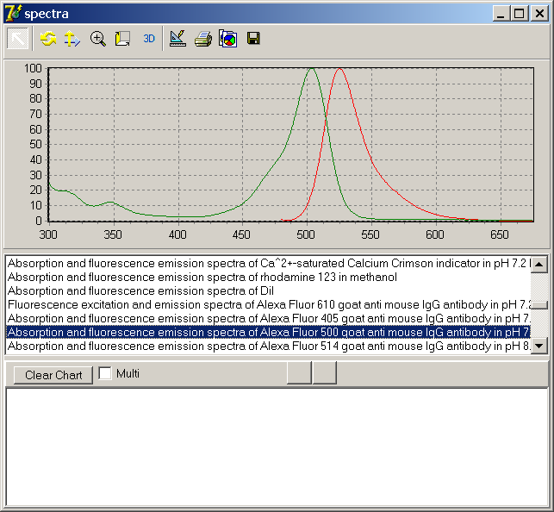
Spectrum database of each fluor
Slide from ISAC 2004
Notes:
We even built a database of dyes in 2004 as we needed this to do unmixing

Slide 35
What is the bottom line?
Slide from ISAC 2004
You should be able to separate many very close dyes using full spectral analysis
There is a need to do some serious data crunching to do this
Very slight change in spectral pattern is adequate to separate the data
Future high-speed analysis will allow this to be done in real time
Clearly opportunities exist for evaluating natural properties of cells in conjunction with exogenous probe

Slide 36
So given that most current spectral instruments are simply versions of our original 2004 design….
What should we expect for Cytometry V 3.0?

Slide 37
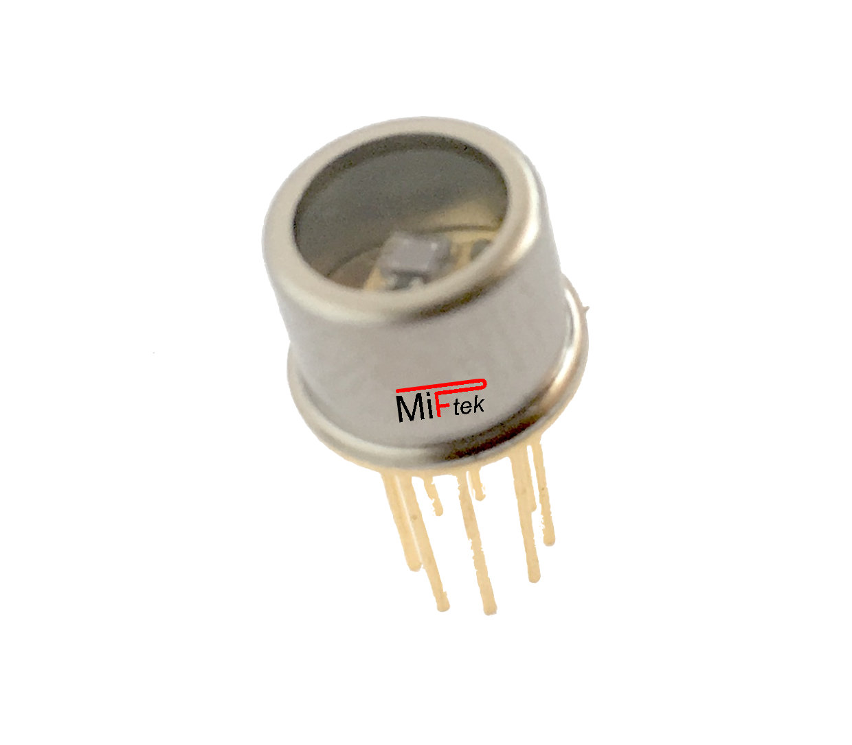
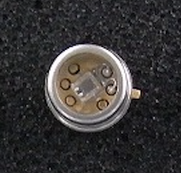
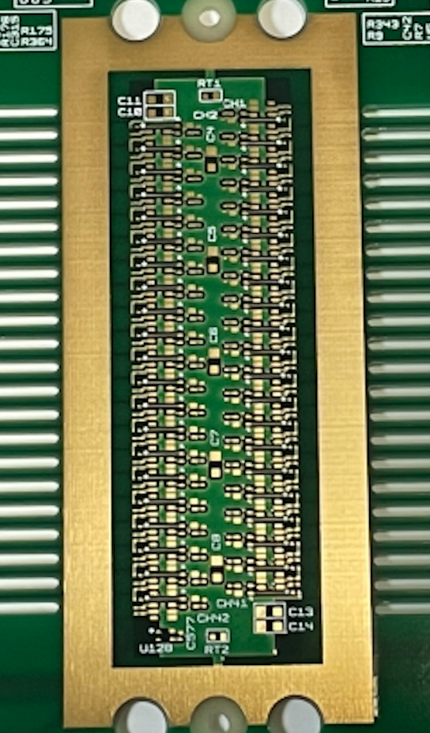
New Sensors……..Unique SiPM
42 CH Si PM Array
Low voltage operation (25-30 V)
Insensitive to magnetic fields
High gains
Mechanically compact
Multi Elements’
Super cooled (-30 deg C)
High Dynamic Range
Allows 42 ch/laser line
10Gs/CH sampling
(new technology)
Notes:
New sensors have to bd developed – this is a new sensor developed by Miftek that is cooled to -30 deg C and has the capacity to collect over 6 logs of dynamic range – and now we are integrating this into a 42 ch high speed sensor array – that will be the basis for cytometry 3.0 – this will transform the field.

Slide 38
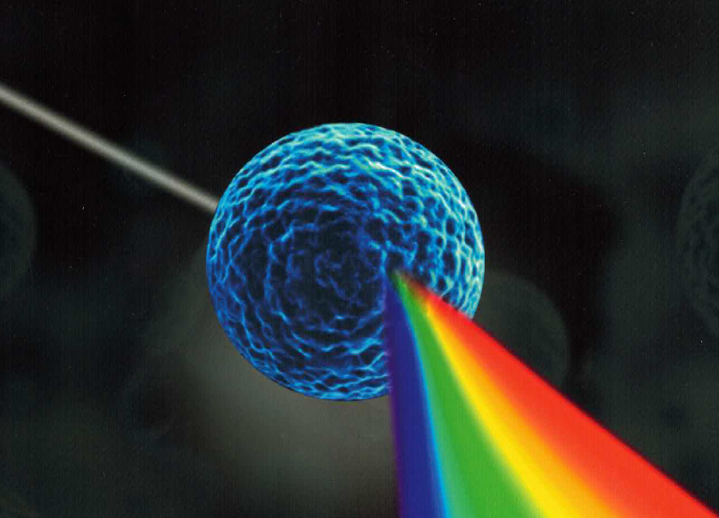
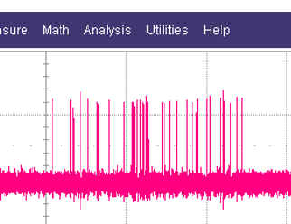
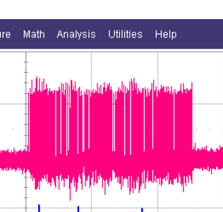
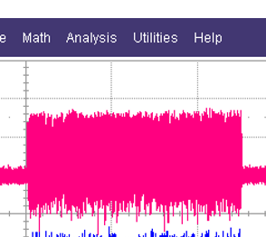
New way of detection and measurement
From Thermo website
“current” measurement
”Photon” measurement
Notes:
instead of these voltage generated peaks (regardless of if they were generated by high sped sampling) they are still generated from a voltage – single photons are digital events and we can actually collect each one using our unique high speed sensors. So we START from DIGITAL and there is no conversion

Slide 39
New high dynamic range dispersion technology
Current spectrometer/dispersion technologies are all 4 decade systems
Cytometry 3.0 requires 6-decade dynamic range

Slide 40
New approach to excitation technology
Cytometry 3.0 Requires Truly Advanced Excitation Systems
A torch is no longer an acceptable approach to excitation…..

Slide 41


New Electronics – WAY faster than today’s
About 1000 times faster than current electronics
Super high-speed Electronics
New coax connection technology
Sophisticated control system
Advanced signal processing
Notes:
Current electronics in pretty much every flow cytometer operates in the megahertz domain – but single photon technology has to be in the gigahertz domain – this can be 100-1000 times faster – this means very complex new electronics is required for the entire electronics – you cant just convert an older instrument – it has to be totally new.

Slide 42
New Analytical Requirements
Internal computational demands are extreme

Slide 43
What do you gain from Cytometry 3.0?

Slide 44





So, are we satisfied with quantification in flow?
We don’t count the grains
of sugar …….
Maybe Counting would be a good idea rather
than guessing….
“Close enough….
is good enough”
Actual single photon counts using new technology
Notes:
talk about how we really don’t have quantification – it’s a bit like a cup of tea – we add a spoon full of sugar – we don’t measure the grains as we are perfectly satified with the result – the tea is fine. BUT if I were to offer you a bowl of notes would you care which bowl you got – you might actually want to count them - !!

Slide 45


Flow as it is today…

Slide 46


Slide 47

Current Peak Intensity Measurements
More

Slide 48
Current Intensity Measurements
Intensity

Slide 50






Single Photon is a messenger of single molecule transitions
1933
Aleksander
Jablonski
1893
George Stokes
Dim-ish
OK-ish
Bright-ish
http://zeiss-campus.magnet.fsu.edu/articles/basics/fluorescence.html
Notes:
While we are all familiar with Jablonsky energy diagrams and Stokes shift, we persist in defining flow cytometry in terms of dim, medium and bright signals. This is really an unscientific process but for 50 years we have continued to go this direction. We call flow cytometry “quantitative” but in fact we rarely do actually quantification at all. We have defined our biology in terms of the limitations of current cytometry. that is we count cells, take percentages of cells that reflect a certain degree of positivity, and we then call this quantitative.

Slide 51










Abe Schwartz, et al
10.6028/jres.107.009
and it keeps going….
Notes:
This is the ONLY quantification used on flow cytometry and was developed by Abe Schwartz over 20 years ago – and is almost never used – virtually no one does the conversions of flow data into MESFs – this is the best we can do and we never do it… So that is why the next gen of instruments will be totally quantitiative – this will be transformative for the pharmaceutical industry – they are probably sick and tired of the lack of quantification of flow cytometry!

Slide 52

Bio-nanoparticle size – can single photon help?
Optical challenge
for bio-origin particles
Flow cytometry by
scattering/Fluorescence
Biological Elementary particles in 1 ~ 100nm size
Notes:
We really don’t now where the limits are – but we think that getting the lowest level of signal event will help.

Slide 53
































IN CONTEXT
IMMUNOLOGY AND INFECTIOUS DISEASE
Mesynchymal
Stem Cell-CD44
Embryonic Stem
Cell-CD29
Megakaryocyte
CD9
Erythrocyte
CD-235a
Macrophage
CD11a
Hematopoietic
Stem Cell-CD34
Astrocyte-CD40
Basophil-CD13
NK Cell
CD69
Th17 Cell
CD4
Platelet
CD63
Monocyte
CD14
Mast Cell
CD117
T Follicular
Helper Cell CD84
MDSC
CD11b
Th22 Cell
CD4
B-Cell
Th1 Cell
CD4
Endothelial
Cell-CD31
Fibroblast
CD10
Stromal
Cell-CD10
Microglia
CD68
Neutrophil
CD16
Plasmacytoid
Dendritic Cell D40
Eosinophil
CD15
Th2 Cell
CD4
371 Known Clusters of Differentiation
(CD Markers)
Myeloid Dendritic
Cell – CD1a
Th9 Cell
CD4
Epithelial
Cell-CD24
Naïve T Cell
CD3
Neuron
CD6
Treg- CD4
Images from www.biolegend.com
Notes:
It turns out that every cell type in the human body has what we call a phenotype – it's a word that define they type of cell, what it looks like, how it acts and where it lives. Immunologists and pathologists use biological markers with fluorescent dyes attached to them to track down every one of these cells and unmask them.

Slide 54


“Photon” is energy packet of light as “Quanta” by Planck & Einstein
[cps]
Flow cytometry
Targeting
Photon Energy : E= hν ( h: Plank constant 6.602E-34 ν= c/λ )
E= 1,240/ λ [nm] [eV] eV= 1.60E-19 [J]
400nm Photon = 3.1eV = 0.5aJ = 2 Mega photon/pW
800nm Photon = 1.55eV=0.25aJ= 4 Mega photon/pW
Poisson Distribution: discrete event probability in a fixed time interval
aW
fW
pW
nW
Notes:
Photon is one of elementary particle and also mandatory for our life. Usually, we never recognize particle characteristics of light.
Main reason is one photon energy is so small and daily light includes Tera, Peta and Exa photons. Such particle count is almost impossible, so we measure light as analog signal. Single photon detection is not easy, but if 1 photon per second is possible to detect, it is 0.5aW power in blue light. It is the ultimate photosensitivity.

Slide 55
Single Photon is messenger of single molecule transition
http://zeiss-campus.magnet.fsu.edu/articles/basics/fluorescence.html
Notes:
Perhaps single photon allows us to delve deeper into the biological world….

Slide 56

Quantitative Cytometry 3.0
Innovative
Excitation
Innovative
Data Collection
Innovative
Analysis
Particle
scatter
Particle
absorption
Particle
diffraction
Particle detection
( Light loss + other features)
λEX.
Ex.Photon N/um²s
Auto-
fluorescence
Fluorescence λEM.
Em. Photon as spectrum
10Gs x 42CH
Conjugated
fluorescence
Plus ???
Sensor
DCR
Stray
Photon
Sheath
Scatter
System Background
Quantitation
Quantitation
Quantitation

Slide 57
Cytometry V 3.0
Can this be achieved?
New | Old | Innovation
Photon | Current ADC | Sensitivity
Digital | Analog | Precise
Ghz | Mhz | Speed
Absolute | Iffy | Quantified
Excitation | Flashlight | Intelligent
Scatter | Traditional | Extended
Dynamic Rn | 4.7 | 6+
additional | Same old | > Parameters
>200 Param | 180s | Extended
Embed AI | Addon | Smarter
Identical inst | variable | Compatibility
Count actual photons not photoelectrons
Photons have integer value
10-1000 x speed of current electronics
Photons converted to energy in Joules
Intelligent lasers not flashlights
Many forms of light scatter exist
Real dynamic range not pretend
Many more types of measurements
Potential for literally 100s of parameters
New hardware technology
Data are identical from every instrument

Slide 58
Quantum flow cytometry is the next generation of flow cytometer that moves away from the current methods of detection, methods of calibration and even methods of analysis.
Watch this space…..
(Let’s put the physics back into cytometry)
Summary

Slide 59






Acknowledgements
  Purdue team:
  Dr. Bartek Rajwa
  Dr. Euiwon Bae
  Dr. Sungho Shin
  Dr. Xi Wu
  Kathy Ragheb
  Brianna Dowden
  Doris Kemler
  Cole Reynolds
  Valery Patsekin
  John González
  Rémi Lechardoy
  Sanjana Abida Shemonti
  Hyun Jung Min
  Joohyeon Lee
  Dal-seong Yoon
  Noah Bousier
  Collaborators:
  Dr. Moon Kim
  Dr. James Lindsay
  Dr. Martha Vaughn
  Dr. Jake Jaccoberger
  Assoc Prof Bill Eades
  Dr. Andreas Cossarizza
  Dr. Euiwon Bae
  Dr. Bartek Rajwa
  Miftek Team
  Masanobu Yamamamoto
  Keegan Hernandez
  Daniel McMillan
  Zilin Xu
  Andy Bieberich
  Josh Harriger
  jared Thompson
  John Gonzales
  JPR
  Valery Patsekin
  Brianna Corman
  Kathy Ragheb
  Euiwon Bae
  Bartek Rajwa
Corporate Support Partners:
ThermoFisher, Beckman Coulter
Sciaps, Miftek Corp
This research was supported by the Center for Food Safety Engineering at Purdue University, funded by the U.S. Department of Agriculture, Agricultural Research Service, under Agreement No. 59-8072-1-002 and Agreement No. 58-8042-0-061 to Purdue University Cytometry Laboratories. Any opinions, findings, conclusions, or recommendations expressed in this publication are those of the author(s) and do not necessarily reflect the view of the U.S. Department of Agriculture.
@Cytometryman

