Slide 1




Advanced sensitivity and resolution in flow cytometry through innovation
J. Paul Robinson
The SVM Professor of Cytomics &
Professor of Biomedical Engineering
Purdue University
Home to:
Purdue University Cytometry Laboratories
Cytometry Listserve: cytometry@lists.purdue.edu
Cytometryman

Slide 2
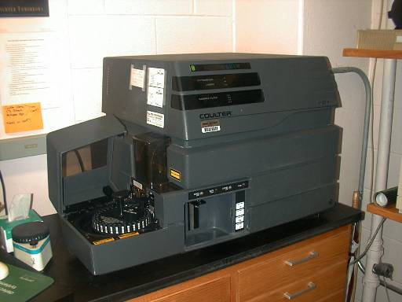
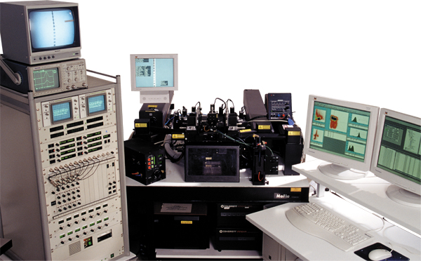
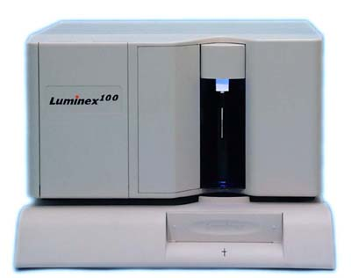
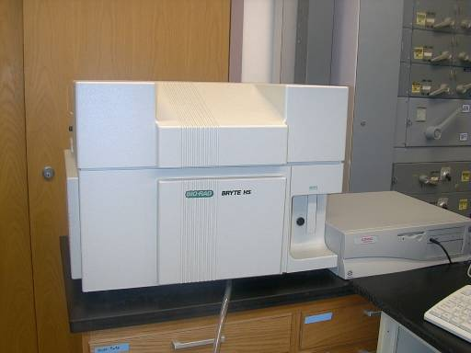
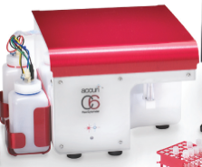
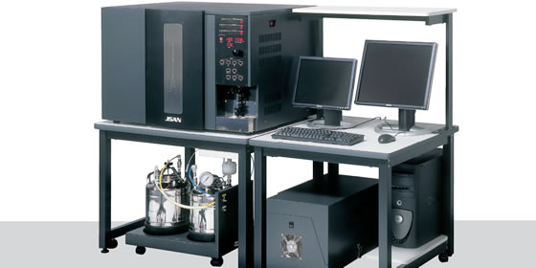
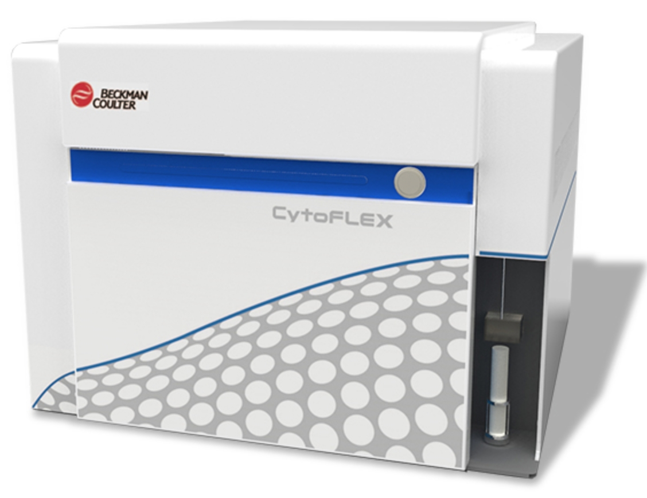
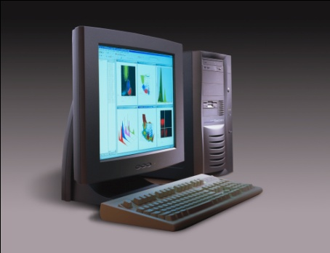
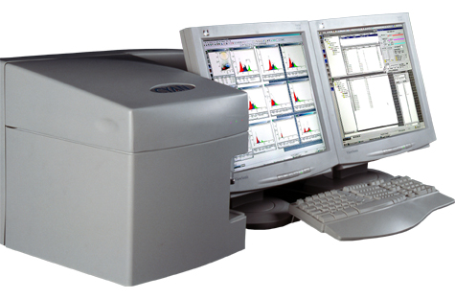
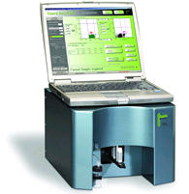
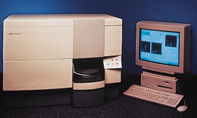
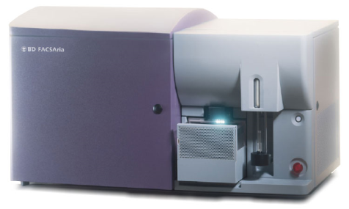
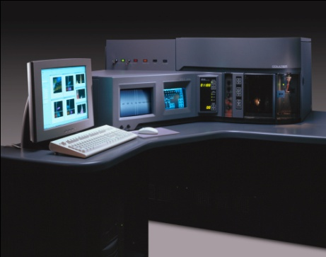
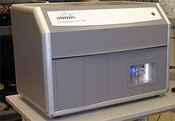
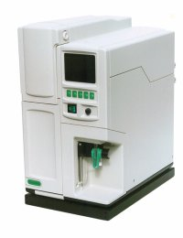

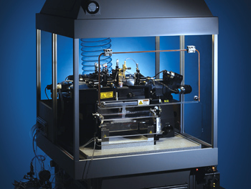
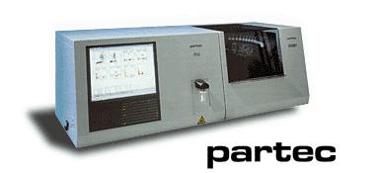
What is different about this small machine?
BC
BC
Bryte
Luminex
Bay
Biosciences
Accuri
Millipore/Guava
BC
BD
Amnis
BD Aria
BD
BC
BD Influx
Apogee

Slide 3
4 Essential Feature differences
The detectors are different
The light management technology is different
The fluidics are different
Multiple side scatter options

Slide 4
Why do we care about these things?
Detectors:
Because 100% of other cytometers use PMTs
PMTS have some advantages that have made them very successful in fluorescence detection for 40 years
Normally you stay with systems that work!

Slide 5
Why do we care about these things?
Light Manipulation
Traditional dichroics work very well
Traditional bandpass filters also work well
Fiber optics also work well

Slide 6
Why do we care about these things?
Fluidics
Positive pressure systems are excellent
Only downside maybe not quantitative
No major negatives

Slide 7
Why do we care about these things?
Side Scatter
Traditionally off a blue laser on most systems
Works well for typical sized particles and cells
Need to consider how to look at smaller particles

Slide 8
Cytoflex changes a few things…
Detectors – non standard
Optics – non standard
Fluidics – non standard
Mixed laser combinations

Slide 9
Detectors

Slide 10
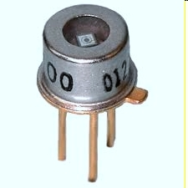
Detectors
No PMTS – only APDs
APD
PMT

Slide 11
APDs
The big deal about APDs is their incredible quantum efficiency around 80% compared to 25% for PMTs
the number of electrons emitted
Remember what QE is: =
the number of incident photons
Notes:
Remember what QE is: it's the number of electrons emitted divided by the number of incident photons

Slide 12
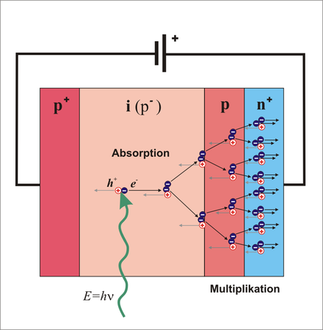
Avalanche Photo Diodes
Notes:
Another big difference between an APD and a PMT is the bias voltage – you remember that PMTs typically require around 1000v whereas APDs are about 20 or 90 volts and it’s not continuous like the HV has to be on a PMT Absorption of incident photons creates electron-hole pairs. A strong internal electric field is created by a high reverse bias voltage This field accelerates the electrons through the silicon crystal lattice to
produce secondary electrons by impact ionization. The resulting electron avalanche produces a high gain.

Slide 13

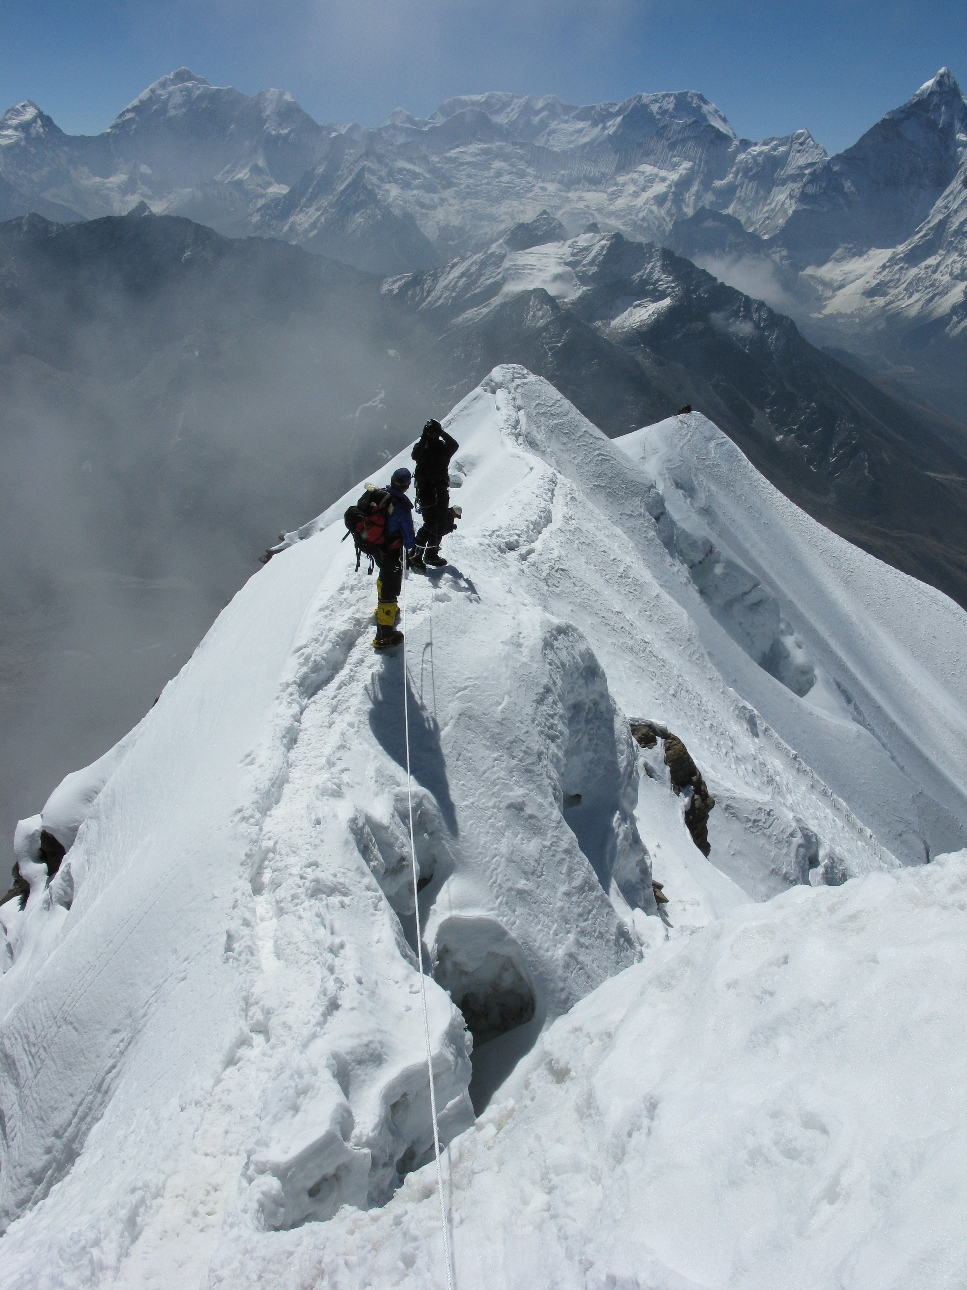

Slide 14
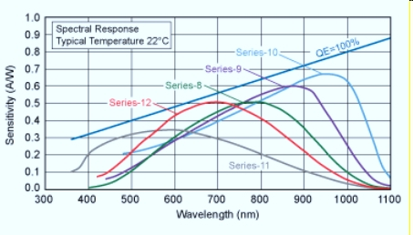
Wavelengths

Slide 15
Detection optics

Slide 16
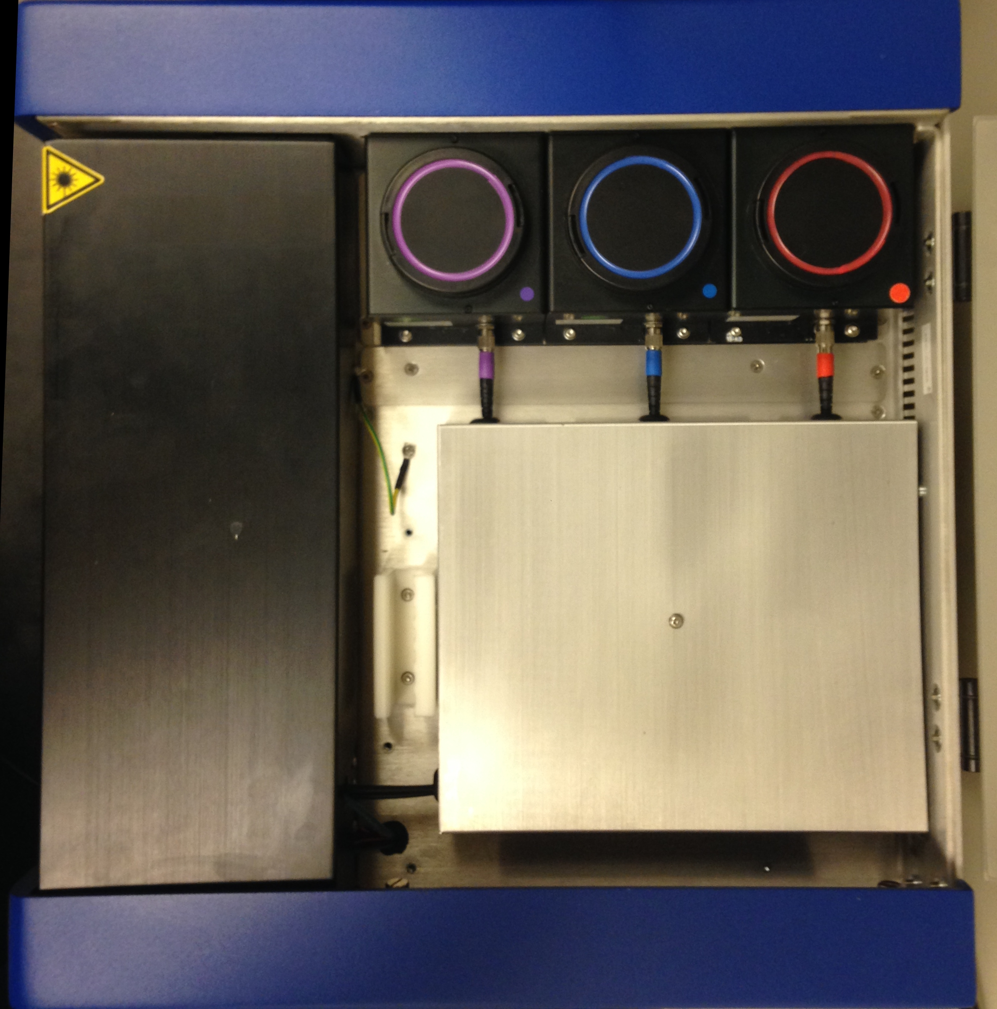
Optical Fibers

Slide 17
Wavelength Division Multiplexing
Modern communication systems can handle up to 160 signals and can thus expand a basic 10Gbit/s system over a single fiber pair to over 1.6 Tbit/s
Transponder
Transponder

Slide 18
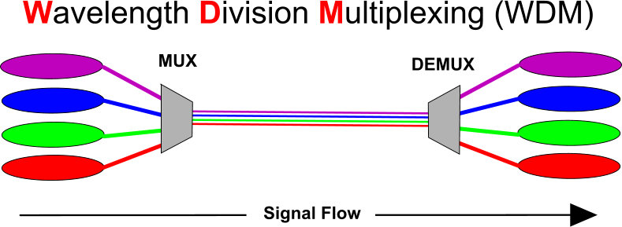
WDM

Slide 19
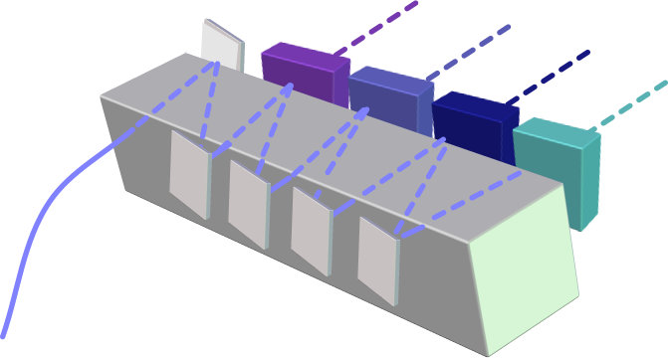
How does WDM Work?
Band pass filters
420/15
To detector (APD)
450/15
480/15
520/15
Mirror
Input light
From fiber optic

Slide 20
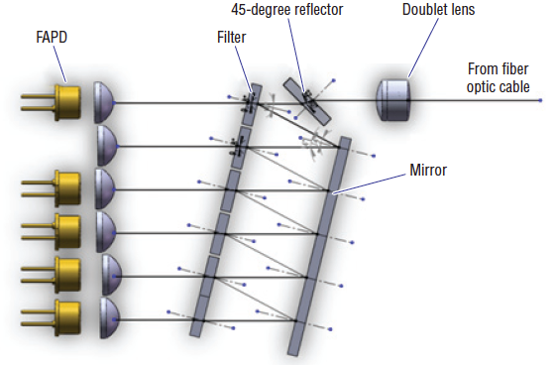
WDM

Slide 21
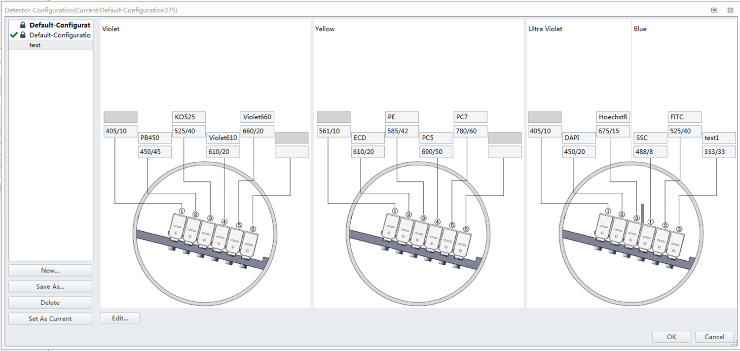
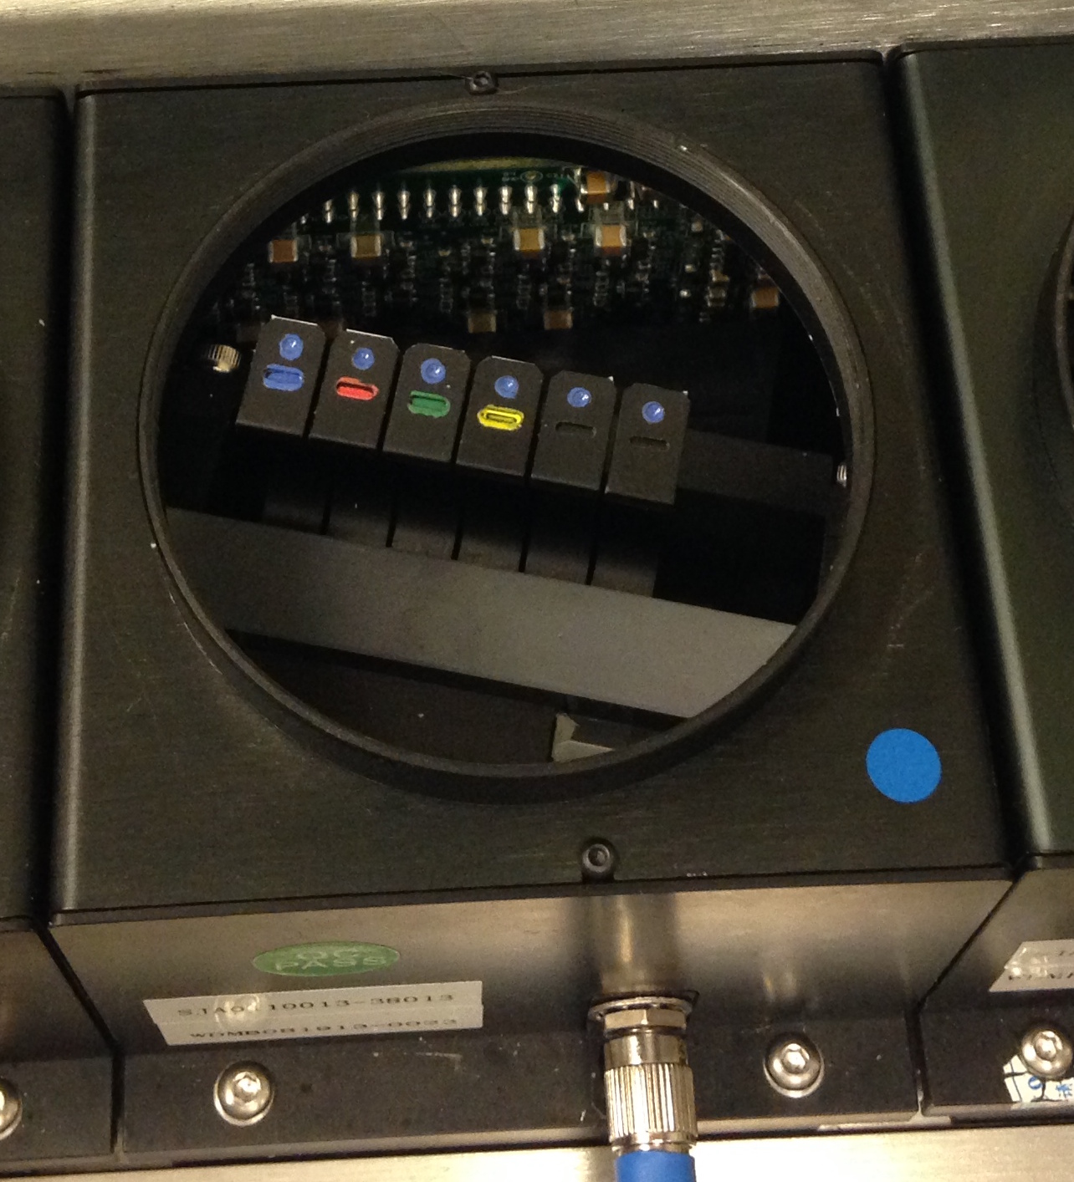
WDM Splitter

Slide 22
Double WMD
3
3

Slide 23
Simplicity, efficiency
Highest efficiency of all current optical pathways for flow cytometers
Its requires very small physical space so is compact
Absolutely minimal distance from signal to detector
Requires a tiny bandpass filter
Any bandpass filter can essentially be put into any of the WDM modules
Virtual unlimited range of combinations of lasers and output pathways.

Slide 24
Fluidics

Slide 25
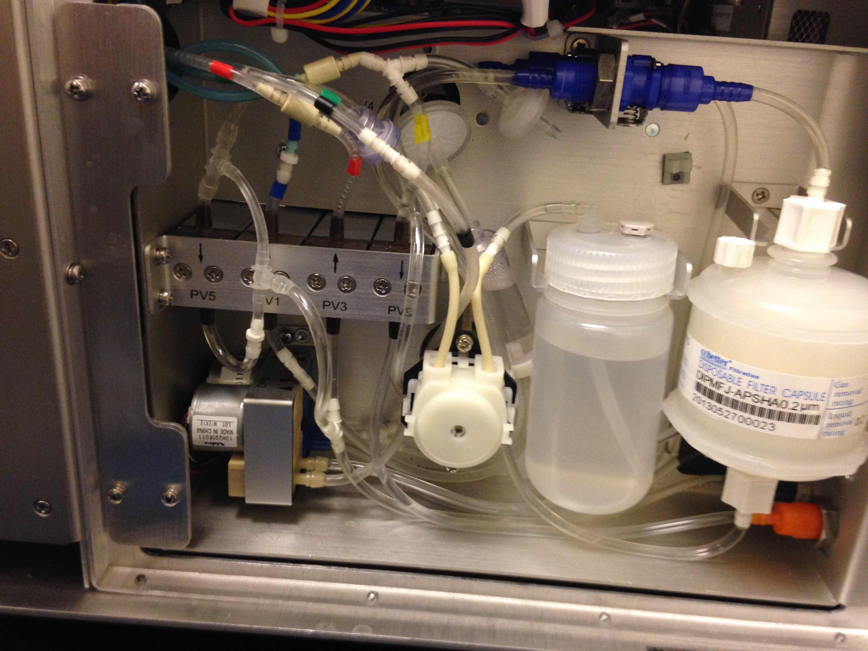
Peristaltic Pump

Slide 26
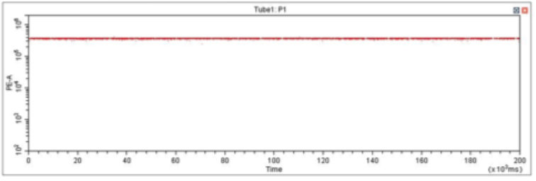
Fluidics
Fluorescence
Time

Slide 27
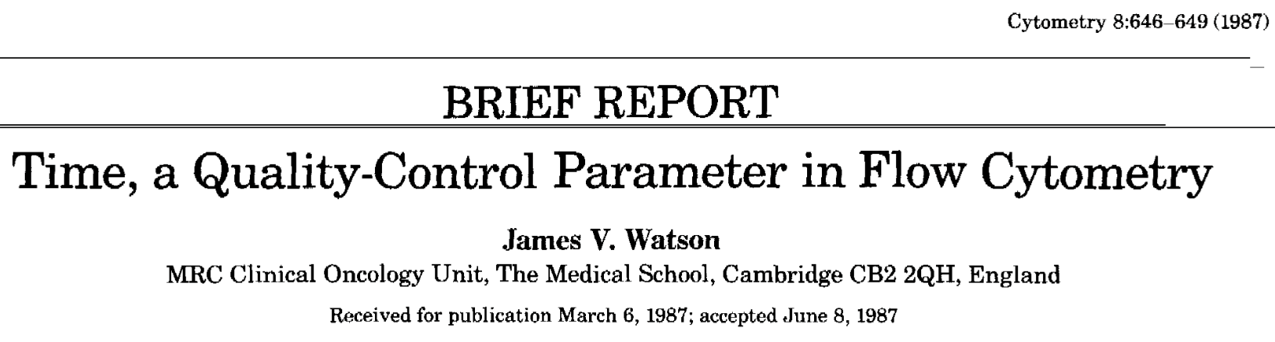
James Watson “Time” as a parameter on EVERY sample collected
Fluorescence
Fluorescence
Time
Cytometry 8:648-649, 1987

Slide 28
V-SSC Side Scatter

Slide 29
Light Scatter
What do we know?
We know that generally the larger the difference in the refractive indices, the more light will be scattered by a particle

Slide 30

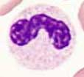

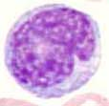

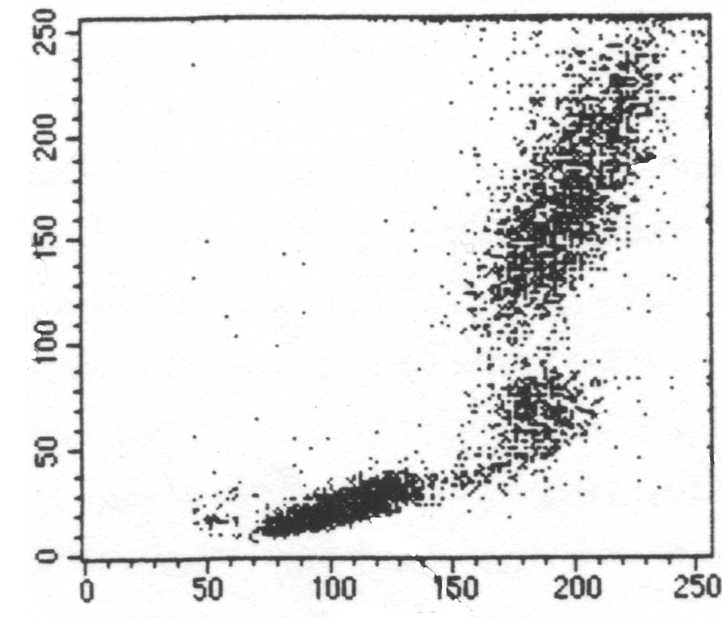
Light Scatter
We also know that the more granular the particle is, the probability of getting light reflecting off of subparticle components increases.
That is why we always see granulocytes have such high side scatter compared to say lymphocytes that have no granules.
We also know that the amount of light scattered by any particle is proportional to the diameter of the particle and inversely proportional to the wavelength of the light being used to detect it.
Granulocytes
Lymphocytes
SSC
SSC
Monocytes
RBCs, Debris,
Dead Cells
FSC
FSC

Slide 31
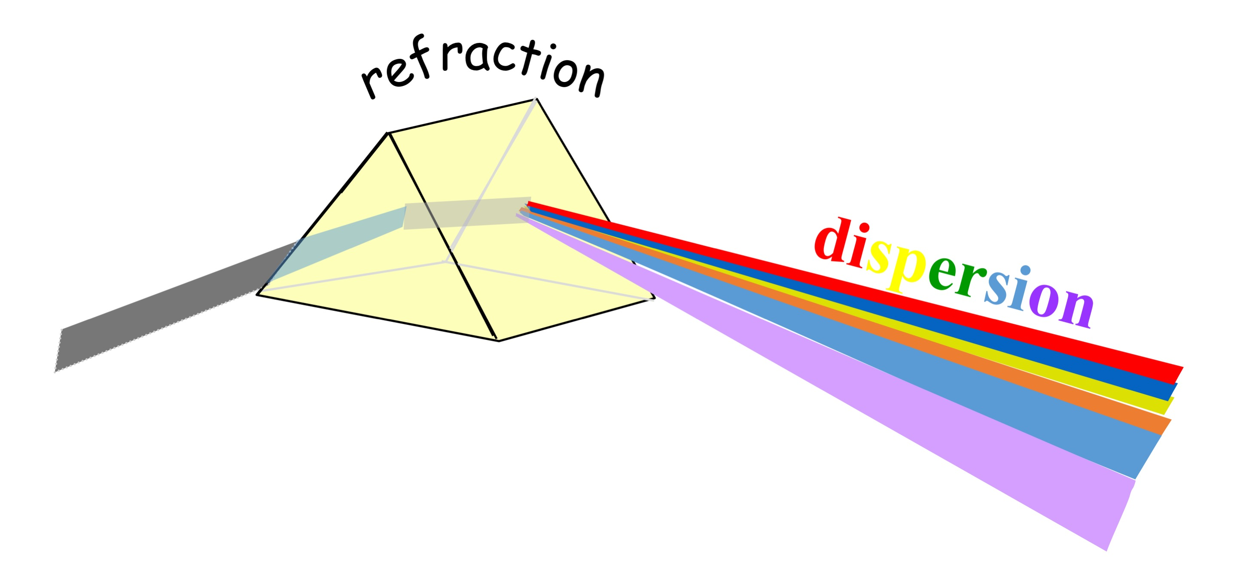
Light Scatter
So if we lower the wavelength of the excitation, we will see increased side scattered light scattering at any given particle size – if we move from say 488 nm excitation to 405 nm excitation, this will increase the range of resolution of smaller particles than can be detected by standard side scatter.
We also know that when entering a medium of a different refractive index, light waves are refracted by the new medium inversely proportional to the wavelength of the light, with lower wavelengths having a higher refraction than larger wavelengths
Thanks Isaac Newton!!!

Slide 32
Violet Side Scatter (VSSC)

Slide 33
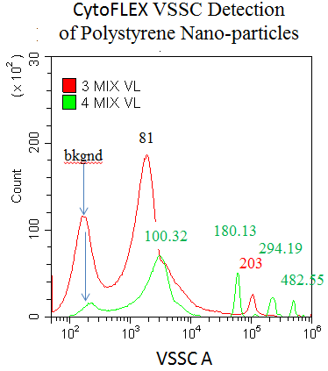
Multiple Side Scatter detectors
CytoFLEX supports 2 side scatter (90 deg) channels. One from 488nm laser, which is designed for cells (minimum detection size 200nm) and the other from violet laser, designed to detect particles as small as 80nm.

Slide 34
Lasers

Slide 35
CytoFLEX S with Near UV Laser
Laser portfolio for the CytoFLEX S
Near UV (375 nm)
Violet (405 nm)
Blue (488 nm)
Yellow/Green (561nm)
Red (638 nm)

Slide 36
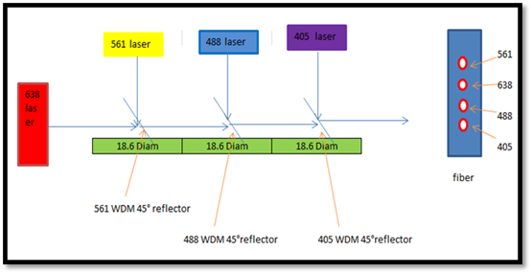
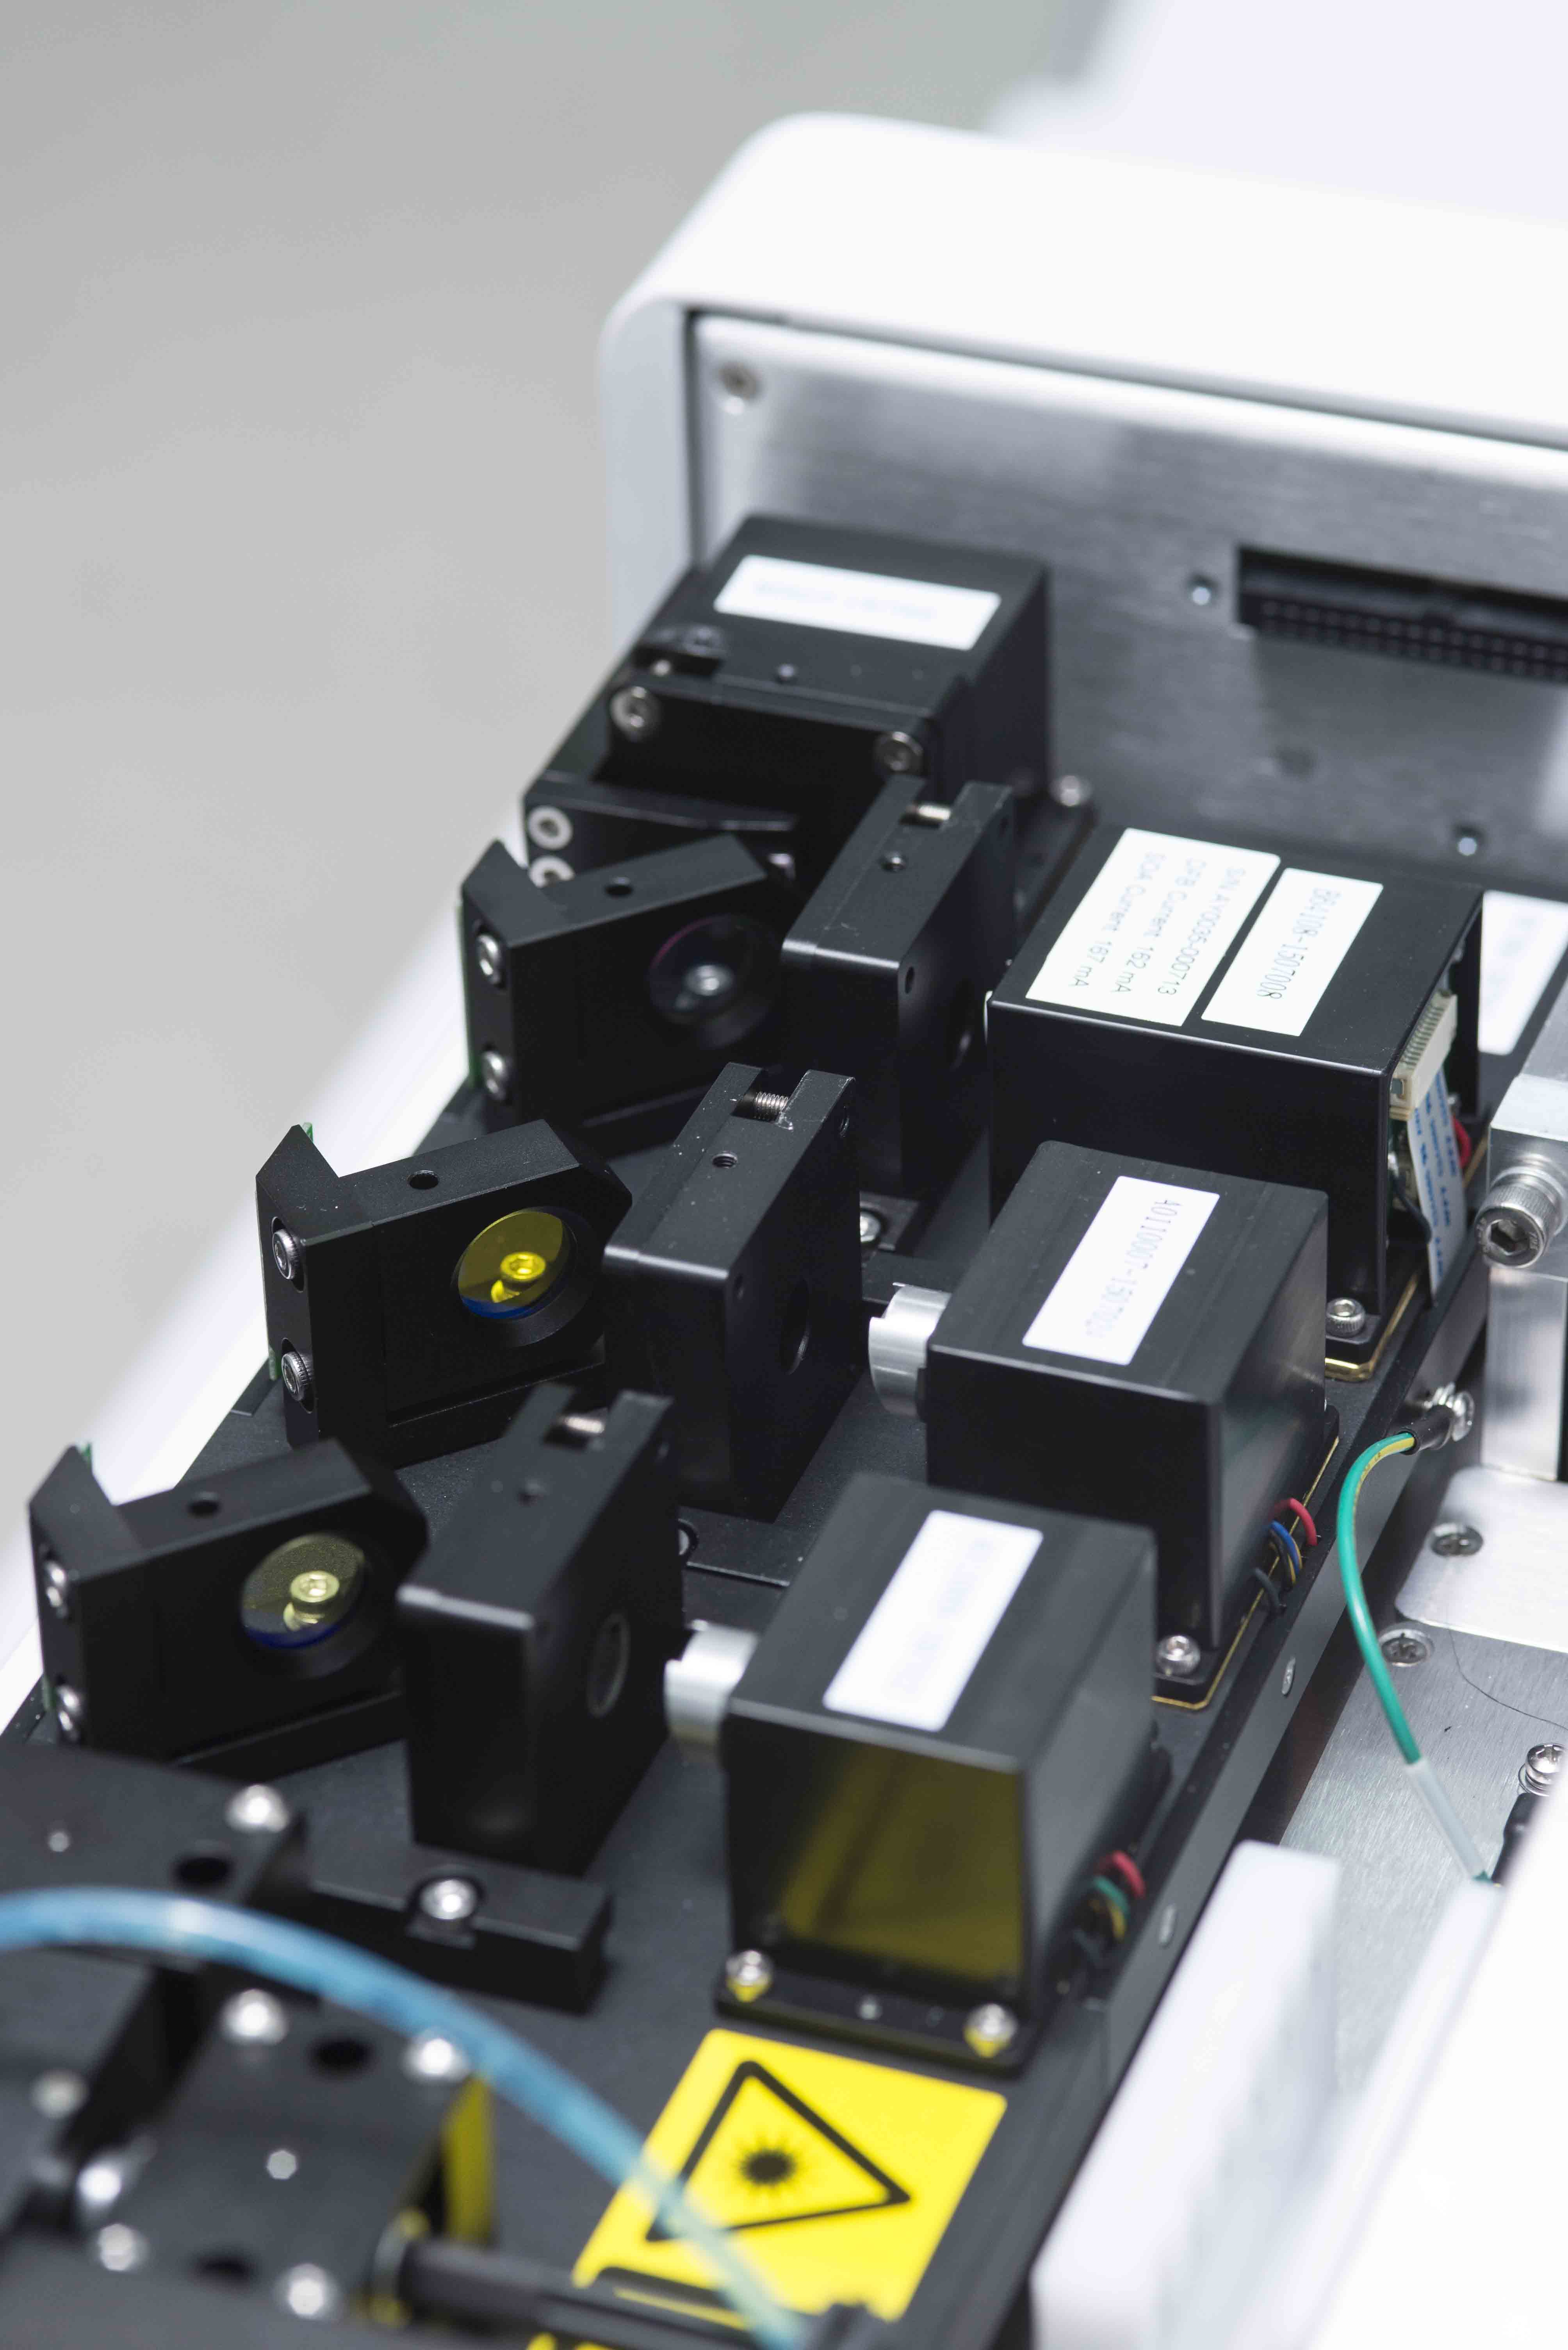
Lasers
638 nm
561 nm
488 nm
405 nm

Slide 37
WDM for 4 lasers including NUV
405 nm
561 nm
375 nm
488 nm

Slide 38
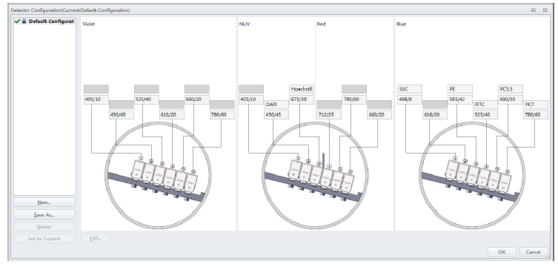
WDM for 4 lasers including NUV
405 nm
375 nm
638 nm
488 nm

Slide 39
CytoFLEX S Near UV Laser
375 nm Near UV laser
Power: 60 mW
Spot size: <5µm x 80µm
CytoFLEX S portfolio with the near UV laser

Slide 40
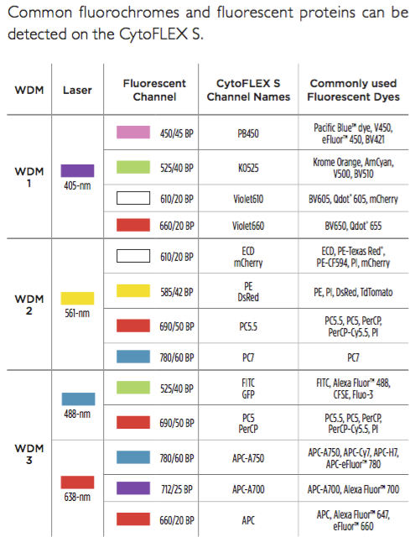
System layout with the Yellow Laser

Slide 41
Why use a 375 nm laser?
375 nm laser is as good or BETTER for the excitation of BV dyes, commonly excited using the 405 nm laser.
375 nm laser allows for applications such as DAPI live/dead and Hoechst 33258 used in murine side population research.
375 nm is an excellent alternative to expensive “true UV”, 351 nm laser.
375 nm does not produce the high thermal output found in the UV 351 nm laser from the laser head or power supply.
375 nm laser is as good or better for the excitation of BUV dyes, commonly excited using the 355 nm laser

Slide 42
Let’s look at BUV dyes with 375 nm Laser
BUV 737 with a 780 or 712 nm bp filter
Whole blood stained with CD3 + DAPI

Slide 43
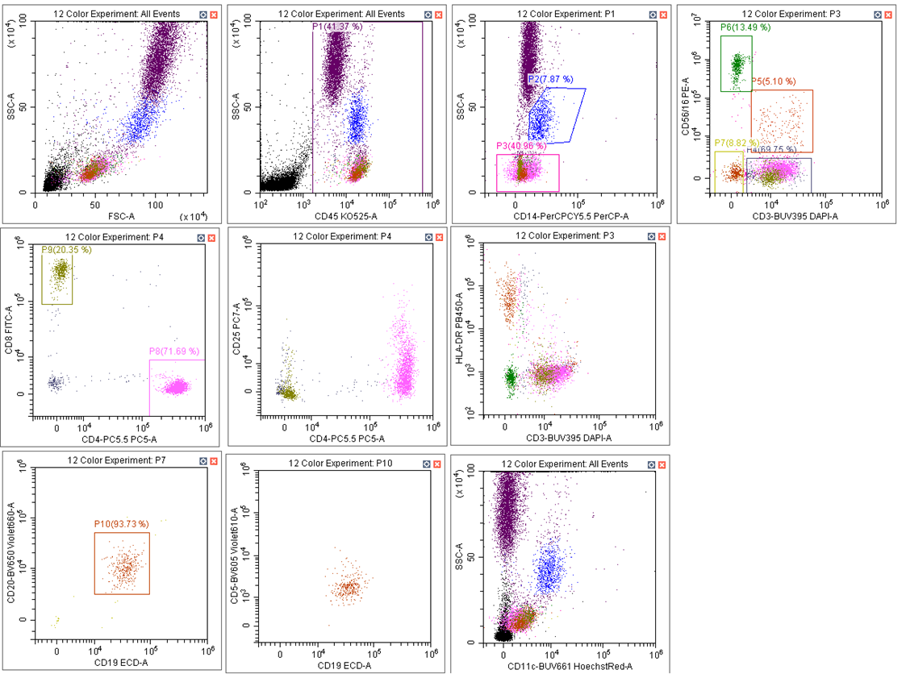
12 color experiment including BUV

Slide 44
Laser Combinations

Slide 45
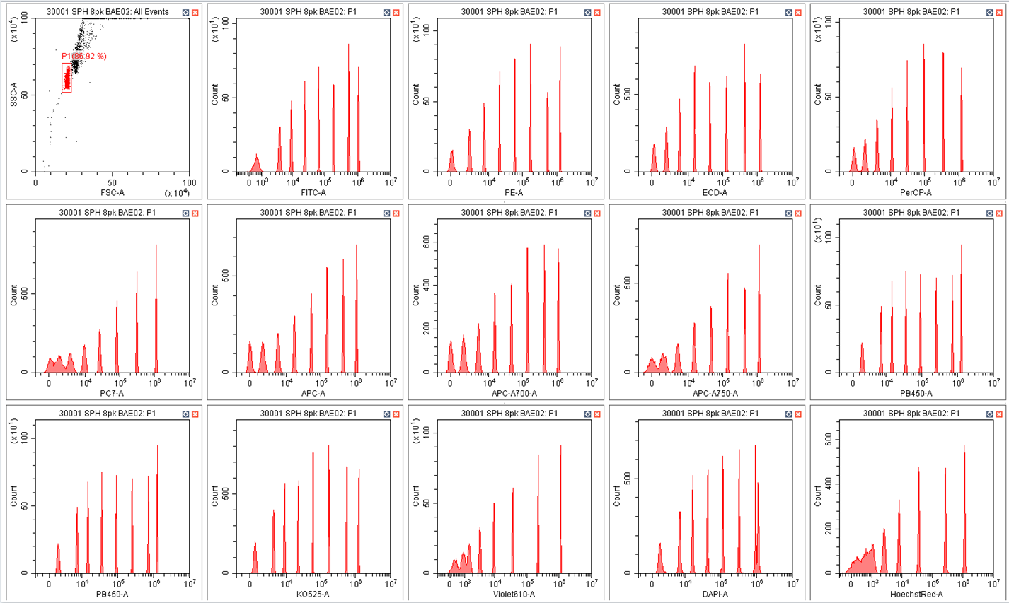
System Resolution

Slide 46
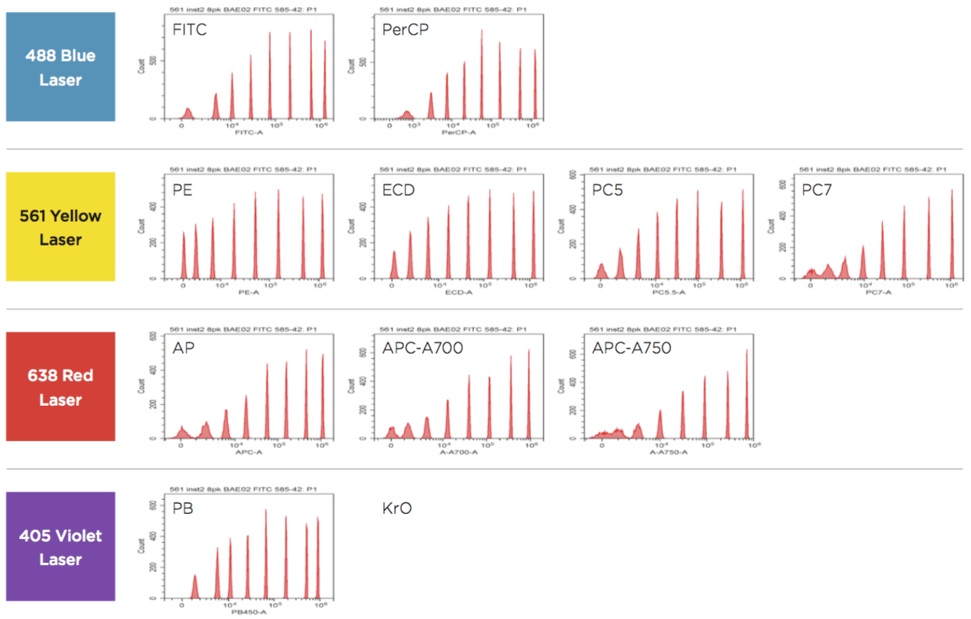
Rainbow Beads Analysis

Slide 47
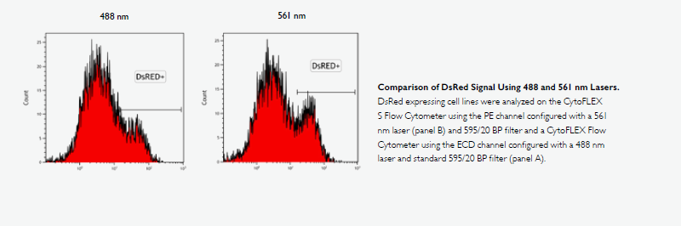
Advantage of 561 nm laser

Slide 48
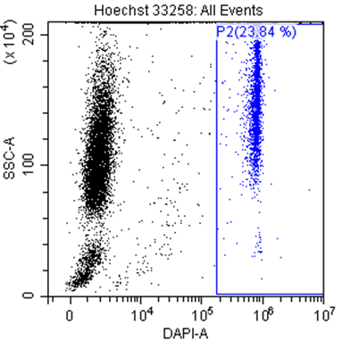
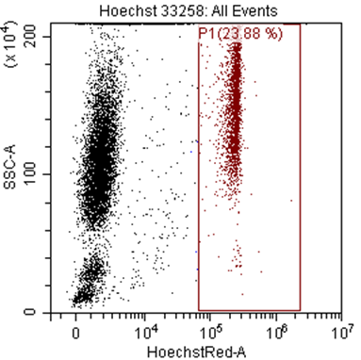
Viability with Hoechst and DAPI
1 day old blood stained with DAPI or Hoechst

Slide 49
Side Population courtesy of Dr. Bill Telford

Slide 50
What might the big Take home messages be….???
Because of the incredible linearity of the APD detectors:
Can use a CD4-stain in a comp-tube and apply the results to any multi-color assay containing the same stain on a dim antibody
The compensation elements of any stable chromophore, e.g., non-tandems such as FITC, PE etc., can also be re-used forever
A user can store these in a compensation library, then mix and match them with other freshly prepared elements for unstable chromophores to construct a full comp matrix.

Slide 51
The Holy Grail of flow…..
A next generation of detectors will have self-calibration capability such that users will be able to port calibration matrix from one instrument to another, across the entire CytoFLEX platform.

Slide 52
Questions

