Slide 1
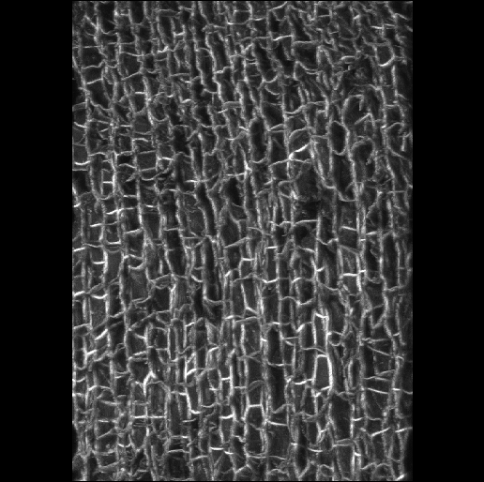
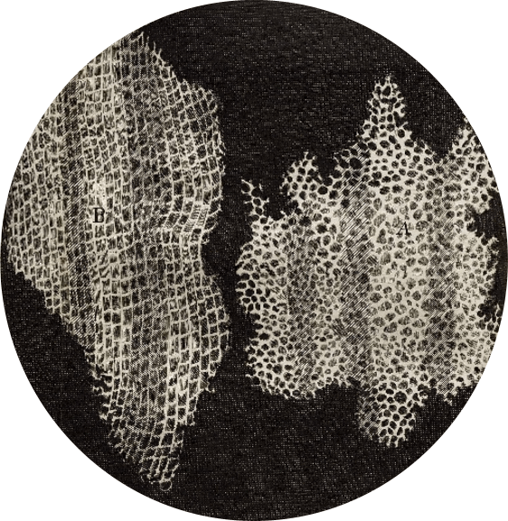
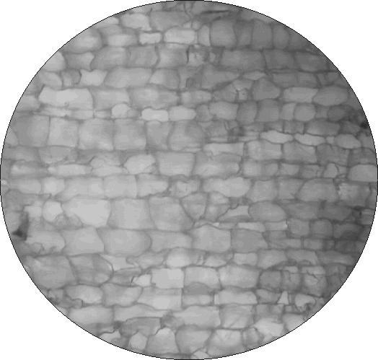
What did Robert Hooke see when he looked at cork?
A confocal
microscope view
of cork
…And even higher
Magnification in 3D
Hooke, 1665
The Purdue version of the
Hooke cork (2002)
Photos: © J. Paul Robinson

Slide 2
A cell
Blue nucleus
Green – connective materials
Red labeled antibody on cell membrane.

Slide 3
Oil droplets under a confocal microscope

