Slide 1


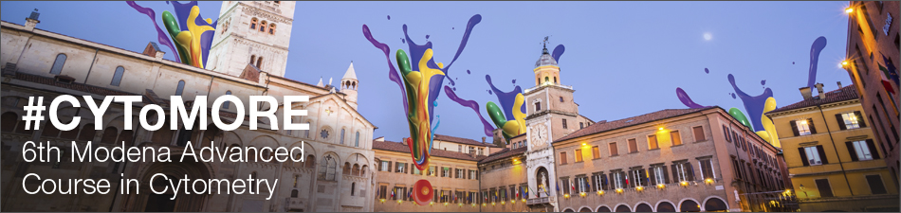
E all'ottavo giorno, Dio creò la citometria
(and on the 8th day, God created cytometry)
J. Paul Robinson
Professor
Purdue University
With thanks to ThermoFisher for sponsoring this Workshop

Slide 2
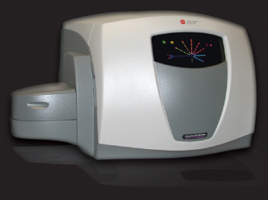
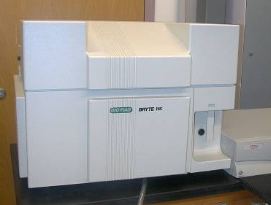
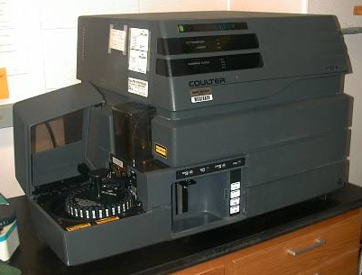
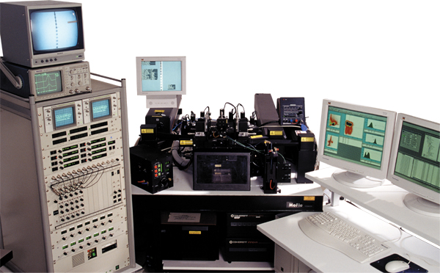
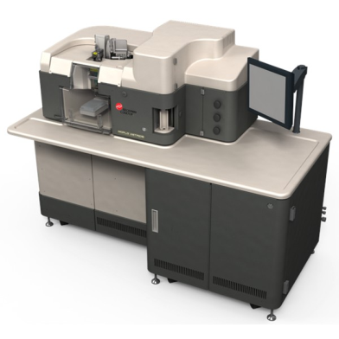
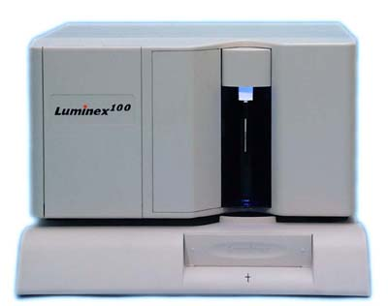
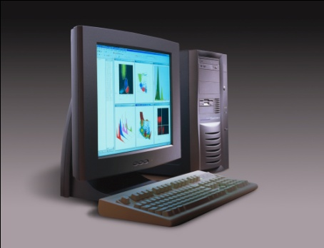
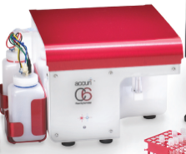
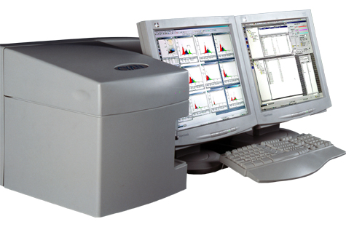
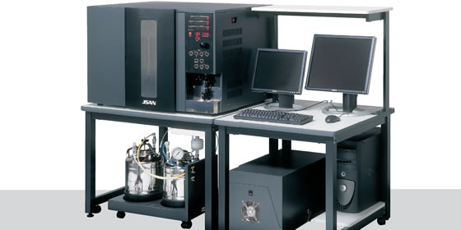
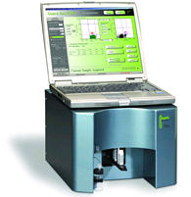
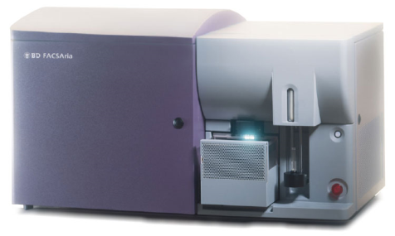
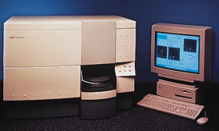
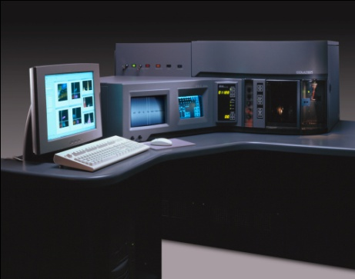
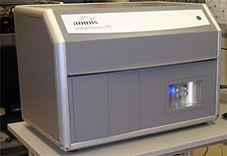
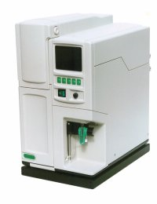

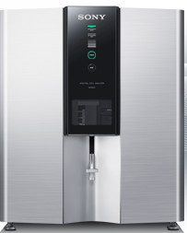
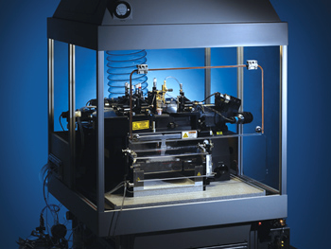
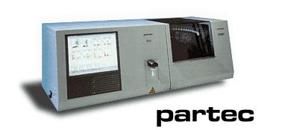
Some Commercial Cytometers….
BC
BC
BC
Bryte
Luminex
BC
Bay
Biosciences
Millipore/Guava
Accuri
BC
Amnis
BD
BD Aria
BC
BD
ThermoFisher
Sony
BD Influx
Apogee

Slide 3
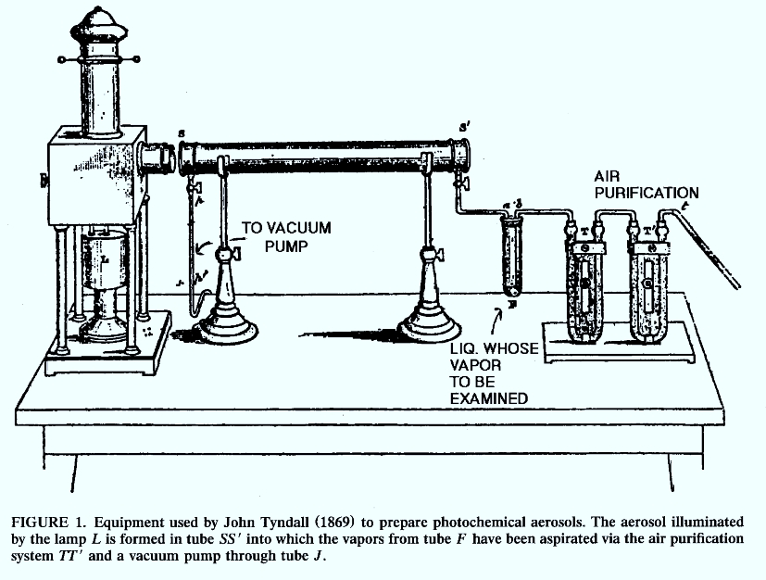
Tyndall 1869
1869

Slide 4
Andrew Moldavan
1934
It is unclear if Moldavan ever built his cell counter. His short article (less than half a page) describes a number of problems but no results.
“The purpose of the experiment is to have each microscopical cell passing through the capillary tube, register itself automatically on the photoelectric apparatus, thus creating a micro-current which can be amplified and recorded.”
Manuscript:
Photo-Electric Technique for the Counting of Microscopical Cells
Andrew Moldavan
Montreal, Canada
Science 80:188-189, 1934
Moldavan (1934) demonstrates use of a suspending fluid in which were blood cells - the measurements were made in a capillary tube using a photoelectric sensor to make extinction measurements

Slide 5
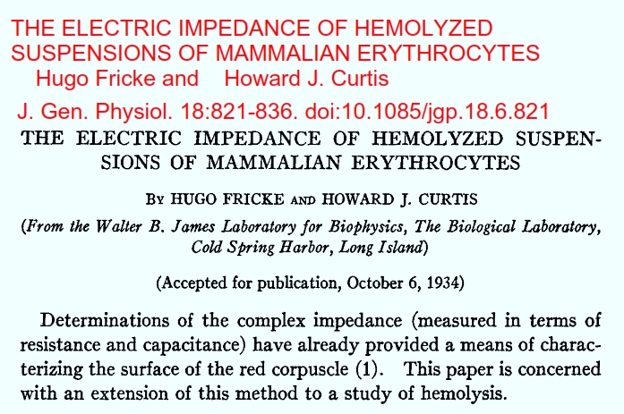
1934

Slide 6
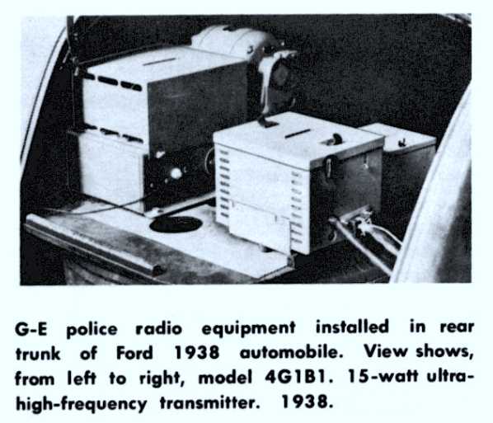
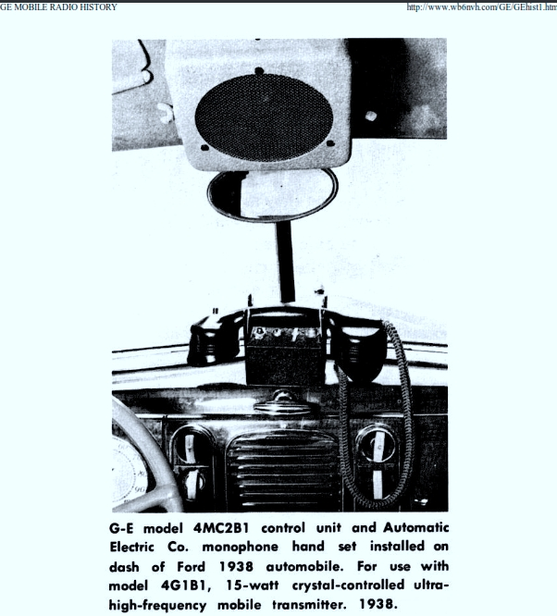
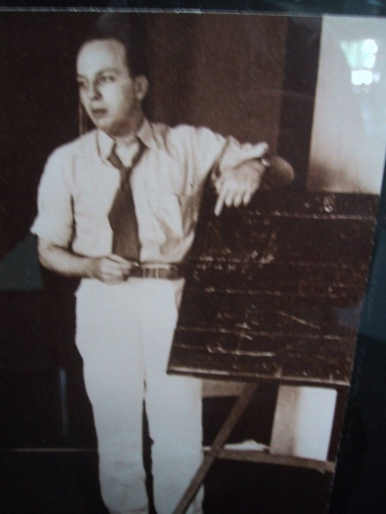
1938
Wallace Coulter
Leaving for Asia to
Sell X-Ray machines for GE

Slide 7

Historical Overview
Torbjorn Caspersson
1941 - demonstrated that “nucleic acids, far from being waste products, were necessary prerequesites for the protein synthesis in the cell (published in Naturwissenschaften in January 1941) and that they actively participated in those processes.”
1950 - demonstrated that both DNA and RNA increase in actively growing cells famous monograph in 1950 “Cell Growth and Cell Function” described nucleic acid and protein metabolism during normal and abnormal growth. - These studies were made using a Cadmium spark source for a UV light, and primitive electronic circuits for detection of signals.
Used Feulgen stain to stain nuclei
Manuscript:
        Torbjorn O. Caspersson, History of the Development of Cytophotometry from 1935 to the present” in Analytical and Quantitative Cytology and Histology, pp2-6, 1986.

Slide 8
Fluorescence Labeling Technique
1941
Coons et al 1941 - developed the fluorescence antibody technique - they labeled antipneumococcal antibodies with anthracene allowing them to detect both the organism and the antibody in tissue using UV excited blue fluorescence
“Moreover, when Type II and III organisms were dried on different parts of the same slide, exposed to the conjugate for 30 minutes, washed in saline and distilled water, and mounted in glycerol, individual Type III organisms could be seen with the fluorescence microscope……”
Manuscript:
Immunological Properties of an Antibody Containing a Fluorescent Group
Albert H. Coons, Hugh J. Creech and R. Norman Jones
Department of Bacteriology and Immunology, Harvard Medical School, and the Chemical Laboratory, Harvard University
Proc. Soc. Exp.Biol.Med. 47:200-202, 1941

Slide 9
Historical Overview
Torbjorn Caspersson
1941 - demonstrated that “nucleic acids, far from being waste products, were necessary prerequesites for the protein synthesis in the cell (published in Naturwissenschaften in January 1941) and that they actively participated in those processes.”
1950 - demonstrated that both DNA and RNA increase in actively growing cells famous monograph in 1950 “Cell Growth and Cell Function” described nucleic acid and protein metabolism during normal and abnormal growth. - These studies were made using a Cadmium spark source for a UV light, and primitive electronic circuits for detection of signals.
Used Feulgen stain to stain nuclei
Manuscript:
        Torbjorn O. Caspersson, History of the Development of Cytophotometry from 1935 to the present” in Analytical and Quantitative Cytology and Histology, pp2-6, 1986.

Slide 10
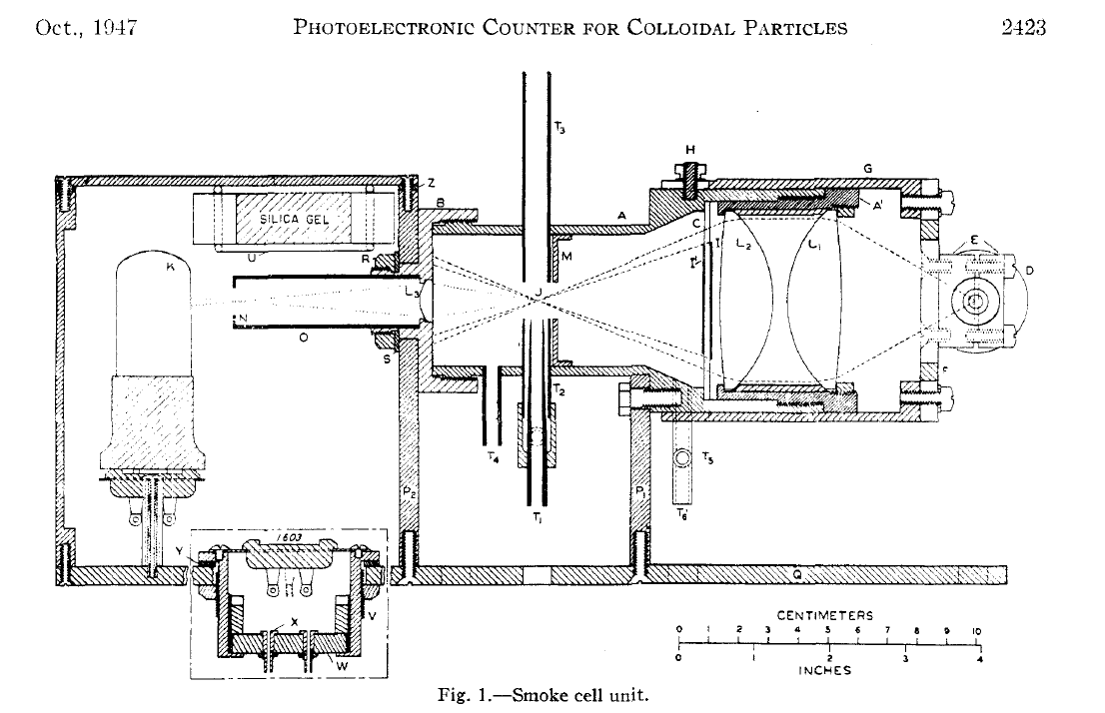
Gucker’s Apparatus
1947
Developed a flow cytometer for detection of bacteria in aerosols
Instrument: Sheath of filtered air flowing through a dark-field flow illuminated chamber. Light source was a Ford headlamp, PMT detector (very early use of PMT)
A Photoelectronic Counter for Colloidal Particles1
BY FRANK T. GUCKER, J R . , ~ CHESTER T. O’KONSKI,~ HUGH B. PICKARD3 AND JAMES N. PITTS, JR.4

Slide 11
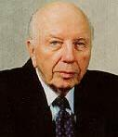
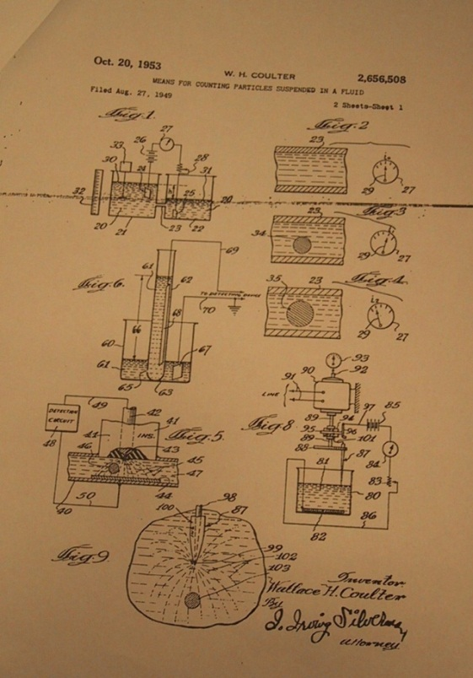
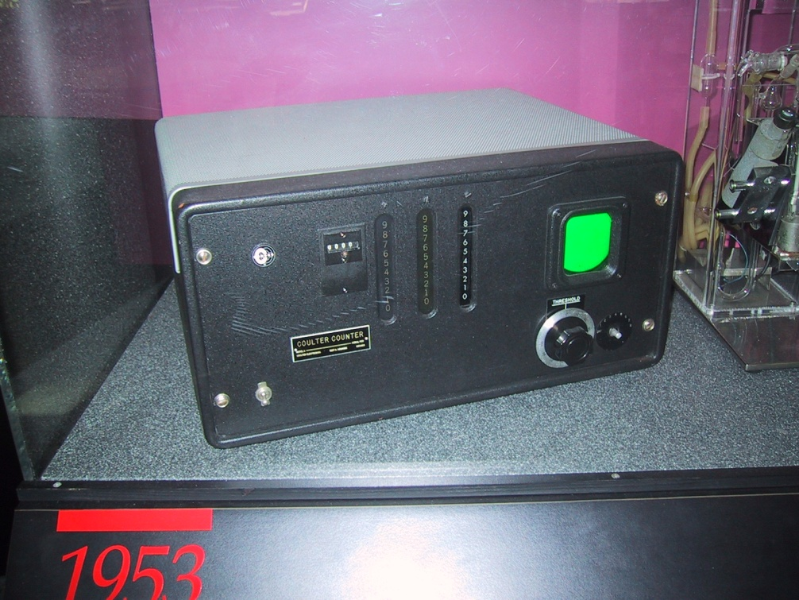
Wallace Coulter
1949
Wallace Coulter - Coulter orifice - 1956 -
(patent 1953) - measured changes in electrical conductance as cells suspended in saline passed through a small orifice
Coulter’s
Original 1953
Patent app’n
From 1949
©J.Paul Robinson
1949 - Coulter WH, US Patent 2,6756, 508.
“Electrical sensing zone method”)
The first commercial version of the Coulter Counter

Slide 12

Conjugated Fluorescein with Isocyanate
1950
Coons and Kaplan (1950) - conjugated fluorescein with isocyanate - better blue green fluorescent signal - further away from tissue autofluorescence. This method used a very dangerous preparative step using phosgene gas

Slide 13
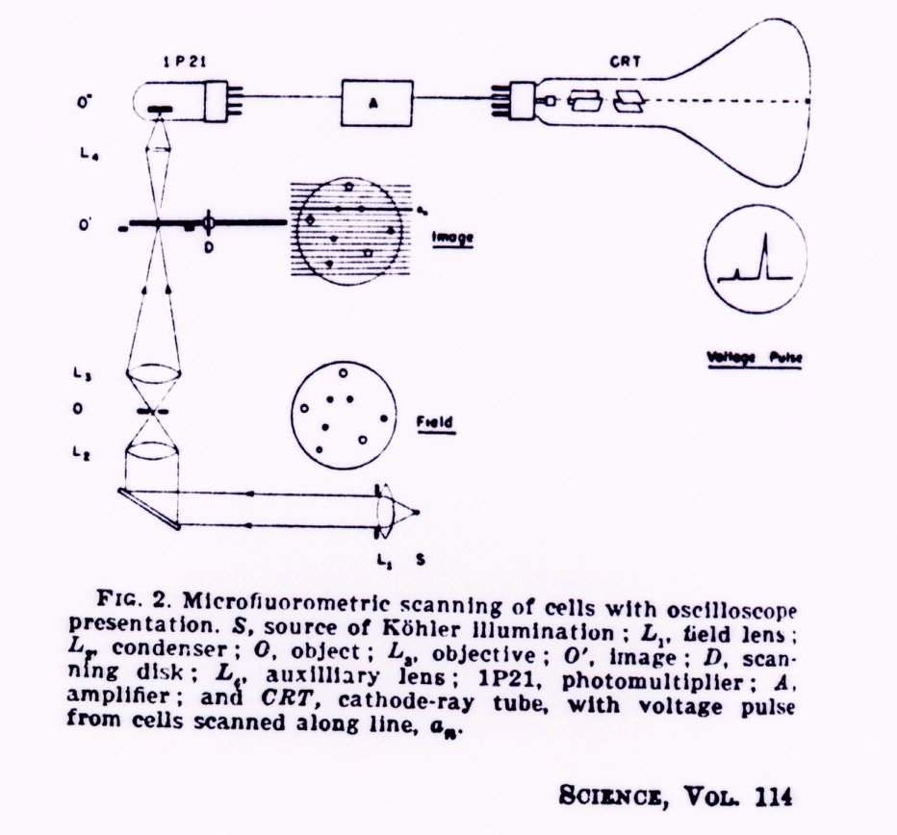
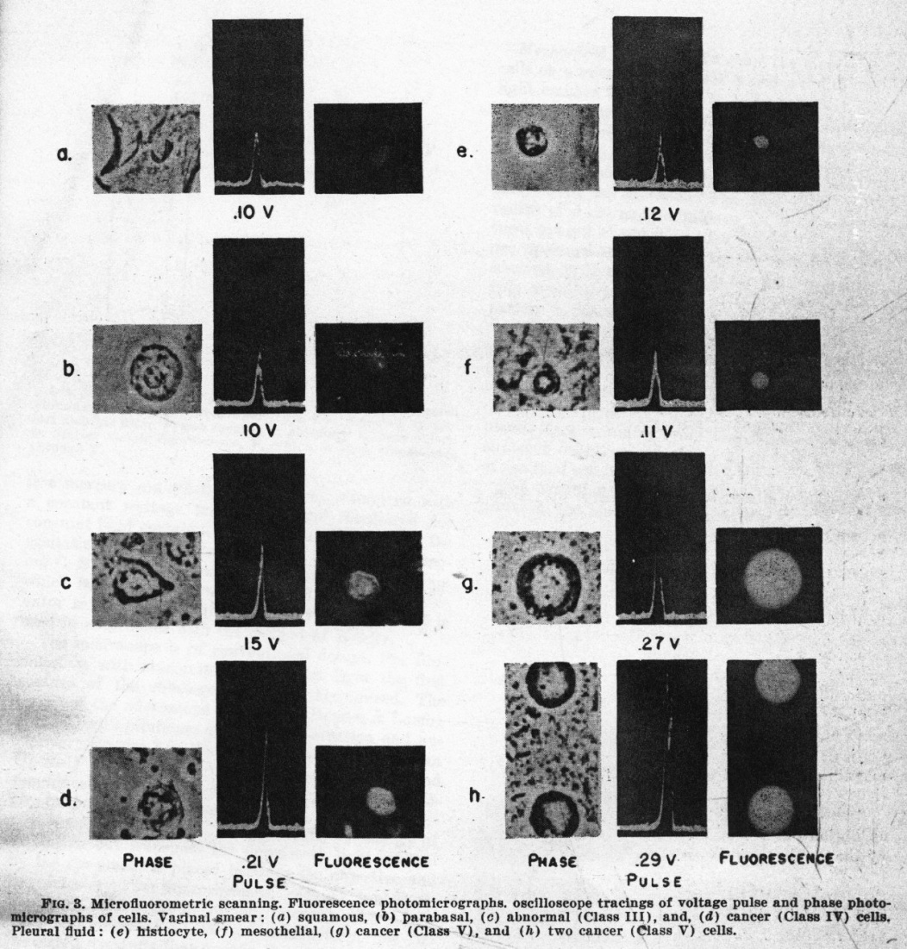
Early Microfluorometric Scanner
Robert Mellors 1951
1951
RC Mellors & R. Silver, A microfluorometric scanner for the differential detection of cells: application to exfoliative cytology, Science 104, 1951

Slide 14
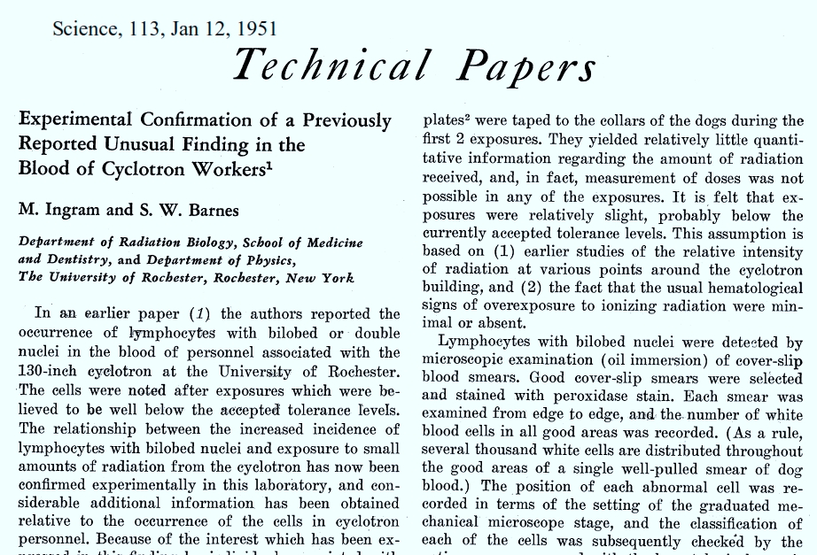
Marylou Ingram
1951

Slide 15
P.J. Crosland-Taylor
1952
Sheath Flow Principle – 1952-3
“Provided there is no turbulence, the wide column of particles will then be accelerated to form a narrow column surrounded by fluid of the same refractive index which in turn is enclosed in a tube which will not interfere with observation of its axial content.”
A Device for Counting Small Particles Suspended in a Fluid through a Tube
P.J. Crosland-Taylor
Bland-Sutton Institute of Pathology
Middlesex Hospital, London, W.1. June 17, 1952 Nature 171: 37-38, 1953

Slide 16
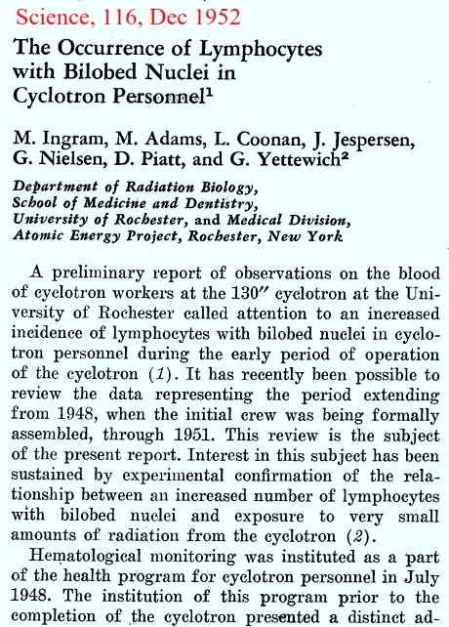
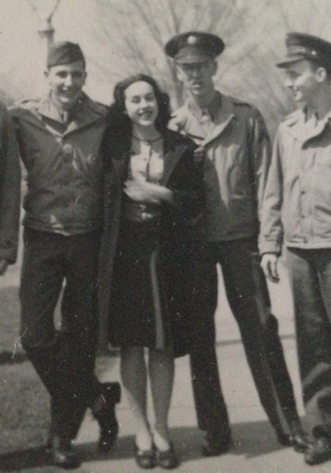
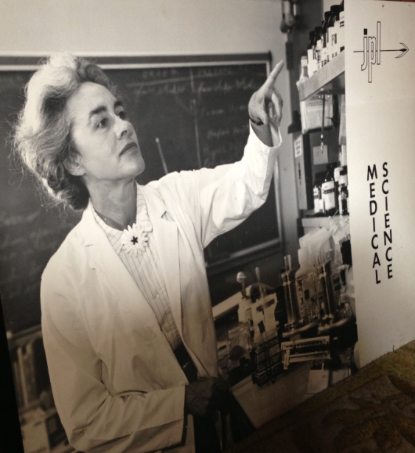
1952
Marylou Ingram in medical school 1944
1960

Slide 17
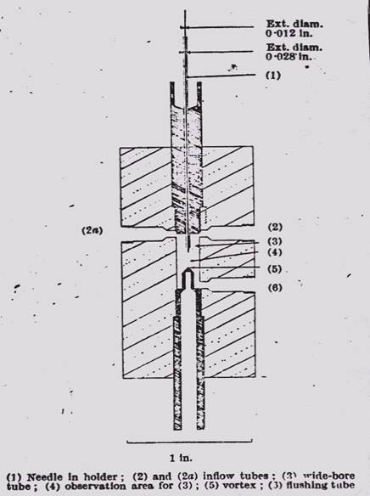
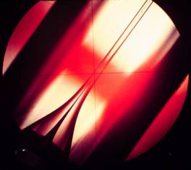
Fundamental principle of Sheath Flow
PJ Crosland-Taylor
1953
A device for counting small particles suspended in fluid through a tube, Nature 171, 1953 (ref 4756)
An Electronic Blood-Cell Counting Machine, Blood 13, 1958 (ref 40974)

Slide 18
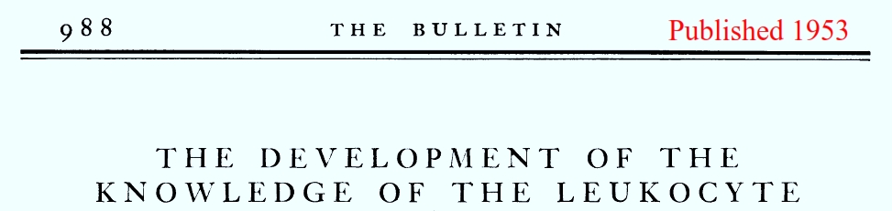
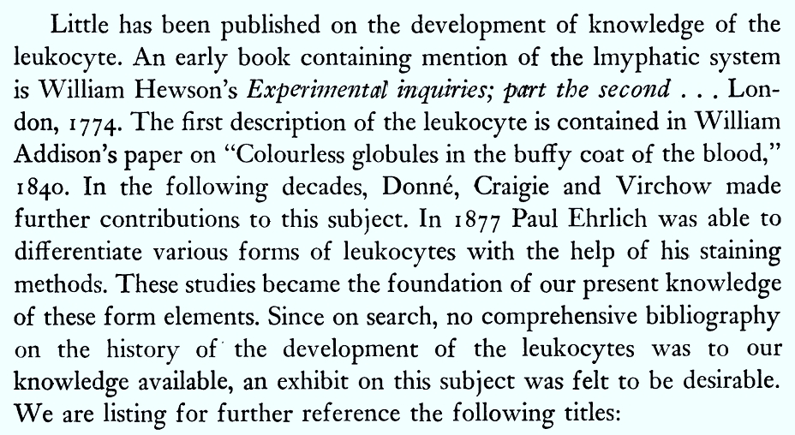
1953

Slide 19
Wallace Coulter and Paint!
Lots of stories about Wallace early experiences in developing particle counting
Did he test paint? Was blood a good substitute for paint on a cold evening?
Was be looking for a better way to analyze paint for the navy?

Slide 20
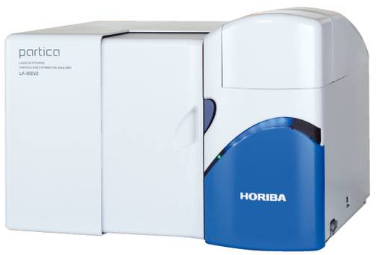
About Paint Pigments…..
Manufacturing and industrial standards
Before the development of synthetic pigments, and the refinement of techniques for extracting mineral pigments, batches of color were often inconsistent. With the development of a modern color industry, manufacturers and professionals have cooperated to create international standards for identifying, producing, measuring, and testing colors.
http://en.wikipedia.org/wiki/Pigment

Slide 21
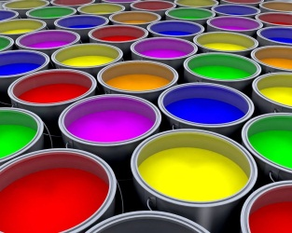
Wallace & The Paint Stories
1949-50
100 μm
coarse historical mineral pigments
modern luster & iridescent pigments
1 μm
ultramarine blue (GS)
red iron oxides
cadmium red
cadmium orange
semiopaque synthetic organics
diarylides
pyrroles
naphthols
perinone orange
50 μm
smallest particles visible without magnification
cobalt violet
manganese blue
10 μm
500nm
cobalt green
cobalt turquoise
cerulean blue
manganese violet
black iron oxides
chromium oxide green
cadmium yellow
bismuth yellow
titanium white
transparent red iron oxides
transparent yellow iron oxides
semitransparent synthetic organics
arylides
5 μm
ultramarine blue (RS)
viridian
cobalt blue
violet (brown) iron oxides
yellow iron oxides
100nm
zinc white
iron [prussian] blue
transparent synthetic organics
quinacridones
phthalocyanines
1um
10um
100 um
Coulter Counter sensitivity claims

Slide 22
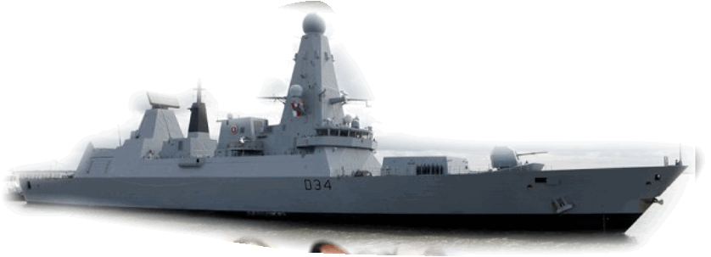
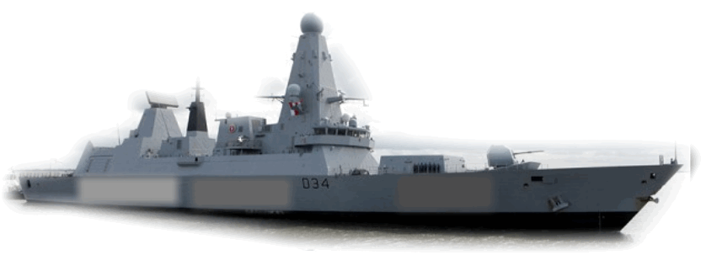
And that story about Navy Paint….

Slide 23

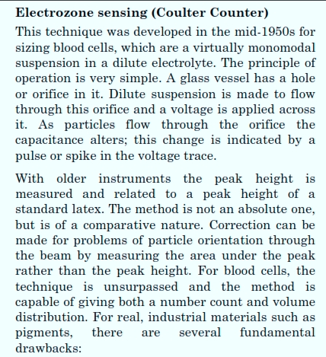
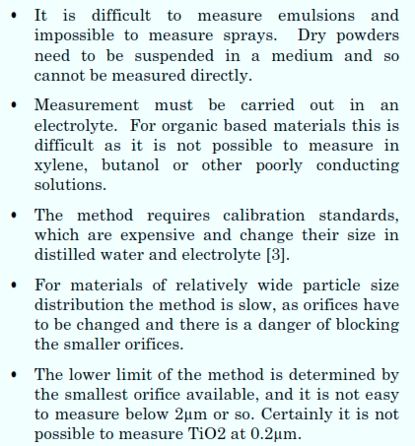

Slide 24
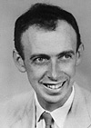
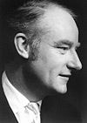
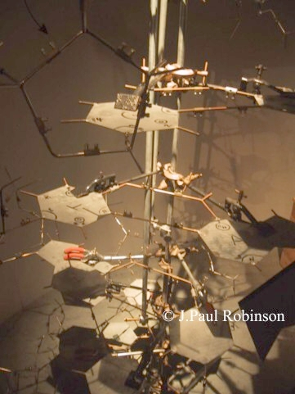
Watson & Crick-1953
J. D. WATSON and F. H. C. CRICK
A Structure for Deoxyribose Nucleic Acid
Nature, 2 April 1953, VOL 171,737 1953
The work which began with Avery's identification of DNA as the "transforming principle" thus led to research that overturned the old conception of DNA as a repetitive and simple molecule, confirmed DNA's role in genetic transmission, and, with James Watson and Francis Crick's 1953 paper, elucidated its structure.
This is a picture of part of the original model built by Watson and Crick at Cambridge in 1953.

Slide 25
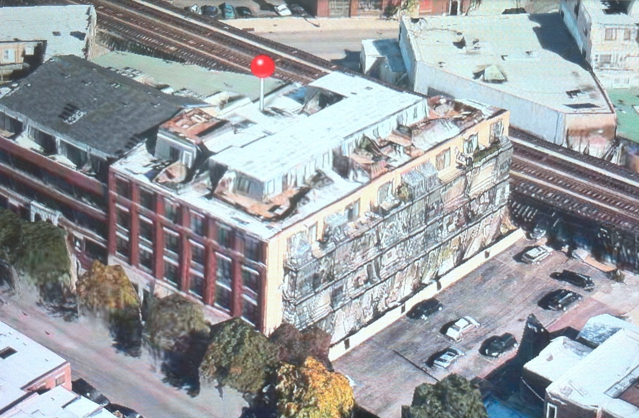
Chicago Operation
Moved to New Building
1955

Slide 26
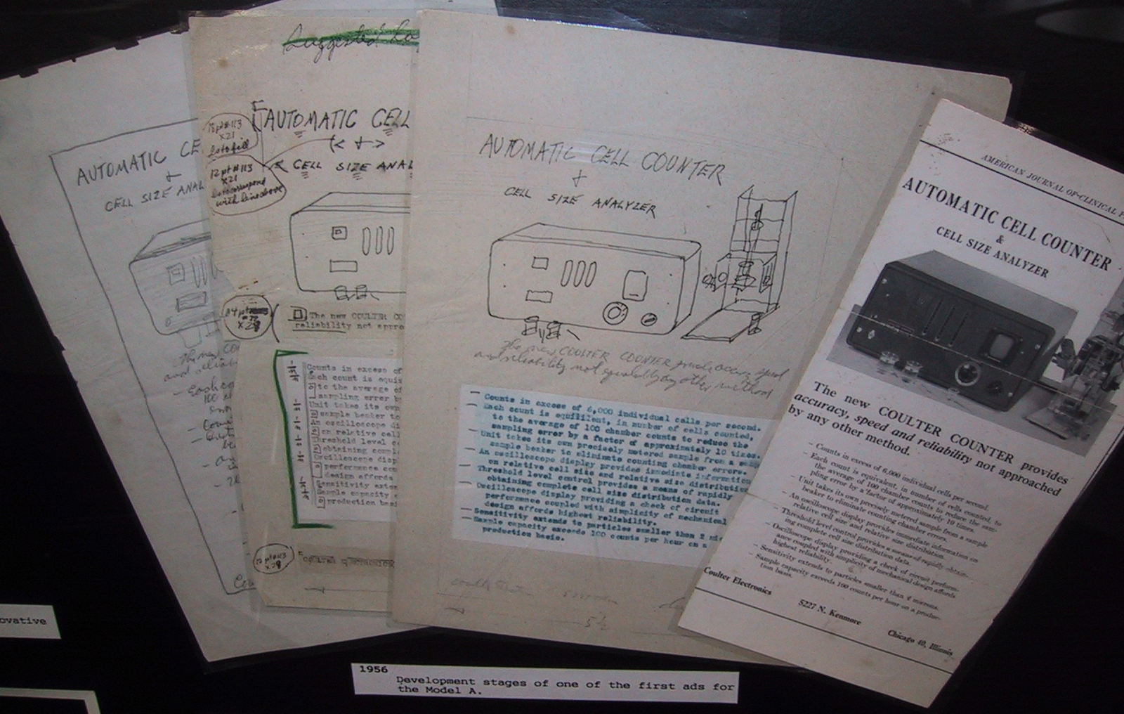
Hand-drawn advertising drafts of the first
Coulter Counter (1956)
1956

Slide 27

1956

Slide 28


Brecher Paper on Coulter Counter
1956
Am. J. Clin Path. 26: 1439-1449, 1956

Slide 29

von Bertalanffy & Bickis - 1956
Ludwig von Bertalanffy (1901--1972)
von Bertalanffy & Bickis (1956)
- the metachromatic fluorescence of AO was used to identify and quantitate RNA in tissues
- also that normal and malignant cells could be discriminated
Absorption Max 467 nm

Slide 30

Two-Color Cell Counter Patent – RBC & WBC
JC Parker and WR Horst 1953
1957

Slide 31

1957

Slide 32


1957

Slide 33

1957

Slide 34

1959

Slide 35

1500 Coulter Counters
1961

Slide 36



Before Cytometry
Lou Kamentsky – at the IBM’s Watson Labs 1950s and 1960s
1960s
Slide Kindly Supplied by Compucyte

Slide 37


1962
Valves, Valves and Valves….

Slide 38

1962

Slide 39


1962

Slide 40

1963

Slide 41



Historical Overview
1964
Early flow systems
Hallermann et al, Kosenow - 1964 - AO staining of leukocytes - was able to use fluorescence (in a flow based system) to select leukocytes from red cells despite a low ratio (1/1000) because they took up lots of AO - also claimed to be able to discriminate between monocytes and PMN
Molecular Formula: C₁₇H₂₀ClN₃
Molecular Weight: 301.82
CAS Number/Name: 65-61-2 / 3,6-Acridinediamine, N,N,N',N'-tetramethyl-, monohydrochloride
Halleman 1964 AO
Scan and structure from www.probes.com

Slide 42


Mort Mendelsohn
Early Technology Developers
CYDAC Analyzer - (1964) - Mendelsohn, Mayall, Prewitt (U.Pen)produced high resolution digital images of leukocytes - cells were stained with gallocyanin chrom alum and naphthol yellow S
Brian Mayall

Slide 43
Richard Sweet
1964
Richard Sweet developed the electrostatic ink-jet printer which was the principle used by Mack Fulwyler to create a cell-sorter.

Slide 44


Electrostatic Printing and Droplet Sorting
RG Sweet - MJ Fulwyler
1965
RG Sweet, Fluid Droplet Recorder
U.S. Patent 3,596,275
filed 3/25/64 (ref 40975)
MJ Fulwyler, Particle Separator, U.S.
Patent 3,380,584 filed 6/4/65

Slide 45



Mack Fulwyler
1965
Mack Fulwyler – worked in Marvin van Dilla’s lab at Los Alamos. – developed the sorter in 1965 – initially used electronic cell volume - at Los Alamos National Labs - this instrument separated cells based on electronic cell volume (same principle as the Coulter counter) and used electrostatic deflection to sort. The cells sorted were RBC because they observed a bimodal distribution of cell volume when counting cells - the sorting principle was based on that developed for the inkjet printer by Richard Sweet at Stanford in 1965.
Mack Fulwyler
Marvin van Dilla
(Photo dated 6/91)
After determining that the bimodal distribution was artifactual, this group were able to sort neutrophils and lymphocytes from blood.
Lushbaugh, CC, Basmann,NJ, Glascock, B. Electronic measurement of cellular volumes.
II Frequency distribution of erythrocyte volume. Blood 1962 20:241-248 Correspondence Blood 1964:23:403-405

Slide 46
The mysterious red cell problem
So it was determined that RBC traveling past the laser were identified as “different” only because of the artifacts developed from the current being too high at the aperture of the coulter counter.
When Fulwyler sorted a single population and reran that population through the Coulter Counter, he again saw the bimodal population proving that the bimodality was an artifact.
As a matter of interest, I spoke to Mack Fulwyler about this experiment, and he told me that the essentially determined the solution to this enormous problem in one afternoon, and after all that, they never actually published a paper about the problem……like good scientists, they just went on to solve a real (biological) problem!!!

Slide 47





Sorting Cancer Cells - Kamentsky
1965
Technology was based on a fluidic switched “Typewriter” that IBM was developing in Zurich research laboratories.
Spectrophotometric Cell Sorter, LA Kamentsky and MR Melamed, Science 156, 1967 (ref 4134)

Slide 48



Four Sensors, Sorting, Auto Sampling and Computer Data Reduction
1966
IBM 1620 Computer
This instrument became the “Hemalog D” by Technicon in 1974
Two analytic instruments were built and one was delivered to LA Herzenberg at Stanford University 1967

Slide 49

1967

Slide 50



1968

Slide 51


1968
J.Pharm.Sci 57:557-563, 1968

Slide 52



Dittrich & Göhde
1969
Dittrich & Gohde - 1969 - Impulscytophotometer (ICP)- used ethidium bromide for a DNA stain and a high NA objective used as a condenser and collection lens
Phywe AG of Gottingen (1969) - produced a commercial version of the ICP built around a Zeiss fluorescent microscope
Laerum, Göhde, Darzynkiewicz (1998)
Göhde and Laerum (1998)
http://www.partec.de/partec/flowmuseum.html
ICP 11 (1969)
Distributed by Phywe, Göttingen
The first commercial flow cytometer
PDP 11 computer
Photos ©2000 – J.P. Robinson

Slide 53


Herzenberg Lab
1969
Len Herzenberg - 1969 - sorter based on fluorescence (arc lamp) built after working with one of Kamentsky’s RCS systems where they built an instrument they called the Fluorescence Activated Cell Sorter (FACS)
Photos from 2000 – JP Robinson

Slide 54

Kamentsky & Biophysics Systems
1970
Kamentsky also built a fluidic cell-sorter to evaluate the cells identified in his RCS. An RCS was sent to Stanford for use by Leonard Herzenberg . The unit was also the model for the Technicon D instrument built by Technicon. (Reference: Shapiro)
©J.Paul Robinson
Kamensky’s first benchtop instrument the Cytograph. This measured scatter using a He-Ne laser. This particular instrument was a model prior to the fluorescence detection model.

Slide 55



Evolution of Leukocyte Gating Strategy for Cluster Subsetting
1971
LR Adams & LA Kamentsky,
Machine characterization of human leukocytes by acridine orange fluorescence, Acta Cytologica 15, 1971
Monocytes
Lymphocytes
Granulocytes
Biophysics Systems
GC Salzman, JM Crowell, JC Martin, TT Trujillo, A. Romero, PF Mullaney, & PM LaBauve,
Cell classification by laser light scattering: identification and separation of unstained leukocytes,
Acta Cytologica 19, 1975
Los Alamos
RA Hoffman, PC Kung, WP Hansen,
Simple & rapid measurement of human T
lymphocytes and their subclasses,
PNAS 77, 1980
Ortho

Slide 56

1971
Bernie Shoor
BD Internal Memos

Slide 57

1971
BD Internal Memos

Slide 58

1971
BD Internal Memos

Slide 59

1971
BD Internal Memos

Slide 60



1971
18 Aug 1971
3 Nov 1971
15 Dec 1971

Slide 61
Stanford Group and BD (Herzenberg)
(Agreements made between Nov 3 and Dec 15, 1971
Coulter Group and Particle Technologies (Fulwyler)
(Agreements made October 1, 1971)
1971

Slide 62

Herzenberg & Becton-Dickinson
1972
Herzenberg -1972 - Argon laser flow sorter - placed an argon laser onto their sorter and successfully did high speed sorting - Coined the term Fluorescence Activated Cell Sorting (FACS) This instrument could detect weak fluorescence with rhodamine and fluorescein tagged antibodies. A commercial version was distributed by B-D in 1974 and could collect forward scatter and fluorescence above 530 nm.
Herzenberg was the recipient of the very
Prestigious 2006 Kyoto Prize for his work
in development of fluorescence based
flow cytometry. Many people well known
in the field were trained in his lab
Monday, Sept 6, 2013
(Photo from the official Kyoto Prize website)
Len Passed away Oct 27, 2013

Slide 63


Herzenberg and Bonner
1972
WA Bonner, HR Hulett, RG Sweet and LA Herzenberg,
Fluorescence Activated Cell Sorting, Review of Scientific Instruments 43, 1972

Slide 64



Los Alamos and Livermore
1970s
Joe Gray sorting chromosomes
Marv Van Dilla and Phil dean
Marv Van Dilla and Harry Crissman

Slide 65






Biophysics Systems
Ortho Instruments
Cytograf (1970)
ELT 8 (1977)
50H (1978)
Cytofluorograf (1970)
Spectrum (1979)
FC200 (1975)

Slide 66

BD Announces FACS-1 April 1974
1974

Slide 67

FASEB April 1974 – Coulter Booth
1974
Bob Auer head of Coulter’s EPICS division, saw that BD was voing to release their sorter at the FASEB meeting in 1974, so they changed their booth and had their sorter on the booth.

Slide 68


1974

Slide 69


EPICS II
1974
Coulter developed big multiparameter sorters but Wallace Coulter was in conflict with the idea of building big instruments so he dropped the program. This precipitated Fulwyler to leave Coulter and join BD
Delivered to Chet Herman
NIH in 1974

Slide 70
Hemalog D
1974
Technicon - Hemalog D - 1974 - first commercial differential flow cytometer - light scatter and absorption at different wavelengths - chromogenic enzyme substrates were used to identify neutrophils and eosinophils by peroxidase and monocytes by esterase, basophils were identified by the presence of glycosaminoglycans using Alcian Blue - the excitation for all measurements was a tungsten-halogen lamp
Insert photos on page 60
Image from Shapiro “Practical Flow Cytometry”, 3rd. Ed.Wiley-Liss, 1994

Slide 71

Mack Fulwyler
1975
Coulter Electronics manufactured the TPS-1 (Two parameter sorter) in 1975 which could measure forward scatter and fluorescence using a 35mW argon laser.
This photo (left) is one of only one or two surviving TPS Instruments. It is very similar to the Coulter Counter of the day.
Photo ©2000 – J.P. Robinson

Slide 72



Monoclonal Antibodies
1975
Nobel Prize in Physiology 1984
César Milstein
Georges J.F. Köhler
A photo I took in 1986 at the Cambridge ISAC meeting.
Milstein with is hand in the air (Howard Shapiro on Guitar)

Slide 73

1975
Wallace Coulter placed this news clipping on Bob Auer’s desk in 1975 after Fulwyler left Coulter to Join Becton Dickinson!! The award was while he was at the Max Plank institute in Germany while he was spending his 1 year sabbatical before he moved to BD.
Wallace

Slide 74



Marylou Ingram - 1976
Early adopter of the Coulter Counter technology

Slide 75


Biophysics -Ortho
1977
Ortho Diagnostics (Johnson and Johnson) purchased Biophysics in 1976 and in 1977 the System 50 Cytofluorograph was developed - this was a droplet sorter, with a flat sided flow cell, forward and orthogonal scatter, extinction, 2 fluorescence parameters, multibeam excitation, computer analysis option.
1979 - NIH scientists had added a krypton laser at 568 nm to excite Texas Red fluorescence at 568 nm and emit at 590-630 nm. Argon (488 nm FITC was measured simultaneously without signal cross-talk - thus the FACS IV was developed (B-D).
FC 200(1975)
System 50H (1978)

Slide 76


Chromosome Analysis on the TPS-1 Sorter
1977

Slide 77


Two groups of Lymphocytes
B Cells and T Cells….
1977

Slide 78


Coulter Electronics
1978
1977-78 developed the Epics series of instruments which were essentially 5 watt argon ion laser instruments, complete with a multiparameter data analysis system, floppy drive and graphics printer.
Photo ©2000 – J.P. Robinson
Epics V front end (left) and MDADS (right)

Slide 79
1980s and 1990s

