Slide 1
The Development of Spectral Flow Cytometry
J. Paul Robinson
Purdue University
May 4, 2020
Confidential
Filename: jpr Historical overview.pptx

Slide 2
Contents
Invention
Patents and First Presentation
Sony License
Impact of Sony
BD- Project Newton
Cytek Formation & Presentation
BD Status
Current Status
The opinions expressed in this presentation are my own and do not represent the opinions or policy of Purdue University or PRF or Miftek Corp.

Slide 3
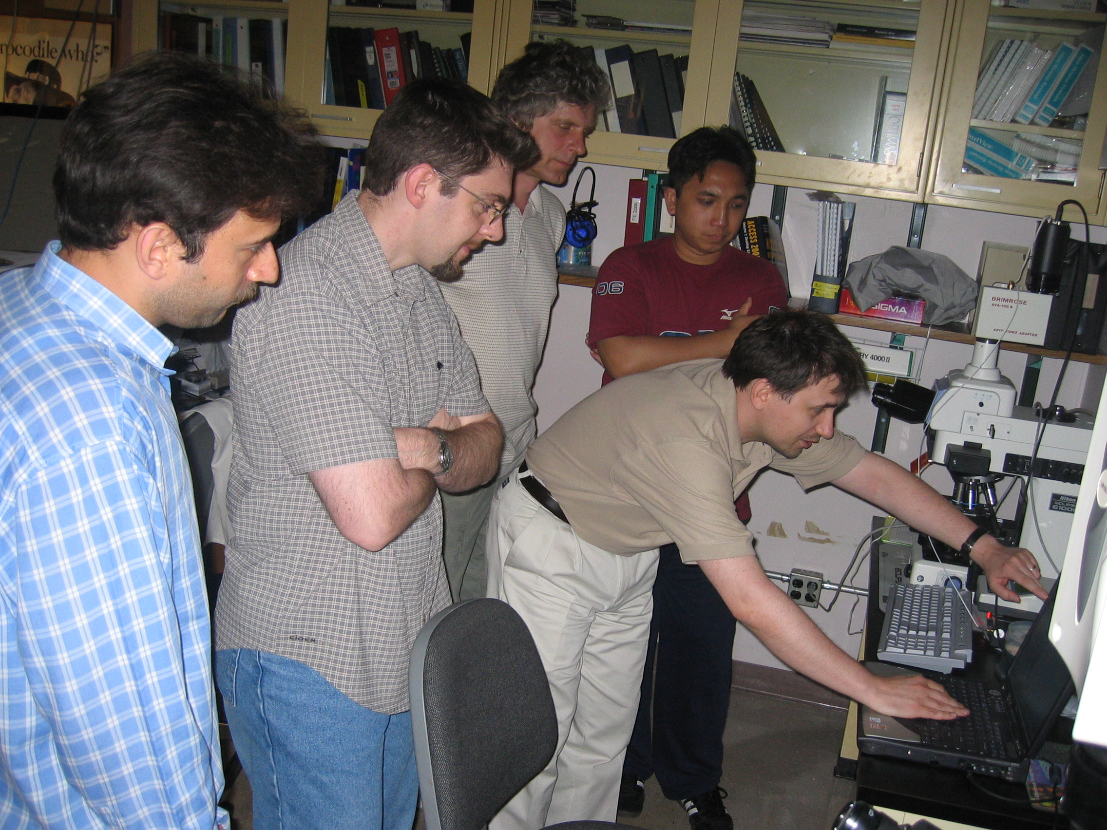
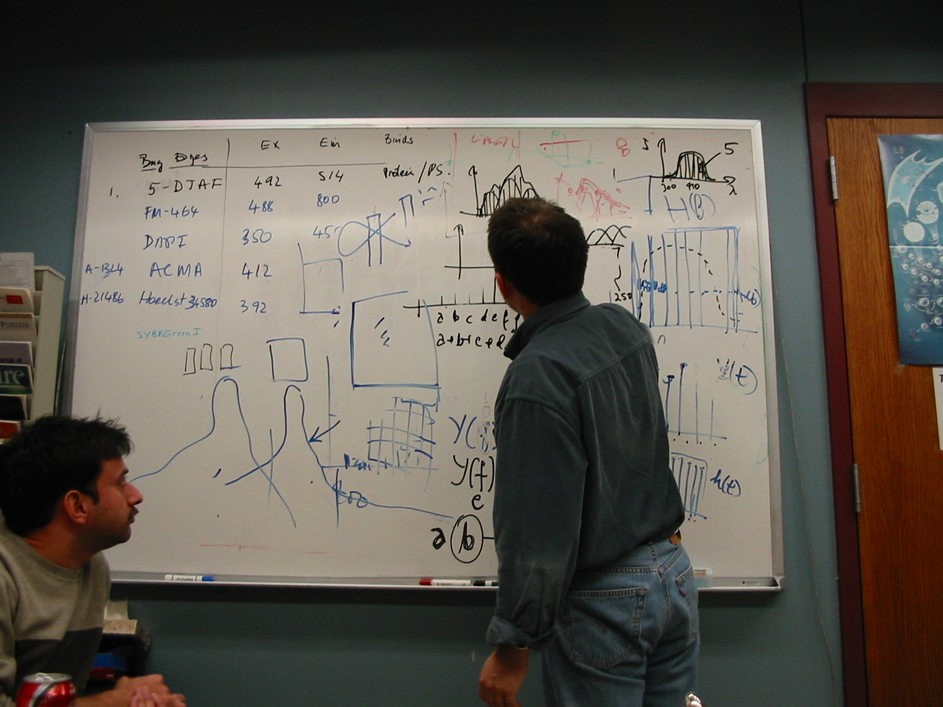
Invention
In around 2000 I started to consider that current flow cytometry could be transformed if we could look at the entire spectra of cells, instead of just a small band.
To enable the concept, we started to implement a spectral approach to imaging, as we believed this would teach us what we needed to build a flow system. We started by taking images and deconvolving them to spectral images.
21 Nov, 2003
Our team working on the concepts of spectral flow cytometry in our laboratory in 2003.

Slide 4
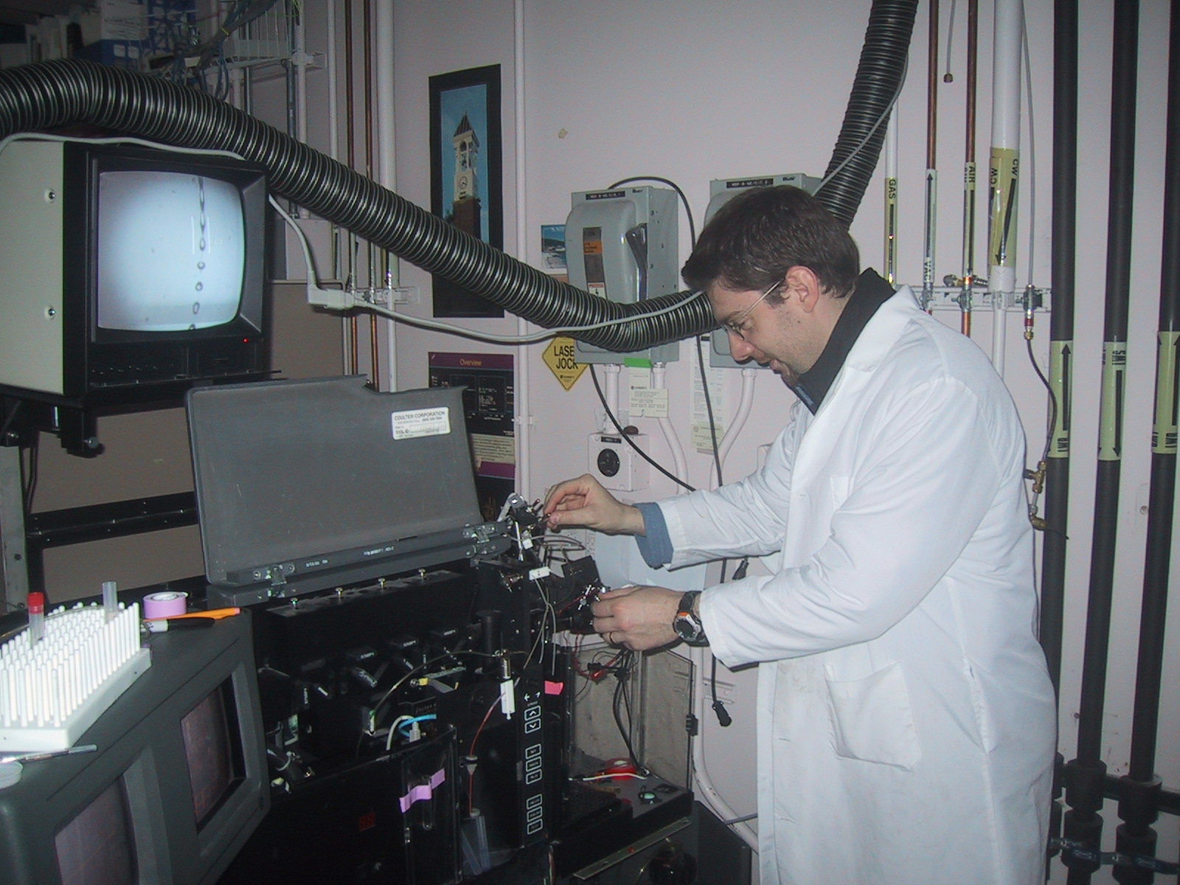
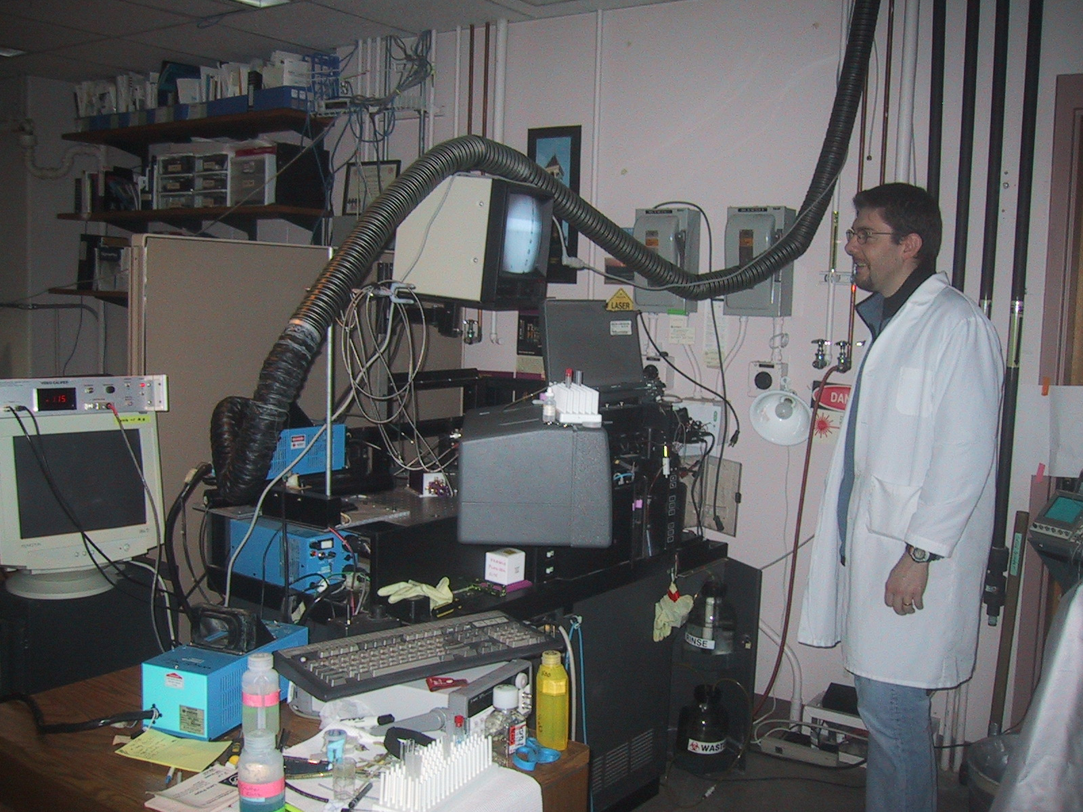
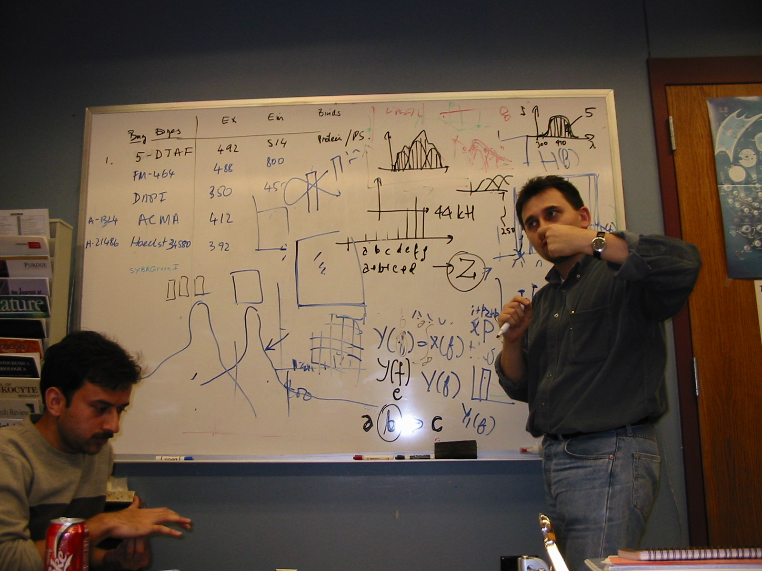
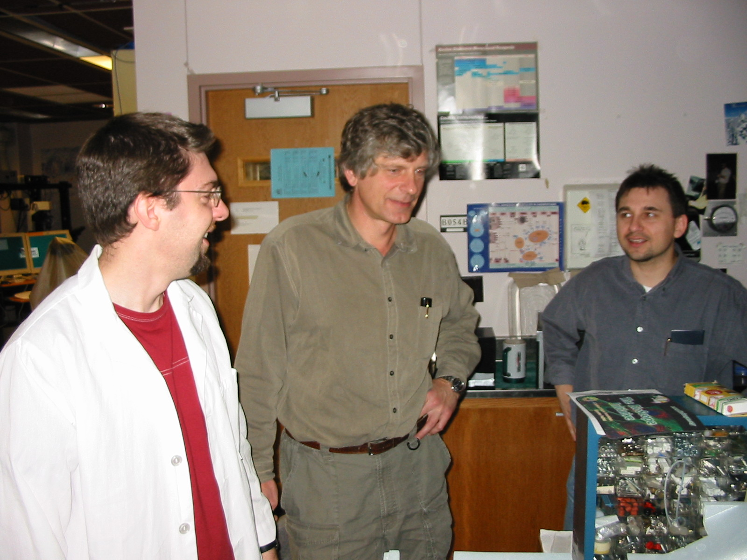
The first spectral prototype
Gerald Gregori was a postdoc in my lab and I tasked him to work on this project with Valery Patsekin and Bartek Rajwa. The instrument was built on a modified EPICS Elite cell sorter
Bartek Rajwa discussion the technology
Photo: Nov 21, 2003. Note at the top center, is a graph of the way spectral data appears – the entire wavelength and the total signature of all the cells.
Gerald, Valery, Bartek
Gerald Gregori marveling at the wonder of it all!
Notes:
We originally were aware of how the Zeiss Meta instrument worked which was an imaging system that had a 32 ch PMT added with a dispersion element. We purchased one of these PMTs and started to build a spectral flow cytometer. We started this in about 2021 and it took about 3 years to get real data. There were no electronics available that could capture so many channels, and we eventually found a board that was designed for a US military project and we purchased this board. It cost $50,000 which was our entire budget at the time. We also tried to get a diffraction grating made by Kodak and we visited their site in Rochester but they wanted $25,000 to make a custom grating so in the end, we pulled a few old spectrometers to pieces and pinched the gratings from them. We also borrowed some grating from a couple of companies and had 2 or 3 different approaches. In the end Valery wrote some pretty clever software as there was no way of unmixing spectral data. So CytoSpec was developed in 2002 and it is still in use today (currently version 11.7) - this software has some very powerful features that were needed to work with spectral data.

Slide 5
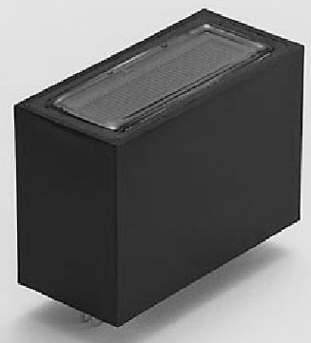
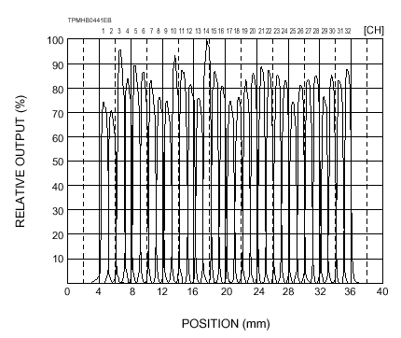
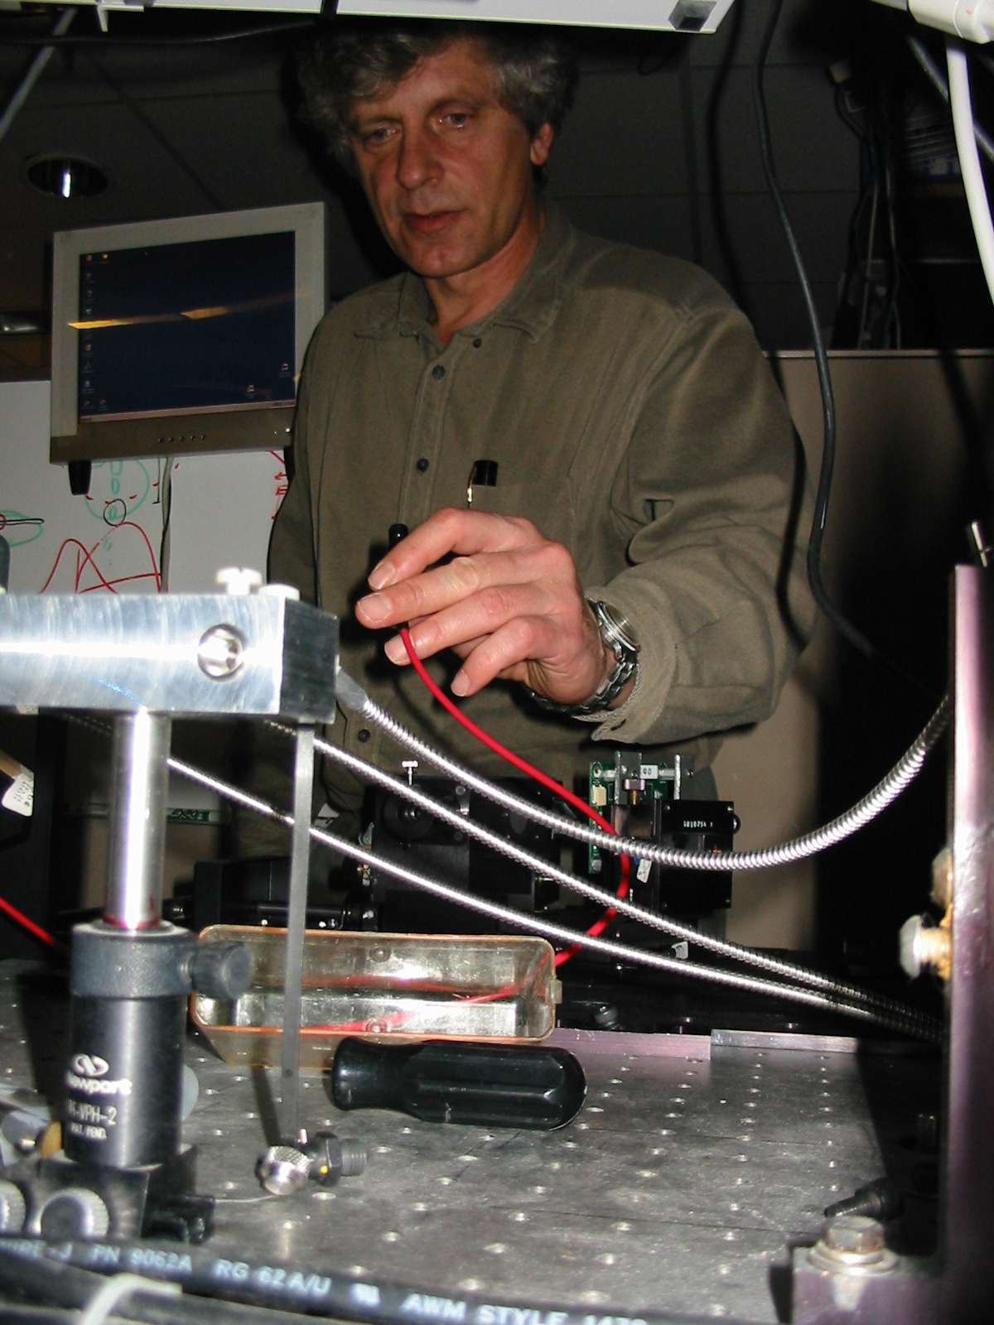
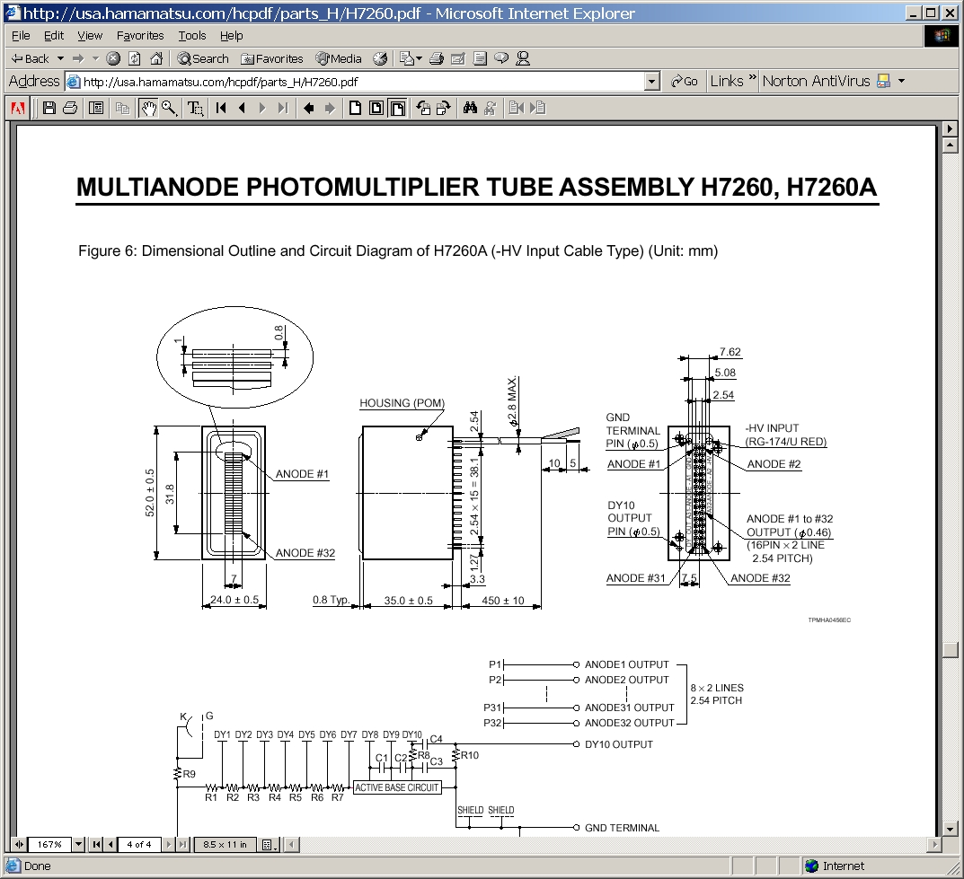
Task 1 – define the detector technology
Notes:
Valery trying to get the data system setup for collecting using a fiber. On the left is the 32 CH pmt we used.

Slide 6
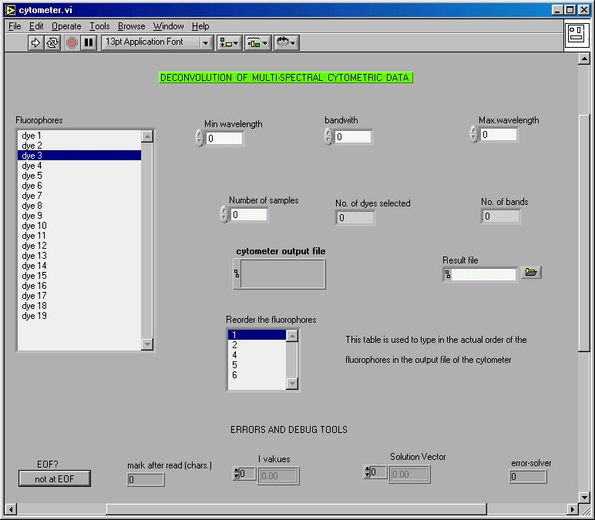
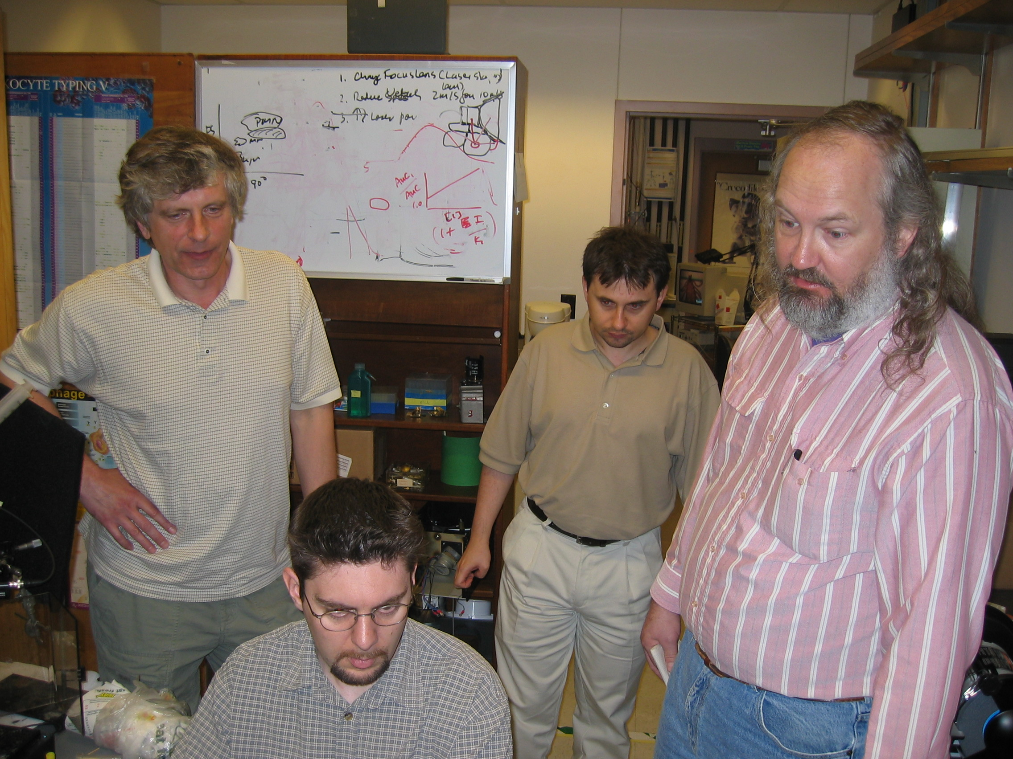
Software had to be written
L-R: Valery Patsekin, Gerald Gregori, Bartek Rajwa, Steve Kelly
The software we used to capture the single cell spectrum – as shown on the right where the x axis is wavelength from 300-800 nm
Notes:
This is the interface for our first data – coming from a bead most likely -

Slide 7
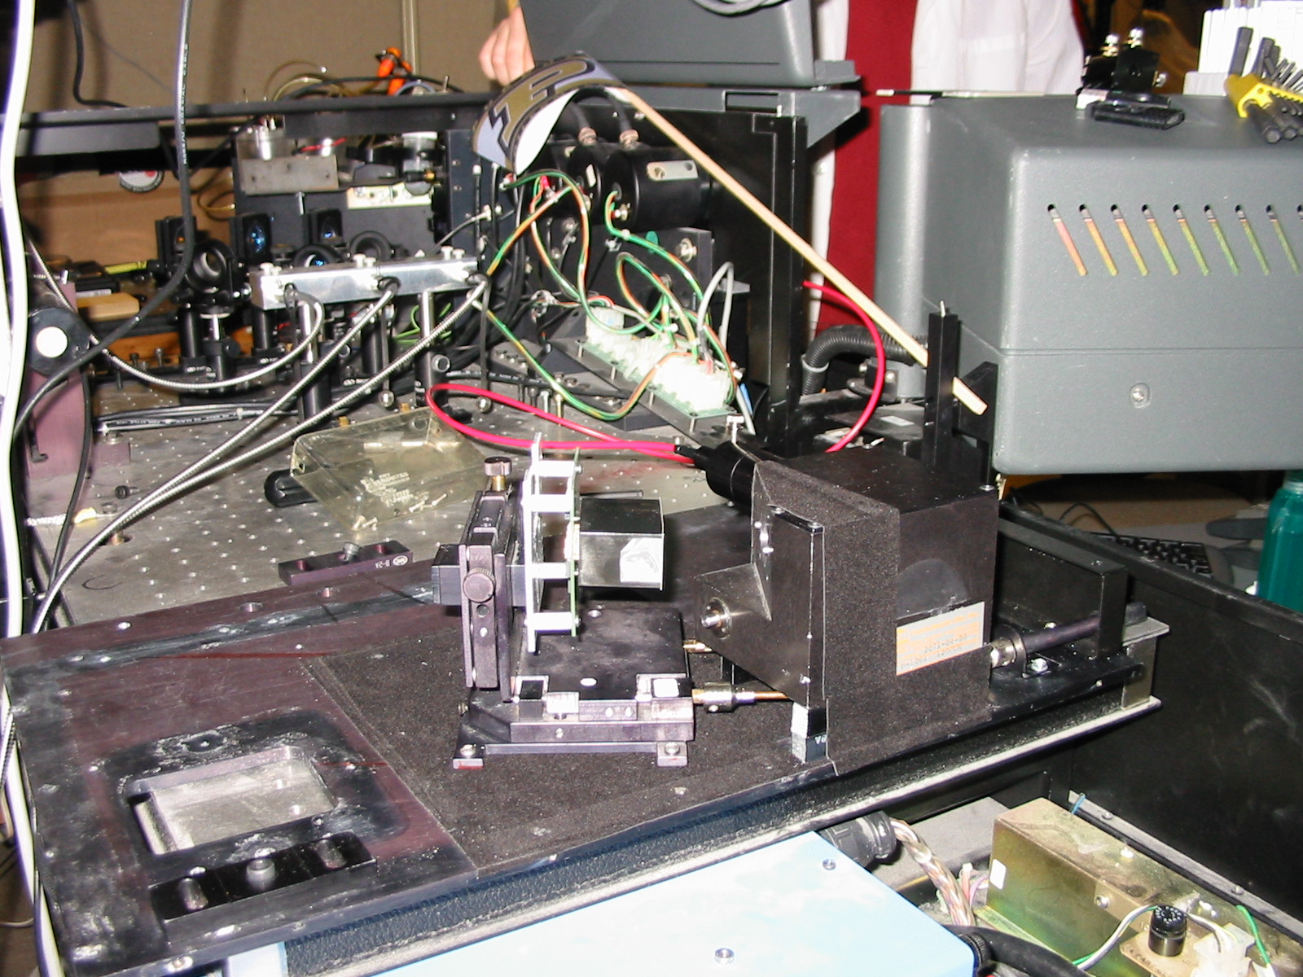
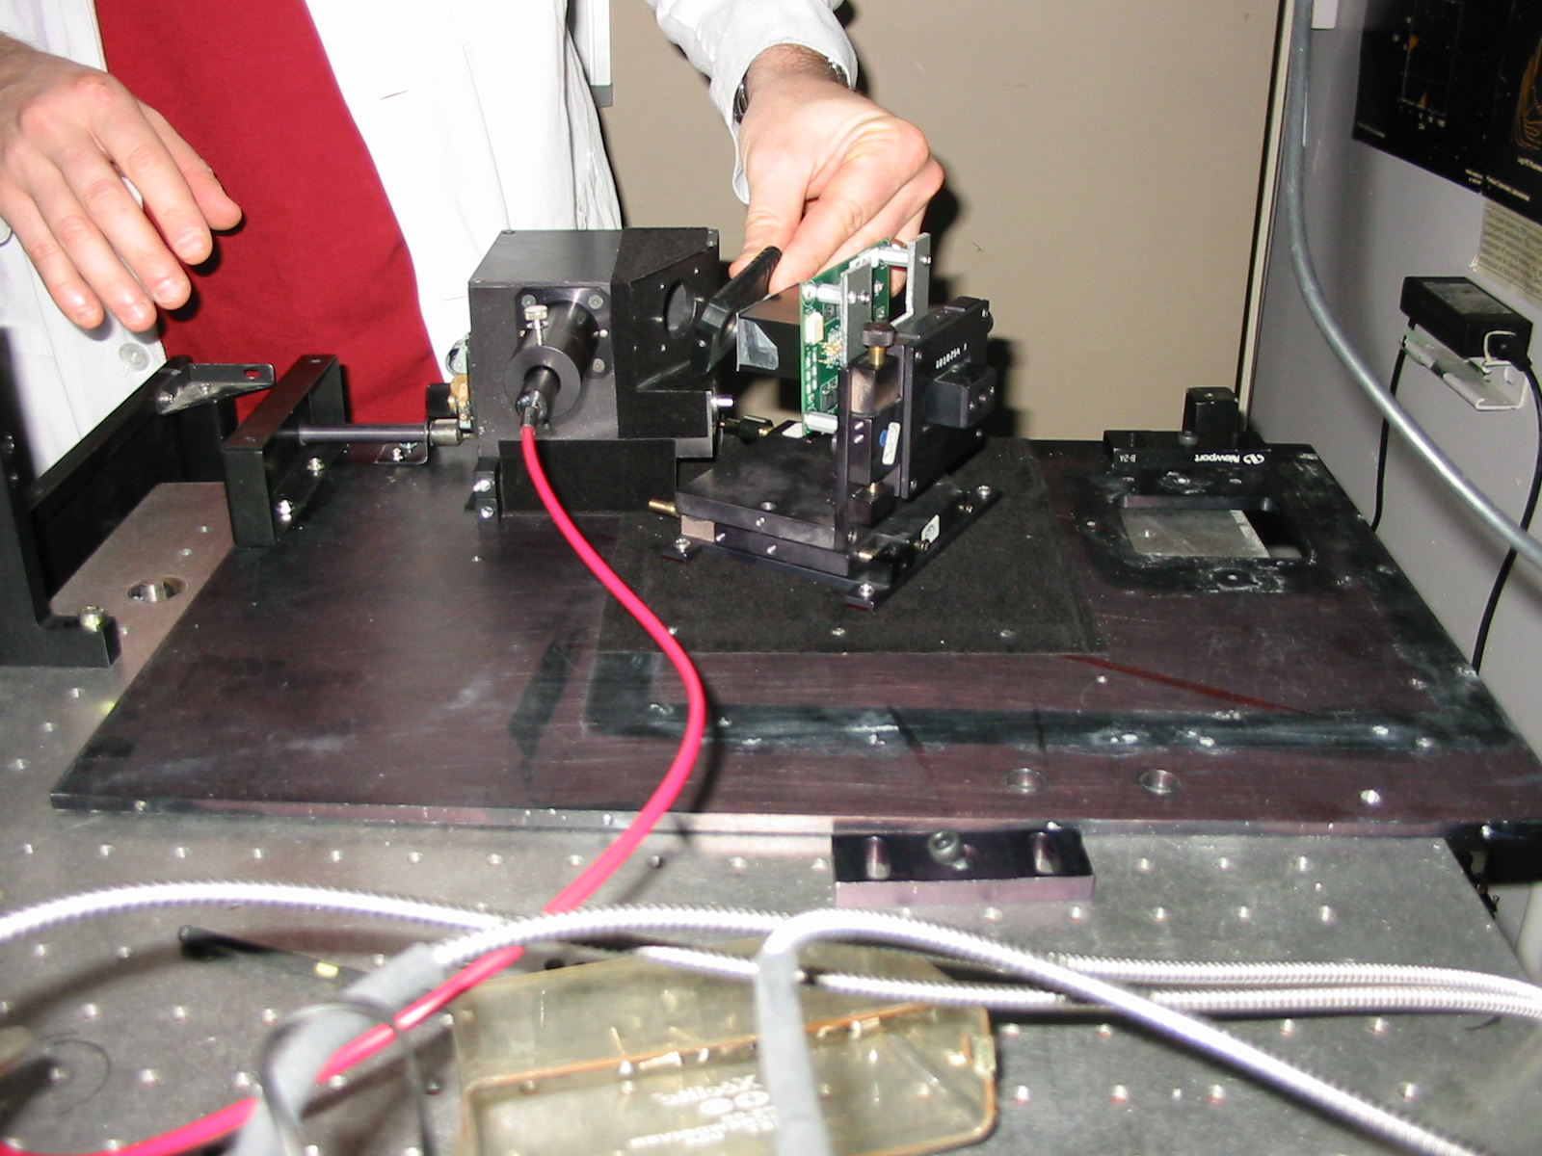
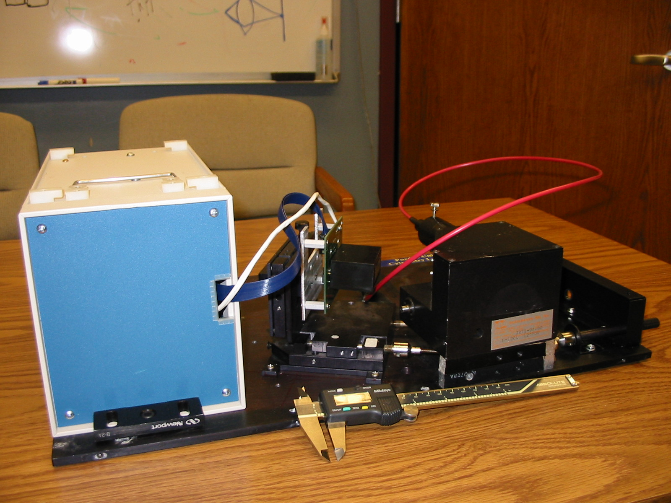
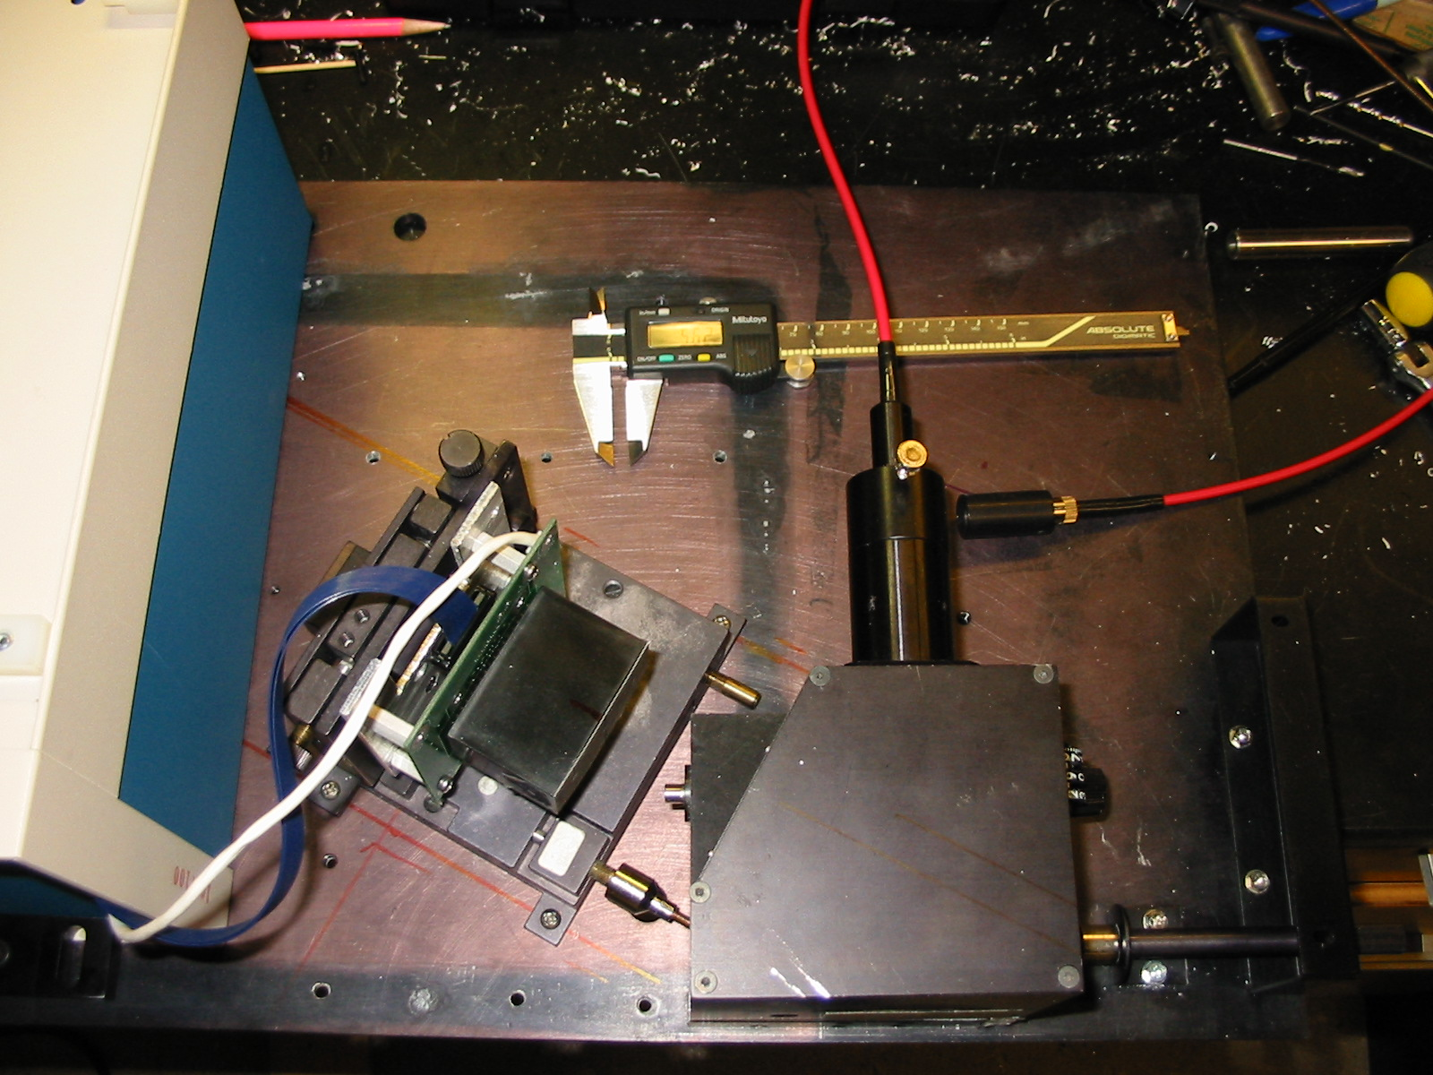
Task 2 – Design a Spectrometer- many iterations
WE developed at least 4 iterations of the spectrometer itself. This was a particularly difficult part of the technology. We visited Kodak in Rochester to try to get a special grating made, but they quoted $25k so we built our own.
Some parts were “borrowed” from other instruments, but generally we made most parts ourselves.

Slide 8
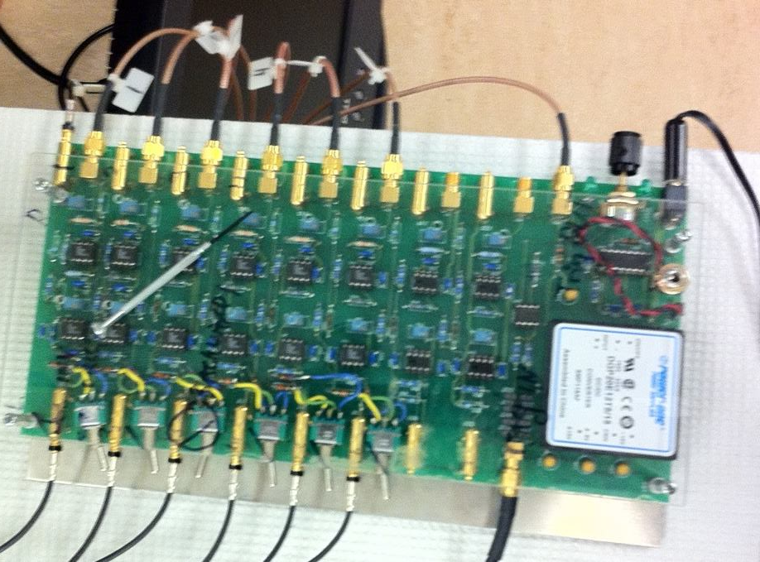
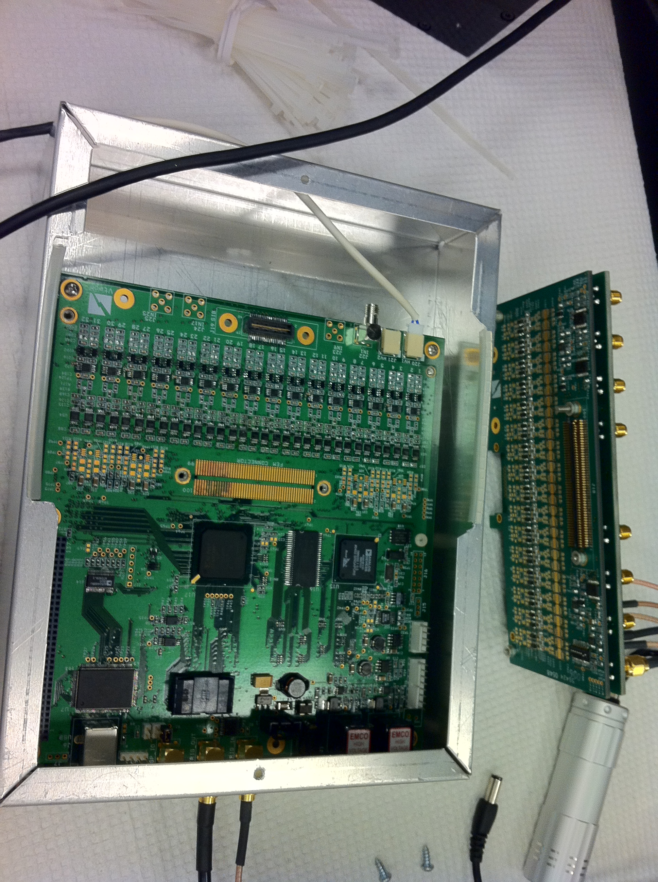
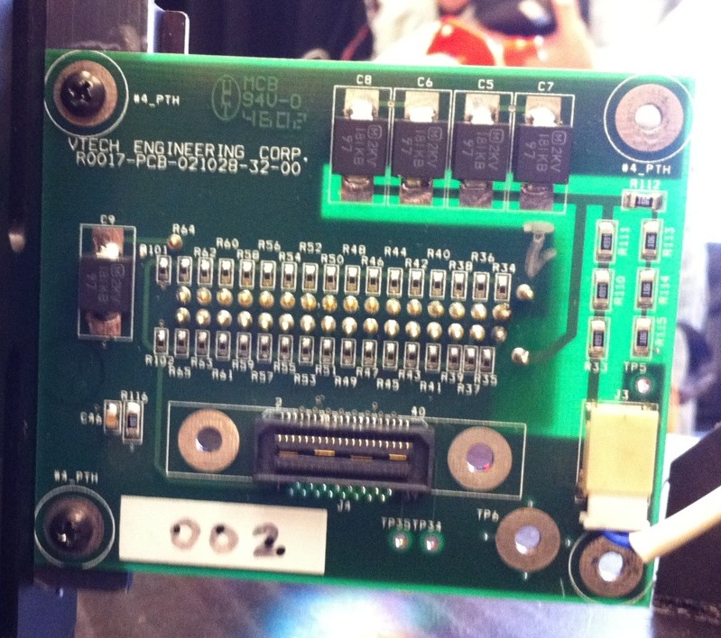
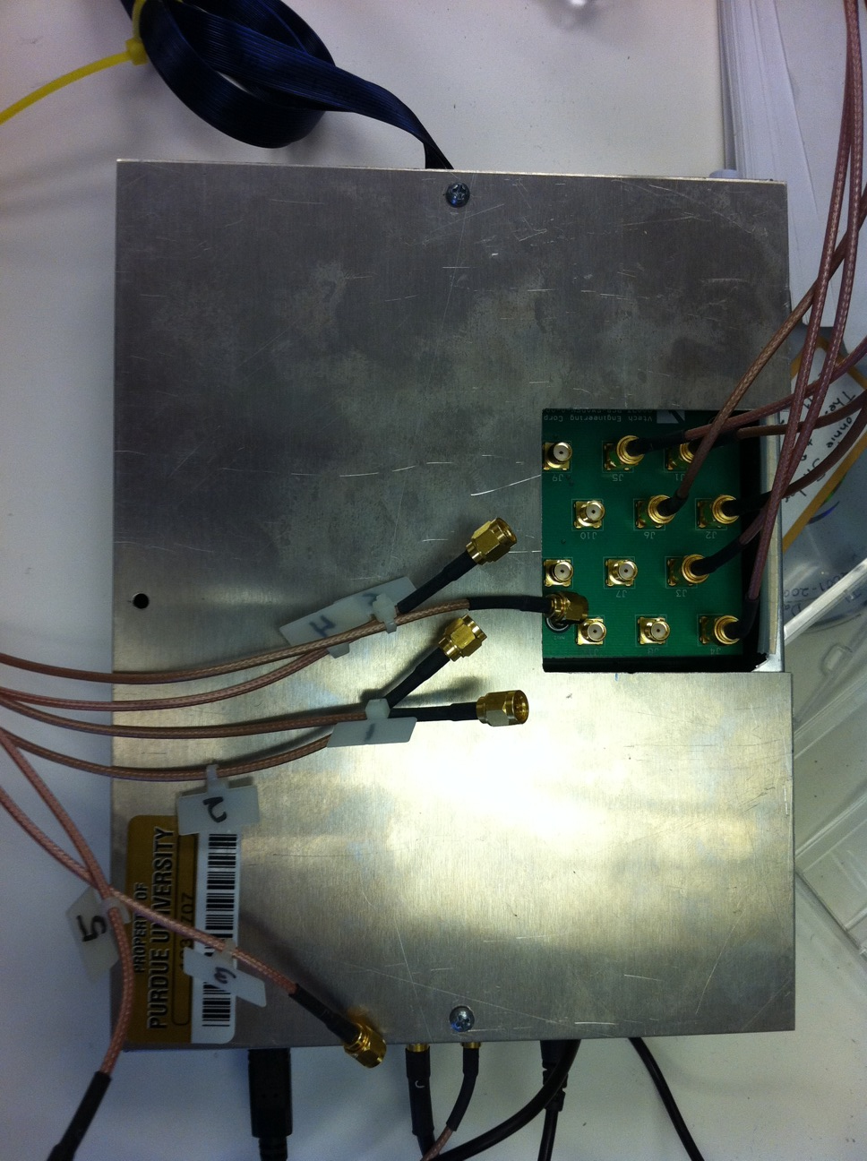
Task 3 - Design the electronics
32 + 32 Ch Electronics
Scatter Electronics Module
Developed by Jim Jones
32ch PMT Holder
Functional 32 + 32 Ch
Electronics Module
In 2004 when we filed the patent, there were no flow cytometers that could collect more than 11colors.
Roederer published 17 color flow cytometry some time in 2004 – probably at the same meeting we presented the first spectral technology at Cyto in Montpelier. We had to develop electronics and hardware system to manage 32 sensors – in addition we had to develop software as well as the optics.

Slide 9
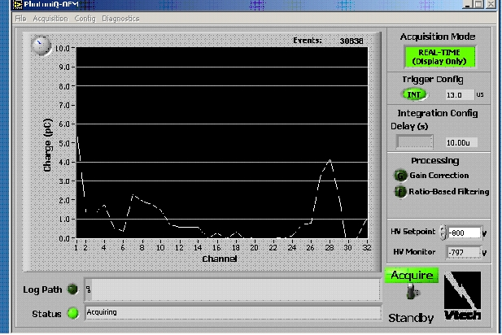
First SPECTRAL DATA COLLECTED
Feb 23, 2004
Flow Check beads
DNA beads with ND Filter
Bangs Beads with PI
These figures show the first data from our spectral flow cytometer – each screen shows a different sample that we used – initially microbeads (5 microns) which are typically used for calibration. The screen shows spectra from about 300 to 800 nm. So, the graphs are intensity (Y axis) vs Wavelength (X axis)

Slide 10
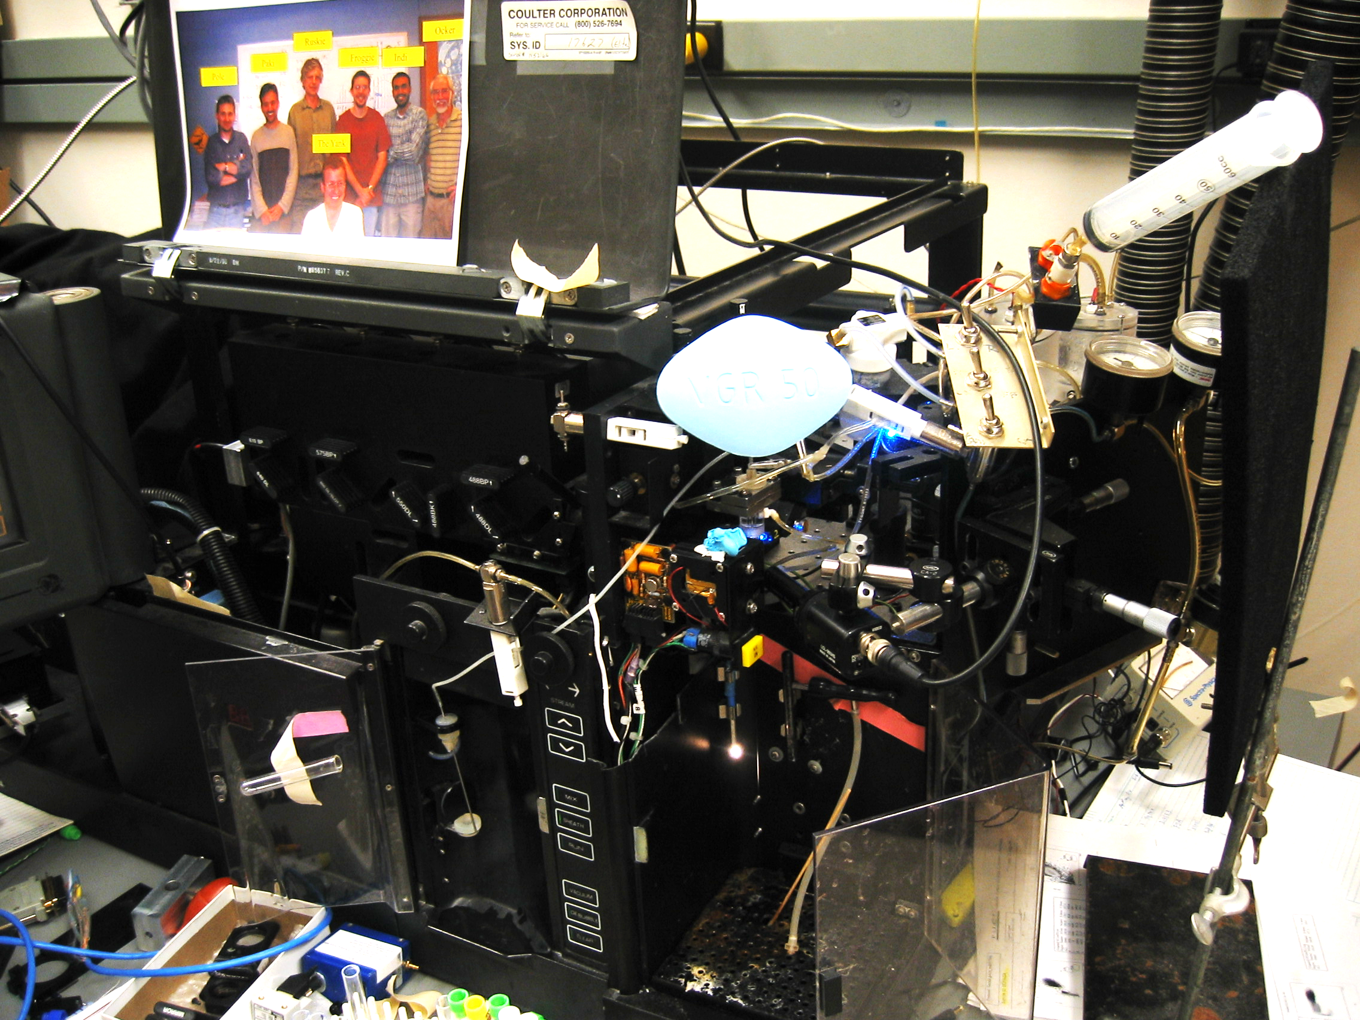
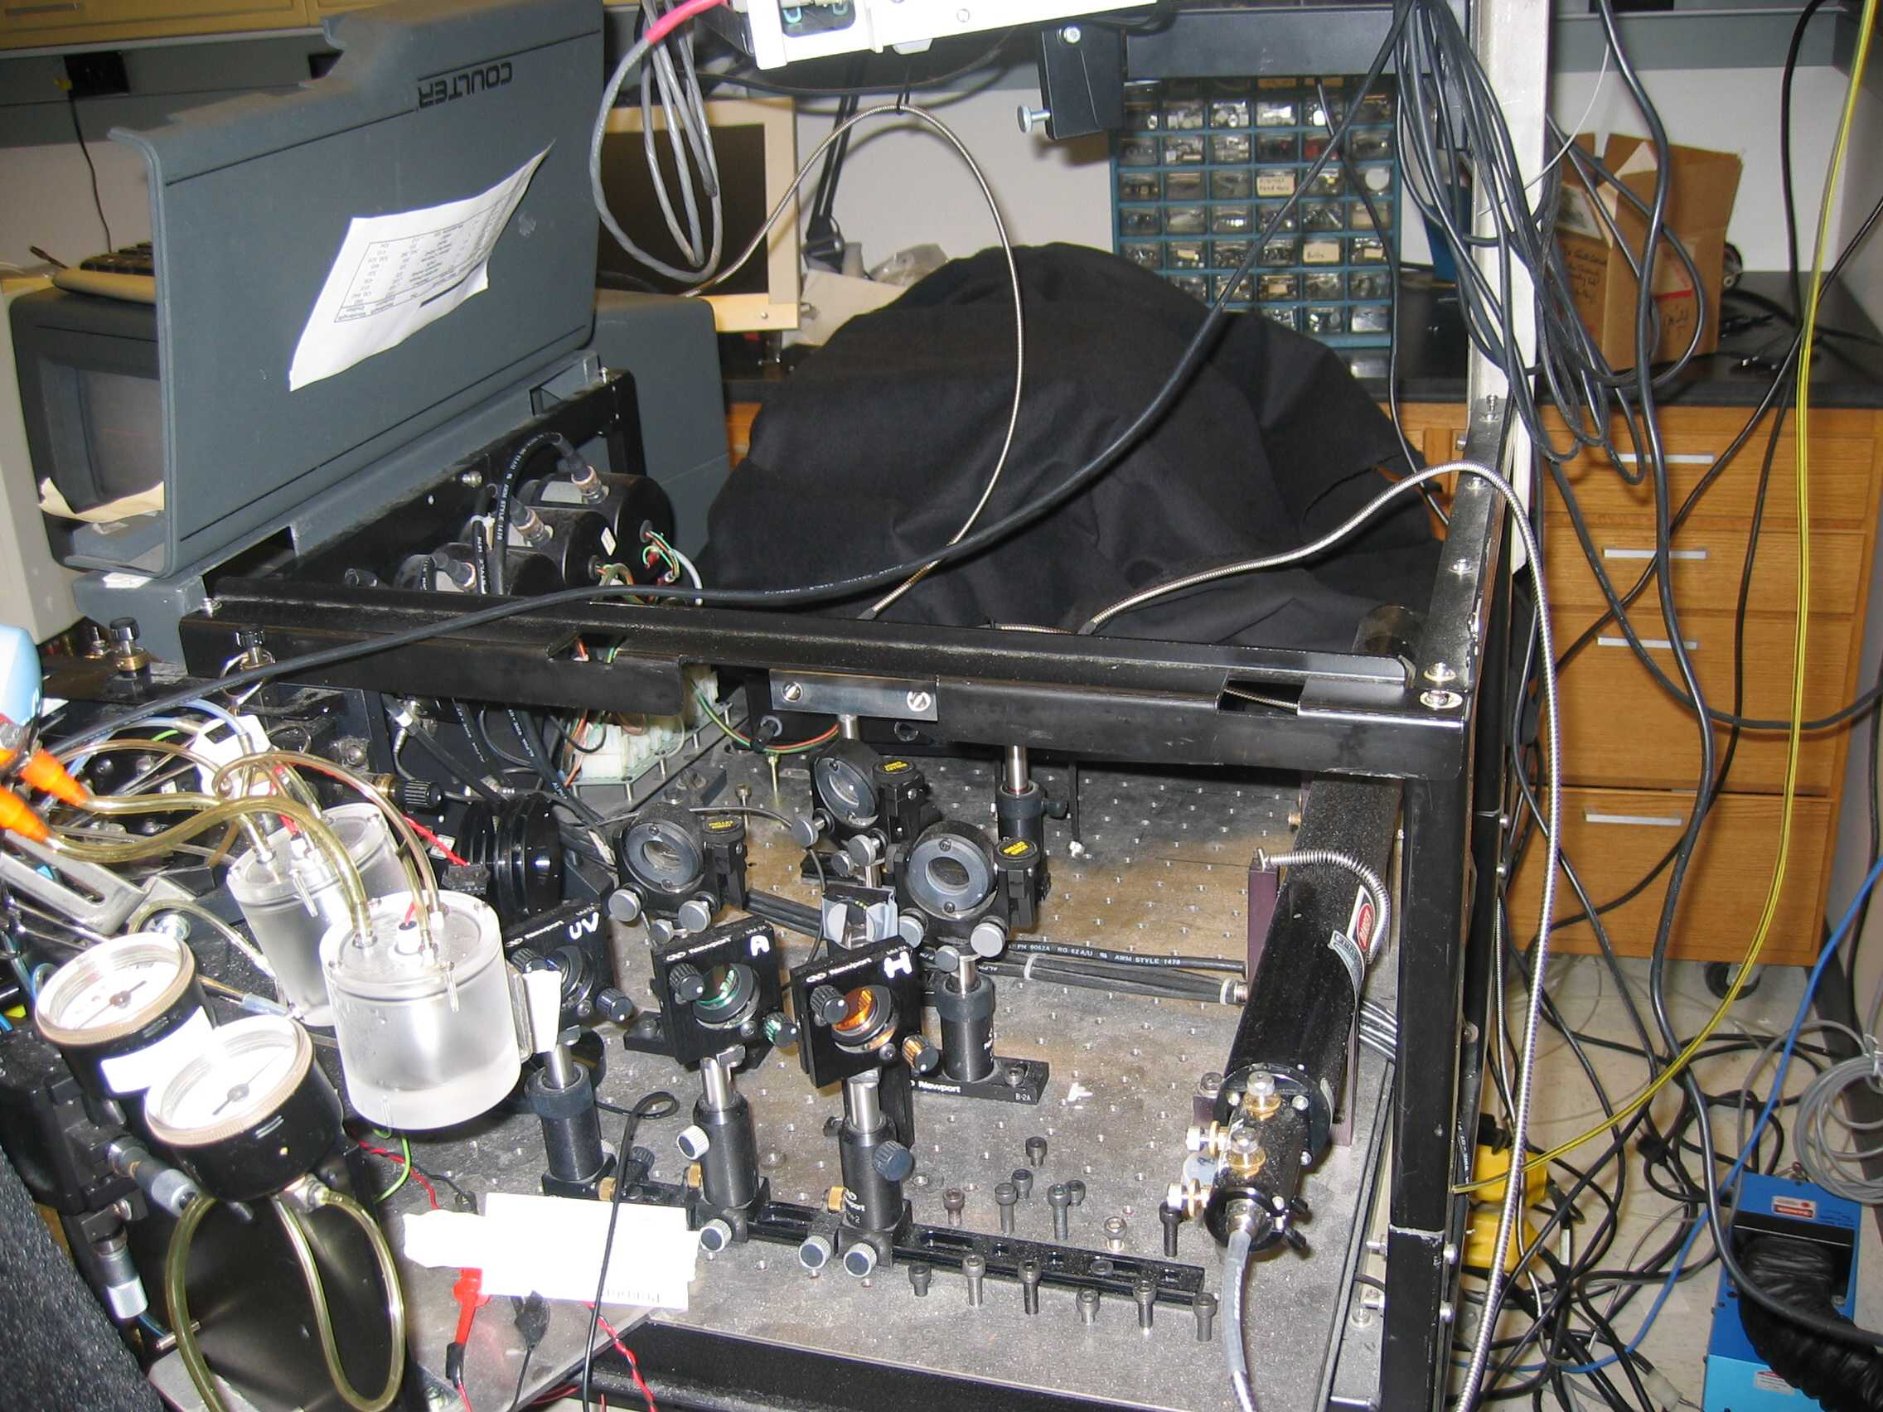
The Prototype instrument
The base-level Spectral cytometer showing optics systems and fluidics. This was built onto an EPICS Elite cell sorter from Coulter.

Slide 11
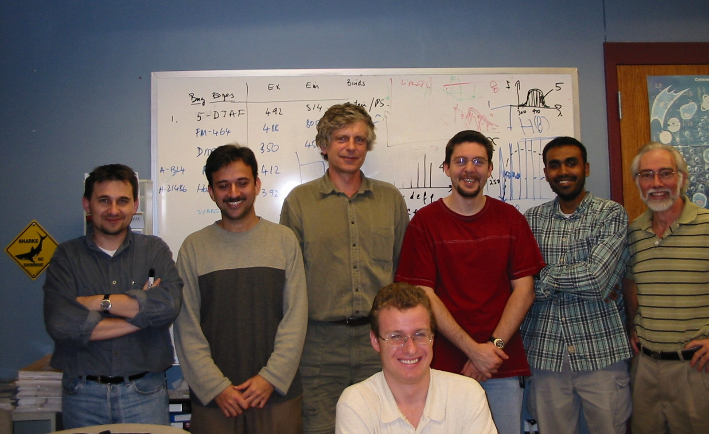
Outstanding team
Valery Patsekin
JPR
Bartek Rajwa
Gerald Gregori
Murugesan
Venkatapathi
Wamiq Ahmed
Silas Leavesley

Slide 12
Spectral Software for flow cytometry did not exist
We developed Cytospec software in 2002-2004 as there was no way to analyze spectral flow cytometry data. It is still in use and currently is at version 11.7 and has some very sophisticated applications.
The current version of CytoSpec, the first spectral software, can be downloaded here
http://www.cyto.purdue.edu/cytospec

Slide 13
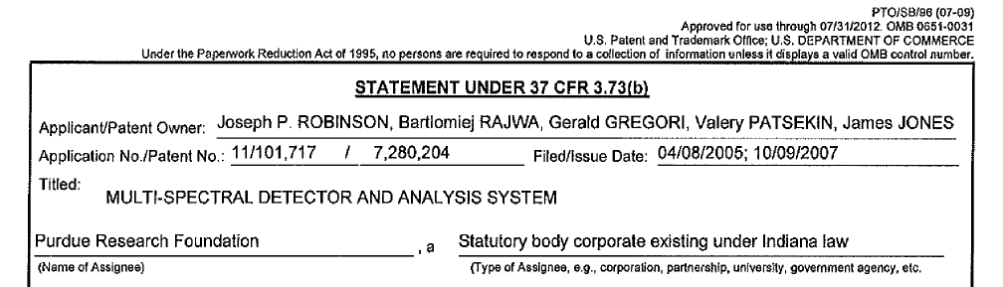
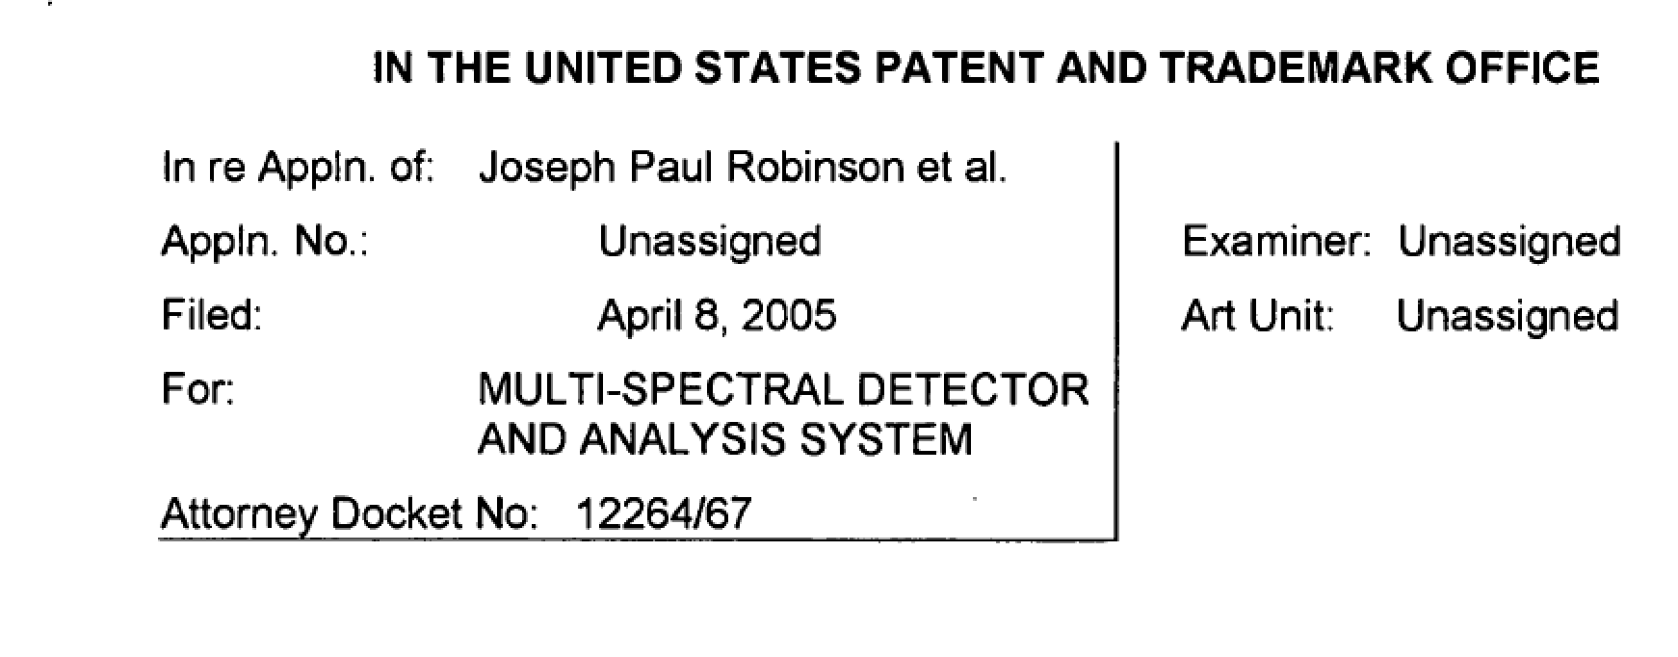
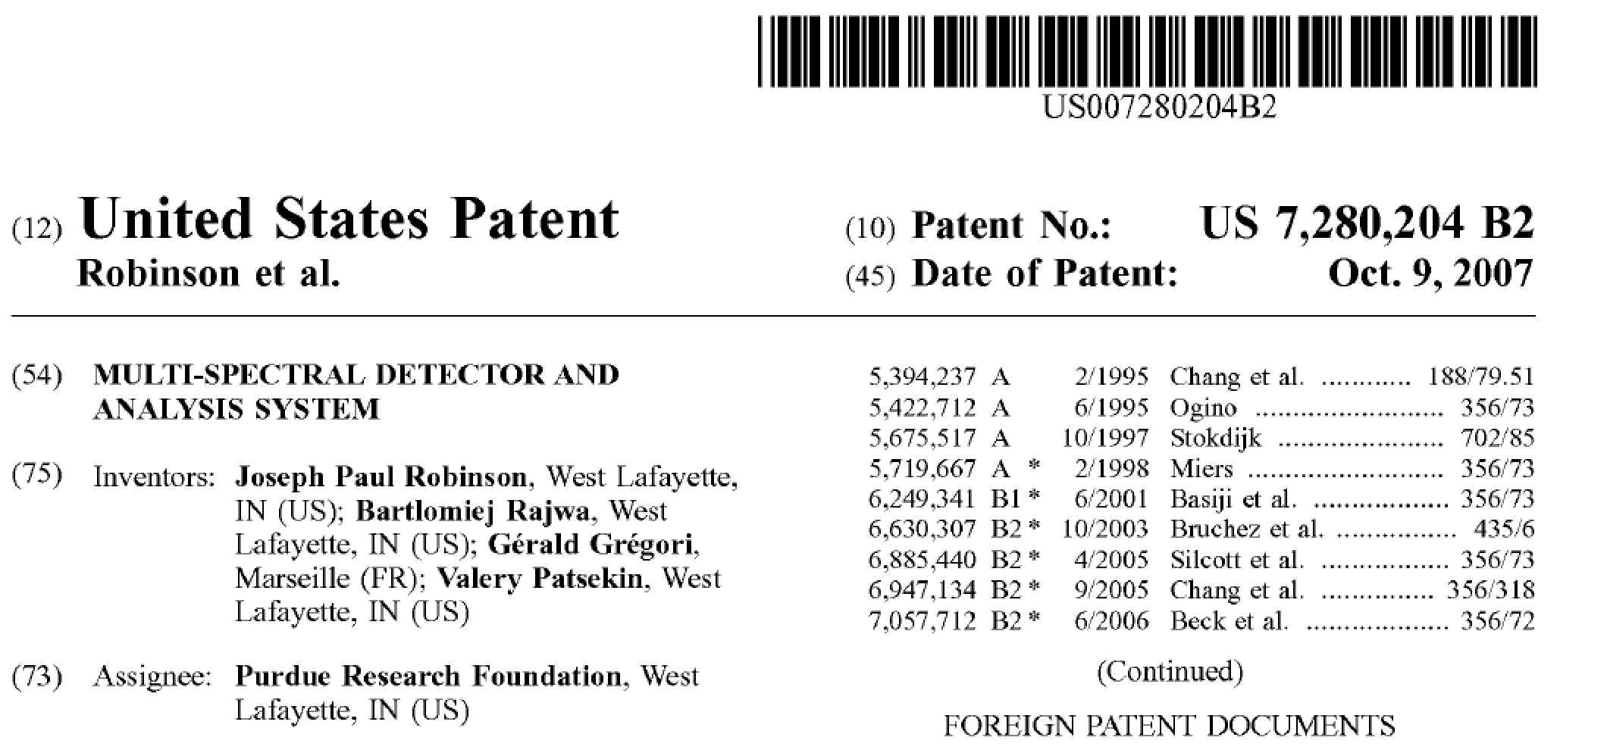
Patents and First Presentation

Slide 14
Sony License
Masanobu Yamamoto (now my business partner in Miftek Corp) who started Sony Life Sciences, visited Purdue in late 2007 in his evaluation of technologies that would be driven by Sony Biotechnology.
We showed Yamamoto-san data and hardware from our Spectral technology although we were not operating the instrument as it was far too complex to maintain as a prototype
In 2008 I worked directly with Yamamoto-san to create a series of workshops around the world to promote microfluidics standardization.
The first meeting was in Budapest, May 2008 where we brought about 20 people to the table including Gary Durack. We met again 3 months later in Eindhoven, Holland at Philips research Center, and again in San Francisco sponsored by Roche
A couple of months later, it was announced that Sony Lifesciences had purchased Durack’s company.
Within a few months, Sony negotiated with Purdue to license our Spectral patent.
Notes:
Consider talking about:
Funding
Other economic considerations

Slide 15
BD- Project Newton
BD’s Project “Newton”
In 2012, we had some meetings with BD regarding the potential to license the Purdue Patent. BD declined to do so, but then set up project Newton which was basically designing an in house spectral flow cytometer. In 2015 for various reasons, BD closed down project Newton and almost all the folks working on Project Newton moved to a new company called Cytek Bioscience. BD sued Cytek and the case documents are in the link below. Cytek settled with BD and this allowed them to go public giving BD a shareholding and royalties from Cytek.
http://www.cyto.purdue.edu/BD_vs_Cytek_legal_case_spectral_flow_cytometry

Slide 16
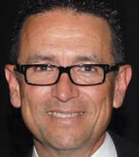
Our interaction with BD - in late 2013 – early 2014
Gerald Gregori and I discussed the opportunity to work with BD and get them involved in Spectral Flow Cytometry
Gerald met Bob Balderas from BD in Marseille. And the French Contact at BD was Florent Navarro and Caroline Maier. There was also a BD guy from UK if I remember well, but Gerald does not recall his name.
Gerald was supposed to have another meeting with Bob, but it was postponed...and then nothing. Flat line. Nothing new happened, beside my emails to Florent (I still have them).
We were also told about a meeting in CA, with Bob and Claude_DARTIGUELONGUE@bd.com.
This was the subject of my email to Bob Balderas on April 19, 2014
04/19/2014 à 23:27, J. Paul Robinson a écrit :
Bob
Hope you are well and not working too hard!
Gerald informed me that the meeting you were to have in France to discuss spectral was postponed.
Is there something we can do to accommodate you? You mentioned the possibility of a presentation in CA - let me know if you are still interested in going that way.
best
paul
Robert Balderas
<robert_balderas@bd.com>

Slide 17
Impact of Sony
Sony Produced the first commercial spectral flow cytometer. For a reason I do not know, they have never publicized the fact that the technology is based on a Purdue ‘204 License.
I believe, but do not have evidence, that Sony actually believed that because they were using a prism array, they were not infringing our patent. But it became increasingly clear that this was not the case, and they signed the license. (I was present in a discussion with Sony Attorney’s when I challenged them that they had taken the idea from us)
Sony sold a significant number of spectral flow cytometers and opened up the market. However, their prices were high – around $350k so the market was hesitant at this price point.
Clearly the high-quality publications coming from Sony instruments opened the floodgates for other companies to look at the technology
Clearly BD saw this and made a decision to invest in Project Newton for 3 years – I estimate at least $20-25M investment in spectral technology
© J. Paul Robinson, Purdue University
Notes:
Consider talking about:
Values
International

Slide 18
Cytek Formation & Presentation
Cytek has been around for about 30 years. Its primary focus was in repair and service of flow cytometers and manufacturing small components to enhance flow cytometry – particularly for things not included by major manufacturers
In about late 2014 Cytek Bioscience was formed and this apparently included the previous employees of Cytek and a number of new employees, mostly coming from BD
Cytek had been preparing to manufacture a traditional polychromatic flow cytometer and when the new company was formed, they released that product and subsequently in June 2017 they released the Aurora a spectral flow cytometer that we believe infringes our Purdue patent
© J. Paul Robinson, Purdue University
Notes:
Consider talking about:
Choice
Autonomous technology
Government

Slide 19
Current Status - Cytek
Cytek has sold between 200-400 instruments within the past 3 years (updated in 2022 ~1500 instruments) and by 2024, may be 3000 instruments
The initial price of the first 100 or so 3 laser instruments was $120,000 (very cheap to break into the market)
There has been universal praise for Cytek’s instruments. Several labs purchased more than one. (one business purchased 10-20 instruments)
At Cytek’s release in May 2017, I estimate there were 6-800 people packed into a hall designed for 300 - it was a huge session and clearly had huge impact.
Since then, they have released a new 5 laser instrument that I understand lists for around $340k – my estimate is around $280k (Govt price) but now it is closer to $400K.
Cytek has received at least $75 million in investment based on data that is publicly available (SEC documents show $200M)
© J. Paul Robinson, Purdue University
Slide modified in 2022

Slide 20
Current Status - BD
BD had Project Newton operating from about 2012-2015
They developed a spectral flow cytometer but did not release it as they shut project Newton down in 2015
MY opinion as to why they closed it down are 3-fold
  They failed to see the future
  BD had released 50 PMT based instruments around ~$1M and could not afford to create a lower price competition instrument
  BD has never been an innovator – they are good at manufacturing quality instruments, but they are all iterative designs
  BD did come to Miftek to discuss where we were on our spectral flow cytometer – they were interested enough to find out what our technology was but did not proceed with Miftek
  I am aware that BD has a prototype spectral flow cytometer in their skunk works. I believe they revitalized this a couple of years ago when they realized the huge mistake they made by dropping the project
  I believe BD has an opinion that the Purdue patent does not cover the collection of spectral data using wide band width band bass filters. Whether or not the patent covers that, it does cover the formation and use of spectral signatures – and so no matter what BD do, they will infringe in my opinion at the least based on the fact that they advertise that they use spectral “signatures”. Purdue patent has several claims on the use of spectral signatures for biological systems..
© J. Paul Robinson, Purdue University

Slide 21
MY personal opinion
I believe that there is no doubt that Cytek is infringing multiple claims in the Purdue patent.
I also believe that because Purdue did not challenge Cytek in 2017, other companies looked at building spectral flow cytometers.
I have heard that Bio-Rad via Propel has been building a spectral flow cytometer –Beckman Coulter is building one, BD already has this internally, but has not disclosed anything publicly except for their modified instrument with broad band filters which they call “spectral” (but if they use “signatures” they will infringe.
I believe that because of the large time span between release of the Cytek instruments and Purdue action, that there are a number of companies that consider the Purdue patent must not be enforceable. This is definitely the word on the street. I was told by colleagues at a several companies that they had heard this same story.
It is my opinion now, and has been since 2004, that all future flow cytometers are going to use spectral technology. It is cheaper, better, and more accurate. Spectral can collect data from samples that polychromatic instruments cannot run. There are no restriction in dyes, or combination of dyes, so it is a universal technology.

Slide 22
Update in 2024
In 2022, Miftek Corporation took control of the Purdue ‘204 patent in its entirety. It is now owned by Miftek Corp.
Miftek has been developing some new technologies and decided that it was prudent to ensure that Miftek did not infringe the Purdue ’204 patent so purchasing it, was the easiest mechanism
Miftek has developed a new sensor technology that is orders of magnitude faster than current systems and plans to utilize that in some new approaches to cell analysis.
Miftek now has an additional 14 patents in the area of single photon detection, associated electronics, data manipulation and related areas.

