Slide 1
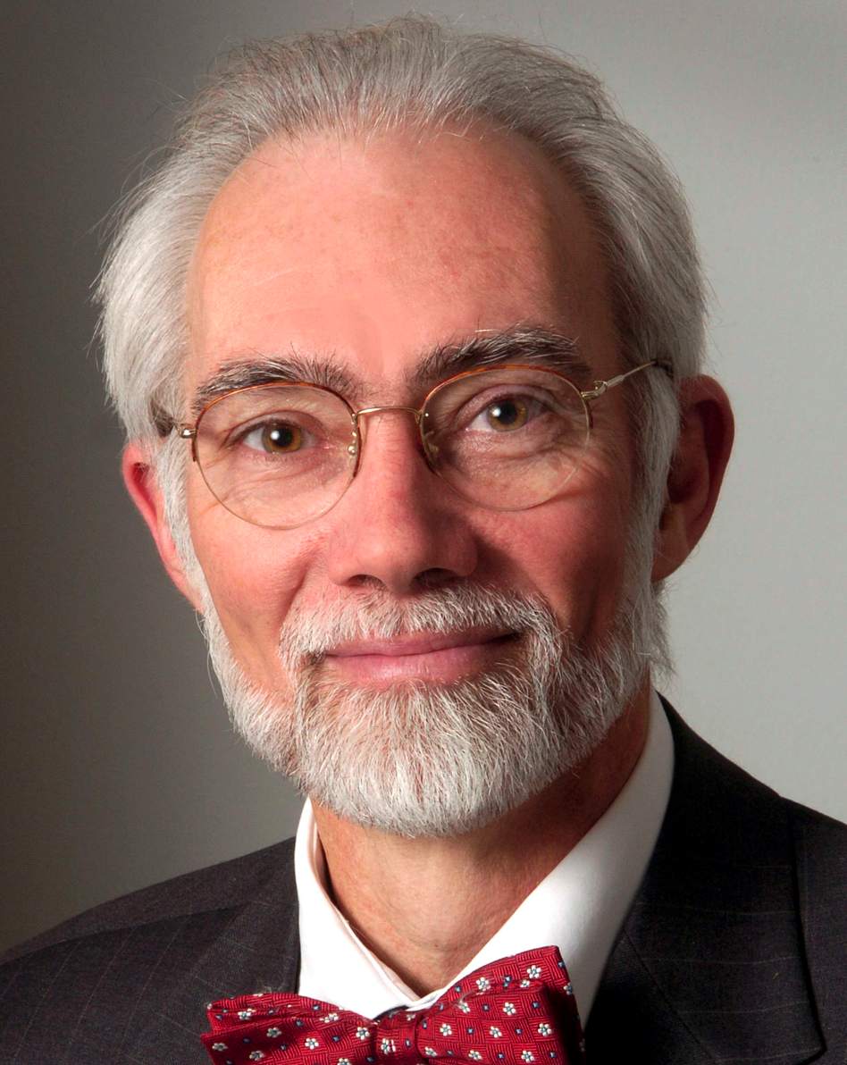
Historical Review of Microscopic Imaging
BMS 524 - Lecture 1, 2 and 3
How did we end up with all the components of modern Microscopy?
The first couple of lectures will introduce you to how each component was invented.
J. Paul Robinson, Ph.D.
Distinguished Professor of Cytometry
& Prof. Biomedical Engineering
Director, Purdue University Cytometry Laboratories
Notice: The materials in this presentation are copyrighted materials. If you want to use any of these slides, you may do so if you credit each slide with the author’s name. No commercial use is allowed. Posting on Course Hero or any other site is Illegal.
UPDATED January2024

Slide 2
Learning Objectives - Lecture 1 this is in 2 parts – Pt#1 and Pt#2 Pt#3
http://www.cyto.purdue.edu
http://www.cyto.purdue.edu/class/bms524/index.htm
Goals and Evaluation
1CR class – goal is to provide a basis for understanding the basics of microscopy, and the nature of images and their correct usage.
Evaluation will be based on a take home exam at the end of the semester.
Understand the invention process of microscopy over several centuries
Learn why each inventor had to change the technology
Discovery why new algorithms changed the process of microscopy
See how these discoveries impact how we use technology today

Slide 3

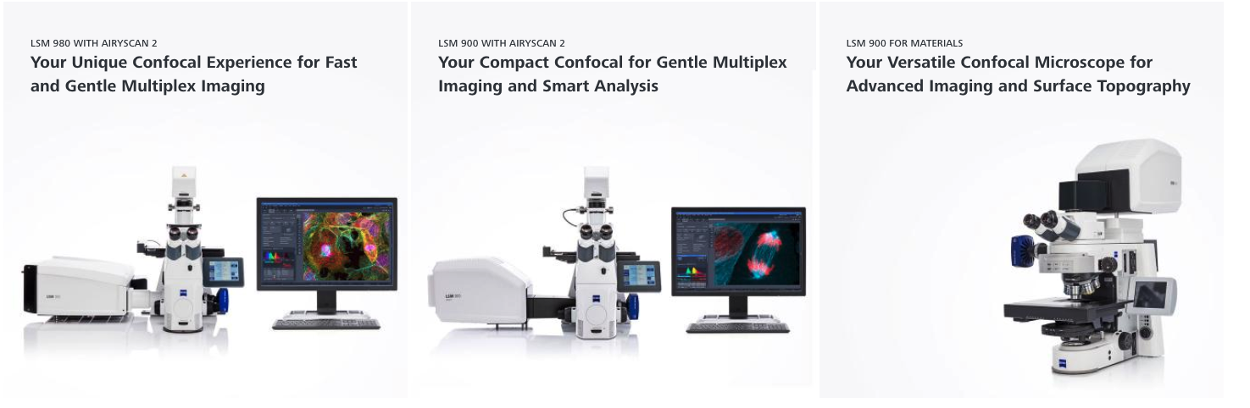
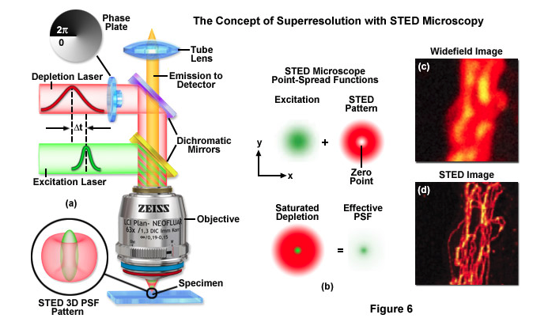
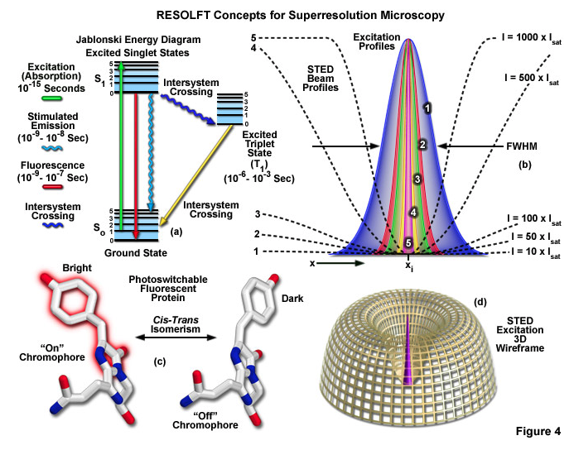
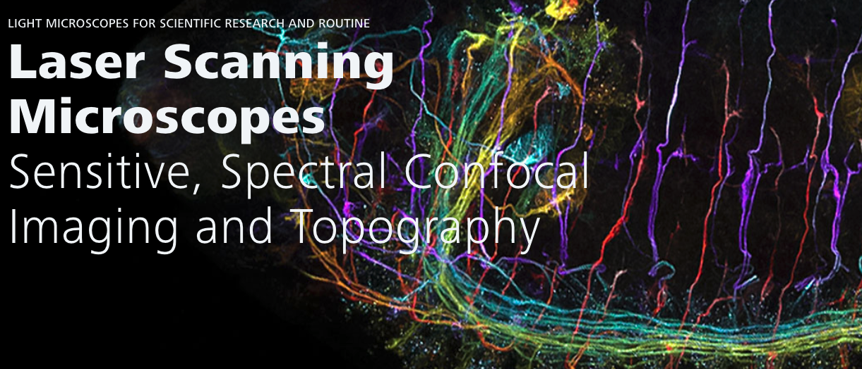
Commercial Super Resolution Systems
https://www.zeiss.com/microscopy/en/products/light-microscopes/super-resolution-microscopes.html

Slide 4
Introduction
Early Microscope History
Fundamental Discoveries
Key Individuals in the 17, 18 and 19th centuries
Modern Microscopy – 20th century

Slide 5
Hans & Zacharias Janssen 1690
1590
1590 - Hans & Zacharias Janssen of Middleburg, Holland manufactured the first compound microscopes
Image from https://www.livescience.com/39649-who-invented-the-microscope.html
Image from https://www.interestingworldfacts.com/10-interesting-facts-about-zacharias-janssen/
Galileo Galilei soon improved upon the compound microscope design in 1609. Galileo called his device an occhiolino, or "little eye."

Slide 6
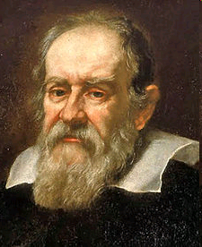
Galileo Galilei (1564-1642)
1610
1610 - he began publicly supporting the heliocentric
view, which placed the Sun at the centre of the universe
Galileo has been variously called
  the "father of modern observational astronomy
  the "father of modern physics
  the "father of science
The name "telescope" was coined for Galileo's instrument by a Greek mathematician, Giovanni Demisiani, at a banquet held in 1611 by Prince Federico Cesi to make Galileo a member of his Accademia dei Lincei (literally the "Academy of the Lynx-Eyed", but anglicised as the Lincean Academy)(Per Wikipedia)
Giovanni Faber coined the word microscope from the Greek word μικρόν (micron) meaning "small", and σκοπεῖν (skopein) meaning "to look at".
The Linceans played a role again in naming the "microscope" a year later when fellow academy member Giovanni Faber coined the word for Galileo's invention from the Greek words μικρόν (micron) meaning "small," and σκοπεῖν (skopein) meaning "to look at."

Slide 7
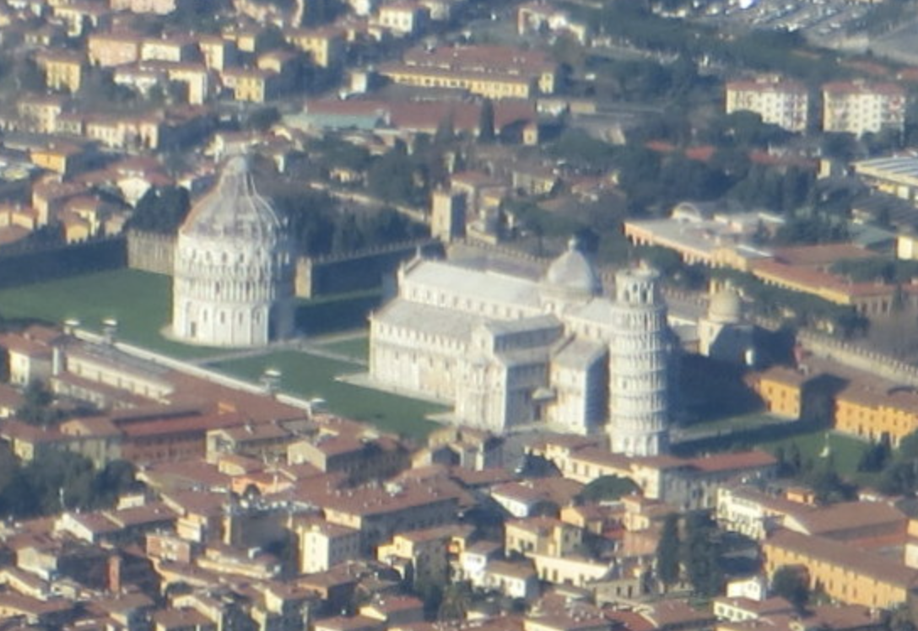
Galileo Galilei (1564-1642)
Entered University of Pisa in 1581 to study medicine
…and flunked out….!! and was eventually given a faculty position there despite no degree!
1610
1610 - he began publicly supporting the heliocentric view, which placed the Sun at the centre of the universe
Galileo has been variously called
  the "father of modern observational astronomy
  the "father of modern physics
  the "father of science

Slide 8
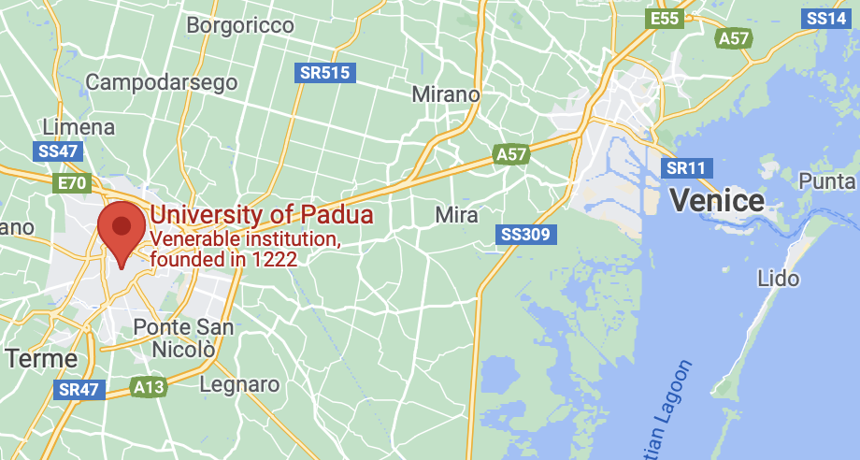
Galileo Galilei (1564-1642)
…well the university eventually fired him….and he move to the university of Padua…..
1610
in 1609 Galileo built an optical device that could magnify images up to 10 times…..
The name "telescope" was coined for Galileo's instrument by a Greek mathematician, Giovanni Demisiani, at a banquet held in 1611 by Prince Federico Cesi to make Galileo a member of his Accademia dei Lincei (literally the "Academy of the Lynx-Eyed", but anglicized as the Lincean Academy)(Per Wikipedia 1610 - he began publicly supporting the heliocentric view, which placed the Sun at the center of the universe

Slide 9
Galileo Galilei (1564-1642)
In 1610, he used a telescope at close range to magnify the parts of insects.
Denounced to the Roman Inquisition early in 1615 and by 1624 he had perfected a compound microscope (by inverting his telescope!)
1610
Giovanni Faber coined the name microscope for the compound microscope Galileo submitted to the Accademia dei Lincei in 1625 (Galileo had called it the "occhiolino" or "little eye"). (This academy disappeared after 1651)
Published “Dialogue Concerning the Two Chief World Systems” in 1632, and was tried by the Inquisition, found "vehemently suspect of heresy," forced to recant, and spent the rest of his life under house arrest (to 1642)
Read up on Nicolau Copernicus …..and Published “Dialogue Concerning the Two Chief World Systems” in 1632, and was tried by the Inquisition, found "vehemently suspect of heresy," forced to recant, and spent the rest of his life under house arrest (to 1642)

Slide 10
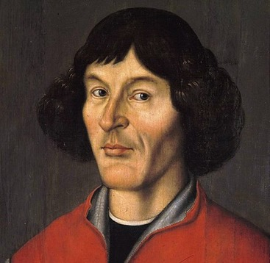
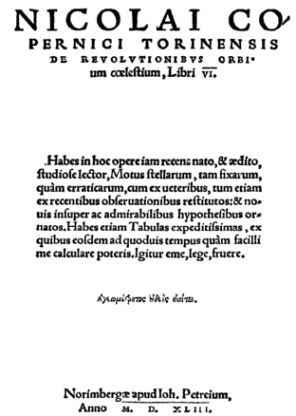
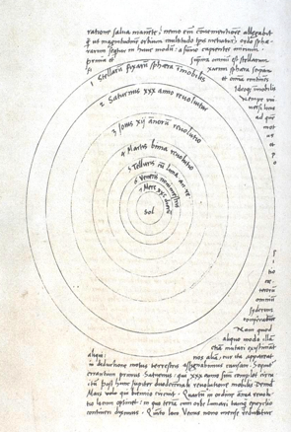
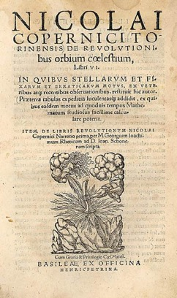
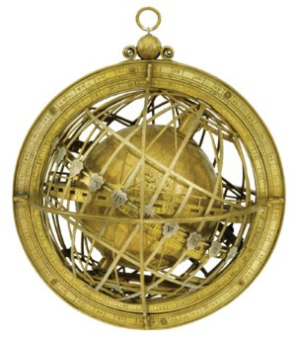
So, what about Copernicus (1473-1543)?
Studied from 1491-1495 at the Jagiellonian University in Kraków, Poland
..and also at the University of Padua
image from https://en.wikipedia.org/wiki/Nicolaus_Copernicus
De revolutionibus orbium coelestium (1543)
De revolutionibus
Published
https://en.wikipedia.org/wiki/De_revolutionibus_orbium_coelestium#/media/File:De_revolutionibus_1543.png

Slide 11
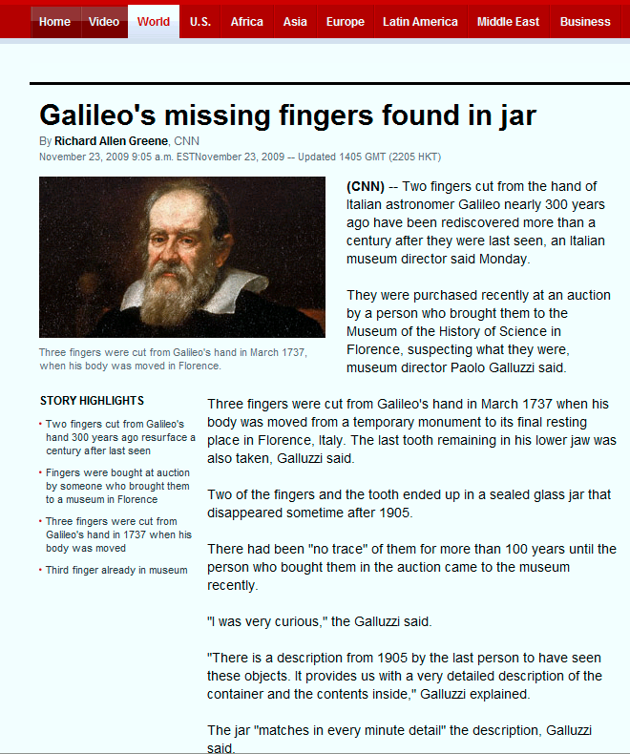

Slide 12
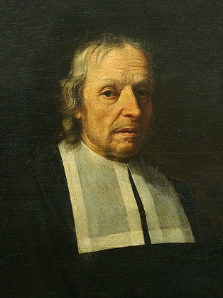
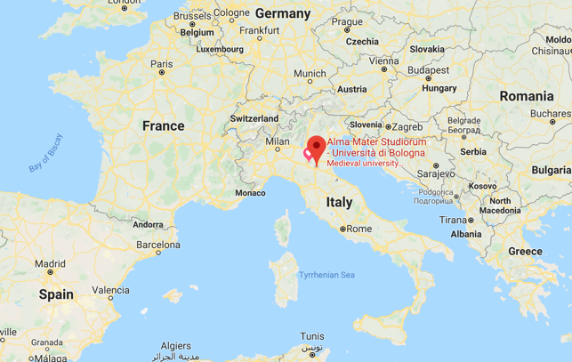
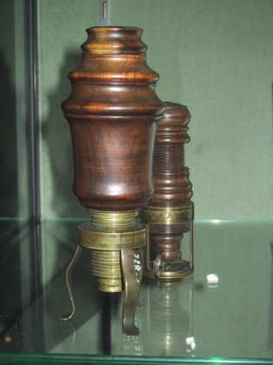
Marcello Malpighi (1628-1694)
University of Bologna
1660
https://en.wikipedia.org/wiki/Marcello_Malpighi
1660 - Marcello Malpighi (1628-1694), was one of the first great microscopists, considered the father embryology and early histology
Italian professor of medicine. He spent much of his time at the University of Bologna.
Observed capillaries in 1660
Wrote observations on how blood clots
First to observe bordered pits in wood sections.
Gave first account of the development of the seed.
Malpighi was made a member of the Royal Society in 1669
Photo: © J. Paul Robinson

Slide 13
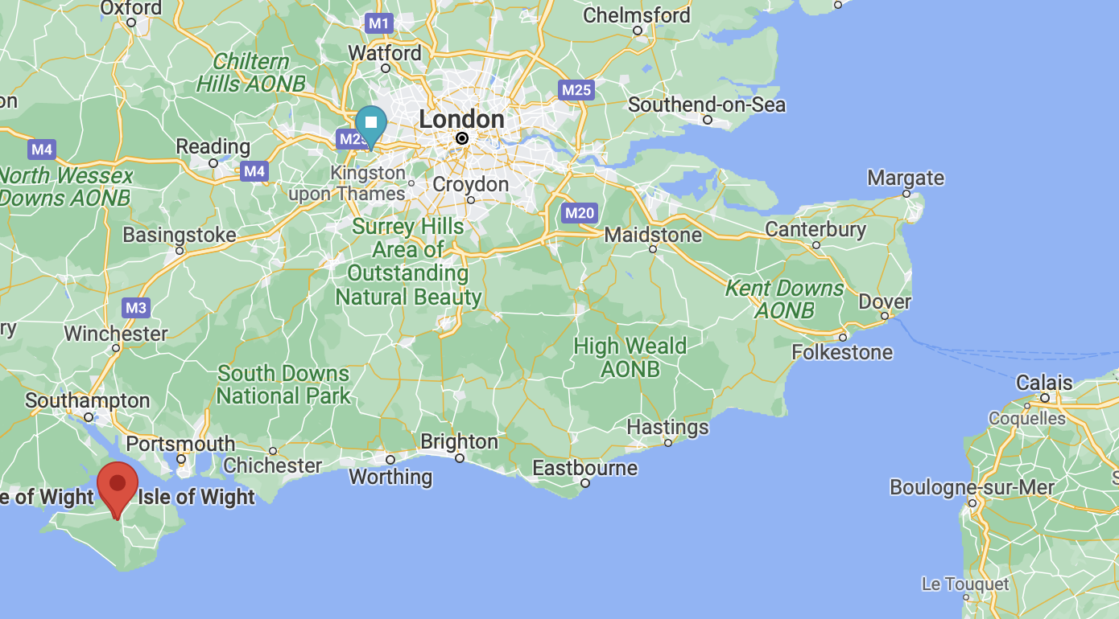
Robert Hooke (1635-1703) (often written as Hook)
Born on England's Isle of Wight in 1635
In 1653, Hooke enrolled at Oxford's Christ Church College and became an assistant to the chemist Robert Boyle
Hooke had very influential friends (Robert Boyle, Christopher Wren)
Hooke was a critical person in the aftermath of the great fire of London in 1666 – re0organizaing many of the city facilities working directly with Christopher Wren
1665
https://www.biography.com/scholar/robert-hooke
No good likeness exists of Robert Hooke for a reason we do not know….
The 1678 publication of Hooke's Lectures of Spring shared his theory of elasticity; in what came to be known as "Hooke’s Law," he stated that the force required to extend or compress a spring is proportional to the distance of that extension or compression.
Isle of Wight
Photos: © J. Paul Robinson
Photo JP Robinson 2003
Oxford University

Slide 14
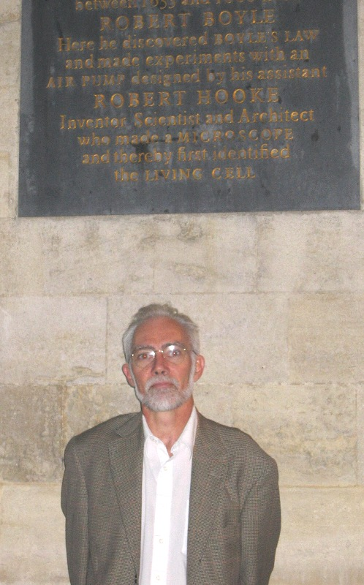
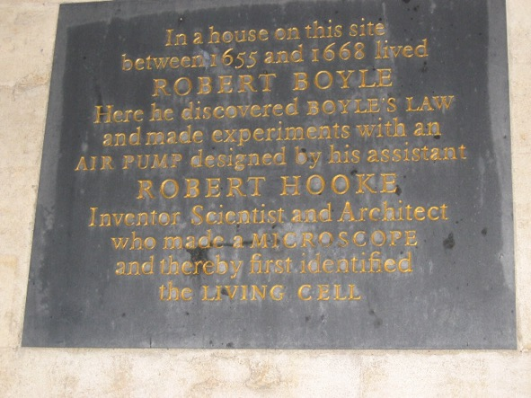
Robert Hooke was Robert Boyle’s laboratory Assistant!
Was an architect in London, England
Robert Hooke was Robert Boyle’s laboratory Assistant at Oxford university (1655-1662)
Built vacuum pumps for Boyle
Built early reflecting telescopes (Gregorian)
first to suggest that matter expands when heated
First to suggest that air is made of small particles separated by relatively large distances.
1665
Me! (not Robert Hooke!)
Photos: © J. Paul Robinson 2003
Photos: © J. Paul Robinson 2003
Oxford University

Slide 15
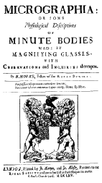
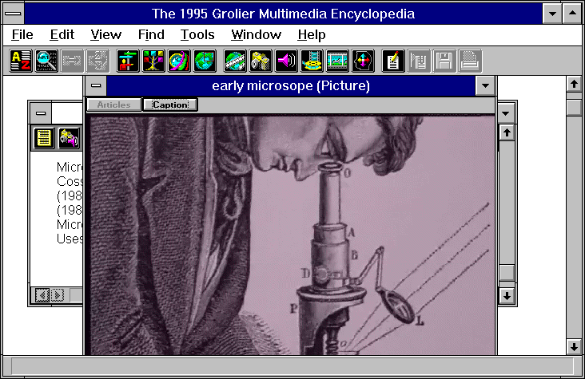
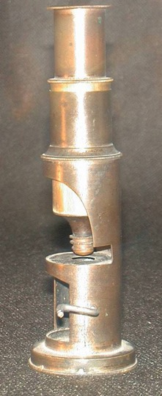
Robert Hooke (1635-1703)
1665 - Robert Hooke (1635-1703)- book Micrographia, published in 1665, devised the compound microscope most famous microscopical observation was his study of thin slices of cork. Named the term “Cell”
1665
Photo: © J. Paul Robinson
The Royal Society of London founded in 1660 by Christopher Wren, Robert Boyle and John Wilkins. Robert Hooke was a member by 1665 and published the first works of the Royal Society in his Micrgraphia
The Royal Society's motto 'Nullius in verba' means 'take nobody's word for it'.
© J.Paul Robinson

Slide 16
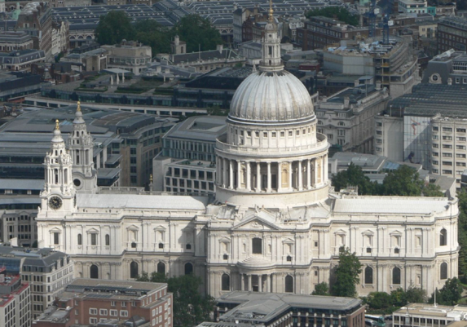
The great Fire of London September 1666
1666
St Paul’s Cathedral designed by Christopher Wren
The Great Fire of London swept through the central parts of the English city from Sunday, 2 September to Thursday, 6 September 1666. The fire gutted the medieval City of London inside the old Roman city wall. It threatened but did not reach the aristocratic district of Westminster, Charles II's Palace of Whitehall, or most of the suburban slums. It consumed 13,200 houses, 87 parish churches, St Paul's Cathedral, and most of the buildings of the City authorities. It is estimated to have destroyed the homes of 70,000 of the city's 80,000 inhabitants
© J.Paul Robinson
https://en.wikipedia.org/wiki/Great_Fire_of_London

Slide 17
Philosophical Transactions
(1665…The first Scientific Journal)
1665
Hooke was the “Curator of Experiments” to the Royal Society. In such a position it was his responsibility to demonstrate that many ideas sent into the Society, were accurate. This gave him a lot of power, but little time to do his own experiments apparently. It also created friction with Issac Newton who was at Cambridge University – the main competitor to Oxford University!
© J.Paul Robinson

Slide 18
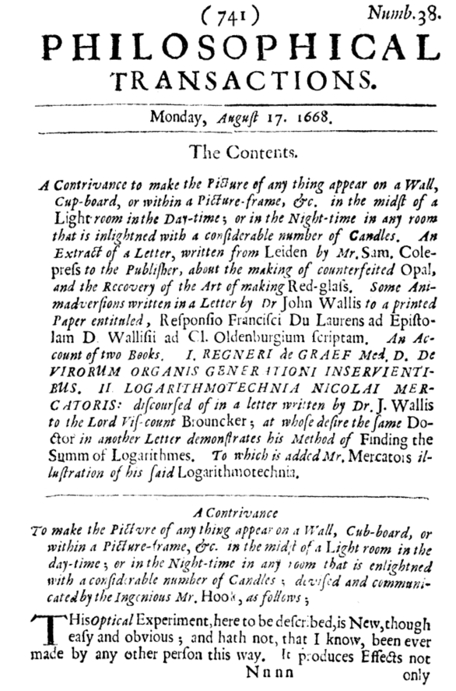
“Robert Hook”
1668
A Contrivance to Make the Picture of Any Thing Appear on a Wall, Cub-Board, or within a Picture-Frame, &c. in the Midst of a Light Room in the Day-Time; Or in the Night-Time in Any Room That is Enlightned with a Considerable Number of Candles;
Devised and Communicated by the Ingenious Mr. Hook, as Follows

Slide 19
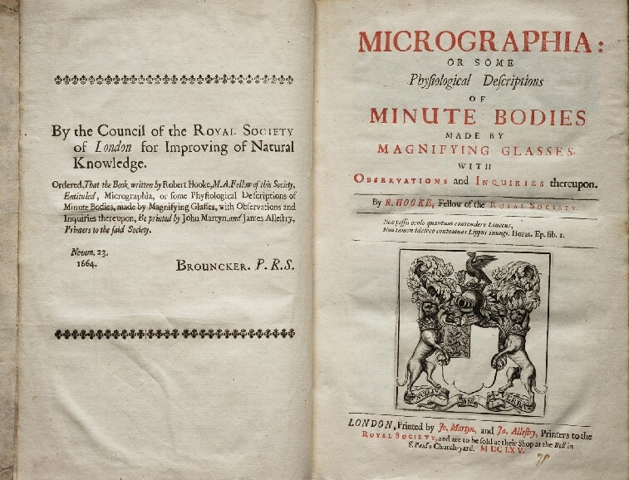

Slide 20
Robert Hooke (1635-1703)
  “. . . I could exceedingly plainly perceive it to be all perforated and porous. . . these pores, or cells, . . . were indeed the first microscopical pores I ever saw, and perhaps, that were ever seen, for I had not met with any Writer or Person, that had made any mention of them before this.” Robert Hooke
1665
Note: this is the famous Robert Hooke quote that is in every textbook, quoted in every manuscript….
But it is actually not a direct quote – it is a classic quote that one person used and everyone else then quotes…

Slide 21
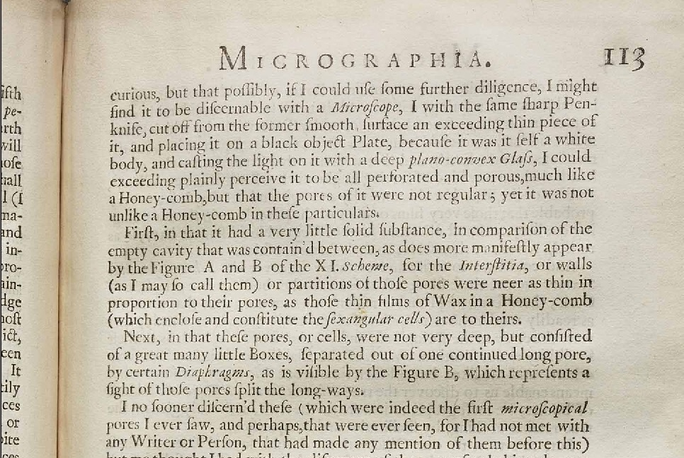
1665

Slide 22
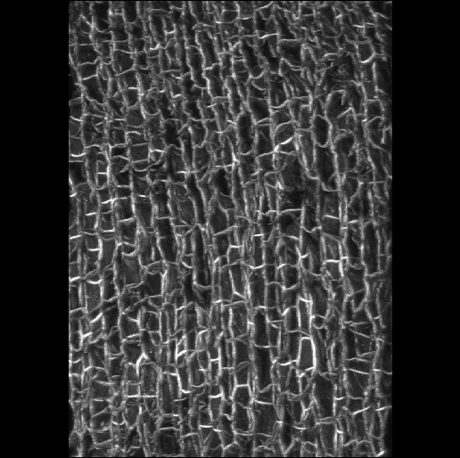
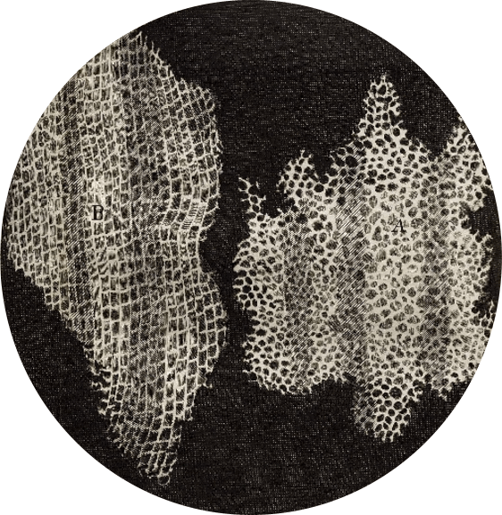
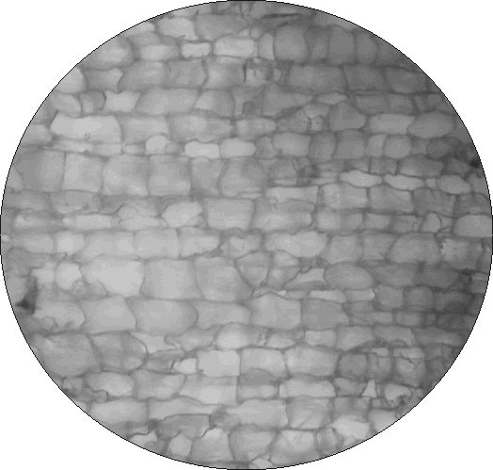
What did Hooke see when he looked at cork?
1665
A confocal
microscope view
of cork
…And even higher
Magnification in 3D
Hooke, 1665
The Purdue version of the
Hooke cork (2002)
Photos: © J. Paul Robinson

Slide 23
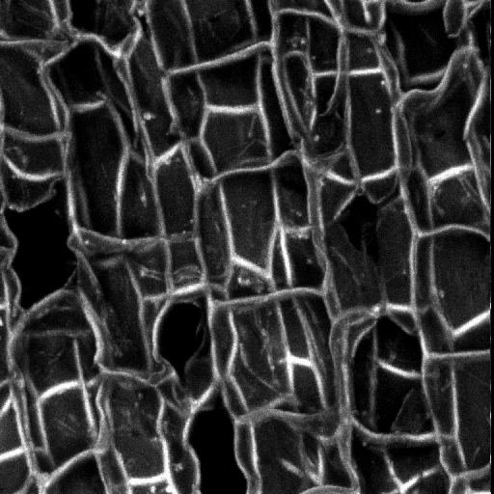

Slide 24
Hooke demonstrated an accurate method of finding the magnifying power of a compound microscope
" Having rectified the microscope to see the desired object through it very distinctly, at the same time that I look upon the object through the glass with one eye, I look upon other objects at the same distance with my other bare eye; by which means I am able, by the help of a ruler divided into inches and small parts, and laid on the pedestal of the microscope, to cast, as it were, the magnified appearance of the object upon the ruler, and thereby exactly to measure the diameter it appears of through the glass, which being compared with the diameter it appears of to the naked eye, will easily afford the quantity of its magnifying."
1665
And how to make high power lenses
" If you take a clear piece of Venice glass, and, in a lamp, draw it out into fine threads, and then hold the ends of these threads in the flame, until they melt, they will run into a small round globule or drop, which will hang to the end of the thread; having made a number of these, they are all to be stuck upon the end of a stick with a little sealing-wax, with the threads standing uppermost ; these ends are to be ground off first on a whetstone, and then polished on a metal plate with tripoli. The lenses thus finished, if placed against a small hole made in a thin piece of metal, and fixed there with wax, will both magnify and make some objects more distinct than any of the great microscopes can do."

Slide 25
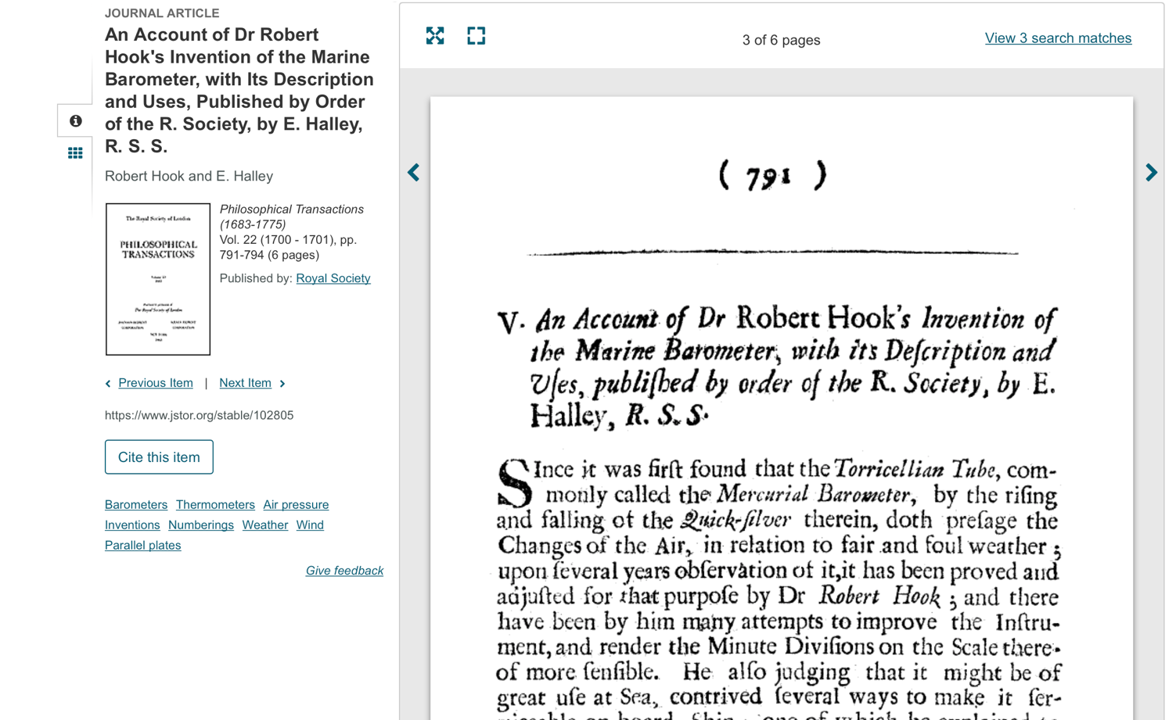
Robert Hook (Robert Hooke) Published in 1700
1700

Slide 26
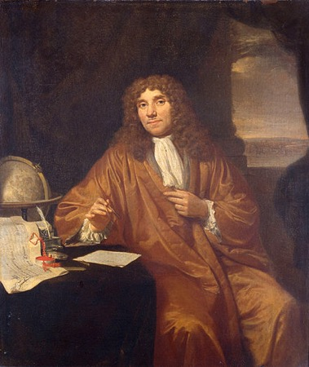
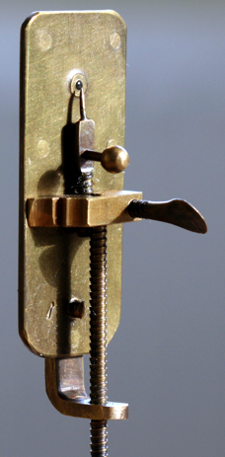
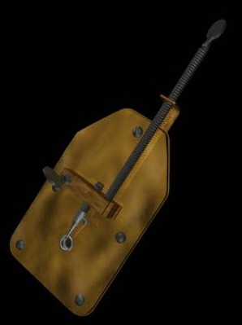

Antioni van Leeuwenhoek (1632-1723)
1673 - Antioni van Leeuwenhoek - Delft, Holland, worked as a draper (a fabric merchant); he is also known to have worked as a surveyor, a wine assayer, and as a minor city official.
Leeuwenhoek is incorrectly called "the inventor of the microscope"
Created a “simple” microscope that could magnify to about 275x, and published drawings of microorganisms in 1683
1673
Images from https://en.wikipedia.org/wiki/Antonie_van_Leeuwenhoek

Slide 27
Antioni van Leeuwenhoek (1632-1723)
Why did he develop an interest in Lens making?
Because as a draper he had difficulty in seeing the quality of thread!!
Could reach magnifications of over 200x with simple ground lenses - however compound microscopes were mostly of poor quality and could only magnify up to 20-30 times. Hooke claimed they were too difficult to use - his eyesight was poor.
Discovered bacteria, free-living and parasitic microscopic protists, sperm cells, blood cells, microscopic nematodes
In 1673, Leeuwenhoek began writing letters to the Royal Society of London - published in Philosophical Transactions of the Royal Society
In 1680 he was elected a full member of the Royal Society, joining Robert Hooke, Henry Oldenburg, Robert Boyle, Christopher Wren
He wrote over 190 published letters to the Royal Society on his scientific findings
His original specimens are still in the Royal Society Collection in London
1673

Slide 28
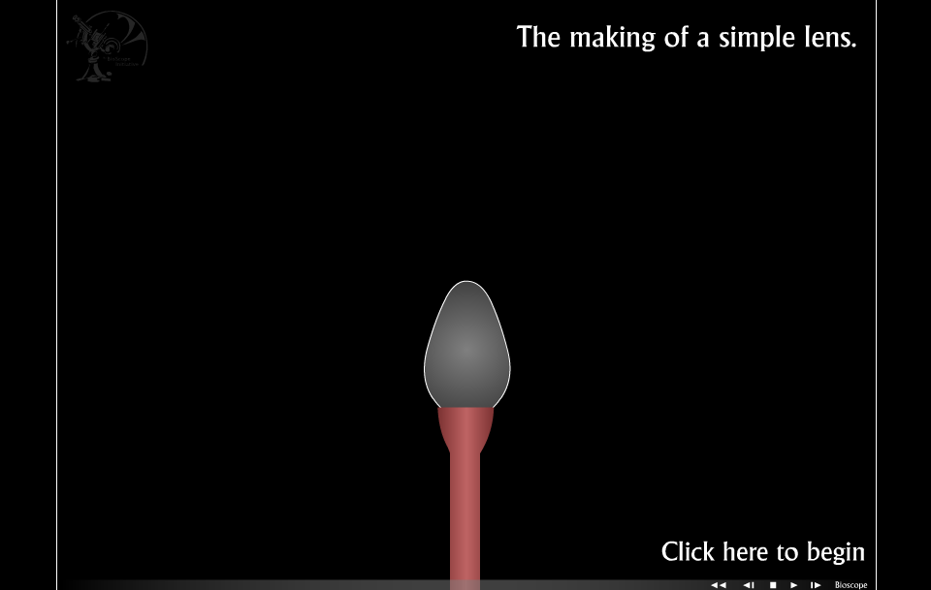
How the first lenses were made

Slide 29
Antioni van Leeuwenhoek (1632-1723)
Accounts of his lenses
"It has been stated by many authors," says Baker ( On Microscopes, vol. ii.), " that the magnifiers used by Leeuwenhoek were globules or spheres of glass, like those invented by Hooke, but such is not the case ; he assures us that in the cabinet of the twenty-six microscopes, left by that famous man at his death to the Royal Society as a legacy, each instrument has a double convex lens, and not a sphere or globule.” p6
1673
" All the parts of these microscopes," says Baker, " are of silver, and fashioned by Mr. Leeuwenhoek's own hand, and the glasses, which are excellent, were all ground and set by himself, each instrument being devoted to one or two objects only, and could be applied to nothing else. This method induced him to make a microscope with a glass adapted to almost every object, till he had got some hundreds of them. The highest magnifying power was 160 diameters, and the lowest 40.” (P7)

Slide 30
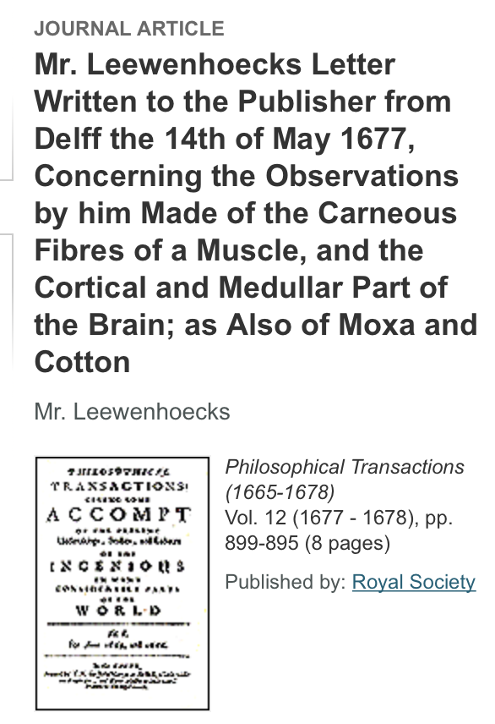
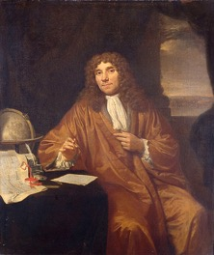
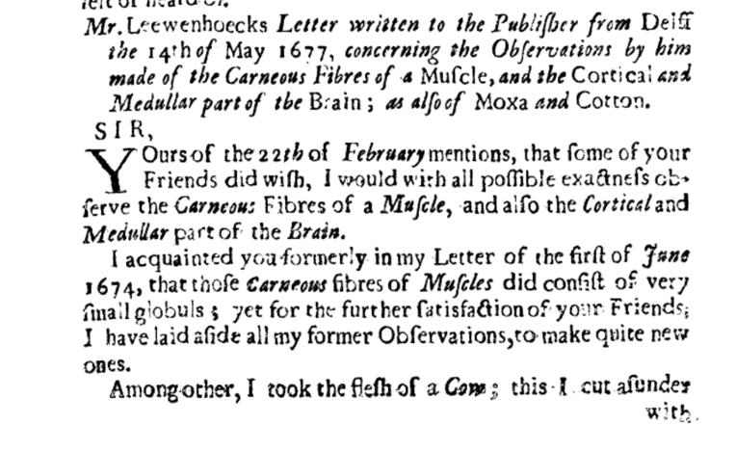
Antioni van Leeuwenhoek (1632-1723)
1677
“An Extract of a Letter from Monsieur Anthony van Leuwenhock to the Royal Society, Containing the History of the Generation of an Insect, by Him Called, The Wolf. With Observations on Insects Bred in Rain-Water, in Apples, Cheese, etc.”
Philosophical Transactions (1683-1775)
Vol. 18 (1694), pp. 194-200 (9 pages)
Published by: Royal Society

Slide 31
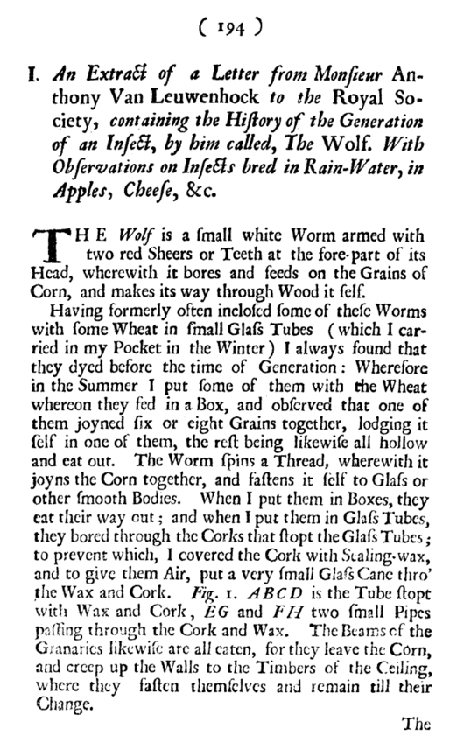
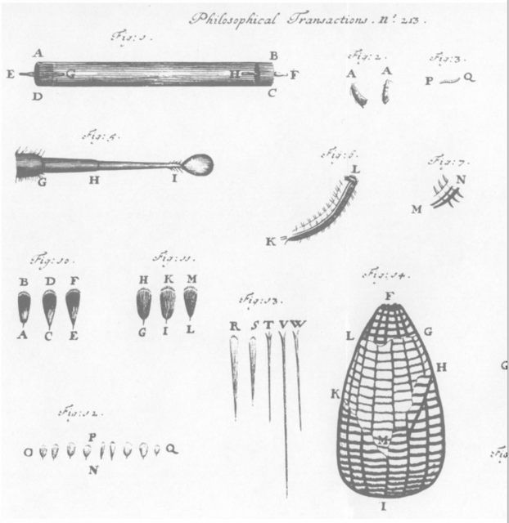
Antioni van Leeuwenhoek (1632-1723)
1694
“An Extract of a Letter from Monsieur Anthony van Leuwenhock to the Royal Society, Containing the History of the Generation of an Insect, by Him Called, The Wolf. With Observations on Insects Bred in Rain-Water, in Apples, Cheese, etc.”
Philosophical Transactions (1683-1775)
Vol. 18 (1694), pp. 194-200 (9 pages)
Published by: Royal Society

Slide 32
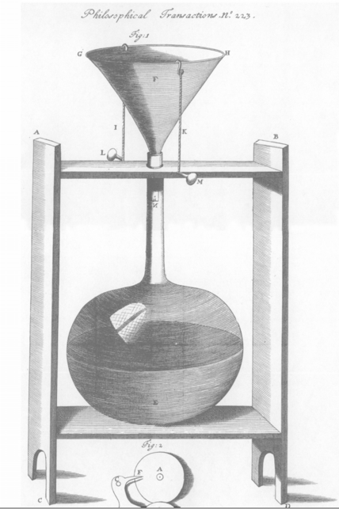
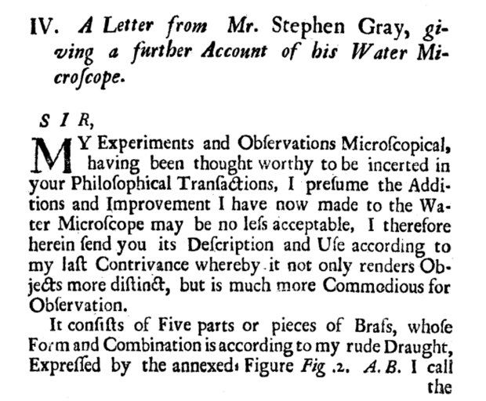
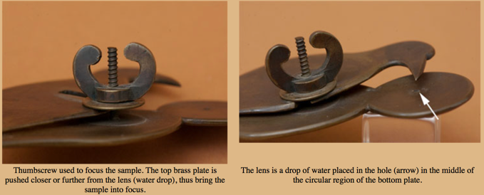
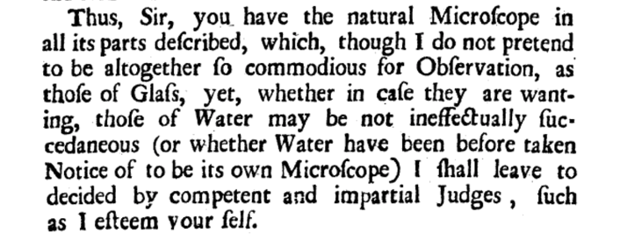
Stephen Grey’s Water Microscope
1695
Philosophical Transactions (1683-1775)
Vol. 19 (1695 - 1697), pp. 353-356 (6 pages)
Published by: Royal Society

Slide 33

Guiseppe Campani - 1670-1690
Back: Italian compound microscopes - 1670
Italian Compound microscopes
Back: 1670 (probably Campani)
This microscope was formerly at the University of Bologna - it contains a field lens which was the first optical advance about 1660. Only opaque objects can be viewed.
Front: Guiseppe Campani, Rome - 1690 - Campani was the leading Italian telescope and microscope maker in the late `17th century - he probably invented the screw focusing mechanism shown on this scope - the slide holder in the base allows transparent and opaque objects to be viewed
1690
Photos: © J. Paul Robinson

Slide 34
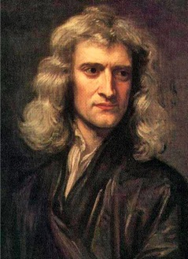
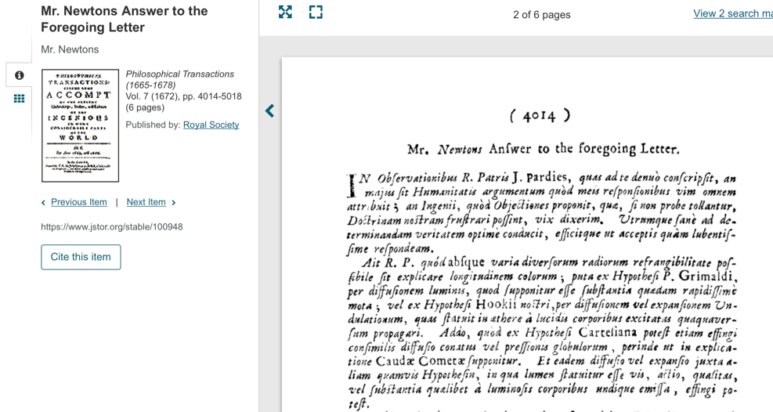
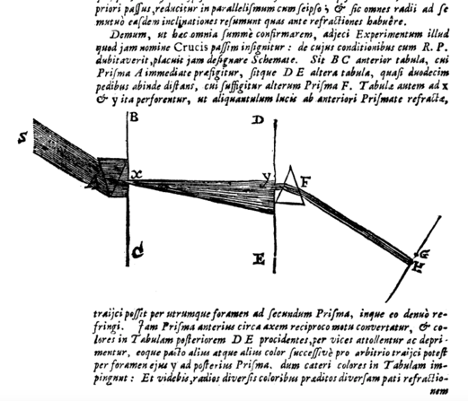
Issac Newton (1643-1726)
1672
Thanks Wiki
Philosophical Transactions (1665-1678)
Vol. 7 (1672), pp. 4014-5018 (6 pages)
Published by: Royal Society

Slide 35
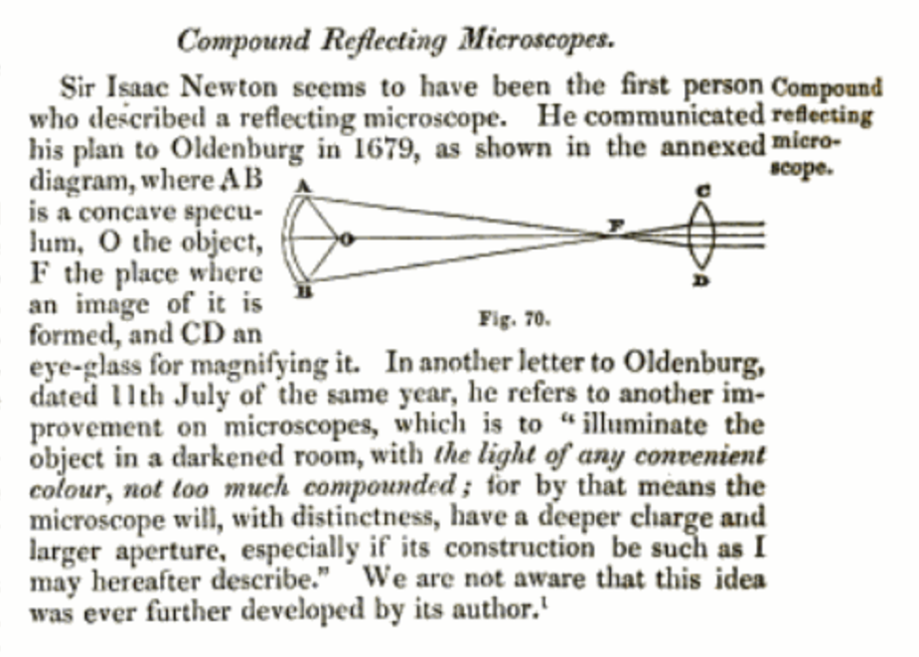
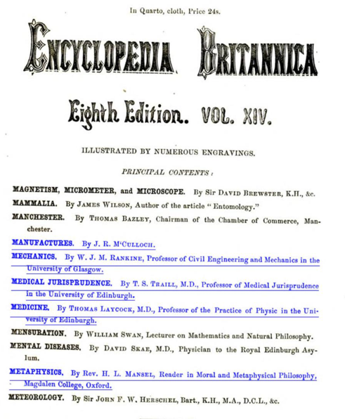
Issac Newton (1643-1726)
In 1672 Newton invented a reflecting compound microscope
1679
1858 Edition
Page 784

Slide 36




Issac Newton (1643-1726)
1704
In 1668 built the first practical reflecting telescope
In 1687 Newton Published Principia (Laws of Motion)
In 1704, Newton published Opticks, a consolidation of his writings and experiments on light, color, and optics and an exposition on his corpuscular theory of light.
https://simple.wikipedia.org/wiki/Philosophiæ_Naturalis_Principia_Mathematica

Slide 37


Issac Newton (1643-1726)
1704
https://simple.wikipedia.org/wiki/Philosophiæ_Naturalis_Principia_Mathematica

Slide 38

Issac Newton (1643-1726)
1672
“A Serie's of Quere's Propounded by Mr. Isaac Newton, to be Determin'd by Experiments, Positively and Directly Concluding His New Theory of Light and Colours; and Here Recommended to the Industry of the Lovers of Experimental Philosophy, as they Were Generously Imparted to the Publisher in a Letter of the Said Mr. Newtons of July 8.1672”
https://simple.wikipedia.org/wiki/Philosophiæ_Naturalis_Principia_Mathematica

Slide 39


Issac Newton (1643-1726)
“Mr. Isaac Newton's Considerations on the Former Reply; together with Further Directions, How to Make the Experiments Controverted Aright: Written to the Publisher from Cambridge, Novemb. 13. 1675”
1675

Slide 40

Edmund Culpeper Screwbarrel Microscope - 1720
Lecture 2
Edmund Culpeper was an apprentice of famous London scientific instrument maker Walter Hayes during the late 1600s to the early 1700s
1720
Photos: © J. Paul Robinson
A concave mirror was inserted below the stage, enabling a specimen to be conveniently lit from below.
https://micro.magnet.fsu.edu/primer/museum/culpeper.html

Slide 41

Chester More Hall (1703-1771)
The issues between simple and compound microscope
Simple microscopes could attain around 2 micron resolution, while the best compound microscopes were limited to around 5 microns because of chromatic aberration
1730
https://en.wikipedia.org/wiki/Chester_Moore_Hall
In the 1730s a barrister names Chester More Hall observed that flint glass (newly made glass) dispersed colors much more than “crown glass” (older glass). He designed a system that used a concave lens next to a convex lens which could realign all the colors. This was the first achromatic lens. (designed for telescopes)

Slide 42

Chester More Hall (1703-1771)
The issues between simple and compound microscope
Hall appears to have studies the human eye – perhaps he reviewed Newton’s “Optiks” that had been published a few years before in 1704….
1730
https://en.wikipedia.org/wiki/Chester_Moore_Hall
Hall focused his attention on building telescopes – and in 1733 he built telescopes with apertures of 2.5 inches (6.5 cm) and focal lengths of 20 inches (50 cm).
https://www.britannica.com/biography/Chester-Moor-Hall

Slide 43
Chester More Hall (1703-1771)
The issues between simple and compound microscope
Hall sent a request to one glass maker for some flint glass and a request to another glass maker for some crown glass.
It is believed that both glass makers actually sent both orders on to another glass maker George Bass
1730

Slide 44
George Bass
Hall sent a request to one glass maker for some flint glass and a request to another glass maker for some crown glass. Apparently, he was concerted that if he sent both requests to one glass maker, they would learn his secret.
It is believed that both glass makers actually sent both orders on to George Bass
1740
z”George Bass was an optician known to have made an achromatic doublet around 1733.
The specifications for the lens elements were given by Chester Moore Hall. According to Hoyle,^{[1]} Hall wished to keep his work on the achromatic lenses a secret and contracted the manufacture of the crown and flint lenses to two different opticians, Edward Scarlett and James Mann.^{[2]} They in turn sub-contracted the work to the same person, George Bass. He realized the two components were for the same client and, after fitting the two parts together, noted the achromatic properties. Not being as reticent as Hall, Bass let others know of the lens's properties and the method of making an achromatic doublet spread.”
https://en.wikipedia.org/wiki/George_Bass_(optician)

Slide 45


John Dollond (1706-1761)
The famous patent of 1758
1758
George Bass was the lens-maker that actually made the lenses in about 1733, but he did not divulge the secret until over 20 years later to John Dollond who copied the idea in 1757 and patented the achromatic lens in 1758.
https://micro.magnet.fsu.edu/optics/timeline/people/dollond.html
image © J.Paul Robinson

Slide 46

John Dollond (1706-1761)
The famous patent of 1758
Eventually Bass was given credit for the invention of the achromatic lens when the story about Bass’ disclosure to Dollond came out..
1758
Making lenses for microscopes are much more difficult than for telescopes – so most of Dollond’s skill was applied to telescope manufacture. The problem was in the manufacture of much smaller lens sets required for microscopy in order to keep the focal distance small
https://micro.magnet.fsu.edu/optics/timeline/people/dollond.html

Slide 47

John Dollond (1706-1761)
The famous patent of 1758
1758
Dollond still won a prestigious award from the Royal Society, known as the Copley Medal – However as noted earlier, it was eventually agreed that Dollond was not the inventor of the achromatic lens despite having a patent!
(Other winners have been Benjamin Franklin, Louis Pasteur, Albert Einstein, Charles Darwin, Stephen Hawking….)
https://micro.magnet.fsu.edu/optics/timeline/people/dollond.html

Slide 48


Secondary Microscopes
George Adams Sr. made many microscopes from about 1740-1790 but he was predominantly just a good manufacturer not inventor (in fact it is thought he was more than a copier!)
1763
“New Improved Compound Microscope, George Adams, 1790
Adams described this instrument in his “Essays on the Microscope” in 1787. The mechanism allowed freedom of movement. The specimen could be viewed in direct light or in light reflected from a large mirror.
© J.Paul Robinson

Slide 49

George Adams
Toymaker to Kings
This microscope made by George Adams, Mathematical Instrument maker to King George III around 1763, It was probably intended for the Prince of Wales, the future King George IV. The instrument is based on the design of the “Universal Double Microscope" (London Museum of Science)
1763
Photos: © J. Paul Robinson

Slide 50


William Hyde Wollaston (1766-1828)
A Wollaston prism separates light into two separate linearly polarized outgoing beams with orthogonal polarization. The two beams will be polarized according to the optical axis of the two right angle prisms.
Although formally trained as a physician, Wollaston studied and made advances in many scientific fields, including chemistry, physics, botany, crystallography, optics, astronomy and mineralogy. He is particularly noted for originating several inventions in optics, including the Wollaston prism that is fundamentally important to interferometry and differential interference (DIC) contrast microscopy.
He discovered the elements palladium (symbol Pd) in 1803 and rhodium (symbol Rh) in 1804. Wollaston became Secretary of the Royal Society in 1806, and president from, 18210-1828
1812

Slide 51


William Hyde Wollaston (1766-1828)
Camera lucida
In 1807, Wollaston developed a version of the camera lucida, which would eventually lead to Fox Talbot's discoveries in photography.
The camera lucida largely consisted of a four-sided prism (the Wollaston prism)
1807
Encyclopedia Britanica, Vol XIV, 1858, P795

Slide 52

William Hyde Wollaston (1766-1828)
Microscopic Doublet
1828
Note: This paper referred to above was published a few months after Wollaston died.
Encyclopedia Britanica, Vol XIV, 1858, P795

Slide 53


David Brewster 1781-1868
For a glass medium (n₂ ≈ 1.5) in air (n₁ ≈ 1), Brewster's angle for visible light is approximately 56°, while for an air-water interface (n₂ ≈ 1.33), it is approximately 53°. Since the refractive index for a given medium changes depending on the wavelength of light, Brewster's angle will also vary with wavelength.
Thanks Wiki
1815
As a point if interest, Sir David Brewster was the editor of the microscopy section of the Encyclopedia Britanica 1858 edition, so many of the suggestions about how wonderful the inventions were of “Sir David Brewster” is not surprising!!

Slide 54




Sir David Brewster, Feb 11, 1815
“Brewster’s Angle”
Thanks Wiki
1815

Slide 55

Sir David Brewster
Monochromatic Light Microscope
Brewster proposed a single line” light source that meant that one did not need to deal with achromatic compensation as there in none! Using an alcohol lamp and adding salt crystals to the flame, he was able to get single red lines for perfect imaging! Not quite a laser, but as close as once could get in about 1850!!
alcohol here
add salt

Slide 56

Encyclopedia Britanica, Vol XIV, 1858
Sir David Brewster happened to be the editor of the microscopy section of Encyclopedia Britanica. All the articles seemed to say very good things about his inventions..!

Slide 57


Giovanni Battista Amici
(“water immersion”)
In 1827 Giovanni Battista Amici, built high quality microscopes and introduced the first matched achromatic microscope in 1827. He had previously (1813) designed “reflecting microscopes” using curved mirrors rather than lenses. He recognized the importance of coverslip thickness and developed the concept of “water immersion”
1827
© J.Paul Robinson
© J.Paul Robinson

Slide 58




Color Correcting Lenses
Encyclopedia Britanica, Vol XIV, 1858
P779

Slide 59


Joseph Lister
(Spherical Aberration )
In 1830, by Joseph Jackson Lister (father of Lord Joseph Lister who was a famous surgeon in London) solved the problem of Spherical Aberration - caused by light passing through different parts of the same lens. He solved it mathematically and published this in the Philosophical Transactions in 1830
1830
Photos: © J. Paul Robinson
Joseph Lister
Photos: © J. Paul Robinson
© J.Paul Robinson

Slide 60

Joseph Lister
(Spherical Aberration )
Excerpt from Encyclopedia Britanica, Volume XIV,1858, P778
1830
In 1830, by Joseph Jackson Lister (father of Lord Joseph Lister) solved the problem of Spherical Aberration - caused by light passing through different parts of the same lens. He solved it mathematically and published this in the Philosophical Transactions in 1830, P 199
© J.Paul Robinson

Slide 61

Henri Hureau de Sénarmont (1808-1862)
(Polarized light)
Henri Hureau de Sénarmont (1808-1862)
Sénarmont was a professor of mineralogy and director of studies at the École des Mines in Paris, especially distinguished for his research on polarization and his studies on the artificial formation of minerals. He also contributed to the Geological Survey of France by preparing geological maps and essays.
Perhaps the most significant contribution made by de Sénarmont to optics was the polarized light retardation compensator bearing his name, which is still widely utilized today
1830
Image source: http://micro.magnet.fsu.edu/optics/timeline/people/senarmont.html

Slide 62
Henri Hureau de Sénarmont (1808-1862)
(Polarized light)
The de Sénarmont compensator couples a highly precise quarter wavelength birefringent quartz or mica crystalline plate with a 180-degree rotating analyzer to provide retardation measurements having an accuracy that approaches one thousandth of a wavelength or less.
1830
Much of our knowledge of mineral structure was derived by Senarmont who worked closely with Augustin Fresnel
Image source: http://micro.magnet.fsu.edu/optics/timeline/people/senarmont.html

Slide 63


Carl Zeiss 1816-1888
(Oil Immersion)
Carl Zeiss opens his workshop in Jana, Germany to make eyeglasses and microscopes for the University in 1846
Abbe and Zeiss developed oil immersion systems by making oils that matched the refractive index of glass. Thus they were able to make the Numeric Aperture (N.A.) to the maximum of 1.4 allowing light microscopes to resolve two points distanced only 0.2 microns apart (the theoretical maximum resolution of visible light microscopes). Leitz was also making microscope at this time.
1846
Zeiss student microscope 1880
(Photos by JPR taken in the Zeiss Museum in Jena)

Slide 64


Pasteur - 1860
Photos: taken in London
Science Museum by J. Paul Robinson
1860
Photo: © J. Paul Robinson
Louis Pasteur – his microscope was made in Paris by Nachet in about 1860 and was made of brass

Slide 65


Ernst Abbe (1840-1905) & Zeiss
Ernst Abbe joined Zeiss (Jena), developedAbbe sine condition optics, improved optics significantly
By 1870, Abbe invented the Abbe condenser, used for microscope illumination
In 1871, he designed the first refractometer, which he described in a booklet published in 1874
Abbe was the first to define the term numerical aperture, as the sine of the half angle multiplied by the refractive index of the medium filling the space between the cover glass and front lens.
In 1876, Abbe was offered a partnership by Zeiss and began to share in the considerable profits.
In 1878, he built the first homogenous immersion system for the microscope
In 1886 he invented the apochromatic lens, a microscope lens which eliminates both the primary and secondary color distortion
1877
Jena

Slide 66


Ernst Abbe (1840-1905) & Zeiss
Ernst Abbe together with Carl Zeiss published a paper in 1877 defining the physical laws that determined resolving distance of an objective. Known as Abbe’s Law
“minimum resolving distance (d) is related to the wavelength of light (lambda) divided by the Numeric Aperture, which is proportional to the angle of the light cone (theta) formed by a point on the object, to the objective”.
“The impetus for the emergence into the industrial age was given by Ernst Abbe (appointed Associate Professor in 1870), who, while still in his early 30s, developed his theory of microscope image formation, which took into consideration the familiar phenomenon of diffraction, and thus made the leap in microscope construction from trial and error to methodical design. He was given this commission by a university mechanic, Carl Zeiss, who had been steadily perfecting the construction of optical equipment in his private workshops. Otto Schott, who received his doctorate at Jena in 1875, was the third to enter into this alliance by founding, at Abbe’s urging, a "Laboratory for Glass Technology" in 1884, to produce the highly pure special lenses for Zeiss’s microscopes and optical equipment. Humboldt’s pupil Matthias Jakob Schleiden, Professor of Botany and famous for his cell theory, encouraged -- and later benefited from -- this process, which was to prove exemplary in German economic history.”
http://www.uni-jena.de/History-lang-en.html
1877

Slide 67
Abbe & Zeiss
Abbe and Zeiss developed oil immersion systems by making oils that matched the refractive index of glass. Thus they were able to make the a Numeric Aperture (N.A.) to the maximum of 1.4 allowing light microscopes to resolve two points distanced only 0.2 microns apart (the theoretical maximum resolution of visible light microscopes).
Leitz was also making microscope at this time.
Paul Rudolph of Zeiss Jena, develops Tessar high resolution & contrast lens; 4 elements in 3 groups 1902
1880
Photo: © J. Paul Robinson
Zeiss student microscope 1880

Slide 68



Photos: © J. Paul Robinson
Photos: © J. Paul Robinson
1880
Ernst Abbe memorial in Jena, Germany
2005
Photos: © J. Paul Robinson

Slide 69


Abbe’s Sine Condition (1881)
1881

Slide 70
Ernst Abbe (1840-1905)
Abbe Number (or V Number) - The value (often symbolized by the Greek letter n or the letter V) expressing the dispersion of an optical medium, which is directly proportional to the chromatic quality of a lens. Its value is given by the expression:
V = n = (n_{d} - 1)/(n_{F} - n_{c})
Where n(d), n(F) and n(c) are the refractive indices pertaining to the wavelengths of the Fraunhofer lines 587.6, 486.1, and 656.3 nanometers respectively. The Abbe number of a glass mixture is carefully monitored and controlled by manufacturers to achieve target dispersion values, which usually range between 20 and 60. A typical plot of Abbe number versus refractive index is presented in the figure below. The glass map is subdivided into regions that represent various types of glass.
1900

Slide 71

Ernst Abbe (1840-1905)
In 1889, the year after Zeiss’ Death, Abbe set and endowed the Carl Zeiss Foundation
In 1900, Abbe introduced the eight-hour workday to the Zeiss Company
In addition, he created a pension fund and a discharge compensation fund
A crater on the moon is named after Abbe
1900
Oblique view of Abbe, facing west. Lunar Orbiter 5 image.
https://wikimili.com/en/Abbe_%28crater%29

Slide 72


Otto Schott (1851-1935)
Otto Schott, who received his doctorate at Jena in 1875, was the third to enter into this alliance by founding, at Abbe’s urging, a "Laboratory for Glass Technology" in 1884, to produce the highly pure special lenses for Zeiss’s microscopes and optical equipment.
Otto Schott joined Abbe and Zeiss in 1884, and produced glass equal to Abbe’s work Apochromatic lens, 1886
Dr Otto Schott formulated glass lenses that color-corrected objectives and produced the first “apochromatic” objectives in 1886.
Between 1887 and 1893, Schott developed borosilicate glass, distinguished for its high tolerance to heat and a substantial resistance to sudden changes in temperature and exposure to chemicals.
1886
https://micro.magnet.fsu.edu/optics/timeline/people/schott.html

Slide 73

August Karl Johann Valentin Köhler (1866-1948)
Early 20th Century Professor Köhler developed the method of illumination still called “Köhler Illumination”
In 1900, he was invited to join the Zeiss Optical Works company in Jena, Germany, by Siegfried Czapski based on his earlier work on improving microscope illumination. He stayed with Zeiss as a physicist for 45 years and became instrumental to the development of modern light microscope design.
Köhler recognized that using shorter wavelength light (UV) could improve resolution
The driving force for Köhler’s even illumunation invention was the use of gas lamps and similar uneven light sources that created serious problems in trying to gain even and constant illumination
1900
Image source: http://en.wikipedia.org/wiki/File:August_Koehler.jpg

Slide 74


August Köhler
Köhler illumination creates an evenly illuminated field of view while illuminating the specimen with a very wide cone of light
Two conjugate image planes are formed
  one contains an image of the specimen and the other the filament from the light
He filed an application for a fixed-ocular microscope of his design in Germany on April 16, 1924 and with the United States Patent Office on March 31, 1925 (patent number 1649068)
1900

Slide 75



August Kohler -1904
First Ultraviolet Imaging
A. Kohler 1904
275 nm
280 nm
1900
Salamander maculosa larva epidermal cells - 1300 X
A. Kohler, Mikrophotographische Untersuchungen mit ultraviolettem Licht, Z. Wiss. Mikroskopie 21, 1904

Slide 76
Köhler Illumination
Köhler illumination creates an evenly illuminated field of view while illuminating the specimen with a very wide cone of light
Two conjugate image planes are formed
  one contains an image of the specimen and the other the filament from the light
condenser
Specimen
eyepiece
Field iris
Field stop
retina
Conjugate planes for image-forming rays
Field iris
Specimen
Field stop
1900
Conjugate planes for illuminating rays
Try this tutorial: https://www.microscopyu.com/tutorials/kohler

Slide 77







Feulgen Reaction 1924
Demonstrated that DNA was present in both animal and plant cell nuclei - developed a stoichiometric procedure for staining DNA involving a derivatizing dye, (fuchsin) to a Schiff base
Schema of formation of Schiff Reagent from Pararosanilin and its reaction with aldehydes to form colored products
After Wieland and Scheuing (1921)
Shortened from Kasten (1960)
1924
R. Feulgen & H. Rossenback, Microskopisch-chemischer Nachweis einer Nucleinsaure von
Typus der Thymonucleinsaure und auf die darauf berunhende elektive Farbung von
Zellkernen in mikroskopischen Präparaten, Hoppe Seyler Z. Physiol. Chem. 135, 1924

Slide 78



Conn’s Biological Stains - First Published in 1925
The most comprehensive documentation of biological stains
(still available today)
Was available from Sigma until a few years ago when they discontinued it!
1925

Slide 79


UV Measurements of DNA and Cytoplasm
T. Caspersson 1936
Ultraviolet absorption measurements of
a grasshopper metaphase chromosome
Densitometer traces across
a region of the chromosome
Extinction values for chromosome and cytoplasm plotted against wavelength
1936
Cytoplasmic absorption
Chromosomal absorption
Background
signal
Uber den chemischen Aufbau der Strukturen des Zellkernes, Skand. Arch. Physiol. 73, 1936

Slide 80



Early Microfluorometric Scanner
Robert Mellors 1951
1951
RC Mellors & R. Silver, A microfluorometric scanner for the differential detection of cells: application to exfoliative cytology, Science 104, 1951

Slide 81


Georges Nomarski (1919-1997)
Georges Nomarski (1919-1997) - A Polish born physicist and optics theoretician, Georges Nomarski adopted France as his home after World War II. Nomarski is credited with numerous inventions and patents, including a major contribution to the well-known differential interference contrast (DIC) microscopy technique.
The modifications Nomarski made to the Wollaston prism during the 1950s are still of significant consequence.
Also referred to as Nomarski interference contrast (NIC), the method is widely used to study live biological specimens and unstained tissues.
The first prism is identical to Wollaston Prism. The second wedge of the prism is modified by cutting the crystal so that the optical axis is oriented obliquely with respect to the flat surface of the prism. The Nomarski modification causes the light rays to come to a focal point outside the body of the prism, and allows greater flexibility so that when setting up the microscope the prism can be actively focused.
1953
Additional Information and Image from:
http://micro.magnet.fsu.edu/optics/timeline/people/nomarski.html
https://en.wikipedia.org/wiki/Nomarski_prism

Slide 82

Georges Nomarski (1919-1997)
1953

Slide 83





Marvin Lee Minsky (1927-2016)
First disclosed the confocal microscope principle - 1953
https://en.wikipedia.org/wiki/Marvin_Minsky
1953
Minsky’s prototype
Data from Patents database

Slide 84




Cytometry Analytic Techniques
M.R. Mendelsohn 1958
The Two-Wavelength Method of Microspectrophotometry
J. Biophys. Biochem Cytol. 4, 1958
1958

Slide 85



Character Recognition and the beginning of cancer recognition
Dr. Kamentsky
LA Kamentsky & CN Liu, Computer-automated design of multifont print recognition
logic, IBM J. Research & Development 7, 1963
1963

Slide 86

Kamenstsky’s work at IBM and Character recognition

Slide 87

Kamenstky explains how IBM became involved with pathology

Slide 88



Relating Cytometry to Pathology
O. Caspersson 1964
Cells from a normal cervix
Frequency distribution of DNA content
Cells from a cervical carcinoma
Premalignant cells from the epithelium
Quantitative cytochemical studies on normal, malignant, premalignant and atypical cell populations from the human uterine cervix, Acta Cytologica 8, 1964
1963

Slide 89







Visible & UV Scanning - 1963
Brightfield Image
UV Images
1963
Dr. Melamed
Dr. Koss
Dr. Kamentsky
Slide kindly supplied by Compucyte

Slide 90







UV Scanning - Measurements
Dr. Kamentsky
Normal Cells
Cancer Cells
1963
Ultraviolet Absorption in Epidermoid Cancer Cells LA Kamentsky, H. Derman, & MR Melamed, Science 142, 1963

Slide 91


Johan Sebastiaan (Bas) Ploem
1965
Epi-illumination
Leitz PLOEMOPAK illuminator
An epi-illumination cube used in fluorescence microscopy. Ploem's vertical illuminator bears his name and is commonly used today.
Image from wikimedia.org
Liver tissue. Nuclei stained with Feulgen-pararosaniline for DNA. Epi-illumination with narrow band green light (546nm) and a dichroic beam splitter for reflecting green light. Probably the first example of microscope excitation with green light (Ploem, 1965). Note large image contrast
Image from micro.magnet.fsu.edu
For his contributions to the practice of microscopy, Ploem has received various honors. He was elected as a fellow of the Papanicolaou Cancer Research Institute in 1977 and was a recipient of the C. E. Alken Foundation award in 1982. He is also a member of the Society of Analytical Cytology, the Dutch Society of Cytology, the International Academy of Cytology and the Royal Microscopical Society, for which he served as president in 1986. In 1993, he became an Honorary Fellow of the International Society for Analytical Cytology

Slide 92

Robert Day Allen (1927-1986)
Robert Day Allen (1927-1986) - Robert Day Allen was a renowned microscopist, a prominent researcher of cell motility processes, and a co-developer of video-enhanced contrast microscopy ((VEC)), which is a modification of the traditional form of differential interference contrast (DIC) microscopy. Along with Georges Nomarski and G. B. David, Allen assisted the Carl Zeiss Optical Company in developing a Nomarski differential interference microscope for transmitted light applications. In a hallmark paper published in Zeitschrift für wissenschaftliche Mikroskopie und mikroskopische Technik, Allen and his colleagues defined the basic principles of the DIC technique and the interpretation of images.
Rebhun LI. Robert Day Allen (1927-1986): an appreciation. Cell Motil Cytoskeleton. 1986;6(3):249-55
1966
More information at: (Image reproduced from below URL)
http://micro.magnet.fsu.edu/optics/timeline/people/dayallen.html

Slide 93


Historical Overview
Marylou Ingram – 1950-60’s - identified that radiation caused increase number of binucleated lymphocytes in peripheral blood - she used a scanner to detect these rare cells (1/10000)

Slide 94
Marylou Ingram
CYTO2010 Congress, Seattle, WA, 2010

Slide 95


Marylou Ingram and Automated Imaging
Marylou Ingram - 1960’s - identified that radiation caused increase number of binucleated lymphocytes in peripheral blood - she used a scanner to detect these rare cells (1/10000)
Preston 1964, Cytoanalyzer was designed to identify Ingram’s rare cells using a Vidicon based system - digitized images of lymphocytes were produced stained with eosin-methylene azure dye combinations.
References: "Preparation of Cytologic Material for Automatic Scanning Machines" J.C.Pruitt, Ingraham, S.C.; Kaiser, R.F.; and Hilberg, A.W. – J. Nat. Cancer Inst. 22; 1105-1117, 1959
"Field Trial of the Cytoanalyzer; 1186 Specimens Analyzed" J.C.Pruitt, Courtney, W.B.; Hilberg, A.W.; Ingraham, S.C.; Kaiser, R.F. and Houser, M.H. J. Nat. Cancer Inst. 24; 1167-1179, 1960
“Importance of automatic pattern recognition techniques in the early detection of altered blood cell production”; Ingram, M. & Prestin, K.; Annals of the New York Academy of Sciences 113:1066-1072, 1964

Slide 96

1966

Slide 97

Young & Roberts, 1952
Flying spot” microscope based on a scanned spot on the surface of an oscilloscope tube as the illuminant in an image plane of a microscope and a photocell positioned to capture all the light that entered the eyepiece as the detector
Reference: Young, J.Z., Roberts, F., 1951. A flying spot microscope. Nature 167, 231.

Slide 98


Confocal Microscope -1986-1988
MRC Laboratory of Molecular Biology in Cambridge in 1986
https://www2.mrc-lmb.cam.ac.uk/brad-amos-john-white-win-abrf-biomolecular-technologies-award/
Image from Biology of the Cell 95 (2003) 335–342
1986

Slide 99

Brad Amos photo of 2 photon fluorescence
https://www2.mrc-lmb.cam.ac.uk/group-leaders/emeritus/brad-amos/
Honorary Fellow of the Royal Microscopical Society (RMS)
https://www2.mrc-lmb.cam.ac.uk/brad-amos-elected-honorary-fellow-of-the-royal-microscopical-society/

Slide 100
Laser Scanning Cytometry – 1990
Kamentsky
Dr. Kamentsky
Laser Scanning Cytometer
1990

Slide 101










Laser Scanning Cytometry
The iCyte Automated Imaging Cytometer was designed for automated analysis. With no microscope oculars or viewing optics, it relied on laser scan imaging to visualize cells during analysis. Further, it had an auto-focus capability that makes walk-away operation a possibility. An optional robotic autoloader was available.
Untreated
Treated
P27 in Prostate Tissue
Quantification of total γH2AX
expression & foci count
Drug-induced apoptosis results in changes to cell morphology
Notes:
The iCyte Automated Imaging Cytometer is designed for automated analysis. With no microscope oculars or viewing optics, it relies on laser scan imaging to visualize cells during analysis. Further, iCyte has an auto-focus capability that makes walk-away operation a possibility. An optional robotic autoloader is available.

Slide 102






Other Microscopies
Stochastic Optical Reconstruction Microscopy (STORM) Imaging
“..activated state of a photo-switchable molecule must lead to the consecutive emission of sufficient photons to enable precise localization before it enters a dark state or becomes deactivated by photobleaching.”
Pulse
Fluorescence
Image
Successive pulses of light activate photosensitive probes and the network is built up as an image
https://www.microscopyu.com/tutorials/stochastic-optical-reconstruction-microscopy-storm-imaging

Slide 103




Commercial Super Resolution Systems
https://www.microscope.healthcare.nikon.com/solutions/life-sciences/nano-scale-imaging

Slide 104



Commercial Super Resolution Systems
https://www.olympus-lifescience.com/en/

Slide 105



Commercial Super Resolution Systems
https://www.leica-microsystems.com/

Slide 106
Commercial Super Resolution Systems
https://www.zeiss.com/microscopy/en/products/light-microscopes/super-resolution-microscopes.html

Slide 107



Commercial Super Resolution Systems
https://oni.bio/

Slide 108
Conclusion
Microscopes have developed over the past 400 years
Achromatic aberration, spherical aberration were key discoveries
Köhler illumination enabled microscopy for 100 years
Refraction, absorption, dispersion, diffraction, magnification are key concepts
Upright and inverted microscopes differ
Optical Designs - 160 mm and infinity optics were developed to deal with advances in users needs
The most advanced microscopes of today have a direct lineage to the discoveries outlined in this series of lectures

