Slide 1
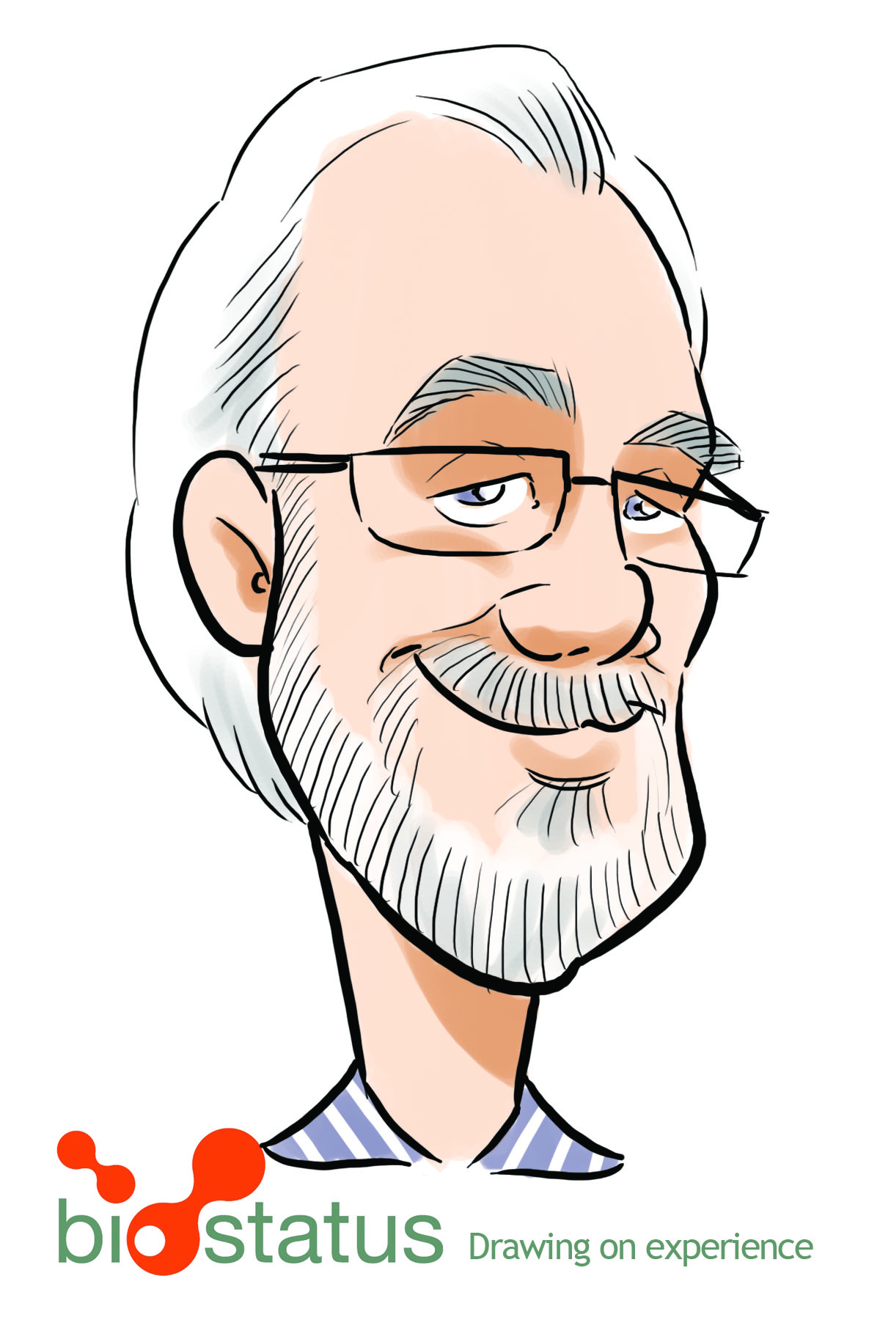
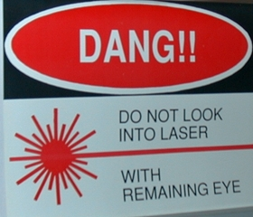
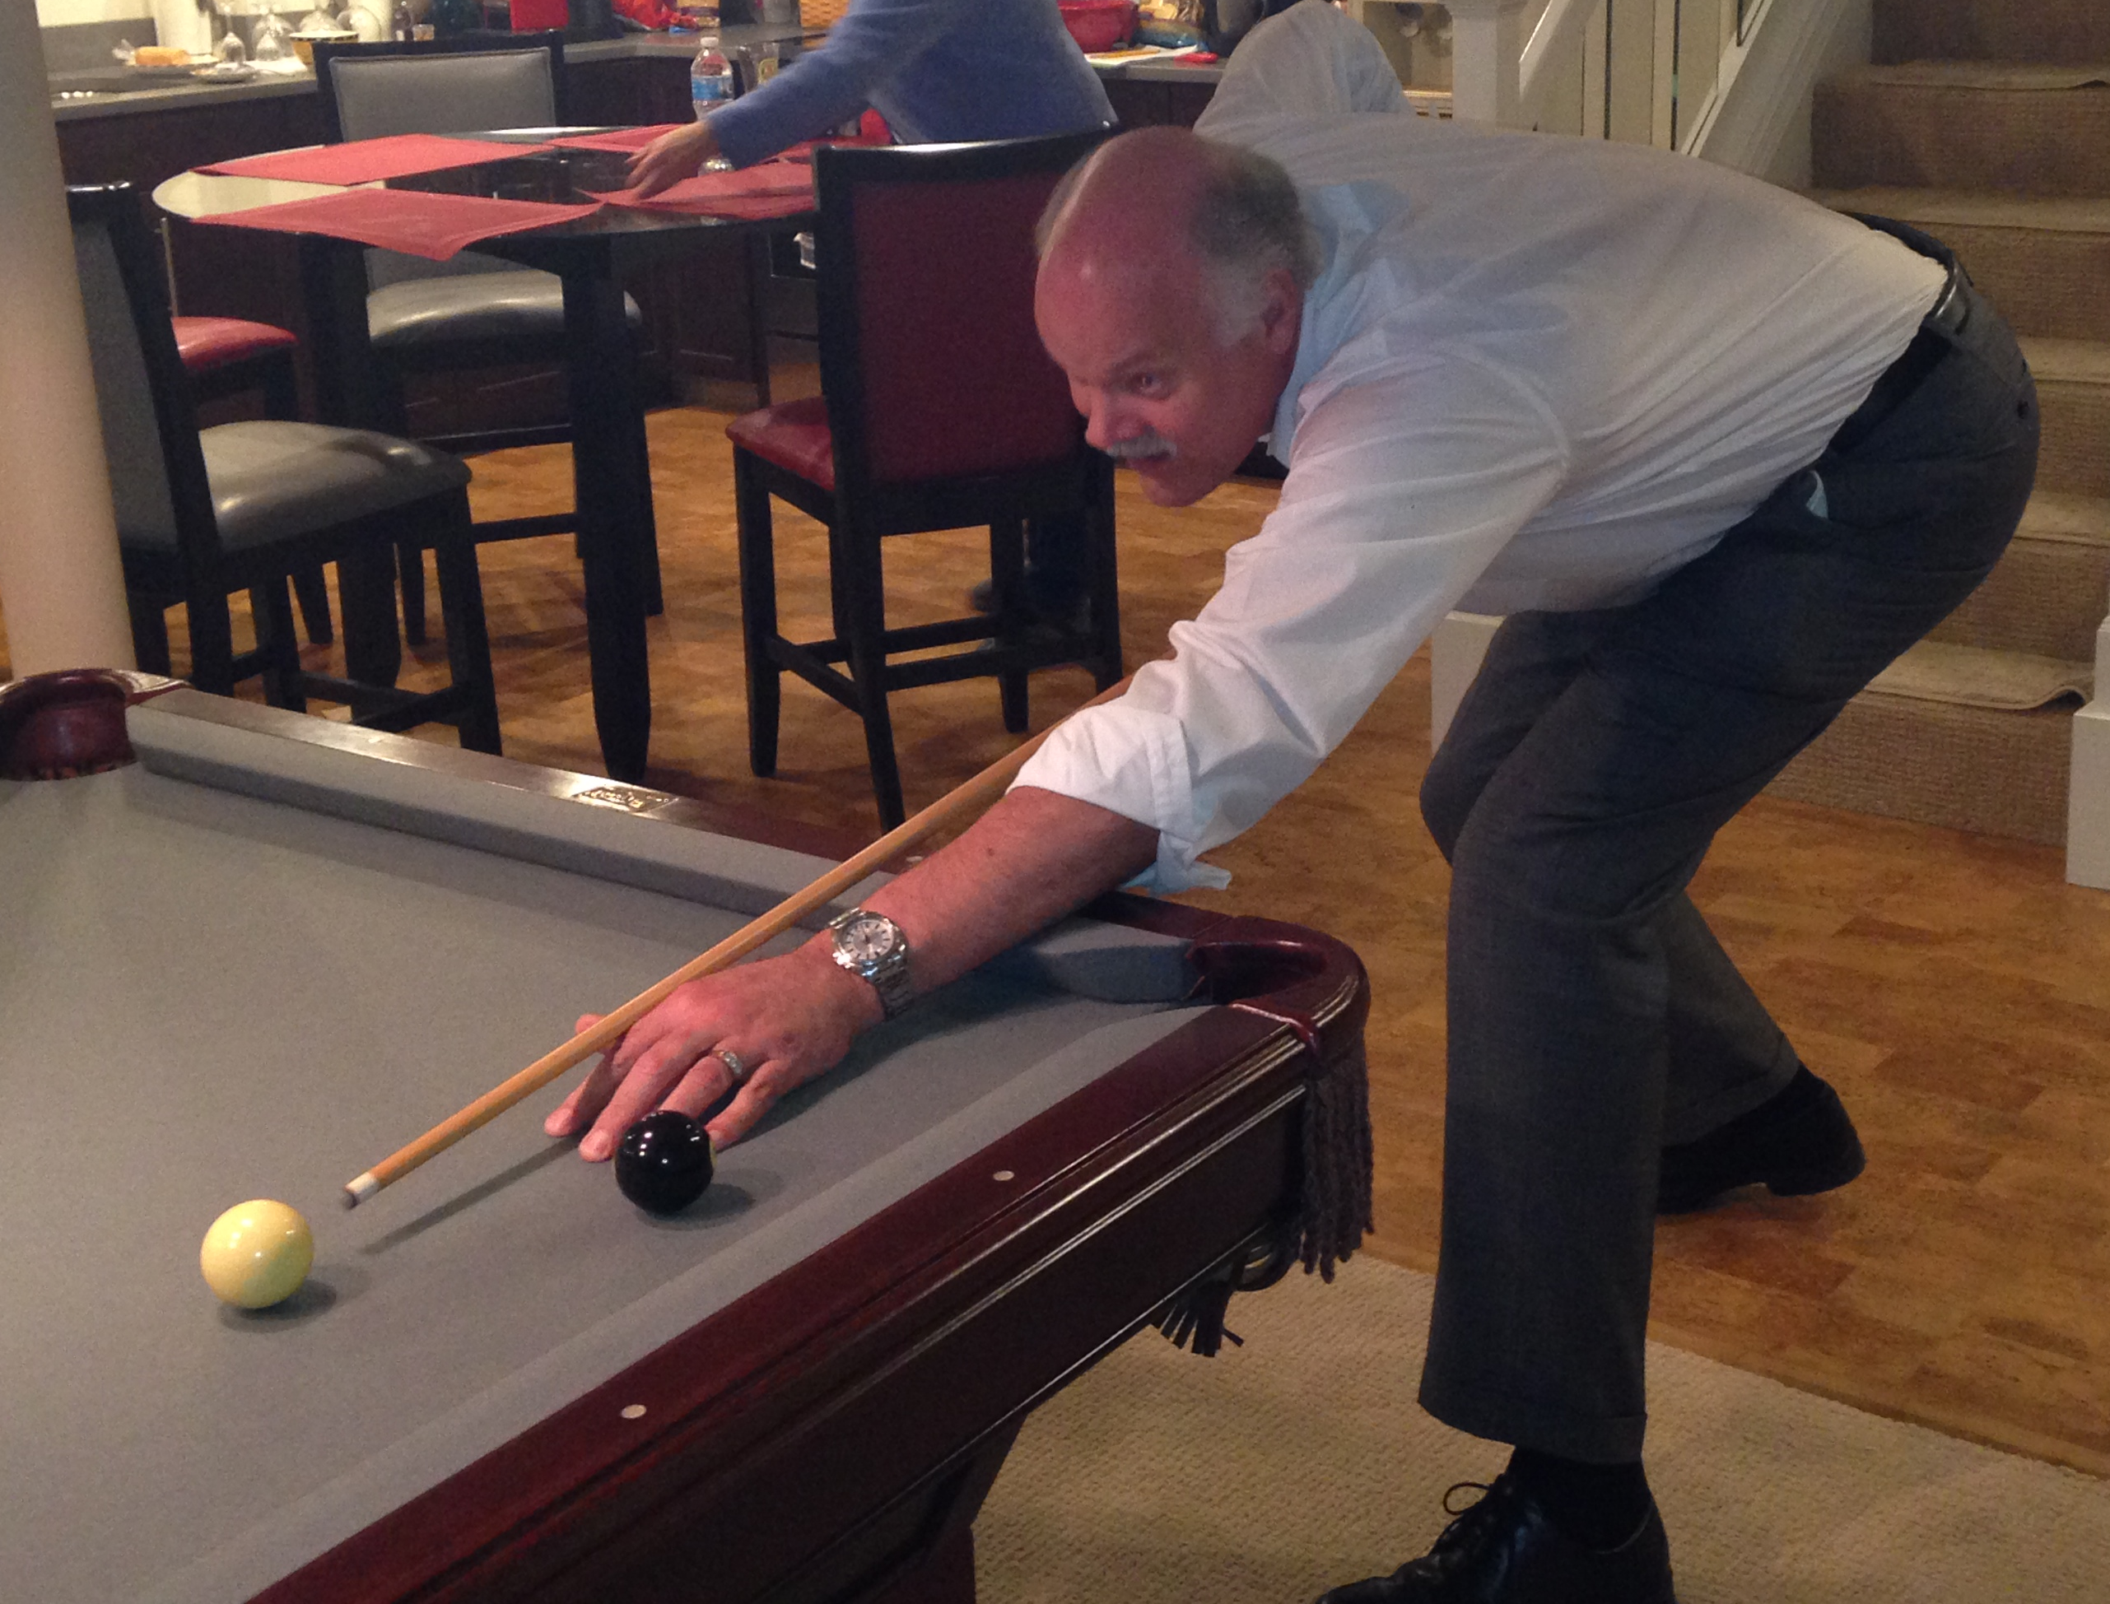
Commercial Development of Cytometry Innovations Workshop
Terry J. Fetterhoff
Sr. Director, Technology Management
Head, US Chief Technology Office
Diagnostics Division
Hoffmann-La Roche, Inc
4300 Hacienda Dr.
Pleasanton, CA 94588
J. Paul Robinson
The SVM Professor of Cytomics
Professor of Biomedical Engineering
Purdue University, USA
Guess who made this famous sign 25
years ago?

Slide 2
Workshop Outline
This workshop will address some of the issues of commercial development of cytometry and imaging technology from two perspectives:
Diagnostic/pharmaceutical company that is constantly seeking the latest ideas to support its commercial operations
University laboratory that seeks to create new ideas and solve interesting problems
This will be an opportunity for participants to gain some insight into how industry goes about identifying, evaluating and acquiring technologies. We will also discuss the benefits and advantages of university –industry interactions as well as the challenges and complications this might bring to a laboratory. We will discuss issues of Intellectual Property (IP), contracts, evaluations, timeliness, and reporting that are all important in developing relationships with companies.

Slide 3
The University Perspective
General goals of Academic Research
Fundamental Discovery
Mentoring graduate students and postdocs
Knowledge distribution
Publication of results
Presentations at conferences
http://www.barnesandnoble.com/review/in-the-basement-of-the-ivory-tower

Slide 4
Potential Conflicts with Industry
Industry often requires confidentiality
Industry may want IP ownership
Industry might be more time demanding
Needs/interests may be different to traditional academics

Slide 5
Confidentiality
Academicians have typically not been so good at keeping secrets
Can you allow students to work on this project?
Can you control all the people you work with not to divulge information?
Our job is knowledge and information distribution, so this is sometimes inconsistent with Industry expectations
You may not be able to publish without industry permission
Industry often invests a lot of $$ onto projects, so they want absolute control over information distribution

Slide 6
IP Ownership
Are you prepared to give up your IP?
Are you allowed to give up your IP? (institution owns it)
Can you even discuss this with Industry? (your institution probably has an office for this)
Do you even have an IP position?
PROVISIONAL
FULL PATENT
PATENT PORTFOLIO

Slide 7
Time demands
You may have to produced data faster
You may be required to do monthly/qtrly reports
Continued funding may be based on results
The academic calendar has teaching, and other demands which may conflict

Slide 8
Needs/interests
Industry wants your ideas only if they have commercial opportunities
Industry will be focused on very specific needs
May not be so interested in pure research

Slide 9
Suggestions
Establish a strong process for confidentiality in your group
Build a solid relationship with your industrial contacts
Separate as much as possible purely academic and industrial research
Make sure you establish good relationships with the IP division at your institution
Do not mix funding sources across academic and industrial projects
Do only what you have contracted to do!
Do everything that you have been contracted to do!!

Slide 10
Academic – Industrial Relationships can be very valuable
They can bring valuable resources to the lab
They bring a different knowledge set
You may benefit $$$$ significantly
You may be able to be first-to-bat with new commercialized technology
There may be opportunities for students and postdocs to work for your industrial partners
Your technology might have a major impact on the world as opposed to staying on your laboratory shelves

Slide 11
Discussion items
What is the best way to develop an industrial partnership with a company?
When do you bring these issues to the IP “officials” at your institution”?
What is the best way to protect our IP and ideas?
How to you manage students and staff when you are working with a commercial entity?
What are the upsides and downsides of corporate relationships?
How do we know if the technologies we have are going to be of interest to industry?

