Slide 1
USDA meeting – PUCL contributions
Database
Calibration
Analytical tools
Automation
Baby Bardot
June 13, 2011

Slide 2
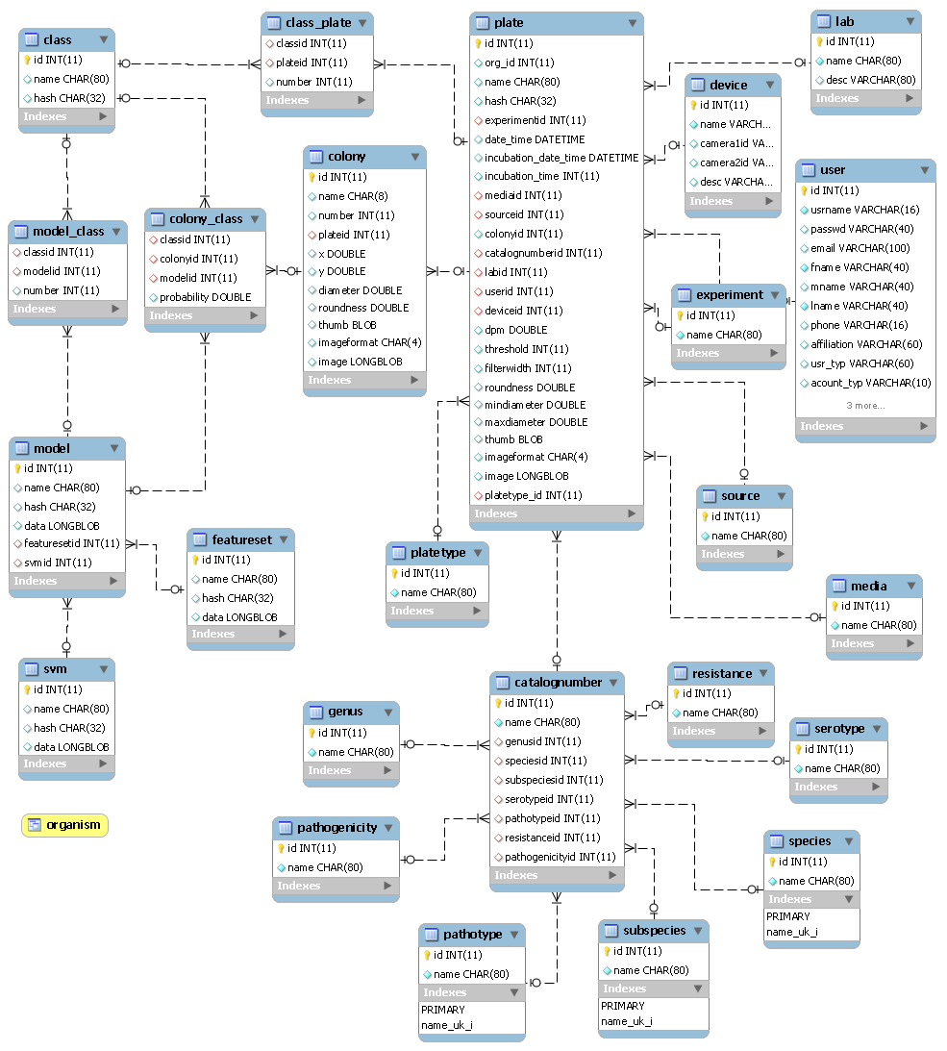
The database
MySQL
Delphi-based reporting system

Slide 3
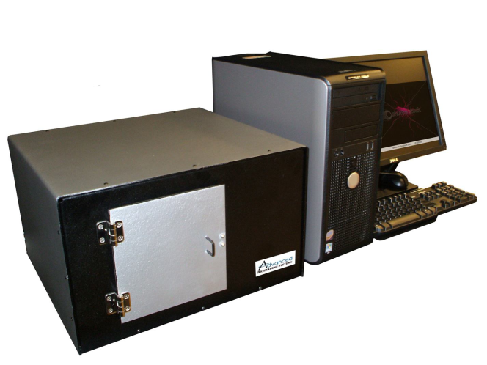
First test implementation
USDA-ARS
Purdue
West Virginia University
UC Merced

Slide 4
Videos of system
Big Boy Bugbuster http://www.youtube.com/watch?v=afBb9QvXNkY&feature=related
Baby bugbuster
http://www.youtube.com/watch?v=kDgh2xoEWIw
Colony growth videos http://www.youtube.com/watch?v=kidRi3ZWP24

Slide 5
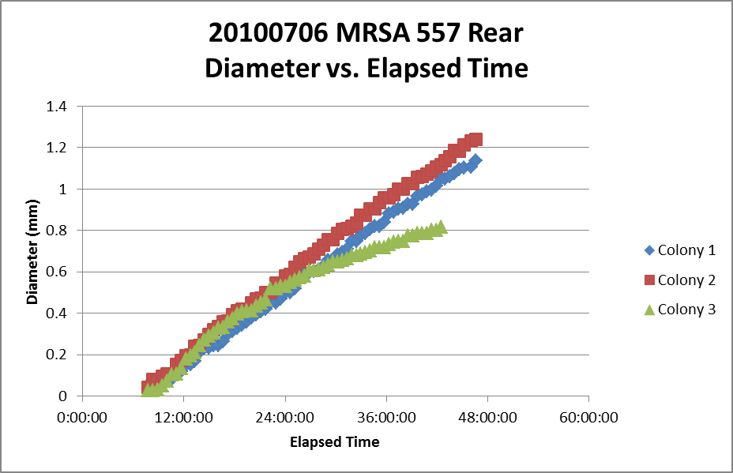
Initial problems related to growth rate
L:\cyan\Cyan data\special data\Bardot Timelapse Files

Slide 6
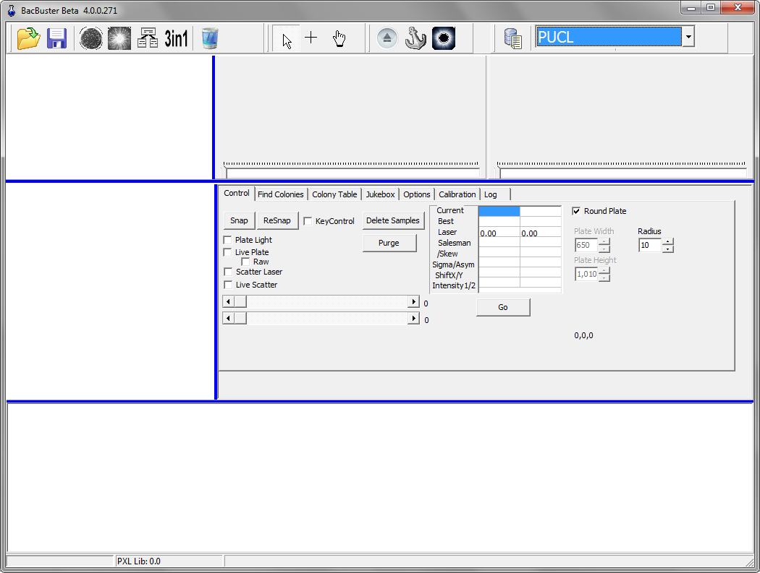
Bardot Software

Slide 7
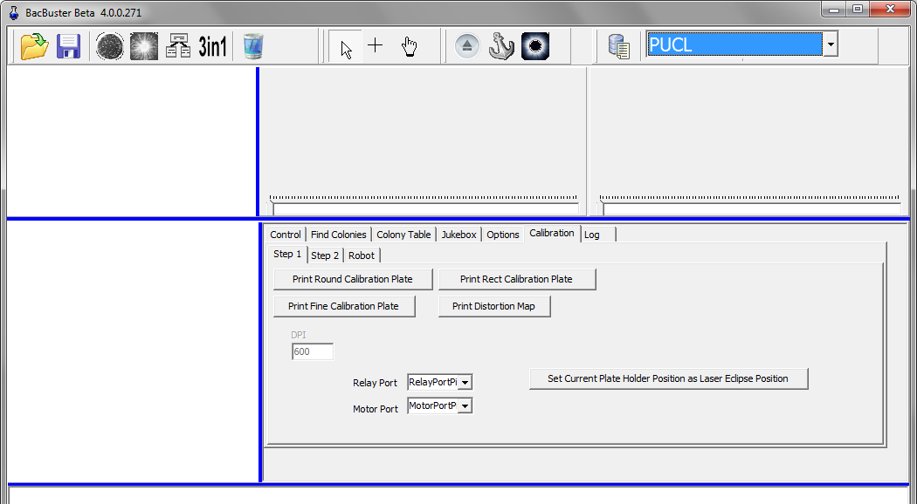
New calibration

Slide 8
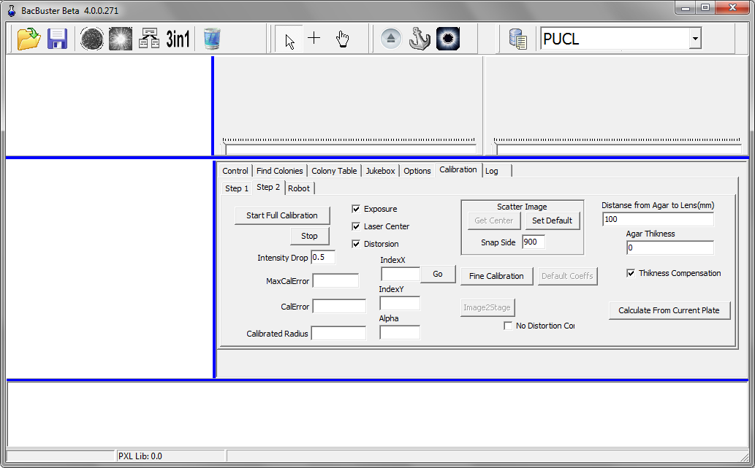
New Calibration

Slide 9
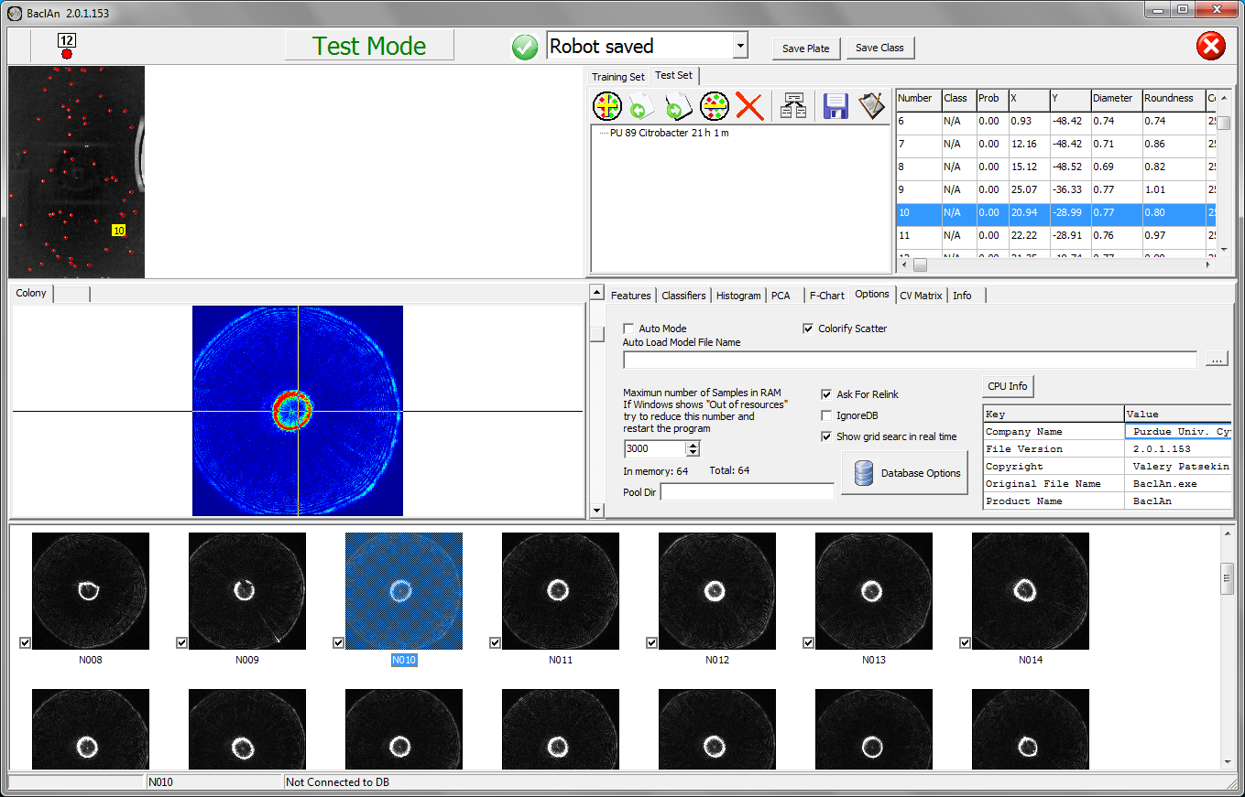

Slide 10
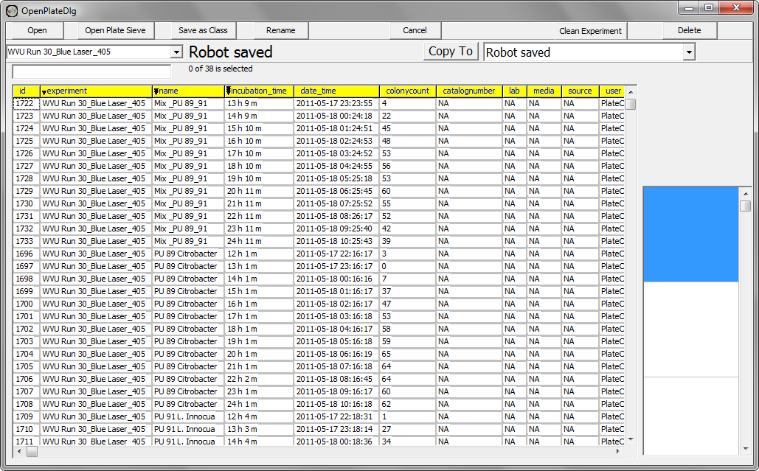
Baclan

Slide 11
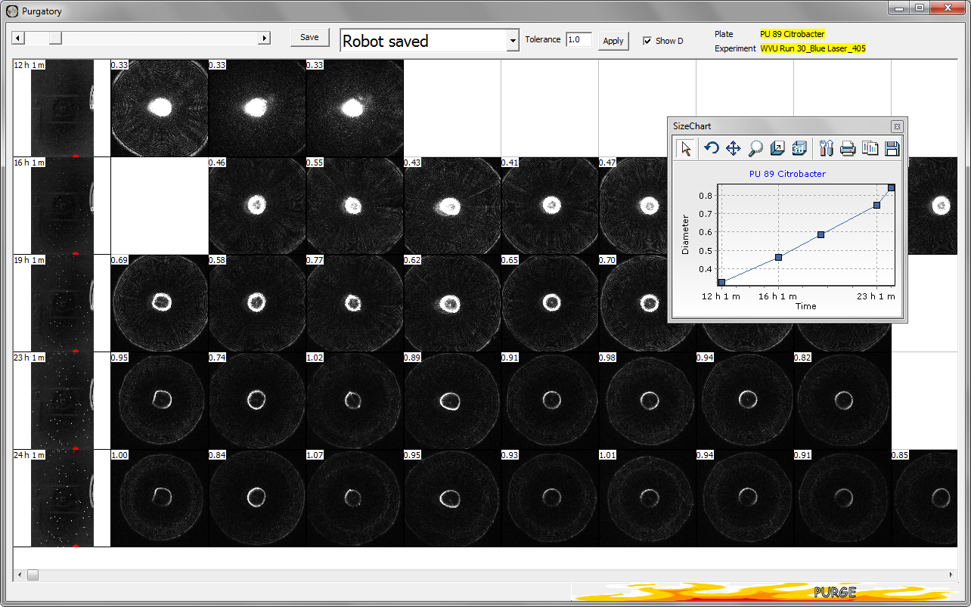

Slide 12
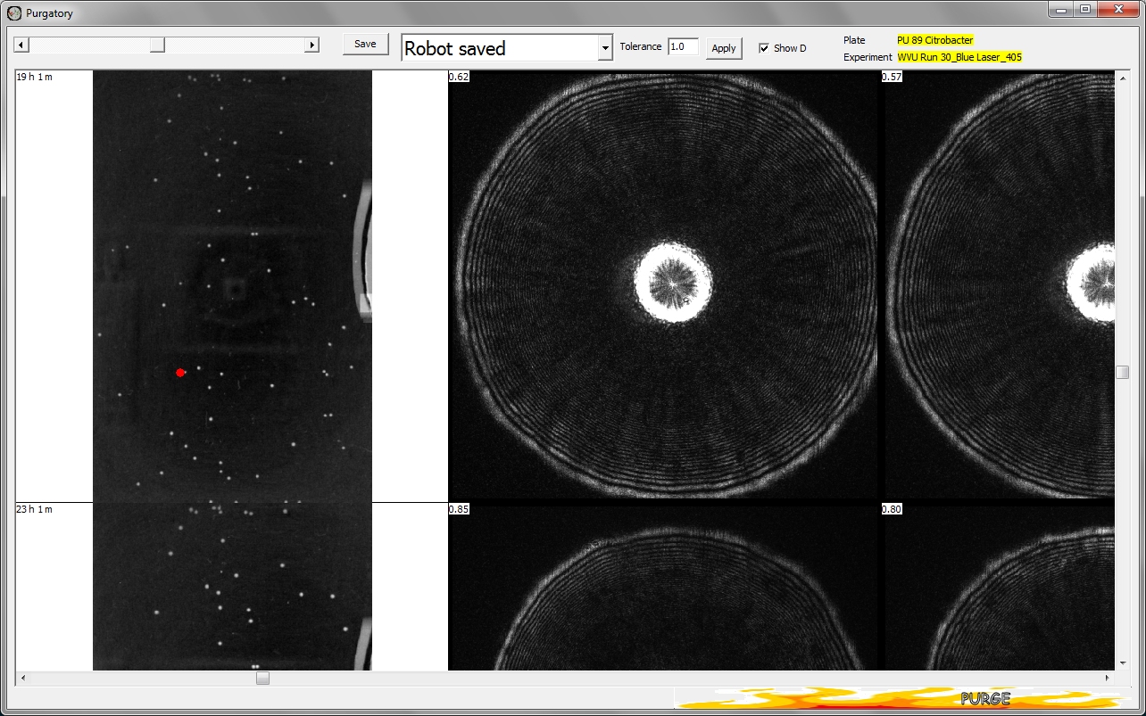

Slide 13
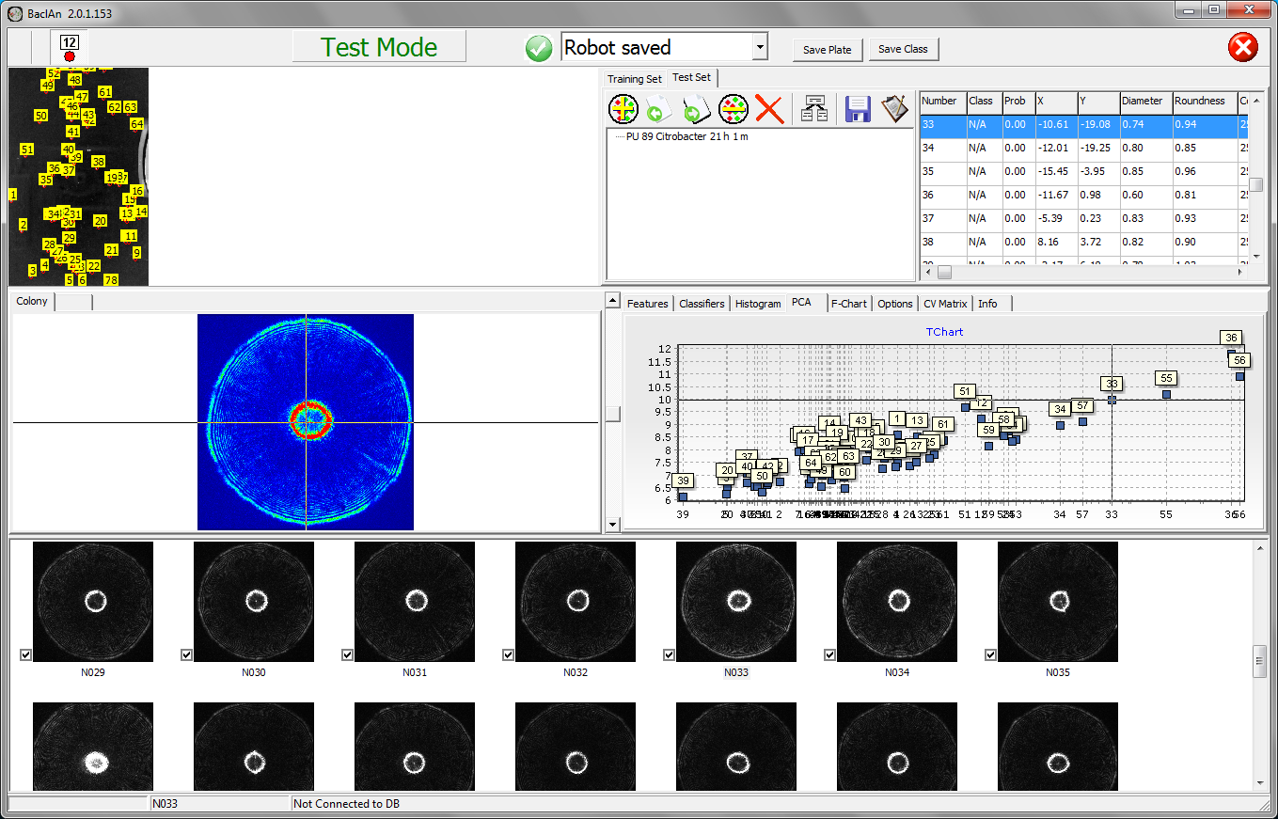

Slide 14
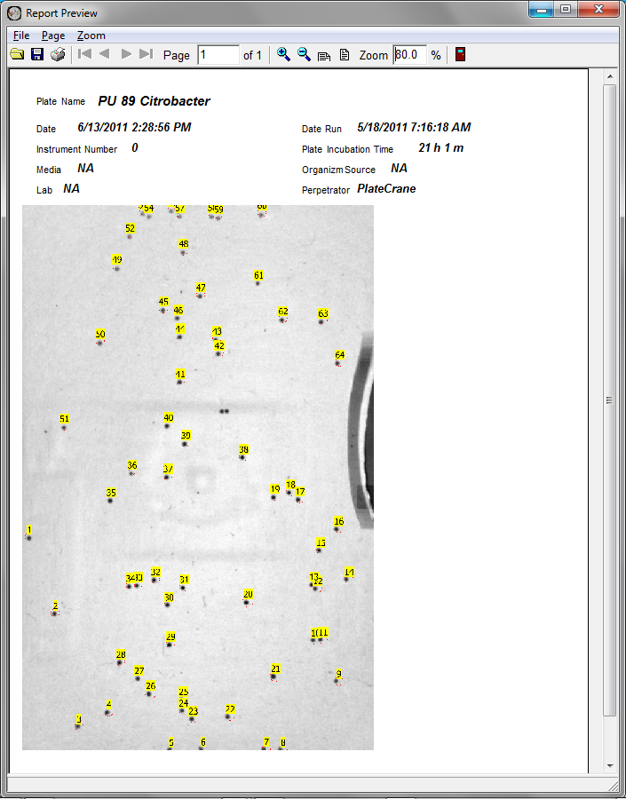

Slide 15
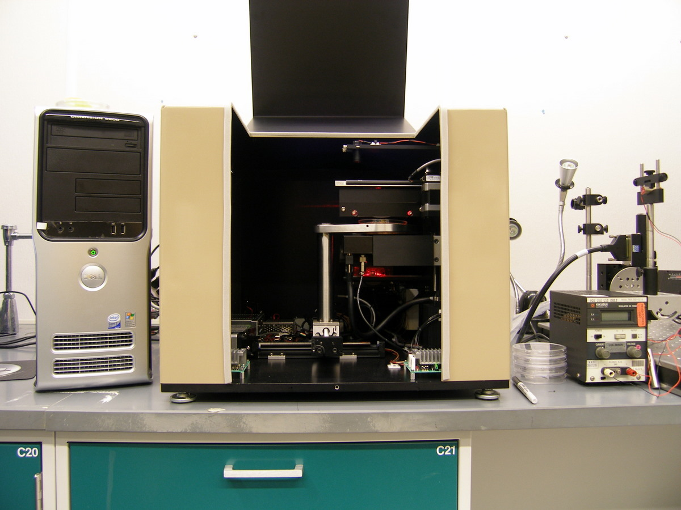
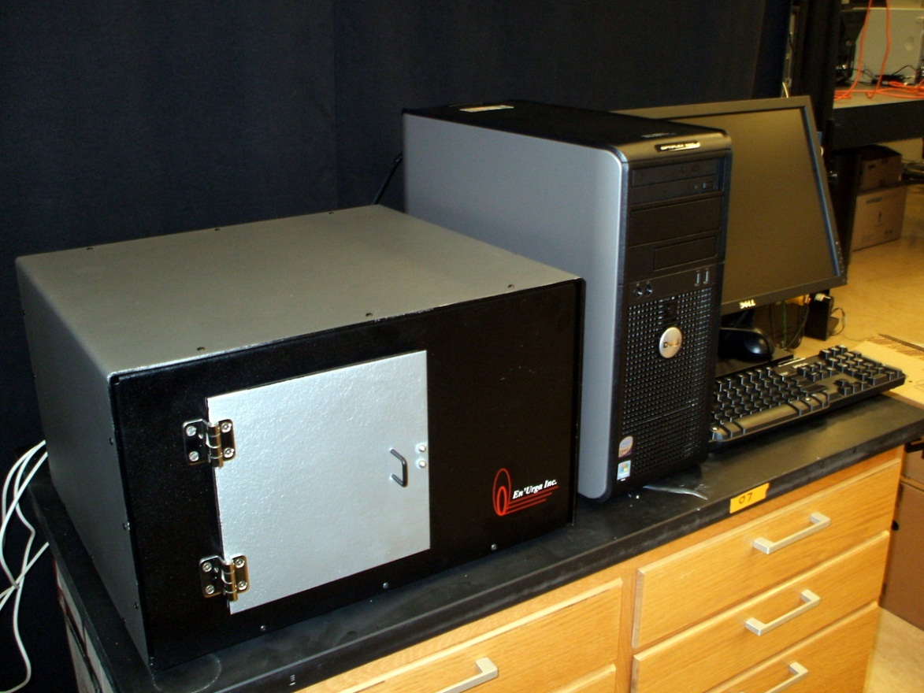
First complete
Prototype
Second complete
Prototype

Slide 16
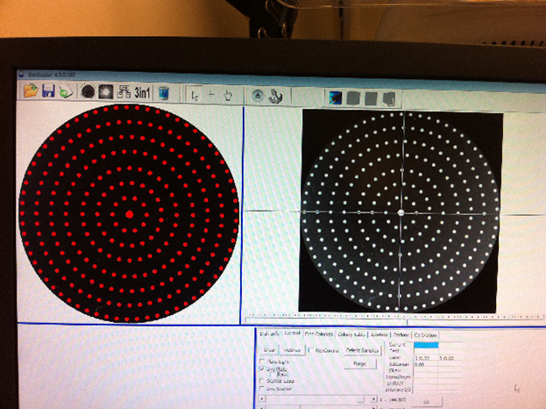
New centering algorithms and process including standard calibration plate

Slide 17
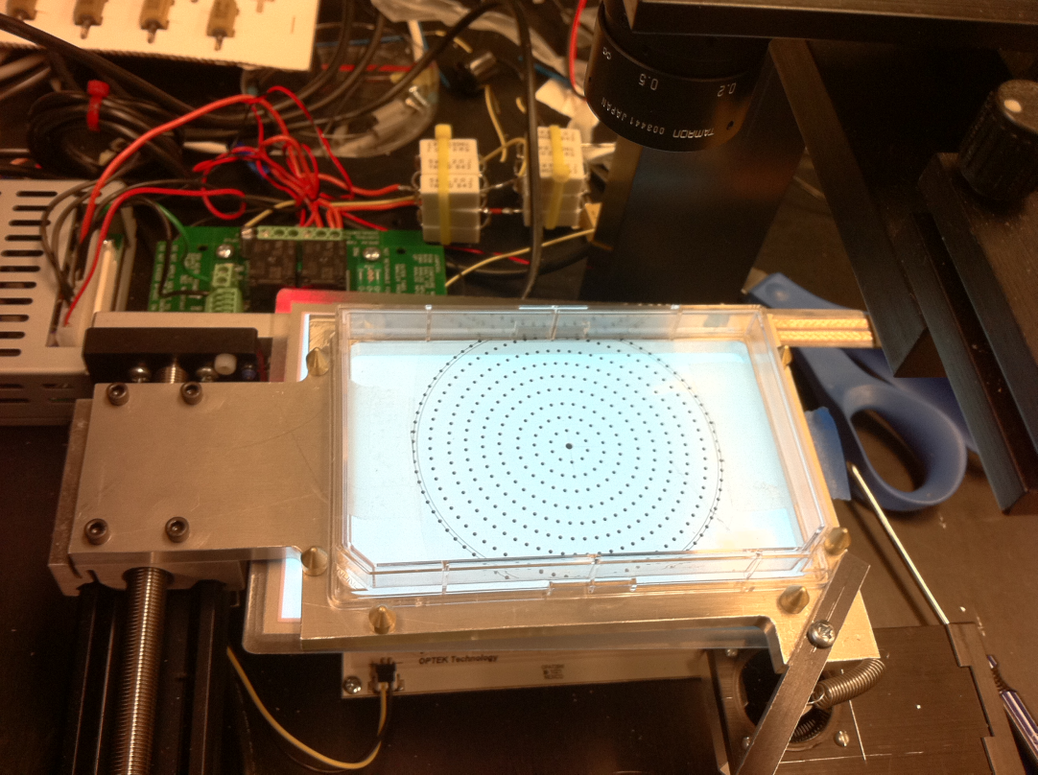
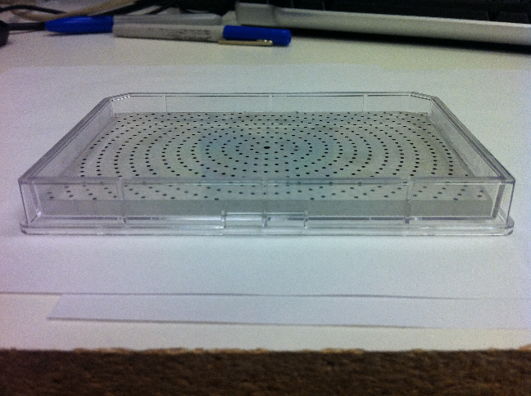
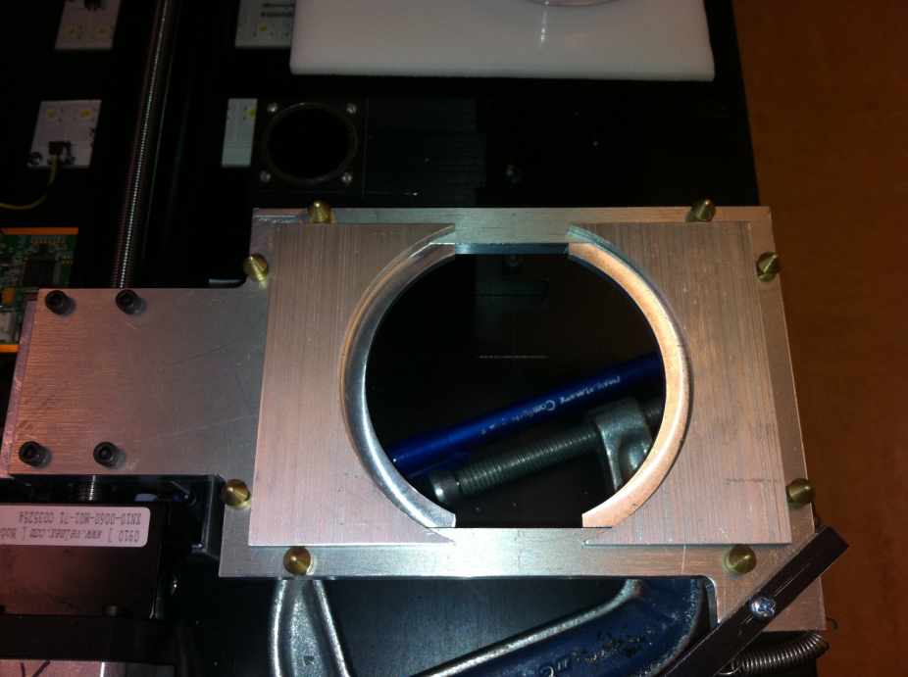
Rectangular plates
New calibration plate – with agar depth
Insert allows round plate inserted into rectangular holder

Slide 18
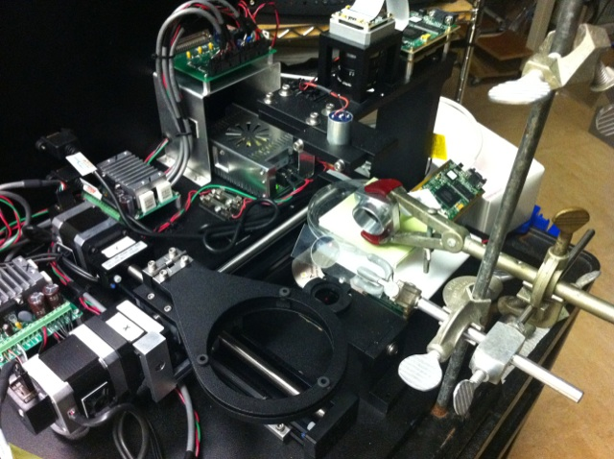
Backscatter data

Slide 19
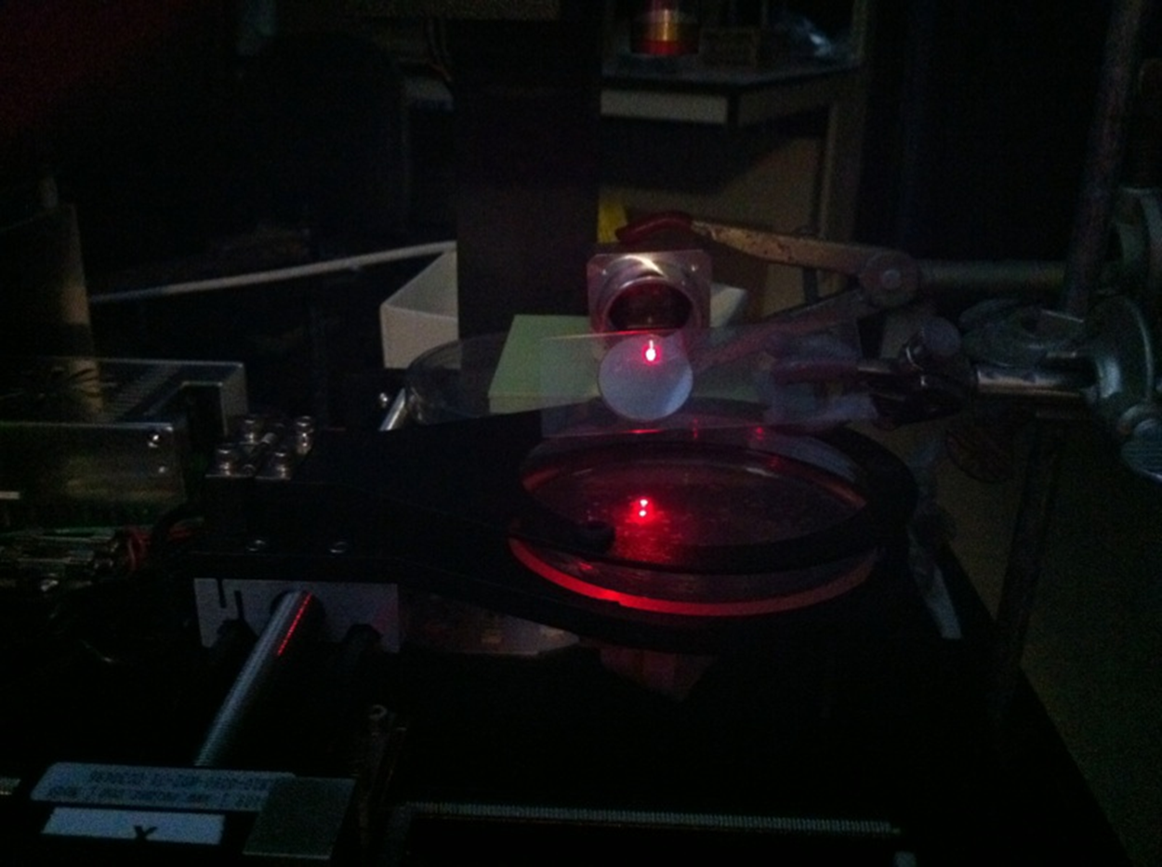
Backscatter data

Slide 20
Videos of system
Big Boy Bugbuster (automation)
http://www.youtube.com/watch?v=afBb9QvXNkY&feature=related
Baby bugbuster (manual system – resource limited regions)
http://www.youtube.com/watch?v=kDgh2xoEWIw
Colony growth videos http://www.youtube.com/watch?v=kidRi3ZWP24

Slide 21
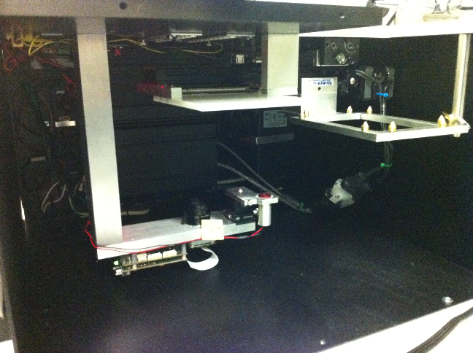
Automation

Slide 22
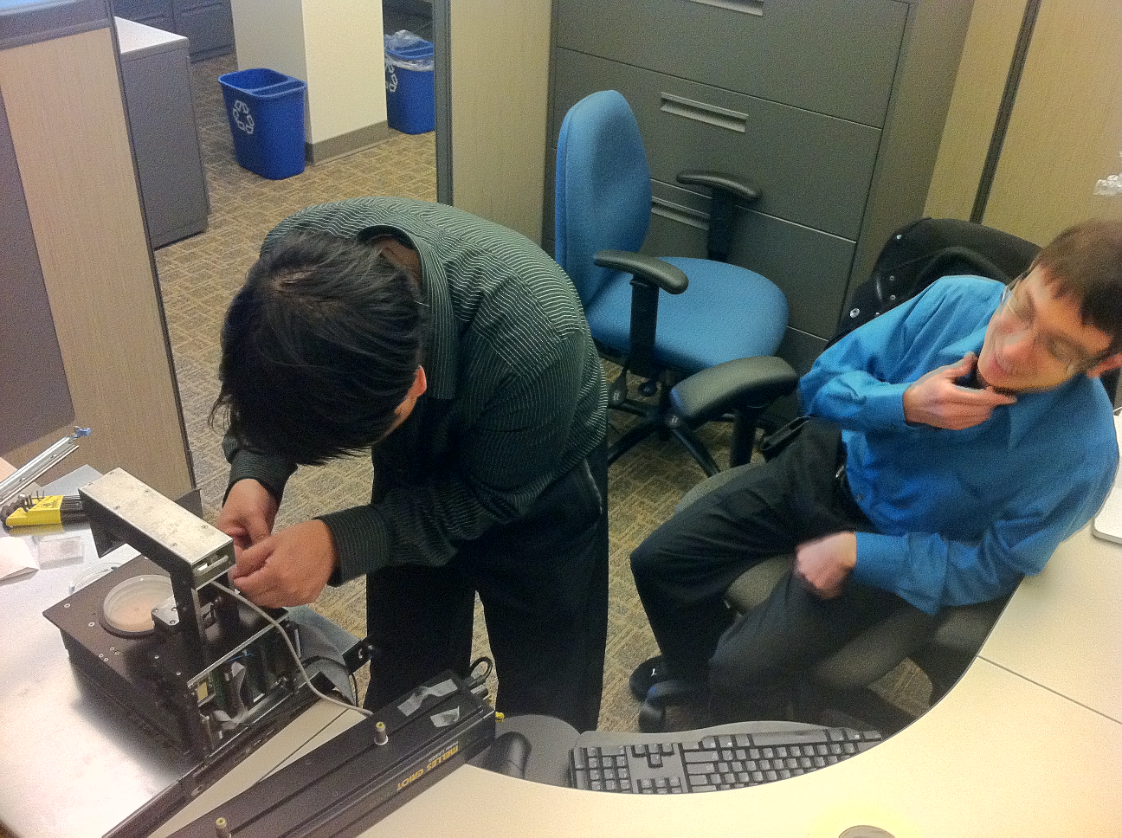
Baby Bardot

