Slide 1


Bacterial light scatter as an opportunity for development of a Biodefense system
J. Paul Robinson
SVM Professor of Cytomics
Professor of Biomedical Engineering
Purdue University
This work reflects a major multidisciplinary collaboration between Arun Bhunia (Food Science), E. Dan Hirleman (ME), Bartek Rajwa (PUCL), V. J. Davisson and JPR.

Slide 2
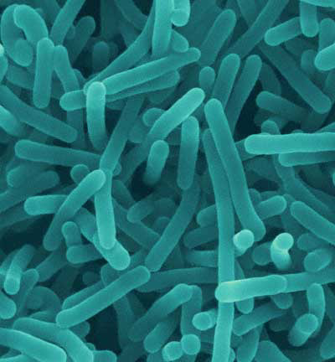
Major Food-borne pathogens
Salmonella (48.7% of pathogen tests)
  1.4 million cases per year
Listeria (Listeria monoctyogenes) (45.3% of pathogen testing.
  2,500 serious cases/yr¹
  About 500 of these people die¹
E. coli 0157 (3.8% of pathogen tests)
  32,000 serious cases/yr
Listeria monocytogenes
Dennis Kunkel Microscopy, Inc.
1 Centers for Disease Control and Prevention

Slide 3
Drivers of technology need
Increased Government Scrutiny:
  Increased regulation for Listeria: mandatory testing RTE (ready to eat) meat process surface, zero tolerance, HACCP (Hazard Analysis and Critical Control Point)
Convenience driving new (ready-to-eat) processing technique e.g. fresh vegetables, fruits, RTE meats/meals (e.g. spinach, Taco Bell; Westco Fruit and Nut Co., Peanut Butter)
Bioterrorism concerns

Slide 4
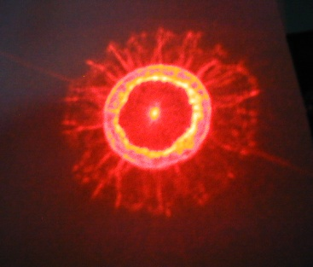
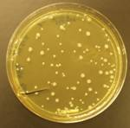

Bacteria Rapid Detection using Optical Scattering Technology
(BARDOT)
>2000 scatter patterns from cultures of 108 Listeria strains were measured and analyzed
69 – L. monocytogenes
16 - L. innocua
12 - L. ivanovii
5 - L. seeligeri
3 - L. welshimeri
3 - L. grayi
Schematic representation of the laser scatterometer used to perform analysis of bacterial colonies. A – 635-nm diode laser, B – Petri dish containing bacterial colonies, C – CCD camera, D – Petri-dish holder, and E – detection screen.

Slide 5
Bacteria Rapid Detection using Optical Scattering Technology (BARDOT) – the new system
BARDOT (Bacteria Rapid Detection using Optical Scattering Technology) designed by Hirleman group.
Broaden the library of scatter images for additional bacterial colonies (Bhunia group)
New technology for features extraction (Rajwa/Robinson group)

Slide 6
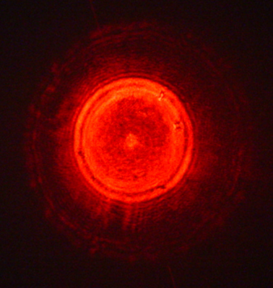
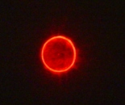
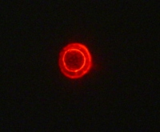
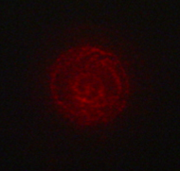
Every organism has a very specific scatter pattern
L. monocytogenes ATCC19113
L. innocua F4248
L. ivanovii ATCC19119
L. seeligeri LA 15
L. welshimeri ATCC35897
L. grayi LM37
Purdue University Patent Pending

Slide 7
Listeria scatter patterns

Slide 8
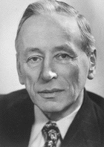
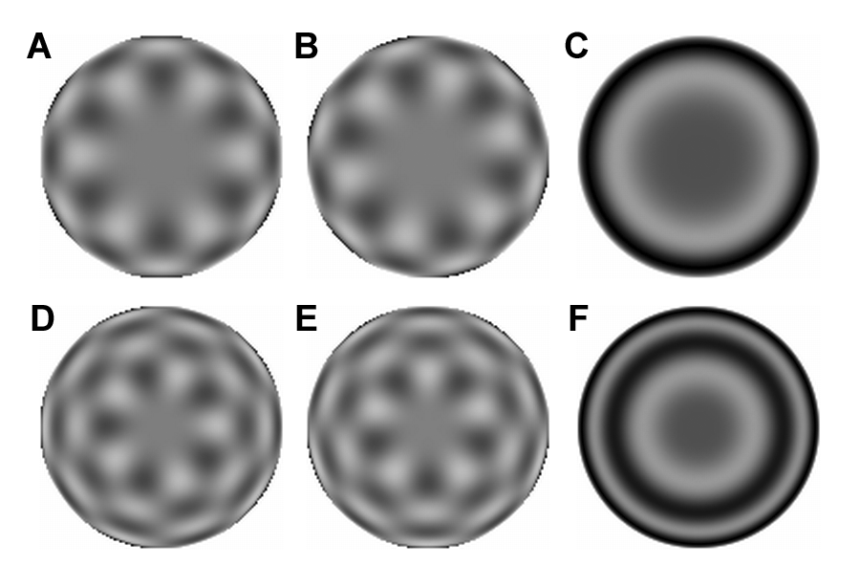
Image analysis using 2D radial Zernike polynomials
Frits Zernike
The Nobel Prize in Physics 1953
The Zernike polynomials are a set of orthogonal polynomials that arise in the expansion of a wavefront function for optical systems with circular pupils. They were introduced by F. Zernike in 1934: Zernike, F. "Beugungstheorie des Schneidenverfahrens und seiner verbesserten Form, der Phasenkontrastmethode." Physica 1, 689-704, 1934.
Graphical representation of radial Zernike polynomials Z_{n,m} in 2D (image size 128 x 128 pixels), and their magnitudes: A – real part Z_{10,6}; B – imaginary part Z_{10,6}; C – magnitude Z_{10,6}; D – real part Z_{13,5}; E – imaginary part Z_{13,5}; F – magnitude Z_{13,5}. The larger the n-|m| difference, the more oscillations are present in the shape. Features used in this study are the magnitudes of Zernike polynomials. One may note that the values of the magnitudes do not change when arbitrary rotations are applied.

Slide 9
Question
If you can reduce an organism’s identity to a definable mathematical structure, could that representation be useful for identifying “unidentifiable” organisms such as might be used in in bio-terrorism?

Slide 11
A line scan defines where a colony is
The Scan Identifies the location of each colony

Slide 12

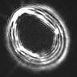
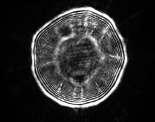
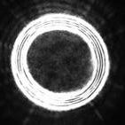
individual Imaging of Scatter Patterns
Click to
start
Each colony is then hit with the laser to obtain a scatter pattern

Slide 13
Classification of Scatter Patterns
Data Reduction
Match: E.coli

Slide 14
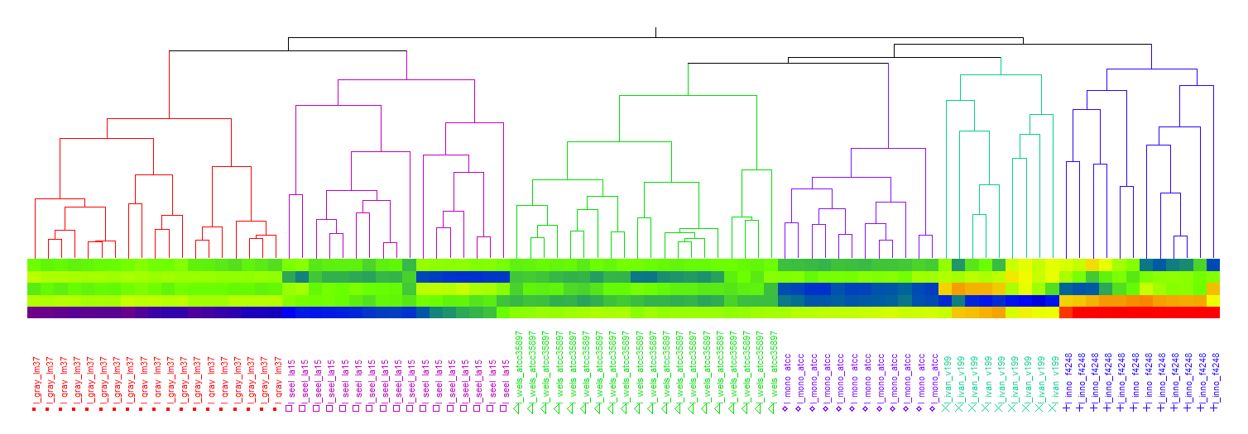
Hierarchical clustering based on Zernike moment invariants
Color map visualizing PC values
L. grayi
L. seeligeri
L. welshimeri
L. mono-
cytogenes
L. ivanovii
L. seeligeri
Hierarchical clustering of bacterial scatter patterns. Symbols represent six different strains of Listeria belonging to six species: ■ L. grayi LM37, □ L. seeligeri LA15, r L. welshimeri ATCC35897, ◊ L. monocytogenes ATCC19113, + L. innocua F4248, L. ivanovii V199. Numbers represent identified clusters of patterns. Note that identified clusters coincide with the groups of colonies from different strains.
Notes:
Using the first 5 principal components of the features vectors we were able to separate each of the species (L. monocytogenes, L. innocua, L. ivanovii, L. grayi, L. seeligeri, and L. welshimeri) by performing hierarchical clustering.
The hierarchical clustering connects observation vectors into clusters whose values are close to each other relative to those of other clusters. Hierarchical clustering is a process that starts with each point in its own cluster. At each step, the two clusters that are closest together are combined into a single cluster. This process continues until there is only one cluster containing all the points. The clustering sequence is easily visualized with the help of the dendrogram, shown in this slide. A dendrogram is a tree diagram that lists each observation, and shows which cluster it is in and when it entered its cluster.
We used the Ward’s method to produce the clusters. In Ward’s minimum variance method, the distance between two clusters is the ANOVA sum of squares between the two clusters added up over all the variables. At each generation, the within-cluster sum of squares is minimized over all partitions obtainable by merging two clusters from the previous generation. The sums of squares are easier to interpret when they are divided by the total sum of squares to give the proportions of variance (squared semipartial correlations). Ward’s method joins clusters to maximize the likelihood at each level of the hierarchy under the assumptions of multivariate normal mixtures, spherical covariance matrices, and equal sampling probabilities.

Slide 15
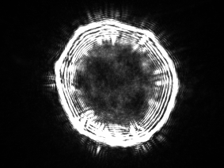
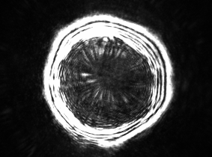
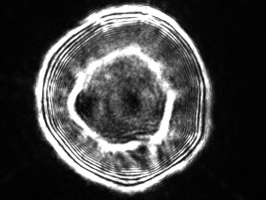
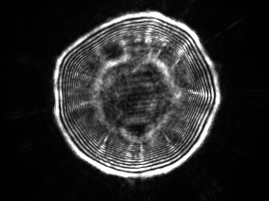
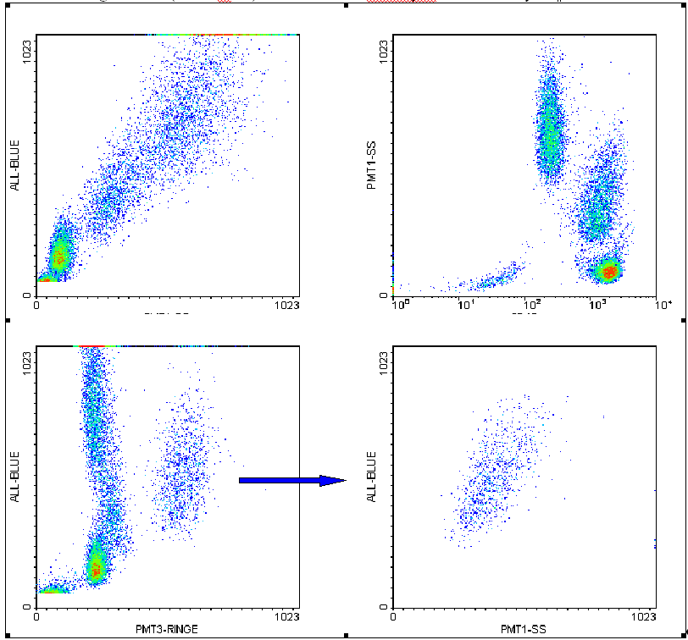
What Applications are potentially candidates for advanced scatter technology?
Plate based systems
Hematological malignancies – e.g. AML cells
Stem Cell Colonies?
Islets?
Any homogeneous group of cells
Cytometry based systems
Multi-scatter angles
No labels needed
Added structural classifiers
Pattern II
E. coli O157:H7 K6
E. coli O157:H7 EDL933

Slide 16
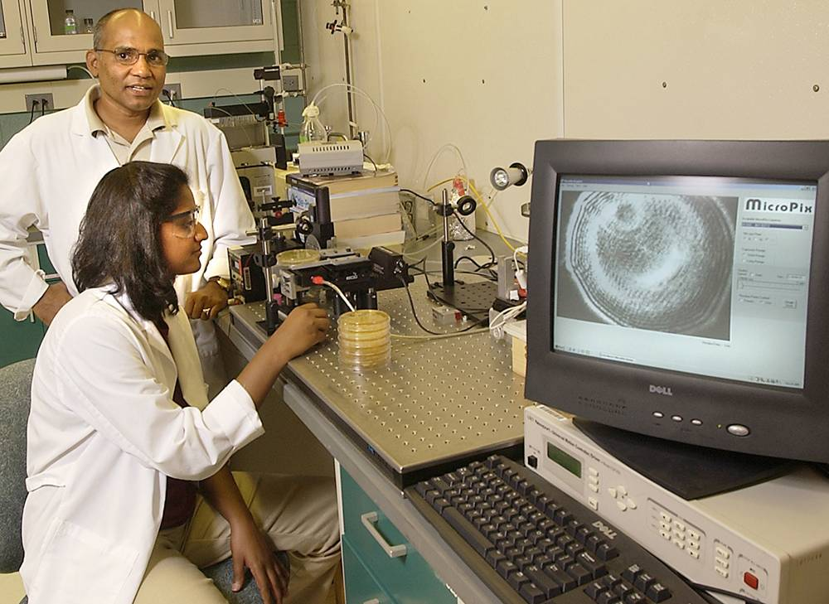
Bacteria Rapid Detection using Optical Scattering Technology (BARDOT)

Slide 17
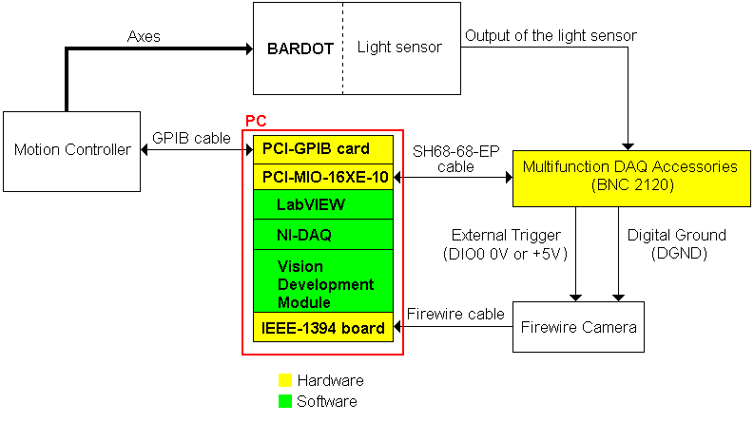
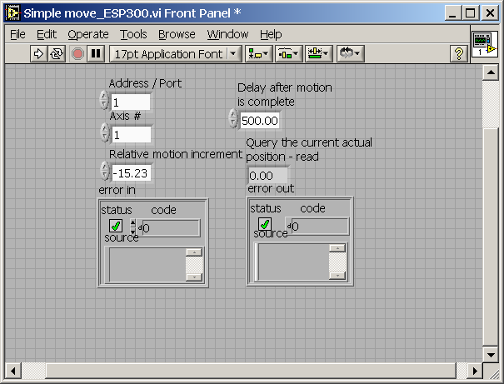
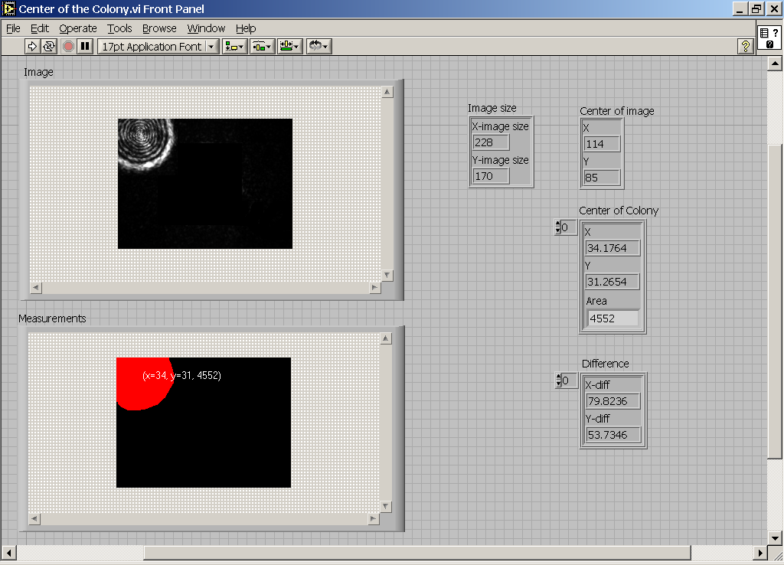
BARDOT automation
  Integrating mechanical part (XY stage) and detector part (sensor) with algorithm
Notes:
Light deviates from its straight path when it hits an obstacle. This is known as a diffraction theory which is a subcategory of scattering.
When there is no external field, atom or molecule is in neutral state which means there is no polarity.
But when external field is applied to this neutral state, they start to create +, - poles which changes according to the incident wavelength.
And change of +,- polarity creates secondary wave which is a scattering phenomena.

Slide 18
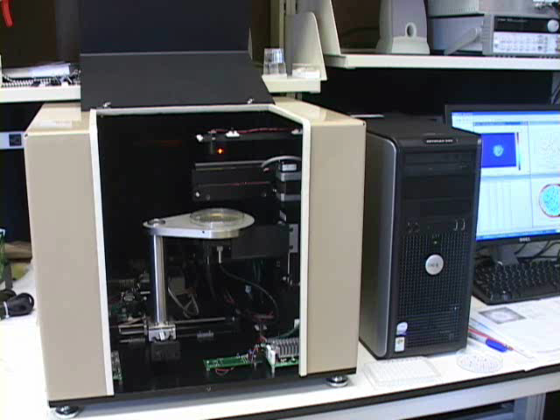
Early prototype operation

Slide 19
Generate scatter images of pure cultures of different bacteria (Genus) to create image libraries
Listeria
Escherichia
Salmonella
Staphylococcus
Bacillus
Vibrio
Miscellaneous
Liquid cultures diluted, spread on BHI agar (15 ml) plate to obtain ~100 colonies.
Colony size~1.5-2mm
Incubation temp (30-37C) and time (12-48 h) variable

Slide 20
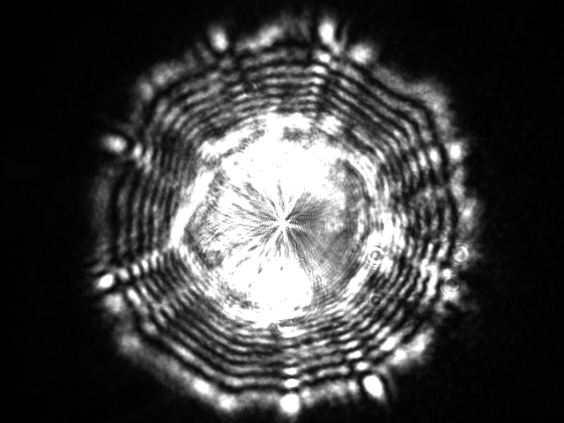
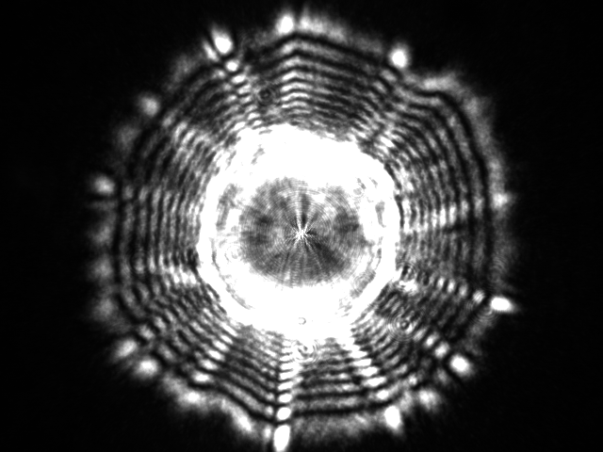
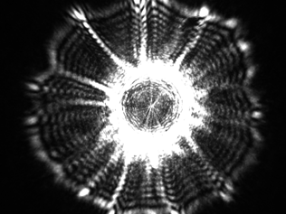
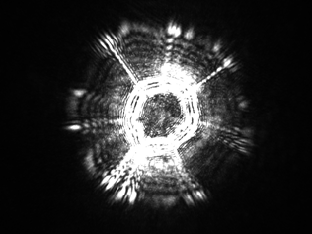
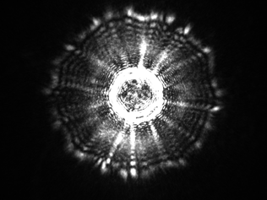
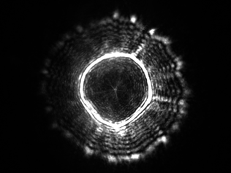
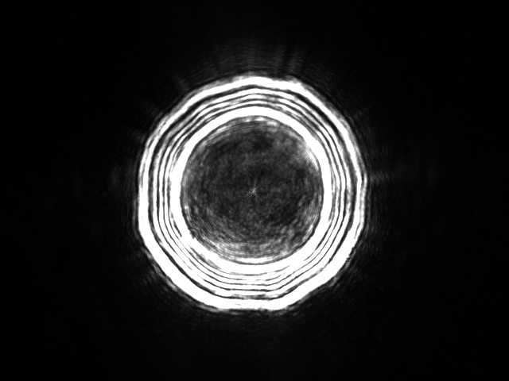
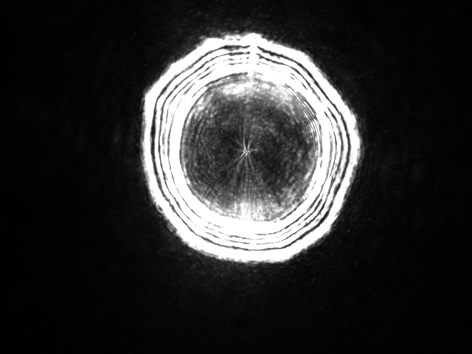
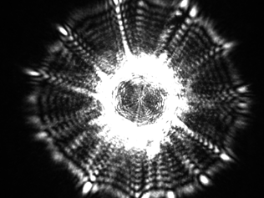
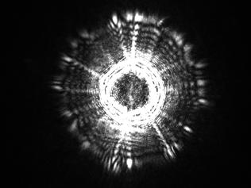
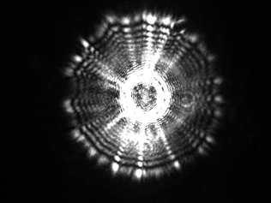
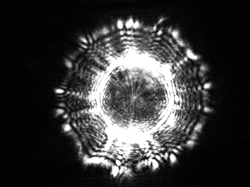
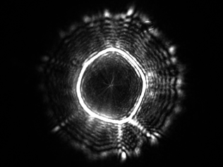
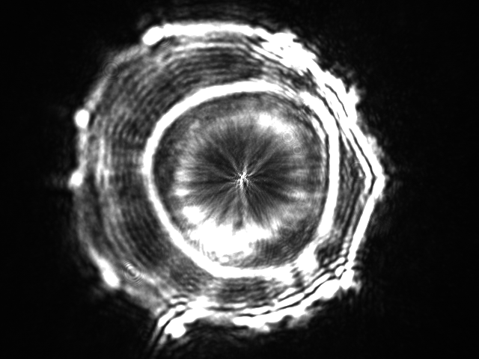
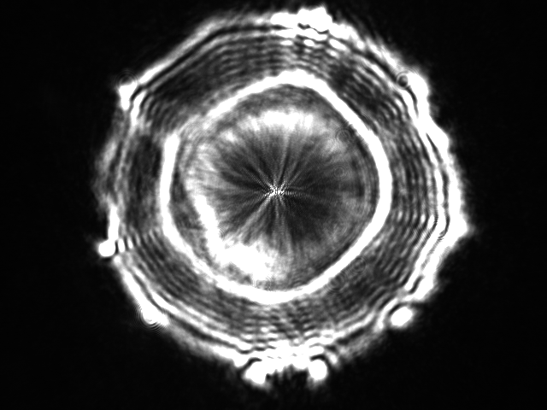
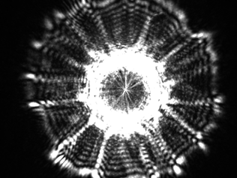
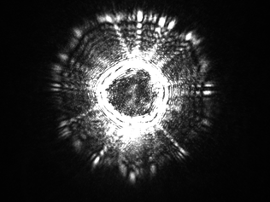
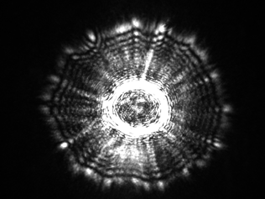
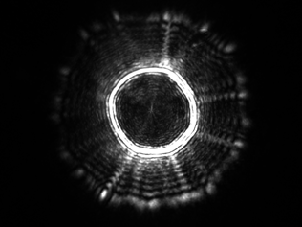
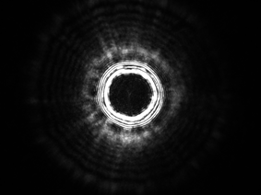
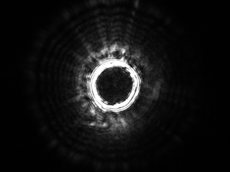
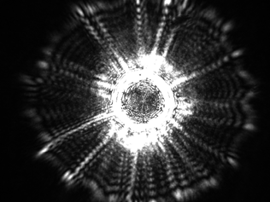
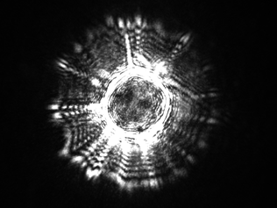
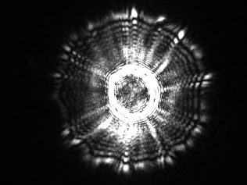
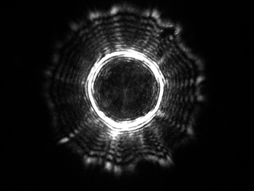
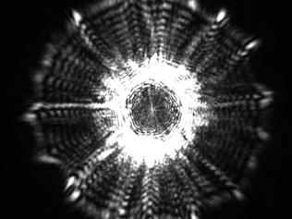
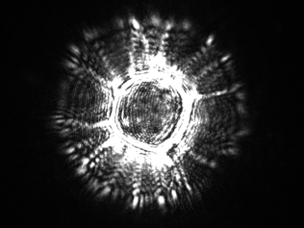


L. mono 19117 (4d)
L. mono F4233 (1/2b)
L. mono F4244 (4b)
L. mono 7644(1/2c)
L. monocytogenes V7 (1/2a)
L. welshimeri 35897
L. grayi 19120
L. seeligeri V34
L. innocua F4248
L. ivanovii 45C2

Slide 21






















Escherichia coli
Based on scatter patterns, we can identify everything we
have attempted so far. All of the organisms of interest have
been pathogens – mostly food borne in nature
Nonpathogenic
EHEC
E. coli K12
Pattern I
Pattern II
EPEC
E. coli O157:H7 01
E. coli O157:H7 K6
E. coli O142:H6 E851171
E. coli O157:H7SEA 13A53
E. coli O157:H7 EDL933
E. coli E2348169 O127:H6
Pattern III
ETEC
E. coli O157:H7 505B
E. coli O25:K19:NM
E. coli O157:H7 G5295
E. coli O157:H7 K1
E. coli O157:H7 G458
E. coli O78:H11

Slide 22




















Salmonella
Sal. Enteritidis
Salmonella Typhimurium
1773-92
Sal. Typhimurium copenhagen
PT21
PT4
Salmonella Tennessee
13096
Salmonella Kentucky
PT28
Salmonella Agona

Slide 23








































Staphylococcus
S. aureus ATCC 25923
S. aureus isolate 103
S. aureus S-41
S. aureus ATCC 13301
S. epidermidis ATCC 35547
S. epidermidis isolate 101
S. epidermidis isolate 302
S. hyicus T6346
S. xylosus 18 V042A
S. lentus 4 V025B

Slide 24




















Vibrio
Vibrio cincinnatiensis
Vibrio alginolyticus Vibrio campbelli Vibrio fluvialis
Vibrio mimicus Vibrio parahaemolyticus Vibrio anguillarum
Vibrio holisae Vibrio orientalis Vibrio metchinovic 7708

Slide 25
























Vibrio vulnificus
Opaque (pathogenic!)
Transparent (nonpathogenic!)
MLT 352
MLT 364
MLT 362
MLT 403
MLT 1003
MLT 404
*Pathogens are typically opaque.
MLT 1009
LL 728

Slide 26












Light scattering image of stress-exposed bacteria
BARDOT analysis of viable but not culturable Vibrio after resuscitation
Control
Resuscitation after VBNC state
VBNC V. vulnificus 406
V. vulnificus 406
V. vulnificus 367
VBNC V. vulnificus 367
V. vulnificus 404
VBNC V. vulnificus 404

Slide 27
















Osmotic stress
Osmotic stress on Vibrio cincinnati
(Cont) 1% NaCl broth
(Cont) 1% NaCl broth
Control L. mono F4244
5% NaCl broth
5% NaCl broth
10% NaCl broth
10% NaCl broth
1% NaCl Agar Plate
5% NaCl Agar Plate
Osmotic stressed L. mono F4244
No survivors on 10% NaCl agar
L. monocytogenes F4244 grown in BHI broth with 5.5% NaCl for 24h then plated on BHI agar

Slide 28






Heat and acid stress
Heat Stress
Acid Stress
Heat shock: Lm V7 at 42C for 3h - plated on BHI agar
pH stress: Lm F4244 grown in BHI broth with pH of 4.0
Control - Lm V7
Control Lm F4244
Heat stress recovered Lm V7
Acid-stressed Lm F4244

Slide 29
Listeria
10
Discriminant Function 4
0
-10
Listeria innocua F4248
Listeria ivanovii 19119
Listeria monocytogenes 19118
Listeria monocytogenes 7644
-20
Listeria monocytogenes v7
Listeria welshimeri 35897
15
0
100
200
300
400
500
Discriminant Function 1
Staphylococcus
Salmonella
E. coli
10
6
8
6
4
4
2
2
0
Discriminant Function 2
Discriminant Function 2
0
-2
-2
-4
S. copenhagen
-4
E. coli ETEC025
-6
S. enteriditis 13096
E. coli ETEC078
S. enteriditis PT28
E. coli H701
-8
S. enteriditis PT4
-6
E. coli H7G458
S. tennessee
E. coli H7G5295
-10
-8
E. coli K12
-25
-20
-15
-10
-5
0
5
10
-8
-6
-4
-2
0
2
4
6
8
Discriminant Function 1
Discriminant Function 3

Slide 30
Staphylococcus aureus S41
Staphylococcus hyicus T6346
Staphylococcus aureus PS103
Staphylococcus aureus ATCC13301
Staphylococcus epidermidis 302
Staphylococcus epidermidis ATCC35547
Staphylococcus spp
95.78%
Salmonella Enteritidis PT28
Salmonella Enteritidis PT4
Salmonella Enteritidis ser. 13096
Salmonella Agona
Salmonella Typhimurium var. copenhagen
Salmonella Tennessee
Salmonella serovars
78%
E. coli H701
E. coli ETEC025
E. coli ETEC078
E. coli K12
E. coli H7G458 (O157:H7)
E. coli H7G5295 (O157:H7)
E. coli
87%
96.6%
L. monocytogenes 7644
L. welshimeri 35897
L. innocua F4248
L. ivanovii 19119
L. monocytogenes 19118
L. monocytogenes V7
Listeria spp
99.6%
Vibrio alginolyticus
Vibrio campbellii
Vibrio cincinnatiensis
Vibrio hollisae
Vibrio orientalis
Vibrio parahaemolyticus
Vibrio vulnificus
Vibrio spp
94%

Slide 31

Food testing with BARDOT
Notes:
31

Slide 32

PCR confirmation of scatter images of Listeria monocytogenes colonies from hotdog
Hotdog
Aroonnual et al 2008
32

Slide 33

PCR confirmation of scatter images of Salmonella Enteritidis PT1 colonies
Tomato
Aroonnual et al 2008
33

Slide 34

Multiplex PCR confirmation of scatter images of V. paraheamolyticus and V. vulnificus colonies from spiked oyster
vp
vv
vp
vv
Oysters
34

Slide 35




1 cfu/ 25g sample: 8 h enrichment + 14 h on plate
100 cfu/ 25g sample: 6 h enrichment + 14 h on plate
1000 cfu/ 25g sample: 4 h enrichment + 14 h on plate
E. coli O157:H7 EDL933
Shredded beef Frozen spinach
1 cell/25 g – no growth, even after 24 h
100 cfu/ 25g sample: 10 h enrichment + 14 h on plate
1000 cfu/ 25g sample: 8 h enrichment + 14 h on plate

Slide 36


Hot Dog
Listeria monocytogenes V7
Positive control
Growth on plate = 26 hours

Slide 37


Tomato
Salmonella Tennessee
Positive control
1 cell/25g – no detection
100 cells/25g: 6-8 h enrichment+ 13h
1000 cells/25g: 4 h enrichment+ 13h

Slide 38
Modeling I
Applying Rayleigh Sommerfeld diffraction theorm, we could model the diffraction from bacterial colony
Amplitude/Phase modulation is applied to compute the modulation of light when it passes through the colony

Slide 39

Modeling II
λ |  | 0.635 nm | XY stage |  | 50 mm/0.01mm
Beam diameter |  | 1 mm | CCD pixel |  | 640x480
Stage holder |  | 1” – 4” | Unit pixel |  | 7 μm

Slide 40

Modeling III
Based on the previous modeling, we could compute the diffraction pattern with certain amplitude and phase modulation
Comparison of Listeria innocua case for z= 40 mm is shown
BARDOT
Modeling

Slide 41

Laser beam optics (II)
Find the maximum intensity of the original image
Threshold the image with the value of 1/e² of the maximum intensity
Calculate the total number of pixels that have intensity above the threshold value and obtain the equivalent spot size
Notes:
41
Lens focal length?
Profile asymmetric any reason?

Slide 42


Built-in Incubator inside BARDOT
Automatic colony detection via imaging camera & laser beam size is controlled according to the colony diameter
Incubator is designed with ITO coating to provide laser to pass through and constant temperature is maintained
Notes:
42

Slide 43


Bacterial colony profile measurement (I)
Laser confocal displacement sensor to accurately measure the 2D profile of the single colony
Wavelength | 670 nm
Reference distance | 6 mm
Measure range | 0.6 mm
Resolution | 0.01 μm
Notes:
43

Slide 44




Bacterial colony profile measurement (II)
E.coli O157:H7 EDL933 (D=293 um)
L. innocua F4248 (D=312 um)
Notes:
44

Slide 45

Smaller colonies detection (I)
Escherichia coli O157:H7 EDL933
Listeria monocytogenes
Salmonella
Listeria innocua F4248
Bacteria | Growth Time | Diameter Range (um) | Average Diameter (um) | Std(um)
Escherichia coli O157:H7 DEL933 | 6hrs | 29-128 | 62.2 | 22.242
 | 8hrs | 77-263 | 168.5 | 63.1792
L. mono V7 | 14hrs | 251-418 | 348 | 45.222
Salmonella | 6hrs | 20-67 | 39.63 | 12.7
 | 8hrs | 67-271 | 164.79 | 44.575
L. innocua | 10hrs | 105-201 | 160.33 | 18.805
Notes:
45

Slide 46
New set of features – Haralick texture descriptors
In many images, structures are discernible visually based on textural rather than brightness differences. Texture operators are able to enhance and quantify this differences
Scatter image of L. Ivanovii processed with three different Haralick operators

Slide 47




From scatter pattern to colony morphology – overview of data analysis system
Complicated
inverse
methods
Pattern recognition and classification on basis of image features
model
Type of microorganism
47

Slide 48
Overview of the classification system
Pseudo-Zernike
orthogonal
moments
Collect training dataset
Select features
Model-based
selection
Radial Chebyshev
orthogonal
moments
Feature selection
(e.g. by stepwise
discriminant analysis)
Ensemble
of features
Statistics-based
selection
Haralick texture
descriptors
Build the classifier
Collect the data
Train and validate
the classifier
Classify in real-time
48
Notes:
48

Slide 49
Method: Automated classification using support vector machines
The SVM algorithm creates a hyperplane that separates the data into two classes with the maximum-margin. The SVM idea was proposed by Vladimir Vapnik in 1963
For categorical variables a dummy variable is created with case values as either 0 or 1. Thus, a categorical dependent variable consisting of three levels, say (A, B, C), is represented by a set of three dummy variables: A: {1 0 0}, B: {0 1 0}, C: {0 0 1}

Slide 50
Sensitivity and specificity of classification using SVM algorithm
 | Predicted class
Correct class | E. coli sp. | Listeria spp. | Staphylococcus spp. | Salmonella spp. | Vibrio spp.
E. coli sp. | 90.56% | 3.37% | 0.64% | 4.60% | 0.83%
Listeria spp. | 1.96% | 93.36% | 0.34% | 1.15% | 3.19%
Staphylococcus spp. | 0.26% | 0.39% | 97.66% | 0.45% | 1.23%
Salmonella spp. | 4.36% | 0.64% | 0.04% | 93.53% | 1.43%
Vibrio spp. | 0.85% | 4.47% | 0.62% | 1.71% | 92.35%
Class | Sensitivity | Precision
E. coli sp. | 90.56% | 90.78%
Listeria spp. | 93.36% | 91.38%
Staphylococcus spp. | 97.66% | 97.54%
Salmonella spp. | 93.53% | 93.53%
Vibrio spp. | 92.35% | 94.10%
50

Slide 51
Staphylococcus spp. classification
where P⁽¹⁾ is the number of true positives (number of instances correctly predicted to belong to a given class), P⁽⁰⁾ is the number of false positives (number of instances incorrectly predicted to belong to a given class), and N⁽⁰⁾ is the number of false negatives (number of instances from a given class incorrectly predicted to belong to other classes). Sensitivity gives the probability of correct classification, whereas 1-Precision estimates probability of false alarms.
51

Slide 52
Canonical and PCA plots illustrating features extracted from scatter patterns produced by colonies belonging to six different strains of Listeria.
Legend:
■ – L. welshimeri 35897,
┼ – L. innocua V58,
­ – L. ivanovi 19119,
◊ – L. ivanovi SE98,
□ – L. monocytogenes 19113
● – L. monocytogenes V7.
PC1
PC1
PC1
PC1
PC1

Slide 53
Classification success rate for Listeria spp.
BARDOT system, SVM algorithm

Slide 54
Training and testing – mixture of species
Only ≈700 examples shown
Training set
Training set
Testing set
Listeria
Salmonella
Vibrio
Test set

Slide 55
Failure of clustering – we need supervised machine learning
Non-supervised learning
Ground truth (visualization of the a priori information about the test set)

Slide 56
Visualization of the classification results
Only ≈700 examples shown
2-D visualization of the test set
Listeria
Salmonella
Vibrio
Misclassified colonies are shown as red crosses
Classification result (SVM)

Slide 57
Classification example – mixture of species
Bootstrap error estimate ≈ 3%

Slide 58
Overview of the classification system
(in development)
Collect training dataset
Select features
Model-based
selection
Currently classification system works off-line. Data set have to be transferred to a separate computer workstation for classification. Next goal: real-time classification
Statistics-based
selection
Build the classifier
Collect your data
Train and validate
the classifier
Classify in real-time

Slide 59


The BARDOT system can be used for purposes previously unforeseen – e. g.: biodiversity estimation of soil bacteria
E3
BU
The light scattering patterns formed by the colonies of actinomycetes from Indiana soil.
59

Slide 60

Simple exploratory analysis show two subpopulations
60

Slide 61

Determination of presence of a new population in the sample
61

Slide 62
Rapid measurement of sample biodiversity on the basis of morphotype analysis
E3
A5
BU
Diversity index = median[dist]
350
175
62

Slide 63

What about clinical microbiology?

Slide 64











First, each organism is cultured and plated. Many colonies are collected (50-100) and a classification matrix is developed. Then we plate these organisms onto half plates to check the classifier.
1006 (MRSA)
1020
Organisms kindly supplied by Dr. John Thomas, WVU

Slide 65







Can we determine antibiotic resistant strains?
S.aureus 1020
S.aureus 1004
S.aureus 1006
MRSA
A mixture of 3 organism – all S.aureus
Organisms kindly supplied by Dr. John Thomas, WVU

Slide 66

Can we determine antibiotic resistant strains?
A mix of 3 organisms (1020, 1004 and 1006) randomly read on the plate. The three patterns can be clearly discerned. Organisms kindly supplied by Dr. John Thomas, WVU

Slide 67


A
MRSA
B
Strain 1004
Strain 1006
Strain 1020
MRSA
C
Supervised classification accuracy:
RBF SVM classifier – 100%
Linear SVM classifier – 100%
LDA classifier – 100 %
MRSA
Strain 1004
Strain 1006
Strain 1020

Slide 68

Time lapse bacterial colony growth
So when is the colony identification accurate?
Does it change over time?

Slide 69
Bioterrorism and bacterial scatter
How do you identify a genetically modified organism?
Will that organism be identified by standard tests?
How will we know it is even there?

Slide 70

Bioterrorism Distributed Alarm Sequence
Security
Intel
PCR
Fingerprint
Partial ID
Absolute
ID
Samples are spaced at 6 hour Intervals for demonstration purposes only
Bardot
Pattern
Generation
Unknown
Send to DB
Bardot
Pattern
Generation
Unknown
Send to DB
Bardot
Pattern
Generation
Partial ID
Send to DB
Bardot
Pattern
Pathogen ID
RED Alert
Sample 1
Clinical
isolate
Lab A
New York
Sample 2
Factory food
Distribution
Center
Lab B- LA
Sample 3
Clinical
isolate
Lab C
Chicago
Central
DB
Local
DB
Local
DB
Local
DB
Sample “n”
Lab W
Miami
0
6
12
18
24
30
36
42
48 Hrs
Figure: A sample arrives at lab A in New York. A pattern is taken – no identification made. A second sample from a food distribution center is sent to a lab in LA. It is processed by bardot – a partial ID is made as the system knows it has seen that patter before but it does not have an ID. A third specimen arrives at a Chicago lab. Immediately the system recognizes that the pattern has been seen 3 times- this is a major alert flag. By this time (18 hours after 1st sample) a full ID has been made and a full red alert is engaged. The pattern from a subculture of the isolate is used to train the database classifier with ‘truth” and from now on, all subsequent isolates of this organism are immediately recognized regardless of the isolation site.
Unknown
Alert
No Alarm
Pattern A
Unknown
Alert
Yellow
Pattern A
Partial ID
Alert
Orange
Pattern A
Known ID
Alert
RED
Pattern A
Known ID
Alert
RED
Pattern A
0
6
12
18
24 Hours
Time sequence for alert confirmation

Slide 71



Data management, Features and Services
How does this technology fit the biodefense paradigm?
Web-services Layer
Interface
Security
Service Composition
Schema and Standards
Change Management
Optimization
CMU-Supported Features/Services
Privacy
Query/Update Authorization
Data Capture
Data Integration
Data Lineage and History Tracking
Data Analytics
Visualization Tools
Ontology Management
Annotation Management
Central Management Unit (CMU)
Pathogens Database
Classifiers
EG Response Status
OMICS
Data
Demograp-hics
RSBs
Scientific Data
Corresponding Demographics
Local
DB
National Databases
genomic
Proteomic
Pharmaco-genomic
Figure legend: The data management profile uses secure web services to connect each of the remote sites that are participating in this proposal. Data are collected at the remote sites (as patterns and accompanying meta data where applicable) and these patterns are submitted through a secure pipeline to a remote center management unit (CMU). In essence this CMU can deliver updated pattern, or related meta data back to any and all remote sites within seconds.

Slide 72

An Automated scanning systems

Slide 74

Self Communicating Network

Slide 75


Slide 76
Summary - BARDOT
Detects viable cells
Reagent-free and involves minimal steps
Noninvasive and nondestructive method and colonies can be used for further confirmation/verification
BARDOT based detection was successful with stress exposed and spiked food samples
Organism analysis results in a mathematical representation of each organism
Actual detection time: Seconds-minutes
Significant reduction in biochemical analysis
Application in food production industry
Biosecurity application
May have clinical application – preliminary data suggests we can determine antibiotic resistant strains

Slide 77


Acknowledgements
NOTE: This work was performed by 3 major groups: Arun Bhunia (Food Science), E. Dan Hirleman (Mechanical Engineering) & J. Paul Robinson (Biomed. Engineering)
Contributors to this presentation
Senior Scientists: Bartek Rajwa, Andy Bieberich, Maria Tsiper
Postdocs: Valery Patsekin, Andy Bieberich, , Meiguo Xin, Ana Ruan
Graduate Students: Wamiq Ahmed, Muru Venkatapathi, Awais Mansoor, Angela Wolf, Fiona Thomas, Anthony Pedley
Faculty: Kinam Park, V.J.Davisson, Arun Bhunia, E. Dan Hirleman
Collaborator on CD4 project: Gary Durack, Tony Ward, Jeff Harvey, Gilbert Rochon
Bhunia – Robinson - Hirleman
Staff
  Jennie Sturgis (Imaging)
  Kathy Ragheb (Flow)
  Cheryl Holdman (Flow)
  Hildred Rochon (C4L)
  Sherry Wood (Biodiversity)
  Lararissa Avramova
  Raymond Fatig
Funding:
NIH, NSF, USDA, DOD, Purdue University
Corporate: Beckman Coulter, Parker-Hannifin,
Polysciences, Bangs labs, MediaCybernetics, Q-Imaging,
Kodak Medical Systems, Crystalplex, Becton-Dickinson , Icyt,
eBioscience, Intellicyte, Amgen, ITG Indiana, Digilab, Roche
Bindley Bioscience Center, Purdue University

