Slide 1
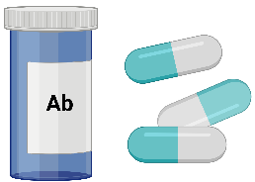
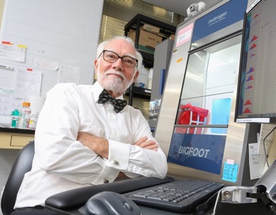
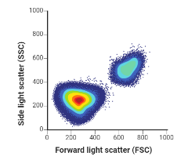
Flow Cytometry applications for antimicrobial resistance
J. Paul Robinson
Distinguished Professor of Cytometry
Dept of Biomedical Sciences
Professor of Biomedical Engineering
wombat@purdue.edu
Purdue AMR conference Feb 27, 2024

Slide 2
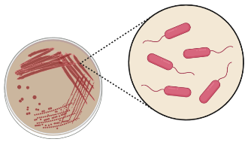
Outline of the presentation
Overview of bacterial detection methods
Why flow cytometry for microbiology?
Bacterial analysis using conventional flow cytometry
Challenges in bacterial analysis using flow cytometry
Difference between conventional and spectral flow cytometry
Bigfoot spectral cell sorter and ELS technology for detecting MRSA
Measuring bacterial autofluorescence for detecting MRSA using bigfoot
Safety precautions
Opportunities for collaboration

Slide 3
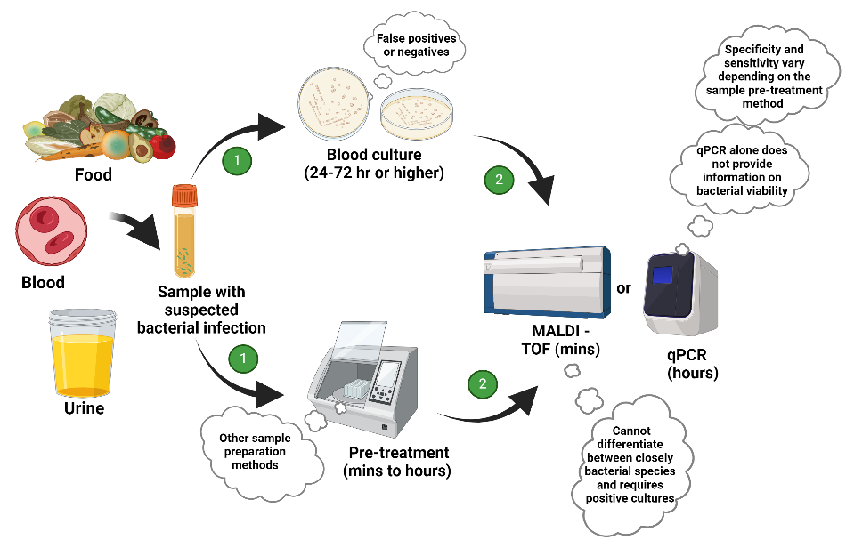
Bacterial detection and identification methods
Notes:
Limitations of current method for bacterial detection

Slide 4
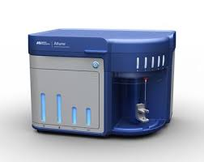
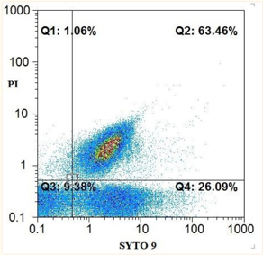
General principle of flow cytometry in microbiology
Blood Culture
Run samples (~1 min each)
Flow Cytometer
Add dye
Result
3-4 Hours
Petri Dish

Slide 5
Basic flow cytometry analysis
2017 Study
How long did this take?
2 hours to result
Antibiotic Sensitive
Antibiotic Resistant
10.3889/oamjms.2017.104

Slide 6
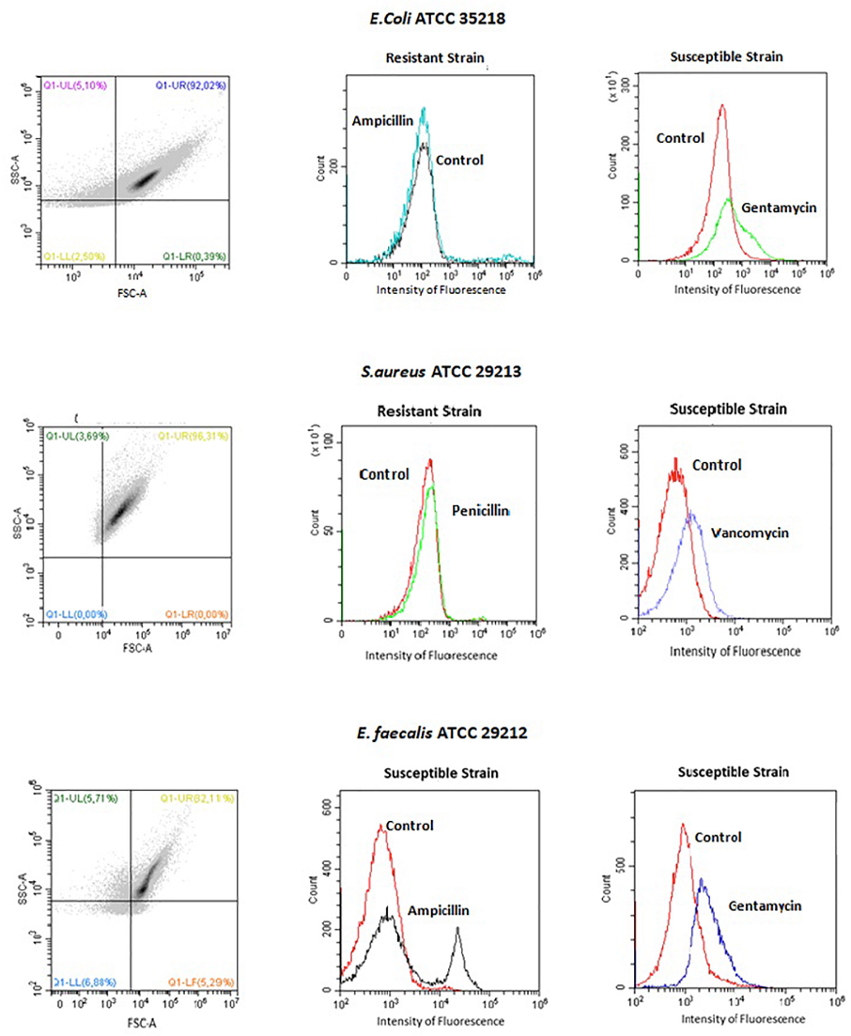
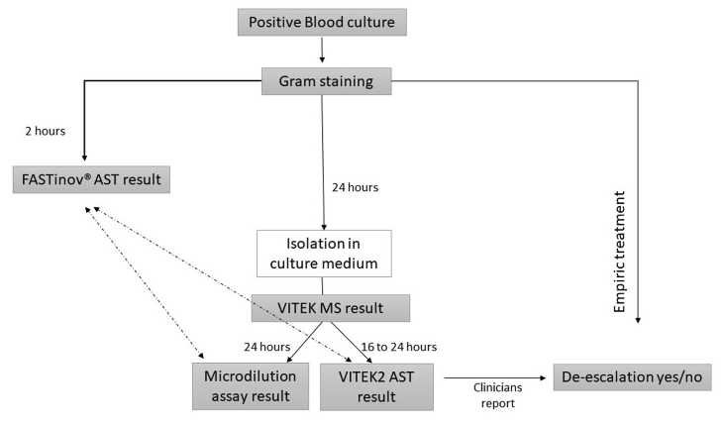
“The time required to obtain a final AST, using FASTvet panel was 2H”
https://www.frontiersin.org/journals/microbiology/articles/10.3389/fmicb.2020.01944/full

Slide 7
Streptococcus pneumoniae
PSSP, penicillin susceptible S. pneumoniae
PRSP, penicillin resistant S. pneumoniae
Similar data with Haemophilus
MRSP, multi-drug resistant S. pneumoniae
Media
0.125 μg/mL penicillin
1 μg/mL cefotaxime
2 μg/mL cefotaxime
R
MR
MR
SYTO9 and propidium iodide PI
https://www.nature.com/articles/s41598-021-82186-4

Slide 8
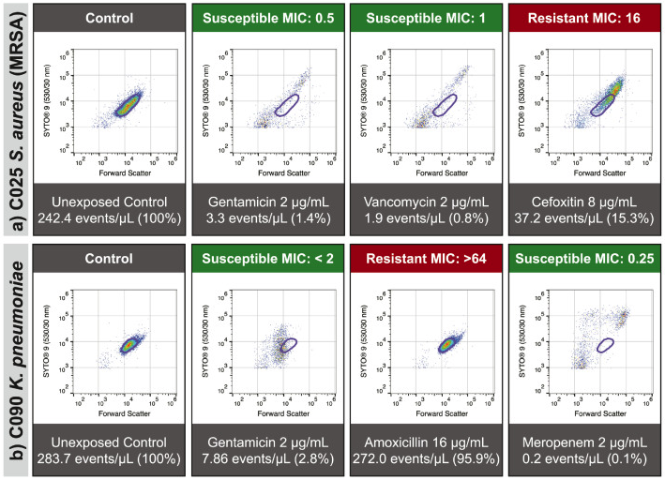
2022 Study
“Flow cytometry-assisted Antimicrobial Susceptibility Test (FAST) returns results in 3-6 hours.”
https://www.thelancet.com/journals/ebiom/article/PIIS2352-3964(22)00326-7/fulltext

Slide 9
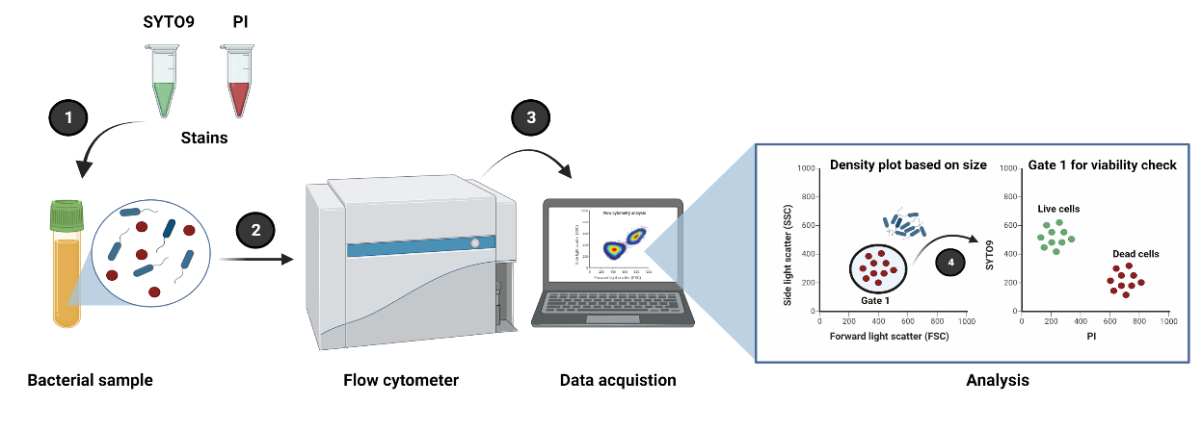
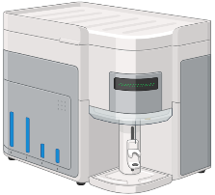
Bacterial analysis using conventional flow cytometry
5 minutes

Slide 10
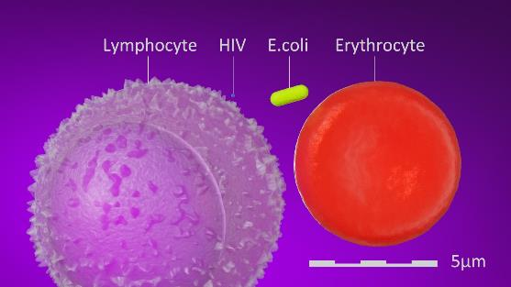
Challenges in bacterial analysis using flow cytometry
Image credit: https://blenderartists.org/t/10-000-x-magnification/693576
Size/volume
Small size/volume of bacteria- signal to noise ratio.
Lack of availability of specific antibodies (stain) to all bacteria species/across strains.
Effect on stains on bacterial viability for downstream analysis.
Wide emission band among stains- signal overlap.
Autofluorescence from bacteria and media.
Need to safe sort pathogenic bacteria for clinical applications.
Volume of lymphocytes: 206 µm3 [1]
Volume of bacteria: 0.4-3µm3 [2]
References:
[1] Kuse R, et al, Blood lymphocyte volumes and diameters in patients with chronic lymphocytic leukemia and normal controls. Blut. 1985 Apr50(4):243-8
[2] Levin PA, Angert ER. Small but Mighty: Cell Size and Bacteria. Cold Spring Harb Perspect Biol. 2015 Jun 8;7(7):a019216.
Safety
Antibodies

Slide 11
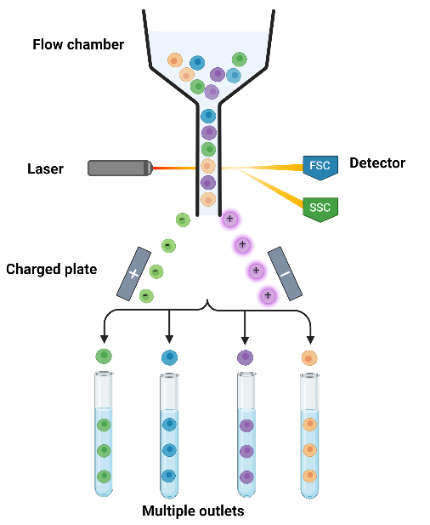
Working principle of cell sorting
Why flow cytometer?
Single cell handling capabilities
High throughput screening
Efficiency sorting
Multiplexing detection capabilities
Can be integrated to different down stream analysis
Available in clinical settings
Working principle
Notes:
Why flow cytometry is interesting?

Slide 12
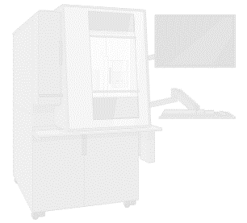
Motivation
Can we address some of the limitations?
Wide emission and signal overlap.
Autofluorescence from bacteria and media.
Need for safe sorting pathogenic bacteria and identification.
Pathogens
Spectral signatures can address signal overlap.
Multiplexing capabilities
Sorter with biosafety features can be used for safe handling of pathogens.
?
Safety

Slide 13
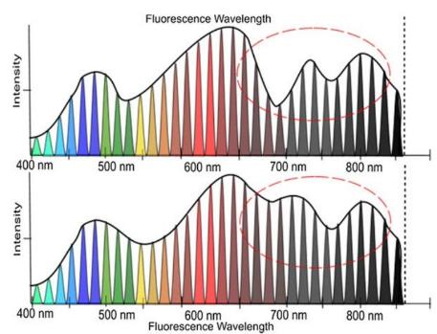
Spectral over conventional flow cytometers
Conventional flow cytometer [1]
Spectral flow cytometer [2]
530/30 band pass filter
Stain 1
Stain 2
Specific band of emission wavelength recorded-
Loss of information due to signal overlap and spillover
Light emission across the whole spectra
More information with unique spectral signature
[1] ThermoFisher, Fluorescence Spectral Viewer
[2] Images adopted from hand-book ‘’Particle Separation Techniques: Fundamentals, Instrumentation, and Selected Applications’’ (Robinson, 2022)

Slide 14
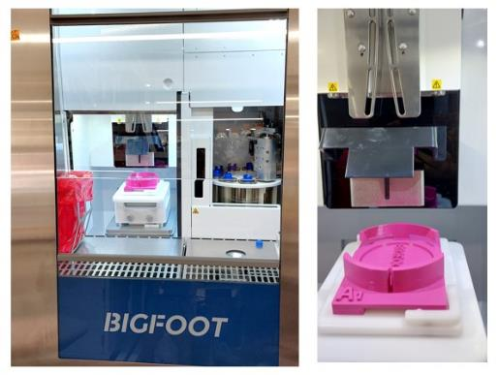
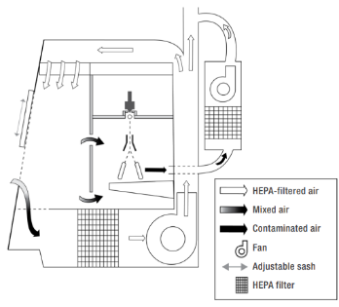
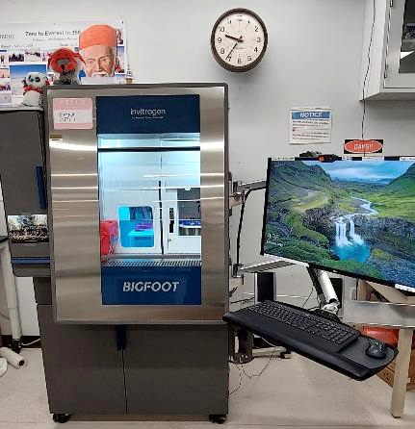
Thermo Fisher’s Bigfoot spectral cell sorter features
Placed in normal laboratory settings
Voltage plates
Biosafety cabinet
1.
3.
2.
Photo credit: Thermo Fisher
3D printed agar plate holder
Three levels of border control:
1. Anti-splash patrol
2. Contaminated air patrol
3. Sample exposure patrol

Slide 15
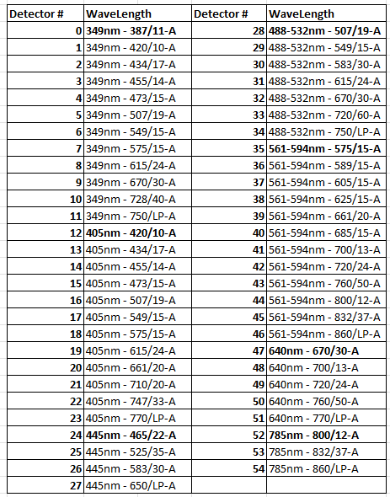
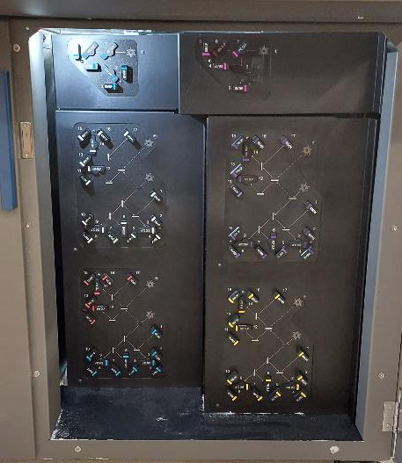
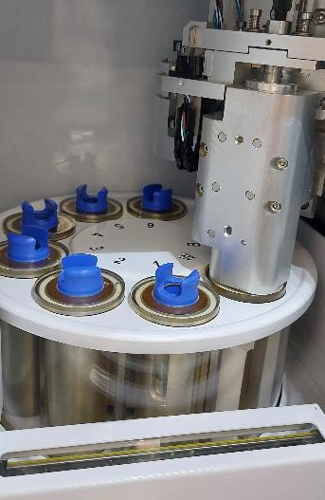
Bigfoot spectral cell sorter features continued..
6 samples handling
9 lasers and 54 detectors

Slide 16
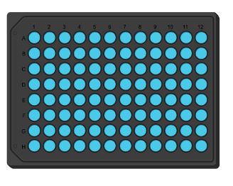
Detection and identification of antibiotic resistant bacteria using Bigfoot cell sorter and ELS technology

Slide 18
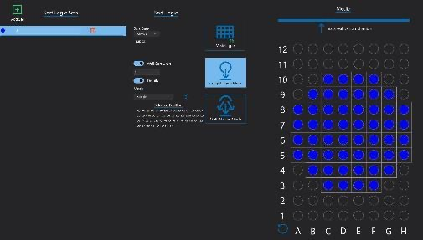
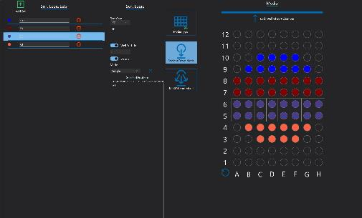
Rapid single bacterial cell patterning using Bigfoot
Real time patterning of bacteria on agar plate
Screenshots of sorting parameters in Bigfoot
96 well plate map
(52 spots)
13 secs to plate 52 single bacterial cell (<1000 cells per sec)
Message: Sorting and patterning time depends on bacterial concentration and flow rate
Sorting and patterning polymicrobial population

Slide 19
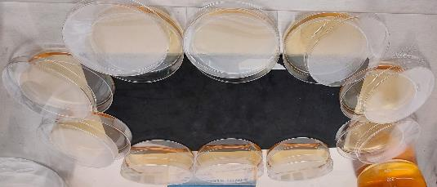
Preparation of Antibiotic Gradient Agar (AGA) plate
Layer 2: TSA agar
3mm thick mat
Low
High
Layer1 :TSA agar Oxacillin
Bryson, V. and W. Szybalski, Microbial Selection. Science, 1952. 116(3003): p. 45-51
Notes:
Method for patterning antibiotic gradient plate (AGA) plate. Preparation of AGA plate in the hood by preparing two separate layers

Slide 20
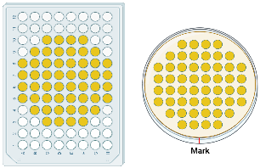
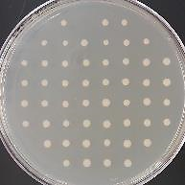
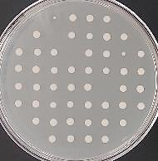
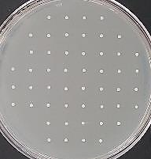
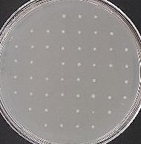
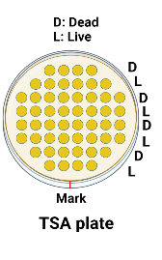
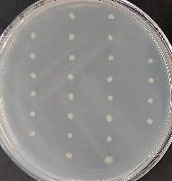
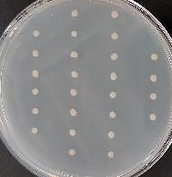
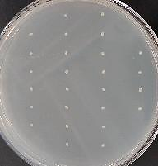
Patterning bacteria on agar plate using Bigfoot
Mapped wells/spots
After 24hr
Escherichia coli
(51 colonies)
Klebsiella pneumoniae
(49 colonies)
Staphylococcus aureus
(52 colonies)
Salmonella Enteritidis
(49 colonies)
52 colonies/plate
96 well plate
(reference)
Klebsiella pneumoniae
Escherichia coli
Staphylococcus aureus
Notes:
Here the idea is to show single cell patterning on the agar plate using Bigfoot sorting using 96 well plate maps. 52 colonies per plate.
Then we show live dead (heat killed) bacteria patterned on agar plate

Slide 21
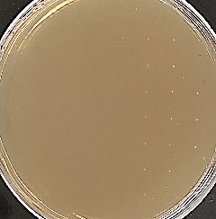
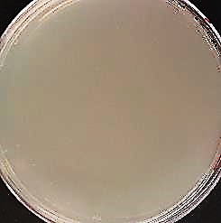
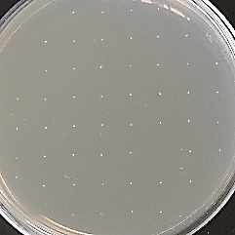
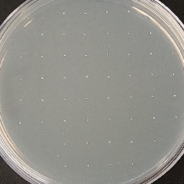
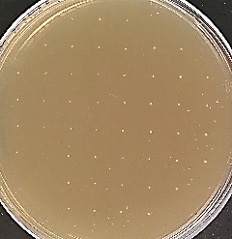
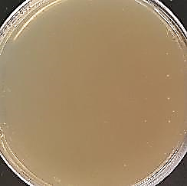
Patterning antibiotic susceptible & resistant bacteria on antibiotic gradient plate
Incubation time: 11hr
Incubation time: 15hr
Layer 2: TSA agar
Low
High
AGA agar
Total 1ug/mL
AGA agar
Total 2ug/mL
TSA agar
0ug/ml
Layer1 :TSA agar Oxacillin
High
Methicillin-susceptible staphylococcus aureus
(MSSA)
Oxacillin concentration
Low
Methicillin-resistant staphylococcus aureus
(MRSA)
Notes:
Examples of patterning MSSA and MRSA on Oxacillin AGA plate using Bigfoot.
Bacteria grown on TSA used as positive control
MSSA found growing at low conc region on 1 ug/mL and no growth on 2 ug/mL AGA plate after 15hr. (11 hr is enough to find this though!!)
MRSA found growing all over 1ug/mL AGA plate where as only at low conc region on 2ug/mL after 15hr

Slide 22
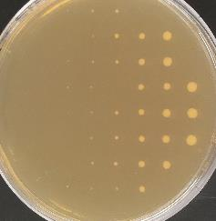
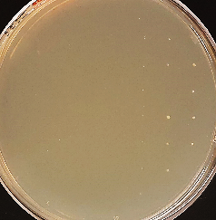
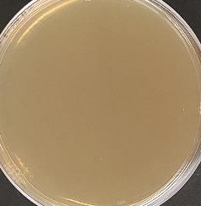
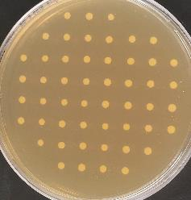
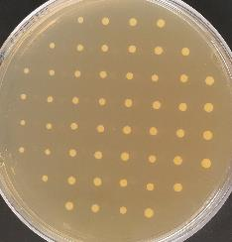
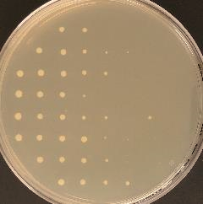
Patterning MSSA and MRSA on AGA plate (continued)
Incubation time: 31hr
AGA agar
Total 1ug/mL
AGA agar
Total 2ug/mL
AGA agar
Total 4ug/mL
High
MSSA
Oxacillin Concentration
Low
MRSA
Notes:
The plates from previous slide result were incubated to observe for colony formation
After 31hr MSSA growth found only at low to medium conc region on 1ug/mL AGA plate and low conc region on 2ug/mL AGA plate
After 31hr MRSA growth found everywhere on both 1 and 2ug/mL AGA plate and low to medium conc on 4ug/mL AGA plate

Slide 23
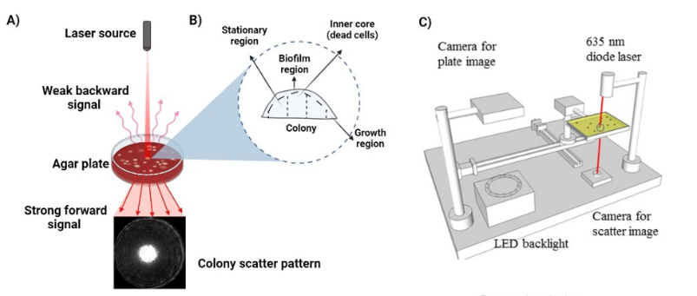
Bacterial identification using Elastic light scattering
Tang Y et al., 2014

Slide 24
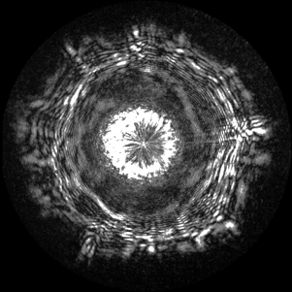
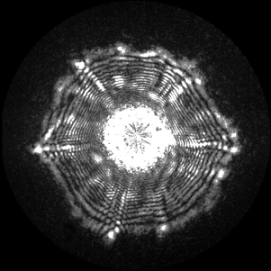
Scatter patterns of different bacterial species
E.coli
(non-pathogenic)
SE
(non-pathogenic)
SE 015
(Pathogenic)
11hr of incubation
2X magnification
TSA agar
TSA: Tryptic Soya agar
(Both gram negatives and positives)
Selective agars:
XLT4: Xylose-Lysine-Tergitol 4 agar
(Gram negatives, mostly Salmonella sp. and some E.coli strains)
VRBG: Violet red bile glucose agar
(Gram negatives)
XLT4 agar
VRBG agar
Notes:
Scatter patterns of diff bacteria grown on different types of agar

Slide 25
MSSA and MRSA colony scatter pattern comparison
TSA-11hr (Positive control)
AGA-11hr
MSSA
MRSA
Less
MSSA
MRSA
Oxa.
conc
High
Total Oxa.= 1ug/mL
Total Oxa.= 1ug/mL
Total Oxa.= 2ug/mL
Colony =1
Colony =5
Colony =2
Colony =1
Colony =1
Colony =3
Colony =2
Colony =19
Colony =19
Colony =3
Colony =26
Colony =3
Colony =4
Colony =7
Notes:
Scatter pattern from ELS of selected colonies of MSSA and MRSA on AGA plate (1 and 2ug/mL )
Scatter pattern of MSSA and MRSA grown on normal TSA plate used as positive control and both colony pattern looks the same
Scatter patterns of both MSSA and MRSA has changed in the presence of antibiotics (depends on the antibiotic conc). The growth is mainly along the vertical direction rather than horizontal to avoid antibiotics stress on agar plate
Need machine learning to better differentiate between the colony scatter patterns

Slide 26
Machine learning model for bacterial classification
Training set
E.coli
Model prediction accuracy for training set:
97% for E.coli
98% for SE
76% for MSSA
72% for MRSA
SE
MRSA on 1 ug/ml AGA
PCA 1
SE
PCA 2
MSSA and MRSA
Model prediction accuracy for test set:
96% for MRSA colonies on 1 μg/mL oxa AGA
MSSA and MRSA
Test sample
(MRSA on 1ug/mL AGA)
E.coli and SE
Test sample
Notes:
Machine learning software to train the knowing scatter patterns of bacteria.
Examples shown using PCA after training then with E,coli SE MSSA and MRSA.
The CV matrix (not shown here) gave good training accuracy for all bacteria (>70%).
Similar looking scatter patterns cluster together such as for E.coli and SE; MSSA and MRSA
When MRSA grown on 1u1g/mL AGA plate was given as a test set, the model predicted with 96% accuracy that the colony scatter pattern belongs to MRSA.
This shows thar our model working accuracy is great and I is possible to identify bacteria using scatter patterns

Slide 27
Detection of antibiotic resistant bacteria using bacterial autofluorescence signature

Slide 28
Method: Bacterial autofluorescence analysis
Advantages:
If unique signatures are obtained for different bacteria, bacterial identification can be performed without staining.
Saves money and time!

Slide 29
Autofluorescence spectral signatures of stressed vs non-stressed bacteria
FCS express 7.0
E.coli
(Non-stressed)
(Stressed with Gentamicin)
Bacteria in TSB
Bacteria in 0.125ug/mL genta
Bacteria in 0.25ug/mL genta
Bacteria in 0.5ug/mL genta
Full spectrum – 9 lasers 54 detectors
Selected wavelengths – 3 lasers 29 detectors
1
2
Intensity
1
2
3
3
Ex-Em wavelength (nm)
Ex-Em wavelength (nm)
Notes:
Comparing autofluorescence signature of stressed (diff concentration of gentamicin) and non-stressed E.coli. Unmixed data using TSB + antibiotics used as negative controls
The full spectrum (9 lasers and 54 detectors) from bigfoot is shown. But it is the average signature of 20,000 events per case. Meaning for each stressed and non-stressed case the average signature of autofluorescence is taken from 20,000 bacterial events and shown as a full spectrum here.
Among 9 lasers and 54 detectors, selected ex (349, 405 and 488-532 nm) and em wavelengths shows increase in autofluorescence for stressed E.coli (green- 0.5ug/mL genta). This corresponds to 3 lasers and 29 detectors.

Slide 30
Gentamicin stressed vs non-stressed bacteria
Dimensionality reduction method - Principal Component Analysis (PCA)
Cytospec 11.4
(Non-stressed)
(Stressed with Gentamicin)
Bacteria in TSB
Bacteria in 0.125ug/mL genta
Bacteria in 0.25ug/mL genta
Bacteria in 0.5ug/mL genta
E.coli
Salmonella Enteritidis
PC2
PC2
PC1
PC1
Increase in autofluorescence observed at selected wavelengths for bacteria stressed with high conc of antibiotics
Notes:
Autofluorescence signatures projected in the form of PCA plots of the stressed and non-stressed E.coli and Salmonella shown
As E.coli is stressed with high conc of gentamicin, a clear shift in the PCA density plot is seen showing increase in autofluorescence for the stressed E.coli and Salmonella

Slide 31
Detection of MRSA by stressing with Oxacillin- PCA
2 hr
6 hr
(Non-stressed)
Bacteria in TSB
PC2
(Stressed with Oxacillin)
MSSA
Bacteria in 1 ug/mL oxa
Bacteria in 2 ug/mL oxa
PC1
Increase in autofluorescence observed at 6 hr for non-resistant strain.
Non-resistant or resistant strain can be detected in 6 hr.
MRSA
Notes:
Detecting MSSA and MRSA by stressing them with oxacillin and measuring autofluorescence at selected wavelengths (3 lasers 29 detectors)
Autofluorescence signatures projected in the form of PCA plots, showing two time points (2 hr and 6 hr) comparing stressed and non-stressed MSSA and MRSA)
Bacteria gown in TSB used as positive control and TSB + antibiotics used as negative controls
At 2hr no major difference between stressed and the non-stressed case were observed for both MSSA and MRSA
At 6hr stressed MSSA (green -2ug/mL oxacillin) shows shift in the PCA density plot where as MRSA which is resistant shows no significant difference from growing in TSB media
By adding 1 or 2ug/mL Oxacillin, presence or absence of MRSA can be said by measuring autofluorescence from the suspected samples

Slide 32
Why does autofluorescence increase in stressed bacteria?
Bacterial metabolism
Shewanellla oneidensis MR‐1
Photo credit:
Nealson, K. H et al., (2016)
Increase in flavins,
FAD and NADH
Increase in fluorescence is due to increase in flavin protein/FAD, NADH cofactors
(This mechanism is enhanced when exposed to stress such as antibiotics. Amount varies based on bacterial species)
Notes:
Reasons for increase in autofluorescence.
When stressed they take Flavin pathway which results in increase in concentration of flavins, FAD and NADH leading to increase in autofluorescence as a part of survival.

Slide 33
Safety precautions
Placed in a dedicated room for sample preparation
Normal lab settings
BSL2 cabinet
Trained professionals only!
Trained professionals maintain the same dress code
Goggles for splash protection
Separate incubator for pathogenic organisms
Lab coat
Lab bench cover trashed after experiment
Dedicated box for transporting plates
Double gloves

Slide 34
Safety precautions - Contamination management
Non-pathogenic bacterial samples plated after cleaning with 70% ethanol – 48hr incubation.
Inside the bigfoot biosafety hood
Mouse and keyboard
Waste tank closed cabin
Separate waste tank for pathogenic bacteria
(Bleach, Overnight)
After experiment we clean the Bigfoot system by running:
10% Bleach (5min)
70% ethanol (5min)
Coulter clenz (5min)
Cavicide solution (5min)
Check with milliQ water for contamination (10min)
Bigfoot runs a thorough cleaning step during shutdown
Message:
Few months were spent to optimize the cleaning steps to prevent any sort of contamination before working with pathogenic bacteria.

Slide 35
Summary and Conclusions
Flow cytometry is designed to run small particles and cells – bacteria area well suited
Because we can measure a very small change in organism number in a sample, we can determine if an organism is growing or not
With a specialty instrument like the Bigfoot sorter – we can sort highly pathogenic organisms
We can also sort and culture directly on to petri dishes or tubes
We can measure changes in autofluorescence which has potential for rapid identification of resistant organisms
BMS in the vet school has the most advanced flow cytometer currently available and we are interested in collaborating with anyone interested

Slide 36
Acknowledgements
Purdue team:
Dr. Bartek Rajwa
Dr. Euiwon Bae
Dr. Sungho Shin
Dr. Xi Wu
Dr. Sharath Iyengar
Kathy Ragheb
Brianna Dowden
Valery Patsekin
John González
Rémi Lechardoy
Sanjana Shemonti
Hyun Jung Min
Joohyeon Lee
Dr. Kennedy Okeyo
Dal-Seong Yoon
Noah Bousier
Collaborators:
Dr. Moon Kim
Dr. James Lindsay
Dr. Andrew Gehring
Dr. Martha Vaughn
Dr. Stephen On
Dr. Jake Jacobberger
Assoc Prof Bill Eades
Dr. Andreas Cossarizza
Dr. Euiwon Bae
Dr. Bartek Rajwa
Miftek Team
Masanobu Yamamamoto
Keegan Hernandez
Daniel McMillan
Zilin Xu
Andy Bieberich
Josh Harriger
Jared Thompson
John Gonzales
Nikolas Mahaffey
David McMillan
Aamodini Jayaram
Valery Patsekin
Brianna Corman
Kathy Ragheb
Corporate Support Partners:
ThermoFisher, Beckman Coulter
SciAps,
This research was supported by the Center for Food Safety Engineering at Purdue University, funded by the U.S. Department of Agriculture, Agricultural Research Service, under Agreement No. 59-8072-1-002 and Agreement No. 58-8042-0-061 to Purdue University Cytometry Laboratories. Any opinions, findings, conclusions, or recommendations expressed in this publication are those of the author(s) and do not necessarily reflect the view of the U.S. Department of Agriculture.
@Cytometryman
College of Veterinary Medicine

