Slide 1
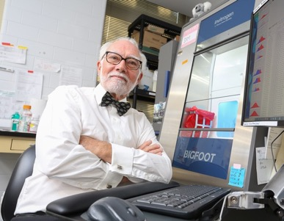
Cytometry 3.0: Are you ready for a new generation of Instruments?
J. Paul Robinson
Distinguished Professor of Cytometry
Professor of Biomedical Engineering
Purdue University
Home of the Purdue Listserve

Slide 2

Disclosures & Conflict of Interest
Professor Robinson is a founder of Corporation and has a financial interest in that corporation.
Our university laboratory has been funded by Beckman Coulter, Thermo Fisher, SCIAPS, and some contributions from many companies over the past 3 decades

Slide 3
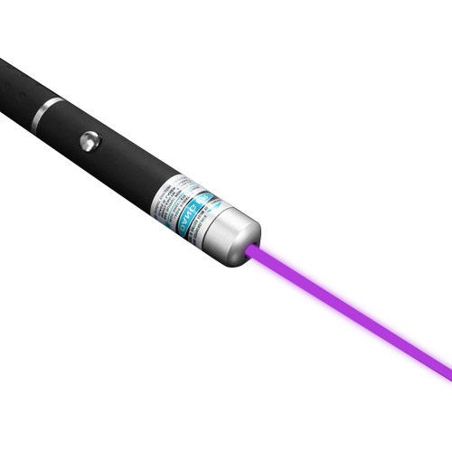
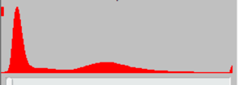
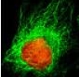
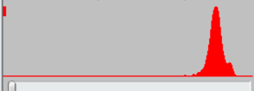

Flow Cytometry – for nearly 60 years
Light Source
Cell
Fluorescence Result
This is who we are!
500
600
700
800
Wavelength (nm)

Slide 4
So how did we get here?
Detectors | Light Source | Output
Impedance | None | Scope
Current/PMT | Lamp | Scope
Current/PMT | Laser | Scope
Current/PMT | Laser | Hist/dot
Current/PMT | Laser | Hist/dot
Cytometry V 1.0
Coulter volume and sorting 1960s
Fluorescence & mercury lamps
Laser used for fluorescence detection
Multiple color flow cytometry
Move to analyzers from sorters
Detectors | Light Source | Output
Current/PMT | Laser | Image
Current/PMT/APD | Laser | Spectrum
Atomic Mass | Charge | tSNE
Current/PMT/APD | Laser | Hist/dot
Current/PMT/APD | Laser | Various
Cytometry V 2.0
Imaging and flow
Spectral flow
Mass cytometry
Microfluidic chip flow
Spectral sorting flow

Slide 5
What has Not Changed?
Lasers - we all use …..but we use them the same way for 50 years
PMTs or APDs are used the same way we have for 50 years
6 and 7 log data - many manufacturers claim, but we all know that this is simply not the case – no instrument collects more than 4.6 or 4.7 logs of fluorescence
Analog - all current instruments are analog but we call them digital because we convert the voltage to a digital value using DSPs
Arbitrary units - We all measure the output of fluorescence using some kind of ”arbitrary unit” – we don’t actually know what an arbitrary unit is…
Calibration – this is one of the dirty little secrets of flow cytometry – there is really no such thing as true quantification – we just try to get our instrument setup so we think it’s “calibrated”……
Scatter and fluorescence – it’s pretty much the way it has always be

Slide 6
So what is happening out in the physics world …

Slide 7
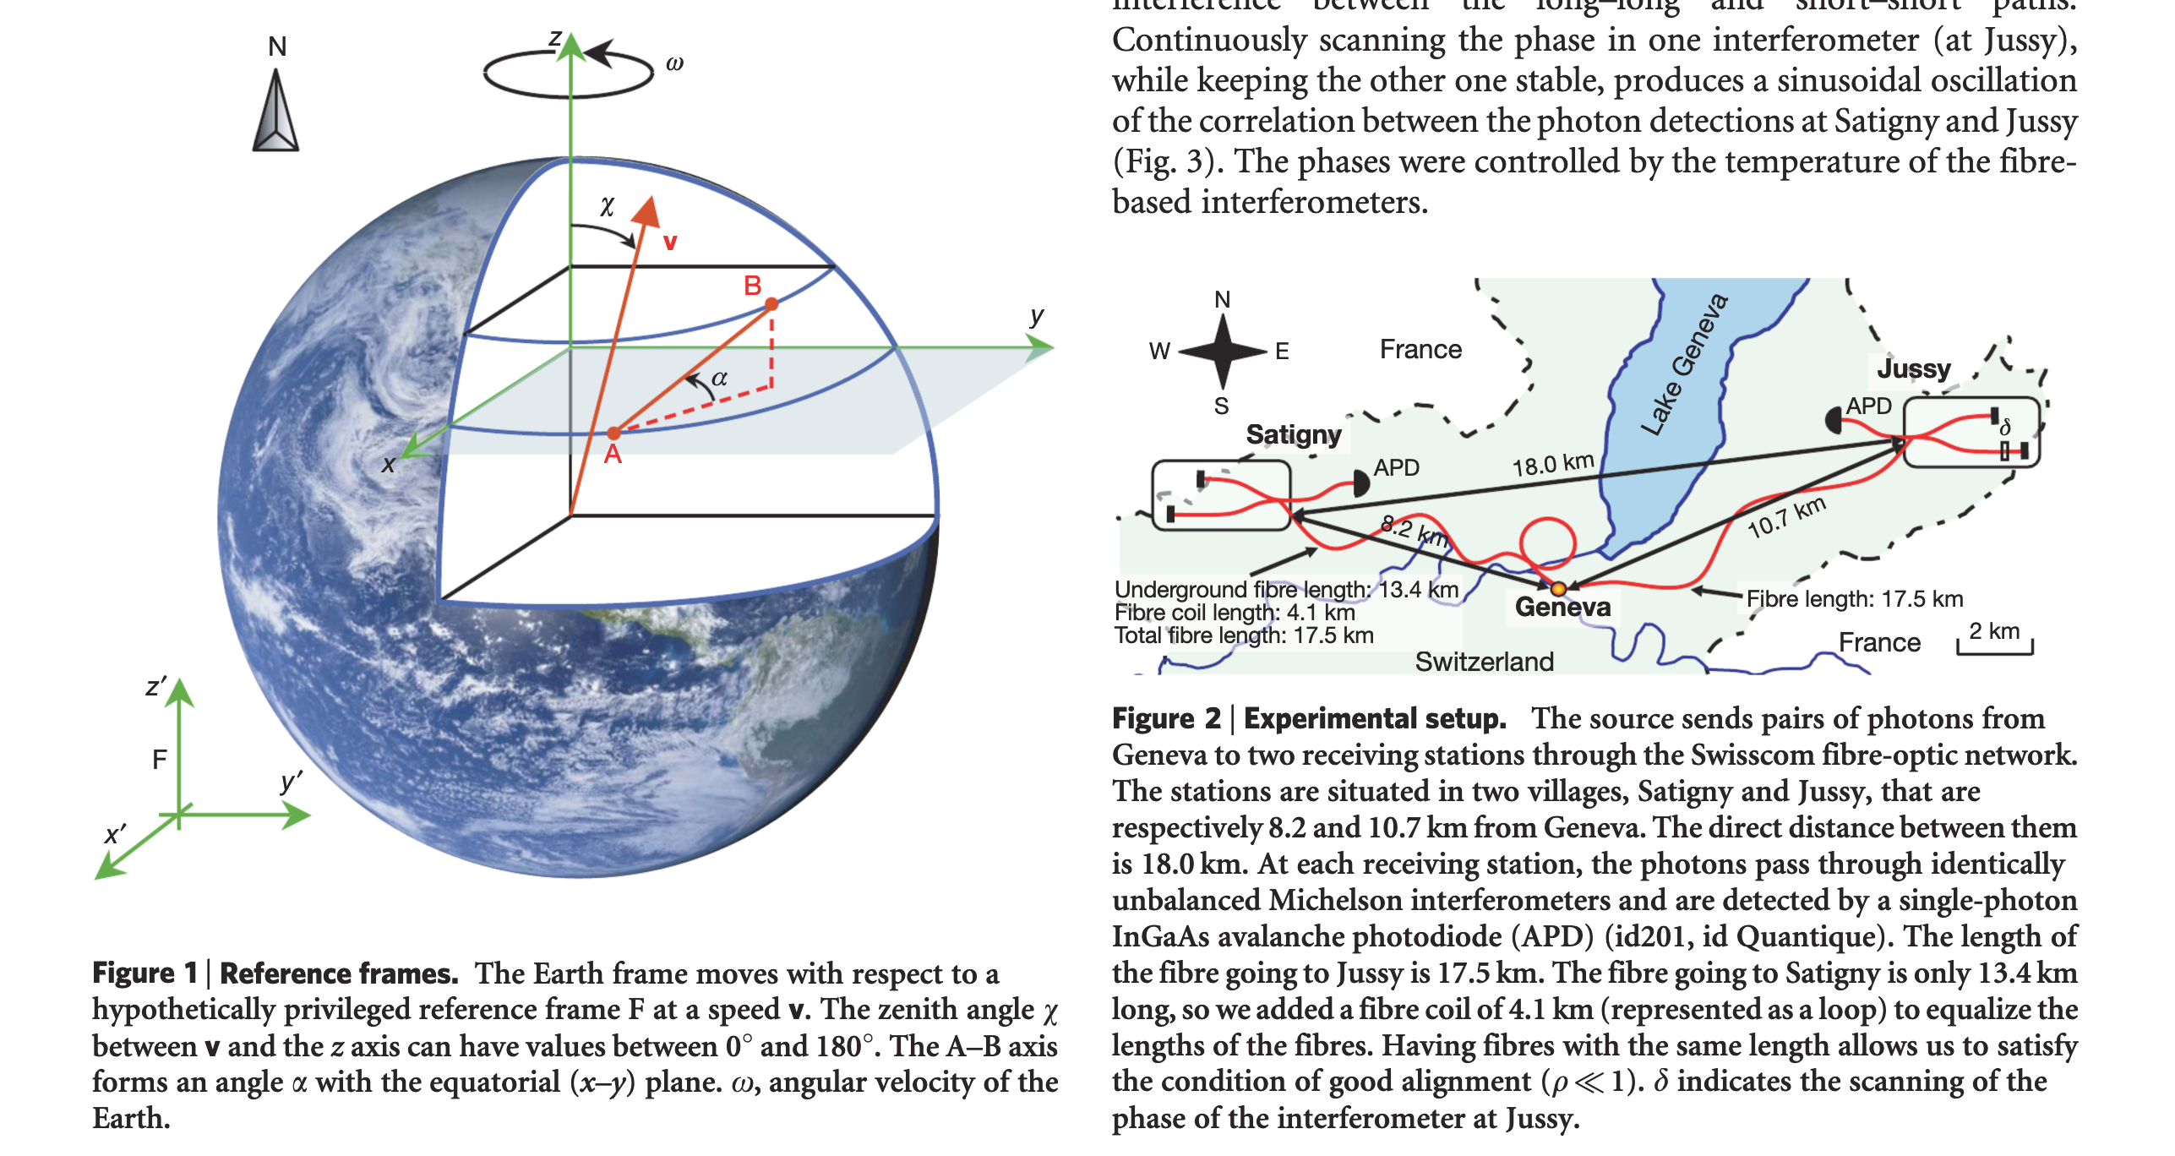
Quantum computing is a rapidly-emerging technology that harnesses the laws of quantum mechanics to solve problems too complex for classical computers.
Quantum entanglement is a bizarre, counterintuitive phenomenon that explains how two subatomic particles can be intimately linked to each other even if separated by billions of light-years of space. Despite their vast separation, a change induced in one will affect the other.
Photons can exert weird behaviour - Entanglement
Vol 454 | 14 August 2008 | doi:10.1038/nature07121

Slide 8
Quantum….
What is a quantum? A quantum (plural: quanta) is the smallest discrete unit of a phenomenon. For example:
a quantum of light is a photon
a quantum of electricity is an electron.
Quantum comes from Latin, meaning "an amount" or "how much?"
If something is quantifiable, then it can be measured.
The word quantum refers to the smallest amount of something that you can have. You can't break a quantum of something into smaller parts.
Thanks Wiki

Slide 9
A term we often toss around…
Photon (from Greek phōs, phōtos, “light”)
All photons travel at the speed of light.
Considered among the subatomic particles, photons are bosons, having no electric charge or rest mass and one unit of spin
Photons are field particles that are thought to be the carriers of the electromagnetic field.
The energy of a photon depends on radiation frequency

Slide 10
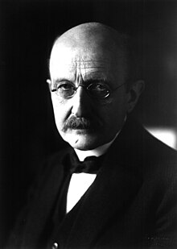
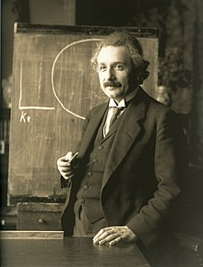
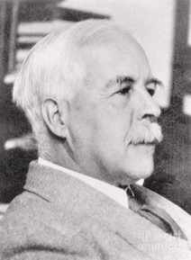
Quantum and Photon
In 1901, Max Planck used quanta to mean "quanta of matter and electricity",^{[5]} gas, and heat.^{[6]} In 1905, in response to Planck's work and the experimental work of Lenard (who explained his results by using the term quanta of electricity), Albert Einstein suggested that radiation existed in spatially localized packets which he called "quanta of light"
“I therefore take the liberty of proposing for this hypothetical new atom, which is not light but plays an essential part in every process of radiation, the name photon.” In that sense, his concept differed from Einstein’s 1905 quantum theory of light, but “photon” came to be used to describe what Einstein originally termed “light quantum”
Lewis had a record 35 nominations to the Nobel Committee over his lifetime (despite 2 of his students winning Nobel prizes)
The term photon (from Greek phōs, phōtos, “light”), however, was not used until 1926. The energy of a photon depends on radiation frequency;
Planck
Einstein
G. N. Lewis (1875-1946) proposed the term “photon” in 1926
Letters to the Editor; Conservation of Photons.
Nature, 118, P 874, 1926
Thanks Wiki
German Physicist and 1918 Nobel Prize for Physics recipient Max Planck (1858–1947)

Slide 11
Quantum computing is a rapidly-emerging technology that harnesses the laws of quantum mechanics to solve problems too complex for classical computers.
Thanks Wiki
What does it mean “too complex for classical computers”

Slide 12
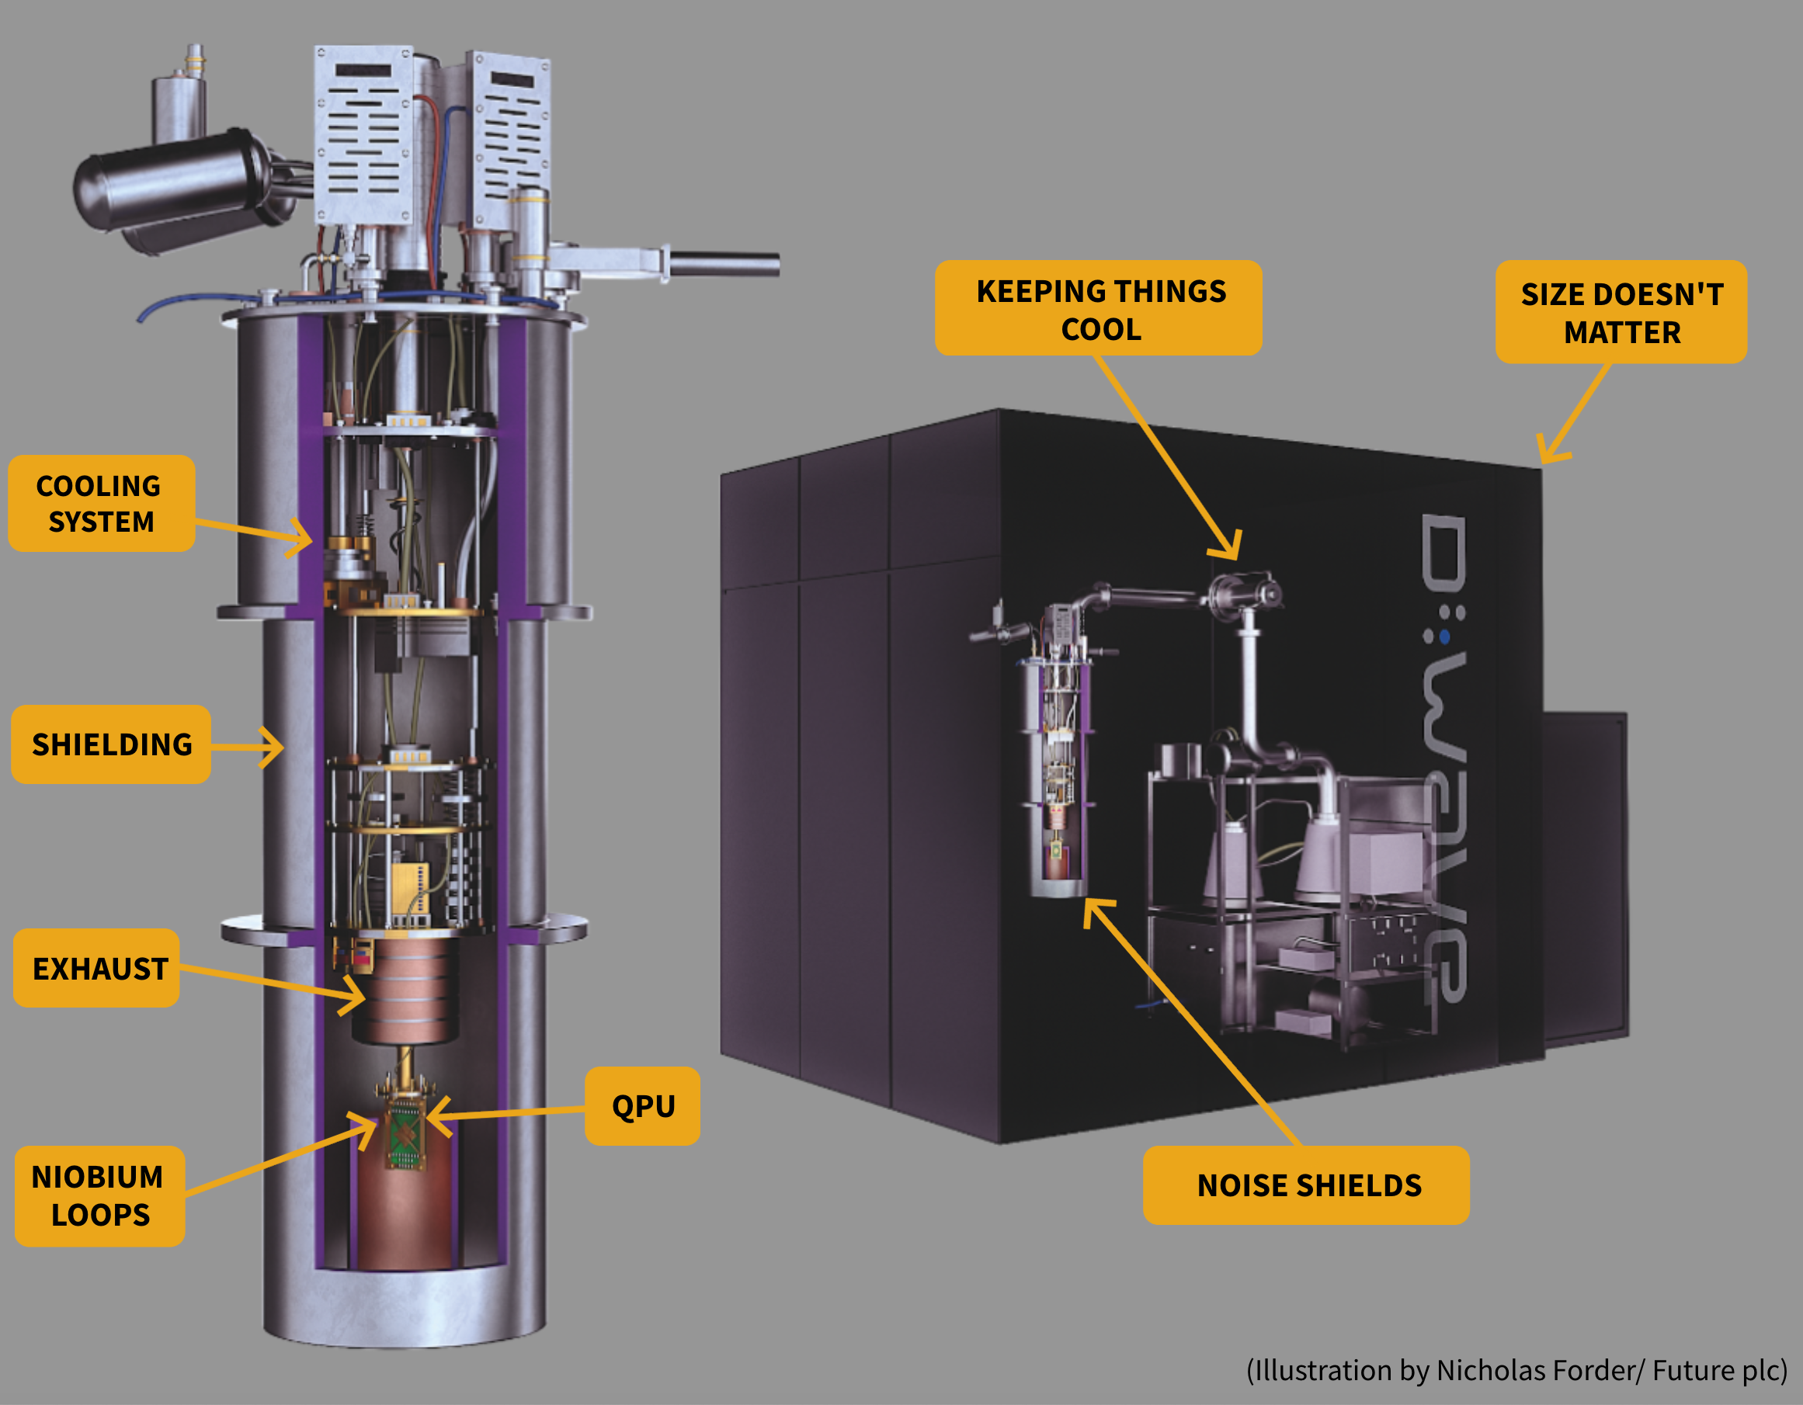
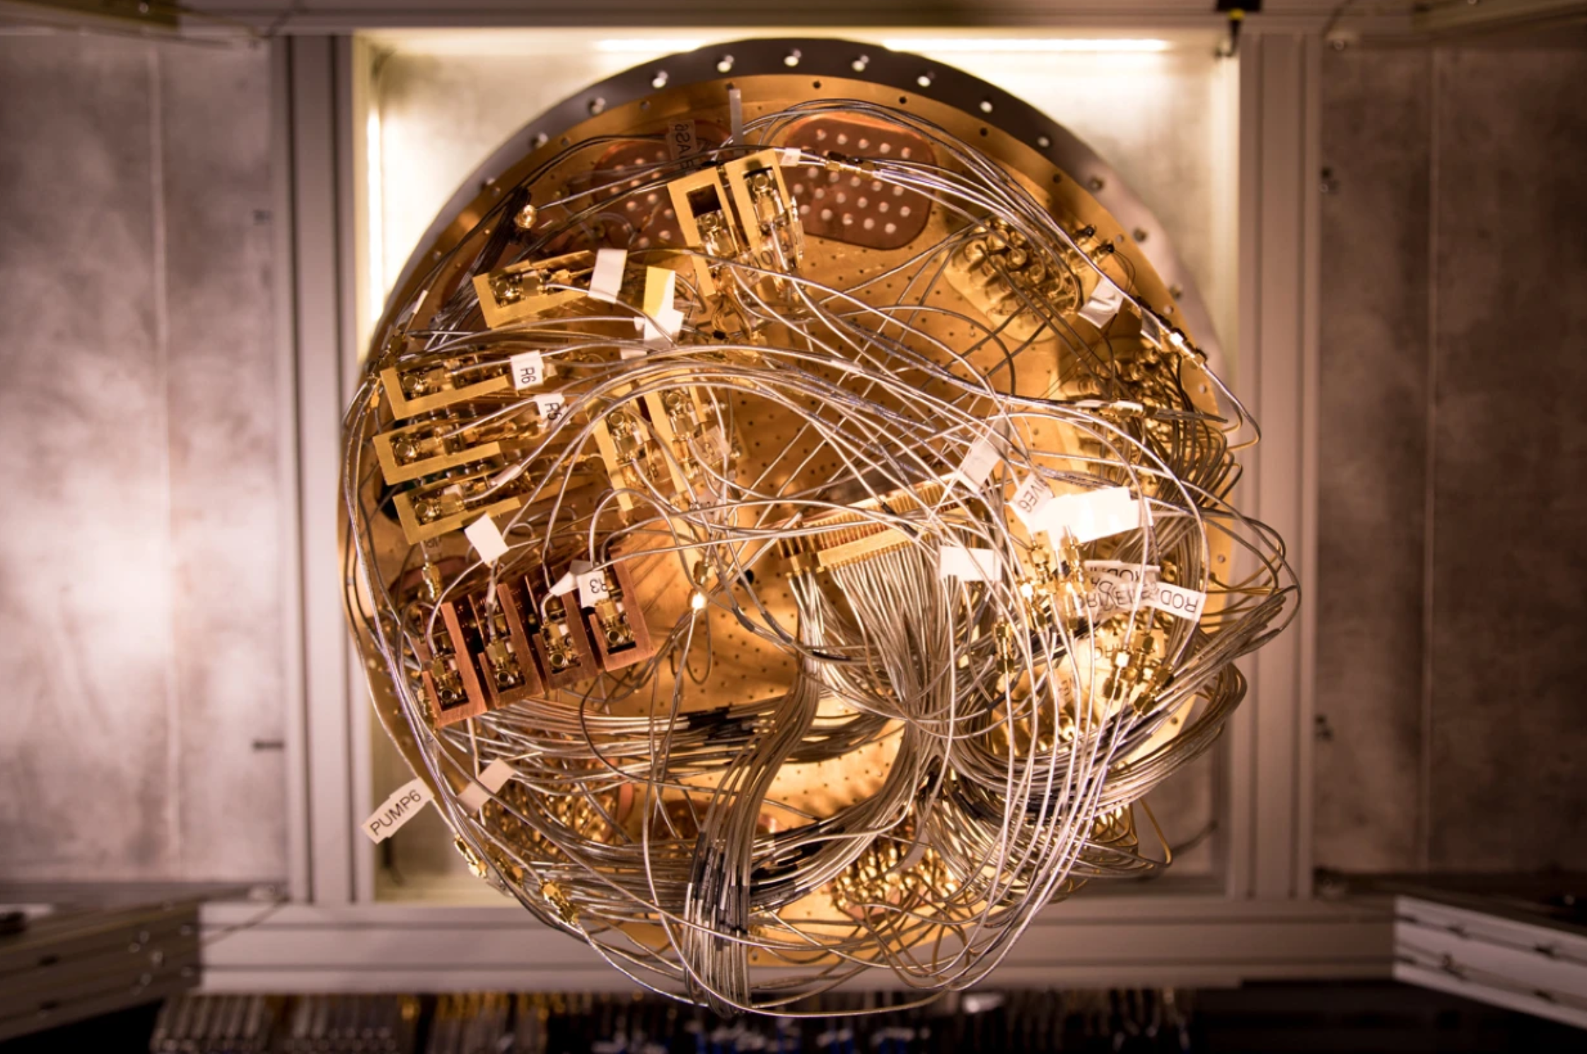
Quantum Computer Hardware is New Technology
To move to a new generation of computing
you need a new generation of hardware
https://www.nature.com/articles/d41586-019-02936-3
https://www.livescience.com/quantum-computing
A cryostat used to cool Google quantum computing hardware.
Credit: Erik Lucero

Slide 13
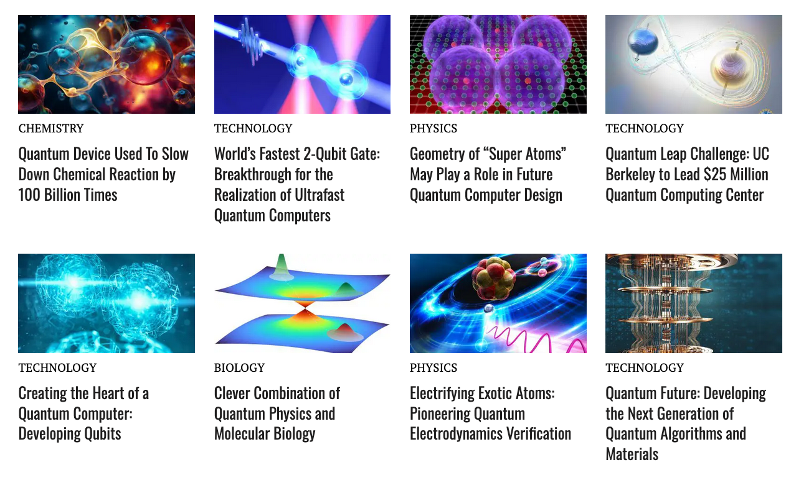
ARTICLES PUBLISHED RECENTLY ON THIS TOPIC

Slide 14
Some facts about light…(photons)
Light travels 186,282 miles per second
Light travels 186.282 miles per ms
Light travels 0.186282 miles per μs or 299.792458 m (300 m)

Slide 15
1 cm corresponds to a light travel time of 49 ps
10 cm takes about 490 ps
20-30 cm (about how long a photon takes to get to the sensor in most flow cytometers about 1.0-1.5 ns
Micro 10⁻⁶ The time needed to execute one machine cycle by a 1960s minicomputer
Nano 10⁻⁹ The time needed to execute one machine cycle by a 1 GHz microprocessor
Pico 10⁻¹² The lifetime of a transition state one machine cycle by IBM silicon-germanium transistor
Femto 10⁻¹⁵ The cycle time for ultraviolet light with a wavelength of 300 nanometres
Atto 10⁻¹⁸ The best timing control of laser pulses

Slide 16
Picosecond…..
1,000,000,000,000 ps in a second
1 thousand billion seconds is approximately 31,690 years
There are only 31,536,000 seconds in one year
Nanosecond…..
1,000,000,000 ns in a second
1 billion seconds is approximately 31.69 years
Fluorescein lifetime is about 3 ns

Slide 17
So fundamental issue #1
It takes time for photons to travel
Need equal distances of optical platform and electronics cables if you want to actually measure actual photon pulses
Need super fast electronics
30 cm (1 foot) – 1470 ps or 1.5 ns

Slide 18
So fundamental issue #2
This is why new hardware is necessary to implement quantum computing
and…
New hardware is necessary to implement quantum/single photon detection in cytometry

Slide 19
I asked ChatGPT…
What does the saying “You can’t put new wine into old wineskins” mean?
“The metaphor implies that new ideas, beliefs, or practices cannot always be effectively integrated into existing structures or systems that are rigid or outdated.”
We should clarify what we need to achieve to move to the next level…

Slide 20
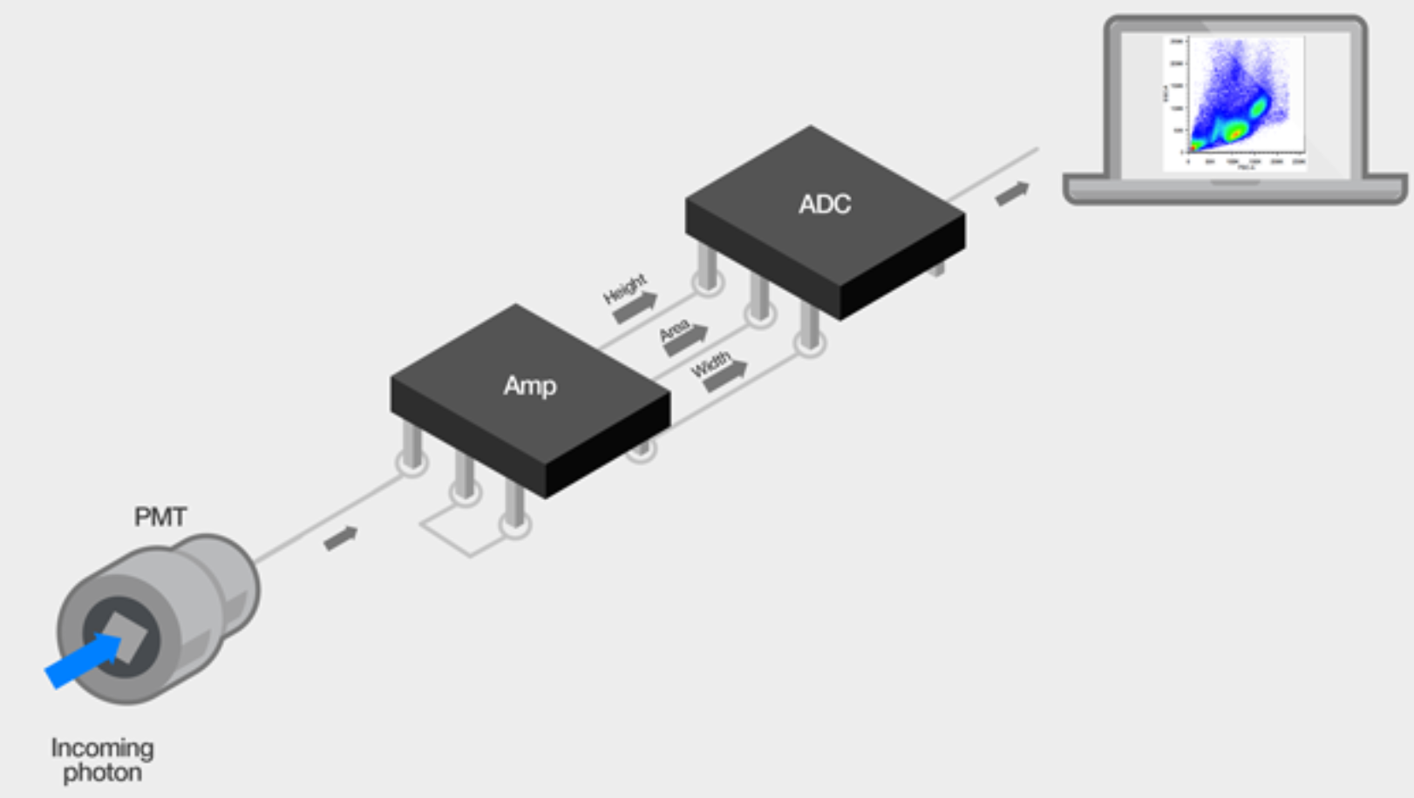
Follow the photons
The photons that are emitted when the laser hits the cell as it passes through the interrogation point are detected by the photomultiplier (PMD) or photodiode (PD). These photons can come from light being scattered by the cell or by fluorescence emission of fluorophores associated with the cell.
Once in the detector, the photons are converted to electrons, and the signal is multiplied proportionately. The signal exits the detector as an electric current (also called photocurrent), and this is the point where the signal enters the electronics system.
https://www.thermofisher.com/uk/en/home/life-science/cell-analysis/cell-analysis-learning-center/molecular-probes-school-of-fluorescence/flow-cytometry-basics/flow-cytometry-fundamentals/electronics-flow-cytometer.html

Slide 21
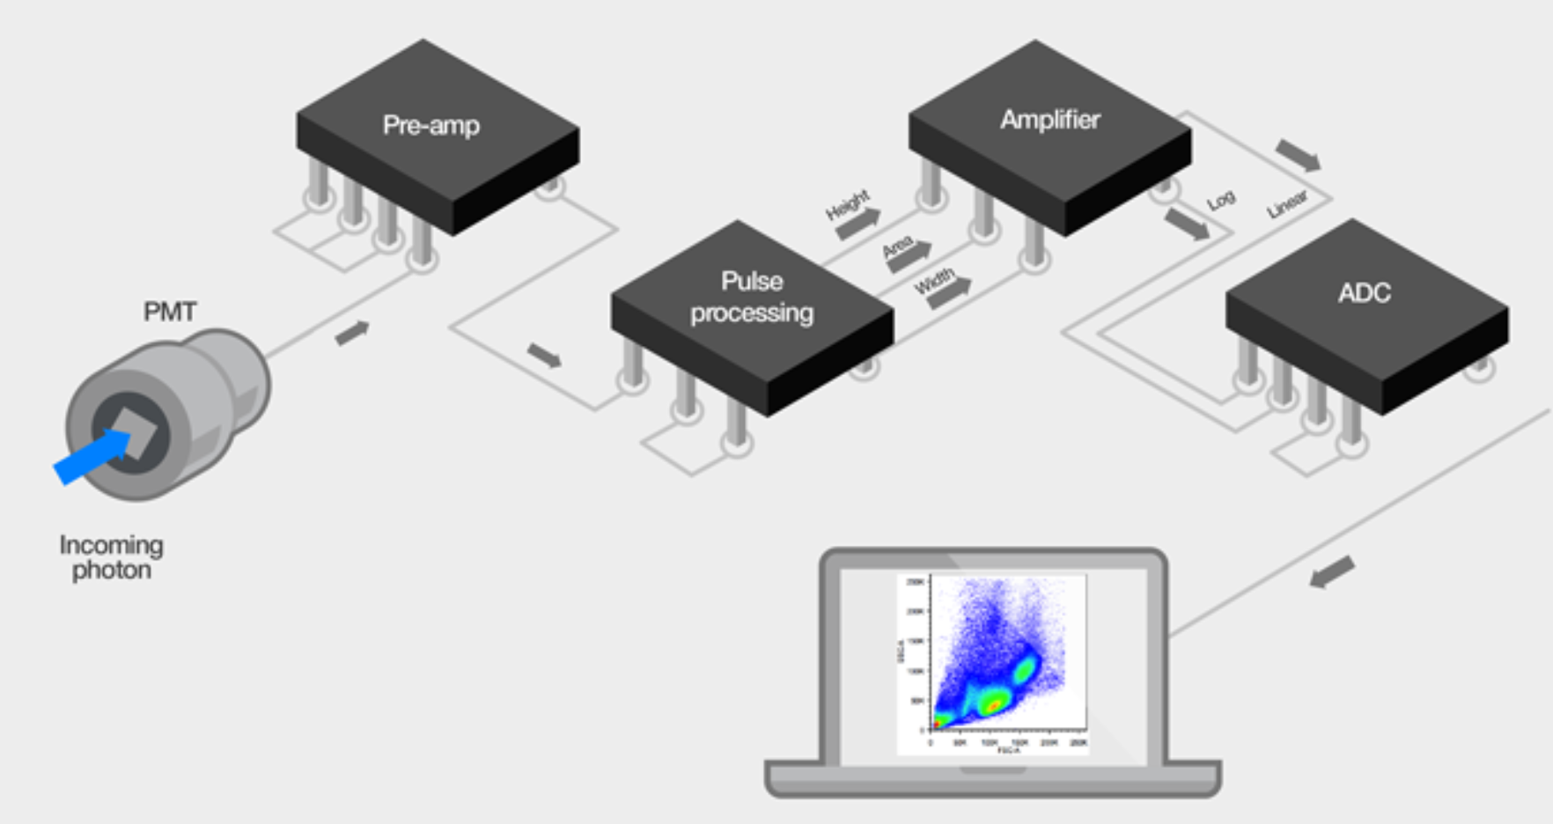
Flow cytometers—old versus new
The signal from the PMT is very low, and typically goes through some pre-amp circuitry to amplify the signal before processing. While there are still pulses generated in some earlier-generation flow cytometers that use an analog pulse processing path (Figure 8), modern cytometers use a digital signal processing path (Figure 9).
In this pathway, after the amplification the signal pulse is sampled at some rate (between 10 and 25 MHz on commercial systems), and with each sampling the pulse is digitized based on the analog-to-digital converter (ADC) resolution (ranging from 14 to 24 bits).
Analog-to-digital converter (ADC) resolution increases with each new instrument generation
Newer instruments can handle larger data sets and convert at higher bit rates (24 versus 10 bit ADC). For the researcher, this means that higher data resolution can be obtained from the sample when analyzed on an instrument with a 24-bit ADC as opposed to a 10-bit ADC..
https://www.thermofisher.com/uk/en/home/life-science/cell-analysis/cell-analysis-learning-center/molecular-probes-school-of-fluorescence/flow-cytometry-basics/
flow-cytometry-fundamentals/electronics-flow-cytometer.html

Slide 22
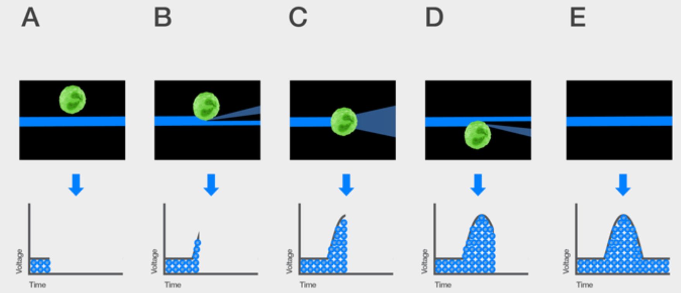
COULDN’T YOU
JUST MEASURE
THESE PHOTONS?
Understanding the voltage pulse
The voltage pulse (also called a signal pulse) is created when the cell reaches the interrogation point and crosses the path of the laser. The number of photons emitted is proportional to the fluorescent light generated after the cell passes through the laser as demonstrated by the pattern shown in Figure 2. These photons are converted to electrons in the detector, which is why these are called voltage pulses. The size of the voltage pulse also depends on the PMT voltage or pre-amplifier gain and the amplification factor (also called the amplification gain). Signals can be amplified by applying a voltage to the PMTs, thus creating a greater electrical current, or by increasing the amplification gain. Amplifier settings can be linear or logarithmic (Lin or Log). Log amplification is often used to separate negative from dim positive signals, whereas Lin amplification is often used to amplify scatter and fluorescent parameters.
WHY CONVERT THEM
TO PHOTOELECTRONS?
https://www.thermofisher.com/uk/en/home/life-science/cell-analysis/cell-analysis-learning-center/molecular-probes-school-of-fluorescence/flow-cytometry-basics/
flow-cytometry-fundamentals/electronics-flow-cytometer.html

Slide 23
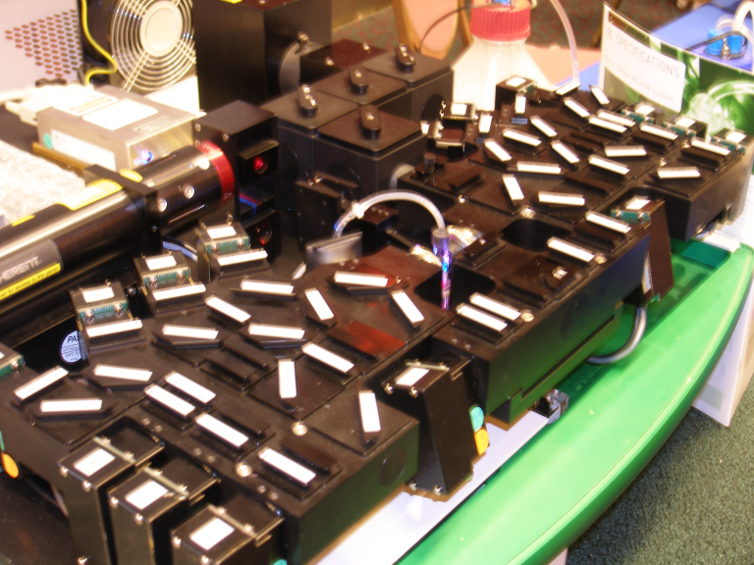

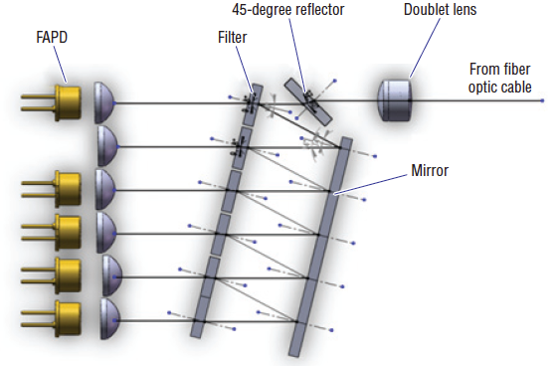
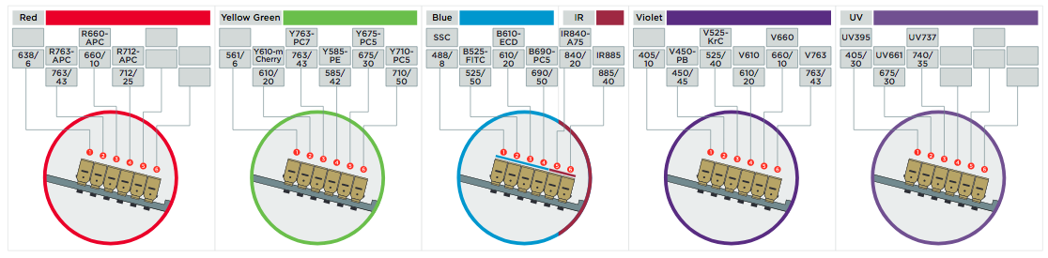
Looking at Optics Systems
16 optics
16 optics
16 optics
48 optics
16 optics
16 optics
=48 optics
16 optics
16 optics
16 optics
48 optics
16 optics
=48 optics
16 optics
16 optics
48 optics
16 optics
=48 optics
16 optics
48 optics
16 optics
16 optics
=48 optics
16 optics
16 optics
48 optics
16 optics
=48 optics
=240 optics

Slide 24
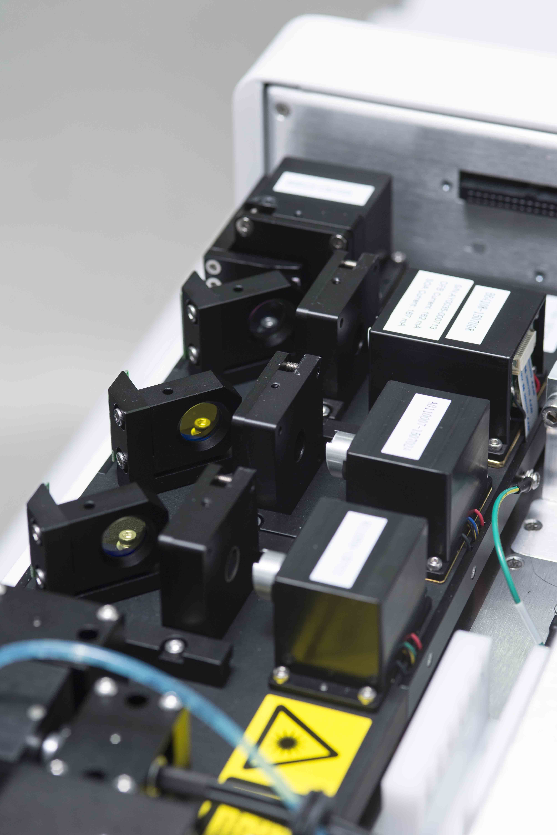
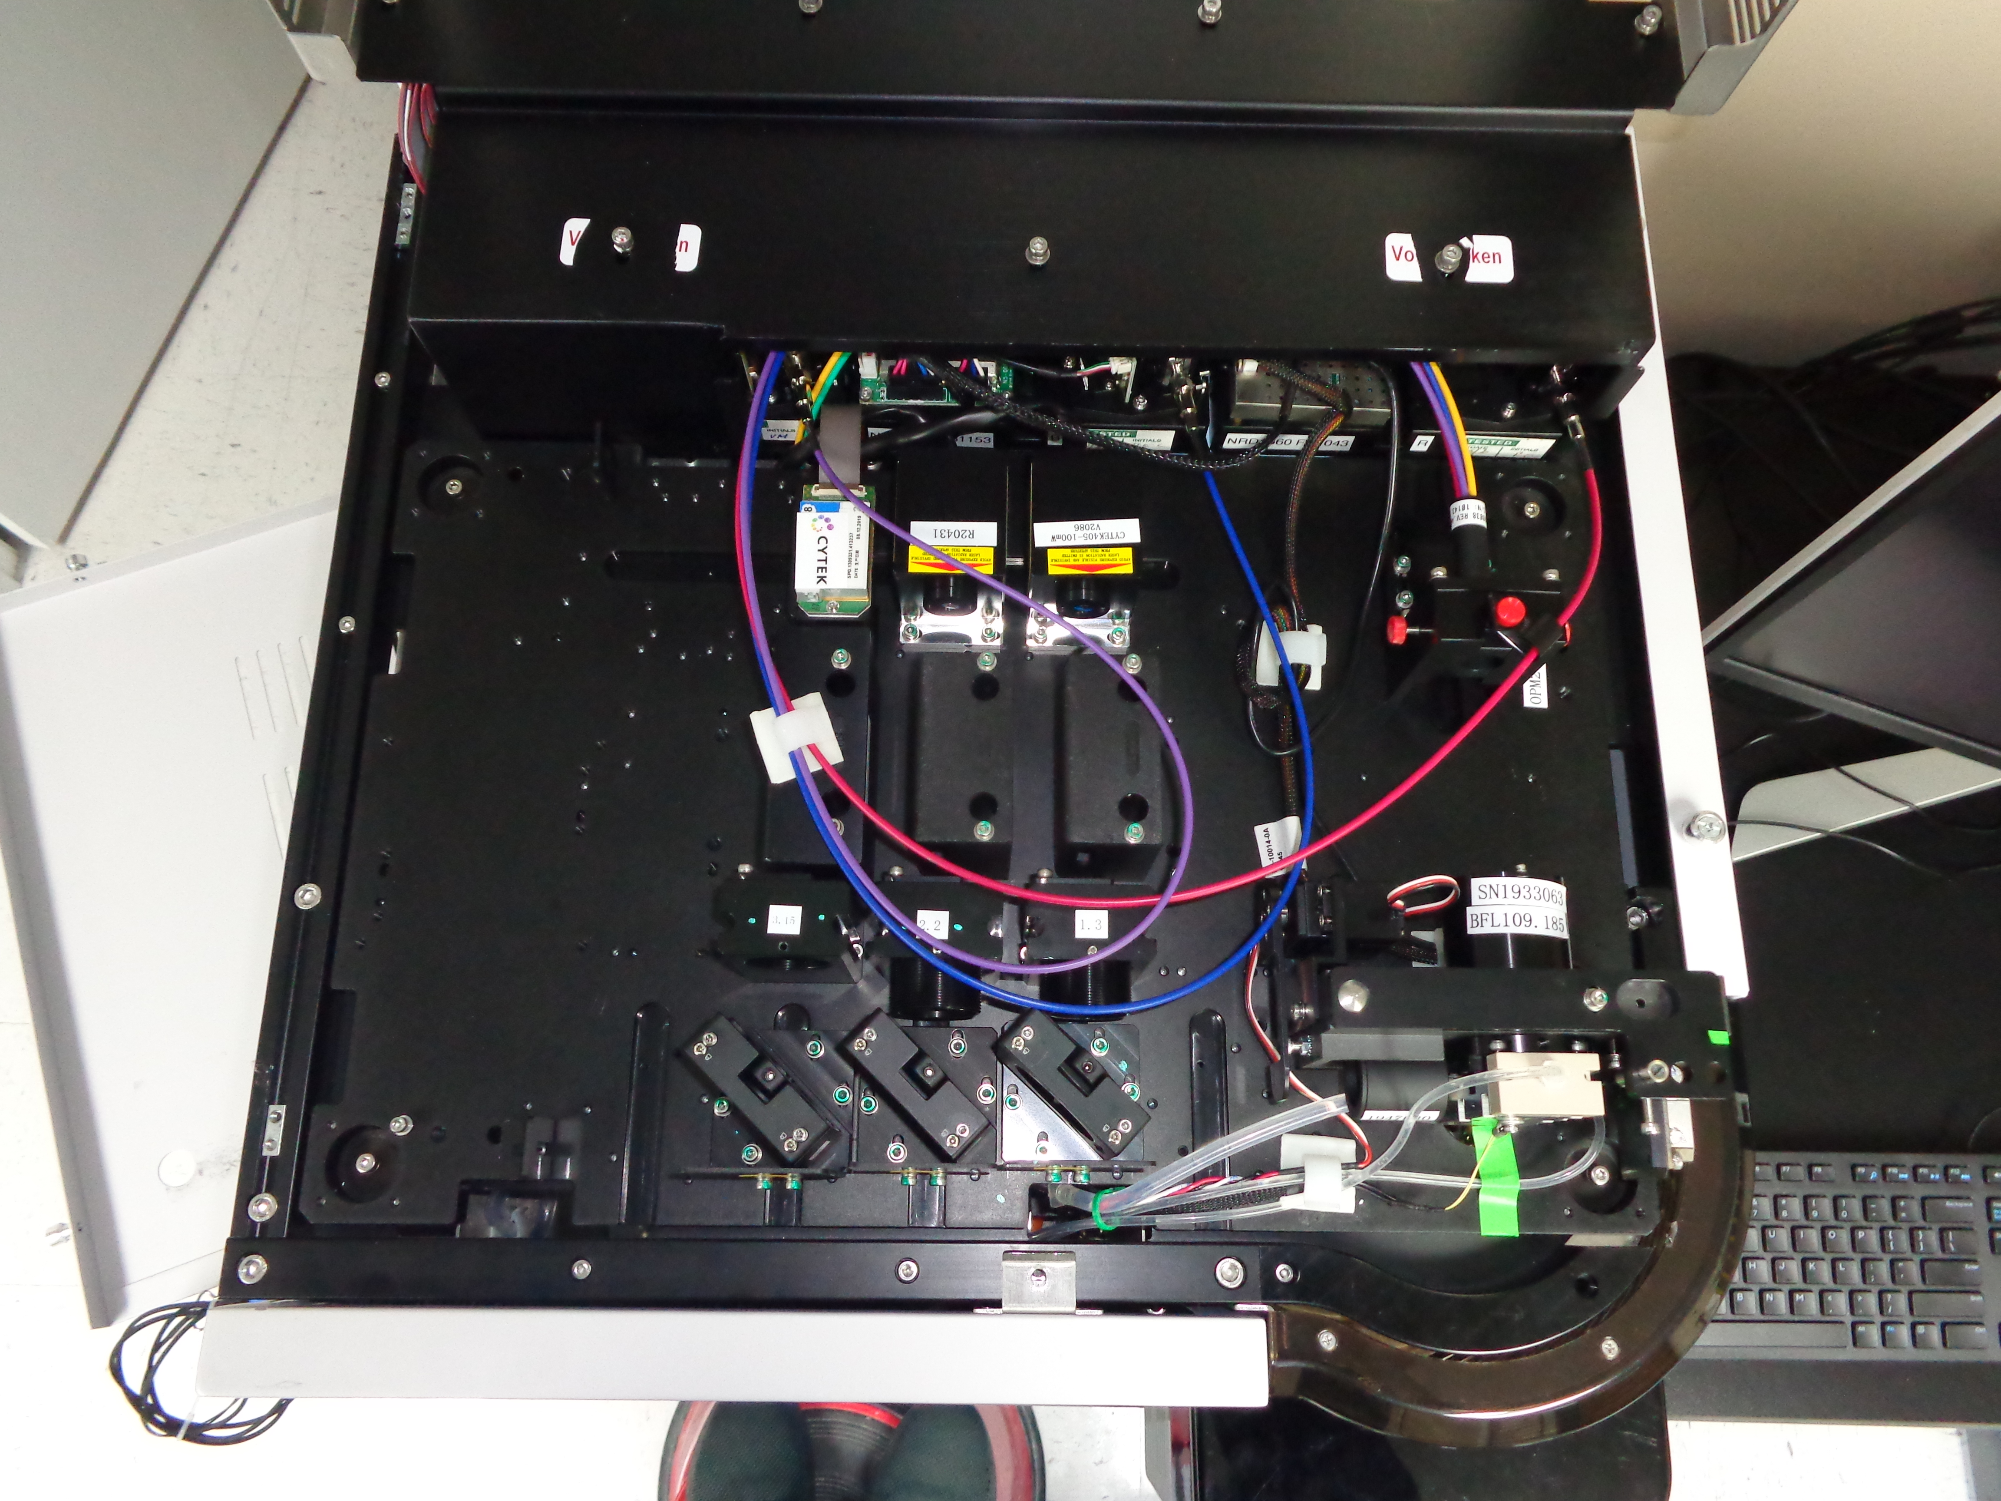
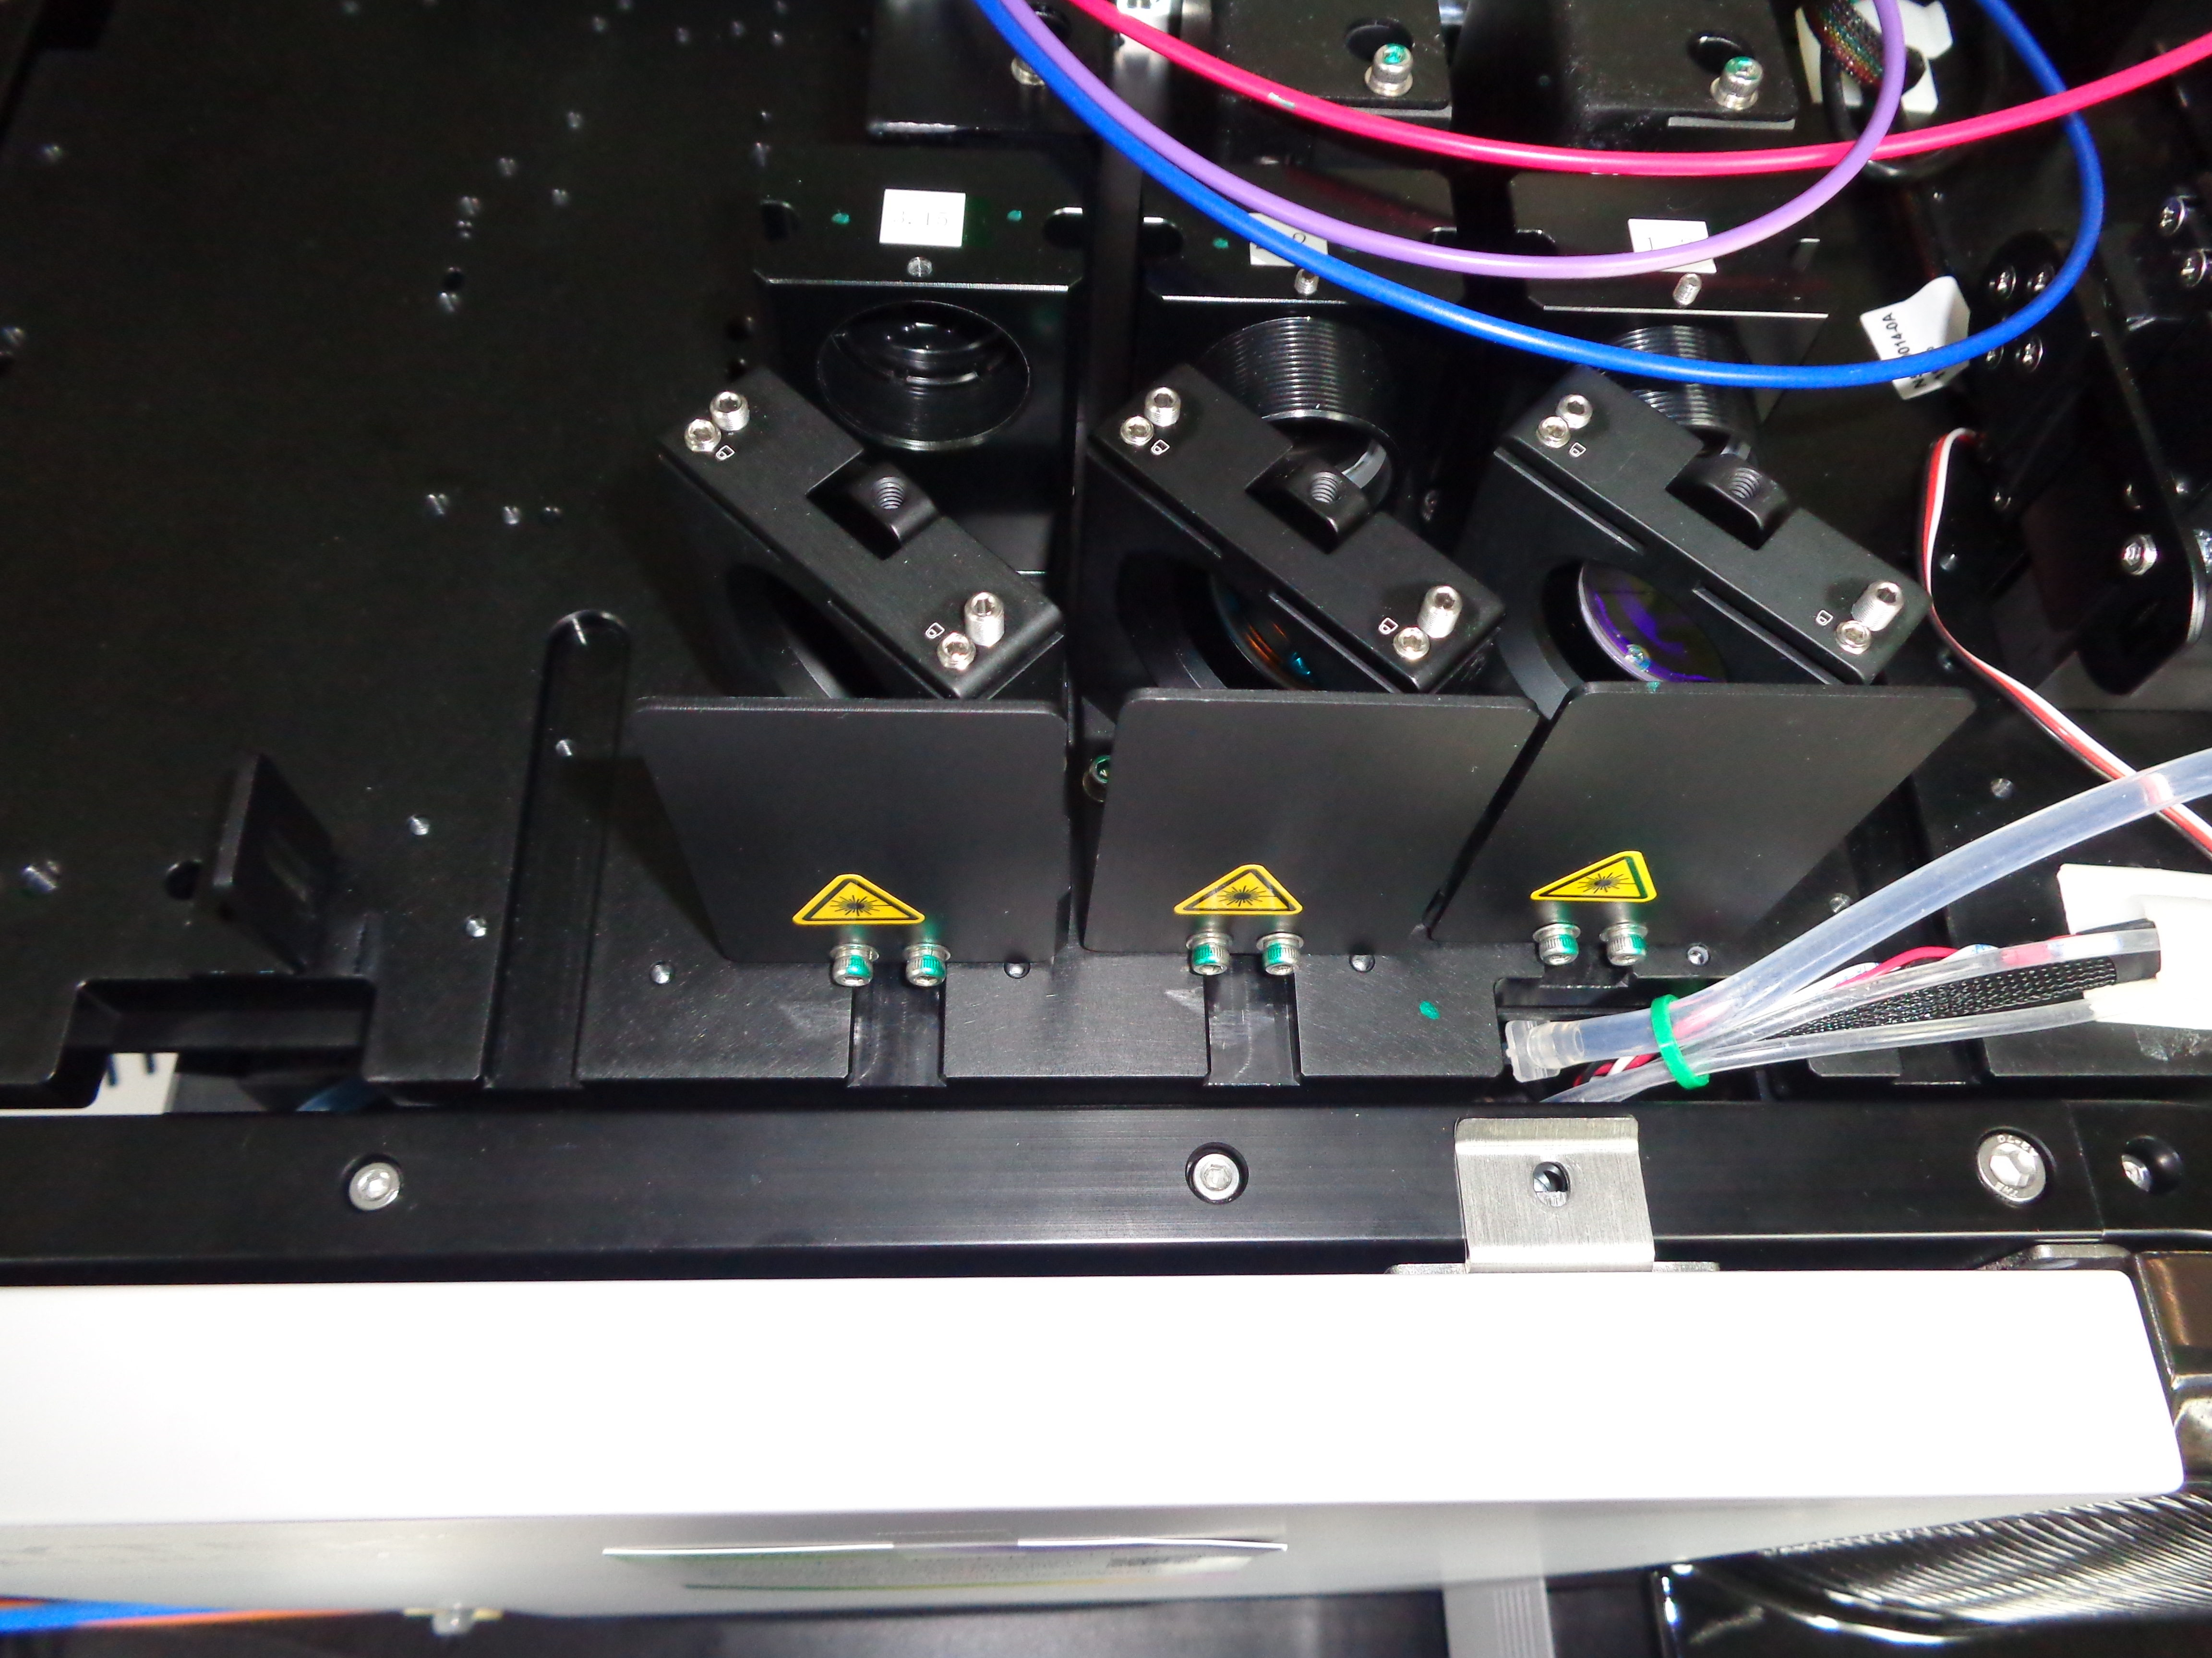
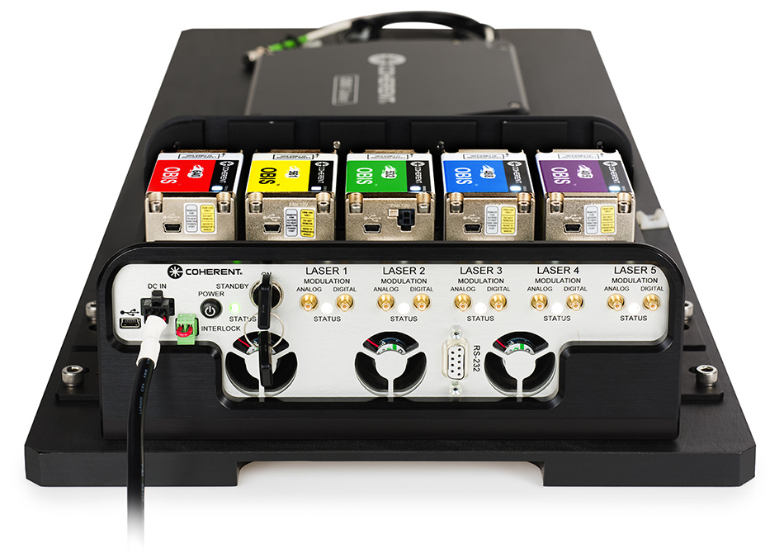
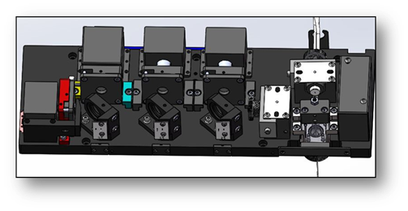
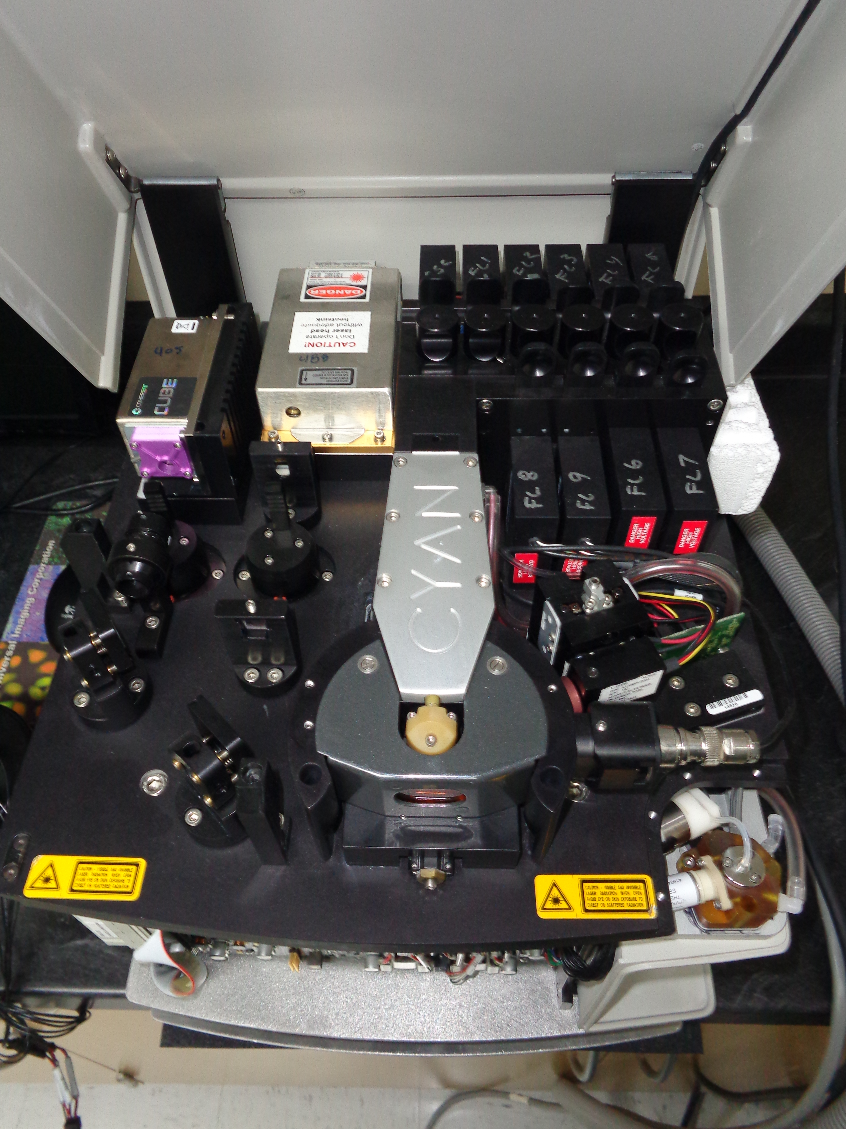
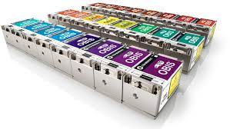
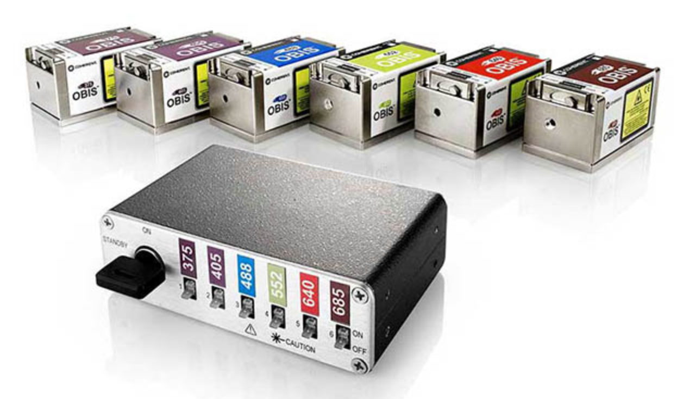
Look at how Lasers are used and arranged….

Slide 25
Let’s Compare Electronics demands
In Cytometry 1.0 you have external peak hold circuits, log amps, etc. In that case you have an ADC which makes a couple analog to digital conversions per event. So, it's maybe 8-10 bits x (number of parameters) x event rate = [hundreds of Kbps or a few Mbps]
In “current digital” Cytometry 2.0 where you are directly sampling the waveforms, then the throughput is not dependent on event rate anymore, it's based on for example: 16-24 bits x ADC sample rate x (number of channels) = [hundreds of Mbps]
In fully DIGITAL Cytometry 3.0 with individual photon capturing, it’s a similar calculation but we have just 1 bit (photon/no-photon) x (number of channels = 42) x ADC sample rate (12Gbps) = [504 Gbps] (“ADC” acts as a multi-gigabit transceiver, which is like a 1bit ADC)

Slide 26
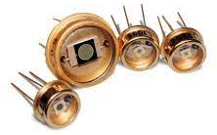
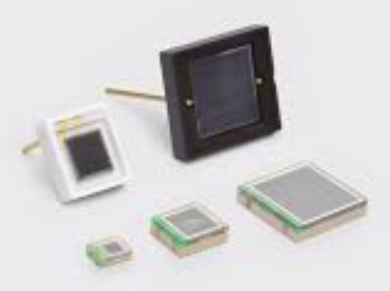
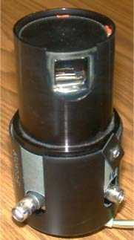
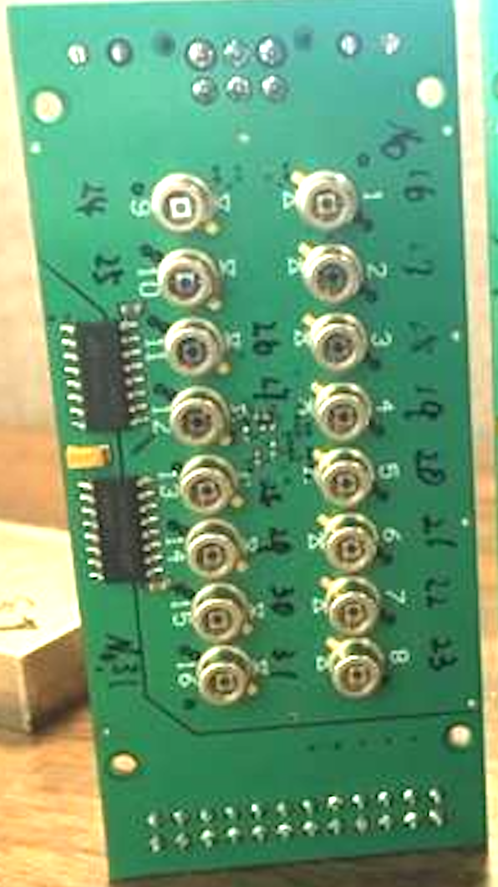
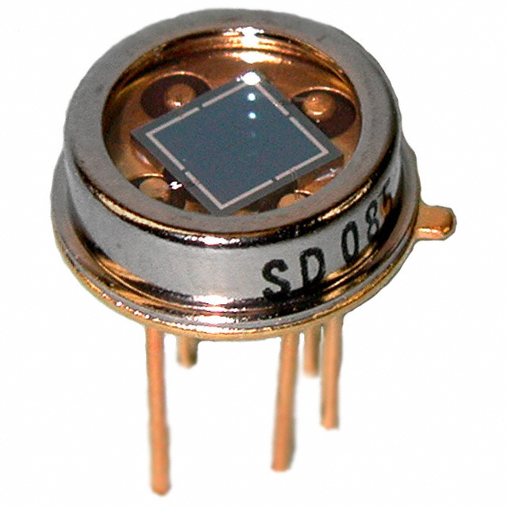
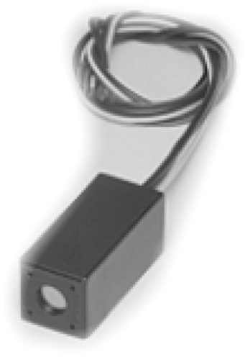
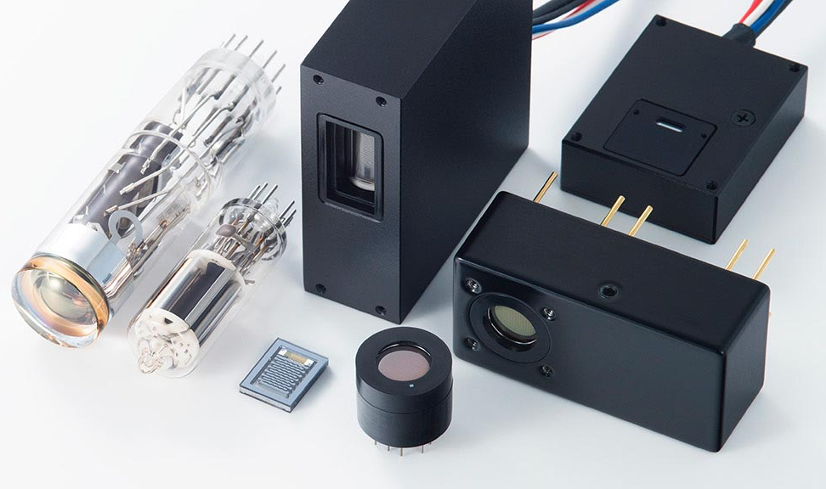
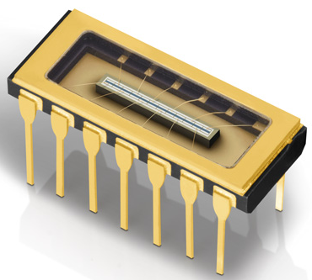
APDs, PMTs….

Slide 27
Look at the Sensors…
SiPMs are attractive (gain 10⁵-10⁶)
But there are no commercially cooled SiPMs
Also commercial SiPMs have about 30-50 ns recharge time – so these are not going to be able to collect all of the photons –
If you want to do true digital measurements, you have to operate a detector in Geiger mode – and it has to be able to collect photons continuously to collect all the photons

Slide 28
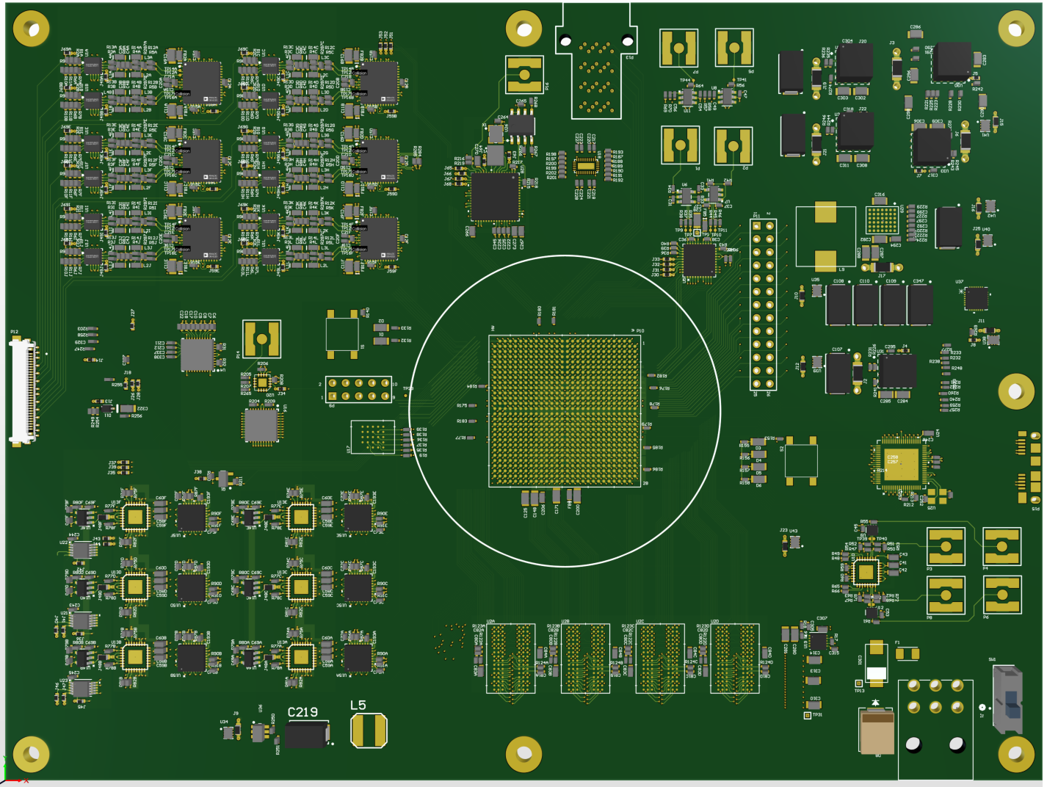

Electronics – has to be WAY faster than today’s
About 100-1000 times faster than current electronics
Must operate into
the ++Ghz domain
Super high-speed Electronics
New coax connection technology
Sophisticated control system
Advanced signal processing

Slide 29
Cytometry V 3.0
Can this be achieved?
New | Old | Innovation
Photon | Current ADC | Sensitivity
Digital | Analog | Precise
Ghz | Mhz | Speed
Absolute | Iffy | Quantified
Excitation | Flashlight | Intelligent
Scatter | Traditional | Extended
Dynamic Rn | 4.7 | 6+
additional | Same old | > Parameters
>200 Param | 180s | Extended
Embed AI | Addon | Smarter
Identical inst | variable | Compatibility
Count actual photons not photoelectrons
Photons have integer value
10-1000 x speed of current electronics
Photons converted to energy in Joules
Intelligent lasers not flashlights
Many forms of light scatter exist
Real dynamic range not pretend
Many more types of measurements
Potential for literally 100s of parameters
New hardware technology
Data are identical from every instrument

Slide 30
So given that most current spectral instruments are simply versions of our original 2004 design….
What should we expect for Cytometry V 3.0?

Slide 31
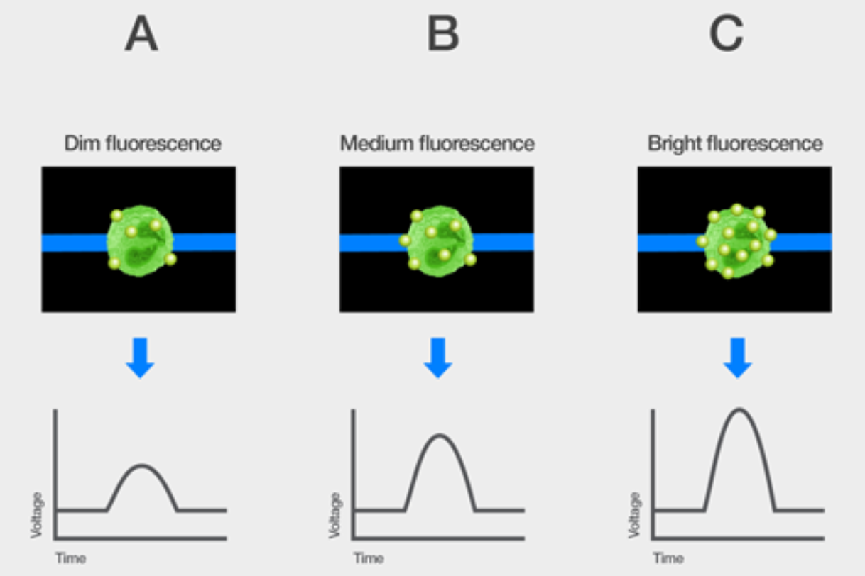
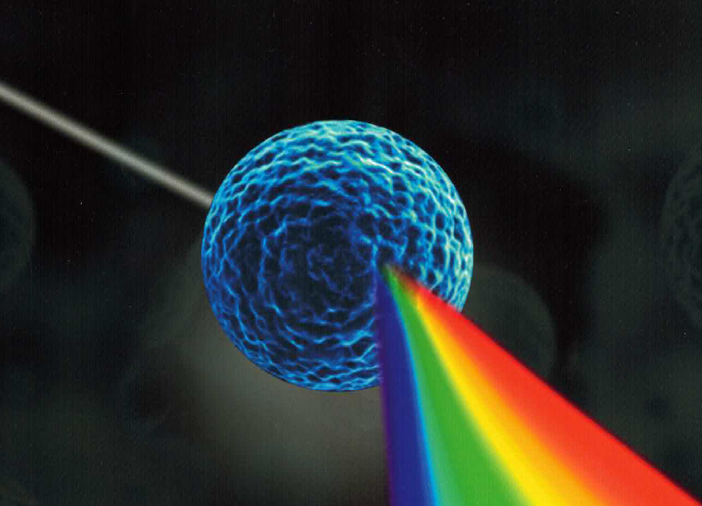
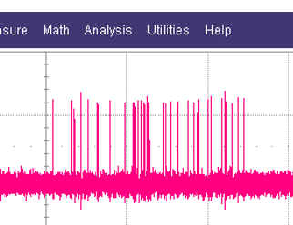
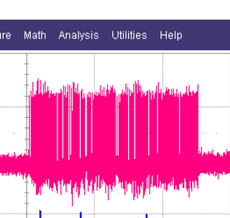
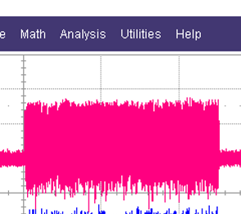
Requires a new way of detection & measurement
& Thinking
From Thermo website
Estimation
Actual
photons
Precision counting

Slide 32
Requires high dynamic range dispersion technology
Current optical technologies have difficulty exceeding 4+ decades
Cytometry 3.0 requires 6+ decade dynamic range
So new dispersion technology designs are going to be required.

Slide 33
New approach to excitation technology
Cytometry 3.0 requires advanced excitation systems
A flashlight approach will not be an acceptable approach to excitation…..

Slide 34
New approach to Optics technology
Cytometry 3.0 requires new optical systems
Designing instrument with off the shelf optical components restricts us

Slide 35
New approach to Detection technology
Cytometry 3.0 requires new detectors
Designing instrument with off the shelf detectors restricts us

Slide 36
New output/analytical Requirements
Can we measure actual cell energy level in SI units?
Internal computational demands would be extreme

Slide 37
What could you gain from Cytometry 3.0?

Slide 38
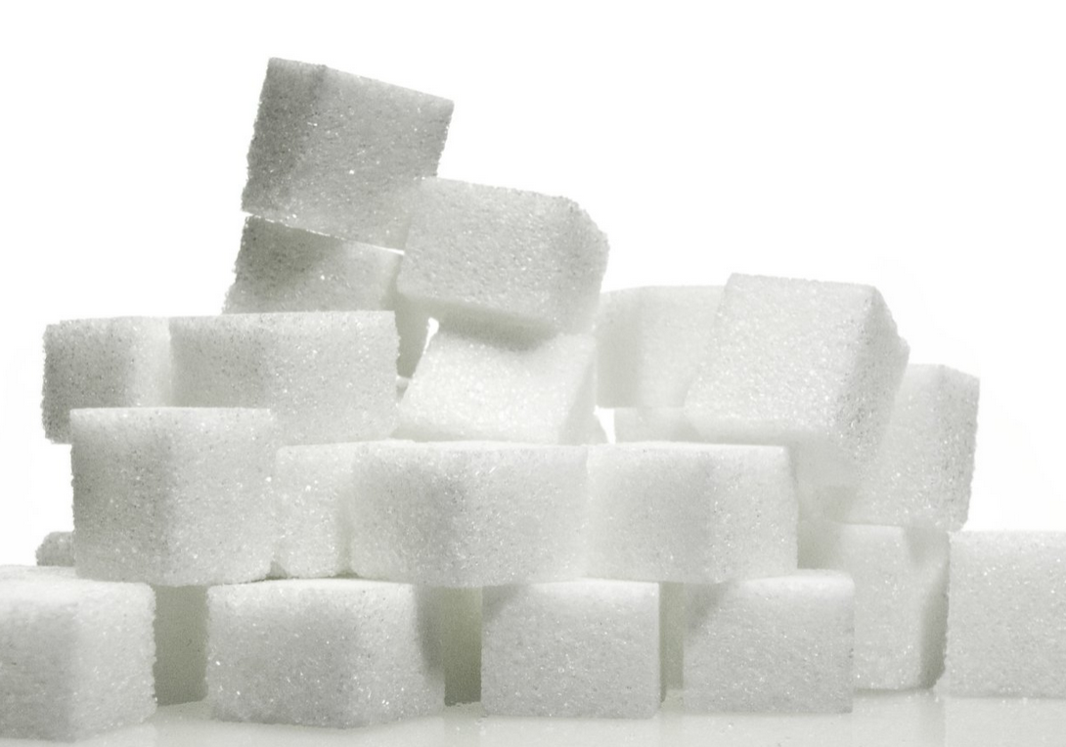
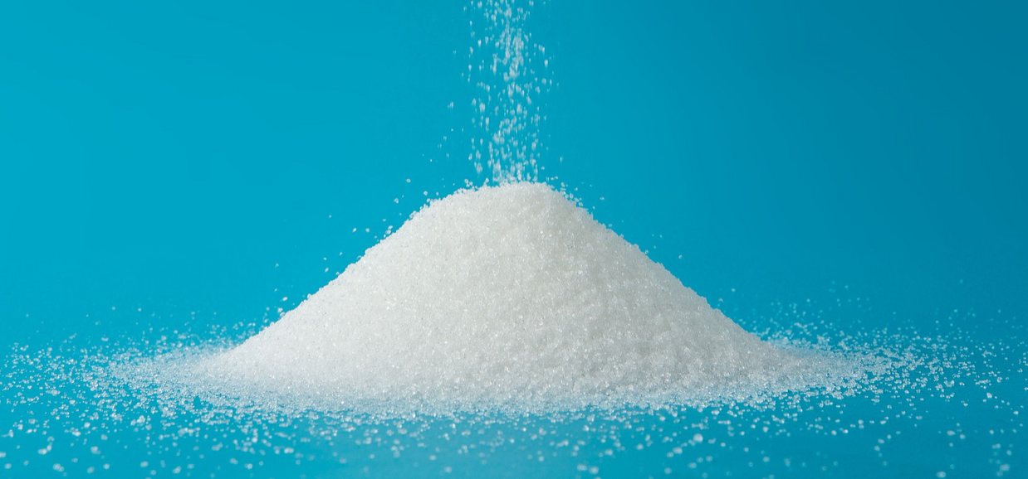

Is quantification today satisfactory?…
What is the difference between MESF and ERF?
The ERF unit is different from MESF in that the fluorophores attached to particles and the fluorophores in solution can be very different and may have very different molar absorptivities. Hence, MESF is a special case of ERF where the labeling fluorophore and fluorophore in solution are the same.
ERF=Equivalent Reference Fluorophores
MESF =Molecules of Equivalent Soluble Fluorochrome

Slide 39
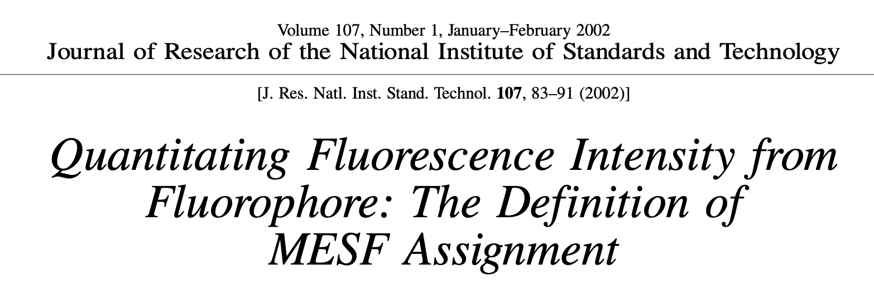
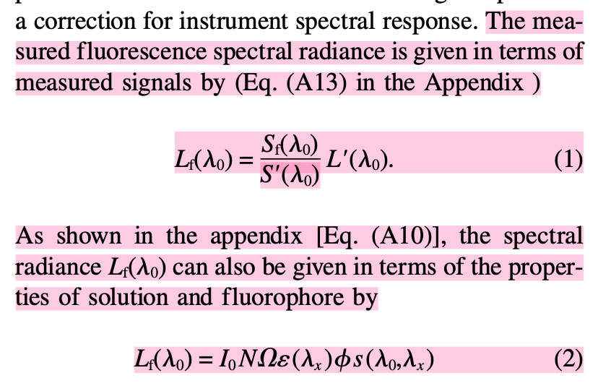
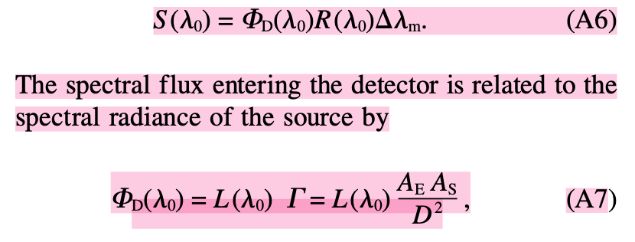
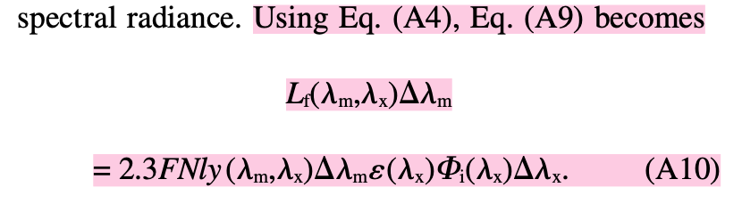
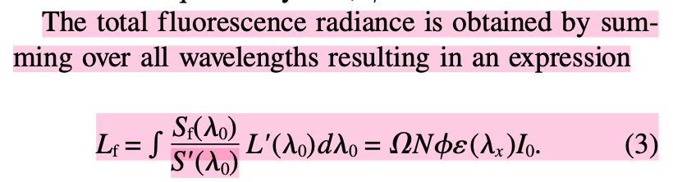
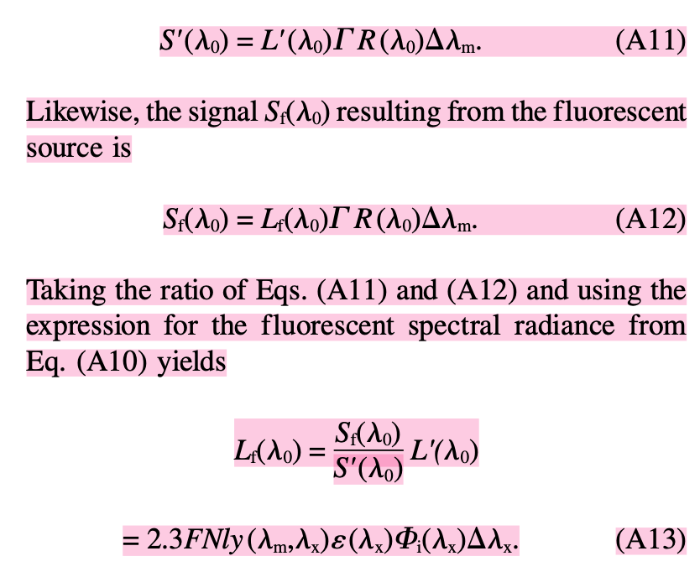
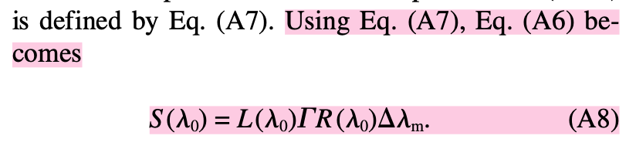
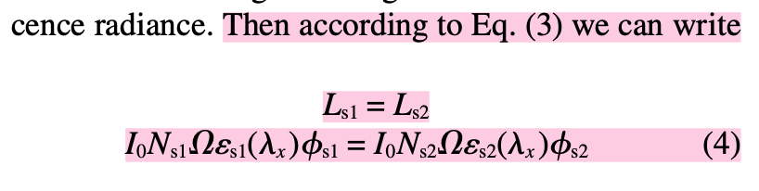


Abe Schwartz, et al
10.6028/jres.107.009
and it keeps going….

Slide 40






So, are we satisfied with quantification in flow?
This is an actual number - just like your bank account!!!
not a spoonful of sugar….
MES(F) –
Molecular Equivalents of Sugar (F)
We don’t count the grains
of sugar …….
“Close enough….
is good enough”
Maybe counting would be a good idea rather
than estimating….
We have this much

Slide 41

Current Peak Intensity Measurements
More

Slide 42
Current based Intensity Measurements
Intensity

Slide 43






Single Photon is a messenger of single molecule transitions
1933
Aleksander
Jablonski
1893
George Stokes
Dim-ish
OK-ish
Bright-ish
http://zeiss-campus.magnet.fsu.edu/articles/basics/fluorescence.html

Slide 44

Single Photon is messenger of single molecule transition
http://zeiss-campus.magnet.fsu.edu/articles/basics/fluorescence.html

Slide 45




“Photon” is an energy packet of light - “Quanta” from Planck & Einstein
[cps]
Flow cytometry
Targeting
nW
Photon Energy : E= hν ( h: Plank constant 6.602E-34 ν= c/λ )
E= 1,240/ λ [nm] [eV] eV= 1.60E-19 [J]
400nm Photon = 3.1eV = 0.5aJ = 2 Mega photon/pW
800nm Photon = 1.55eV=0.25aJ= 4 Mega photon/pW
Poisson Distribution: discrete event probability in a fixed time interval
Max Planck
Albert Einstein
aW
fW
pW
nW
Notes:
Photon is one of elementary particle and also mandatory for our life. Usually, we never recognize particle characteristics of light.
Main reason is one photon energy is so small and daily light includes Tera, Peta and Exa photons. Such particle count is almost impossible, so we measure
light as analog signal. Single photon detection is not easy, but if 1 photon per second is possible to detect, it is 0.5aW power in blue light. It is the ultimate photosensitivity.

Slide 46

Cytometry 3.0 should be based on Energy Conservation Principle
Single Cell –Single Molecule-Single Photon
360nm: 3.4 [eV] = 0.55 [aJ/photon]
820nm: 1.5 [eV] = 0.24 [aJ/photon]
Photon Energy= hc/λ [Joule]
Cell/Particle + Medium
kf= σa*I*Q
ka: Rate of single photon absorption
[photon/s]
σa: molar absorption cross section
I: intensity of excitation
[photon/um²s]
Q: Quantum yield
kf = 1/t
t: excited state lifetime
OUTPUT:
- Em. Wavelength λ
- Em. Photon number per event
- Em. Photo energy per event
- Ex - Em quantum parameters
- Successive Molar Decay
- Photon Correlation
- Photon Statistics
- Background analysis
- Rayleigh/Raman scatter
- SI unit calibration
- New discovery ?
INPUT:
- Ex. Wavelength λ
- Ex. Photon density
per unit area & time
[ Ex. photon/um²s]
- Highspeed Pulse
Photon density is critical
for quantitative analysis

Slide 47

What would an instrument look like for Cytometry 3.0?
A truly quantitative spectral cytometer
An instrument with Intelligent lasers (up to 7)
An instrument with exquisite Sensitivity
A fully Digital cytometer
An instrument with state-of-art optics
An instrument with no Laser alignment?
An instrument with plug’n play lasers
An instrument with almost no user alignment
An instrument not restricted to simple fluorescence
Way more parameters (>200)
Super high-speed electronics (Ghz)
An instrument with no voltage knobs
Made in the USA

Slide 48






Acknowledgements
  Collaborators:
  Dr. Moon Kim
  Dr. James Lindsay
  Dr. Martha Vaughn
  Dr. Jake Jacobberger
  Dr, Pratip Chattopadhyay
  Dr. James Wood
  Dr. Hervé Luche
  Dr. Rui Gardner
  Assoc Prof Bill Eades
  Dr. Andreas Cossarizza
  Dr. Jessica Houston
  Dr. Euiwon Bae
  Dr. Bartek Rajwa
  Miftek Team
  Masanobu Yamamamoto
  Matt Mindrum
  Keegan Hernandez
  Daniel McMillan
  John Gonzales
  Zilin Xu
  Andy Bieberich
  Josh Harriger
  Jared Thompson
  John Gonzales
  Nikolas Mahaffey
  David McMillan
  Aamodini Jayaram
  Michael Kalb
  Valery Patsekin
  Brianna Corman
  Kathy Ragheb
  Purdue team:
  Dr. Bartek Rajwa
  Dr. Euiwon Bae
  Dr. Sungho Shin
  Dr. Xi Wu
  Dr. Sharath Iyengar
  Kathy Ragheb
  Brianna Dowden
  Valery Patsekin
  John González
  Rémi Lechardoy
  Sanjana Shemonti
  Hyun Jung Min
  Joohyeon Lee
  Dal-seong Yoon
  Noah Bousier
Corporate Support Partners:
ThermoFisher, Beckman Coulter
Sciaps, Miftek Corp
Some of this research was supported by the Center for Food Safety Engineering at Purdue University, funded by the U.S. Department of Agriculture, Agricultural Research Service, under Agreement No. 59-8072-1-002 and Agreement No. 58-8042-0-061 to Purdue University Cytometry Laboratories. Any opinions, findings, conclusions, or recommendations expressed in this publication are those of the author(s) and do not necessarily reflect the view of the U.S. Department of Agriculture.
@Cytometryman

Slide 51
355 nm is approximately 8.45×10148.45×1014 Hz.
375 nm is approximately 8.00×10148.00×1014 Hz. E≈5.57×10−19 J
405 nm is approximately 7.41×10147.41×1014 Hz.
488 nm is approximately 6.15×10146.15×1014 Hz.
520 nm is approximately 5.77×10145.77×1014 Hz.
638 nm is approximately 4.70×10144.70×1014 Hz.
780 nm is approximately 3.85×10143.85×1014 Hz.
320 nm is approximately 9.38×10149.38×1014 Hz.
Joule - the SI unit of work or energy, equal to the work done by a force of one newton when its point of application moves one meter in the direction of action of the force, equivalent to one 3600th of a watt-hour.
Photon energy can be expressed using any unit of energy. Among the units commonly used to denote photon energy are the electronvolt (eV) and the joule (as well as its multiples, such as the microjoule).
Watts are defined as 1 Watt = 1 Joule per second (1W = 1 J/s) which means that 1 kW = 1000 J/s. A Watt is the amount of energy (in Joules) that an electrical device (such as a light) is burning per second that it's running.
The energy of a single photon is: hν or = (h/2π)ω where h is Planck's constant: 6.626 x 10-34 Joule-sec. One photon of visible light contains about 10-19 Joules (not much!) the number of photons per second in a beam.
One joule is also equivalent to one watt-second.
SI Units - The International System of Units, internationally known by the abbreviation SI (from French Système international d'unités), is the modern form of the metric system and the world's most widely used system of measurement.
If you multiply the number of watts by the number of seconds, you'll end up with joules. To find out how much energy a 60W light bulb consumes in 120 seconds, simply multiply (60 watts) x (120 seconds) = 7200 Joules.
wikki

Slide 52
Let's calculate the number of photons per second for each wavelength provided:
At 330330 nm:
  λ=330×10−9λ=330×10−9 m
  E=(6.626×10−34 J*s)×(3.00×108 m/s)330×10−9 mE=330×10−9m(6.626×10−34J*s)×(3.00×108m/s)​
  E≈6.01×10−19E≈6.01×10−19 J
At 355355 nm:
  λ=355×10−9λ=355×10−9 m
  E=(6.626×10−34 J*s)×(3.00×108 m/s)355×10−9 mE=355×10−9m(6.626×10−34J*s)×(3.00×108m/s)​
  E≈5.57×10−19E≈5.57×10−19 J
At 375375 nm:
  λ=375×10−9λ=375×10−9 m
  E=(6.626×10−34 J*s)×(3.00×108 m/s)375×10−9 mE=375×10−9m(6.626×10−34J*s)×(3.00×108m/s)​
  E≈5.31×10−19E≈5.31×10−19 J
At 405405 nm:
  λ=405×10−9λ=405×10−9 m
  E=(6.626×10−34 J*s)×(3.00×108 m/s)405×10−9 mE=405×10−9m(6.626×10−34J*s)×(3.00×108m/s)​
  E≈4.90×10−19E≈4.90×10−19 J
At 488488 nm:
  λ=488×10−9λ=488×10−9 m
  E=(6.626×10−34 J*s)×(3.00×108 m/s)488×10−9 mE=488×10−9m(6.626×10−34J*s)×(3.00×108m/s)​
  E≈4.07×10−19E≈4.07×10−19 J
At 520520 nm:
  λ=520×10−9λ=520×10−9 m
  E=(6.626×10−34 J*s)×(3.00×108 m/s)520×10−9 mE=520×10−9m(6.626×10−34J*s)×(3.00×108m/s)​
  E≈3.82×10−19E≈3.82×10−19 J
At 638638 nm:
  λ=638×10−9λ=638×10−9 m
  E=(6.626×10−34 J*s)×(3.00×108 m/s)638×10−9 mE=638×10−9m(6.626×10−34J*s)×(3.00×108m/s)​
  E≈3.11×10−19E≈3.11×10−19 J
At 780780 nm:
  λ=780×10−9λ=780×10−9 m
  E=(6.626×10−34 J*s)×(3.00×108 m/s)780×10−9 mE=780×10−9m(6.626×10−34J*s)×(3.00×108m/s)​
  E≈2.55×10−19E≈2.55×10−19 J
The energy of a photon (EE) is given by the equation:
E=hc/λ
where:
h is Planck's constant (6.626×10−34 Joule⋅second 6.626×10−34 Joule⋅second),
c is the speed of light (3.00×108 m/s3.00×108m/s),
λ is the wavelength of light (in meters).

Slide 53
Antoine Lavoisier's
The Law of Conservation of Mass dates from Antoine Lavoisier's 1789 discovery that mass is neither created nor destroyed in chemical reactions.
Who verified the law of conservation of energy?
Answer. Answer: Law of conservation of energy was verified experimentally by James Prescott Joule. According to the law of conservation of energy, Energy can only be transformed form one form to another.
There is a scientific law called the Law of Conservation of Mass, discovered by Antoine Lavoisier in 1785. In its most compact form, it states: Matter is neither created nor destroyed. In 1842, Julius Robert Mayer discovered the Law of Conservation of Energy.

Slide 54

DRAFT IDEAS for
Miftek booth backdrop
What is the cytometry field waiting for?
Others
1. A truly quantitative spectral cytometer?
NO
YES
2. An instrument with Intelligent lasers (up to 7)?
NO
YES
3. An instrument with exquisite Sensitivity?
YES
NO
YES
4. Finally a fully Digital cytometer?
5. An instrument with no Laser alignment?
NO
YES
6. An instrument with almost no user alignment?
NO
YES
7. An instrument not restricted to simple fluorescence?
NO
YES
8. Way more parameters than any other (>200)?
NO
YES
9. Super high-speed electronics (Ghz)?
NO
YES
10. An instrument with no voltage knobs?
NO
YES
11. An instrument with plug’n play lasers?
NO
YES
12. An instrument made in good ole’ USA?
NO
YES
So why spend your money now on old technology?
Soon Cytometry 3.0 will be an alternative

