Slide 1


CYTOSPECTRUM
Next Generation Spectral Cytometry
As presented to PE on March 3, 2022
Contact:
Masanobu Yamamoto, CTO: Email: CTO@Miftek.com
J. Paul Robinson, CSO Email: CSO@Miftek.com
CONFIDENTIAL MATERIALS
© MIFTEK CORPORATION
PUBLIC DISTRIBUTION PROHIBITED
Last Update
02/01/22
Notes:
This presentation outlines Miftek’s CytoSpectrum spectral flow cytometer and its significant advantages.

Slide 2


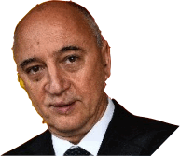

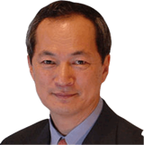








THE TEAM
2
J. PAUL ROBINSON
Founder & CEO
Professor, Purdue Univ.
Inventor of Spectral Flow Cytometry >$30M research
IP licensed to Sony, Cook, Propel
Key Opinion Leaders
Dr. Andrea Cossarizza
Univ Modena, Italy
Dr. James Wood
Wake Forrest University
MASANOBU YAMAMOTO
Founder & CTO
40 Years at Sony Electronics
Inventor of Blu-Ray Technology - >200 Patents Issued
Dr. Hervé Luche
CIPHE, Marseille, France
Dr. Bill Eades
Washington Univ.
MATT MINDRUM
Commercial Advisor
7 Years at Eli Lilly & Co.
Harvard MBA
Valery Patsekin
Software Engineer
Dr. Pratip Chattopadhyay
NY University & Talon
Biomarkers
Keegan Hernandez
Electrical Engineer
Euiwon Bae
Mechanical Engineer
Notes:
Founders include J. Paul Robinson and Masanobu Yamamoto. Yamamoto-san is the inventor of the Blu-Ray technology from Sony that we are all familiar with. Matt Mindrum is our commercial advisor, Keegan Hernandez Valery Patsekin and Euiwon Bae are engineering team. Pete Kissinger, Dan Hasler, and Richard Parker have been our business advisers. Drs. Cossarizza, Wood, Luche, Chattopadhyay and Eades comprise our scientific advisory board. The Scientific advisory board have reviewed all of our technology in detail and will continue to be advocates for the Miftek technology as it is commercialized. This is a very powerful and influential group of advisers.

Slide 3
What Does Miftek Want?
11
Miftek has significant knowledge, strengths and IP but needs capital to complete development of a functional prototype and beta units
Miftek wants a strong partner that has strength in fluorescence reagents to create unique products particularly reagent kits specific for spectral, new products combining molecular tools and spectral flow
Miftek does not have manufacturing capability and would like to find a partner that can assist with the transfer to manufacturing, whether that be with the partner or a CMO
Miftek needs strong commercialization and sales organization for distribution and support
Miftek would like a strategic partner to help translate our IP into products that enable a new era of flow cytometry applications in research and clinical
Miftek wants to continue to develop technology that enables new applications – how can we leverage our single photon technology beyond flow
Notes:
Miftek needs capital to take our significant IP and our protoptypic modules and convert them to commercial products. We also need a partner who has strength in reagents as the combination of a reagent rich company with technology rich aspects, allows new applications to be developed to generate sales in both reagents and hardware. New kits are particularly exciting in this scenario. Miftek wants its extensive IP portfolio transformed into high quality commercial instruments.

Slide 4












3
CURRENT STATE OF CYTOMETRY
POLYCHROMATIC CYTOMETRY BEEN THE BASIS OF CURRENT CYTOMETRY
POLYCHROMATIC
FLOW CYTOMETRY MARKET GROWTH BY 2027
9.73% CAGR
~14K units, ~$7.4B sales ($2B U.S.)
Driven By Expanded Industry Use
Past
Strengths
SPECTRAL CYTOMETRY IS FUTURE GROWTH
SPECTRAL ANALYZERS
Likely - Future
Future
Growth
SPECTRAL SORTERS
Notes:
The flow cytometry market is growing. More instruments are being sold. By 2025 the market will be expecting 12,000 instruments/year. The majority of companies are selling polychromatic – old technology – it is hard for many of them to adapt – they are so locked into current technologies. The future though is in spectral flow cytometry and there are currently only two companies selling spectral analyzers and they are doing very well. Thermo has released a spectral sorter – it is expensive but works well. Cytek has announced a spectral sorter but has clearly had many problems in implementation.

Slide 5
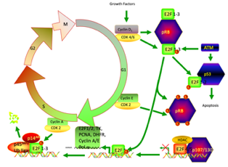
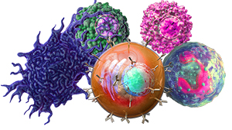
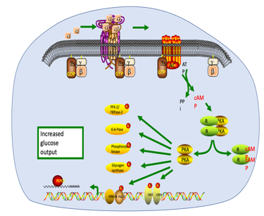
EXPANDS CAPACITY
BY 50-100%
4
WHY SPECTRAL?
Spectral
~75 20 20 20
Polychromatic
30
2-3
2
2-4
SPECTRAL CAN COMBINE THESE
+
+
+
Structural/
physical
Phenotype
Cell Cycle
Metabolic
CD3
CD4
CD8
CD16
CDx
Fluorescence
Life-time is not
well served in the
flow market
Users are demanding more capacity, higher content, more information, additional parameters; Imagine being able to do the following…..
RNA Flow cytometry + phenotype; enzyme kinetics + phenotype; organelle status + phenotype + cell cycle
Functional flow + enzyme status + quantification; absolute molecular quantification; Cell Cycle + Phenotype;
absolute antibody binding site quantification; small particle analysis with higher sensitivity, real quantification based on digital
Notes:
Why spectral – because it opens up far more capacity than polychromatic flow cytometry. In fact, it is likely that Spectral will expand significantly due to user demand – users want more “colors” – they want to combine traditional phenotypic parameters with cell cycle, metabolic and physical structural parameters. This concept was not possible with polychromatic cytometry because of limitations in the technology.

Slide 6
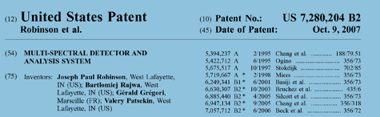
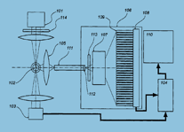
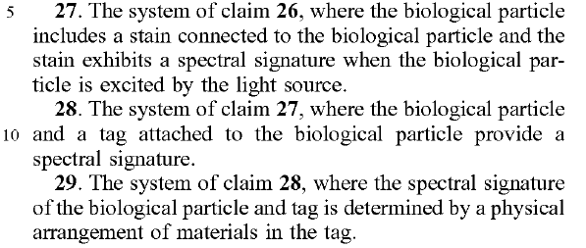
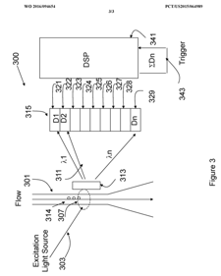
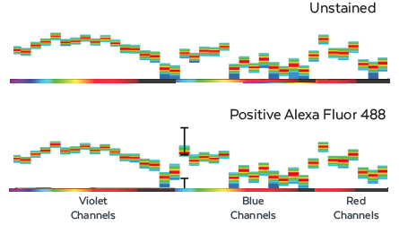


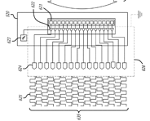
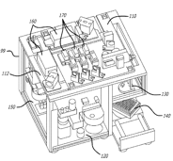

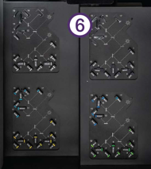
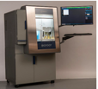
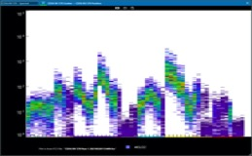

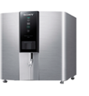
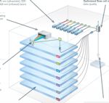
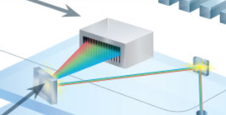
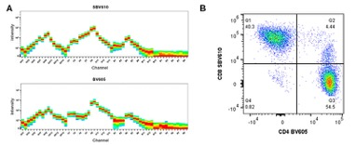

5
Current Spectral Technology
Claims 27-29
ALL BASED ON
US Patent
#7,280,204B2*
~120 OPTIC COMPONENTS
PD Array
Open space Lasers
ADC
Analog
*
Analog
Sorter only
Bigfoot – 60 PMT detectors
~130 Optical Components
Very expensive complex optics
~50 OPTICAL COMPONENTS
*
Analog
* License to Spectral Patent
Prizm Optic
7 x Hamamatsu 32Ch PMT
Very expensive optics
Notes:
All current spectral technologies are based on the Purdue Spectral patent. Sony and Thermo both have licenses to operate. All current instruments operate in similar manner– but their approach is complex compared to what it could be. Each current instrument has a significant number of expensive optical parts which increases manufacturing costs, and upkeep costs. We spent time developing the original spectral technology, and over the past few years we moved to look at what the future should be,

Slide 7

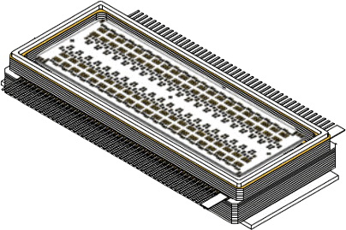

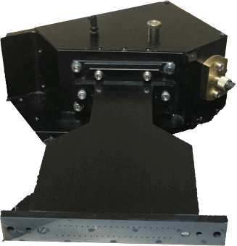

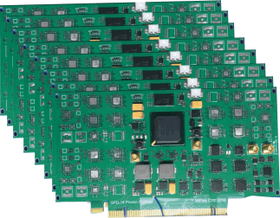
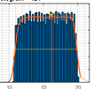
7
CYTOSPECTRUM
Key Advances
PUSHING FLOW TO ITS THEORETICAL LIMITS
CURRENT BARRIER
CYTOSPECTRUM INNOVATION
Sensor speed Fastest single-photon sensor 500ps detection
Limited simultaneous parameters Only 42-channel array available
Background noise Lowest detector noise
Fluorescence sensitivity Most sensitive detector
Open lasers alignment “Plug-and-Play,” lasers
Laser noise and heat generation Modulated lasers system
Complex optical alignment Pre-aligned, fiber-linked single-stage optics
Analog electronics Fully digital, 10GS high-speed electronics
Regular fluorescence output Regular and Lifetime fluorescence on all lasers
Complexity of design, high-cost Modular system, low manufacturing cost
Notes:
This is where Miftek’s CytoSpectrum comes in. We have developed the fastest optical detector existing - and we are creating a game-changing 42 Channel detector array which in combination with our unique modulated plug-n-play lasers, pre aligned optical detector module and giga-speed electronics, produces the most innovative and leading-edge flow cytometer available. We address the issues of speed, sensitivity and capacity. We reduce heat and power generation, we remove analog electronics, we reduce complexity and therefore manufacturing cost.

Slide 8






Spectral Comparisons
6
1st Gen
~120 Optical components
5 Sets of APD arrays
China
5 Fiber optics
from Chamber
$$$$
64 Channels
Analog
5 Lasers
$300-450k
Complex optical alignment
20-30 optical
mirrors (detection side)
7 Sets of
32 ch PMT arrays
1st Gen
7 Fiber optics
from Chamber
Japan
$$$$$$$$
Analog
150 Channels
7 Lasers
$800-950k
Complex optical alignment
2nd Gen
$$$$
1 Fiber optic
from Chamber
USA
$$
141 Channels
Digital
6 Lasers
$200-250k
1 SpectroOptic
1 x 42 Ch Array
Modular optical System – no alignment
Manufacturing cost: ~$50k
Nyquist
Notes:
For example, Cytek’s detection path has over 120 optical components – and 5 separate fibers – one for each laser. Sony has a large number of carefully aligned optics and 7 sets of detectors – all with optical alignment issues. Cytek is made in China, Sony in Japan. Miftek has only one optical fiber coming from 6 lasers. A single spectro-Optic module with an attached 42 ch sensor array. The optical path is alignment free. It never needs alignment. There are essentially only 3 components to the entire light collection system and they are built into a single module. Why ~140 channels? – think Nyquist theory! Sampling theory covers all areas so design. We should not be focused on current practice that designs to exact # fluors , 6 color, 10 color 14 color, etc – this is no longer relevant in spectral domain! At 140 possible channels, there are almost no limits to what we can do.

Slide 9
FLOW CYTOMETRY
8
A LARGE AND GROWING MARKET
Clinical Diagnostics (req. regulatory approval)
Second-Tier Labs: Cell Biology, Protein Analysis
Clinical Research: Pharma, Biotech, CROs, AMCs
Bench Science: Academic Medical Centers, Core Labs, Drug Discovery
Entry Market: Early Adopter Core Labs
LONG TERM OPPORTUNITY
Clinical Diagnostics
MARKET GROWTH BY 2025
~9.73% CAGR
~14K units, ~$7.4B sales ($2B U.S.)
Driven By Expanded Industry Use
TARGET MARKET
Academic Medical Centers, Labs
Current Installed Base of 100K
2019: ~7K units, $3B sales ($1B US)
ENTRY MARKET
Early Adopter Core Academic Labs
Estimated Installed base of ~20K
e.g. 2019: 1K units, $450M sales ($200M US)
We can capture 10-20% of this base quickly
*Markets and Markets, Jan 2020 Flow Cytometry Market
Notes:
Miftek’s CytoSpectrum is a timely introduction into a growing technology field where by 2027, Markets and Markets 2022 report identifies a $7.4B market space with a total of 14,000 units per year. Miftek’s target market is the Academic/medical center research environment which by 2025 alone will reach 1000 units valued at $824Million.
<$100k 20%
>$200k 40%
>300k 30%
>700k *10%

Slide 10
CYTOSPECTRUM VS. COMPETITION
TECHNICAL / FUNCTIONAL SUPERIORITY
9
Feature
Miftek
Cytek
Sony
BD
BC
Sysmex
BIGFOOT
Thermo
BioRad
Calibration - Fully Digital
✓
High Content Channels
141
67
150
50
26
12
60
28
Service – Plug’n-Play Lasers
✓
User Familiarity
✓
✓
✓
Dim Markers - Sensitivity
✓
✓
Custom Reagents
✓
✓
✓
Lifetime Measurement
✓
Noise – Low Background
✓
Quantitative - Absolute
✓
Sorting capable
✓
✓
✓
Spectral Flow Cytometry
✓
Predictability, Efficiency, Throughput, Cost, Speed
✓
✓
✓
Value - Costs
$200k
$450k*
$850k
$1,200k
$350k
$250k
$1,100k
$600k
# P’n-P - Plug’n’Play
* Cytek GSA Contract price ~$270k
Spectral Competitors
Conventional, <= 50 Parameters
Notes:
Miftek’s CytoSpectrum competes in all of the major key user demands spaces – calibration, high content, sensitivity and value. It outshines the competition in all of the most significant feature spaces that users identified to us as being critical. Significantly, because it will be made in the USA, and has a low manufacturing price because of its clever modular design, it is highly price-competitive with significant profit. It competes with the most expensive instrument in the field (Sony ID7000).

Slide 11
What Does Miftek Offer?
10
Miftek brings unique knowledge and experience
Reputation & influence in field
Product development experience (e.g. BluRay)
Strength in single photon space which is expanding
Single photon will be a go to technology across both biological and physics spectrum, Spectroscopy, very sensitive light detection
CytoSpectrum technology
Excellent patent position
7 Issued Patents on key technologies
9,372,143B2; 10,036,698; 10,613,096; 10,775,292; 10,900,985; 11,187,584; 11,255,771 Including the Purdue Spectral Patent #7,280,204 B2
PE has multiple technologies that could be ready for next generation updates
e.g. PE’s Envision Multilabel Reader, LQA 300 FT-IR Wine Analyzer, Vanadis cfDNA Reader, Avio Optical Emission Spectrometer, Wizard² 1-Detector Gamma Counter, etc
Notes:
Miftek has strength in our leadership team – very strong knowledge and reputation in the field. We have a strong IP Portfolio – this has been a significant component of Miftek’s development. We also however, have transformed many of these patent concepts into tested prototypes and we have also taken our extensive knowledge and transformed this into many of the critical components of a new spectral technology. We have overall strength in single photon technology which will become far more important across other technologies as instrumentation demands focus on sensitivity, speed and new applications.

Slide 12
What Does Miftek Want?
11
Miftek has significant knowledge, strengths and IP but needs capital to complete development of a functional prototype and beta units
Miftek wants a strong partner that has strength in fluorescence reagents to create unique products particularly reagent kits specific for spectral, new products combining molecular tools and spectral flow
Miftek does not have manufacturing capability and would like to find a partner that can assist with the transfer to manufacturing, whether that be with the partner or a CMO
Miftek needs strong commercialization and sales organization for distribution and support
Miftek would like a strategic partner to help translate our IP into products that enable a new era of flow cytometry applications in research and clinical
Miftek wants to continue to develop technology that enables new applications – how can we leverage our single photon technology beyond flow
Notes:
Miftek needs capital to take our significant IP and our prototypic modules and convert them to commercial products. We also need a partner who has strength in reagents as the combination of a reagent rich company with technology rich aspects, allows new applications to be developed to generate sales in both reagents and hardware. New kits are particularly exciting in this scenario. Miftek wants its extensive IP portfolio transformed into high quality commercial instruments. We also see opportunities for continues technology development in the detection space.

Slide 13
KEY INVESTMENT & FUNDING
12
TIMELINE
Year 1
Year 2
Alpha Prototype Base Instrument
Fluidics system/Flow chamber
42-Ch Sensor Development
Manufacture Spectro/optics
12-Ch Electronics Board
Beta Prototype Base Instrument
Laser Module Test Unit
Optical Unit Development
Laser Module Full 6-Laser Unit
Hire EE, ME, Bio staff
Hire Software Team
Prototype Manufacture costs
Fully functional demo units
Immediate Funding need
100-Unit Production
$250K
$350K
$300K
$200K
$300K
$200K
$200K
$200K
$100K
$900K
$950K
$1200K
$700K
$700K
$500K
~$500K
~$7M
100 unit BOM + assembly staff + Manufacturing $5M
Total ~$13M
Notes:
The $7M required in the immediate term will be used to build fully functional prototypes that will be the basis for sales and demonstrations. A significant cost of these prototypes are NRE costs for module design and prototype manufacture. Depending upon the manufacturing model we develop, instruments may undergo final assembly in Miftek’s current 4000 sq ft operation or just testing and certification. Software development is an important component of the development. Funding will be used to finalize component designs, test these systems and provide fully demonstrable instruments for demonstration and sales.

Slide 14
CYTOSPECTRUM
13
The Next Generation of fully Digital Spectral Cytometry
Please review this video on the technology developed by Miftek
https://www.youtube.com/watch?v=IdEnMcFs1cw
Note: A video demonstrating Miftek’s approach is here
Contact:
Masanobu Yamamoto, CTO: Email: CTO@Miftek.com
J. Paul Robinson, CSO Email: CSO@Miftek.com
© MIFTEK CORPORATION
PUBLIC DISTRIBUTION PROHIBITED

Slide 15
Appendix follows – supporting slides

Slide 16
Appendix - slides use if necessary
1. Cellular markers
2. CytoSpectrum innovations
3. Recent changes in company ownership in flow field
4. Worldwide instruments present and company products
5. Most influential flow companies 2022
6. Changes in company ownership over past decade
7. Cytek success story
8. CytoSpectrum value proposition vs competition
9. Flow Competitive Landscape
10. Manufacturing cost projections for Miftek instrument @100 units
11. Three-year cash flow
12. List of Issued Patents (not including present submissions)
13. Potential partnership slide
14. Cost Benefit analysis polychromatic vs spectral
Notes:
This is the approximate order of sppendices

Slide 17
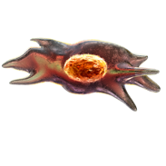
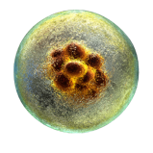
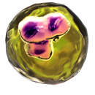
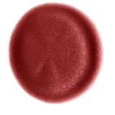
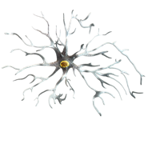
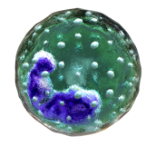
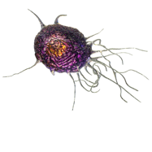
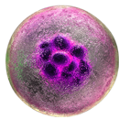
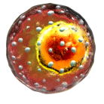
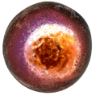
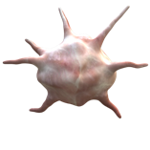
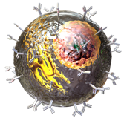
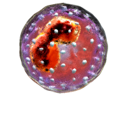
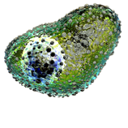
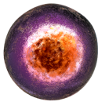
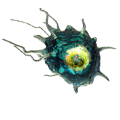
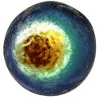
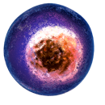
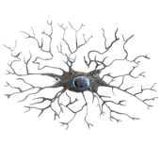
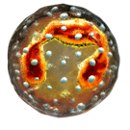
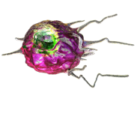
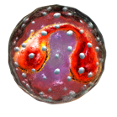
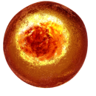
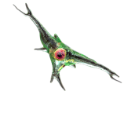
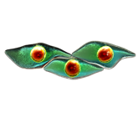
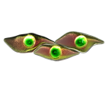
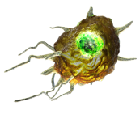





IN CONTEXT
7
IMMUNOLOGY AND INFECTIOUS DISEASE
Mesynchymal
Stem Cell-CD44
Embryonic Stem
Cell-CD29
Megakaryocyte
CD9
Erythrocyte
CD-235a
Macrophage
CD11a
Hematopoietic
Stem Cell-CD34
Astrocyte-CD40
Basophil-CD13
NK Cell
CD69
Th17 Cell
CD4
Platelet
CD63
Monocyte
CD14
Mast Cell
CD117
T Follicular
Helper Cell CD84
MDSC
CD11b
Th22 Cell
CD4
B-Cell
Th1 Cell
CD4
Endothelial
Cell-CD31
Fibroblast
CD10
Stromal
Cell-CD10
Microglia
CD68
Neutrophil
CD16
Plasmacytoid
Dendritic Cell D40
Eosinophil
CD15
Th2 Cell
CD4
371 Known Clusters of Differentiation
(CD Markers)
Myeloid Dendritic
Cell – CD1a
Th9 Cell
CD4
Epithelial
Cell-CD24
Naïve T Cell
CD3
Neuron
CD6
Treg- CD4
Images from www.biolegend.com
Notes:
It turns out that every cell type in the human body has what we call a phenotype – it's a word that define they type of cell, what it looks like, how it acts and where it lives. Immunologists and pathologists use biological markers with fluorescent dyes attached to them to track down every one of these cells and unmask them. Spectral flow cytometry is driving much higher complexity assay designs allowing scientists to better understand the immune system and expand out knowledge of biology to better address treatment monitoring and drug design.

Slide 18
CYTOSPECTRUM INNOVATIONS
DIRECTLY ADDRESS CURRENT LIMITATIONS
10
CURRENT BARRIER
CYTOSPECTRUM INNOVATION
Fluorescence Sensitivity
Background Signal and Noise
Limited Number of Simultaneous Parameters
Limited Throughput, Slow Data Processing
Instrument Calibration, Manual Alignment and Adjustment
Single-Photon Sensor
Modulated Laser Array (No Signal Overlap), Low Noise Components
6 Lasers, 42CH Spectral Array, Up to 141 Parameters
Fully Digital (No ADC), 10GS High-Speed Electronics
“Plug-and-Play” Laser Modules, Pre-Aligned Optics
Notes:
With its incredible fluorescence sensitivity it can detect just a few molecules on a cell to find those rare cancer cells. With is low background due to its modulated lasers and low noise unique optical materials construction, and it fully digital electronics, there is no analog signal to manage creating the first entirely digital flow cytometer in 50 years.

Slide 19
What has Changed since 2018?
16
Agilent Purchased ACEA – Agilent is now a flow company
Sartorius Purchased Intellicyt – IQ3 – Sartorius now a flow cytometry Company
BD Sued Cytek – then Settled (Cytek paid $20m fees, 1.5M shares plus milestones)
Cytek IPO after raising $200m Market cap $3.4B (12/2022) (BD is stockholder)
BioLegend Sold to PE for $5.2B – PE is now a flow reagent company (no flow instrument)
BC is trying to build a spectral flow cytometer using CytoFlex at LabCyt
BD just sued Beckman for CytoFlex patent infringements
BD just sued Beckman for polymer dye patent infringements
DiaSorin Purchased Luminex $1.8B
Software Companies: FlowJo sold to BD and De Novo Software sold Insightful Sci and CytoBank sold to BC
Standard Biotools purchased Fluidigm for $250m in Jan 2022
BD purchased Cytognos in Feb 2022
Notes:
There have been many changes in the industry over the past several years. There has been no time that change has been so dramatic as in the past 3 years. There are few companies left that can innovate.

Slide 20



















































# Instruments WorldWide
Historical ranking of Flow Cytometry Companies as of 2017
Highest
Lowest
FACSLyric
FACSAria Fision
FACSAria
FACSMelody
FACSymphony S6
Muse, EasyCyte
CellStream,
FloSight
ImageStream
Attune NxT
Bigfoot
ID 7000
SP6800
MA900
SH800S
Gigasort
Hydris
Viva
S3 Sorter
Z5
Aurora
Aurora CS
Northern Lights
Astrios
CytoFlex
MACsQuant
Tito
XF-1600
CyFlow Space
Cube6, 8
Sample Prep
Advanteon
Quanteon
Started with
$12M
investment
in 2016
SE520EON
S1000EON
iQ Screener
Chart © Miftek Corporation
Notes:
This is the status of flow cytometry companies in 2017. Cytek introduced their spectral product in July 2017. At that time BD was the undisputed leader followed by Beckman Coulter. Many other companies were competing for the same polychromatic market with machines that were all essentially the same, except for the number of “colors”. Cytek was definitely in last place in 2017.

Slide 21
















Most Influential from user Perspective 2022
Value Degradation Index (VDI*)
Lowest
Highest
ID 7000
SP6800
MA900
SH800S
Attune NxT
Bigfoot
Muse, EasyCyte
CellStream,
FloSight
ImageStream
XF-1600
CyFlow Space
Cube6, 8
Sample Prep
Gigasort
Hydris
Viva
S3 Sorter
Z5
Aurora
Aurora CS
Northern Lights
Astrios
CytoFlex
FACSLyric
FACSAria Fision
FACSAria
FACSMelody
FACSymphony S6
MACsQuant
Tito
Advanteon
Quanteon
Struggling
no new
technology
Holding
ground
Just holding
ground
New CytPix
Analyzer (2021)
Sued by BD
07/2021
Only
sperm
sorting
New CGX10
Cell Isolation
System (2022)
Struggling
no new technology
(just sold to DiaSorin)
Spectral Instruments
(Designing?)
Struggling
new image/flow
technology
Struggling
no new technology
SE520EON
S1000EON
iQ Screener
Chart © Miftek Corporation
*VDI indicates how companies value changes in terms of user perspective over time
Notes:
Cytek 2021, Cytek would be considered the most influential company in flow cytometry. While they might not have outsold BD or BC, every instrument that Cytek sold, could collect more colors that the most expensive BD instrument at over $1M. Even tho’ Sony has been selling for 5 more years, Cytek cracked Thermo entered the market with a spectral sorter (Bigfoot) in 2020 and has done well in the sorter market (~50 units sold). All other companies’ sales have been relatively static as Cytek has gained influence (>1000 units sold). BD’s introduction of an imaging sorter might give BD some advantage in 2022-23, but they will not be selling many more of their $1M, 50 parameter analyzers because Cytek can sell a system with more capacity for half the price. BD will be the biggest looser in the flow cytometry market. Sysmex has proven not be competitive even with their reagent system – they forgot about updating their aging Partec based instruments. Miltenyi are a but unknown, and have a strong position in Europe. Biorad lost several leading individuals in their flow team, have depended on Propel for technology and seem to be going nowhere. Agilent is still bringing ACEA on board. Thermo is trying to integrate Propel and their Attune team. I predict they will be very slow in bringing out a competitive spectral instrument. BC is trying to build a spectral instrument based on Cytoflex – but the patent litigation is likely causing disruption in the company.

Slide 22


































































Flow Cytometry related Companies Purchased in last decade
2022
2021
2021^
2021%
2019!
2019*
2018@
2017#
2013*
2006/
2012
2011**
2010
Standard
Biotools.
+
Advanteon
Quanteon
iQ Screener
XF-1600
CyFlow Space
Cube6, 8
Sample Prep
Muse, EasyCyte
CellStream,
FloSight
ImageStream
FACSLyric
FACSAria Fision
FACSAria
FACSMelody
FACSymphony S6
ID 7000
SP6800
MA900
SH800S
S3 Sorter
Z5
$250M
$5.3B
Muse, EasyCyte
CellStream,
FloSight
ImageStream
Attune NxT
Bigfoot
$??
Muse, EasyCyte
CellStream,
FloSight
ImageStream
*
$90M
$21B
Previously all
Propel Products
Opportunity
$??
$260M
$??
Opportunity
$243M
**
Opportunity
Opportunity
New CGX10
Cell Isolation
System (2022)
$??
New CytPix
Analyzer (2021)
$??
$210M
$1.8B
$??
Opportunity
Opportunity
Purchased by
Who is left?
**
Purchased by
SE520EON
S1000EON
Purchased by
Purchased by
GE Life Sciences/Labcyte
Flow Software Companies
Chart © Miftek Corporation
Notes:
Huge changes have occurred in the flow markets over the past several years and these are identified here. So far, large conglomerates have taken over most smaller companies to the point that there are only very few small companies left. From Miftek’s perspective we see at least 5 or six potential partners all of whom have very good reasons to need our technology. BioRad could be a partner as they have now lost their technical design group (Propel) and they also lost many of the engineers and staff in their flow group recently. Sartorius is stuck with an ACEA product controlled by Agilent since Agilent purchased ACEA, Beckman is struggling with patent infringement issued with BD on the very optics that they need for a spectral instrument. Thermo is trying to work out how to transition from their Attune product to next generation, DiaSorin has a significant number of diverse instruments and will struggle to maintain them all. PE has the biggest reagent company and has significant instruments in biology, but no flow cytometer. Nexcelom is unlikely to be able to produce a high-level cytometer to compete with Cytek – their technology is excellent but very basic and is likely to be competing more with basic Thermo lab products. Moving Nexcelom to high level spectral cytometer would likely be very difficult and time consuming.

Slide 23



THE SUCCESS STORY
4
CYTEK IS THE CURRENT INSTRUMENT POWERHOUSE
FORMED IN 2015
RELEASED FIRST PRODUCT IN 2017
HIRED MOST OF THE BEST PEOPLE
IPO IN 2021 – INITIAL VALUATION $3.4B
SPECTRAL SORTER 2021-22
Notes:
How do we know things are changing? Look at Cytek success. It started off in 2015 with a $25 million investment. Within 6 years they had sold 1000 instruments. The went public in July 2021 and the were valued at $3.4B within a month. Cytek has moved the field more in the past 6 years than BD or BC did in 40 years.

Slide 24

CYTOSPECTRUM
14
BEST-IN-CLASS
FEATURES AND
FUNCTION
AT DISRUPTIVE
PRICE POINT
Sony@
CytoSpectrum
$850K
$200-250K
Cytek&
$300-450K
Becton
Dickinson
Resolution/Complexity
Beckman Coulter#
Thermo Fisher*
Value
Concept drawing only
Spectral instruments
* Attune #CytoFlex &Aurora @ID7000
^Cytek also have a low-end spectral instrument Northern Lights which is lower cost but limited function
Notes:
When evaluating Mifteks Cytospectrum in the two most important features of resolution and value, CytoSpectrum leads all of the competition by a significant margin. Not only can CytoSpectrum be price competitive, it is absolutely leading edge technology and has features that the competition cannot apply for both technology and IP reasons.

Slide 25







FLOW CYTOMETRY
12
COMPETITIVE LANDSCAPE
Tesla model – activate lasers post-purchase
6-laser, 25-parameter conventional: $450K
Planning spectral instrument for next gen
Introduced new CytoFlex sorter 2021
www.beckman.com
KEY PLAYERS
Share*
2018-2021^
Full range of 7 models
2-laser, 4-parameter conventional: $60K
9-laser, 50-parameter conventional: $1.3M
Introducing Image-Sorter 2022 Q3
www.bdbiosciences.com
Becton Dickinson
Beckman Coulter
Bio-Rad
ThermoFisher#
Agilent#
Luminex#
Sysmex
Miltenyi Biotech
Sony
Cytek
Stratedigm
Apogee
(* historical approximations)
(^ estimates based on interviews)
(# Trying to manage new entities)
48%
30%
2%
3%
3%
5%
1%
4%
6%
0.5%
<1%
<1%
34%
25%
1-2%
4-4%
First commercial spectral cytometer (2012)
3-laser, 15-param spectral instrument: $350K
7-laser, 150-parameter spectral inst: $850K
www.sonybiotechnology.com
3%
3-4%
2017 entrant to spectral cytometry market
300+ instruments / $100M+ in three years
5-laser, 64-param spectral instrument: $450K
Introduced CS spectral sorter (but slow intro)
www.cytekbio.com
1%
3%
10%
15%
2020 entrant to spectral cytometry market
First Spectral Cell Sorter
9-laser, 60-param spectral instrument: $1.3M
https://www.thermofisher.com/order/catalog/product/PL00285#/PL00285
<1%
<1%
6 lasers, 141 Parameter target $200,000
Fully digital/pre-aligned optical system
Only instrument to integrate single photon
www.Miftek.com
*Total instrument sales
Notes:
With about a dozen competing companies, we believe Miftek is position to both enter the market with an innovative product line, and capture a significant percentage of the market from the leading companies. Only two companies selling spectral analyzers– Sony and Cytek and in the past 3 years these companies alone have sold over 1500 spectral instruments moving the market away from the traditional instruments sold by Becton Dickinson and Beckman Coulter the leading companies. These numbers are estimates and may not be precise as there is no real mechanism for precision in this area.

Slide 26

Unit cost based on Spreadsheet
BOM For 100 Unit production | Cost per unit @ 100 unit prod’n
Component | Cost
42 ch sensor | 4,000
Spectrometer | 3,000
Fiber optic unit | 800
6 laser module | 8,000
Flow chamber | 2,000
42 ch Electronics | 5,000
Fluidics module | 4,500
Fiber connectors | 3,000
Case / Base | 2,000
Computer/monitor | 2,000
Sheath/waste materials | 1,200
Power supply/cabling | 1,000
Optics components | 4,000
misc | 1,000.00
Additional Electronics | 2,000.00
Total BOM/unit | 43,500.00
Assembly cost | 6700.00
Each total unit cost | 50200.00
Assembly cost
Estimation of assembly and testing costs based on staff time
at $30/hr ($60,000/year). This cost includes $2500 for shipping and packing
Component costs are based on 100-unit costs per item. This is based
on our current knowledge of product costs and includes estimates for
several components such as case, based, and fluidics components.
/Users/wombat/Dropbox (MIFTEK work dropbox)/Share with Yamamoto/Miftek documents/Spectral flow cytometry project/Instrument design for new Spectral cytometer/Cost estimations data/Cytospectrum Costs estimates-092520.xlsx
Notes:
These slides show the basics of our costing structure. On the left is a 6 laser, 141 channel instrument that is competitive with the top-level Sony instrument that is selling at ~$900,000 (and with a very high build price). On the right is our assembly cost estimation per instrument. Key to the lower cost basis for the CytoSpectrum, is the highly modular nature of the instrument. For example, from the flow chamber, there are only 4 parts to the entire optical detection system and all these parts are assembled as a single modular unit. Once assembled this unit comprises the entire optical output as a single unit. Most if not all other systems required 50-150 components for the same output and all of them require many alignment steps. The same can be said of the input optics. All lasers are in a single box, and once passing through the optical distributor box, require a single fiber to the flow chamber. There are no open lasers in Miftek’s instrument. We use the term plug’n’play for our lasers as they are easily replacable.

Slide 27
THREE-YEAR CASH FLOWS
KEY ASSUMPTIONS
$250K revenue per unit
$50K COGS per unit
20% cost of sales/service
100 units sold
13 in ’24, 82 in ‘25
150 total units manufactured
50 in ‘24 and 100 in ‘25
$8-9M total need
~$4M each in Q2 ‘22 and Q2 ‘23
Cash flow positivity achieved at 25 units sold (Q1 ‘25)
Payback achieved at 80 units sold (Q4 ‘25)
FUNDING NEEDS
Notes:
This is based on our operational spreadsheet – and shows cash flow based on the costs in the unit cost spreadsheet slide above. Sales are very conservative and could be more aggressive with additional capital for manufacture and staff, but this is a realistic approach that we believe would be a minimal expectation giving the funding position identified. An advantage Miftek has is it can move quickly as a small company. A large sales and marketing organization could significantly expand this opportunity.

Slide 28
Issued Patents
US Patent: 9,372,143 B2 “Scanning Image Flow Cytometer” issued June 22, 2016
US Patent:10,036,698 “Time Sequential Cytometry” Issued July 31, 2018
US Patent: 10,613,096 “Multispectral microparticle fluorescence photon cytometry” 11/18/2019
US Patent: 10,775,292 “Multiple-spot time sequential Cytometry” Issued September 15, 2020
US Patent: 10,900,885 “Flow cytometry using Hydrodynamically planar flow” 1/26/2021
US Patent: 11,187,584 “Photon Counting and Spectroscopy Issued 11/30/2021
US Patent: 11,255,771 “Photon Signal processing for Particle Detection”
Issued Japanese Patent
2016-514059 – “Image flow cytometer, system, and method” issued Aug 22, 2017
Notes:
We have 7 patents issued as of Feb 22m 2022 the last patent issued (11,255,771). Dr. Robinson has also negotiated the transfer of the Purdue spectral patent 7,280,204 B2 to him personally. This transfer will be completed in March 2022.

Slide 29
PE + MIFTEK PARTNERSHIP
18
LEADING INTEGRATED PROVIDER OF REAGENTS + INSTRUMENTS
Synergy in flow field (LY/MIF)
Partnership
Opportunity
Products
Impact
2nd Gen Digital
Spectral Flow Cytometry
Release flow software package
New fully integrated
Reagents and Kits
New Fluors matched to spectraI Inst.
Potential to plan clinical reagents
Miftek translates IP into
commercial product
Future single photon tech strength
PE expands its reagent line into combo regent/instrument
Capture 25-30% spectral mkt within 5 years
Strength in flow applications (LY)
Premier mftr of flow reagents (LY)
Best-in-class spectral hardware (MIF)
+
Best-in-class spectral software (MIF)
Global distribution (LY)
Sales and Marketing (LY expands)
Cytometry Ed. Resource(MIF)
Spectral reagent kits
Spectral reagents opens up pharma
Potential new industrial applications
Goal: Be a top-3 company in the flow cytometry reagent/instrument market within 5 years

Slide 30
Cost Benefit Analysis
* Practical Upper Limit
Polychromatic
Spectral
Mass Cytometry
New Sony
1000k
50
Sony ID7000
50
120*
800k
600k
50
30
$
40
$
$
400k
20
>100
10
>100
>100
200k
10
100k
# detectors
Miftek
# Colors
Miftek
# Markers
Miftek
*but noone has actually done
more than about 50 so far
Images from: http://www.spectroscopyonline.com/mass-cytometry-evolution-icp-ms-enabling-novel-insights-single-cell-biology
Notes:
This slide attempts to show the relative costs of instruments measuring specific number of “colors” (in polychromatic terms this means fluorescent parameter number). Traditionally flow cytometry instruments are sold based on the number of fluorescent channels they have so we have been able to track the costs on this basis. So a 10 color instrument might cost $250k, a 30 color $600k, and BDs 50 color over $1M. On the right is the cost basis for the Mass cytometry instruments that have been the go to instruments for very high parameter. However, these are around $1M and have very high operation expenses and are likely struggling to survive. The presence of 40 plus color spectral cytometers is putting enormous pressure on Fluidigm. What is important to note in this chart is that the Miftek CytoSpectrum competes directly with top of line Cytek, Sony and Fluidigm and could displace both Sony and Fluidigm from the market based on cost pressures.

Slide 31

- Agilent Technologies, Inc. - Apogee Flow Systems - BD life sciences - Becton, Dickinson and Company - Bio-Rad Laboratories - Biomérieux SA - Cytek Biosciences, Inc. - Enzo Life Sciences, Inc. - GE Healthcare - GenScript Biotech Corporation - Integrated DNA Technologies, Inc. - Luminex Corporation - Miltenyi Biotec - Nanocellect Biomedical, Inc. - New England Biolabs (NEB) - Novozymes A/S - On-Chip Biotechnologies Co., Ltd. - Sartorius AG - Sony Biotechnology Inc. - Stratedigm, Inc. - Synthetic Genomics, Inc. - Sysmex Corporation - Takara Bio Inc. - Thermo Fisher Scientific, Inc - Twist Bioscience - Union Biometrica, Inc. by Harvard Bioscience, Inc
The Global Flow Cytometry Market size is projected to grow at a CAGR of 9.73% to reach USD 7,372.67 million by 2027.
Notes:
Some of the flow companies identified in the latest Research and Markets report.

Slide 32
Video on Miftek’s Technology
Please review this video on the technology developed by Miftek
https://www.youtube.com/watch?v=IdEnMcFs1cw
Youtube Video
Notes:
This is a video that discusses Miftek’s technology.

