Slide 1
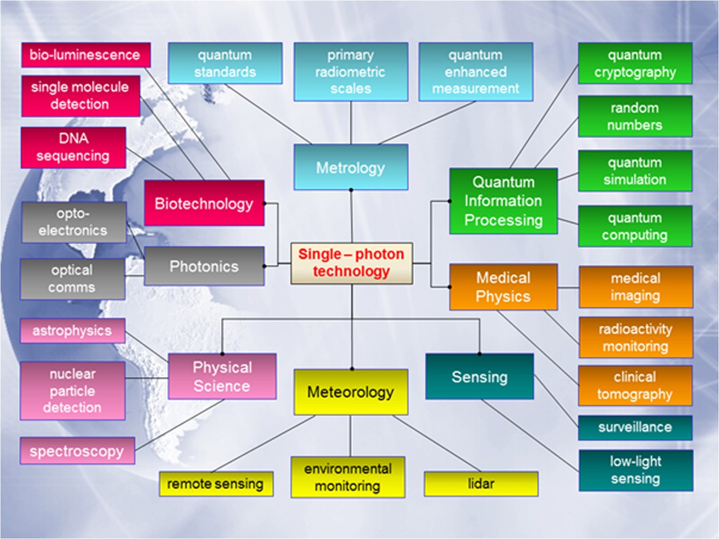
Single Photon Technology and Applications
Miftek developments
Deadtime-less photon sensor
Flow standards?
Photon Cytometry
Biophoton detection
Nano-particle detection
TCMPC
Time-Correlated Multi-Photon
Counting Analysis
UPC
Underwater Photon
Communication
FL Bronchoscopy
LIPS
Laser Induced Photon
Spectroscopy

Slide 2
Technical Achievements within the last 24 months
Preliminary Data Collection Software
PhotonAnalyzer - Operational
Signal Connectivity Cables
30pins Coaxial Cable/Connector design & Prototype
Sourced and identified new supplier with specific cable requirements (size and speed requirement)
Integrated Plug’n’Play Laser
Identified manufacturer and had prototype unit manufactured
tested and verified performance
Designed and tested fluorescence lifetime electronics using our single photon sensor
Four Issued US patents in last 24 months, 2 continuations (0013) on single photon detection
CytoSpectrum optical configuration verified for photon cytometry
Designed and manufactured final 42 ch optical fiber control unit – test and operational
42CH Spectro-sensor Unit to detect 350nm to 800nm spectra at high speed
Final design confirmed
Costing established
Sourcing of all parts
8CH/42CH Sensor board Design
Prototype 8 ch board constructed
Identified minor issues to modify design
Tested 8 ch system - verified
8CH Electronics Test Board at 10Gs – tested
12CH board under development – new FPGA higher speed
lower cost, lower power consumption

Slide 3

CytoSpectrum optical configuration for Photon Cytometry
Multi-laser
module
42CH Spectro-sensor
Beam combiner
Fiber array
Top-hat
Beam shaping
focusing
Particle
Detection
FS/PD
Flow chamber
Spherical Mirror
Parabolic mirror

Slide 4
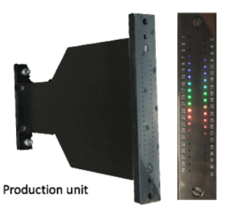
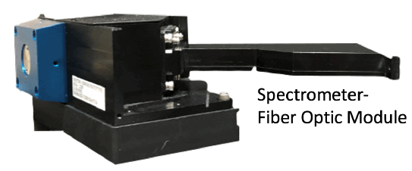
42CH Spectro-sensor Unit to detect 350nm to 800nm
Spectrometer and fiber optic array are physically connected
No alignment for fiber unit
Sensor is attached to fiber array, so no alignment is necessary

Slide 5
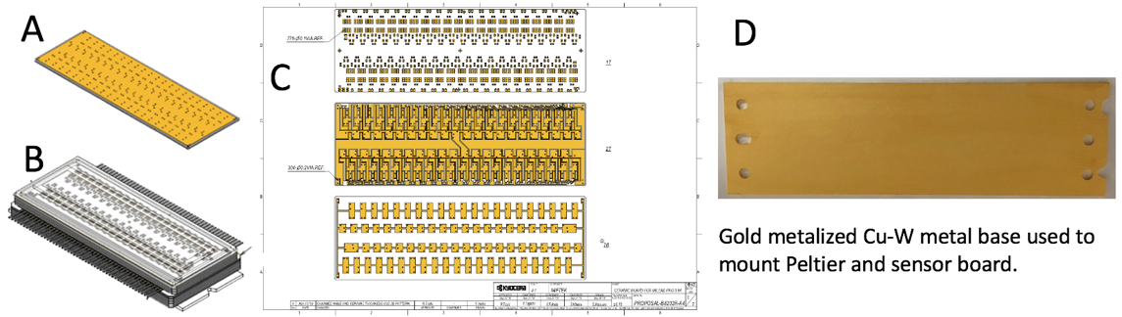
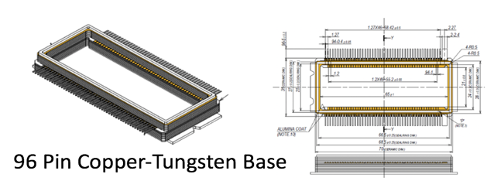
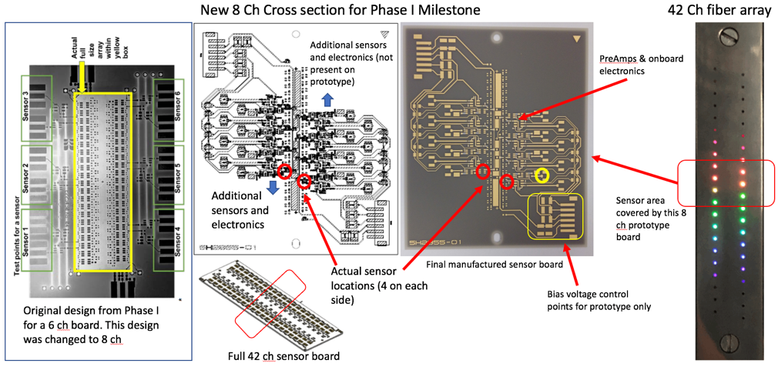
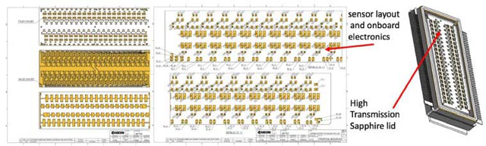
8CH/42CH Sensor board Design and Prototype
Single Channel sensor developed and tested
8 CH prototype developed and tested
42 CH designed but not manufactured
Board Schematic
8 Ch Test Prototype
Board Physical Design – 96 Pins

Slide 6
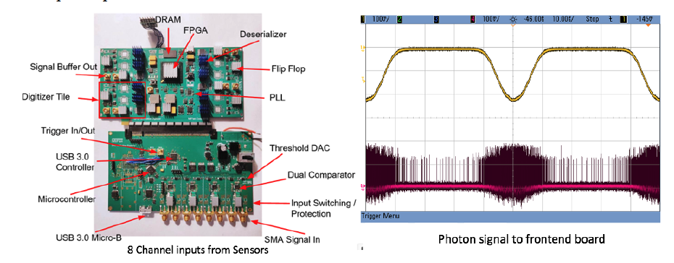
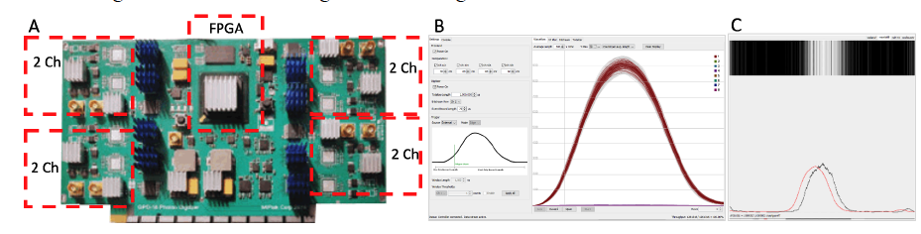
8CH Photon Digitizer Board: confirmed 10Gs (100ps resolution)
Utilized custom designed FPGA board for initial testing
Unit required two additional board – including a deserializer board
Data collection demonstrated at very high speed for single photon

Slide 7
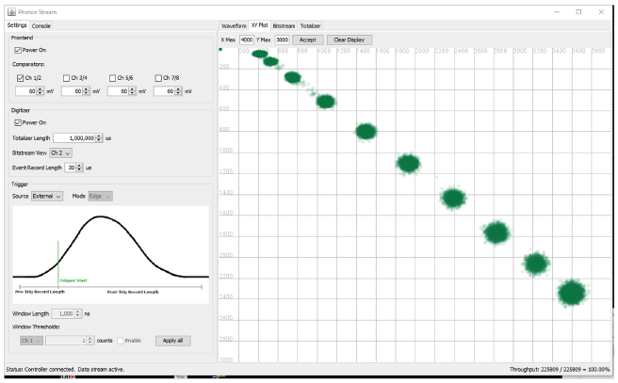
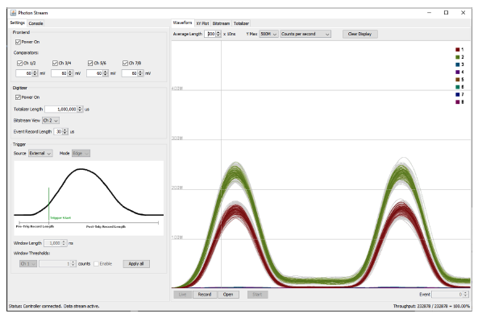
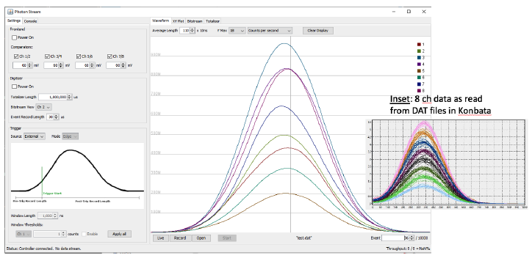
Preliminary Data Collection Software - PhotonAnalyzer
Inhouse Software for data collection developed
Tested for up to 8 channels

Slide 8
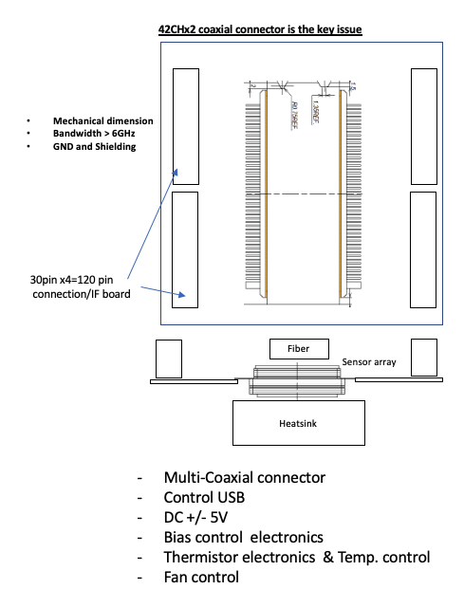
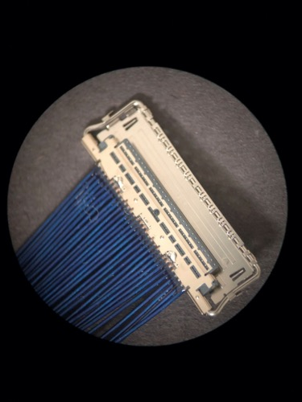
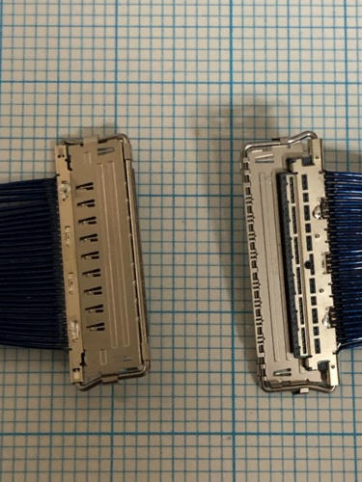
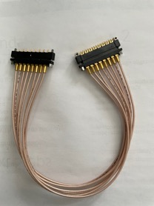
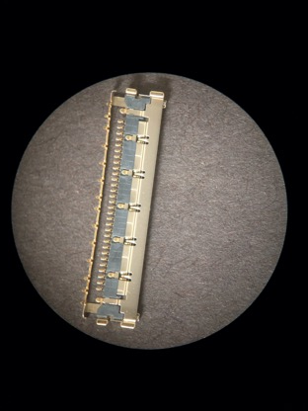
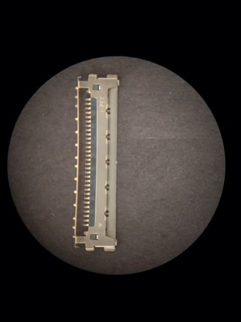
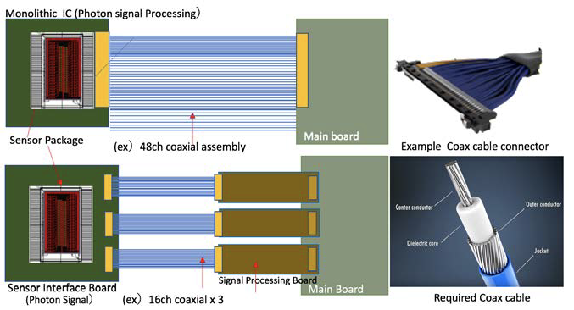
Photon Signal Connectivity Cables - 30pins Coaxial Cable/connector design & Prototype
Reasoning
1. Current data cables are too large
2. Current cables must be a precise
length for every channel
3. Custom cable must be
manufactured as shown
Current Data
Cables are too large
New Design concept
for Data Cables which
must have high
signal protection
Prototype connectors
We have a test cable
already manufactured

Slide 9
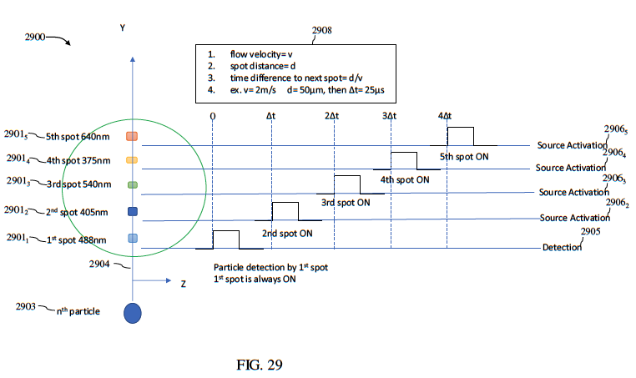
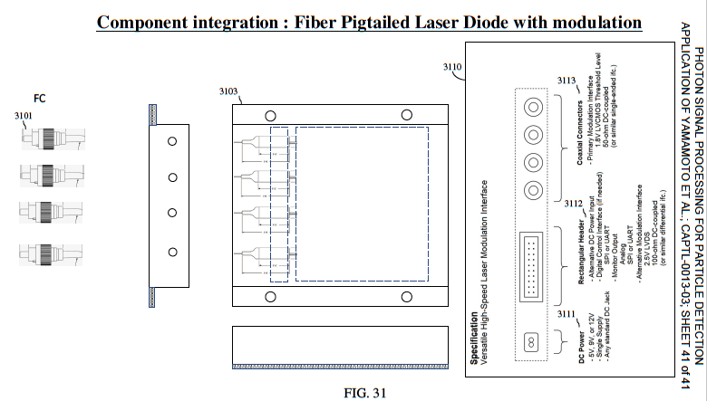
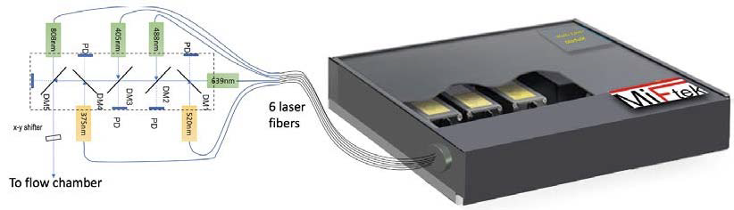
Multiple Laser Collimator Unit
New Features
Plug’n’play lasers
Modulation with First laser always on (IP submission)
Triggering using 808 nm laser (IP submission)
Single fiber to Chamber (IP submission)
Lifetime on all lasers (except first)
Modulation reduces heat generation
Modulation removes cross laser noise
Submitted IP under Review
6 x plug’n Play lasers will be in a single box.

Slide 10
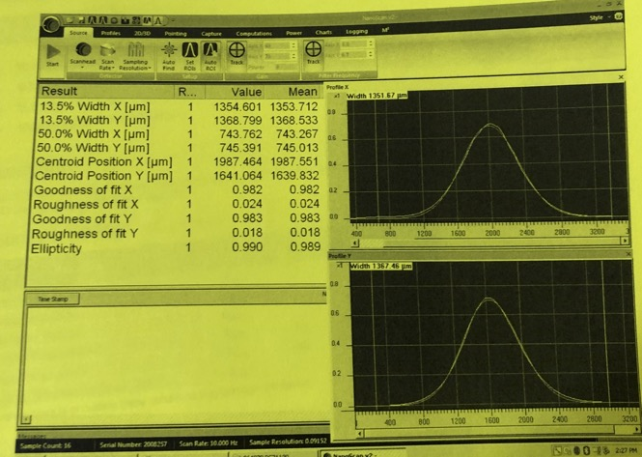
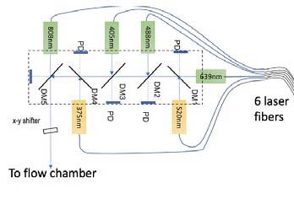
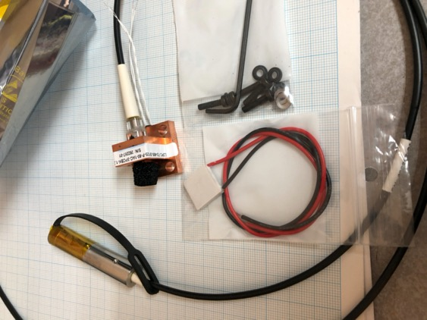
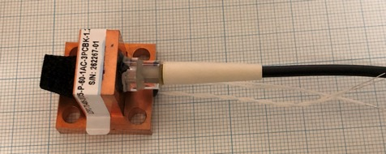
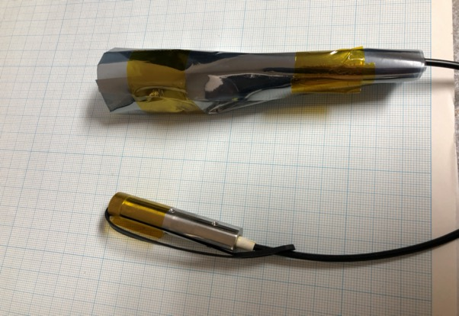
Unique Multi-Laser Unit
Good quality
Beam profile
Laser head
Prototype Plug’n’Play
Laser unit
Collimator

Slide 11
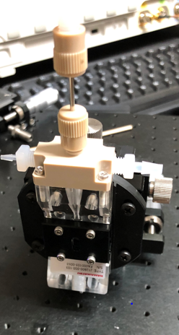
New Approaches under Development
1) Replace Current FPGA with Cyclone 10GX
2) Integrated Peltier Chip Cooler
3) Flow Chamber and collection optics
3) Laser Optical Unit
4) Time Correlated Multi Photon Counting Analysis

Slide 12

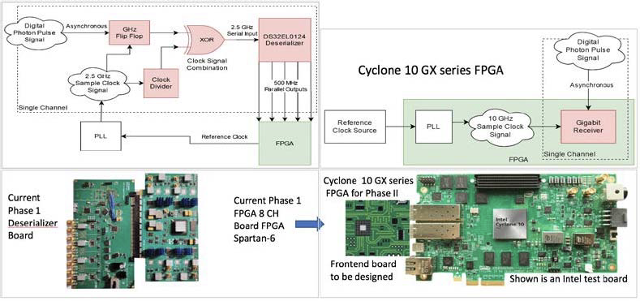
Replace Current FPGA with Cyclone 10GX
Reasoning
Faster Unit
Lower cost
Lower power consumption
12 channel/chip instead of 8
New Generation with 10-15 year life expectancy

Slide 13
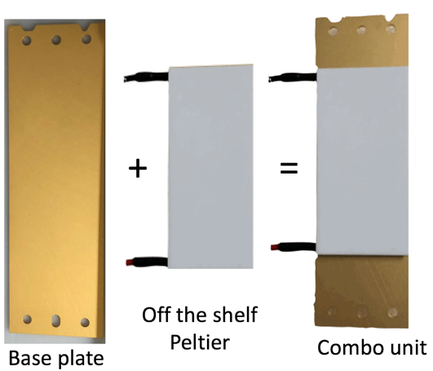
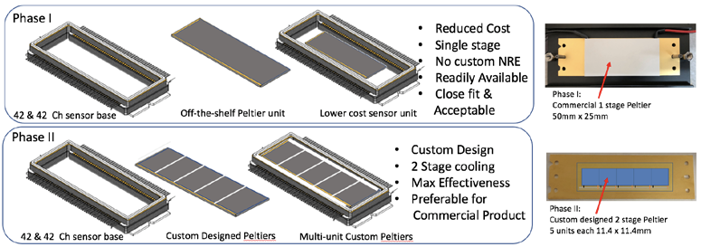
Integrated Peltier Chip Cooler
Reasoning:
Chip cooling is essential for sensitivity
cooling must be efficient – ie on sensor itself
Electronics on board is also cooled
Must have optimum heat dissipation
Peltier Cooling system

Slide 14
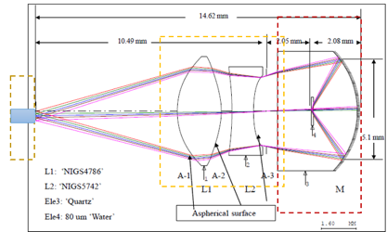
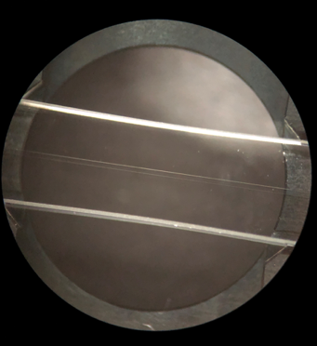
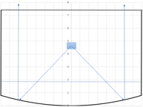
Flow Chamber and Collection Optic for higher efficiency and less-aberration
Spectro-sensor
(reflective)
Spectro-sensor
(transmissive)
Flow channel
Finite to infinite optics
Without aspherical lens
Less aberration
Less λ-dependence
Original Design
Spherical Mirror
Modified Design
Parabolic Mirror

Slide 15
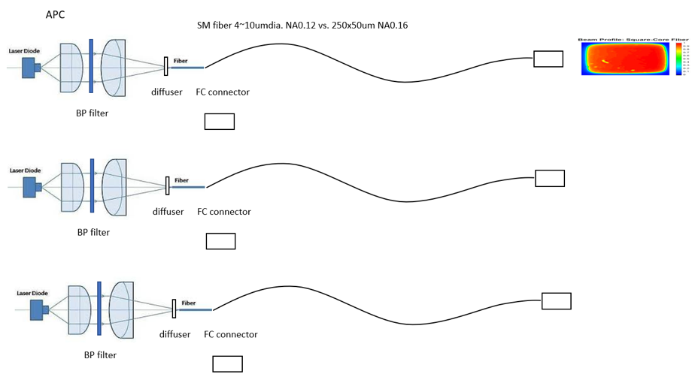
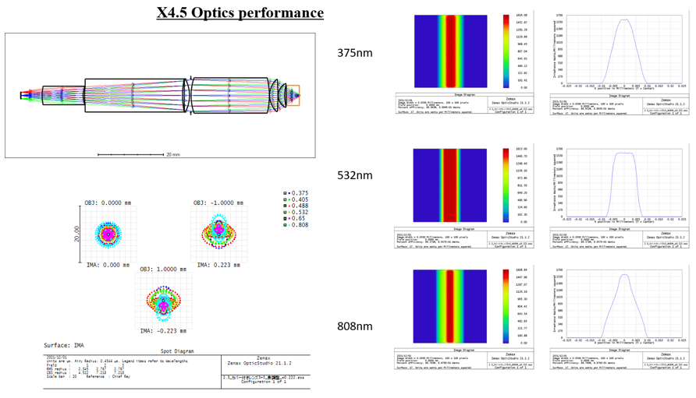
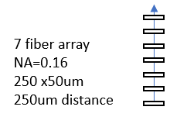
Integrated Plug’n’Play Laser & rectangular fiber array
Reasoning
Lasers are the single highest cost component of flow instruments
Developing a unique laser module will reduce cost
Complete laser unit is plug’n’ play – easily replaceable
No alignment for lasers when replacing or adding lasers
Wavelength exchange-able and fixed spot distance

Slide 16
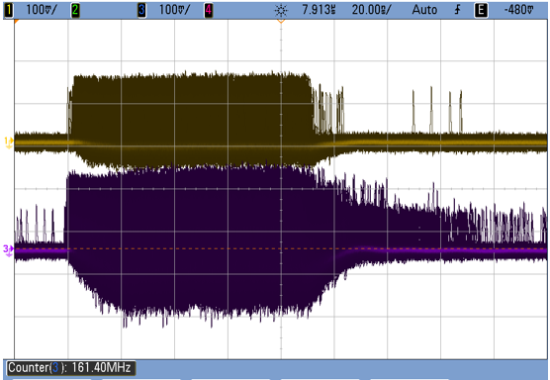
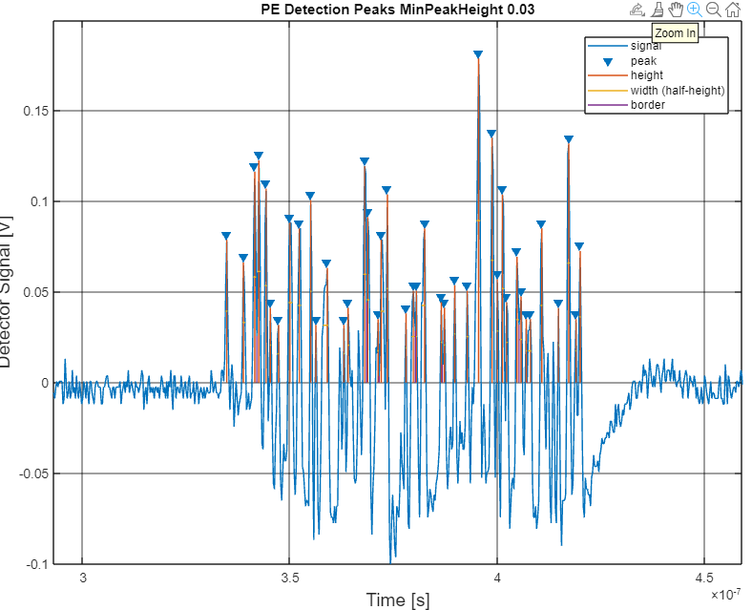
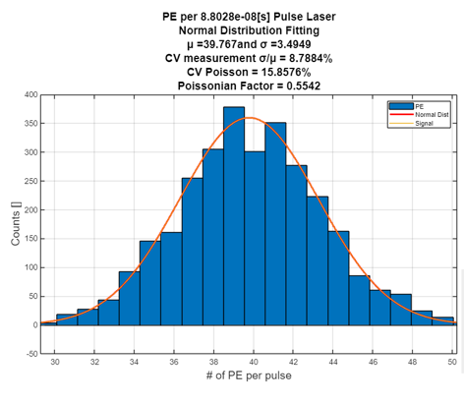
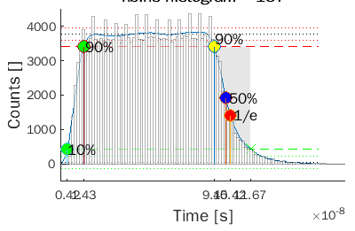
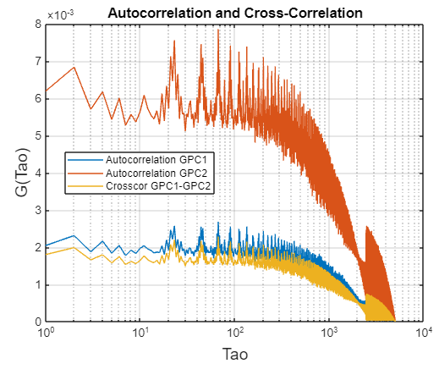
Time Correlated Multi Photon Counting Analysis by PE capturing & MATLAB
Statistical Analysis of SI intensity, decay and photon correlation from PE-PE stream
Digital
Oscilloscope
BIN file
4Gs
MATLAB
Peak
detection
EX-PE
EM-PE
Intensity analysis(SI)
Decay analysis
Correlation analysis

Slide 17
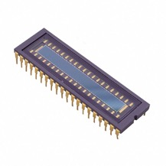
3rd Generation Features under consideration
IMPACT
New Spectrometer concept
New Fiber optic collection
optic Concept
3. New single photon Senor
chip concept
IP protected
Lower production cost
Small more compact
IP protected
Higher efficiency
unique for multi
wavelength collection
IP protected
High Channel #, smaller
Integrated into Spectrometer

Slide 18
Issued US Patents
US Patent: 9,372,143 B2 “Scanning Image Flow Cytometer” issued June 22, 2016
US Patent:10,036,698 “Time Sequential Cytometry” Issued July 31, 2018
US Patent: 10,613,096 “Multispectral microparticle fluorescence photon cytometry” 11/18/2019
US Patent: 10,775,292 “Multiple-spot time sequential Cytometry” Issued September 15, 2020
US Patent: 10,900,885 “Flow cytometry using Hydrodynamically planar flow” 1/26/2021
US Patent: 11,187,584 “Photon Counting and Spectroscopy Issued 11/30/2021
US Patent: 16/908/638 US20200400547A1 “Photon Signal processing for Particle Detection” Notice of
Allowance (10/15/21) (issued (02/03/2022)
Issued Japanese Patent
2016-514059 – “Image flow cytometer, system, and method” issued Aug 22, 2017

