Slide 1

Liquid Biopsy and MIF update for Roche
Jan. 31, 2015
M. Yamamoto
J. Paul Robinson
Ｃｏｎｆｉｄｅｎｔｉａｌ

Slide 2
IP Migration for “Next Generation Cytometry” Paradigm shift forwarding new cellular/intercellular analysis
Concept
Key technology
Features
Smaller Spot Cytometry:
US filed in May ,2013
Filed in EP & JP Jan. ,2016
Smaller Spot than cell/particle
Aberration-free Flow Chamber for Diffraction Limited Optics
Absolute shape & dimension
Smaller spot cytometry
High speed laser
scanning
Unique spatial location & Sensitivity
1st IP
High speed devices
& electronics
3D intra-cellular image
Multiple Cell Cytometry:
US filed in Dec.,2014
+ provisional
Hamamatsu Joint IP : combined PCT submission on Dec.,2015
Hydrodynamic
Focused Plane
2D Hydro-focus
Flow Chamber
High throughput
μ-fluidic chamber
2nd IP
2-1 IP
Multiple Cell cytometry
Time Sequential Cytometry:
Provisional Jun.19,2015
3 Spots Scanning
3 spot scanning
Perpendicular to flow direction
Accurate flow velocity & V-scan
3rd IP
Cell Tracking
flow-axis linear
movement
Time frame
observation
Time Sequential cytometry

Slide 3
IP continued
Concept
Key technology
Features
Quantitative Micro Vesicle
Measurement Platform:
(US provisional Apr.,’15)
Nanoparticle detection
on reflective phase grating
Focused scanning
Laser spot on
Reflective phase
Grating in microfluidic channel
Measurement of
10~1000nm particle
quantitatively
4th IP
Micro particle cytometry
Single Photons Spectroscopy:
(US provisional Aug.28,’15)
Multi-color Fluorescence detection
by single photons
Focused Flying spot excitation and single photons detection
with spectro sensor
Analysis Fl of microparticles
and its origin
5th IP
Single Photon cytometry
Reflective Flow Chamber with in-focus gap & Optics
Reflective Chamber & Optics
Double path detection & conjugate optics
Reflective cytometry
Reflective cytometry
6th IP
Photo Reactive Cytometry:
Photo-reactive
Exposure
(Cell Cooking)
Higher power or
Different λ
Active Exposure
on cell map
7th IP
Micro Phase Imaging Cytometry:
Microscopic
Phase detection
Interferometer
optics
Refractive Index
Thickness mapping
8th IP

Slide 4
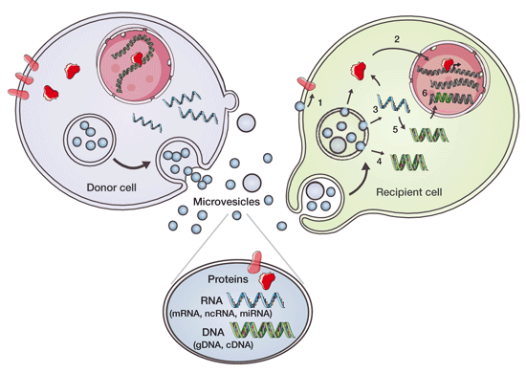
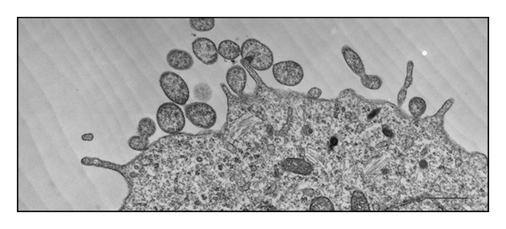
Micro vesicles:
Transmission electron micrograph of the microvesicle shedding process from B16 mouse melanoma cells. Scale bar: 500 nm (personal original unpublished data) : web source
Gesicles: Microvesicle “Cookies” for Transient Information Transfer Between Cells
Xandra O Breakefield, Robert M Frederickson and Richard J Simpson

Slide 5
The Key Issue : How to detect/observe micro vesicles to 10nm ? (beyond optical resolution)
<Conventional method>:
1) electron microscope: possible to observe nanostructure. Dry and dead in vacuum.
2) Brownian motion detection in suspension : commercialized as NanoSight.
3) Scattering : Flow cytometry or nanoparticle analysis instrument by scattering.
widely used, but limitation of detection size. Normal flow cytometry is
detectable >500nm. Nano particle analyzer is very complicated.
Advantage is possible to evaluate in suspension.
<Current status on micro vesicle measurement>:
There is no appropriate way to evaluate micro vesicle in clinical environment.

Slide 6
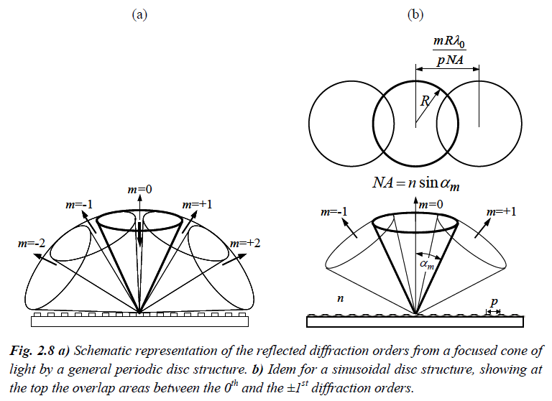
Theory: Diffraction by reflective phase grating
m=±1 order is possible to capture at λ/p < 2NA :
CD : λ/p= 0.78/1.6 =0.487 < 2NA=2x0.45=0.9
DVD: λ/p= 0.65/0.78=0.833 < 2NA=2x0.60=1.2
Blu-ray: λ/p= 0.405/0.32=1.265 < 2NA=2x0.85=1.7
( “Near-Field Optical Data Storage”: Ferry Zijp, Philips,2007, ISBN978-90-9022391-9/NUR926), P.11

Slide 7
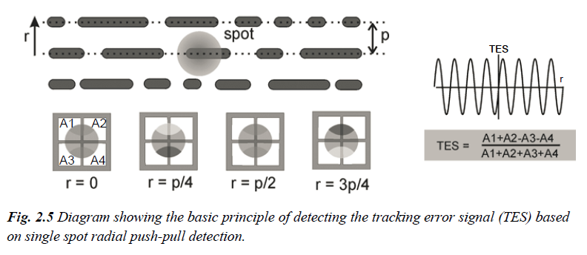
Detected signal from phase grating(Push Pull Signal)
(A1+A2+A3+A4) = HF signal
(A1+A2) - (A3+A4) = Radial Push Pull
(A1+A3) – (A2+A4) = Tangential Push Pull
R-PP
T-PP
( “Near-Field Optical Data Storage”: Ferry Zijp, Philips,2007, ISBN978-90-9022391-9/NUR926), P.7 modifiy pit to groove)

Slide 8
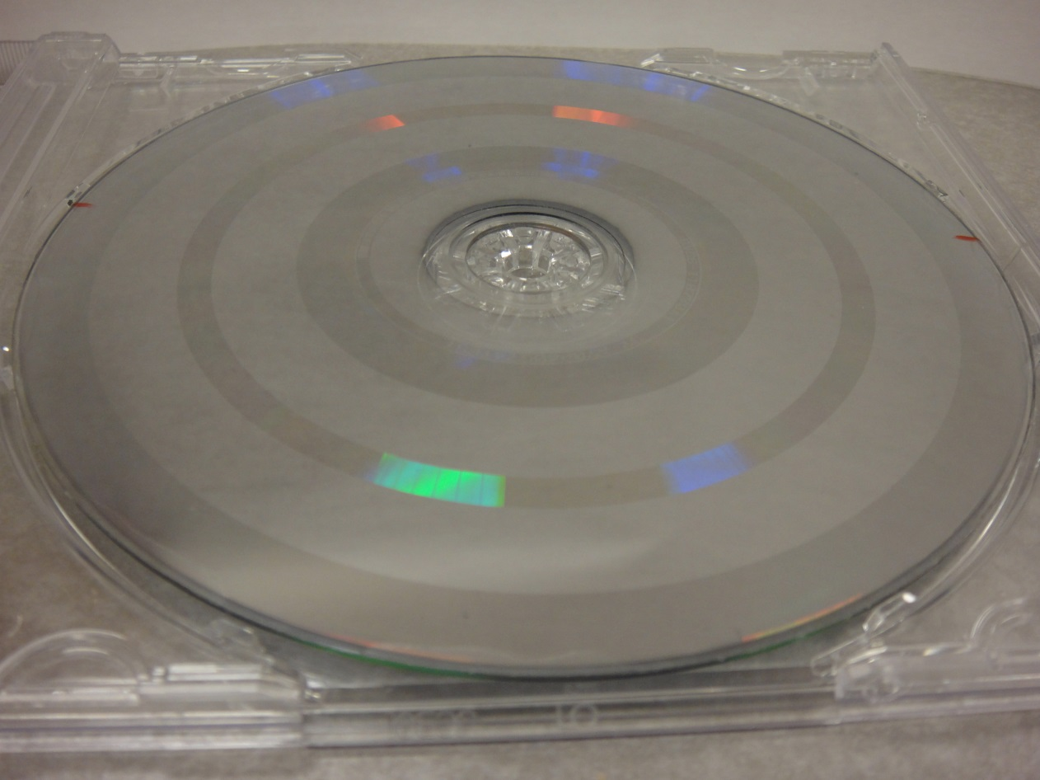
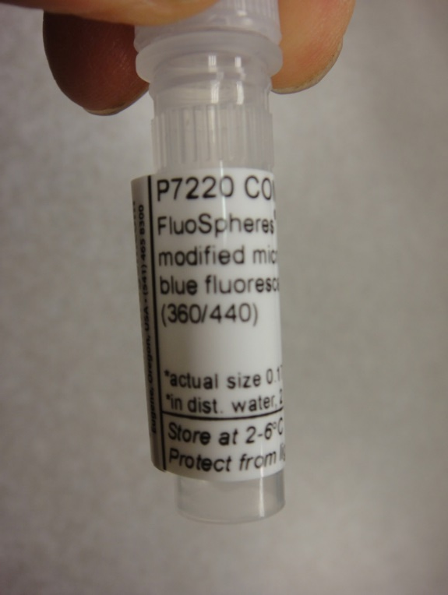
Experimental Disc with pitch 500nm L/G
Groove Zone r=38-42mm
Particle samples
Sample drop
Sample drop
Concentration ~E9/ml
~E6/ul
~E5/0.1ul
Drop and dry takes 3 ~8min.
Drop area is 5~6mm – hydrophilic or groove effect ?

Slide 9
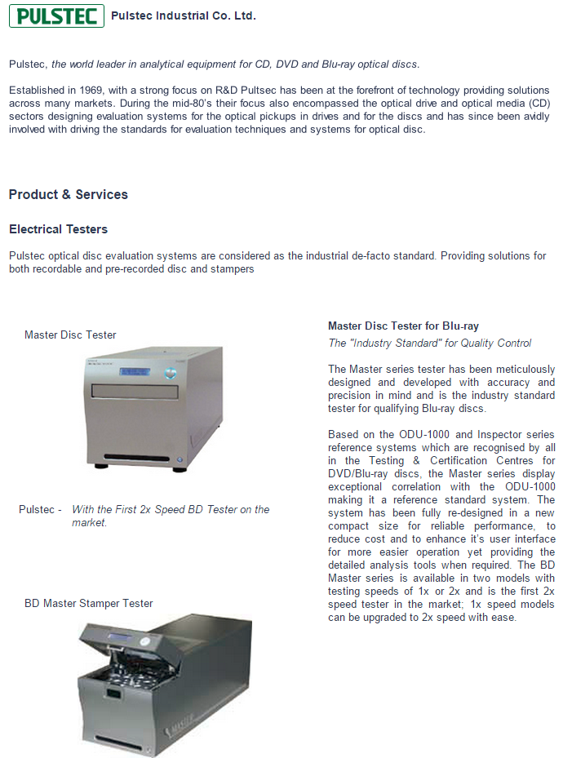
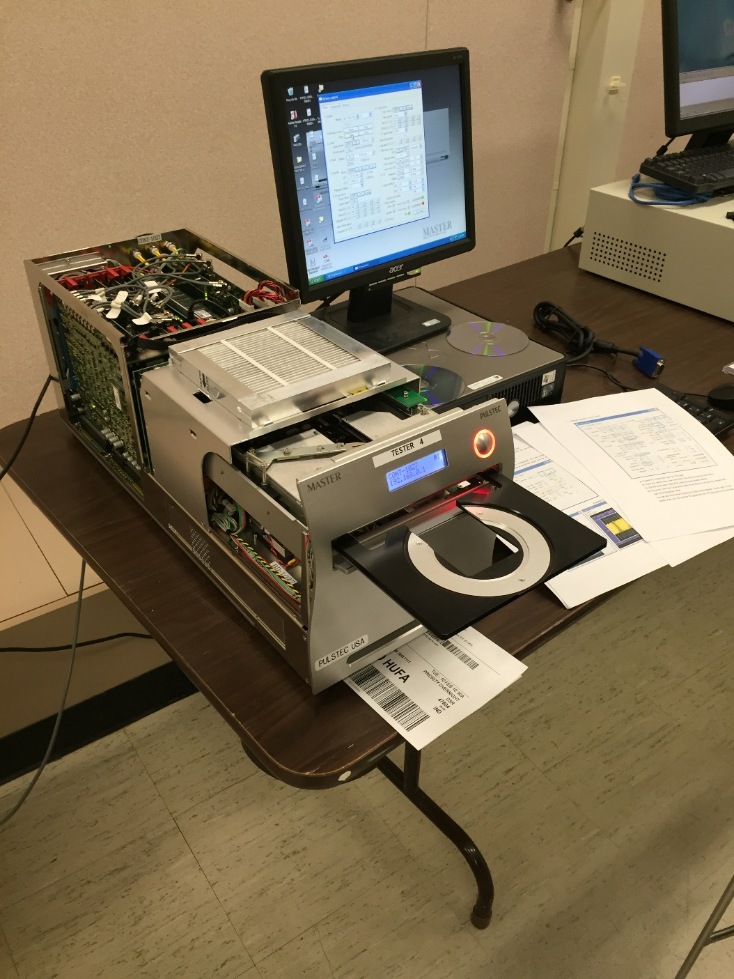
Signal detection by Blu-ray Tester

Slide 10
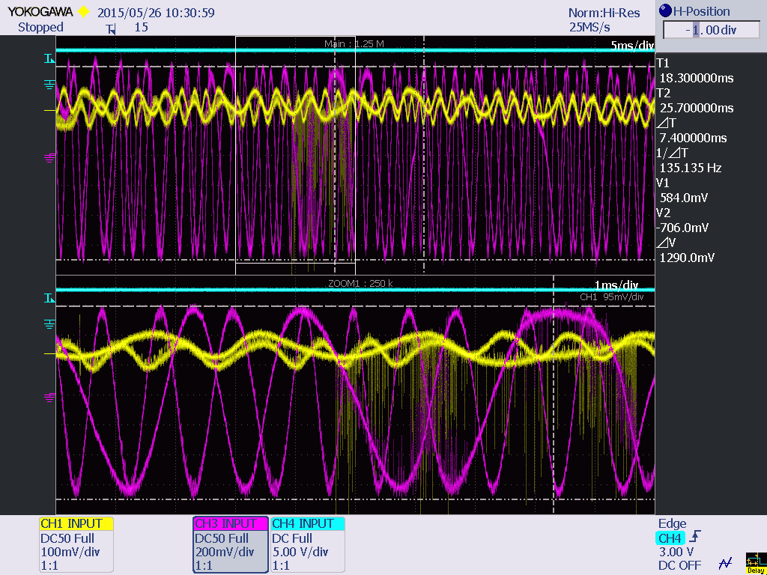
HF(Yellow) & Push Pull(Red) Traverse signal

Slide 11
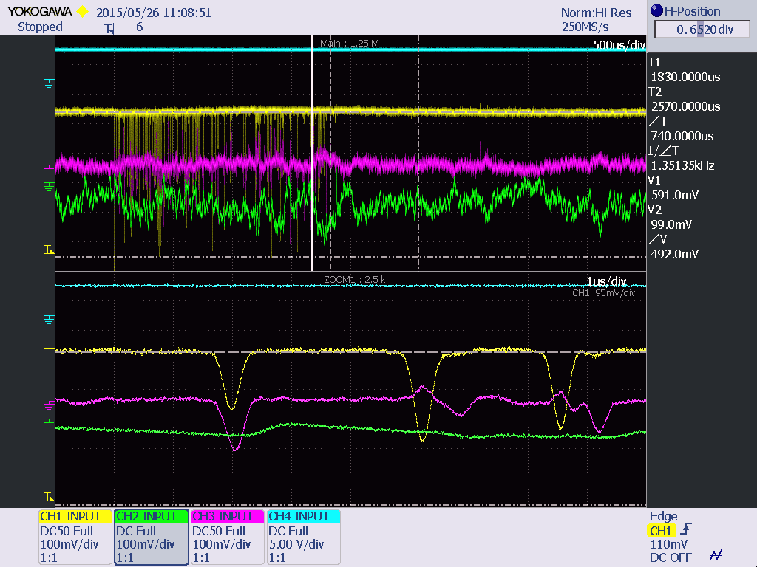
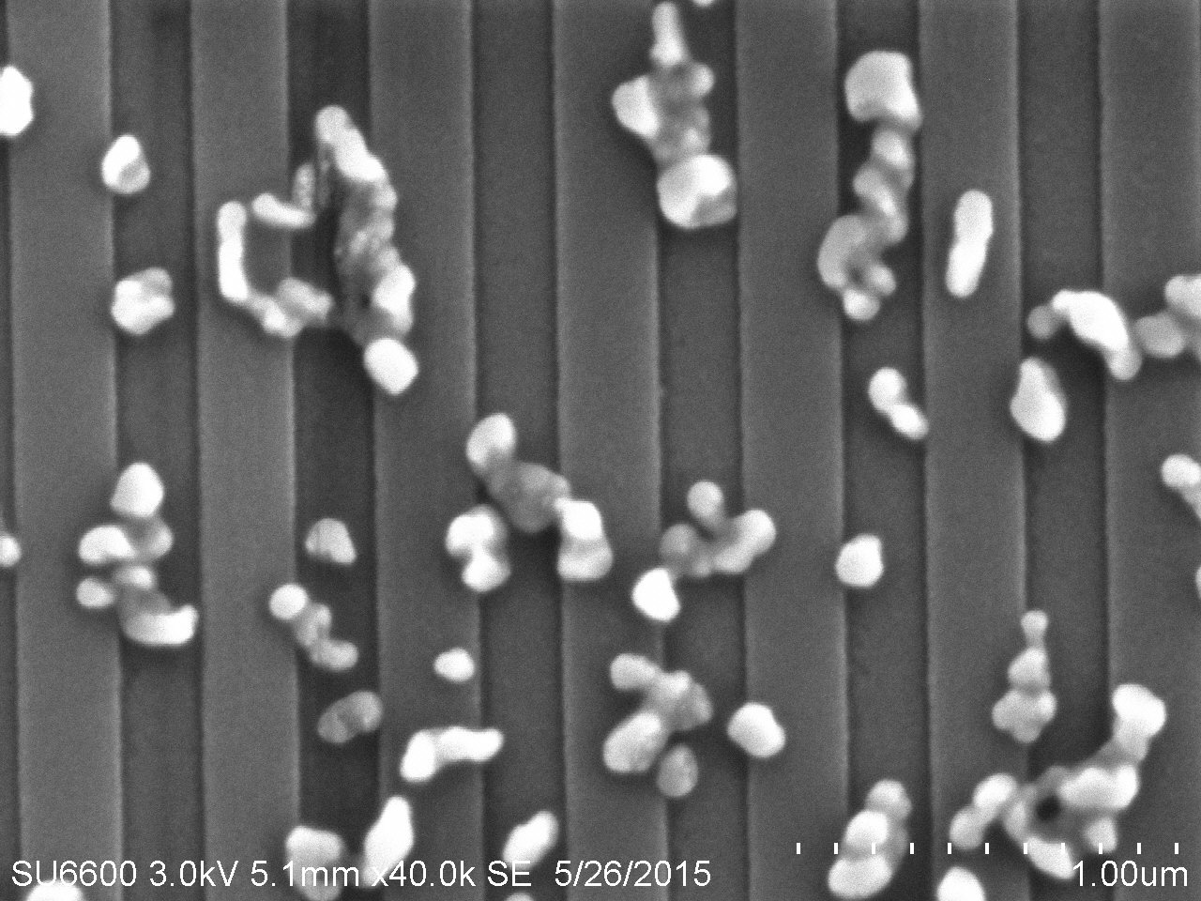
Au 100nm detected signal & SEM picture:
Au 100nm HF & PP
Au 100nm SEM
HF
PP
HF
PP

Slide 12
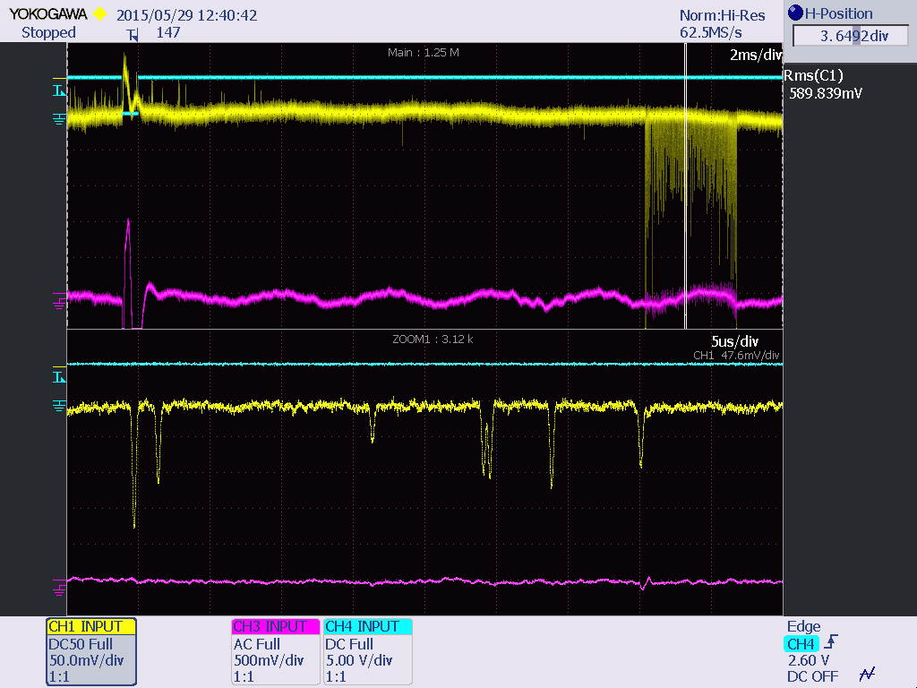
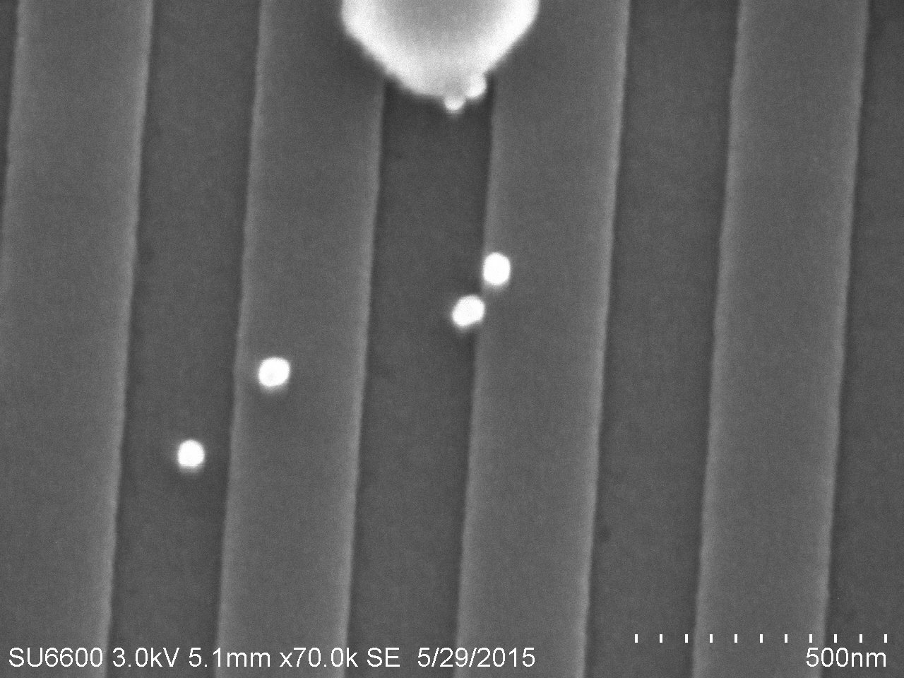
(2) Au 50nm detected signal & SEM picture:
Au 50nm HF & PP
Au 50nm SEM picture

Slide 13
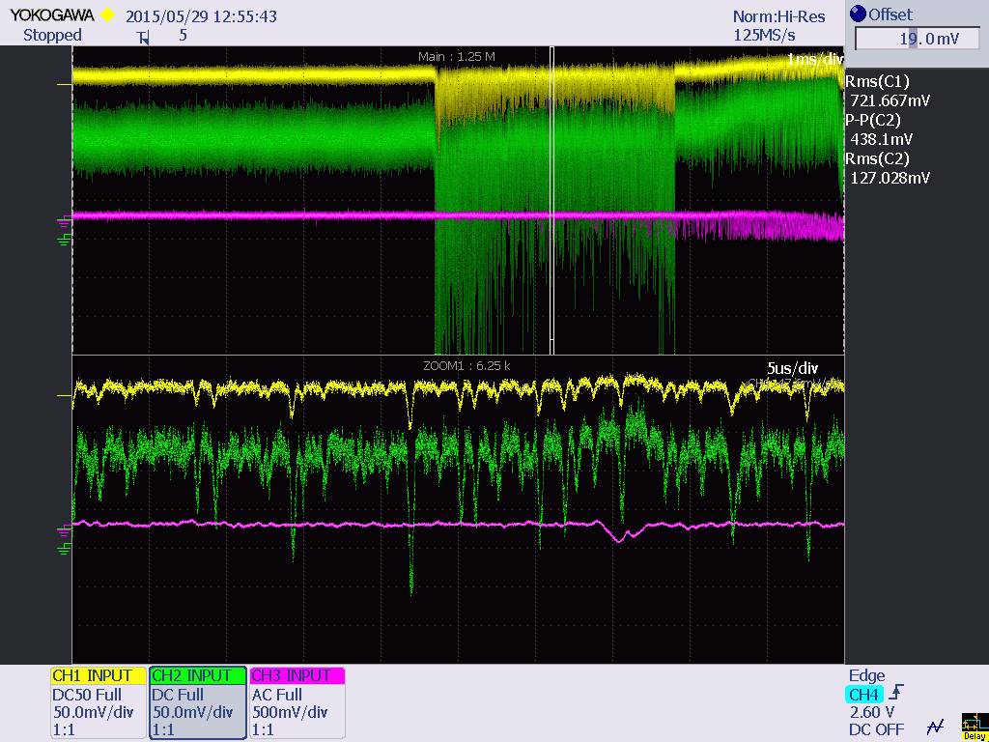
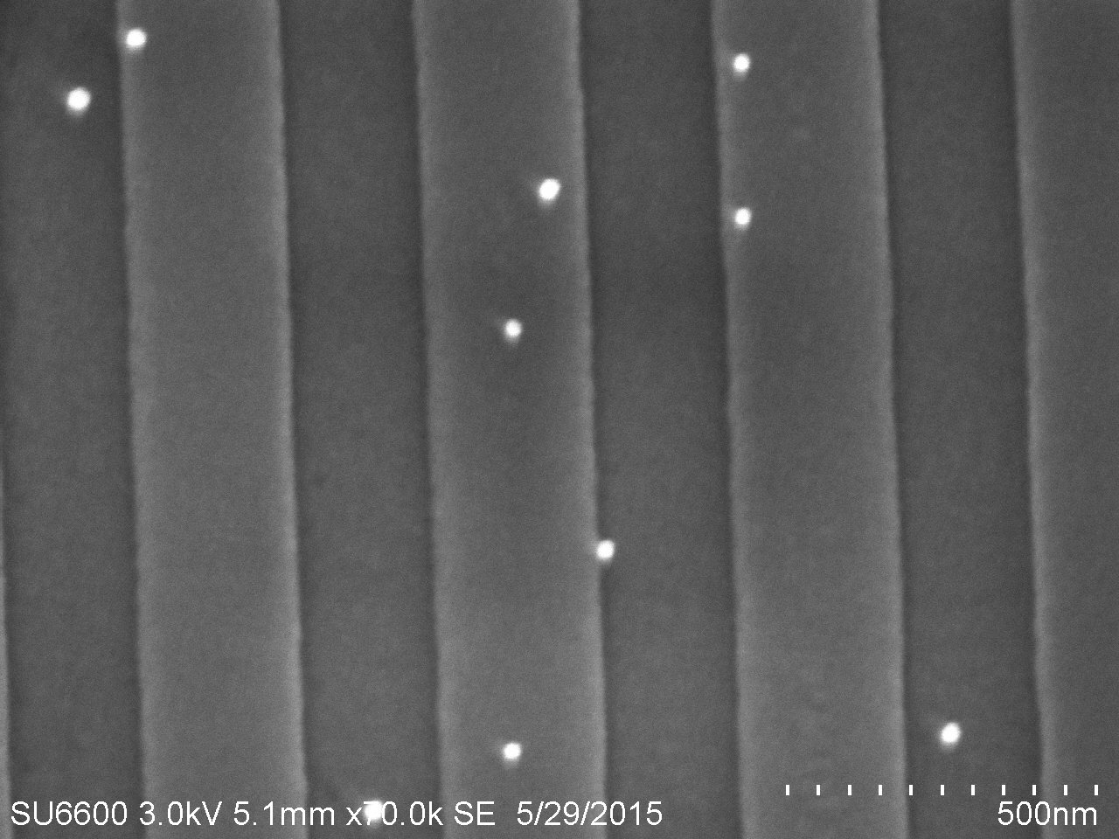
Au 30nm detected signal & SEM picture:
Au 30nm HF & PP
Au 30nm SEM picture
HF OUT
HF EQ
OUT

Slide 14
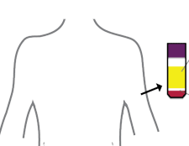
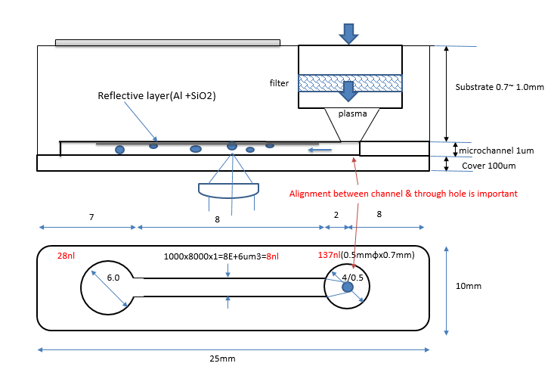

Liquid Biopsy Work Flow
Liquid biopsy
Sample IN
Whole blood
Cell Separation
staining
Microvesicles
Measurement
Slide glass shape LOC
Disk shape LOC
Sorting
PCR
Targeted
Sequencing
X-Y scanning
R-θ scanning

Slide 15
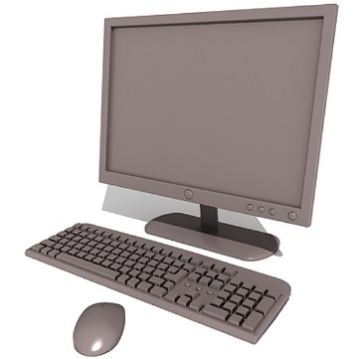
Quantitative microvesicles measurement system
Spectro Sensor
PMT
PMT
Optical Fiber
PMT
> 100kHz
HF
R-PP
T-PP
405nm
Detection
Fluorescence
Focus &
Tracking Error Signal
< 50kHz
A/D converter
Disk type
405nm
laser
Servo Drive
FPGA
Memory
Slide type
CPU
Land
Groove
405nm NA0.85
Focused spot size = 0.39 um(1/e2)
Micro vesicles
in medium
(plasma)
Reflective layer
Polymer substrate
500nm pitch
groove depth : 38 nm

Slide 16
Microvesicle Disk cross section:
Whole blood after pealing protective seal
Label – product, instruction, logo, etc.
Microchannel zone
with reflective grating
filter
Substrate 1.1mm
plasma
microchannel ~um
Cover 100um
Plasma 1ul =1E9 um³= 10E7 Microvesicles
In case of gap 1um, measurement area:
1E9 um² = 1,000mm² =31.6x31.6mm
In case of 1millions particle. Measurement area:
10mm²=3.16x3.16mm
Disk r=38~42mm, area= 2010 mm²
Focus depth=λ/NA²=0.56um

Slide 17
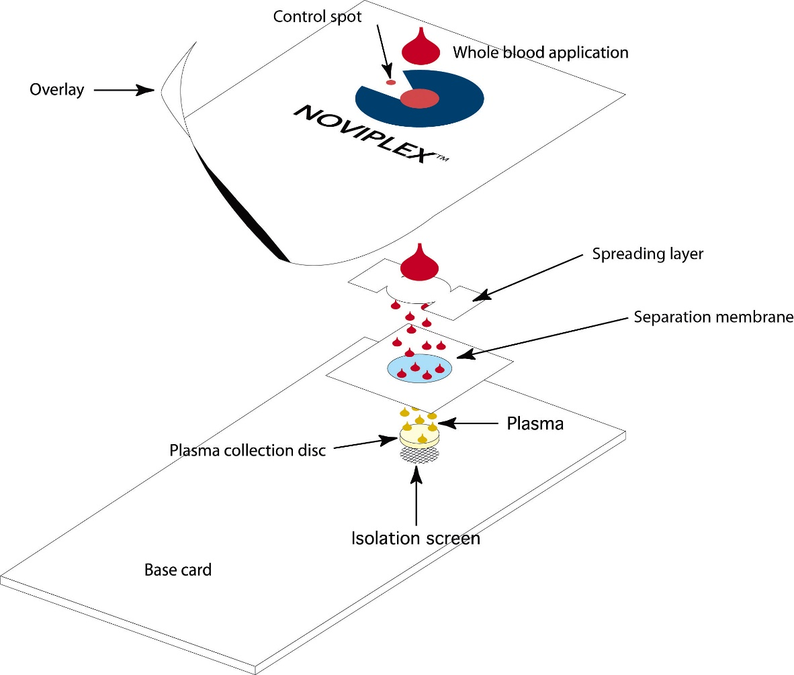
Plasma extraction (Noviplex): plasma/whole blood ~ 1/10
https://www.ssi.shimadzu.com/products/product.cfm?product=noviplex
1ul whole blood
→ 0.1ul plasma
→ 1E7 microvesicles
→ 100mm²/um gap area
→ 10x10mm area

Slide 18
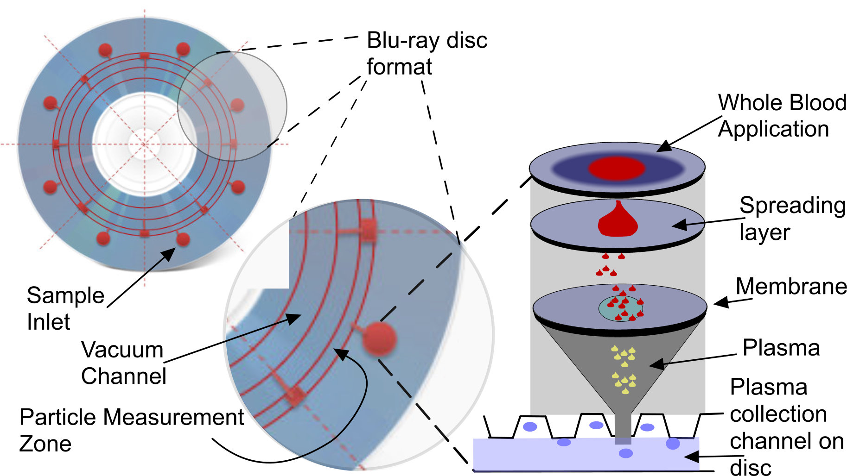
The relationship of the disc and the filter system and separation of plasma containing microparticles

Slide 19
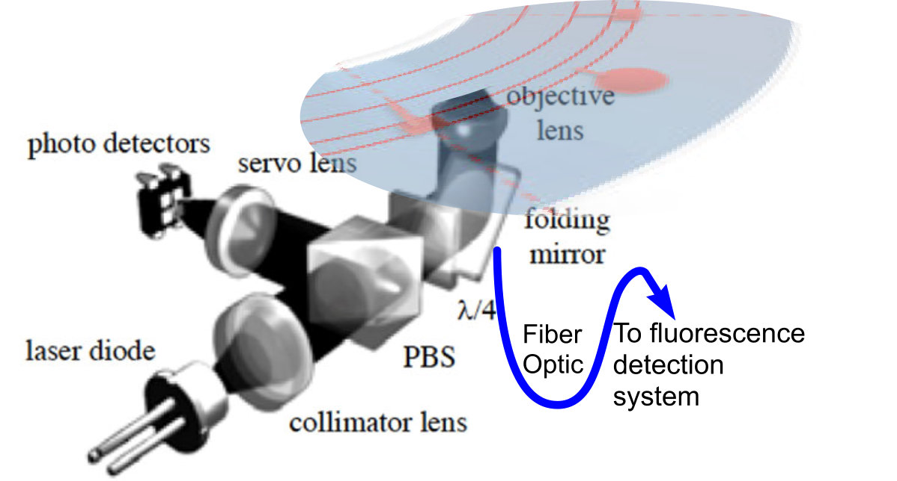
Showing how the read head would interact with the disc and its measurement location

Slide 20
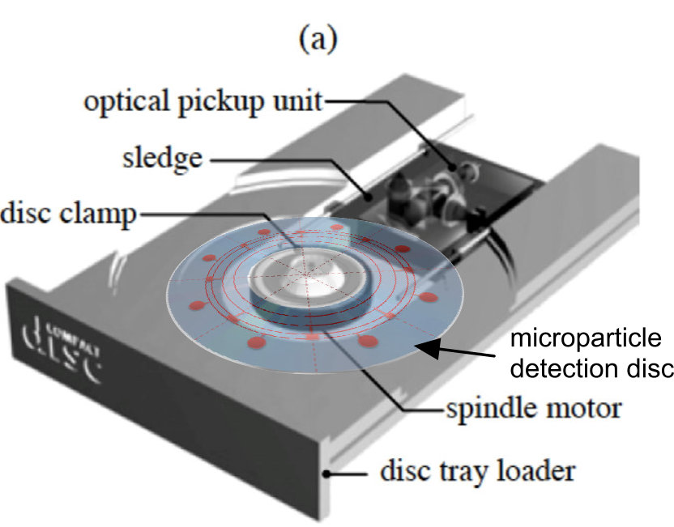
Example of possible reader unit with disk inserted

Slide 21

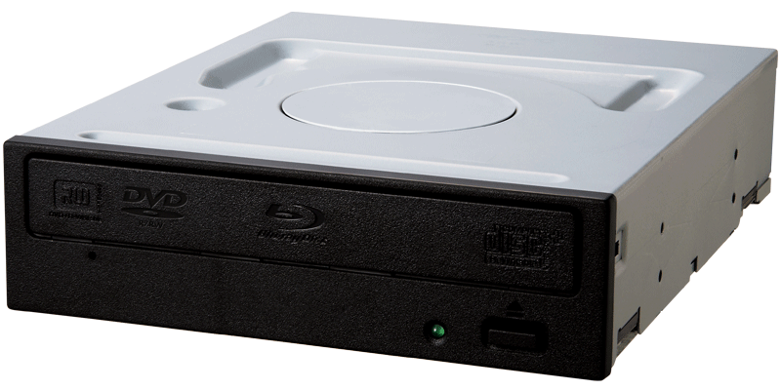
Pioneer Drive is available in Feb. under NDA
Pioneer provides drive control software.
-individual servo control is possible.
BDR-209DBK

Slide 22
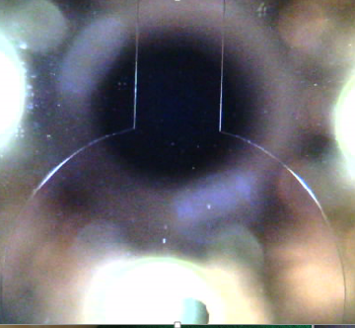
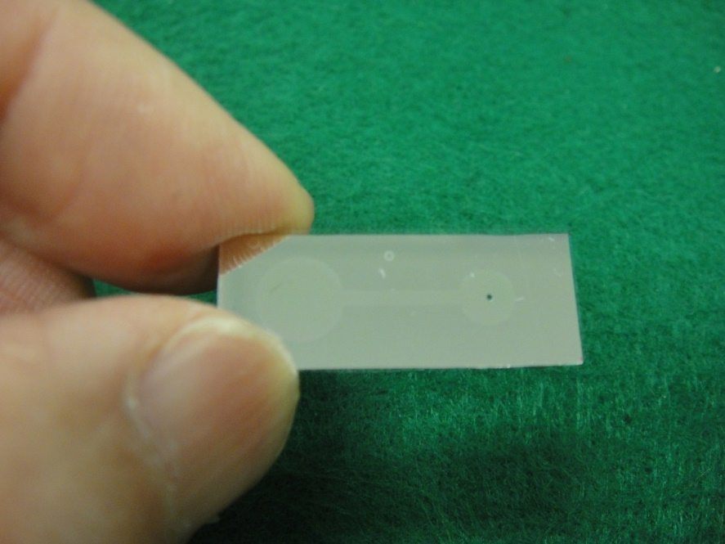
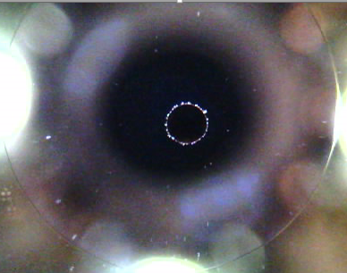
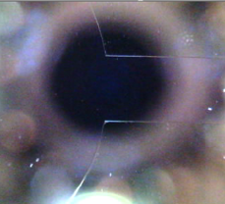
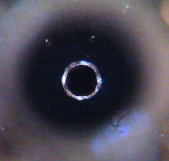
Disposable Glass Chip with 1um gap
Inlet channel
Inlet 0.5mm & 1um gap
Reservoir channel
Inlet hole sub-side
0.5mm dia.

Slide 23
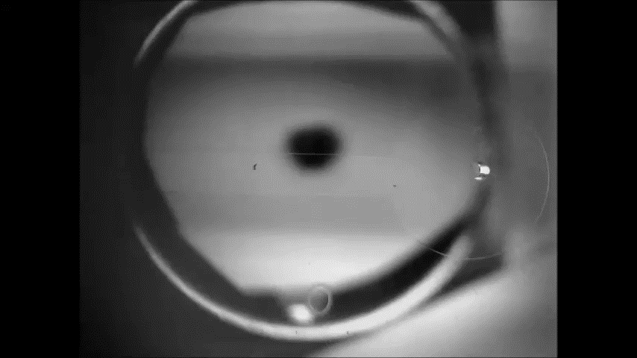
Channel Filling Flow : ~3mm/s(impressive !!)

Slide 24
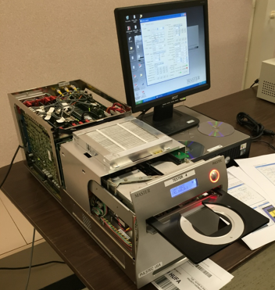


DADC Disc Manufacturing for Liquid Experiment:
DADC developed special substrate with ~um gap channel with 500nm L/G.
100um glass cover is applied for 1st experiment.
1st experiment is planned at Purdue Technology Center soon.
DADC kindly provides Disc, BD MASTER(reference drive) and Digital Oscilloscope.
We will prepare several samples;
- gold nanoparticle - Polymer nanoparticle
- IgG albumin
- Microvesicle/Plasma and different refractive index medium
- others
6. This is the first liquid evaluation by 250nm FWHM spot/405nm.
BD MASTER can evaluate both chip & disc

Slide 25
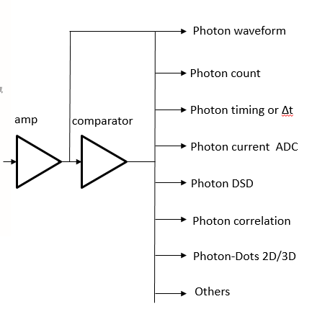
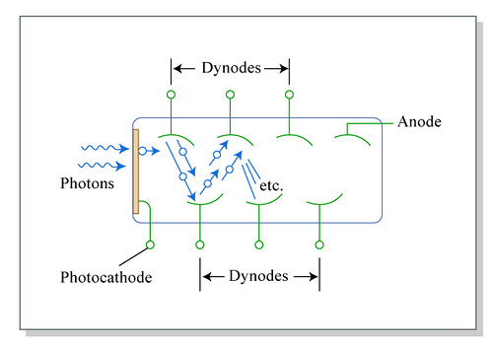
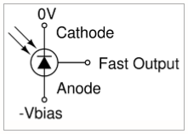
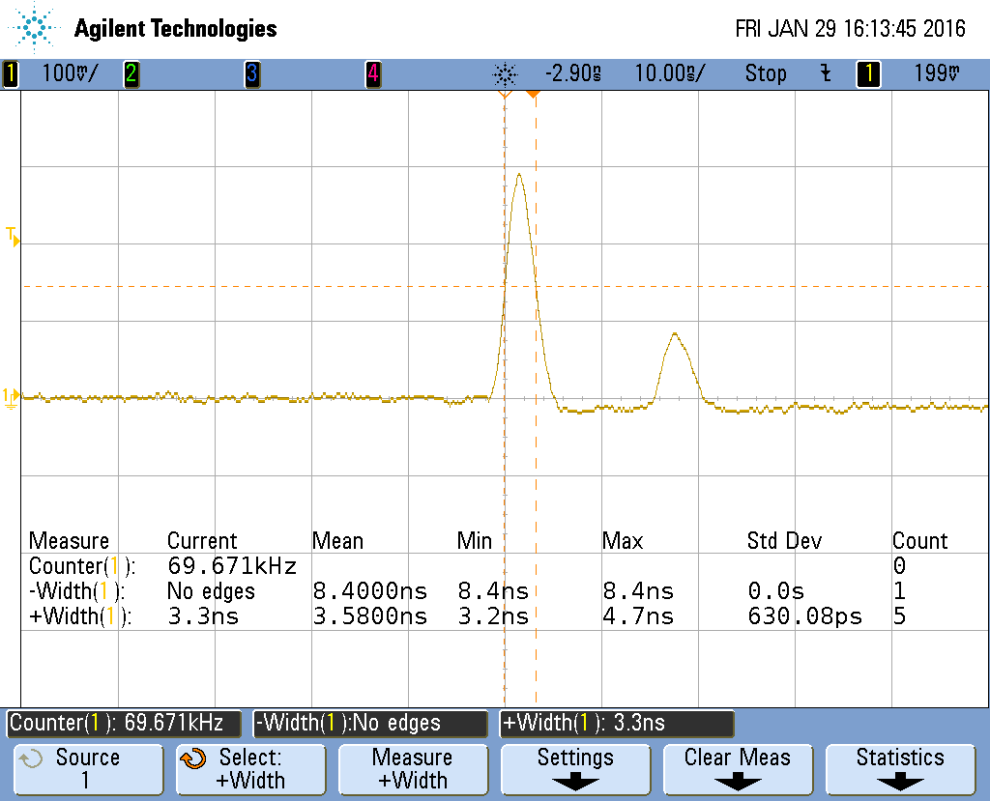
Photon Detection <1ns or ~1Hz dark & Photon Analysis
uPMT dark count ~1Hz
SiPM photon pulse =600pS

Slide 26
SiPM counting limit ~1GHz at E+4 gain
uPMT counting limit, 5uA ~300MHz at E+5 gain
FC500 FL Total
Dark Count
Smaller area
Cooling half each 8deg cool
1fW
1nW x nCH

Slide 27
Single Photon Detection IP (Aug.,15) & Phase 1 submission
Amp
Discriminator
Delete
thermal noise
Gating
Ptn from
Particle
Counter
(integrator)
Fluorescence
Analysis
Detector
Band Pass Filter
xN
Comparator
Fluorescence
4split detector
Matrix amp
HF=
a+b+c+d
A/D
Beam splitter
Laser
a
b
Particles
Analysis
Size
Number
Shape
c
d
TPP=
(a+b)-(c+d)
Track
RPP=
(a+c)-(b+d)
Radial
Focus
Tracking Control
Land
Groove
Micro vesicles
in medium
(plasma)
Reflective layer

Slide 28
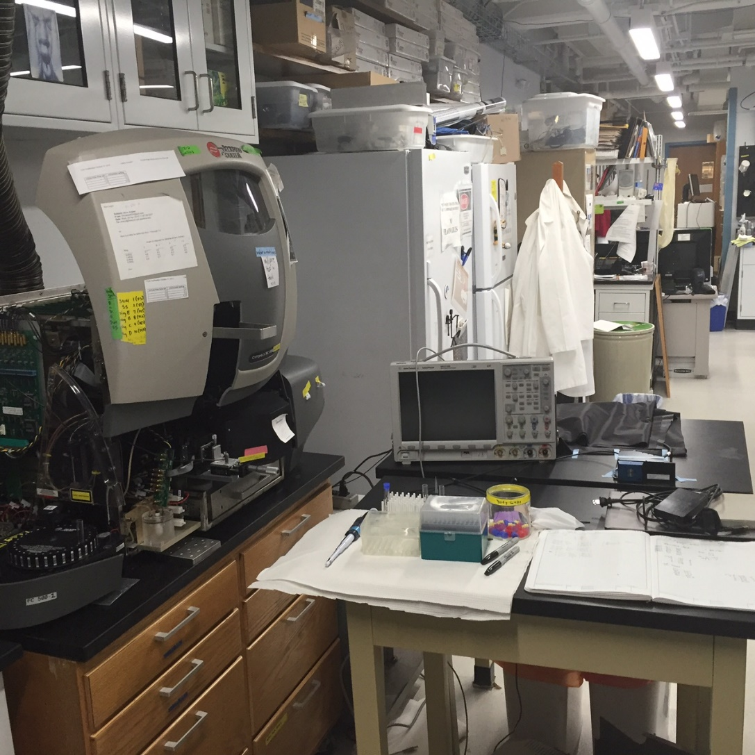
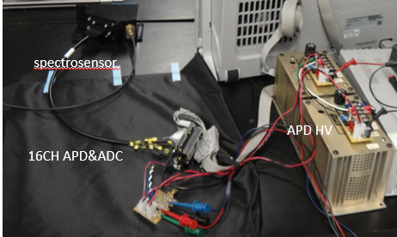
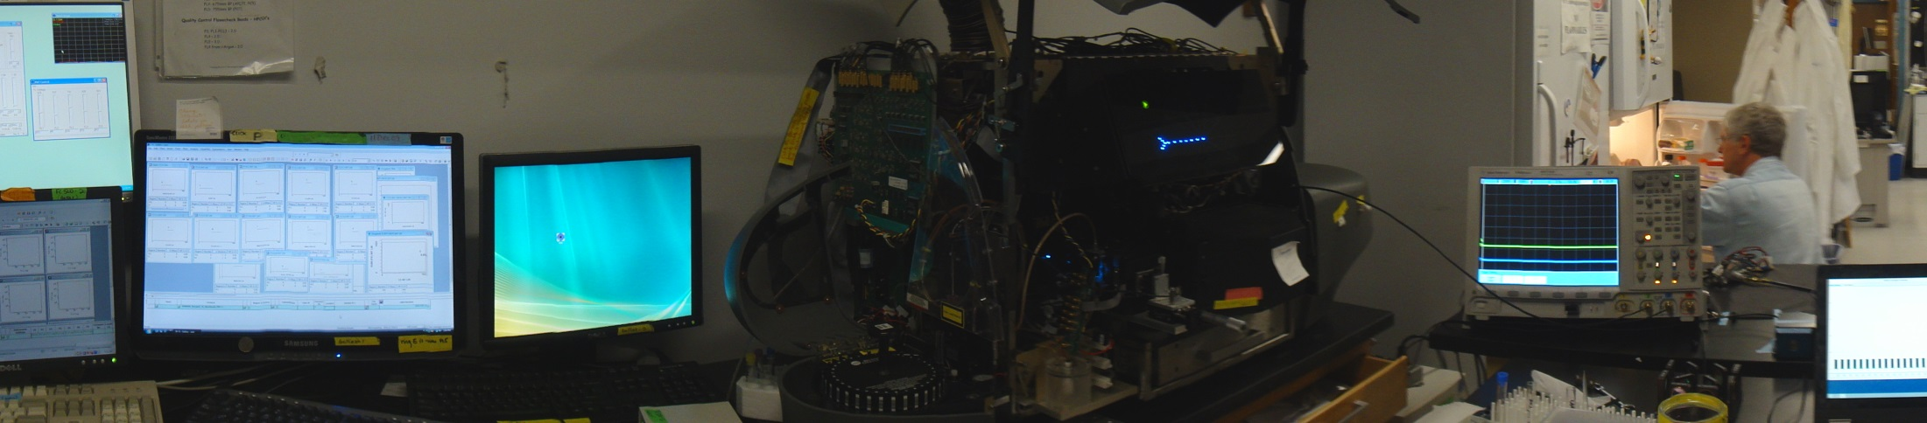
16CH Hyperspectrum Experiment

Slide 29
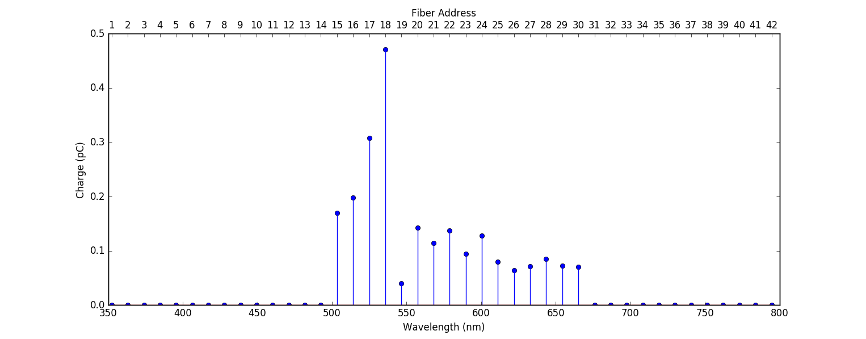
Observed 16CH spectrum by APD
-Spectrum profile can adjust peak value easily.
-Rainbow bead peak is slightly lower level to Highlighter Y-G, not big difference
No.19 is observed by uPMT

Slide 30
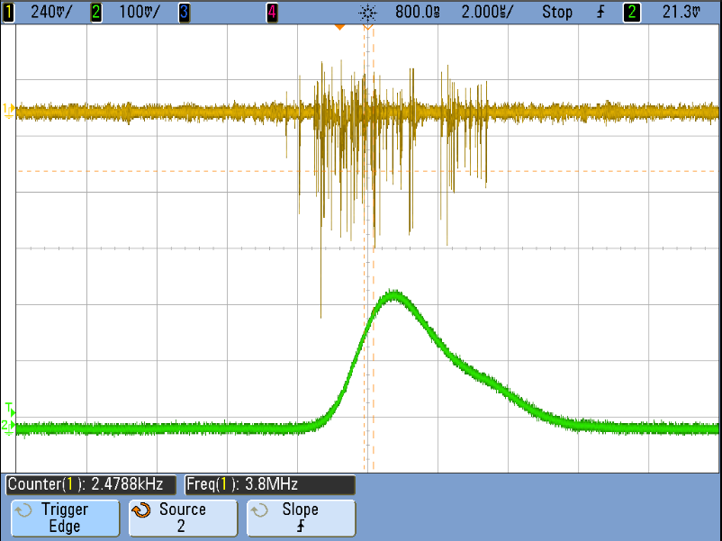
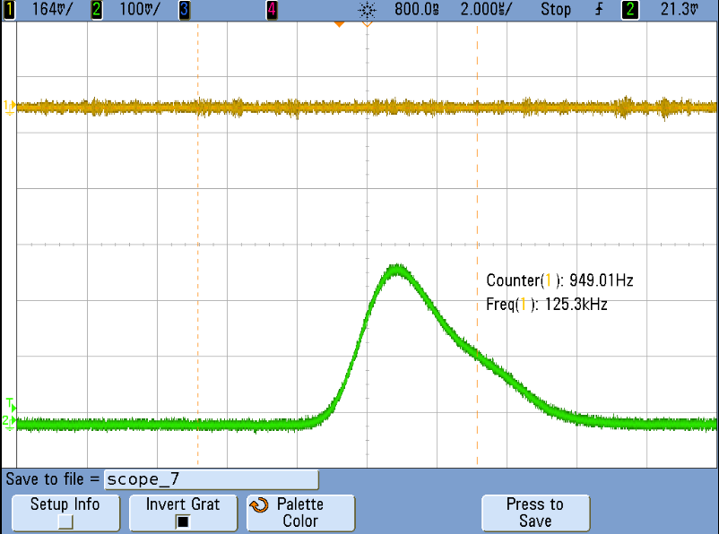
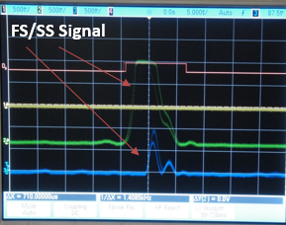
Firstly observed Photon-Dots of Rainbow Bead in Flow
Separated spot
Very low background photon due to Quartz ?
uPMT HV=950V
No.3
No.7
FL photon signal
include
1PE~10PE
No dye particle
SS: delayed timing

Slide 31
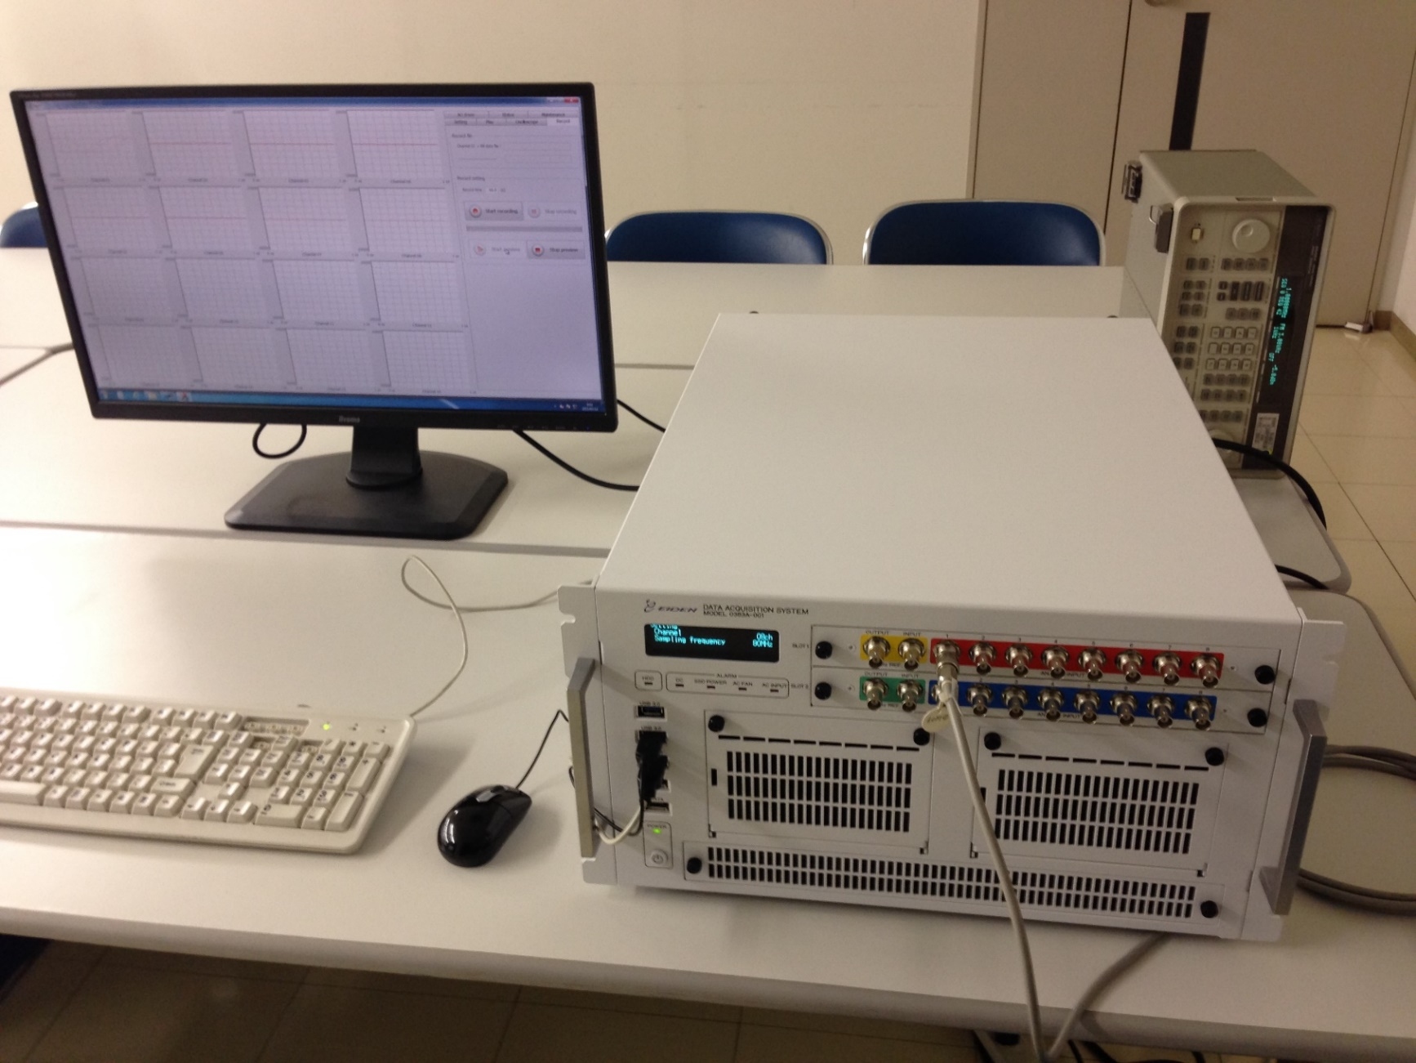
MIF-2 Data Acquisition System (8/16CH,16bit,160/80MHz=20.48Gbps with 3.0TB SSD)

Slide 32
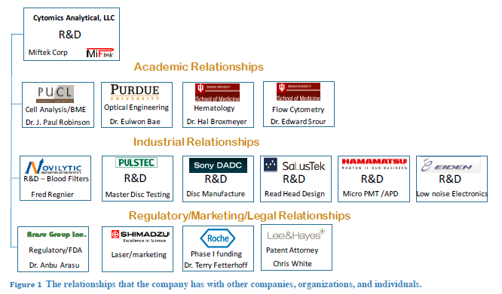
NIH Direct Phase 2 re-submission completed in Jan.,16:

Slide 33
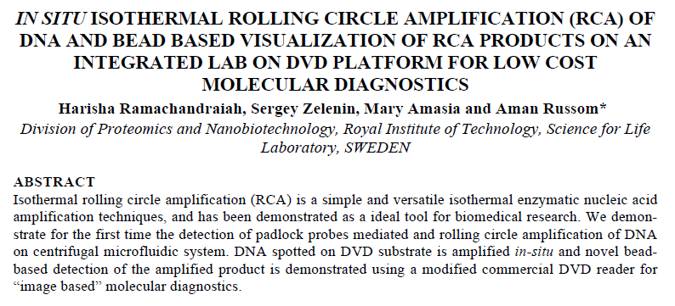
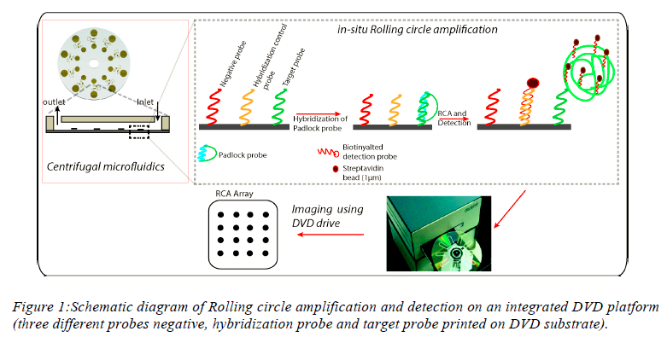
New Topics for collaboration

Slide 34
Summary:
Many progress has been achieved and on-going development on micro particle detection.
Scanning small laser beam flow cytometry is awarded by NIH Phase 1.
We submitted Phase 2 Award in Jan.,2016.
Micro particles detection are re-submitted as Direct Phase 2 (Disc) and Phase 1 (chip).
AGC Glass chip shows impressive capillary action with 1um gap.
Pioneer and Sony DADC provides drive, disc, etc. – we will start liquid experiment soon.
We developed 16CH Hyper spectrum and expand to 42CH soon. Combined with FC500 experiment is on-going.
Photon detection technology is progress – 1 Hz dark count and 0.6ns photon pulse.
MIF2 data acquisition system 20.48Gbps is completed soon.
We are welcome to discuss with Roche on the future opportunities.

