Slide 1
Deep Cytometry Embedding (DiCE): a deep-learning approach for display and interrogation of multi-relational flow cytometry data
Valery Patsekin, Bartek Rajwa^{1,3}, & J. Paul Robinson^{1,4}
Purdue University, USA
Théo Loustaud, Hervé Luche
Centre d’Immunophénomique, Marseille, France
Notes:
We have previously presented the PlateAnalyzer package for analysis of multiparameter flow cytometry (FC) data. The tool utilizes a GUI employing a virtual canvas and interoperable modules allowing users to construct complex gating and filtering strategies.

Slide 2
Current 2D outputs used in Dimensionality Reduction
Low rank approximation
e.g. PCA, Factor Analysis, CUR decomposition, etc
Low rank approximation
Finding approximated lower rank matrix
Linear transform
Methods based on neighborhood-graph methods
E.g. tSNE, LLE, Isomap, Umap
Represent Similarities of high dimensional data in low dimensional space
Topological representation
Autoencoder
Dimensionality reduction
Free of underlying statistical model
Data driven compression
Loss function driven
Notes:
Recently, however, many cytometrist expressed interest in the utility of dimensionality reduction (DR), and manifold-learning (ML) techniques which offer means to visualize complex data, enabling rapid exploratory analysis, gating, and comparisons of samples.

Slide 3
Use in Flow Cytometry
Logic of use
PCA
Speed, Availability, interpretability
tSNE
Advantage is focused on finding local communities (specific populations)
Preserves local similarities
UMAP
Mapping approach – trained transformation can be transferred to a similar data set (like PCA)
Notes:
Among these methods, the most debated ones are PCA, SNE variants, and UMAP. In the presented work we pursued an alternative solution incorporating contractive autoencoder (CA) built on deep learning (DL) framework
We demonstrated that the resultant DiCE (Deep Cytometry Embedding) tool not only competes favorably with the existing techniques concerning the visualization output but is also faster and more flexible

Slide 4
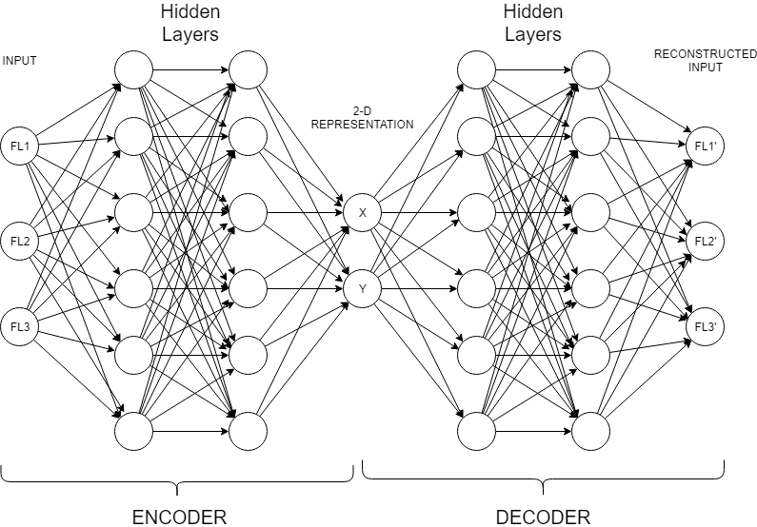
AUTOENCODER PIPELINE
Notes:
Autoencoders are an unsupervised learning technique in which we leverage neural networks for the task of compressing data. Autoencoder should be accurate enough in input reconstruction. And usually it should not be overfitted. In other words it should not just ”remember” the data. But in our case overfitting is what we actually need as long as we are not going to use it for different data files.

Slide 5
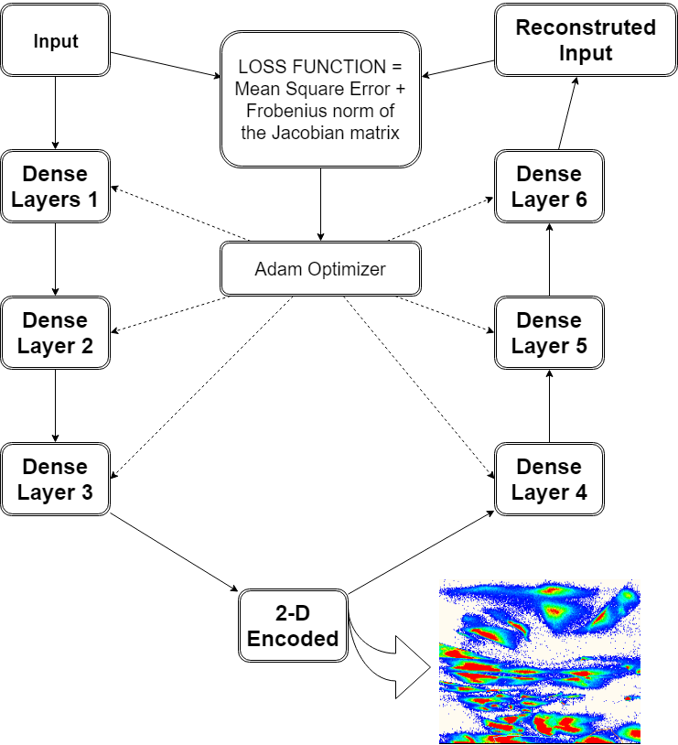
Contractive Autoencoder Computational Graph
Each layer except 2-D
Includes
BatchNormalization
And
Activation functions
To keep Neurons Values
Under Control
Notes:
A contractive autoencoder makes this encoding less sensitive to small variations in its training dataset. This is accomplished by adding a regularizer, or penalty term, to whatever cost or objective function the algorithm is trying to minimize. The end result is to reduce the learned representation’s sensitivity towards the training input. As regularizer the Frobenius norm of the Jacobian matrix is used for the encoder activation sequence, with respect to the input.

Slide 6
Comparison of time to result
tSNE, PCA, UMAP, Autoencoder
5.74 Hr
42.6 min
19.4 min
1.5 sec
Plot of time to result comparing # cells with model

Slide 7
GPU Results
GPU – Nvidia GeForce RTX 2080ti ~3 million cells 6 parameters
Total time ~ 4 minutes Batch size 10000
CPU Intel® Core™ i7-7700 @3.6 GHz 4 Cores 8 Threads same data
Total time ~ 84 minutes
Notes:
Ratio depends on batch size. When batch size is about 500, times are almost the same. Because most of the time is spent of data exchange between RAM and GPU memory. Batch size is a trade between speed and accuracy in GPU case.

Slide 8
Multiple Simultaneous Outputs tSNE, UMAP, PCA, DiCE
2D Maps
ALL
PARAMETERS

Slide 9
Can show any gated population in all displays

Slide 10
And add other known populations as desired

Slide 11
Use PRISM Fn to evaluate full Pop’ns
Set this gate
On any pop’n

Slide 12
Or just identify true negative cells in entire map
Where are the
CD45 Neg cells?

Slide 13
Or make combinatorial relationships..

Slide 15
And add a gate on Autoencoder for phenotype..
Gated Pop’n
phenotype

Slide 16
1 button statistics for all populations and gates

Slide 17
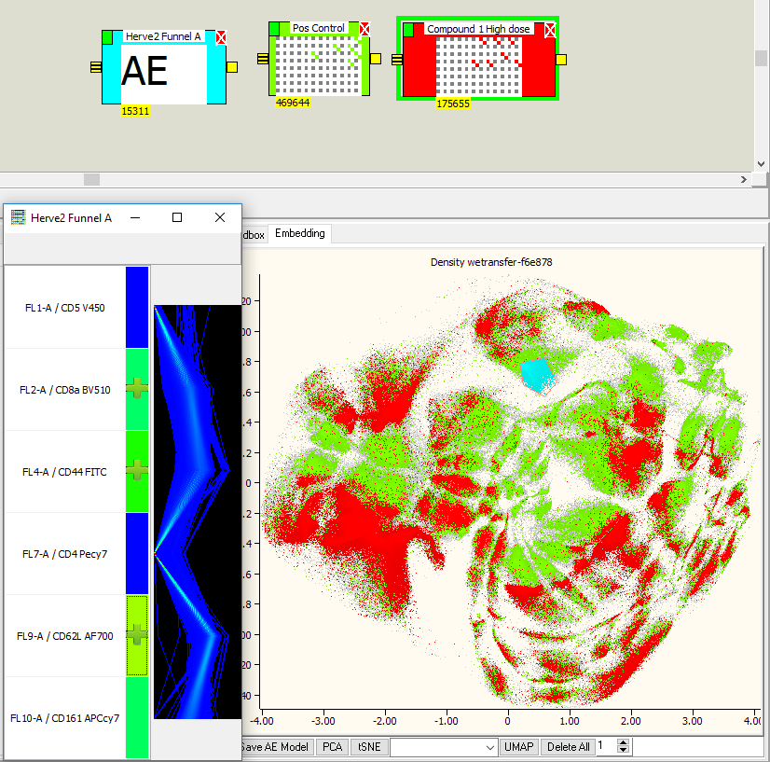
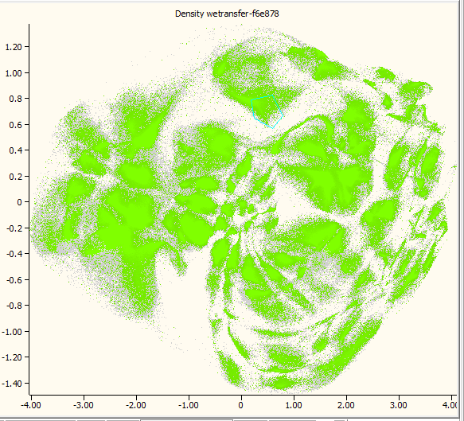
Positive Control overlapped with
Compound 1 High dose
Positive Control

Slide 18
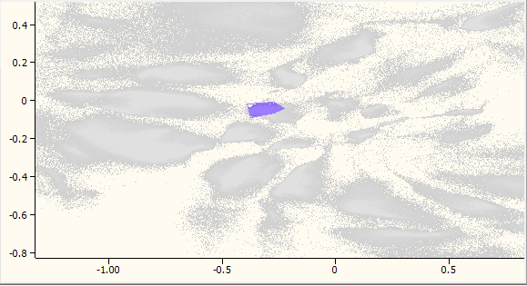
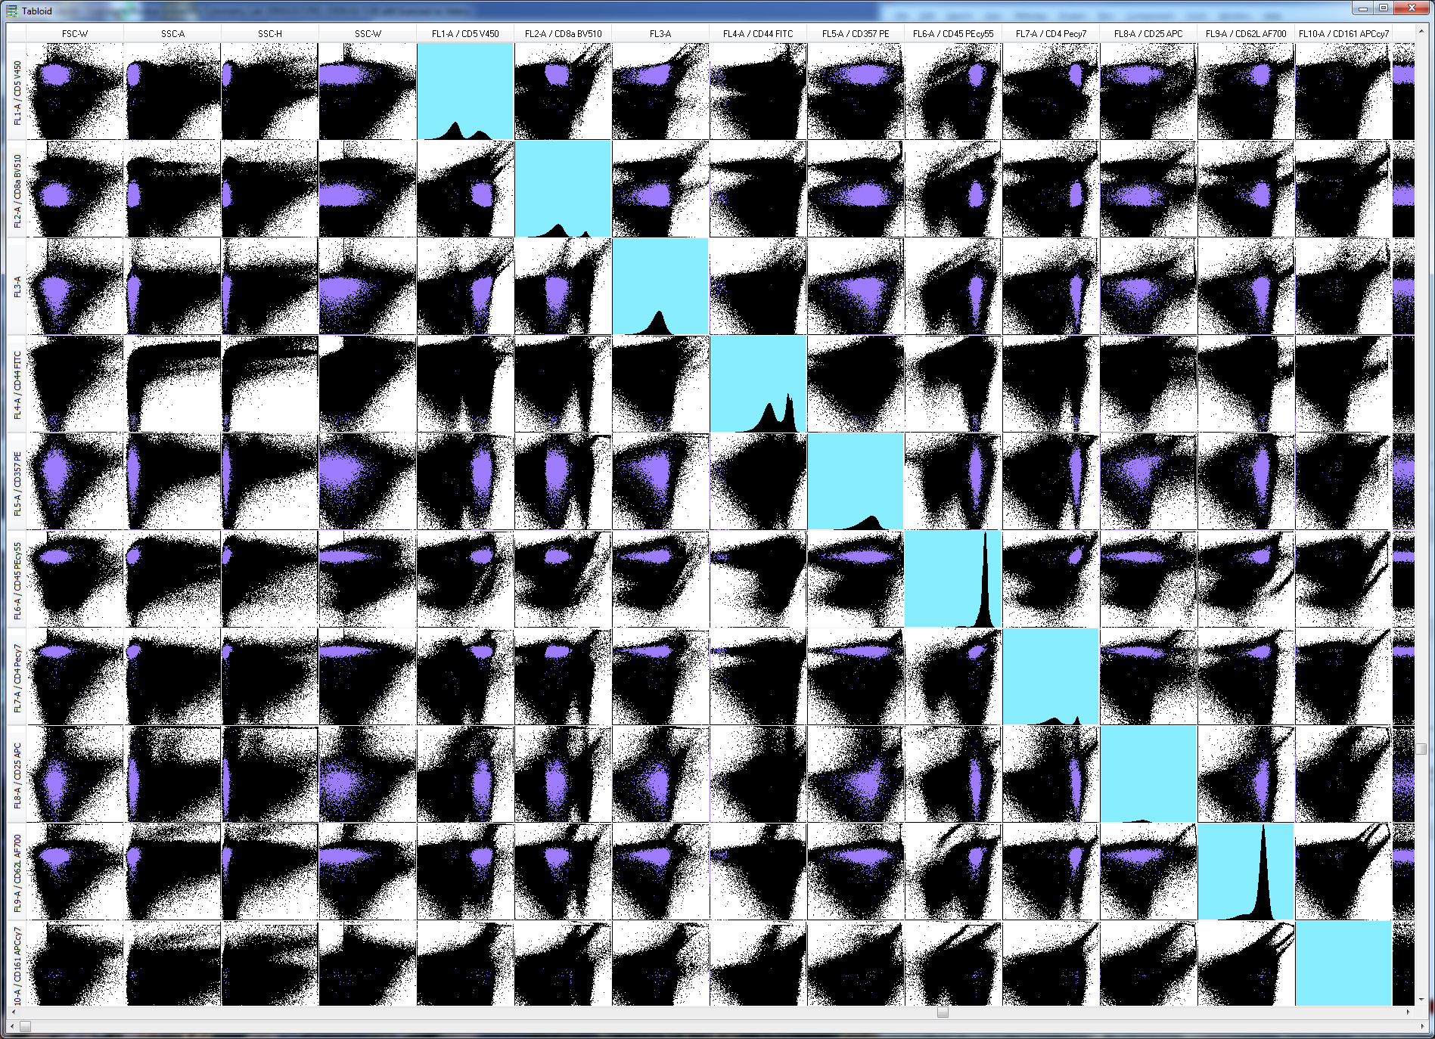
Back Gate to Traditional Gates
Notes:
Phenotype
Outliers

Slide 19
Look at parameter distribution on all plots simultaneously

Slide 20
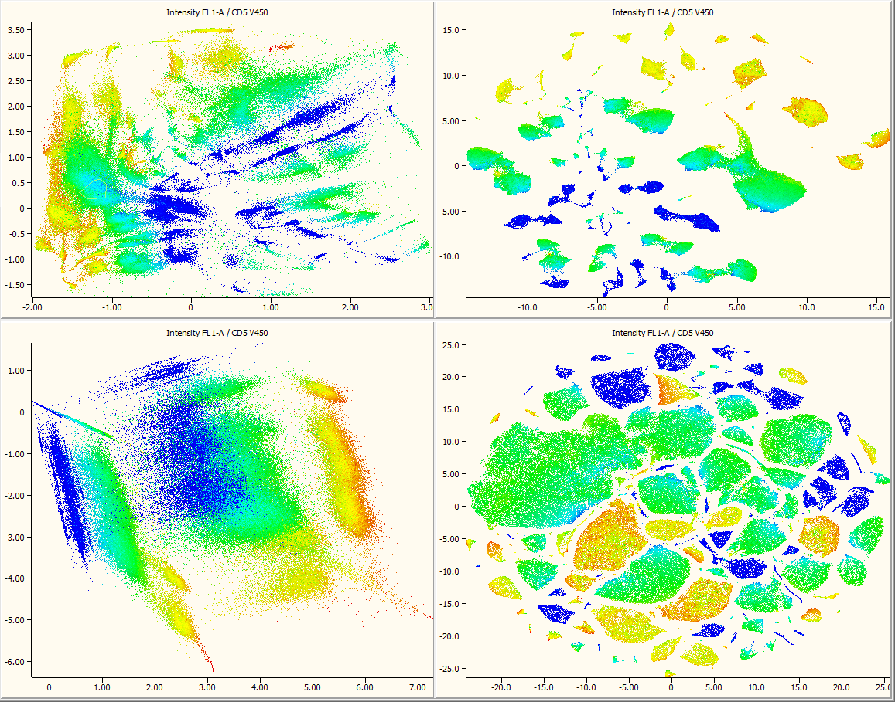
CD5-V450

Slide 21
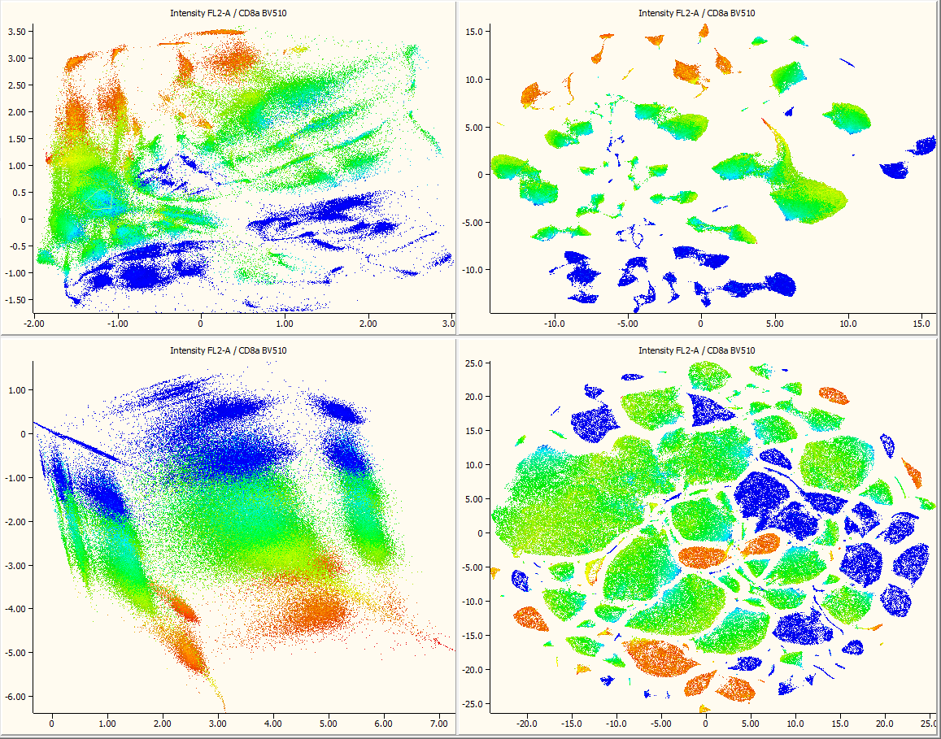
CD8a-BV510

Slide 22
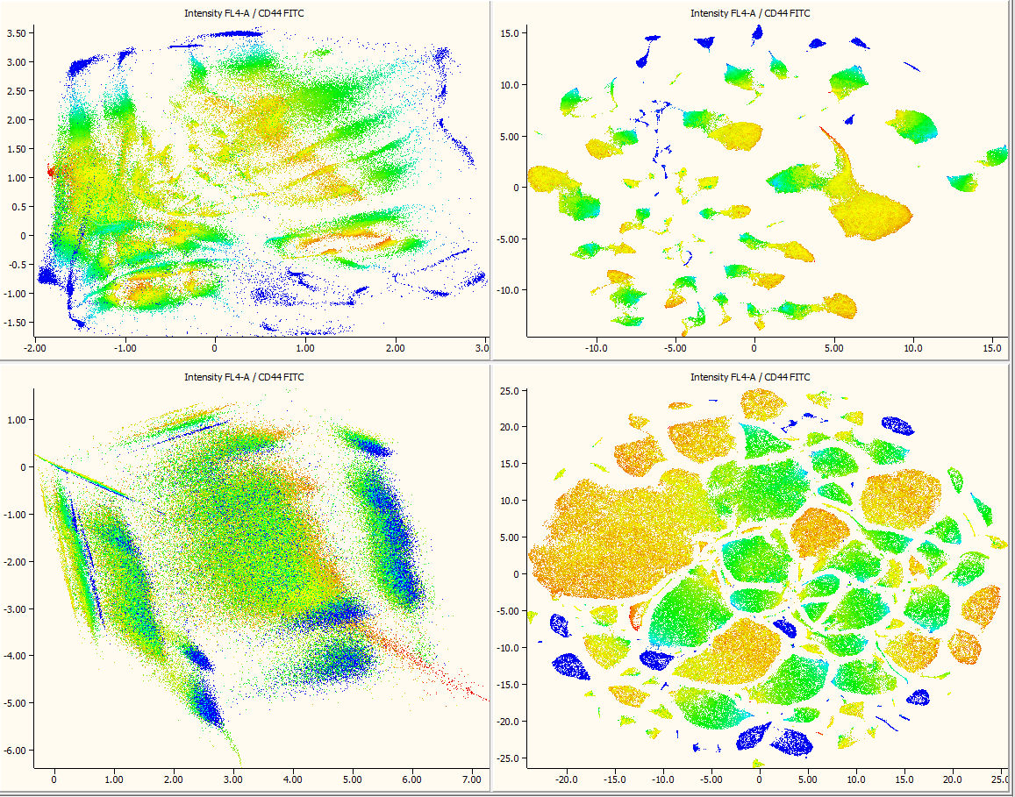
CD44-FITC

Slide 23
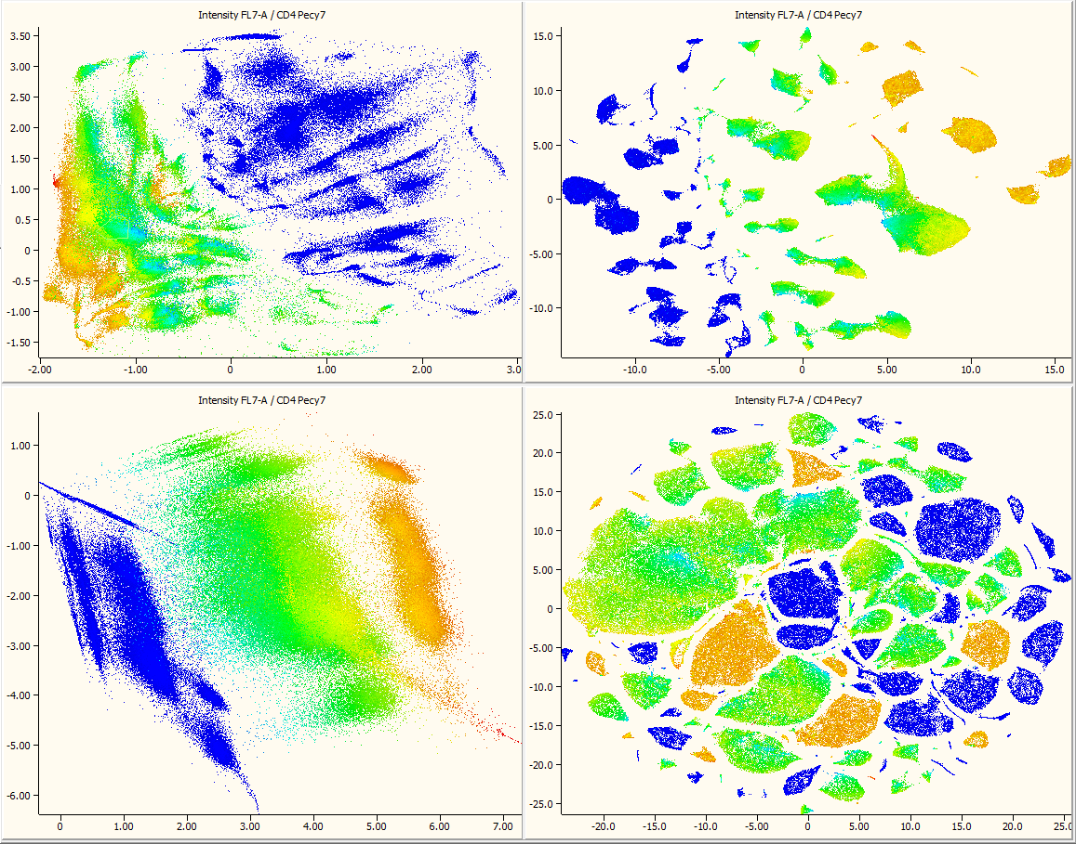
CD4-Pecy7

Slide 24
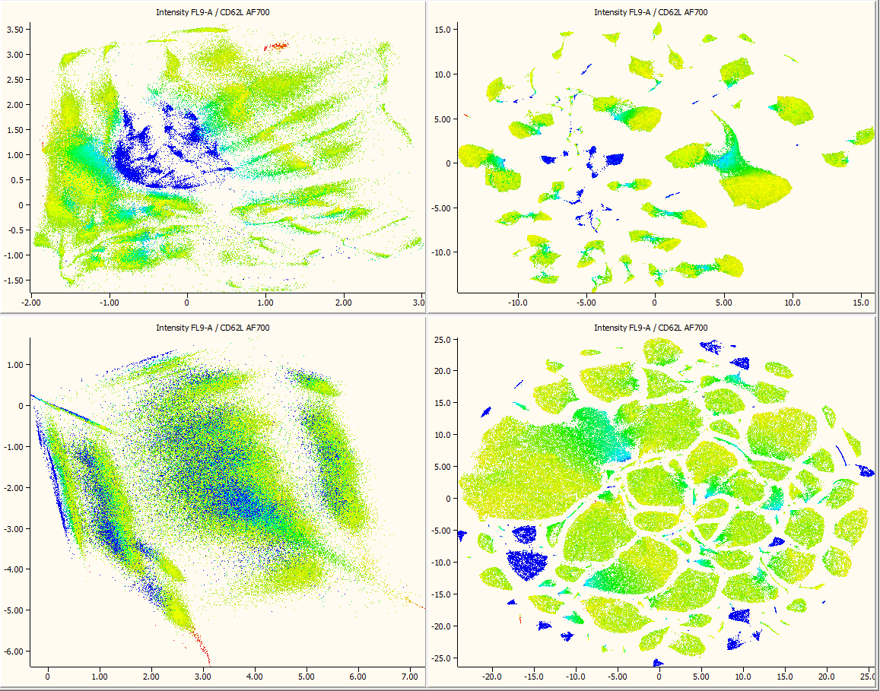
CD62L-AF700

Slide 25
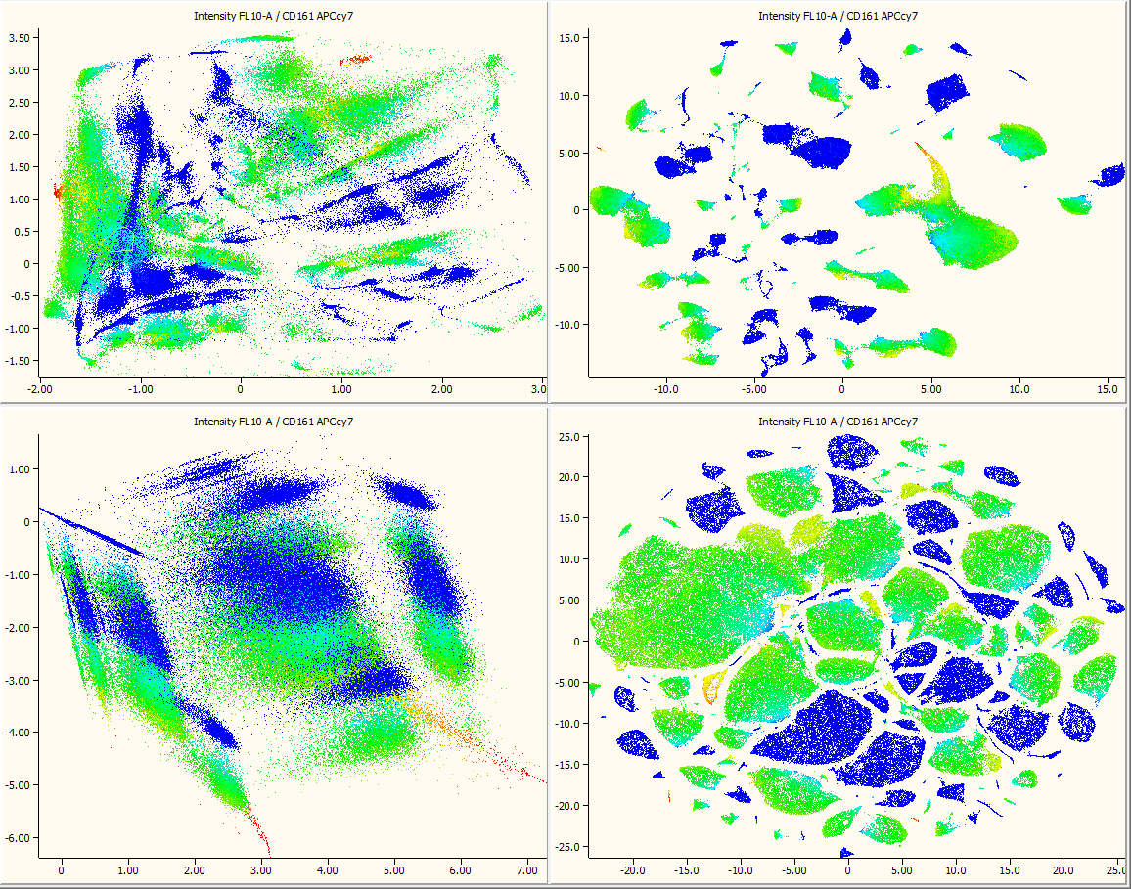
CD161-APCcy7

Slide 26
Real time gating using autoencoder, or any population gate
Notes:
Example gating and manipulating datasets in real time

Slide 27
Summary Advantages of Autoencoders
Speed of application
No assumptions regarding underlying data
Can be applied after training to another data set (i.e. model is transferable)
Can modify loss function to user constraints
Notes:
We applied the DiCE to visualize and interrogate a rich dataset describing the expression of 8 receptors on T-cells subsets . We also created 2D maps based on approaches offered by PCA, SNE, and UMAP. The qualitative comparison demonstrates that the features learned by DiCE produce a more interpretable and cleaner output permitting easy back-gating. The large size of the dataset favored DiCE which is significantly faster than the competing techniques (excluding PCA). The SNE and UMAP methods were unable to process all the cells in the dataset and required subsampling. Importantly, DiCE can project the incoming data (similarly to PCA and UMAP), which makes it decidedly more useful than SNE. DiCE can also benefit from the ubiquity of the specialized Deep Learning -oriented hardware like NVIDIA GPUs.

Slide 28
Acknowledgements
Purdue University Cytometry Laboratories colleagues and staff
Data sets from a variety of colleagues including, Gary Nolan, Paul Wallace, Hérve Luche, Andrea Cossarizza
Research reported in this presentation was supported by the National Institute of General Medical Sciences & the National Cancer Institute of the National Institutes of Health under Award Numbers 1R56AI089511-01, R21RR033593-01 & 1R33CA140084. The content is solely the responsibility of the authors and does not necessarily represent the official views of the National Institutes of Health. National Science Foundation (DGE-1333468) U.S. Department of Agriculture, project 1935-42000-072-02G, Center for Food Safety Engineering at Purdue University

Slide 29
Recent publication
Valery Patsekin, Stephen On, Jennifer Sturgis, Euiwon Bae, Bartek Rajwa, Aleksandr Patsekin, J. Paul Robinson, "Classification of Arcobacter species using variational autoencoders," Proc. SPIE 11016, Sensing for Agriculture and Food Quality and Safety XI, 1101608 (30 April 2019); doi:10.1117/12.2521722
Notes:
This approach has been successfully used for classification of bacterium colony scatter images. This was a driving force to develop application for Flow Cytometry.

