Slide 1
EnzaZarden Data
XploidTM is a semi automated software program to provide rapid cell cycle analysis. It is not designed to perform complex cell cycle but is designed to rapidly identify significant differences in cycling activity of flow cytometry samples.
XploidTM is designed to read entire directory at once. It is not designed to read single wells/tubes, although there is no reason why it cannot do that if desired.
XploidTM is designed to operate on a single user computer per license.
All materials in this presentation are ©2016 copyright Doclu LLC. Screen design, output figures and graphics are all copyright Doclu LLC 1231 Cumberland Av Suite B, West Lafayette, In 47906 www.doclu.com
Filename:/oneDrive….Doclu/xploid software.pptx

Slide 2
General Look and Feel of XploidTM
Gate screen – any parameter vs any parameter
A gate can be drawn to exclude debris
The reporter (ie PI or DAPI fluorescence for cell cycle) shows the histograms. You can draw gates for as many histograms as you want. The names for the histograms are transferred to the plate map.
All the data are presented here and
can be output to an XL spreadsheet
A visual output of each well – colors denote clusters.
The number of clusters can be automatic or manual

Slide 3
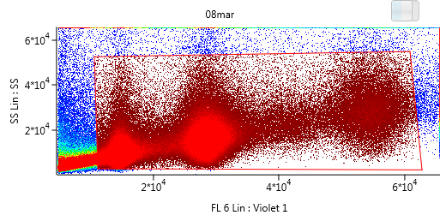
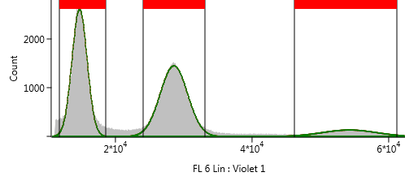
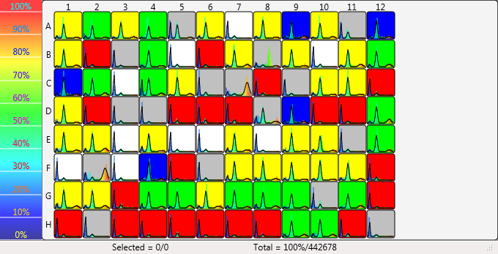
All graphic sections can be output as images by right click, copy

Slide 4
The data table includes all data for each histogram gate selected and is CSV file output

Slide 5
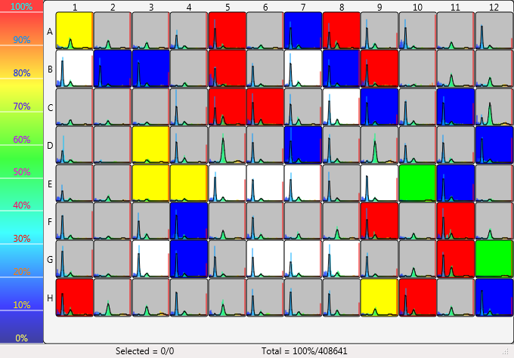
Example Enza data 08Mar-6
Note: No gates were changed for all the following analyses of next 5 slides

Slide 6
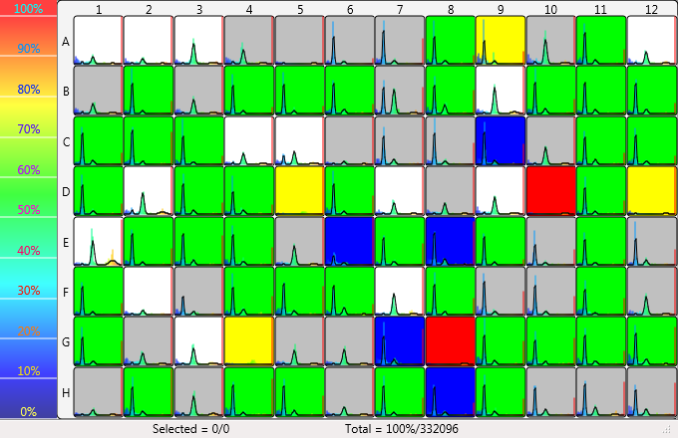
Eample Enza Data set 08Mar-7

Slide 7
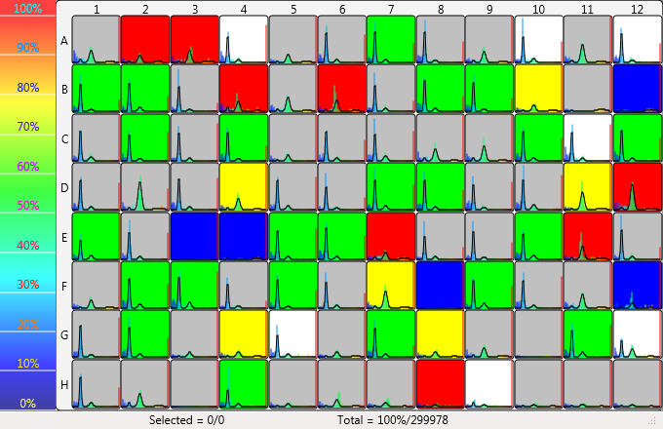
Eample Enza Data set 08Mar-8

Slide 8
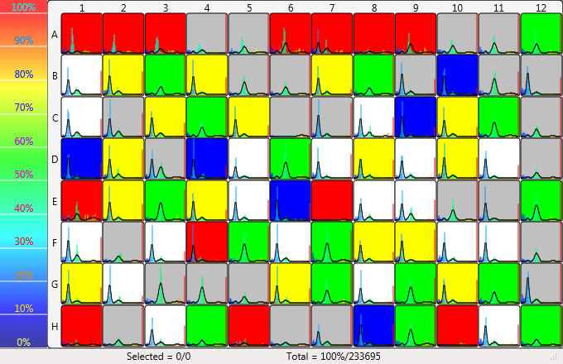
Eample Enza Data set 27Feb

Slide 9
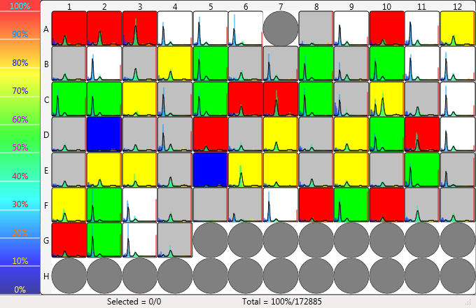
Eample Enza Data set 27Feb-7

