Slide 1
Bloodborne Pathogens
Radiological and Environmental Management
Purdue University
Jennifer Asbury
Presented by J. Paul Robinson
Filename:wombat/onedrive/SOPs/blood borne pathogen training materials/BBP new template 2018

Slide 2
Questions
If you reach a point in this training where you have a question, STOP. Raise your hand and ask, DO NOT continue until your question has been answered.

Slide 3
WHY
The Occupational Safety and Health Administration (OSHA) has issued regulations for the employers to protect employees from occupational exposure to bloodborne pathogens. Requires all employees with occupational exposure to bloodborne pathogens to participate in an annual training program.
This includes exposure to Human fluids such as blood, tissue, cells, or any other bodily material.

Slide 4
Purdue Specific Bloodborne Plan
Located on the REM webpage:
www.purdue.edu/REM

Slide 5
What are bloodborne pathogens
Microorganisms such as viruses, bacteria, or parasites that can enter the human blood stream causing diseases.

Slide 6
How do they enter the bloodstream
In the workplace these microorganisms may be transmitted when mucous membranes or non-intact skin (cuts, abrasions, burns) are exposed to human blood or body fluids. Other modes of workplace transmissions include blood splashes, handling contaminated items, needle sticks or cuts from contaminated sharps.
Sharps accidents. (needles, metal, broken plastic, or glass)
Splash: into eyes, nose, or mouth.
Hand to mouth.
Aerosols: inhalation

Slide 7
How Widespread is Bloodborne Diseases
CDC estimates that more than one million people are living with HIV in the United States. One in five (21%) of those people living with HIV is unaware of their infection.
3.2 million people in the United States have chronic Hepatitis C virus infection

Slide 8
Purdue Exposures/Diseases
Direct Human Blood Contact
HIV/AIDS, Syphilis, Hepatitis B + C,
Raw Sewage Exposure (not bloodborne)
Cholera, Hepatitis A, Polio, Rotavirus and Norovirus, Salmonella, Human fluids
Environmental
Rabies, Vector borne (West Nile, Lyme Disease, Encephalitis)

Slide 9
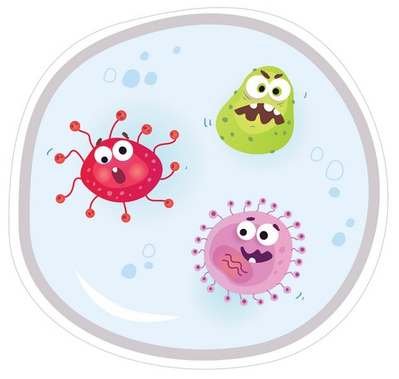
Big Three Bloodborne Disease Symptoms
Human Immunodeficiency Virus: non-specific symptoms such as loss of appetite, chronic diarrhea, weight loss, fever, fatigue, opportunistic infections; death.
Hepatitis B + C: loss of appetite, vague abdominal discomfort, nausea and vomiting, often progressing to jaundice; long term case fatality rate is 2-3% due to cancer or cirrhosis of the liver.

Slide 10
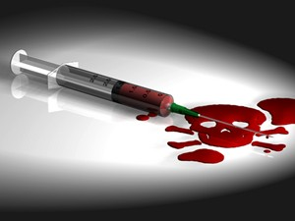
What is Hepatitis
Hepatitis refers to inflammation, redness, swelling, and soreness of the liver.
Hepatitis B is a contagious virus that causes inflammation of the liver.

Slide 11
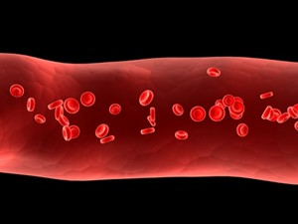
How Long do HBV Symptoms Last
Symptoms may begin as early as 60 days or up to 150 days after exposure to HBV. Ninety-five percent of the adults recover completely from HBV and do not become chronically infected. In contrast, 90% of infants and 35% of children under the age of 5 years old will remain chronically (life long) ill with HBV
What happens in chronic HBV infection
15-25% of the people with chronic HBV develop cirrhosis (liver damage), liver failure, or liver cancer.
How is it treated?
There are no special treatments for acute hepatitis B infection.
For chronic infection, many antiviral drugs are available.

Slide 12
What is Hepatitis C Virus
Hepatitis C is a contagious virus that causes inflammation of the liver.
How is it transmitted in the workplace?
In your workplace Hepatitis C is transmitted by needle stick injury, blood, blood products, needles, and from any other sharps, or unprotected body parts. What is the risk of acquiring Hepatitis C after a needle stick contaminated with Hepatitis C blood? HCV infection is about 1.8%

Slide 13
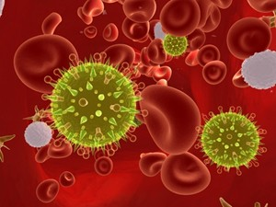
What are the signs and symptoms of HCV
Most of the people newly infected with Hepatitis C do not show any symptoms. Most common symptoms if present include: Fever
Fatigue
Jaundice (yellowing of the skin and/or eyes)
Nausea and Vomiting
Abdominal pain
Dark urine
Clay-colored bowel movements
Loss of appetite

Slide 14
What is Human Immunodeficiency virus (HIV)
Human Immunodeficiency virus (HIV) is the virus that causes AIDS.
What is AIDS?
AIDS stands for acquired immunodeficiency syndrome. HIV infection causes suppression of the immune system (The immune system gives our bodies the ability to fight infections), which could lead to opportunistic infections and unusual types of cancer. AIDS may not develop for 8-10 years after the initial infection. AIDS is the final stage of HIV infection.

Slide 15
HIV Virus
Who is at risk for HIV?
In your workplace environment Healthcare staffs who get stuck with needles containing HIV-infected blood or any lab persons that are working with the HIV virus.
What are the symptoms of HIV?
Most of the people newly infected with HIV do not show any symptoms for many years. Some people may get flu like symptoms for few weeks after becoming infected. Signs and symptoms may include:
Fever
Headache
Sore throat
Swollen lymph glands

Slide 16
What are the symptoms of AIDS
AIDS may develop over an 8-10 year period after the initial HIV infection. AIDS is the final stage of HIV infection, when the immune system has been severely damaged, which can lead to opportunistic infections and unusual types of cancers. Signs and symptoms may include:
Night sweats
Chills and fatigue
Fever >100 F (38 C) for several weeks
Dry cough and shortness of breath
Chronic diarrhea
Persistent white spots or unusual lesions on your tongue or in your mouth
Headaches
Weight loss

Slide 17
HIV Virus
How long does the HIV infection last?
There is no cure for HIV infection. Usually HIV infection is a chronic condition.
How is it treated?
It is treated with multiple antiviral medications.
How can you prevent HIV in the workplace?
Practice universal precautions. The concept that all bodily products are
contaminated and must be handled with protective safeguards.

Slide 18
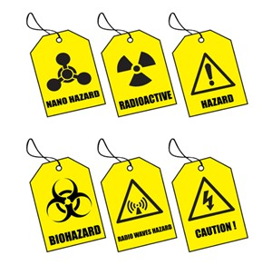
Prevention of Bloodborne Diseases
Prevention of Bloodborne Diseases:
The Occupational Safety and Health Administration (OSHA) defined four principal strategies to prevent or reduce exposure to bloodborne pathogens:
1. Engineering controls
2. Work practice control (BBP Training)
3. Personal Protective Equipment
4. Universal Precautions

Slide 19
Prevention
Examples:
Readily accessible hand washing facilities
Eye stations
Sharps containers
Biohazard labels
Self-sheathing needles or syringes with retractable needles
Needleless IV systems

Slide 20
Personal Protective Equipment
PPE outerwear such as gloves, Tyvex suit, and face shields that prevents contact with Human fluids. For a laboratory it is eye protection, gloves, and a lab coat.
PPE is considered "appropriate" only if it does not permit blood or other potentially infectious materials to pass through to or reach the employee's clothes, skin, eyes, mouth, or other mucous membranes under normal conditions of use and for the duration of time which the protective equipment will be used.

Slide 21
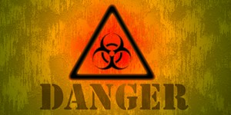
Biohazard Warning Labels
Biohazard warning labels will be affixed to containers of blood, refrigerators and freezers containing blood, potentially infectious material, biohazard bags, and containers used to store, transport or ship these materials.
Biohazard labels will be fluorescent orange or orange-red or predominantly so, with lettering and symbols in a contrasting color.

Slide 22
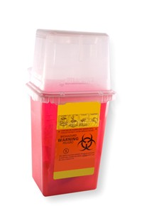
Contaminated Sharps
Needles
Scalpels
Broken capillary tubes
Glass Pipettes
Contaminated needles or other contaminated sharps must not be bent or recapped. Needle removal or recapping needles must be accomplished through a one-handed technique or the use of a mechanical device. A sharps container must have a warning label affixed to it. Contaminated sharps must be discarded immediately or as soon as possible into an acceptable sharps container.
Reusable Sharps:
Reusable sharps, including pointed scissors must be decontaminated before reuse. Containers containing reusable sharps should be clearly labeled. Use forceps or tongs, to remove contaminated sharps from containers.

Slide 23
Contaminated Sharps Waste
Contaminated sharps such as broken glass or razors must be placed in properly labeled (Biohazards) puncture proof containers.
Contaminated PPE must be placed in properly labeled biohazard bag.
Contaminated waste materials must be decontaminated before disposal.
Contact REM for proper disposal and removal.

Slide 24
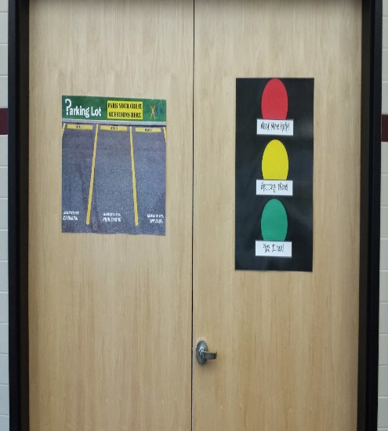
Prevention & Recognizing Job Task Exposures
Job tasks that potentially expose employees to Human fluids should be documented (Hazard Assessment) and discussed before work or contact takes place.
Practice Universal Precautions; the concept that all blood products are contaminated and must be handled with protective safeguards.

Slide 25
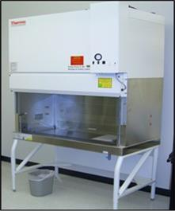
Biosafety Cabinet
Handling of human cell lines must be conducted in a Biosafety Cabinet
Everyone in a shared lab must be made aware that human cell lines are being used.
Sharps safety is very important.
Review your lab’s Biosafety Level 2 SOP. If your lab does not have a BSL2-SOP
contact the BSO .

Slide 26
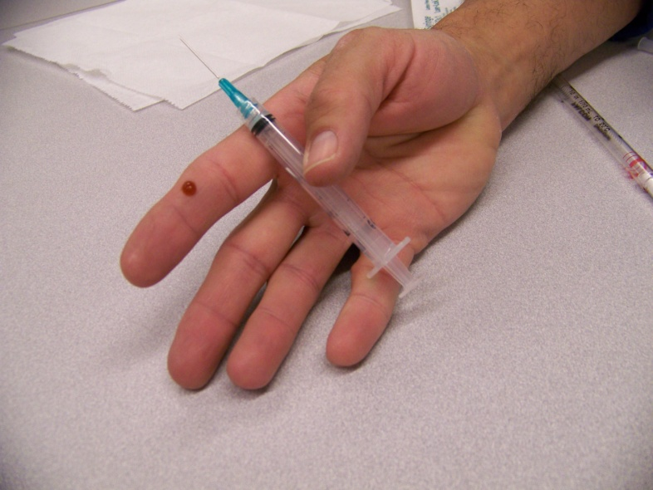
Exposure Incident
In the event of an accidental exposure the employee should:
Wash the exposure site with soap and water
Flush splashes to nose, mouth or skin with water.
Irrigate eyes with water or saline.
Inform their supervisor immediately, and seek medical attention.
The supervisor is required to complete a First Report of Injury.

Slide 27
Post-Exposure Evaluation
After an exposure incident, Purdue will provide the exposed employee with a confidential medical evaluation and follow-up. (Occ. Health provider)
The exposed employee will be asked to document the route of exposure, the circumstances under which the exposure incident occurred, and asked for the identification of the source individual.
The source individual's blood will be tested as soon as feasible and after consent is obtained in order to determine HBV, HCV, and HIV infectivity.

Slide 28
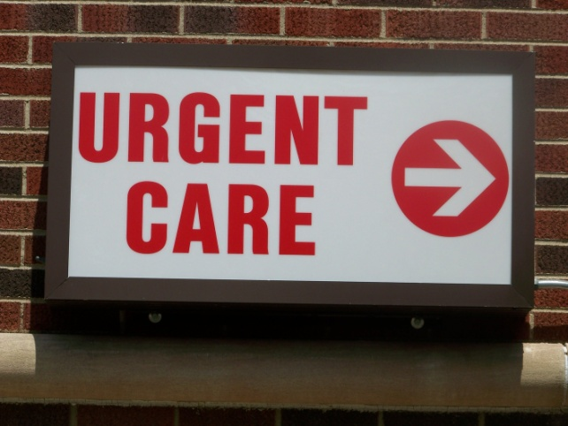
Local Medical Providers
Non-Emergency Treatment and Follow-up Care
IU Health Arnett Occupational Health
Regional Occupational Care Center (ROCC) Use the Urgent Care and Immediate Care Center if the facilities above are closed.
IU Health Arnett Urgent Care
Unity Immediate care Center Franciscan Express Care Franciscan Express Care Use the hospital emergency rooms if it is a true emergency or if the above facilities are not open.
Emergency Care
IU Health Arnett

Slide 29
Hepatitis B Vaccine
Hepatitis B vaccine inoculations are available to employees exposed to blood products at no cost.
There are a total of three scheduled injections spanning six months followed by titer blood work.
Adverse reactions occur in 1 - 10% of injections; symptoms could include fever, headache, and dizziness.
Effective immunity is usually permanent

Slide 30
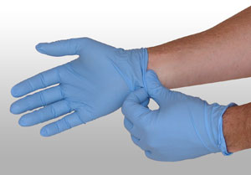
Blood Spill Clean-Up
Materials:
-PPE: nitrile or latex gloves, tyvex, goggles….
-Biohazard Bag
-Spray bottle with 10% bleach + water solution
-Adsorbent toweling

Slide 31
Blood Spill Kit

Slide 32
Blood Spill Clean-Up Cont.
Spray the blood contaminated surfaces with the 10% solution of bleach and water.
Absorb and remove all traces of the spill with paper towels or other acceptable materials. Be careful not to contaminate the outside of the spray bottle.
Re-spray the cleaned area with the bleach solution and allow the air to dry.
Place all waste materials, including disposable PPE, into the biohazard bag. Be careful not to contaminate the outside of the bag.
This type of waste cannot be disposed through the regular trash service.

Slide 33
Workplace controls
Work practice controls must be evaluated and updated regularly to ensure their effectiveness.
Hand washing:
Hand washing is the most important method in preventing transmission of bloodborne pathogens. It is required that you wash your hands after removal of gloves and other PPE.
Cleaning Work surfaces:
The work areas that involve exposure or potential exposure to blood, along with potential contamination of surfaces, must be cleaned regularly. The cleaning must occur at least weekly or after completion of tasks or procedures or at the end of a shift if there is a possibility of contamination. Use 10% bleach and water solution or other approved disinfectant. You should use disposable towels to clean up the spill and then dispose of the towels in a biohazard-labeled bag. Use a dustpan and brush, cardboard, or tongs, to clean up any contaminated broken glass. Do not clean it up with your hands.

Slide 34
Thank You
Jennifer Asbury
jkasbury@purdue.edu
765-494-1498
Presented by J. Paul Robinson, 765-4940757
wombat@purdue.edu

Slide 35
Fill in your forms now

