Slide 1
BMS 631 - LECTURE 11 Flow Cytometry: Theory
DNA-RNA Fluorescence Probes
J. Paul Robinson
Distinguished Professor of Cytometrt &
Professor of Biomedical Engineering
Purdue University
Notice: The materials in this presentation are copyrighted materials. If you want to use any of these slides, you may do so if you credit each slide with the author’s name.
Lynn Hall G221
Purdue University Cytometry Laboratories
Purdue University
Office: 494 0757
Email: robinson@flowcyt.cyto.purdue.edu
Some material from these lectures uses data from files on Michael Ormerod’s Cytometry CD-ROM and Howard Shapiro’s text “Practical Flow Cytometry”, Wiley-Liss, 3rd Ed. 1994
WEB http://www.cyto.purdue.edu/class

Slide 2
DNA & RNA Parameters
total DNA & RNA content
nucleic acid sequence
cell cycle analysis
chromosome analysis
reticulocyte analysis
live/dead
  membrane integrity
identify microorganisms

Slide 3
Sample preparation
wash cells well
  clean, single cell suspension
living or fixed
  EtOH may be best for DNA
  paraformaldehyde for membrane antigens
treat with RNase
  may lyse cells to get rid of cytoplasm then filter cells for DNA content
permeabilize membrane if necessary
Notes:
imperative to have clean single cell suspensions
need only intact nuclei to measure DNA content
to look at DNA and membrane antigens must fix and must use mild dispersal methods so preserve intact cells--damaged or dead cells can nonspecifically bind antibodies and appear to be populations they are not
fixation may be a compromise, according to Crissman and Hirons EtoH is the better fixative to use for DNA because the aldehydes may interfere with binding of dyes to DNA...yet the aldehydes are probably better for preserving membrane antigens
they note that Hoechst 33342 may be used for DNA content after fixation in 1% paraformaldehyde , rinsed, then stored in Ca and Mg-free PBS...so can simultaneously look at DNA and membrane antigens
Feulgen procedure: rarely used/time-consuming/sample preparation time hours, cannot do kinetic studies/causes cell loss /may get nonspecific staining

Slide 4
Ethidium bromide
Ex: 480-550 nm Em: ~604 nm
intercalate between DNA & RNA bp
  20-25% increase in fluorescence quantum efficiency over unbound
  no base specificity
emissions 50-100x greater than free dye
  increased quantum efficiency
  increased intensity (locally increased [dye])
binding affinity varies w/ionic strength
Notes:
Shapiro notes environment between base pairs hydrophobic so is why get shift in absorption spectrum and increased quantum efficiency
can excite at 320-360 nm also
must fix/permeabilize cell membrane though if pH high EtBr will eventually cross the membrane
can use as live/dead stain though PI better since won’t cross

Slide 5
Ethidium bromide
DNA specific if pretreat with RNase
Cells must be fixed
  poor penetration of intact membranes
  can if pH high

Slide 6
Propidium Iodide
  Ex: 536 nm Em: 620 nm
DNA specific if pretreated with RNase
Lower CVs than EtBr
Does not cross intact membrane
  superior to EtBr to test membrane integrity
Binding affinity varies with ionic strength
  use sheath fluid of same ionic strength as sample or see drift (shift in peak of fluorescence distribution)
Notes:
PI fluorescence histogram CVs tend to be lower than those with EtBr so more desireable for this reason
won’t cross membrane regardless of pH...has one more positive charge than EtBr
nonintercalating
also excites at 342

Slide 7
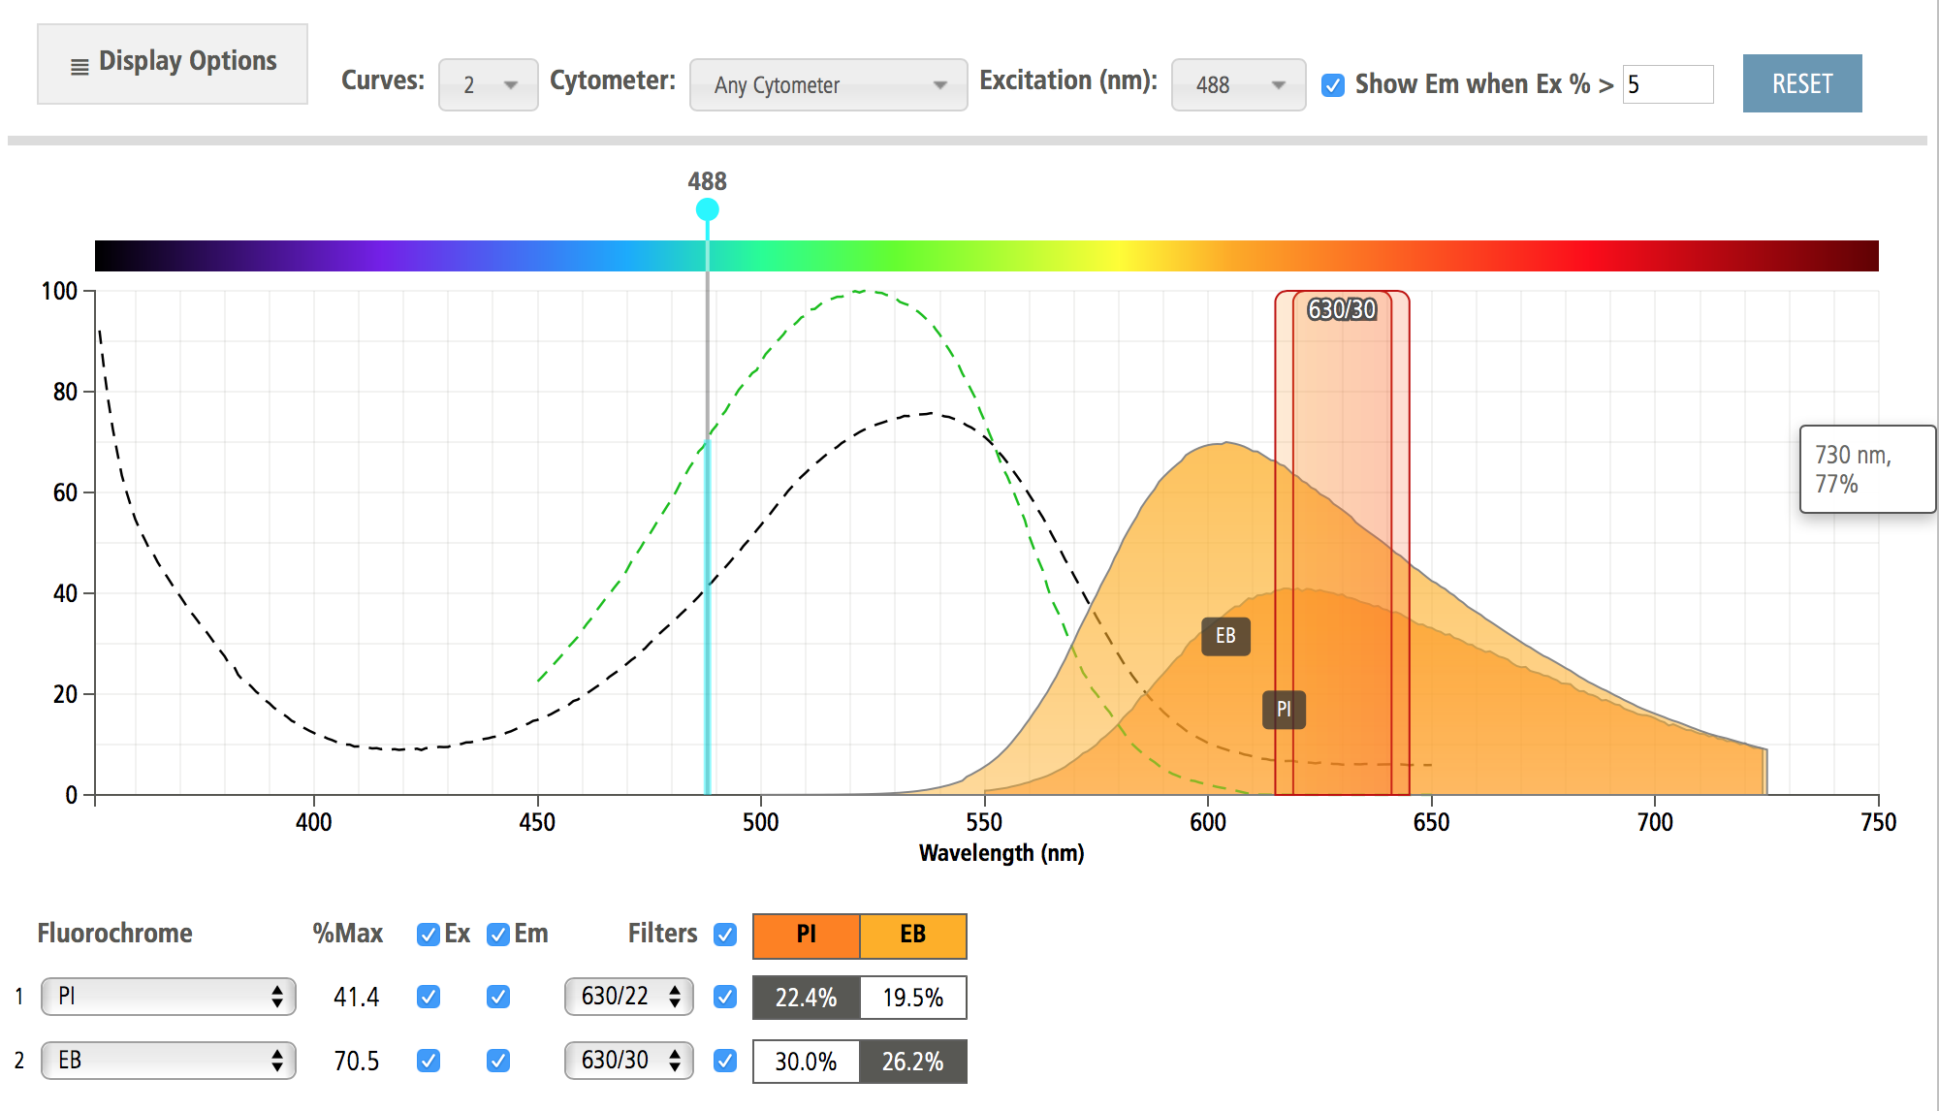
Spectra of PI and EtBr
350
457
488
514
610
632
300 nm
400 nm
500 nm
600 nm
700 nm
PI
Ethidium
Notes:
note that can excite EtBr at both 320-360 and at 480 - 550 to get the red fluorescence

Slide 8
Hydroethidine
Reduced ethidium
Rapidly enters intact cells
  then is dehydrogenated to ethidium
  red in nuclei, blue in cytoplasm if excite at 320-360 nm
    see only the red if excite at 535 nm
May use as live/dead stain
Notes:
also used for oxidative burst...according to Shapiro it is more sensitive to superoxide and DCF is more sensitive to hydrogen peroxide and may be able to use these 2 separately to discriminate between the 2 reactive oxygen products

Slide 9
Mithramycin, Olivomycin, Chromomycin A3
Attach at G-C region of DNA
  do not intercalate; need Mg⁺⁺ to bind
Quantum efficiency low
Ex: ~440 nm Em: 545 - 575 nm
Can excite with:
  457 Ar line
  441 HeCd line
  436 Hg arc lamp line
350
425
488
575
Notes:
GC vs AT for others
cells must be fixed, permeabilized
no interaction with RNA
Crissman and Hirons note 2 Ex peaks: ~320 & ~445
olivomycin Em 545 chromomycin Em 555 mithramycin Em 575
can use with Ar 457 though HeCd 441 or Hg arc 436 better

Slide 10
Mithramycin + EtBr
DNA-specific vs mix of DNA and RNA get with EtBr alone
Excite at 400-457 nm& eliminate most RNA fluorescence
  energy transfer occurs from mithramycin on DNA to EtBr on DNA
350
457
488
300 nm
400 nm
500 nm
600 nm
350
425
488
575
EtBr
Notes:
eliminate problem of RNA broadening peak of DNA EtBr fluorescence since the only way the EtBr will be excited is when bound next to mithramycin

Slide 11
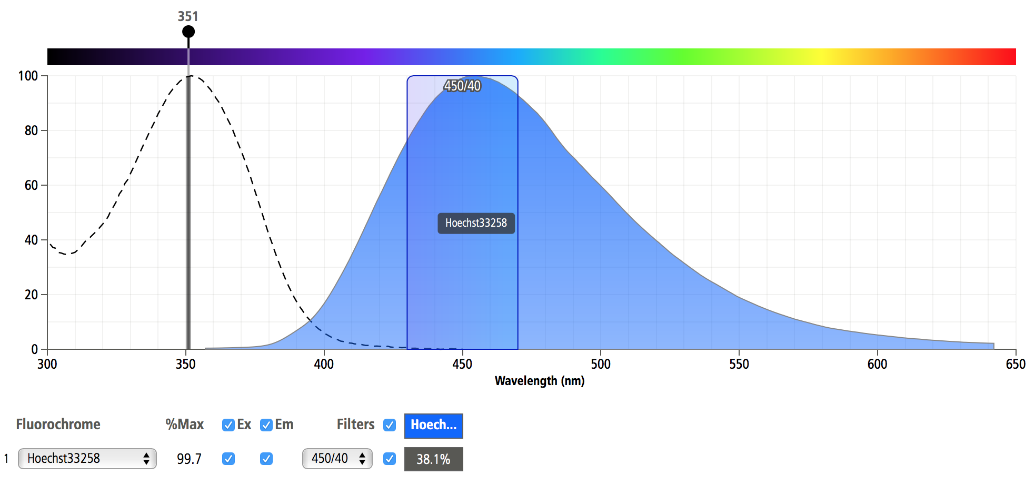
Hoechst
DNA-specific when bound at AT
  bind to sequences of 3 AT pairs
  bind to outer groove of DNA
    do not intercalate
Ex: ~350 nm (UV) Em: ~460 nm (blue)
300 nm 400 nm 500 nm 600 nm

Slide 12
Hoechst 33342
Can cross intact membranes
In/out of cell via drug efflux pump
  see varied staining among cell types
Stoichiometric if efflux pump blocked
  expose cells to 5-10 μM dye at least 30 min
Determine DNA content in living cells
  may then sort and characterize aneuploidy
Variably toxic to different cell types in different conditions
Notes:
drug efflux pump = p-glycoprotein
use of Ca channel blockers stops the pump
apoptosis
increased uptake of 33342
many strand breaks that can detect with FCM using
labeled oligos
hypodiploid peaks
point of sort aneuploids for further analysis...neoplastic cells

Slide 13
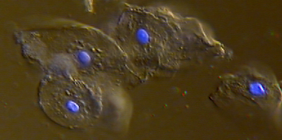
Hoechst
Use for DNA content and cell viability
  33342 for viability
Less needed to stain for DNA content than for viability
  decrease nonspecific fluorescence
Low laser power decreases CVs
Notes:
Ratio of 33342 fluorescence
510-560 (green) vs. 390-440 (violet)
different for different subclasses of chicken thymocytes
shift of 33258 emission toward green as [dye] increased
fixed rat thymocytes
low dye/Protein ratio, Hi affinity binding with hi QE yield blue fluorescence
as increased [dye], lower affinity binding to secondary sites, emission shifts toward green, and DNA precipitates

Slide 14
Hoechst 33342 + PI
Viability, membrane integrity
Spectral shift of 33342
  expose live cells to low [dye] in presence of PI
    exclude PI; retain small amounts of Hoechst
      shorter wavelength emission
  if lost membrane integrity, take up PI
  cells in transition exclude PI; accumulate > [Hoechst]
    emission at > wavelength
Notes:
emission pH dependent...keep between about 7 and 9 or will shift...e.g. to green if pH <7

Slide 15
DAPI/Hoechst fluorescence & Apoptosis
The question was whether DAPI/Hoechst fluorescence could be used for detection of apoptotic nuclei by flow. In this case, what compatible laser could be adapted to a FACSort? If not, would there be any alternative fluorescent probes for detection of apoptotic nuclei?
YO-PRO-1 works VERY well in distinguishing apoptotic cells. It makes dead cells highly fluorescent, apoptotic cells moderately fluorescent and live cells are dimly fluorescent or nonfluorescent. http://www.probes.com/handbook/figures/1517.html
It has green fluorescence only when bound to nucleic acids and uses only FL1 (525 nm), leaving other channels available for other colors.
It can also be used for imaging using fluorescein filters. The unbound dye is essentially nonfluorescent. http://www.ncbi.nlm.nih.gov/entrez/query.fcgi?cmd=Retrieve&db=PubMed&list_uids=7561136&dopt=Abstract
Source: From: Richard Haugland
Date: Thu Nov 08 2001 - 20:41:53 EST
http://www.cyto.purdue.edu/hmarchiv/current/0360.htm

Slide 16
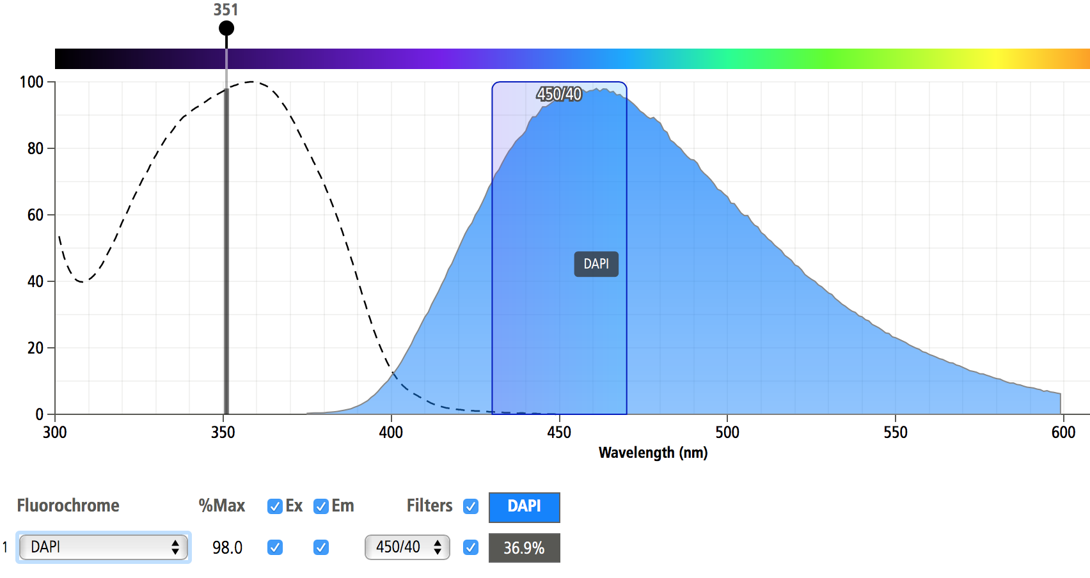
DAPI
DAPI = 4’-6-diamidino-2-phenylindole
  high DNA specificity - crosses intact membranes
  intense fluorescence - A-T specific; non-intercalating
  brighter than the Hoechst dyes
    Hoechst dyes ~86% brightness of DAPI/DIPI
  poorer CVs than Hoechst dyes
    2.2% vs 2.8 - 2.9 %

Slide 17
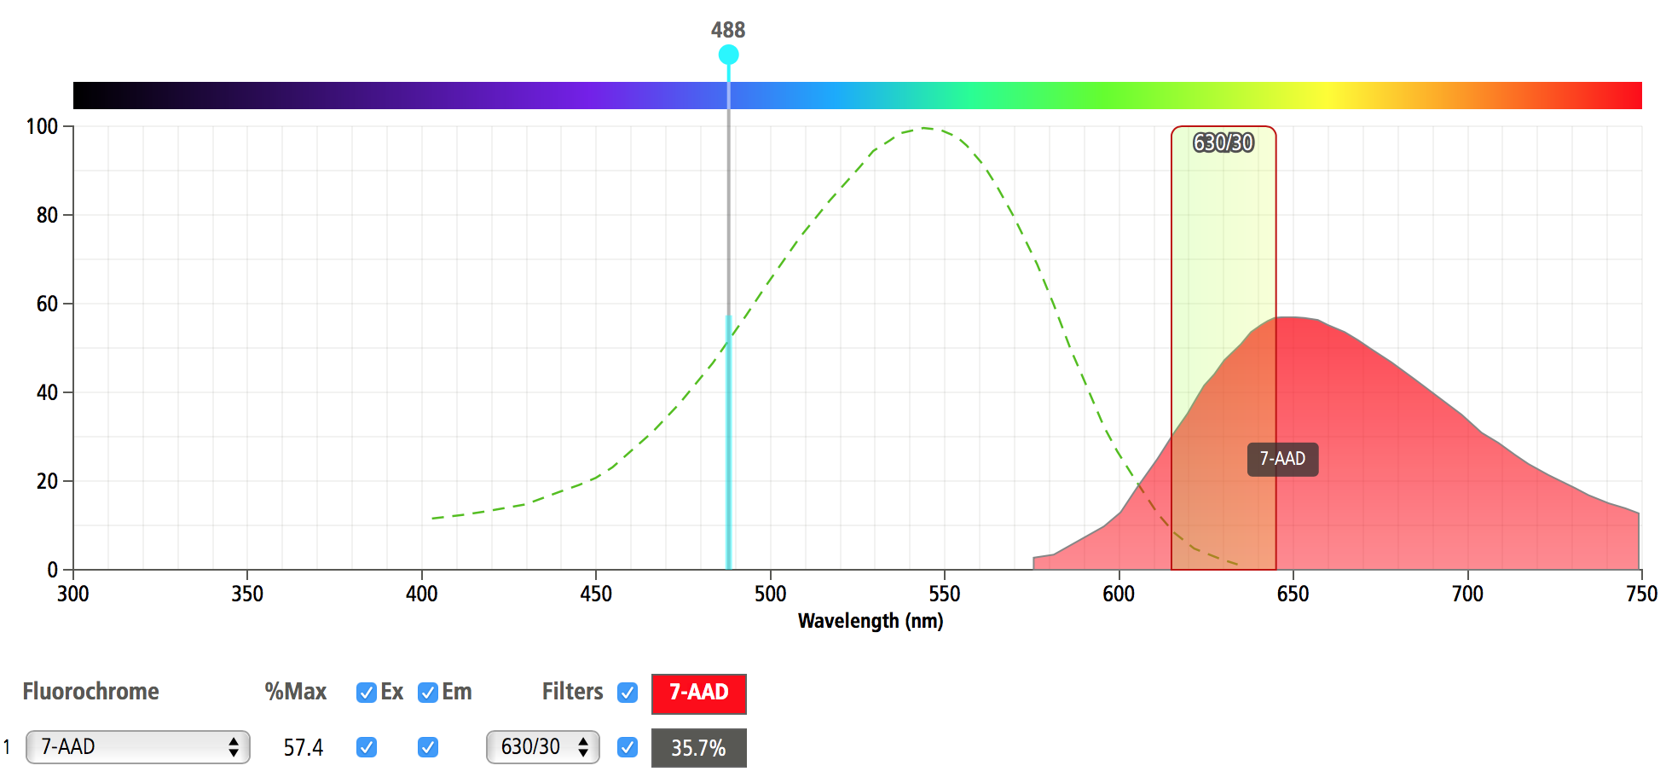
7-Aminoactinomycin D
Ex: ~550 nm
Em: ~660 nm
DNA-specific
  intercalates in G-C regions
  low quantum efficiency
Long emission wavelength
  with FITC & PE labeled Ab for simultaneous evaluation of DNA content and 2-color immunofluorescence using only 488 nm Ex
350
457
488
300 nm
400 nm
500 nm
600 nm
700 nm
Notes:
though Ex maximum is at ~550 nm, there is a wide range of excitation wavelength (half-maximum range is 450-575)
Em range is also wide; half-maximum is ~610-705; tenth-maximum emission range is ~575-750

Slide 18
7-Aminoactinomycin D
Used as live/dead probe
Does not cross intact membranes
  determine live/dead; loss of membrane integrity
  demonstrate apoptosis
Notes:
uptake by cells: necrotic>apoptotic>living
may combine with PI and then use with cells on which surface antigens are stained with FITC/PE
7AAAD + PI similar to HO33342 + PI

Slide 19
Cyanine Dyes
Thiazole orange, thiazole blue, thioflavin T and others
Stain both RNA and DNA
Quantum efficiency greatly increased when bound to NA
  very low when unbound
Cross membranes of intact cells
  will also enter mitochondria
Notes:
thioflavin T used as reticulocyte stain (Ex: 440 Em: 490-500)
base selectivity not established?
also thiazole orange--developed protocol for use as reticulocyte stain in clinical flow cytometer (FACScan) that had a fixed 488 Ar laser
Ex: 509 Em: 533
thiazole blue--Ex: ~640 Em:

Slide 20
Reticulocyte Analysis
150
150
112
112
RMI = 34
RMI = 0
Count
Count
75
75
37
37
0
.1
1
100
1000
0
1000
10
.1
1
10
100
log Thiazole Orange
log Thiazole Orange

Slide 21
Cyanine Dyes
TOTO-1 , YOYO-1, TOTO-3
  developed to have high binding affinity and high quantum efficiency
  homodimers of
    thiazole orange, oxazole yellow, thiazole blue
    positively charged side chains
  do not penetrate intact membranes
  not DNA-specific
    treat cells with RNase
Notes:
Shapiro suggests may have AT preference
(base selectivity still not established)

Slide 22
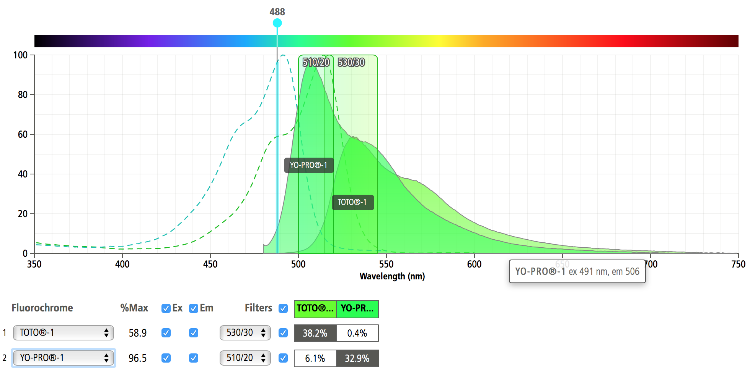
Cyanine Dyes
TOTO-1, YOYO-1, TOTO-3
  Ex: 514, 489, 642 nm Em: 533, 509, 660 nm
  bind strongly to NA
  equilibration time variable / long
    may have large CVs even after hours
  binding proportional to DNA content
Notes:
Shapiro suggests may have AT preference
(base selectivity still not established)
poss reason for long equilibration time = stick better
TOTO-1 Ex 514 Em 533
YOYO-1 Ex 489 Em 509
TOTO-3 Ex 642 Em 660

Slide 23
Cyanine Dyes
PRO dyes
  monomeric cyanines with quaternary ammonium groups that prevent their entry into intact cells
  intense fluorescence, high quantum efficiency

Slide 24
Cyanine Dyes
SYTO/SYTOX dyes
  SYTO dyes have various permeabilities for bacterial, fungal, and mammalian cells
  various DNA/RNA selectivity
  multiple Ex and Em spectra available
  SYTOX Green (Molecular Probes, Inc.)
    works as live/dead stain for Gm+ and Gm-
    Ex 488; high quantum efficiency

Slide 25
Acridine orange
Metachromatic
  green intercalated between base pairs
    excitation at ~488 emission at ~525
  red stacked on RNA or ss DNA
    excitation at ~457 emission at ~630
To differentiate DNA from RNA
  selectively denature dsRNA, not DNA
  stringent conditions ([AO] and ionic strength)
  can measure total cellular RNA
500
600
700
800
Notes:
picture is emission spectra only
acid-treat to selectively denature RNA
quantum efficiency actually decreases when bound to NA; the fluorescence is slightly quenched
under a microscope, fluorescence/phosphorescence of bound dye bleaches more rapidly than free dye so background decreases before bound...does not happen in flow cytometer so much background
green fluorescence of AO bound to DNA bleaches before red fluorescence/phosphorescence of AO bound to RNA
(lifetime of emission from RNA 15nsec so longer than just fluorescence)
the bright nuclear staining get with AO must be due to its increased concentration in the nucleus

Slide 26
Acridine orange
Disadvantages
  sticks to tubing
  very stringent conditions required
  similar emission spectra to FITC, PE, etc.
    poor for use in conjunction with fluorescent antibodies to surface receptors
  need detergent to permeabilize cells
    damage to surface markers
  if high DNA:RNA long tail of green emission into red can obscure fluorescence of RNA
(CH₃ )₂ N
N
N(CH₃ )₂
HCl

Slide 27
Pyronine Y
Intercalates in dsNA
  higher affinity for dsRNA
    rRNA, tRNA are labeled
    not total cellular RNA
Ex: 547-563 nm Em: 565-574 nm
  variation due to different base composition
Does not label ssRNA
  does bind, and complexes precipitate
  PY fluorescence quenched in precipitates
Notes:
PY can denature ds sections of RNA as can AO
fluorescence of PY bound to dsRNA can then be suppressed as the dsRNA is denatured and the bound ssRNA is precipitated and fluorescence quenched
if use low [dye] can get good labeling
in living cells PY also taken up in mitochondria and lysosomes...so in live cells may not be exactly RNA-specific...though Shapiro does not think this is a big proportion of PY staining...
if use high (mM) [PY] can get PY intercalation into DNA and then it is pretty much a DNA-specific fluorochrome...Shapiro says that a DNA-PY complex formed at low concentration is not fluorescent but can get a fluorescent complex with DNA if add millimolar amounts (as in 1st line)
dual labeling with HO 33342 and PY described for simultaneously detecting both RNA and DNA...requires dual excitation

Slide 28
RNA Content Standards
Nonstimulated peripheral blood lymphocytes
  conditions must be identical for lymphocytes and test population or cannot express RNA as index compared to lymphocytes
  treat with RNase and compare to determine RNase-specific fluorescence
  is a difference in RNA content between B and T lymphocytes

Slide 29
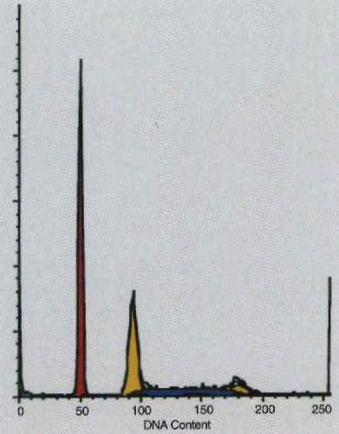
DNA Content Standards
Chicken and rainbow trout erythrocytes
  chicken: ~35% human diploid DNA content
  trout: ~80% human diploid DNA content
May use 2 standards to eliminate calibration errors due to nonlinearity due to signal processing circuitry
Cell Number
Notes:
DNA index
>1 hyperdiploid
<1 hypodiploid
both above = aneuploid
should be off by >10% to call either way
artifacts: doublets, shift of peak that cannot realize unless have standards in same tube so they move at the same time and the relative positions are maintained

Slide 30
Some examples of DNA Analysis
DNA Analysis
DNA Analysis
0
200
2N
400
600
4N
800
1000
PI Fluorescence
Aneuploid peak
0
200
400
600
800
1000
PI Fluorescence

Slide 31
DNA Synthesis
BrUdR and fluorochromes
  Hoechst + BrUdR
    decreased fluorescence of BrUdR-DNA vs plain DNA
  mithramycin + BrUdR
    increased fluorescence of mithramycin
  acridine orange + BrUdR
    green DNA-specific fluorescence decreased
Notes:
not sure what is advantage over tritiated thymidine except that not radioactive...similar potential problems

Slide 32
DNA Synthesis
Ratios and differences of Hoechst and mithramycin signals
  intensity indicates DNA content
  difference indicates amount incorporated
  ratio indicates amount incorporated
BrUdR incorporation detected by fluorescent antibodies
  requires DNA denaturation

Slide 33
Styryl Dyes
Heterocyclic rings with aminostyryl group
Predominantly stain DNA
Ex effectively at 488 nm Em: > 640 nm
Enters intact cells
  more intense staining if damaged membranes
Notes:
LDS-751, LL-585
may or may not have a base preference
combine with another NA stain and FlAb
extended leukocyte differentials, platelet, and reticulocyte counts on unlysed, unfixed whole blood

Slide 34
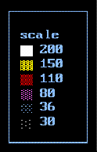
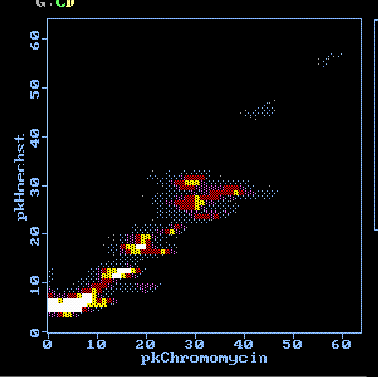
Chromosome Analysis
(Bivariate Flow Karyotyping - porcine)
chromosome 1
chromosome 2

Slide 35
Ethidium monoazide
Positively charged
Excluded by cells with intact membranes
  add to cells before fix, then crosslink photochemically with visible light
  wash, stain with fluorescent antibodies, fix
  ethidium retained only in nuclei of cells that had damaged membranes prior to fixation
  may distinguish fluorescence from that of PE and FITC

Slide 36
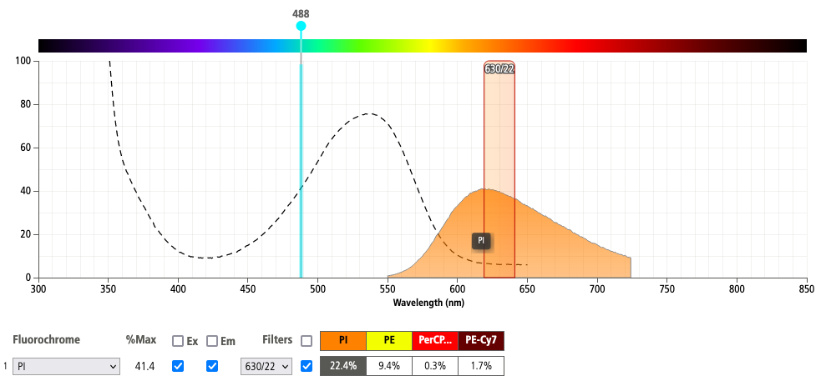
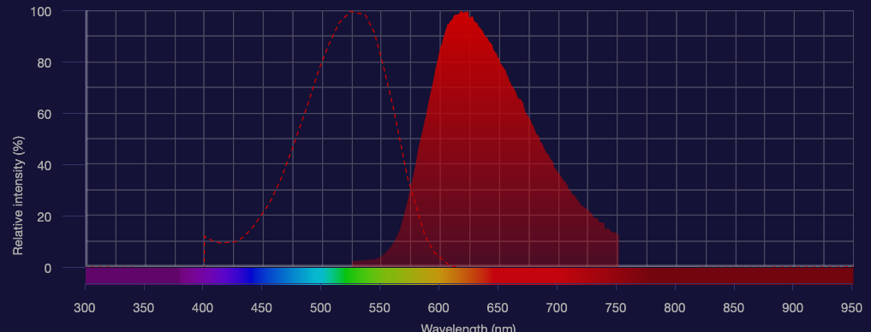
Spectra of PI and EtBr
Ethidium
Notes:
note that can excite EtBr at both 320-360 and at 480 - 550 to get the red fluorescence

Slide 37
DNA & RNA Parameters
Total DNA & RNA content
Nucleic acid sequence
Cell cycle analysis
Chromosome analysis
Reticulocyte analysis
Live/dead
  membrane integrity/potential

Slide 38
Thiozole
Cyanine Dyes
Thiazole Orange, Thiazole Blue, Thioflavin T and others
Stain both RNA and DNA
Quantum efficiency greatly increased when bound to NA
  very low when unbound
Cross membranes of intact cells
  will also enter mitochondria
Notes:
thioflavin T used as reticulocyte stain (Ex: 440 Em: 490-500)
base selectivity not established?
also thiazole orange--developed protocol for use as reticulocyte stain in clinical flow cytometer (FACScan) that had a fixed 488 Ar laser
Ex: 509 Em: 533
thiazole blue--Ex: ~640 Em:

Slide 39
Applications for ploidy analysis
ploidy determination
DNA index
S phase measurement

Slide 40
Normal Cell Cycle
300
G₀
- G₁
G₀
G₂
M
G₀
225
G₁
s
150
Cell Count
75
s
G₂
M
0
0
200
400
600
800
1000
2N
4N
DNA Content

Slide 41
Dual Staining of Cells
Nuclear probes
c-myc, c-fos, p53 monoclonal Ab
Cytoplasmic protooncogene probes
‘ras’, ‘neu’ monoclonal Ab
Cell surface antigens
p-glycoprotein
Breast carcinoma
identify ploidy with PI
identify epithelial origin with
  cytokeratin antibody

Slide 42
Cell Damage

Slide 43
Adduct Formation
H O
2
H+
OH
O
O
HO
-
e
NH
NH
2
2
8-hydroxydeoxyguanosine

Slide 44
Dual staining for esterase/DNA
The leakage rate of fluorescein (from fluorescein diacetate, #3 in the figure below)) from live cells is really too fast. We normally recommend calcein AM (#1 in the figure below) as the green-fluorescent "viability probe" for both imaging and flow cytometry.
BCECF AM is also suitable but the fluorescence of its intracellular product (BCECF) is pH sensitive, whereas that of calcein is not.
The fast leakage rate of fluorescein makes it difficult to get reproducible results because the initial intensity of the live cells decreases so fast and also makes the time zero fluorescence difficult to measure Loading and retention characteristics of intracellular marker dyes.
Cells of a human lymphoid line (GePa) were loaded with the following cell-permeant acetoxymethyl ester (AM) or acetate derivatives of fluorescein: 1) calcein AM (C-1430, C-3099, C-3100), 2) BCECF AM (B-1150), 3) fluorescein diacetate (FDA, F-1303), 4) carboxyfluorescein diacetate (CFDA) (C-1354) and 5) CellTracker Green CMFDA (5-chloromethylfluorescein diacetate, C-2925, C-7025). Cells were incubated in 4 µM staining solutions in Dulbecco's modified eagle medium containing 10% fetal bovine serum (DMEM+) at 37°C. After incubation for 30 minutes, cell samples were immediately analyzed by flow cytometry to determine the average fluorescence per cell at time zero (0 hours). Retained cell samples were subsequently washed twice by centrifugation, resuspended in DMEM+, maintained at 37°C for 2 hours and then analyzed by flow cytometry. The decrease in the average fluorescence intensity per cell in these samples relative to the time zero samples indicates the extent of intracellular dye leakage during the 2-hour incubation period. [Image]
This discrimination is probably best done in combination with ethidium homodimer-1 for dead cells, although propidium iodide is almost as suitable (ethidium homodimer is less likely to be taken up by apoptotic cells, however, than is propidium iodide.) Normalized fluorescence emission spectra of calcein (C-481) and DNA-bound ethidium homodimer-1 (EthD-1, E-1169), both of which can be excited at 488 nm by the argon-ion laser.
Source: From: Richard Haugland (richard.haugland@probes.com)
Date: Thu Feb 07 2002 - 22:29:58 EST
http://www.cyto.purdue.edu/hmarchiv/current/1043.htm

Slide 45
Doublet/aggregate Subtraction
2 x G1
G1
G2
Laser beam
width
PMT
Signal
Height
Cell + beam
width
Peak
Height
Slide: Supplied by David Hedley

Slide 46
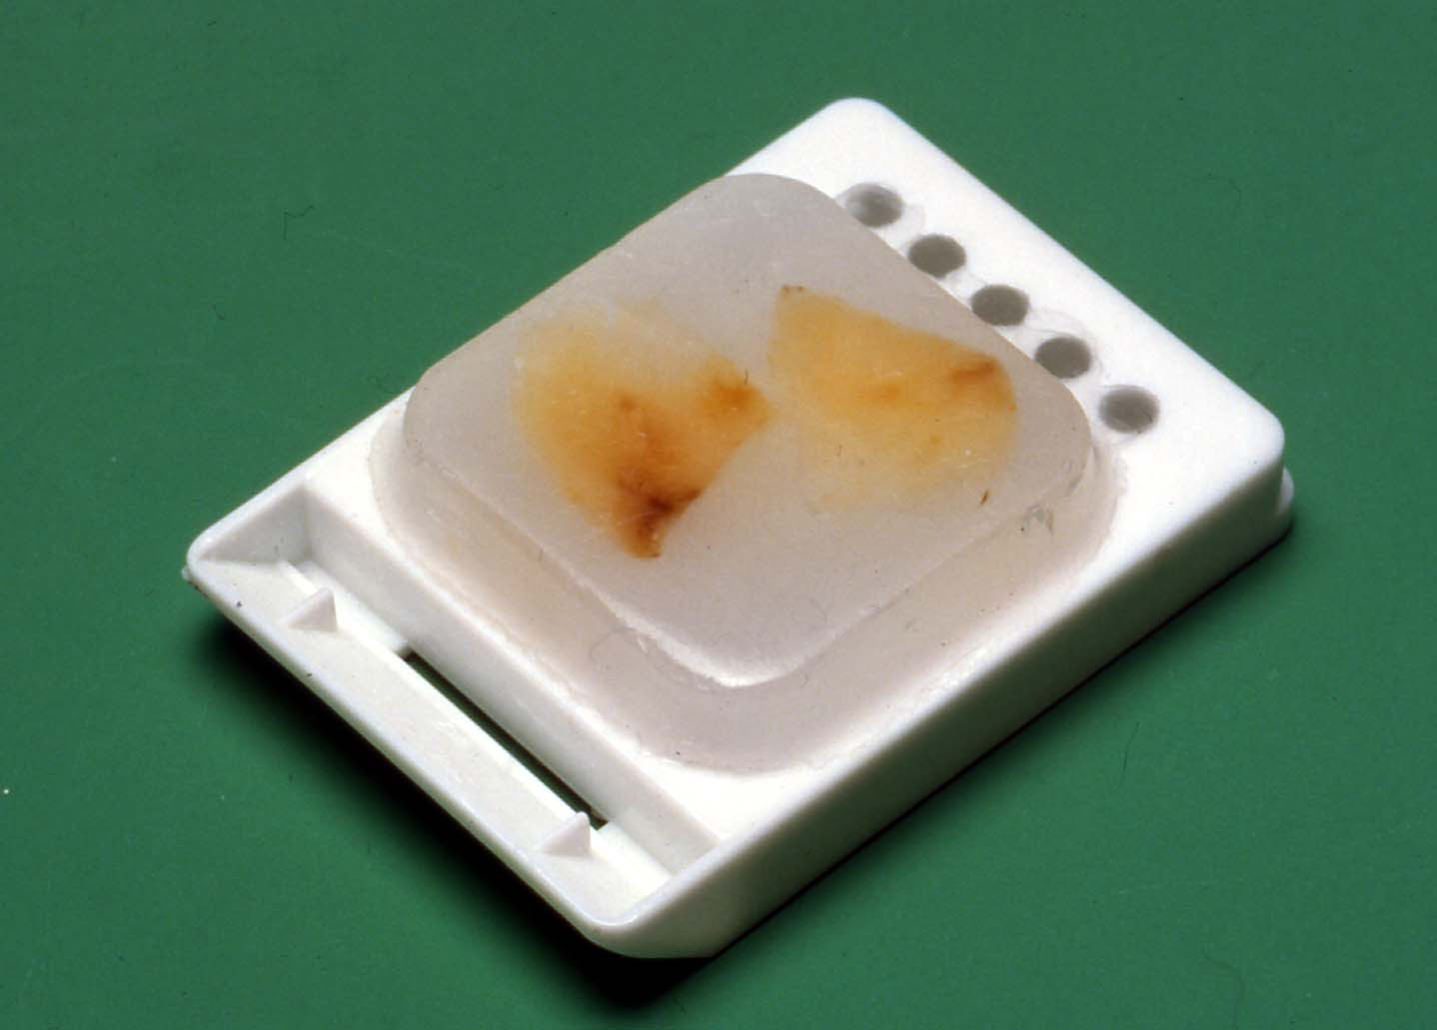
Use of Archival Material for DNA Flow
David Hedley
J Histochem Cytochem 1983;31:1333-1335
Use formaldehyde-fixed, paraffin embedded blocks
Allows retrospective study of patient populations with known outcome
Slide: Supplied by David Hedley

Slide 47
Method for Paraffin Blocks
1-3 thick (>30 μm) microtome sections
Dewax in xylene, then rehydrate through graded alcohols (as for immunohistochemistry)
Digest using 0.5% pepsin pH = 1.5
Best stain is DAPI; can also use propidium iodide
Slide: Supplied by David Hedley

Slide 48
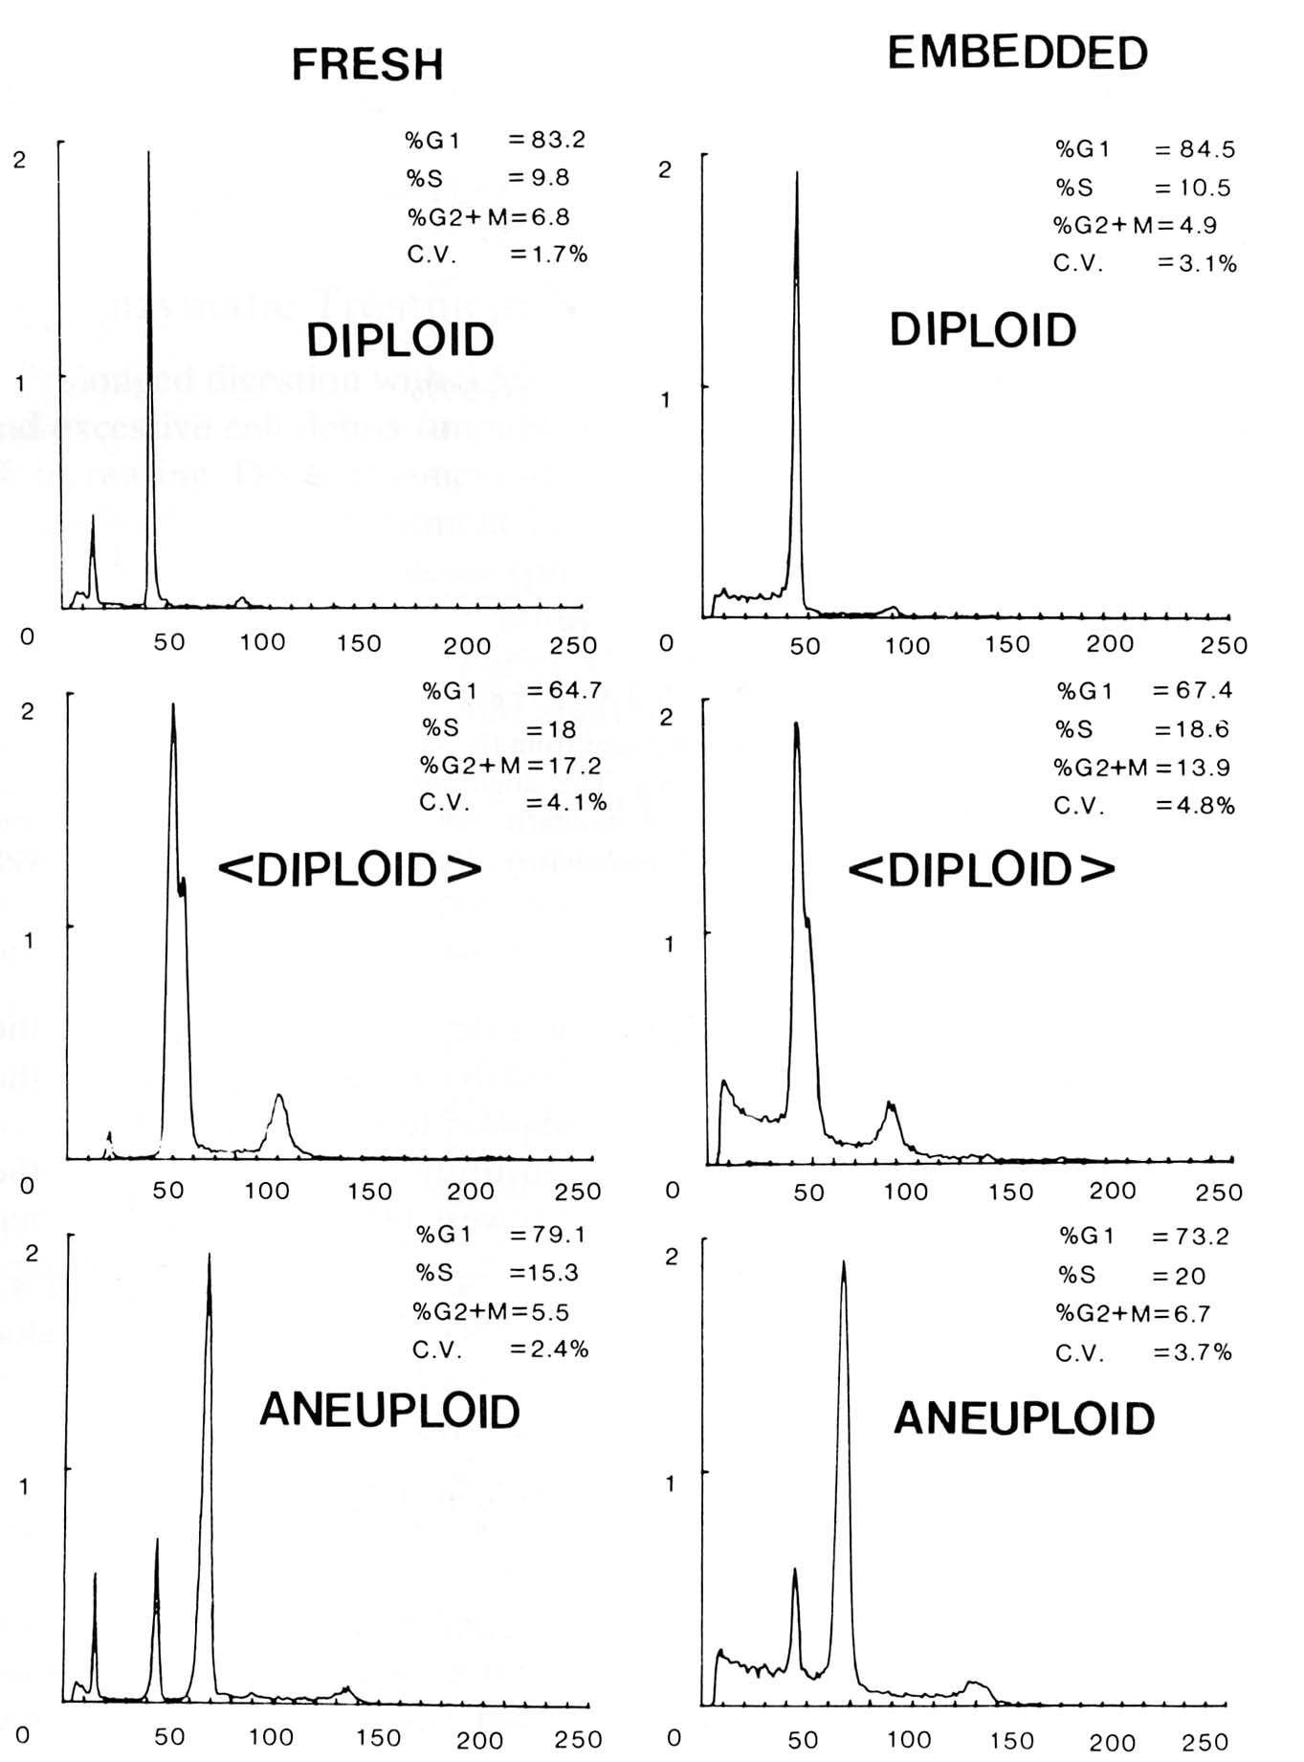

Comparison of Fresh vs Embedded: Same Tumor
Original Sydney series
Surgical biopsies
- one piece mechanically disaggregated with triton X-100 in medium
- remainder fixed in formaldehyde, and processed through to paraffin blocks
Used DAPI as DNA stain, on ICP-22 flow cytometer.
Slide: Supplied by David Hedley

Slide 49

Xploid Demonstration

Slide 50
Summary
Nucleic acid dyes - Each dye has specific properties
DNA/RNA specific probes must be carefully selected
Nature of assays using DNA probes – time of incubation is important
Applications of DNA probes – cell cycle analysis – looking for chromosomal aberrations, etc
Chromosome sorting and analysis
http://www.cyto.purdue.edu

