Slide 1
BMS 631 - LECTURE 11 Flow Cytometry: Theory
Sorting
J. Paul Robinson
SVM Professor of Cytomics
School of Veterinary Medicine,
Professor of Biomedical Engineering
School of Engineering
Purdue University
Notice: The materials in this presentation are copyrighted materials. If you want to use any of these slides, you may do so if you credit each slide with the author’s name. It is illegal to copy this presentation to CourseHero or any other on-line theft system.
Lynn Hall G221
Purdue University
Office: 494 0757
email: robinson at flowcyt.cyto.purdue.edu
WEB http://www.cyto.purdue.edu

Slide 2
The Elements of Flow Sorting
Sample Preparation
Hardware Setup
Droplet formation
Timing
Coincidence - Purity and Efficiency
Sterile Sorting Concepts

Slide 3
Optical Design
PMT 5
PMT 4
Sample
PMT 3
Dichroic
Flow cell
Filters
PMT 2
Scatter
PMT 1
Laser
Sensor
Bandpass
Filters

Slide 4
Sample Preparation
The sample must be a single cell suspension
The suspending fluid must be an electrolyte ie must conduct electricity
High sample concentration is required to obtain adequate numbers
Rare populations are very difficult to sort and require special attention (not dealt with in this section)

Slide 5
Cell Sorting
488 nm laser
FALS Sensor
Fluorescence detector
-
+
Charged Plates
Single cells sorted
into test tubes
J. Paul Robinson - Purdue University Cytometry Laboratories

Slide 6
Sample in
Sheath
Stream
Charge
Figure 1 The central component of a flow cytometer is the flow cell. A cutdown of a typical flow cell indicates the salient features. Sample is introduced via the sample insertion rod. Sheath fluid (usually water or saline) is introduced to surround the insertion rod causing hydrodynamic focussing of flowing cells which are contained within a core fluid. The laser intersects the fluid either outside the flowcell (in air) or in a slightly extruded portion of the flow cell tip (in quartz).
Piezoelectric
crystal oscillator
Sheath in
Sensors
SORT DECISIONS
Laser beam
Sensor
SMALL BEAD
LARGE BEAD
Last attached
droplet
SORT LEFT
SORT RIGHT
+4KV
-4KV
Frequency Histogram
LEFT
RIGHT
Signals are collected from several sensors placed forward or at 90° to the laser beam. It is possible to “sort” individual particles. The flow cell is resonated at a frequency of approximately 32KHZ by the piezoelectric crystal mounted on the flow cell. This causes the flowing stream to break up into individual droplets. Gating characteristics can be determined from histograms (shown right) and these can be used to define the sort criteria. These decisions are all controlled by the computer system and can be made at rates of several thousand per second.
Waste
SMALL BEAD
LARGE BEAD

Slide 7
Droplet formation
As liquid is ejected into air, it will form droplets. By vibrating the nozzle at a defined frequency, the size of these droplets and the position along the stream where they form can be controlled with great precision.
Last Attached Droplet
Satelite droplet
(Slide from Robert Murphy)
T. Lindmo, D.C. Peters & R.G Sweet - MLM Chapt. 8

Slide 8
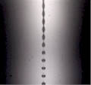
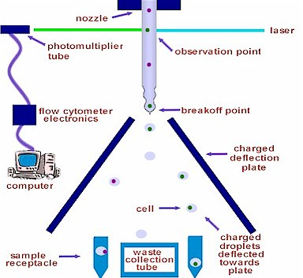
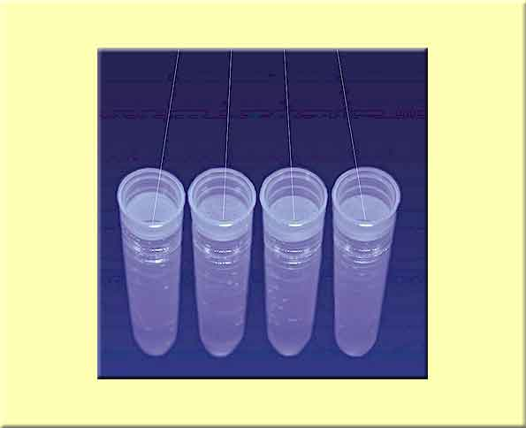

Sorting principle
-
+
☺

Slide 9
Timing
(Slide from Robert Murphy)
T. Lindmo, D.C. Peters & R.G Sweet - MLM Chapt. 8

Slide 10
Coincidence - Purity
As droplets form, they can contain wanted cells as well as unwanted cells. If all droplets containing a wanted cell are sorted (regardless of whether they also contain unwanted cells), the purity of the sorted sample will be reduced.
(Slide from Robert Murphy)

Slide 11
Coincidence - Purity
The purity can be improved by checking for coincidence events and not sorting any wanted cell that occurs too close to an unwanted cell.
This causes an increase in purity but a reduction in sorting efficiency.
(Slide from Robert Murphy)

Slide 12
Coincidence - Efficiency
The efficiency of sorting (with coincidence checking) for three-droplet sorting (solid lines) and one-droplet sorting (broken line) is shown as a function of event rate.
(Slide from Robert Murphy)
T. Lindmo, D.C. Peters & R.G Sweet - MLM Chapt. 8

Slide 13
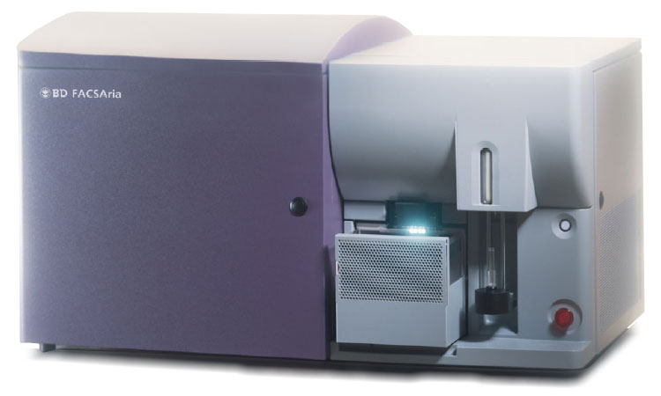
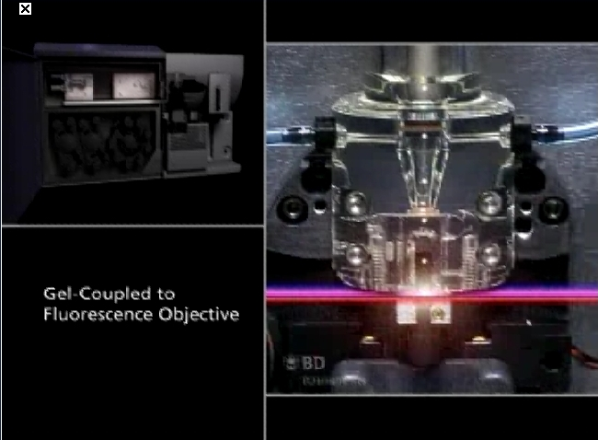
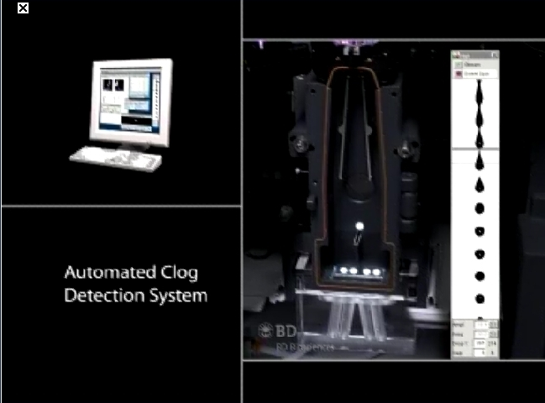
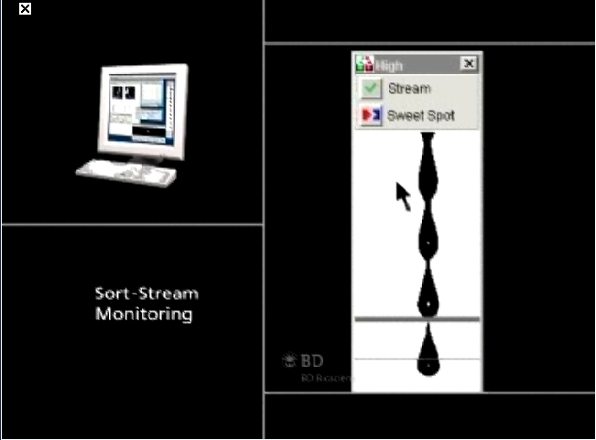
Aria
Images from BD Website and Public Presentations

Slide 14
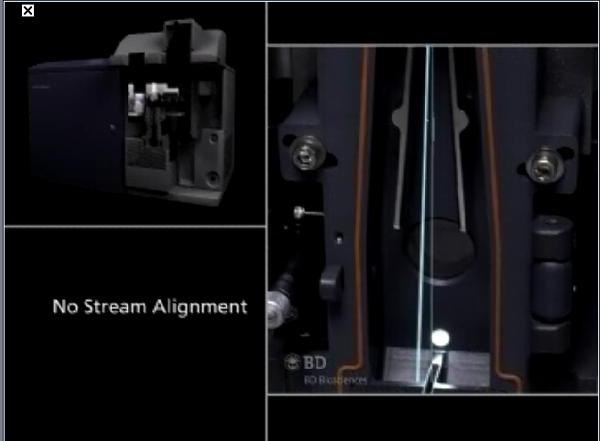
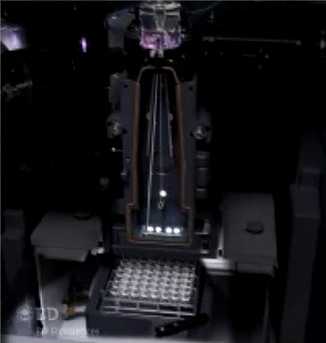
Images from BD Website and Public Presentations

Slide 15
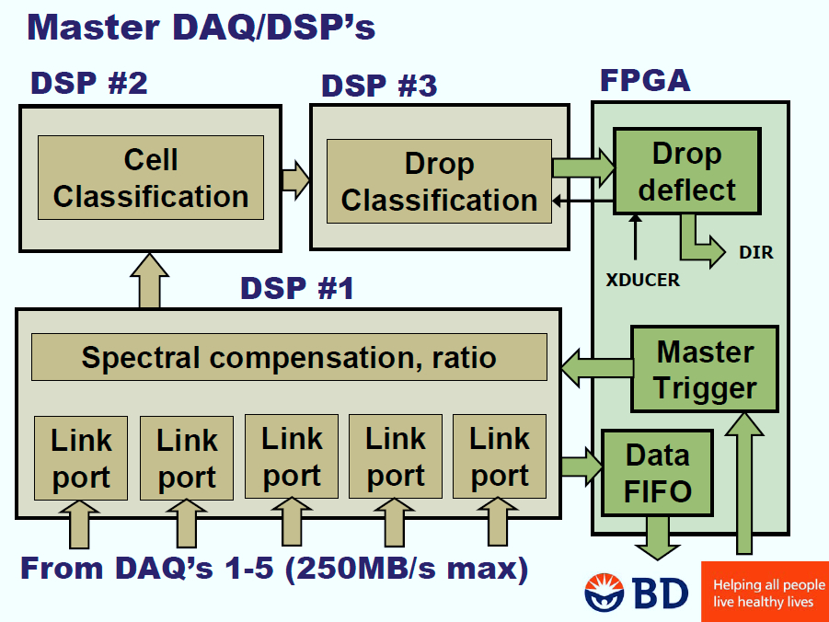
Images from BD Website and Public Presentations

Slide 16
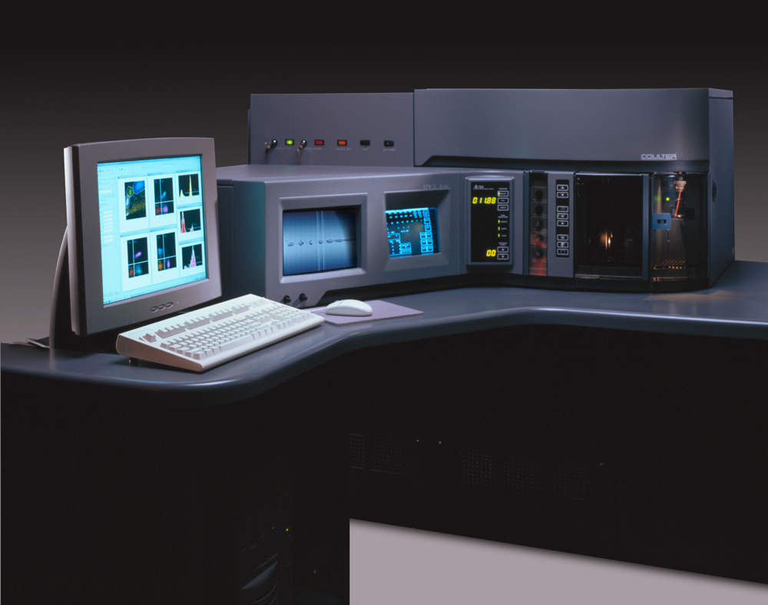
Elite-Altra

Slide 17
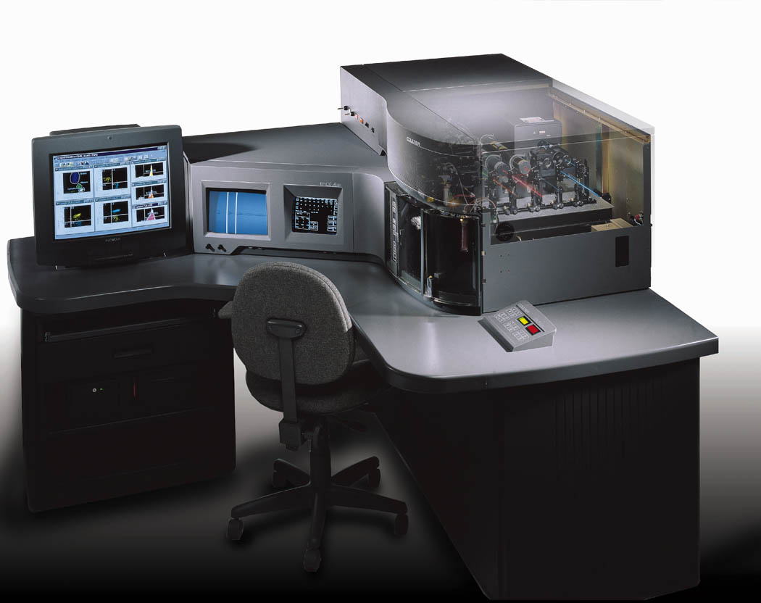
Images from BC Website and Public Presentations

Slide 18
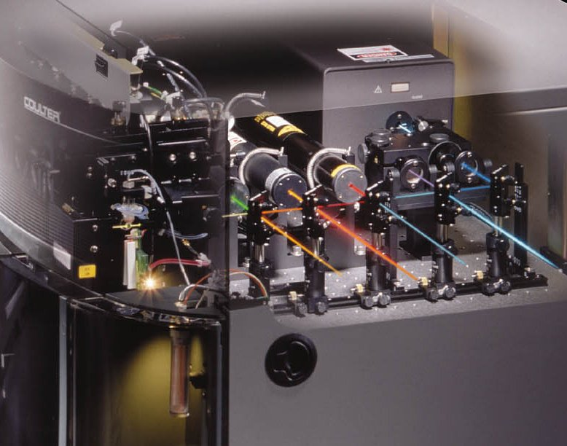
Images from BC Website and Public Presentations

Slide 19
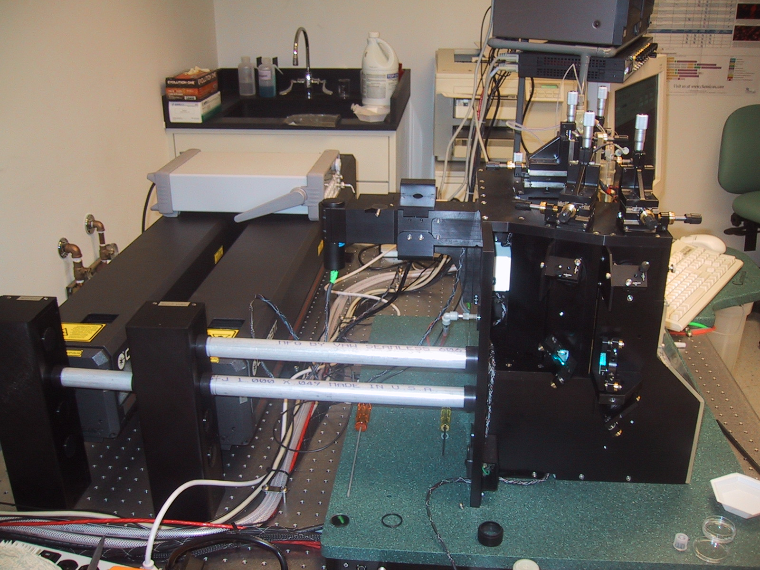
Cytopia (Now BD)
Photo by JPR

Slide 20
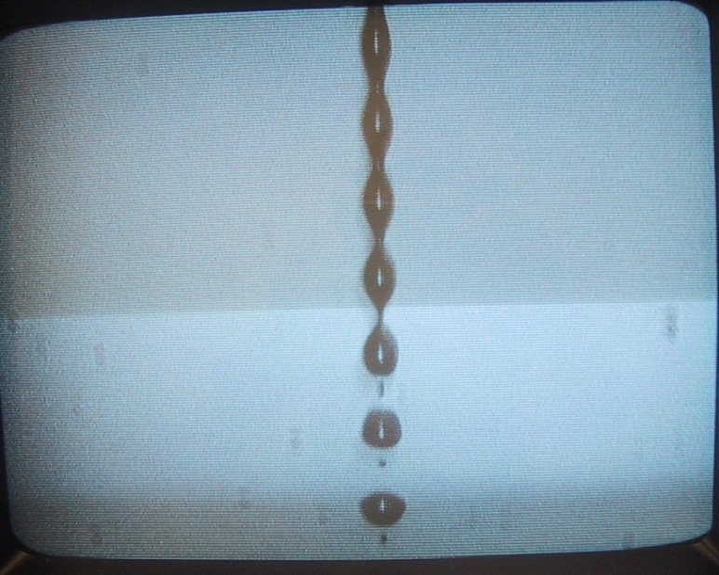
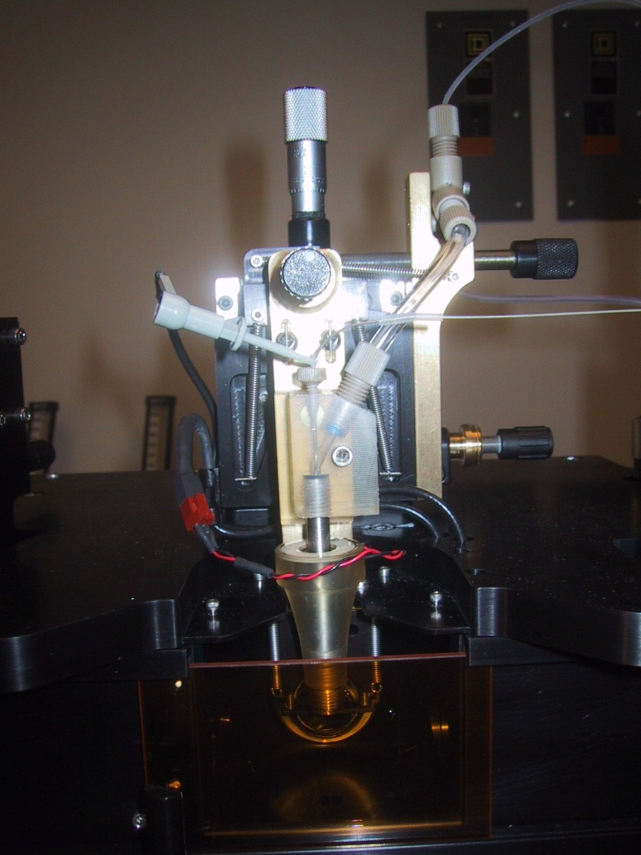
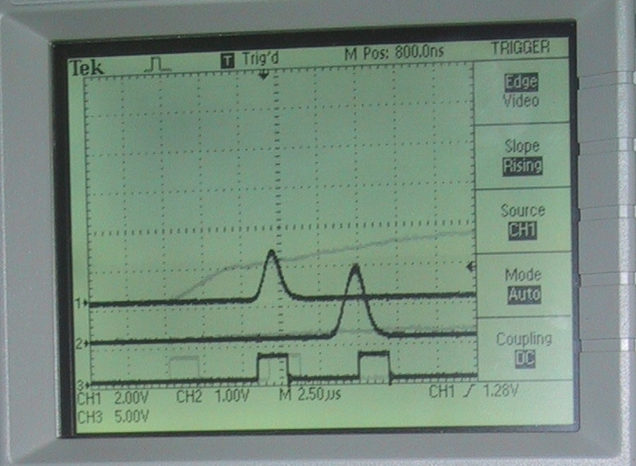
Cytopia (Now BD)
Photo by JPR

Slide 21
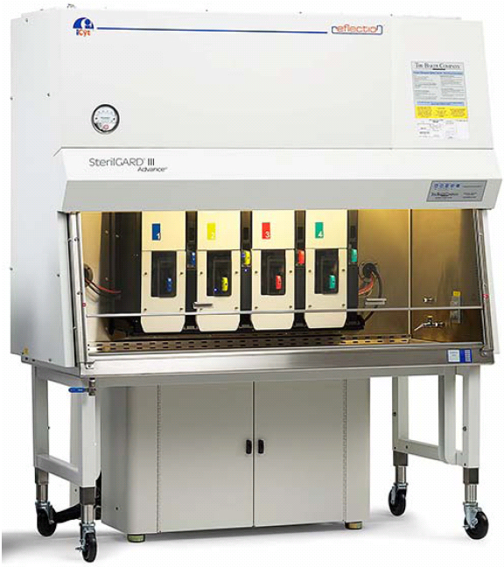
Icyt-Sony Reflection Sorter

Slide 22
Reflection Key features
Listmode Parameters: Up to 256
Pulse features (area, height, width, rise time)
Sort decisions (cell sort classification, droplet stream classification)
Time interval between pulses
Custom programmable pulse features
Fluorescence Compensation: Full matrix among all features
Simultaneous Laser Excitation Lines: Up to 7 (355, 405, 488, 532, 561, 592, 640 nm)
Laser Options: Any vendor, any configuration with industry standard optical table
Nozzle Sizes: 50 μm to 200 μm
Measurement Dynamic Range: >10,000 x
Measurement Precision: CV of < 1%
Narrow Forward Scatter Collection Angle: 1 to 5 degrees half-angle
Optional Wide Forward Scatter Collection Angle: 5 to 41.3 degrees half-angle
Number of Analysis Regions: Greater than 512
Number of Separate Sort Gates (Based on Boolean Expressions of Region): Up to 256
AOTF (Acousto-Optical Tunable Filter) with < 3 nm resolution
16 channel spectrometer (370 nm to 730 nm)
Amplitude modulation (either directly or with EOM) from 5 to 40 MHz
Secondary fluorescence collection optic
Sort deposition system
Biohazard containment: Baker SterilGard ® III Advance hood integration

Slide 23
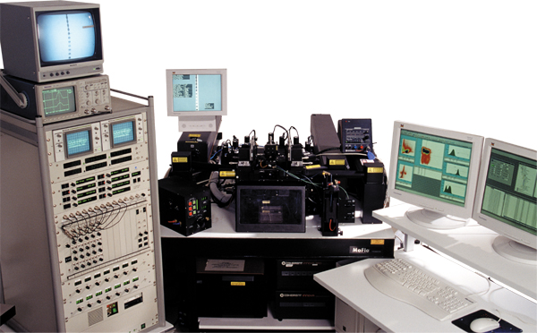
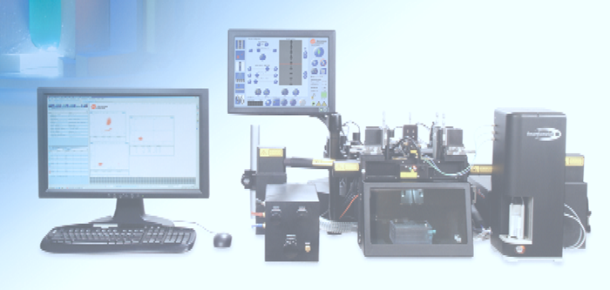
Moflo sorter
Images from BC Website and Public Presentations

Slide 24
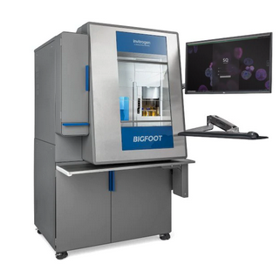
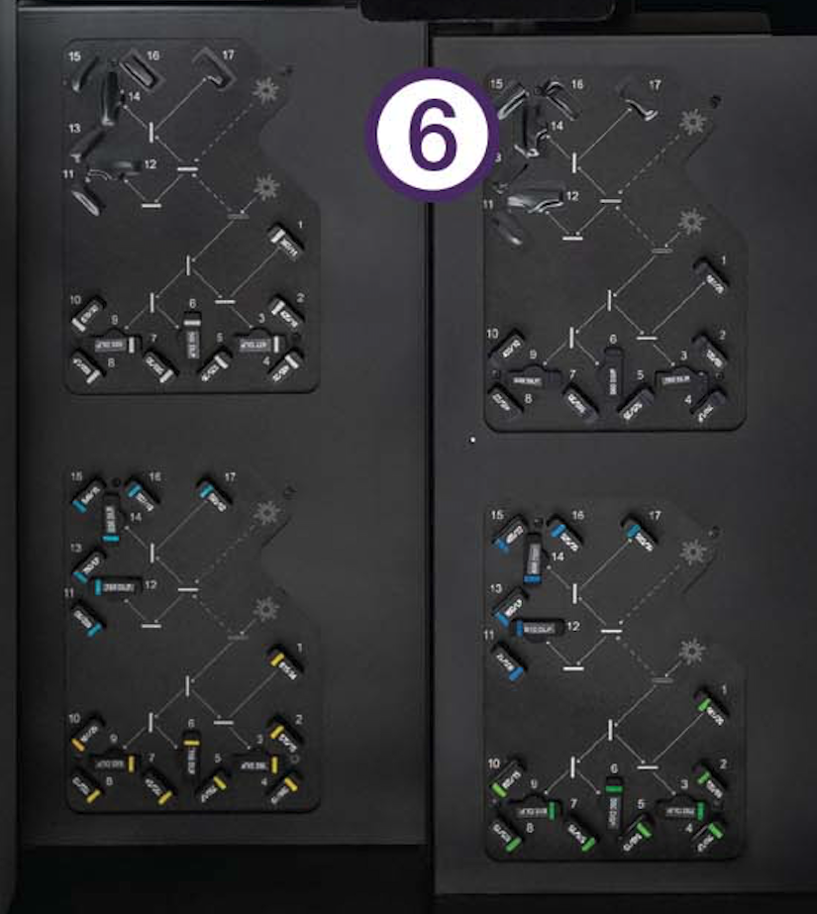
BigFoot - ThermoFisher

Slide 25
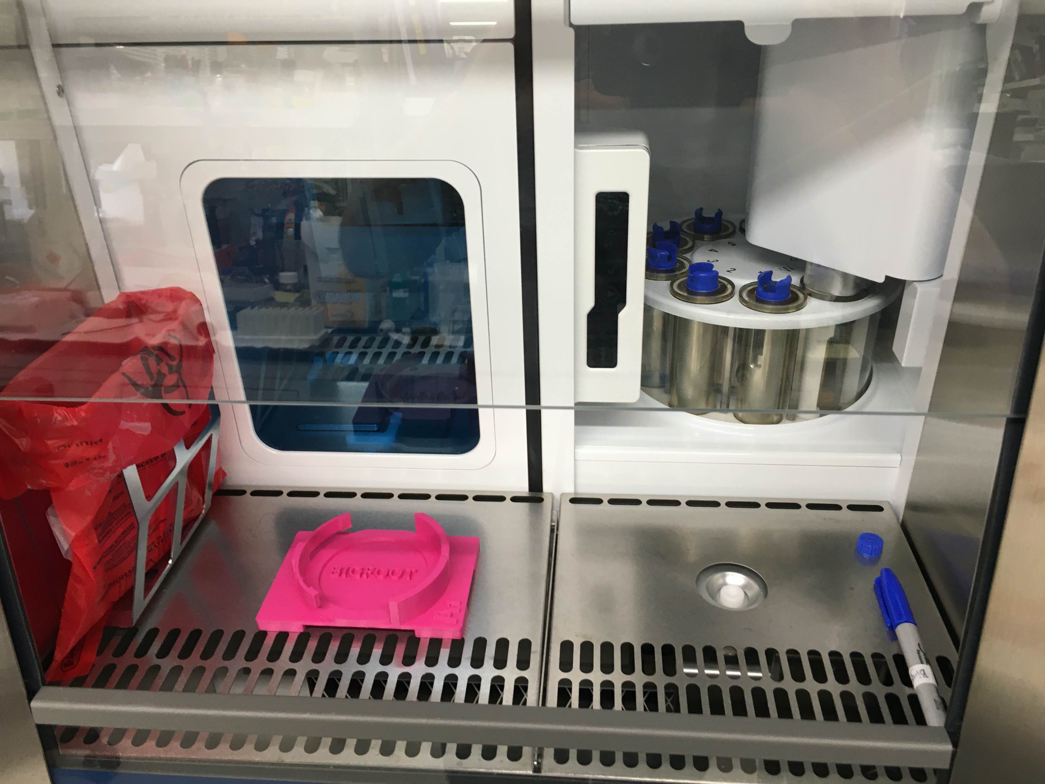
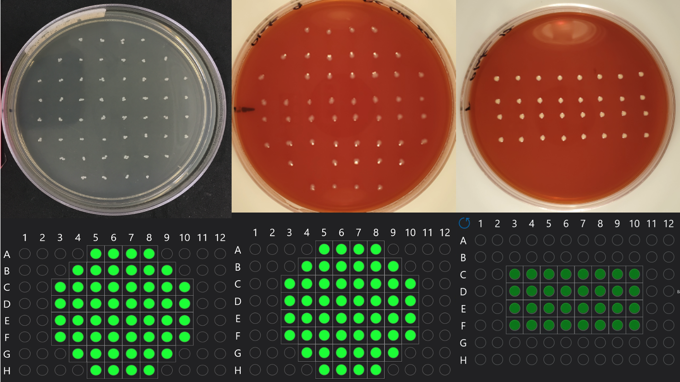
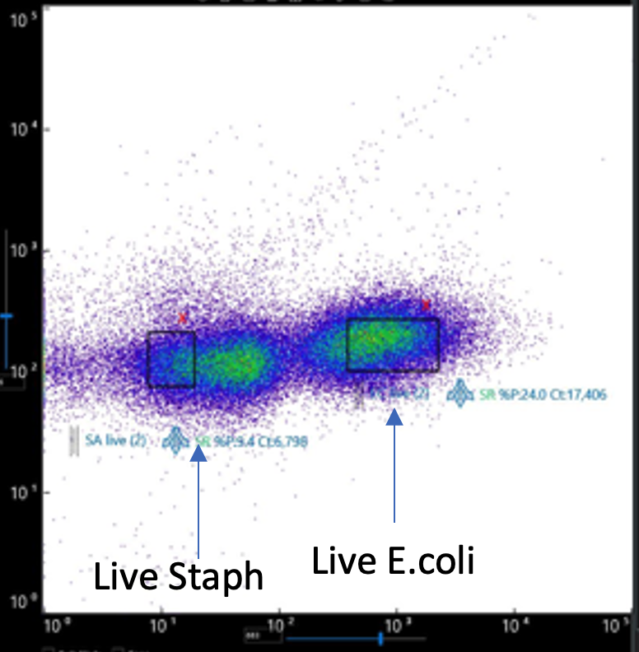

Slide 26
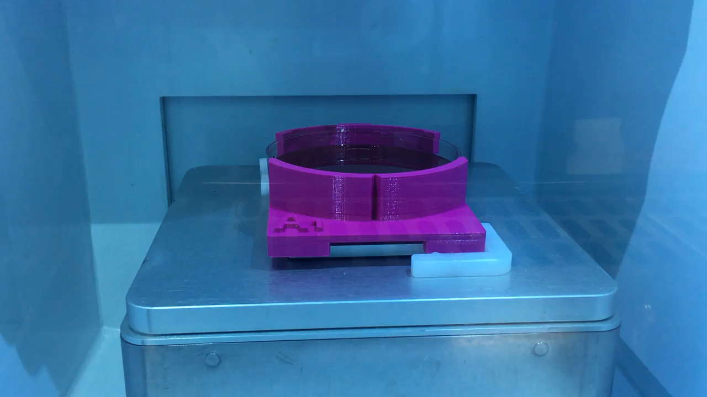

Slide 27
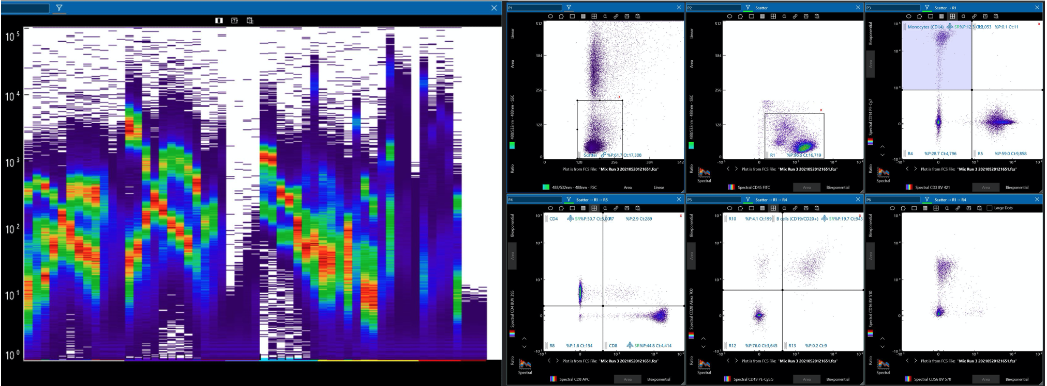
Spectral Sorting Capacity

Slide 28
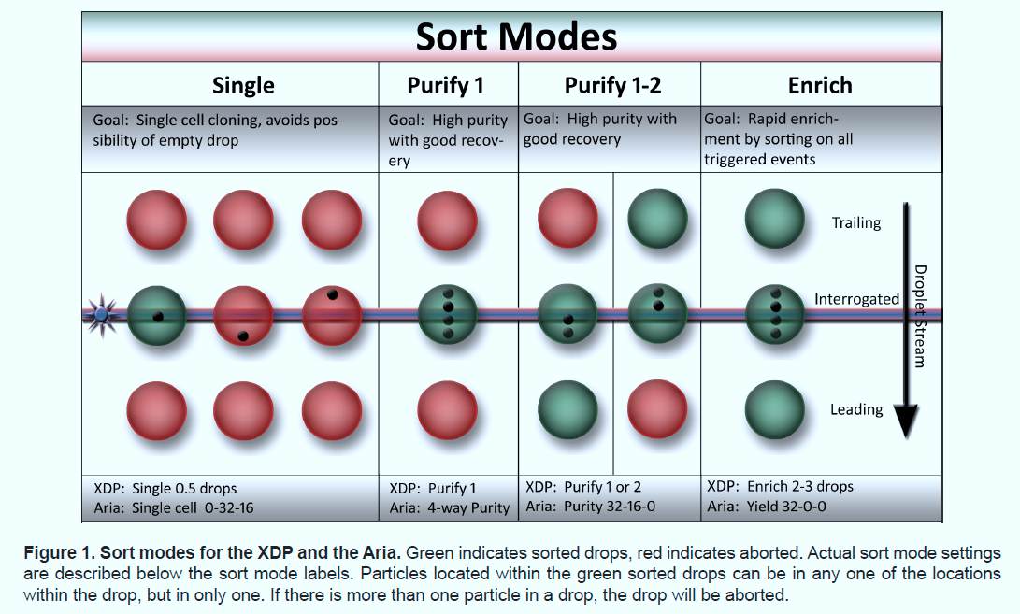
Images from BC Website and Public Presentations

Slide 29
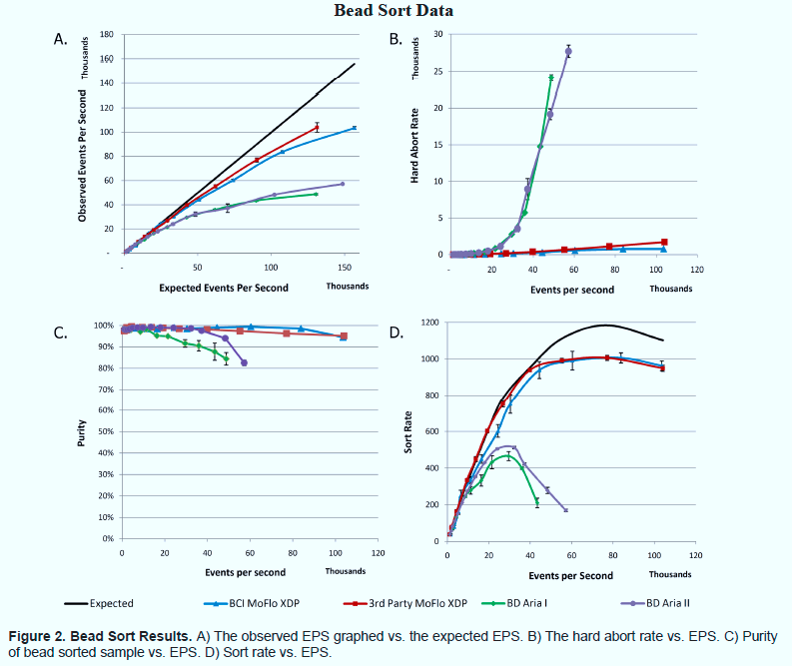
Note: This is not an endorsement of this instrument. Data are from a commercial brochure
Images from BC Website and Public Presentations

Slide 30
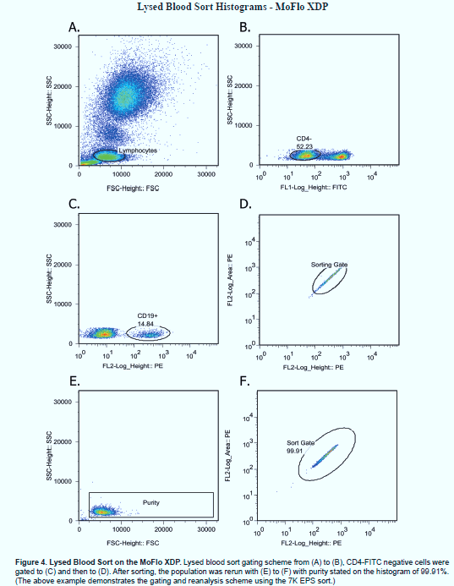
XDP sorting of Lysed Blood example
Note: This is not an endorsement of this instrument. Data are from a commercial brochure
Images from BC Website and Public Presentations

Slide 31
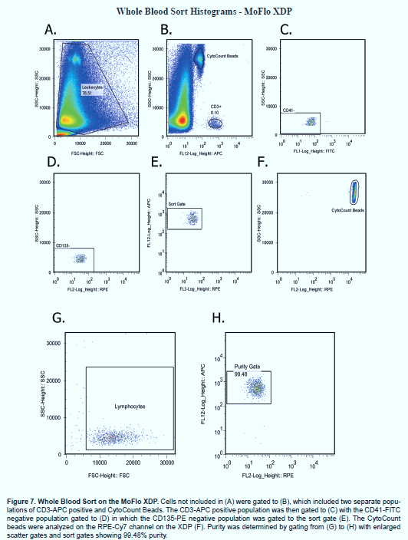
XDP sorting of Whole Blood example
Note: This is not an endorsement of this instrument. Data are from a commercial brochure
Images from BC Website and Public Presentations

Slide 32
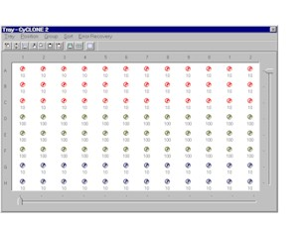
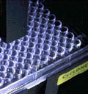
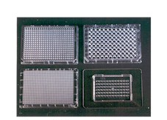
Automatic plate deposition is standard on most systems

Slide 33
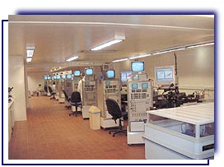
XY technologies – sperm sorting

Slide 34
BD Sorters

Slide 35
Sony Sorters

Slide 36
Beckman Sorters

Slide 37
Nanosellect Cell Sorter

Slide 38
BioRad Sorters

Slide 39
Miltenyi Biotec
autoMACS® Pro Separator

Slide 40
Human Sperm Sorting
MicroSort® Current Results
XSORT®
XSORT® to increase the probability of conceiving a girl has resulted in an average of 88% X-bearing (female) sperm in the enriched specimen and 91% of the babies have been female. (295/325)
YSORT®
YSORT® to increase the probability of conceiving a boy has resulted in an average of 73% Y-bearing (male) sperm in the enriched specimen and 76% of the babies have been male. (39/51)
Conception Rate
The MicroSort Clinic average cumulative IUI clinical pregnancy rate is 16.6% (242/1452) per treatment cycle. The overall IVF/ICSI clinical pregnancy rate is 33% (164/497) This includes MicroSort collaborators doing IVF/ICSI.
Pregnancies & Births
As of January 2004, more than 500 pregnancies have been achieved using MicroSort®; 419 babies have been born so far with many more due to deliver.
Source: http://www.microsort.net/index.htm

Slide 41
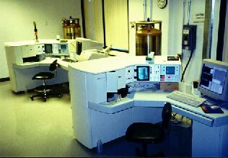
Microsort Sperm Sorting Facility
From the Microsort Website
Sperm Sorting (Gender Selection) for Prevention of X-Linked Diseases and for Family Balancing
The Genetics & IVF Institute (GIVF) reported the first human births in the world following flow cytometric separation of X (female) and Y (male) chromosome-bearing sperm cells (MicroSort).
“Concerns regarding the use of UV and Hoechst 33342 (bisbenzimide) for FCS of human sperm cells have been expressed (Ashwood-Smith, 1994 and Munne, 1994) and clarified (Johnson and Schulman, 1994). Bisbenzimide is a non-intercalating non-cytotoxic DNA stain that preferentially binds to triplet adenine and thymine base pairs in the minor groove outside of the double helix and is reversible at 37C. Hoechst 33342 absorbs at 358nm, a substantial distance from the maximum DNA absorption of approximately 260nm, excites at 367nm and emits at 461nm. While some somatic cells have been found to be sensitive to bisbenzimide staining (Van Zandt and Fry, 1983; Durand and Olive, 1982), sperm nuclear DNA has undergone changes including compaction and stabilization that is uniquely different from other cell types. Watkins et al. (1996) found no evidence of mutagenicity of human sperm cells stained with <900 M bisbenzimide as assessed by PCR analysis of the B-globin gene. Catt et al. (1997) also reported no increase in the incidence of endogenous DNA nicks in human sperm cells after bisbenzimide staining and UV exposure during passage through a fluorescence activated cell sorter. Concerns regarding embryo development in the bovine (Cran et al., 1994) and rabbit (McNutt and Johnson, 1996) were not observed in our human experience that resulted in a 92% embryo cleavage rate (unpublished data) and 21.2% pregnancy rate per transfer cycle. Most important, as in the animal data in several species with hundreds of normal births, all offspring born from FCS of human sperm have been normal and healthy.”
Births of normal daughters after MicroSort sperm separation and intrauterine insemination, in-vitro fertilization, or intracytoplasmic sperm injection”, E.F.Fugger, S.H.Black K. Keyvanfar, J.D. Schulman
NOTE: The FDA withdrew Microsort license to perform human sorts recently. As I understand it, this was due to ethical reasons related to “population balancing” and not safety issues.
Source: http://www.microsort.net/index.htm

Slide 42
References to Human Sperm Sorting
Vidal, F., Fugger, E.F., Blanco, J., Keyvanfar, K. et al, Efficiency of MicroSort Flow Cytometry for Producing Sperm Populations Enriched in X- or Y Chromosome Haplotypes: a Blind Trial Assessed by Double and Triple Colour Fluorescent In-Situ Hybridization,? Hum Reprod, Vol. 13, 1998, pp. 308-312.
Fugger, E.F., Black, S.H., Keyvanfar, K. and Schulman, J.D., Births of Normal Daughters After MicroSort Sperm Separation and Medical Insemination, IVF, or ICSI,? Hum Reprod, Vol. 13, No. 9, 1998, pp. 2367-2370.
Stern, H., Wiley, S., Matken, R., Karabinus, D., and Blauer, K., MicroSort⼯span> Babies: 1994-2002 Preliminary Postnatal Follow-up Results,? American Society of Reproductive Medicine, Meeting Abstracts, Seattle, Washington, October 2002, Fertility and Sterility, Vol. 76, No. 3S, September 2002, p. 54
Laboratory Sort Fees (2004)
To be used with IVF or IVF / ICSI with a collaborating Physician
MicroSort Lab fee for sorting 1 vial $2,370
Additional vial sorted from the same specimen* $515
Preliminary Purity Results by FISH (optional) $250
Source: http://www.microsort.net/index.htm

Slide 43
Methods Used
Flow cytometric separation
The specimens were sorted by FCS as previously described (Johnson et al., 1993). Briefly, sperm were sorted using buffered sheath fluid with either a modified Epics® 753 (Coulter Corporation, Hialeah, FL) or a modified FACS® Vantage (Becton-Dickinson Immunocytometry Systems, San Jose, California). Fluorescence emitted from each sperm cell was detected through a 400nm long pass filter, and the enriched fraction of the sorted sample was collected. The motility and progression of the sorted specimen was evaluated at 35C under paraffin oil using an inverted microscope with Hoffman optics (Leitz, Bunton Instruments, Rockville, MD).
Sperm preparation and staining
Fresh or frozen semen specimens were provided for sorting. Fresh semen specimens were allowed to liquefy at 35C for 30 minutes. Frozen specimens were thawed at room temperature in a laminar flow hood for 15 minutes. Specimens were evaluated for volume, count, motility, progression, viability, and percent abnormal cells using WHO standards (World Health Organization, 1992). Specimens to be sorted were extended, centrifuged, resuspended, filtered through glass wool to remove debris and non-motile sperm cells (Johann et al., 1989), and treated with a solution of Hoechst 33342, the vital fluorochrome bisbenzimide (Calbiochem-Behring Corporation, La Jolla, CA) using previously described techniques (Johnson et al., 1993).
Source: Fugger, E.F., Black, S.H., Keyvanfar, K. and Schulman, J.D., Births of Normal Daughters After MicroSort Sperm Separation and Medical Insemination, IVF, or ICSI,? Hum Reprod, Vol. 13, No. 9, 1998, pp. 2367-2370.

Slide 44
Safety in Sorting
We often discuss cell sorting when we are really talking about analysis….analyzers analyze, sorters analyze AND sort!
Sorters produce a mist of droplets ….. this is a potentially dangerous environment
Care must be taken when you sort anything because most samples contain fluorescent dyes and you must not ingest these if you are in the vicinity of the mist. Note: PI is also something to take into consideration here.
Sorting live human cells should be achieved only under extraordinary conditions
  1. Total and complete safety environment
  2. Fully tested environment
  3. OSHA tested instrument and environment
  4. Possibly using OSHA tested masks
Lasers are also dangerous – so laser safety in sorters is much more important that analyzers because of open plans

Slide 45
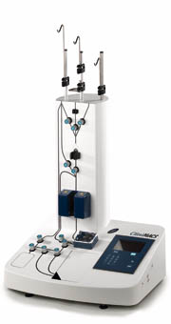
ClinimacsTM
Magnetic bead sorter
http://www.miltenyibiotec.com/en/clinical-applications/clinimacs-system/clinimacs-instruments/clinimacs-plus-instrument/clinimacs-plus-instrument.aspx

Slide 46

Fluorescence Cell Sorting in a Closed,
Single-Use Disposable Cartridge
These slides kindly provided by Jack Dunne
Notes:
Corporate information

Slide 47
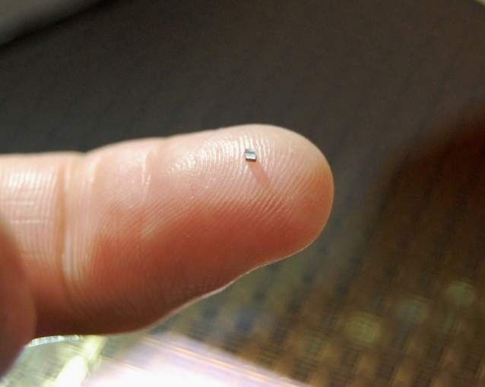
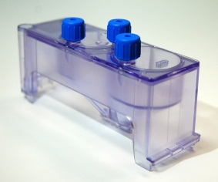
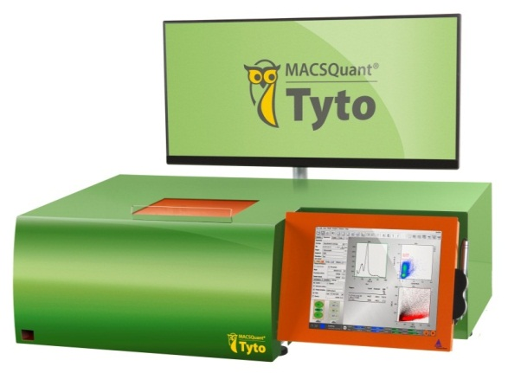

Owl Biomedical Microchip Sorting
World’s fastest valve performs sorting
No sheath fluids or aerosols
Keep cells and operator safe with sterile, disposable, closed cartridge system
No cleaning or carryover between sorts
Provides low stress to cells, high cell viability
Cell throughput up to 200M cells/hour
  55k cells/s
8-color fluorescence-based sorting
4C – 37C temperature operation
“Walk-away” fluorescent cell sorting
Tyto Microchip
Tyto Cartridge

Slide 48
Tyto Development and
Product Status
US Early Adopter Program fully subscribed
  Application-specific feasibility in progress
  Deliveries with simplified software and firmware start this summer
General Availability: End of 2015
  Finishing complex sort processing
  Manufacturing scale-up
  Support and service training

Slide 49
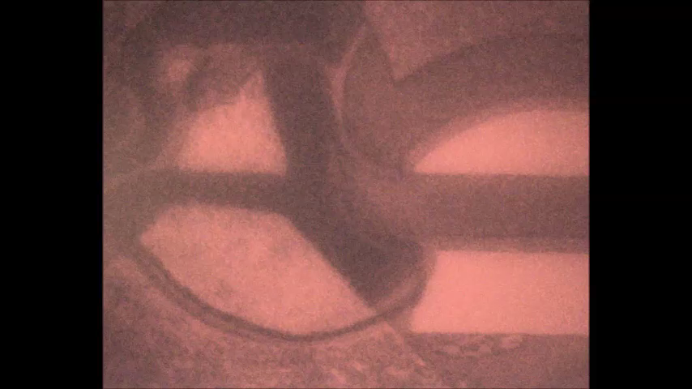
TITO- Visualization of Valve Speed
Strobe imaging: 1us frames, full cycle = 30us

Slide 50
Reproducible, High Viability
Across Cell Types
Labeled Cell Type | Label | Sort Output Mean Viability | Sort Output Variance | Sample N
K562 (Leukemia) | ALDH FITC | 98.5% | 0.3% | 4
K562 (Leukemia) | CFSE FITC | 97.1% | 1.0% | 13
H1650 (Lung Cancer) | EpCAM PE | 97.4% | 0.6% | 3
MCF7 (Breast Cancer) | EpCAM PE | 97% | 0.5% | 6
PDA (Pancreatic Cancer) | KPC GFP | 99.3% | 0.03% | 3
T cells (Lymphocytes) | Tetramer PE | 96% | 1.1 % | 3
Buffy (White Blood Cells) | CD4 PE, CD45 APC | 99% | 1% | 12
Whole Blood (Dilute 1:4) | CD4 PE, CD45 APC | 96% | 0.07% | 105
Neuronal precursor | CD47+ | 99% | 0.2% | 2
iPS Neural Stem Cells | CD133+ | 98% | 0.5% | 4

Slide 51
Summary
Cell sorting is highly mature
Sorting can be at high speed or typical low speed sorting
Sorting can be multiway – some systems can sort 7 ways – or you can sort to 96 well plates or petrie dishes
Sorting hazardous samples is dangerous and should only be done with proper precautions
High speed sorting requires careful attention, proper sample preparation
All the instruments on the market do a good job!

