Slide 1

BMS 631 - LECTURE 10 Flow Cytometry: Theory
Data Structure and Basic Multiparameter Data Analysis
J. Paul Robinson
SVM Professor of Cytomics
Professor of Biomedical Engineering
Purdue University
Notice: The materials in this presentation are copyrighted materials. If you want to use any of these slides, you may do so if you credit each slide with the author’s name.
Lynn Hall G221
Purdue University
Office: 494 0757
email; robinson at flowcyt.cyto.purdue.edu
WEB http://www.cyto.purdue.edu
3rd Ed. Shapiro p 207-214
4th Ed p
This lecture last updated: March 23, 2016

Slide 2
Data Analysis
File Structure
Gating
Data displays
  histogram
  dot plot
  isometric display
  contour plot
  chromatic (color) plots
  3 D projection

Slide 3




Progression of Flow Cytometry
1960s
1970s
1980s
1990s
2000s
2010s
Hyper spectral
Parallel μ-fluidics
1 color
2 color
3-8 color
5-18 color
PDP 11
computer
Floppy
100 to 500 megs
500 megs to
100 gigs
Tb or >
No
software
Manuf.
System software
3rd Pty
software
3rd Pty
software
3rd Pty
software
File
standards
Lab automation
Data
pipelines
1 sample
per hour
At best
3-4 sample
per hour
5-10 samples
per hour
20-60 samples
per hour
50-100 samples
per hour
2000-20,000 samples/Hr
Notes:
On the left is the only output of the original coulter counter – a graph on an oscilloscope – this was the data you had – eventually Fulwylers 1965 cell sorter (the original invention) has an osciloscope – and the only way to get the data off was with a polaroid camera – and one could actually cut out the histogram and weight it…!

Slide 4
Data Acquisition
Each measurement from each detector is referred to as a “parameter” or “variable”
Data are acquired as a “list” of the values for each “parameter” (variable) for each “event” (cell)
[RFM]
Notes:
.Data Collection
Most flow cytometers collect between 3 and 10 "parameters" or "variables". Each variable can be used to discriminate some component of the cell populations. The standard for data collection has been known as the "Flow Cytometry Standard" or FCS data file structure. Data can be collected in either histogram mode or listmode. It is now routine to collect flow cytometry data in listmode because there are few constraints in the size of data collection files. Originally, flow cytometers did not have good network capability, small hard disks (5-20 Mb, and floppy drive that could save only about 1 Mb of data). With high capacity hard disks and Ethernet access now routine, listmode is the most useful collection modality. Data can be collected in a gated or ungated mode. If the data are ungated, all events registered by the instruments electronic circuits will be saved in listmode files. If gated collection is chosen, it is possible to collect a listmode file of only those events that satisfy certain criteria established by the operator.

Slide 5
Flow Cytometer Computer Files
Listmode files
-correlated data file where each event is listed sequentially, parameter by parameter
-large file size
Histogram files
    uncorrelated data used for display only
Flow cytometry standard (FCS1.0 (1984) FCS 2.0 (1990), FCS 3.0 (1997), FCS 3.1 )2010)
    format used to save data
    use other software programs to analyze data
MIFlowCYt (2008)
Minimum Information about a Flow Cytometry Experiment
http://isac-net.org/Resources-for-Cytometrists/Data-Standards/Data-File-Standards/Flow-Cytometry-Data-File-Format-Standards.aspx

Slide 6
Types of Listmode data
Ungated Listmode (normal for all instruments today) this means everything is collected
Gated Listmode collection
  (this is essentially no longer done because storage is not a big issue as it was when disc drives were only 5 megabytes)
Notes:
.Data structure
As noted above the file structure of the collected data is normally saved in a format known as FSC (Flow Cytometry Standard). This was originally proposed by Murphy et al (ref) to encourage all manufacturers and software engineers to comply with the standard to allow relatively easy data exchange between users of different instruments. Most manufacturers comply with a reasonable extent and a number of conversion utilities exist in software packages to allow cross-analysis of data from different instruments. The current standard is FCS-2, which adds a number of additional components to the file structure.
Each file collected has a number of keywords, PMT (Photomultiplier Tube) values and gating regions associated with it. Some listmode file structures also contain the instrument setup used to collect the original data. While each instrument collects files of different internal structure, in essence the information collected retains a relatively common format allowing 3rd party software manufacturers to create value added analysis packages.

Slide 7
Data Acquisition - Listmode
Structure of a list mode file
Notes:
.List Mode Data
Essentially however, a listmode file is a series of numbers which sequentially list data for each variable collected on each cell. This is shown in the associated table provided.

Slide 8
Listmode File Example
FILEVERSION;1.15
BTRIEVE;7058418 IBA13-2 collected 6/27/95;28/6/1995;;2;1
PARAM;LS1;400;LS2;600;FL1;460;FL2;400;FL3;300;WID;TIM
GAIN;1;1;2;2;0
THRES;0;10;0;5;0;5;1;11;0;5
FLUIDIC;3;4;1;7.20
FCM;357;2;2;1;1;0;0;1;1;1;1;0;1;1;0;1
SUBTRACT;15;0
AUTOCYCLE;1;0;0;0;0;0;0;-1;1;20000;7;0;1;0;1;0
PCBUFFER;374000;1
SERIAL;2
ADBOARD;1;0;0;30;0
PEAKAREA;0;0;0;0
CALIBRATION;300;300;300;300;0;0;0;0
MAINWINDOW;1
PRINTHEADER; Flow cytometry Report;Win-Bryte software - Bryte-HS flow cytometer
PRINTFOOTER; Purdue University Cytometry Laboratories
PRINTSTATISTICS;1;1;1;1;1;1;1;1;1;1;1;1;1;1;1;1;1;1;1;1;1;1;1;1;1;1;0;0;1;20;15;1;8;12;5;0;0;5
ROI;1;1;3;3;4;45;65;61;65;0;0;0;0;0;0;0;0;0;0;0;0;0;0;0;0;0;0;0;0;0;0;0;0;0;0;0;0;0;0;0;0;0;0;0;0;bird;1;1;1;0;1;1;1;0;1;1;0;;-1;-1;3;0;255;0;0
ROI;2;1;3;3;0;121;41;141;41;0;0;0;0;0;0;0;0;0;0;0;0;0;0;0;0;0;0;0;0;0;0;0;0;0;0;0;0;0;0;0;0;0;0;0;0;human;1;1;1;0;1;1;1;0;1;1;0;;-1;-1;3;0;255;0;0
ROI;7;3;5;1;0;0;18;24;63;52;48;16;2;0;2;0;0;0;0;0;0;0;0;0;0;0;0;0;0;0;0;0;0;0;0;0;0;0;0;0;0;0;0;0;0;;1;1;1;0;1;1;1;0;1;1;0;;-1;-1;3;5;255;0;0
ROIDATACYTO;7;20022;4845.7;98.7;0.0
ROIDATAHIST;1;2.4;16712;52;53;4044.6;2.4;53;83.5;0.0
ROIDATAHIST;2;2.2;1875;128;128;531.3;1.7;128;7.8;0.0
HISTOGRAM;FALS;24;49;290;320;256;0;Count;1;1;0;0;0;255;0;255;0;0;0;0;0;255;1;1;C;0;1;1;1;S;0;-1;-1;-1;-1;-1;-1;-1;-1;-1;-1;-1;-1;-1;1;1;1;255;0;255
HISTOGRAM;SIDE-SCATTER;290;49;556;320;256;1;Count;1;1;0;0;0;255;0;255;0;0;0;0;0;255;1;1;C;0;1;1;1;S;0;-1;-1;-1;-1;-1;-1;-1;-1;-1;-1;-1;-1;-1;1;1;1;255;0;255
CYTOGRAM;LS1-LS2;24;320;290;591;64;1;0;1;1;0;0;0;255;0;255;0;0;0;0;0;0;1;1;O;0;1;0;0;S;0;6;-1;-1;-1;-1;-1;-1;-1;-1;-1;6;-1;-1;1;0;1;0;A;B;C;D;1;1;255;0;0;32;32;0;255;0;255
HISTOGRAM;FL2;290;320;556;591;256;3;Count;1;1;0;0;0;255;0;255;0;0;0;255;0;0;1;1;C;10;1;1;1;S;0;0;1;-1;-1;-1;-1;-1;-1;-1;-1;0;7;-1;1;1;1;255;0;255
CYTOGRAM;FL2-TIM;556;320;822;591;64;6;3;1;1;0;0;0;255;0;255;0;0;0;0;0;0;1;1;I;0;1;0;0;S;0;-1;-1;-1;-1;-1;-1;-1;-1;-1;-1;-1;-1;-1;1;0;1;0;A;B;C;D;1;1;255;0;0;32;32;0;255;0;255
LISTDATA
226;0;426;426;243;81;0
412;225;8;426;426;239;0
380;262;2;427;427;245;0
578;348;0;412;412;239;0
529;377;0;431;431;240;0
420;203;0;438;438;243;0
444;221;0;427;0;240;0
383;215;0;421;421;238;0
735;716;0;1027;1027;280;0
499;228;0;431;431;239;0
531;328;0;433;433;241;0
520;218;0;423;423;243;0
471;252;0;425;425;244;0
652;298;0;441;441;240;0
561;291;0;421;421;240;0
608;307;0;415;415;241;0
541;231;0;424;424;245;0

Slide 9
Listmode data Analysis
PARAM;LS1;400;LS2;600;FL1;460;FL2;400;FL3;300;WID;TIM
226;0;426;426;243;81;0
LS1 LS2 FL1 FL2 FL3 WID TIM
226 0 426 426 243 81 0

Slide 10
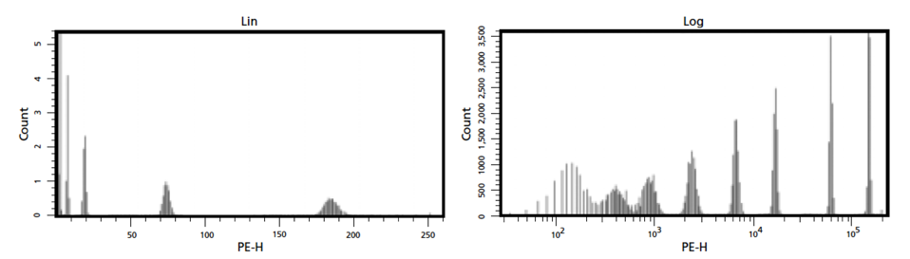
Analog vs digital data collection
Data from BD White paper on Diva (Ben Verwer dated 2001)

Slide 11
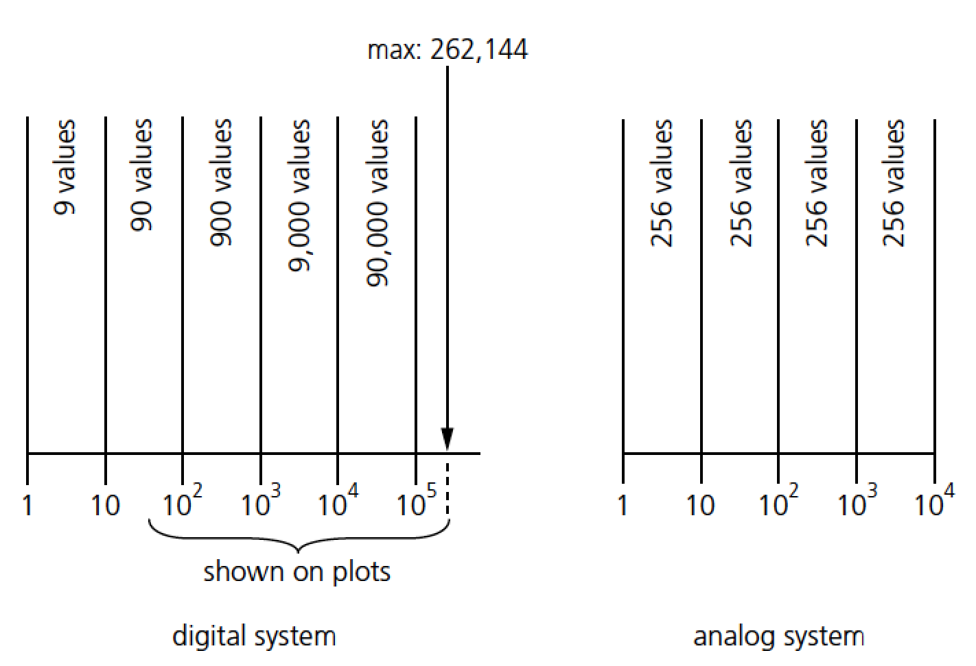
Digital structure (18 bits)
Data from BD White paper on Diva (Ben Verwer dated 2001)

Slide 12
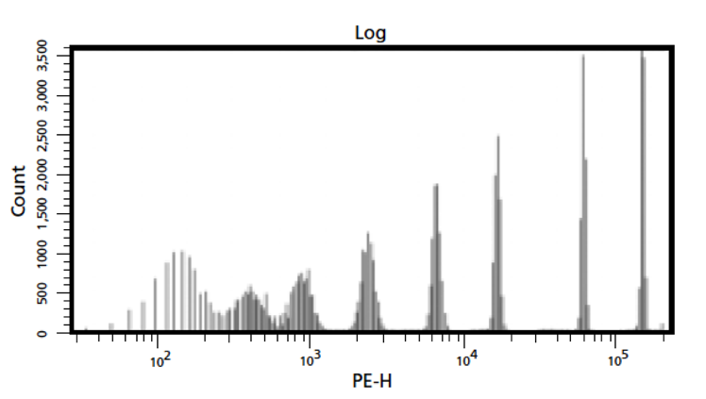
90k values
9 values
The famous “picket fence”
Data from BD White paper on Diva (Ben Verwer dated 2001)

Slide 13
Gating
Real-time gating vs. software gating
Establishing regions
Gating strategies
Quadrant analysis
Complex or Boolean gates
Back gating
Note: some software differentiates between a region and a gate…
To me it is 6 of one thing and half a dozen of the other.....

Slide 14
Real-Time vs. Software Gating
Real-time or live gating:
Restrict the data that will be accepted by a computer (some characteristic must be met before data is stored)
Software or analysis gating:
Excludes certain stored data from a particular analysis procedure

Slide 15
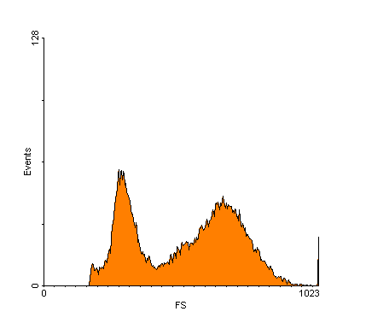
Establishing Regions
Establishing regions:
  -objective or subjective?
  -training/skill/practice
Possible shapes:
  -rectangles
  -ellipses
  -free-hand
  -quadrants
Statistics
R1
Notes:
.Gating: Principles and Terms
There are a number of terms associated with flow cytometry analysis. One important concept is the idea of creating an electronic gate. A gate can also be referred to as a bitmap or region. Usually these terms are synonymous in usage, although they can mean slightly different things to different manufacturers.

Slide 16
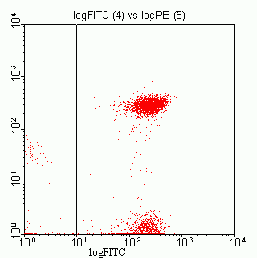
Using Gates
R1
log PE
Region 1 established
Gated on Region 1

Slide 17
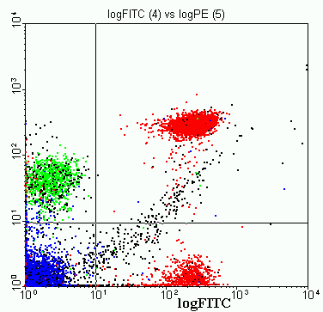
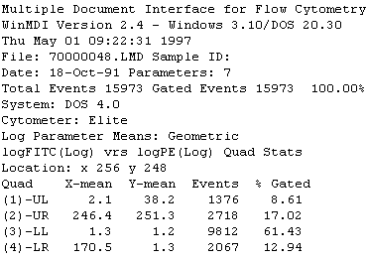
Quadrant Analysis
( - +)
(+ +)
log PE
(- -)
(+ -)

Slide 18
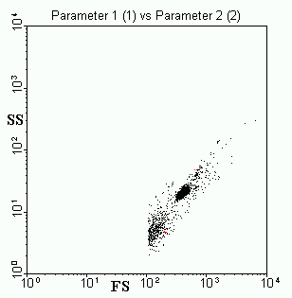
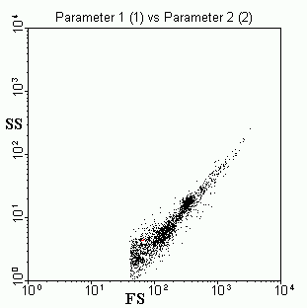
Drawing Regions: Sample Preparation
Data removed
From analysis
Spores
Spores
Debris
Vegetative
Debris
B.subtilis spores B.subtilis veg. + spores

Slide 19
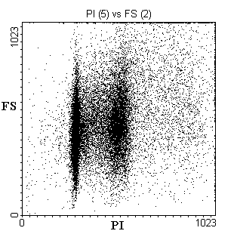
Complex or Boolean Gating
With two overlapping regions, several options are available:

Slide 20
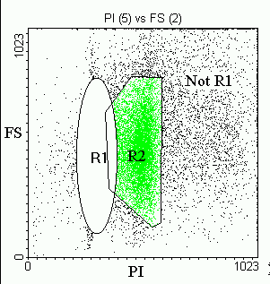
Boolean Gating
Not Region 1:

Slide 21
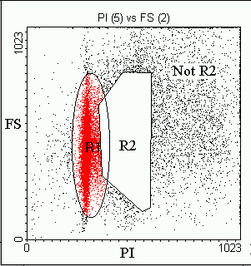
Boolean Gating
Not Region 2:

Slide 22
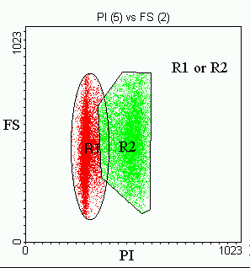
Boolean Gating
Region 1 or Region 2:

Slide 23
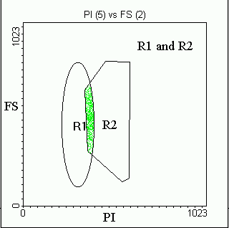
Boolean Gating
Region 1 and Region 2:

Slide 24
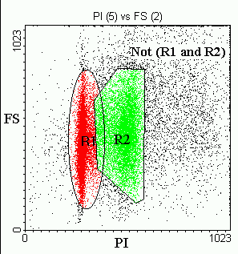
Boolean Gating
Not (Region1 and Region 2):

Slide 25
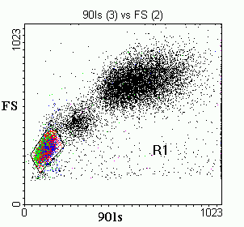
Light Scatter Gating
Side Scatter Projection
Projections show 2D
Plots in 1 parameter
space
Neutrophils
Forward Scatter
Forward Scatter Projection
Monocytes
Lymphocytes
0
200
400
600
800
1000
90 Degree Scatter
Human white blood cells (red cells lysed)
☺
☺
☺

Slide 26
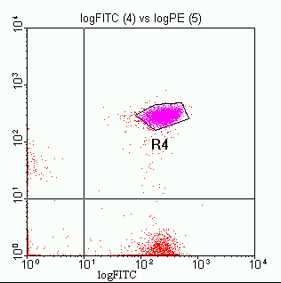
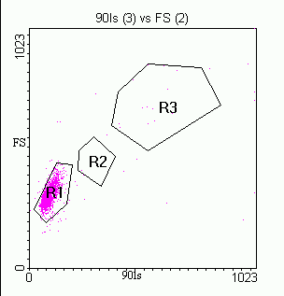
Back-Gating
Back gate
log PE
Region 4 established
Back-gating using Region 4

Slide 27
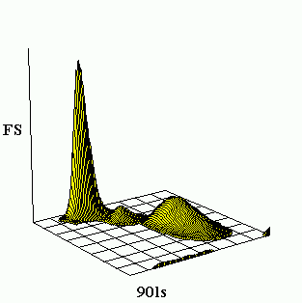
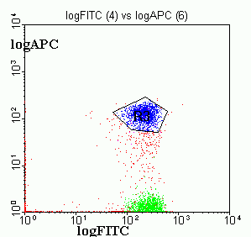
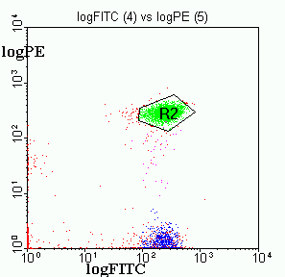
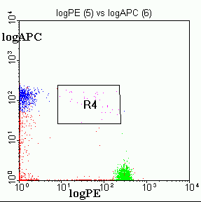
3 Parameter Data Display
Isometric Display

Slide 28
Methods that can change results:
1. Doublet discrimination
2. Time as a quality control parameter
Example: DNA content
- need to eliminate debris & clumps
- need to gate out doublets
- maintain constant flow rate

Slide 29
DNA Histogram
Gating out bad data
G₀-G₁
G₂-M
S
# of Events
A
B
C
Counts
Possible
blockage
Time
Fluorescence Intensity

Slide 30
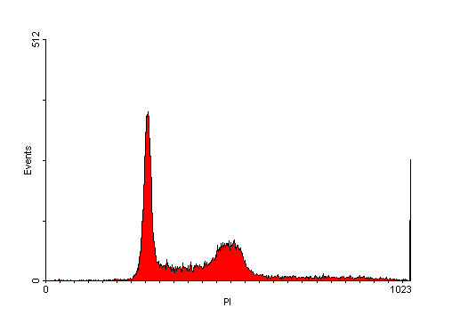
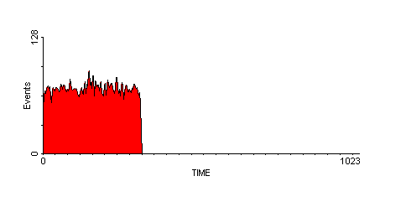
Time as a quality Control Parameter
“blockage” or other fluidic problem - data can be removed by gating the time histogram.
A
Abnormal histogram caused by turbulence (not biological variation)
B
A
B
Normalized histogram after subtraction of list mdoe data collected during the blockage shown at B on right.
Notes:
Time was first proposed as a quality control parameter by Watson. IN the above example the DNA histogram (Top left) appears to have an abnormal G₀-G₁ population. By collecting time as a parameter, an observation can be made as to the rate of cell collection. As can be seen at the right of this histogram, the collection rate appears to have been significantly reduced at region B. This may have been caused by a blockage in the flow cell or some other non-biological problem. If this caused turbulence in the flow cell, a significant impact might be seen on the CV of the fluorescence histogram. By removing the data collected during the time gate B (by using a Boolean operator [a NOT B], only data collected at the appropriate rate is included in the data analysis as seen on the lower left histogram. A normal time histogram is shown on the lower right.

Slide 31
Multi-color studies generate a lot of data
4 color
5 color
3 color
1 2 3 4 5 6 7 8 9 10
QUADSTATS
QUADSTATS
QUADSTATS
QUADSTATS
QUADSTATS
QUADSTATS
QUADSTATS
QUADSTATS
QUADSTATS
QUADSTATS
-+
++
-+
++
-+
++
-+
++
-+
++
-+
++
-+
++
-+
++
-+
++
-+
++
Log Fluorescence
Log Fluorescence
Log Fluorescence
Log Fluorescence
Log Fluorescence
Log Fluorescence
Log Fluorescence
Log Fluorescence
Log Fluorescence
Log Fluorescence
--
+-
--
+-
--
+-
--
+-
--
+-
--
+-
--
+-
--
+-
--
+-
--
+-
Log Fluorescence
Log Fluorescence
Log Fluorescence
Log Fluorescence
Log Fluorescence
Log Fluorescence
Log Fluorescence
Log Fluorescence
Log Fluorescence
Log Fluorescence
QUADSTATS
QUADSTATS
QUADSTATS
QUADSTATS
QUADSTATS
QUADSTATS
QUADSTATS
QUADSTATS
QUADSTATS
QUADSTATS
-+
++
-+
++
-+
++
-+
++
-+
++
-+
++
-+
++
-+
++
-+
++
-+
++
Log Fluorescence
Log Fluorescence
Log Fluorescence
Log Fluorescence
Log Fluorescence
Log Fluorescence
Log Fluorescence
Log Fluorescence
Log Fluorescence
Log Fluorescence
--
+-
--
+-
--
+-
--
+-
--
+-
--
+-
--
+-
--
+-
--
+-
--
+-
Log Fluorescence
Log Fluorescence
Log Fluorescence
Log Fluorescence
Log Fluorescence
Log Fluorescence
Log Fluorescence
Log Fluorescence
Log Fluorescence
Log Fluorescence
QUADSTATS
QUADSTATS
QUADSTATS
QUADSTATS
QUADSTATS
QUADSTATS
QUADSTATS
QUADSTATS
QUADSTATS
QUADSTATS
-+
++
-+
++
-+
++
-+
++
-+
++
-+
++
-+
++
-+
++
-+
++
-+
++
Log Fluorescence
Log Fluorescence
Log Fluorescence
Log Fluorescence
Log Fluorescence
Log Fluorescence
Log Fluorescence
Log Fluorescence
Log Fluorescence
Log Fluorescence
--
+-
--
+-
--
+-
--
+-
--
+-
--
+-
--
+-
--
+-
--
+-
--
+-
Log Fluorescence
Log Fluorescence
Log Fluorescence
Log Fluorescence
Log Fluorescence
Log Fluorescence
Log Fluorescence
Log Fluorescence
Log Fluorescence
Log Fluorescence

Slide 32
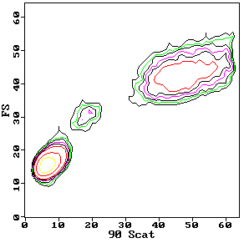
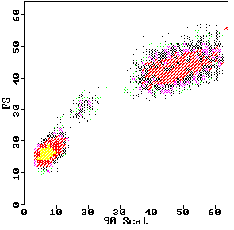
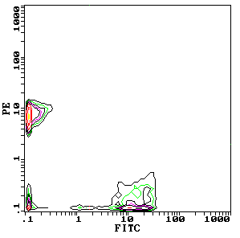
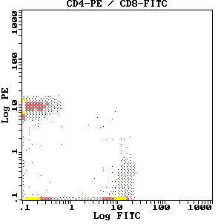
Contour plots
Dot plots

Slide 33
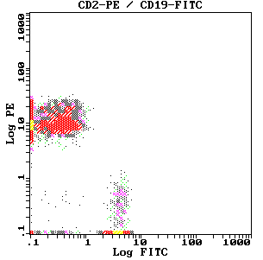
Typical phenotypic analysis histograms
This figure shows two examples of simultaneous 2 color immunophenotyping. In figure 3 (a) the directly labeled MABs used were CD4-PE / CD8-FITC. In this example approximately 50% of the cells were positive for CD4 and 23% positive for CD8. These percentages were calculated based upon the settings of the negative control for 2% positivity. Right figure shows a similar situation for CD2-PE / CD19-FITC.

Slide 34
Kinetic Analysis
0 ng PMA
Unstimulated
50 ng PMA
Stimulated
Fluorescence
Fluorescence
0
450
900
1350
1800
0
450
900
1350
1800
TIME (seconds)
TIME (seconds)
Figure: This figure shows an example of stimulation of neutrophils by PMA (50 nm/ml). On the left the unstimulated cells show no increase in DCF fluorescence . On the right, activated
cells increase the green DCF fluorescence at least 10 times the initial fluorescence.
References: (1) Robinson, J. Paul, Durack, Gary & Kelley, Stephen: "An innovation in flow cytometry data collection & analysis producing a correlated multiple sample analysis in a single file". Cytometry 12:82-90,1991.
(2) Durack, Gary, Lawler, Gretchen, Kelley, Stephen, Ragheb, Kathy, Robinson, J. Paul: "Time Interval Gating for analysis of cell function using flow cytometry" Cytometry, 12:701-706, 1991
References: (1) Robinson, J. Paul, Durack, Gary & Kelley, Stephen: "An innovation in flow cytometry data collection & analysis producing a correlated multiple sample analysis in a single file". Cytometry 12:82-90,1991.
(2) Durack, Gary, Lawler, Gretchen, Kelley, Stephen, Ragheb, Kathy, Robinson, J. Paul: "Time Interval Gating for analysis of cell function using flow cytometry" Cytometry, 12:701-706, 1991

Slide 35
Color Coded Dot Plots
Key to understanding this figure, is the notion that different populations can be identified by colors and the relationship of these populations to one another can be monitored.

Slide 36
Contour Plot with Projection
Similar to the dot plot with projection
Scale
1000
200
100
Side Scatter Projection
50
40
30
20
15
1000
60
8
Neutrophils
50
800
Forward Scatter
40
Forward Scatter
30
600
Monocytes
20
400
10
Lymphocytes
0
60
200
0
10
20
30
40
50
90 Light Scatter
0
200
400
600
800
1000
90 Degree Scatter

Slide 37
3 Color Combinations
What does it mean?
APC
4+4+4=12
Positives
PE
PE
FITC
4+4=8
FITC
PE
FITC
Negatives

Slide 38
3 Color Combinations
PE-FITC Pattern
TR-FITC Pattern
TR-PE Pattern
4+4+4=12
1000
1000
1000
APC
100
CD38
100
CD20
CD8
100
CD5
CD3
CD8
Phycoerytherin
CD3
CD20
CD4
CD8
10
IgM
Texas Red
10
K/L
10
CD3
Texas Red
CD20
IgG
CD20
CD7
CD8 (dim)
IgG
1
HLA-DR
CD2
CD2
1
CD10
1
L
CD3
CD3
CD4
K
.1
Negative
CD45
.1
Negative
CD45
.1
Negative
CD5
PE
.1
1
10
100
1000
.1
1
10
100
1000
.1
1
10
100
1000
FITC
FITC
Phycoerytherin
These are actually 3D relationship, not 2D as may appear on this figure
FITC

Slide 39
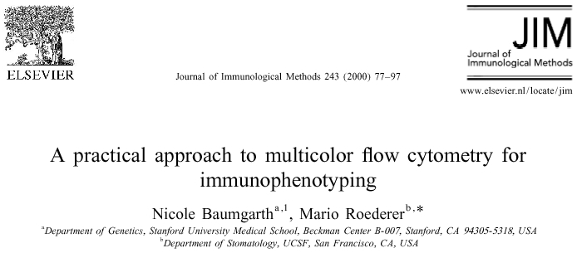

Slide 40
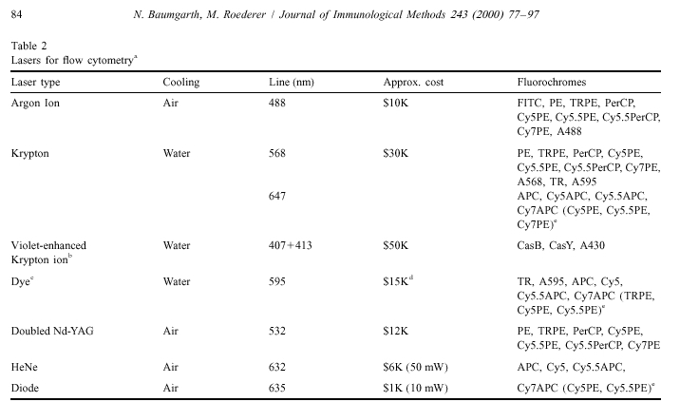
Lasers used for multicolor studies

Slide 41
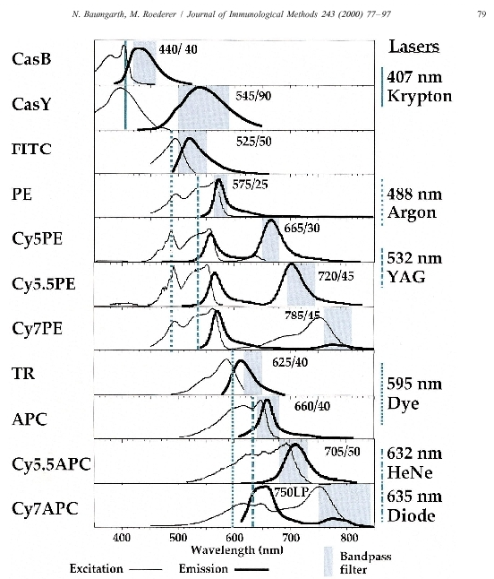

Slide 42
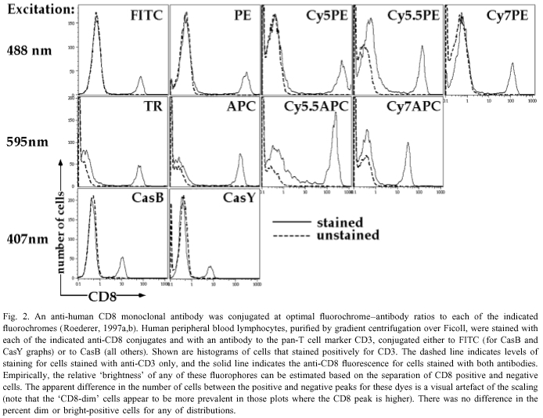

Slide 43
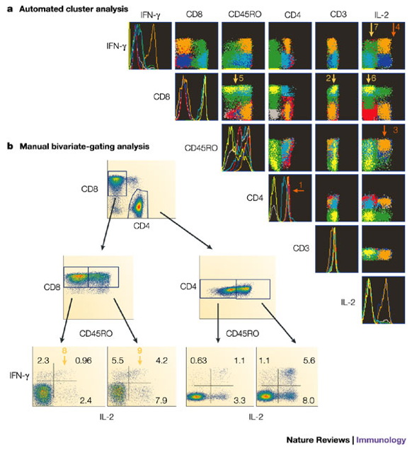
Many color flow cytometry
Nature Reviews Immunology 4, 648-655 (August 2004) | doi:10.1038/nri1416
Seventeen-colour flow cytometry: unravelling the immune system
Stephen P. Perfetto, Pratip K. Chattopadhyay & Mario Roederer

Slide 44
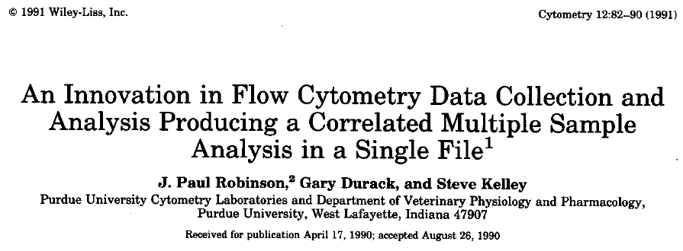
Innovative Data Analysis

Slide 45
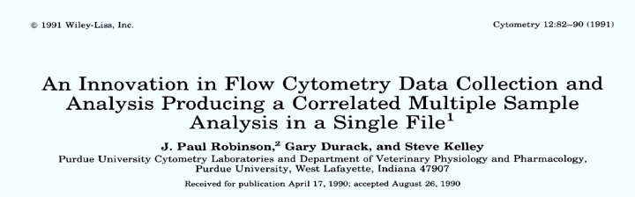
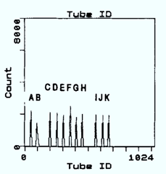
The trick was the invention of a virtual parameter “Tube ID” Or Tube Identification Parameter (TIP) and a Single file structure for an entire assay
Reference: Robinson, J. Paul, Durack, Gary & Kelley, Stephen: "An innovation in flow cytometry data collection & analysis producing a correlated multiple sample analysis in a single file". Cytometry 12:82-90,1991.

Slide 46
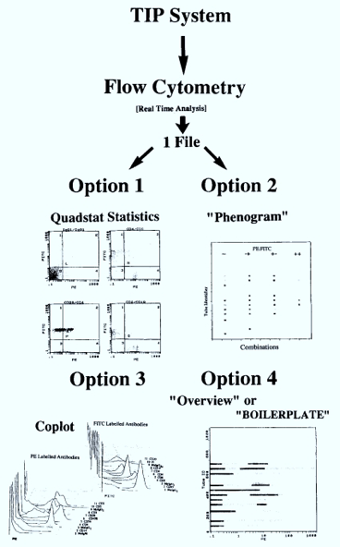
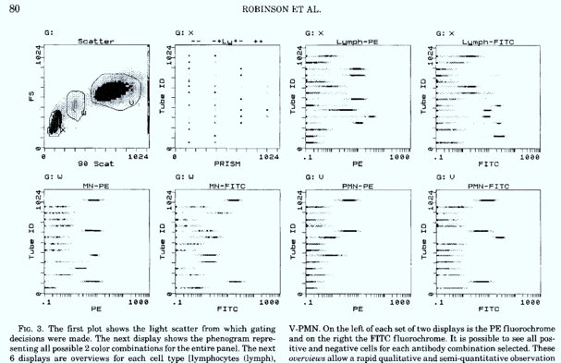
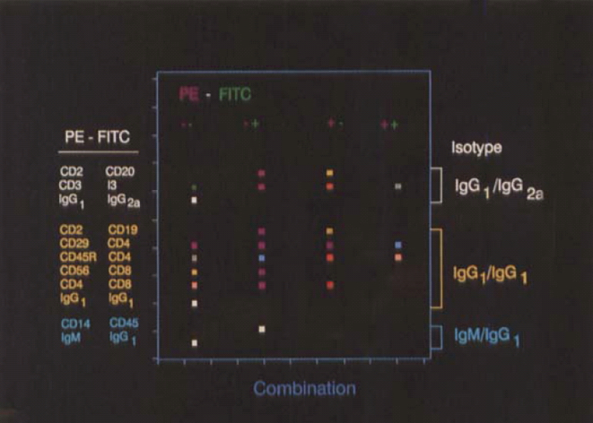
14 Tubes, 2 color, single file, single plot
Dozens of files linked during collection
Robinson et al, Cytometry 12:82-90, 1991

Slide 47
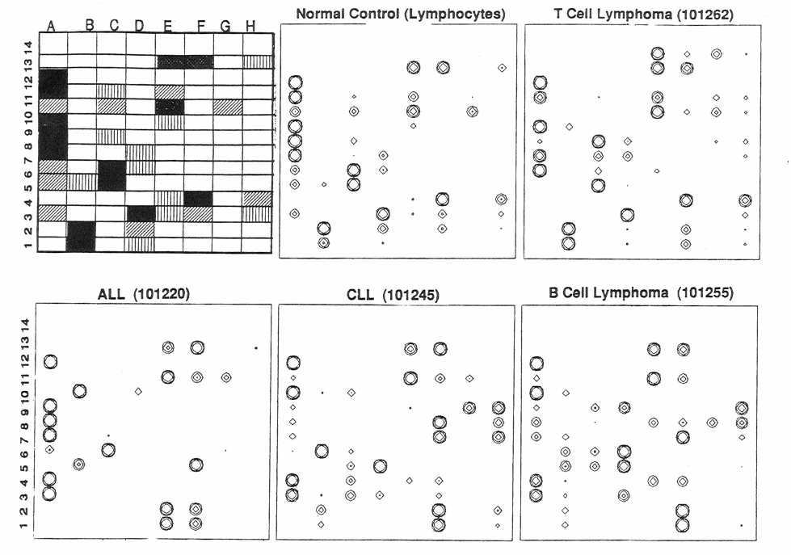
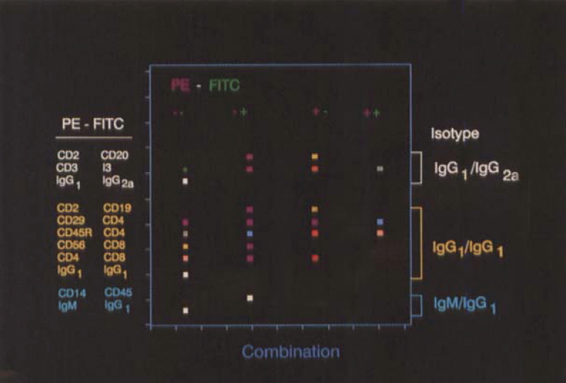
14 tubes, 3 color – single representation – expandable to n colors
Robinson et al, Cytometry 12:82-90, 1991

Slide 48
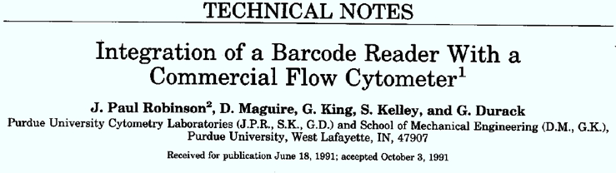
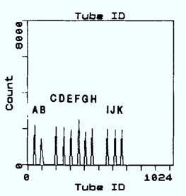


Innovation
Technologies Licensed to Beckman Coulter in 1991

Slide 49
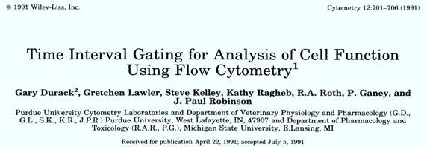
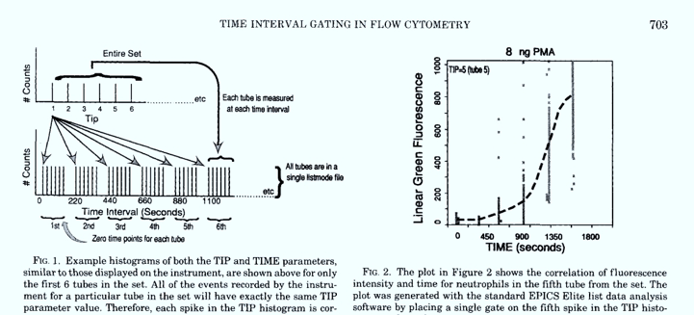
Use of time as a parameter for gating

Slide 50
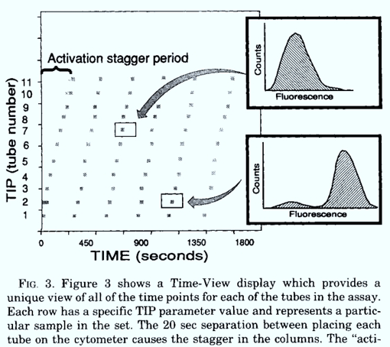
Creation of data sets for rapid analysis
Circa 1991
132 samples
per hour
ANALYSIS
132 sample in about 2 minutes
This file structure was adopted by “Intellicyt” and is the basis of their combination files used for HT Flow (but was developed by us in 1991)
(reducing to DB file

Slide 51
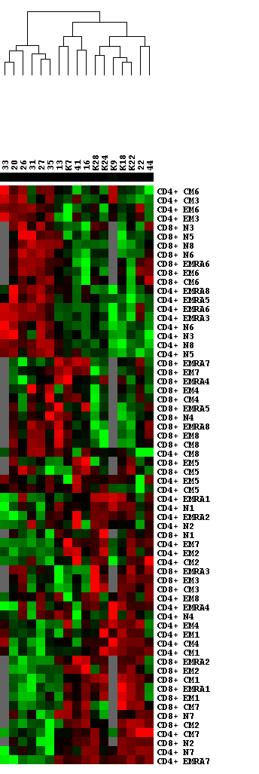
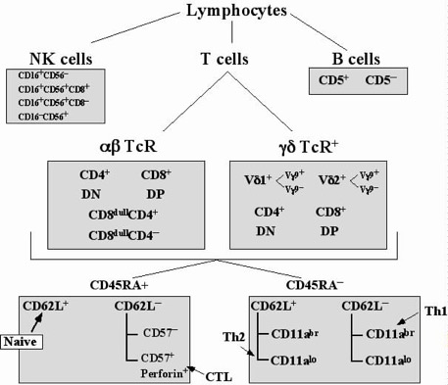
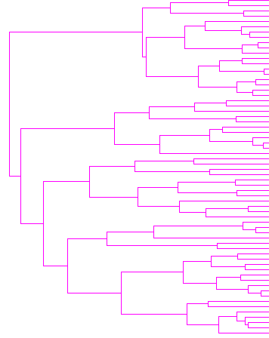
Advanced ways of showing data relationships
20
60
100
?
Classification
Enrico Lugli et al, Università di Modena e Reggio Emilia
Oral Presentation Immunology section 15.30-17.30 today

Slide 53

Spectral analysis allows classification

Slide 54

Cytometry Pt A, Volume: 97, Issue: 10, Pages: 1044-1051, First published: 24 August 2020, DOI: (10.1002/cyto.a.24213)

Slide 55
Cytometry Pt A, Volume: 97, Issue: 10, Pages: 1044-1051, First published: 24 August 2020, DOI: (10.1002/cyto.a.24213)

Slide 56


Optical Design of a basic flow cytometer
PMT 5
HyperCyt system added to flow cytometer
PMT 5
PMT 4
Sample
PMT 4
PMT 3
Dichroic
Flow chamber
Filters
PMT 3
Dichroic
PMT 2
Flow chamber
Filters
PMT 2
Scatter
Scatter
PMT 1
PMT 1
Laser
Laser
Copyright 2006 Nature Publishing Group
Nature Reviews Protocols
Sensor
Sensor
Bandpass
Bandpass
Filters
Filters
HyperCyte diagram kindly supplied by Larry Sklar
384 wells/10 min
1 μl/sample
Notes:
Basic schematic for how a flow cytometer works – a cell passes via a laser (blue line) and signals are passed down to each PMT and light scatter detector

Slide 57


9 color very fast flow cytometer
High speed HyperCyte robot
Historical References:
Robinson, J. Paul, Durack, Gary & Kelley, Stephen: "An innovation in flow cytometry data collection & analysis producing a correlated multiple sample analysis in a single file". Cytometry 12:82-90,1991.
Durack, Gary, Lawler, Gretchen, Kelley, Stephen, Ragheb, Kathy, Robinson, J. Paul: "Time Interval Gating for analysis of cell function using flow cytometry" Cytometry, 12:701-706, 1991

Slide 58



HyperPlex =
HyperCyt and Luminex
Theoretical potential for 50 plex in 1536 well format, 10 min
(20M per day per detector)
Selectivity
20 bead set,
2 colors, 7 levels each
Color 2, 7 levels
Color 1, 7 levels
Slide kindly supplied by Dr. Larry Sklar

Slide 59

Automated Cytomat
Incubator
Automated Biomek
Preparative system
Automated HyperCyte
Sample Delivery
Cyan flow cytometer

Slide 60

384 Well Plate layout For drug screen – Mito Memb Pot
JC-1
2 color assay
Negative
control wells
Negative
control wells
Valinomycin
positive controls
3-5,000 cells per well (1 to 2 x 10⁶ cells/plate)

Slide 61

Plate Analyzer – all the parts

Slide 62






Instantly see any well or combination of wells with any parameter or combination of parameters

Slide 63


All 384 list mode files are loaded in a few seconds…

Slide 64

Highlight the Plate Heatmap Format

Slide 65

Highlight the Histogram/Dotplot Format

Slide 66

Highlight the 3D Display Format

Slide 67

Highlight the IC 50 Display Format

Slide 68

Highlight the Analysis Logic Format

Slide 69

Direct IC50 generation (on 4 functional tests simultaneously)
IC50-1
(32 drugs)
Conclusion from this:
The goal is to design assays as systems and integrate into the design an analytical process with a defined result. The focus of such approaches is a known endpoint.

Slide 70

Data from every graph is available as an XL spreadsheet

Slide 71




Slide 72









Possible Gate Strategies
Any single parameter gate
Combinatorial gate
6 IC50 Models, Log/lin conversion
Interactive gate
On any global parameter
Any 2 parameter gate
Any Boolean gate
Gate any well or combination of wells

Slide 78
SPADE-Spanning tree Progression of Density normalized Events
(SPADE) is an algorithmic visualization tool for high-dimensional flow and mass cytometry data.
Bendall SC, Simonds EF, Qiu P, Amir ED, Krutzik PO, Finck R, Bruggner RV, Melamed R, Trejo A, Ornatsky OI, Balderas RS, Plevritis SK, Sachs K, Pe’er D, Tanner SD, Nolan GP. Single-cell mass cytometry of differential immune and drug responses across a human hematopoietic continuum. Science. 2011 May 6; 332(6030):687-96
http://blog.cytobank.org/2011/05/20/what-is-spade/
http://docs.flowjo.com/d2/plugins/spade/

Slide 79
Some free software

Slide 80
Learning objectives
Understand the data structure of flow cytometry data files
Understand the basic concepts for gating populations of cells
Understand the relationships between different parameters
Understand back-gating
Understand the basic principles of multiparameter analysis
Observe how High-Throughput flow (HT Flow) can be achieved

Slide 81
Conclusions
The more parameters you have, the more complex the analysis will be
But…when you have more parameters (variables) you have more opportunities for population discrimination
Display of data in histogram and dotplot formats assists the analysis process
Displays in 3D are nice but not particularly useful for analysis.
Multiple parameter displays such as PCA or LDA are more useful for high content data sets
Very high throughput (96 to 384 well plates) require special treatment – new forms of data processing are necessary

