Slide 1

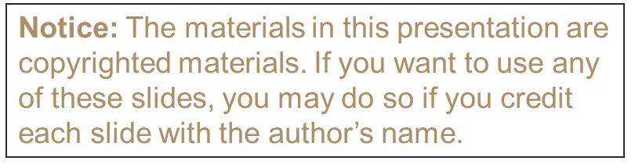
BMS 632 – Lecture 6 – Optical Filters & light manipulation
J. Paul Robinson
Distinguished Professor of Cytometry
Professor of Biomedical Engineering
Purdue University
Reading materials: 4th Ed. Shapiro pp 119-125)
Lynn Hall
Lab: Room G221
Office G140

Slide 2
Lecture Goals & Learning Objectives
This lecture is intended to describe the nature and function of optical systems
It will describe how optical filters are made and operate
What the properties of optical filters are
When filters should be used
What problems and issues must be taken into consideration

Slide 3
Optics - Filter Properties
Using filters with laser systems demands higher quality and more stringent management because of the high intensity of the laser which can be 6 orders of magnitude higher than a fluorescence signal
Therefore filters must have strict limits for blocking and allowing light to pass
Rejection of light is crucial because low levels of light from lasers will override your low-level signals and this rejection level is established by a % transmission of light

Slide 4
Optics - Filter Properties
Long pass filters transmit wavelengths above a cut-on wavelength
Short pass filters transmit wavelengths below a cut-off wavelength
Band pass filters transmit wavelengths in a narrow range around a specified wavelength
  Band width can be specified
Neutral Density filter is a nondiscriminant intensity reducing filter
Absorption Filter is colored glass that absorbs unwanted light
Dichroic Mirror/Filter is a filter that passes some bands while reflecting other bands

Slide 5
Nomenclature and Conventions
Excitation filter (D480/30x) -- Center wavelength is at 480nm; full bandwidth is 30 [ = +/- 15]. In some cases for which the band width is not specified the letter "x" is used to define the filter as an excitation filter. This is generally used for narrow band UV excitation filters, i.e. d340x.
Dichroic beamsplitter (505DCLP) -- Cut-on wavelength is 505nm for this dichroic longpass filter.
Emission filter (D535/40m) -- Center wavelength here is at 535nm; full bandwidth is 40nm [ = +/- 20].
LP -- indicates a longpass filter which transmits wavelengths longer than the cut-on and blocks shorter wavelengths
SP -- indicates a shortpass filter which transmits wavelengths shorter than the cut-on, and blocks longer wavelengths
DCLP -- dichroic longpass
DCXR -- dichroic long pass, extended reflection
DCXRU -- dichroic longpass, extended reflection including the UV
PC -- polychroic beamsplitter. Beamsplitter that reflects and transmits more than two bands of light.
GG -- Green Glass. Longpass absorption glass from Schott Glassworks with cut-on wavelengths in the violet and blue-green regions.
OG -- Orange Glass. Longpass absorption glass from Schott Glassworks with cut-on wavelengths in the green, yellow and orange regions.
RG -- Red Glass. Longpass absorption glass from Schott Glassworks with cut-on wavelengths in the red and far red regions.
x -- excitation filter; bs -- beamsplitter ; m -- emission filter

Slide 6
Optics – Dichroic Mirrors
Dichroic mirrors allow some light to pass (transmitted light) and bounce some light (reflected light)
Mostly we use Dichroics at 45 degrees because that is the most effective design
(google dictionary)

Slide 7
Interference and Diffraction: Gratings
Diffraction essentially describes a departure from theoretical geometric optics
Thus a sharp objet casts an alternating shadow of light and dark “patterns” because of interference
Diffraction is the component that limits resolution
KEY CONCEPT: Transmission is a linear function
i.e. you add up all the loss of transmission to obtain the total transmission function
3rd Ed. Shapiro p 83

Slide 8
Interference in Thin Films
Small amounts of incident light are reflected at the interface between two material of different RI
Thickness of the material will alter the constructive or destructive interference patterns - increasing or decreasing certain wavelengths
Optical filters can thus be created that “interfere” with the normal transmission of light
3rd Ed. Shapiro p 82

Slide 9
Optical filters
Interference filters: Dichroic, Dielectric, reflective filters…….reflect the unwanted wavelengths
Absorptive filters: Colored glass filters…..absorb the unwanted wavelengths

Slide 10
Absorption filters
Low Selectivity
550 SP DC
550nm
650nm
550 SP DC
490nm
650nm

Slide 11
Interference filters
They are composed of transparent glass or quartz substrate on which multiple thin layers of dielectric material, sometimes separated by spacer layers
Permit great selectivity

Slide 12
Interference
0º
90º
180º
270º
360º
Wavelength
A+B
A
The frequency does not change, but the amplitude is doubled
Amplitude
B
Constructive
Interference
C+D
Here we have a phase difference of 180º (2π radians) so the waves cancel each other out
C
Destructive
Interference
D
Figure modified from Shapiro “Practical Flow Cytometry” Wiley-Liss, p79

Slide 13
Standard Band Pass Filters
630 nm BandPass Filter
White Light Source
Transmitted Light
620 -640 nm Light

Slide 14
Standard Band Pass Filters
530 nm/20 BandPass Filter
White Light Source
Transmitted Light
520 -540 nm Light
Example: FITC excited by a 488nm laser and a 530/20 filter
This is the “band” of light

Slide 15
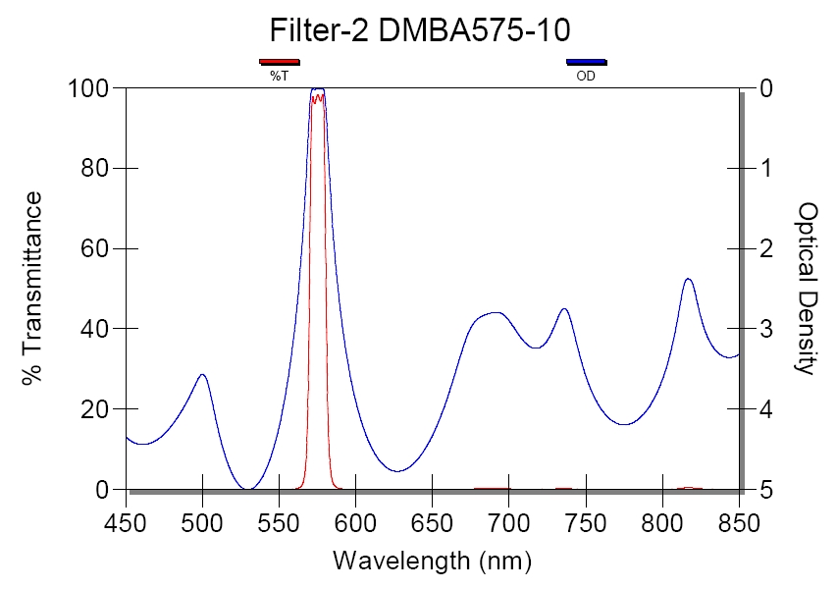
A 575 nm band pass (10 nm & 10 nm wide band)

Slide 16
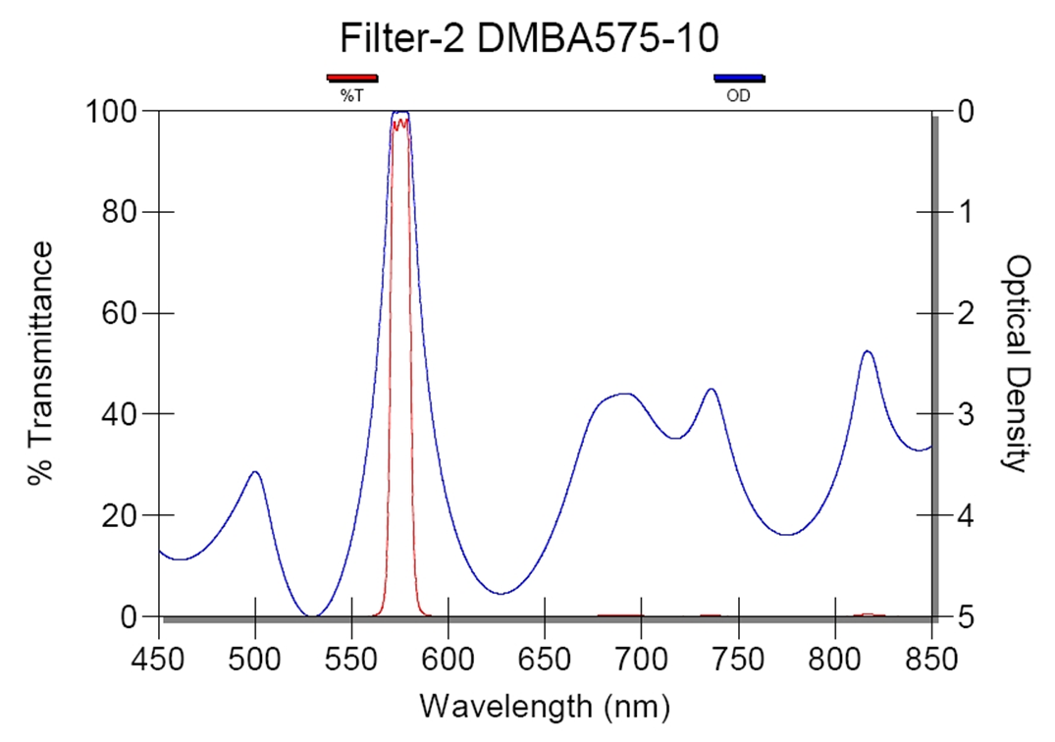
A 575 nm band pass (10 nm wide band)
10 nm
FWHM
center
This means that the 575 nm is in the center of the band, and that 5 nm on either side are going to be transmitted – the width of this filter is effectively 20 nm and so it will be a filter that transmits from 570 nm to 580 nm

Slide 17
Standard Long Pass Filters
520 nm Long Pass Filter
Light Source
Transmitted Light
>520 nm Light
Standard Short Pass Filters
575 nm Short Pass Filter
Light Source
Transmitted Light
<575 nm Light

Slide 18
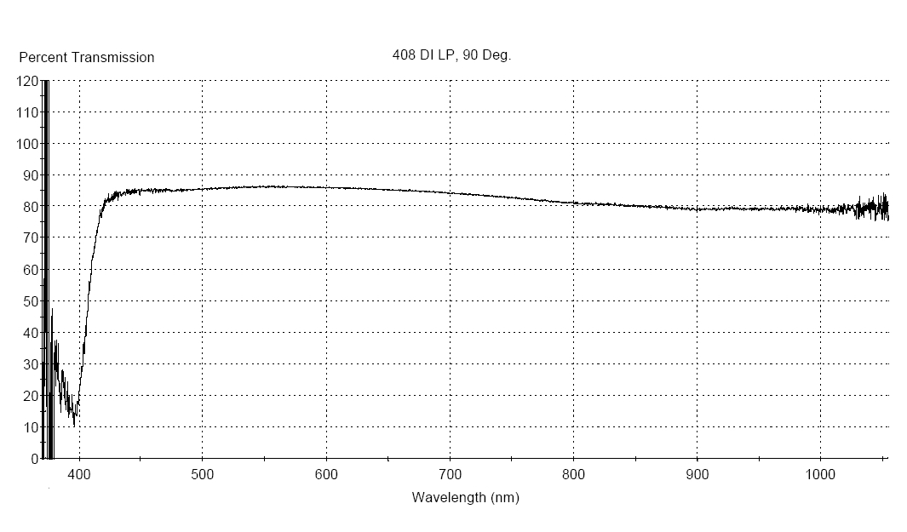
Long Pass filter
Transmission Curve

Slide 19
Dichroics
They used to direct light in different spectral region to different detectors.
They are interference filters , long pass or short pass.
"dichroic" Di- is Greek for two, and -chroic is Greek for color - from Greek dikhroos, bicolored

Slide 20
Optical Filters
Dichroic Filter/Mirror at 45 deg
Light Source
Transmitted Light
Reflected light

Slide 21
Dichroic Filters
mλ=2dSinθ
Reflected
Light
m=order of interference
d=distance between dielectric
layers
d
Transmitted
Light
Filter acting as a DICHROIC

Slide 22

Construction of Filters
Filter
components
Single Optical
filter
“optical
glue” or
mostly filters
are spatter
Coated in a
vacuum
Interference filters

Slide 23
Examples
550 SP DC
550nm
650nm
550nm
550 SP DC
550 BP
550nm

Slide 24
Neutral Density Filters 10^{-OD}
Optical density is a logarithmic function when we discuss OD1, OD2 etc
10⁻¹
OD1=10% Light through
550nm
650nm
550 SP DC
10⁻²
OD2=1% Light through
550nm
650nm
550 SP DC

Slide 25
Transmission determination
Constructive and destructive interference occurs between reflections from various layers
Transmission determined by :
  thickness of the dielectric layers
  number of these layers
  angle of incident light on the filters

Slide 26
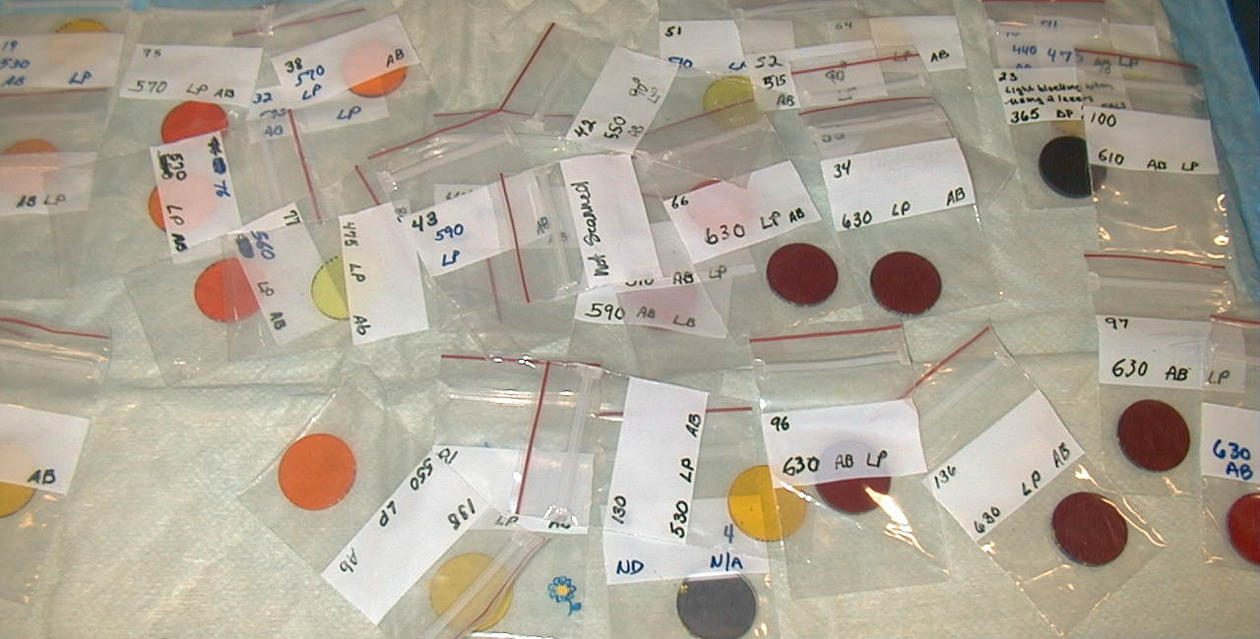
Absorptive filters
Such as colored glass filters which absorb unwanted light.
Consist of dye molecules uniformly suspended in glass or plastic.
Remove much more of the unwanted light than do the interference filters
Will often fluoresce (not good!)

Slide 27
Definitions
100
Wavelength
400 nm
500 nm
600 nm
Max
700 nm
Full Width at
Half Max
(FWHM)
% Transmission
Half Max
0
Wavelength

Slide 28
Filters transmission
Bandpass filters: characterized by there
T _{max} and (the Full Width at Half Maximum) FWHM
Notch filters are band pass filters in the upside down position
Long pass and Short pass filters: characterized by their T _{max} and cut-on, cut-off wavelength

Slide 29
Fluorescein - (FITC)
Excitation
Emission
300 nm 400 nm 500 nm 600 nm 700 nm
Wavelength
400 nm
500 nm
600 nm
700 nm
Band Pass Filter
Protein

Slide 30
Fluorescein - (FITC)
Excitation
Emission
300 nm 400 nm 500 nm 600 nm 700 nm
Wavelength
400 nm
500 nm
600 nm
700 nm
Band Pass Filter

Slide 31
Fluorescein-Phycoerytherin - (FITC-PE)
Excitation
Emission
300 nm 400 nm 500 nm 600 nm 700 nm
Wavelength
400 nm
500 nm
600 nm
Band Pass Filters
700 nm
Protein

Slide 32
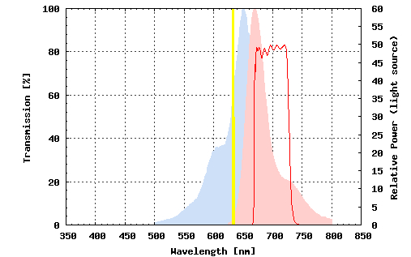
Using a Band pass filter correctly
https://www.omegafilters.com/curvo2/index.php

Slide 33
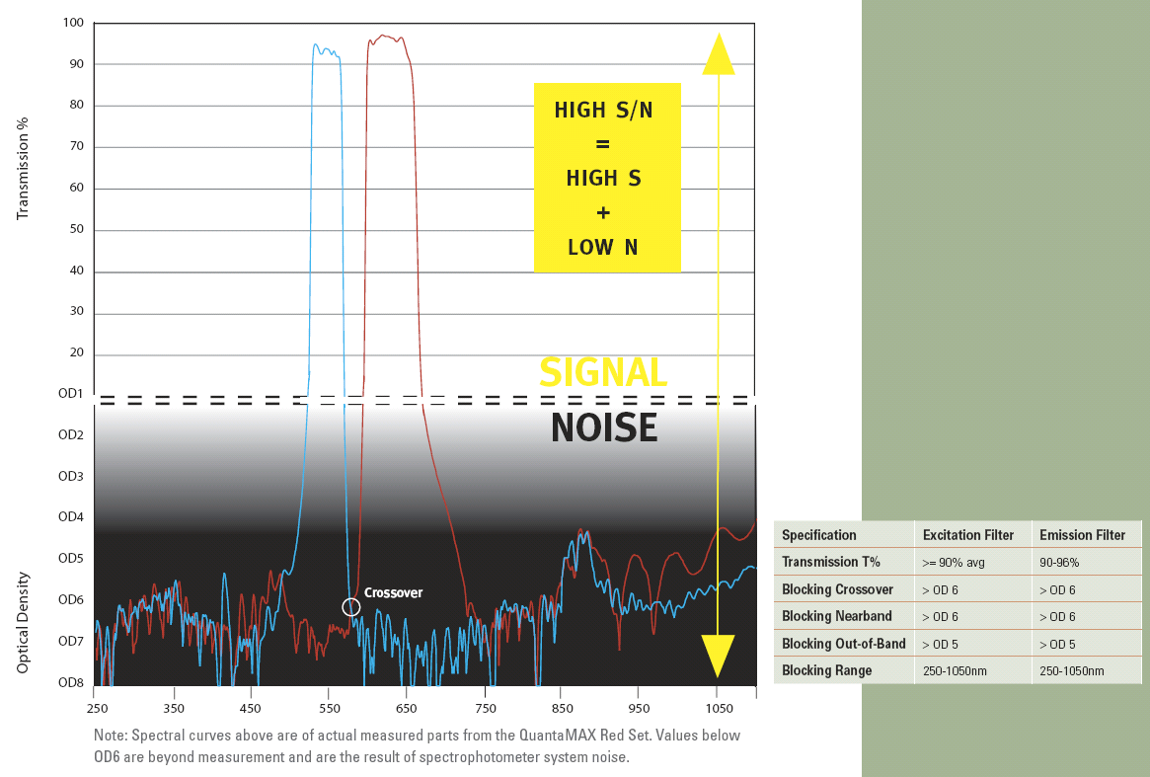
Source: https://www.omegafilters.com/

Slide 34
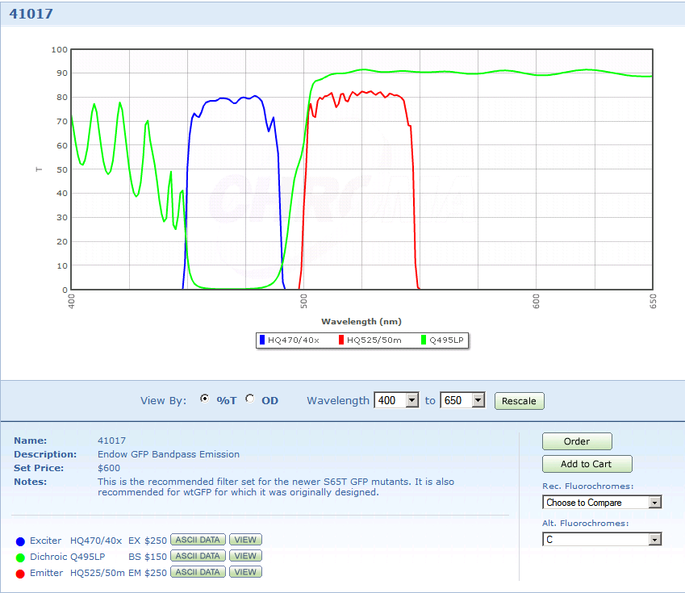
Finding the right filter -
Exciter
Source: http://www.chroma.com/index.php?option=com_products&Itemid=53#

Slide 35
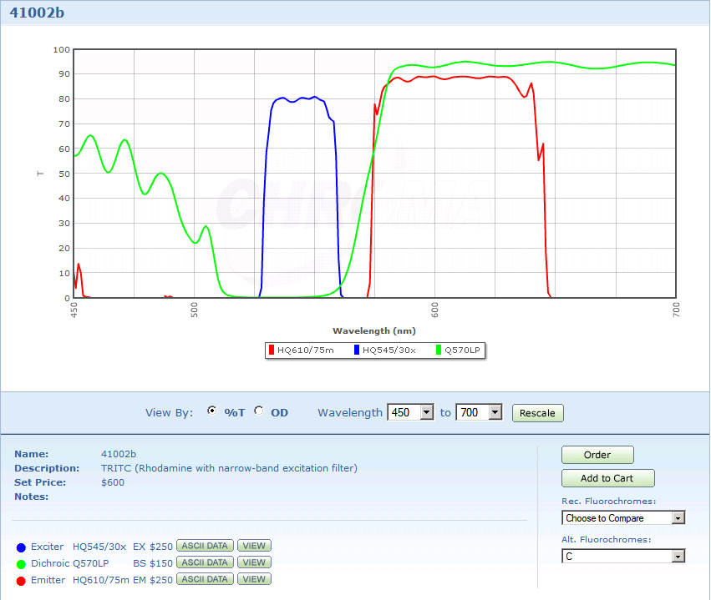
Exciter
Source: from Chroma website

Slide 36
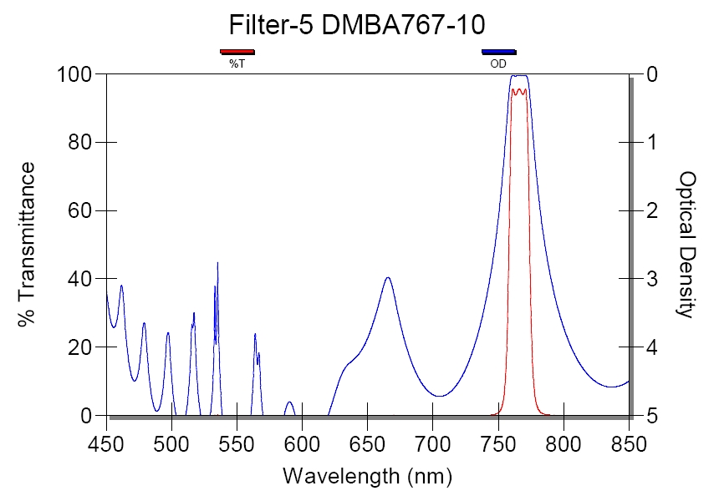

Slide 37
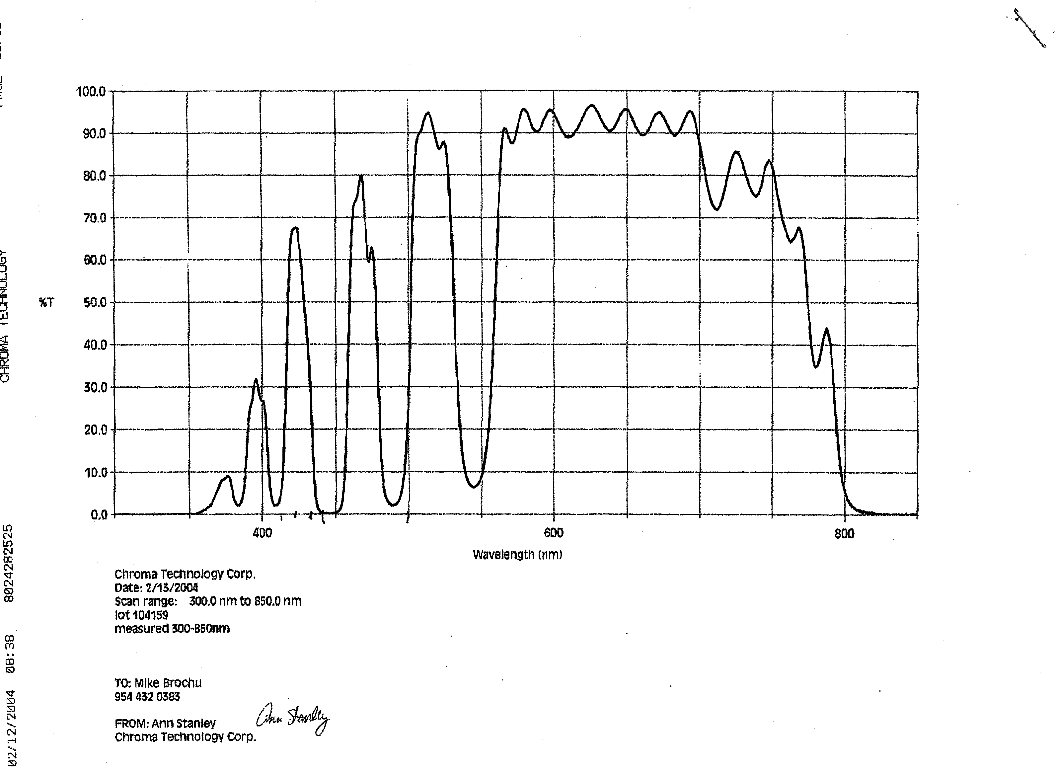
500
Typical Emission scan

Slide 38
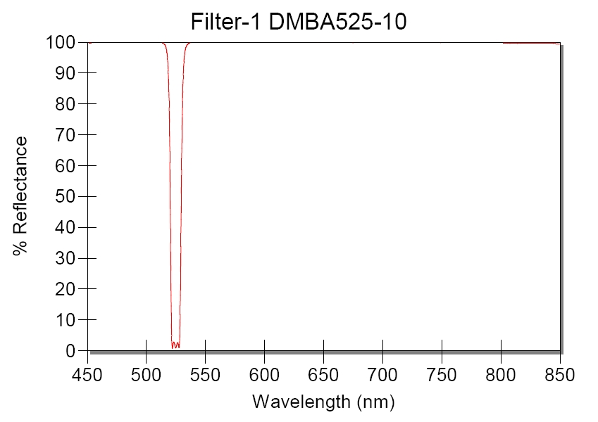
Laser Blocking Filters
525 nm LEDs

Slide 39
Interference filters advantages
They can be used as reflectors in two and three color analysis.
They usually do not themselves produce fluorescence.
They are available in short pass versions.
They are excellent as primary barrier filters.

Slide 40
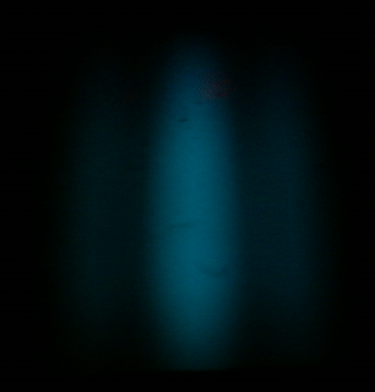
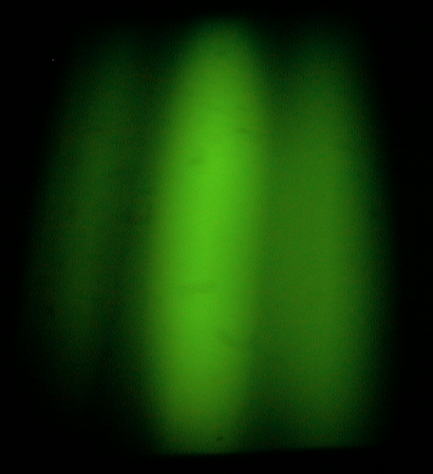
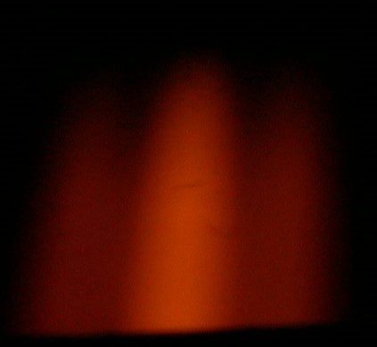
The output of a band pass filter
Band filters allow light close to the band width to pass

Slide 41
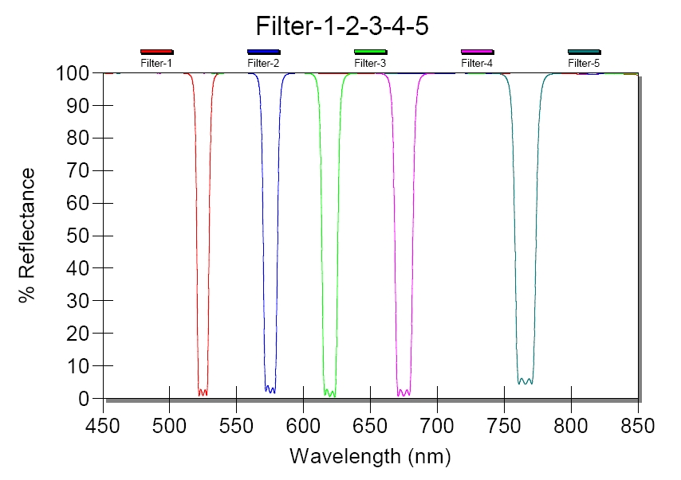
Designed to block laser light of 5 lasers

Slide 42
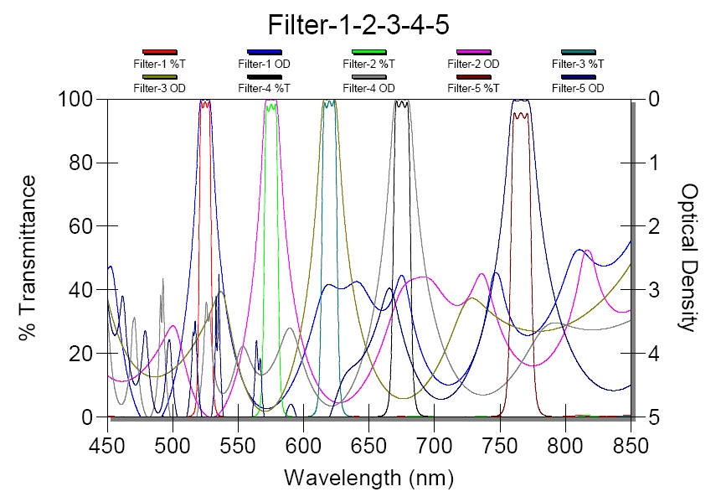

Slide 43
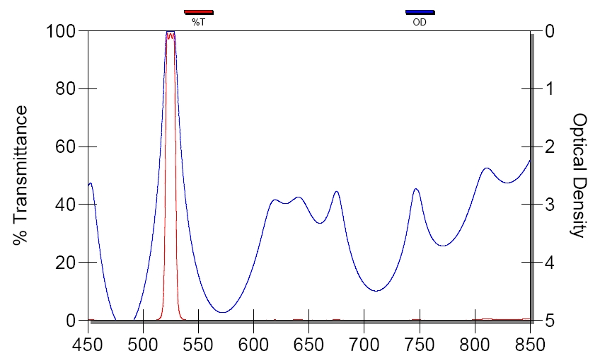
Filter 525-10
Just because the filter says “525-10” does not
Mean that it is its only transmission!!
What is all this?

Slide 44


Slide 45
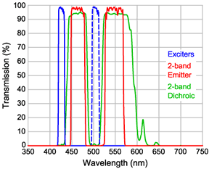
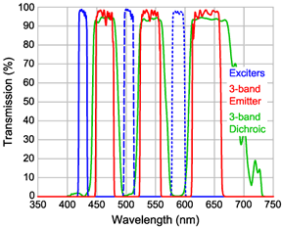
CFP-YFP filter ex - em
CFP-YFP-Hc-Red filter ex - em

Slide 46
Filter damage
Moisture
Humidity can cause filters to become “cloudy” or for layers to be physically damaged – this will change the property of the filter.
Laser damage – if a filter is an excitation filter, it can be destroyed by the very laser it is designed to work with – so check excitation filters if they are used (often in imaging)
Old age!! – Who knows what happens to filters that are “just old” – they should be tested regularly (at least once every couple of years.

Slide 47
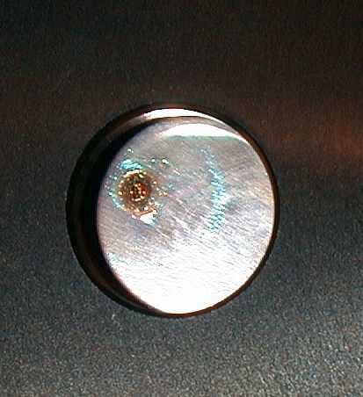
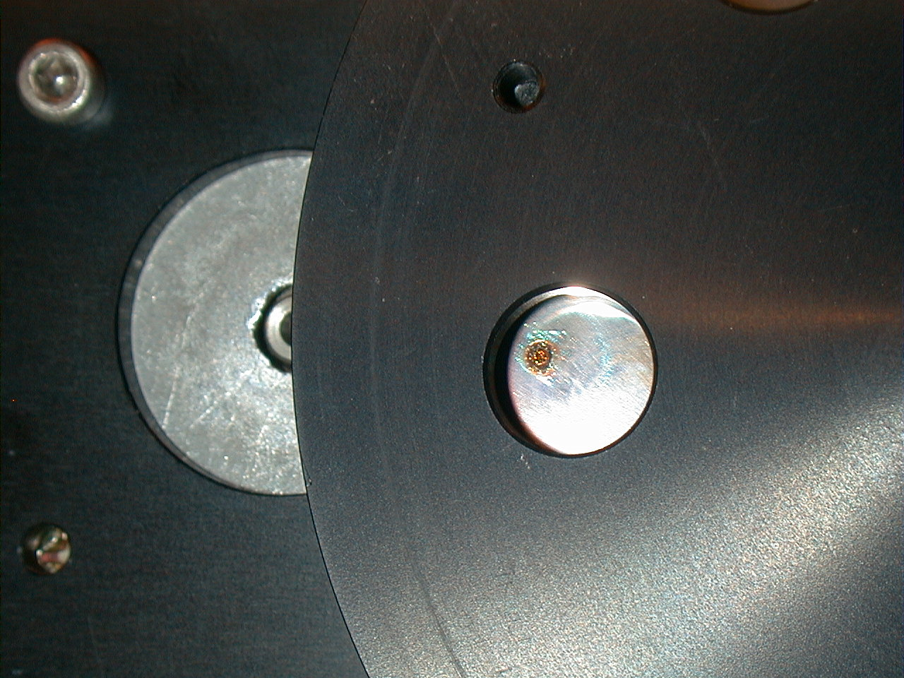

Slide 48
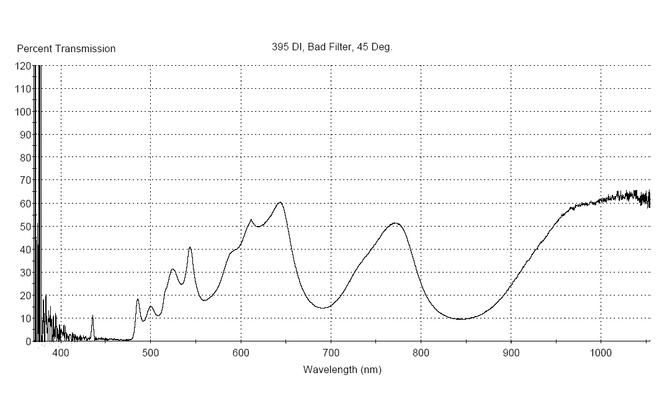
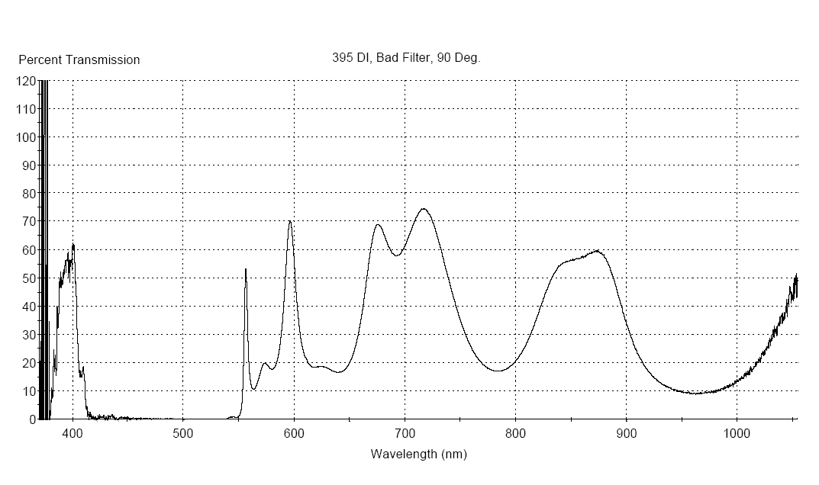
395 nm bad filter

Slide 49
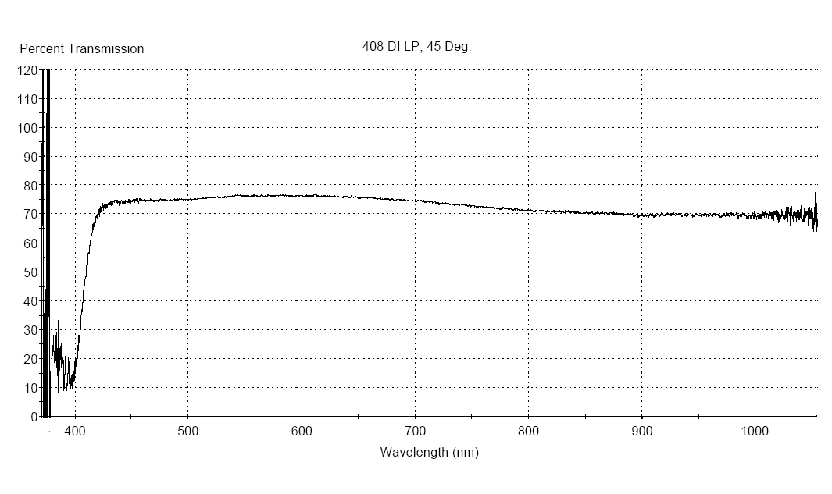
408 nm Long Pass

Slide 50
Optical Filters Worksheet
Standard Band Pass Filters (BP)
Standard Short Pass Filters (SP)
White Light Source
630 nm BandPass Filter
575 nm Short Pass Filter
Transmitted Light
Light Source
Transmitted Light
620 -640 nm Light
<575 nm Light
Standard Long Pass Filters (LP)
Standard Dichroic Filters (DC)
Light Source
520 nm Long Pass Filter
Dichroic filter/Mirror at 45 deg
Transmitted Light
Light Source
Transmitted Light
%T
>520 nm Light
520nm
λ
Reflected light
Create the following filters
Show filters for these dyes
515 BP
%T
FITC
575 DC/LP
λ
%T
APC
λ
FITC
680 DC/LP
%T
PE
λ
DAPI
620 SP
%T
Cy5
λ

Slide 51
Example
http://evrogen.com/spectra-viewer/viewer.shtml

Slide 52
Chroma Spectra Viewer
Example
https://www.chroma.com/spectra-viewer?fluorochromes=10484&sets=13593

Slide 53
Example
633nm Laser Excitation
Mercury Lamp Excitation
https://www.thermofisher.com/us/en/home/life-science/cell-analysis/labeling-chemistry/fluorescence-spectraviewer.html

Slide 54
BD Spectrum Viewer
Example
http://www.bdbiosciences.com/us/s/spectrumviewer

Slide 55
Example
Lasers
Dyes

Slide 56
We can learn about dyes and filters by going to several sites to reveal properties
BioLegend: https://www.biolegend.com/spectraanalyzer
BD: http://www.bdbiosciences.com/us/s/spectrumviewer
Thermo: https://www.thermofisher.com/us/en/home/life-science/cell-analysis/labeling-chemistry/fluorescence-spectraviewer.html
Chroma: https://www.chroma.com/spectra-viewer
Sigma: https://www.sigmaaldrich.com/labware/learning-center/spectral-viewer.html
Evrogen: http://evrogen.com/spectra-viewer/viewer.shtml
Expedeon: https://www.expedeon.com/resources/applications/flow-cytometry/new-fluorescence-spectra-viewer/
Fluorophoresorg: http://www.fluorophores.tugraz.at/substance/
Semrock: https://searchlight.semrock.com

Slide 57
Interference filters: disadvantages
Lower blocking properties
Reduced passing properties
Their reflecting and passing properties are not absolute, this should be considered while dealing with multiple wavelengths

Slide 58
Conclusions
Optical filters play a critical role in selecting appropriate bands of fluorescence emission
`Each filter will be responsible for some loss in transmission
Absorbance filters may actually cause fluorescence
Filter efficiency may be important in complex optical systems

