Slide 1
BMS 631 - LECTURE 11 Flow Cytometry: Theory
Sorting
J. Paul Robinson
SVM Professor of Cytomics
School of Veterinary Medicine,
Professor of Biomedical Engineering
School of Engineering
Purdue University
Notice: The materials in this presentation are copyrighted materials. If you want to use any of these slides, you may do so if you credit each slide with the author’s name. It is illegal to copy this presentation to CourseHero or any other on-line theft system.
Lynn Hall G221
Purdue University
Office: 494 0757
email: robinson at flowcyt.cyto.purdue.edu
WEB http://www.cyto.purdue.edu

Slide 2
The Elements of Flow Sorting
Sample Preparation
Hardware Setup
Droplet formation
Timing
Coincidence - Purity and Efficiency
Sterile Sorting Concepts

Slide 3
Optical Design
PMT 5
PMT 4
Sample
PMT 3
Dichroic
Flow cell
Filters
PMT 2
Scatter
PMT 1
Laser
Sensor
Bandpass
Filters

Slide 4
Sample Preparation
The sample must be a single cell suspension
The suspending fluid must be an electrolyte ie must conduct electricity
High sample concentration is required to obtain adequate numbers
Rare populations are very difficult to sort and require special attention (not dealt with in this section)

Slide 5
History
Motivation for development of the cell sorter: to verify the cell classification.
Time Name | People | Basis of approach | Droplet formation
1965 1st cell sorter | Mack Fulwyler | Coulter principle | Richard Sweet ink jet printer technology
1974 1st commercialized Fluorescence activated cell sorting, FACS | Len Herzenberg | light scattering fluorescent characteristics
Notes:
Analyze hundreds of cells /second, high enough data acquisition rate to be useful for clinical use.
Scanning cytometers could reposition cells on a slide.
it was, initially , not possible to extract cells with known measured characteristics from a flow cytometry.
Mack Fulwyler working at the Los Alamos National Laboratory, and Kamentsky, at IBM, demonstrated cell sorters built as adjuncts to their flow cytometers. Fulwyler was based on ink jet printer technology then recently developed by Richard Sweet at Stanford. Following passage through the cytometer’s measurement system (originally a Coulter orifice), the saline sample stream was broken into droplets, and those droplets that contained cells with selected measurement values were electrically charged at the droplet breakoff point. The selected charged droplets were then deflected into a collection vessel by an electric field, while uncharged droplets went, as it were, down the drain.
Right now, the selected cell are not charged, it is easy to trace the location of the interest cell groups.
Herzenberg won the Kyoto Prize in 2006 for his seminal work in flow cytometry. The acronym FACS is trademarked and owned by Becton, Dickinson and Company. It provides a method for sorting a heterogeneous mixture of biological cells into two or more containers, one cell at a time, based upon the specific light scattering and fluorescent characteristics of each cell.

Slide 6
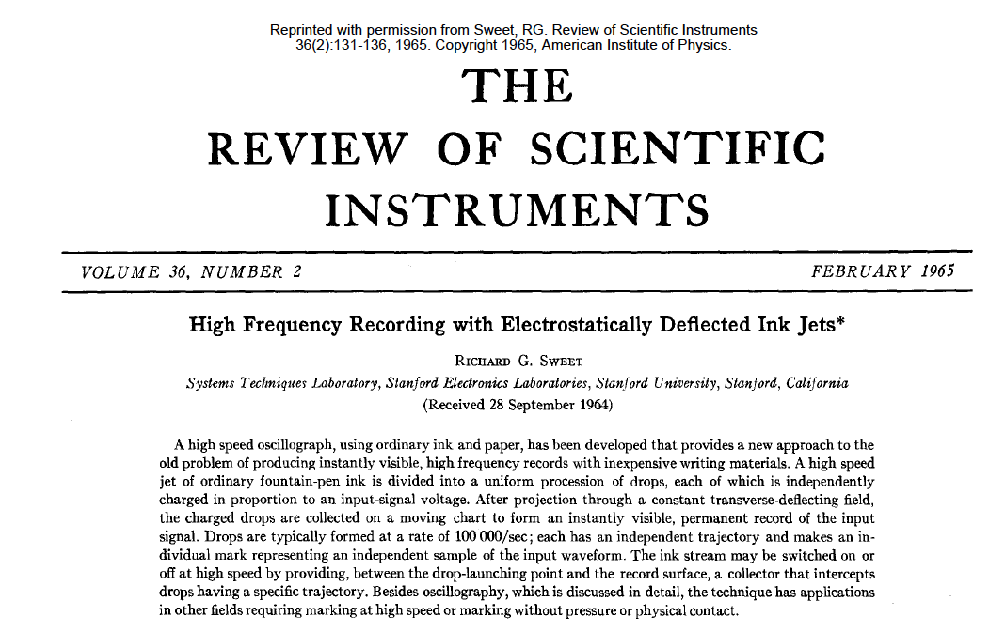
Richard Sweet

Slide 7
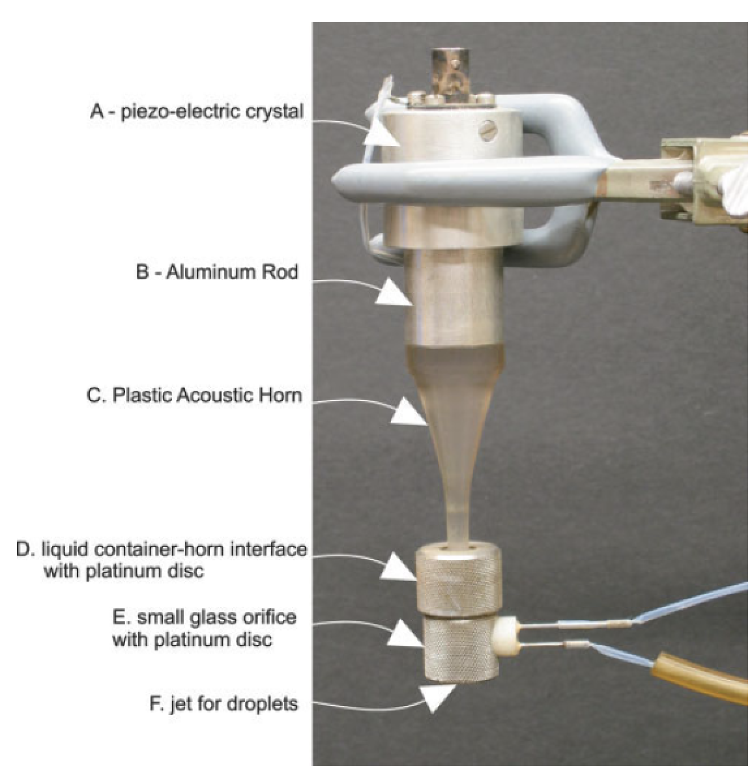
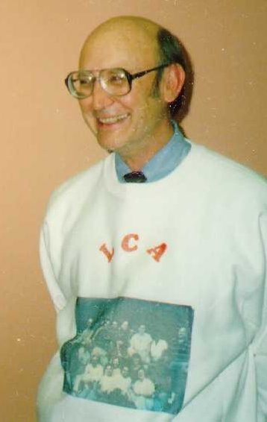
Mack Fulwyler

Slide 8
Cell Sorting
488 nm laser
FALS Sensor
Fluorescence detector
-
+
Charged Plates
Single cells sorted
into test tubes
J. Paul Robinson - Purdue University Cytometry Laboratories

Slide 9
Sample in
Sheath
Stream
Charge
Figure 1 The central component of a flow cytometer is the flow cell. A cutdown of a typical flow cell indicates the salient features. Sample is introduced via the sample insertion rod. Sheath fluid (usually water or saline) is introduced to surround the insertion rod causing hydrodynamic focussing of flowing cells which are contained within a core fluid. The laser intersects the fluid either outside the flowcell (in air) or in a slightly extruded portion of the flow cell tip (in quartz).
Piezoelectric
crystal oscillator
Sheath in
Sensors
SORT DECISIONS
Laser beam
Sensor
SMALL BEAD
LARGE BEAD
Last attached
droplet
SORT LEFT
SORT RIGHT
+4KV
-4KV
Frequency Histogram
LEFT
RIGHT
Signals are collected from several sensors placed forward or at 90° to the laser beam. It is possible to “sort” individual particles. The flow cell is resonated at a frequency of approximately 32KHZ by the piezoelectric crystal mounted on the flow cell. This causes the flowing stream to break up into individual droplets. Gating characteristics can be determined from histograms (shown right) and these can be used to define the sort criteria. These decisions are all controlled by the computer system and can be made at rates of several thousand per second.
Waste
SMALL BEAD
LARGE BEAD

Slide 10
Droplet formation
As liquid is ejected into air, it will form droplets. By vibrating the nozzle at a defined frequency, the size of these droplets and the position along the stream where they form can be controlled with great precision.
Last Attached Droplet
Satelite droplet
(Slide from Robert Murphy)
T. Lindmo, D.C. Peters & R.G Sweet - MLM Chapt. 8

Slide 11
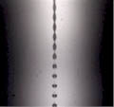
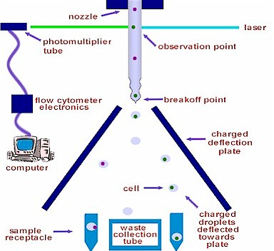
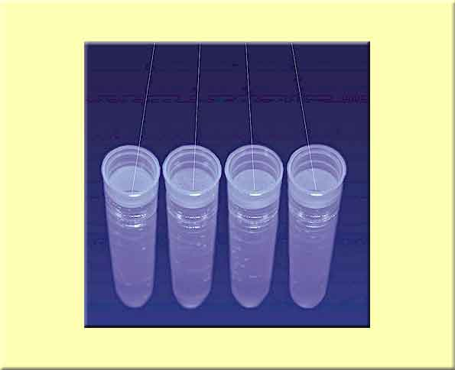

Sorting principle
-
+
☺

Slide 12
Timing
(Slide from Robert Murphy)
T. Lindmo, D.C. Peters & R.G Sweet - MLM Chapt. 8

Slide 13
Main sort modes
Conflicts: random arrival of a cell in each droplet.
Purity: general default, some cell loss with high coincidence aborts.
Enrich: all events of interest are sorted at the expense of reduced purity.
Single-cell: high count accuracy, only one cell in a drop, the cell in the center of the drop, no possible of coincidence.
http://www.med.unc.edu/flowcytometry/basic-flow-cytometry/sorting
Notes:
The ability to know where cells are relative to nearby cells provides the flow cytometer operator the ability to make decisions about how conflicts should affect the sort process. The decisions will affect purity and recovery. Also since cells can arrive at random relative to the drop frequency, i.e. the cell may be in any part of the drop, it is useful to be able to make sort decisions based on this prediction. If a cell arrives very near a drop boundary it is difficult to predict which drop it will actually partition into and as we will discuss below may actually perturb the drop break off leading to unpleasant results. Flow cytometry sorters have evolved to deal with these potential conflicts. T

Slide 14
Coincidence - Purity
As droplets form, they can contain wanted cells as well as unwanted cells. If all droplets containing a wanted cell are sorted (regardless of whether they also contain unwanted cells), the purity of the sorted sample will be reduced.
(Slide from Robert Murphy)

Slide 15
Coincidence - Purity
The purity can be improved by checking for coincidence events and not sorting any wanted cell that occurs too close to an unwanted cell.
This causes an increase in purity but a reduction in sorting efficiency.
(Slide from Robert Murphy)

Slide 16
Coincidence - Efficiency
The efficiency of sorting (with coincidence checking) for three-droplet sorting (solid lines) and one-droplet sorting (broken line) is shown as a function of event rate.
(Slide from Robert Murphy)
T. Lindmo, D.C. Peters & R.G Sweet - MLM Chapt. 8

Slide 17
Droplet Generation
The higher the frequency, the smaller the droplets
This becomes important when setting the sort parameters for your cells or particles
So if we want to sort at very high speed, we are restricted in the size of particles we can sort
Can think of it like this:
Higher Frequency
Lower Frequency
Higher frequency over the same volume of water will mean less volume per droplet and thus smaller particles or cells can be sorted

Slide 18
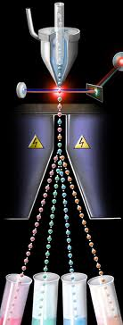
Drop Deflection test
Four streams of droplets
Evaluate the stability of the droplet generation pattern.
+
-
Test tubes
1(----) 4(+) 2(-) 3(+++) droplet sequence
Figures modified from http://www.cvm.ncsu.edu/ccmtr/flocyt-sorter.html
Http://www.semrock.com/flow-cytometry.aspx

Slide 19
Issues of importance in cell sorting
Droplet rate depends on the nozzle size and the sheath pressure.
The larger the nozzle size, the lower the droplet rate (droplet/s).
The larger the sheath pressure, the higher the droplet rate.
The droplet rate is optimized to achieve the shortest break off point.
Smaller particle size, smaller nozzle diameter, faster sorting, higher droplet rate.
The nozzle size needs to be several times larger than the sample size in order to avoid the clogging and fanning.
Nozzle Diameter (µm) | Velocity (m/s) | Pressure (PSI) | Droplet Rate (kHz)
50 | 46.0 | 162.6 | 204.4
70 | 32.8 | 84.9 | 104.3
100 | 23.0 | 43.6 | 51.1
300 | 7.6 | 8.4 | 5.7
Table. Safety speed limits for sorting based on Reynolds number calculations. From Shapiro. Practical flow cytometry 4th edition.
Notes:
The stream formed by a jetting orifice is womewhat less than the diameter of the orifice.
Jett and Alexander modified a B-D sorter to sort tumor cell spheroids, as large as 100 µm
Sorting smaller objects is to keep the orifice diameter about 5 times the average particle diameter
For large particles, 100µm particles through 200µm orifices (Jett and Alexander)
For very large or small particles, use fluidic switching sorters

Slide 20
Sterile sorting- sterile tubes
Pre-flush with 5% hydrogen peroxide, 70%EtOH.
70%EtOH kept in the sorter lines overnight and the interior of the sheath tank.
Flush with sterile sheath buffer.
New high-pressure fluid filter installed on the sheath tank.
Swab the surface of the instrument surrounding the sample port and collection tubes with 70%EtOH.
Cells cultured with antibiotics to prevent bacterial contamination.
A sterile ground wire may be inserted to discharge the deflected droplets in the tubes or plates.
Notes:
Protocol for sterile cell sorting.
The requirements for sterile cell sorting are similar to those for non-sterile sorting with the following modifications...
Due to lab space limitations, we do not provide sterile sheath buffer. Please deliver 5 liters of sterile sheath buffer to the flow lab the day before the scheduled sort (2 liters are for presort instrument washing).
On the day prior to the sort, the instrument is completely flushed with 5% hydrogen peroxide followed by 70% EtOH. The instrument is then shut down with 70% EtOH still in the lines, and allowed to sit overnight. On the morning of the sort, the instrument is flushed with sterile sheath buffer for one hour prior to sorting. The interior of the sheath tank is also sterilized with 70% EtOH overnight prior to sorting. Immediately prior to the sort, a disposable sterile 0.2 um high-pressure fluid filter (Spectrum Mediacap) is installed on the sheath tank on the inlet line, providing an additional barrier to contamination. All surfaces of the instrument surrounding the sample port and collection tubes are swabbed with 70% EtOH prior to sorting.
Tube changes (both sample and collection) provide opportunities for sterile sort contamination. Please take special care in filtering samples prior to sorting, to prevent clogs and subsequent removal of the sample tube.
Due to its complexity, cell sorting is generally considered to be an aseptic process (as opposed to truly sterile). Therefore, cells should be subsequently cultured with antibiotics (at least pen-strep) to prevent bacterial contamination.

Slide 21
Motivation for high-speed sorters:
The need to separate relatively large numbers of individual human chromosomes to provide libraries for Human Genome Project.
High speed sorting |  | Multi-sorting
Conventional sorting 5k~20k cells/s Digital circuit Separate the decision making and the drop charging circuit. The time delay is the formation of the droplet. | High-speed sorting 20k~100k cells/s Ger van den Engh (MoFlo) Multiple digital processors Branching tree sort architectures (DB Biosciences, Beckman Coulter, and Dako Cytomation) | Multi-way sorting (1,2,4,6 , 12ways) Capture any populations and separate them out BD influx TM in 2007 (4way sorting)’ BD FACSAria in 2003 | Multi-color sorting (up to 7 lasers) Select the proper combination of excitation bands depending on your experiment conditions.
Notes:
Sequencing the human genomes will be more efficient if we could separate all the human chromosomes. Sequence the genome on one chromosome a time.
Motivate to develop the sorter more precise, because the chromosome is dim and small. It is not easy to measure them correctly.
Shift register circuit + clock signal to queue sort decisions.
Avoid the inefficiency of monostable multivibrators (time for capacitor charging and discharging)
Know the particle goes to separate laser beam. Keep tract of the timing
The digital value stored in the system are all belongs to the same particle
http://www.bdbiosciences.com/instruments/influx/index.jsp
Every month or two, we get a new flavor of laser, new fluorophore, new assay, assay complex.
Not limited by a given set of fluorescence dyes any more. You have the freedom to select whatever excitation band you want depending on the dye or dye combination you are using in your experiment.

Slide 22
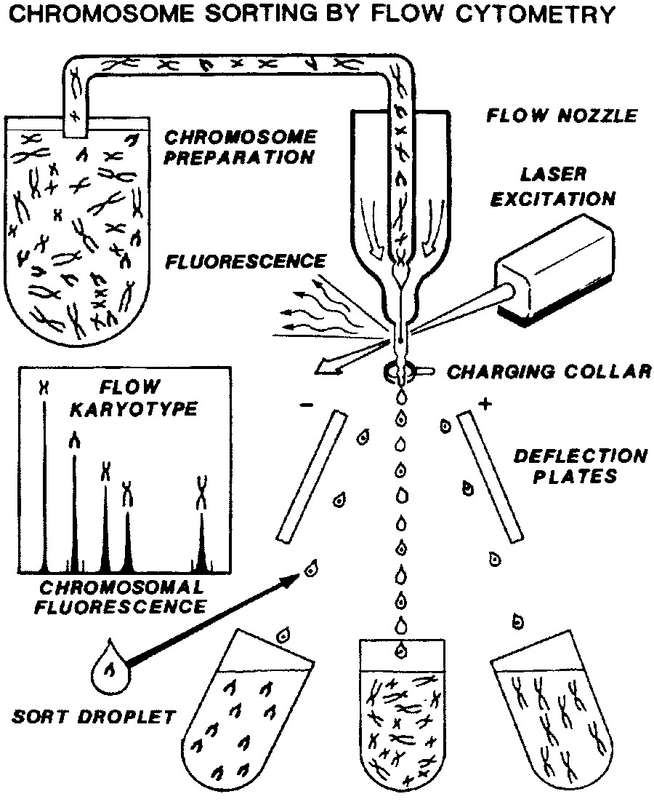
Enabling chromosome sorting:
Human Genome Project
Dr. Scott Cram
Flow cytogenetics : the analysis and sorting of single specific chromosomes In a flow cytometer.
Offers the advantage of sorting individual chromosomes for the cloning and mapping of separate distinct components.
Producing chromosome specific libraries from these sorted populations, the task of mapping the human genome has been greatly simplified.
Figure cited from Cram et al. Chromosome sorting and genomics. Methods in Cell Science. 2002
Notes:
To reduce the
By dividing up a cells genetic material into the 24 different types of chromosomes and complexity of a genome, chromosome sorting

Slide 23
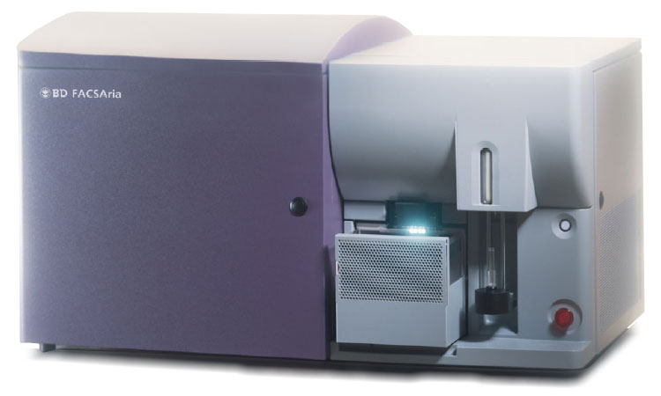
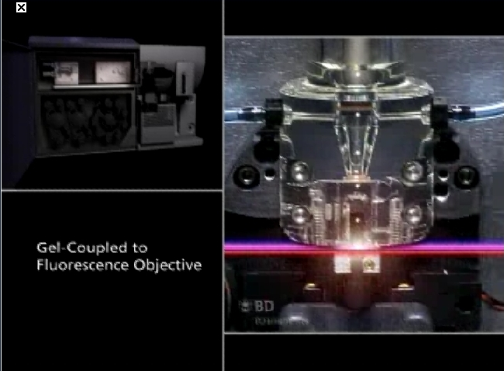
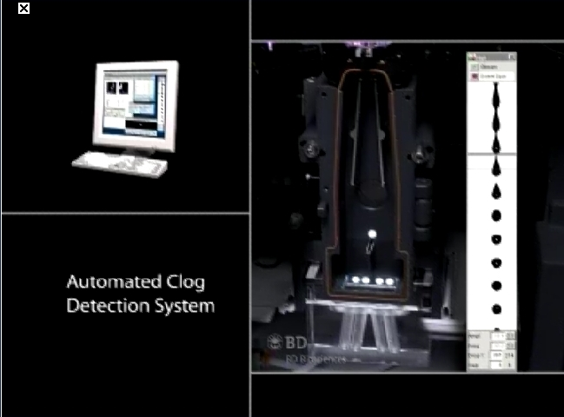
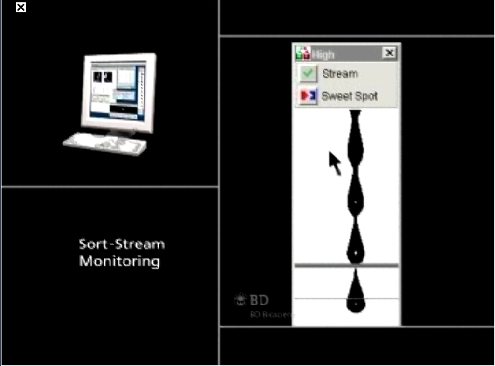
Aria
Images from BD Website and Public Presentations

Slide 24
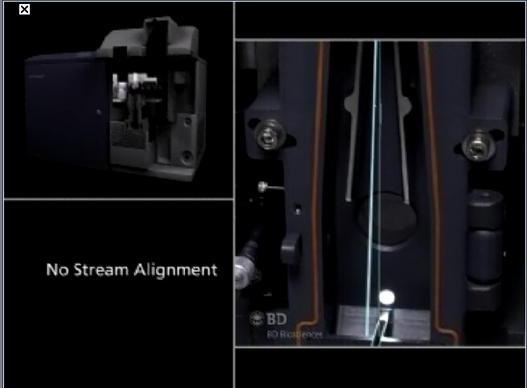
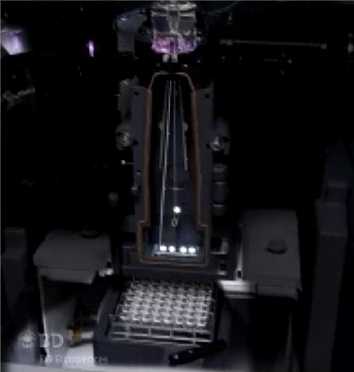
Aria sort components
Images from BD Website and Public Presentations

Slide 25
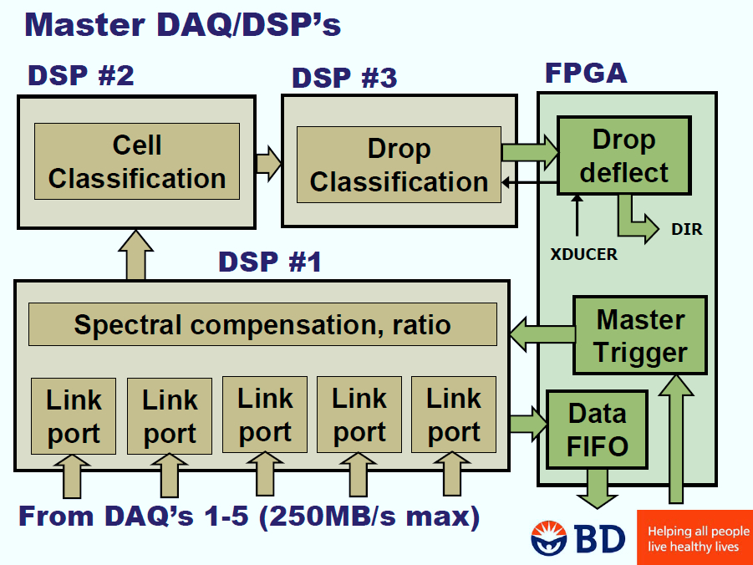
Aria logic controls
Images from BD Website and Public Presentations

Slide 26
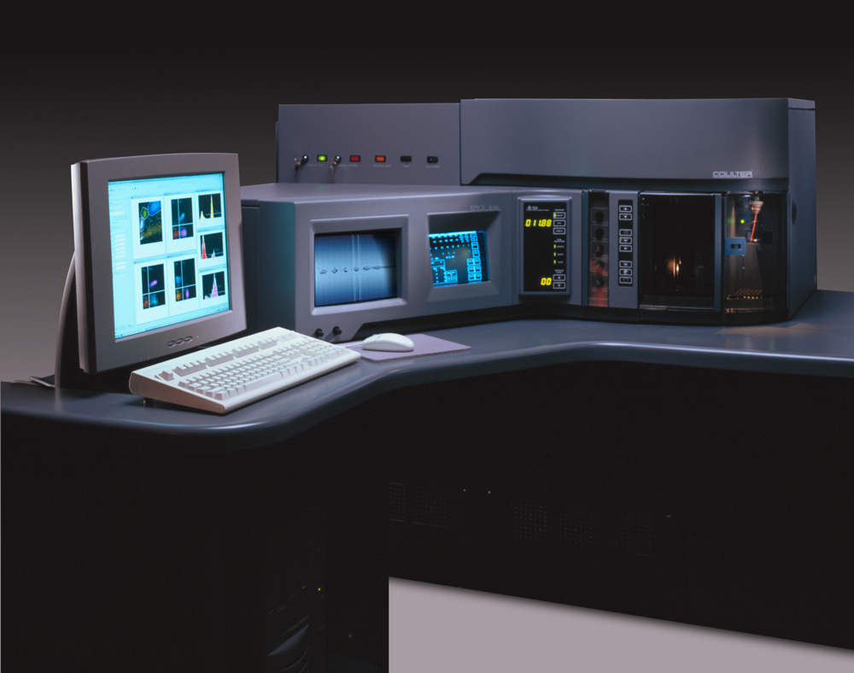
Elite-Altra

Slide 27
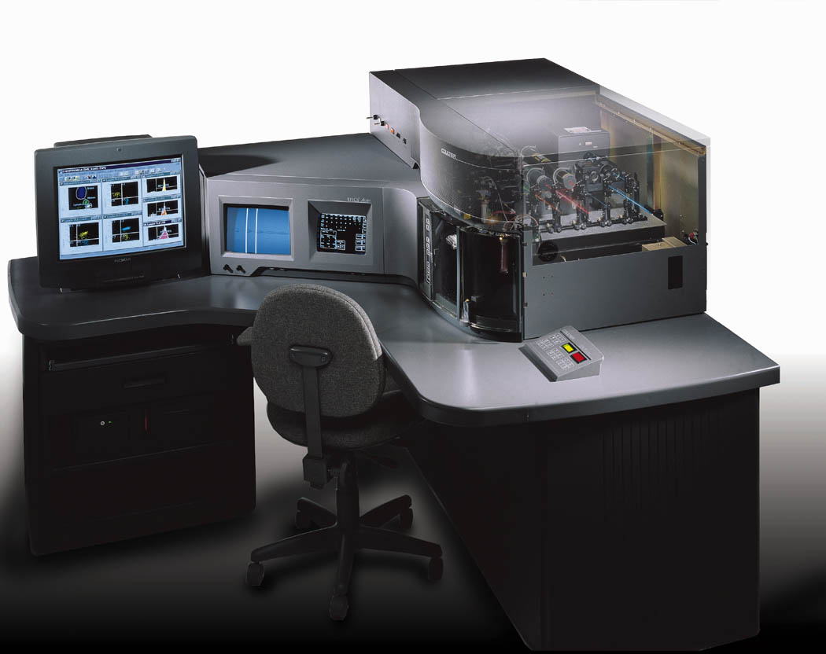
Images from BC Website and Public Presentations

Slide 28
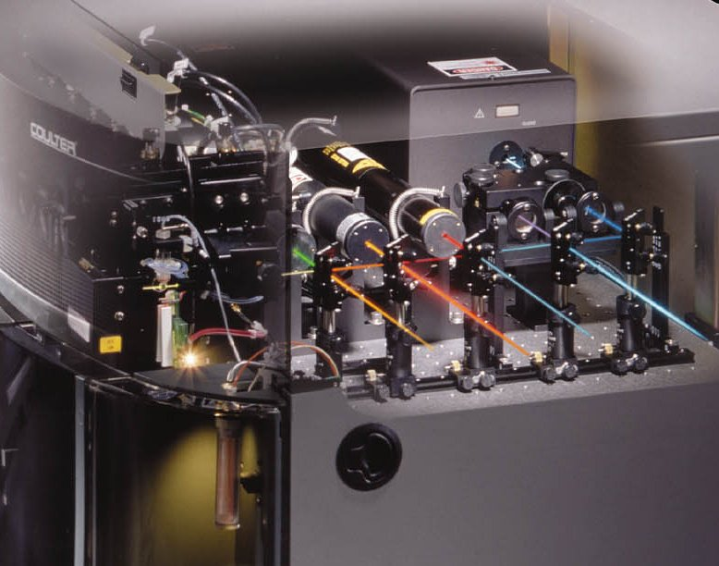
Images from BC Website and Public Presentations

Slide 29
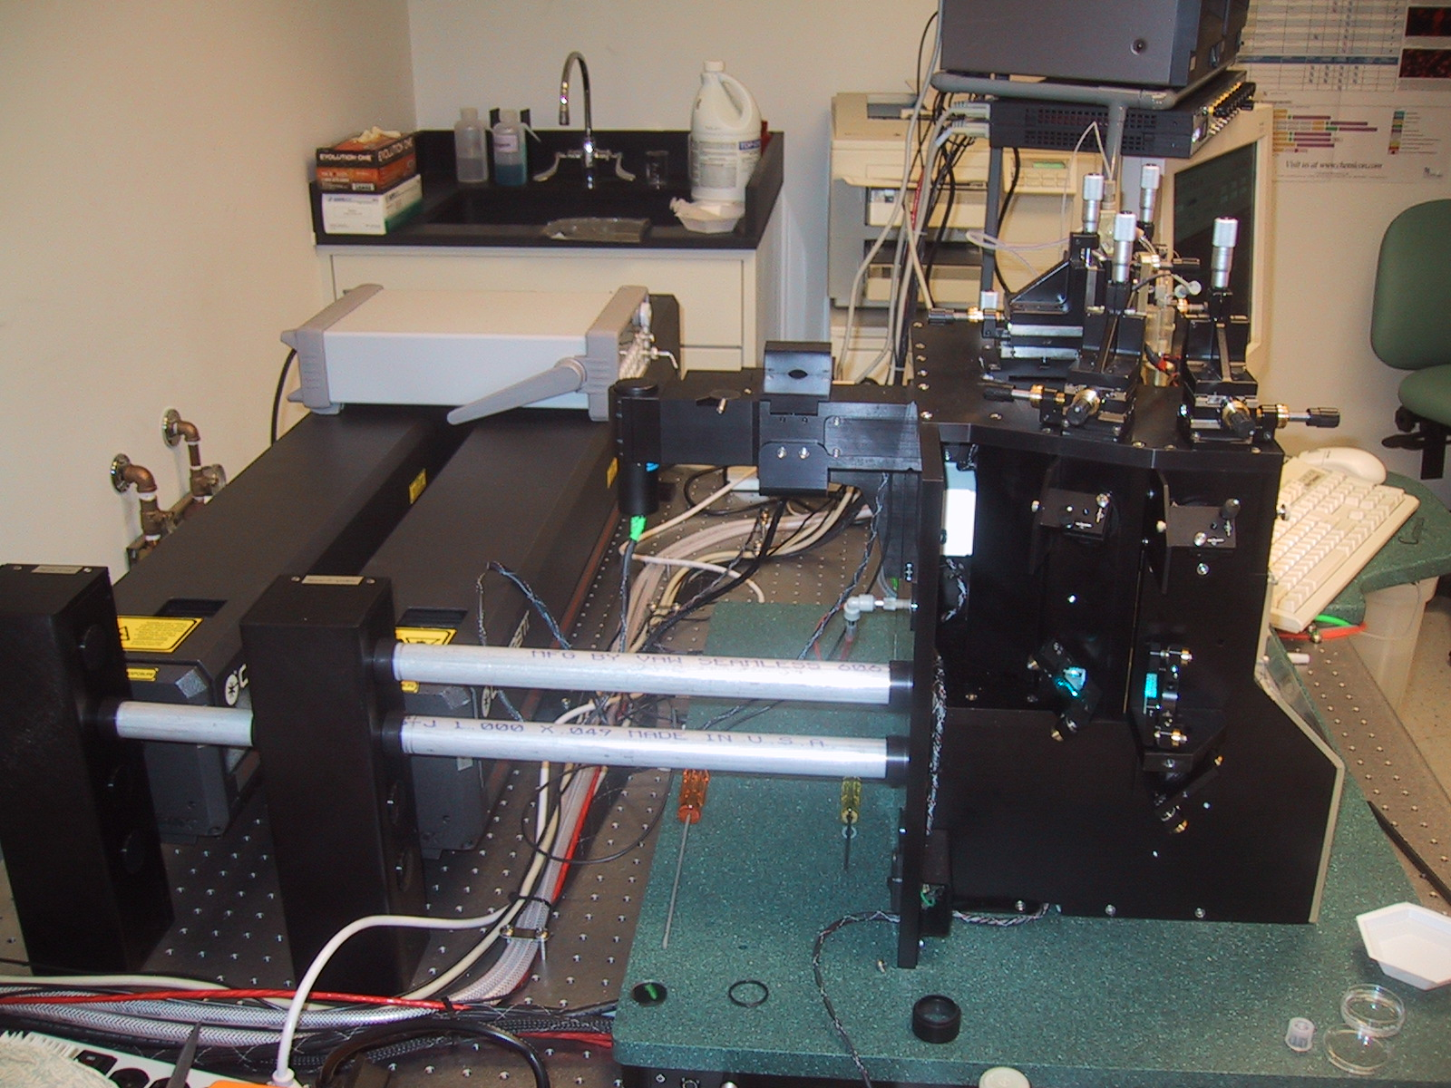
Cytopia (Now BD)
Photo by JPR

Slide 30
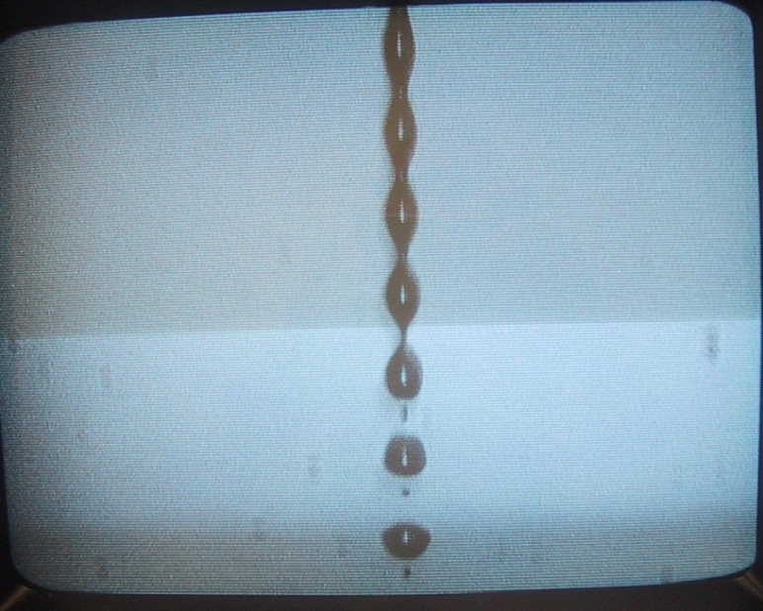
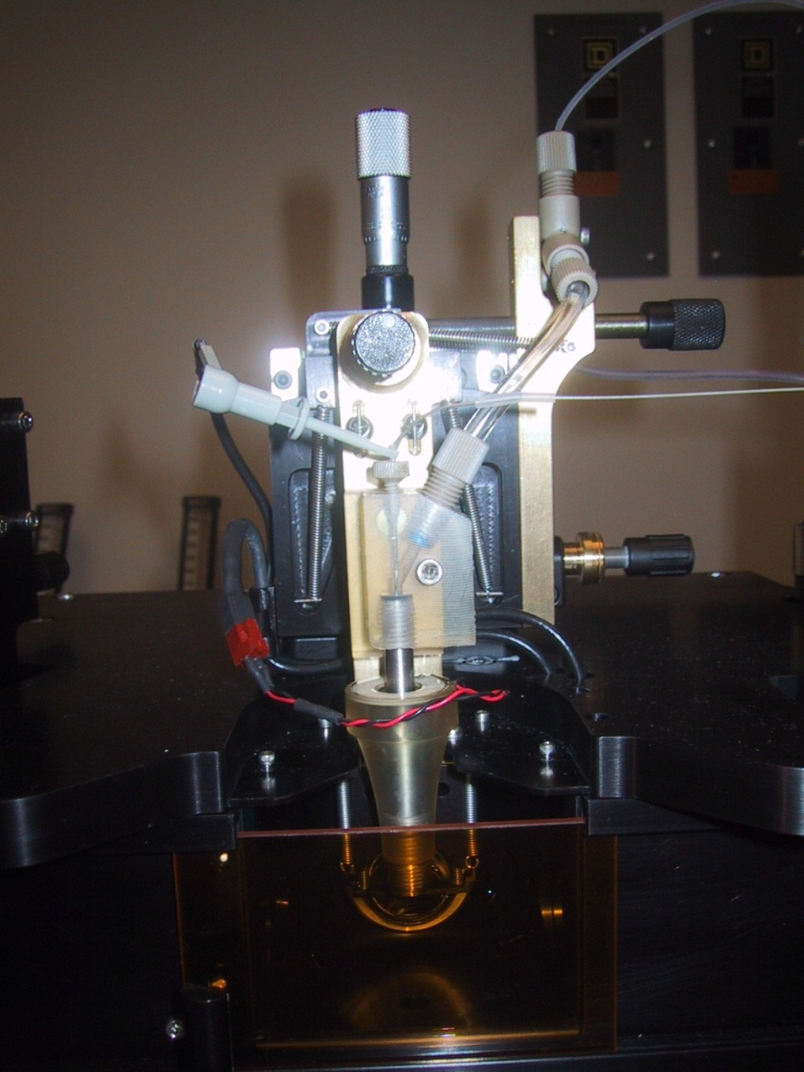
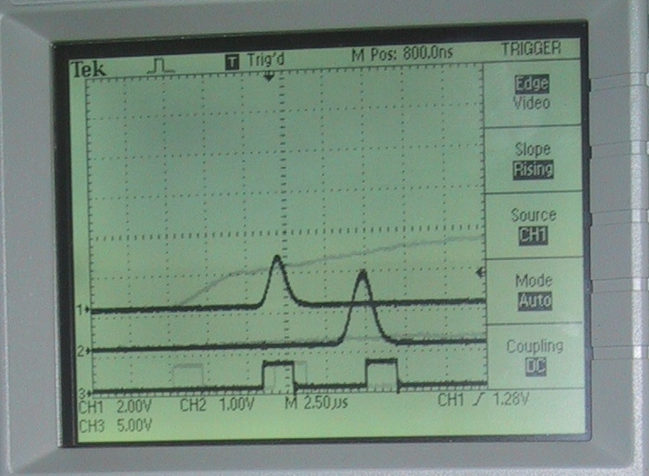
Cytopia (Now BD)
Photo by JPR

Slide 31
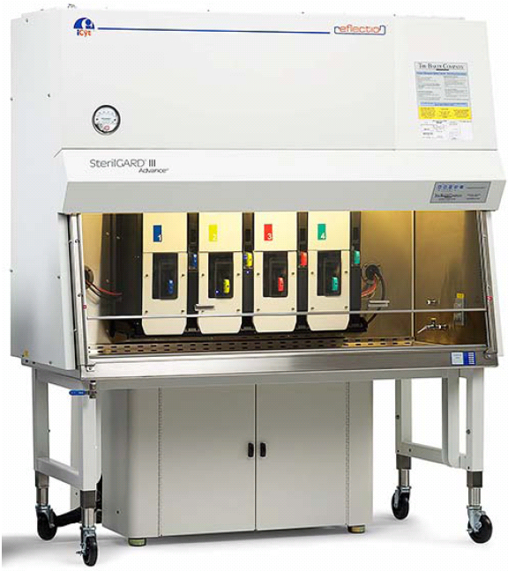
Icyt-Sony Reflection Sorter

Slide 32
Reflection Key features
Listmode Parameters: Up to 256
Pulse features (area, height, width, rise time)
Sort decisions (cell sort classification, droplet stream classification)
Time interval between pulses
Custom programmable pulse features
Fluorescence Compensation: Full matrix among all features
Simultaneous Laser Excitation Lines: Up to 7 (355, 405, 488, 532, 561, 592, 640 nm)
Laser Options: Any vendor, any configuration with industry standard optical table
Nozzle Sizes: 50 μm to 200 μm
Measurement Dynamic Range: >10,000 x
Measurement Precision: CV of < 1%
Narrow Forward Scatter Collection Angle: 1 to 5 degrees half-angle
Optional Wide Forward Scatter Collection Angle: 5 to 41.3 degrees half-angle
Number of Analysis Regions: Greater than 512
Number of Separate Sort Gates (Based on Boolean Expressions of Region): Up to 256
AOTF (Acousto-Optical Tunable Filter) with < 3 nm resolution
16 channel spectrometer (370 nm to 730 nm)
Amplitude modulation (either directly or with EOM) from 5 to 40 MHz
Secondary fluorescence collection optic
Sort deposition system
Biohazard containment: Baker SterilGard ® III Advance hood integration

Slide 33
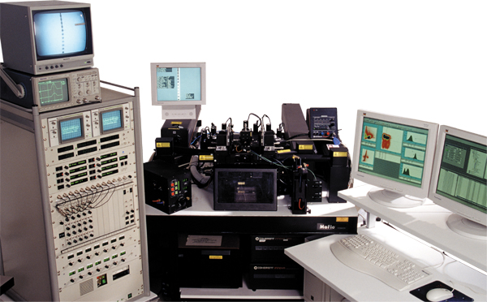
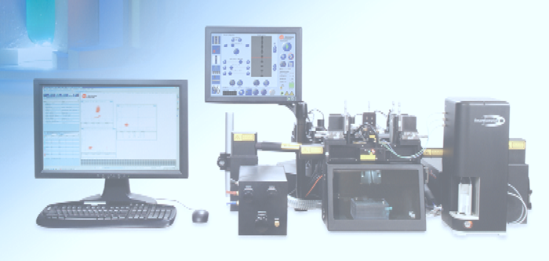
Moflo sorter
Images from BC Website and Public Presentations

Slide 34
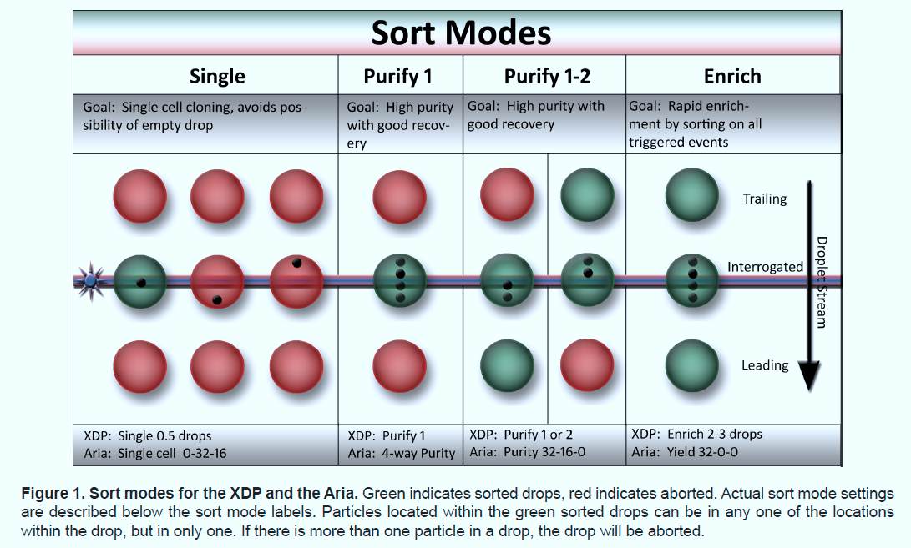
Images from BC Website and Public Presentations

Slide 35
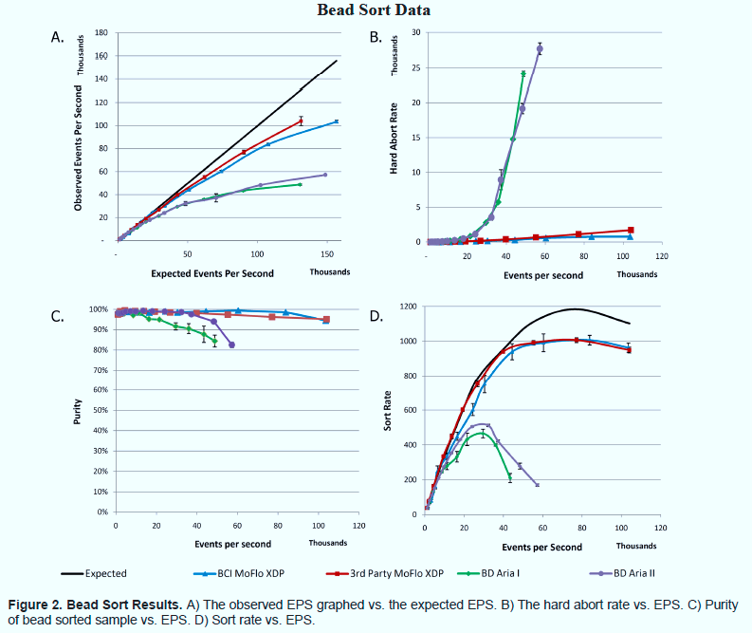
Note: This is not an endorsement of this instrument. Data are from a commercial brochure
Images from BC Website and Public Presentations

Slide 36
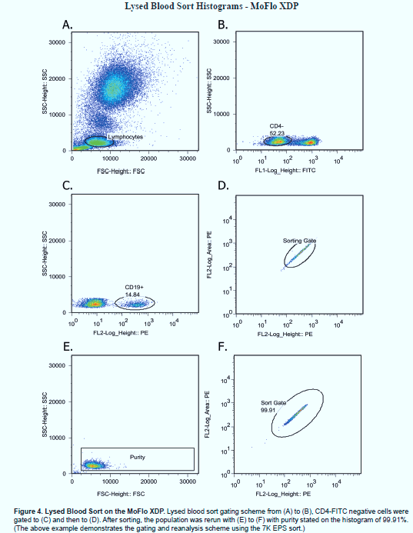
XDP sorting of Lysed Blood example
Note: This is not an endorsement of this instrument. Data are from a commercial brochure
Images from BC Website and Public Presentations

Slide 37
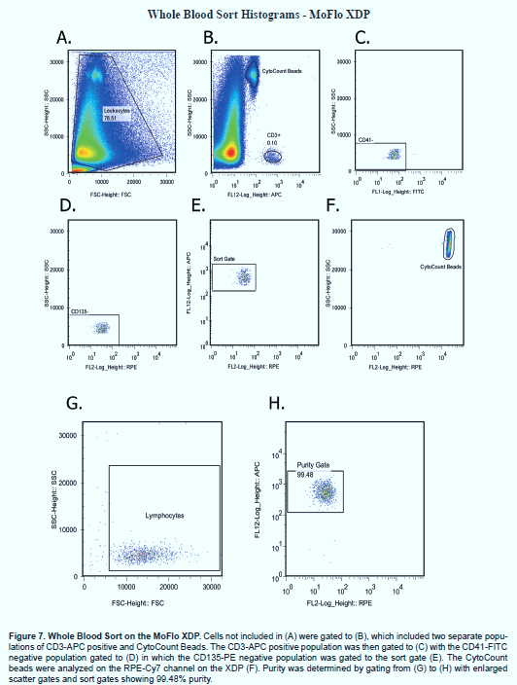
XDP sorting of Whole Blood example
Note: This is not an endorsement of this instrument. Data are from a commercial brochure
Images from BC Website and Public Presentations

Slide 38
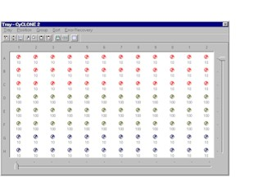
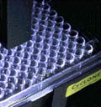
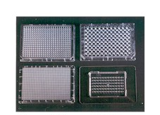
Automatic plate deposition is standard on most systems

Slide 39
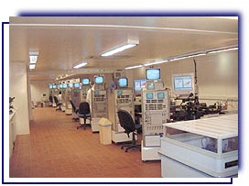
XY technologies – sperm sorting

Slide 40
BD Sorters

Slide 41
Sony Sorters

Slide 42
Beckman Sorters

Slide 43
Nanosellect Cell Sorter

Slide 44
BioRad Sorters

Slide 45
Miltenyi Biotec
autoMACS® Pro Separator

Slide 46
Human Sperm Sorting
MicroSort® Current Results
XSORT®
XSORT® to increase the probability of conceiving a girl has resulted in an average of 88% X-bearing (female) sperm in the enriched specimen and 91% of the babies have been female. (295/325)
YSORT®
YSORT® to increase the probability of conceiving a boy has resulted in an average of 73% Y-bearing (male) sperm in the enriched specimen and 76% of the babies have been male. (39/51)
Conception Rate
The MicroSort Clinic average cumulative IUI clinical pregnancy rate is 16.6% (242/1452) per treatment cycle. The overall IVF/ICSI clinical pregnancy rate is 33% (164/497) This includes MicroSort collaborators doing IVF/ICSI.
Pregnancies & Births
As of January 2004, more than 500 pregnancies have been achieved using MicroSort®; 419 babies have been born so far with many more due to deliver.
Source: http://www.microsort.net/index.htm

Slide 47
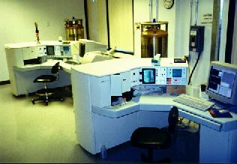
Microsort Sperm Sorting Facility
From the Microsort Website
Sperm Sorting (Gender Selection) for Prevention of X-Linked Diseases and for Family Balancing
The Genetics & IVF Institute (GIVF) reported the first human births in the world following flow cytometric separation of X (female) and Y (male) chromosome-bearing sperm cells (MicroSort).
“Concerns regarding the use of UV and Hoechst 33342 (bisbenzimide) for FCS of human sperm cells have been expressed (Ashwood-Smith, 1994 and Munne, 1994) and clarified (Johnson and Schulman, 1994). Bisbenzimide is a non-intercalating non-cytotoxic DNA stain that preferentially binds to triplet adenine and thymine base pairs in the minor groove outside of the double helix and is reversible at 37C. Hoechst 33342 absorbs at 358nm, a substantial distance from the maximum DNA absorption of approximately 260nm, excites at 367nm and emits at 461nm. While some somatic cells have been found to be sensitive to bisbenzimide staining (Van Zandt and Fry, 1983; Durand and Olive, 1982), sperm nuclear DNA has undergone changes including compaction and stabilization that is uniquely different from other cell types. Watkins et al. (1996) found no evidence of mutagenicity of human sperm cells stained with <900 M bisbenzimide as assessed by PCR analysis of the B-globin gene. Catt et al. (1997) also reported no increase in the incidence of endogenous DNA nicks in human sperm cells after bisbenzimide staining and UV exposure during passage through a fluorescence activated cell sorter. Concerns regarding embryo development in the bovine (Cran et al., 1994) and rabbit (McNutt and Johnson, 1996) were not observed in our human experience that resulted in a 92% embryo cleavage rate (unpublished data) and 21.2% pregnancy rate per transfer cycle. Most important, as in the animal data in several species with hundreds of normal births, all offspring born from FCS of human sperm have been normal and healthy.”
Births of normal daughters after MicroSort sperm separation and intrauterine insemination, in-vitro fertilization, or intracytoplasmic sperm injection”, E.F.Fugger, S.H.Black K. Keyvanfar, J.D. Schulman
NOTE: The FDA withdrew Microsort license to perform human sorts recently. As I understand it, this was due to ethical reasons related to “population balancing” and not safety issues.
Source: http://www.microsort.net/index.htm

Slide 48
References to Human Sperm Sorting
Vidal, F., Fugger, E.F., Blanco, J., Keyvanfar, K. et al, Efficiency of MicroSort Flow Cytometry for Producing Sperm Populations Enriched in X- or Y Chromosome Haplotypes: a Blind Trial Assessed by Double and Triple Colour Fluorescent In-Situ Hybridization,? Hum Reprod, Vol. 13, 1998, pp. 308-312.
Fugger, E.F., Black, S.H., Keyvanfar, K. and Schulman, J.D., Births of Normal Daughters After MicroSort Sperm Separation and Medical Insemination, IVF, or ICSI,? Hum Reprod, Vol. 13, No. 9, 1998, pp. 2367-2370.
Stern, H., Wiley, S., Matken, R., Karabinus, D., and Blauer, K., MicroSort⼯span> Babies: 1994-2002 Preliminary Postnatal Follow-up Results,? American Society of Reproductive Medicine, Meeting Abstracts, Seattle, Washington, October 2002, Fertility and Sterility, Vol. 76, No. 3S, September 2002, p. 54
Laboratory Sort Fees (2004)
To be used with IVF or IVF / ICSI with a collaborating Physician
MicroSort Lab fee for sorting 1 vial $2,370
Additional vial sorted from the same specimen* $515
Preliminary Purity Results by FISH (optional) $250
Source: http://www.microsort.net/index.htm

Slide 49
Methods Used
Flow cytometric separation
The specimens were sorted by FCS as previously described (Johnson et al., 1993). Briefly, sperm were sorted using buffered sheath fluid with either a modified Epics® 753 (Coulter Corporation, Hialeah, FL) or a modified FACS® Vantage (Becton-Dickinson Immunocytometry Systems, San Jose, California). Fluorescence emitted from each sperm cell was detected through a 400nm long pass filter, and the enriched fraction of the sorted sample was collected. The motility and progression of the sorted specimen was evaluated at 35C under paraffin oil using an inverted microscope with Hoffman optics (Leitz, Bunton Instruments, Rockville, MD).
Sperm preparation and staining
Fresh or frozen semen specimens were provided for sorting. Fresh semen specimens were allowed to liquefy at 35C for 30 minutes. Frozen specimens were thawed at room temperature in a laminar flow hood for 15 minutes. Specimens were evaluated for volume, count, motility, progression, viability, and percent abnormal cells using WHO standards (World Health Organization, 1992). Specimens to be sorted were extended, centrifuged, resuspended, filtered through glass wool to remove debris and non-motile sperm cells (Johann et al., 1989), and treated with a solution of Hoechst 33342, the vital fluorochrome bisbenzimide (Calbiochem-Behring Corporation, La Jolla, CA) using previously described techniques (Johnson et al., 1993).
Source: Fugger, E.F., Black, S.H., Keyvanfar, K. and Schulman, J.D., Births of Normal Daughters After MicroSort Sperm Separation and Medical Insemination, IVF, or ICSI,? Hum Reprod, Vol. 13, No. 9, 1998, pp. 2367-2370.

Slide 50
Safety in Sorting
We often discuss cell sorting when we are really talking about analysis….analyzers analyze, sorters analyze AND sort!
Sorters produce a mist of droplets ….. this is a potentially dangerous environment
Care must be taken when you sort anything because most samples contain fluorescent dyes and you must not ingest these if you are in the vicinity of the mist. Note: PI is also something to take into consideration here.
Sorting live human cells should be achieved only under extraordinary conditions
  1. Total and complete safety environment
  2. Fully tested environment
  3. OSHA tested instrument and environment
  4. Possibly using OSHA tested masks
Lasers are also dangerous – so laser safety in sorters is much more important that analyzers because of open plans

Slide 51
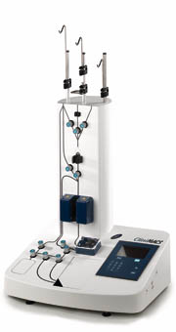
ClinimacsTM
Magnetic bead sorter
http://www.miltenyibiotec.com/en/clinical-applications/clinimacs-system/clinimacs-instruments/clinimacs-plus-instrument/clinimacs-plus-instrument.aspx

Slide 52

Fluorescence Cell Sorting in a Closed,
Single-Use Disposable Cartridge
The following slides kindly provided by Dr. Jack Dunne
Notes:
Corporate information

Slide 53
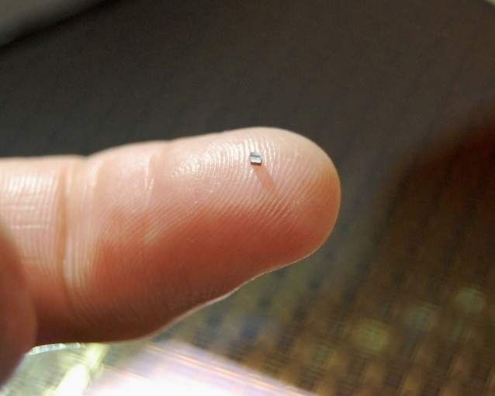
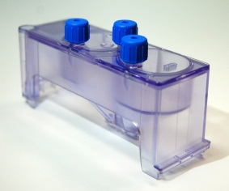
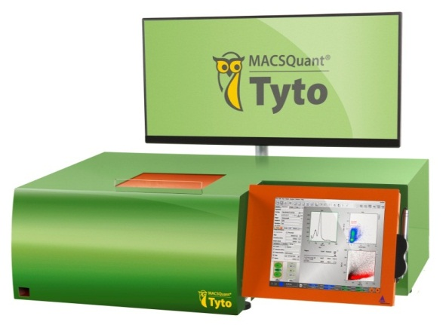

Owl Biomedical Microchip Sorting
World’s fastest valve performs sorting
No sheath fluids or aerosols
Keep cells and operator safe with sterile, disposable, closed cartridge system
No cleaning or carryover between sorts
Provides low stress to cells, high cell viability
Cell throughput up to 200M cells/hour
  55k cells/s
8-color fluorescence-based sorting
4C – 37C temperature operation
“Walk-away” fluorescent cell sorting
Tyto Microchip
Tyto Cartridge

Slide 54
Tyto Development and Product Status
US Early Adopter Program fully subscribed
  Application-specific feasibility in progress
  Deliveries with simplified software
General Availability:
  Finishing complex sort processing
  Manufacturing scale-up
  Support and service training

Slide 55
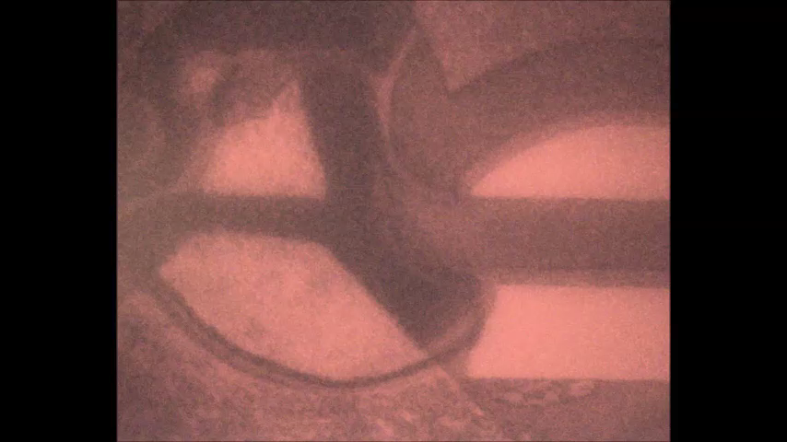
TITO- Visualization of Valve Speed
Strobe imaging: 1us frames, full cycle = 30us

Slide 56
Reproducible, High Viability
Across Cell Types
Labeled Cell Type | Label | Sort Output Mean Viability | Sort Output Variance | Sample N
K562 (Leukemia) | ALDH FITC | 98.5% | 0.3% | 4
K562 (Leukemia) | CFSE FITC | 97.1% | 1.0% | 13
H1650 (Lung Cancer) | EpCAM PE | 97.4% | 0.6% | 3
MCF7 (Breast Cancer) | EpCAM PE | 97% | 0.5% | 6
PDA (Pancreatic Cancer) | KPC GFP | 99.3% | 0.03% | 3
T cells (Lymphocytes) | Tetramer PE | 96% | 1.1 % | 3
Buffy (White Blood Cells) | CD4 PE, CD45 APC | 99% | 1% | 12
Whole Blood (Dilute 1:4) | CD4 PE, CD45 APC | 96% | 0.07% | 105
Neuronal precursor | CD47+ | 99% | 0.2% | 2
iPS Neural Stem Cells | CD133+ | 98% | 0.5% | 4

Slide 57
Summary
Cell sorting is highly mature
Sorting can be at high speed or typical low speed sorting
Sorting can be multiway – some systems can sort 7 ways – or you can sort to 96 well plates or petrie dishes
Sorting hazardous samples is dangerous and should only be done with proper precautions
High speed sorting requires careful attention, proper sample preparation
All the instruments on the market do a good job!

