Slide 1
BMS 631 - LECTURE 3
Light and Matter
J.Paul Robinson
The SVM Professor of Cytomics
College of Veterinary Medicine
&
Professor of Biomedical Engineering
College of Engineering
Purdue University
Lynn Hall, G221
Purdue University
Office: 494 0757
email; robinson@flowcyt.cyto.purdue.edu
WEB http://www.cyto.purdue.edu
4th Ed Shapiro p 75-96

Slide 2
Light and Matter
Energy
  joules, radiant flux (energy/unit time)
  watts (1 watt=1 joule/second)
Angles
  steradians - sphere radius r - circumference is 2πr²; the angle that intercepts an arc r along the circumference is defined as 1 radian. (57.3 degrees) a sphere of radius r has a surface area of 4πr². One steradian is defined as the solid angle which intercepts as area equal; to r² on the sphere surface
Shapiro p 75

Slide 3
Terms
Side scatter, forward angle scatter, cell volume, coulter volume:
Understand light scattering concepts; intrinsic and extrinsic parameters
Photometry:
Light - what is it - wavelengths we can see 400-750 nm, most sensitive around 550 nm. Below 400 nm essentially measuring radiant energy. Joules (energy) radiant flux (energy per unit time) is measured in watts (1 watt=1 joule/second).
Steradian (sphere radius r has surface area of 4 πr²; one steradian is defined as that solid angle which intercepts an area equal to r² on the surface.
Mole - contains Avogadro's number of molecules (6.02 x 10²³) and contains a mass in grams = molecular weight. Photons - light particles - waves - Photons are particles which have no rest mass - pure electromagnetic energy - these are absorbed and emitted by atoms and molecules as they gain or release energy. This process is quantized, is a discrete process involving photons of the same energy for a given molecule or atom. The sum total of this energy gain or loss is electromagnetic radiation propagating at the speed of light (3 x 10⁸ m/s). The energy (joules) of a photon is
E=hν and E=hν/l [ν-frequency, l-wavelength, h-Planck's constant 6.63 x 10⁻³⁴ joule-seconds]
Energy - higher at short wavelengths - lower at longer wavelengths.

Slide 4
Photons and Quantum Theory
Photons
  particles have no rest mass - composed of pure electromagnetic energy - the absorption and emission of photons by atoms and molecules is the only mechanism for atoms and molecules can gain or lose energy
Quantum mechanics
  absorption and emission are quantized - i.e. discrete process of gaining or losing energy in strict units of energy - i.e. photons of the same energy (multiple units are referred to as electromagnetic radiation)
Energy of a photon
  can be computed from its frequency (ν)
  in hertz (Hz) or its wavelength (l) in meters from
        E=hν and E=hc/λ
λ = wavelength
h = Planck’s constant
(6.63 x 10⁻³⁴ joule-seconds
c = speed of light (3x10⁸ m/s)
Shapiro p 76

Slide 5
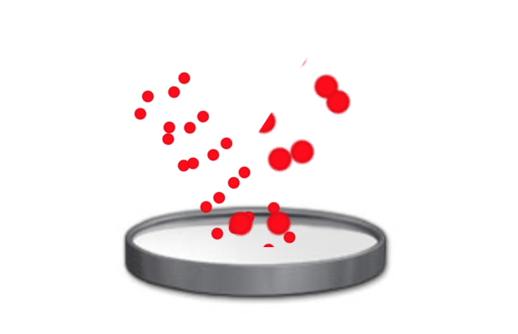
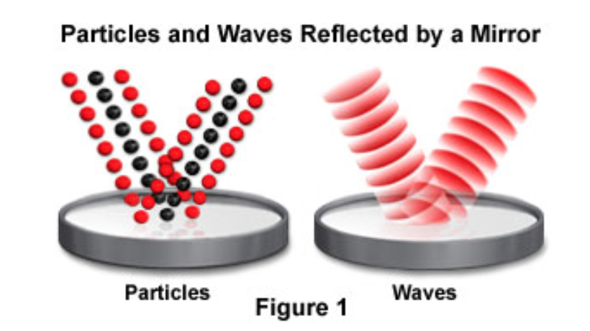

Light – Particles and waves - Reflection
Diagrams from: http://micro.magnet.fsu.edu/primer/java/particleorwave/reflection/index.html

Slide 6
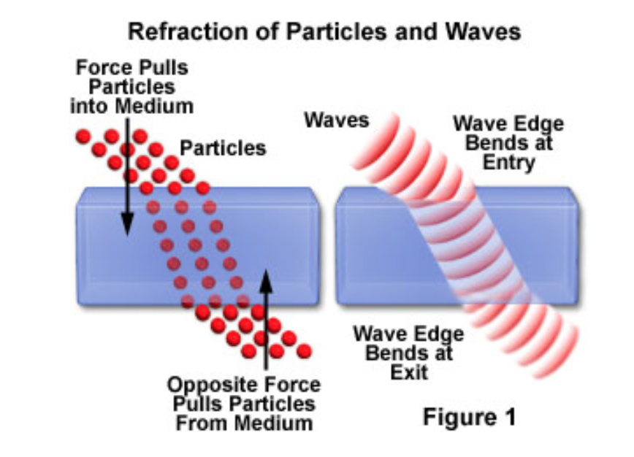
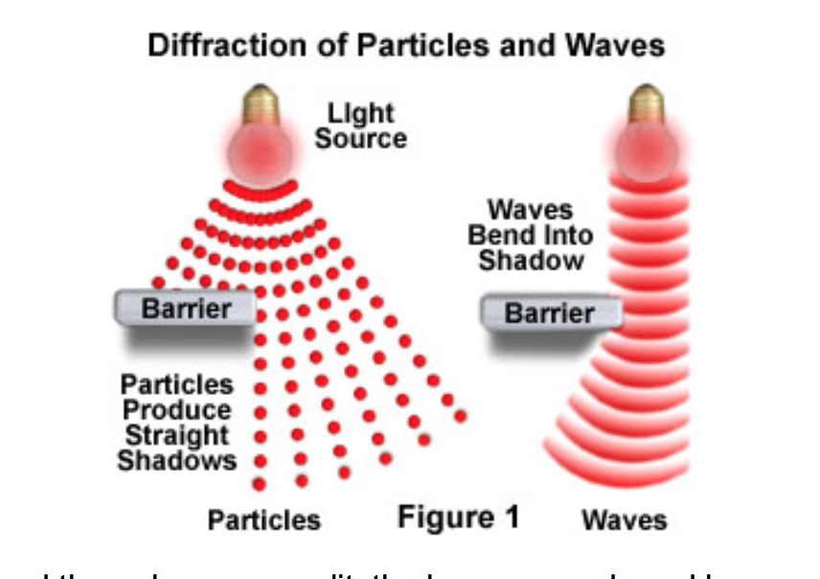
Light – Particles and waves -
Refraction
Diffraction
Diagrams from: http://micro.magnet.fsu.edu/primer/java/particleorwave/reflection/index.html

Slide 7
Laser power
E=hν and E=hc/λ
One photon from a 488 nm argon laser has an energy of
  E= 6.63x10⁻³⁴ joule-seconds x 3x10⁸
To get 1 joule out of a 488 nm laser you need 2.45 x 10¹⁸ photons
1 watt (W) = 1 joule/second a 10 mW laser at 488 nm is putting out 2.45x10¹⁶ photons/sec
= 4.08x10⁻¹⁹ J
488 x 10⁻³
(lasers will be discussed in more detail in a later lecture)
Shapiro p 77

Slide 8
What about a HeCd UV laser?
  E= 6.63x10⁻³⁴ joule-seconds x 3x10⁸
325 x 10⁻³
A photon has energy
= 6.12 x 10⁻¹⁹ J so 1 Joule at 325 nm = 1.63x10¹⁸ photons
What about a He-Ne laser?
  E= 6.63x10⁻³⁴ joule-seconds x 3x10⁸
633 x 10⁻³
A photon has energy
= 3.14 x 10⁻¹⁹ J so 1 Joule at 633 nm = 3.18x10¹⁸ photons
Shapiro p 77

Slide 9
Polarization and Phase: Interference
Electric and magnetic fields are vectors - i.e. they have both magnitude and direction
The inverse of the period (wavelength) is the frequency in Hz
Axis of Electric Field
Wavelength (period T)
Axis of
Magnetic Field
Axis of Propagation
Shapiro p 78

Slide 10
Interference
0º
90º
180º
270º
360º
Wavelength
A+B
A
The frequency does not change, but the amplitude is doubled
Amplitude
B
Constructive
Interference
C+D
Here we have a phase difference of 180º (2π radians) so the waves cancel each other out
C
D
Destructive
Interference
Figure modified from Shapiro “Practical Flow Cytometry” Wiley-Liss, p79

Slide 11
Interference in Thin Films
Small amounts of incident light are reflected at the interface between two material of different RI
Thickness of the material will alter the constructive or destructive interference patterns - increasing or decreasing certain wavelengths
Optical filters can thus be created that “interfere” with the normal transmission of light
Shapiro p 82

Slide 12
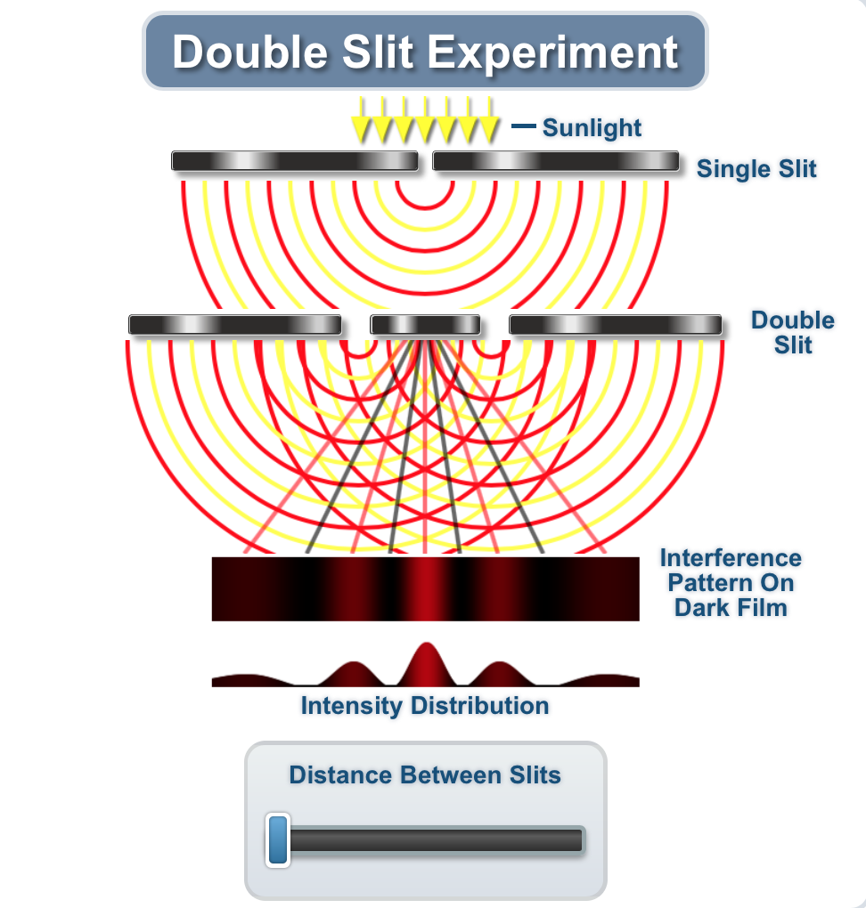
Interference and Diffraction: Gratings
Diffraction essentially describes a departure from theoretical geometric optics
Thus a sharp objet casts an alternating shadow of light and dark “patterns” because of interference
Diffraction is the component that limits resolution
Thomas Young’s double split experiment in 1801
http://micro.magnet.fsu.edu/primer/java/interference/doubleslit/index.html
Shapiro p 83

Slide 13
Light Scatter
Materials scatter light at wavelengths at which they do not absorb
If we consider the visible spectrum to be 350-750 nm then small particles (< 1/10 λ) scatter rather than absorb light
For small particles (molecular up to sub micron) the Rayleigh scatter intensity at 0º and 180º are about the same
For larger particles (i.e. size from 1/4 to tens of wavelengths) larger amounts of scatter occur in the forward not the side scatter direction - this is called Mie Scatter (after Gustav Mie) - this is how we come up with forward scatter be related to size
Gustav Mie 1969-1957
From Wikipedia
Shapiro p 79

Slide 14

Light Scatter video….. https://www.youtube.com/watch?v=IOOtw3TQXE8

Slide 15
The laser volume vs the particle volume
10 μ
The fundamental problem is that microparticles are detected within the noise region of virtually all flow cytometers; despite a number of attempts to measure them via FC, with some level of success, all have identified significant problems because of the failure of cytometers to adequately separate microparticles from noise. It is almost absurd to consider a minimum of a 12-order differentiation acceptable. There are increasing numbers of papers making unsustainable claims about the effectiveness of FC for sub micron–size particles, most using fluorescence-based triggering that cannot guarantee anything about the size or even the number of particles within the excitation volume

Slide 16
Light Scatter and Particle size
Dia (ratio 1) | Volume 4/3 πr³ | Ratio | Surface Area | Ratio particle to laser vol
10 Microns =1 | 4.1887902E-6 μ³ | 1 | 1.25663706E-3 μ² | 1
1 micron 1/10 | 4.1887902E-9 μ³ | 1E+3 | 1.25663706E-5 μ² | 1E+2
500 nm 1/50 | 5.23598776E-10 μ³ | 8E+3 | 3.14159265E-6 μ² | 4E+2
100 nm 1/100 | 4.1887902E-12 μ³ | 1E+6 | 1.25663706E-7 μ² | 1E+4
50 nm 1/500 | 5.23598776E-13 μ³ | 8E+6 | 3.14159265E-8 μ² | 4E+4
10 nm 1/1000 | 4.1887902E-15 μ³ | 1E+9 | 1.25663706E-9 μ² | 1E+6
Having some idea of the size of a particle, will give you knowledge of what the detection limits might be of a flow cytometer

Slide 17
Rayleigh Scatter
Molecules and very small particles do not absorb, but scatter light in the visible region (same freq as excitation)
Rayleigh scattering is directly proportional to the electric dipole and inversely proportional to the 4th power of the wavelength of the incident light
the sky looks blue because the gas molecules scatter more
light at shorter (blue) rather than longer wavelengths (red)

Slide 18
Refraction & Dispersion
ref
rac
tion
Short wavelengths are “bent” more than long wavelengths
dispersion
Light is “bent” and the resultant colors separate (dispersion).
Red is least refracted, violet most refracted.

Slide 19
Reflection and Refraction
Snell’s Law: The angle of reflection (Ø_{r}) is equal to the angle of incidence (Ø_{i}) regardless of the surface material
The angle of the transmitted beam (Ø_{t}) is dependent upon the composition of the material
Transmitted
(refracted)Beam
Incident Beam
θ_{i}
θ_{t}
θ_{r}
Reflected Beam
n₁ sin Ø_{i} = n₂ sin Ø_{t}
The velocity of light in a material of refractive index n is c/n
Shapiro p 81

Slide 20
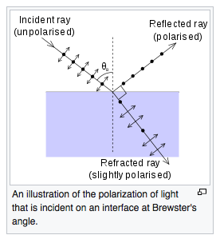
Brewster’s Angle
For a glass medium (n₂ ≈ 1.5) in air (n₁ ≈ 1), Brewster's angle for visible light is approximately 56°, while for an air-water interface (n₂ ≈ 1.33), it is approximately 53°. Since the refractive index for a given medium changes depending on the wavelength of light, Brewster's angle will also vary with wavelength.
Brewster’s angle is the angle at which the reflected light is linearly polarized normal to the plane incidence
At the end of the plasma tube, light can leave through a particular angle (Brewster’s angle) and essentially be highly polarized
Maximum polarization occurs when the angle between reflected and transmitted light is 90º
    thus Ø_{r} + Ø_{t} = 90º
    since sin (90-x) = cos x
    Snell’s provides (sin Ø_{i} / cos Ø_{i} ) = n₂/n₁
    Ø_{r} is Brewster’s angle
Ø_{r} = tan ⁻¹ (n₂/n₁)
Shapiro p 82

Slide 21
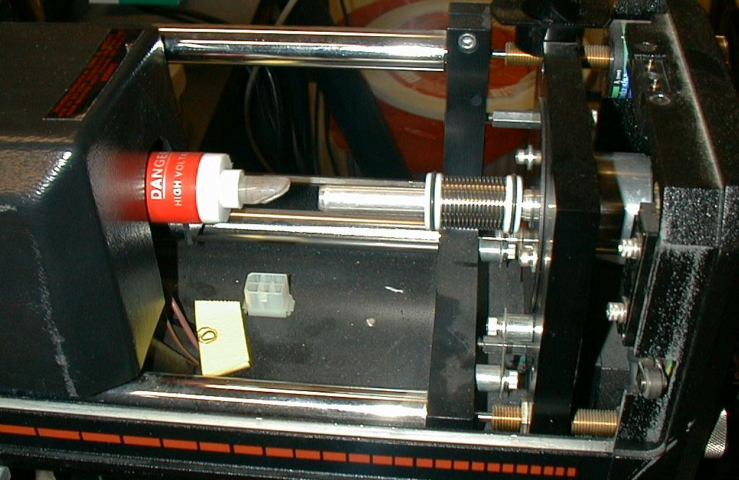
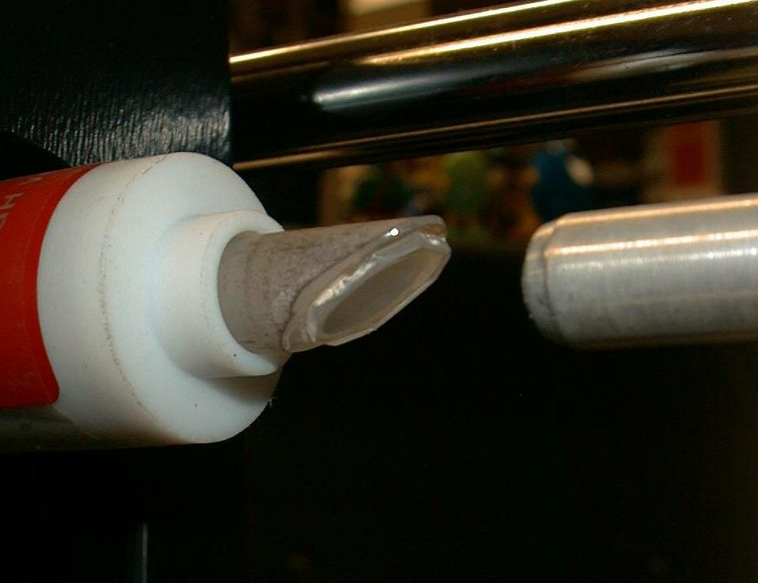
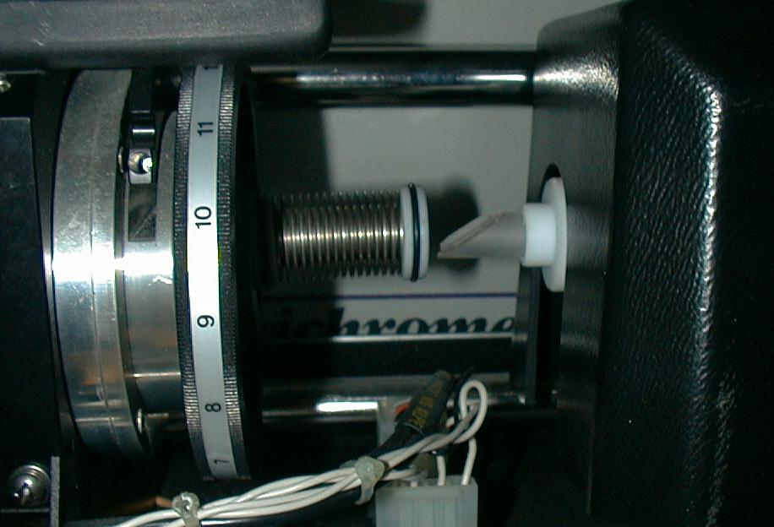
Brewster’s Angle
seen on the laser tubes from an argon laser

Slide 22
Absorption
Discussed more in lecture on fluorescence
Basic quantum mechanics requires that molecules absorb energy as quanta (photons) based upon a criteria specific for each molecular structure
Absorption of a photon raises the molecule from ground state to an excited state
Total energy is the sum of all components (electronic, vibrational, rotational, translations, spin orientation energies) (vibrational energies are quite small)
The structure of the molecule dictates the likely-hood of absorption of energy to raise the energy state to an excited one (that is why some molecules are fluorescent and other are not!
Shapiro p 84

Slide 23
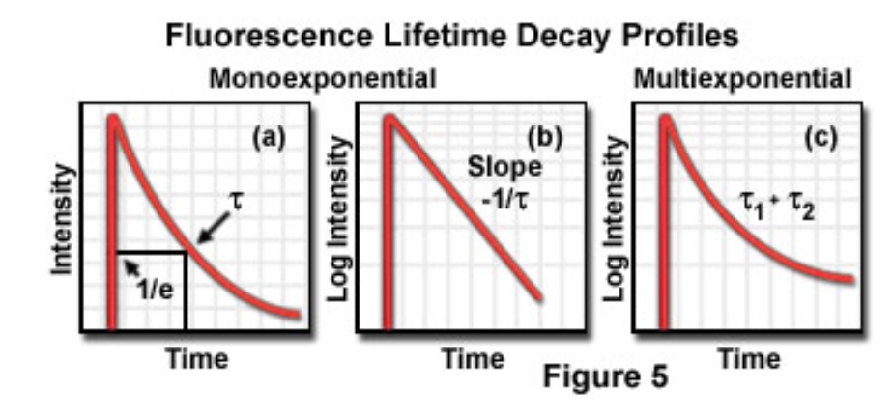
Fluorescence Lifetime
Absorption associated with electronic transitions (electrons changing states) occurs in about 1 femptosecond (10⁻¹⁵ s)
Fluorescence lifetime is defined as the time in which the initial fluorescence intensity of a fluorophore decays to 1/e (approx 37 percent) of the initial intensity
The lifetime of a molecule depends on how the molecule disposes of the extra energy
Because of the uncertainty principle, the more rapidly the energy is changing, the less precisely we can define the energy
So, long-lifetime-excited-states have narrow absorption peaks, and short-lifetime-excited-states have broad absorption peaks
http://micro.magnet.fsu.edu/primer/techniques/fluorescence/fluorescenceintro.html
Shapiro p 85

Slide 24
Exctinction
Using Beer’s law (Beer-Lambert law) for light travelling through a curvette thickness d cm containing n molecules/cm³
  ln (I_{o}/I) = σnd
    where Io and I are the light entering and leaving and σ is the molecular property called the absorption cross section
Now we can state that
  ln (I_{o}/I) = σnd where C is the concentration and σ is the absorption coefficient which reflects the capacity of the absorbing substance to absorb light
If there are n (molecules/cm³ ; d in cm, σ must be in cm² so if σ is in cm²/mol, C must be in mol/cm³ so C= σ/10³
giving
  log10 (I_{o}/I) = εαd = A
  where A is the absorbance or optical density
  and ε is the decadic molar exctinction coeficient in dm³mol⁻¹cm⁻¹
Shapiro p 86

Slide 25
Absorbance
O.D. units or absorbance is expressed in logarithmic terms so they are additive.
e.g. an object of O.D. of 1.0 absorbs 90% of the light. Another object of O.D. 1.0 placed in the path of the 10% of the light 10% of this light or 1% of the original light is transmitted by the second object
It is possible to express the absorbance of a mixture of substances at a particular wavelength as the sum of the absorbances of the components
You can calculate the cross sectional area of a molecule to determine how efficient it will absorb photons. The extinction coefficient indicates this value
Shapiro p 87

Slide 26
Fluorescence
Photon emission as an electron returns from an excited state to ground state
(More details in a later lecture)

Slide 27
Parameters
Extinction Coefficient
  ε refers to a single wavelength (usually the absorption maximum) (The extinction coefficient is determined by measuring the absorbance at a reference wavelength (characteristic of the absorbing molecule) for a one molar (M) concentration (one mole per liter) of the target chemical in a cuvette having a one-centimeter path length.)
  the intrinsic lifetime of a fluorophore is inversely proportional to the extinction coefficient, molecules exhibiting a high extinction coefficient have an excited state with a short intrinsic lifetime.
Quantum Yield
  Q_{f} is a measure of the integrated photon emission over the fluorophore spectral band
  Expressed as ratio of photons emitted to the number of photons absorbed (zero to 1 (best)
At sub-saturation excitation rates, fluorescence intensity is proportional to the product of ε and Q_{f}

Slide 28
Fluorescence
Quantum Yield
photons emitted
photons absorbed
k_{r}
k_{r} + k_{nr}
Q =
=
Fluorescence Lifetime (τ)
  - is the time delay between the absorbance and the emission
τ
1
k_{r} + k_{nr}
=

Slide 29
Fluorescence
Excitation Spectrum
  Intensity of emission as a function of exciting wavelength
Chromophores are components of molecules which absorb light
They are frequently aromatic rings

Slide 30
Raman Scatter
A molecule may undergo a vibrational transition (not an electronic shift) at exactly the same time as scattering occurs
This results in a photon emission of a photon differing in energy from the energy of the incident photon by the amount of the above energy - this is Raman scattering.
The dominant effect in flow cytometry is the stretch of the O-H bonds of water. At 488 nm excitation this would give emission at 575-595 nm
Shapiro p 93

Slide 31
Quenching, Bleaching & Saturation
Quenching is when excited molecules relax to ground stat5es via nonradiative pathways avoiding fluorescence emission (vibration, collision, intersystem crossing)
Molecular oxygen quenches by increasing the probability of intersystem crossing
Polar solvents such as water generally quench fluorescence by orienting around the exited state dipoles
Shapiro p 90

Slide 32
Matter – types of samples are used in flow cytometry
Biological materials particularly cells
Microbials – bacteria, algae, viruses
Synthetic beads – calibration applications
Solid tissue – when disaggregated

Slide 33
Sheath examples
Sheath used to be saline because almost all early instruments were cell sorters – so we always used saline
BUT – saline is not good for fluidics so it really does not matter what you run in the sheath since in principle, the sheath and sample do not mix
Water is preferred to keep systems clean

Slide 34
Summary
Review of nature of light
Review of fundamental features of light
Review of how de define efficiency of light
Introduction to fluorescence
Review of factors that influence light (quenching, lifetime, etc)

