Slide 1

Principles of 2D Image Analysis
Part 2 of 3
Notes prepared by Dr. Bartek Rajwa, Prof. John Turek & Prof. J. Paul Robinson
Purdue University Department of Basic Medical Sciences, College of Veterinary Medicine & Weldon School of Biomedical Engineering
These slides are intended for use in a lecture series. Copies of the graphics are distributed and students encouraged to take their notes on these graphics. The intent is to have the student NOT try to reproduce the figures, but to LISTEN and UNDERSTAND the material. All material copyright J. Paul Robinson unless otherwise stated, however, the material may be freely used for lectures, tutorials and workshops on non-commercial nature. They may not be used for any commercial purpose including for profit courses. It is illegal to upload this lecture to CourseHero or any other site.
www.cyto.purdue.edu
Last UPDATED January 2023

Slide 2
Morphometry: "The quantitative description of a structure" (Weibel, ER, 1969. Stereological principles for morphometry in electron microscopy. Int. Rev. Cytol. 26:235-302.
Stereology: The extraction/interpretation of 3D data from 2D data (i.e. sections of objects)
Image processing: Computer enhancement of a digitized image (i.e., using various filters to remove noise, improve contrast, pseudocoloring. Enhancement of regular structures (virus, crystals)
Image analysis: Information extracted from an image (area, perimeter, length, etc.)

Slide 3
How do humans classify objects?
Human method is pattern recognition based upon multiple exposure to known samples. We build up mental templates of objects, this image information coupled with other information about an object allows rapid object classification with some degree of objectivity, but there is always a subjective element.
We are sensitive to differences in contrast. We will tend to overestimate the amount or size of an object if there is high contrast vs low contrast.
We are sensitive to perspective and depth changes
We are sensitive to orientation of lighting. We prefer light to come from above.
We fill in what we think should be in the image

Slide 4
Biological structures present a continuous spectrum of change.
Morphometry eliminates subjectivity,
it is more reproducible, and has greater limits of detection.

Slide 5
Image Processing
Image processing is a method to perform some operations on an image, in order to get an enhanced image or to extract some useful information from it.
Image Analysis
Image analysis is the extraction of meaningful information from images; mainly from digital images by means of digital image processing techniques

Slide 6
Acquire digital image: CCD camera/Scanner

Slide 7
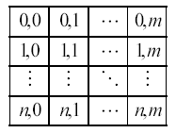
Digital images
Reminder…..
a 2D structure comprised of pixels
a “matrix” composed of n rows and m columns where each pixel location is denoted by the index (i,j)
for: 0 ≤ I < n and 0 ≤ j < m

Slide 8
Resolution
Microscopy
Rayleigh criterion
Sparrow criterion
FWHM
Digital image processing
The spatial resolution of an image is the physical size of a pixel in an image
λ
Sin θ = 1.2
D
θ is the angular resolution,
λ is the wavelength of light,
and D is the diameter of the lens' aperture.

Slide 9
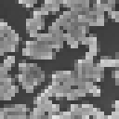







Digital resolution (cont.)
128x128 64x64 32x32 16x16

Slide 10
Image resolution in electronic publishing
Image resolution is measured in pixels per inch (ppi).
An image with a resolution of 100 ppi, contains 10,000 pixels in a square inch (100 pixels wide x 100 pixels high = 10,000).
The higher the resolution, the more pixels in the image. A 2-by-2-inch image with a resolution of 100 ppi would have 40000 pixels.
The same image with a resolution of 300 ppi would have 360,000 pixels in the same 2-by-2-inch area.
To perform image analysis, it is necessary that the features of interest are captured so that the measurements are performed on images that are not “pixelated”.
A round object when pixelated will have jagged edges.

Slide 11
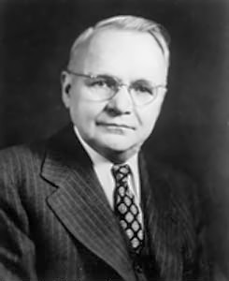
Henry Nyquist
Henry Nyquist worked at Bell Telephone Laboratories in the early 20th century.
In 1928, was interested in sound quality and discovered that to accurately represent an analog wave digitally, that analog wave needs to be sampled by at least TWICE the amount of the highest perceived frequency that is desired for playback.
Originally this was designed for the human voice which is around 90 to 1200 Hz.
Nyquist determined that he had to digitize the analog wave at 8KHz
Thus, the highest perceived frequency would only be half of that, 4KHz - but this was more than adequate for the human voice
https://en.wikipedia.org/wiki/Harry_Nyquist
Harry Nyquist was a Swedish-American physicist and electronic engineer who made important contributions to communication theory

Slide 12
Sampling Theory
The Nyquist Theorem
  Nyquest theory describes the sampling frequency (f) required to represent the true identity of the sample.
  i.e., how many times must you sample an image to know that your sample truly represents the image?
  In other words to capture the periodic components of frequency f in a signal we need to sample at least 2f times
Nyquist claimed that the rate was 2f. It has been determined that in reality the rate is 2.3f - in essence you must sample at least 2 times the highest frequency.
For example in audio, to capture the 22 kHz in the digitized signal, we need to sample at least 44.1 kHz
Excellent example here:
Excellent Example here
http://www.olympusmicro.com/primer/techniques/confocal/resolutionintro.html

Slide 13
Sampling and Nyquist
1

Slide 14
Sampling and Nyquist
Sample 6 times
Sample 12 times
2

Slide 15

😊

Slide 16
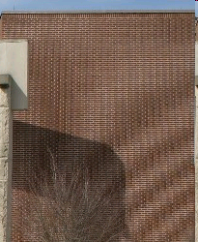
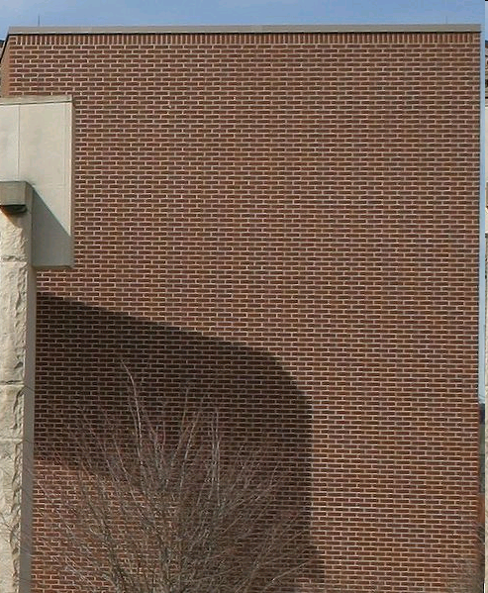

Slide 17
”What dpi do I need to preserve all of the detail in my image"?
In practice, the dpi necessary to preserve image detail can be quickly determined empirically. The sampling rate (dpi) that is used will depend upon how the image is going to be displayed. If a printed copy of an image is going to be made, there is little value in sampling with a dpi greater than the dpi capability of the printer. An exception to this is if the image is going to be magnified or enlarged in a manner analogous to optical photographic enlargement prior to printing.

Slide 18
cont…
An image 3 x 4 inches that is digitized at a rate of 600 dpi will only be 300 dpi if enlarged 2X and printed.
Therefore, a practical sampling guideline for printed images is that the final image should have at least the resolution of the printing device.
For light and electron micrographs of biological tissue, prints with a final resolution of 600 dpi will preserve most detail.
However, fine granular structures such as autoradiography silver grains or colloidal gold particles used in immunolabeling will not be as sharp as those in a traditional photograph.
For very fine granular structures, the final print resolution may need to be 1200 dpi or higher.

Slide 19
Bit resolution or pixel depth
This is a measurement of the number of bits of information per pixel.
The pixel depth will determine how much color or gray scale information is available for each pixel.
Greater pixel depth means more available colors and more accurate color representation.
Pixels in binary images have a depth of 1 (on or off), and are black and white images
A pixel with a bit depth of 8 has 2⁸, or 256, possible values; and a pixel with a bit depth of 24 has 2²⁴, or 16 million possible values (Red=8, Green=8, Blue=8).
Common values for pixel depth range from 1 to 24 bits per pixel.

Slide 20
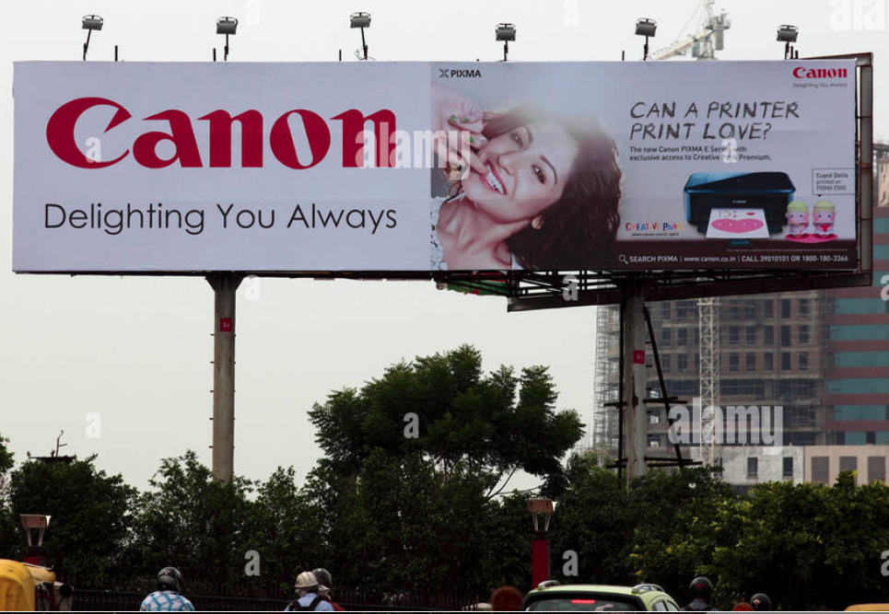
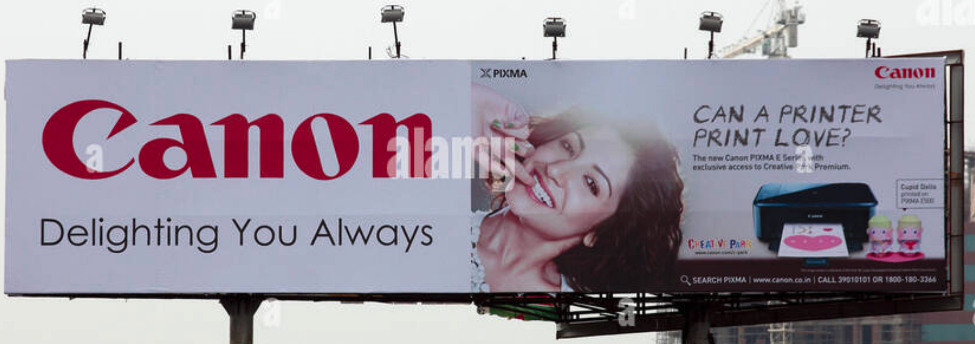
Pixels
Pixels & image structure
Hardcopy usually compromises pixel representation. With 20/20 vision you can distinguish dots 1 arc second apart (300 μm at 1 m) so 300 DPS on a page is fine. So, at 100 m, you could use dots 30.0 mm in size and get the same effect! Thus, an image need only be parsimonius, i.e., it only needs to show what is necessary to provide the expected image.

Slide 21
Quantization
A set of n quantization levels comprises the integers: 0, 1, 2, …, n-1
0 and n-1 are usually black and white respectively, with intermediate levels rendered in various shades of gray.
Quantization levels are commonly referred to as gray levels.
n is usually an integral power of two: n=2b, where b is the number of bits used for quantization.
If b=1 then the image is binary

Slide 22

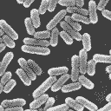


Quantization (cont.)
256 16 4 2
Binary Image of B Rajwa

Slide 23
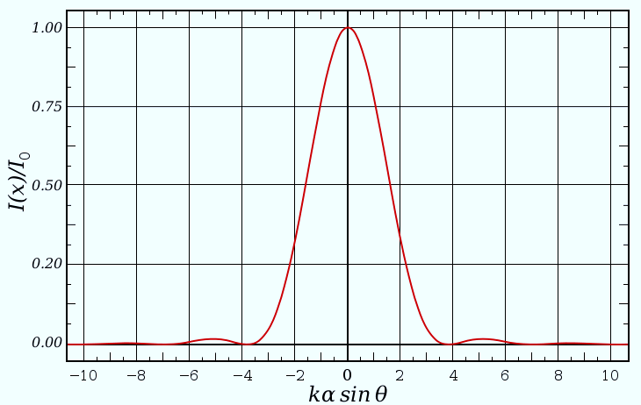
Resolution
1
20% intensity
drop
0.8
0.6
Intensity [A.U.]
0.4
0.2
0
-10
-8
-6
-4
-2
0
2
4
6
8
10
Spatial coordinate [A.U.]
The Rayleigh criterion is the generally accepted, although arbitrary, criterion for the minimum resolvable detail – the imaging process is said to be diffraction-limited when the first diffraction minimum of the image of one source point coincides with the maximum of another.

Slide 24
Resolution – confocal microscope
1
0.8
0.8
0.6
0.6
Intensity [A.U.]
0.4
0.4
0.2
0.2
0
-10
-8
-6
-4
-2
0
2
4
6
8
10
0
Spatial coordinate [A.U.]

Slide 25
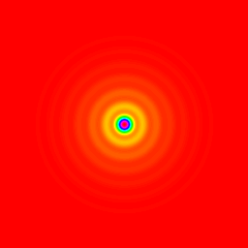
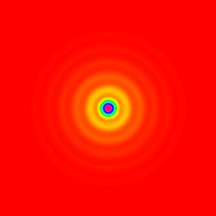

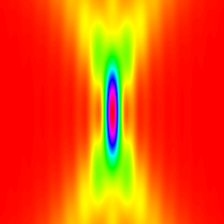
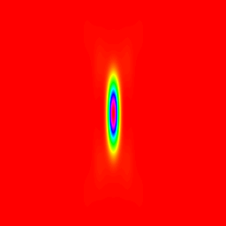
Confocal PSF – example
n = 1
NA = 0.6
The point spread function (PSF) is the three-dimensional diffraction pattern of light emitted from an infinitely small point source in the specimen and transmitted to the image plane through a high numerical aperture (NA) objective
Light waves converge and interfere at the focal point to produce a diffraction pattern of concentric rings of light surrounding a central, bright disk, when viewed in the x-y plane. The radius of disk is determined by the NA, thus the resolving power of an objective lens can be evaluated by measuring the size of the Airy disk
Lateral
●
=
Axial
●
=
PSF₄₈₈
●
PSF₅₆₀
=
PSF_{conf}

Slide 26
Signal-to-noise ratio and resolution
The influence of Poisson noise on two intensity distributions separated spatially according to the Rayleigh criterion.

Slide 27
Image Processing in the Spatial Domain
Arithmetic and logic operations
Basic gray level transformations on histograms
Spatial filtering
Overview of analytical techniques

Slide 28
Modifying image contrast and brightness
The easiest and most frequent method is histogram manipulation
An 8 bit gray scale image will display 2⁸ =256 different brightness levels ranging from 0 (black) to 255 (white) (2¹⁰=1024, 2¹²=4096). An image that has pixel values throughout the entire range has a large dynamic range, and may or may not display the appropriate contrast for the features of interest. 16 bit would be 2¹⁶ (or 65,536)
(Non-linear enhancements - e.g. Equalization see later)

Slide 29
Histogram Sliding
It is not uncommon for the histogram to display most of the pixel values clustered to one side of the histogram or distributed around a narrow range in the middle. This is where the power of digital imaging to modify contrast exceeds the capabilities of traditional photographic optical methods.
Images that are overly dark or bright may be modified by histogram sliding.
In this procedure, a constant brightness is added or subtracted from all of the pixels in the image or just to a pixel falling within a certain gray scale level ( i.e. 64 to 128).

Slide 30
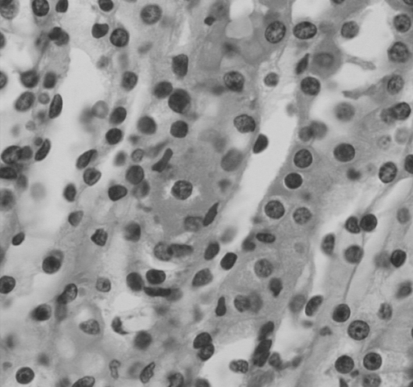
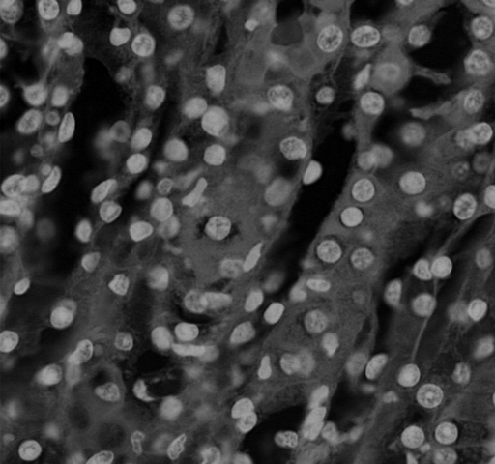
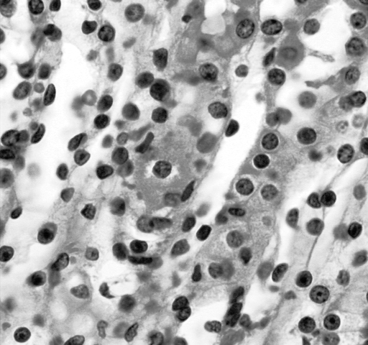
Histogram Operations
Sliding
Sliding

Slide 31
Histogram Stretching
A somewhat similar operation is histogram stretching in which all or a range of pixel values in the image are multiplied or divided by a constant value. The result of this operation is to have the pixels occupy a greater portion of the dynamic range between 0 and 255 and thereby increase or decrease image contrast.
It is important to emphasize that these operations do not improve the resolution in the image, but may have the appearance of enhanced resolution due to improved image contrast.

Slide 32
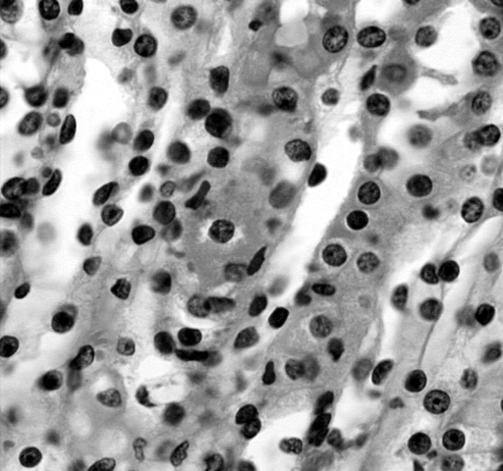
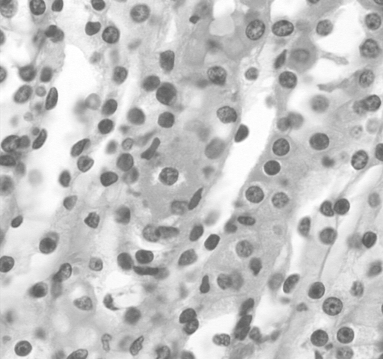
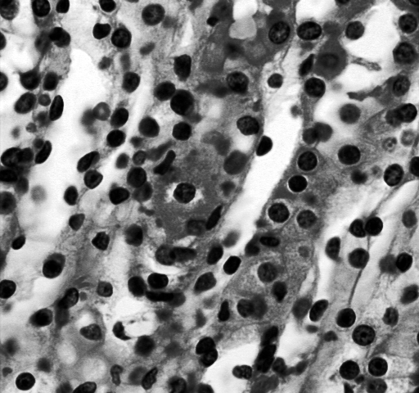
Histogram operations
Stretching
Stretching

Slide 33
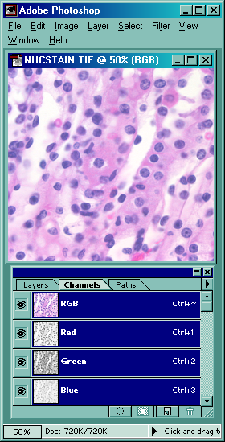
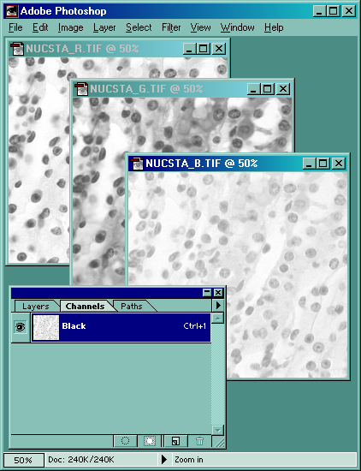
Color images (RGB)

Slide 34
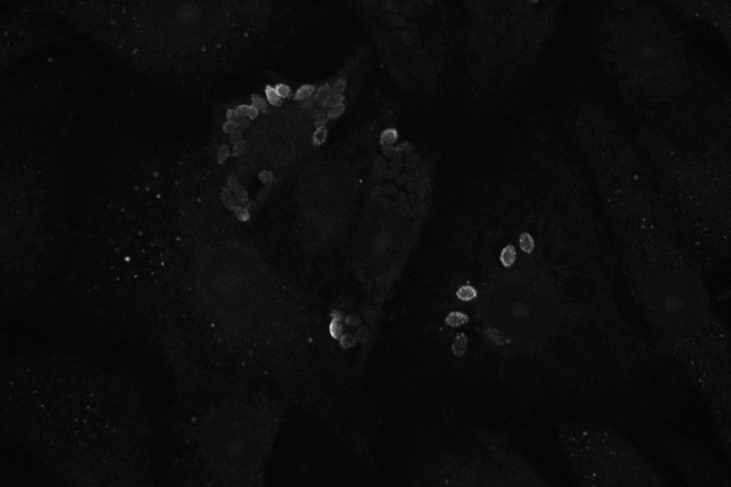
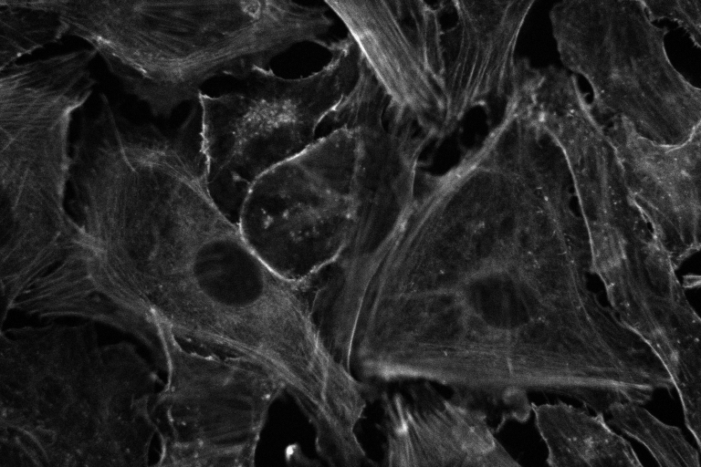
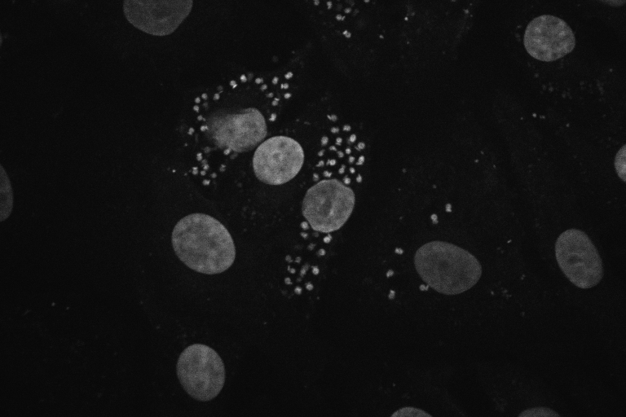
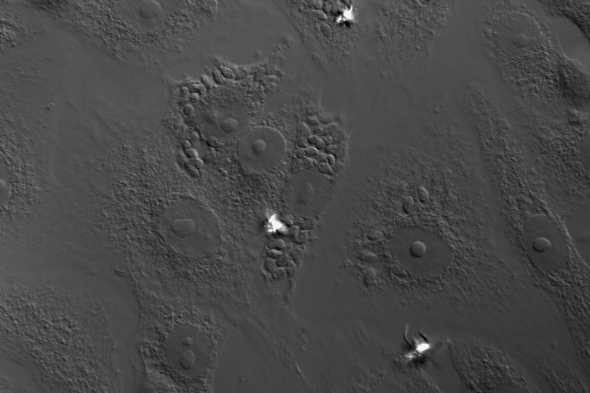
Actin - Rhodamine-phalloidin
Antibody to T.cruzi - FITC
DNA - Dapi
Imaged using an MRC 1000
Confocal Microscope, 40 x 1.3 NA Fluor
(Image prepared 1994)

Slide 35
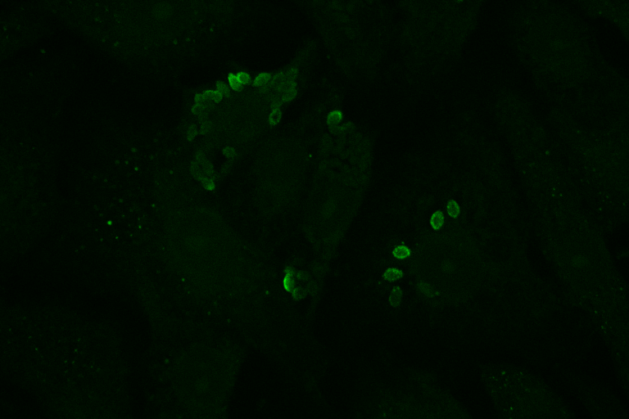
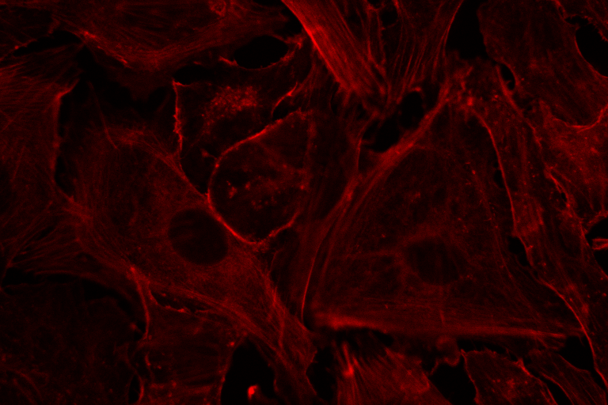
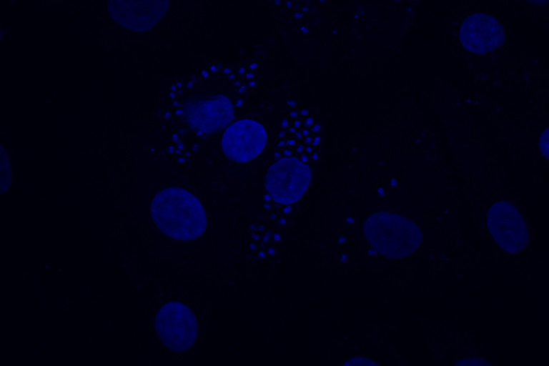
Actin - Rhodamine-phalloidin
Antibody to T.cruzi - FITC
DNA - Dapi
Imaged using an MRC 1000
Confocal Microscope, 40 x 1.3 NA Fluor
(Image prepared 1994)

Slide 36
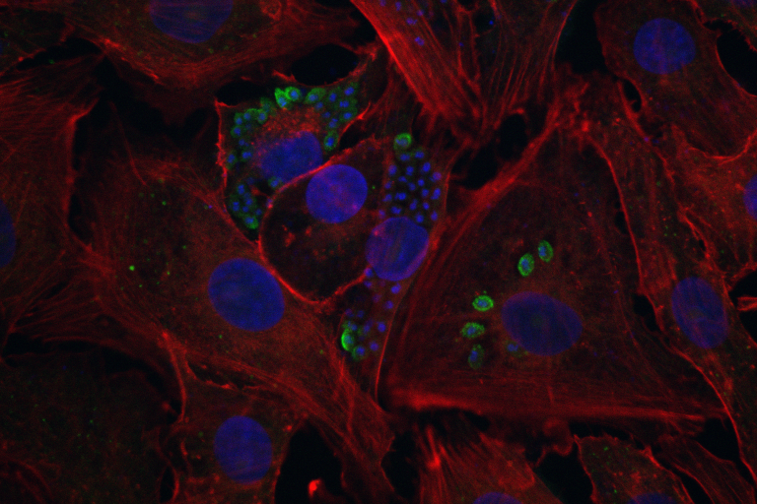
Actin - Rhodamine-phalloidin
Antibody to T.cruzi - FITC
DNA - Dapi
Imaged using an MRC 1000
Confocal Microscope, 40 x 1.3 NA Fluor
(Image prepared 1994)

Slide 37
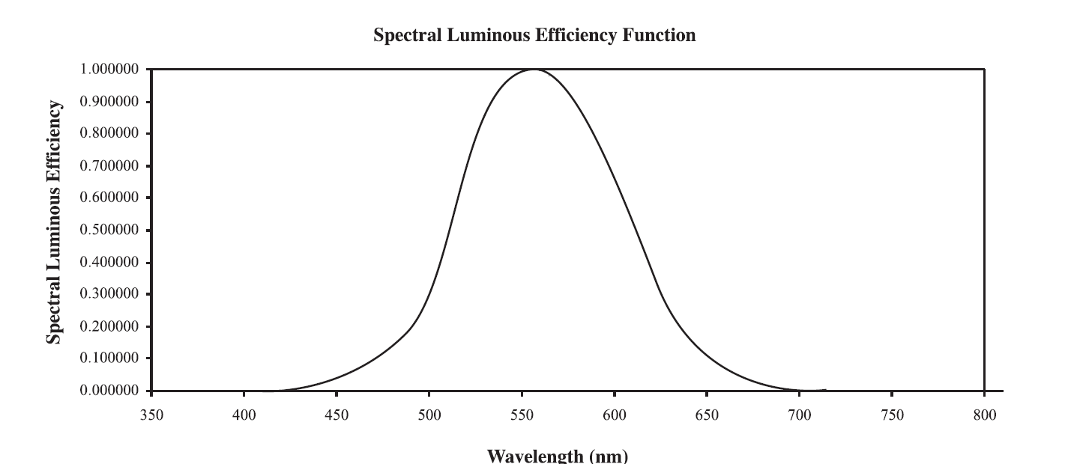
Sensitivity of the Human Eye to Light of Different Wavelengths

Slide 38
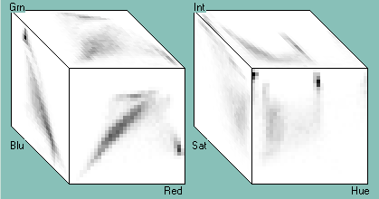
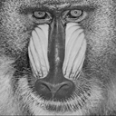
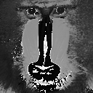
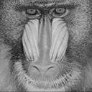
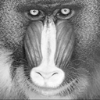
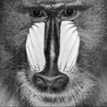
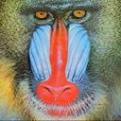
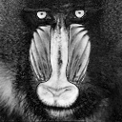
Color models
RGB
red
green
blue
HSI
hue
saturation
lightness
(intensity)

Slide 39
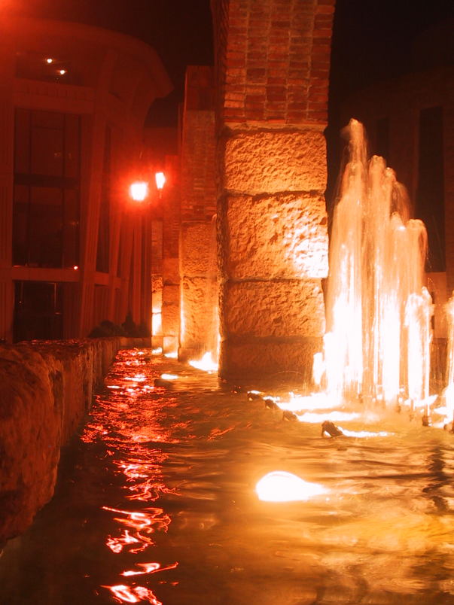
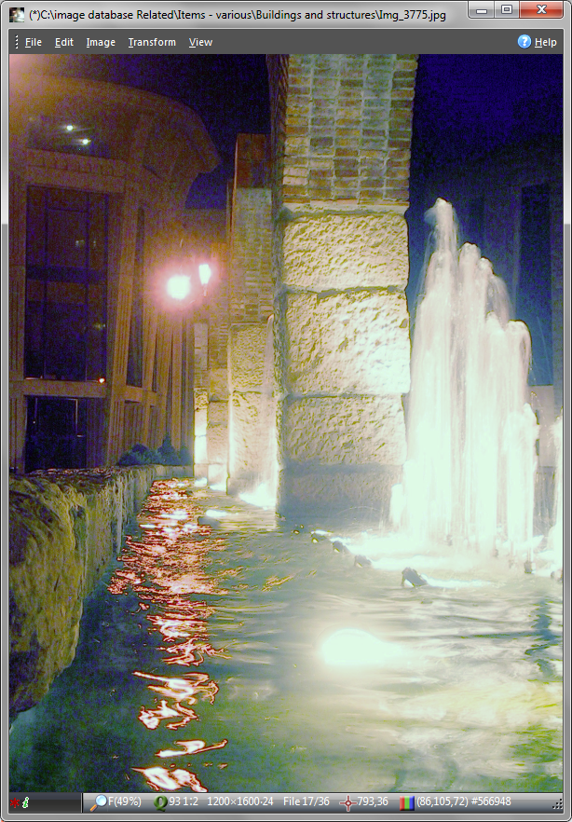
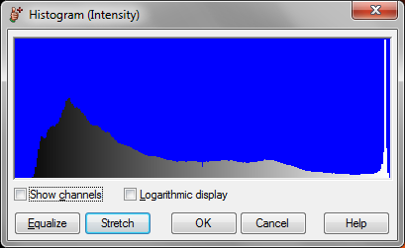
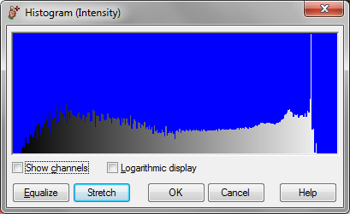
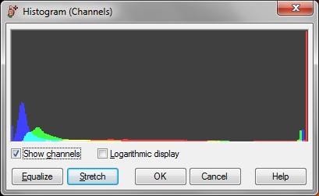
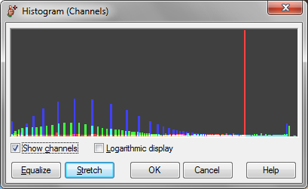

Slide 40
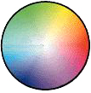
Color (HSL, HSV, HIS)
Hue is a color attribute associated with the dominant wavelength in a mixture of wavelengths (“red”, “green”, “yellow”)
Saturation refers to the relative purity, or the amount of white light mixed with a hue.
Intensity refers to the relative lightness or darkness of a color.
white
intensity
saturation
hue
0°
black

Slide 41
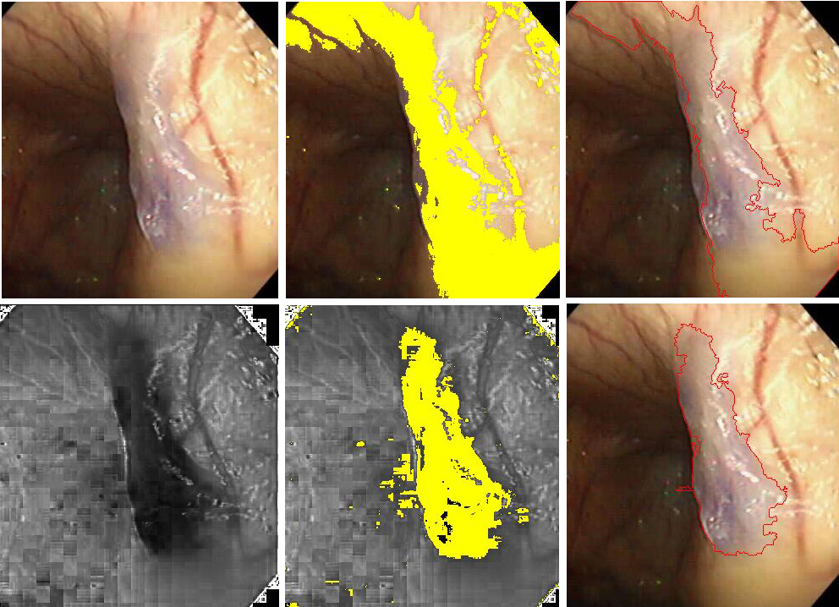
Image thresholding based on RGB or HSI

Slide 42
Look Up Tables (LUT)
A look up table (LUT) is an operation that uses a mathematical calculation to change the display of any pixel in an image
This usually is the basis for both the visualization (the main purpose) but also the saved image
LUTs are integer operations and can significantly improve output performance and standardize the image display manipulation
LUTs allow you to assign colors that relate to your own imaging situation

Slide 43
Gamma
The gamma of a histogram curve is the slope, expressed as a ratio of the logs of the output to input values. A gamma value of 1.0 equals an output:input ratio of 1:1 and no correction is applied. In some programs, a gamma function applies a lookup table function (LUT) to compensate or correct for the bias which may be built into the video source.
A camera's light response is often set to a power function (Gamma function) to mimic the photometric response of the human eye. This may result in a non-linear response from the video source and cause errors if you are making densitometric measurements. The camera bias can be removed by applying an inverse gamma function.
This function calculates a lookup table to correct for the bias based on operator provided parameters. The gamma function for decalibrating the camera can be obtained from the camera manufacturer.

Slide 44
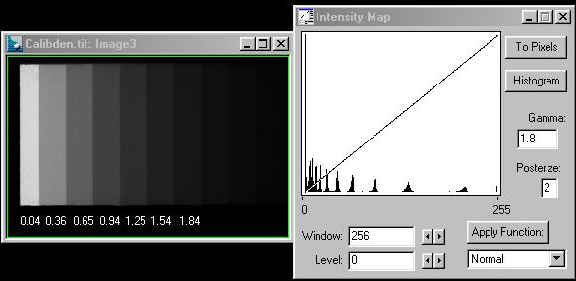
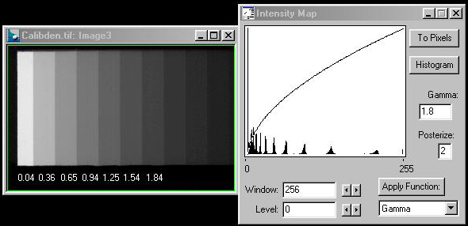
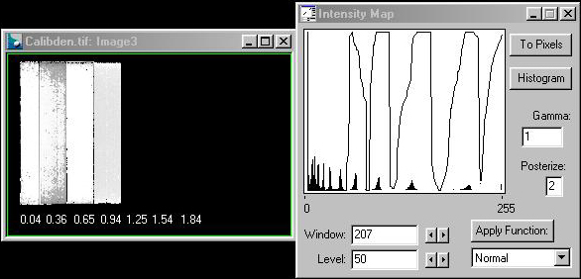
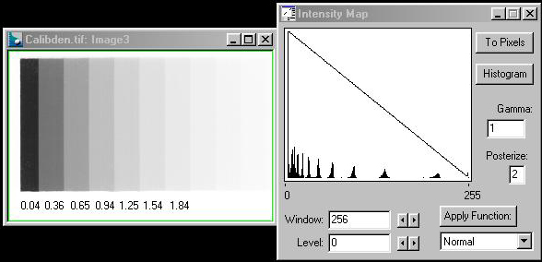
1.0
The straight line at the 45 degree angle in the output lookup table indicates that no processing has been performed on the pixels - gamma = 1.0

Slide 45
Principles of 2D Image Analysis
End of Part 2
Part 3 is the next lecture
  Histogram operations
  Image Filters
  Shape analysis
  Area, perimeter, aspect ratio, Boolean operators, etc
  Thresholding, segmentation, non-linear filters

