Slide 1

Principles of 2D Image Analysis
Part 1
Notes prepared by Dr. Bartek Rajwa, Prof. John Turek & Prof. J. Paul Robinson
Purdue University Department of Basic Medical Sciences, College of Veterinary Medicine & Weldon School of Biomedical Engineering
These slides are intended for use in a lecture series. Copies of the graphics are distributed and students encouraged to take their notes on these graphics. The intent is to have the student NOT try to reproduce the figures, but to LISTEN and UNDERSTAND the material. All material copyright J. Paul Robinson unless otherwise stated, however, the material may be freely used for lectures, tutorials and workshops on non-commercial nature. They may not be used for any commercial purpose including for profit courses. It is illegal to upload this lecture to CourseHero or any other site.
www.cyto.purdue.edu
Last UPDATED January 2023

Slide 2
Learning Objectives – lecture 6
Understand how humans evaluate images
See that most of our processes for evaluation of image information is subjective
Learn why we must use only objective methods for image evaluation
Learn how we make incorrect judgements when we lean upon our brains and not our image analysis software!!

Slide 3
Morphometry: "The quantitative description of a structure" (Weibel, ER, 1969. Stereological principles for morphometry in electron microscopy. Int. Rev. Cytol. 26:235-302.
Stereology: The extraction/interpretation of 3D data from 2D data (i.e. sections of objects)
Image processing: Computer enhancement of a digitized image (i.e., using various filters to remove noise, improve contrast, pseudocoloring. Enhancement of regular structures (virus, crystals)
Image analysis: Information extracted from an image (area, perimeter, length, etc.)

Slide 4
How do humans classify objects?
Human method is pattern recognition based upon multiple exposure to known samples. We build up mental templates of objects, this image information coupled with other information about an object allows rapid object classification with some degree of objectivity, but there is always a subjective element.
We are sensitive to differences in contrast. We will tend to overestimate the amount or size of an object if there is high contrast vs low contrast.
We are sensitive to perspective and depth changes
We are sensitive to orientation of lighting. We prefer light to come from above.
We fill in what we think should be in the image

Slide 5
Biological structures present a continuous spectrum of change.
Morphometry eliminates subjectivity, it is more reproducible, and has greater limits of detection.

Slide 6


Slide 8

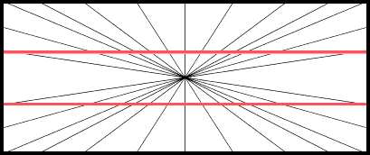
Hering illusion
This illustration was first published in 1861 by Ewald Hering. Astronomers became very interested in Hering's work because they were worried that visual observations might prove unreliable.

Slide 9
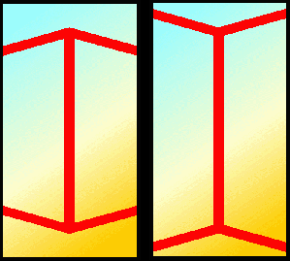
Moller-Franz illusion
This illusion was created in 1889 by Franz Müller-Lyon. The lengths of the two identical vertical lines are distorted by reversing the arrowheads. Some researchers think the effect may be related to the way the human eye and brain use perspective to determine depth and distance, even though the objects appear flat.

Slide 10

This line distortion illusion was first published by Johann Zöllner in 1860. The diagonal lines are parallel, but appear not to be. The illusion was designed to cause errors in optical equipment. It did cause errors, and also great concern among scientists of the time, over the validity of all human observations.

Slide 11
Acute angles in the figure are seen by viewers as expanded
In 1860 Johann Poggendorff created this line distortion illusion. The two segments of the diagonal line appear to be slightly offset in this figure.
It is named after Poggendorff, the editor of the journal, who discovered it in the figures Johann Karl Friedrich Zöllner submitted when first reporting on what is now known as the Zöllner illusion, in 1860

Slide 12
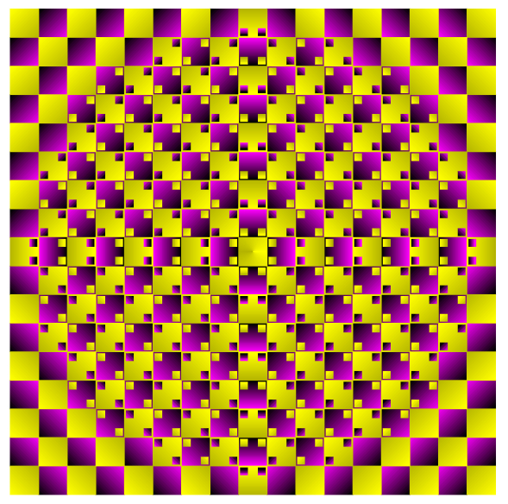
Are your eyes cheating on you?

Slide 13
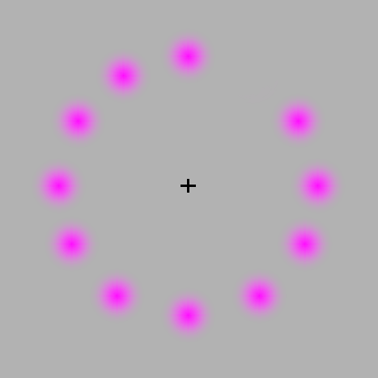
If your eyes follow the movement of the rotating pink dot, you will only see one color- pink. If you stare at the black + in the center, the moving dot turns to green. Now, concentrate on the black + in the center of the picture. After a short period of time, all the pink dots will slowly disappear, and you will only see a green dot rotating if you’re lucky!
https://www.moillusions.com/disappearing-dots/

Slide 14
Illusions and their impact
Some real-life examples….

Slide 15
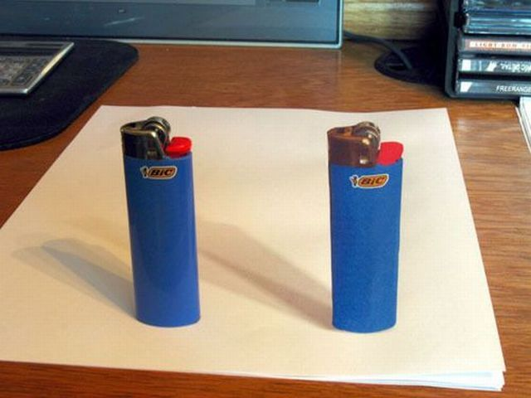
Image from: http://izismile.com/2009/09/07/3d_images_-_amusing_illusions_10_pics.html

Slide 16
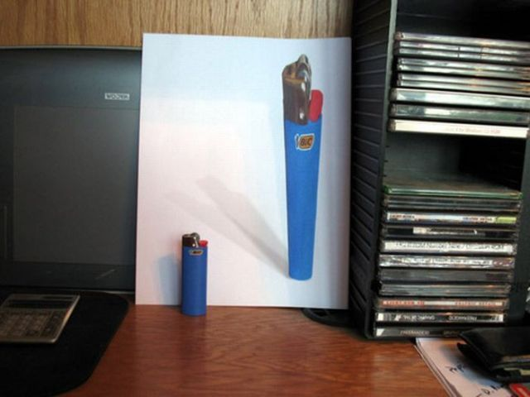
Image from: http://izismile.com/2009/09/07/3d_images_-_amusing_illusions_10_pics.html

Slide 17
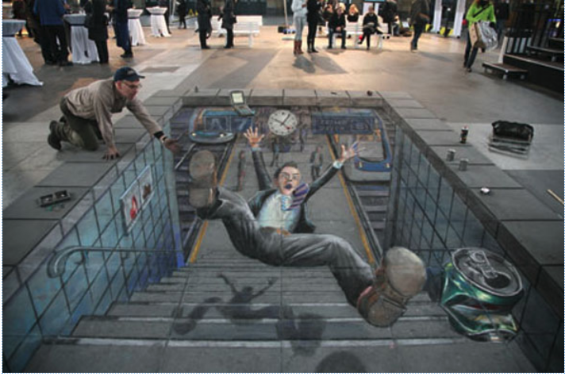
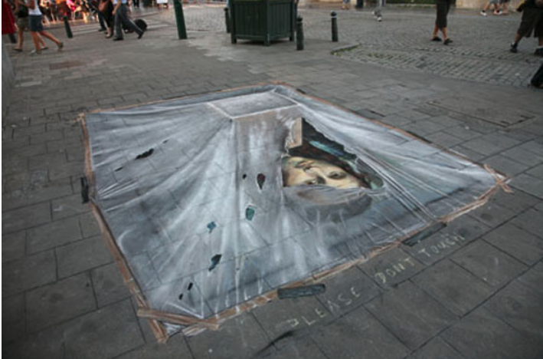
More Images from Julian Beever
https://www.moillusions.com/julian-beever-is-back-again/

Slide 18
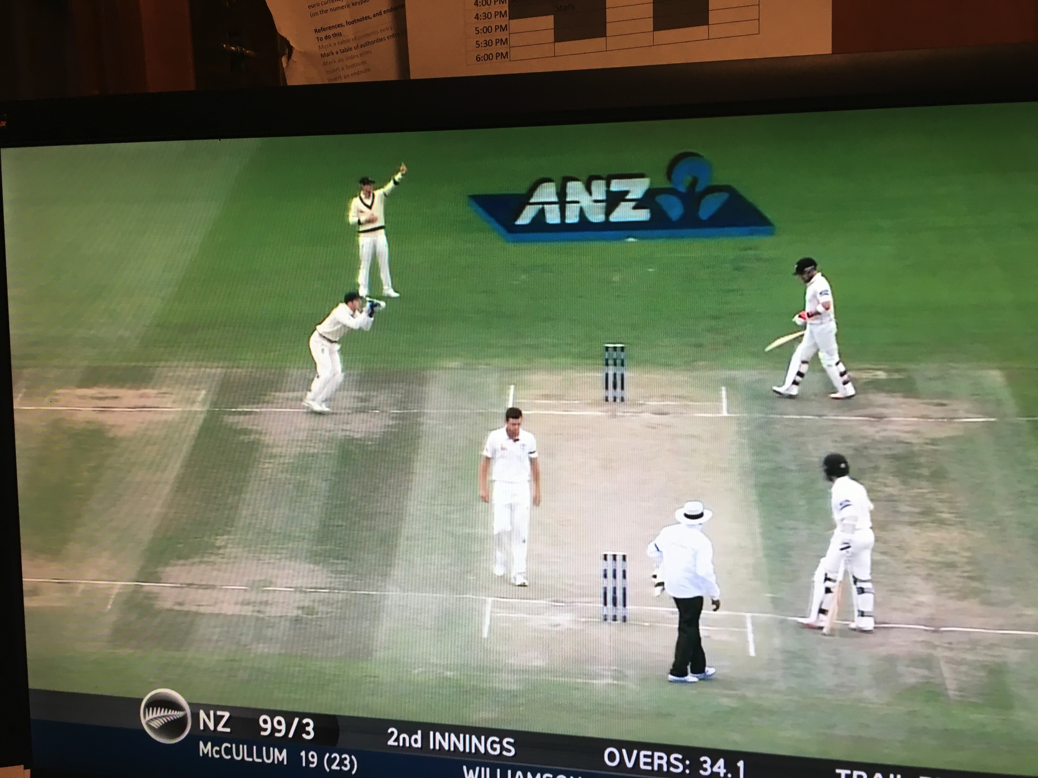

Slide 19
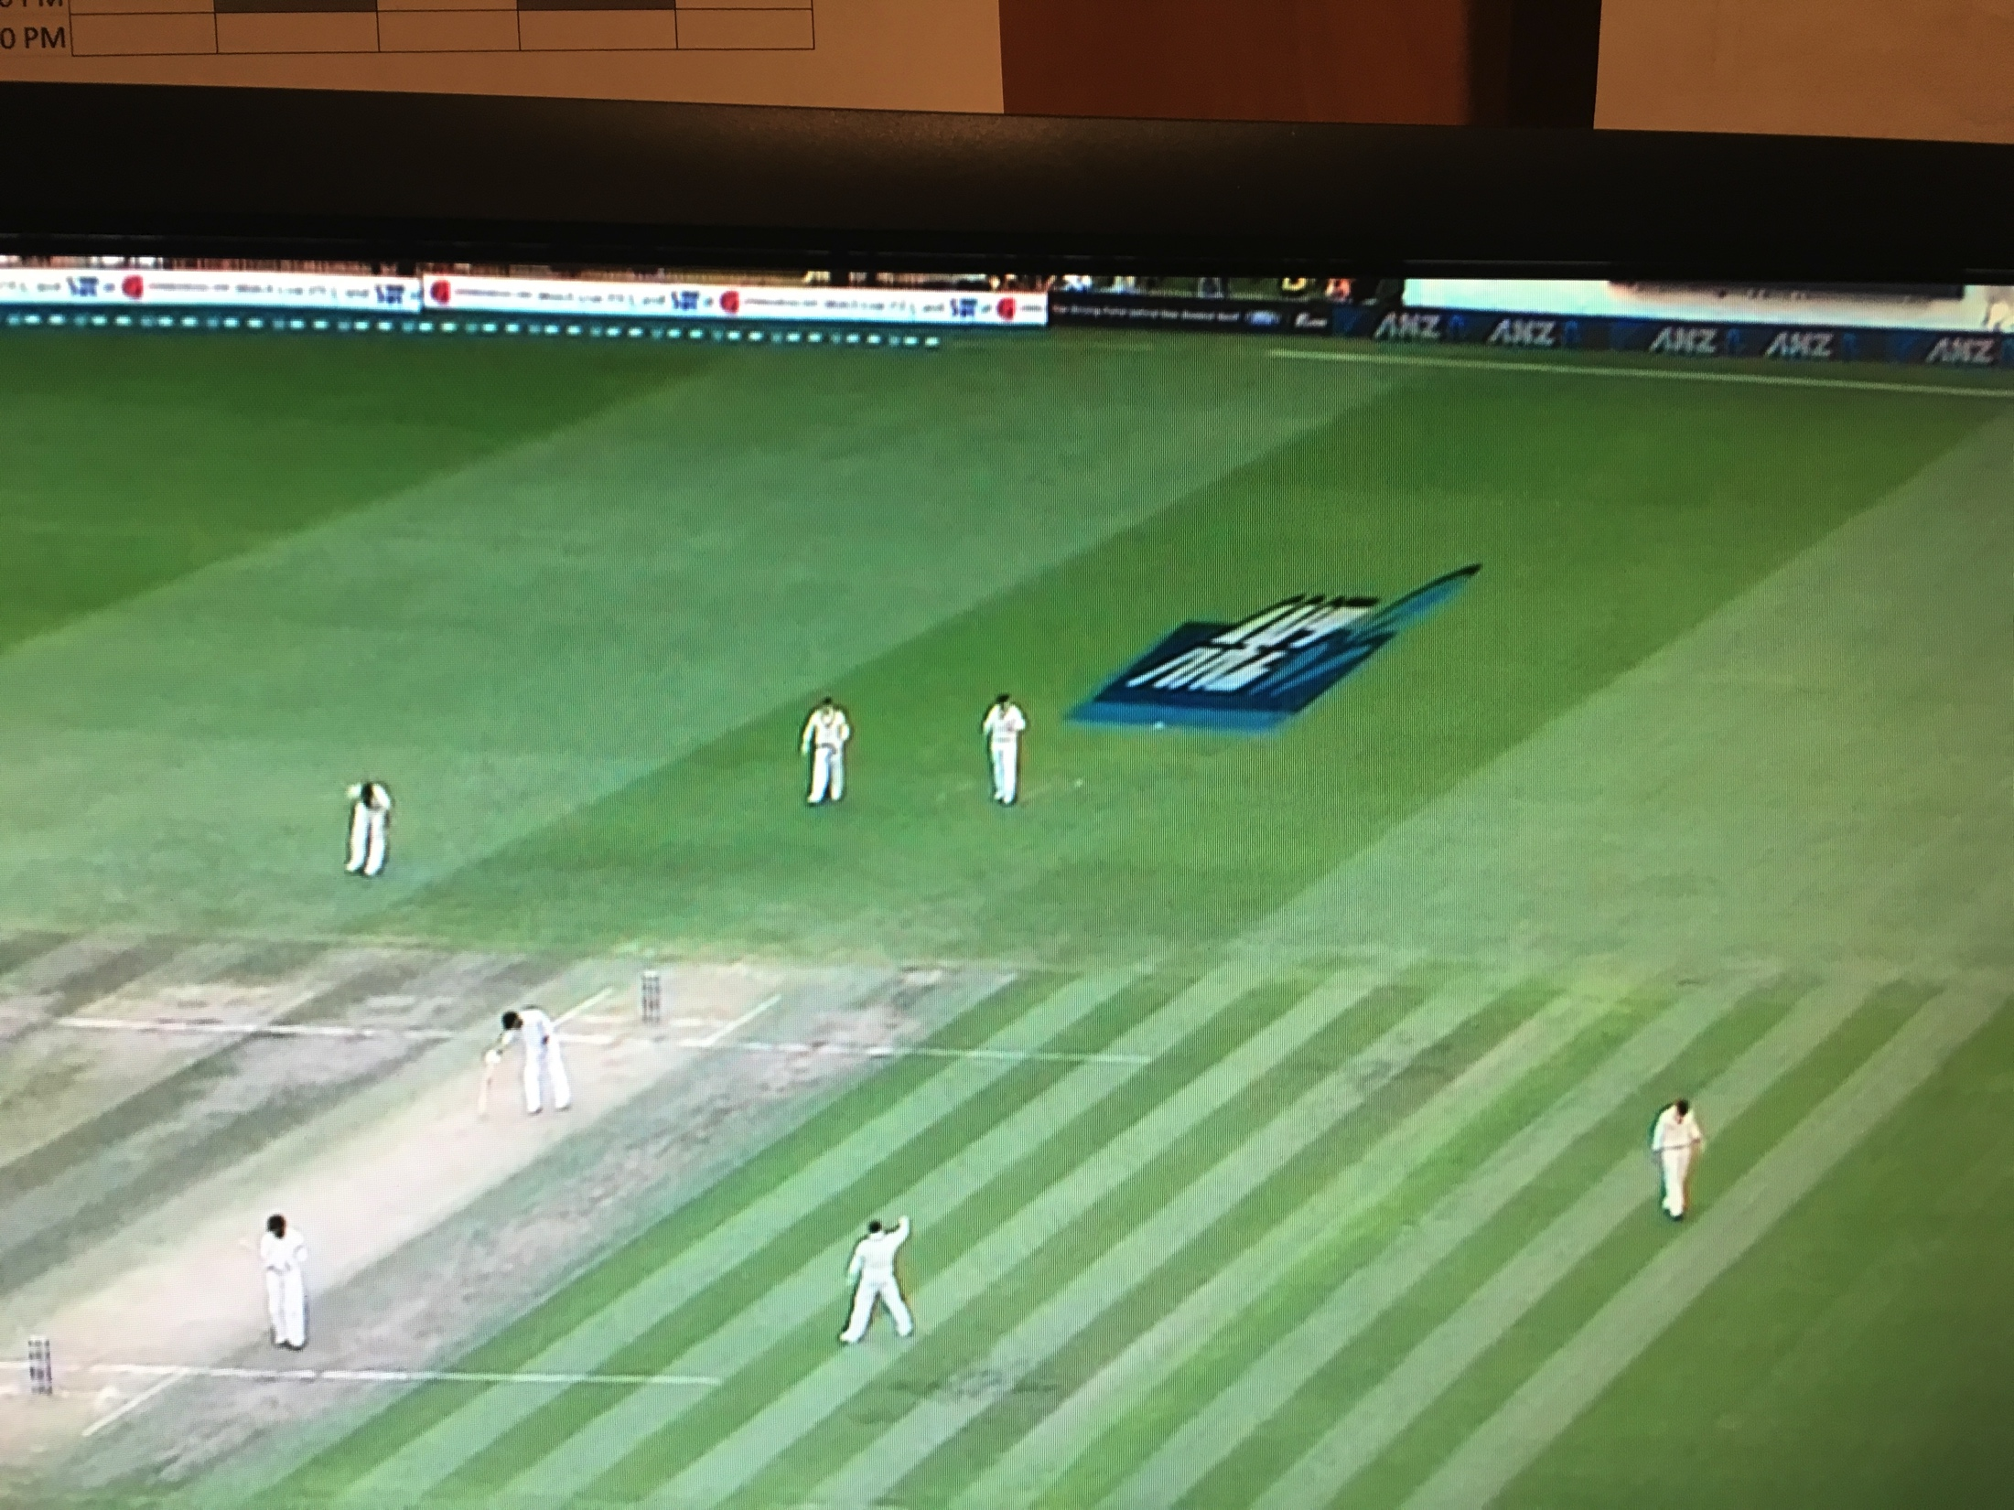
Originally these were painted on the field in a way that would appear nornal to a viewer only when viewing from a particular anagle

Slide 21
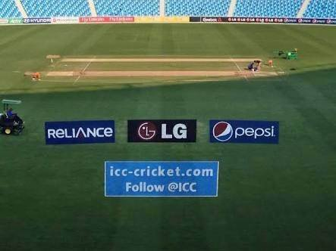
Today they are just inserted on the video screen – so not as interesting as the manufactured images

Slide 22
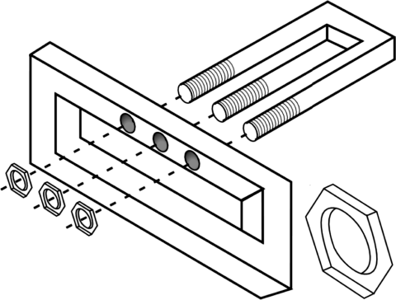
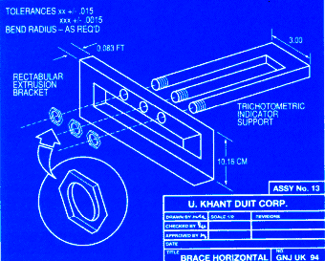
Research scientists who use the trident illusion to test populations, have divided us into two groups: two-dimensional perceivers and three-dimensional perceivers. Presumably, the perspective in this illustration would not be confusing to a two-dimensional perceiver.

Slide 23
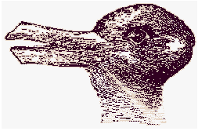

This illustration was used at the turn of the century by psychologists to study how our mind learns to cope with conflicting images. The figure is either a duck facing left or a rabbit facing right. When both aspects are finally realized, ambiguity conflict occurs.
New version of the old trick

Slide 24

Reversible Goblet: Classic demonstration of figure-background reversal first used by Edgar Rubin in 1915.

Slide 25
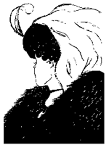
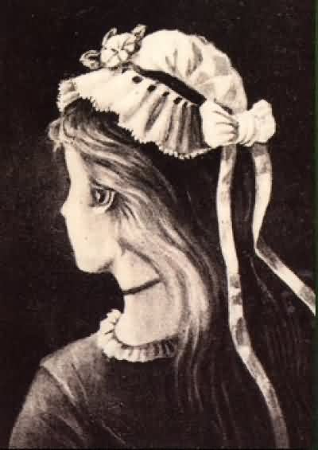

An anonymous German postcard from 1888 (left figure) depicts the image in its earliest known form, and a rendition on an advertisement for the Anchor Buggy Company from 1890 (center figure) provides another early example (IllusionWorks). For many years, the creator of this figure was thought to be British cartoonist W. E. Hill, who published it in 1915 in Puck humor magazine, an American magazine inspired by the British magazine Punch. (right figure). However, Hill almost certainly adapted the figure from an original concept that was popular throughout the world on trading and puzzle cards.

Slide 26
An anonymous German postcard from 1888 (left figure) depicts the image in its earliest known form, and a rendition on an advertisement for the Anchor Buggy Company from 1890 (center figure) provides another early example (IllusionWorks). For many years, the creator of this figure was thought to be British cartoonist W. E. Hill, who published it in 1915 in Puck humor magazine, an American magazine inspired by the British magazine Punch. (right figure). However, Hill almost certainly adapted the figure from an original concept that was popular throughout the world on trading and puzzle cards.

Slide 27
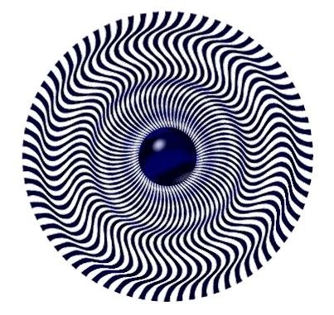
Mystic Wheel
Several things happen when you stare at the Mystic Wheel. You might see the illusion shimmer or flutter slightly. This is because the lenses of your eyeballs are slightly out-of-round. Parts of the illusion move in and out of focus as your eye scans the image. Looking closer, you get the impression of three dimensions, where some parts look higher or lower than others. Now, follow the ring of curves nearest the outer edge, around the wheel and you will see the geometry go from hump to hollow, an impossible trick in three dimensions.

Slide 28
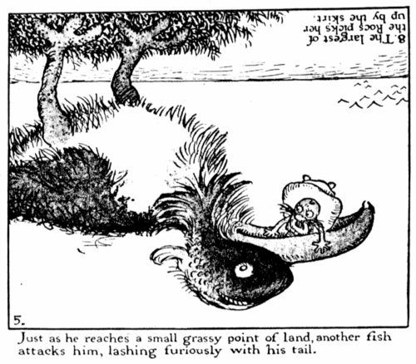
An ambiguous image by Gustave Verbeek

Slide 29
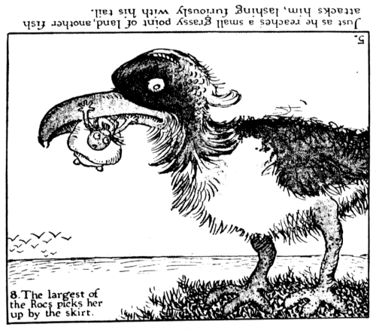
An ambiguous image by Gustave Verbeek

Slide 30
The Schröder Stairs is a variation on the spontaneous perspective reversal illusion. In this illustration, the stairs will turn upside down during a steady gaze. The wall with the glass bead will shift from the foreground to the background or visa versa. The Schroeder stairs appear in M. C. Escher's works "Relativity" and "Convex and Concave"

Slide 31
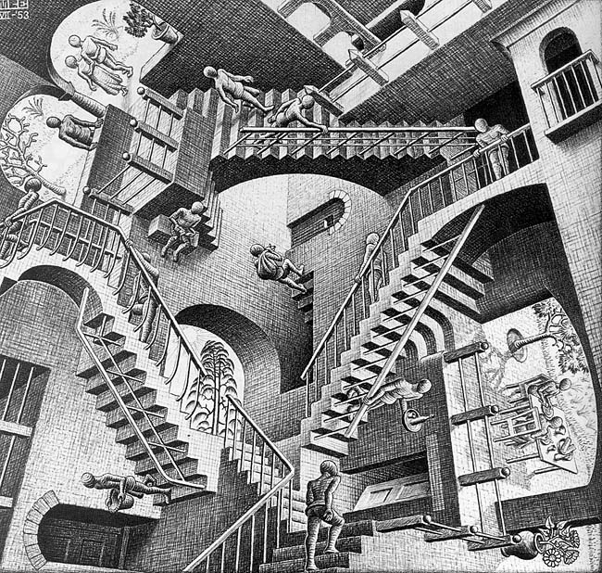
Maurits Cornelis Escher “Relativity”
1953, lithograph, 11 1/8 x 11 5/8 inches (282 x 294 mm), National Gallery of Art, Washington D.C.

Slide 32
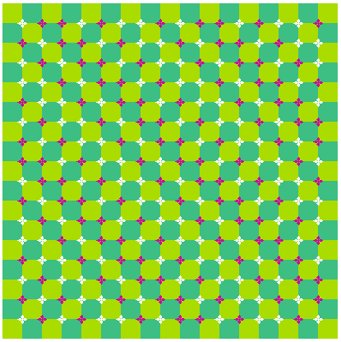
Primrose's field by Akiyoshi Kitaoka
Department of Psychology, Ritsumeikan University, Kyoto,
More can be found at http://www.ritsumei.ac.jp/~akitaoka/motion-e.html
and http://www.ritsumei.ac.jp/~akitaoka/index-e.html

Slide 33
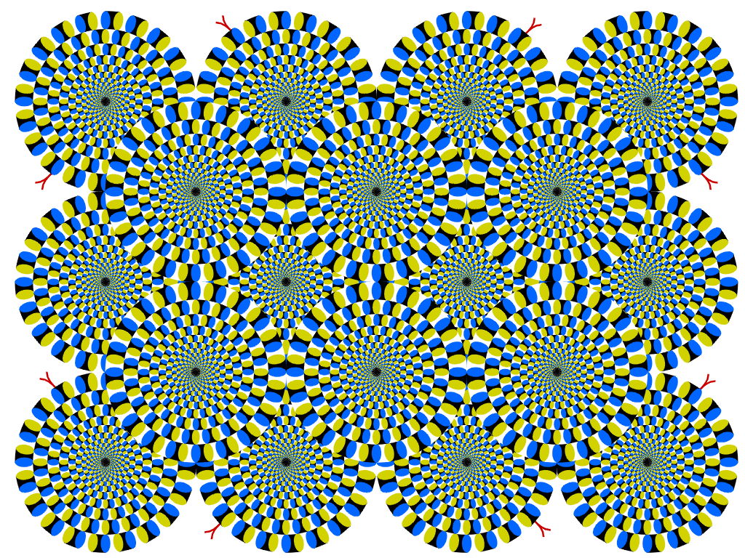
Rotating snakes by Akiyoshi Kitaoka

Slide 34
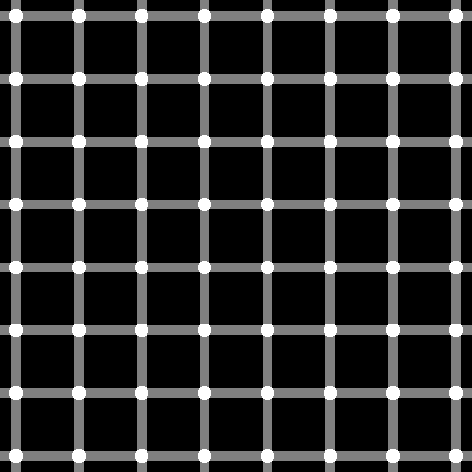
Scintillating grid
Count the black dots!

Slide 35
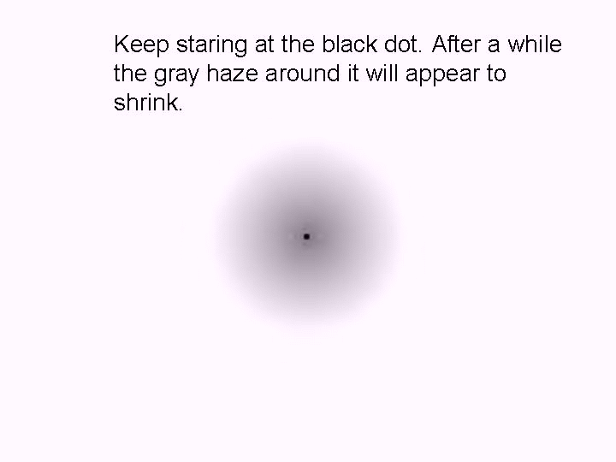

Slide 36
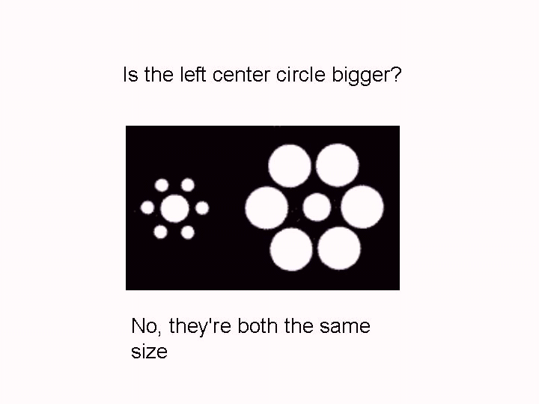

Slide 37
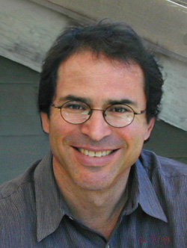
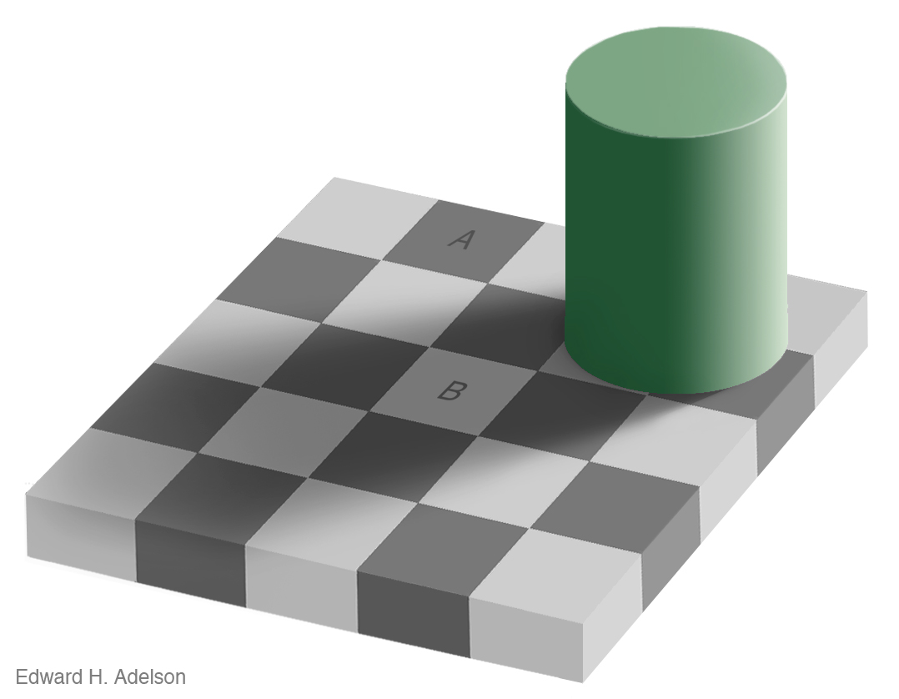
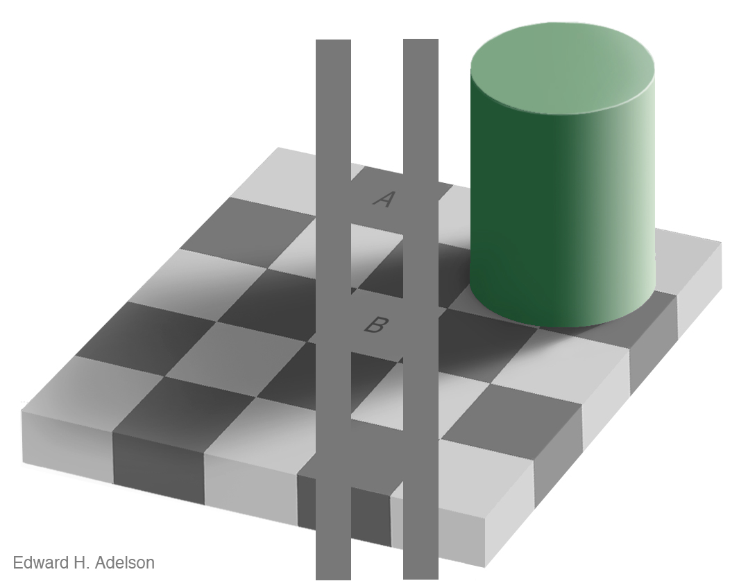
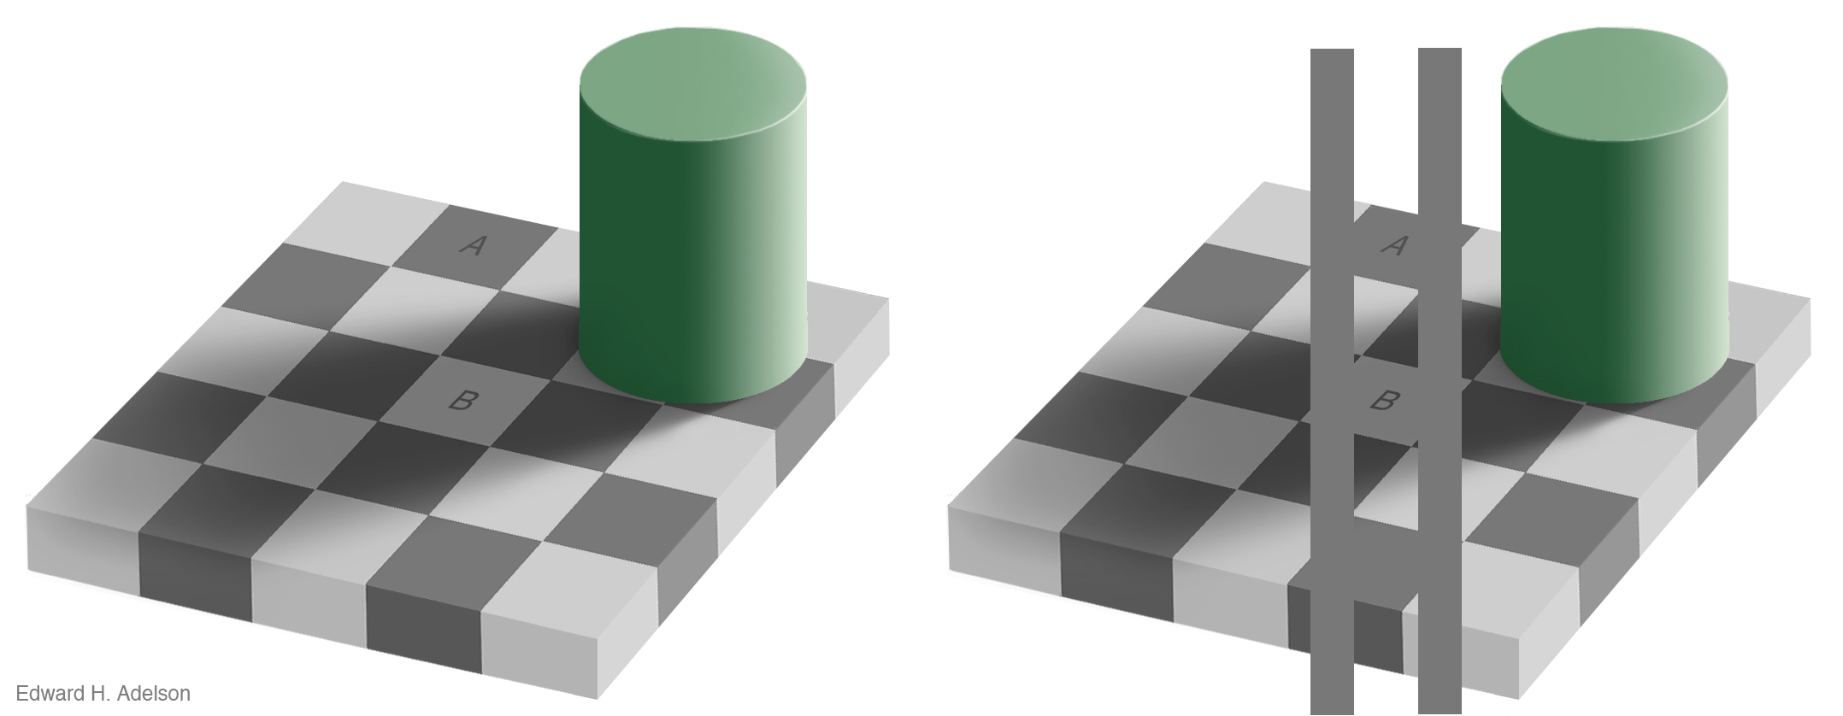
Adelson Illusion
How different are blocks A and B?
http://web.mit.edu/persci/people/adelson/illusions_demos.html

Slide 38
Adelson Illusion
http://web.mit.edu/persci/people/adelson/illusions_demos.html

Slide 39
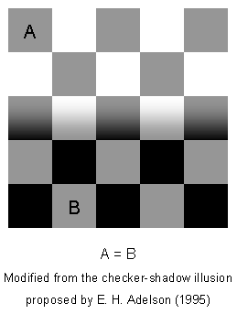
Still don’t believe?
http://web.mit.edu/persci/people/adelson/illusions_demos.html

Slide 40
Other illusions by Edward H. Adelson
web.mit.edu/persci/gaz/gaz-teaching/flash/koffka-movie.swf

Slide 41
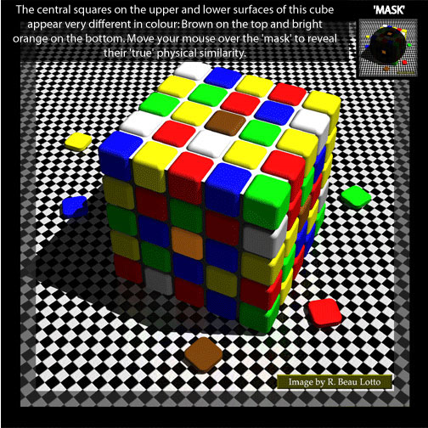
http://www.lottolab.org/articles/illusionsoflight.asp

Slide 42
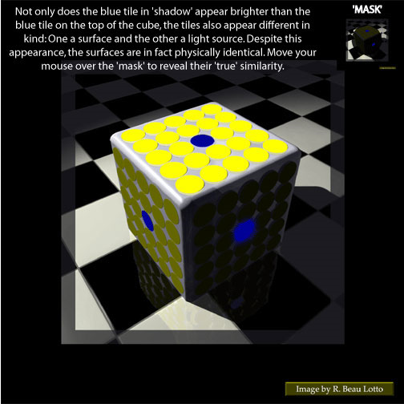
http://www.lottolab.org/illusiondemos/Demo%2013.html#

Slide 43
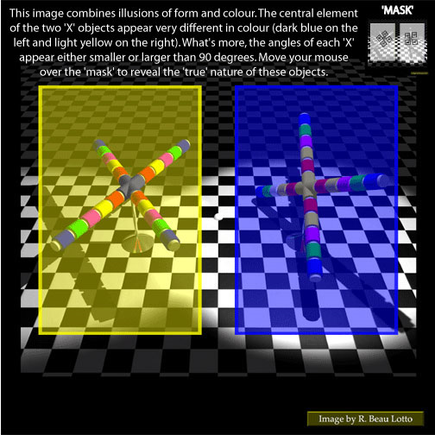
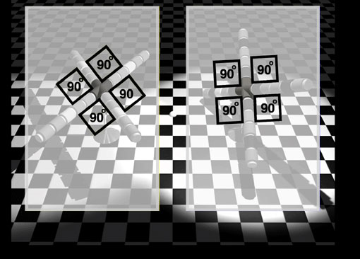
http://www.lottolab.org/illusiondemos/Demo%2024.html

Slide 44
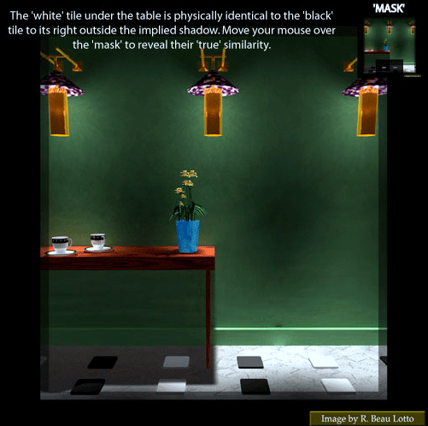
http://www.lottolab.org/illusiondemos/Demo%2019.html#

Slide 45
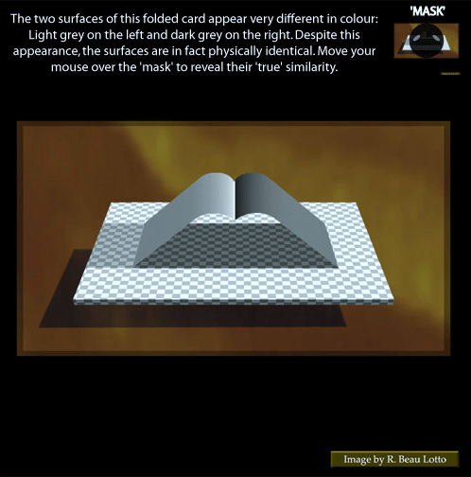

Slide 46
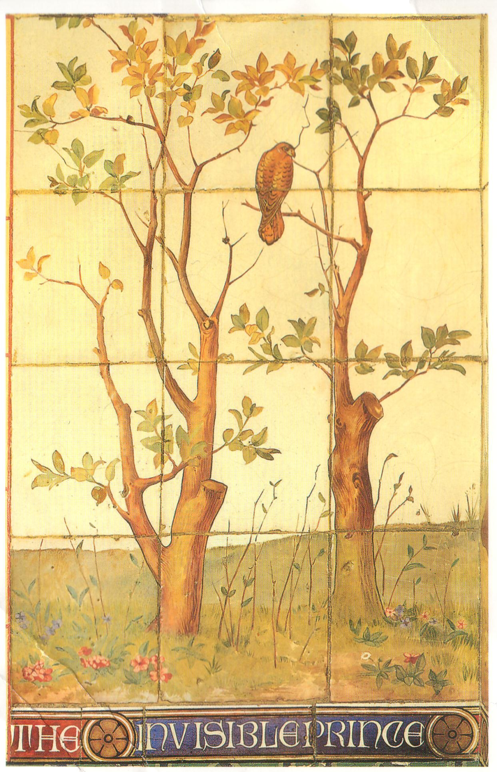
Image from Cardiff
Castle, Cardiff, Wales
Find the “man”

Slide 47
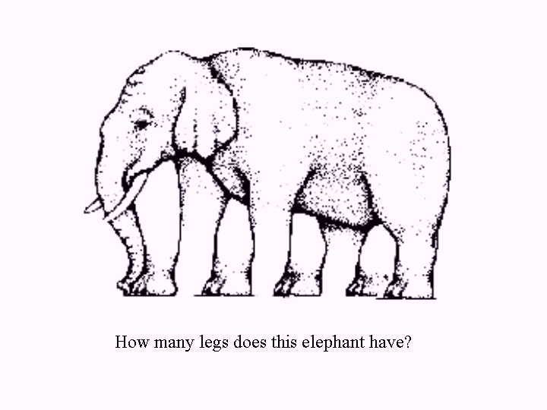

Slide 48
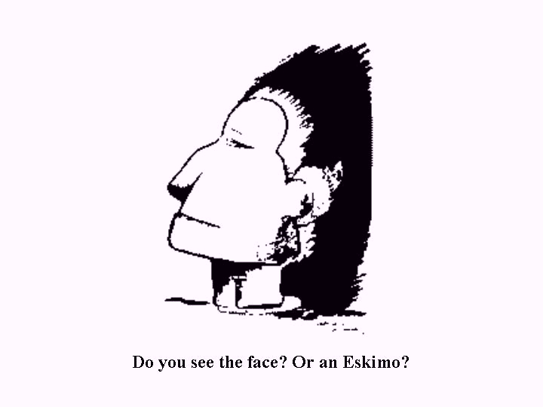

Slide 49
A
B
Figure 1. Simultaneous contrast illusion and the Mach band effect
The edge detection is working to enhance object separation.
although the luminance within each block is constant the apparent lightness of each strip seems to vary across its length. Close to the left edge of the strip it appears lighter than at the centre, and close to the right edge of the strip it appears darker than at the centre. The visual system is exaggerating the difference in luminance (contrast) at each edge in order to detect it.

Slide 50
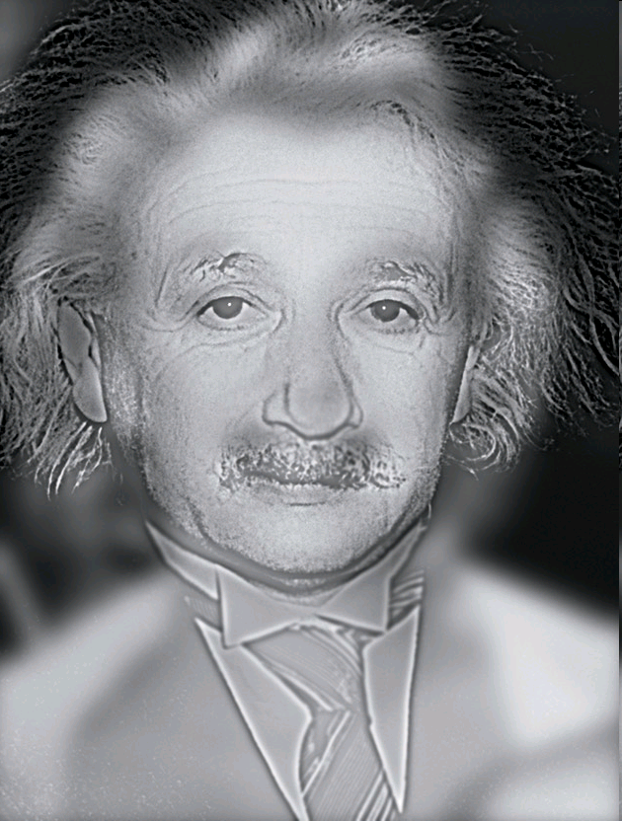
We focus on higher frequencies close & register softer shapes from afar.
Look at the picture above and you see Albert Einstein. Now walk across the room. Suddenly, he morphs into Marilyn Monroe. Trippy, right? Aude Oliva, an associate professor of cognitive science at MIT, uses images like this one to study how our brains make sense of sight.
Our eyes pick up resolutions with both high spatial frequencies (sharp lines) and low ones (blurred shapes). By blending the high frequencies from one picture with the lows from another, Oliva creates images that change as a function of distance and time—allowing her to parse how humans absorb visual information. Turns out that we perceive coarse features quickly, within the first 30 milliseconds, and then home in on details at around 100 milliseconds. We also focus on the higher frequencies close up and register softer shapes from afar.
"It's something we never think about," Oliva says. "But we still don't know how our brains digest new images so seamlessly and so rapidly." The answer could help treat cognitive disorders or assist in the development of more-perceptive bots. Because, let's be honest: What good is a robot if it can't tell the difference between a sexy, troubled icon and Marilyn Monroe?
http://www.wired.com/medtech/health/magazine/17-05/st_alphageek

Slide 51
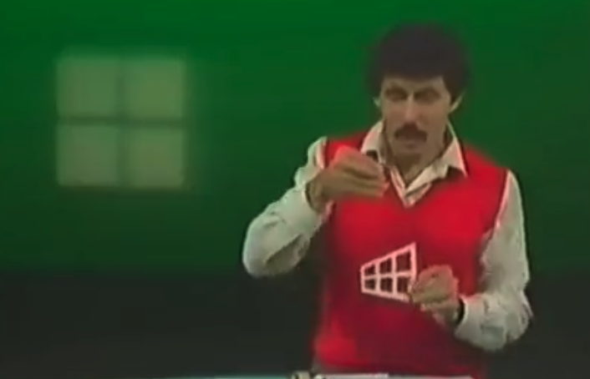
Ames Window
https://twitter.com/historyinmemes/status/1611804675686154240?t=6phDu3KwWT8snvwXItpNYQ&s=08

Slide 52
Is this the best quality image -…or the next slide..

Slide 54
Humans are used to light coming from above…
So we have a bias for sample that look that way…
In other words, we don’t evaluate objectively…

Slide 55
Principles of 2D Image Analysis
End of Part 1
Part 2 is the next lecture
  Histogram operations
  Image Filters
  Shape analysis
  Area, perimeter, aspect ratio, Boolean operators, etc
  Thresholding, segmentation, non-linear filters

