Slide 1

BMS 524 - “Introduction to Confocal Microscopy and Image Analysis”
Lecture 5: Fluorescence
Department of Basic Medical Sciences,
College of Veterinary Medicine
and
Weldon School of Biomedical Engineering
College of Engineering
Purdue University
J. Paul Robinson, Ph.D.
Distinguished Professor of Cytometry
& Professor of Biomedical Engineering
Director, Purdue University Cytometry Laboratories, Purdue University
These slides are intended for use in a lecture series. Copies of the slides are distributed and students encouraged to take their notes on these graphics. All material copyright J.Paul Robinson unless otherwise stated. No reproduction of this material is permitted without the written permission of J. Paul Robinson. Except that our materials may be used in not-for-profit educational institutions with appropriate acknowledgement. It is illegal to upload this lecture to CourseHero or any other site.
This lecture was last updated in January, 2023
Find other PUCL Educational Materials at http://www.cyto.purdue.edu/class

Slide 2
Overview
Fluorescence
The fluorescent microscope
Types of fluorescent probes
Problems with fluorochromes
General applications

Slide 3
Learning Objectives – Lecture 5
At the conclusion of this lecture, you should:
Understand the nature of fluorescence
The restrictions under which fluorescence occurs
Nature of fluorescence probes
Spectra of different probes
Resonance Energy Transfer and what it is
Features of fluorescence

Slide 4
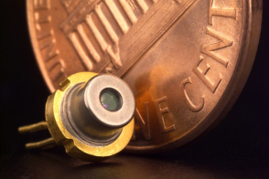
Excitation Sources
Excitation Sources
Lamps
    Xenon
    Xenon/Mercury
Lasers
    Mostly solid-state lasers
    Argon Ion (Ar) Krypton (Kr) (almost never used)
    Blue 488 nm
    Violet 405nm, 380 nm
    Green 561 nm
    Helium-Neon (He-Ne)
    Helium-Cadmium (He-Cd) (rarely used)
    Krypton-Argon (Kr-Ar) (no longer used)
Laser Diodes
375nm up to NIR
LEDs see next side
2004 sales of approximately 733 million diode laser; 131,000 of other types of lasers

Slide 5
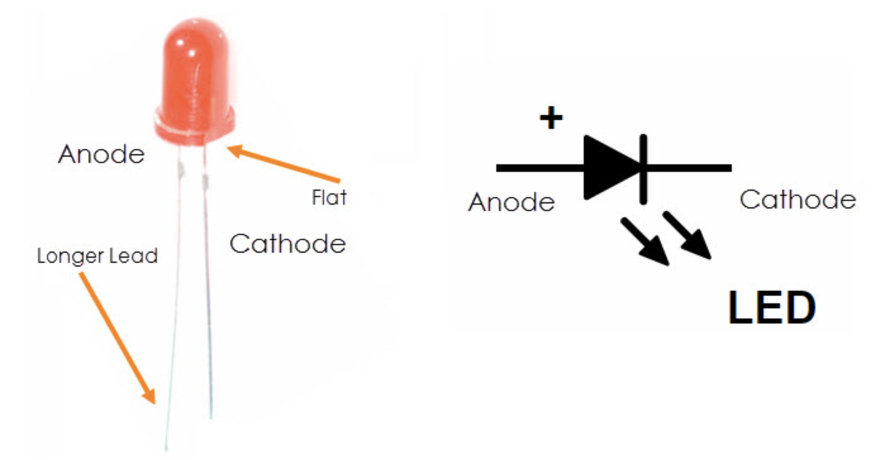
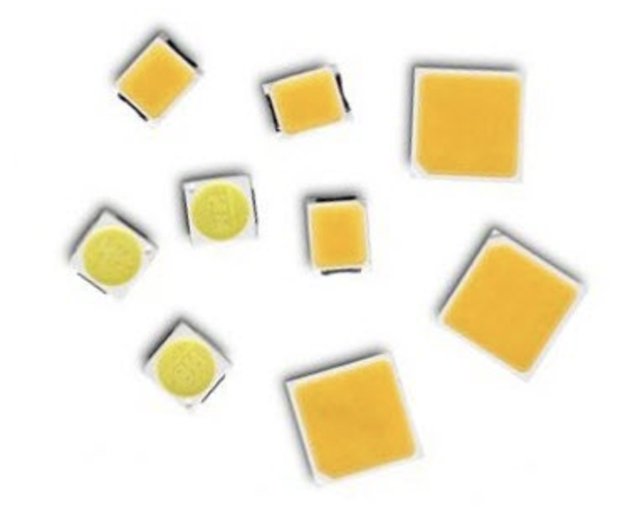
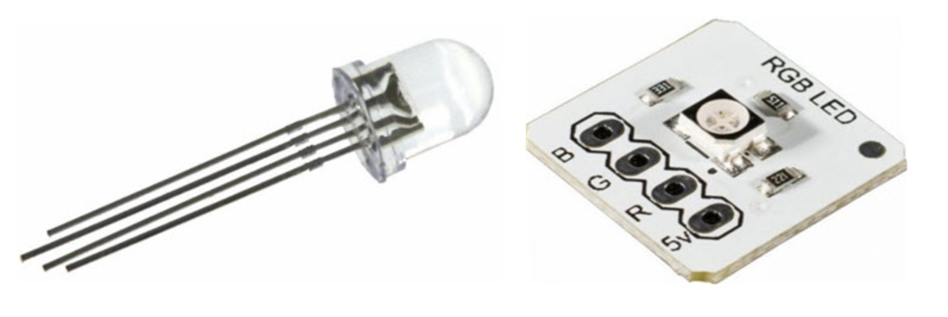
LEDs in Microscopy
Photon-emitting diode p-n junctions are typically based on a mixture of Group III and Group V elements, such as gallium, arsenic, phosphorous, indium, and aluminum. The relatively recent addition of silicon carbide and gallium nitride to this semiconductor palette has yielded blue-emitting diodes, which can be combined with other colors or secondary phosphors to produce LEDs that emit white light. The fundamental key to manipulating the properties of LEDs is the electronic nature of the p-n junction between two different semiconductor materials. When dissimilar doped semiconductors are fused, the flow of current into the junction and the wavelength characteristics of the emitted light are determined by the electronic character of each material.
https://www.zeiss.com/microscopy/us/solutions/reference/all-tutorials/light-sources/led-operation.html
https://www.electronicshub.org/led-light-emitting-diode/

Slide 6
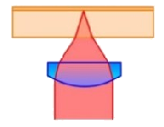
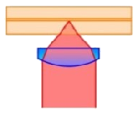
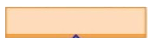
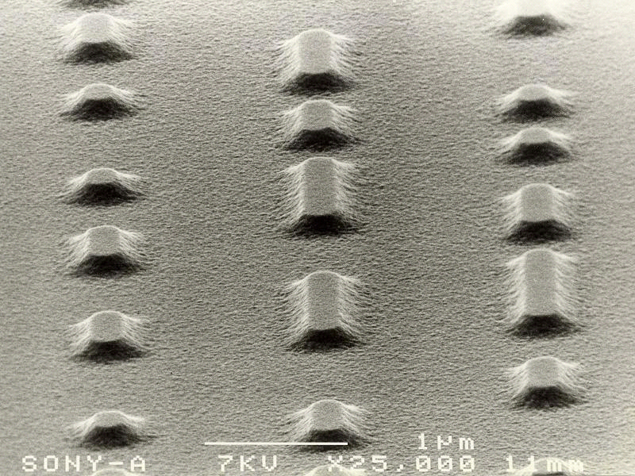
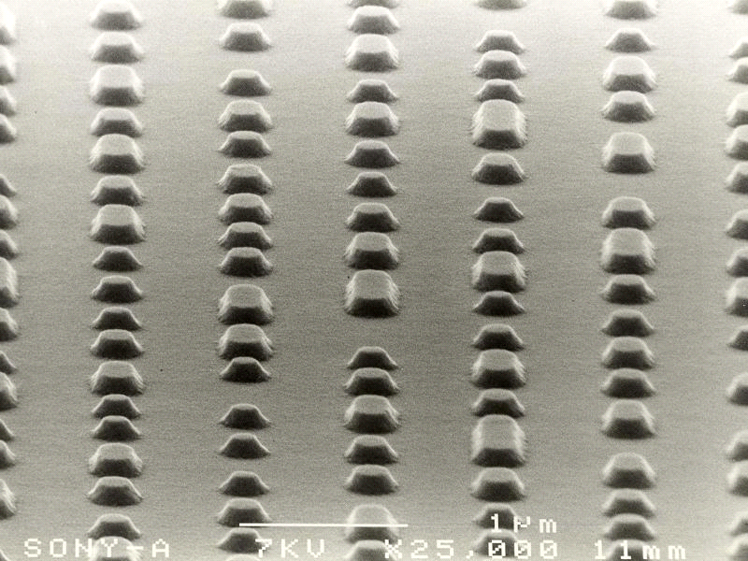
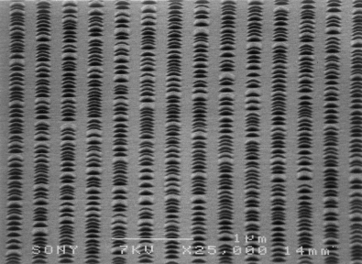
Higher Capacity by Smaller Spot and Thinner Cover
780nm
650nm
405nm
CD
DVD
BD
Wavelength: 780 nm
NA : 0.45
Capacity: 0.78 GB
Spot Size D = 1.42um
Wavelength: 650 nm
NA : 0.60
Capacity: 4.7GB
D = 0.88um
Wavelength: 405 nm
NA : 0.85
Capacity: 25GB
D = 0.39um
Cover Thickness
1.2mm
Cover Thickness
0.6mm
Cover Thickness
0.1mm
405nm PTM
E-beam
257nm Ar
350nm Ar/Kr
Pit Mastering 442nm He-Cd
406nm Kr
413nm Ar

Slide 7
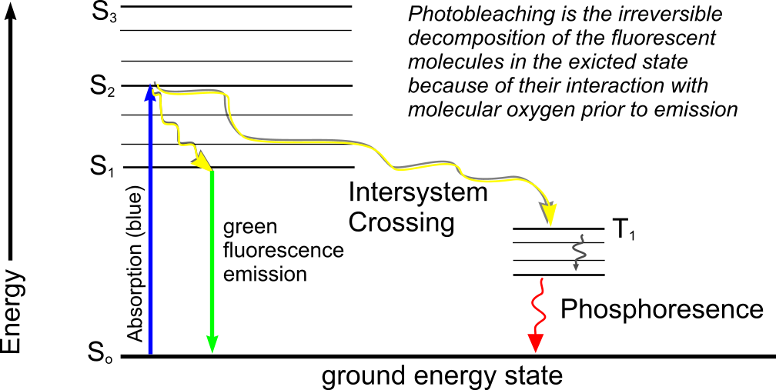
Fluorescence

Slide 8
Fluorescence
Review:
Chromophores are components of molecules which absorb light
e.g. from protein most fluorescence results from the indole ring of tryptophan residue
They are generally aromatic rings

Slide 9
Fluorescence
The wavelength of absorption is related to the size of the chromophores
Smaller chromophores, higher energy (shorter wavelength)

Slide 10
Fluorescence
Stokes Shift
  is the energy difference between the lowest energy peak of absorbance and the highest energy of emission
Fluorescein
molecule
Stokes Shift is 25 nm
495 nm
518 nm
Fluorescence Intensity
Wavelength

Slide 11
Fluorescence
Intensity
related to the probability of the event
Wavelength
  the energy of the light absorbed or emitted
The longer the wavelength the lower the energy
The shorter the wavelength the higher the energy
  e.g. UV light from sun causes the sunburn
  not the red visible light

Slide 12
First Synthetic Dyes
https://www.ncbi.nlm.nih.gov/pmc/articles/PMC2924670/

Slide 13
Light Sources - Lasers
Laser Abbrev. Excitation Lines
Argon Ar 353-361, 454, 488, 514nm
Violet Diode 380-405 nm
Krypton-Ar Kr-Ar 488, 568, 647nm
Helium-Neon He-Ne 543 nm, 633nm
He-Cadmium He-Cd 325 or/and 441nm
Diode – (CD) 780nm
Diode – (DVD) 650nm
Diode – (Blu-Ray) 405nm
Solid-State Many wavelengths
(He-Cd light difficult to get 325 nm band through some optical systems – need quartz)

Slide 14
Arc Lamp Excitation Spectra
350
405
488
632
Xe Lamp
10²
10¹
Irradiance at 0.5 m (mW m⁻² nm⁻¹)
1
Hg Lamp
10⁻¹
200 400 600 800

Slide 15
This is why Xenon is used
Xenon/Mercury Lamp
Xenon Lamp
Mercury Lamp

Slide 16
Excitation - Emission Peaks
% Max Excitation at
488 568 647 nm
Fluorophore EX_{peak} EM_{peak}
FITC 496 518 87 0 0
Bodipy 503 511 58 1 1
Tetra-M-Rho 554 576 10 61 0
L-Rhodamine 572 590 5 92 0
Texas Red 592 610 3 45 1
CY5 649 666 1 11 98
Note: You will not be able to see CY5 fluorescence
under the regular fluorescent microscope because
the wavelength is too high.
Note: the 3 laser combination is no longer used
Material Source:
Pawley: Handbook of Confocal Microscopy

Slide 17
Parameters
Extinction Coefficient
  ε (extinction coefficient) refers to a single wavelength (usually the absorption maximum)
Quantum Yield
  Q_{f} is a measure of the integrated photon emission over the fluorophore spectral band
At sub-saturation excitation rates, fluorescence intensity is proportional to the product of ε and Q_{f}
φ=
Number of emitted photons
Number of absorbed photons
Lifetime 1 –10x10⁻⁹secs (1-10 ns)

Slide 18
Fluorescence Lifetimes
https://www.ncbi.nlm.nih.gov/pmc/articles/PMC2924670/

Slide 19
Fluorescence Lifetimes
http://www.iss.com/resources/reference/data_tables/LifetimeDataFluorophores.html

Slide 20
Relative absorbance of phycobiliproteins
Phycobiliproteins are stable and highly soluble proteins derived from cyanobacteria and eukaryotic algae with quantum yields up to 0.98 and molar extinction coefficients of up to 2.4 × 10⁶
Protein | 488nm % absorbance | 568nm% absorbance | 633nm % absorbance
B-phycoerytherin | 33 | 97 | 0
R-phycoerytherin | 63 | 92 | 0
allophycocyanin | 0.5 | 20 | 56
Data from Molecular Probes Website

Slide 21
Excitation Saturation
The rate of emission is dependent upon the time the molecule remains within the excitation state (the excited state lifetime τ_{f})
Optical saturation occurs when the rate of excitation exceeds the reciprocal of τ_{f}
In a scanned image of 512 x 768 pixels (400,000 pixels) if scanned in 1 second requires a dwell time per pixel of 2 x 10⁻⁶ sec.
Molecules that remain in the excitation beam for extended periods have higher probability of interstate crossings and thus phosphorescence
Usually, increasing dye concentration can be the most effective means of increasing signal when energy is not the limiting factor (ie laser based confocal systems)
Material Source:
Pawley: Handbook of Confocal Microscopy

Slide 22
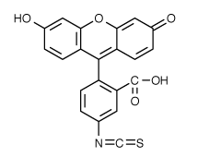
How many Photons?
Consider 1 mW of power at 488 nm focused to a Gaussian spot whose radius at 1/e² intensity is 0.25μm via a 1.25 NA objective
The peak intensity at the center will be 10⁻³W [π.(0.25 x 10⁻⁴ cm)²]= 5.1 x 10⁵ W/cm² or 1.25 x 10²⁴ photons/(cm² sec⁻¹)
At this power, FITC would have 63% of its molecules in an excited state and 37% in ground state at any one time
C₂₁H₁₁NO₅S
Material Source:
Pawley: Handbook of Confocal Microscopy

Slide 23
Photobleaching
Defined as the irreversible destruction of an excited fluorophore (discussed in later lecture)
Methods for countering photobleaching
  Scan for shorter times
  Use high magnification, high NA objective
  Use wide emission filters
  Reduce excitation intensity
  Use “antifade” reagents (not compatible with viable cells)

Slide 24
Quenching
Not a chemical process
Dynamic quenching =- Collisional process usually controlled by mutual diffusion
Typical quenchers – oxygen
Aliphatic and aromatic amines* ( NO₂, CHCl₃)
Static Quenching
Formation of ground state complex between the fluorophores and quencher with a non-fluorescent complex (temperature dependent – if you have higher quencher ground state complex is less likely and therefore less quenching)
*primary amines - only one alkyl group

Slide 25
Antifade Agents
Many quenchers act by reducing oxygen concentration to prevent formation of singlet oxygen
Satisfactory for fixed samples but not live cells!
Antioxidents such as propyl gallate, hydroquinone, p-phenylenediamine are used
Reduce O₂ concentration or use singlet oxygen quenchers such as carotenoids (50 mM crocetin or etretinate in cell cultures); ascorbate, imidazole, histidine, cysteamine, reduced glutathione, uric acid, trolox (vitamin E analogue)

Slide 26
Photobleaching example
FITC - at 4.4 x 10²³ photons cm⁻² sec⁻¹ FITC bleaches with a quantum efficiency Q_{b} of 3 x 10⁻⁵
Therefore, FITC would be bleaching with a rate constant of 4.2 x 10³ sec⁻¹ so 37% of the molecules would remain after 240 μsec of irradiation.
In a single plane, 16 scans would cause 6-50% bleaching
Material Source:
Pawley: Handbook of Confocal Microscopy

Slide 27
Förster/Fluorescence
Resonance Energy Transfer
Resonance energy transfer can occur when the donor and acceptor molecules are less than 100 Å of one another (preferable 20-50 Å)
Energy transfer is non-radiative which means the donor is not emitting a photon which is absorbed by the acceptor
Förster (Fluorescence) RET (FRET) can be used to spectrally shift the fluorescence emission of a molecular combination.
3rd Ed. Shapiro p 90
4th Ed. Shapiro p 115

Slide 28
FRET properties
Isolated donor
Donor distance too great
Donor distance correct

Slide 29
Energy Transfer
Non radiative energy transfer – a quantum mechanical process of resonance between transition dipoles
Effective between 10-100 Å only
Emission and excitation spectrum must significantly overlap
Donor transfers non-radiatively to the acceptor
PE-Texas Red™
Carboxyfluorescein-Sulforhodamine B

Slide 30
Resonance Energy Transfer
Molecule 1
Molecule 2
Molecule 1
Molecule 2
Fluorescence
Fluorescence
Fluorescence
Fluorescence
DONOR
ACCEPTOR
Intensity
Donor
Acceptor
Intensity
Absorbance
Absorbance
Wavelength

Slide 31
Bathochromic shift
Bathochromic shift (from Greek βαθύς bathys, "deep"; and χρῶμα chrōma, "color"; hence less common alternate spelling "bathychromic") is a change of spectral band position in the absorption, reflectance, transmittance, or emission spectrum of a molecule to longer wavelength (lower frequency).^{[1]} Because the red color in the visible spectrum has a longer wavelength than most other colors, the effect is also commonly called a red shift.
Hypsochromic shift is a change to shorter wavelength (higher frequency).
https://en.wikipedia.org/wiki/Bathochromic_shift

Slide 32
Hypsochromic shift
Hypsochromic shift (from ancient Greek ὕψος (upsos) "height"; and χρῶμα chrōma, "color") is a change of spectral band position in the absorption, reflectance, transmittance, or emission spectrum of a molecule to a shorter wavelength (higher frequency). Because the blue color in the visible spectrum has a shorter wavelength than most other colors, this effect is also commonly called a blue shift.
This can occur because of a change in environmental conditions: for example, a change in solvent polarity will result in solvatochromism. A series of structurally related molecules in a substitution series can also show a hypsochromic shift. Hypsochromic shift is a phenomenon seen in molecular spectra, not atomic spectra - it is thus more common to speak of the movement of the peaks in the spectrum rather than lines.
https://en.wikipedia.org/wiki/Hypsochromic_shift

Slide 33
Hyperchromicity
Hyperchromicity is the increase of absorbance (optical density) of a material. The most famous example is the hyperchromicity of DNA that occurs when the DNA duplex is denatured.^{[1]} The UV absorption is increased when the two single DNA strands are being separated, either by heat or by addition of denaturant or by increasing the pH level. The opposite, a decrease of absorbance is called hypochromicity.
https://en.wikipedia.org/wiki/Hyperchromicity

Slide 34
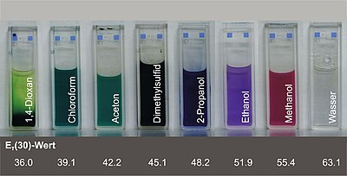
In chemistry, solvatochromism is the phenomenon observed when the colour due to a solute is different when that solute dissolved in different solvents.^{[1][2]}
Reichardt's dye dissolved in different solvents
The solvatochromic effect is the way the spectrum of a substance (the solute) varies when the substance is dissolved in a variety of solvents. In this context, the dielectric constant and hydrogen bonding capacity are the most important properties of the solvent. With various solvents there is a different effect on the electronic ground stateand excited state of the solute, so that the size of energy gap between them changes as the solvent changes. This is reflected in the absorption or emission spectrum of the solute as differences in the position, intensity, and shape of the spectroscopic bands. When the spectroscopic band occurs in the visible part of the spectrum solvatochromism is observed as a change of colour. This is illustrated by Reichardt's dye, as shown in the image.
https://en.wikipedia.org/wiki/Solvatochromism

Slide 35
Measuring Fluorescence
Fluorescent Microscope
Arc Lamp
EPI-Illumination
Excitation Diaphragm
Excitation Filter
Ocular
Dichroic Filter
Objective
Emission Filter

Slide 36
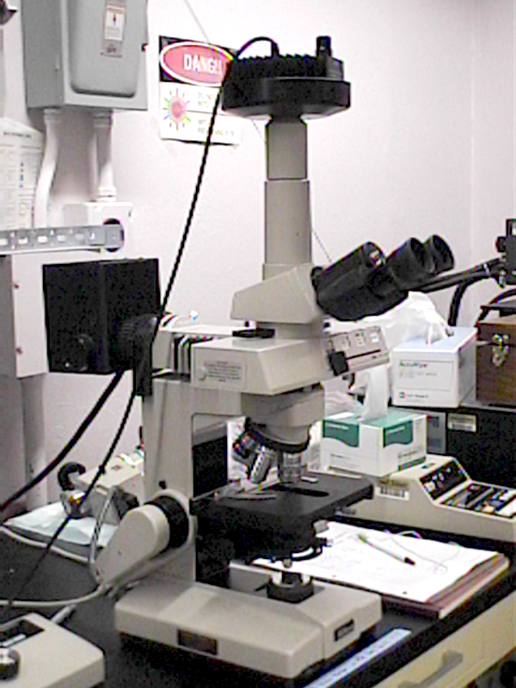
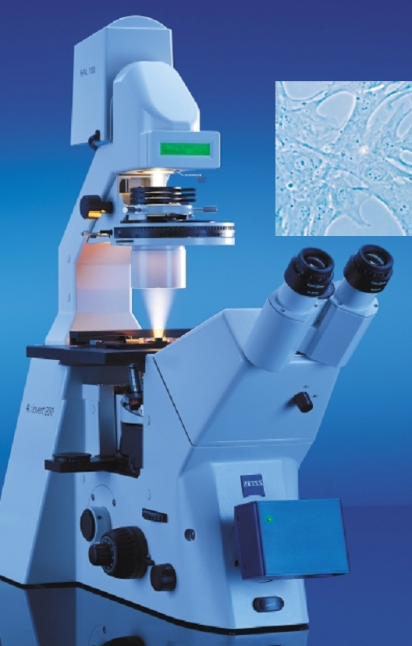
Typical Fluorescence Microscopes
upright
inverted

Slide 37
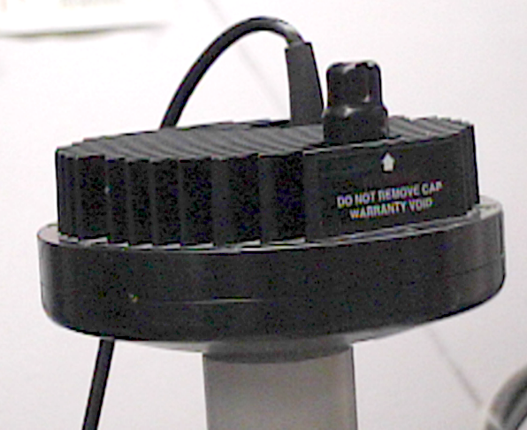
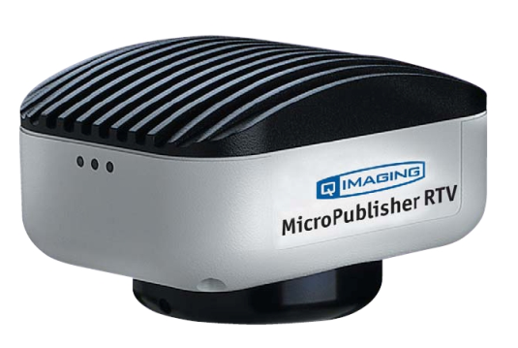
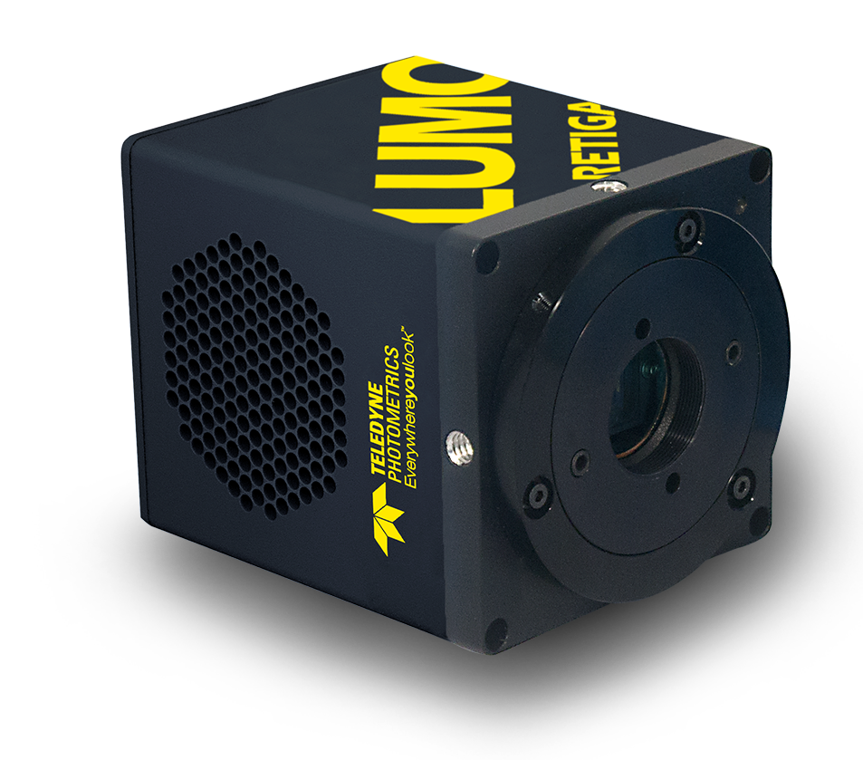
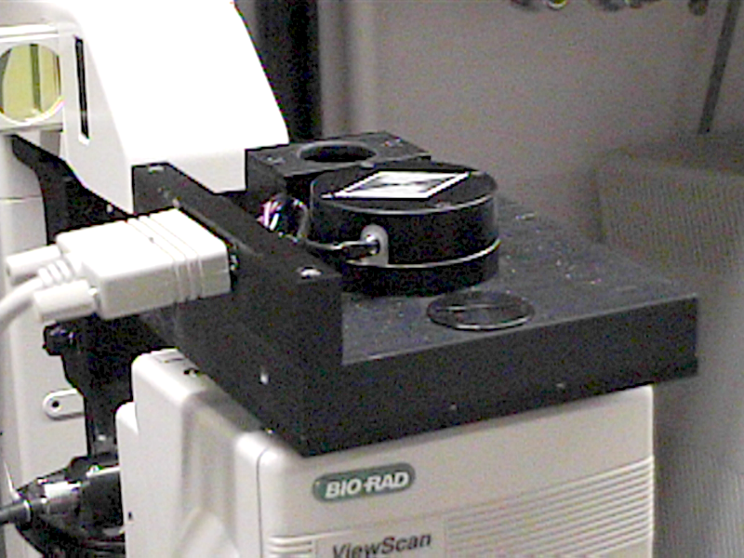
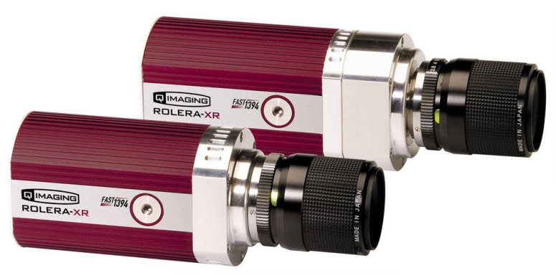
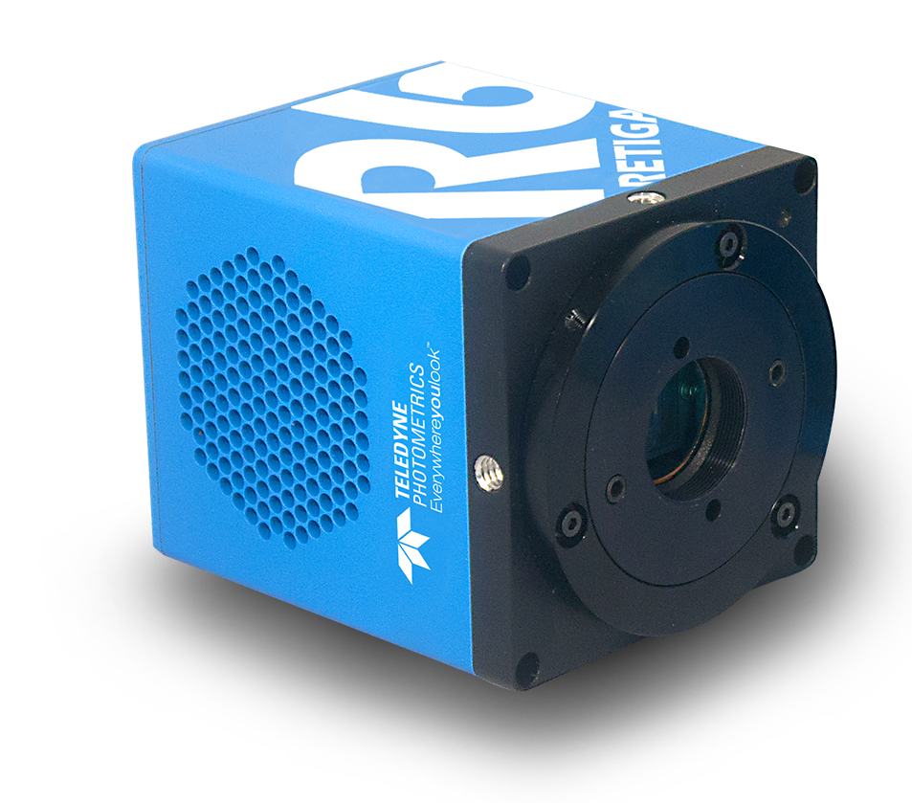
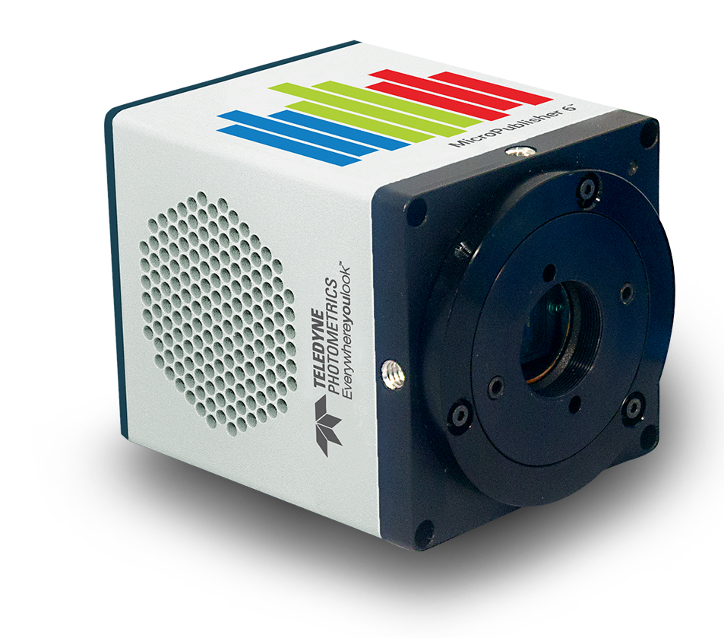
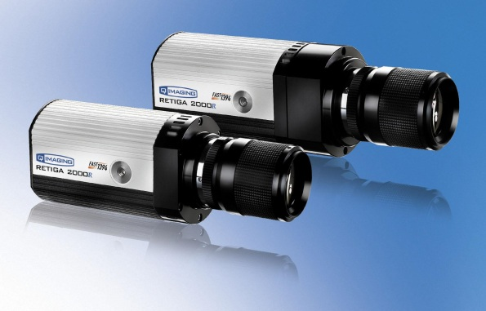
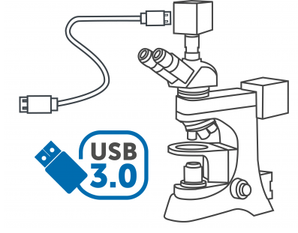
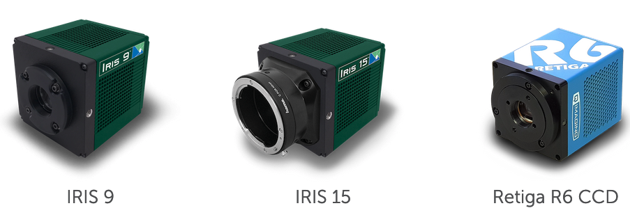
Measuring Fluorescence
Cameras and emission filters
Camera goes here
Color CCD camera does not need optical filters to collect all wavelengths but if you want to collect each emission wavelength optimally, you need a monochrome camera with separate emission filters shown on the right. Alternatives include AOTF or liquid crystal filters.

Slide 38
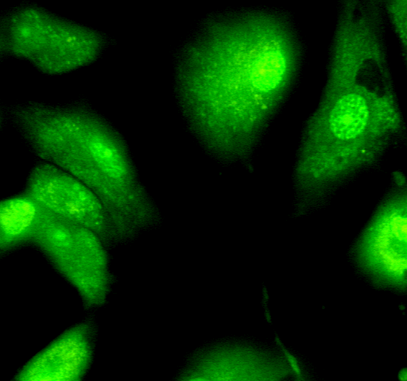
Stained frozen C57BL/6 mouse spleen tissue using antibodies against CD4 and CD8a to detect T cells, B220 to stain B cells, and CD169 and F4/80 to detect tissue-resident macrophages. For this staining, we took advantage of antibodies directly-conjugated to bright photostable fluorophores including the Brilliant Violet™ and Alexa Fluor® dyes.
Human paraffin-embedded colon tissue slices were Alexa Fluor® 594 anti-human Galectin-9 (clone 9M1-3, red) and Alexa Fluor® 647 anti-Vimentin (clone O91D3, green) and DAPI (blue).
https://www.biolegend.com/microscopy
https://www.biolegend.com/microscopy

Slide 39
Probes for Proteins
Probe Excitation Emission
FITC 488 525
PE 488 575
APC 630 650
PerCP™ 488 680
Cascade Blue 360 450
Coumerin-phalloidin 350 450
Texas Red™ 610 630
Tetramethylrhodamine-amines 550 575
CY3 (indotrimethinecyanines) 540 575
CY5 (indopentamethinecyanines) 640 670

Slide 40
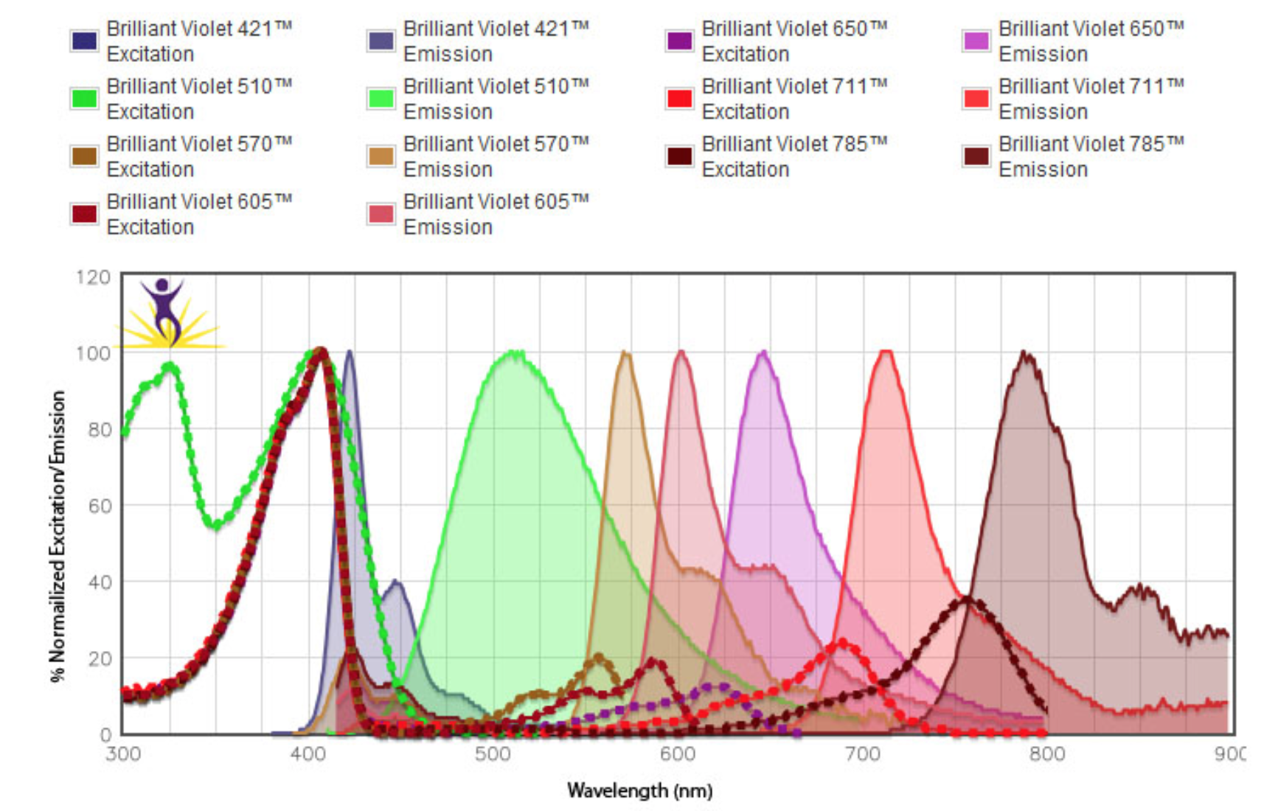
Additional dyes
https://www.biolegend.com/media_assets/brilliantviolet/BVSpectraChart062512.jpg

Slide 41
Panel Selector tools
e.g. https://www.biolegend.com/panelselector

Slide 42
Probes for Nucleic Acids
Hoechst 33342 (AT rich) (uv) 346 460
DAPI (uv) 359 461
POPO-1 434 456
YOYO-1 491 509
Acridine Orange (RNA) 460 650
Acridine Orange (DNA) 502 536
Thiazole Orange (vis) 509 525
TOTO-1 514 533
Ethidium Bromide 526 604
PI (uv/vis) 536 620
7-Aminoactinomycin D (7AAD) 555 655

Slide 43
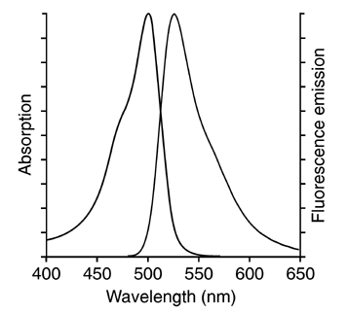
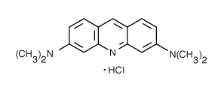
DNA Probes
AO
  Metachromatic dye
    concentration dependent emission
    double stranded NA - Green
    single stranded NA - Red
AT/GC binding dyes
  AT rich: DAPI, Hoechst, quinacrine
  GC rich: antibiotics bleomycin, chromamycin A₃, mithramycin, olivomycin, rhodamine 800

Slide 44
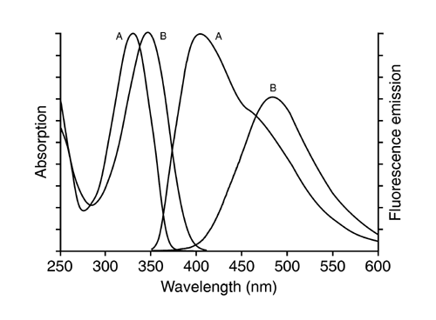
Probes for Ions
Indo-1
INDO-1 E_{x}350 E_{m}405/480
QUIN-2 E_{x}350 E_{m}490
Fluo-3 E_{x}488 E_{m}525
Fura -2 E_{x}330/360 E_{m}510
INDO-1: 1H-Indole-6-carboxylic acid, 2-[4-[bis[2-[(acetyloxy)methoxy]-2- oxoethyl]amino]-3-[2-[2-[bis[2- [(acetyloxy)methoxy]-2-oxoetyl]amino]-5- methylphenoxy]ethoxy]phenyl]-, (acetyloxy)methyl ester [C₄₇H₅₁N₃O₂₂ ] (just in case you want to know….!!)
FLUO-3: Glycine, N-[4-[6-[(acetyloxy)methoxy]-2,7- dichloro-3-oxo-3H-xanthen-9-yl]-2-[2-[2- [bis[2-[(acetyloxy)methoxy]-2- oxyethyl]amino]-5- methylphenoxy]ethoxy]phenyl]-N-[2- [(acetyloxy)methoxy]-2-oxyethyl]-, (acetyloxy)methyl ester

Slide 45
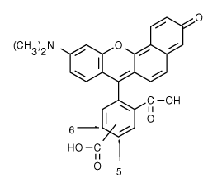
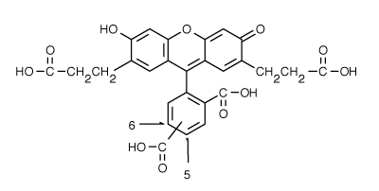
pH Sensitive Indicators
Probe Excitation Emission
SNARF-1 488 575
BCECF 488 525/620
440/488 525
C₂₇H₁₉NO₆
C₂₇H₂₀O₁₁
SNARF-1: Benzenedicarboxylic acid, 2(or 4)-[10-(dimethylamino)-3-oxo-3H- benzo[c]xanthene-7-yl]-
BCECF: Spiro(isobenzofuran-1(3H),9'-(9H) xanthene)-2',7'-dipropanoic acid, ar-carboxy-3',6'-dihydroxy-3-oxo-

Slide 46
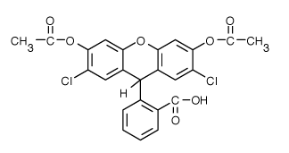
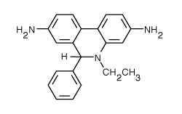
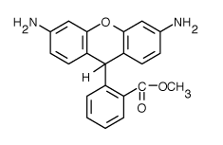
Probes for Oxidation States
Probe Oxidant Excitation Emission
DCFH-DA (H₂O₂) 488 525
HE (O₂⁻) 488 590
DHR 123 (H₂O₂) 488 525
DCFH-DA: 2',7'-dichlorodihydrofluorescein diacetate (2',7'-dichlorofluorescin diacetate; H2DCFDA)
C₂₄H₁₆C_{l2}O₇
DCFH-DA - dichlorofluorescin diacetate
HE - hydroethidine 3,8-Phenanthridinediamine, 5-ethyl-5,6-dihydro-6-phenyl-
DHR-123 - dihydrorhodamine 123 Benzoic acid, 2-(3,6-diamino-9H-xanthene-9-yl)-, methyl ester
C₂₁H₂₁N₃
C₂₁H₁₈N₂O₃

Slide 47
Specific Organelle Probes
Probe Site Excitation Emission
BODIPY Golgi 505 511
NBD Golgi 488 525
DPH Lipid 350 420
TMA-DPH Lipid 350 420
Rhodamine 123 Mitochondria 488 525
DiO Lipid 488 500
diI-Cn-(5) Lipid 550 565
diO-Cn-(3) Lipid 488 500
BODIPY - borate-dipyrromethene complexes NBD - nitrobenzoxadiazole
DPH – diphenylhexatriene TMA - trimethylammonium

Slide 48

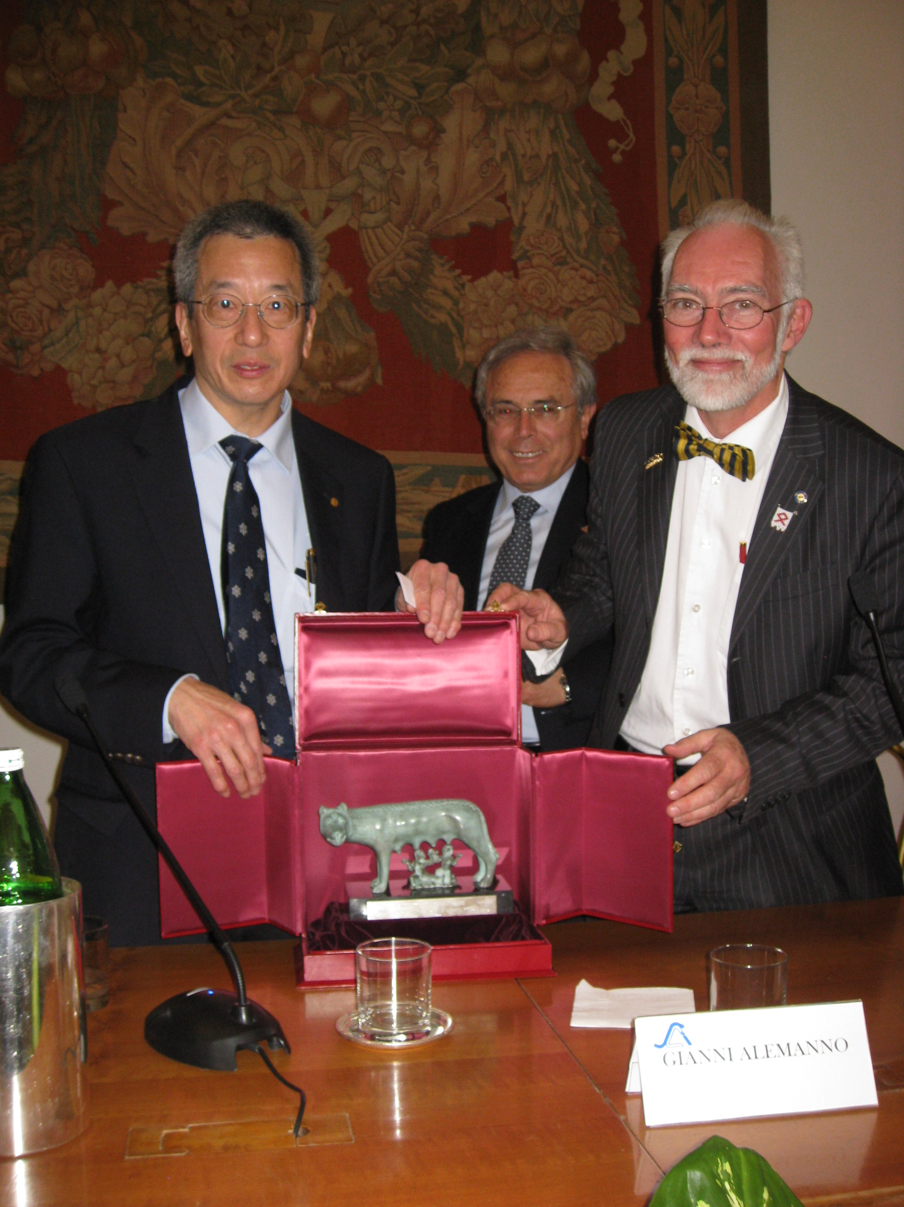
Other Probes of Interest
GFP - Green Fluorescent Protein
  GFP is from the chemiluminescent jellyfish Aequorea victoria
  excitation maxima at 395 and 470 nm (quantum efficiency is 0.8) Peak emission at 509 nm
  contains a p-hydroxybenzylidene-imidazolone chromophore generated by oxidation of the Ser-Tyr-Gly at positions 65-67 of the primary sequence
  Major application is as a reporter gene for assay of promoter activity
  requires no added substrates
Note: 2008 Nobel prize for Chemistry was for GFP (Roger Tsien)
Roger Tsien and J.Paul Robinson in Rome in March 2009 when Roger was awarded the Romulus and Remus award by the Mayor of Rome

Slide 49
Multiple Emissions
Many possibilities for using multiple probes with a single excitation
Multiple excitation lines are possible
Combination of multiple excitation lines or probes that have same excitation and quite different emissions
  e.g. Calcein AM and Ethidium (ex 488 nm)
  emissions 530 nm and 617 nm

Slide 50
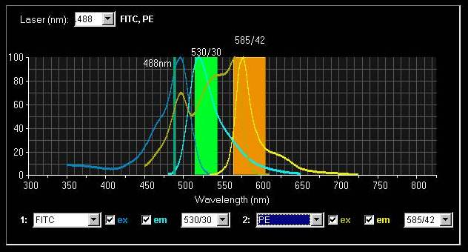
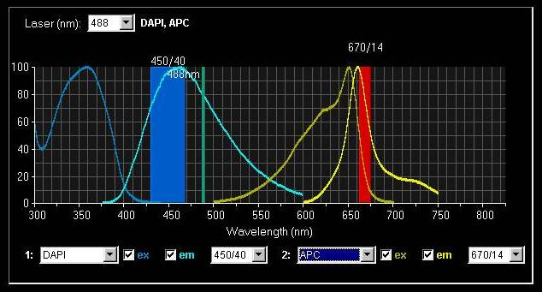
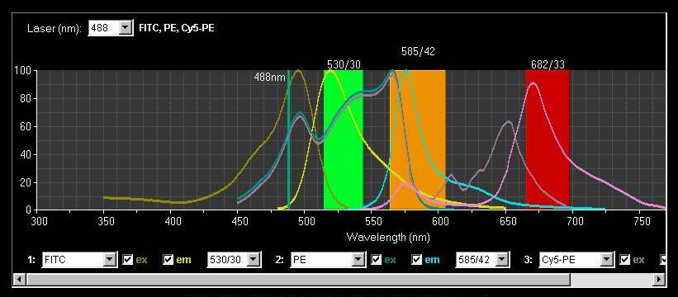
Filter combinations
The band width of the filter will change the intensity of the measurement

Slide 51
Fluorescence Overlap

Slide 52
Fluorescence Overlap

Slide 53
Fluorescence Overlap
This is your bandpass filter
Overlap of FITC fluorescence in PE PMT
a
Overlap of PE fluorescence in FITC PMT
b

Slide 54
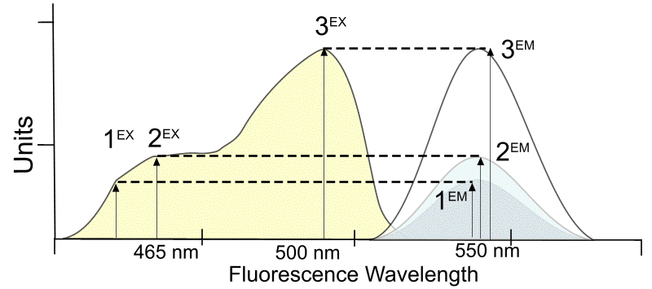
Fluorescence
The longer the wavelength the lower the energy
The shorter the wavelength the higher the energy
  eg. UV light from sun - this causes the sunburn, not the red visible light
The spectrum is independent of precise excitation line but the intensity of emission is not

Slide 55

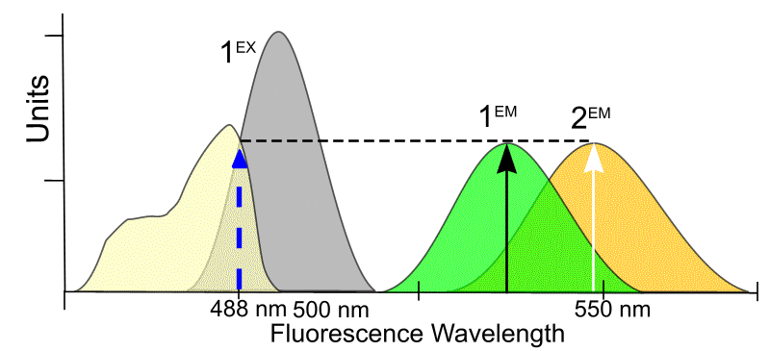
Mixing fluorochromes
When there are two molecules with different absorption spectra, it is important to consider where a fixed wavelength excitation should be placed. It is possible to increase or decrease the sensitivity of one molecule or another.

Slide 56
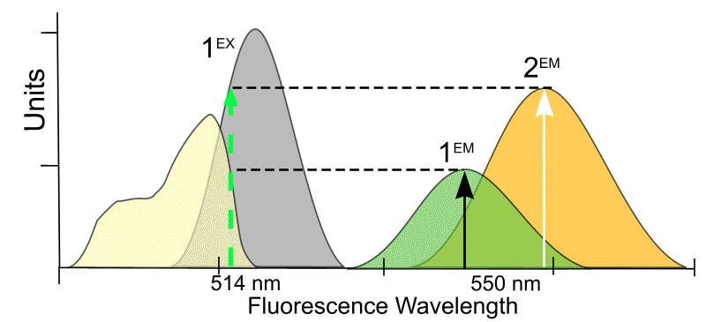
Mixing fluorochromes
When there are two molecules with different absorption spectra, it is important to consider where a fixed wavelength excitation should be placed. It is possible to increase or decrease the sensitivity of one molecule or another.

Slide 57
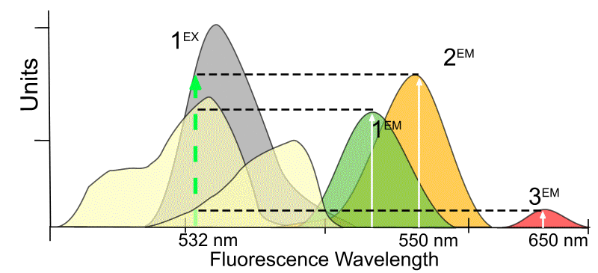
Excitation of 3 Dyes with emission spectra
J. Paul Robinson, Class lecture notes, BMS 631

Slide 58
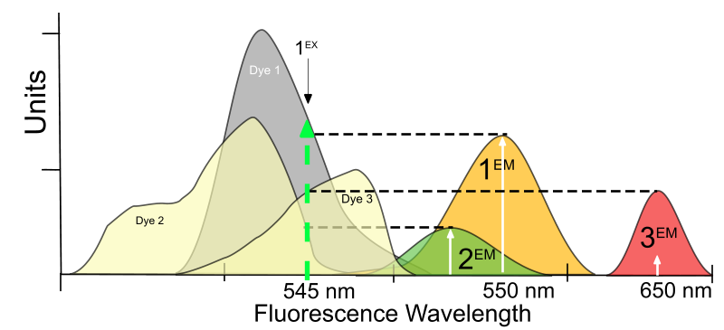
Change of Excitation
J. Paul Robinson, Class lecture notes, BMS 631

Slide 59
LEDs for microscopy
Figure 3. Fluorescent bovine pulmonary artery endothelial cells. The cell nucleus is shown blue, the green is tubulin and the red shows actin. Courtesy of Jordi Recasens/Izasa Scientific.
https://www.photonics.com/Articles/LEDs_in_Microscopy_An_Emerging_Research_Tool/a62272

Slide 60
Commercial Microscopes use LEDs
https://www.thermofisher.com/us/en/home/life-science/cell-analysis/cellular-imaging/cell-imaging-systems/floid-cell-imaging-station.html

Slide 61
LEDs used in Microscopy
Figure 4. This graph shows a 385-nm LED and Hg spectrum overlaid on DAPI absorption and emission, with an example excitation and emission filter. Courtesy of Gerard Whoriskey/CoolLED Ltd.
340-nm LEDs are also available for deep UYV probes like Fura 2
https://www.photonics.com/Articles/LEDs_in_Microscopy_An_Emerging_Research_Tool/a62272

Slide 62
Conclusions
Fluorescence is the primary energy source for confocal microscopes
Dye molecules must be close to, but below saturation levels for optimum emission
Fluorescence emission is longer than the exciting wavelength
The energy of the light increases with reduction of wavelength
Fluorescence probes must be appropriate for the excitation source and the sample of interest
Correct optical filters must be used for multiple color fluorescence emission

