Slide 1
BMS 524 - “Introduction to Confocal Microscopy and Image Analysis”
Lecture 4: Image file formats
Department of Basic Medical Sciences,
School of Veterinary Medicine
Weldon School of Biomedical Engineering
Purdue University
J. Paul Robinson, Ph.D.
Distinguished Professor of Cytometry
Professor of Biomedical Engineering
Director, Purdue University Cytometry Laboratories,
Purdue University
These slides are intended for use in a lecture series. Copies of the slides are distributed and students encouraged to take their notes on these graphics. All material copyright J.Paul Robinson unless otherwise stated. No reproduction of this material is permitted without the written permission of J. Paul Robinson. Except that our materials may be used in not-for-profit educational institutions with appropriate acknowledgement. It is illegal to upload this lecture to Course Hero or any other site.
This lecture was last updated in January, 2023
Find other PUCL Educational Materials at http://www.cyto.purdue.edu/class

Slide 2
What are data file formats?
Data files are a representation of an original image, which is itself a representation of reality.
The chain of digital image processing includes both creation of digital data from an image, and recreation of an image from the digital data.
Data file formats are created in order to make specific operations more convenient. The most convenient format may differ with the particular application.

Slide 3
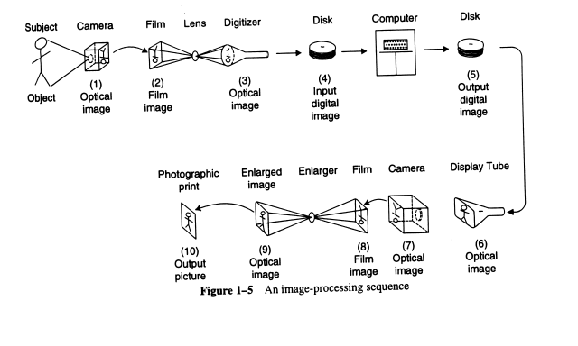
Image process - from subject to output
digital
Analogue

Slide 4
Creating an Image
Analogue Camera
Digital Camera
Film
CMOS
sensor
Negative
Monitor
Print
(positive)

Slide 5
What is image manipulation?
Manipulation of Digital Images Should only be Performed on a Copy of the Unprocessed Image Data File (Always Keep the Original Data File Safe and Unchanged!)
For most purposes, a one-to-one mapping of pixels to data values is most useful, but the internal representation of the data values may be different for different file formats.
Files can be either compressed, or not, and compression can be either lossy or not. For scientific analysis lossy compression is unacceptable; it may be useful for overview presentations.
Image manipulation can take place before image acquisition, during image acquisition, on the digital data, or during re-creation of an output image.

Slide 6
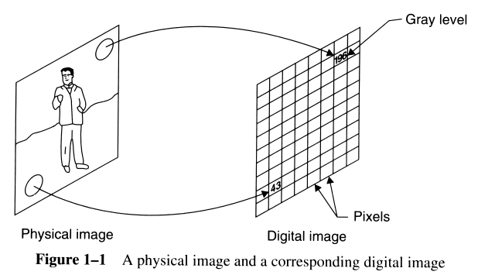
8 bits provide
256 possible
gray levels

Slide 7
SiliconMentor/computer-science-thesis-in-digital-image-processing

Slide 8
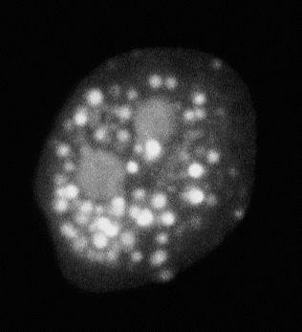
How does this translate from an image into an image map?

Slide 9
How does this translate from an image into an image map?
512
512
512
512
An image need only be parsimonius, i.e., it only needs to show what is necessary to provide the expected image.

Slide 10
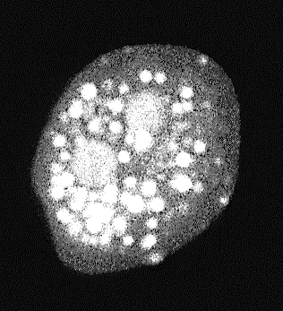
It depends on what you are collecting the image for as to the resolution required
For example, in this neutrophil, perhaps the goal is to only measure the changes in the area of the nucleus which would be a good example of doing some image analysis.
Thus, we need to understand how this process might work

Slide 11
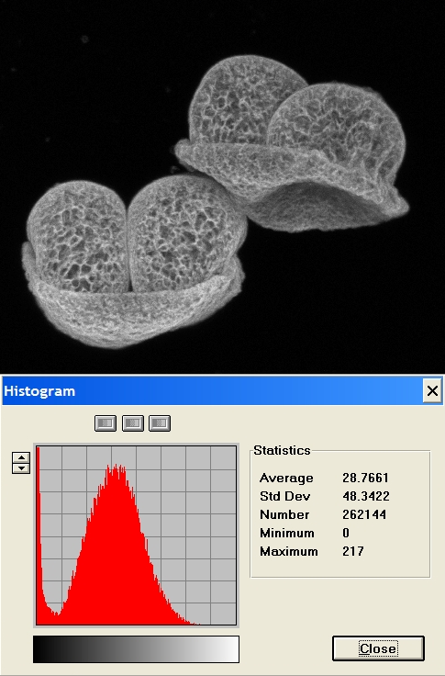
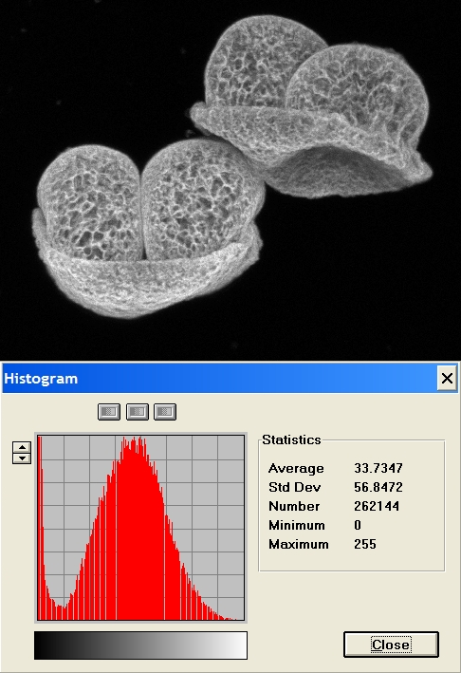
How does this translate from an image into an image map?
min
0=black, 255=white
max

Slide 12
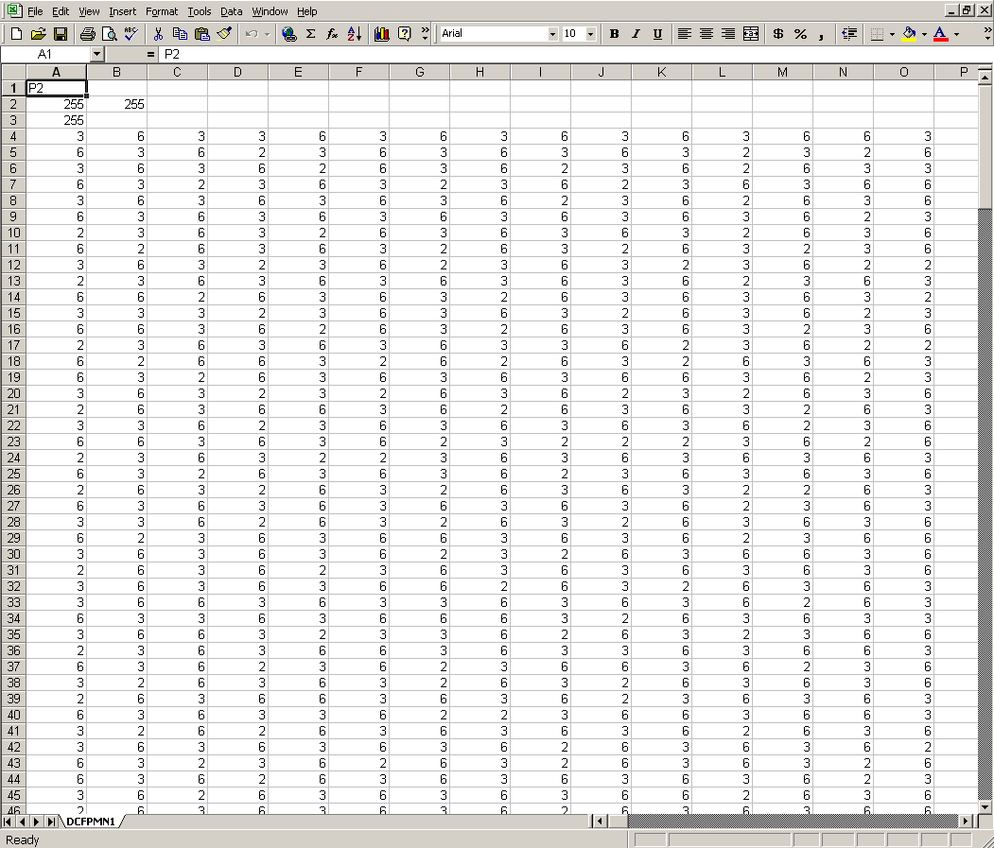
Pixel values are in a list file

Slide 13
Pixels in an image
512
0
255
512

Slide 14
Image size
The higher the resolution of the image, the more data points there are
Very high-resolution files need to be reduced in size to store the data, although today large drives and fast computers help with this issue
We often need to employ compression algorithms to reduce the file size
But the goal is to maintain the quality of the image
Lossless compression is ideal for biological images
Every year, digital cameras have higher resolution, so images just get bigger!!

Slide 15
Quality vs File size
CC BY-SA 3.0, https://commons.wikimedia.org/w/index.php?curid=4595485

Slide 16
Common screen resolutions available
# Pixels
Apple II - 280 x 192 (original Apple computer from 1970-80s)
54,144
CGA - 640 x 480 (original IBM computer from 1990s)
307,200
720p = 1280 x 720 - is usually known as HD or "HD Ready" resolution
1080p = 1920 x 1080 - is usually known as FHD or "Full HD" resolution
2K = 2048 x 1080 - this refers to displays that have a horizontal resolution of approximately 2000 pixels. Although it is close to 1080p, it is considered as a different resolution standard.
1440p = 2560 x 1440 - commonly known as QHD or Quad HD resolution, and typically seen on gaming monitors and on high-end smartphones. 1440p is four times the resolution of 720p HD or "HD ready.”
4K or 2160p = 3840 x 2160 - commonly known as 4K, UHD or Ultra HD resolution. It is a huge display resolution, and it is found on premium TVs and computer monitors. 2160p is called 4K because the width is close to 4000 pixels. It offers four times the pixels of 1080p FHD or "Full HD.”
8K or 4320p = 7680 x 4320 - is known as 8K and it offers 16 times more pixels than the regular 1080p FHD or "Full HD" resolution. 8K TVs were on the shelves in stores in Japan in 2017.
921,600
2,073,600
2,211,840
3,686,400
8,294,400
(612x Apple II)
33,177,600

Slide 17
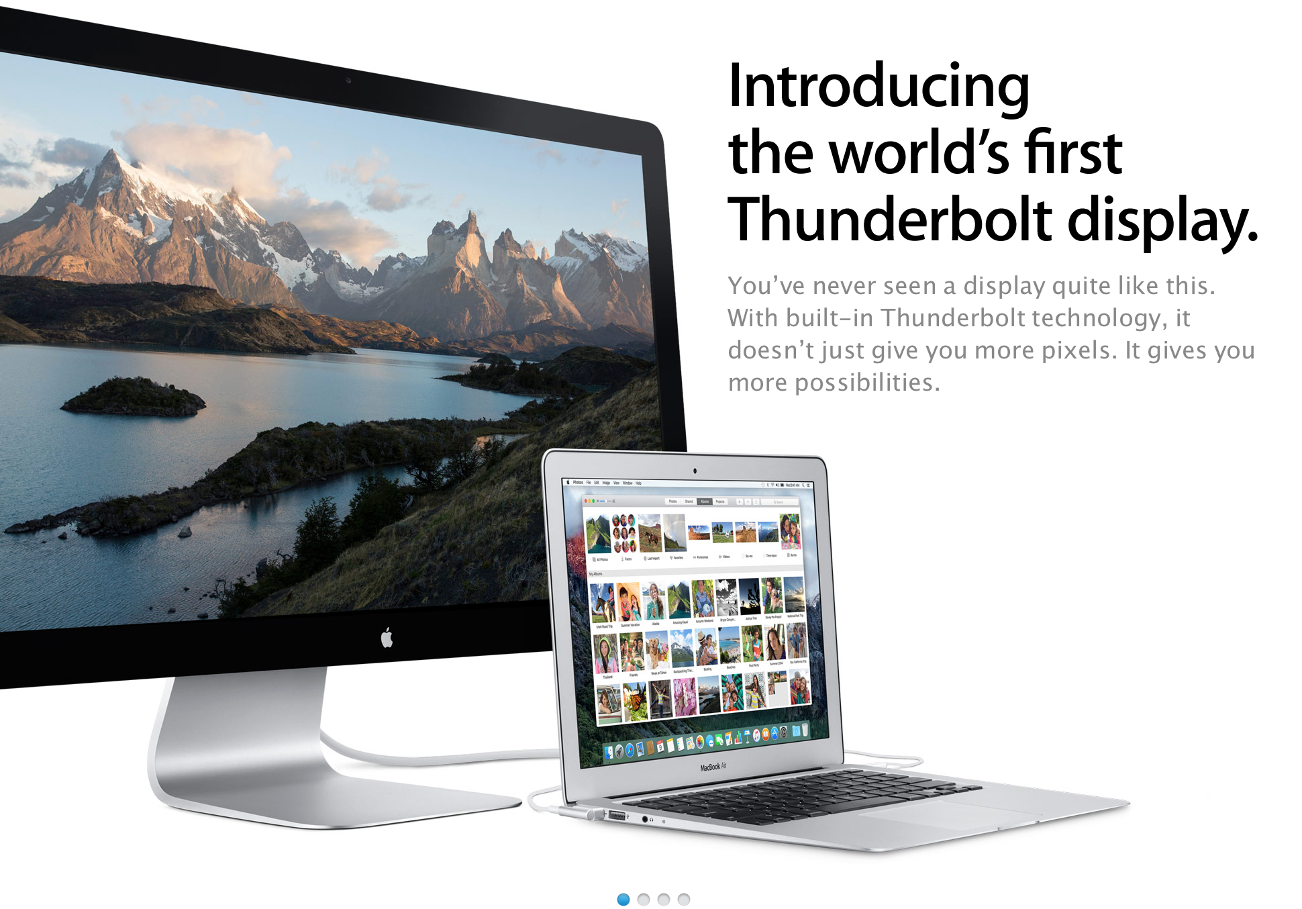
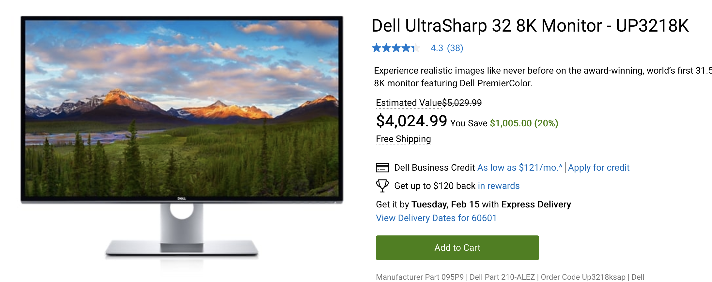
How big is an image?
Size is dependent on several factors –
The X-Y size in pixels
The number of bits (colors)
For example, a 640 x 480 x 24 bit image = 7,372,800 bits = 921,600 bytes
The same image “double the size” (means 4 times pixels)
1280 x 960 = 1228800 x 24 bits = 29,491,200 bits = 3,686,400 bytes
An image at full MacThunderbolt (from 2011) screen resolution of
2560 x 1440 = 3,686,400 x 24 = 88,473,600 bytes
Dell UltraSharp 49 Curved Monitor: U4919DW
Native Resolution
5120 x 1440 at 60Hz (49 inches)
(as of 2018)
Introduced in 2011
33,177,600 pixels
7,372,800 pixels

Slide 18
Image Compression
Image compression is a type of data compression applied to digital images, to reduce their cost for storage or transmission. Algorithms may take advantage of visual perception and the statistical properties of image data to provide superior results compared with generic compression methods
https://en.wikipedia.org/wiki/Image_compression
Lossy Compression
is often used when storage space is a premium, or small file size is preferred. When you use lossy compression algorithms, you will introduce artifacts so the image no longer represents the entirety of the original image and cannot be reconstructed from a lossy image. Some photographs that have landscapes, or natural forms, might look very similar to the original even when compressed. But the key is that data are lost when you use lossy compression.
Lossless Compression
Is used when you do not want to lose any of the original data. This is typical for medical and biological, & technical images. Essentially, we want all scientific images to be lossless when we save them or when we compress them.

Slide 19
Lossless Compression Example
Run Length Encoding – count the number of identical values, replace the values with a count followed by the value
AAAAABCCCCCCCCCCDDDDDDDDDDDDDDDDDDDDEEEEFFFFFFFFFF
=50
=15
5A1B10C20D4E10F
This is a 70% reduction in file size with no loss of data
A kind of compression algorithm which replaces sequences ("runs") of consecutive repeated characters

Slide 20
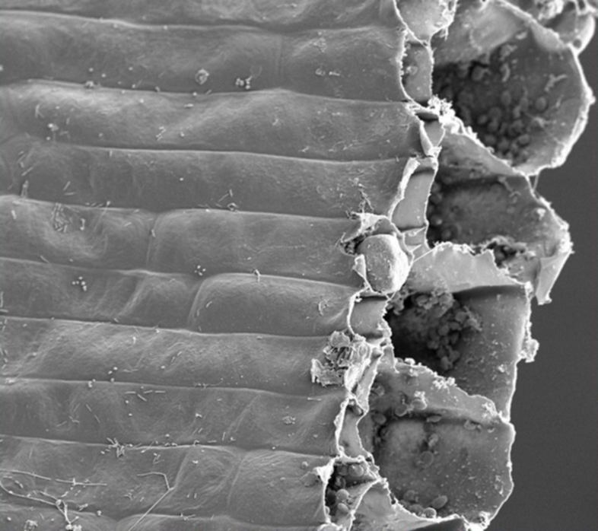
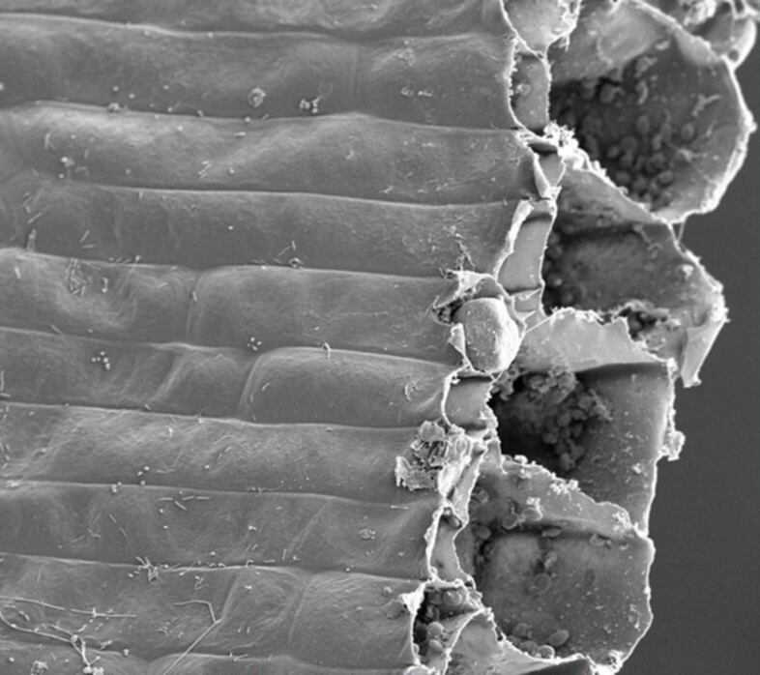
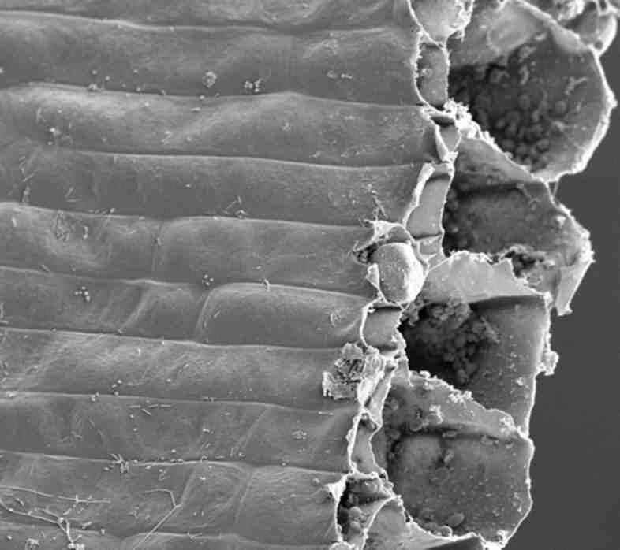

0% Compression
50% Compression
76k
42k
75% Compression
80% Compression
28k
26k

Slide 21
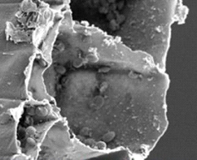
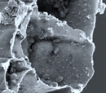
Looks reasonable
Looks very lossy - pixelated
The 76 k file (original)
The 26 k file (80% compression)

Slide 22


4 x magnification
(note the pixilation – i.e. there are more pixels than data)
The 76 k file
The 26 k file

Slide 23
What is image analysis?
Brightness and contrast variation are controlled by a system input-output curve.
Spatial kernel filtering and median filtering use information local to a particular area of an image to modify that area.
Digital image analysis is “Data Analysis”.

Slide 24
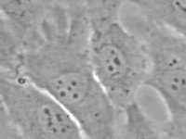
Original Image

Slide 25
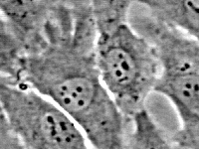
Contrast enhanced image

Slide 26
Both images
Original
Contrast Enhanced

Slide 27
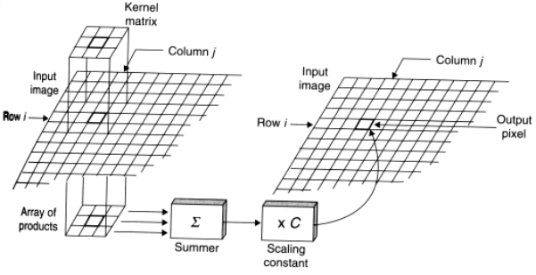
Conversion of image manipulation into new image

Slide 28
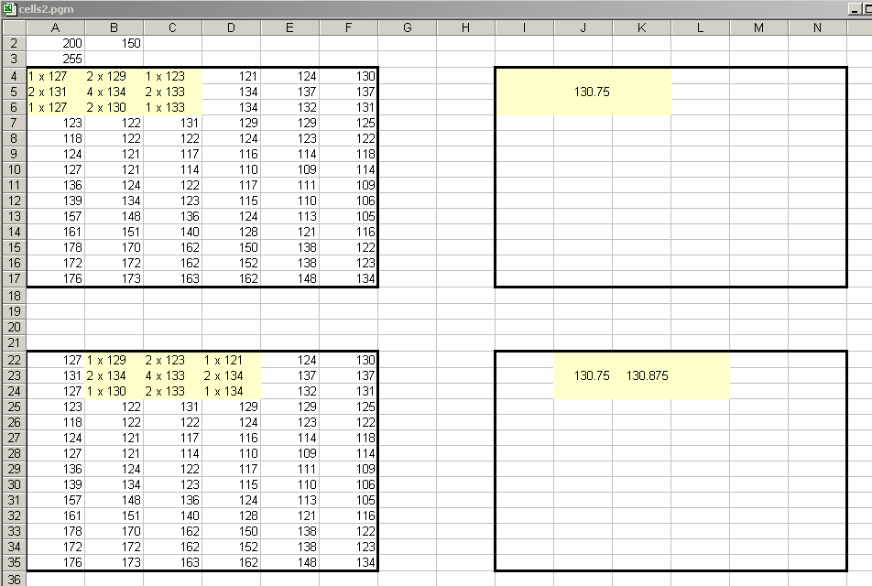
Smoothing
A smoothing filter attempts to create an approximating function that tries to capture key patters in the data, but may leaves out noise or very fine scale structures.

Slide 29
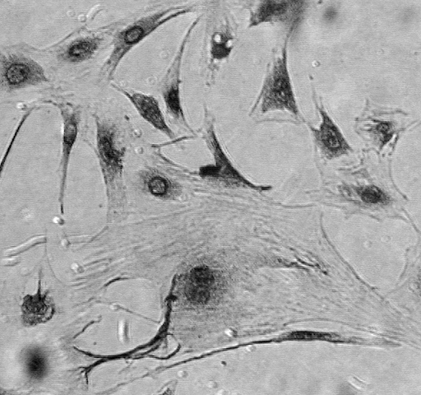
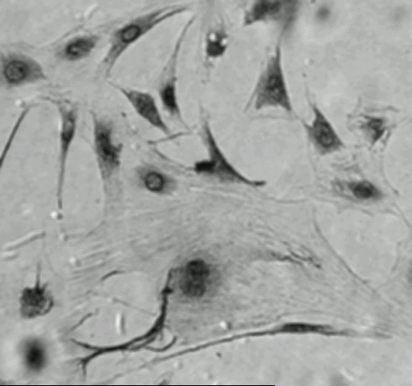
Smoothing
Less background “noise”
Loss of very fine structures

Slide 30
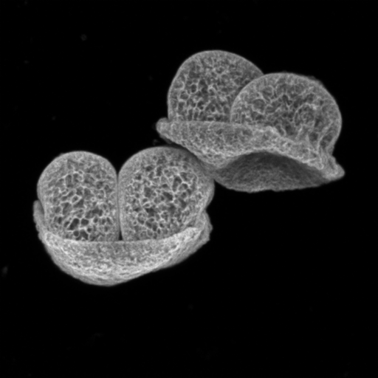


Smoothing
3 x 3 Smooth
original
9 x 9 Smooth

Slide 31


Sharpening
3 x 3 Sharpen
original
9 x 9 Sharpen

Slide 32

Gaussian Filter
1 2 1
2 4 2
1 2 1
Gaussian filters are filters where a filter is a filter whose impulse response is Gaussian – it is designed to give no overshoot to a step function input while minimizing the rise and fall time

Slide 33
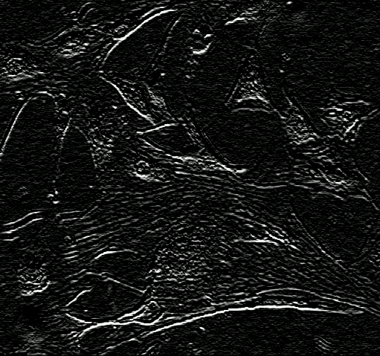
Sobel Filter
1 2 1
0 0 0
-1 -2 -1
Sobel is a discrete differentiation operator, computing an approximation of the gradient of the image intensity function. It basically operates in the vertical and horizontal planes and thus produces edges (abrupt changes in gradient)

Slide 34
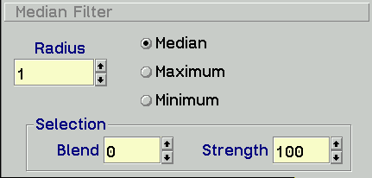

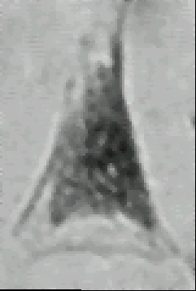
Application of a median filter
A median filter is often desirable to be able to perform some kind of noise reduction and it preserves edges while removing the noise

Slide 35
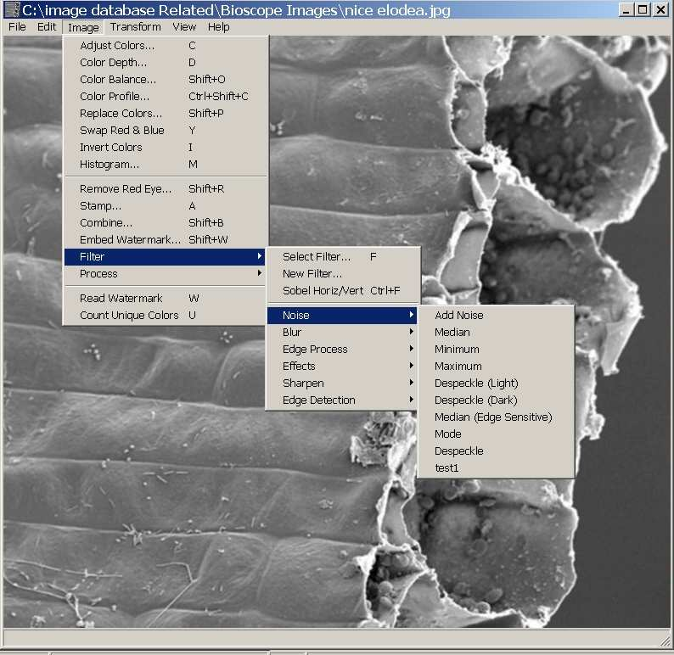

Slide 36
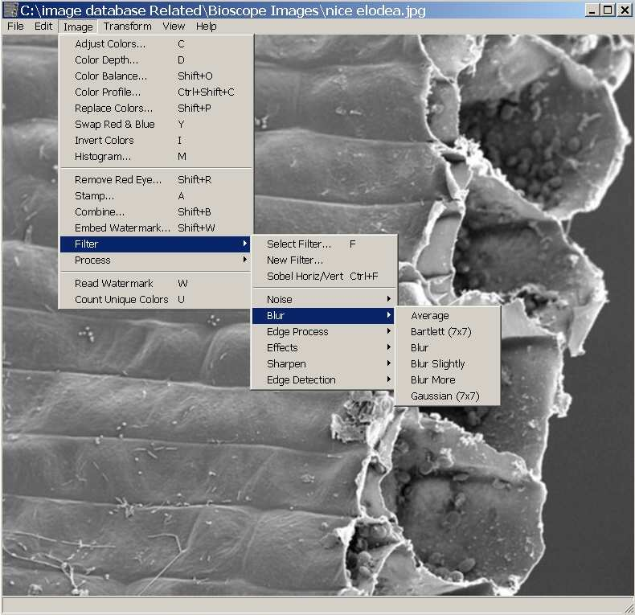

Slide 37
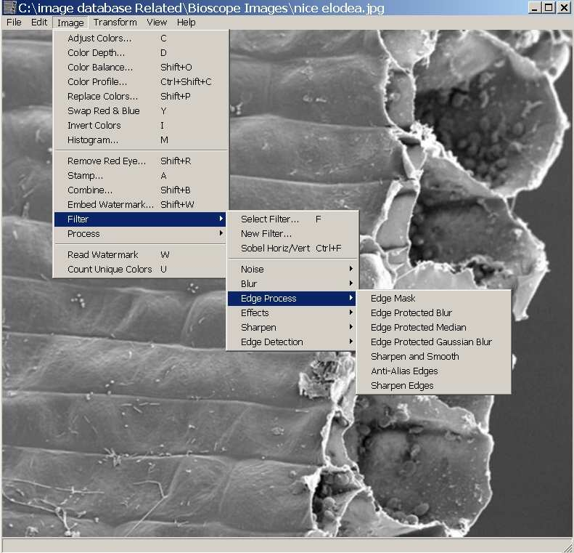

Slide 38
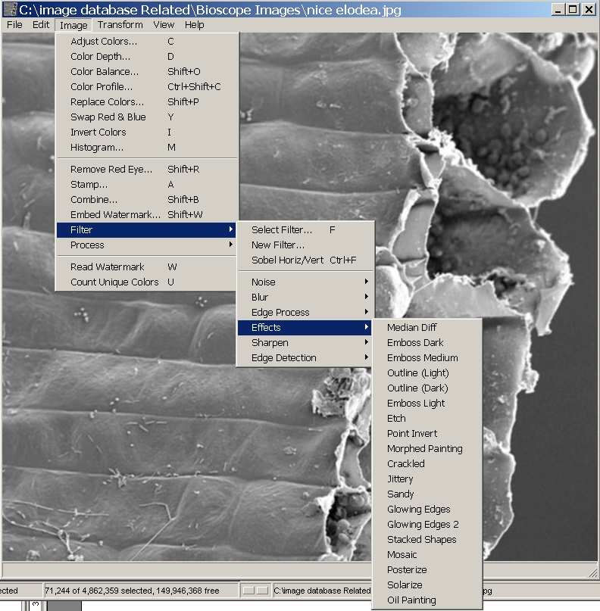

Slide 39
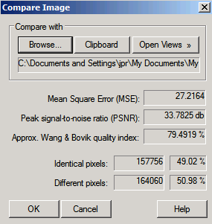
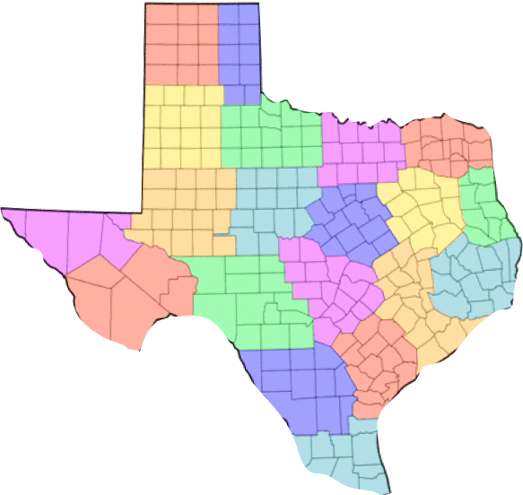

Comparing Images
(Thumbsplus)
file size: 73,011
file size: 21,358

Slide 40
It depends on what the purpose is of your image as to the resolution needed
file size: 73,011
file size: 21,358
File size 12,470
An image need only be parsimonius, i.e., it only needs to show what is necessary to provide the expected image.

Slide 41
What are you loosing?
Same image as previous page, expanded 10-15 times

Slide 42
Lossy & Lossless Compression
Lossy
Most filters will result in lossy compression. This means once you compress the image, you can never return the image back to its original self. One needs to be careful with biological data to ensure that you preserve the raw files
Lossless:
These processes allow the reconstruction of the original data to be perfectly from the compressed data.
Examples GIF - Graphics Interchange Format (it uses LZW lossless compression)
(GIF is usually limited to an 8-bit palette, or 256 colors and a single transparency color and useful for animation – but is a very old image format not suitable for high color content. This format was patented by Unisys and caused many issued in the early days of the WEB – but the patents on LZW expired on June 20, 2003)
TIFF - Tagged Image File Format

Slide 43
Some image formats
(Lossy)
Approximately 1382 different image formats
RAW – this differs from product to product so there is no standard
PNG (Portable Network Graphics) uses ZIP compression which is lossless, and slightly more effective than LZW (slightly smaller files) (designed for web).
More recent format, royalty free, note patent issues over the LZW format (GIF).
GIF files can be saved with a maximum of 256 colors. (not good for photographic images even though it retains the limited information collected)
JPEG (JPG)— Joint Photographic Experts Group
PSD, PDD - Photoshop's native format. PSD preserves layers, transparency, adjustment layers, masks, clipping paths, layer styles, blending modes, vector text & shapes
BMP is an uncompressed proprietary format invented by Microsoft.
http://en.wikipedia.org/wiki/Lossless_data_compression

Slide 44
Lossless Formats
ILBM – (lossless RLE compression of Amiga IFF images)
JBIG2 – (lossless or lossy compression of B&W images)
JPEG-LS – (lossless/near-lossless compression standard)
JPEG 2000 – (includes lossless compression method)
JPEG XR – formerly WMPhoto and HD Photo, includes a lossless compression method
PGF – Progressive Graphics File (lossless or lossy compression)
TIFF – Tagged Image File Format (LZW compression, lossless data-compression)
Gifsicle (GPL) – Optimize gif files
Jpegoptim (GPL) – Optimize jpeg files
HEIC – Apple Phones
Note: High Efficiency Image Format
HEIC is the file format name Apple has chosen for the new HEIF (High Efficiency Image Format) Standard. Using advanced and modern compression methods, it allows photos to be created in smaller file sizes while retaining a higher image quality compared to JPEG/JPG.

Slide 45
Image Structure types
Raster Graphics
This is a bitmap image or a dot matrix structure represented by a grid of pixels
Vector Graphics
Vector graphics images are images that are defined in terms of 2D points, connect by lone and curves to form polygons and other shapes

Slide 46
Vector Image file formats
Vector graphics images are images that are defined in terms of 2D points, connect by lone and curves to form polygons and other shapes
EPS (Adobe Encapsulated Postscript)
AI (Adobe Illustrator)
PDF (Portable Document format
SVG – W3C standard vector image format (Scalable Vector Graphics) (Inscape and Corel Draw)
DXF – Drawing eXchange Format (CAD format from Autodesk)

Slide 47
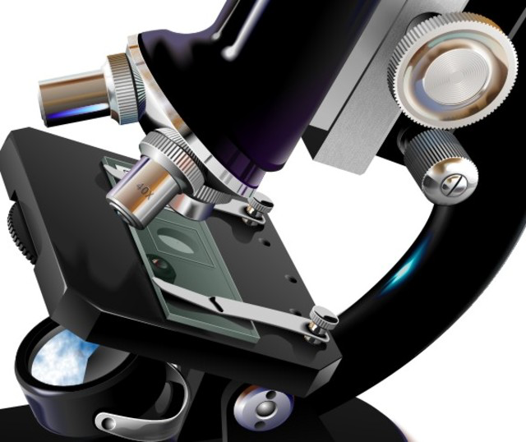
A vector image (e.g. Corel Xara Designer)
In a vectored image, every component is editable – whereas in most other images, unless it is composed of multiple layers, then editing that image is quite difficult.
When you magnify a vector image, you do not lose resolution.
Biological images formats will not be vector images.
https://www.magix.com/us/

Slide 48



Vector Vs Bitmap images
Loss of resolution with magnification in bitmap images
Vector Image
Bitmap Image

Slide 49
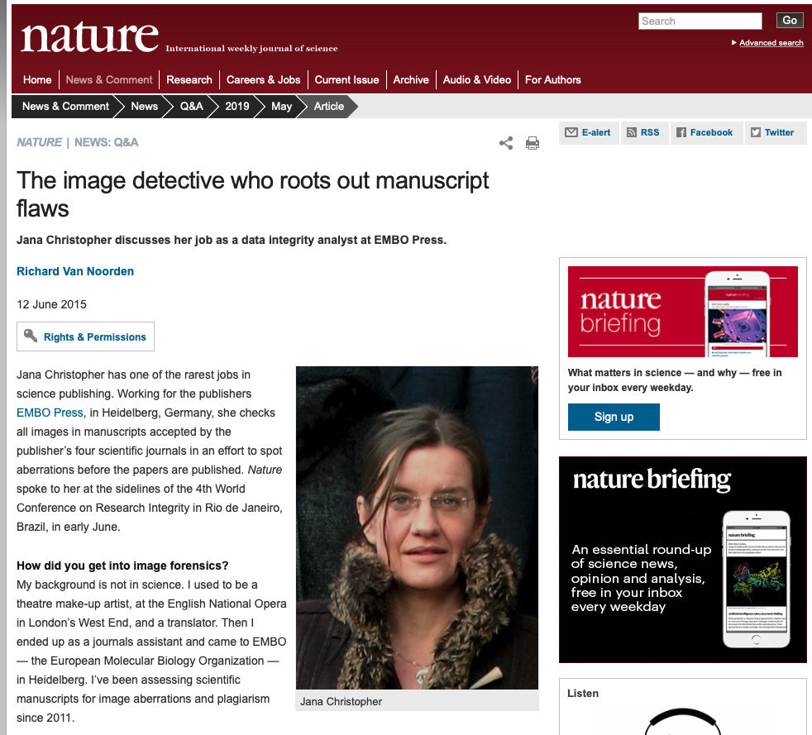
Understanding image structure has larger implications….
We will discuss fraud in imaging in a later lecture in this class

Slide 50
Summary
Structure of data files
Image manipulation
Different Kernels
Filters to modify images
Lossy and Lossless compression
Difference between Vector Graphics and Bitmap graphics

