Slide 1
Alternative technologies to fluorescence and confocal systems (Slide-set from Dr. Bartek Rajwa) BMS 524 - “Introduction to Confocal Microscopy and Image Analysis” 1 Credit course offered by Purdue University Department of Basic Medical Sciences, College of Veterinary Medicine
J. Paul Robinson, Ph.D.
SVM Professor of Cytomics
Professor of Biomedical Engineering
Director, Purdue University Cytometry Laboratories
www.cyto.purdue.edu
These slides are intended for use in a lecture series. Copies of the graphics are distributed and students encouraged to take their notes on these graphics. The intent is to have the student NOT try to reproduce the figures, but to LISTEN and UNDERSTAND the material. All material copyright J. Paul Robinson unless otherwise stated, however, the material may be freely used for lectures, tutorials and workshops. It may not be used for any commercial purpose and may not be uploaded to CourseHero.
The text for this course is Pawley “Introduction to Confocal Microscopy”, Plenum Press, 2nd Ed. A number of the ideas and figures in these lecture notes are taken from this text.
Updated March 2020 – Material developed by Dr. Bartek Rajwa

Slide 2
Non-Linear Phenomena
In “classical” optics the optical properties of materials are independent of the intensity of illumination
• If the illumination is sufficiently intense, the optical properties may depend on the characteristics of light!
– Several novel 3-D microscopy techniques rely on non-linear optical phenomena
– 2-p and multiphoton microscopy
– Higher harmonics microscopy (SGH, TTH)
– Coherent Anti-Stokes Raman scattering microscopy (CARS)

Slide 3
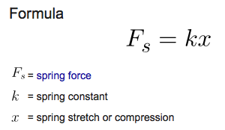
“ut tensio, sic vis,” “as the extension, so the force.”
Robert Hooke, 1678
Typical first order effect i.e. it is a linear relationship such as
absorption and reflection

Slide 4
But- this does not always hold…
2nd order process: SHG, Pockels effect
3rd order process: 2-photon absorption, Kerr effect, CARS
(The Kerr effect, also called the quadratic electro-optic effect, is a change in the refractive index of a material in response to an applied electric field.)

Slide 5
2-Photon Excitation
Multiphoton excitation of molecules is a nonlinear process involving the absorption of multiple photons whose combined energy is sufficient to induce a molecular transition to an excited electronic state. It is a process unknown in nature except in stars
Quantum mechanically, a single photon excites the molecule to a virtual intermediate state, and the molecule is eventually brought to the final excited state by the absorption of the second photon (for two-photon excitation).

Slide 6
History of 2-P microscopy

Slide 7
2-P excitation

Slide 8
From 2-P to Multiphoton

Slide 9
The difference between single photon and 2 photon excitation

Slide 10
Our 2-Photon Radiance 2100MP

Slide 11
Wide field, confocal and 2-photon

Slide 12
Probability of 2-photon excitation

Slide 13
Resolution of 2-photon systems

Slide 14
Practical Resolution

Slide 15
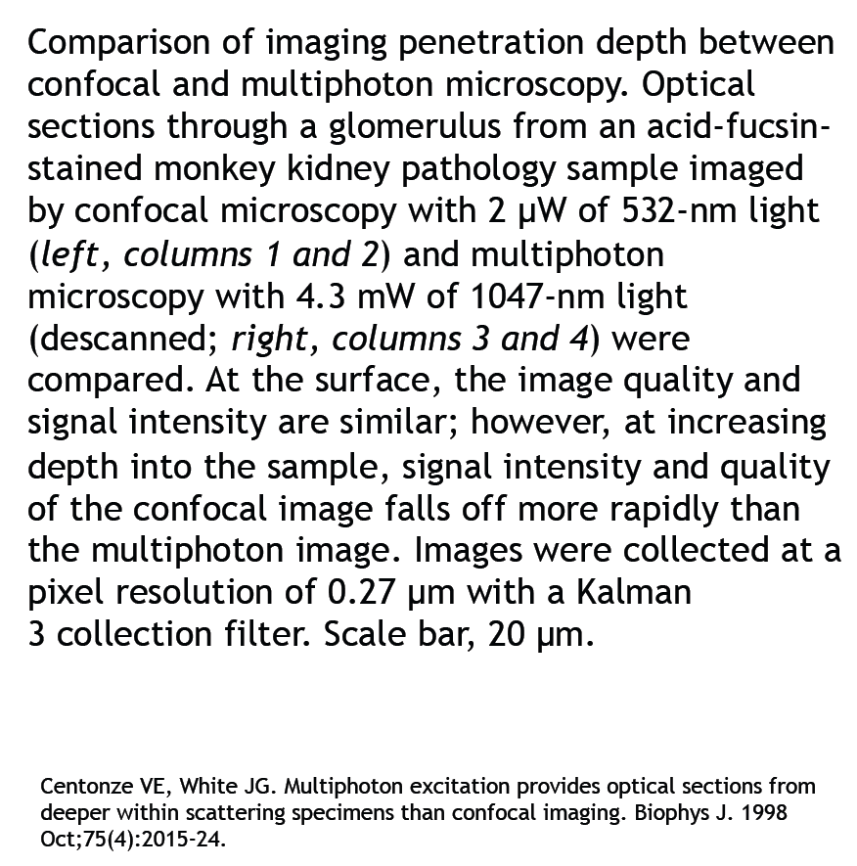
Penetration depth

Slide 16
Multiphoton microscopes need pulsed lasers

Slide 17
Lasers

Slide 18
Advantages of 2-P microscopy

Slide 19
Second Harmonic Generation (SHG)
Second-harmonic generation (SHG, also called frequency doubling) is a nonlinear optical process in which two photons with the same frequency interact with a nonlinear material, are "combined", and generate a new photon with twice the energy of the initial photons (equivalently, twice the frequency and half the wavelength), that conserves the coherence of the excitation. It is a special case of sum-frequency generation (2 photons), and more generally of harmonic generation.
In some cases, almost 100% of the light energy can be converted to the second harmonic frequency. These cases typically involve intense pulsed laser beams passing through large crystals, and careful alignment to obtain phase matching. In other cases, like second-harmonic imaging microscopy, only a tiny fraction of the light energy is converted to the second harmonic—but this light can nevertheless be detected with the help of optical filters.
Wikipedia

Slide 20
2-p plus SHG

Slide 21
Higher Harmonic Microscopy

Slide 22
4π confocal microscopy

Slide 23
History of 4π microscopy

Slide 24
4π microscopy

Slide 26
Resolution extension through the moiré effect

Slide 27
Saturated structured illumination

Slide 28
Excitation and deexcitation beans for 3D STED

Slide 29
Stimulated Emission Depletion (STED)

Slide 30
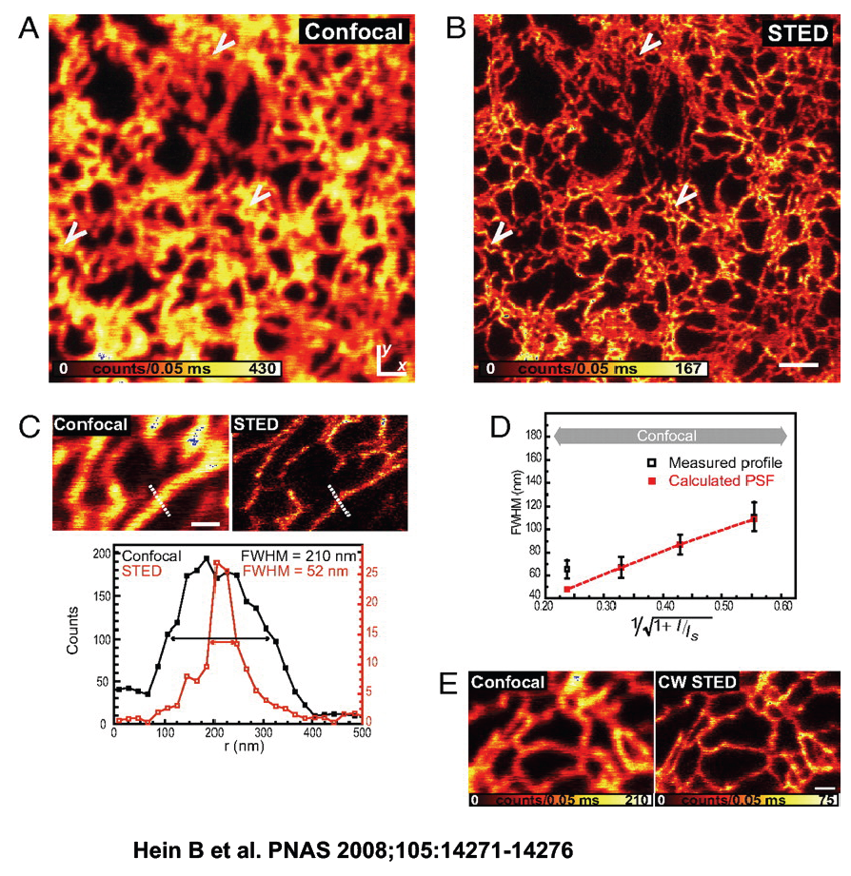
Subdiffraction resolution imaging
Microtubules
Living mammalian cells

Slide 31
Stochastic optical reconstruction microscopy (STORM) or Photoactivation Localization microscopy (PALM)

Slide 32
Selective Plane Illumination Microscopy (SPIM)

Slide 33
Light Sheet Microscopy
Eric Betzig
DOI: 10.1002/cyto.a.23046

Slide 34
Conclusion
Non-linear microscopy has developed over the past 20 years
Many types of instruments have been developed to improve resolution
Non-linear instruments usually require specialty lasers and optics
These technologies have revolutionized cell biology
New approaches are being developed yearly

