Slide 1

Preparation Techniques for
Confocal Microscopy
BMS 524 - “Introduction to Confocal Microscopy and Image Analysis”
1 Credit course offered by Purdue University Department of Basic Medical Sciences, College of Veterinary Medicine
J. Paul Robinson, Ph.D.
SVM Professor of Cytomics
Professor of Biomedical Engineering
Director, Purdue University Cytometry Laboratories
www.cyto.purdue.edu
These slides are intended for use in a lecture series. Copies of the graphics are distributed and students encouraged to take their notes on these graphics. The intent is to have the student NOT try to reproduce the figures, but to LISTEN and UNDERSTAND the material. All material copyright J. Paul Robinson unless otherwise stated, however, the material may be freely used for lectures, tutorials and workshops. It may not be used for any commercial purpose and may not be uploaded to CourseHero.
The text for this course is Pawley “Introduction to Confocal Microscopy”, Plenum Press, 2nd Ed. A number of the ideas and figures in these lecture notes are taken from this text.
Updated January 2020

Slide 2
Learning Objectives
Students will understand different fixation procedures
Students will be able to determine what fixation procedure is appropriate for their samples
Students will understand the importance of proper fixation of tissue
Students will learn how to create a procedure to test a fixation method
Students will understand how fixation impacts physical structures and changes all basic measurements typically used in confocal microscopy.

Slide 3
Characteristics of Fixatives
Chemical Fixatives
Freeze Substitution
Microwave Fixation
Excellent techniques page
http://www.itg.uiuc.edu/publications/techreports/99-006/

Slide 4
Ideal Fixative
Penetrate cells or tissue rapidly
Preserve cellular structure before cell can react to produce structural artifacts
Ensure that subsequent manipulation of the cells or tissue has little impact on structure
Not cause autofluorescence, and act as an antifade reagent

Slide 5
Chemical Fixation
Coagulating Fixatives
Crosslinking Fixatives

Slide 6
Coagulating Fixatives
Ethanol
Methanol
Acetone
Essentially these fix by dehydration. Water molecules are extracted from around protein which results in precipitation of those proteins.

Slide 7
Coagulating Fixatives
Ethanol
Methanol
acetone
Advantages
Fix specimens by rapidly changing hydration state of cellular components
Proteins are either coagulated or extracted
Preserve antigen recognition often
Disadvantages
Cause significant shrinkage of specimens
Difficult to do accurate 3D confocal images
Can shrink cells to 50% size (height)
Commercial preparations of formaldehyde contain methanol as a stabilizing agent

Slide 8
Acetone
“Just a little clarification.
Acetone is a good protein denaturant like ethanol/methanol.
As for its actions on membranes, it does not dissolve phospholipids. In fact, acetone is used as a specific solvent to precipitate phospholipids to help isolate them from other components solubilized by acetone.
Its permeabilizing action on cell membranes is probably quite complex.
The standard procedure is to use -20 deg acetone. This is likely to freeze the cell water, which has catastrophic consequences on osmotic salt balance and will most certainly break open membranes.
No doubt there is also extraction of some components from the cell membranes, e.g., cholesterol that leads to membrane disruption but not dissolution”
Information source: Confocal Listserve
Mon, 15 Oct 2001 Dr. Alan Hibbs

Slide 9
Crosslinking Fixatives
Glutaraldehyde
Formaldehyde
Ethelene glycol-bis-succinimidyl succinate (EGS)

Slide 10
Crosslinking Fixatives
Form covalent crosslinks that are determined by the active groups of each compound
Since glutaraldehyde crosslinks many epitopes it will make the tissue unlabelable by many probes (including antibodies)
Paraformaldehyde does preserve epitope structures and is an excellent fixative for immunolabeling

Slide 11
Glutaraldehyde
First used in 1962 by Sabatini et al*
Shown to preserve properties of subcellular structures by EM
Renders tissue autofluorescent so less useful for fluorescence microscopy, but fluorescence can be attenuated by NaBH₄.
Forms a Schiff’s base with amino groups on proteins and polymerizes via Schiff’s base catalyzed reactions
Forms extensive crosslinks - reacts with the ε-amino group of lysine, α-amino group of amino acids - reacts with tyrosine, tryptophan, histidine, phenylalanine and cysteine
Fixes proteins rapidly, but has slow penetration rate
Can cause cells to form membrane blebs
*Sabatini, D.D., et al, “New means of fixation for electron
microscopy and histochemistry. j. hISTOCHEM.cYTOCHEM. 37:61-65.

Slide 12
Glutaraldehyde
Supplied commercially as either 25% or 8% solution
Must be careful of the impurities - can change fixation properties - best product from Polysciences (Worthington, PA)
As solution ages, it polymerizes and turns yellow.
Store at -20 °C and thaw for daily use. Discard.

Slide 13
Formaldehyde
Purchase as:
  35% formaldehyde solution without methanol
  37% formaldehyde solution with 10% methanol (careful of using this!!)
  Paraformaldehyde (solid polymer) (8-10 formaldehyde units per molecule)
Crosslinks proteins by forming methelene bridges between reactive groups
The rate-limiting step is the de-protonation of amino groups, thus the pH dependence of the crosslinking
Functional groups that are reactive are amido, guanidino, thiol, phenol, imidazole and indolyl groups
Can crosslink nucleic acids
Therefore the preferred fixative for in situ hybridization
Does not crosslink lipids but can produce extensive vesiculation of the plasma membrane which can be averted by addition of CaCl₂
Not good preservative for microtubules at physiologic pH
Protein crosslinking is slower than for glutaraldehyde, but formaldehyde penetrates 10 times faster.
It is possible to mix the two and there may be some advantage for preservation of the 3D nature of some structures.

Slide 14
Paraformaldehyde vs Formaldehyde
The "fixation efficiency" in terms of the rate of crsosslinking and other formaldehyde reactions should be quite similar in solutions that contain methanol-free formaldehyde vs. formaldehyde with minor contamination of methanol (e.g. about 0 3% methanol at 1 % formaldehyde concentration)

Slide 15
Paraformaldehyde vs Formaldehyde
Paraformaldehyde is a polymerized form of formaldehyde.
It is hardly soluble and it cannot be used as a fixative.
Only formaldehyde is used as a fixative. However, formaldehyde in aqueous solutions spontaneously polymerizes. Therefore, methanol is often added to slowdown the polymerization reaction.
Solutions of formaldehyde (usually~37%) in water, containing10-15 % methanol as a preservative are generally called "formaldehyde"; such solutions are being sold by most reagent companies.
Solutions further diluted (4-10 %) received name "formalin". Methanol-free formaldehyde, which sometimes is preferred (e.g. for fixing cells for some some histochemical reactions or in immunocytochemistry), can be obtained by hydrolysis of paraformaldehyde. This is usually done by extensive heating of paraformaldehyde solutions. Because of this procedure the methanol-free formaldehyde received (incorrrectly) the name "paraformaldehyde". In the past, this was the most common way to obtain methanol-free formaldehyde. Unfortunately, this incorrect name is still often used in the literature, generating the confusion.
The methanol-free formaldehyde solutions can now be purchased. Some are called "ultrapure". We purchase such solutions (10%) from Polysciences, Inc. (800-523-2575); they can be stored at room temperature. I would not recommend, however, to store them longer than one year, since formaldehyde in these solutions still has tendency to polymerize. It should be noted that all formaldehyde solutions are highly toxic and carcinogenic.
https://lists.purdue.edu/pipermail/cytometry/2000-May/016518.html
Zbigniew Darzynkiewicz message from the Purdue discussion list
Wed May 31 15:34:02, 2000

Slide 16
Ethelene glycol-bis-succinimidyl succinate (EGS)
Crosslinking agent that reacts with primary amino groups and with the epsilon amino groups of lysine
Advantage is its reversibility
Crosslinks are cleavable at pH 8.5
Mainly used for membrane bound proteins
Limited solubility in water is a problem

Slide 17
Fixation and preparation of tissue
Solutions
  8% glutaraldehyde EM grade
  80 mM Kpipes, pH 6.8, 5 mM EGTA, 2 mM MgCl₂, both with and without 0.1% Triton X-100 (triton for cytoskeletal proteins)
  PBS Ca⁺⁺/Mg⁺⁺ free
  PBS Ca⁺⁺/Mg⁺⁺ free, pH 8.0
When using glutaraldehyde 8% - open new vial, dilute to 0.3% in solution of 80 mM Kpipes, pH 6.8, 5 mM EGTA, 2 mM MgCl₂, 0.1% triton X-100. Store aliquots at -20°C. Never re-use once thawed out.

Slide 18
Fixation Protocol pH-shift/Formaldehyde
Method developed for fixing rat brain
Excellent preservation of neuronal cells and intracellular compartments
Formaldehyde is applied twice - once at near physiological pH to halt metabolism and second time at high pH for effective crosslinking

Slide 19
Method
Solutions
  40% formaldehyde in H₂O (Merck)
  80 mM Kpipes, pH 6.8, 5 mM EGTA, 2 mM MgCl₂
  100 mM NaB₄ O₇ pH 11.0
  PBS Ca⁺⁺/Mg⁺⁺ free
  PBS Ca⁺⁺/Mg⁺⁺ free, pH 8.0 (plus both with and without 0.1% Triton X-100
  pre-measured 10 mg aliquots of dry NaBH₄
  see detailed methods page 314 of Pawley , 2nd ed.

Slide 20
Fluorescence Labeling
There are no “standard” methods for all cells - each cell type will be different.
It is useful to use vital labeled specimens to determine changes induced by the fixation procedure
  e.g.: Rhodamine 123 [mitochondria]
  3,3’-dihexyloxaccarbo-cyanine (DiOC₆) [ER]
  C6-NBD-ceramide [Golgi]

Slide 21
Examples of useful Fluorescent labels
DiI Plasma membrane or ER
DiOC₆(3) ER/mitochondria
Bodipy ceramide Golgi
Fl tubulin Microtubules
Rho phalloidin Actin
Fl dextran Nuclear envelope breakdown
Rho 6G Leukocyte labeling

Slide 22
Rhodamine 123
Imaged on Biorad MRC 10424, 1994)
Rhodamine 123 staining mitochondria (endothelial cells)
Imaged on a Bio-Rad MRC 1024 scope

Slide 23
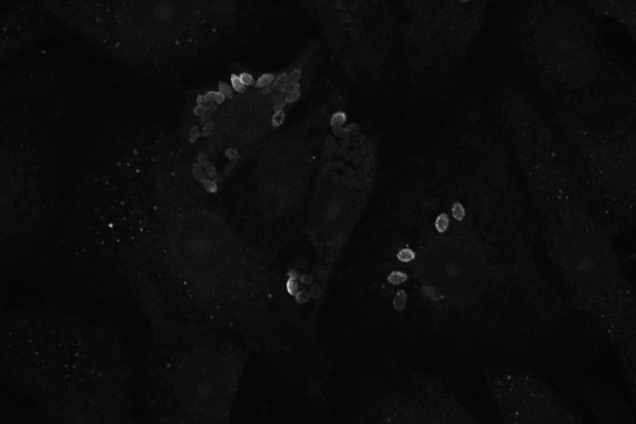
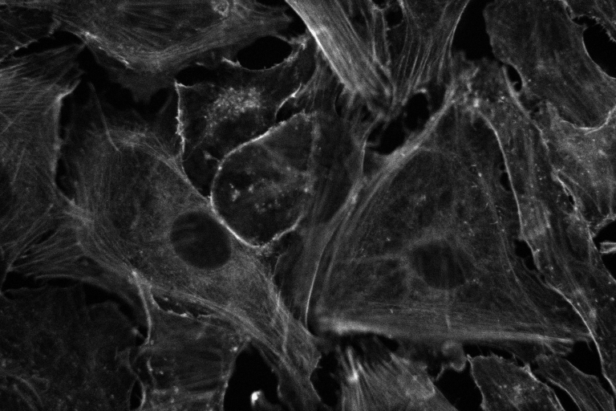
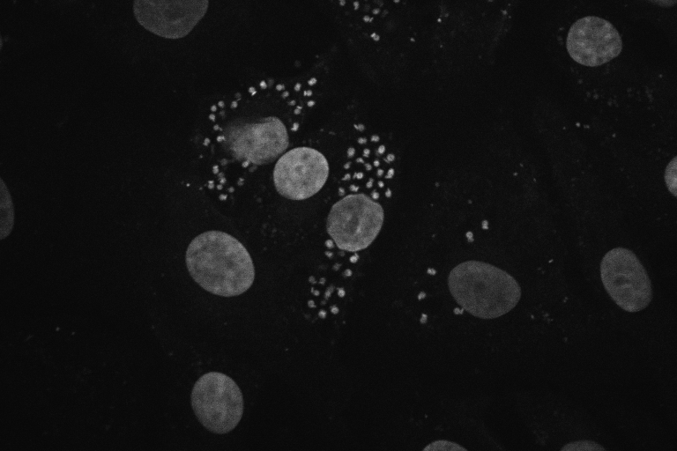
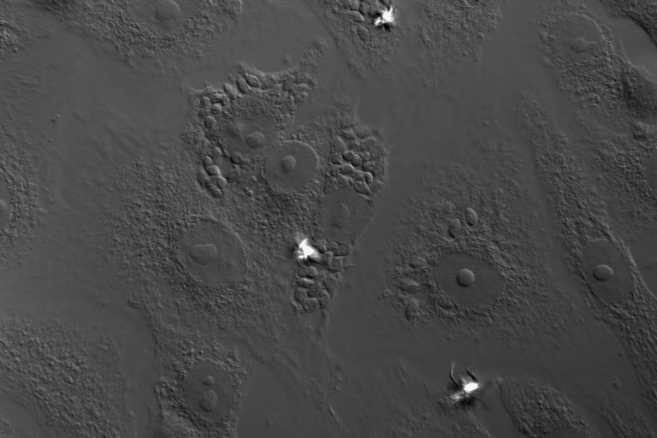
Actin - Rhodamine-phalloidin
Antibody to T.cruzi - FITC
DNA - Dapi
Imaged using an MRC 1000
Confocal Microscope, 40 x 1.3 NA Fluor
(Image prepared 1994)

Slide 24
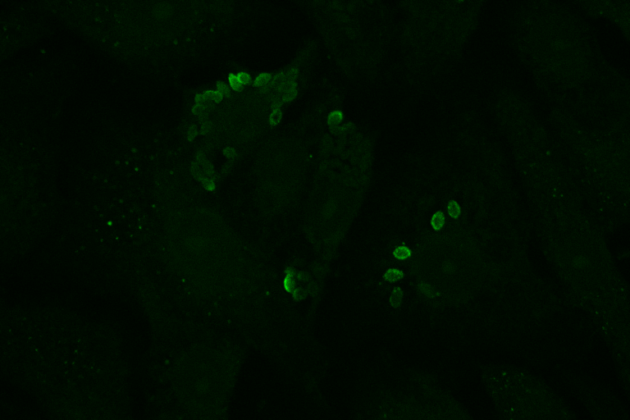
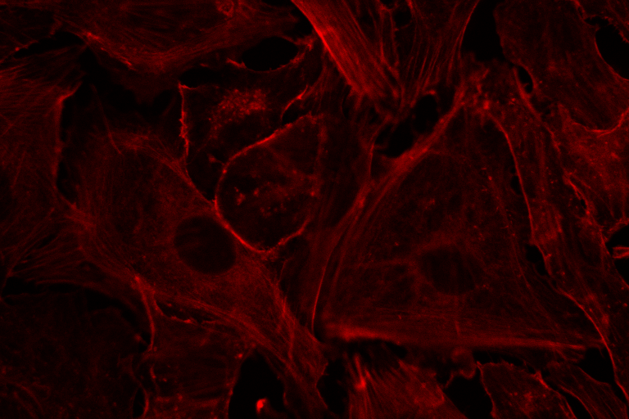
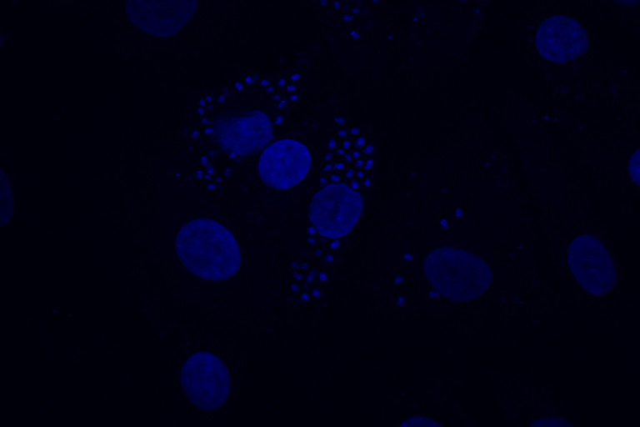
Actin - Rhodamine-phalloidin
Antibody to T.cruzi - FITC
DNA - Dapi
Imaged using an MRC 1000
Confocal Microscope, 40 x 1.3 NA Fluor
(Image prepared 1994)

Slide 25
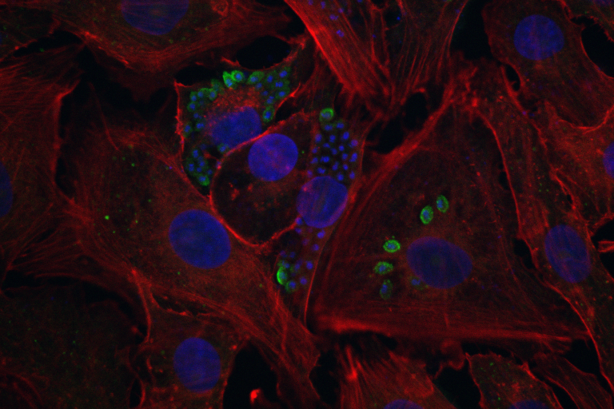
Actin - Rhodamine-phalloidin
Antibody to T.cruzi - FITC
DNA - Dapi
Imaged using an MRC 1000
Confocal Microscope, 40 x 1.3 NA Fluor

Slide 26
Test Specimen
According to Terasaki & Dailey (p330, Pawley, 2nd ed) a convenient test specimen for a living cell is onion epithelium
Stain with DiOC₆(3) (stock solution is 0.5 mg/ml in ethanol. For final stain dilute 1:1000 in water
Stains ER and mitochondria

Slide 27
Test Specimen - Onion
Peel off epithelium
Stain with DiOC₆(3)
Modified from Pawley, “Handbook of Confocal Microscopy”, Plenum Press
ER and Mitochondria stained

Slide 28
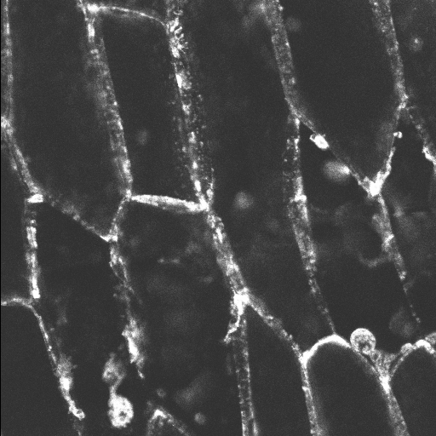
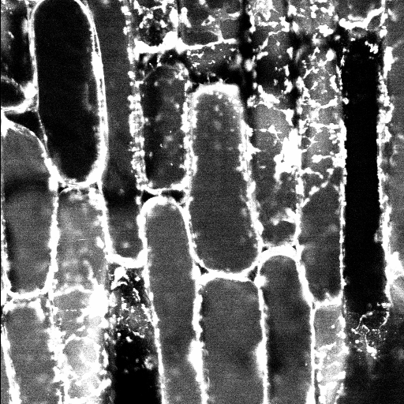
Test images
Onion Fluorescence Images
Imaged on a Bio-Rad MRC 1024 scope

Slide 29
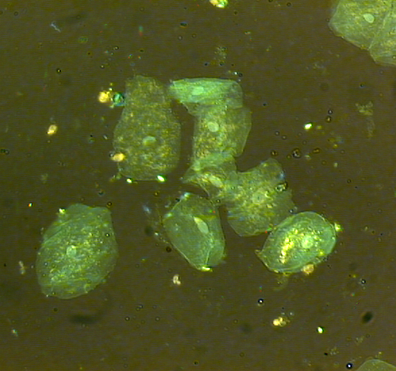
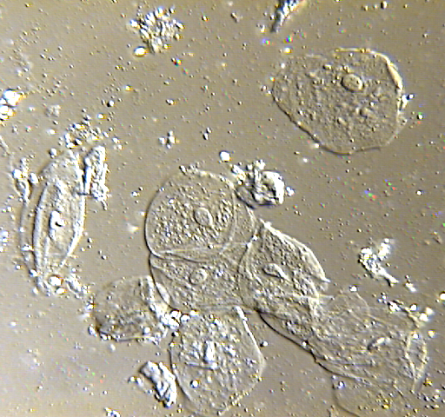
Epithelial Cell

Slide 30
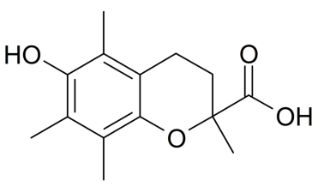
Practical methods for Reducing Photobleaching
Photobleaching is often generated by free radicals
Free radical scavengers can reduce the rate of photobleaching
Scavengers include:
n-propyl gallate
p-phenylenediamine
DABCO (1,4-diazobicyclo-(2,2,2)-octane).
For live cell works photobleaching may be reduced in the presence of:
vitamin C
Trolox (C₁₄H₁₈O₄₎ (6-hydroxy-2,5,7,8-tetramethylchroman-2-carboxylic acid, a water-soluble derivative of vitamin E)

Slide 31
Practical Mounting Slides - sealant
Create a container with VALIP
Vaseline (petrolatum)
Lanolin
Parafin wax (flakes if possible)
Make up a 1:1:1 ratio of above, and head in a glass container
on a hot plate. Let them meld and you can reheat many times.
Paint around
coverslip

Slide 32
Mounting “Thick” Specimens
Mountant to raise
Cover slip to preserve
3D structure of material
Cover slip
Use a mounting material (you can use VALIP or just nail polish!!
To raise the area around the specimen so that it is not damaged by pressing the cover slip down.
Note: Clean cover slips with analysis grade methanol, ethanol or acetone to reduce potential contaminants that may contribute to non-specific fluorescence.

Slide 33
Mounting specimens on slides
Matching Refractive Index
Methyl Salicylate | 1.53-1.54
Common Tissue | 1.515
Immersion Oil (can vary) | 1.515
Glycerol | 1.47
Vectashield | 1.45
Gel/Mount | 1.36
Water | 1.33
Air | 1.0

Slide 34
Some issues about sample preparation
The quality of sample preparation directly impacts the quality of the final image
Many probes require specific sample preparation to be effective
The nature of the sample (thickness, type of specimen) and conditions (temperature, pH) all impact the final image
It is far better to make sure the quality of the specimen is high as opposed to trying to make the image look better!!
Good quality samples can lead to good quality images. Bad quality samples make it really difficult to get good images!!

Slide 35
Summary
Good confocal images require good preparation techniques
Preparations will be the most significant factor in image quality
Preparation techniques can damage the 3D structure of specimens
Quality control of specimen preparation requires attention to protocols

